Slide 1


Profiling hot and dense nuclear medium with high transverse momentum hadrons produced in d+Au and Au+Au collisions by the PHENIX experiment at RHIC
Takao Sakaguchi
Brookhaven National Laboratory
For the PHENIX Collaboration

Slide 2
Hard scattering as densimeter
Parton may change its momentum in the medium
  Energy loss through Gluon radiation, etc. (A+A)
  Momentum broadening by multiple scattering in nucleus (p, d+A)
Effect may be path-length and system dependent
  A densimeter of the medium
p+p
d+Au
Au+Au

Slide 3
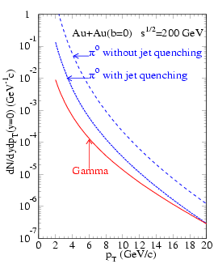
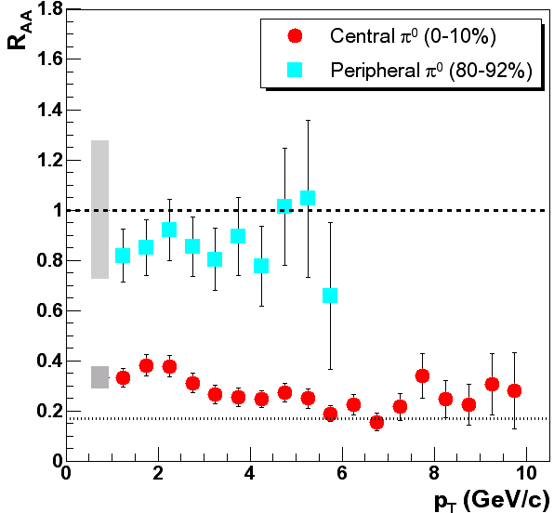
Way to look at jet modification
Look at leading particles of jet as a measure of jet momentum
Yield modification. We focus on π⁰ and η as observables
PHENIX, π⁰ in Au+Au, PRL. 91, 072301 (2003)
π⁰ without energy loss
π⁰ with energy loss
Yield [GeV⁻¹c]
Energy loss =Yield suppress
p_{T} [GeV/c]
X.-N., Wang, PRC 58 (1998)2321

Slide 4
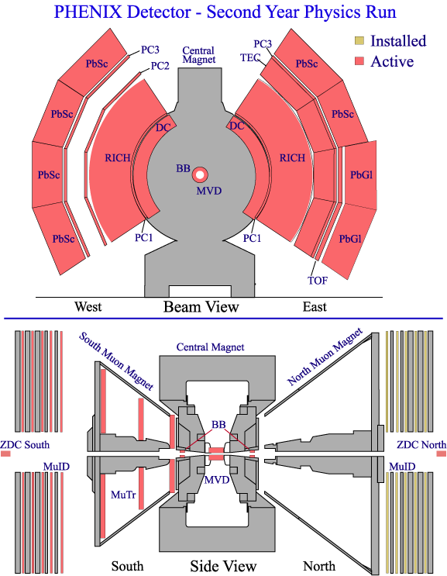
PHENIX Detector
View From Beam
Photon measurement
  EMCal(PbSc, PbGl): Energy measurement and identification of real photons
  Tracking(DC, PC): Veto to Charged particles
Event triggered by a coincidence of BBC South and BBC North
  Sitting in 3.1<|η|<3.9
View From Side
PHENIX recorded:
d+Au events of 80 nb⁻¹ in 2008
Au+Au events of 0.813nb⁻¹ in 2007

Slide 5
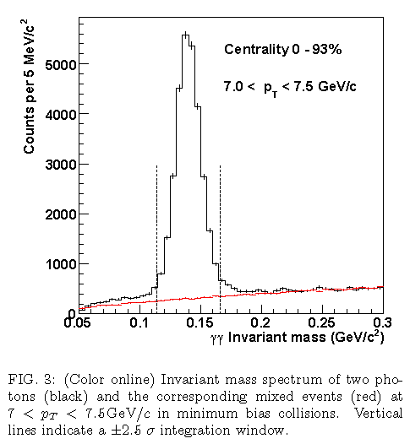
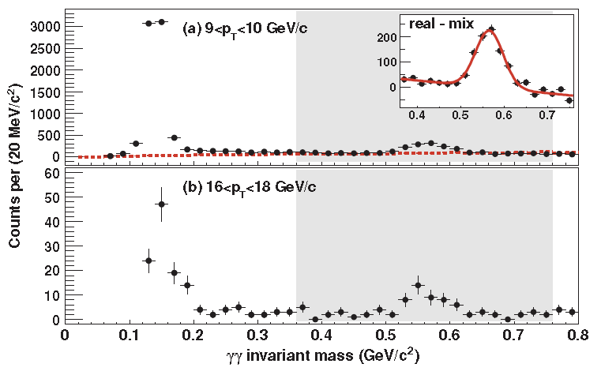
How we measure π⁰, η?
Reconstruct hadrons via 2γ invariant mass in EMCal (example is in Au+Au)
Subtract Combinatorial background
  Compute Mass using γs from different events. (mixed-event technique)
PRC87, 034911 (2013)
PRC82, 011902(R) (2010)
π⁰
η
π⁰
η

Slide 6
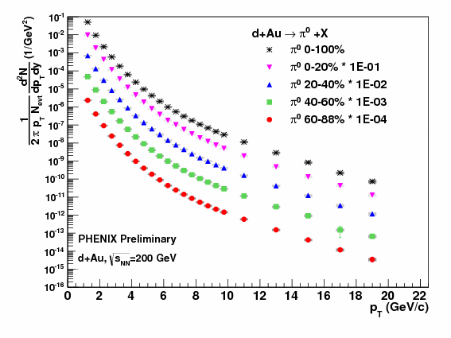
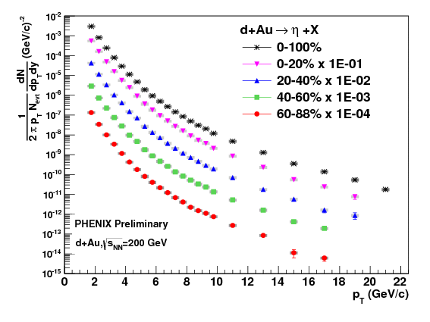
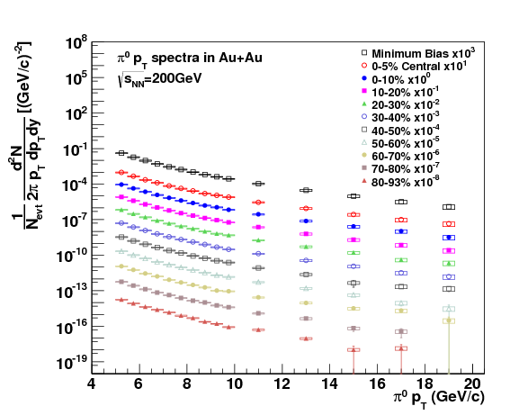
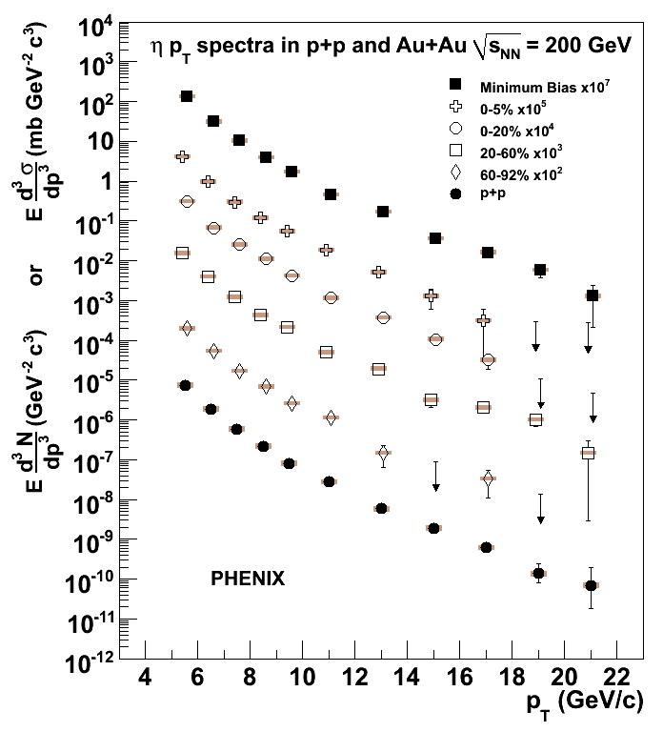
π⁰, η spectra in d+Au and Au+Au
Spectra reached to ~20GeV/c for π⁰ and ~22GeV/c for η
π⁰
η
d+Au
Au+Au

Slide 7
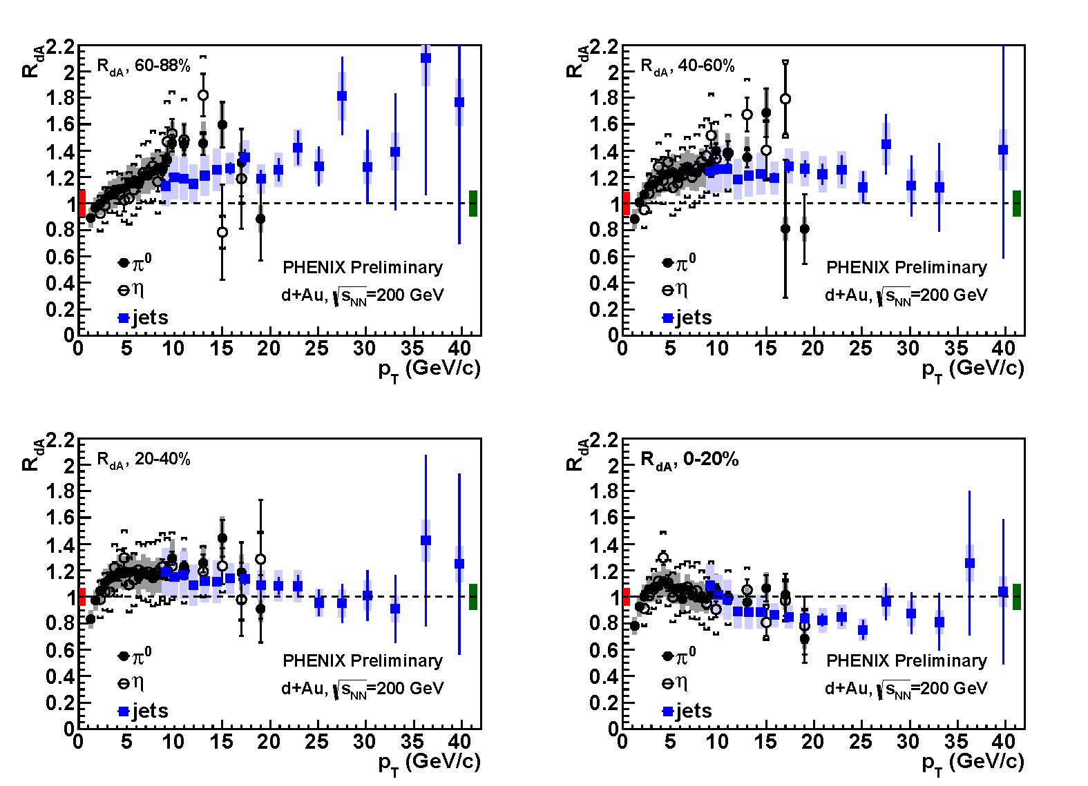
π⁰ and η (and jets) R_{dA}
Consistent with 1 for p_{T}<10GeV for most of centrality class
Strong centrality dependence is seen
π⁰ , η and jets are in good agreement, though the systematics is very different

Slide 8
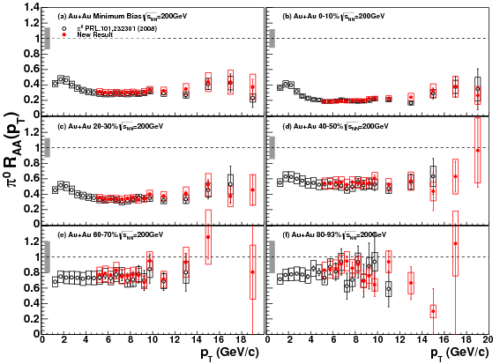
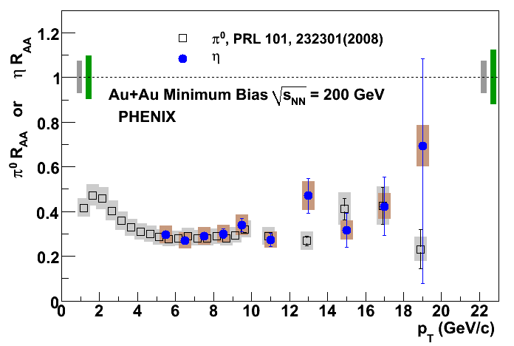
π⁰ and η R_{AA}
200GeV Au+Au collision system
π⁰ and η nicely agree
Very nice agreement between RHIC Year-2004 and 2007 results
PRC87, 034911 (2013)
Black: Year-2004, Red: Year-2007
PRC82, 011902(R) (2010)
MinBias, Black: π⁰, Blue: η

Slide 9
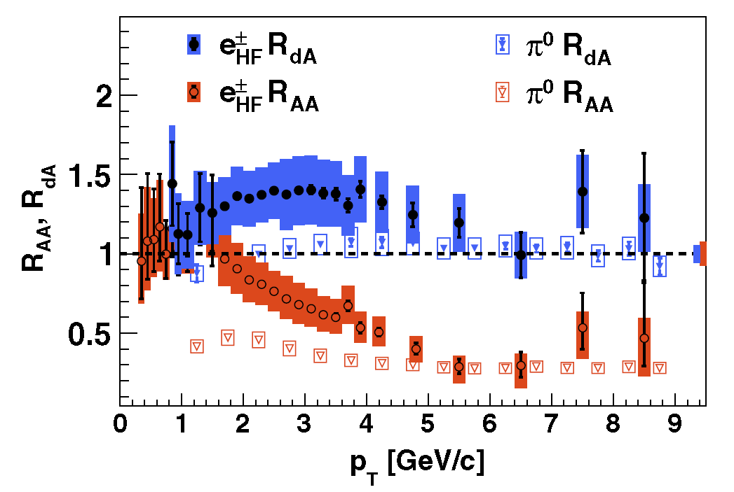
Flavor similarity?
Different quark flavor may give different interaction
  Mass ordering (dead-cone effect, etc.)
Electrons from Heavy flavor quark (c,b) show similar R_{AA} and R_{dA} as π⁰ decayed from light flavor quark (u,d) or gluons
PHENIX, PRL. 109, 242301 (2012)

Slide 10
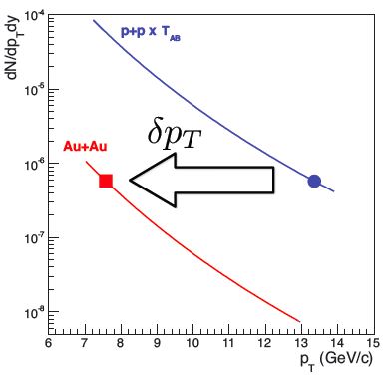
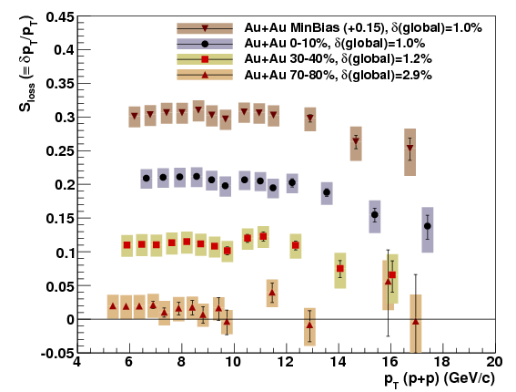
Fractional momentum loss of partons
Measured fractional momentum loss (δp_{T}/p_{T}) instead of R_{AA}
  In A+A collisions
δp_{T}/p_{T}=0.2 in 0-10% centrality, =0.02 in 70-80% centrality
PRC87, 034911 (2013)
δp_{T}/p_{T}
p_{T}

Slide 11
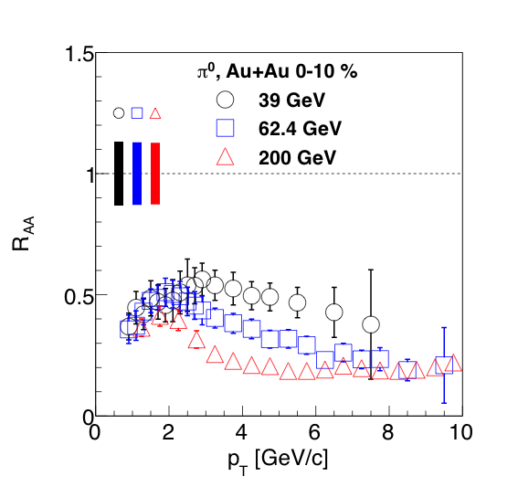
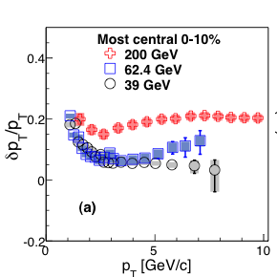
Energy dependence of δp_{T}/p_{T} (I)
δp_{T}/p_{T} decreases significantly going from 200 to 62, 39GeV
Significantly different δp_{T}/p_{T} even the R_{AA} is similar
PRL109, 152301 (2012)
R_{AA}

Slide 12
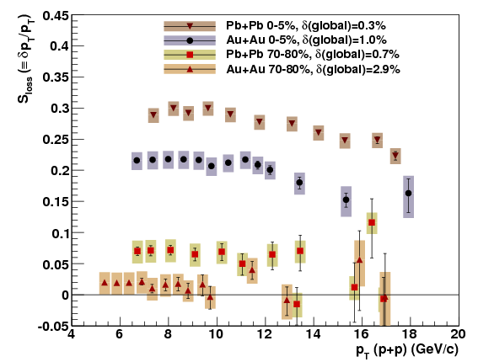
Energy dependence of δp_{T}/p_{T} (II)
δp_{T}/p_{T} from 39GeV to 2.76TeV!: ~0.3 for LHC
PRL109, 152301 (2012)
PRC87, 034911 (2013)
LHC
RHIC

Slide 13
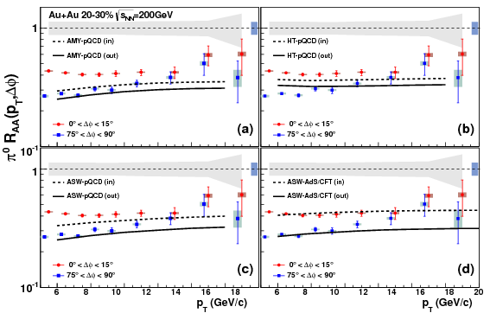
Path-length dependence of energy loss
Comparison of R_{AA} between data and models in in- and out-plane
  Different path-length in in-plane (event plane direction) and out-plane
PRC87, 034911 (2013)

Slide 14
Path-length dependence of energy loss
Comparison of R_{AA} between data and models in in- and out-plane
  Different path-length in in-plane (event plane direction) and out-plane
Data favor AdS/CFT-inspired model (very strong coupling) rather than pQCD-inspired, suggesting the Energy loss is L³ dependent not L².
PRC87, 034911 (2013)

Slide 15
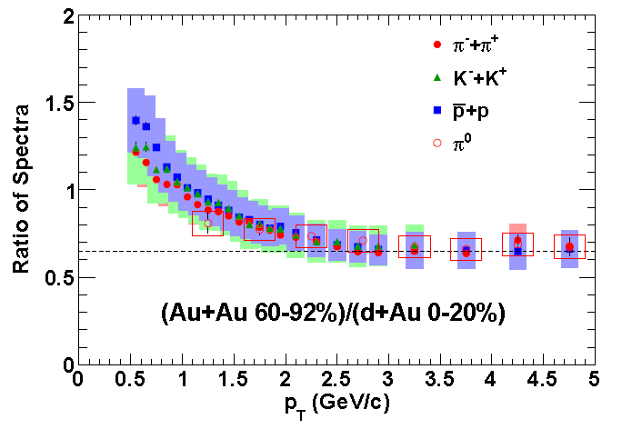
d+Au and Au+Au system similarity?
Au+Au 60-92% and d+Au 0-20% have similar N_{part}, N_{coll}
Ratios of all ID’ed hadron spectra are on the same curve
Common production mechanism?
If all CNM scales with N_{part}, ratios may mean E_{loss} in the medium in peripheral Au+Au
Low p_{T} increase may rise from rapidity shift in d+Au
arXiv:1304.3410

Slide 16
Summary
π⁰ and η are measured in 200GeV d+Au and Au+Au collisions
  π⁰ and η give very consistent results in R_{dA} and R_{AA}
π⁰ and HF electrons R_{AA} and R_{dA} have similar trend
  Similar amount of final state interaction for LF and HF?
Fractional momentum losses vary a factor of 6, as going from 39GeV Au+Au to 2.76TeV Pb+Pb collisions
Eloss of partons is L³ dependent
Partons may lose their energies in peripheral Au+Au collisions rather than in central d+Au collisions
  If CNM effects scales with N_{part}

Slide 17
Backup

Slide 18
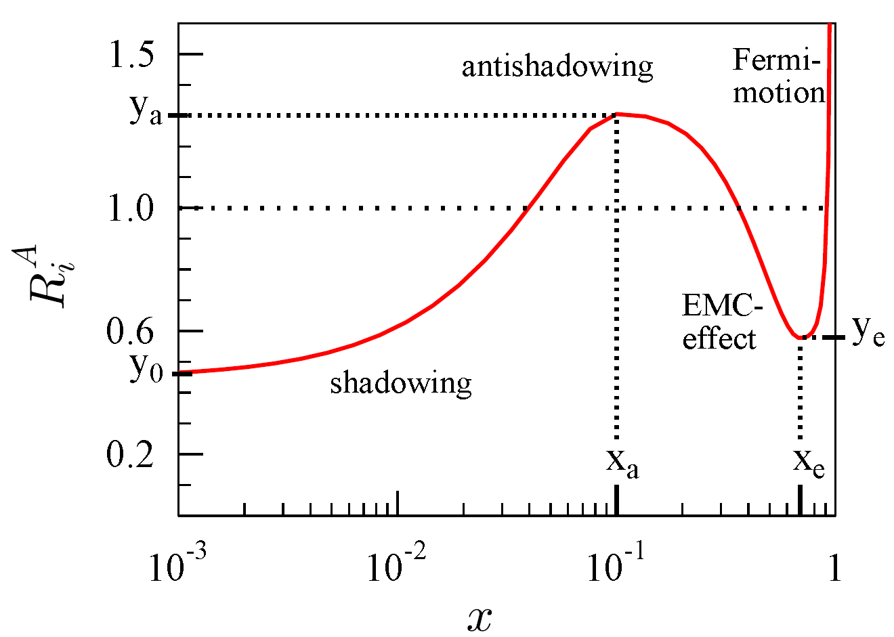
Why are we interested in d+Au collisions?
PHENIX, Phys. Rev. Lett. 91, 072301 (2003)
In order to confirm that the high p_{T} hadron suppression in Au+Au collisions is due to final state effect, and not cold nuclear matter (CNM) effect
  Need system without additional effects from a hot medium.
CNM effect include:
  k_{T}-broadening (Cronin enhancement at moderate p_{T})
  Shadowing of parton distributions
  Cold nuclear matter energy loss
  And possibly more…
d+Au is more favorable for RHIC operation
  p+Au becomes feasible now (M.Bai)
π⁰ in Au+Au at 200GeV
cartoon

Slide 19
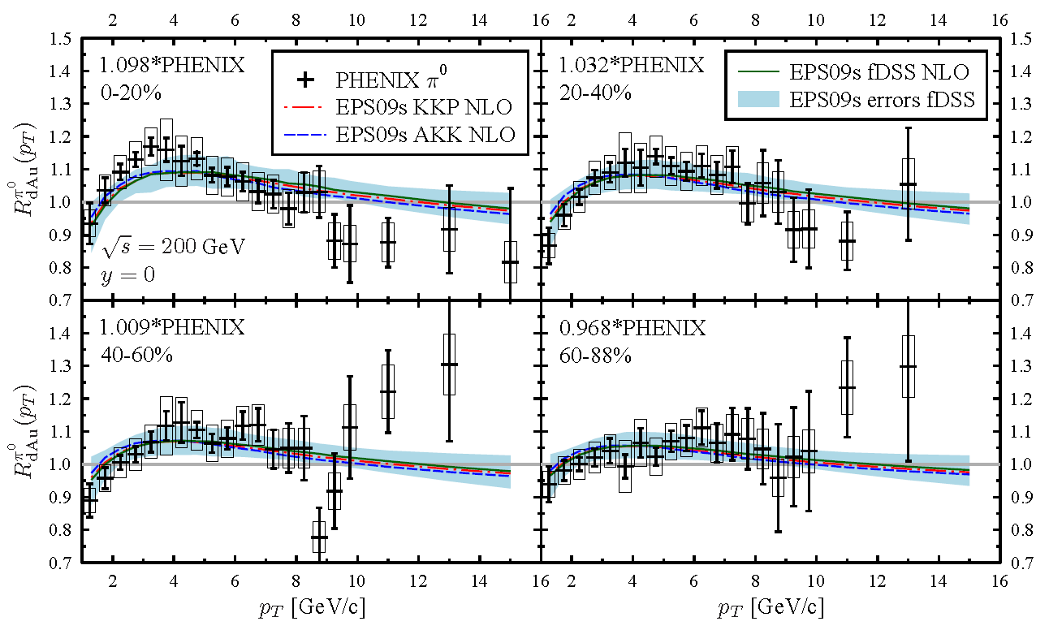
Nuclear PDFs are centrality dependent?
Helenius, Eskola et.al. published centrality dependent nuclear PDFs (arXiv:1205.5359)
Compared to PHENIX π⁰ R_{dA} published in 2003
Theory curves are scaled up/down within systematics
New data can help better constraining nPDFs

Slide 20
Systematic errors
π⁰ systematic errors
source | type | 5GeV | 10GeV | 15GeV | 20GeV
peak extraction | B | 2 | 2 | 2 | 2
acceptance | C | 2.5 | 2.5 | 2.5 | 2.5
PID efficiency | B | 7 | 8 | 8.5 | 9
energy scale | B | 7.5 | 8 | 8 | 8
photon conversion | C | 2 | 2 | 2 | 2
cluster merging | B | 0 | 0 | 8 | 18
total |  | 11 | 12 | 15 | 22
Type A: point-by-point fluctuating errors
Type B: p_{T}-correlated errors
Type C: overall normalization errors
η systematic errors
source | type | 5GeV | 10GeV | 15GeV
peak extraction | B | 4 | 3.5 | 3
acceptance | C | 2.5 | 2.5 | 2.5
PID efficiency | B | 7 | 8 | 8.5
energy scale | B | 11 | 12 | 12
photon conversion | C | 2 | 2 | 2
total |  | 12 | 15 | 15

Slide 21
Comparison to shadowing calculation (I)
π⁰ R_{dA}
(Very basic) shadowing calculation uses EPS09 PDF modification* + Glauber MC + PYTHIA (x,Q²) sampling for π⁰.
Shadowing effects match reasonably well within the global scale uncertainties in central events (where modification is weak), but is not compatible with the p_{T} shape in peripheral.
*nPDF modification assumed to scale linearly with longitudinal nuclear thickness.

Slide 22
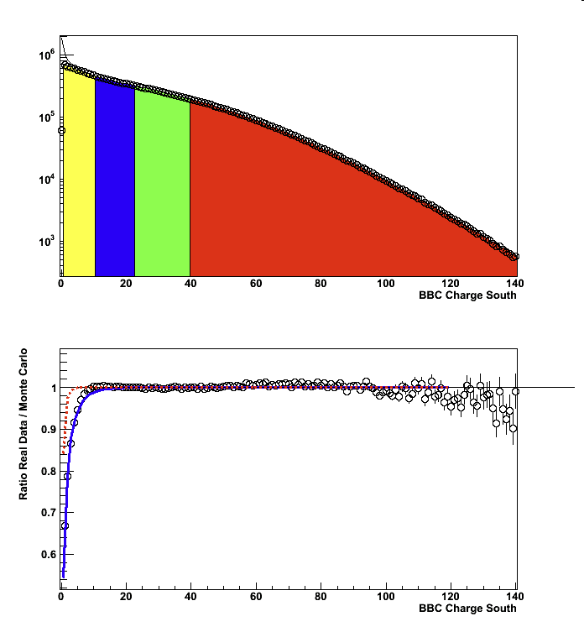
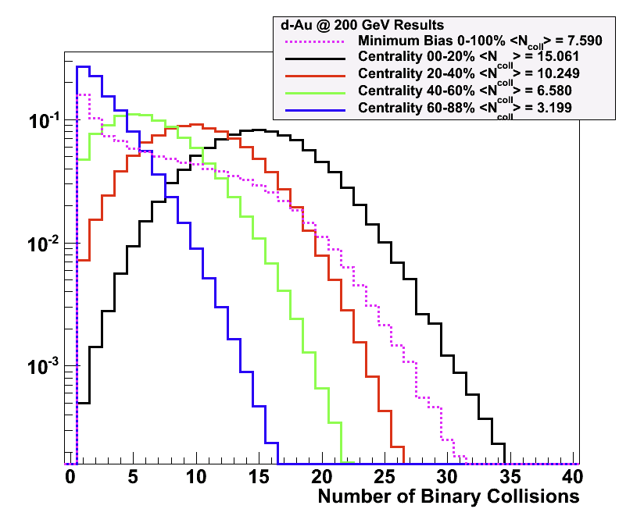
How we define centralities?
Use Beam-Beam counter (BBC) installed in 3.1<|η|<3.9
  Centrality defined by BBC south charge (Gold going direction)
  Participant region
Compare with Monte Carlo simulations and determine T_{AB}
  Glauber calculation folded with negative binominal distributions (NBD)
Charge distribution in BBC
(South, gold going direction)
60-88%
40-60%
20-40%
0-20%

Slide 23
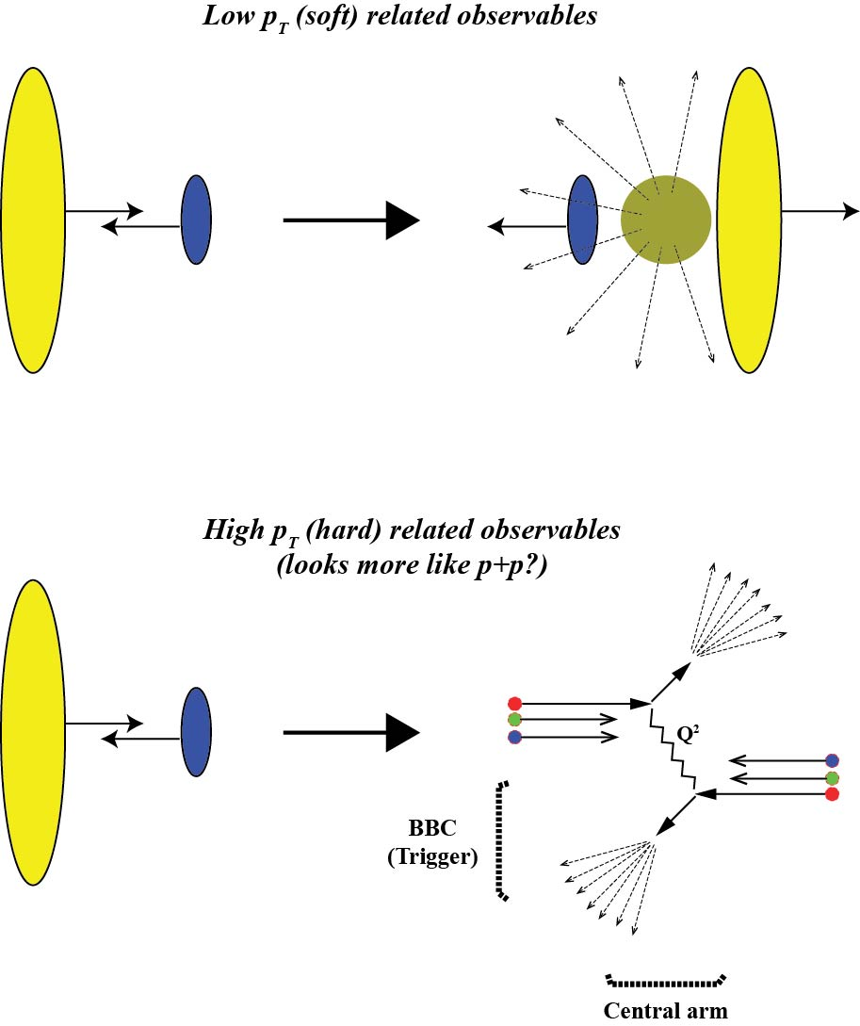
Possible dynamics in d+Au collisions
We talk about peripheral collision case
Soft- and hard-dominated events may produce different hit distributions in BBC
In case that hardest jets are produced, less energy will be available for soft-production at high η
There could be p_{T} dependent effect?
  We use BBC for event triggering as well as centrality definition
BBC
Mid-rapidity
Detector

Slide 24
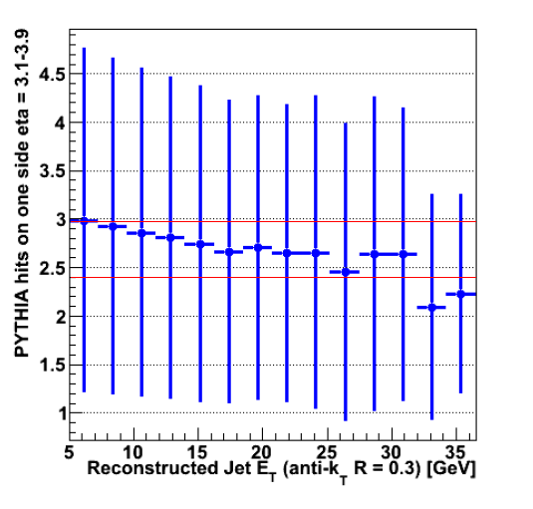
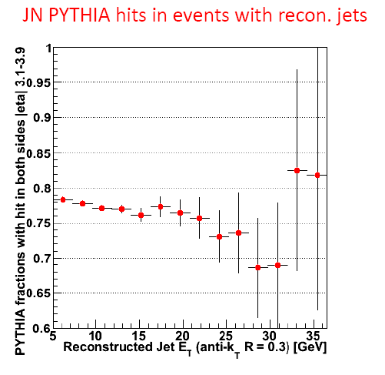
PYTHIA simulation
Ran PYTHIA and look reconstructed jets in mid-rapidity
PYTHIA sees a small anti-correlation effect
Number of hits in BBC vs
reconstructed jet p_{T}
Fraction of reconstructed jets
when requiring BBC trigger
Errors are RMS’s of dists.

Slide 25
AMPT p+p simulation
AMPT is a HIJING + hadron cascade event generator
Plotted as a function of hadron p_{T} in mid-rapidity
  Jets are not reconstructed.
  AMPT also sees similar effect in single hadrons
Number of hits in BBC vs
hadron p_{T} in mid-rapidity
Fraction of hadrons
when requiring BBC trigger
Errors are RMS’s of dists

Slide 26
π⁰ R_{dA} by centrality
New π⁰ R_{dA} from Run8
Better statistics than Run 3
  Extends p_{T} reach by 5 GeV/c
  Better constraint for nPDFs
Peripheral is most enhanced
Central consistent with no modification at p_{T} > 2 GeV/c
How do we understand this?
Competing nuclear effects?

Slide 27
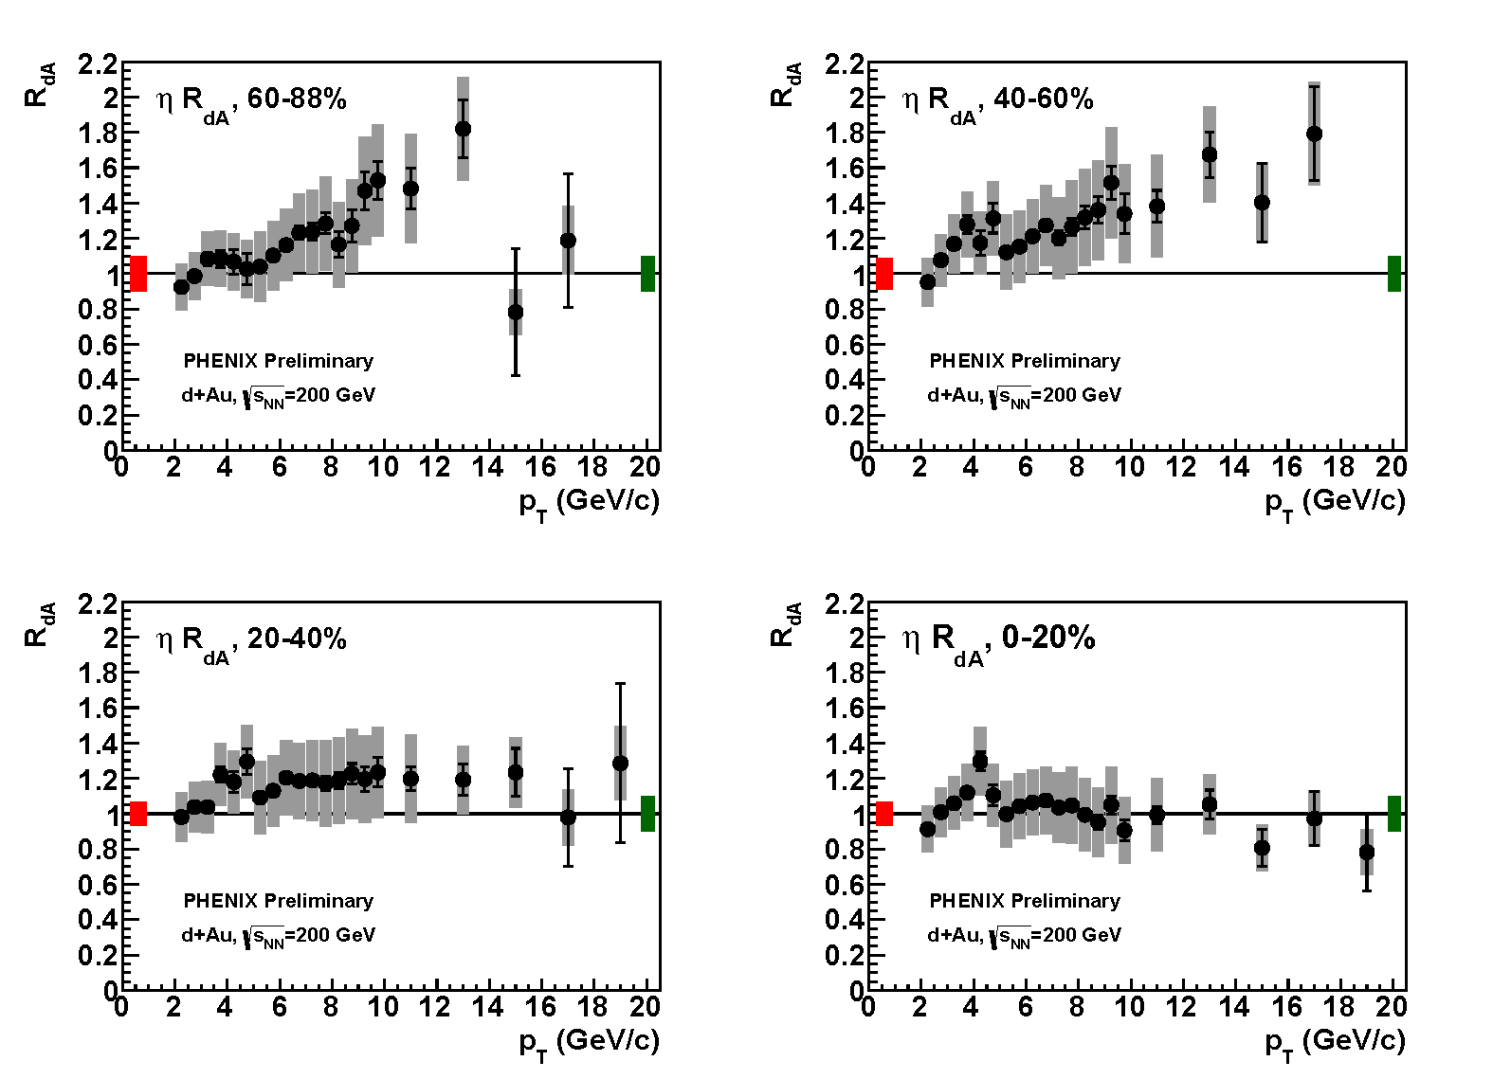
η R_{dA} by centrality
New η R_{dA} from Run8
Better statistics than Run 3
  Extends p_{T} reach by 5 GeV/c
  Better constraint for nPDFs
Peripheral is most enhanced
Central consistent with no modification at p_{T} > 2 GeV/c
How do we understand this?
Competing nuclear effects?

Slide 28
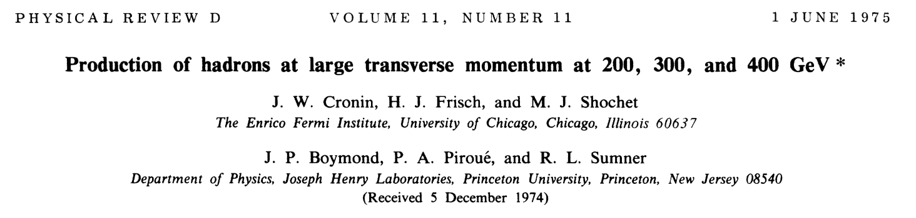
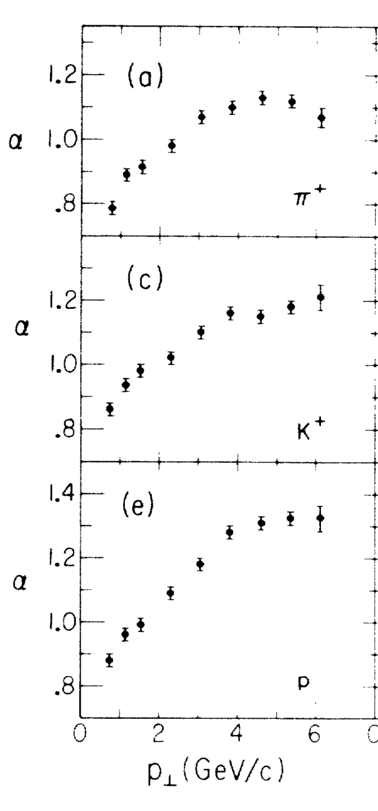
Cronin Enhancement
π⁺
Enhancement of hadron production in heavy ion collisions
Usually modeled as multiple scattering of the incoming parton on the nucleus.
Most models don’t have any PID dependence…
However, measured enhancement is larger for protons than pions/kaons.
Originally thought to be due to steeper p_{T} spectrum of protons and that it would go away at higher energies.
But proton enhancement is still much larger at RHIC energies!
K⁺
p

