Slide 1
Search for Time-Reversal Invariance Violation in Nuclei
Vladimir Gudkov and Young-Ho Song
University of South Carolina
June 3, 2013

Slide 2
Sakharov Criteria (JETP Lett. 5, 32 (1967))
Particle Physics can produce matter/antimatter asymmetry in
the early universe IF there is:
Baryon Number Violation
CP & C violation TRIV
Departure from Thermal Equilibrium

Slide 3
Motivation
CPT → CP ~ T
independent test (for the case of suppression/cancelation)
CPT-violation:
T and CP are “independent”
problems with the standard field theory → even less trusted relations between different processes
Search for New Physics
independent test (for the case of suppression/cancelation)
High Intensity Neutron Facilities
SNS in Oak Ridge, JSNS at J-PARC, ESS in Lund

Slide 4
TRIV effects in nuclei
Is it unambiguous test?
(no FSI)
Could they be reliably calculated?
(calculations of relative values)
How they are related to EDMs?
(discovery potential)

Slide 5
Neutron EDM
L. Landau, Nucl.Phys. 3, 127 (1957).

Slide 6
Slide courtesy of M. Ramsey-Musolf

Slide 7
T-Reversal Invariance
Detailed Balance Principle (DBP):

Slide 8
PV (First order effects)

Slide 9
FSI:

Slide 10
TRIV effects in nuclei
Is it unambiguous test? – YES! (no FSI)
Could they be reliably calculated?
(calculations of relative values)
How they are related to EDMs?
(discovery potential)

Slide 11
Neutron transmission (= “EDM quality”)
P- and T-violation: P.K. Kabir, PR D25, (1982) 2013
L.. Stodolsky, N.P. B197 (1982) 213
T-violation:
(for 2 MeV, on ¹⁶⁵Ho: <5∙10⁻³, J. E. Koster, 1991)
P-violation:
Enhanced of about 10⁶
O. P. Sushkov and V. V. Flambaum, JETP Pisma 32 (1980) 377
V. E. Bunakov and V.G., Z. Phys. A303 (1981) 285

Slide 12
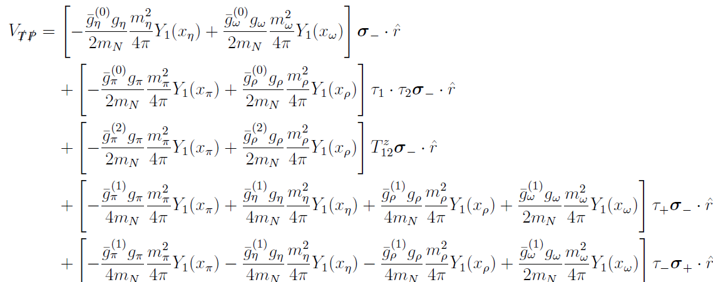
TVPV potential P. Herczeg (1966)
Y.-H. Song, R. Lazauskas and V. G, Phys. Rev. C83, 065503 (2011).

Slide 13
TVPV n-D
Y.-H. Song, R. Lazauskas and V. G., Phys. Rev. C83, 065503 (2011).

Slide 14
Enhancements:
“Weak” structure
“Strong” structure
P-violation:
Enhanced of about ~10⁶
O. P. Sushkov and V. V. Flambaum, JETP Pisma 32 (1980) 377
V. E. Bunakov and V.G., Z. Phys. A303 (1981) 285

Slide 15
P- and T-violation in Neutron transmission
n
n
n
n
p
s
s
X
W
V. E. Bunakov and V.G., Z. Phys. A308 (1982) 363
V.G., Phys. Lett.B243 (1990) 319

Slide 16
Nuclear dependent factor

Slide 17
Theoretical predictions

Slide 18
TRIV effects in nuclei
Is it unambiguous test? – YES! (no FSI)
Could they be reliably calculated? – YES!
(calculations of relative values)
How they are related to EDMs?
(discovery potential)

Slide 19
EDM limits
M. Pospelov and A. Ritz (2005)
V. Dmitriev and I. Khriplovich (2004)

Slide 20
EDMs:
TRIV:
Y.-H. Song, R. Lazauskas and V. G., Phys. Rev. C83, 065503 (2011); and arXiv:1211.3762 (2012)

Slide 21
Slide courtesy of M. Ramsey-Musolf

Slide 22
Conclusions
No FSI = like “EDM”
Reasonably simple theoretical description
A possibility for an additional enhancement
Sensitive to a variety of TRIV couplings
New facilities with high neutron fluxes
The possibility to improve limits on TRIV
(or to discover new physics) by 10² - 10⁴

