Slide 1
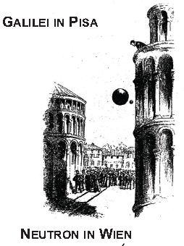


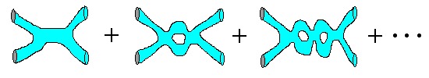
High Precision Experiments with Cold and Ultra-Cold Neutrons
qBounce- and PERC-Collaboration
|3 > 3.32 peV
a, A, B, C
|1 > 1.4 peV
Hartmut Abele
INPC 2013, 3 June 2013

Slide 2
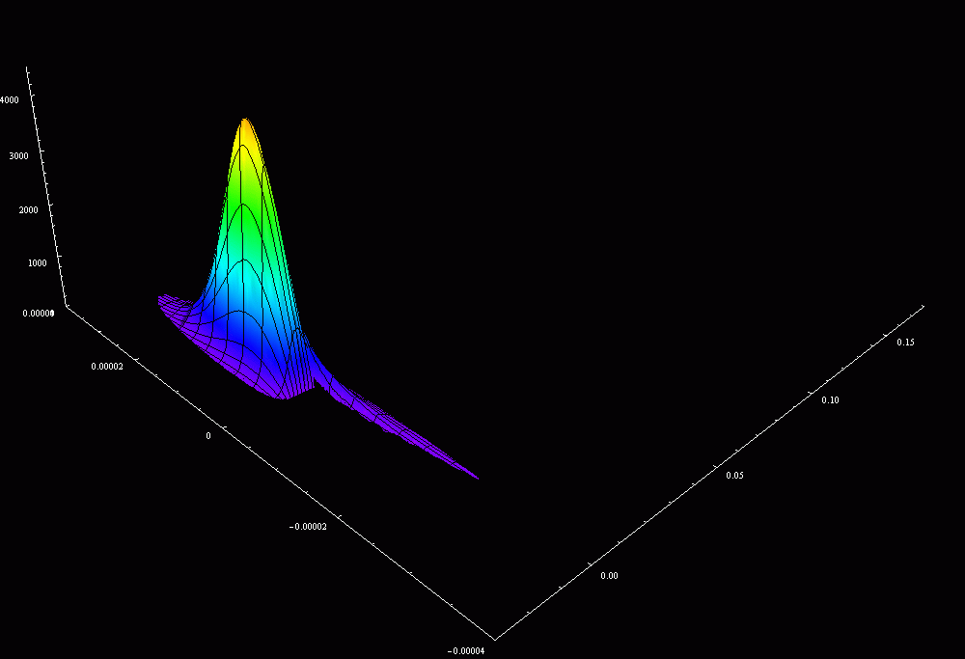
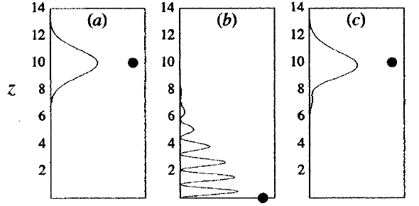
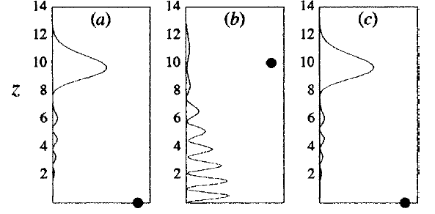

Show Case I:
Test of Gravitation at Short Distances with Quantum Interference
Julio Gea-Banacloche, Am. J. Phys.1999
Height, 40 µm
Time
Quantum interference: sensitivity to fifth forces
Simulation:
Reiter, Schlederer, Seppi
Hartmut Abele, Atominstitut, TU Wien
Rafael Reiter, Bernhard Schlederer, David Sepp

Slide 3
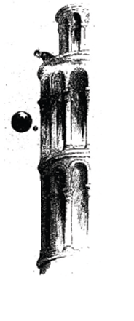
qBounce
the dynamics of ultra-cold neutrons in the gravity potential
the free Fall
Quantum interference:
sensitivity to fifth forces
coming from extra dimensions
string theories
(higher dimensional field
theories) axion fields at short distances
Theory:
Kajari et al., Inertial and gravitational mass in quantum mechanics,
Appl. Phys. B 100, 43 (2010)
Julio Gea-Banacloche, Am. J. Phys.(1999)
H.A. et al., PRD (2010)

Slide 4
Key Technique: Gravity Resonance Spectroscopy
Nature Physics, 1 June 2011
|3 > 3.32 peV
|1 > 1.4 peV
atomic clocks
nuclear magnetic resonance spectroscopy
spin echo technique
quantum metrology
gamma resonance spectroscopy
Test Newton‘s law at short distances:
String Theories
Dark Matter
Dark Energy
Hartmut Abele, Atominstitut, TU Wien
High Precision - Low Energy

Slide 5
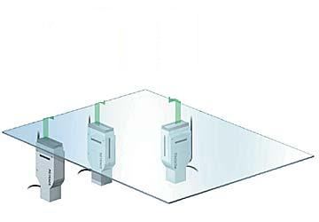



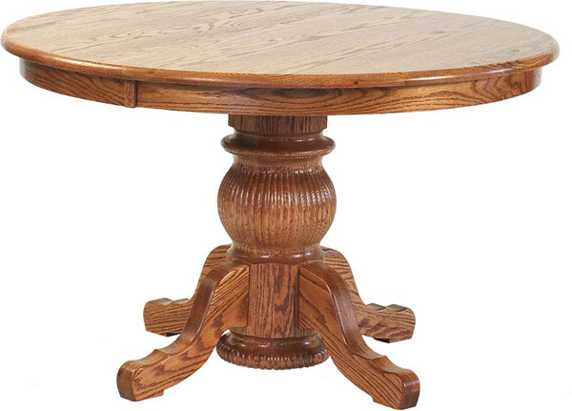
Quantum Bounce
?
Cold-Source at 40 K
System Neutron & Earth
  Neutron bound in the gravity potential of the earth
  <r> = 6 µm
  Ground state energy of 1.4 peV
  1 dim.
  Schrödinger Equ.
    Airy Functions
Hydrogen Atom
  Electron bound in proton potential
  Bohr radius <r> = 1 A
  Ground state energy of 13 eV
  3 dim.
  Schrödinger Equ.
    Legrendre Polynomials
Hartmut Abele, Technische Universität München
Hartmut Abele
5
5

Slide 6
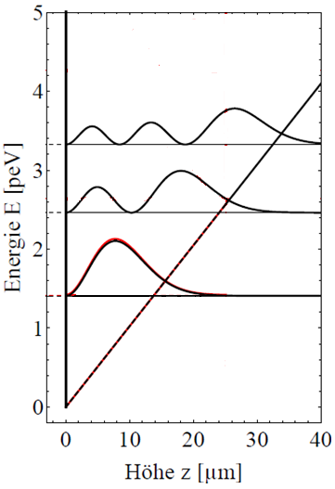
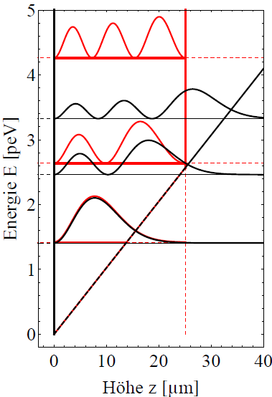
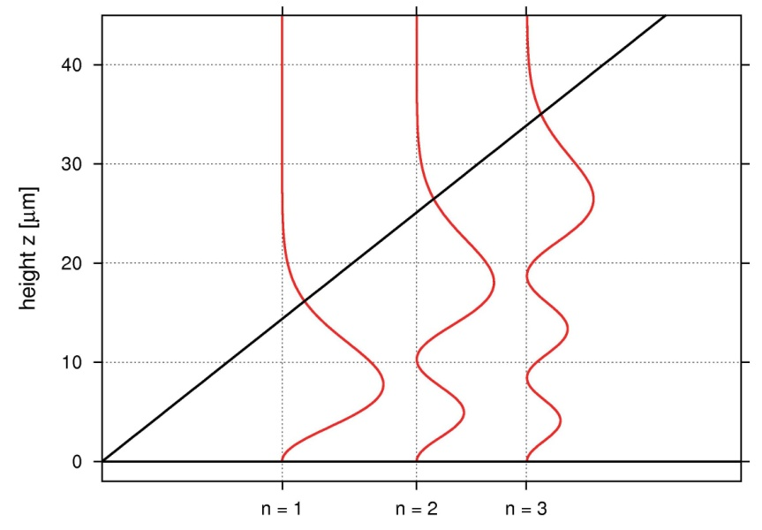
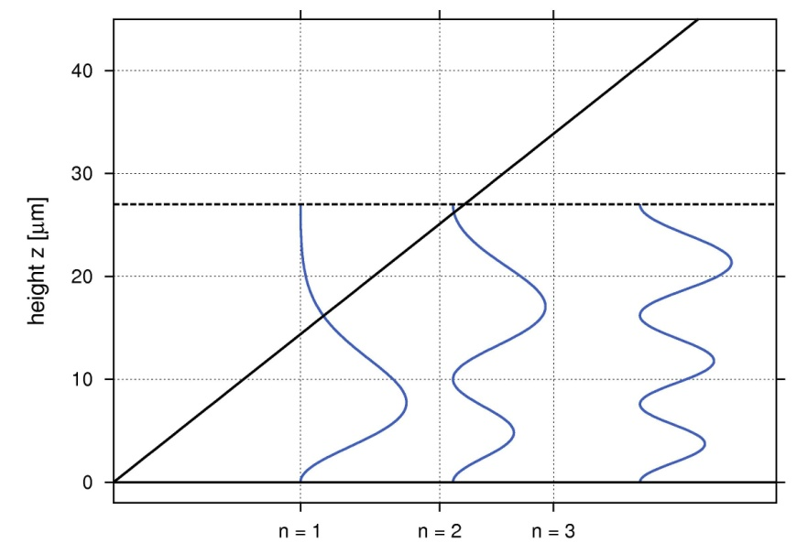
Gravity and Quantum Mechanics
Schrödinger equation:
Solutions: Airy-functions: Ai & Bi
boundary conditions:
 | E_{n} | E_{n}
1st state | 1.41peV | 1.41peV
2nd state | 2.46peV | 2.56peV
3rd state | 3.32peV | 4.2 peV
with 2nd mirror at height
_{V [peV]}

Slide 7
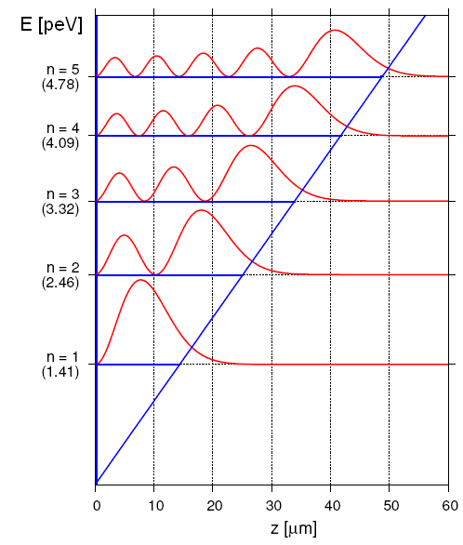
Rabi-Gravity-Spectroscopy
a 2-level system can be considered as a Spin ½ - System
|3 > 3.32 peV
|1 > 1.4 peV
QS: V.N., H.A. et al.,
Nature 2002
Vibrating mirror
Alternating Magnetic gradient fields

Slide 8
Outline
Gravity Resonance Spectroscopy
  Quantum states in the gravity potential of the earth and coherence superposition
Search for deviations from Newtons gravity law at short distances
  Large extra dimensions
  Dark matter particles
  Dark energy
Tests of weak interaction with neutron beta-decay experiments
  New results published (UCNA, PERKEO)
  Experiment PERC, Nab
Scientific Programme /Broad overview of the field

Slide 9
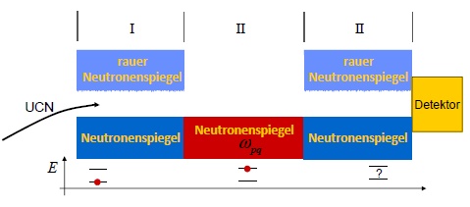
Frequency Reference for Gravitation
Based on natural constants:
  Mass of the neutron m
  Planck constant ħ
  Acceleration of earth g
Based on 2 natural constants:
  Mass of the neutron m
  Planck constant ħ
  Plus Acceleration of earth g
|3 > 3.32 peV
|1 > 1.4 peV

Slide 10
Neutrons test Newton
Strength α
Range λ
For a neutron with mass m_{n},
gravitational constant G,
mass m_{E} and density ρ of the earth with radius R_{E}
(r = R_{E} + z),
V(r) is usually approximated by

Slide 11
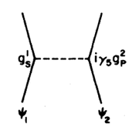
Discoveries: the dark universe
Spectroscopy of Gravity
  It does not use electromagnetic forces
  It does not use coupling to em Potential
Hyothetical gravity-like forces
  Axions?
  Chameleons?
constraint on any possible new interaction
Axion
Sensitivity: 10⁻¹⁴ eV Scale

Slide 12
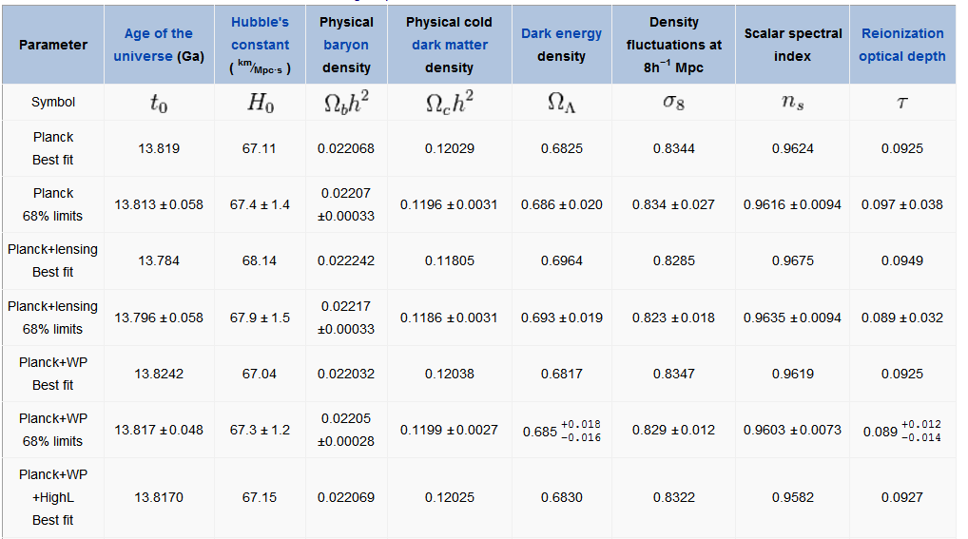
Cosmological Parameters

Slide 13
Neutrons test Newton
Strength α
Range λ
Hypothetical Gravity Like Forces
Extra Dimensions:
The string and D_{p}-brane theories predict the existence of extra space-time dimensions
Infinite-Volume Extra Dimensions: Randall and Sundrum
Exchange Forces from new Bosons: a deviation from the ISL can be induced by the exchange of new (pseudo)scalar and (pseudo)vector bosons
  Axion - - - - - - - - - - - - - - - - - - - → 0.2 µm < λ < 0.2 cm
  Scalar boson. Cosmological consideration
  Bosons from Hidden Supersymmetric Sectors
  Gauge fields in the bulk (ADD, PRD 1999) - - - - →10⁶ < α < 10⁹
Supersymmetric large Extra Dimensions (B.& C.) - - - - → α < 10⁶
Chameleon fields-

Slide 14
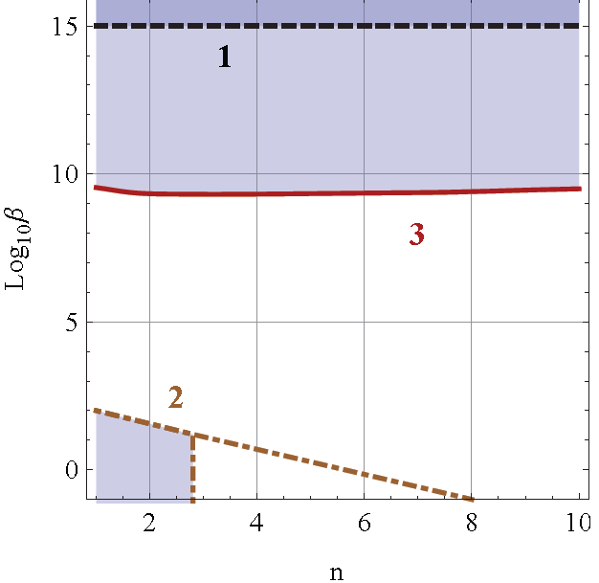
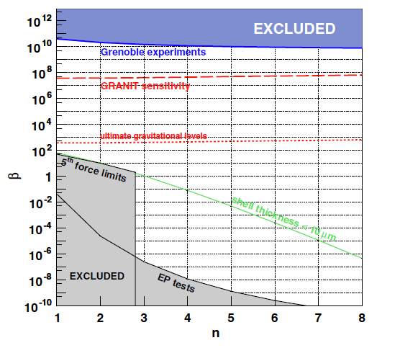

Dark Energy – Scalar Fields
Chameleon fields, Brax et al. PRD 70, 123518 (2004)
2 Parameters β, n

Slide 15
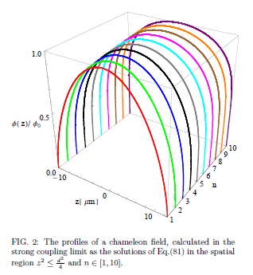

qBounce and Chameleons
Bounds on coupling β
  By comparing transition frequency with theoretical expectation:
  as long as β > 10⁵
  Cite as: arXiv:1207.0419v1

Slide 16

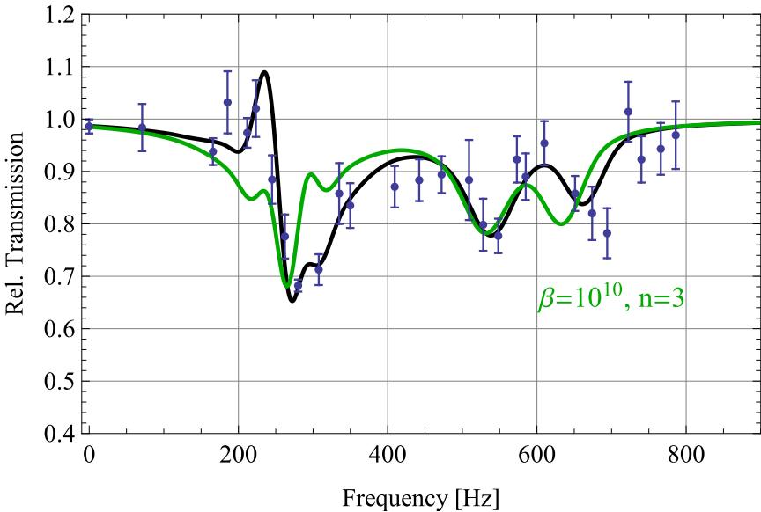
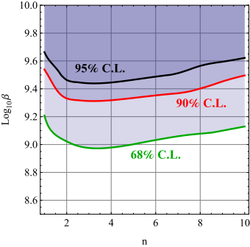
Applications II:
Strongly coupled chameleons
T. Jenke, ÖPG 2012
A.N. Ivanov et.al., arXiv:1207.0419 (2012)
T. Jenke et.al., arXiv:1208.3875 (2012)

Slide 17
Dark Energy – Scalar Fields
Chameleon fields, Brax et al. PRD 70, 123518 (2004)
2 Parameters β, n

Slide 18

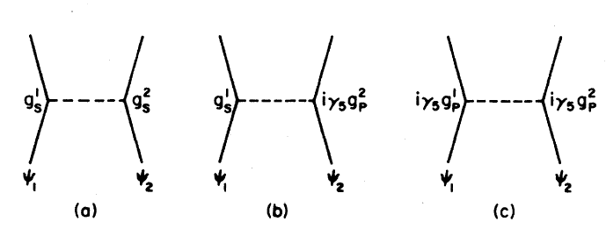
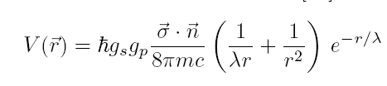
Limits on Axions
SM: 0 < θ < 2π
EDM neutron→ θ < 10⁻¹⁰
Axion: Spin-Mass coupling g_{s}g_{p}/ħc: θ = 0
J. E. Moody and F. Wilczek, Phys. Rev. D 30, 130 (1984).

Slide 19
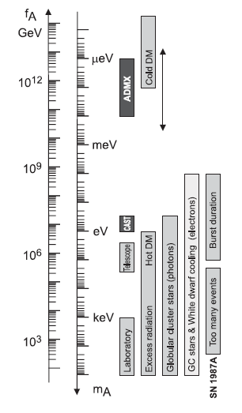
AXION: PDG Exclusion Ranges

Slide 20
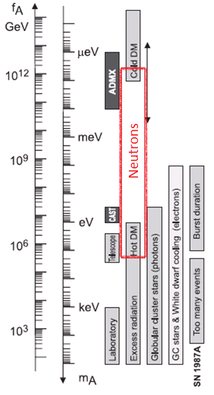
PDG Exclusion Ranges on Axion masses
←
←

Slide 21
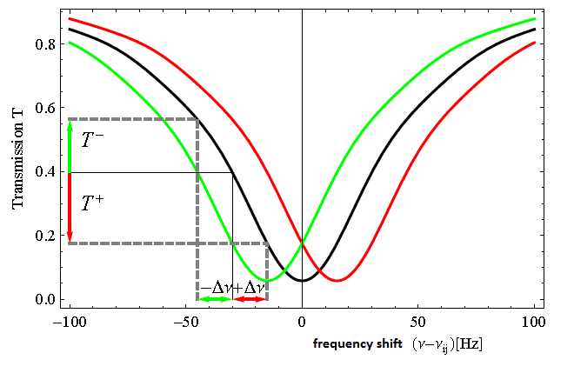
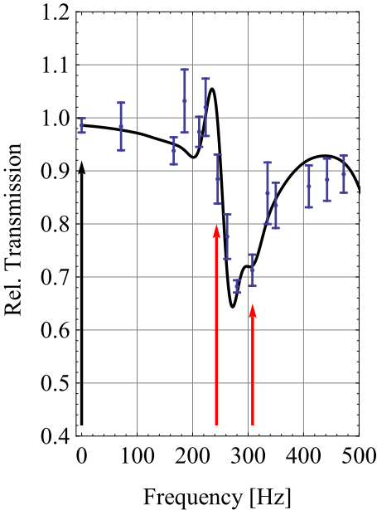
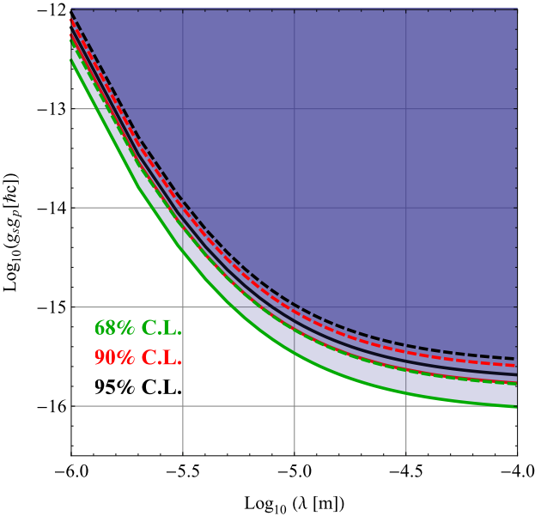
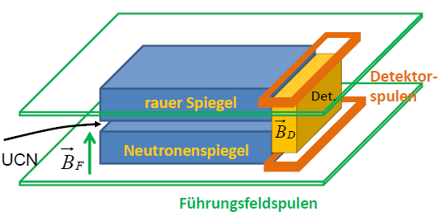
Applications I:
Spin-dependant short-ranged interactions
J.E. Moody, F. Wilczek, Phys. Rev. D30, 131-138 (1984)
discovery potential [Setup 2010]:
3 days of beamtime
T. Jenke et.al., arXiv:1208.3875 (2012)
T. Jenke, ÖPG 2012

Slide 22
Casimir Force
Atom
Neutron:
Casimir force absent
Example Rb
r = 1 Micron
Polarizability extremely small:

Slide 23
Priority Programme 1491
Research Area A: CP-symmetry violation and particle physics in the early universe
  Neutron EDM ΔE = 10⁻²³ eV
Research Area B: The structure and nature of weak interaction and possible extensions of the Standard Model
  Neutron β-decay V – A Theory
Research Area C: Relation between gravitation and quantum theory
  Neutron bound gravitational quantum states
Research Area D: Charge quantization and the electric neutrality of the neutron
  Neutron charge
Research Area E: New measuring techniques
  Particle detection
  Magnetometry
  Neutron optics

Slide 24
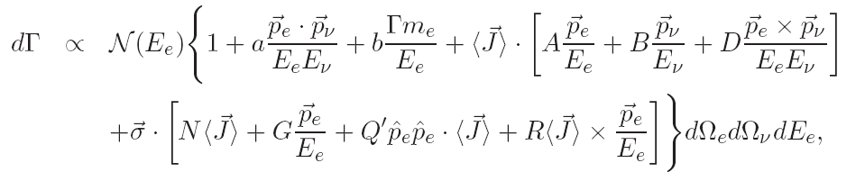
Neutron Alphabet deciphers the SM
A
Observables
Lifetime τ
Correlation A
Correlation B
Correlation C
Correlation a
Correlation D
Correlation N
Correlation Q
Correlation R
Beta Spectrum
Proton Spectrum
Polarized Spectra
Beta Helicity
Parameters
Strength: G_{F}
Quark mixing: V_{ud}
Ratio: λ = g_{A}/g_{V}
Neutron Spin
ϑ
Electron
a
B
D
R
N
Neutrino
C
Q
R
Proton

Slide 25
Neutron Alphabet deciphers the SM
a,A → λ = g_{A}/ g_{V}
A + τ → V_{ud} from CKM matrix
A + B + τ → Right Handed Currents (RHC)?
W_{L}
W_{R}
25

Slide 26
Grand Challenges II for ESS
Sensitive to any theory beyond the Standard Model
Left Right Symmetry
Supersymmetry
Tensor or scalar interactions
GUT

Slide 27
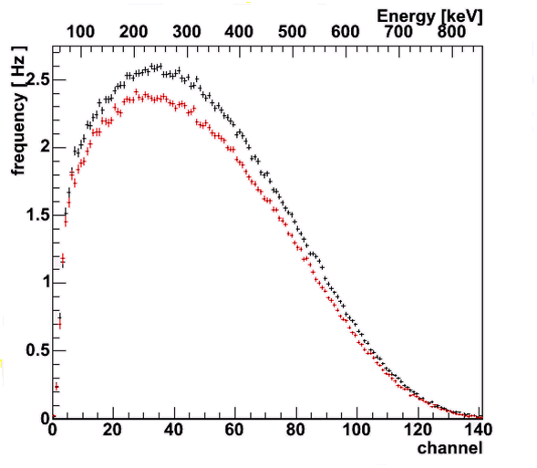
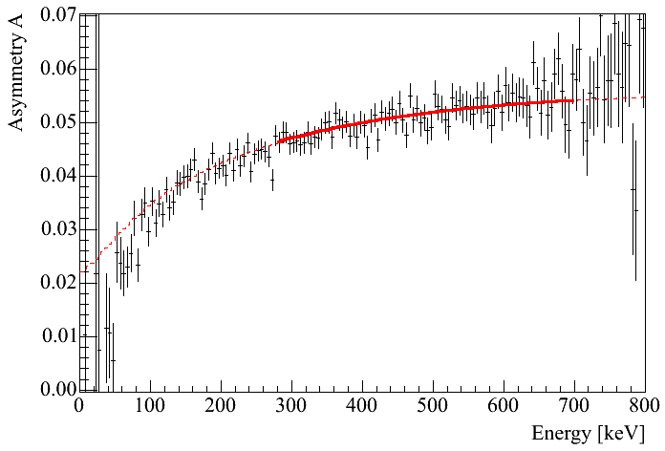
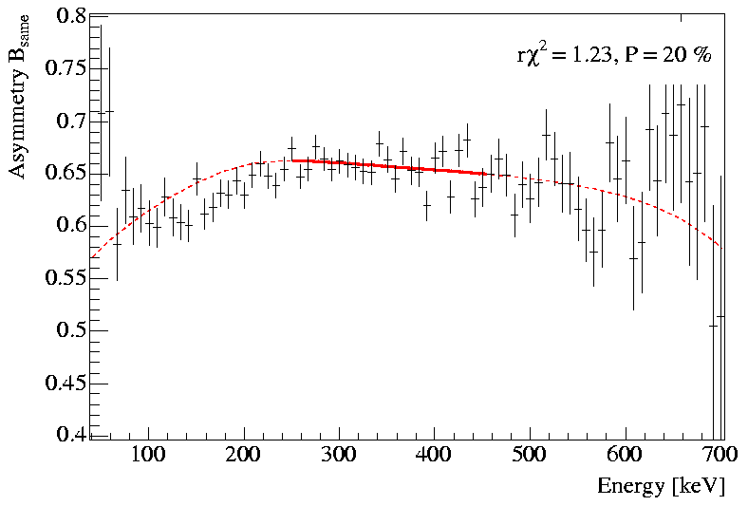



Recent Results: PERKEO Collaboration
Electron Asymmetry A:
A = −0.1193(5)
PERKEO II combined:
A_{PII} = −0.1193(4)
λ_{PII} = −1.2748(13)
error: 8.6×10⁻⁴
Prog. Part. Nucl.
Phys 60, 1-81 (2008)
Neutrino Asymmetry B:
B = 0.9802(50)
Schumann et a.
PRL 99, 191803 (2007)
Proton Asymmetry C:
C = −0.2377(36)
first precision measurement
Schumann et al.,
PRL 100, 151801 (2008)
₂₇

Slide 28
a bit history: λ from neutron β-decay
-1.1900(200), PDG (1960)
-1.2500(200), PDG (1975)
-1.2610(40), PDG (1990)
-1.2594(38), Gatchina (1997)
-1.2660(40), M, ILL (1997)
-1.2740(30), PERKEO II (1997)
-1.2686(47), Gatchina, ILL (2001)
-1.2739(19), PERKEO II (2002)
-1.2762(13), HD, ILL (2006)
−1.27590(+409)(−445), UCNA (2011)
-1.2756(30), UCNA (2013)
-1.2748⁺¹³₋₁₄ PERKEO II (2013)

Slide 29
Close to Publication
aCORN @ NIST
aSPECT @ Mz, ILL
PERKEO III @ UHD, ILL, TUW
New Instruments
Nab, PERC

Slide 30
SOURCE OF ERROR | COMMENT | SIZE OF CORRECT. | SIZE OF ERROR:
non-uniform n-beam | for ΔΦ/Φ = 10 % over 1 cm width | 2.5·10⁻⁴ | 5·10⁻⁵
other edge effects on e/p-window | for worst case at max. energy | 4·10⁻⁴ | 1·10⁻⁴
magn. mirror effect, contin's n-beam |  | 1.4·10⁻² | 2·10⁻⁴
magn. mirror effect, pulsed n-beam | for ΔB/B = 10 % over 8 m length | 5·10⁻⁵ | <10⁻⁵
non-adiabatic e/p-transport |  | 5·10⁻⁵ | 5·10⁻⁵
background from n-guide | }is separately measurable | 2∙10⁻³ | 1·10⁻⁴
background from n-beam stop |  | 2·10⁻⁴ | 1·10⁻⁵
backscattering off e/p-window |  | 2·10⁻⁵ | 1·10⁻⁵
backscattering off e/p-beam dump |  | 5∙10⁻⁵ | 1∙10⁻⁵
backscatt. off plastic scintillator | }for worst case | 2∙10⁻³ | 4·10⁻⁴
~ same with active e/p-beam dump |  | − | 1·10⁻⁴
neutron polarisation | present status | 3·10⁻³ | 1·10⁻³
Dubbers, Baessler, Märkisch, Schumann, Soldner, Zimmer, H.A., arXiv 2007
Hartmut Abele, Technische Universität München
30
Table 1: Error budget of PERC in standard configuration.
The numbering in this list is the same as in Sections 4.1 to 4.5.

Slide 31
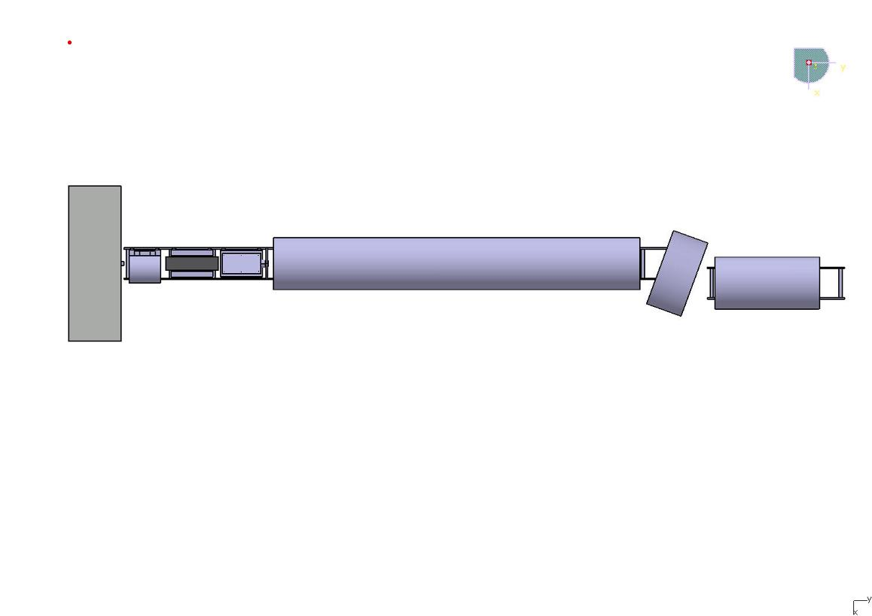
Key Instrument: PERC
A clean, bright and versatile source of neutron decay products
Univ.Heidelberg & TU Wien, Mainz, ILL,FRM2,TU Munich
High Flux : Φ = 2 x 10¹⁰ cm⁻²s⁻¹
→ Decay rate of 1 MHz / metre
Polarizer: 99.7 ± 0.1 %
Spin Flipper: 100.05 ± 0.1 %
Analyzer: 100 % ³He-cells
Polarizer
Chopper
Decay Volume, 8m
Analyzing area
Spin flipper
n-guide + solenoid: field B₀
polarized, monochromatic
n-pulse
Beam stop
solenoid, field B₂
p+ + e− window-frame
p+ + e− beam
v- selector
n + γ-beam stop
solenoid, field B1
D. Dubbers, H. A., S. Baeßler, B. Maerkisch, M. Schumann, T. Soldner, O. Zimmer, arXiv:0709.4440.

Slide 32
Bastian Maerkisch, Univ.Heidelberg
TU Wien, FRM2, TUM, ILL,
PERC:
A clean, bright and versatile source of neutron decay products
Beam stop
Decay Volume, 8m
n + γ-beam stop
solenoid, field B1
Polarizer
Chopper
Spin flipper
n-guide + solenoid: field B0
polarized, monochromatic
n-pulse
e,p selector
Analyzing area
v- selector
solenoid, field B2
p+ + e− window-frame
p+ + e− beam

Slide 33
qBounce Summary
Progress Report with Galileo in Quantum Land
  qBounce: first demonstration of the quantum bouncing ball
  Realization of Gravity Resonance Spectroscopy:
  New Tool for
    A Search for a deviation from Newton‘s Law at short distances, where polarizability effects are extremely small ,
    A quantum test of the equivalence principle
  Direct best limits on axion coupling at short distances,
  Chameleon limits 5 orders of magnitude better than from other methods (arXiv: 1208.3875)
  New results for A, from UCNA, PERKEO

Slide 34
Reserva

