Slide 1
High-Precision Half-Life and Branching Ratio Measurements for Superallowed Fermi β Emitters at TRIUMF–ISAC
Alex Laffoley – University of Guelph
International Nuclear Physics Conference
June 2-6, 2013 – Florence, Italy
Notes:
Thank you to organisers for allowing me to speak about a series of recent experiments performed at the ISAC facility at TRIUMF. The study of superallowed Fermi beta emitters provide demanding, and fundamental, tests of the standard model.

Slide 2
Extracting V_{ud} from Superallowed Fermi β Decay
To first order, β decay ft values can be expressed as:
K
constants
phase space (Q-value)
ft =
|M_{fi}|² g²
Weak coupling strength
half-life, branching ratio
matrix element
For the special case of 0⁺ 0⁺ (pure Fermi) β decays between isobaric analogue states (superallowed) the matrix element is that of an isospin ladder operator:
|M_{fi}|² = (T – T_{Z})(T + T_{Z} + 1) = 2 (for T=1)
Strategy: Measure superallowed ft-values, deduce G_{V} and V_{ud}
Vector coupling
constant
K
Fermi coupling
constant
G_{V}² =
|V_{ud}| = G_{V} / G_{F}
2ft
Notes:
(for superallowed) g -> Gv, the vector coupling constant, so RHS is a collection of constants (under CVC hypothesis)

Slide 3
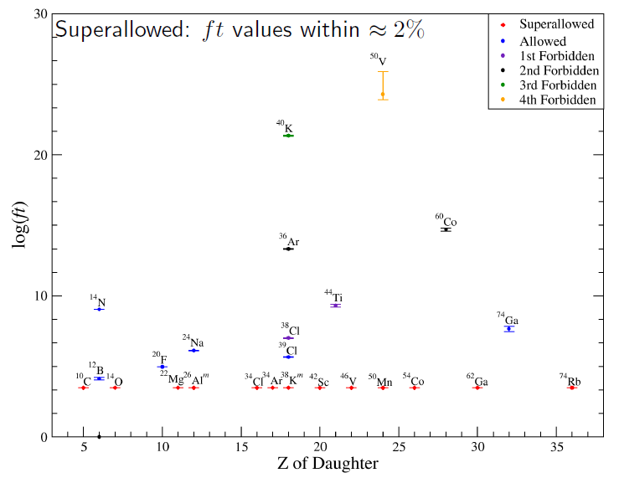
β Decay ft Values
Notes:
Spans 20 orders of magnitude (logarithmic plot). Superallowed are constant.

Slide 4
Superallowed ft Values
K
ft ≈
= constant (CVC)
2 G_{v}²
2%
J.C. Hardy and I.S. Towner, Physical Review C 79, 055502 (2009)
Notes:
Not perfect, but we don’t expect that (isospin not a perfect symmetry)

Slide 5
Superallowed Fermi β Decay: Corrections
K
2G_{V}(1 + Δ_{R})
Ft = ft(1 + δ_{R})(1 + δ_{NS} – δ_{C}) =
= constant
²
^{V}
“Corrected” ft value
Experiment
▫ Half-life
▫ Q-value
▫ Branching Ratio
Inner radiative correction (~2.4%) (nucleus independent)
CVC Hypothesis
Calculated corrections (~1%) (nucleus dependent)
Δ_{R} = nucleus independent inner radiative correction: 2.361(38)%
δ_{R} = nucleus dependent radiative correction to order Z²α³: ~1.4%
- depends on electron’s energy and Z of nucleus
δ_{NS} = nuclear structure dependent radiative correction: -0.3% – 0.03%
δ_{C} = nucleus dependent isospin-symmetry-breaking correction: 0.2% – 1.5%
- strong nuclear structure dependence (radial overlap)
V
Notes:
Delta C depends strongly on model and provides (additional) motivation for precision measurement (differentiate between and provide uncertainty to theory).

Slide 6
Corrected ft Values
Notes:
Study many nuclei, span across large range of Z.

Slide 7
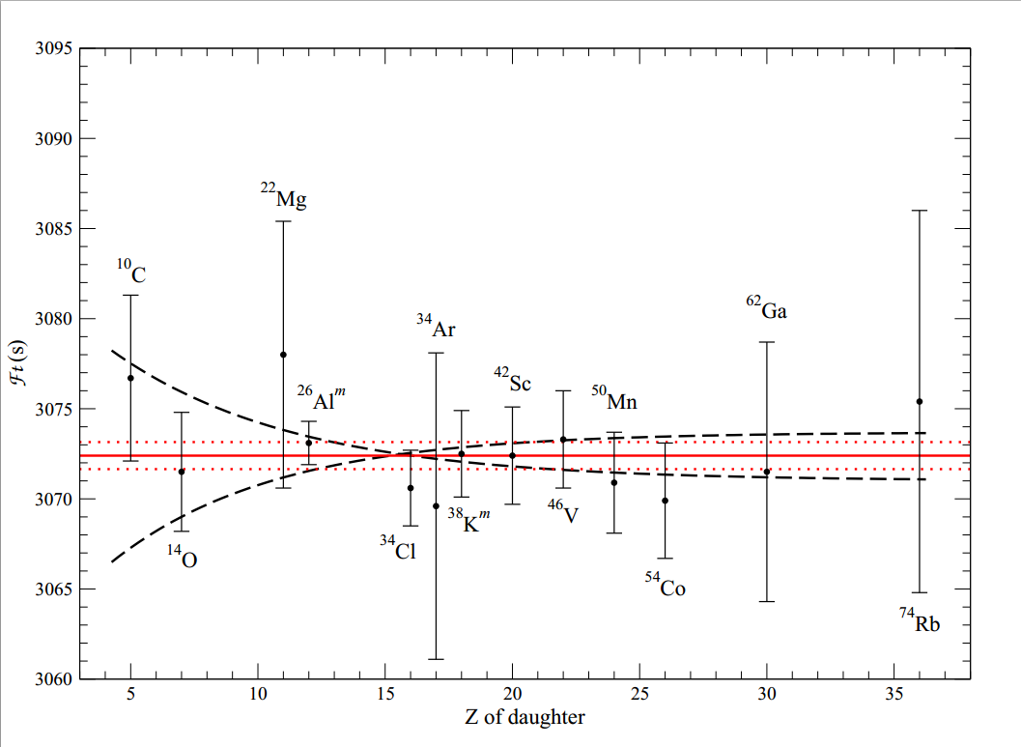
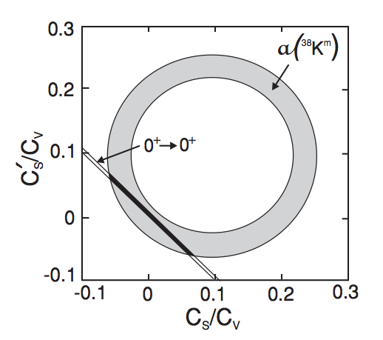
Testing Extensions of the SM
Set sensitive limits on the existence of scalar currents in nuclear β decay
Ft values for ¹⁰C and ¹⁴O are the most important
Complementary to measurements of β-ν angular correlation coefficients “a”
Resolving trivial sources of systematic uncertainty in superallowed data are essential
C_{S}/C_{V} ± 0.2%
Notes:
Scalar currents are an additional motivation for precision measurements, especially the lightest superallowed emitters (as they are the most sensitive).

Slide 8
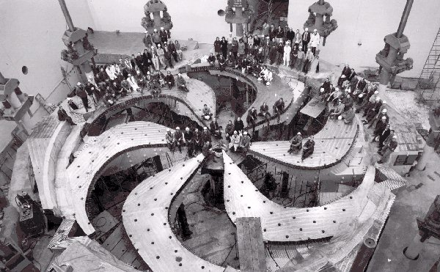
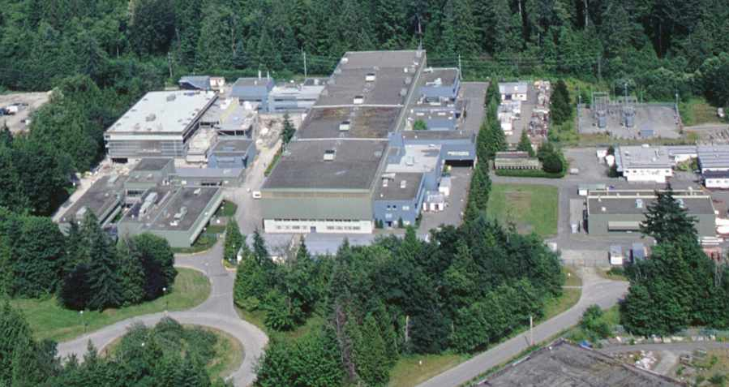
TRIUMF–ISAC
Up to 100 μA, 500 MeV proton beams from the TRIUMF main cyclotron produce high-intensity secondary beams of many of the superallowed emitters by the ISOL technique.
Notes:
Canada’s National Particle and Nuclear Physics Laboratory in Vancouver BC. ISOL facility.

Slide 9
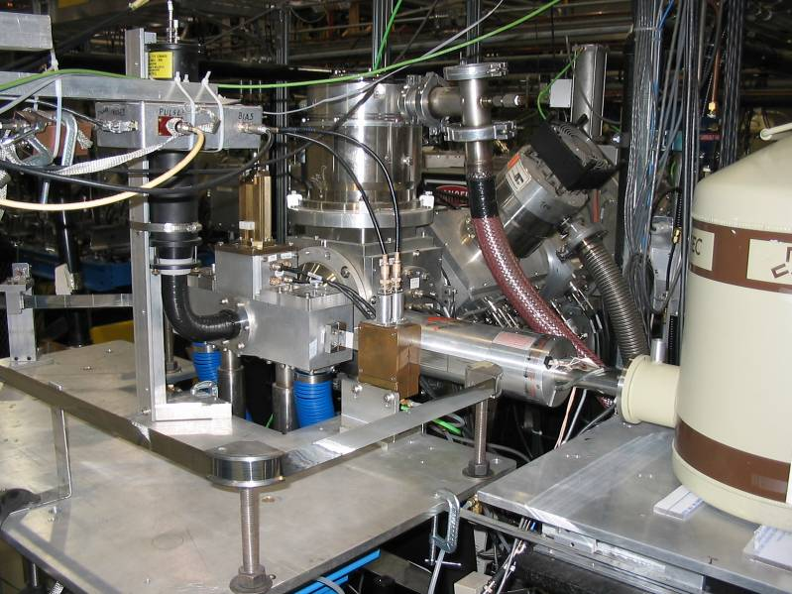
4π Gas Counter
4π continuous-flow gas-proportional counter and fast tape transport system
Notes:
Beta counting experiments.

Slide 10
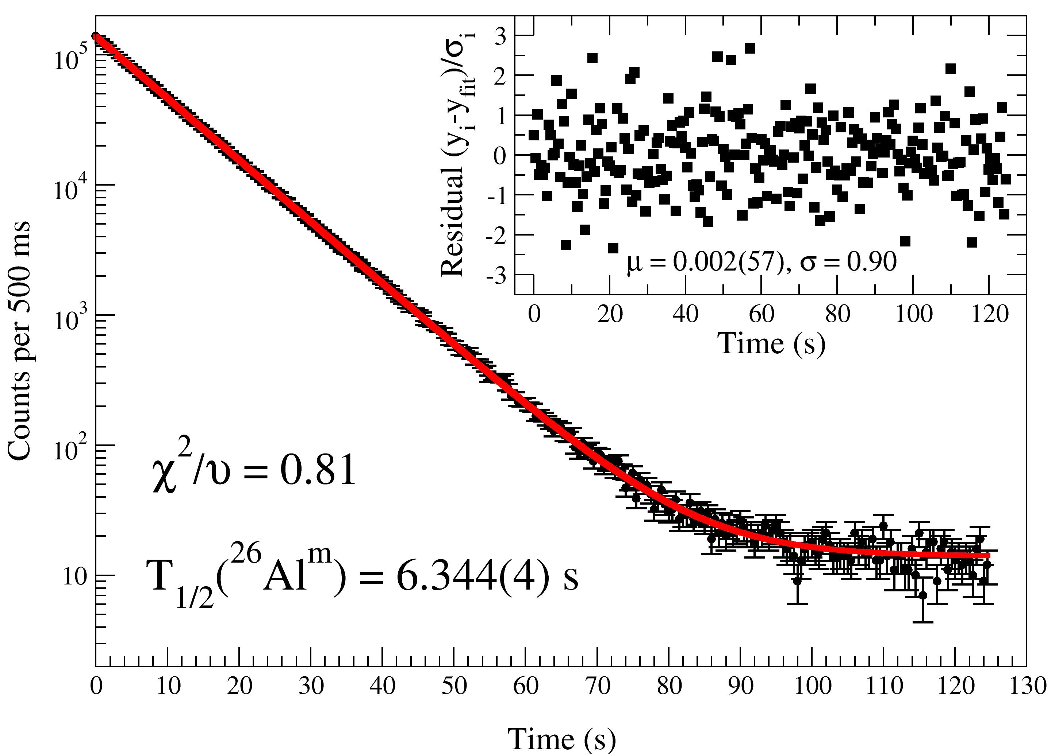
Measuring the ²⁶Al^{m} Half-Life
²⁶Al^{m}: T_{1/2} = 6.3465 s
²⁶Na: T_{1/2} = 1.072 s
²⁶Al^{g}: T_{1/2} = 7.4x10⁵ yrs
Beam
Cycle
Implant 6-14 s
Allow ²⁶Na to decay 26-34 s
Move tape to detector and count ²⁶Al^{m} decays for ~20, 25, 30 half-lives, then repeat.
Change detector voltage, discriminator setting, and swap fixed, nonextendable dead times between two MCS units to investigate systematic effects.
Notes:
Using the gas counter, …

Slide 11
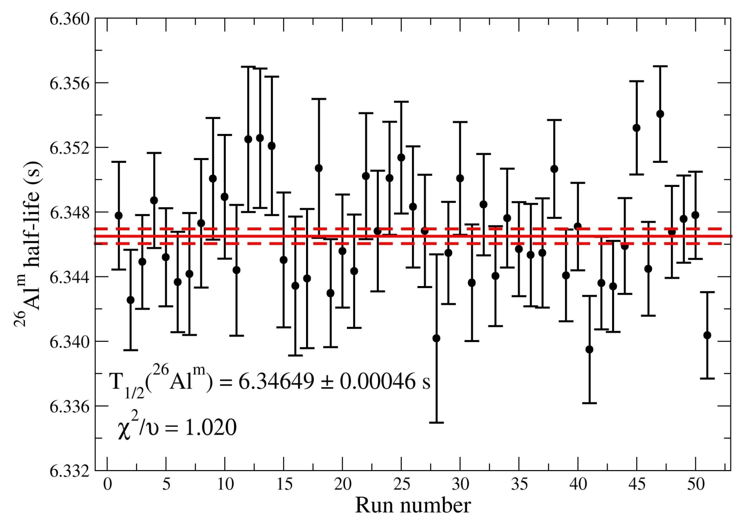
Measuring the ²⁶Al^{m} Half-Life
2008 cycles spanning 51 runs, Stat. uncertainty = 0.007%
0.1%
This work: 6.34654 ± 0.00046_{stat.} ± 0.00060_{syst.} s
Most precise half-life measurement for any superallowed Fermi β emitter.

Slide 12
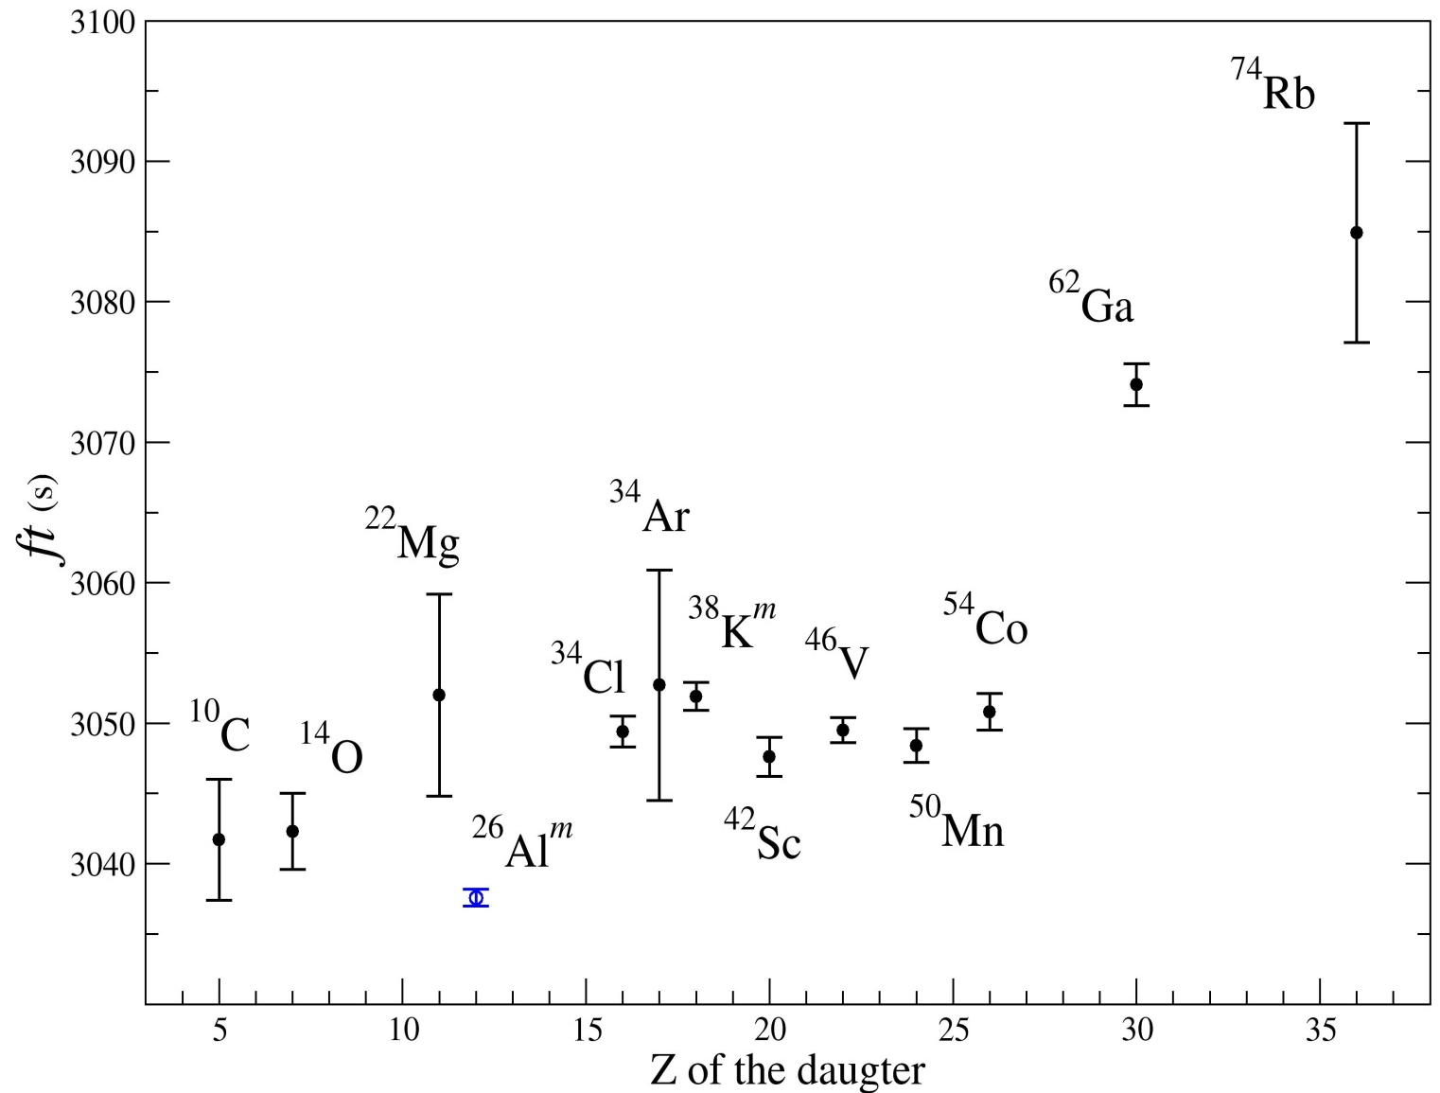
²⁶Al^{m} ft Value
ft = 3037.58(51)_{f} (32)_{T} (5)_{BR} s
_{½}
T_{½} = 6346.43(68) ms
+0
BR = 100.0000 %
-0.0015
f = 478.237(80)
P_{EC} = 0.082 %
ft =
f T_{½} (1+P_{EC})
BR
Most precise ft for any superallowed emitter
P. Finlay et al, Phys. Rev. Lett. 106, 032501 (2011)
P. Finlay et al, Phys Rev C85, 055501 (2012)

Slide 13
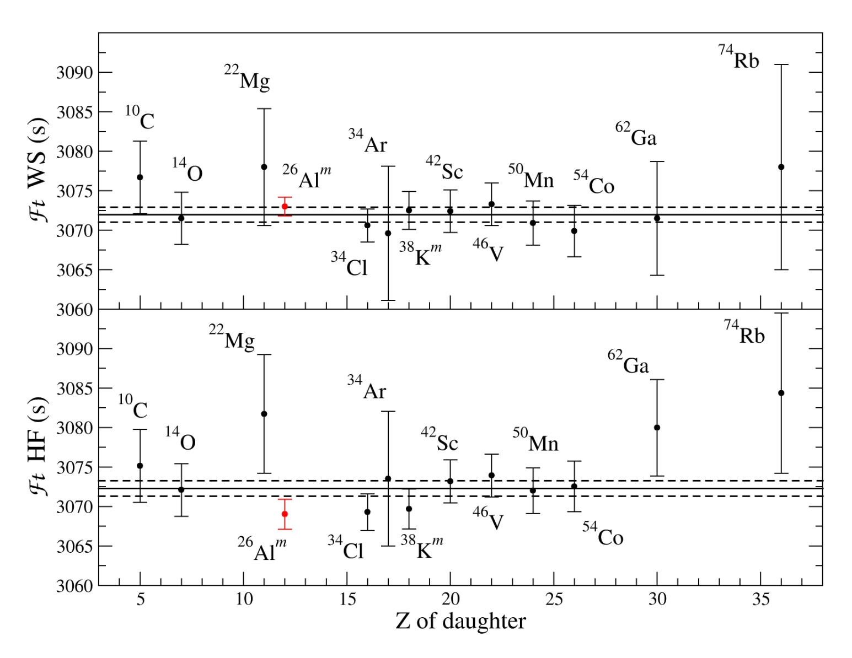
Isospin Symmetry Breaking Systematic
Ft_{WS} = 3072.38(75)
Difference in Ft between
WS and HF radial overlap
models for δ_{C2}:
Δ(Ft) = 0.79 s
Increased by 50% and
now larger than the statistical uncertainty
of 0.75 s on the world
Ft data.
Ft_{HF} = 3071.59(87)
Notes:
Error associated with Delta C correction (model/theory dependent) is usually the difference between the world average Ft values. After the high-precision 26Al measurements,

Slide 14
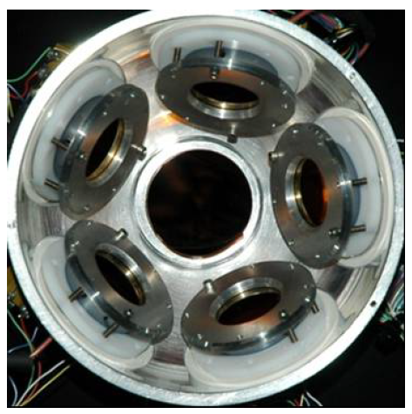
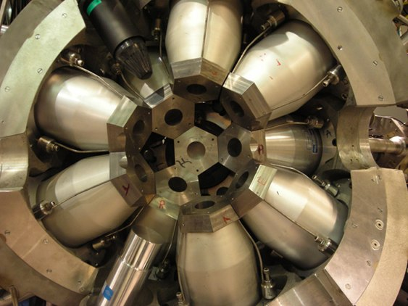
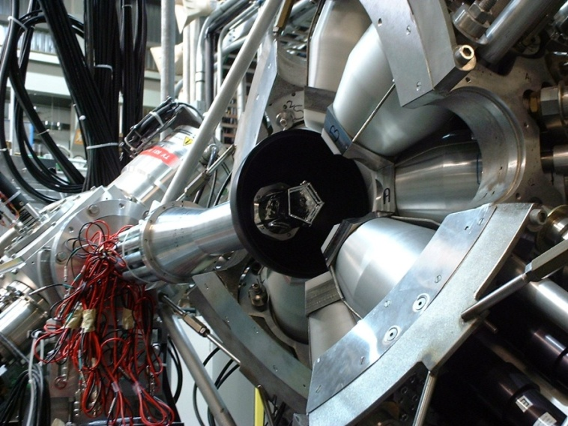
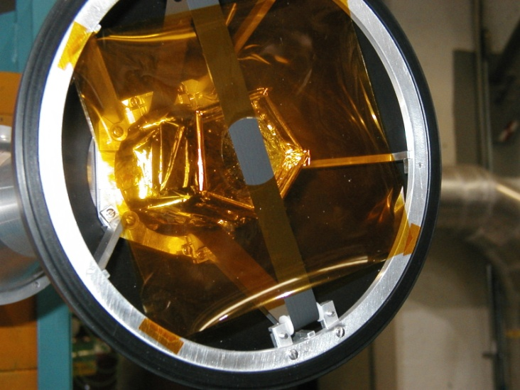
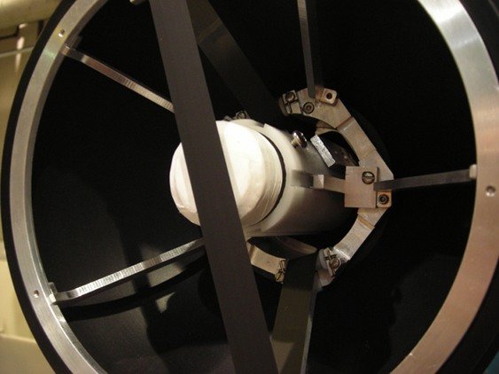
8π γ-Ray Spectrometer
20 Compton-Suppressed HPGe detectors
SCEPTAR: 20 plastic scintillators for β detection
PACES: 5 Si(Li) detectors for conversion electron spectroscopy
ZDS: One forward angle fast plastic scintillator for β detection

Slide 15
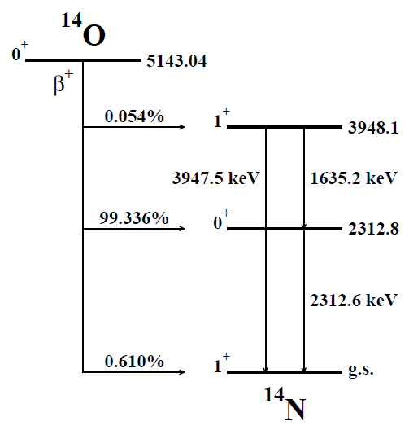
¹⁴O Half-Life Measurement
Simultaneous independent direct β and γ-ray counting experiments using the 8π spectrometer and the Zero-Degree Scintillator.
γ Counting:
-Decay Selective
-Slow & Inefficient
Previous measurements reveal a systematic discrepancy between detection method
β Counting:
-Fast & Efficient
-Not Decay Selective
Notes:
Each method has its own advantages and disadvantages.

Slide 16
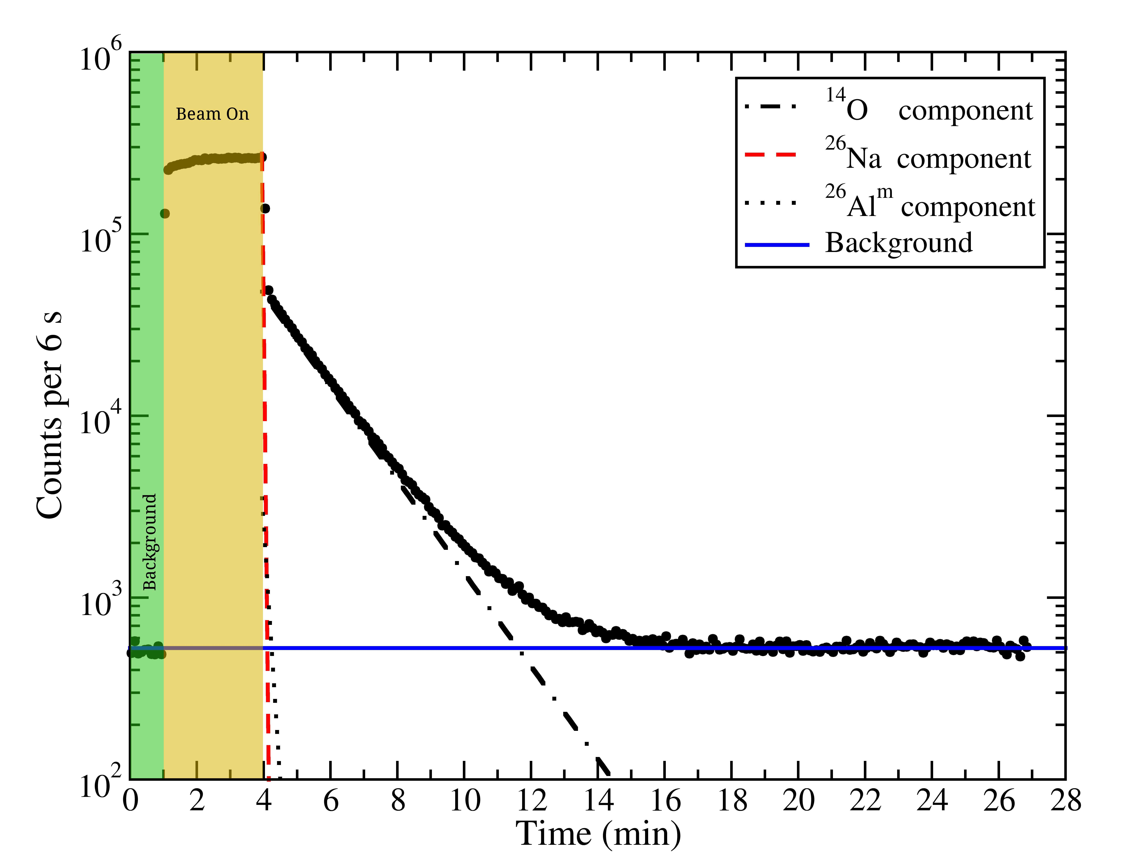
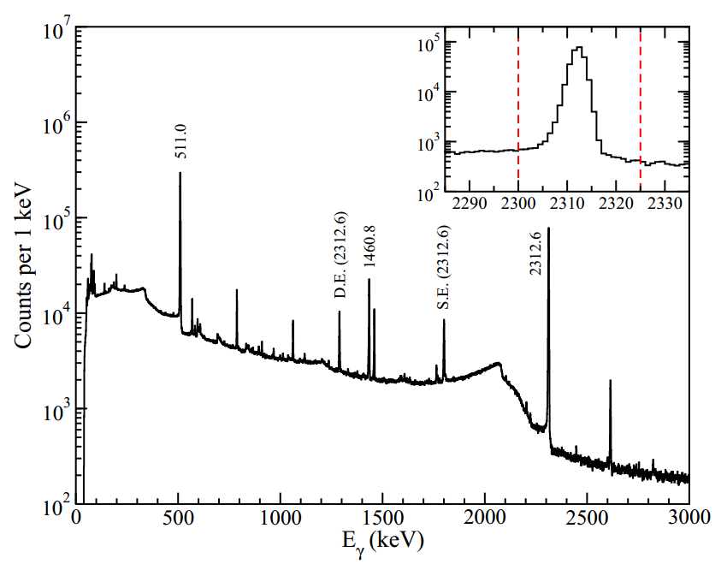
¹⁴O Half-Life Measurement
¹²C-¹⁴O: T_{1/2} = 70.620 s
²⁶Al^{m}: T_{1/2} = 6.3465 s
²⁶Na: T_{1/2} = 1.072 s
Beam
Notes:
Molecular carbon-monoxide. Similar to 26Al. 2612keV gamma ray we gated on as well as a sample beta spectra.

Slide 17
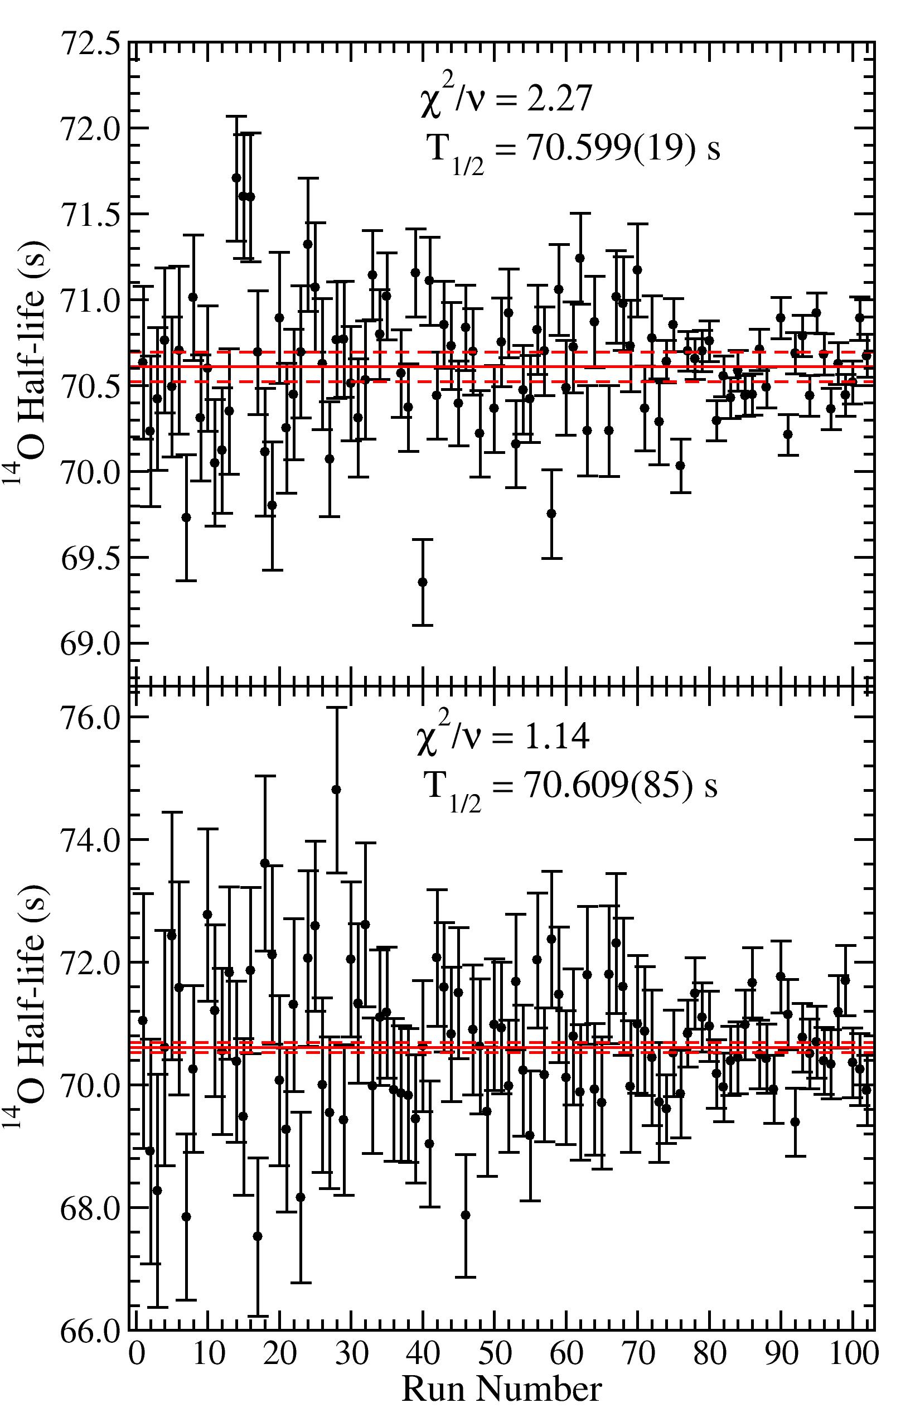
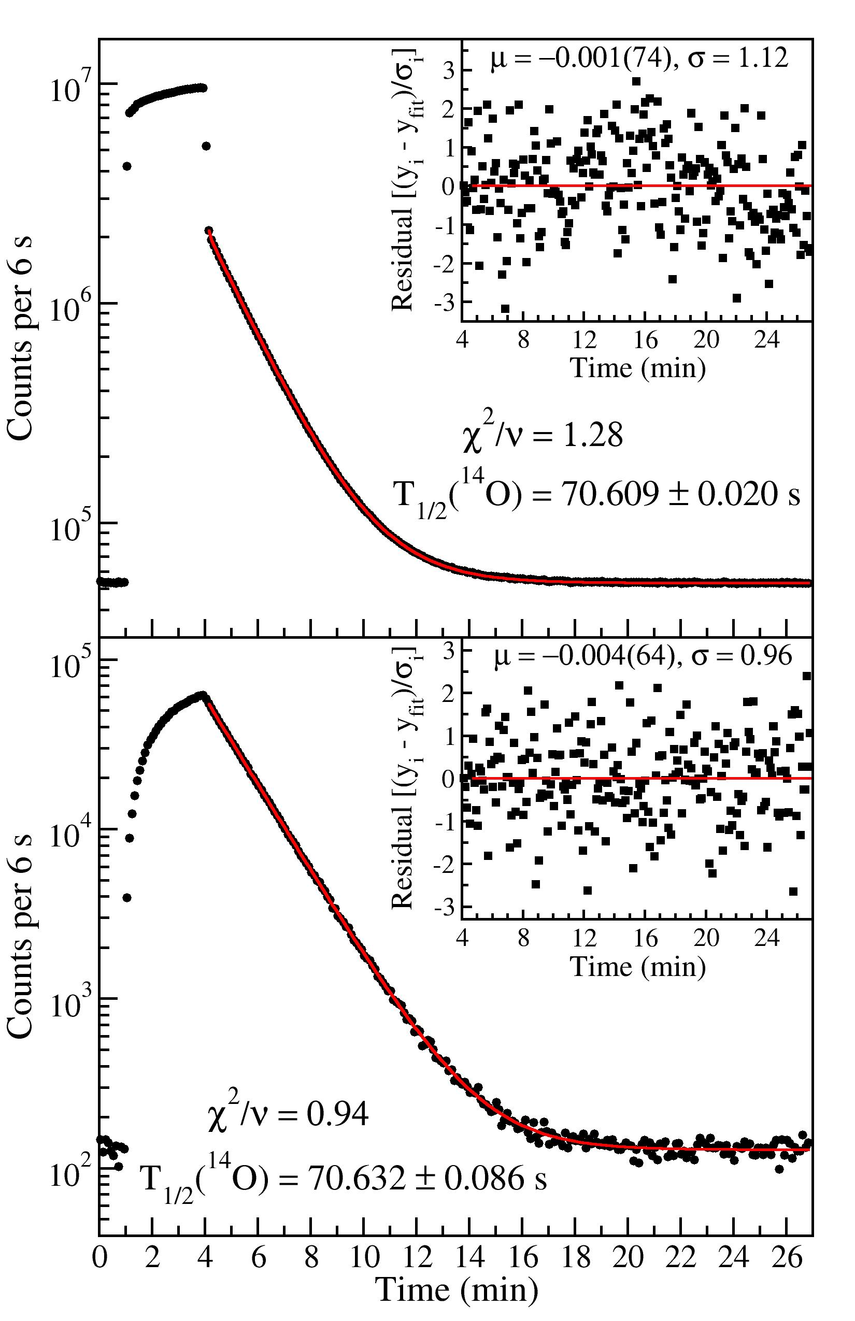
β
γ
Notes:
You can see the stark advantages each detection method carries. Gamma = decay selectivity, Beta = higher statistics.

Slide 18
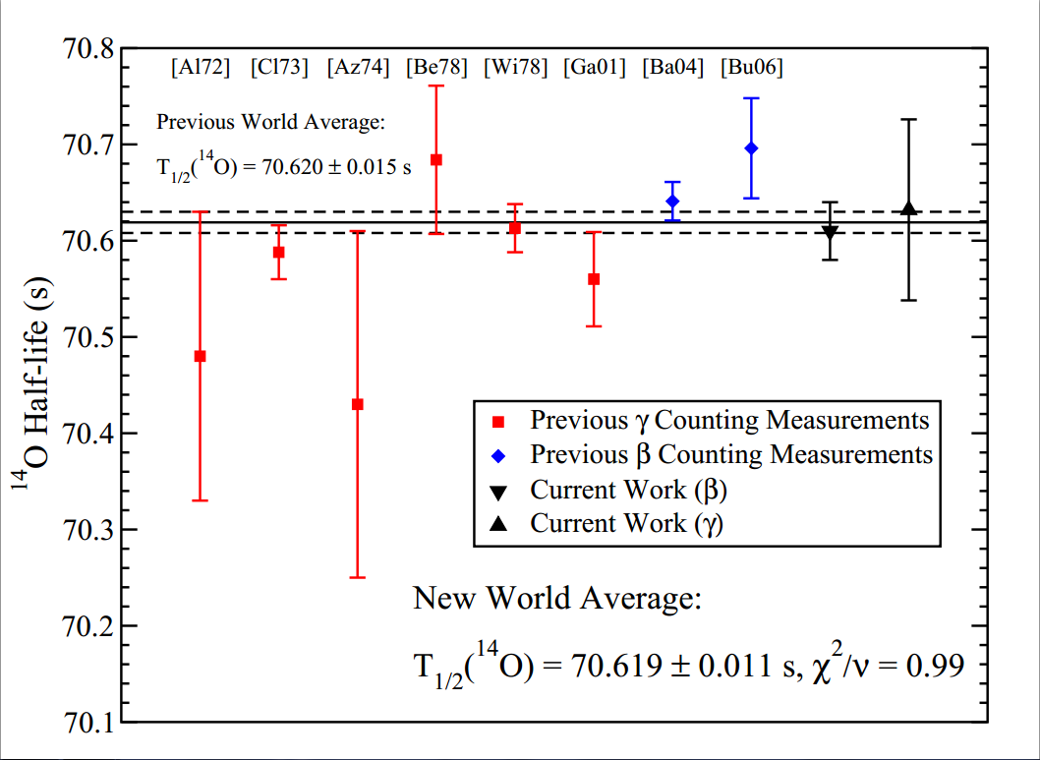
Status of ¹⁴O Half-Life
Performing simultaneous β and γ half-life measurements for ¹⁴O will help address the current systematic discrepancy.
A follow-up experiment is scheduled for August to push 0.03% precision.
Precision ft determination of light superallowed Fermi β emitters will help push the limits of scalar currents in the Weak interaction.
For more details, see the poster session!
Notes:
Agree with each other. Follow-up in August will rival the world average error. Helps set limits of scalar interactions.

Slide 19
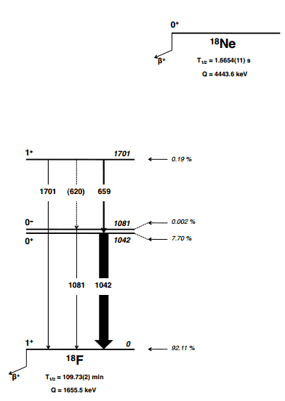
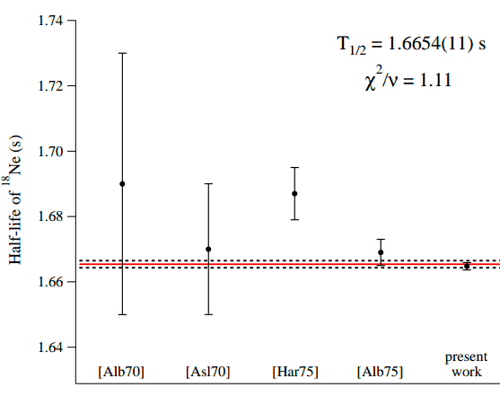
¹⁸Ne Half-Life Measurement
4 times more precise!
G.F. Grinyer et al, Phys Rev C87, 045502 (2013)
Notes:
Also used gamma ray counting technique to measure 18Ne half-life and improve the precision of the half-life by a factor of 4.

Slide 20
Superallowed β Branching Ratios for
A ≥ 62 and the Pandemonium Effect
For large Q-value β decays, there are generally many weak β branches to the large number of daughter states within the Q-value window.
In the subsequent γ decay, many individual γ-rays may be too weak to identify.
The sum of these unobserved γ intensities will, however, generally be sufficient to prevent precision determination of β decay branching ratios through γ-ray spectroscopy.
J.C. Hardy and I.S. Towner, Phys. Rev. Lett. 88, 252501 (2002)
Notes:
Majority (>99%) of beta decay intensity goes to ground state, but it is the <1% we must accurately measure.

Slide 21
Placing γ-Rays Transitions
Note: ppm transitions
Notes:
Parts per million transitions!

Slide 22
Measuring Internal Conversion Electrons
β − γ − electron
Coincidence Spectrum
Notes:
Ppm transitions!

Slide 23
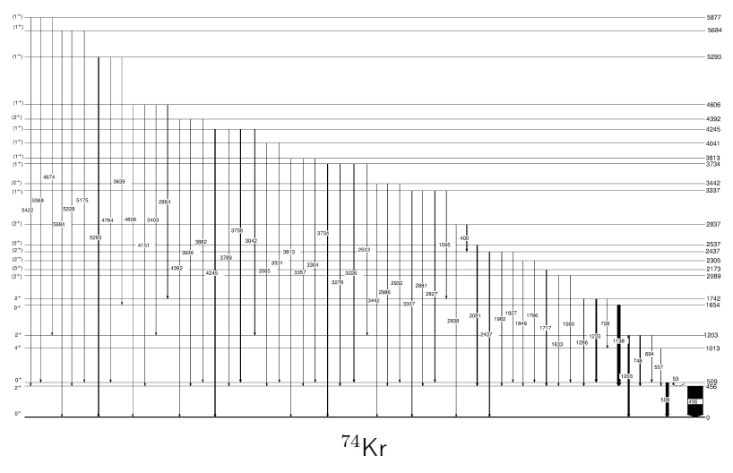
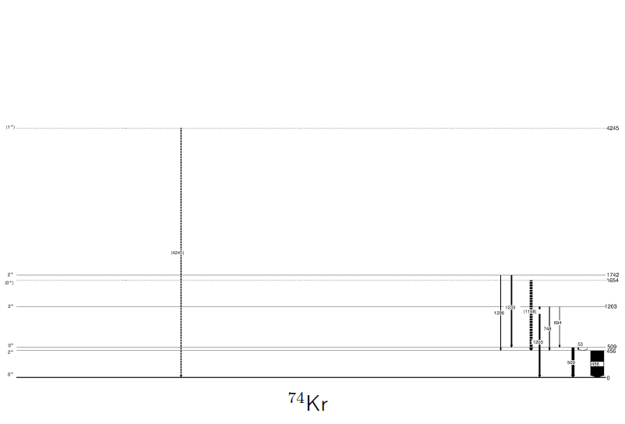
Controlling Pandemonium via 2⁺ Collector States
I'_{gs}
I'₂₊
Ground-state γ-feeding of
I_{gs} = 3960(70) ppm identified
~ 400 1⁺ Levels
Direct β feeding of 2⁺
states is negligible
I'₂₊ = 1223(57) ppm
B_{gs} = I'_{gs} /(I'_{gs} + I'₂₊)
Shell Model:
B_{gs} = 0.33(11)
I'_{gs} = 600(300) ppm
Superallowed BR:
99.544 ± 0.031 %
Previous: (99.5 ± 0.1)%
Piechaczek PRC 67 051305 (2003)
58 new transitions identified

Slide 24
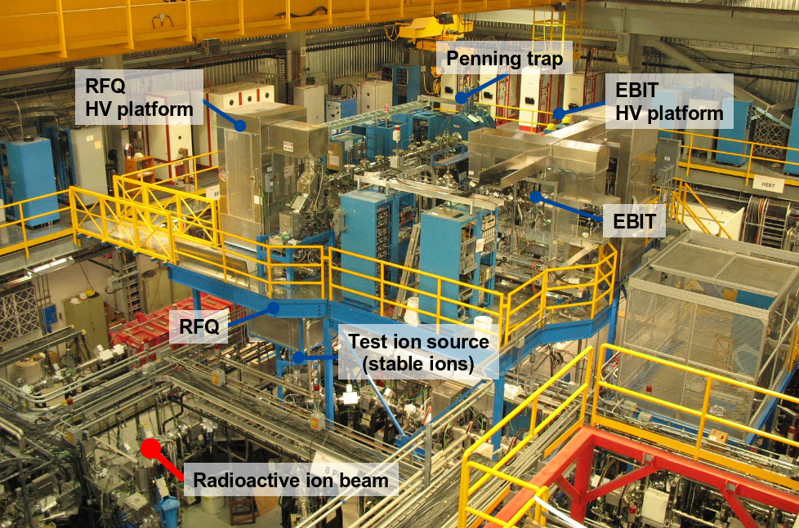
Mass Measurements @ TITAN
Penning Trap located at ISAC
High-precision mass measurements → Q-value
Last experimental quantity required for determination of ft values
Notes:
Also located in the ISAC hall is TITAN, a penning trap used for high-precision mass measurements, the final experimental quantity required for measuring ft values.

Slide 25
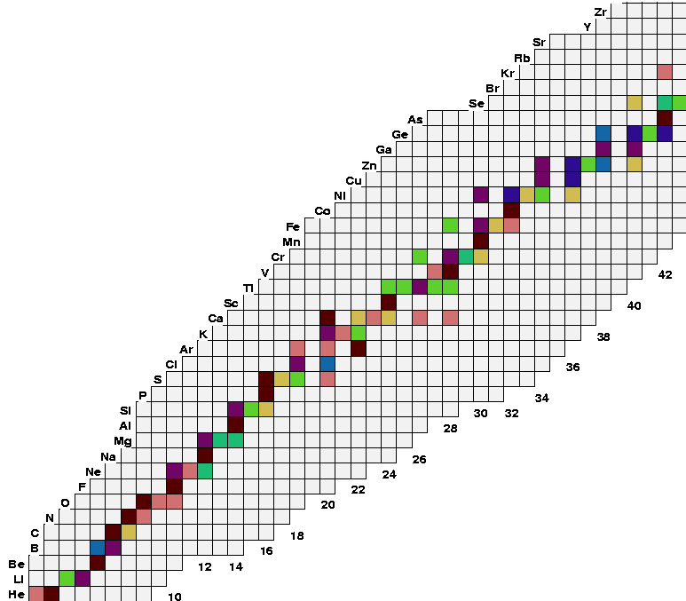
Superallowed β decay studies at ISAC
T_{1/2} , G.C. Ball et al., PRL 86 1454 (2001)
BR, A. Piechaczek et al., PRC 67, 051305 (2003)
BR, R. Dunlop et al., PRC submitted (2012)
Q, S. Ettenauer et al., PRL 107, 272501 (2011)
CR, E. Mané et al., PRL 107, 212502 (2011)
⁷⁴Rb
T_{½} , G.F. Grinyer et al., PRC 77, 201501 (2008)
BR, B.H. Hyland et al., PRL 97, 102501 (2006)
BR, P. Finlay et al., PRC 78, 044321 (2008)
⁷⁰Br
⁶²Ga
⁶⁶As
{
T_{½} and BR
⁵⁴Co
⁵⁰Mn
BR, K.G. Leach et al., PRL 100, 192504 (2008) T_{½} , G.C. Ball et al., PRC 82, 045501 (2010)
⁴⁶V
N=Z line
T_{½} and BR
^{38m}K
³⁴Ar
T_{½} , P. Finlay et al., PRL 106, 032501 (2011)
BR, P. Finlay et al., PRC 85, 055501 (2012)
^{26m}Al
T_{½} , G.F. Grinyer et al., PRC 76, 025503 (2007) T_{½} , G.F. Grinyer et al., PRC 87, 045502 (2013)
¹⁸Ne
T_{½} , A.T. Laffoley et al., PRC submitted (2013)
¹⁴O
T_{½} by β and γ counting
¹⁰C
Notes:
An overview of the impact of ISAC on the study of superallowed Fermi beta emitters. Included are an array of half-life, branching ratio, and Q-value measurements, and several more are expected to occur before the end of the year (10C/14O).

Slide 26
Conclusions
At TRIUMF–ISAC we perform high-precision half-life (GPS/8π), branching ratio (8π) and Q-value (TITAN) measurements for superallowed Fermi β decays–all of the experimental inputs required for ft value determination
²⁶Al^{m} now has the most precisely measured T_{½} and ft value for any superallowed Fermi β emitter
The pandemonium problem that has previously limited the experimental precision of ⁷⁴Rb and ⁶²Ga ft values has been overcome
Simultaneous β and γ counting half-life measurements help address systematic uncertainties (¹⁴O,¹⁰C, ¹⁸Ne)
Notes:
26Al : Also raises questions to the uncertainties we assign to these model independent corrections (delta C)
74Rb : pushing tests of CVC to high Z (largest corrections)
14O : setting limits on scalar currents in the Weak interaction

Slide 27
Acknowledgements
University of Guelph
S. Chagnon-Lessard
G. Demand
A. Diaz Varela
R. Dunlop
P. Finlay
P.E. Garrett
B. Hadinia
D.S. Jamieson
A.T. Laffoley
K.G. Leach
A.A. Phillips
E.T. Rand
C.S. Sumithrarachchi
C.E. Svensson
J. Wong
TRIUMF
G.C. Ball
D. Bandyopadhyay
M. Djongolov
S. Ettenauer
A.B. Garnsworthy
J. Glister
G. Hackman
S. Ketelhut
C.J. Pearson
E. Tardiff
S. Triambak
S.J. Williams
C. Unsworth
Simon Fraser
C. Andreoiu
A. Chester
D.S. Cross
K. Starosta
CENBG
B. Blank
J. Giovinazzo
Queens University
J.R. Leslie
Texas A&M
I. S. Towner
Louisiana State
E.F. Zganjar
GANIL
H. Bouzomita
G.F. Grinyer
J.C. Thomas
St. Mary’s University
R.A.E. Austin
University of Kentucky
S.W. Yates

