Slide 1
GDR in highly excited nuclei
INPC 2013, Florence, June 2 – 7, 2013
Nguyen Dinh Dang
RIKEN Nishina Center

Slide 2
Experimental systematics
GDR built on the ground state:
First observed in 1947 (Baldwin & Klaiber) in photonuclear reactions.
- EWSR: 60 NZ/A (1+ ζ) MeV mb, ζ is around 0.5 – 0.7 between 30 ~ 140 MeV;
- E_{GDR} ~ 79 A^{-1/3} MeV;
- FWHM: ~ 4 – 5 MeV (≈ 0.3 E_{GDR}) in heavy nuclei;
- can be fitted well with Lorentzian or Breit-Wigner curves.
GDR in highly-excited nuclei (T ≠ 0, J ≠ 0):
First observed in 1981 (Newton et al.) in heavy-ion fusion reactions. Limitation: 1) very difficult at low T because of large Coulomb barrier, 2) broad J distribution.
Inelastic scattering of light particles on heavy targets (mainly T). Limitation: Large uncertainty in extracting T because of large excitation energy windows ~ 10 MeV.
Alpha induced fusion (2012): precise extraction of T and low J.
FWHM changes slightly at T≤ 1 MeV, increases with T at 1 < T < 3 - 4 MeV.
At T> 4 MeV the GDR width seems to saturate.

Slide 3
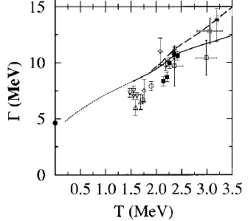
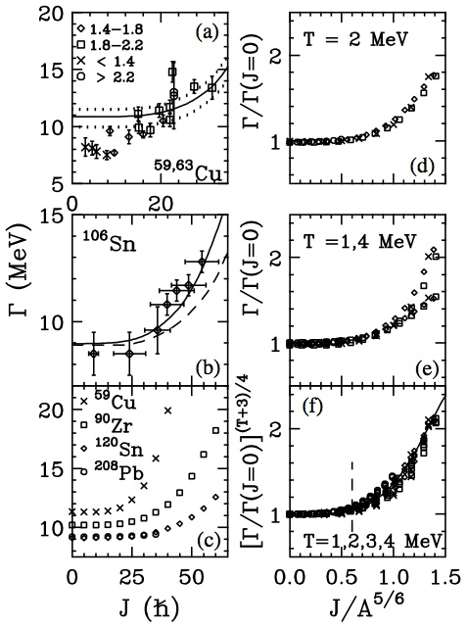
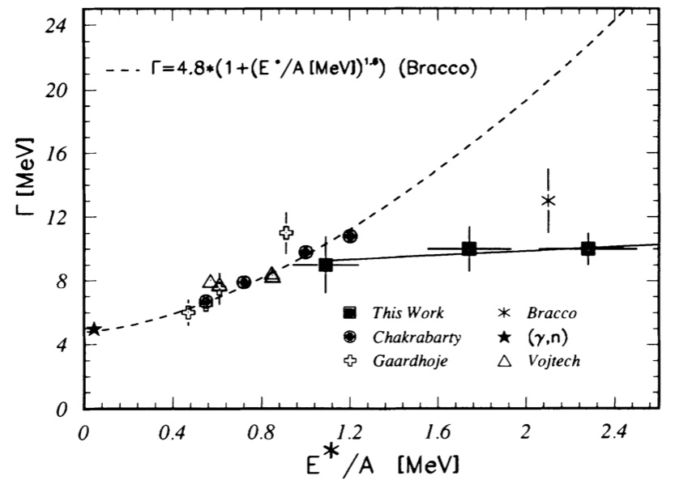
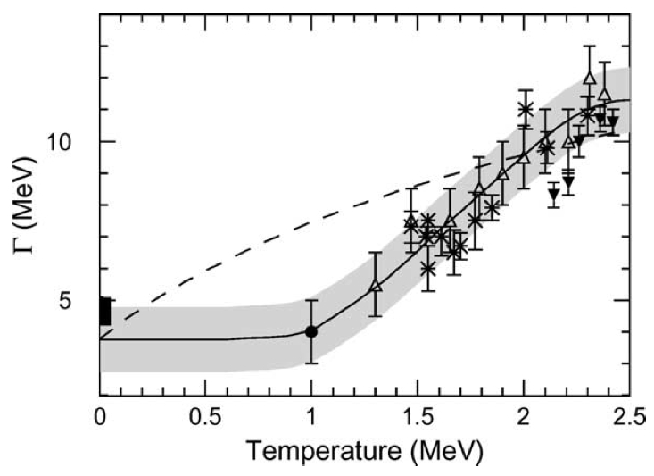
Dependence of GDR width on T
Dependence of GDR width on J
To saturate, or not to saturate, that is the question.
1) Pre-equilibrium emission is proportional to (N/Z)_{p} – (N/Z)_{t}
2) Pre-equilibrium emission lowers the CN excitation energy
Kelly et al. (1999) included pre-equilibrium
(dynamic dipole) emission
pTSPM

Slide 4
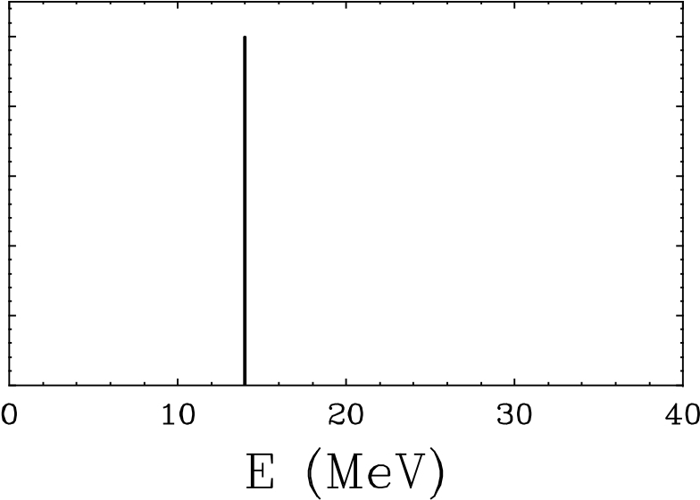
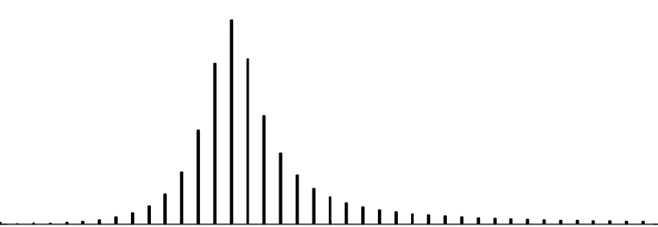
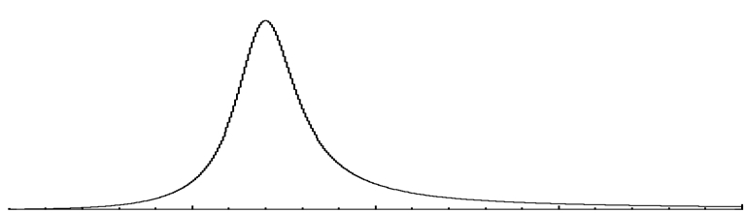





Mechanism of GDR damping at T = 0
Few MeV
Few hundreds keV
The variance of the distribution of ph states is the Landau width Γ^{LD}
to be added into Γ (the quantal width) .

Slide 5
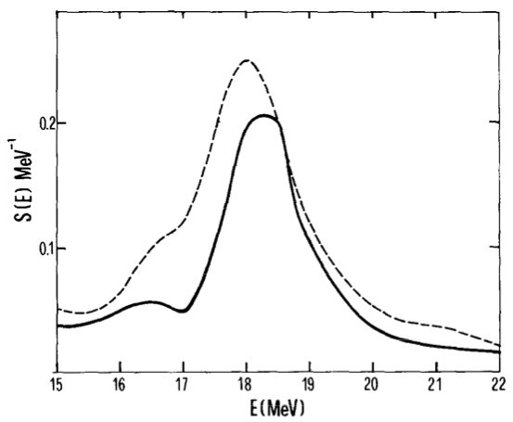
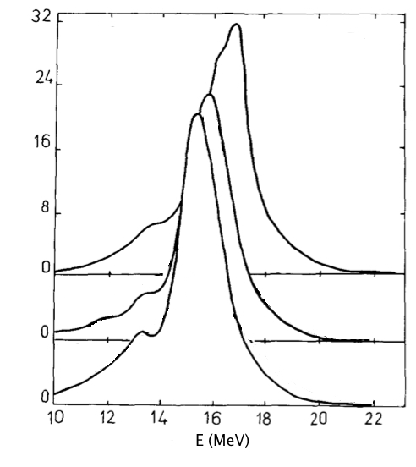
GDR damping at T≠0
Γ = Γ_{Q} + Γ_{T}
How to describe the thermal width?
⬇
ph + phonon coupling
Bortignon et al. NPA 460 (1986) 149
Coupling to 2 phonons
NDD, NPA 504 (1989) 143
⁹⁰Zr
⁹⁰Zr
b(E1, E) (e² fm⁴ Mev⁻¹)
T=0
T=0
T=1 MeV
T=3 MeV
T=3 MeV
The quantal width (spreading width) does NOT increase with T.

Slide 6
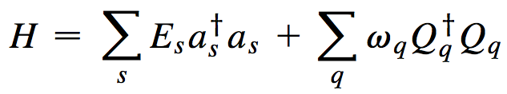
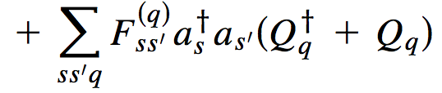

Phonon Damping Model (PDM)
NDD & Arima, PRL 80 (1998) 4145
NB: This model does NOT include the pre-equilibrium effect and the evaporation width of the CN states
p’
p
p
h’
h
Quantal: ss’ = ph Thermal: ss’ = pp’ , hh’
h
GDR strenght function:

Slide 7
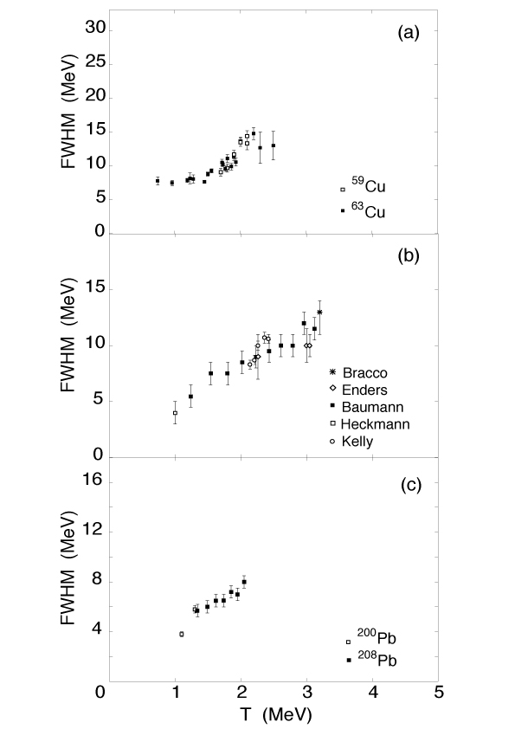
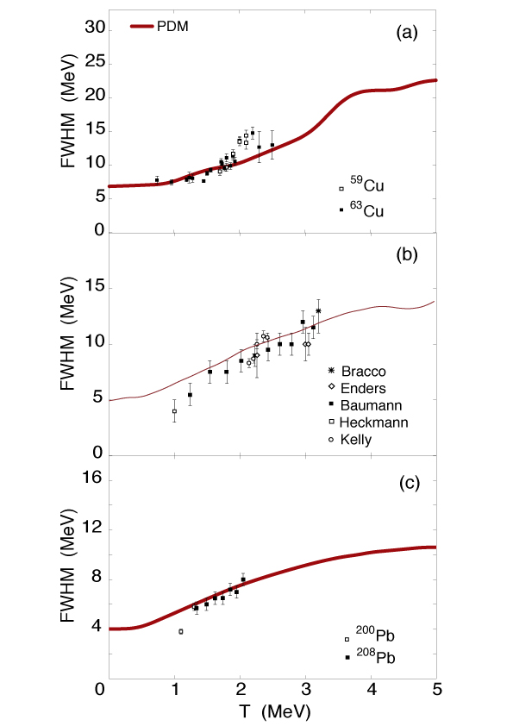
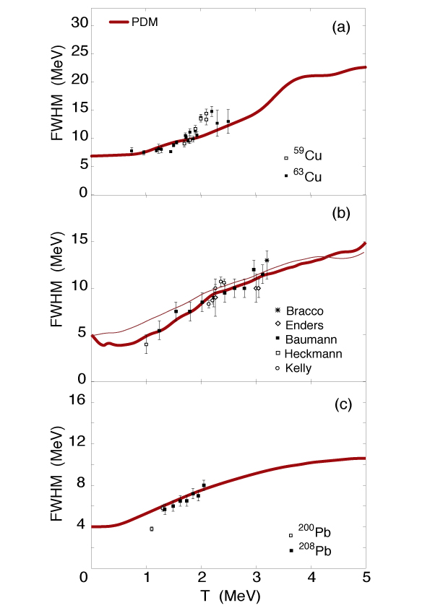
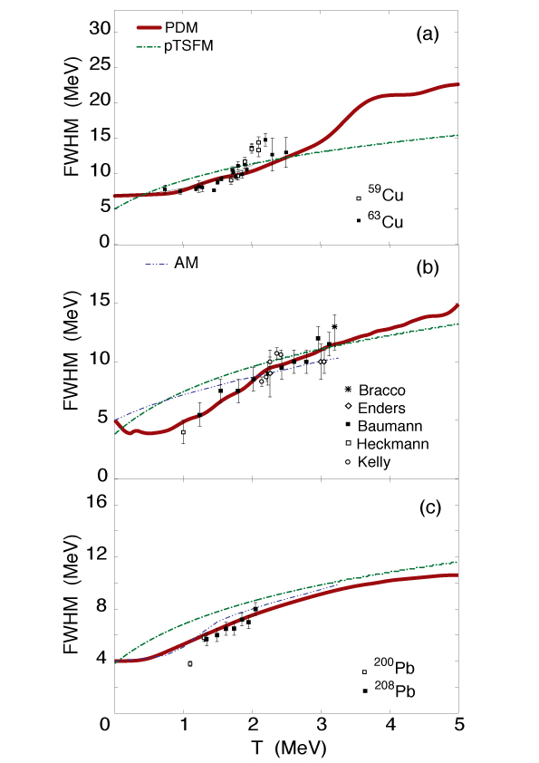
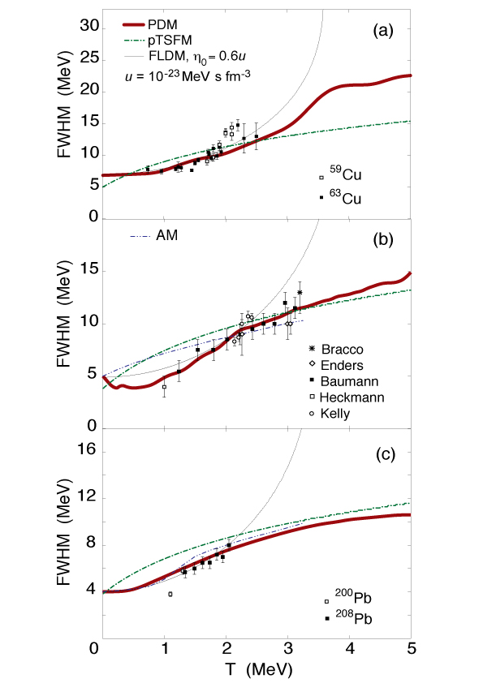
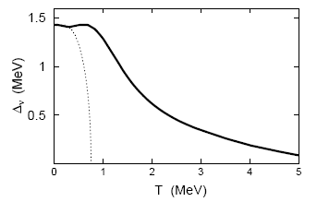
GDR width as a function of T
pTSFM
(Kusnezov, Alhassid, Snover)
⁶³Cu
NDD, PRC 84 (2011) 034309
AM
(Ormand, Bortignon, Broglia, Bracco)
FLDM
(Auerbach, Shlomo)
NDD & Arima, PRC 68 (2003) 044303
Tin region
T_{c} ≈ 0.57Δ(0)
¹²⁰Sn & ²⁰⁸ Pb
NDD & Arima, PRL 80 (1998) 4145

Slide 8
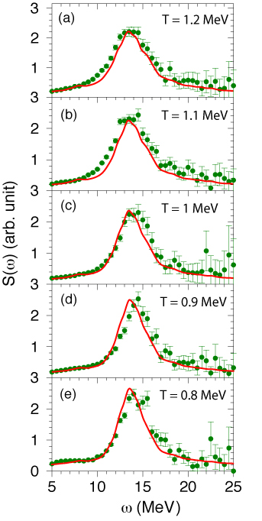
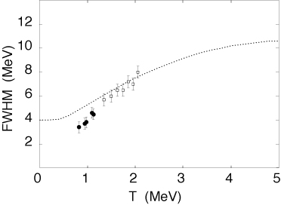
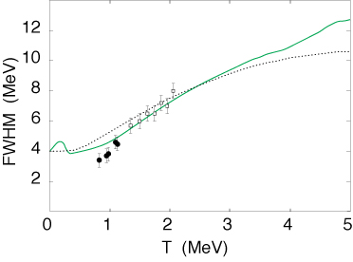
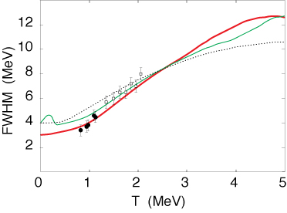
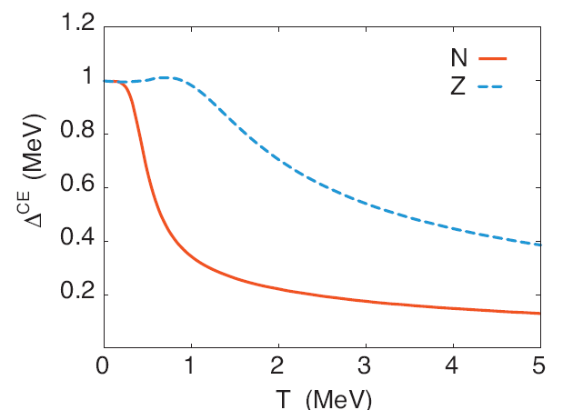
201
Tl
New data at low T:
D. Pandit et al. PLB 713 (2012) 434
Exact canonical pairing gaps
Baumann 1998
Junghans 2008
Pandit 2012
²⁰⁸Pb
no pairing
with pairing
NDD & N. Quang Hung PRC 86 (2012) 044333

Slide 9

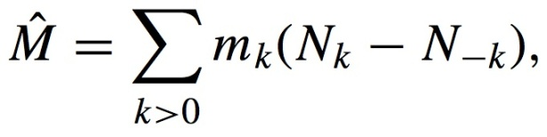
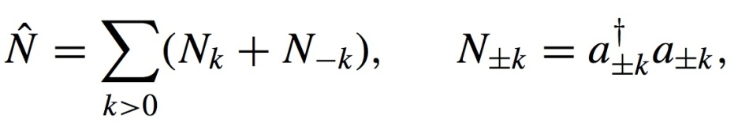
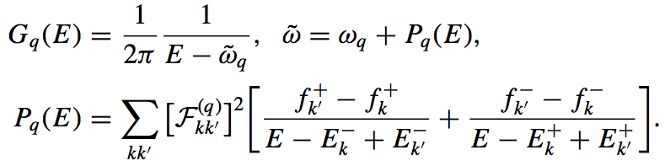
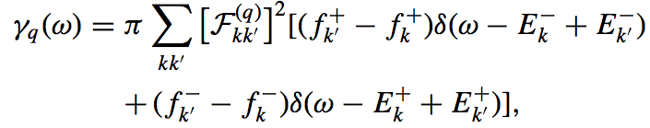
PDM at T≠0 & J=M≠0
NDD, PRC 85 (2012) 064323

Slide 10
⁴⁸Ti + ⁴⁰Ca ➔⁸⁸Mo* at various E* between 58 and 308 MeV
NDD, Ciemala, Kmiecik, and Maj, PRC 87 (2013) 054313

Slide 11
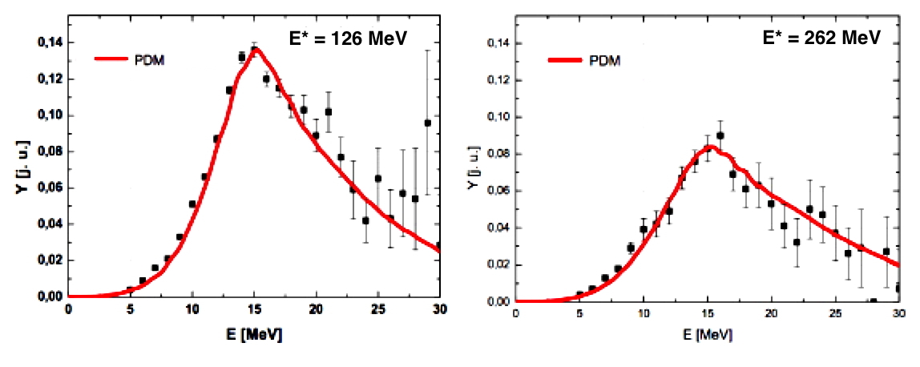
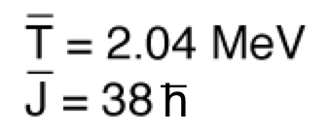
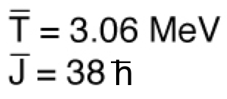
Ciemala, PhD thesis (2013) & talk at INPC2013 on June 4, 2013

Slide 12
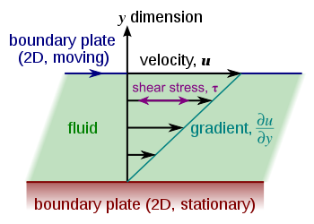
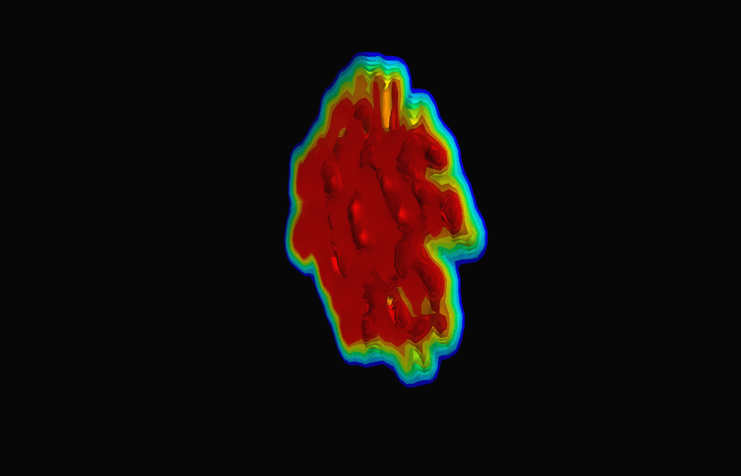


Shear viscosity η
Resistance of a fluid (liquid or gas) to flow
QGP at RHIC
2001: Kovtun – Son – Starinets (KSS)
conjectured the lower bound for all fluids:
η/s ≥ ħ/(4πk_{B})
First estimation for hot nuclei (using FLDM):
Auerbach & Shlomo, PRL 103 (2009) 172501:
4 ≤ η/s ≤ 19 KSS
NDD, PRC 84 (2011) 034309:

Slide 13
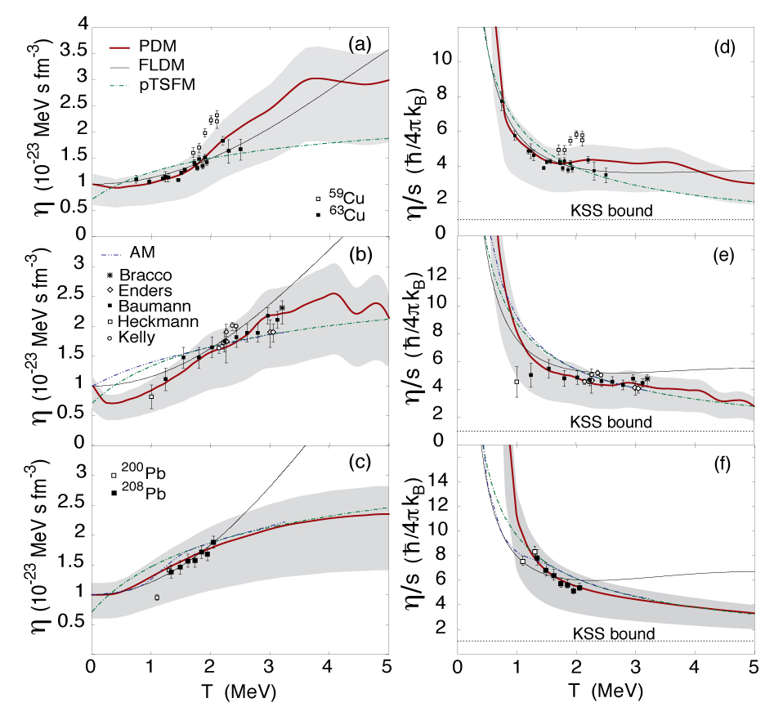
1.3 ≤ η/s ≤ 4 ћ/(4πk_{B})
at T = 5 MeV

Slide 14
Conclusions
The PDM describes reasonably well the GDR’s width and line shape as functions of temperature T and angular momentum J.
The mechanism of this dependence on T and J resides in the coupling of GDR to ph, pp and hh configurations at T≠ 0.
As a function of T: The quantal width (owing to coupling to ph configurations) slightly decreases as T increases. The thermal width (owing to coupling to pp and hh configurations) increases with T up to T ≈ 4 MeV, so does the total width. The width saturates at T ≥ 4 MeV. Pairing plays a crucial role in keeping the GDR’s width nearly constant at T≤ 1 MeV.
As a function of J: The GDR width approaches a saturation at high T= 4 MeV when J > 50ħ. At J≥70ħ, the width saturation shows up at any T.
The two ways of generating the GDR linear line shape, namely by averaging the strength function over the T- and J- probability distributions and by calculating the strength function at average T and J, yield very similar results.
The specific shear viscosity in heavy nuclei can be as low as 1.3 ~ 4 KSS at T = 5 MeV, the same as that of QGP at T> 170 MeV (1.5 ~ 2.5 KSS).

