Slide 1
Studies of neutron-rich isotopes at the CARIBU facility
Guy Savard
Argonne National Laboratory
&
University of Chicago
INPC 2013
June 2-7 2013, Firenze, Italy

Slide 2

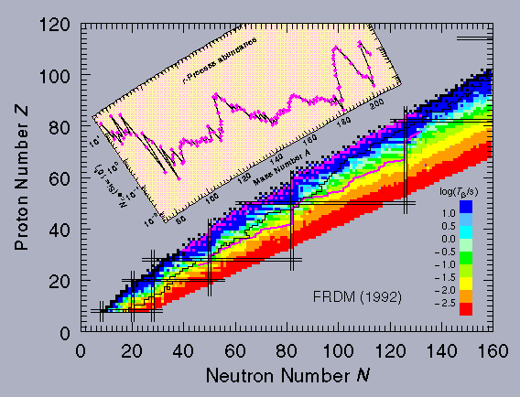
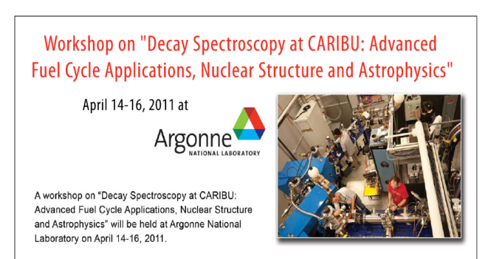
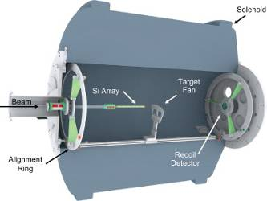
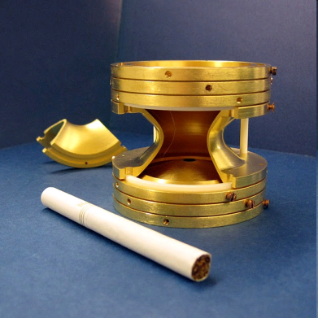
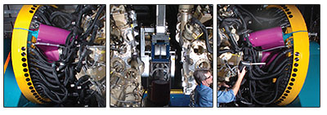
Why study heavy neutron-rich isotopes?
Nature uses them to produce half of the heavy isotopes
Mass known
Half-life known
nothing known
protons
We have the tools and techniques
to study them:
neutrons
We know little about them
They are critical to many societal applications
We just don’t have available the right beams with the right purity and properties

Slide 3
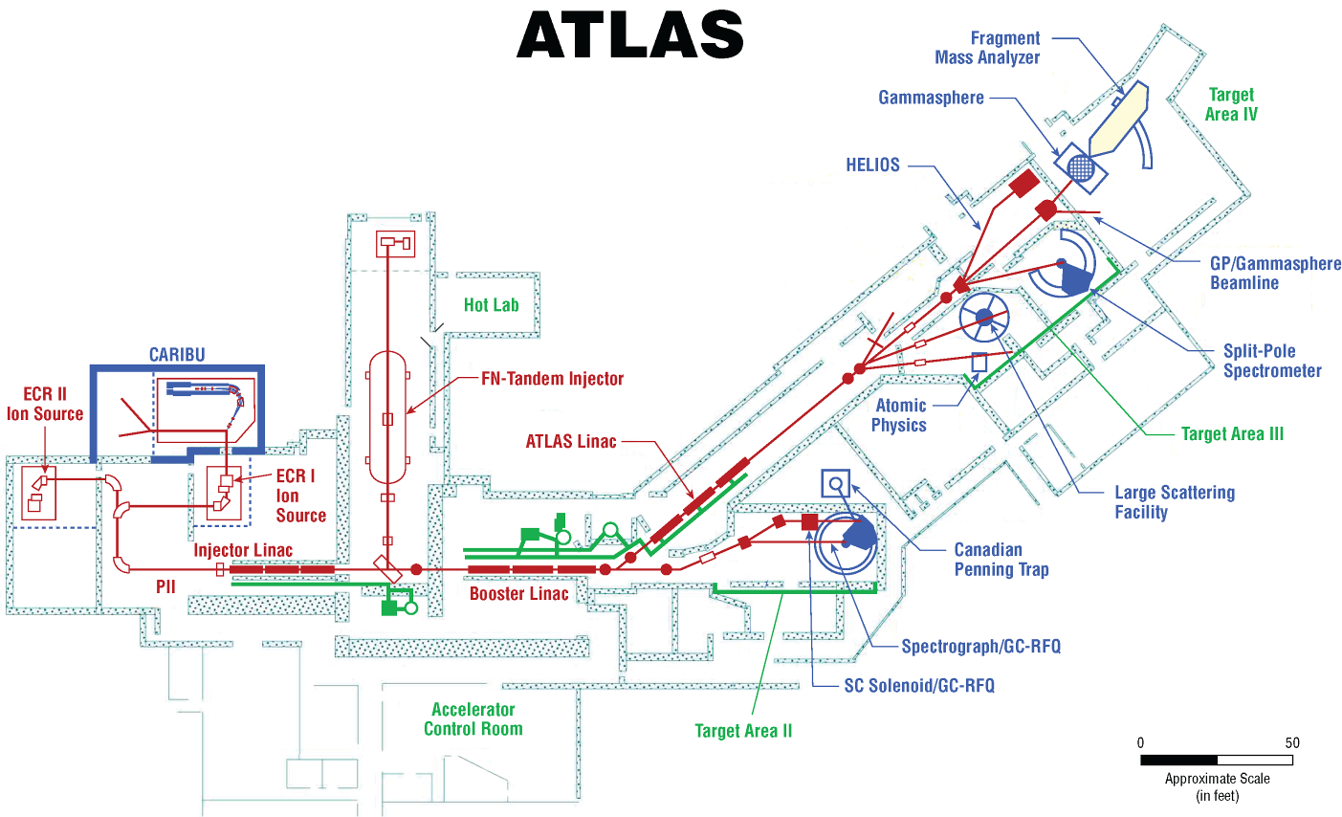

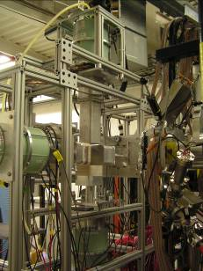
CARIBU – Californium Rare Ion Breeder Upgrade
Access to n-rich region obtained at ATLAS via fission of the most neutron-rich “available” very heavy nuclei (e.g. ²⁵²Cf)
Project goal: Provide neutron-rich radioactive beams to user community
  Low-energy
    Masses, decay spectroscopy, laser spectroscopy, …
  Reaccelerated through ATLAS at up to 15 MeV/u
    Single particle structure, gamma-ray spectroscopy, …
Project Description
  Gas catcher/RFQ cooler
  Source and radiological issues
  Isobar separator
  ECR Charge-breeder
  Diagnostics
  Experimental equipment
Gammasphere
HELIOS spectrometer
ATLAS
CPT mass spectrometer
X-array

Slide 4
Neutron-rich beam source: CARIBU “front end” layout
Main components of CARIBU
  PRODUCTION: “ion source” is ²⁵²Cf source inside gas catcher
    Thermalizes fission fragments
    Extracts all species quickly
    Forms low emittance beam
  SELECTION: Isobar separator
    Purifies beam
  DELIVERY: beamlines and preparation
    Switchyard
    Low-energy buncher and beamlines
    Charge breeder to Increase charge state for post-acceleration
    Post-accelerator ATLAS and weak-beam diagnostics
X-array
tape station

Slide 5
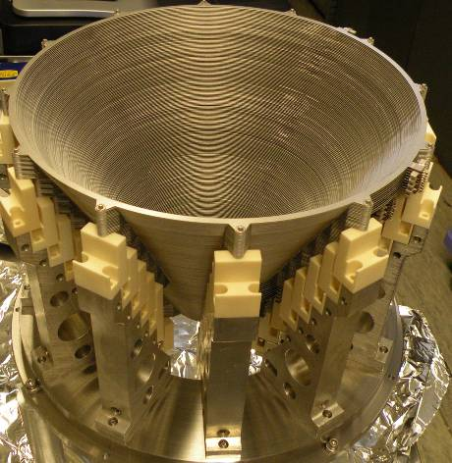
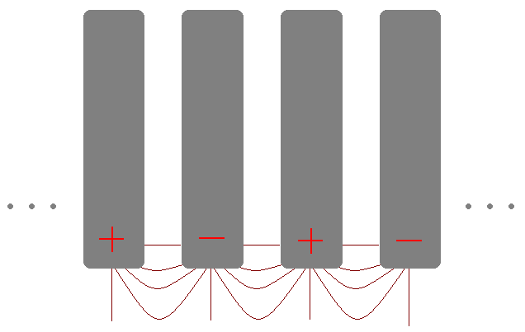
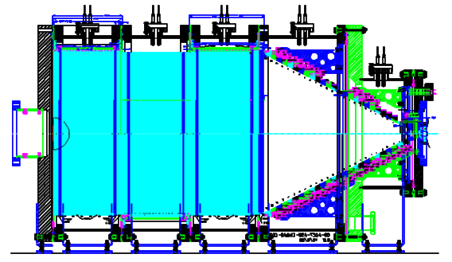
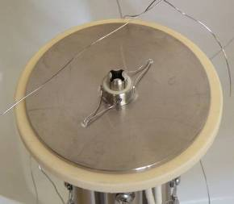
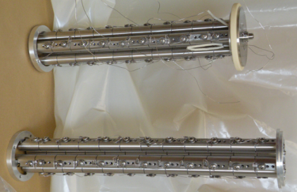
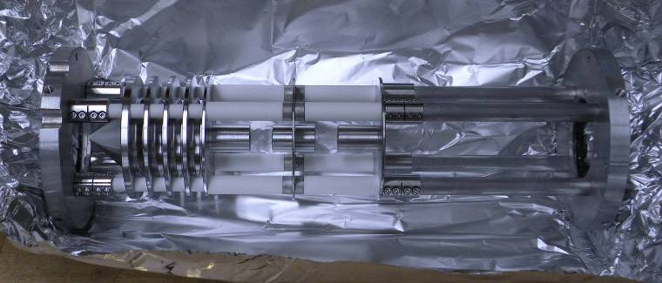
CARIBU gas catcher: transforms fission recoils into a beam with good optical properties
Based on smaller devices developed at ANL
  Radioactive recoils stop in sub-ppb level impurity Helium gas
  Radioactive ion transport by RF field + DC field + gas flow
  Stainless steel and ceramics construction (1.2 m length, 50 cm inner diameter)
  Fast and essentially universally applicable
  Extraction in 2 RFQ sections with μRFQs for differential pumping
²⁵²Cf
DC gradient
RF (body)
He gas
RF (cone)
To acceleration and mass separator

Slide 6
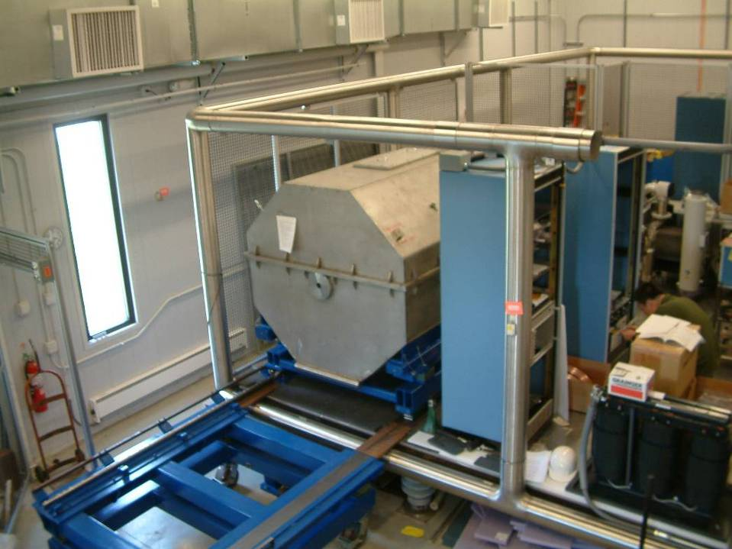
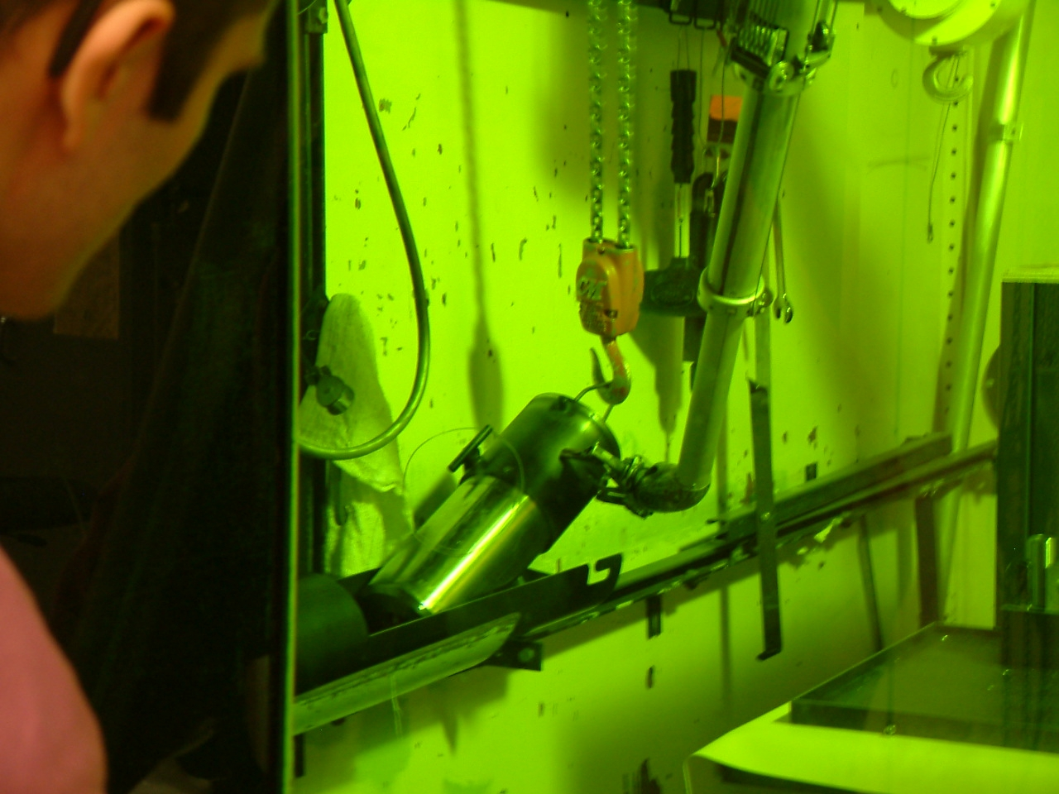
Californium source and transport cask
Cf source is made at the HIFR high-flux reactor in Oak Ridge (~50 rem/hr unshielded)
  Progression of 3 sources … 2 mCi, 80 mCi, “1 Ci”
Transported in a steel/cement cask to Argonne
Installed in the CARIBU transport cask using manipulators in hot cells at Argonne
Move in the cask on site at Argonne
For installation in the gas catcher, the source and shielding plug are pushed from the storage location into position at the end of the gas catcher.
The assembly is sealed to the gas catcher, the source being inside the gas catcher.

Slide 7
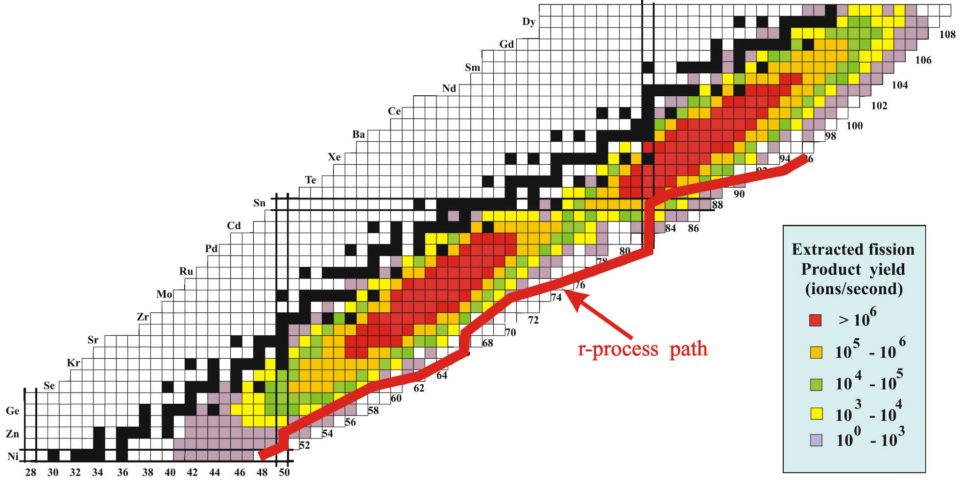
Extracted isotope yield at low energy (50 keV)
1 Ci ²⁵²Cf source
about 20% of total activity extracted as ions
works for all species
complementary to uranium fission
> than 500 neutron-rich species extracted at > 1/s
> 150 whose masses have never been measured

Slide 8
Fragment selection: Isobar separator
Dipoles
Compact design (fits on HV platform):
  two 60º bends
  50 cm radius
  first-order mass resolving power: 20,000
Electrostatic multipoles (up to 5th order corrections)
Far from stability, mass separation is larger …
but so is needed rejection ratio
CARIBU Beams
Tc
R = 40000
R = 5000
R = 20000
Rh,Ru
Mo
¹³²Sn
Nb
R = 20000

Slide 9
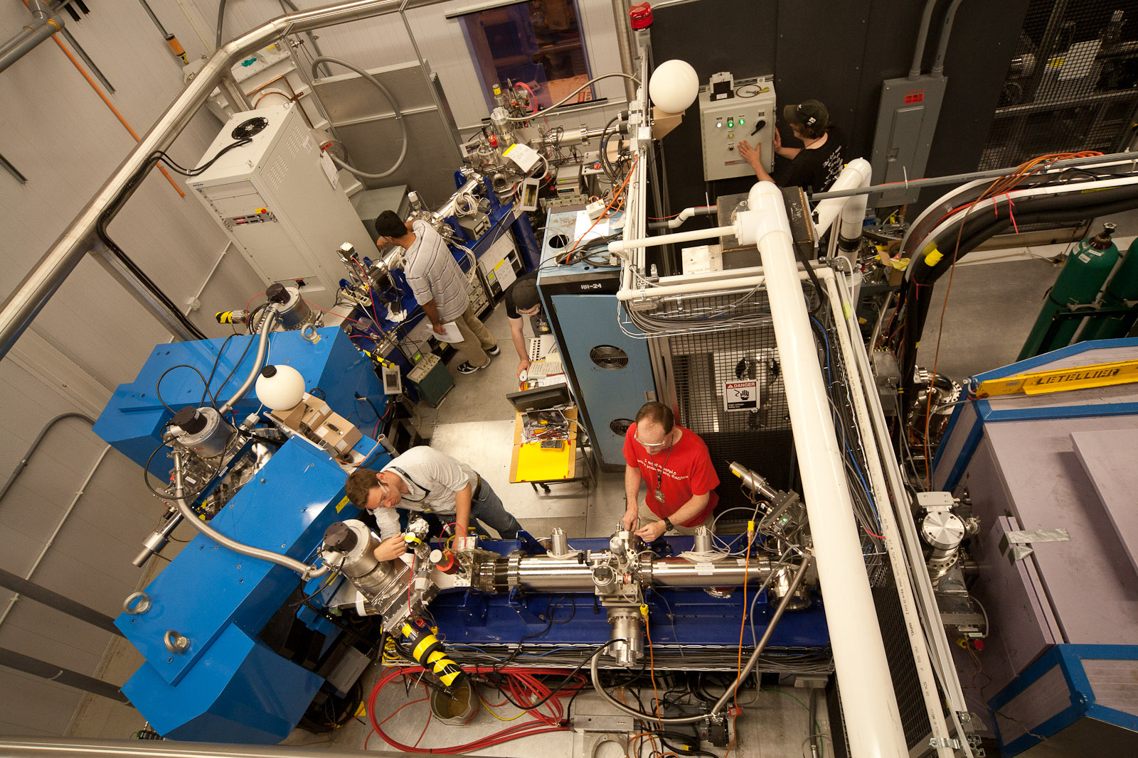
Selection by compact CARIBU isobar separator
M/ΔM = 9000-14000 @ >80% transmission … still being improved

Slide 10
Beam Delivery
After isobar separation, two options for beam use
Low energy experiments after beam bunching
  Mass measurement
  Laser Spectroscopy
  Beta decay studies
Reaccelerated Beams
  Use ECR-1 as charge breeder
  Inject ions into ATLAS in high charge state (q/m > 0.15) and energy (~100-200 keV)
Source / Gas Catcher
Isobar Separator

Slide 11
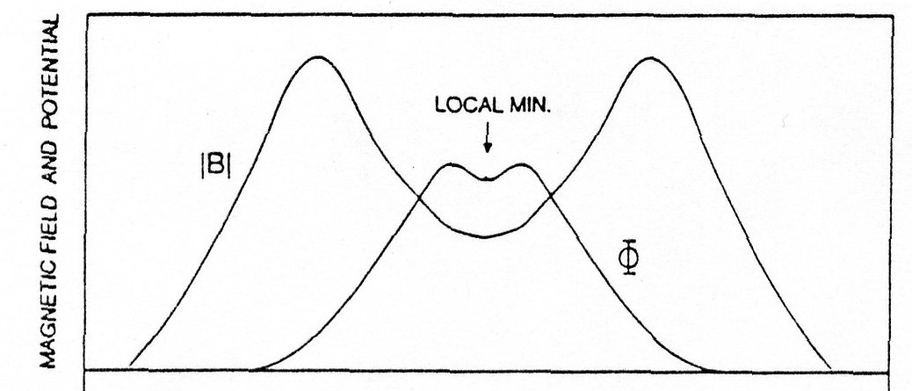
CARIBU ECR Charge-Breeder System
Shielding
Fission Source
Gas catcher
50 kV
HV
RFQ cooler
Einzel Lens
Source Z-axis
Faraday Cup/MCP Diagnostics
Steering Correction
±δ V
MCP Diagnostics
Mass Analysis
Charge Analysis
ECR Source

Slide 12
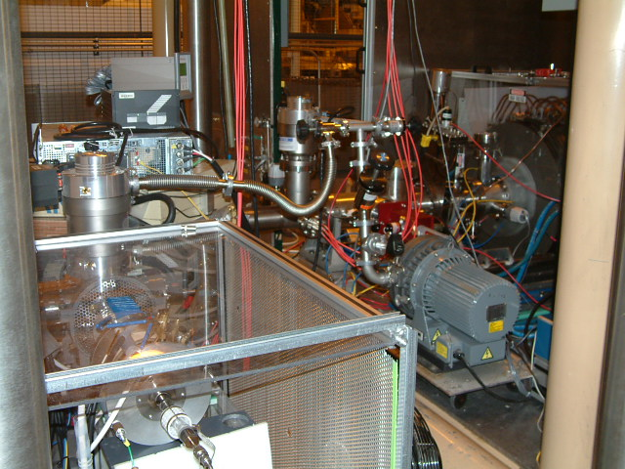
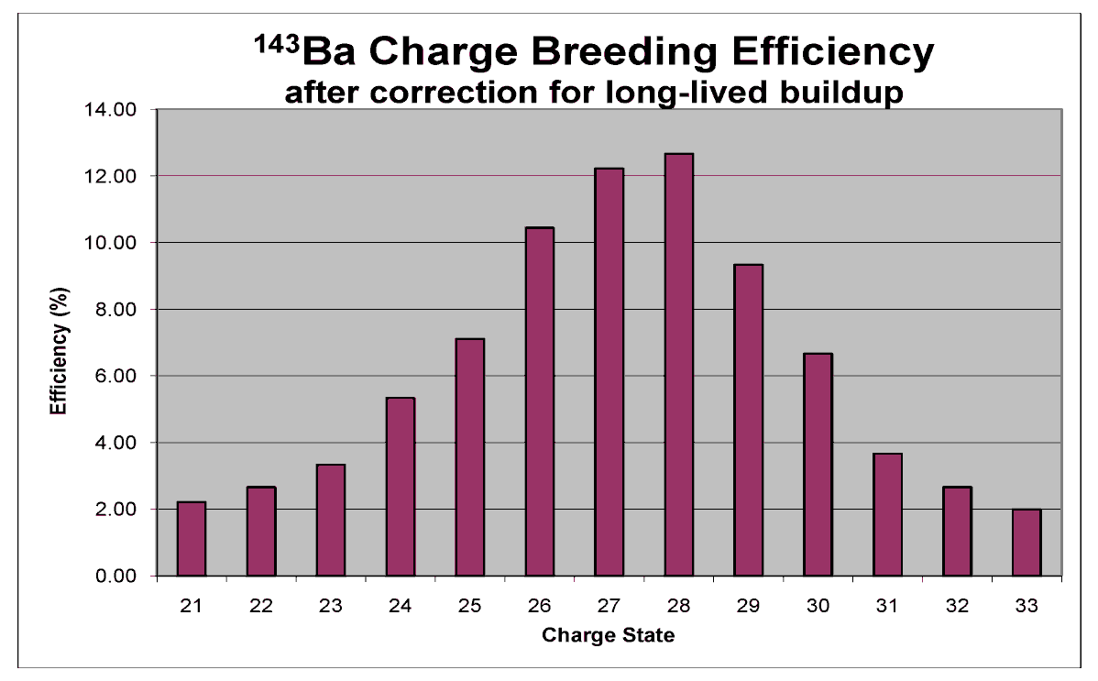
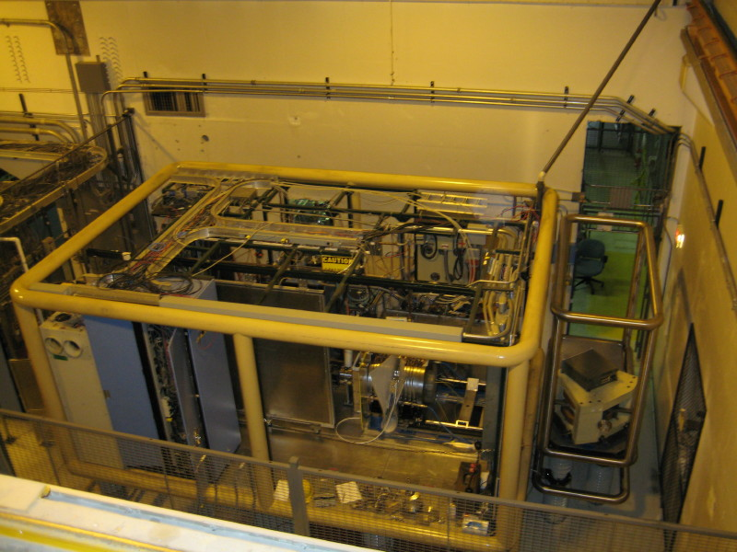
ECR Charge Breeder Results
In order to accelerate beams in ATLAS the charge-to-mass ration (q/m) must be raised to >1/8 (depending on the desired energy).
Best breeding efficiencies: 11-16% for all gases, solid, & RIBs.
Rate and Efficiency for Mass 142/25+, ¹²⁹Xe²⁵⁺ and ¹³³Cs²⁶⁺ as function of Voltage difference between ECRCB & 1+ source

Slide 13
CARIBU beams reaccelerated to Gammasphere (… and HELIOS)

Slide 14

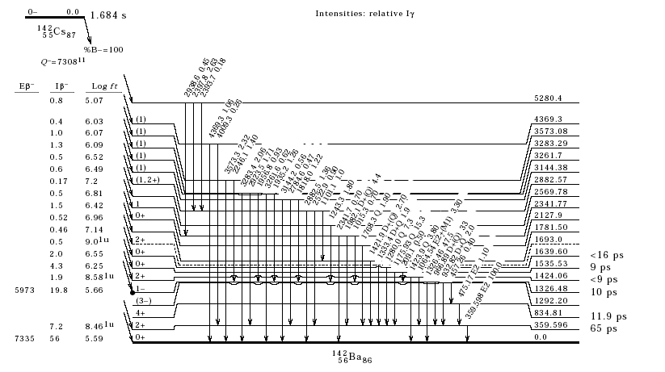
Decay of ¹⁴²Cs in Gammasphere: Expanded β-decay level scheme of ¹⁴²Ba

Slide 15
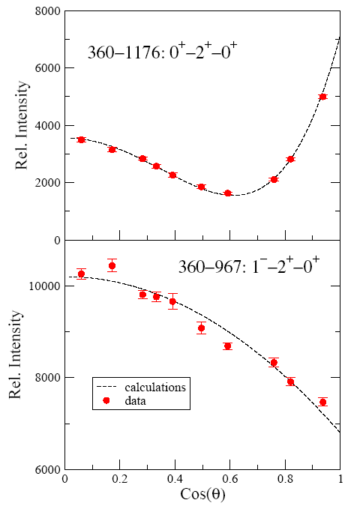
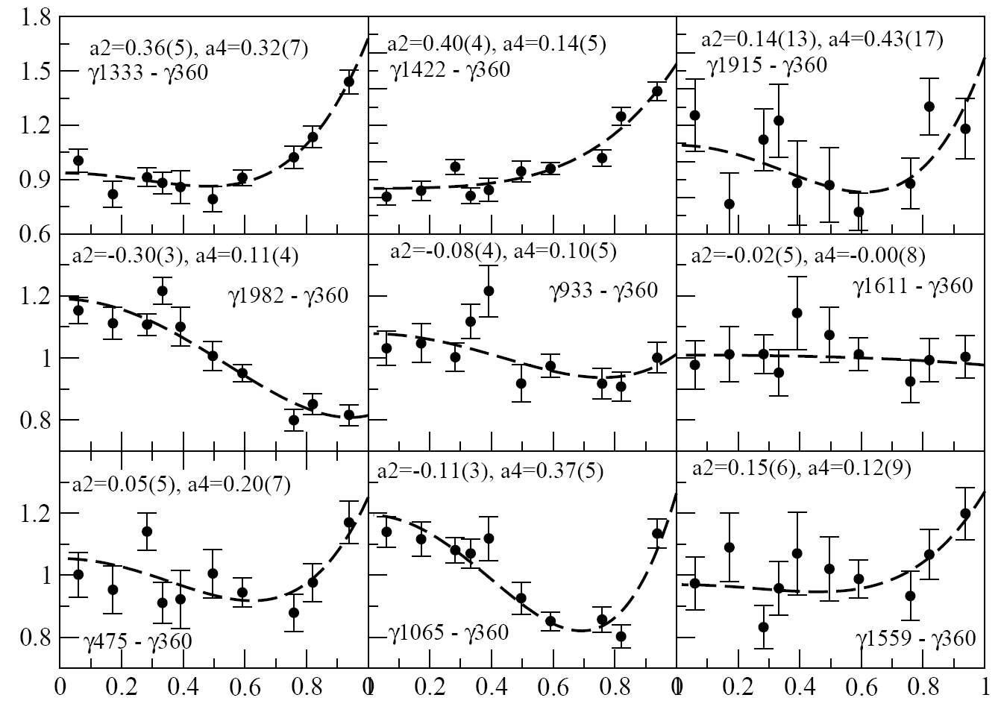
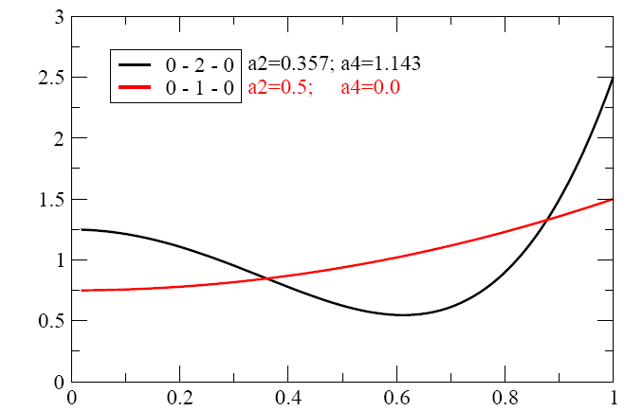
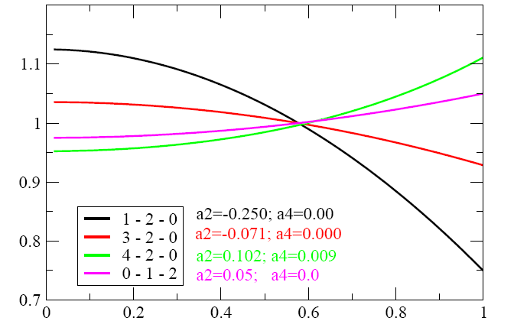
The power of Gammasphere: Spin-Parity Assignments via Angular Correlations

Slide 16
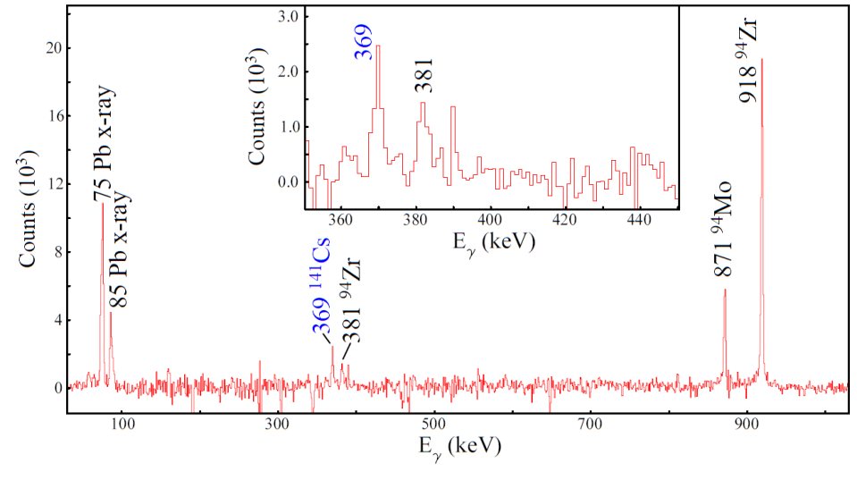
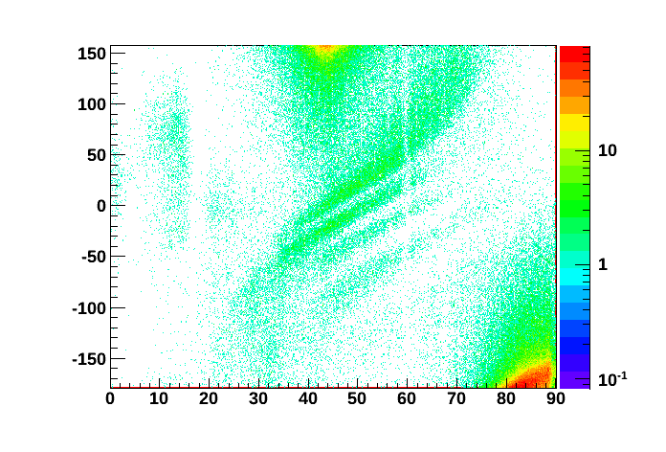
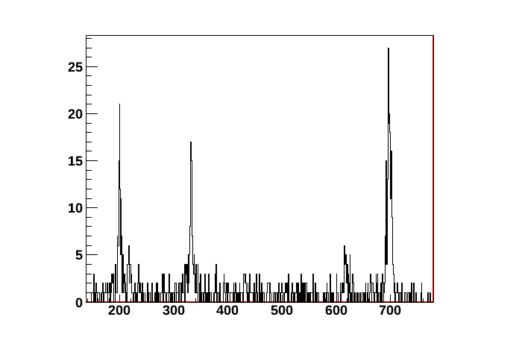
First Coulomb excitation measurements with CARIBU beams
First Coulex with ¹⁴¹Cs – two goals:
  1. Demonstrate feasibility & study backgrounds from stable beam contamination
  2. Measure B(E2) of the 11/2⁺ state in ¹⁴¹Cs
Improved system to study ¹⁴⁴Ba
  Use CHICO to detect recoil and provide kinematic selection and better Doppler correction
  Measure B(E2) and B(E3) to study onset of octupole deformation
600-MeV ¹⁴¹Cs + ²⁰⁸Pb (50 mg/cm²)
650-MeV ¹⁴⁴Ba + ²⁰⁸Pb (1mg/cm²) first Digital GS + CHICO2 expt. ← Rochester – LLNL – ANL collab.
¹⁴⁴Ba: 2⁺
¹⁴⁴Nd: 2⁺
²⁰⁸Pb
¹⁴⁴Ba: 4⁺
ΔT₁₂
¹⁴⁴Ba/Nd
Counts
¹⁸⁰Hf
¹⁸⁰Hf: 4⁺
¹⁴⁴Ba: 6⁺
¹⁴⁴Nd: 4⁺
⁷²Ge
θ
E_{γ} (keV)
16

Slide 17
Beam Delivery
After isobar separation, two options for beam use
Low energy experiments after beam bunching
  Mass measurement
  Laser Spectroscopy
  Beta decay studies
Reaccelerated Beams
  Use ECR-1 as charge breeder
  Inject ions into ATLAS in high charge state (q/m > 0.15) and energy (~100-200 keV)
Source / Gas Catcher
Isobar Separator

Slide 18
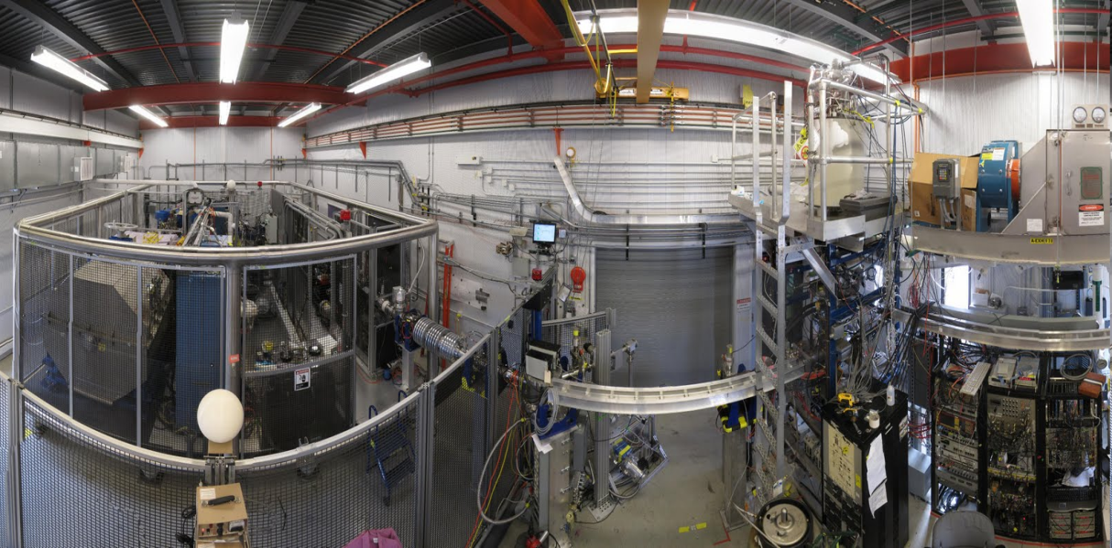
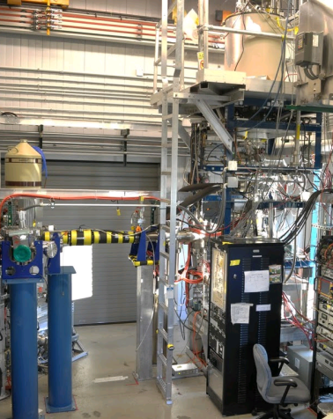
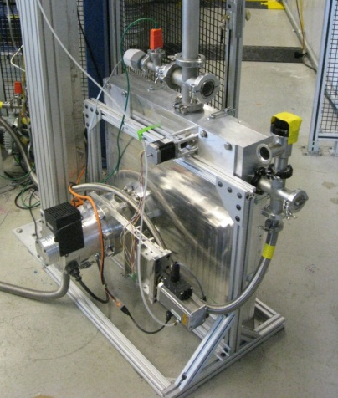
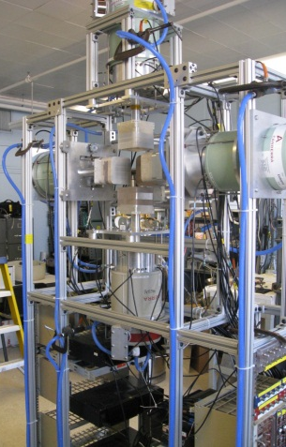
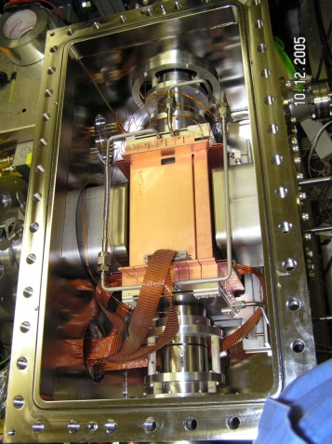
The CARIBU low-energy experimental area
Delivers 1.5 kV to 10 kV beam to experimental stations
Pulsed beams with rates from ~ 50 ms to seconds
Low emittance
Experimental stations:
CPT
(installed)
TAPE STATION
(installed)
X-ARRAY
(installed)
BPT
(late 2013)
LASER SPECTROSCOPY: After CPT move (2013/2014)
Limited amount of space … removal of Tandem will provide new experimental area

Slide 19
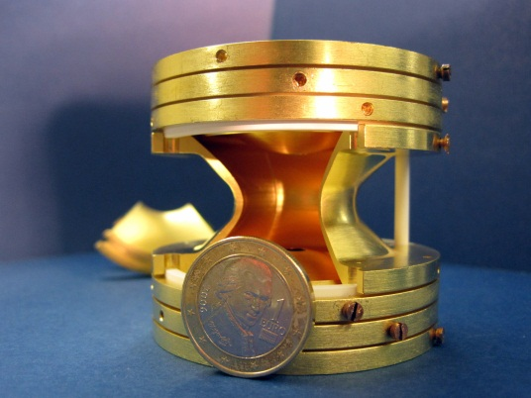
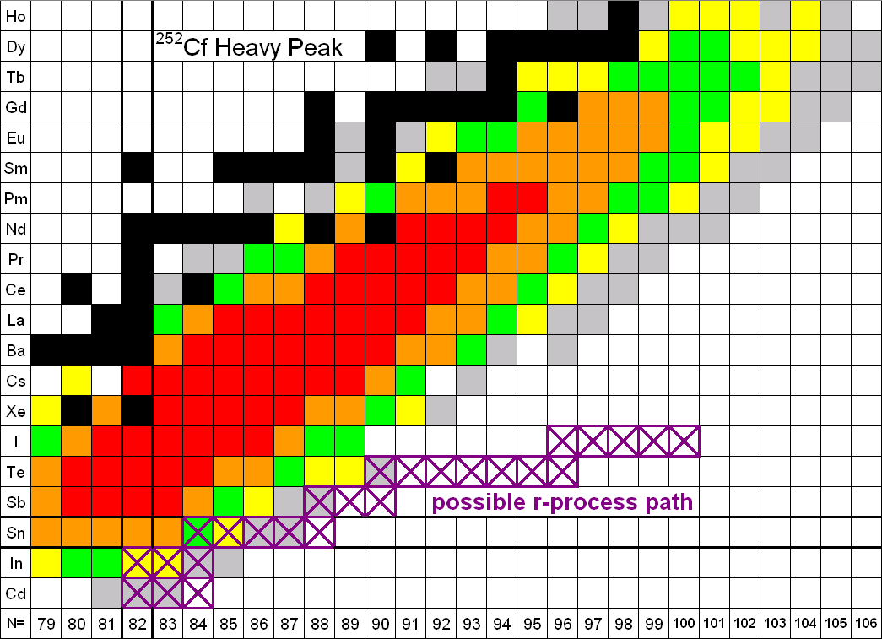
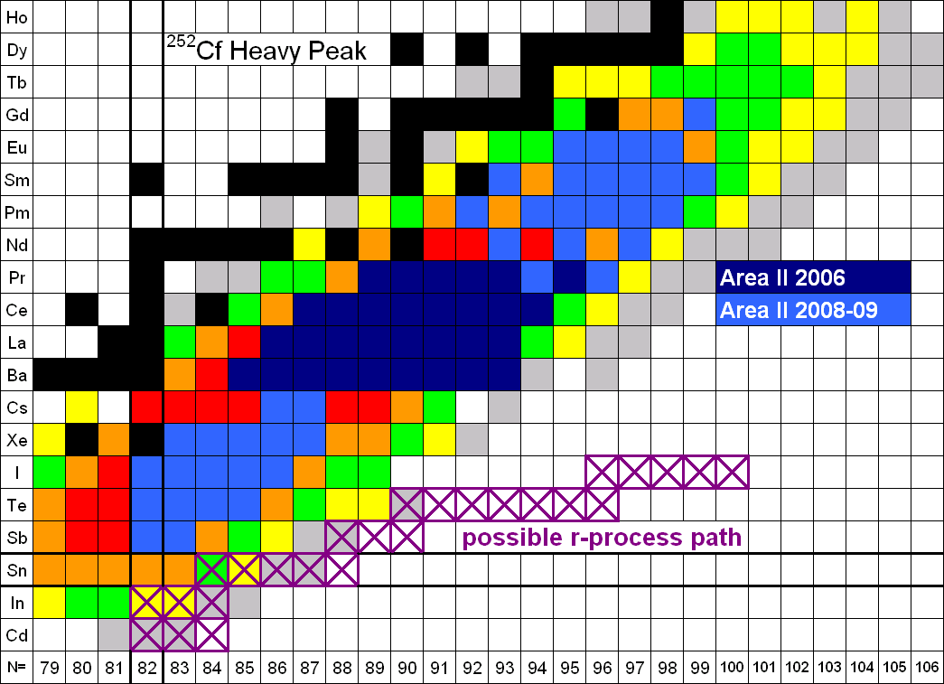
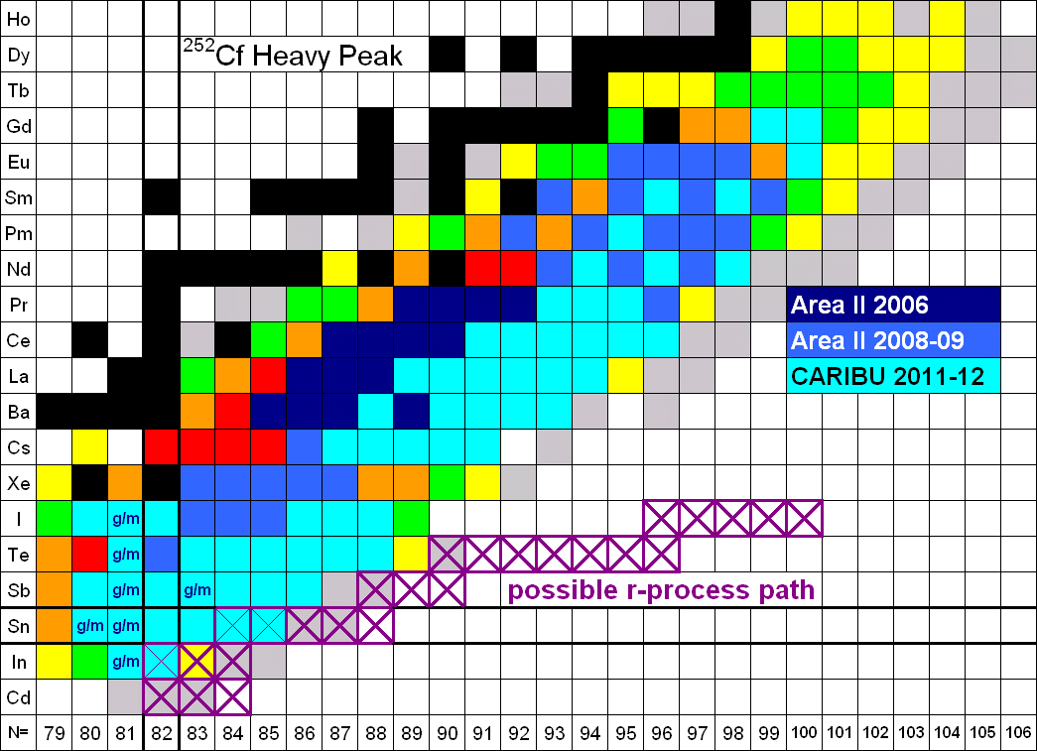
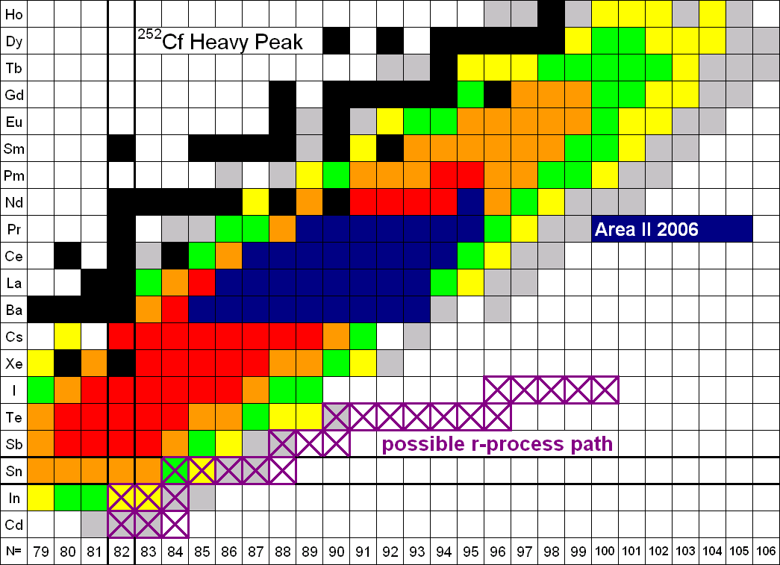
Mass measurements of neutron-rich nuclides
Masses determined via a measurement of the ions’ cyclotron frequency
Can measure the mass with a production rate of ~ 1 ion / s
Mass precision ~ 10⁻⁷ to 10⁻⁸ (10 -100 keV/c²) for masses approaching the r process
Canadian Penning Trap (CPT) has measured more than 100 neutron-rich nuclides, including more than 70 from CARIBU (including 6 isomers)
~ 20 had never been previously measured by any technique
Currently reaching isotopes produced at the 10⁻⁶ fission branch level
For some nuclei, no prior information on the nuclide existed!
Original
Original
Original
Area II 2012
Area II 2012
CARIBU 2013
J. Van Schelt et al., Phys. Rev. C 85, 045805 (2012)
J. Van Schelt et al., Phys. Rev. Lett., submitted (2013)

Slide 20
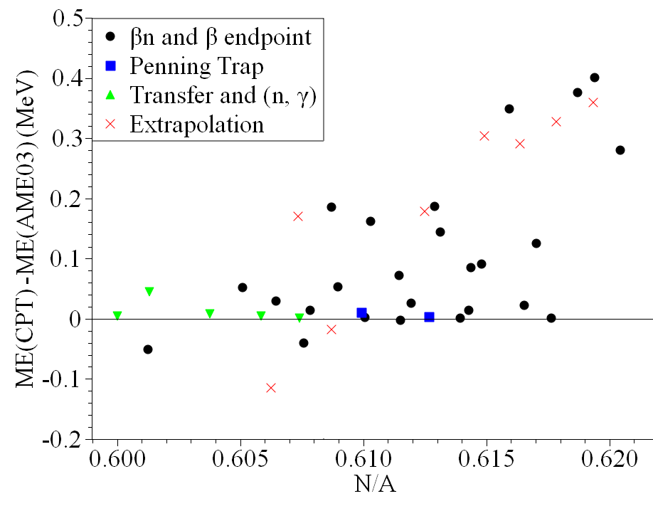
Comparison with the 2003 atomic mass evaluation
J. Van Schelt et al., Phys. Rev. C 85, 045805 (2012)
J. Van Schelt et al., Phys. Rev. Lett., submitted (2013)
In Sn Sb Te I Xe Cs Pr Nd Pm Sm Eu
Gd
Less binding
Higher N
Trends indicate nuclei are less bound with neutron excess (affects the location of the r-process path)
Good agreement with other Penning trap results and reaction Q value measurements
Large disagreement with results obtained with β-decay measurements
Notes:
mention these trends are consistent with JYFLTRAP seen in other elements

Slide 21
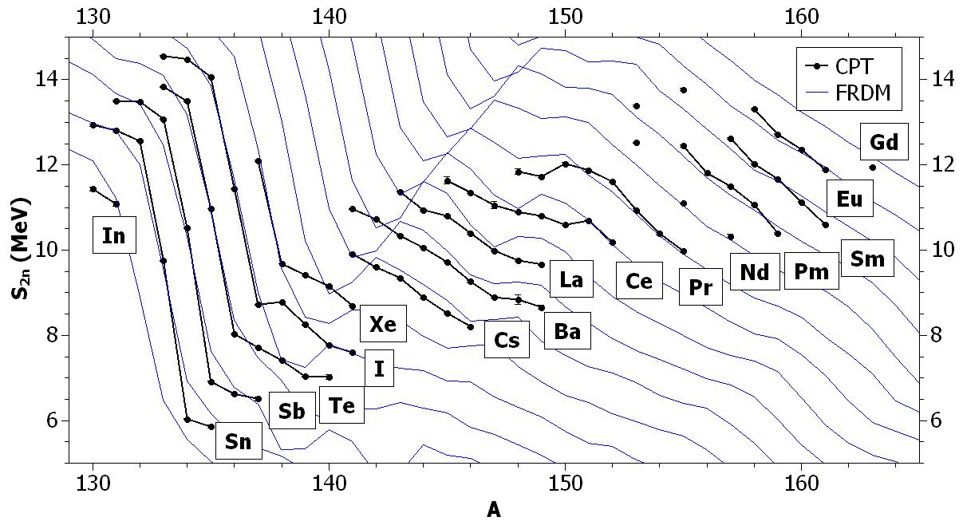
Effect on the r process: comparisons with the FRDM mass model
Effect of masses on r-process simulations (with T = 1.5 GK)
r-process path
Ran simulations to compare our new measurements with mass models for the r process
Result: FRDM (and other mass models) have insufficient mass precision for r process models
Comparative Review, Nuclear Structure and Nuclear Astrophysics, May 20, 2013
21

Slide 22
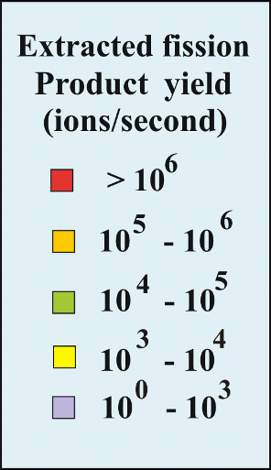
CPT Measurement campaigns

Slide 23
CPT Measurement campaigns
Ongoing heavy-peak measurements
1437 - Being completed from previous PAC
1481 -measurements for r-process studies
1480 - measurements for new isotope discovery

Slide 24
Further development of CARIBU beams
Fall 2012:
RFQ to replace PII
Summer 2013:
Expect x 2 gain
New cryomodule
Fall 2013:
New stronger, thinner source:
Expect x 5-10 gain
2014 – 2015:
EBIS to replace ECR:
New low-energy experimental area
Expect x 2-3 gain
Higher beam purity
EBIS
Isotope | Half-life (s) | Low-Energy Beam Yield (s⁻¹) | Accelerated Beam Yield (s⁻¹)
¹⁰⁴Zr | 1.2 | 6.0x10⁵ | 2.1x10⁴
¹⁴³Ba | 14.3 | 1.2x10⁷ | 4.3x10⁵
¹⁴⁵Ba | 4.0 | 5.5x10⁶ | 2.0x10⁵
¹³⁰Sn | 222. | 9.8x10⁵ | 3.6x10⁴
¹³²Sn | 40. | 3.7x10⁵ | 1.4x10⁴
¹¹⁰Mo | 2.8 | 6.2x10⁴ | 2.3x10³
¹¹¹Mo | 0.5 | 3.3x10³ | 1.2x10²

Slide 25
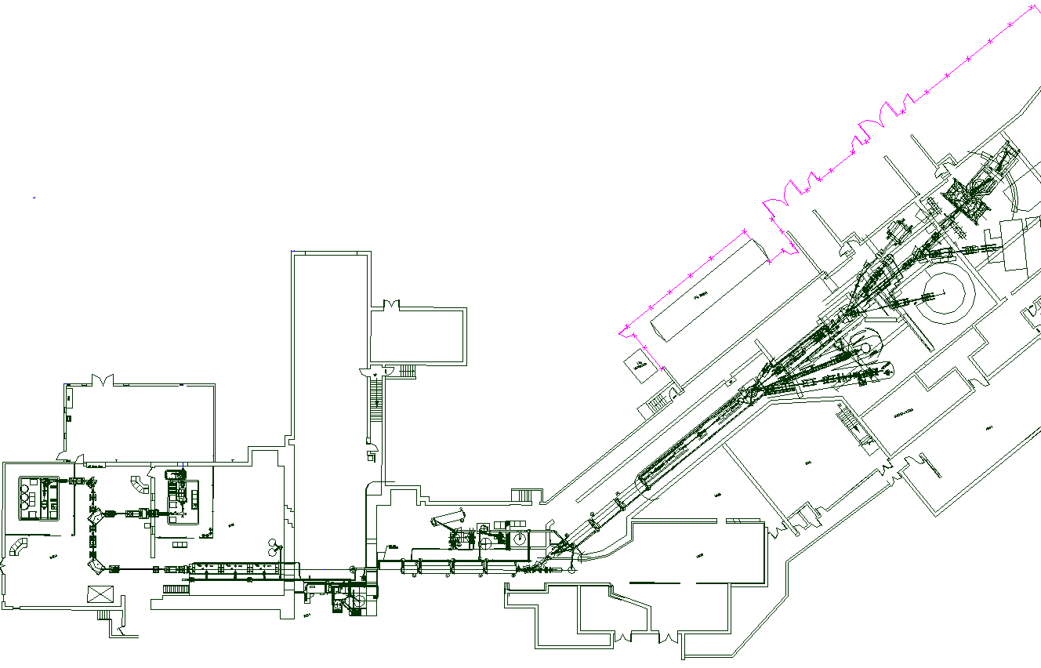
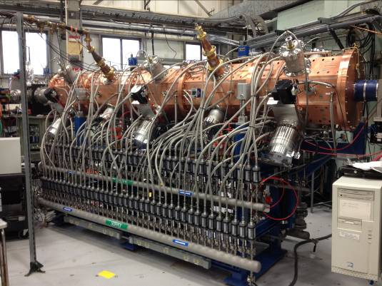
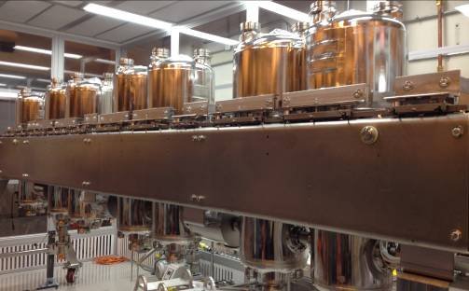
ATLAS layout with ongoing and planned upgrades
Improved instrumentation
New low-energy experimental hall
cryomodule and rebuncher rearranged
EBIS
CARIBU
New in-flight separator (AIRIS)
MHB RFQ new cryomodule

Slide 26
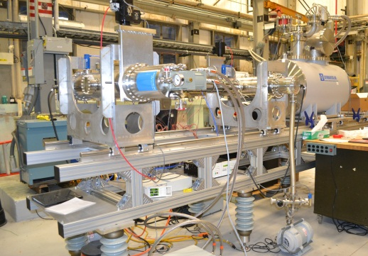
Further development of CARIBU beams
Fall 2012:
RFQ to replace PII
Summer 2013:
Expect x 2 gain
New cryomodule
Fall 2013:
New stronger, thinner source:
Expect x 5-10 gain
2014 – 2015:
EBIS to replace ECR:
New low-energy experimental area
Expect x 2-3 gain
Higher beam purity
EBIS
Isotope | Half-life (s) | Low-Energy Beam Yield (s⁻¹) | Accelerated Beam Yield (s⁻¹)
¹⁰⁴Zr | 1.2 | 6.0x10⁵ | 2.1x10⁴
¹⁴³Ba | 14.3 | 1.2x10⁷ | 4.3x10⁵
¹⁴⁵Ba | 4.0 | 5.5x10⁶ | 2.0x10⁵
¹³⁰Sn | 222. | 9.8x10⁵ | 3.6x10⁴
¹³²Sn | 40. | 3.7x10⁵ | 1.4x10⁴
¹¹⁰Mo | 2.8 | 6.2x10⁴ | 2.3x10³
¹¹¹Mo | 0.5 | 3.3x10³ | 1.2x10²

Slide 27
Status
CARIBU facility is operational
  First RIB facility based on a gas catcher … it works. Over 500 neutron-rich isotopes available at low energy
  Over 70 different neutron-rich radioactive isotope species have been used for experiments in the last year
  Low-energy program in full swing with experiments approved by last two PACs
  Reaccelerated beam program initiated with decay experiments and first Coulomb excitation at Gammasphere, reaccelerated beam experiments approved in Dec 2012 PAC being run
Current source ( ~ 150 mCi) will be replaced by a 1 Ci source in the fall. Combined with completion of ATLAS intensity upgrade (and fire damage repair), will yield gains of ~6-12 in intensity for low-energy and reaccelerated beams.
Next ATLAS/CARIBU PAC will be held at the end of summer 2013 (call for proposals expected soon). Will accept proposals for all ATLAS/CARIBU beams and the first GRETINA campaign.

