Slide 1
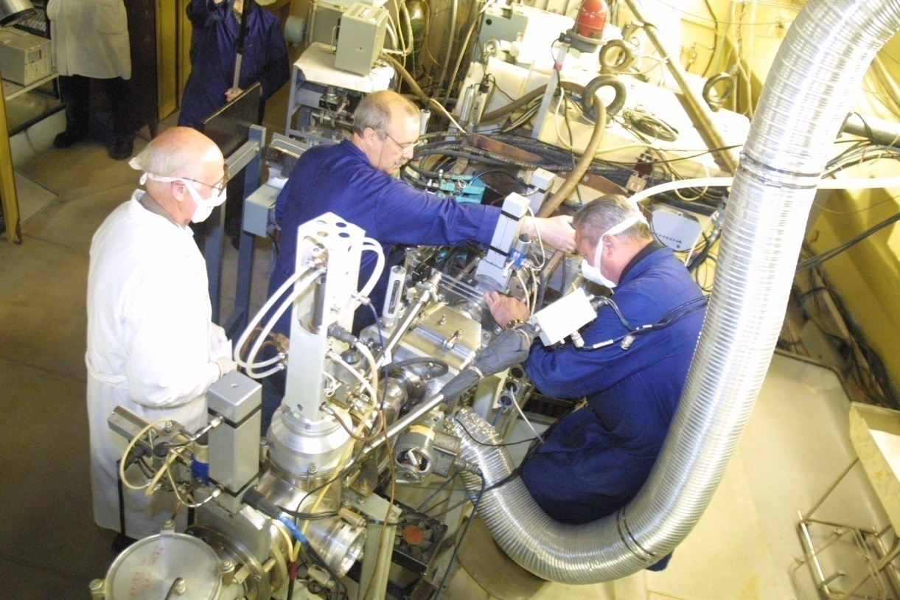
New real-time detection system for heavy element research Yu.S.Tsyganov, A.N.Polyakov, A.A.Voinov FLNR, JINR, 141980 Dubna, Russia @Dubna-Livermore-Oak Ridge Collaboration
June 03, 2013
INPC
2013
Florence, Italy
Contents
(goal : upgrade det. System for rare events detection)
Introduction- The DGFRS and
it’s integrated computer complex for data acquisition&processing . Protection system
a) SHE synthesis experiments: specifics, detection system, software, real-time algorithm.
b) Method of “active correlations”. Applications in the SHE experiments (Z=117)
3) … few words about DSSSD nearest future application
4) SUMMARY
Actinide target mounting

Slide 2
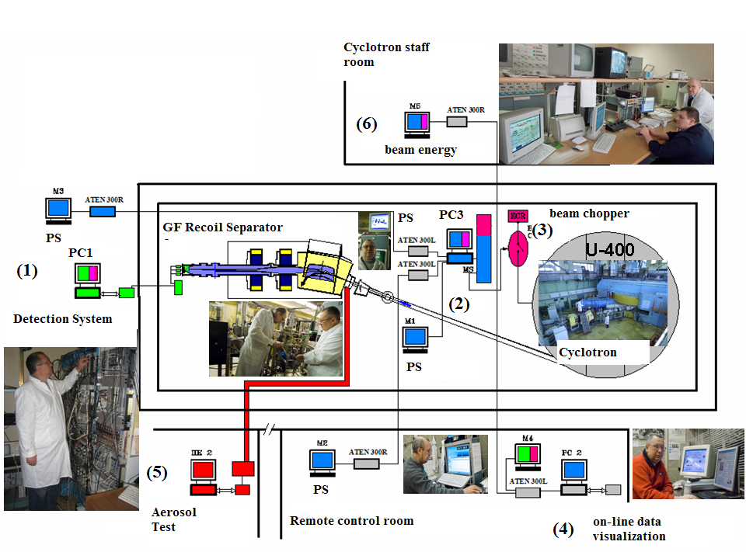
Blue – monitoring&protection
Green – detection
Magenta- “active” correlations ER-alpha
Red – aerosol control (rad. Safety staff, autonomous)

Slide 3
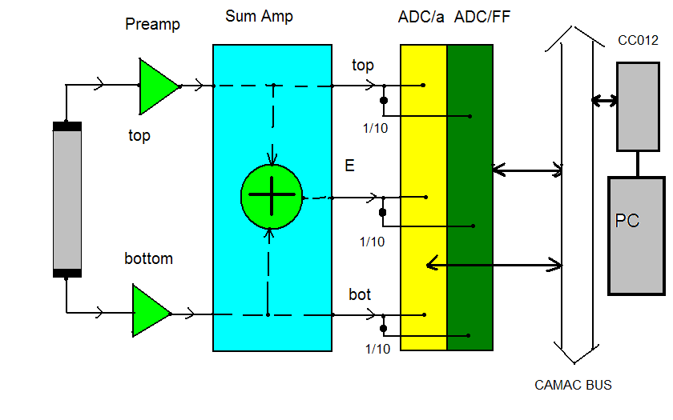
Block-scheme for one strip
One of the basic idea – unification det. System = {“TeckhInvest” SEZ Dubna+FLNR}

Slide 4
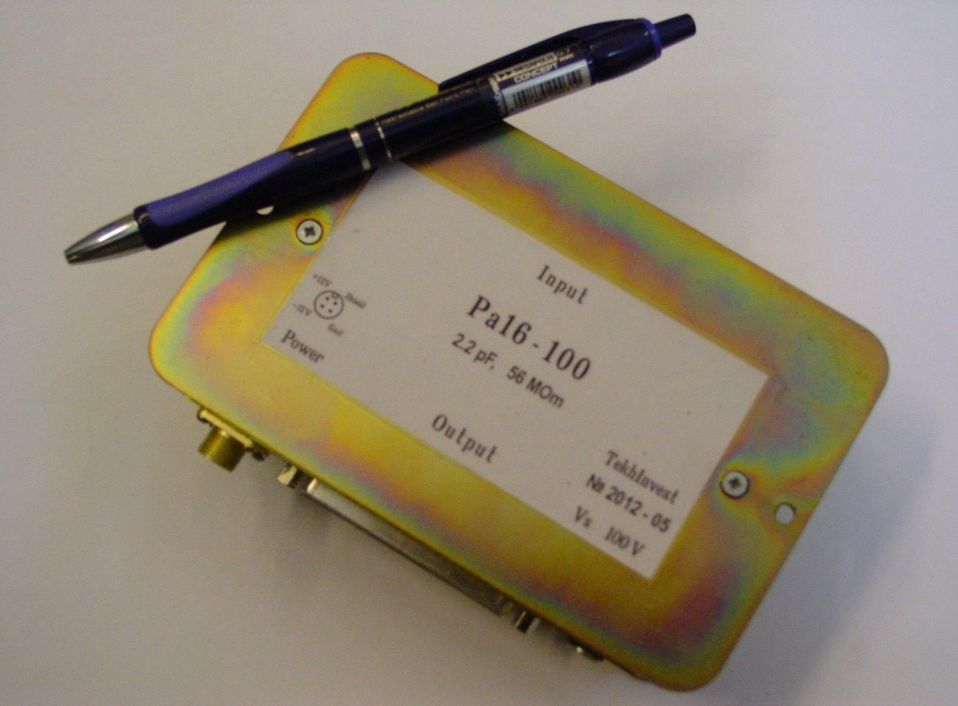
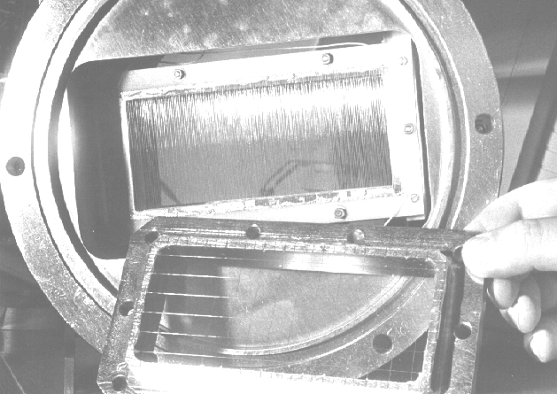
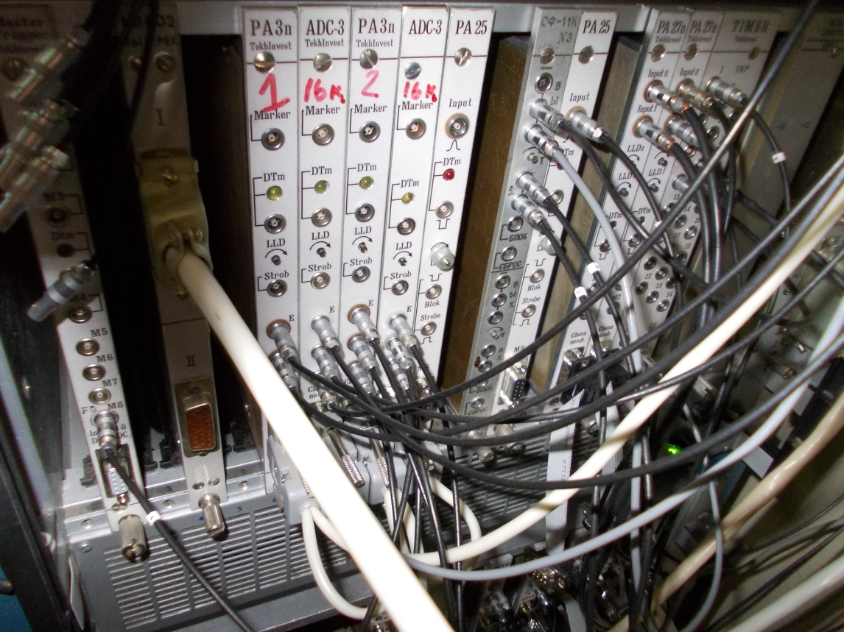
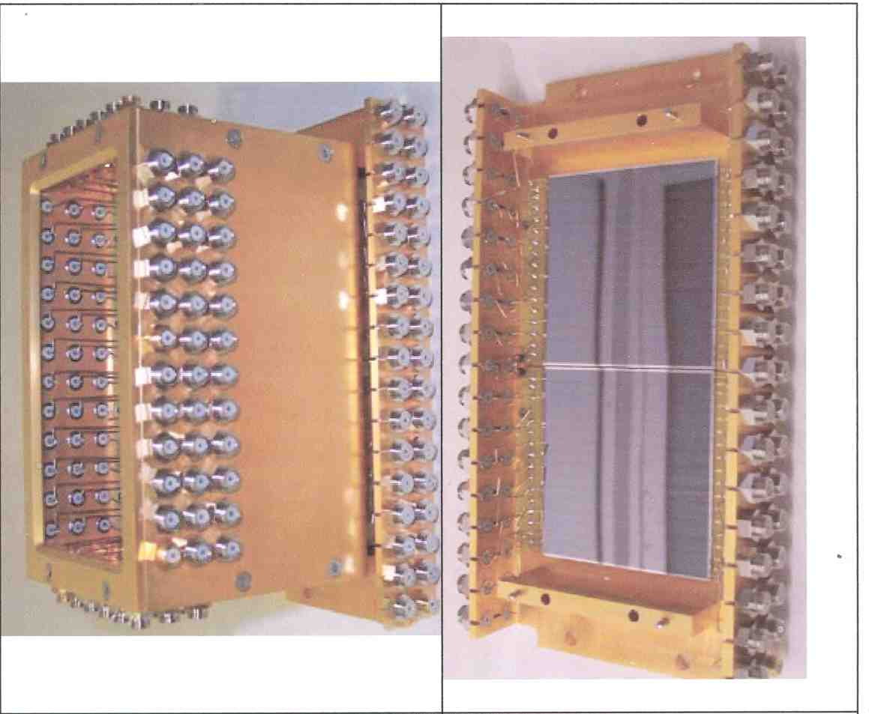
New Detection module of the DGFRS
Veto detector: to suppress charge particles,
coming from cyclotron, passing through
the focal plane one
and creating no signal
in the gaseous TOF detector
Two 6x6cm² chips
~320 μm depth
Totally depleted
TOF module
(filled with~ 1.6 Torr
Pentane. )
32 pos. sensitive strips
3.8 x 60 mm
Side detectors:
Eight chips 6x6 cm²
16 in charge sens. preamplifier
Notes:
4

Slide 5
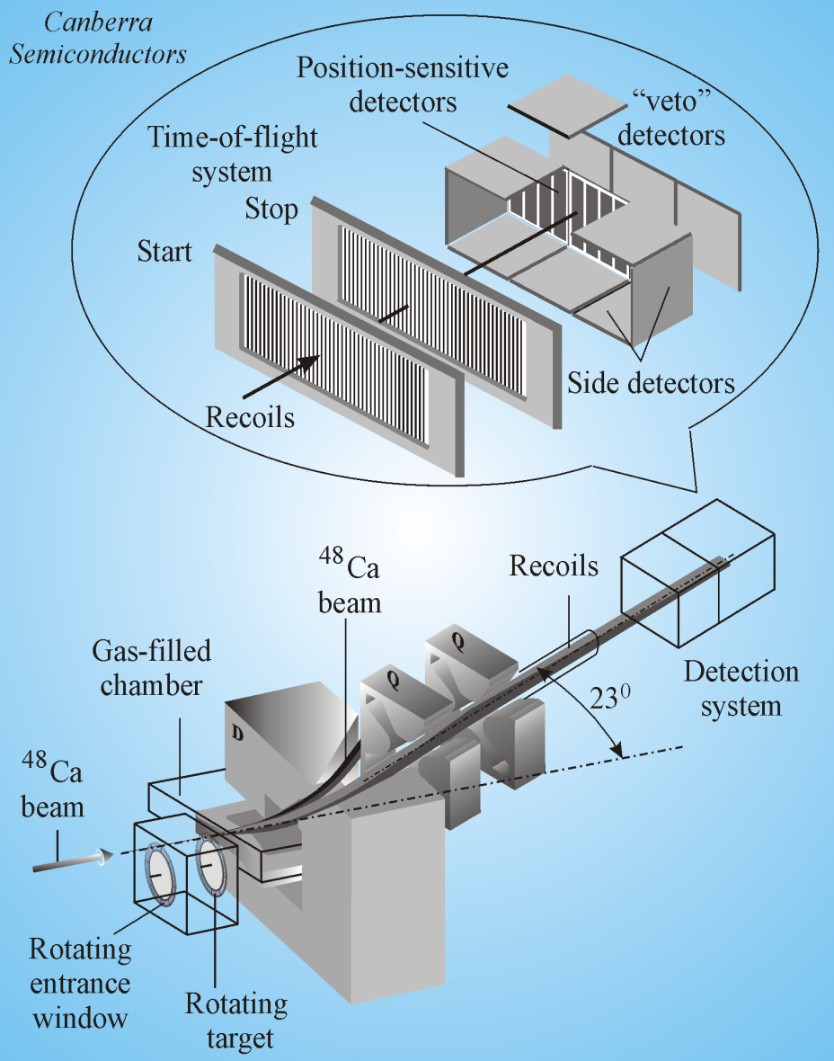
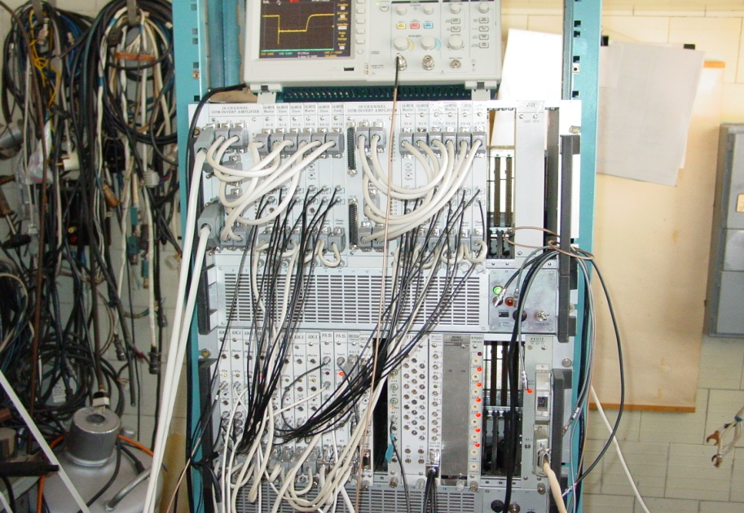
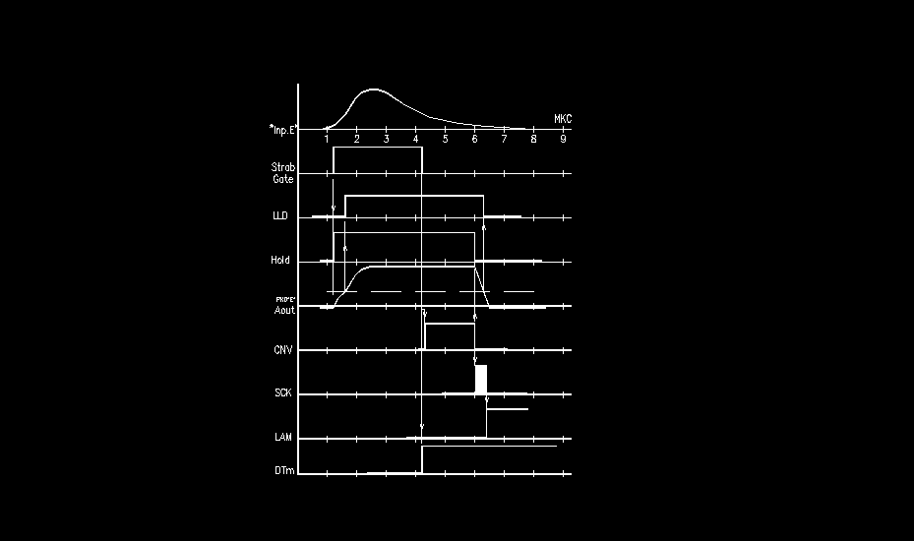
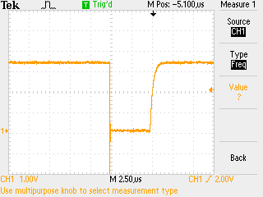
Past
2000-2010
present
Future
~+1 -2 y
Pa3n ADC
E, top, bottom
Basic idea – time “smoothing””

Slide 6
Experiment parameters monitoring & Protection System of the DGFRS
(Phys. Of Part. And Nucl. Lett., v 7, no.5 (2010)370-377; + in Proc. of RT-2010 Symp., June 2010, Lisbon, Portugal ;
Proc. of NEC’2009 Int. Symp., , Sept. 2009, 2011, Varna, Bulgaria, 2009 New Delhi, India (seminar)
PC based, CAMAC, KK012 M , PCI int., Windows XP, C++ Builder 6.0
It provides:
Parameter monitoring, visualization associated with:
cyclotron beam, detection system, separator by itself;
Protection against any abnormal situations
(very actual when one use high activity
Actinide targets e.g.)

Slide 7
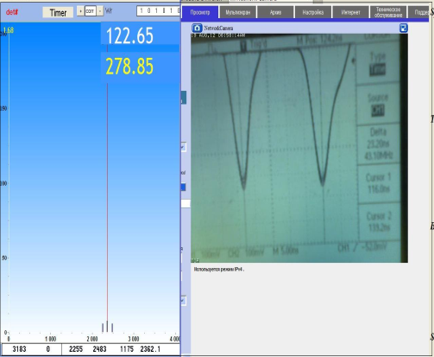
Main user interface /Experiment ⁴⁸Ca+²⁴⁹Bk→117+3,4n April- November 2012
cyclotron
“energy” window

Slide 8
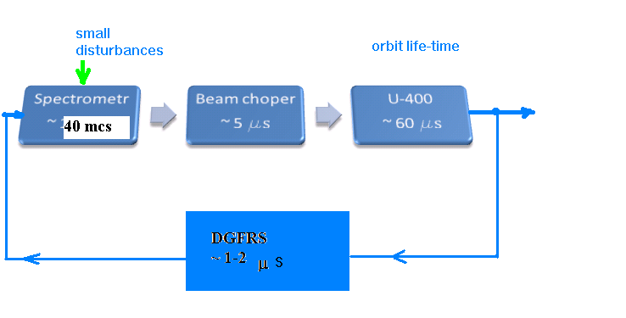
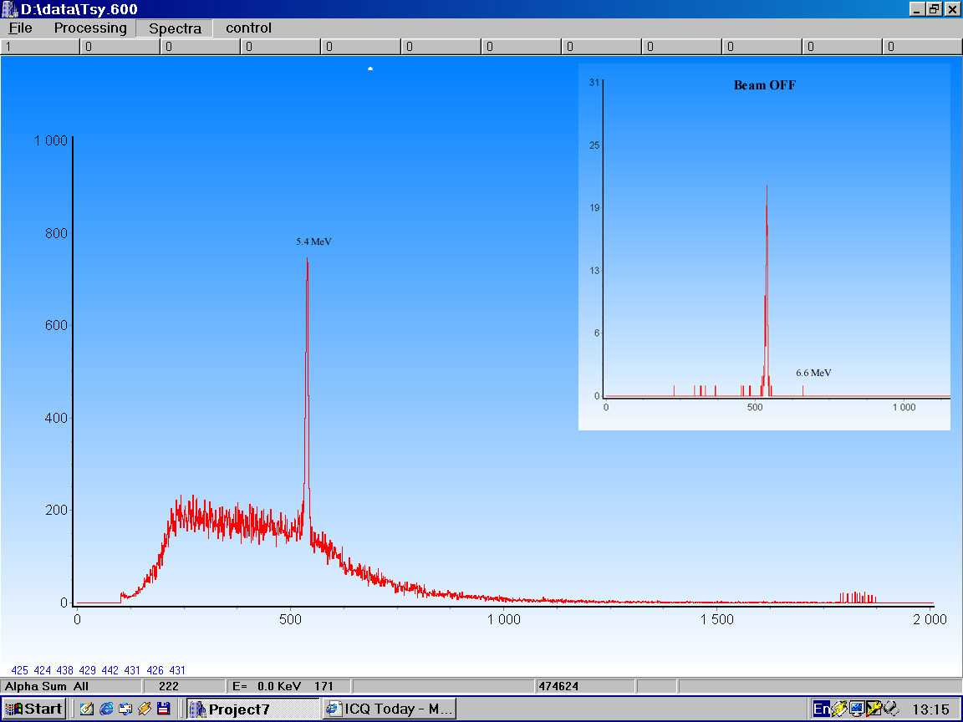
Method of “active correlations” – radical background suppression (idea Yu.Tsyganov HPC ASIA’97, Seoul + NEC’97 VARNA 1st test (Fm ER ) 1998 Int. Conf/ Brighton, Lewis UK)
2 10091.8 32.4 0 0.0 2446.508 0.9509 745 1 0 0:12:29
15 10965.8 40.4 0 0.0 2787.342 0.1006 745 1 0 0:17:57
15 10284.6 35.9 22.4 2787.643 745 0 0 149 3033 (1.265+9.017)
15 9619.9 40.1 18.9 2793.432 745 0 0 100 2064
15 9401.4 40.1 18.8 2942.940 745 0 0 0 0
Beam stop’s+ beam off on-line (~1-2 min after rt..) buffer fragment…

Slide 9
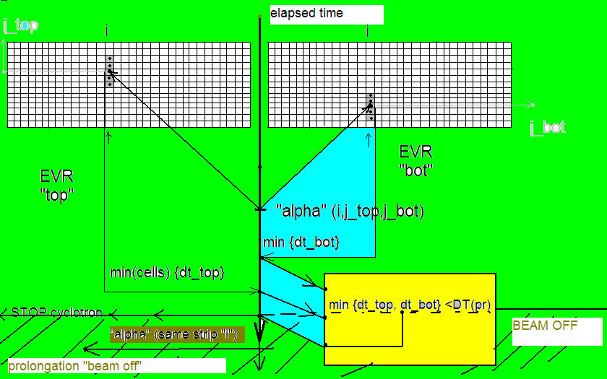
Flow chart of the RT EVR-alpha pointer search algorithm
PC RAM

Slide 10
C++ code fragment : search for potential ER-alpha pointer
int j=0;
T_PRE_SET=0.00000001;
correlationt=false; str_memo=-1; pixelt =0; // глоб
pixelt = int (DISCRET*pstT/60.0);
if (pixelt > DIS-4 || pixelt < 4) pixelt=0;
if (EVR== true && elapsedT > 0.1 ) { RECOT[pixelt][strno]= elapsedT; cnt_EVR_top++; }
if (ALFA==true && situation==false && pixelt > N_PI && pixelt < DIS-N_PI && e_total>EAMIN)
{
cnt_top++;
for (j=0; j < N_PI; j++) dt[j]=0;
for (j=0; j < N_PI; j++) dt[j]=elapsedT - RECOT[pixelt-N_PI/2 + j][strno];
dt_min=5.0;
for (j=0; j<N_PI; j++)
dt_min =(dt[j]<= dt_min)? dt[j] : dt_min;
}….

Slide 11
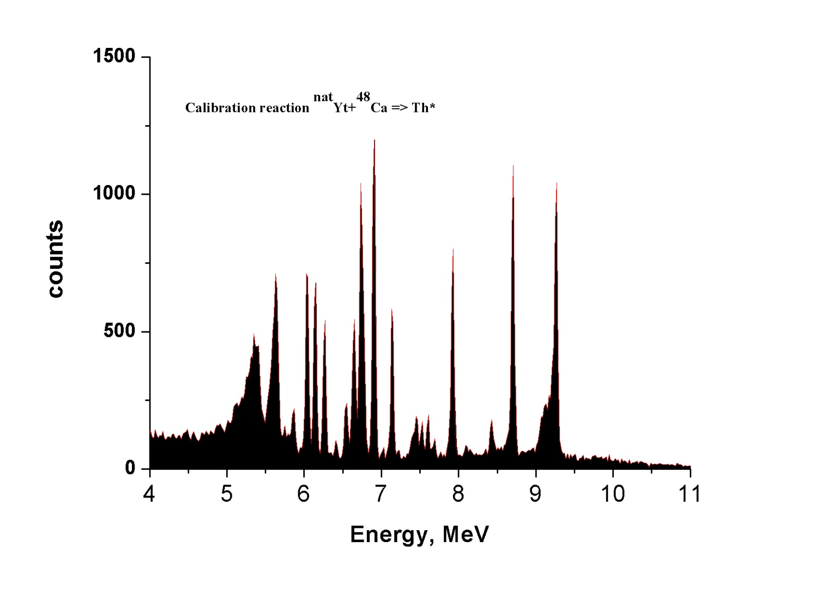
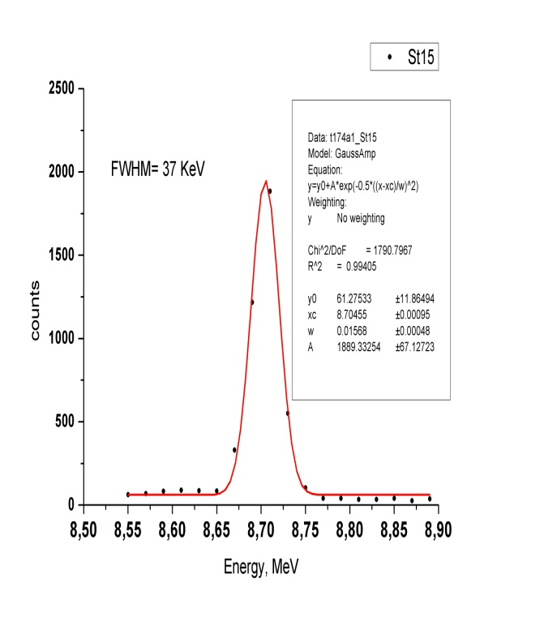
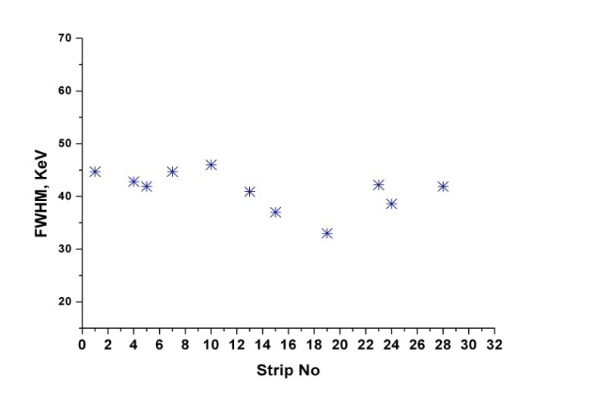
Typical calibration spectrum ( strip#5).
²¹⁷Th (T_{1/2} = 237 µs )
215Ra
To operate in real-time mode it takes 752 calibration parameters to insert to Builder 6.0 C++
data taking code extracted from calibration reactions. (~few days)

Slide 12
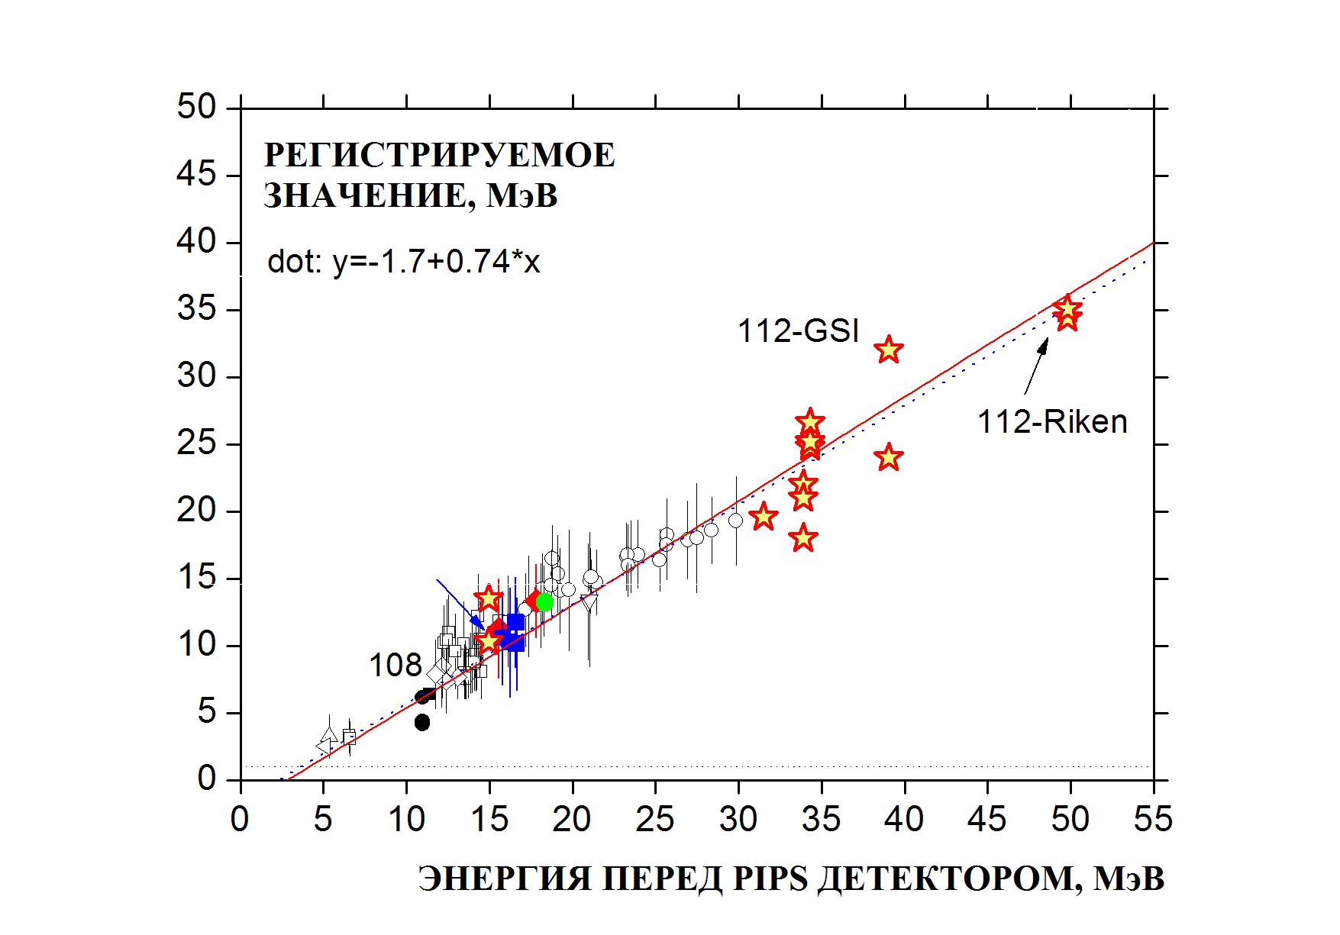
ER registered energy systematics

Slide 13
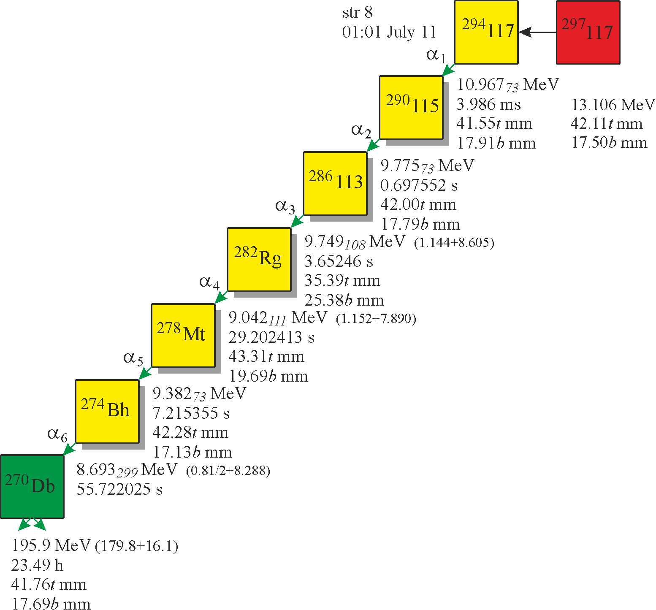
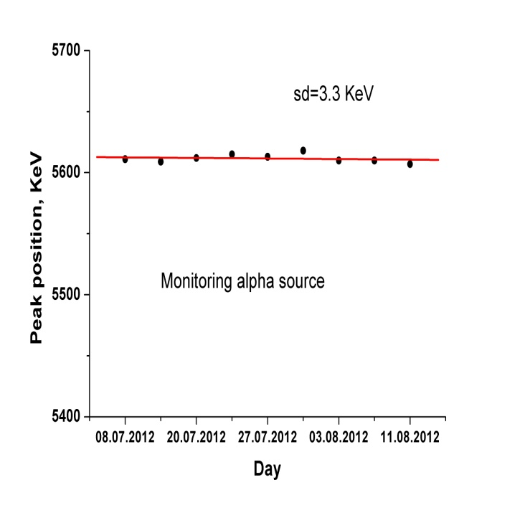
Example of application: reaction ²⁴⁹Bk+⁴⁸Ca→117+3,4n
Preliminary (results)
Beam dose ~ 3E+19
(three energies)
11 events
52.69+6.51 = 59.20
23.5+35.81 = 59.31
35.79+23.91= 59.70
42.11+17.50= 59.61
40.13+19.01= 59.14
39.65+20.66= 60.31
28.57+31.75= 60.32
37.24+22.64= 59.88
24.67+34.63= 59.30
25.14+34.99= 60.13
38.48+20.84= 59.32
May 2013 issue of Physical Review C (Vol.87, No.5):
Experiment Z=117 in details: report by
Dr. A.Voinov 06 June

Slide 14
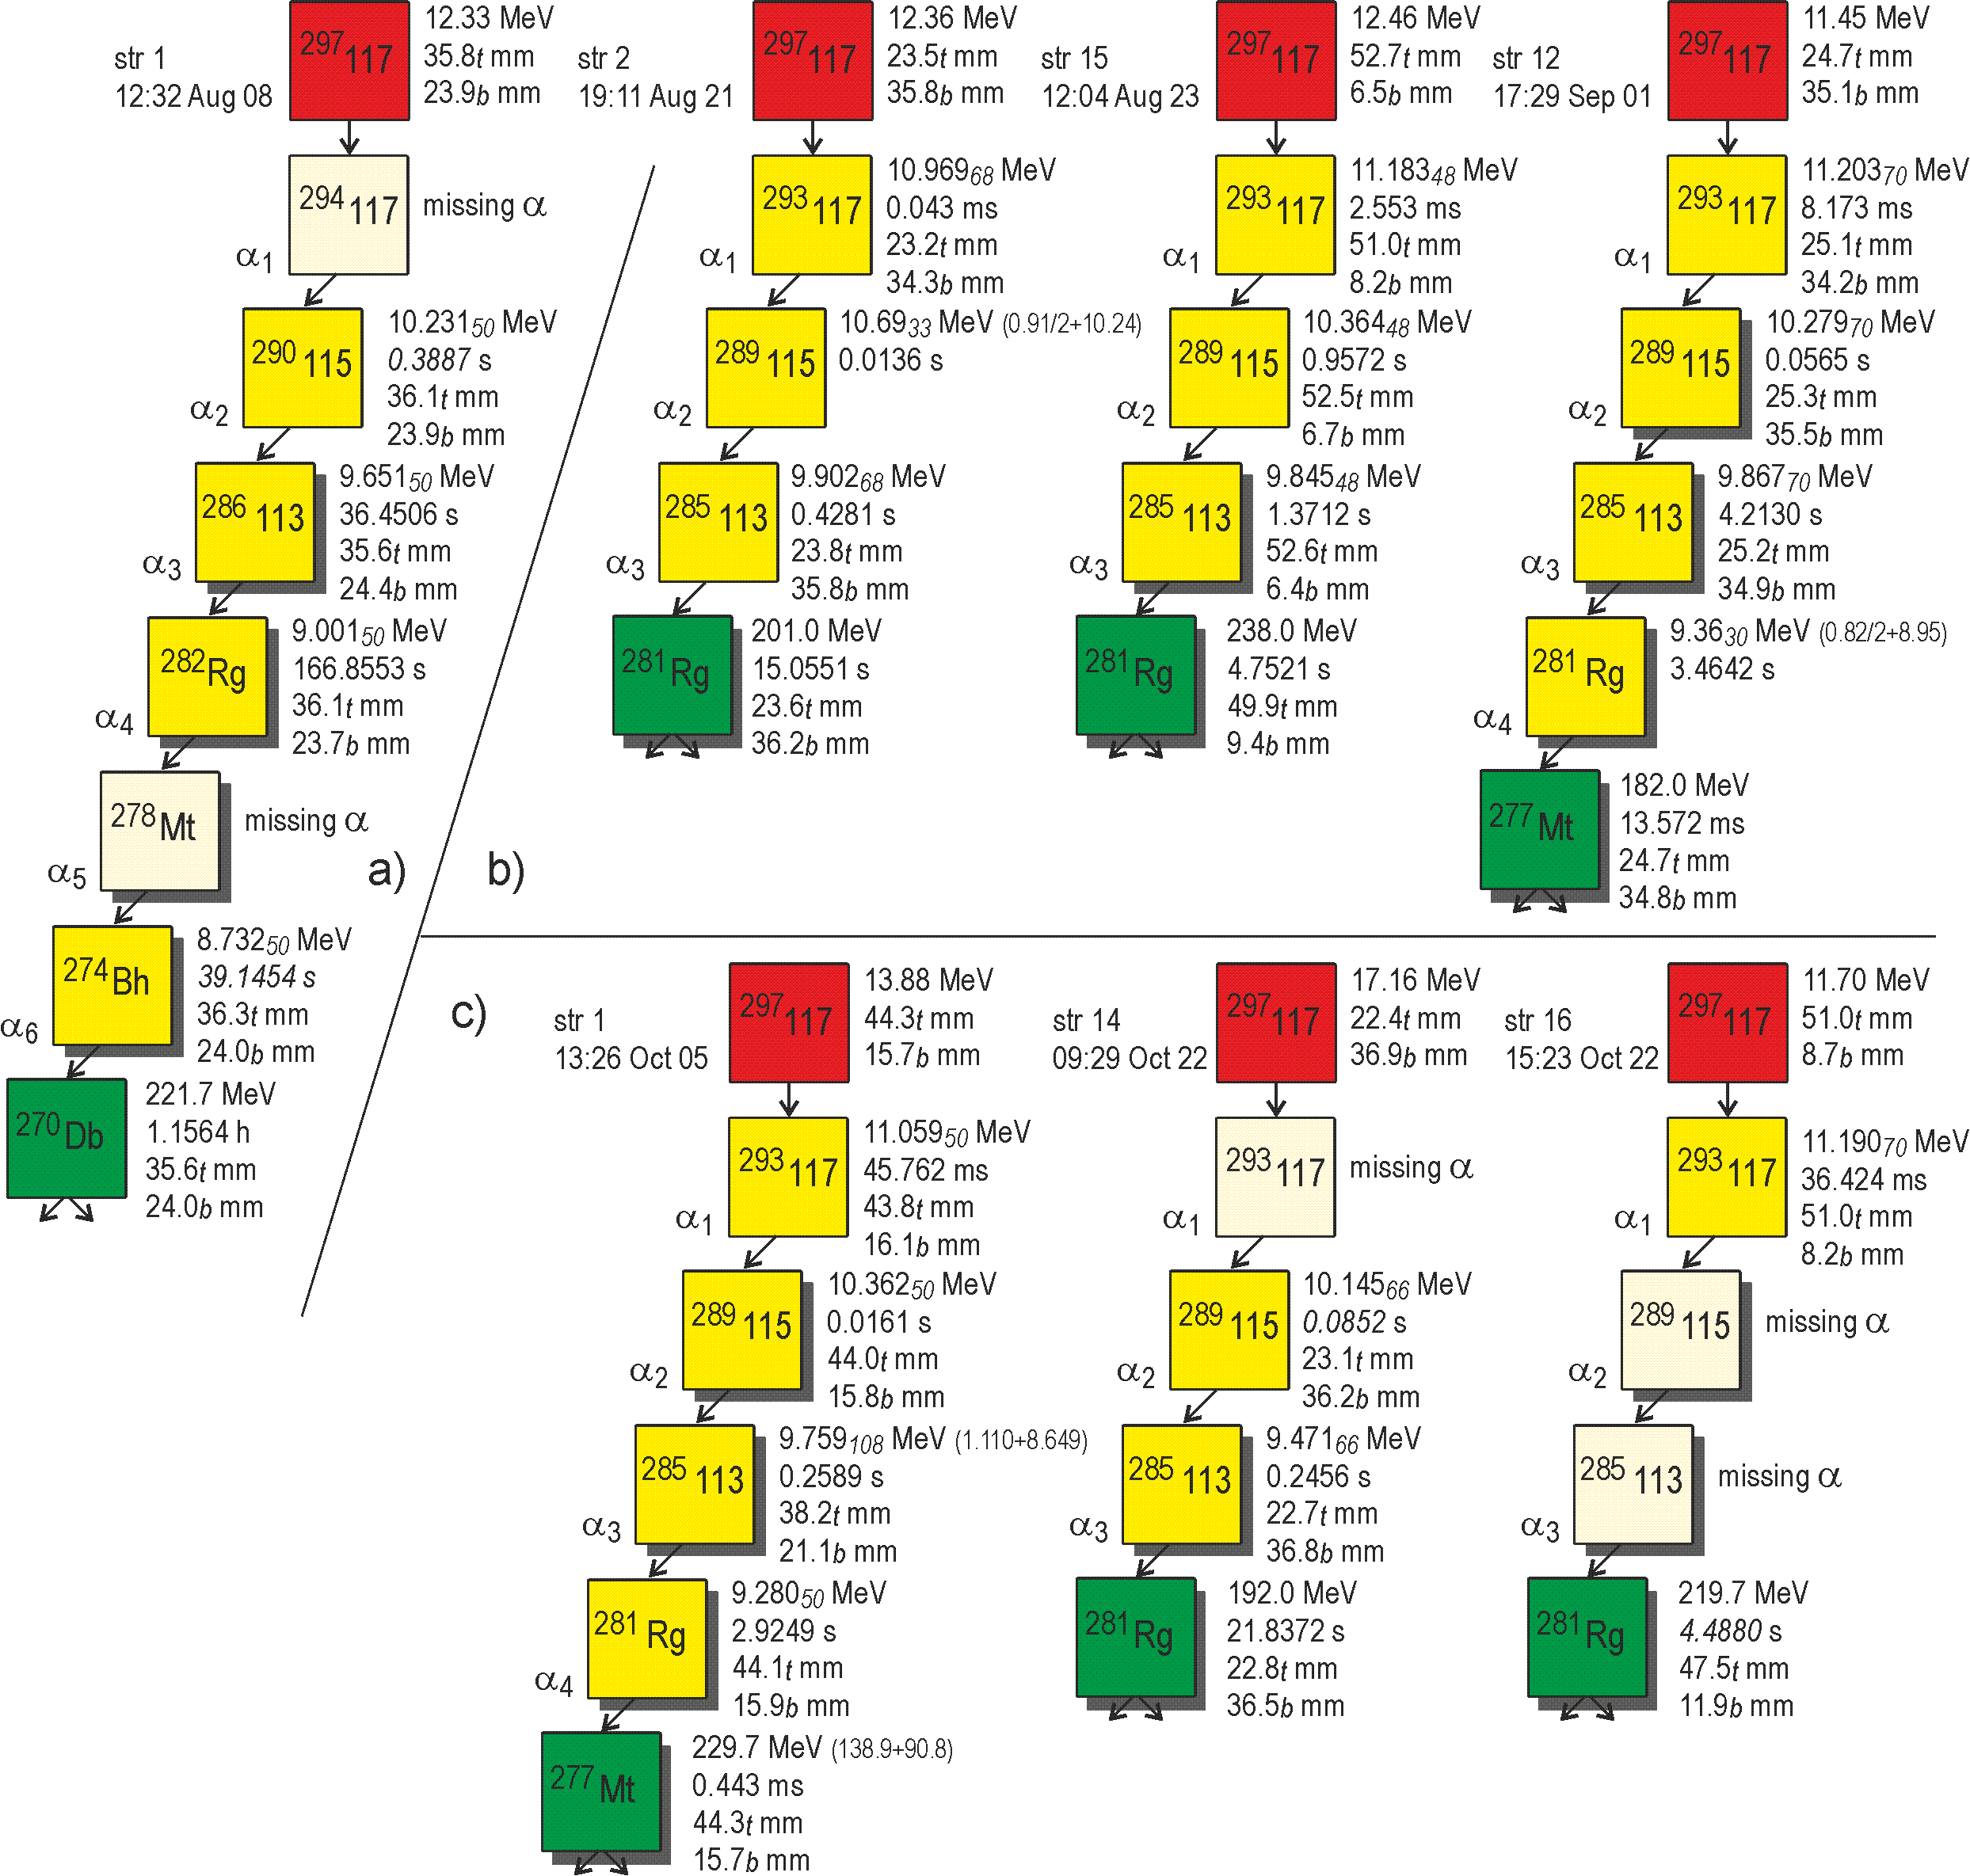
Yu.Oganessian
PRC /in print
Calc. Nr
By Dr. V.Utyonkov
(meth. K.-H.Schmidt)

Slide 15
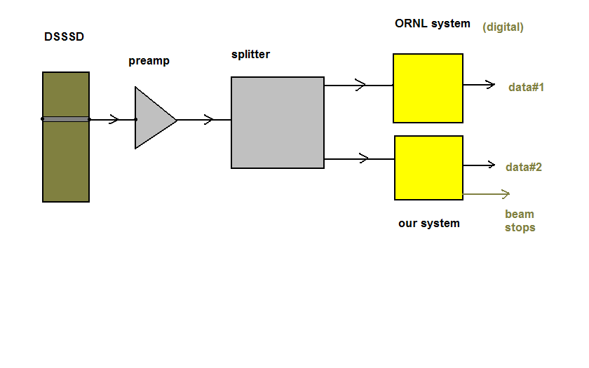
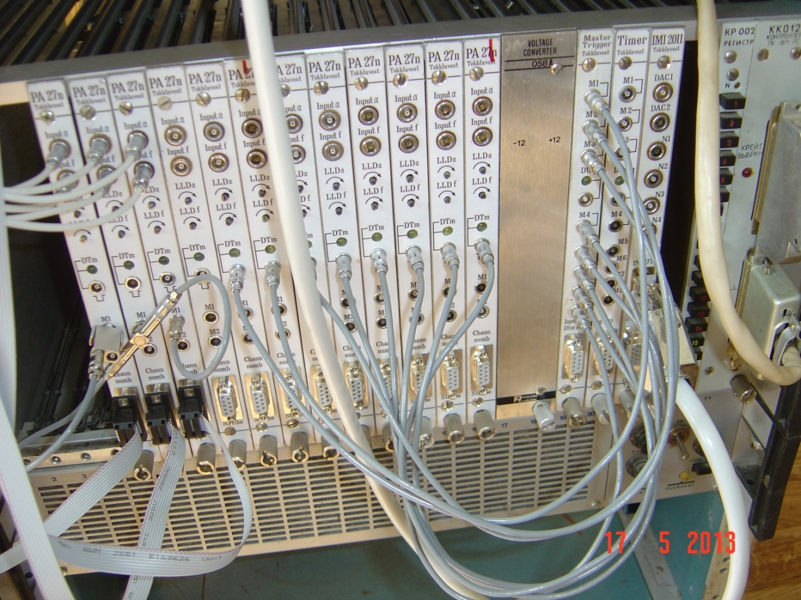
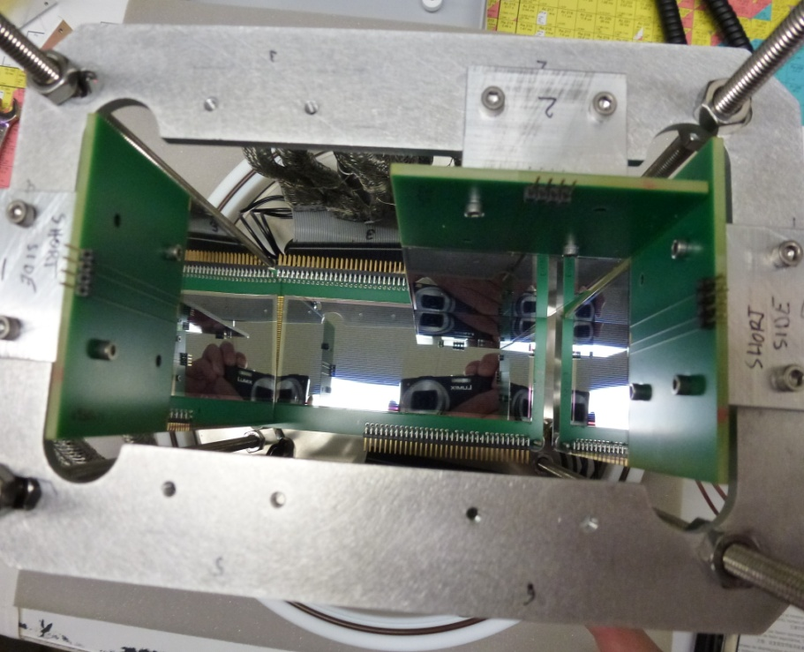
4) .. DSSSD application 48 (front) x 128 (back) strips
Goals: 1) to operate (in parallel) with
ORNL digital system (data flow,beam stops)
2) Autonomosly (~15 mcs)
99% ampl.

Slide 16
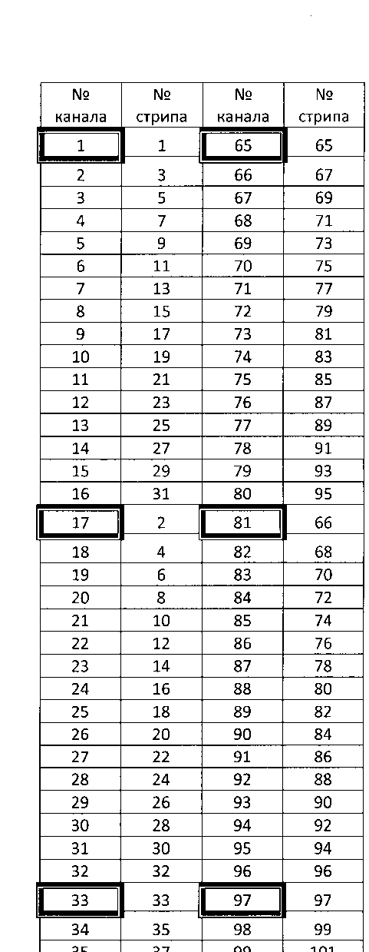
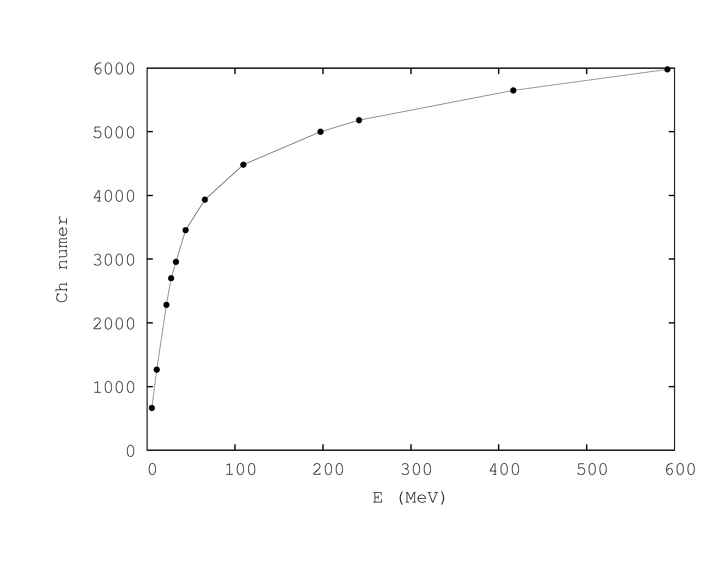
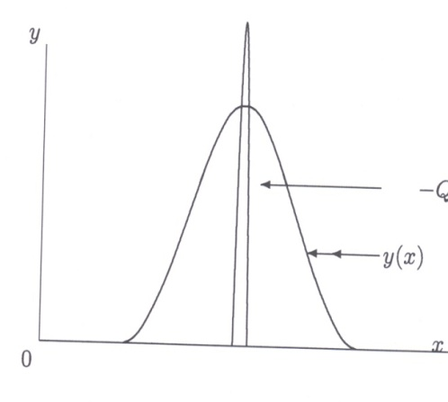
Back side DSSSD strip signals read-out
Dr. Alexandr Yakushev (TASCA) : ~20% signals from back side are shared
between neighbor strips (private communication) ➔ It means, because of we use multiplexers, it is necessary to avoid
Situation when two neighbor signals are coming to the SAME ADC !
(см. рис.22).
Therefore →
Table of connections is :
chan
strip
[CPC v184 Issue 2, 2013pp 429-431]
Plan to a nearest future to use Zlokazov auto calibration method- Polinomial extrapolation basing on Quazicurvature function for 48 strips alpha scale without using interactive mode

Slide 17
Summary
New PC based integrated detection&parameter monitoring system
for the DGFRS experiments has been designed and successfully applied in the
²⁴⁹Bk+⁴⁸Ca→117+3,4n bombardment
in the framework of Dubna-Livermore-Oak Ridge collaboration.
We plan to parallelize present system with a new ORNL digital system (Pixie-16 standard) in a nearest future.
DSSSD application is a reasonable scenario too (2013-2014) (ORNL design)

