Slide 1
The 12 GeV Upgrade of CEBAF – a Status Report on Its Realization and Its Evolving Physics Program
L. Cardman
Thomas Jefferson National Accelerator Facility and
University of Virginia

Slide 2
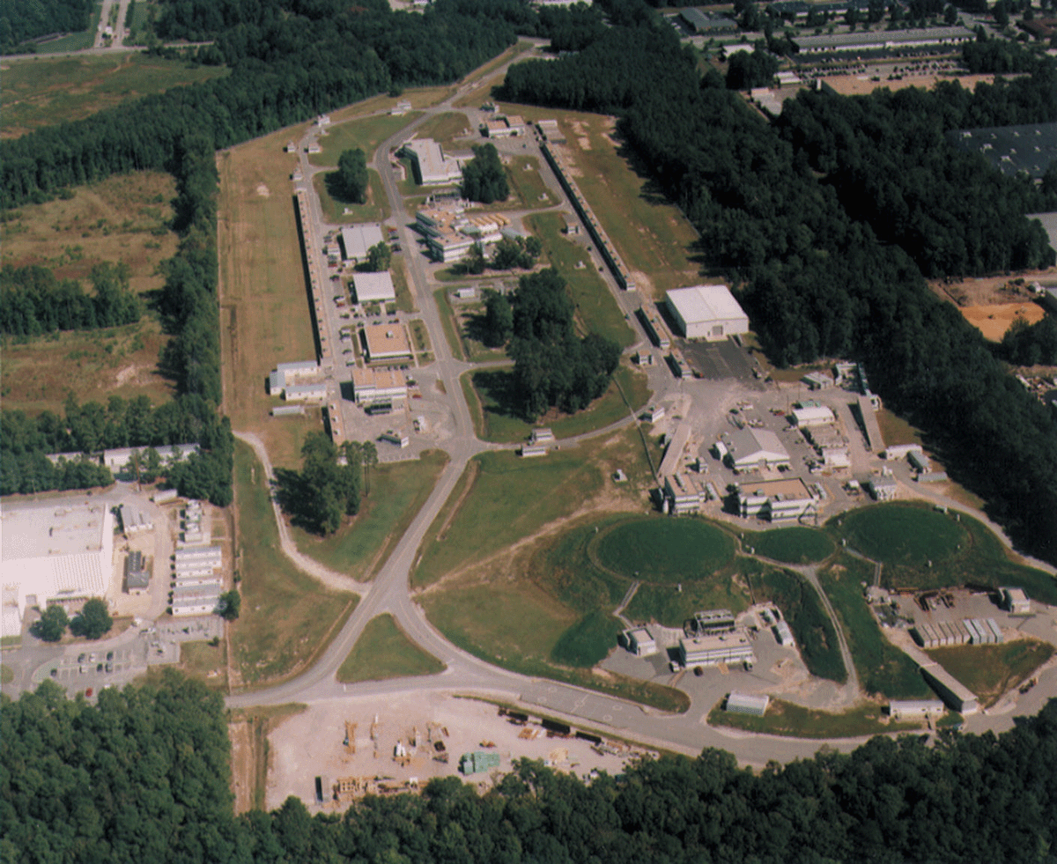
The Original CEBAF Had a Long and Productive Scientific Life
Arc
CHL
Linac
Linac
Arc
3 End Stations
A B C

Slide 3
The Original CEBAF Had a Long and Productive Scientific Life
A Large (the largest in Nuclear Physics) and Active International User Community:
  1351 scientists from 233 institutions in 28 countries
A Decade and a Half of Research operations (10/1995 - 5/2012)
  In full. 3-hall operation for ~15 years (since 11/1997 – 5/2012)
  Data taken for 174 full experiments and 11 more partial experiments
  Results of most have been published; with the remainder under detailed analysis. (e.g. 345 PRL and PL to date: ½ expt, ½ theory)
  444 PhDs to date and 193 in progress (~1/3 of US PhDs in Nuclear Physics)

Slide 4
Highlights from the CEBAF Program
Quantum Chromodynamics and the Structure of Hadrons
  Discovery of unexpected behavior of G_{e}^{p}
  Proton strangeness content ≈0 and nucleon flavor decomposition
  The deformation of Δ and N* transition form factors
  Spin dependent structure functions: Bjorken & GDH sum rule; g₁^{n}; |∆ G|
  Measurement of the pion form factor
  Exploration of duality, pQCD counting rules, color transparency
  Initial exploration of the 3D structure of the nucleon using GPDs and TMDs
  Evidence for missing excited nucleons & a set of complete photoproduction experiments (under analysis)
Nuclei: From Structure to Exploding Stars
  The connection between the EMC effect and the local vs average nuclear density, and the connection to N-N short range correlations
  Confirmed the existence of the neutron skin in model-independent manner
  Studies of hypernuclei – better than 400keV resolution
In Search of the New Standard Model
  Factor 5 (soon 25) increase in precision of Std. Model couplings
  Q_{Weak} constrains new physics to a mass scale of 1.1 TeV (w/ ~2.3 TeV coming)

Slide 5
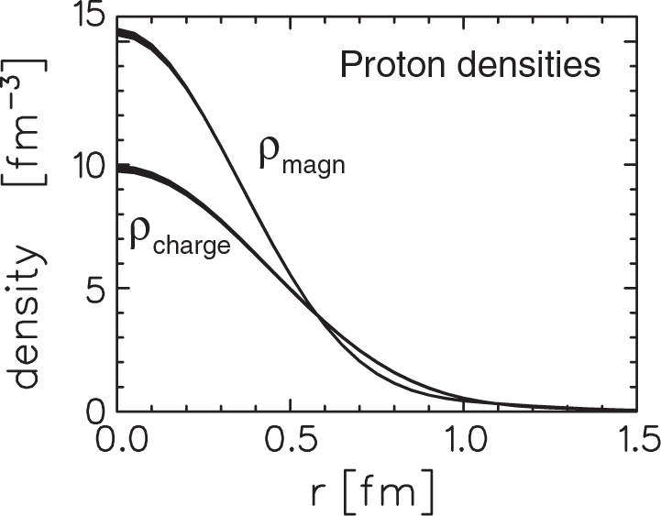
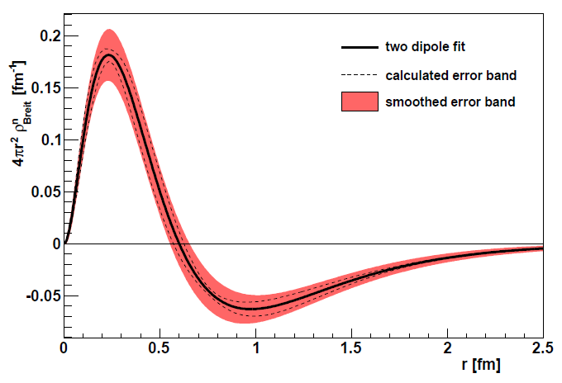
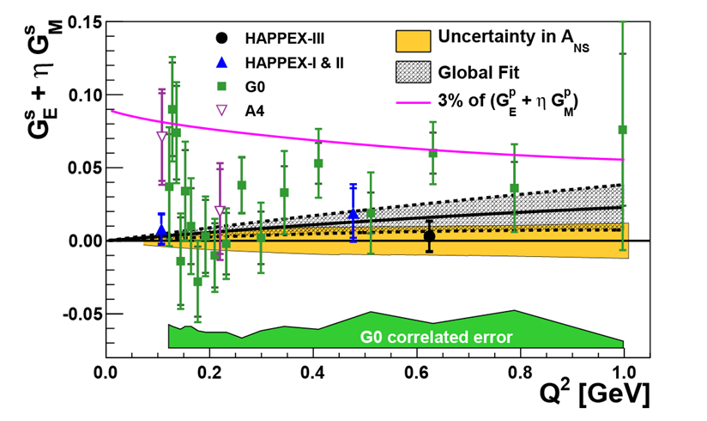
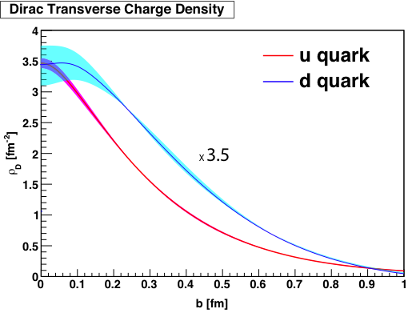
Examples of Highlights from the CEBAF Program: Nucleon Densities
Proton
Neutron
Proton Strangeness
Flavor-Separated Densities

Slide 6
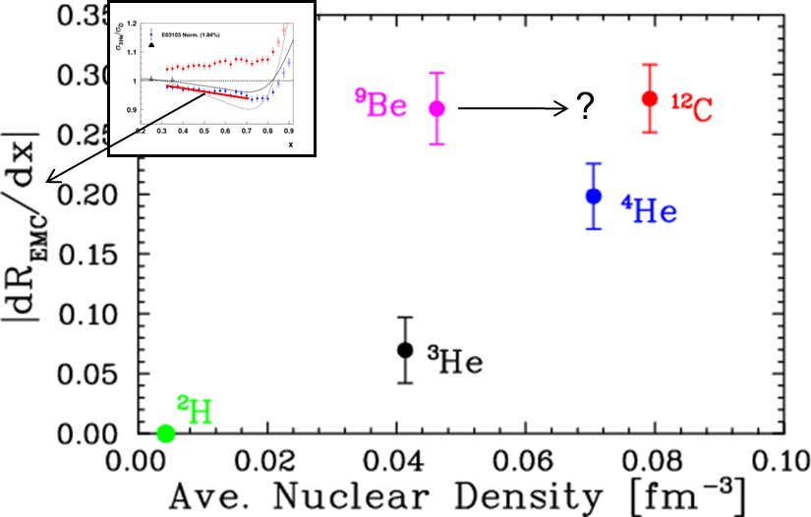
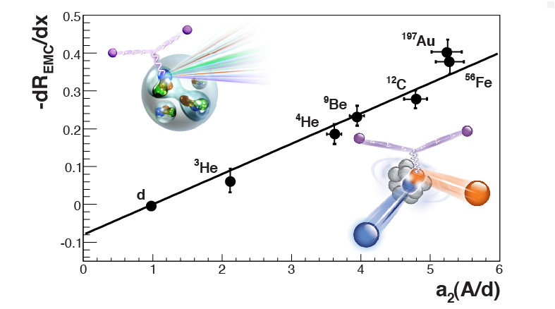
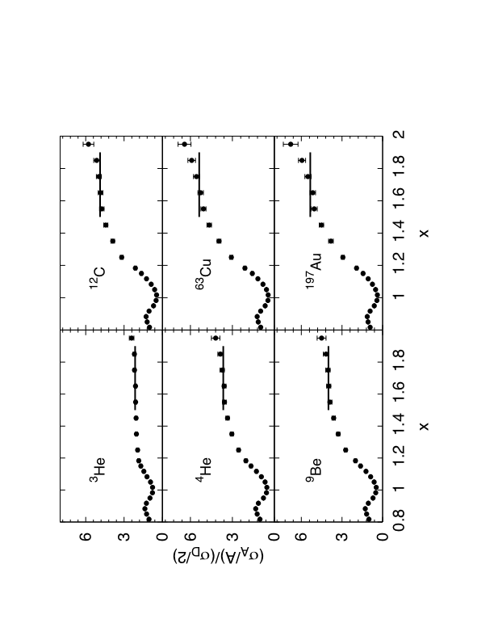
The EMC Effect and Short Range Correlations
EMC Effect Depends on Local Rather than Average Densities
2-N and 3-N Short Range Correlations (SRC) Studied Quantitatively and Unambiguously by x>1 DIS
EMC and SRC are Connected

Slide 7
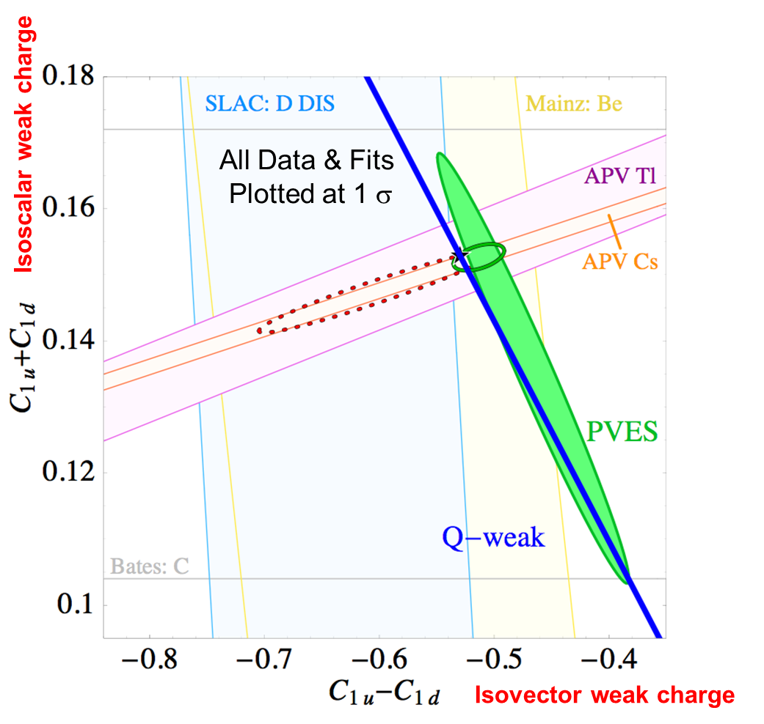
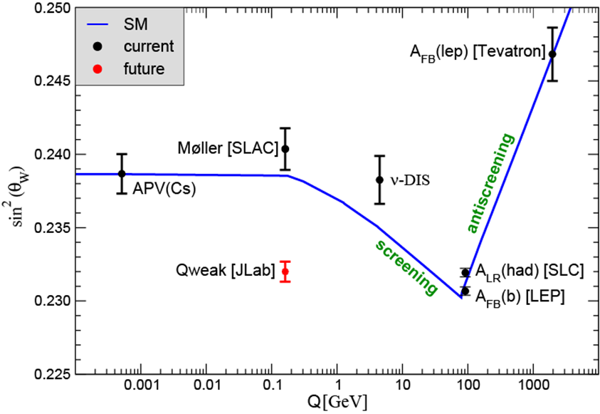
Measurement of the Neutral Current Weak Couplings to the Quarks and the Running of Sin²θ_{W}
Factor of 5 Reduction in Error Band Already Achieved
Anticipated uncertainty in final result from Q_{weak} experiment under analysis.
Expected to set a limit of ~2.3 TeV on Physics Beyond the Standard Model
Second factor of 5 soon:
Anticipated constraints if
Q^{P}_{W} is consistent with the Standard Model.

Slide 8
The Original CEBAF Had a Long and Productive Scientific Life
A Large (the largest in Nuclear Physics) and Active International User Community:
  1351 scientists from 233 institutions in 28 countries
A Decade and a Half of Research operations (10/1995 - 5/2012)
  In full. 3-hall operation for ~15 years (since 11/1997 – 5/2012)
  Data taken for 174 full experiments and 11 more partial experiments
  Results of most have been published; with the remainder under detailed analysis. (e.g. 345 PRL and PL to date: ½ expt, ½ theory)
  444 PhDs to date and 193 in progress (~1/3 of US PhDs in Nuclear Physics)
CEBAF’s Scientific Productivity and the Enhanced Reach of a Program at 12 GeV (together with the simple path to doubling the energy made feasible by SRF advances) Lead the NP Community to Make the Upgrade the Highest Priority of the 2007 NSAC Long Range Plan). It is well underway
  The enhanced reach of the facility and the associated suite of experimental equipment will support continued, cutting edge research well into the 2020s

Slide 9
Scientific Questions Motivating the 12 GeV Upgrade
What is the role of gluonic excitations in the spectroscopy of light mesons? Can these excitations elucidate the origin of quark confinement?
Where is the missing spin in the nucleon? Is there a significant contribution from valence quark orbital angular momentum?
Can we reveal a novel landscape of nucleon substructure through measurements of new multidimensional distribution functions?
What is the relation between short-range N-N correlations and the partonic structure of nuclei?
Can we discover evidence for physics beyond the Standard Model?

Slide 10

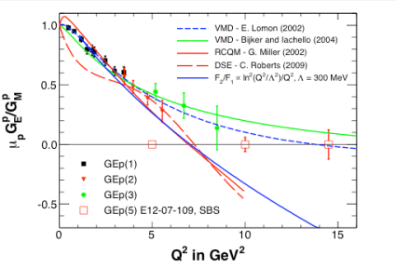
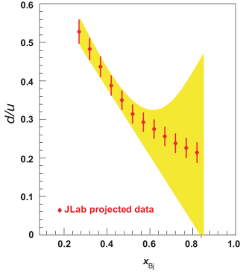

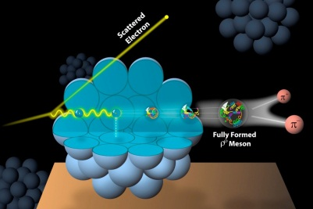
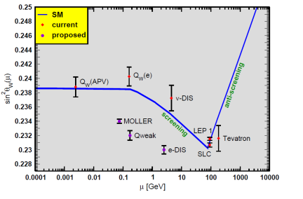
To Address Those Questions the Upgrade Will Support Major Programs in Six Areas
The Hadron spectra as probes of QCD
(GluEx and heavy baryon and meson spectroscopy)
The transverse structure of the hadrons
(Elastic and transition Form Factors)
The longitudinal structure of the hadrons
(Unpolarized and polarized parton distribution functions)
The 3D structure of the hadrons
(Generalized Parton Distributions and Transverse Momentum Distributions)
Hadrons and cold nuclear matter
(Medium modification of the nucleons, quark hadronization, N-N correlations, hypernuclear spectroscopy, few-body experiments)
Low-energy tests of the Standard Model and Fundamental Symmetries
(Møller (accuracy ≈LEP), PVDIS, PRIMEX, …..)
And other science
we can’t foresee

Slide 11
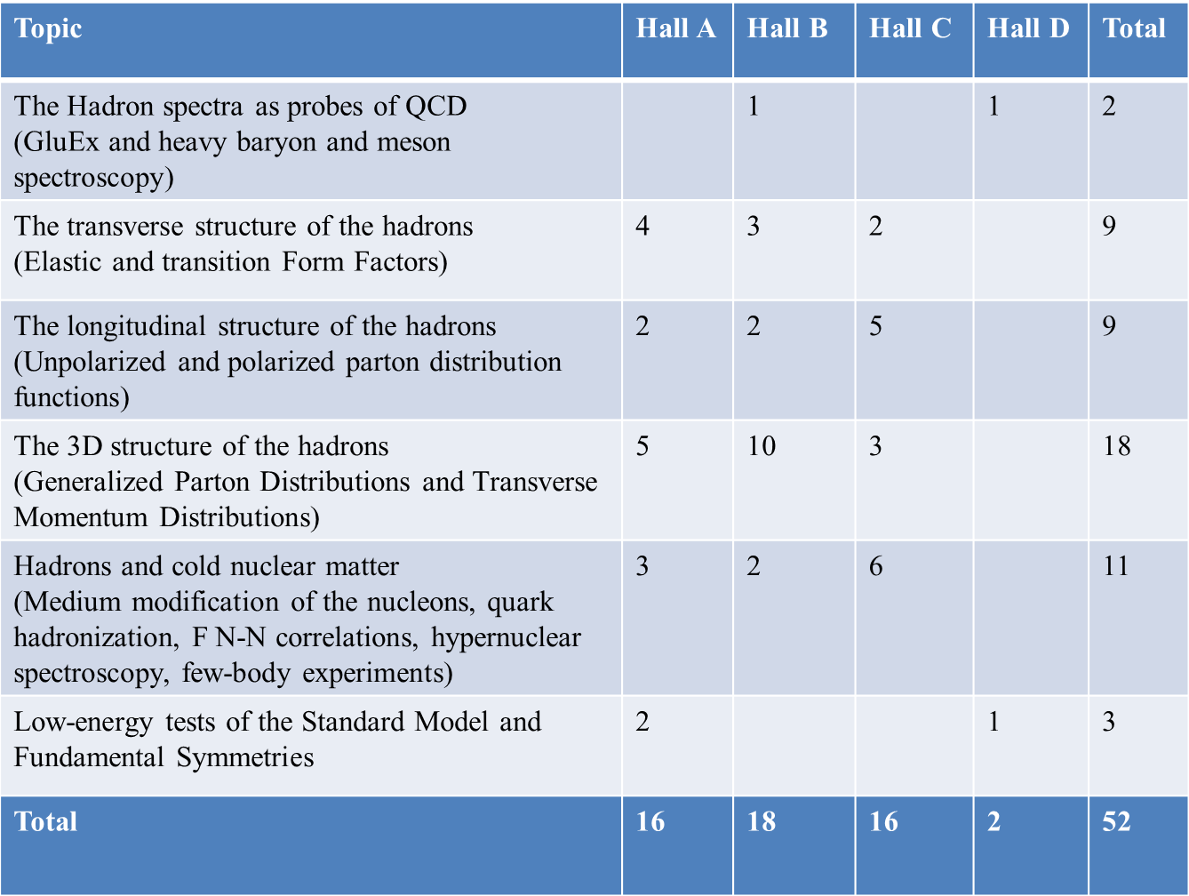
12 GeV Approved Experiments by Physics Topics
E12-11-105 has not been counted with the experiments since it is considered a test

Slide 12
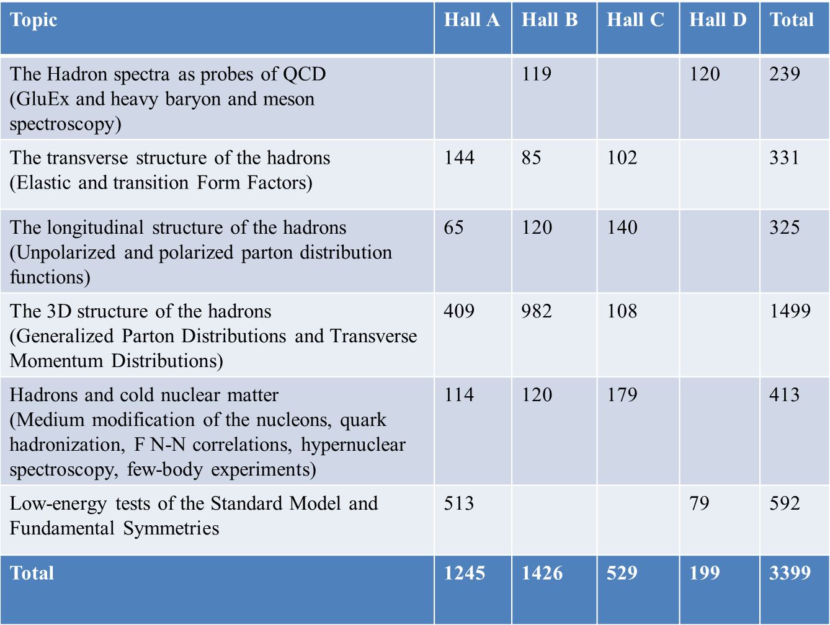
“PAC Days” of 12 GeV Approved Experiments
by Physics Topic
PAC40, which meets June 17-21, will continue the planning
A “Reprioritization” PAC Meeting (to be held ~2015) will review the scientific priority of ALL currently (and PAC40) approved experiments
More than 7 years of approved experiments

Slide 13

Gluonic Excitations and the Origin of Confinement
Theoretical studies of QCD suggest that confinement is due to the formation of “Flux tubes” arising from the self-interaction of the glue, leading to a linear potential (and therefore a constant force)
From G. Bali
linear potential
Experimentally, we want to “pluck” the flux tube
(wiggle the hot dog?) and see how it responds

Slide 14
LQCD Developing Firm Predictions
Major challenge for lattice calculations: the excited spectrum with quantum numbers of states identified.
Lattice QCD Predictions
The Hadron Spectrum Collaboration, Phys.Rev. D 83, 111502 (2011)

Slide 15
LQCD Developing Firm Predictions
Major challenge for lattice calculations: the excited spectrum with quantum numbers of states identified.
Lattice QCD Predictions
States with non-trivial glue in their wave function.
The Hadron Spectrum Collaboration, Phys.Rev. D 83, 111502 (2011)

Slide 16
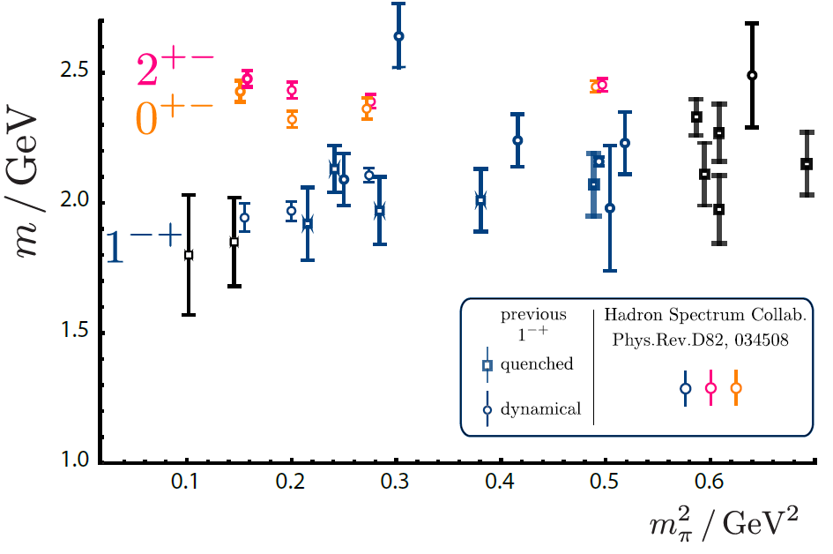
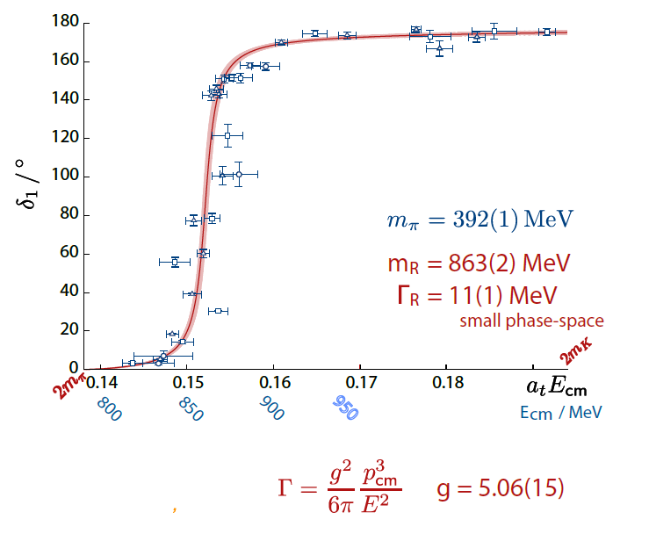
LQCD Developing Firm Predictions
Mass of 1⁻⁺, the lightest expected exotic: ground-breaking advance in precision, laying groundwork for calculations for GlueX
And real progress is being made in learning how to interpret the Lattice calculations in terms of widths
The calculated ππ isospin-1P-wave scattering phase shift can be well described by a single ρ resonance.
The Hadron Spectrum Collaboration, Phys.Rev. D 83, 111502 (2011)
J.J. Dudek, R.G. Edwards & C.E. Thomas, Phys.Rev. D 87 034505 (2013)

Slide 17
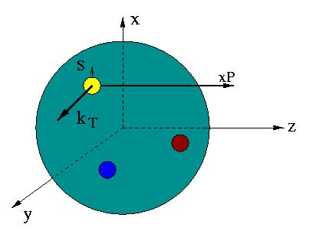

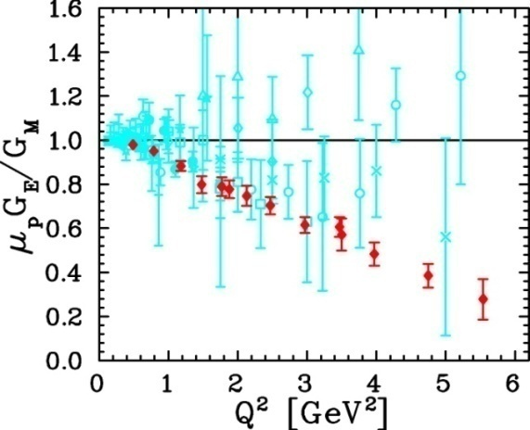
Developing a Unified View of Nucleon Structure
W_{p}^{u}(x,k_{T},r ) Wigner distributions
6D Dist.
d³r
d²k_{T} dr_{z}
TMD PDFs f₁^{u}(x,k_{T}), .. h₁^{u}(x,k_{T})‏
GPDs/IPDs
3D imaging
dx &
Fourier Transformation
d²k_{T}
d²r_{T}
Form Factors
G_{E}(Q²),
G_{M}(Q²)‏
PDFs
f₁^{u}(x), .. h₁^{u}(x)‏
1D

Slide 18
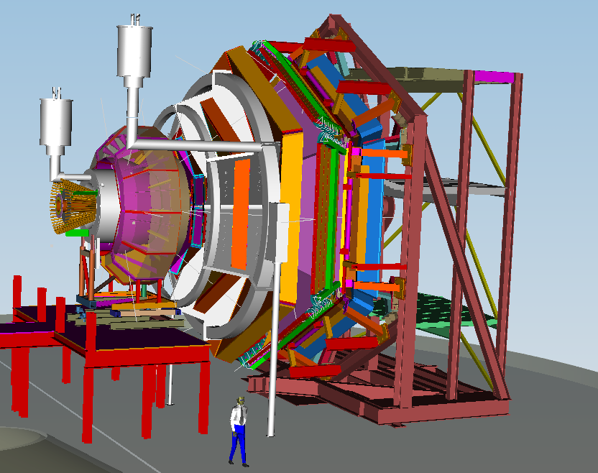
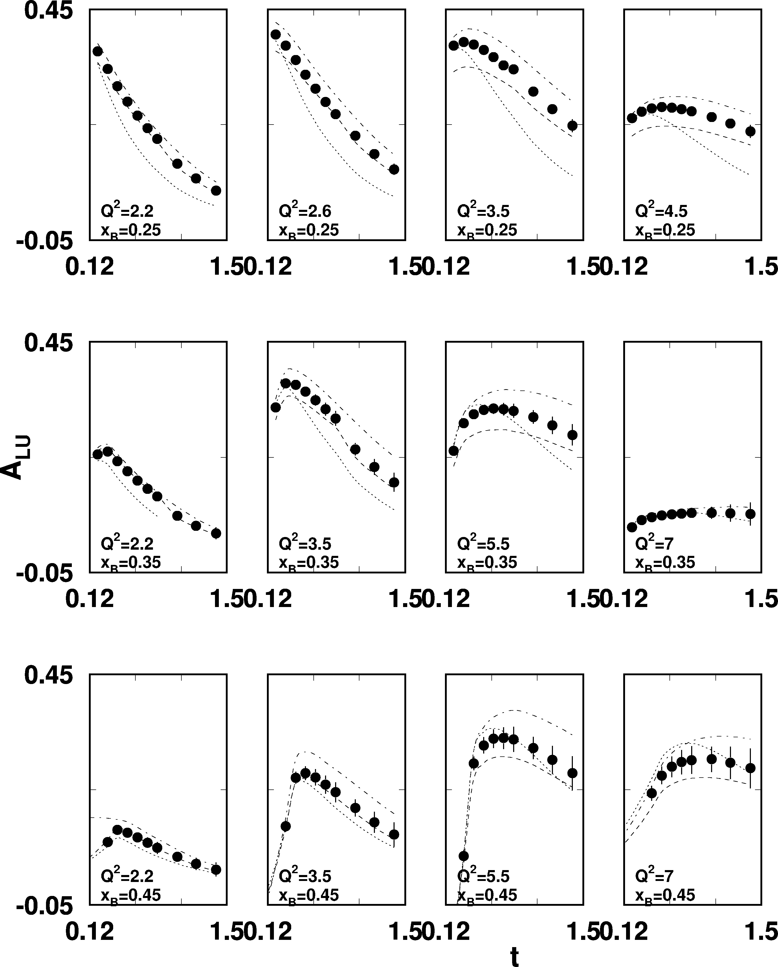
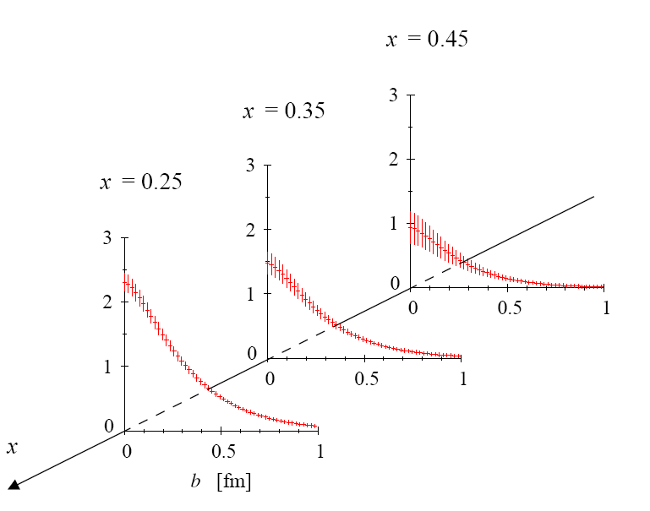
DVCS beam asymmetry at 12 GeV
CLAS12
sinφ moment of A_{LU}
ep epγ
High luminosity and large acceptance allows wide coverage
in Q² < 8 GeV², x_{B}< 0.65, and
t< 1.5GeV²

Slide 19
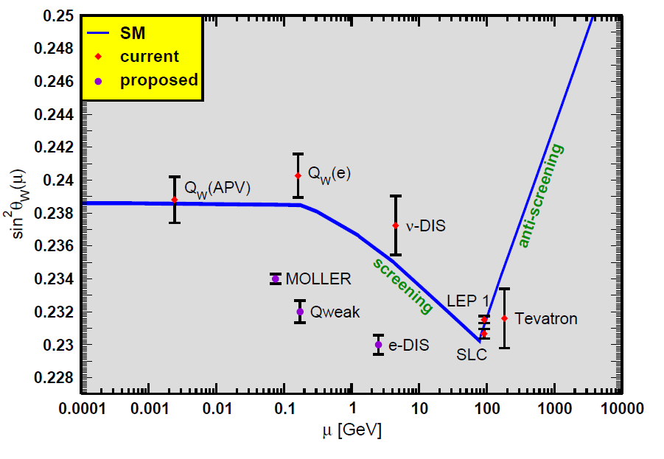
A Future Parity Violation Program at Jlab
Projected Results
JLab program
Will requires major new apparatus (Moller and SoLID)

Slide 20


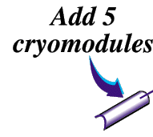




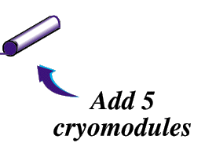
Add new hall
12
11
6 GeV CEBAF
Upgrade magnets and power supplies
CHL-2
Enhance equipment in existing halls
Notes:
INFO FOR ME, BUT DO NOT SAY UNLESS ASKED!!!!!
Cost range (from Mission Needs Statement) $170M-$250M
This includes $30-50 M that could come from redirection of the present JLab Ops budget, and
~$20M that might come from foreign contributors (if they match what they did for the original project)
About $47M of the total could come from a redirection of present operating funds over the duration of the project."

Slide 21
High-level Parameters
Now
Upgrade
ACCELERATOR:
Beam energy 6 GeV
Voltage of each linac 0.6 GV
Number of recirculations 5
Beam power (total program) 1 MW
Beam current (hybrid mesons) -
Emittance 1 nm-rad
Energy spread 0.01%
CRYOPLANT 4.5 kW
EXPERIMENTAL HALLS 3
12 GeV
1.1 GV
5 ½
1 MW
5 µA
7 nm-rad
0.02%
9 kW
4

Slide 22
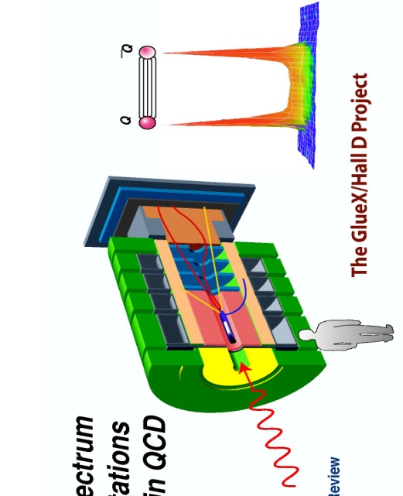
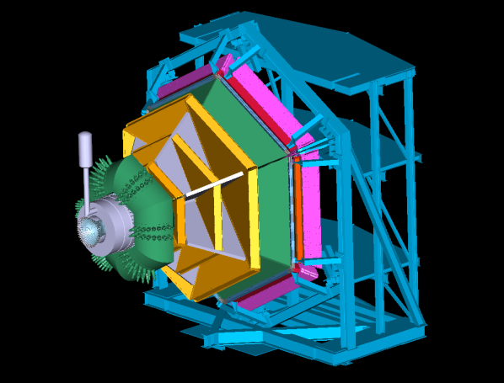
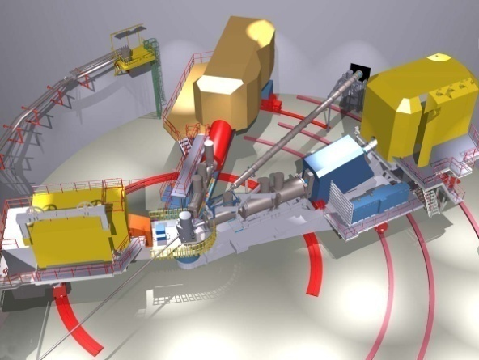

12 GeV Upgrade Physics Instrumentation
GLUEx (Hall D): exploring origin of confinement by studying hybrid mesons
CLAS12 (Hall B): understanding nucleon structure via generalized parton distributions
SHMS (Hall C): precision determination of
valence quark properties in nucleons and nuclei
Hall A: short range correlations, form factors, hypernuclear physics, & future new experiments
such as SoLID and Moller
Notes:
Note BSM not included in project

Slide 23
Ancillary Apparatus – Active User Community
Hall A DVCS (France - Orsay) near-complete
Hall A SBS GEMs (Italy – INFN) ongoing
Hall A Moller – pre-R&D (engineering concept, with MIT) ongoing
Hall A SOLID (China) ongoing
Hall B longitudinally polarized target (NSF) ongoing
Hall B forward tagger (Italy INFN & NSF) ongoing
Hall B RICH sector(s) (Italy INFN) ongoing
Hall B Micromegas (France Saclay) ongoing
Hall B Central Neutron Detector (France Orsay) near-complete
Hall B Heavy Photon Search (HPS) (DOE HEP) MIE review
Hall B H Gas Target for Proton Charge Radius (NSF) ongoing
Hall C Kaon Detection System (NSF) near-complete
Hall C Backward nucleon detection system (Israel Tel Aviv) ongoing
Hall C neutral-particle spectrometer planning
Hall D PID systems (US) planning
Hall D Discussions with China on calorimeter upgrades planning

Slide 24
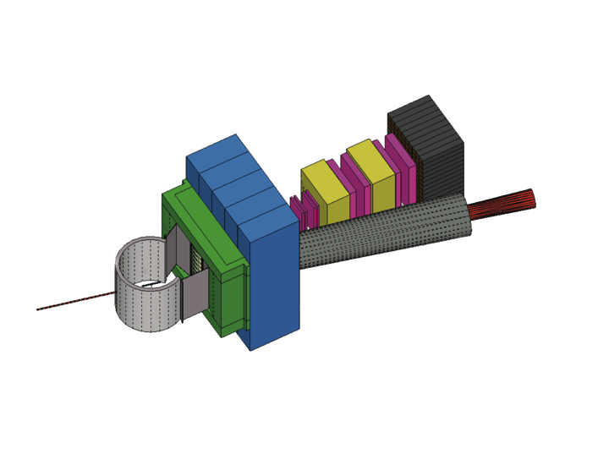
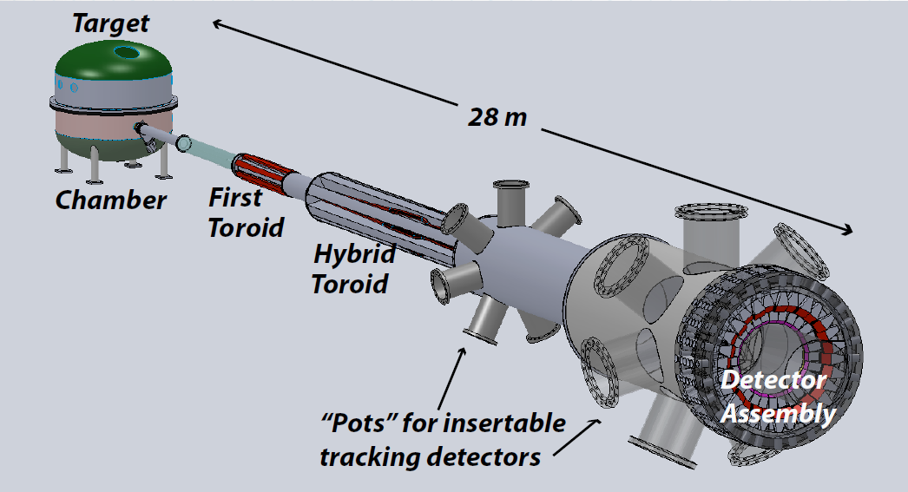

With Major Additional Equpiment Planned Beyond the Formal 12 GeV Upgrade Project
Super BigBite Spectrometer
(Now under construction)
- high Q² form factors
- SIDIS
MOLLER experiment
(MIE – FY14-18?)
- Standard Model Test
SoLID
Chinese collaboration
CLEO Solenoid?

Slide 25
CEBAF @ 6 GeV
Arc
CHL
Linac
Linac
Arc
3 End Stations
A B C

Slide 26
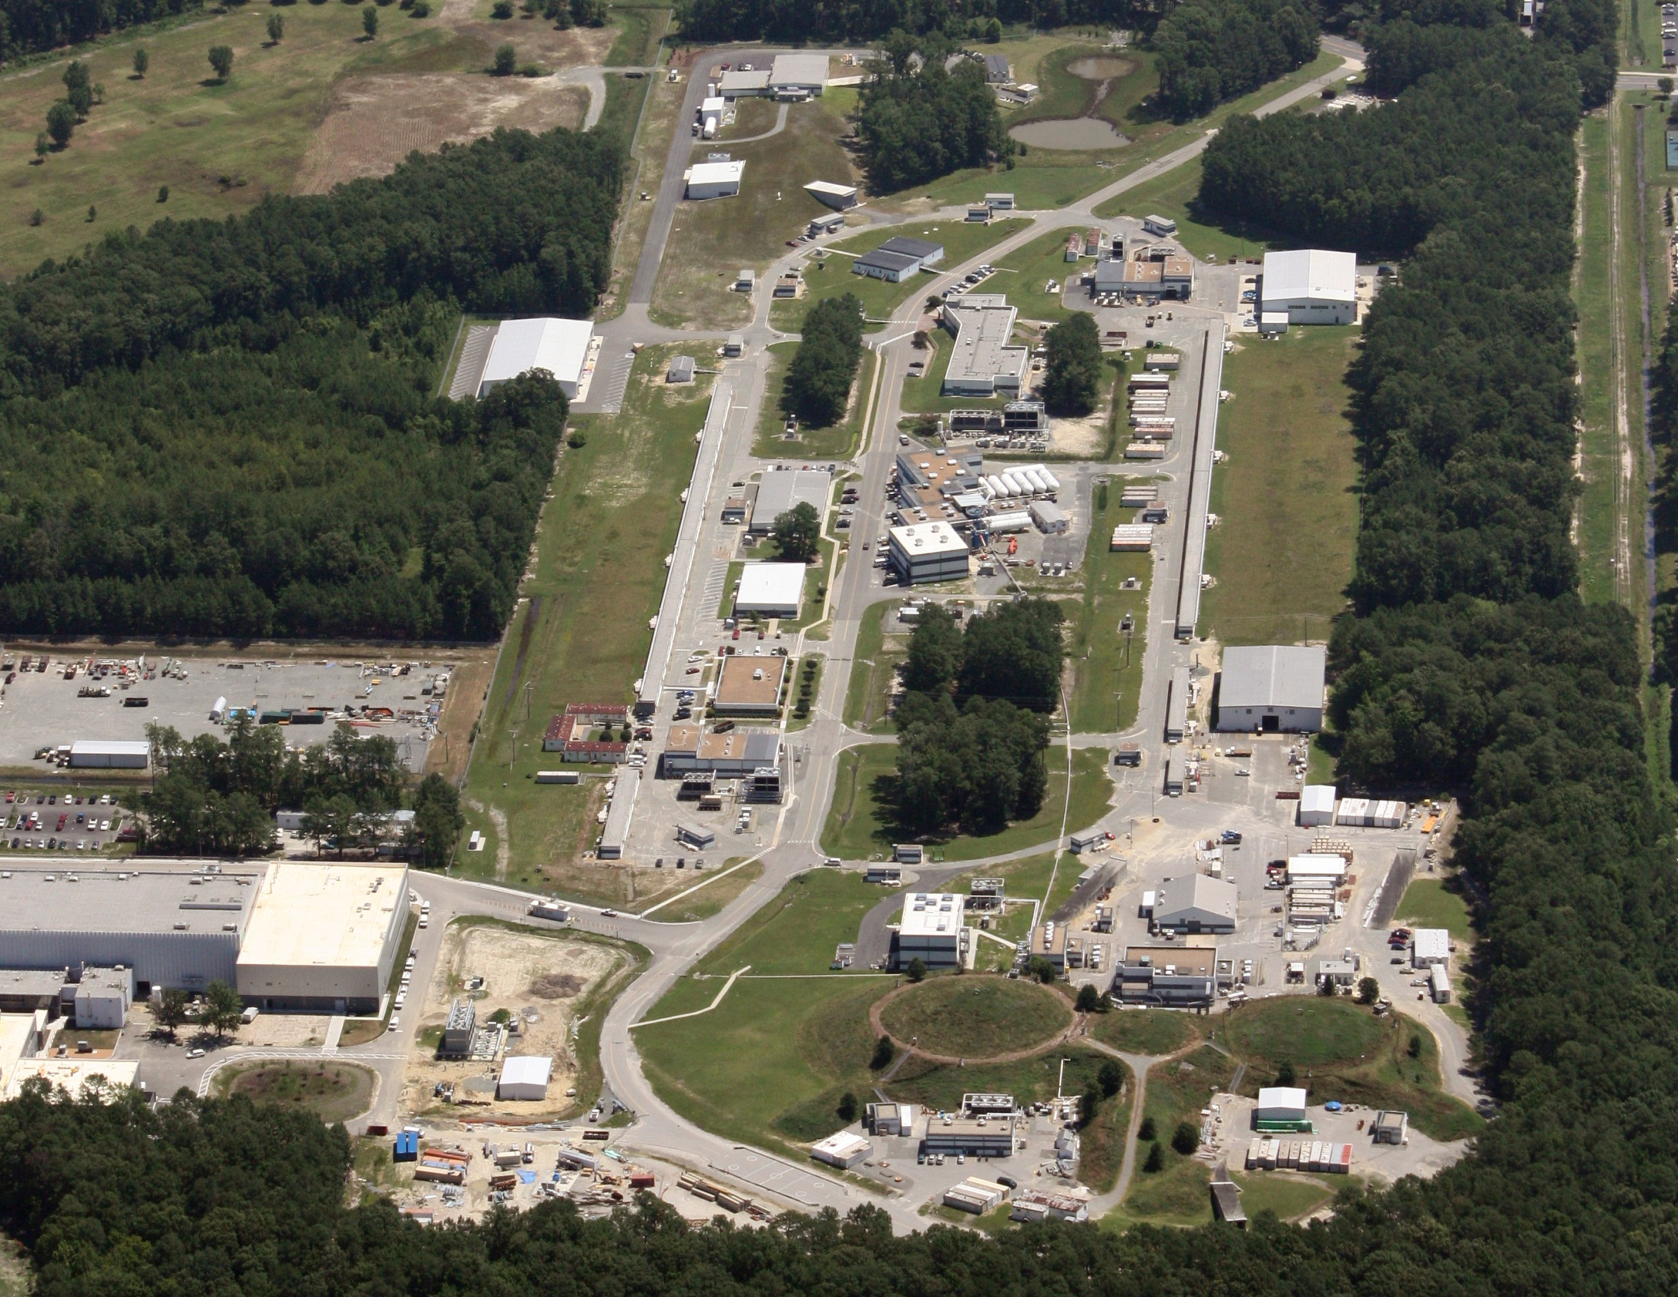
CEBAF Today
Hall D
Arc
Linac
Linac
CHL
X2
TEDF
Arc
A B C
End Stations

Slide 27
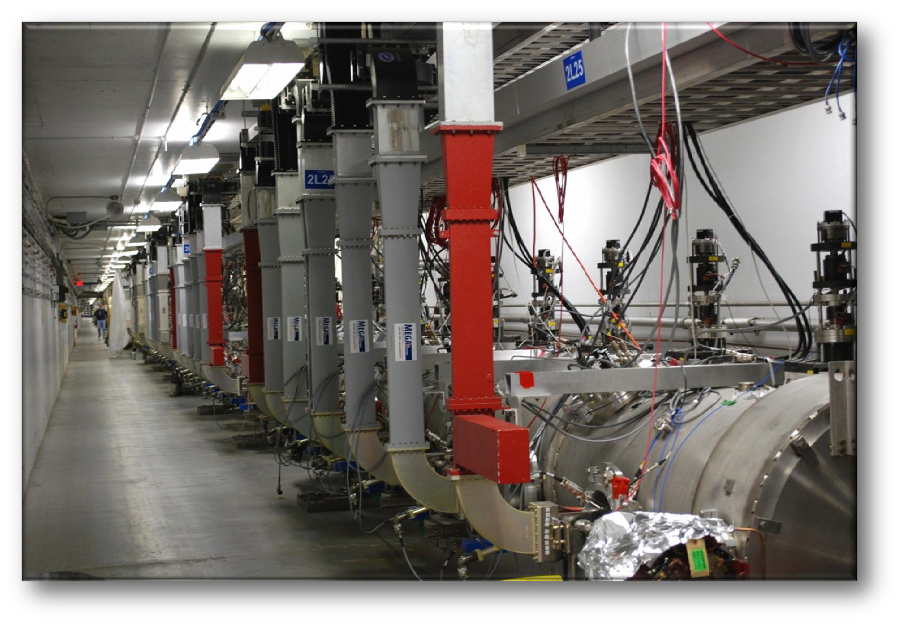
12 GeV Upgrade New Cryomodules

Slide 28
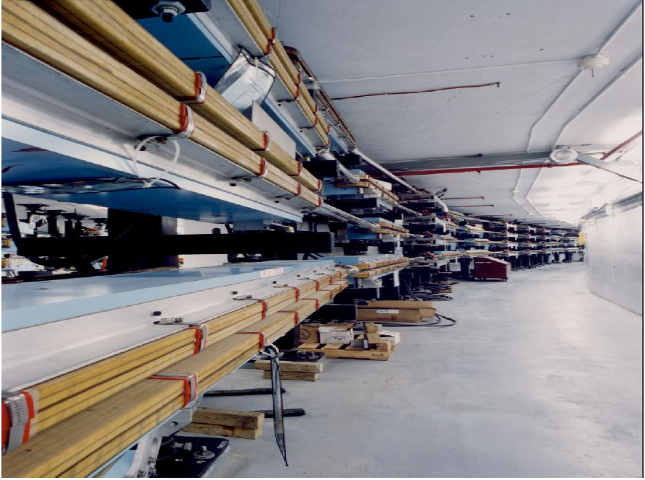
Beam Transport: 6 GeV Arc w/ “C” Dipoles

Slide 29
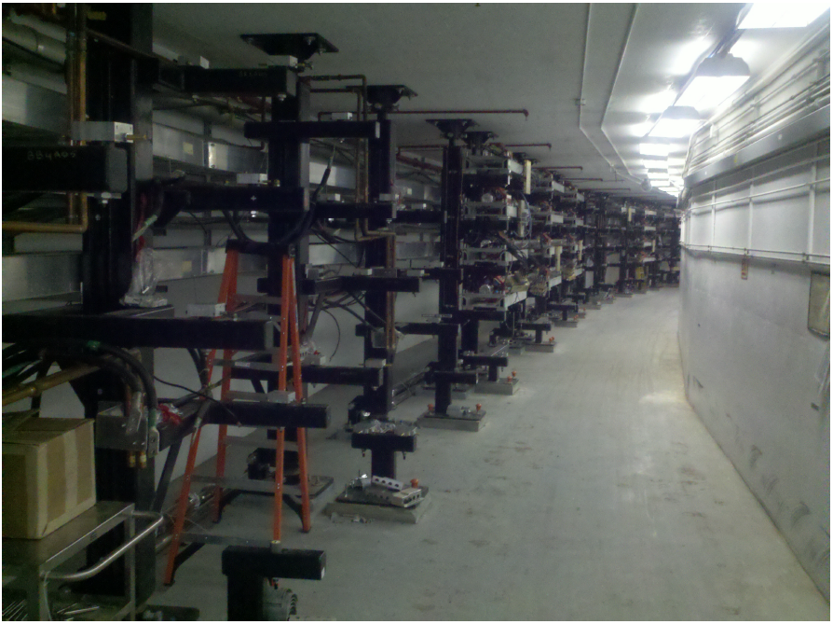
West Arc July 2011: Dipoles ALL removed

Slide 30
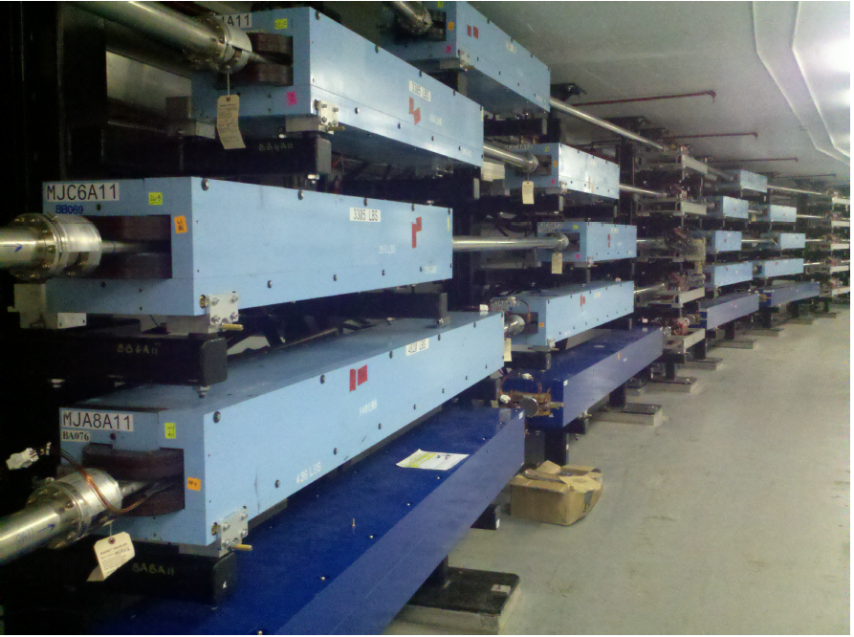
West Arc Today: All Dipoles Converted
Arcs Demonstrated to be Operational
During last 6 Months of CEBAF Ops at 6 GeV

Slide 31
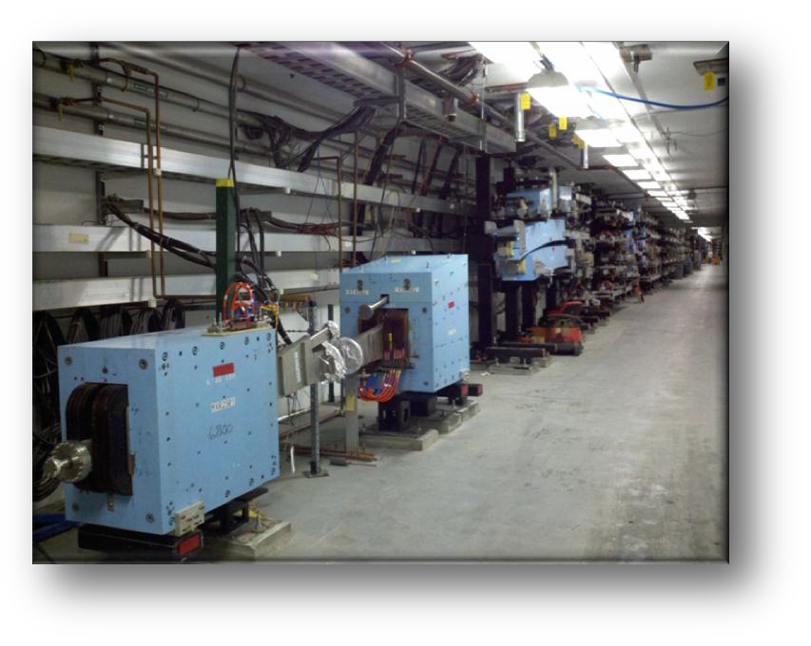
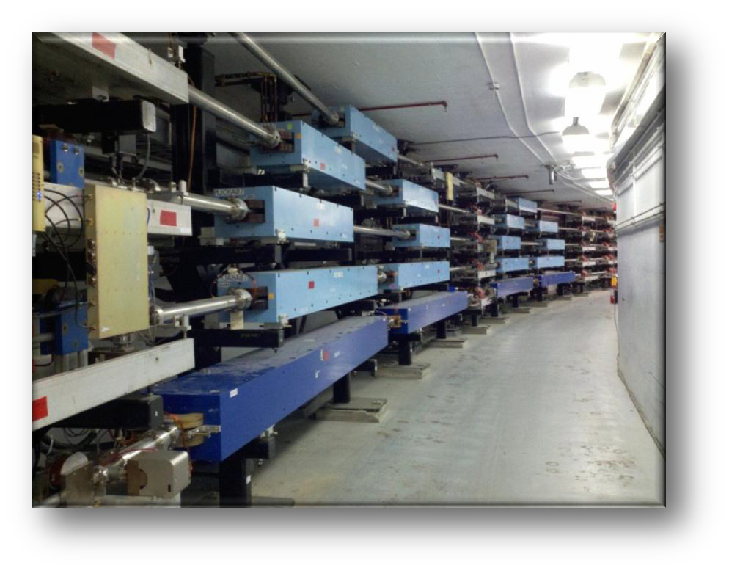
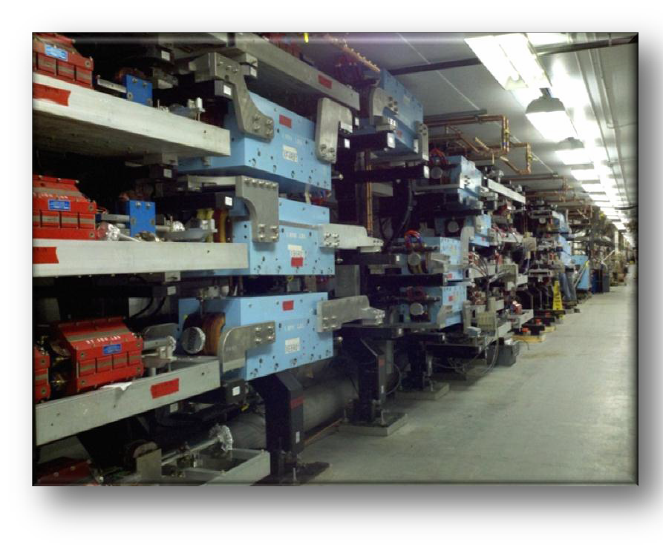
12 GeV Upgrade Accelerator

Slide 32
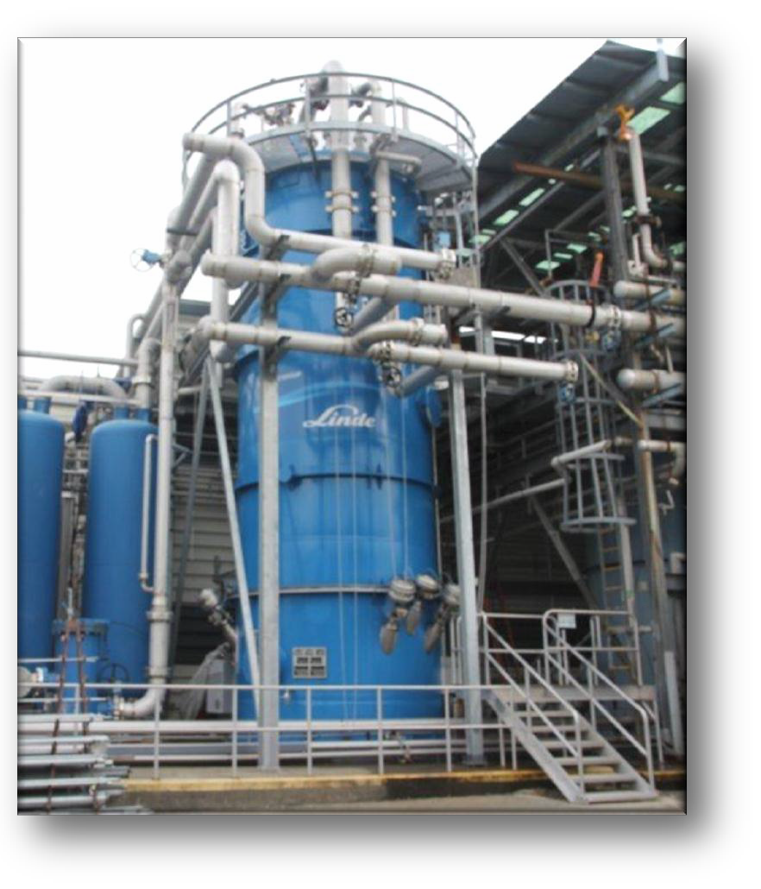
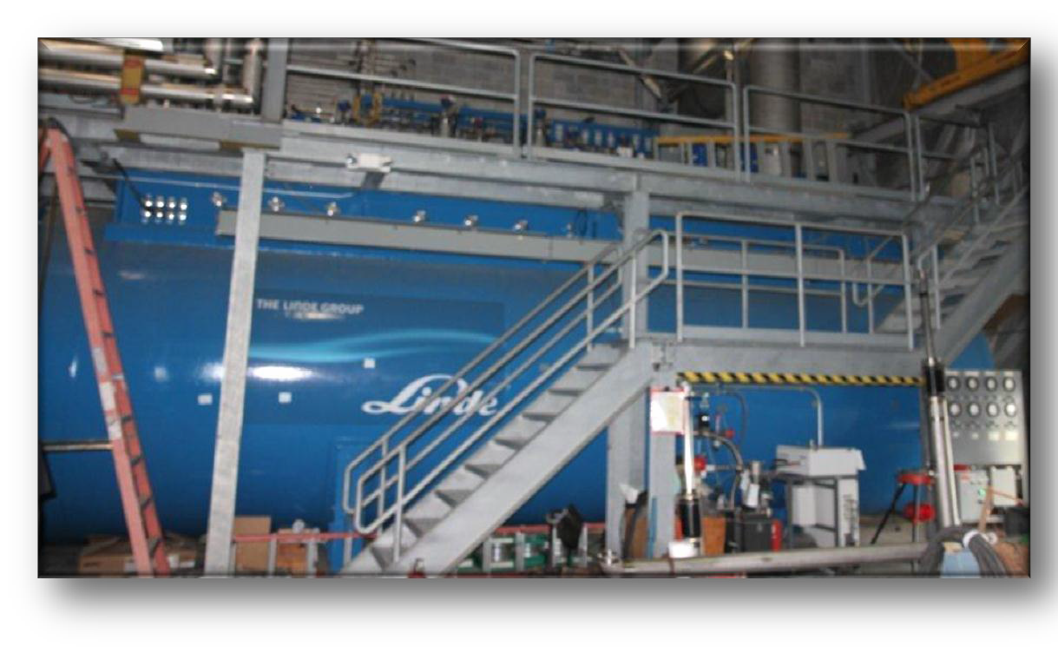
12 GeV Upgrade CHL Components

Slide 33
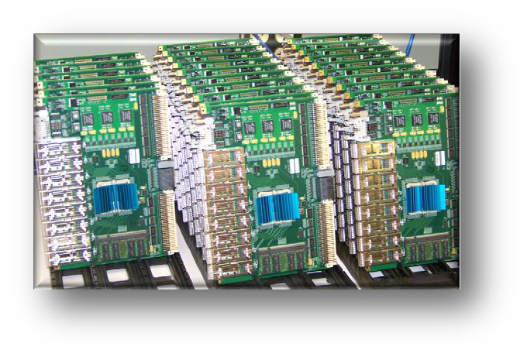
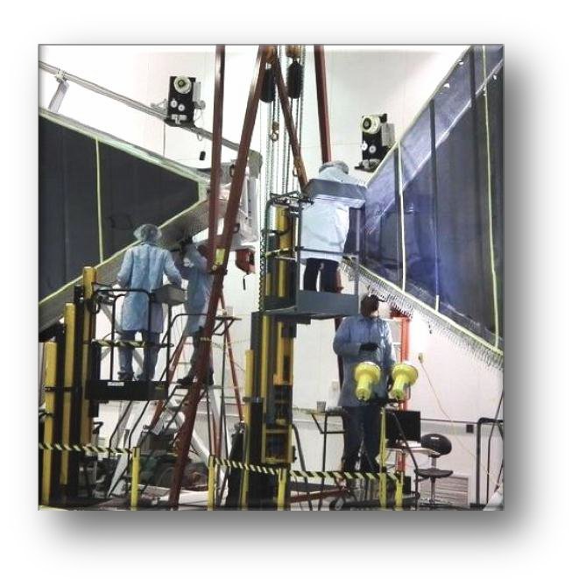
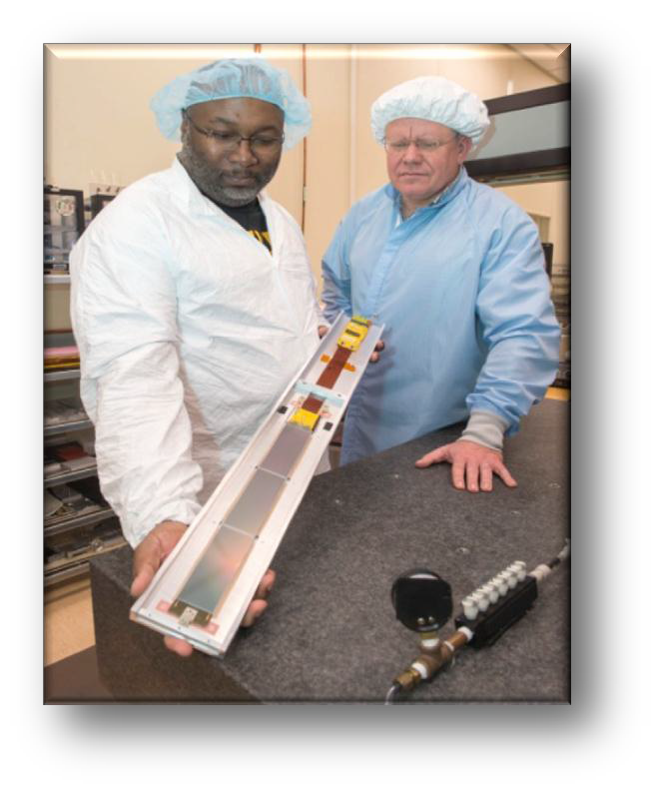
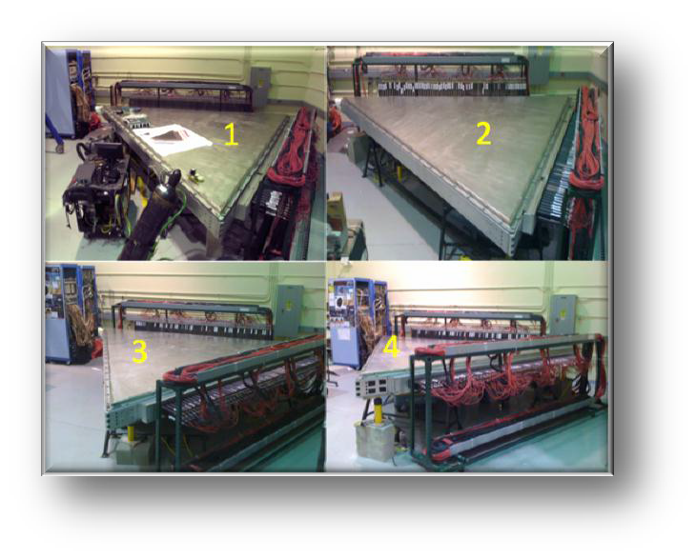
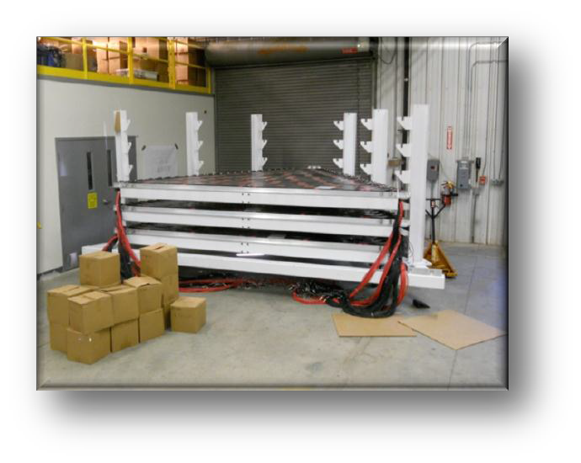
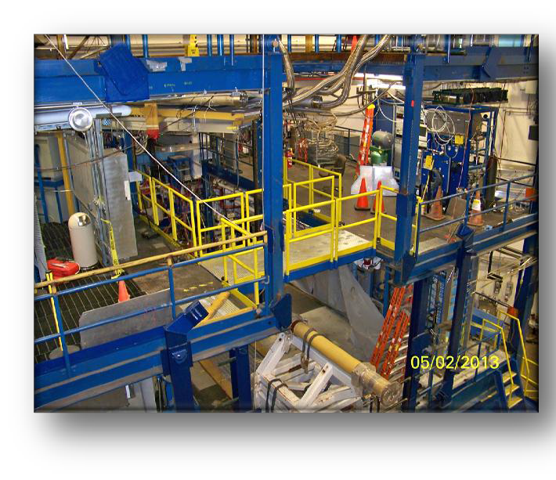
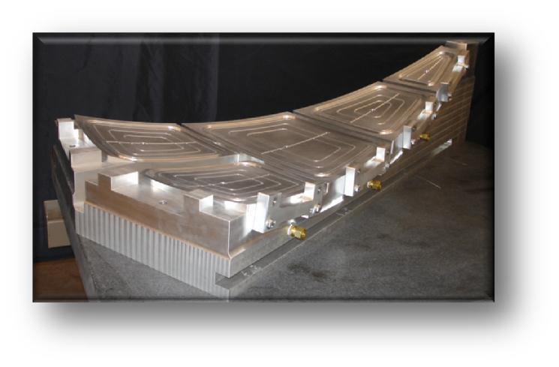
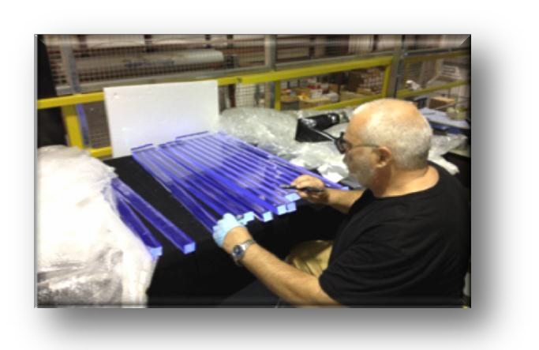
12 GeV Upgrade Hall B
Sub-System Processor SSP
R3 DC – Two crew stringing
PCAL - cosmic ray testing
SVT – First pre-production module at FNAL
FTOF – Testing refurbished CLAS detectors
HTCC - tooling for mirror assembly
Space Frame
CTOF–Testing the fast scintillators

Slide 34
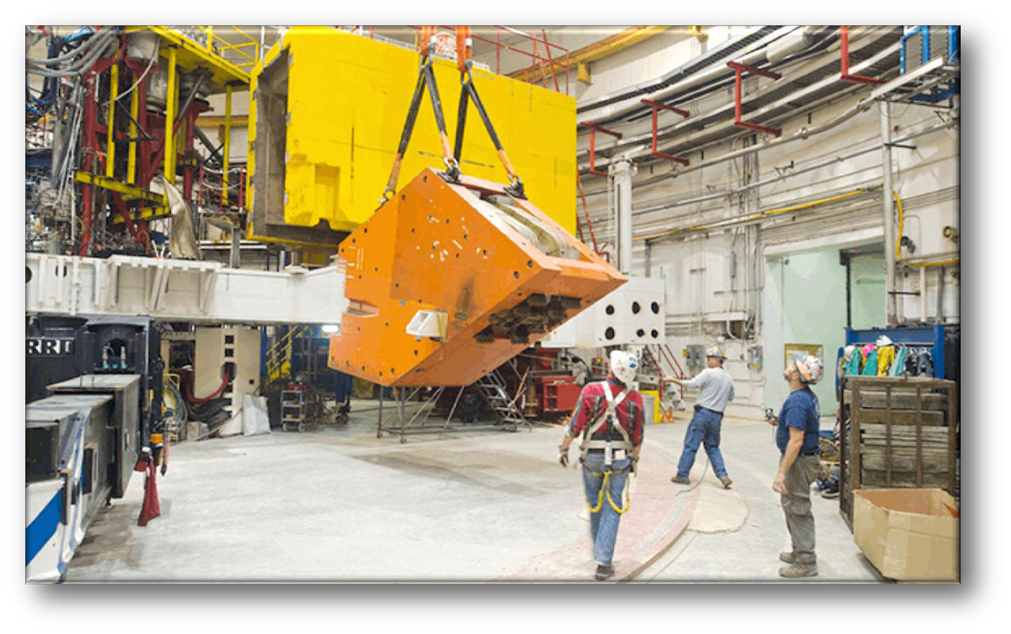




12 GeV Upgrade Hall C

Slide 35




12 GeV Upgrade Hall D

Slide 36









12 GeV Project Status
Hall D & Counting House
Hall D Interior Hall D Drift Chamber
SC Magnet Conductor Press
Hall C Dipole Magnet Coil
Installation in all 4 Halls has begun
Challenges with superconducting magnets for experiments
  All 7 magnets under contract
  Schedule delay a concern for two contracts
  Hall D solenoid cool-down is underway
DOE Obligated (%)
100
80
60
Upgrade Project 73% Complete, 85% Obligated
Accelerator commissioning begins October 2013
Beam to Hall A in 2nd Quarter of FY14
Beam to Hall D in 1st Quarter of FY15
40
20
0

Slide 37

12 GeV Upgrade Project Schedule
FY12: reduction of $16M
FY13: Pres Request – no restoration
    Present expectation (subject to rebaseline approval in August):
    16-month installation
    May 2012 - Sept 2013
    Accelerator commissioning start Oct 2013
    Hall A commissioning start Feb 2014
    Hall D commissioning start
    Oct 2014
    Halls B & C commissioning start Jan/Feb 2016
    Project Completion March 2017
Information based on
DOE Project Review
May 7-9, 2013

Slide 38
Summary and Perspectives
CEBAF@JLab is fulfilling its scientific mission:
  To understand how hadrons are constructed from the quarks and gluons of QCD
  To understand the QCD basis for the nucleon-nucleon force
  To explore the limits of our understanding of nuclear structure
    high precision
    short distances
    the transition from the nucleon-meson to the QCD description
The 12 GeV Upgrade will greatly enhance the scientific “reach” of the facility, supporting an exciting program of fundamental research
Construction is progressing very well, with accelerator commissioning to start this October, and commissioning of Halls A, D, and B&C to start Feb 2014, Oct 2014 and
Jan/Feb 2016, respectively
Join us……!!!!

Slide 40


Preliminary Plans for
First Years of Beam in Hall A
3 A-rated experiments in first years of running
G_{M}^{p} (HRS-R) and DVCS (HRS-L + calo) run is combined
Some flexibility incorporated
16 mo. Shutdown
12 GeV Commissioning
Early Experiments
G_{M}^{p} and DVCS-I
³H/³He PREX (A1n, APEX)
EM Form Factor
Access to GPDs
d/u at High x
Neutron skin
Neutron spin structure
12 GeV Projects: 1. Moller polarimeter
2. Compton polarimeter
3. Energy Meas. upgrade
SBS Experiments
EM Form Factors
at high Q²
SBS Project
SuperBigbite
11 GeV
Beam 1st to Hall A
FY 2013
FY 2014
FY 2015
FY 2016
FY 2017

Slide 41

Preliminary Plans for
First Years of Beam in Hall B
6 A rated experiments in first 3 years of running
PCR, HPS, pDVCS, nDVCS, pSIDIS, g₁^{p}/g₁^{n}
High discovery potential during first year
CLAS12
Construction
Installation
Early 11 GeV Experiments
< 6 GeV beam
pDVCS
& GPDs
pSIDIS &
TMDs
nDVCS
& GPDs
nSIDIS
& TMDs
g₁^{p} , g₁^{n}
large x
spin str.
Proton TMDs Transverse spin structure
Installation
Proton
Charge Radius
Dark
Photon
Search
1st beam to Hall B
First 11 GeV
FY 2014
FY 2015
FY 2016
FY 2017
FY 2018

Slide 42


Preliminary Plans for
First Years of Beam in Hall C
Straightforward “commissioning experiments”
Basic SIDIS and easiest L/T separation
Base equipment in early years
SHMS Installation
12 GeV Commissioning
Early Experiments
p, d,A(e,e’), A(e,e’p), d(e,e’p)
d2n, A1n
High x nucleon structure
Short Range nuclear structure
Neutron Spin Structure
Pt, CSV, (e,e’K)
Polarized ³He Experiments
First 11 GeV Beam
Basic SIDIS
Charge Symm. Violation
Deep Exclusive Kaon Prod.
FY 2015
FY 2016
FY 2017
FY 2018
FY 2018

Slide 43

Preliminary Plans for
First Years of Beam in Hall D
Search for Gluonic Excitations (GlueX)
η, η’ couplings, rare decays using Primakoff reaction
12 GeV Commissioning
Primakoff
η→γγ
GlueX
Hardware
Polarized Beam
10⁷γ/s
Light quark mass ratio
η and η’ mixing angle
E = 12 GeV
polarized
10⁸γ/s preparations
E < 12 GeV
unpolarized
FY 2014
FY 2015
FY 2016
FY 2017

