Slide 1

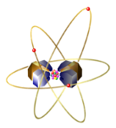
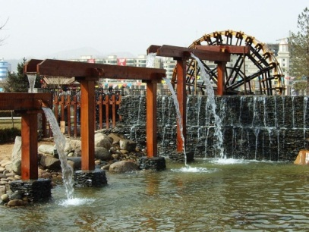
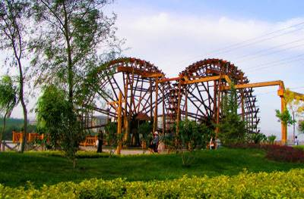
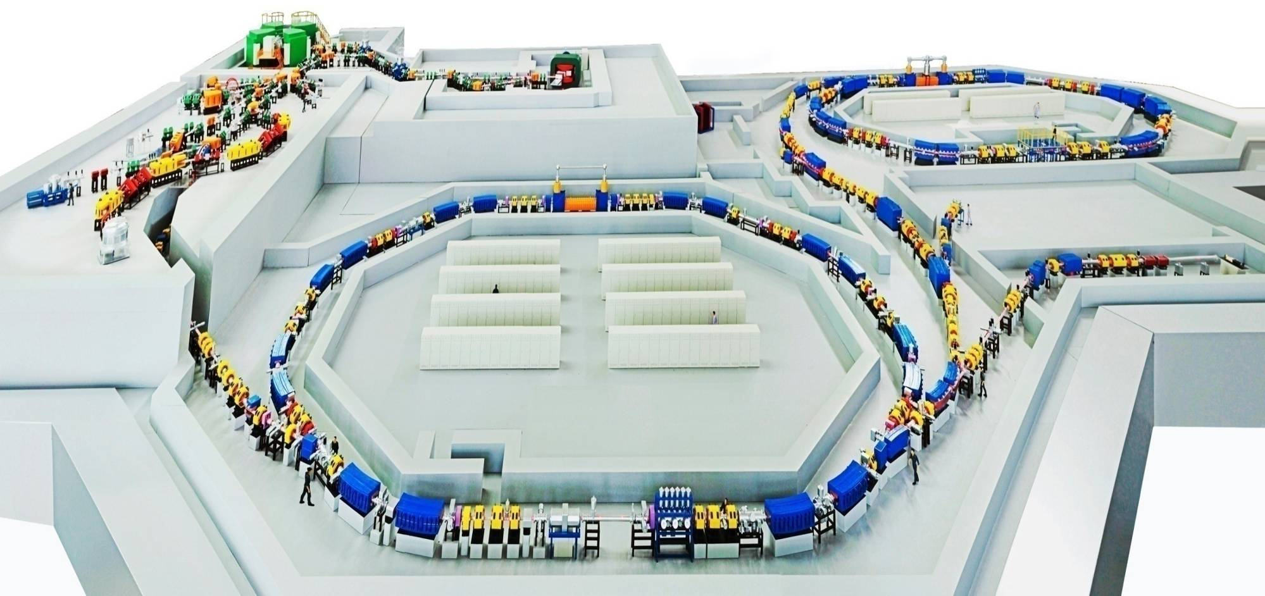
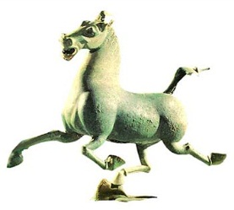



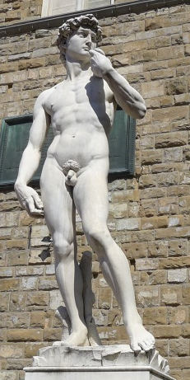

The Status of RIB Facilities at IMP and
Future-Project HIAF
International Nuclear Physics Conference 2013
Institute of Modern Physics
Chinese Academy of Sciences
Guoqing XIAO

Slide 2
Outline
RIB facilities at IMP
Upgrade of HIRFL
New project HIAF
Summary

Slide 3
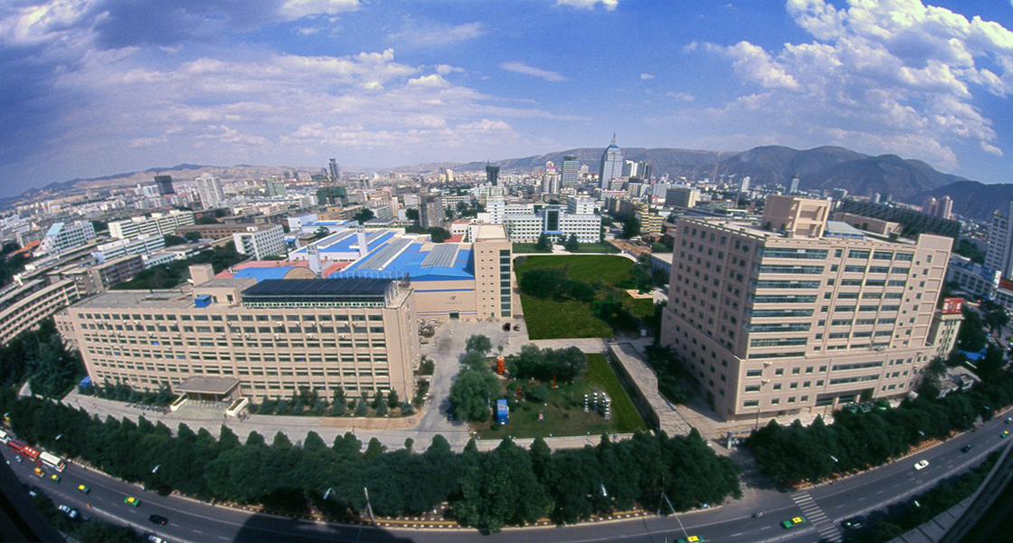
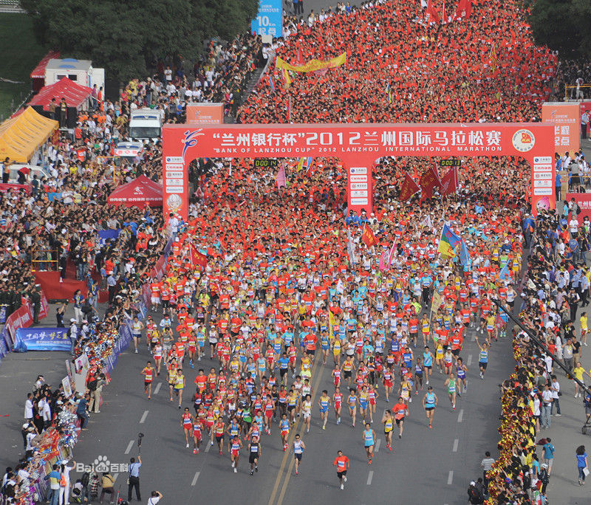

A bird view of IMP
One big accelerator system situated in the city center due to the history reason

Slide 4
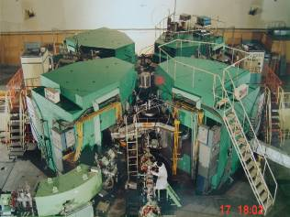
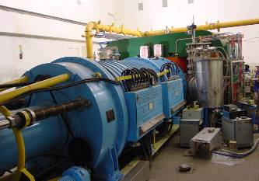
Existing Facility: HIRFL-CSR
National Laboratory of Heavy Ion Accelerator in Lanzhou
SSC (K=450)
100 AMeV (H.I.), 110 MeV (p)
SFC (K=69)
10 AMeV (H.I.), 17~35 MeV (p)
CSRe
RIBLL1
RIBs at tens of AMeV
RIBLL2
RIBs at hundreds of AMeV
CSR(Cooling Storage Ring)
CSRm
1000 AMeV (H.I.), ≤ 2.8 GeV (p)
Heavy Ion Research Facility in Lanzhou (HIRFL)

Slide 5
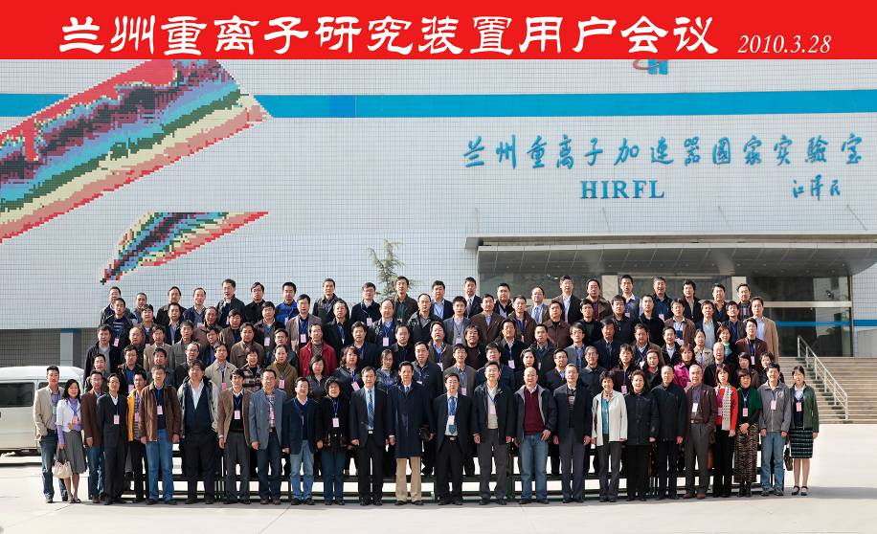
HIRFL: Beam Status
Typical beams in recent years
Beam time needed >14000hrs
Ion Beams | E (MeV/A) |  |  | Intensity (eµA)
 | SFC | SSC | CSR
H₂¹⁺ | 10.0 |  | 400 | 30
⁹Be³⁺ | 6.89 |  |  | 0.55
¹²C^{5+/6+} | 8.47 | 100 |  | 0.4
¹²C⁴⁺ | 7.0 |  |  | 12-15
¹²C⁴⁺ | 7.0 |  | 1000 | 3200
²⁶Mg^{8+/12+} | 6.17 | 70 |  | 0.35
³⁶Ar⁸⁺ | 2.0725 | 22 |  | 3.3
³⁶Ar⁸⁺ | 2.0725 | 22 | 368 | 650
²²Ne^{7+/10+} | 6.17 |  | 70 | 1700
⁴⁰Ca¹²⁺ | 5.625 |  |  | 3.5
⁵⁸Ni¹⁹⁺ | 6.3 |  | 463.36 | 500
⁷⁸Kr^{19+/28+} | 4.0 |  | 487 | 750
¹²⁹Xe²⁷⁺ | 3.0 |  | 235 | 500
¹²⁹Xe²⁷⁺ | 1.844 | 19.5 |  | 0.4
²⁰⁸Pb²⁷⁺ | 1.1 |  |  | 0.8-1.0
²⁰⁹Bi³¹⁺ | 0.911 | 9.5 |  | 0.05
²⁰⁹Bi³⁶⁺ | 2.0 |  | 170 | 60
²³⁸U²⁶⁺ | 0.81 |  |  | 0.33
²³⁸U³²⁺ | 1.22 |  | 100 | 160
Beam time distribution
Bio (8%)
Material (7%)
Space (12%)
Basicresearch (50%)
Medical (23%)
About 5000 hours of beam time per year, and 50% beam delivered by CSR

Slide 6
Scientific Activities at IMP
Fundamental researches on nuclear & atomic physics
  Reactions with exotic nuclei: elastic scattering, total cross-section, …
  Nuclear spectroscopy: mass measurement, γ-spectroscopy, β-delayed neutron(proton) emission, …
  Nuclear matter: properties of asymmetric nuclear matter
  Chemistry of super-heavy elements, and synthesis of new isotopes
  Key reactions in stellar evolution
  Spallation & nuclear data for ADS project
  High energy density physics
  Hadronic physics
  HCI interaction with laser, electron, molecule, and surface
Applications with heavy ions
  Material: nano-tech., nuclear energy structural material, …
  Radio-biology: tumor therapy, mutation breeding, …
Detector development
  Si detectors: Si(Au), Si(Li), Si-strip
  Scintillator detectors: CsI, LaBr, plastic sci., liquid sci. …
  Gaseous detectors: IC, TPC, PPAC, MWPC, MWDC, MicroMeGAS, GEM, …
Key technique development related to HI Accelerator and ADS
Highest Priorities
Mass measurement
key technique R&D related to ADS and HIAF
Tumor therapy & mutation breeding

Slide 7
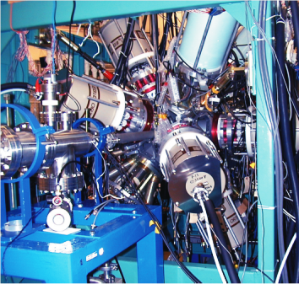
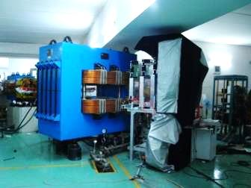
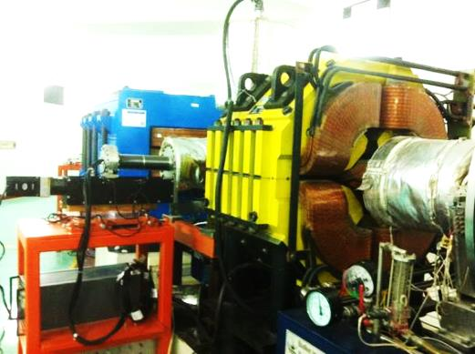
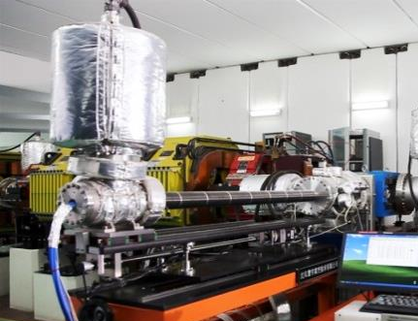
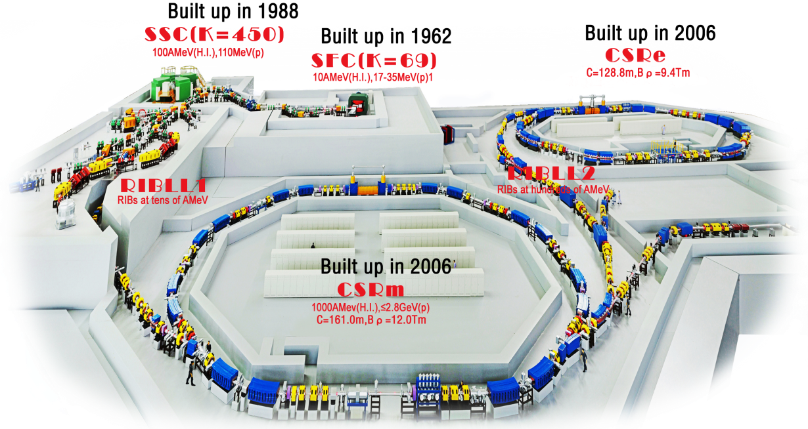
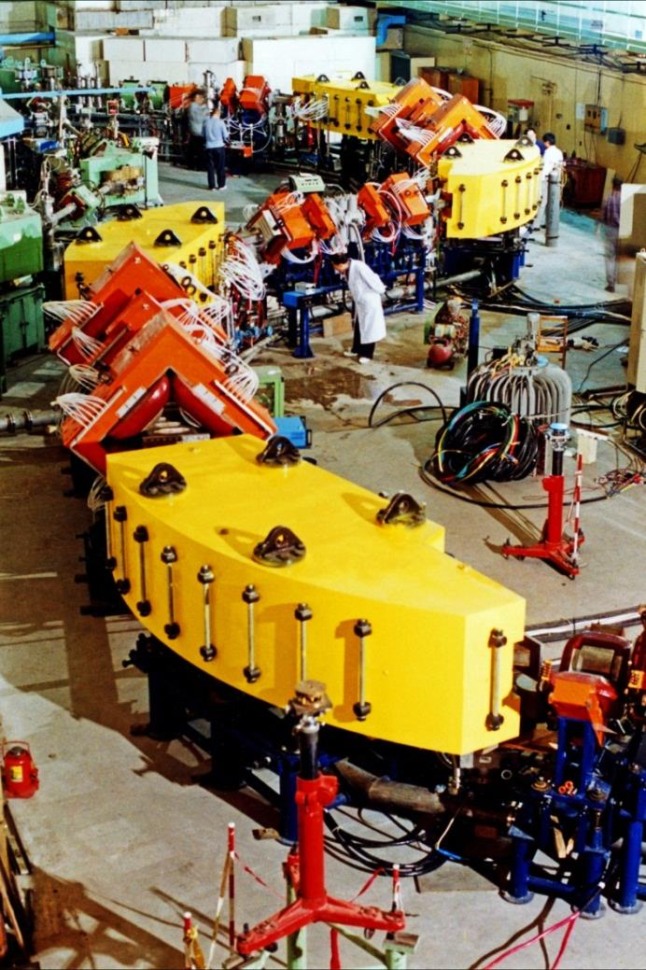
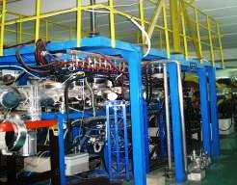
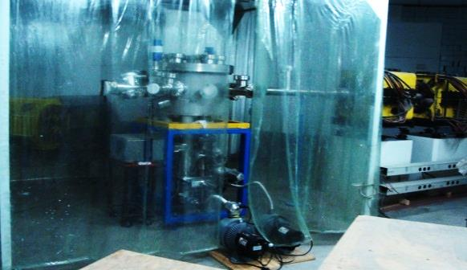
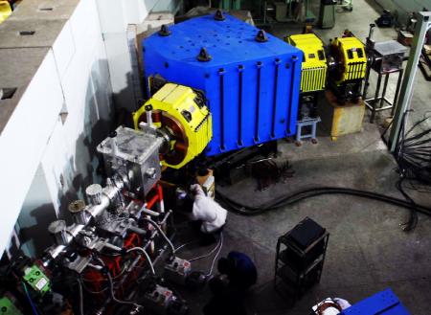
Facilities for Physics Research at IMP
On-line Experiment
for γ ray
External Target
Experiment @ CSRm
Experiment
for DR research
Exp. for Nuclear
mass measurement
Internal Target Exp.
for Atomic Physics
Radioactive Ion
Beam Line
Proton Induced
Spallation
Gas Filled Recoil
Separator

Slide 8
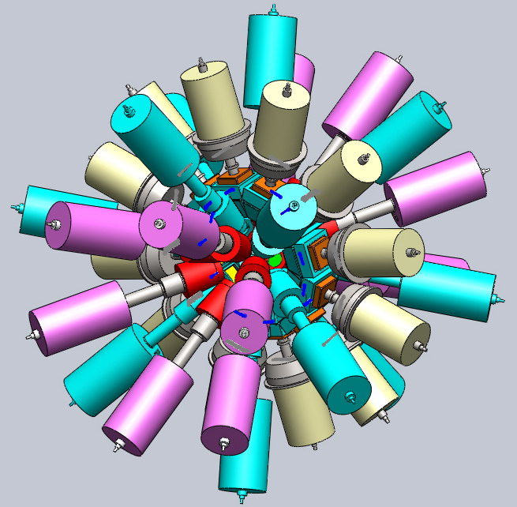
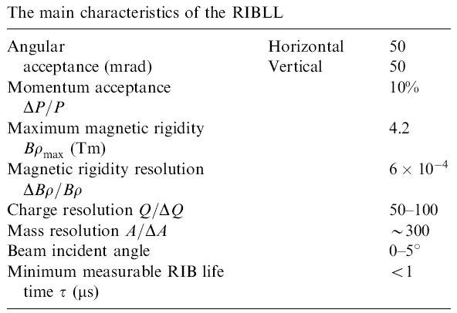
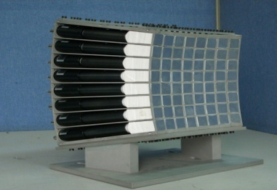
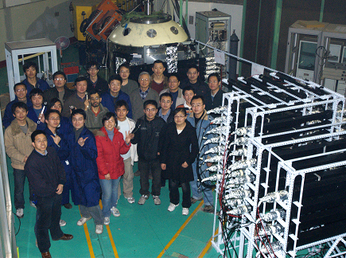
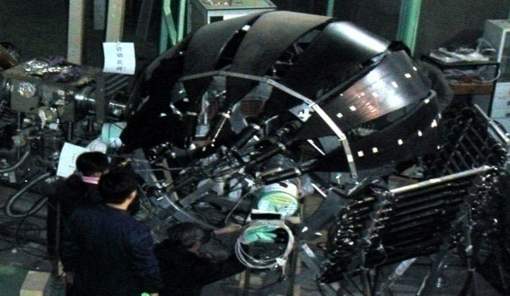
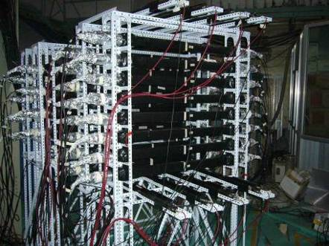
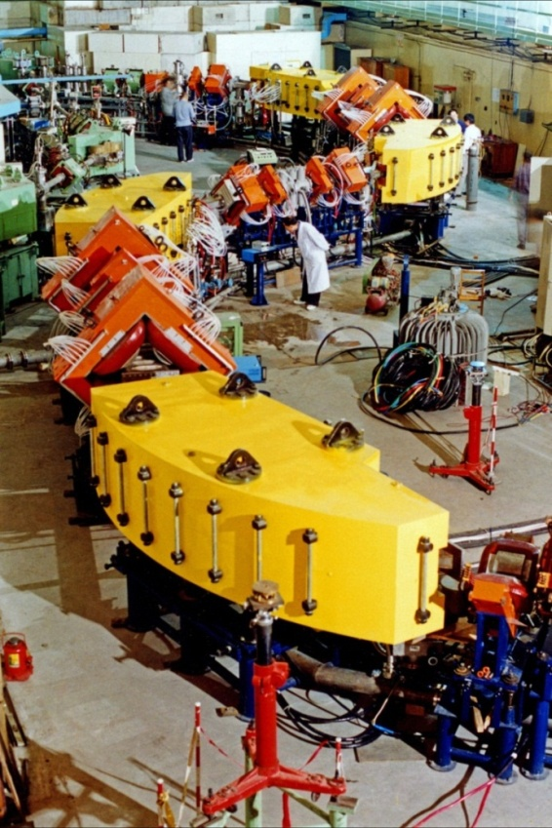
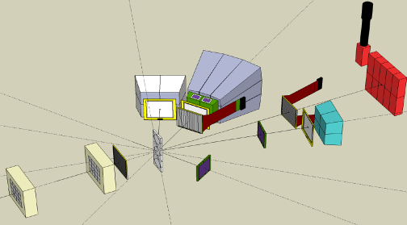
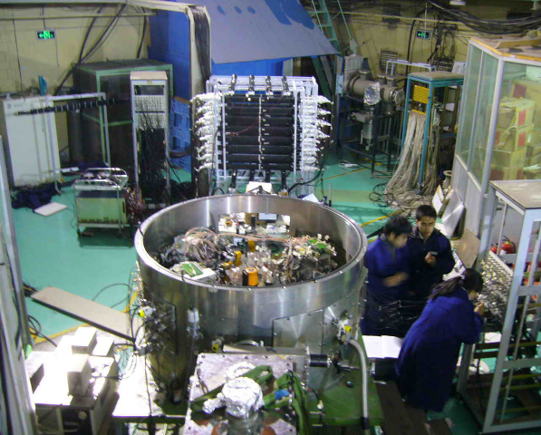
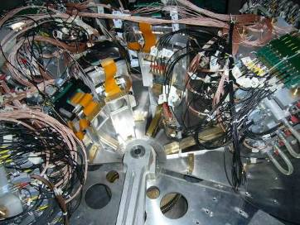
RIB Facilities at IMP
RIBLL1: 1st Radioactive Ion Beam Line in Lanzhou
Clover detector array
Established in 1997
RIBLL Collaboration:
IMP, PKU, CIAE, SINAP,NJU, MSU, GSI, GANIL, IPN, INFN, RIKEN, RCNP.

Slide 9
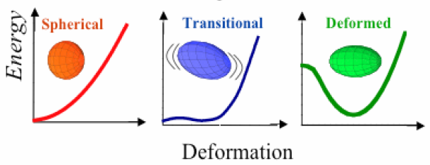
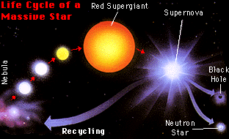
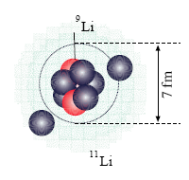
Nuclear Physics at IMP
Exploring the limits of nuclear stability
Nuclear structure and nuclear astro-physics
Precise mass measurements for short-lived nuclei
Synthesis of new isotopes near the proton-drip line
Structure and reaction mechanism with exotic beams
Properties of asym. nuclear matter at high density
Decay and chemical properties of super-heavy nuclei
Evolution of collective motion in complex nuclei
Explosive nuclear astro-physical phenomena

Slide 10
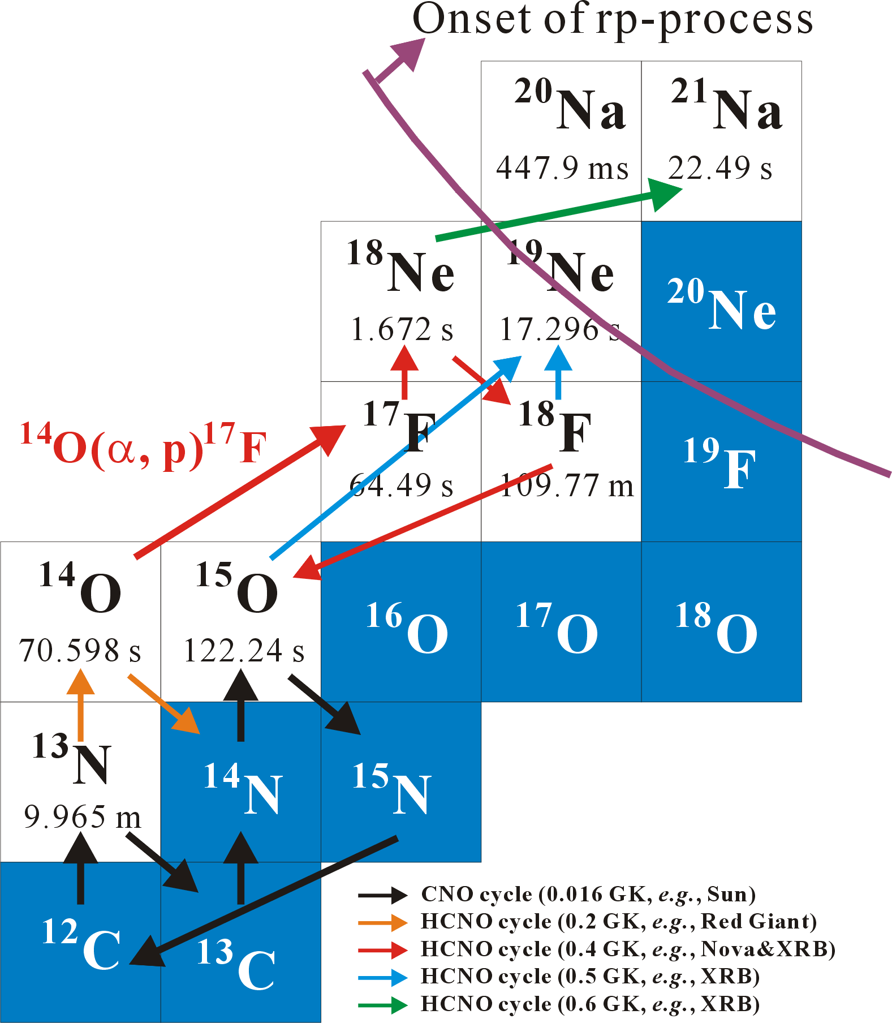
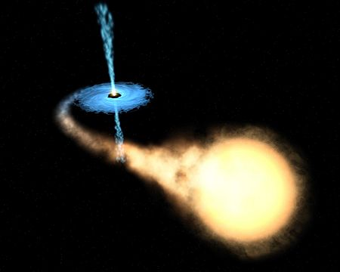
Motivation
Theoretical prediction：
¹⁴O(α,p)¹⁷F is, most probable, one of the breakout reaction (from HCNO cycle to rp-process) in x-ray bursters.
Present Status:
Its reaction rate hasn’t been
determined very well yet.
Neutron Star
Accretion Disk
Companion Star

Slide 11
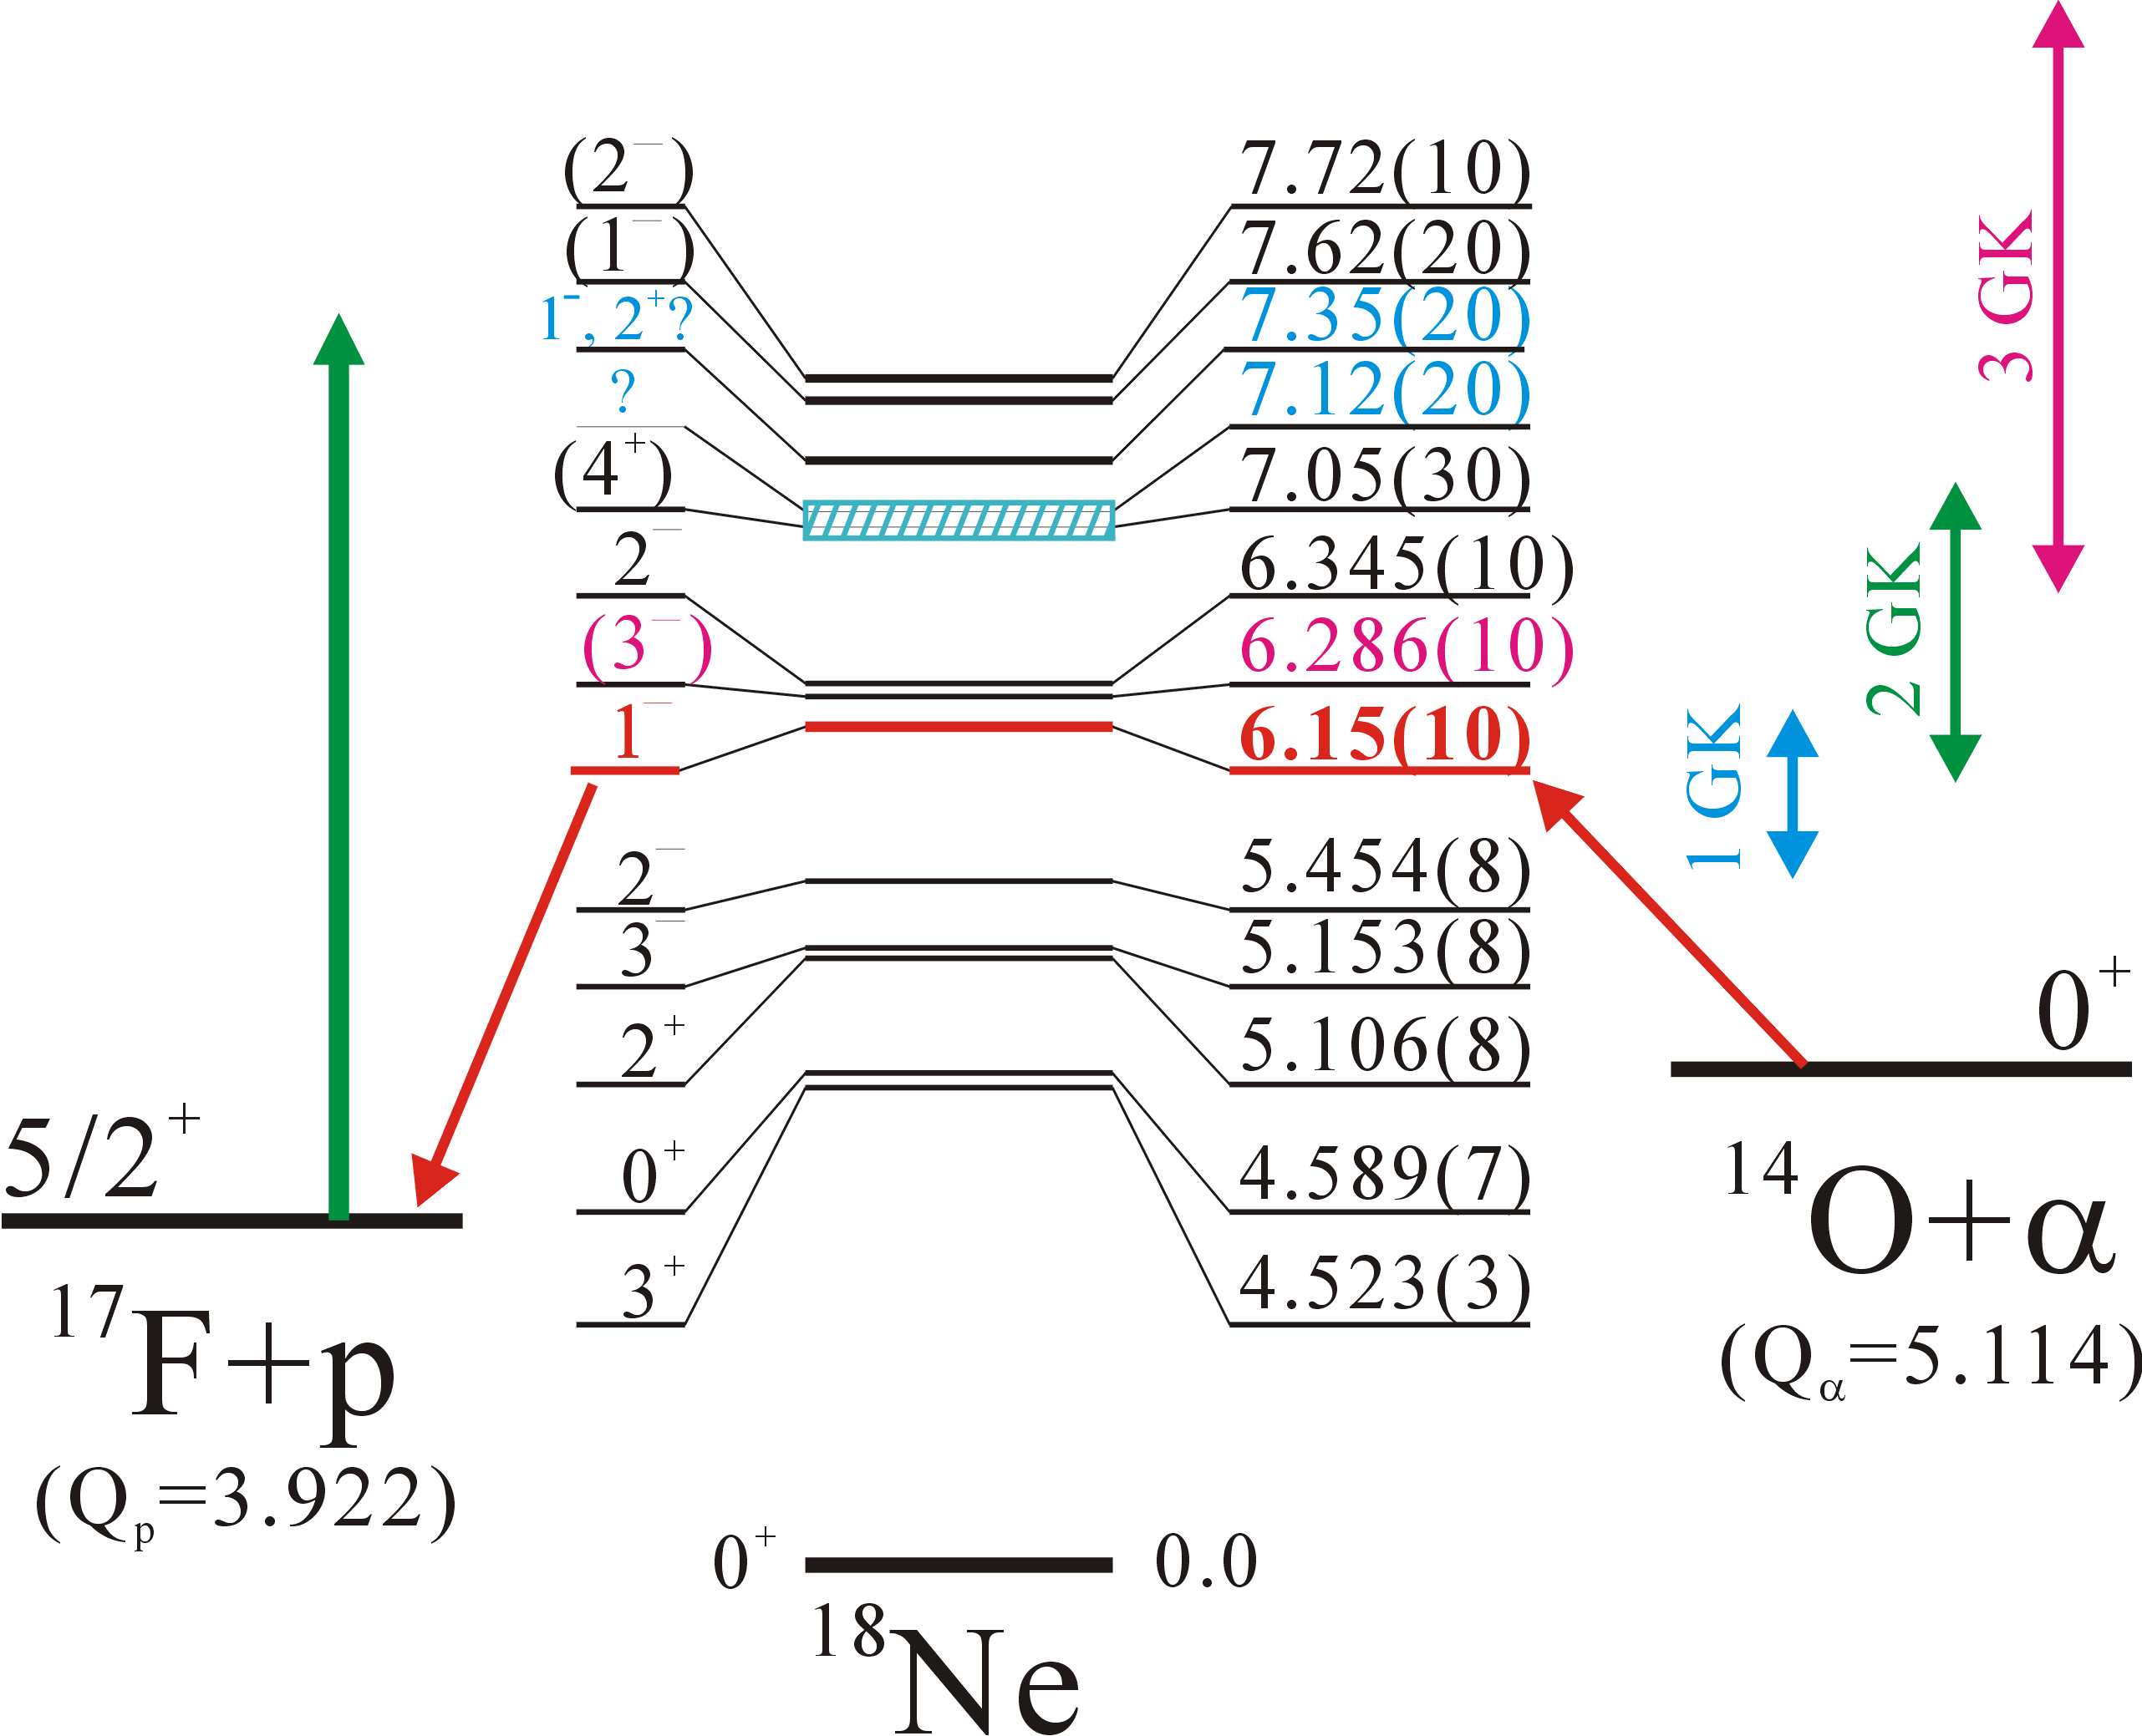
Experimental goal
To determine resonant
properties of unbound
states in ¹⁸Ne (E_{R}, J_{R}, Γ_{α})
To address astrophysical
implication of the
¹⁴O(α,p)¹⁷F reaction

Slide 12
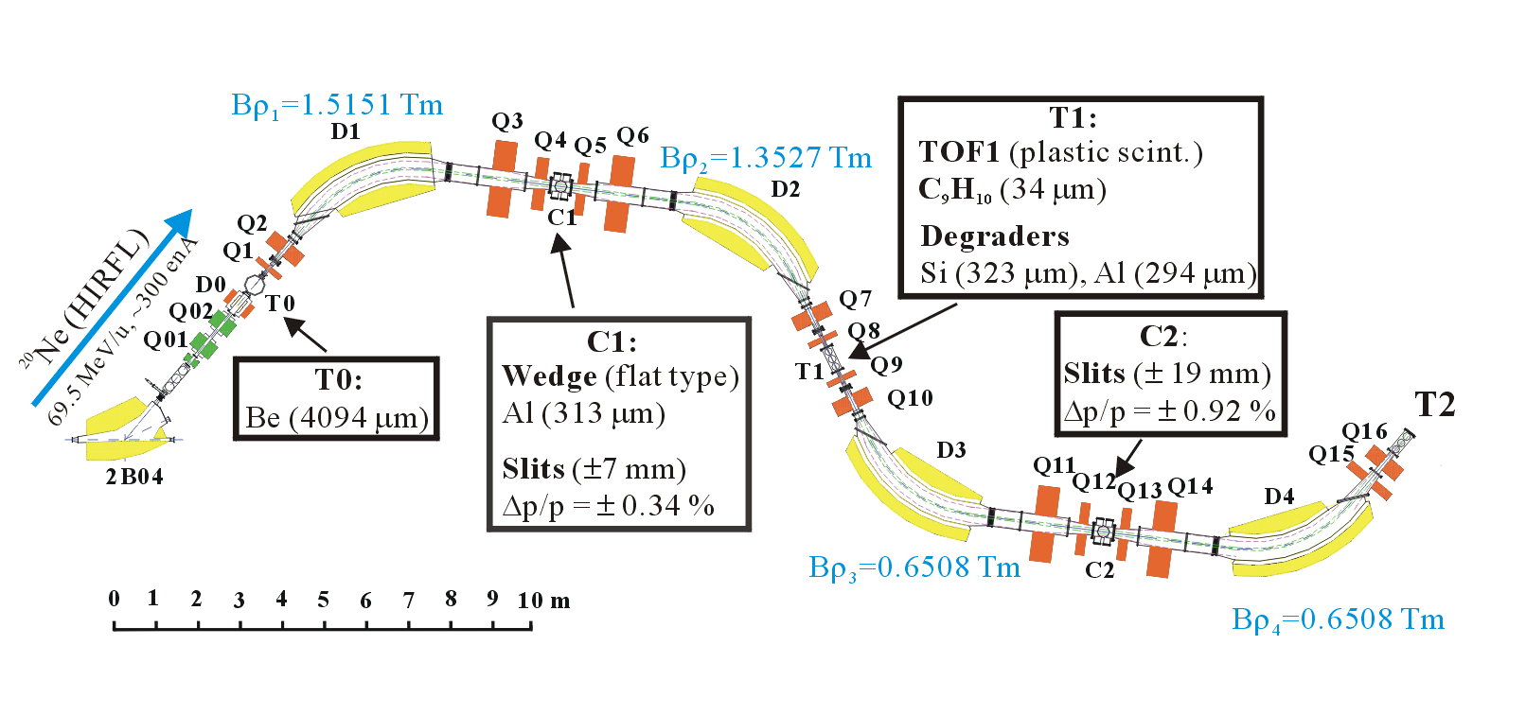
Experiment layout of RIBLL1
Beam condition:
  Primary：²⁰Ne(70 MeV/u, 200∼400 enA)
  Secondary：¹⁷F(@target:4.2 MeV/u, ∼1 kcps)
Collaborators: IMP, CIAE, SINAP, Peking U.

Slide 13
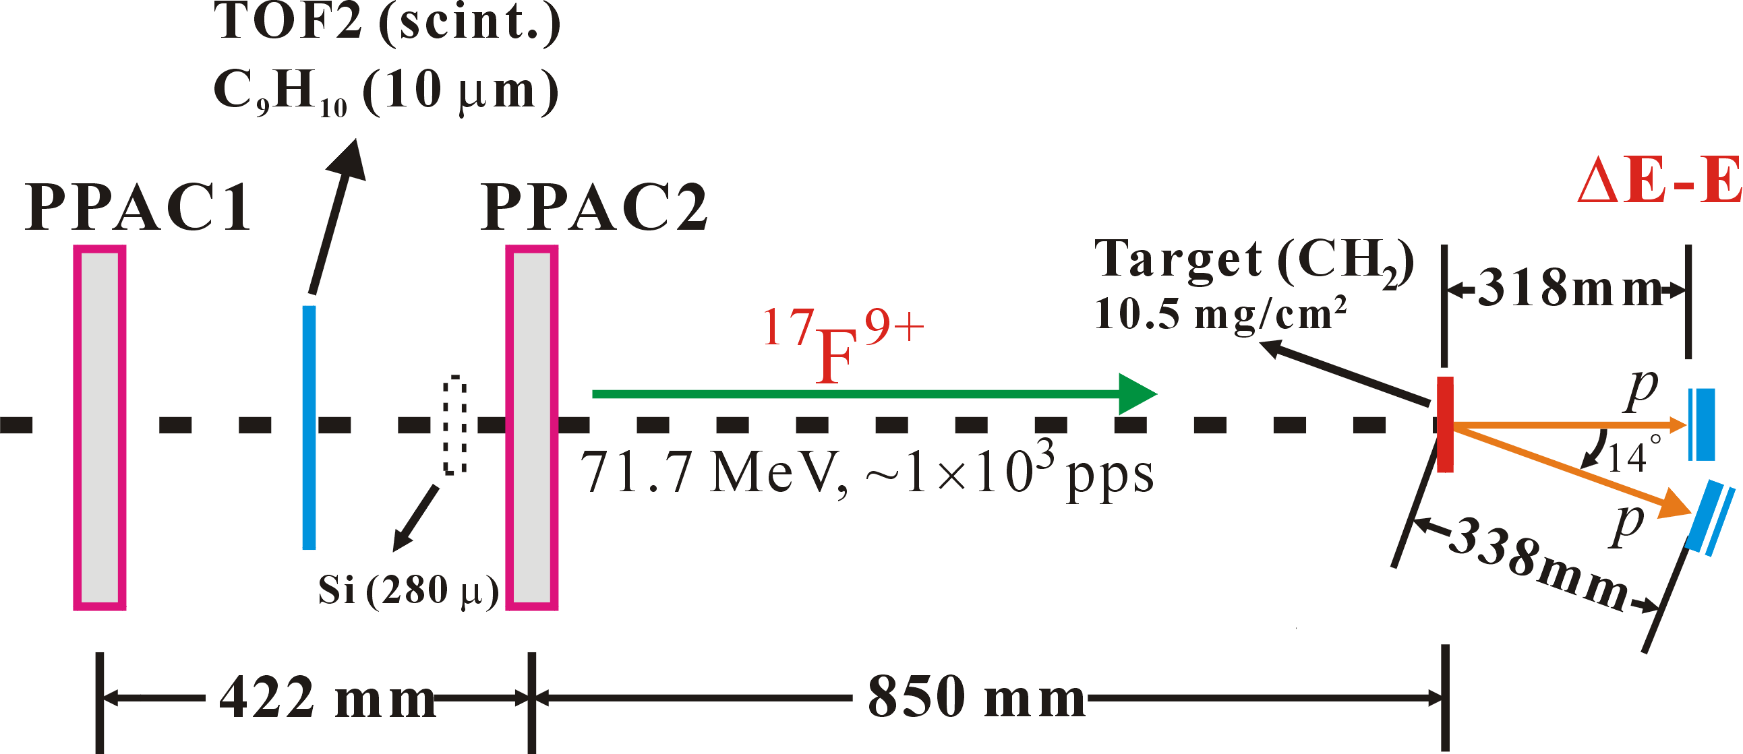
Measurement setup
Si Telescope 1 [@θ_{lab}≈0°, θ_{c.m.}≈175°, ΔΩ_{lab}= 25 msr]
ΔE1: 68 μ, 16×16 strips, E1: 1500 μ
Si Telescope 2 [@θ_{lab}≈14°, θ_{c.m.}≈152°, ΔΩ_{lab}= 22 msr]
ΔE2: 300 μ, E2: 1000 μ, 16×16 strips

Slide 14
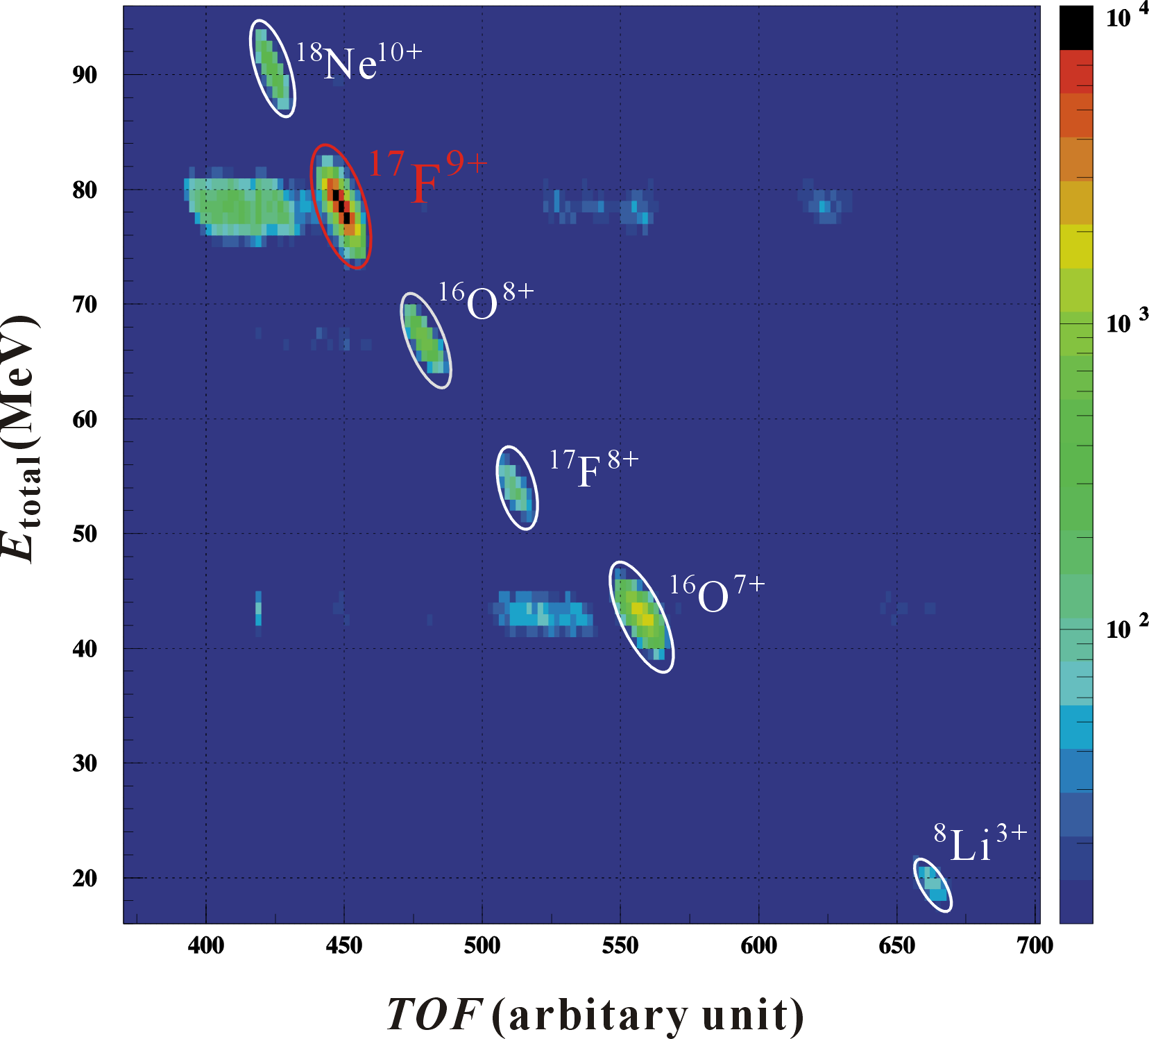
Identification of RIBs
TOF technique
→ can identify the ¹⁷F⁹⁺ beam particles clearly！

Slide 15
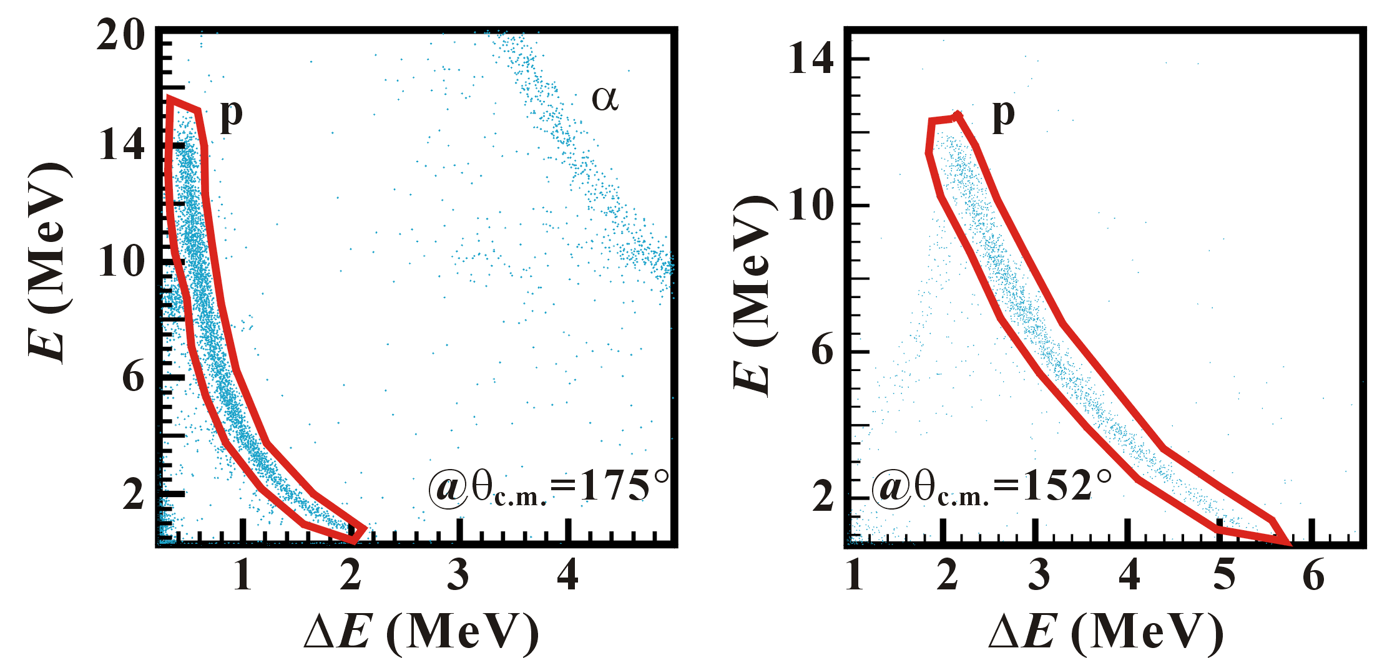
Identification of recoiled particles
ΔE-E technique
→ can identify the recoiled particles (p & α) clearly!

Slide 16
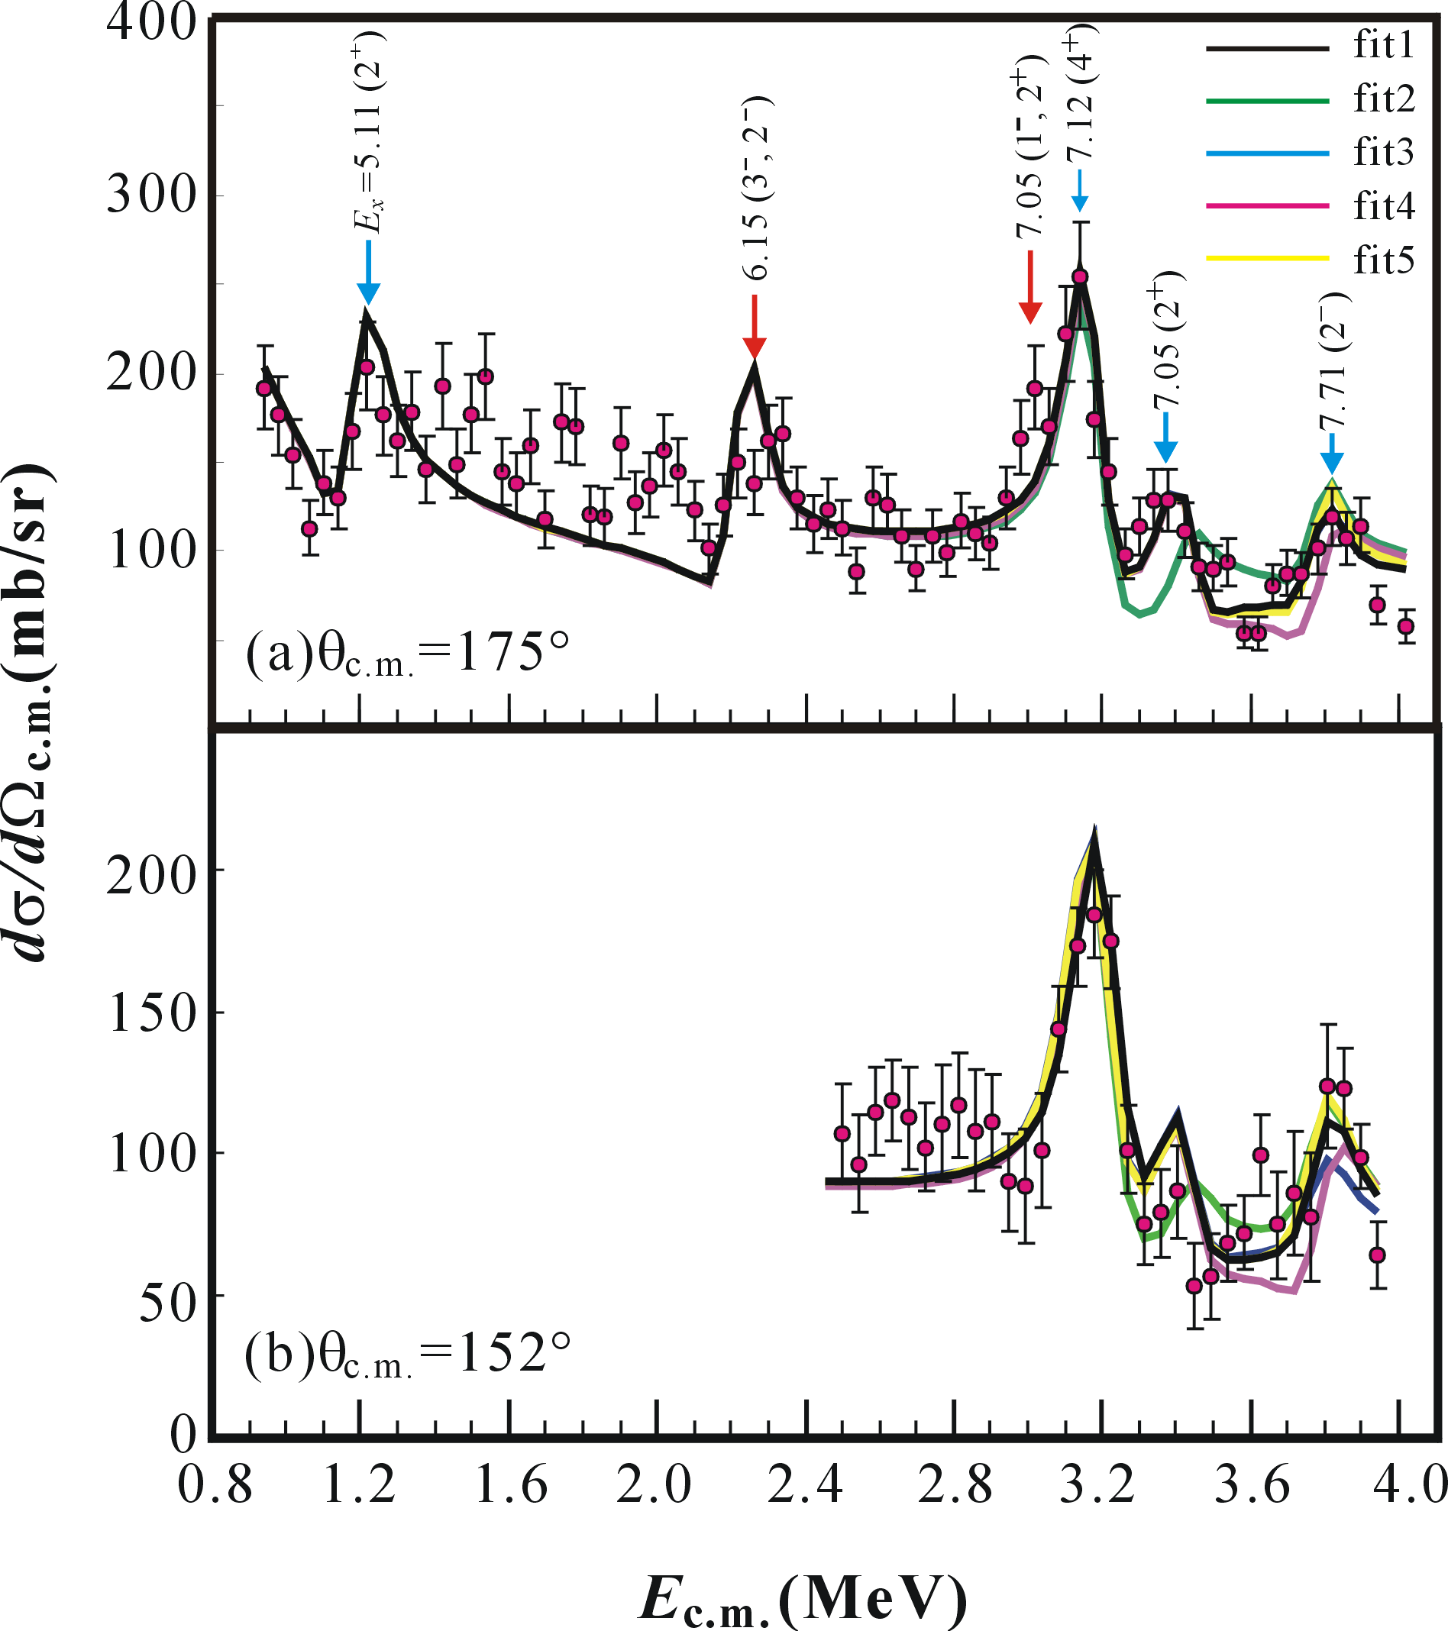
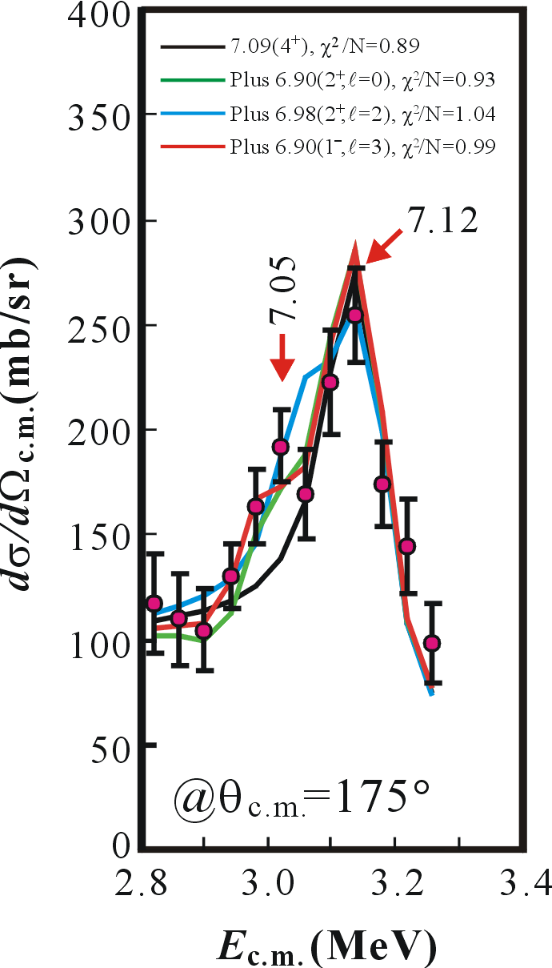
R-matrix analysis

Slide 17
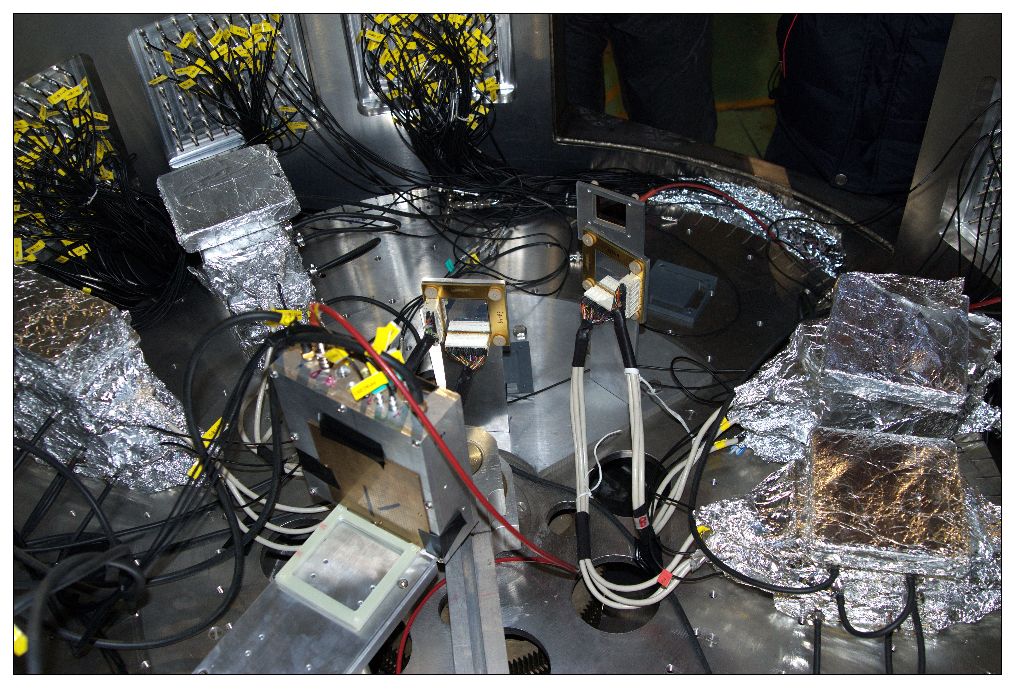
Experimental setup
⁷Be，⁸B+²⁰⁸Pb Elastic Scattering
Telescope 1
50cm
10cm
12cm
26°
13°
Pb
25cm
PPAC1
PPAC2
Telescope 2
Primary beam: 600enA, 56MeV/u ¹²C
Production target: ⁹Be
Secondary Beams: ⁶Li, ⁷Be, ⁸B
Beam Intensity: ~800pps for ⁸B and ~3000pps for ⁷Be

Slide 18
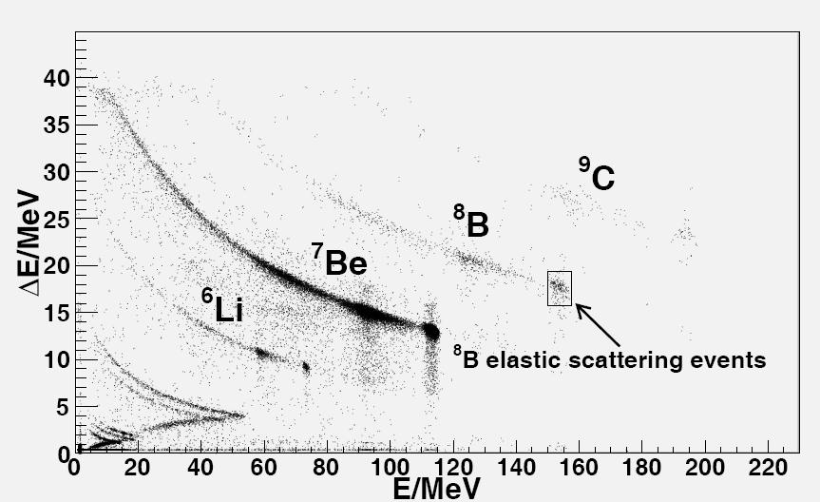
Identification of the Scattering Events
The Left Figure shows a typical particle identification spectrum. The secondary beams ⁸B and the containments, ⁹C, ⁷Be and ⁶Li are separated clearly in the figure. And also, the ⁸B elastic scattering events were identified with the ΔE-E telescopes.
The normalization was obtained from a measurement of ⁸B elastic scattering which is expected to be purely Rutherford at forward angles.

Slide 19
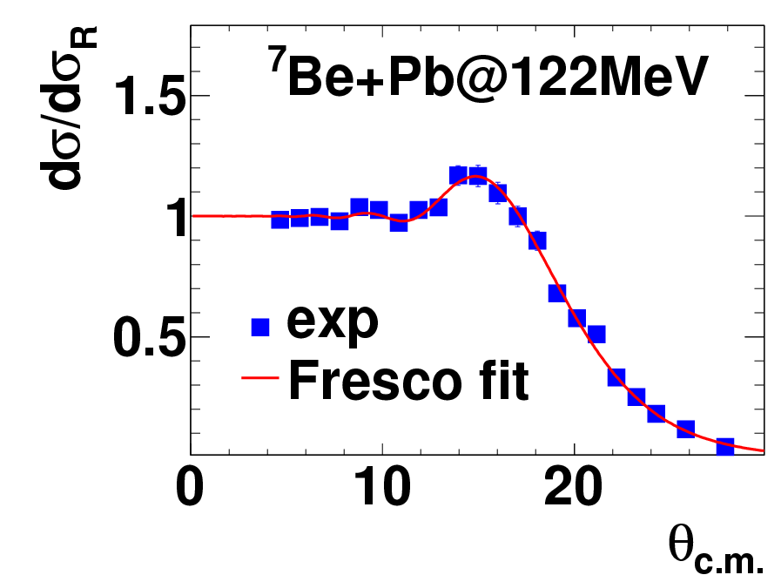
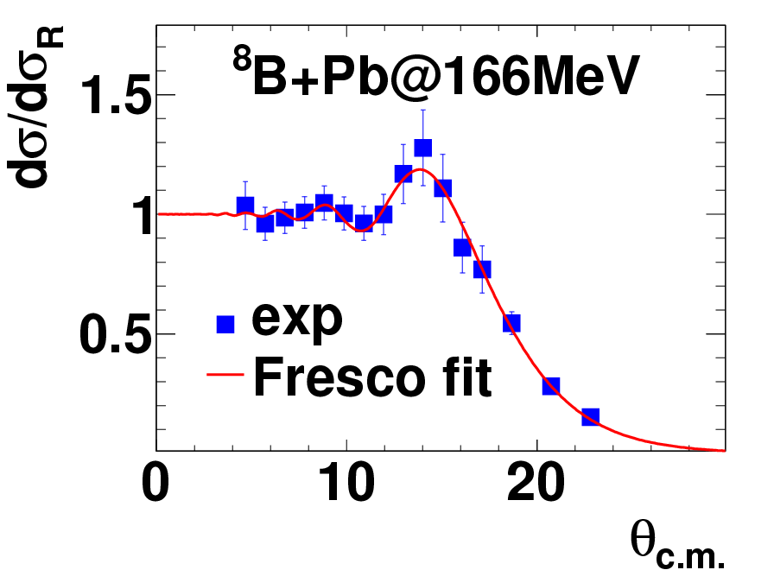
Results
 | v | r_{v} | a_{v} | w | r_{w} | a_{w}
⁷Be | 41.1 | 1.01 | 1.73 | 86.2 | 1.10 | 1.17
⁸B | 30.2 | 1.60 | 0.68 | 13.3 | 1.73 | 0.75
The experimental data are fitted by FRESSCO
The Coulumb Rainbow Peak is Enhanced for ⁸B

Slide 20
Study of β-delayed neutron decay
Detector Setup
  four clover detectors forγrays
  neutron sphere and wall arrays
  An implantation detector made of an NE102 plastic scintillator is also played a role of β detector
The spectroscope information is obtained by β-n, β-γ , and β-n-γ coincidence measurements
Coorperated with Peking University

Slide 21
The decay scheme of ²¹N
Thirteen new β-delayed neutron groups are observed with a total branching ratio of 90.5 ± 4.2%
The half-life for the β decay of ²¹N is determined to be 82.9 ± 7.5 ms.
The level scheme of ²¹O is deduced up to about 9 MeV excitation energy
Z.H. Li et al, Phys. Rev. C 80 054315

Slide 22
2-p emission from the excited states of ²⁹S and ²⁸P
Detector Setup of Complete-kinematics measurements
Co-operated with China Institute of Atomic Energy

Slide 23
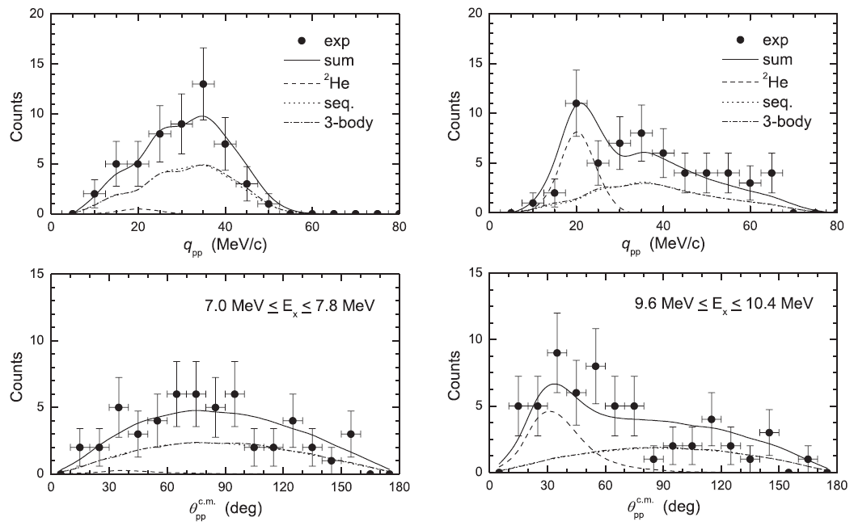
two-proton correlated emission from ²⁹S excited states
Two protons for the states of .0<Ex<7.8MeV.
No obvious ²He cluster decay is observed.
Obvious ²He cluster decay is observed
with a branching ratio of
C.J.Lin et al., Phys. Rev. C80 014310

Slide 24
two-proton emission from excited states of the odd-Z nucleus ²⁸P
two-body sequential emission or three-body simultaneous decay in phase space for the odd-Z nucleus ²⁸P
No obvious di-proton emission was found.
Compared with the results of the experiment on ²⁹S, this indicates that the 2p halo structure rather than the large deformation is responsible for the anisotropy of the opening angle between two protons emitted from the high-lying excited states
X.X.Xu Phys. Rev. C81 054317

Slide 25
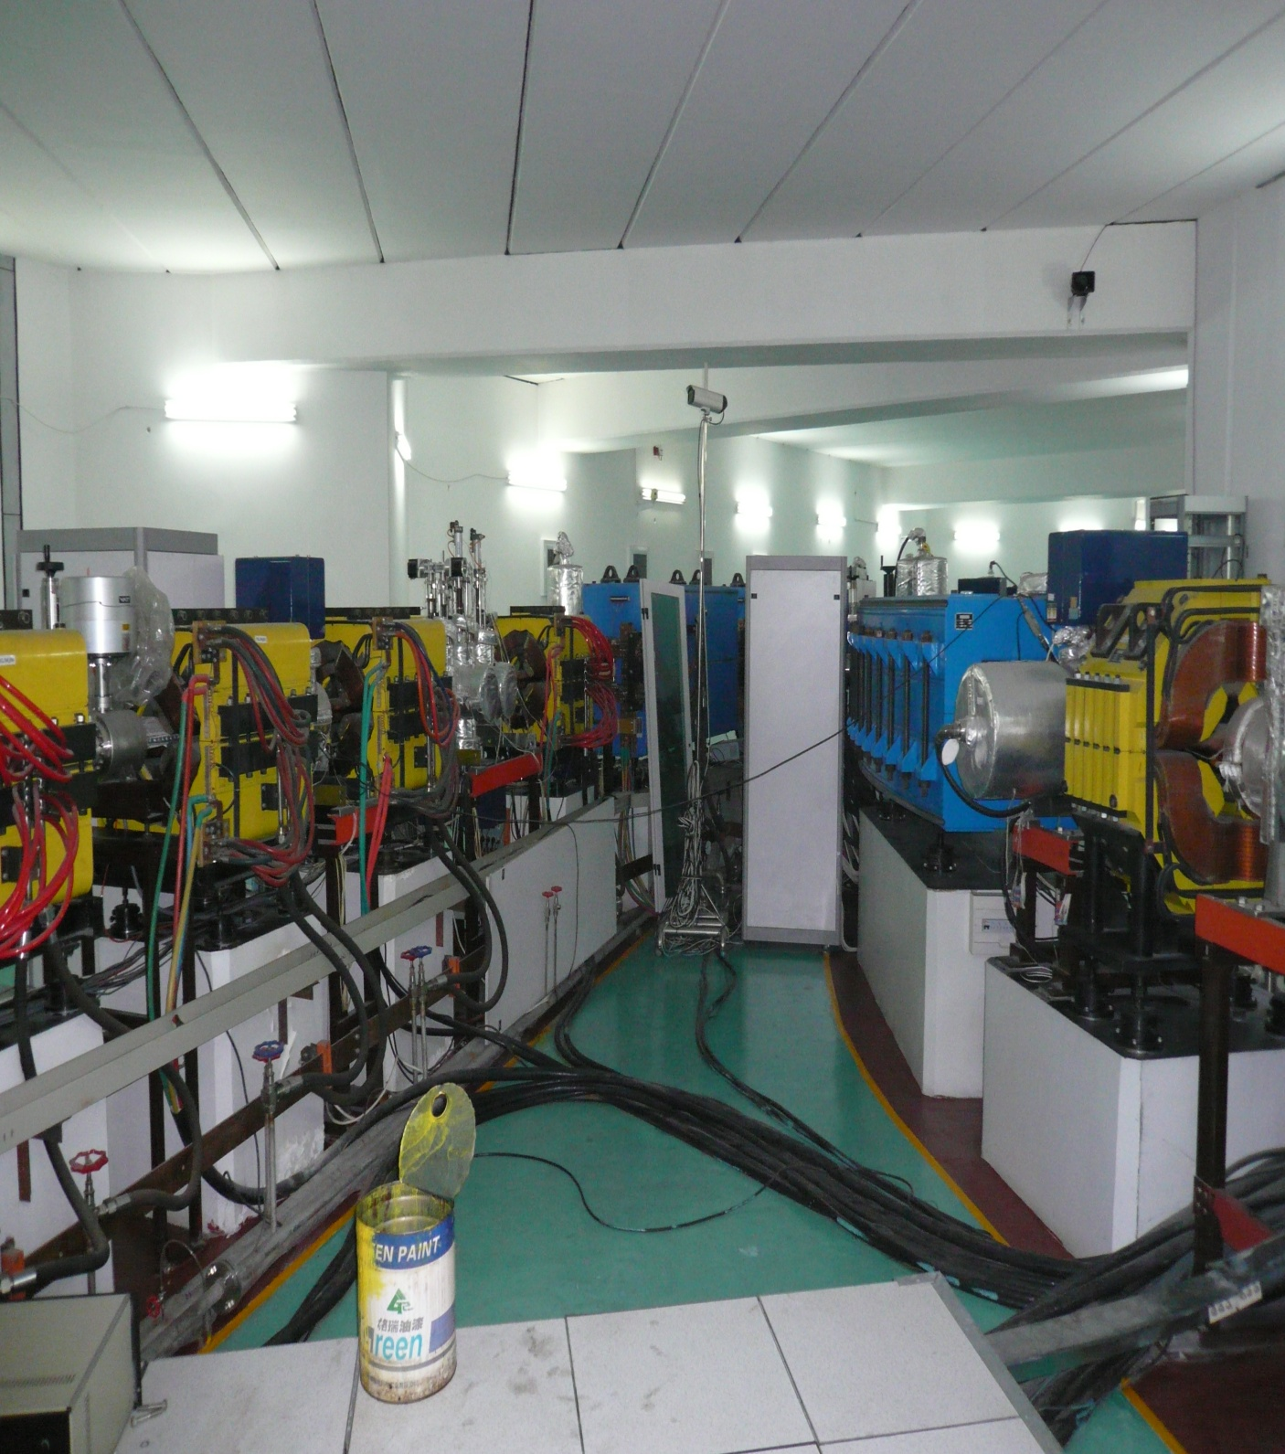
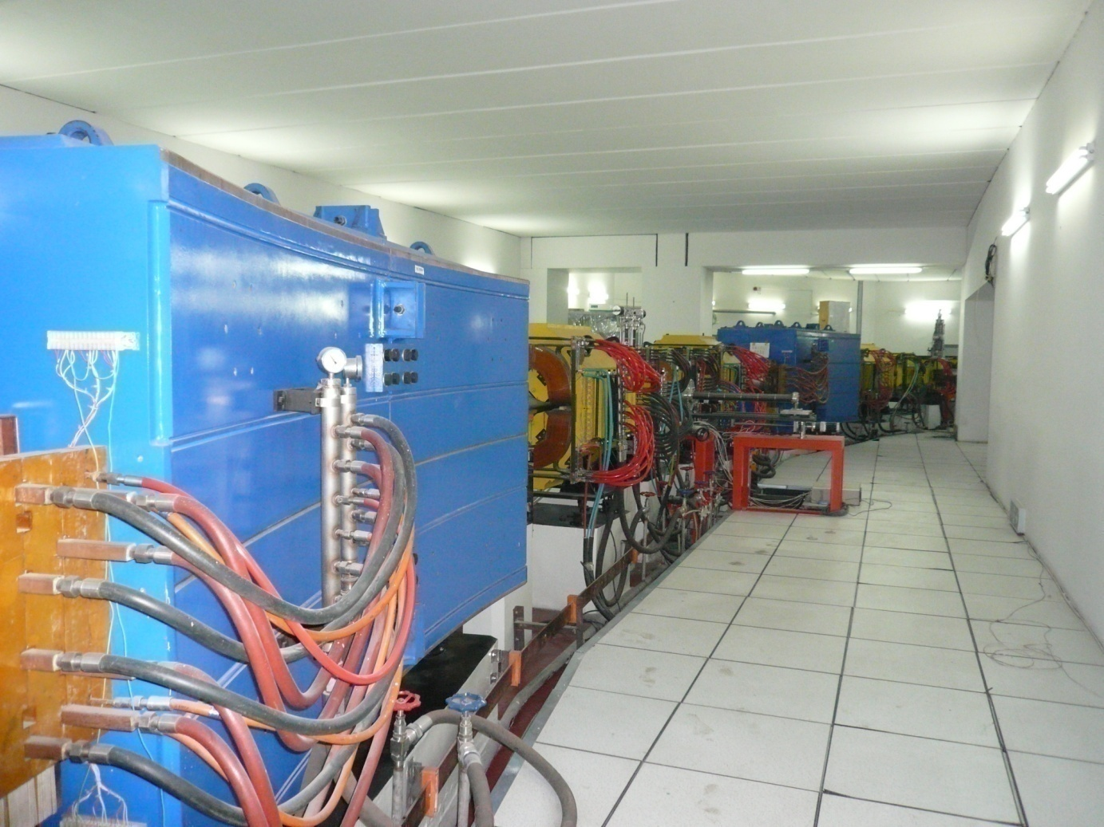
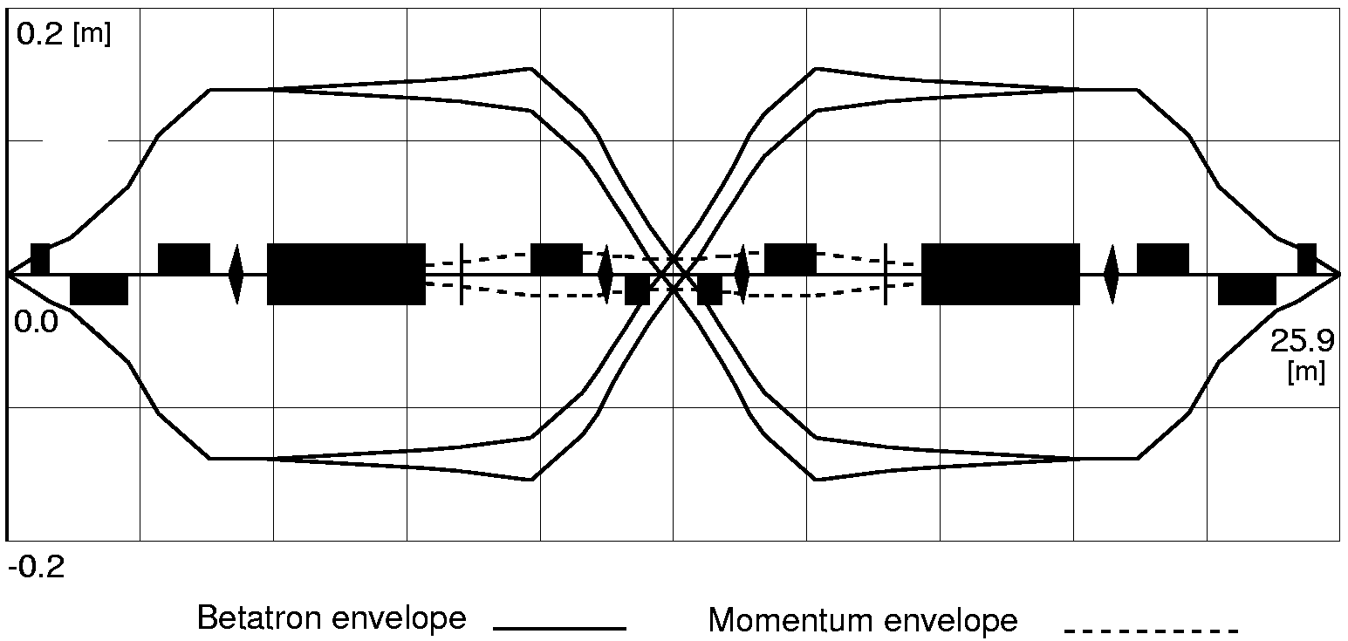
RIB Facilities at IMP
RIBLL2: 2nd Radioactive Ion Beam Line in Lanzhou
ΔP/P =±1% , Emittance = 25π mm-mrad

Slide 26

China External Experimental Setup (CEE)
Observables:
n/p and π+/π− ratios
Nucleon differential flow
Hard photons
Properties of Nuclear Matter, and Structure of Exotic Nuclei

Slide 27
Study an effect of tensor forces and three-body interactions in heavy-ion reactions (I.Tanihata)
Experiment: ¹²C + ¹²C elastic scattering at beam energies from 200A to 400A MeV.
We observe the transition energy where the optical potential changes from attraction to repulsion.
This transition energy depend strongly on tensor force and three-body interactions.

Slide 28

School of Physics and Nuclear Energy Engineering
scattering chamber and detector setup

Slide 29

Principle & method of Measurements
ToF
Injection

Slide 30

Atomic Masses in Nuclear Structure
Test of mass formula (from K.Blaum)
Comparison of different mass predictions

Slide 31




HIRFL−CSR
γ_{t}=1.395
Timing
Detector
Detector
10 mm ⁹BeTarget

Slide 32


⁵⁸Ni beam: Revolution Time Spectrum
Sum of 760 sub-spectra, each of which includes ∼100 spills
³⁴Ar, ⁵¹Co:
same m/q

Slide 33

Mass measurement results at CSRe
Projectiles：⁵⁸Ni, ⁷⁸Kr, ⁸⁶Kr and ¹¹²Sn
B. Mei et al., NIMA A 624, 109 (2010)
X.L. Tu etal., PRL 106, 112501 (2011)
X.L. Tu et al., NIMA A 654, 213 (2011)
Y.H. Zhang et al., PRL 109, 102501(2012)
X.L. Yan et al. Astrophys. J. Lett.
766 (2013) L8
IMP,GSI,MSU,MPIK,RIKEN…
Precision achieved: 10⁻⁷
1) 1st time measured for 16 nuclei, and results of ⁴⁹Fe, ⁵³Ni, ⁶³Ge, ⁶⁵As, ⁶⁷Se published
2) Precision improved for 26 nuclei, and results of ⁴¹Ti, ⁴⁵V, ⁴⁵Cr, ⁴⁷Cr, etc. published

Slide 34


HIRFL Upgrade Plan
Multi-injectors
New experiment setups
Much more operation beamtime
Higher beam current
Better beam quality
Higher energy
SSC-LINAC (under construction)
CEE (applying for budget from NSFC)
MIRFL (applying for budget from NSFC)
HILAC (Searching for funding)
HPLUS (searching for funding)

Slide 35

Layout of 7MeV/u CSR-LINAC
Electron cyclotron resonance ion source (ECRIS):
Low energy beam transport (LEBT) : Beam analytical system
Radio Frequency Quadrupole (RFQ) linac:
Medium energy beam transport (MEBT):
Drift tube linac (IH-KONUS) :108.48MHz, 216.96MHz
High energy beam transport (HEBT):

Slide 36

CSR LINAC MAIN PARAMETER
A/q | 3~7 (²³⁸U³⁴⁺)
frequency | 108.48/216.96/(325.44 )MHz
Kinetic energy | 7(14)MeV/u
Pulsed Beam current | >1puA
Pulsed cycle | 3%
Beam repetition rate | 10 Hz
Beam pulse duration | 3 ms
output beam momentum spread | <0.5%
Transmission (Designed) | >90%

Slide 37
designed by IAP
RFQ main parameter
Beam | Uranium 34+ | Uranium 34+ | --
RFQ structure | 4-Rod-RFQ | 4-Rod-RFQ | --
Frequency | 108.48 | 108.48 | MHz
Duty cycle | 3 | 3 | %
Beam current | 0 | 3 | mA
Input energy | 4 | 4 | AkeV
Output energy | 300 | 300 | AkeV
Mini Vane Length | 202 | 202 | cm
Voltage | 80 | 80 | kV
Transmission (calc.) | 98 | 94 | %
Power losses | 100 | 100 | kW
Shunt impedance | 130 | 130 | kΩm
Total RF power | 100 | 108 | kW
Cell number | 157 | 157 | --
Max. modulation | 2.5 | 2.5 | --
Min. aperture | 2.7 | 2.7 | mm
εin ,x,y,total | 200 | 200 | π mm mrad
εin ,x,y,rms ,norm | 0.1 | 0.1 | mm mrad
εout,x,y,rms ,norm | 0.1 | 0.1 | mm mrad
Twiss- Par. Inxy,α, β, γ | -0.47,0.03,40.7 | -0.47,0.03,40.7 | -,mm/mrad,mrad/mm
Twiss- Par. outx,α, β, γ | -1.39,0.22,13.3 | -1.56,0.250,13.89 | -,mm/mrad,mrad/mm
Twiss- Par. outy,α, β, γ | 1.67,0.285,12.1 | 1.77,0.3,13.8 | -,mm/mrad,mrad/mm
Twiss- Par. outz,α, β, γ | 0.0,0.087,11.4 | -0.145,0.125,8.17 | -,ns/AkeV,AkeV/ns

Slide 38

DTL parameter – 1st stage
3.7AMeV designed by IAP
Contract consideration
 | Frequency (MHz) | Ek_in (MeV/u) | Ek_out (MeV/u) | Length (cm)
Rebuncher | 108.48 | 0.3 | 0.3 | 10.5
DTL1 | 108.48 | 0.3 | 1.761 | 332.4
DTL2 | 216.96 | 1.761 | 2.62 | 114
DTL3 | 216.96 | 2.62 | 3.502 | 156.6
DTL4 | 216.96 | 3.502 | 4.384 | 177
DTL5 | 216.96 | 4.384 | 5.267 | 195.1
DTL6 | 216.96 | 5.267 | 6.149 | 211.6
DTL7 | 216.96 | 6.149 | 7.031 | 226.8

Slide 39

DTL parameter – 2nd stage
 | Frequency (MHz) | Ek_in (MeV/u) | Ek_out (MeV/u) | Length (cm)
DTL8 | 216.96 | 7.031 | 7.825 | 246.48
DTL9 | 325.44 | 7.825 | 8.619 | 183
DTL10 | 325.44 | 8.619 | 9.596 | 200.8
DTL11 | 325.44 | 9.596 | 10.54 | 217.1
DTL12 | 325.44 | 10.54 | 11.52 | 221
DTL13 | 325.44 | 11.52 | 12.45 | 229
DTL14 | 325.44 | 12.45 | 13.2 | 199
DTL15 | 325.44 | 13.2 | 13.89 | 164

Slide 40
Accelerator aspects of
HIAF facility

Slide 41

The Layout of HIAF Complex-1
Main Components:
  High intensity ion source
  High intensity pulse SC-Linac
  Multi-function booster and collector ring
  Long straight ion collider
  Figure-8 electron collider
  Large acceptance RIBs line
Figure-8 electron ring
Electron
Collider Ring
ER
Electron injector
Ion
Collider Ring
ICR-35
Multifuction
Collect Ring
CBR-35
Key features:
  High energy & High intensity & Pulse
  Cooled intense primary beam & RIBs
  Beam compression
  Super long period slow extraction
  Multi-operation modes
Multifuction
Booster Ring
ABR-35
RIBs line
ECR
SC-LINAC
LIS

Slide 42

The Layout of HIAF Complex-2
Figure-8 electron ring
Main Components:
  High intensity ion source
  High intensity pulse SC-Linac
  Multi-function booster and collector ring
  Long straight ion collider
  Figure-8 electron collider
  Large acceptance RIBs line
Electron injector
Electron
Collider Ring
ER
Ion
Collider Ring
ICR-35
Multifuction
Collect Ring
CBR-35
Key features:
  High energy & High intensity & Pulse
  Cooled intense primary beam & RIBs
  Beam compression
  Super long period slow extraction
  Multi-operation modes
RIBs line
Multifuction
Booster Ring
ABR-35
LIS
SC-LINAC
ECR

Slide 43

The Layout of HIAF Complex-3
Figure-8 ion ring
Electron injector
Main Components:
  High intensity ion source
  High intensity pulse SC-Linac
  Multi-function booster and collector ring
  Long straight ion collider
  Figure-8 electron collider
  Large acceptance RIBs line
Electron
Collider Ring
ER
Ion
Collider Ring
ICR-55
Key features:
  High energy & High intensity & Pulse
  Cooled intense primary beam & RIBs
  Beam compression
  Super long period slow extraction
  Multi-operation modes
RIBs line
Multifuction
Collect Ring
CBR-15
Multifuction
Booster Ring
ABR-25
LIS
ECR
SC-LINAC

Slide 44
Main parameters and operation modes
Fast Extraction
Matter States
(Dense plasma research,
High-Energy-Density Matter)
Slow Extraction
Material irradiation
Space electronic device
Application in bioscience
ER
3.0 GeV (e)
7.5×10¹³
Electron injector
Merging
Atomic physics
Mass measurement
ICR-35
Electron-Ion collision
0.8 GeV/u (²³⁸U³⁴⁺)
(0.6-2.4)×10¹¹ ×4 Stacking
CBR-35
2.5 GeV/u (²³⁸U⁷⁶⁺)
(1.2-4.8)×10¹⁰ ×4 Stacking
9.5 GeV/u (p)
1.0×10¹²
9.5 GeV/u (p)
1.0×10¹²
High Purity &
Quality RIBs Station
ABR-35
0.8 GeV/u (²³⁸U³⁴⁺)
(1-2.4)×10¹¹
2.5 GeV/u (²³⁸U⁷⁶⁺)
(1.2-4.8)×10¹⁰
ECR
RIBs line
25 MeV/u
(U³⁴⁺)
SC-LINAC
LIS
0.04-0.15 pmA
2 Hz, 500 μs
0.05- 0.2 pmA,
2 Hz

Slide 45
Main parameters and operation modes
Electron injector
Fast Extraction
Matter States
(Dense plasma research,
High-Energy-Density Matter)
ER
3.0 GeV (e)
7.5×10¹³
Slow Extraction
Material irradiation
Space electronic device
Application in bioscience
Electron-Ion collision
ICR-35
9.5 GeV (p)
2.8×10¹²
0.8 GeV/u (²³⁸U³⁴⁺)
(1.0-3.9)×10¹¹ ×3 Stacking
CBR-35
9.5 GeV (p)
1.0×10¹²
RIBs line
ABR-35
Atomic physics
Mass measurement
0.8 GeV/u (²³⁸U³⁴⁺)
(1.0- 3.9)×10¹¹
25 MeV/u
(U³⁴⁺)
LIS
SC-LINAC
7.4μs/turn, 85turns, 630 μs
(A=400,ε=4.7, f=1.5)
ECR
0.04-0.15 pmA
2 Hz, 630 μs

Slide 46
Main parameters and operation modes
Electron injector
ER
3.0 GeV (e)
7.5×10¹³
Electron-Ion collision
16.0 GeV (p)
2.8×10¹²
1.65 GeV/u (²³⁸U³⁴⁺)
(0.7-2.7)×10¹¹ ×3 Stacking
ICR-55
Fast Extraction
Matter States
(Dense plasma research,
High-Energy-Density Matter)
Atomic physics
Mass measurement
Slow Extraction
Material irradiation
Space electronic device
Application in bioscience
RIBs line
CBR-15
ABR-25
3.7 GeV (p)
1.0×10¹²
0.5 GeV/u (²³⁸U³⁴⁺)
(0.7- 2.7)×10¹¹
LIS
17 MeV/u
(U³⁴⁺)
0.04-0.15 pmA
2 Hz, 430 μs
SC-LINAC
6.2μs/turn, 70turns, 430 μs
(A=400,ε=5.7, f=1.5)
ECR

Slide 47
Beam Prameters of HIAF
Machine |  | Ion | Energy | Current/Intensity
Ion Source | ECR | U³⁴⁺ | 14 keV/u | 0.04 pmA
 | LIS | U³⁴⁺ | 14 keV/u | 0.2 pmA
HISCL |  | U³⁴⁺ | 25 MeV/u | 0.03~0.15 pmA
 |  | U⁷⁶⁺ | 40 MeV/u | 0.006~0.03 pmA
ABR |  | U³⁴⁺ | 0.8 GeV/u | 0.6~2.4×10¹¹ ppp
 |  | p | 9.5 GeV/u | 1.0×10¹² ppp
CBR |  | U⁷⁶⁺ | 2.5 GeV/u | 1.2~4.8×10¹⁰ ppp
 |  | p | 9.5 GeV/u | 1.0×10¹² ppp
ICR |  | U³⁴⁺ | 0.8 GeV/u | 0.6~5.0×10¹¹ ppp
 |  | U⁹²⁺ | 3.2 GeV/u | 0.17~1.0×10¹¹ ppp
 |  | p | 9.5 GeV/u | 5.0×10¹² ppp
ECR |  | e | 3.0-4.0 GeV | 7.5×10¹³ ppp
Notes:
47
In用激光离子源：10^12为隐性目标。
HIRFL指标：输出能量20J, 能量沉积率0.1J/g
SIS18指标：输出能量60J, 能量沉积率1kJ/g
SIS100指标：输出能量6kJ, 能量沉积率100kJ/g
LIAF指标：输出能量10kJ, 能量沉积率<200kJ/g
入射粒子种类 Kr
能量 0.4 GeV/u
束流强度 1*10^12 ppp
束流总能量 5.3kJ
纵向长度 100ns
束流功率 53GW
束斑直径 <1mm / 0.15~1mm
单位沉积能量 46kJ/g

Slide 48


Superconducting ECR Source

Slide 49


Laser Driven Source+RFQ Platform
3J
>500 mA
Notes:
49
LIS+RFQ线上的所加工的各种控件已经到货、已经进行了相关的准直，目前在进行更细的实验调试。
所加工的用于探测RFQ加速后电荷态和能量的EIA已经安装完毕，正在等待实验束流测试。
束流线上的靶控制系统、FFC控制，狭缝与FC 控制中的硬件安装和初步的软件编写已经完成，正在进行测试修改和优化。
激光器维修已经完成，由于为了再次避免YAG棒的反射损伤，因而加入了法拉第隔离器。
49

Slide 50
环形加速器动力学设计
Dynamics design of HIAF
Lattice of ABR-35
To meet to all requirements, the ABR-35 lattice has to provide special features:
Wide energy range 0.025 -- 9.5 GeV
Flexible adjustment of momentum compaction
factor for elimination of transition energy crossing
Dispersion free straight sections for electron cooling
Sufficiently large dynamic aperture after
sextupole correction
Corrected chromaticity by arc’s sextupoles

Slide 51
环形加速器动力学设计
Dynamics design of ABR-35
“Resonant” magneto-optical lattice
with controlled momentum compaction factor
QF1
QF2
QD1
QD2
QF1 is placed at the point of the Beta-x function maximum.
QD1 and QD2 is placed at the point of the Beta-y function maximum.
QF2 is placed at the point of the Dispersion function maximum.

Slide 52

环形加速器动力学设计
Dynamics design of ABR-35
Lattice of high transition energy
Twiss parameters
Main lattice parameters
Circumference（m） | 373
Super period | 2
Tune values | 7.24 / 6.08
Natural chromaticity | -9.47/-9.57
Max.β （m） | β_{x}/β_{y} =15.2/19.1（D）， β_{x}/β_{y} =43.7/25.8（Q）
Max. Dispersion （m） | Dmax(x)=4.53（Q，β_{x}=10.34）
Injection section（m） | β_{x}/β_{y}=8.1/32，D_{x}=0.0（Septum）
Extraction section（m） | β_{x}/β_{y}=4.1/25.3，D_{x}=0.0（Septum）
Tansition gamma γ_{tr} | γ_{tr} = 19.8

Slide 53
环形加速器动力学设计
Dynamics design of ABR-35
Painting+e-cooling
Injection scheme
  Large acceptance
  (500pimmmrad/120pimmmrad)
  Horizontal and vertical Painting
  Fast electron cooling
Injection components layout of Painting+e-cooling
Orbit of Painting+e-cooling injection

Slide 54

环形加速器动力学设计
Dynamics design of CBR-35
Lattice modes
Twiss parameters of normal mode
Twiss parameters of isochronous mode

Slide 55
环形加速器动力学设计
Design of CBR-35
Isochronous modes
TOF1
TOF2
E-Cooler
Schottky pick up
Racetrack layout of CBR
Twiss parameters of isochronous mode

Slide 56

Interaction region design of EIC
Electron
Collider Ring
ER
IP-2
IP-1
Ion
Collider Ring
ICR-35
Figure-8 Collider Ring Topology
  Ensures spin preservation and ease of spin manipulation (spin rotators)
  Removes spin sensitivity to energy for all ion species
The electron beams execute a vertical excursion to the plane
of the ion ring for collision at two interaction points (IP).

Slide 57
Interaction region design HIAF EIC
Interaction point beam optics design of ion beam
Interaction point beam optics design of electron beam

Slide 58

Interaction region design EIC
25 mrad + 25 mrad crossing angle with crab cavity
‘Crab Crossing’ required to alleviate luminosity reduction and to avoid parasitic beam-beam interaction due to high repetition rate.

Slide 59
Luminosity consideration of HIAF
Guidelines:
At low energy, we assume a round beam
A symmetric final focusing (β*_{x}=β*_{y})
Assuming a little smaller emittance
Keep Laslett tune-shift around 0.05
Luminosity bottom-line (3 GeVx12 GeV):
Conservative estimate: ~2x10³²
With optimization: ~4x10³²
Forward-looking: ~1x10³³
(with lots of R&D and introducing uncertainty)
Revised
Optimized
With Traveling FF
Energy
GeV
12
12
12
Bunch repetition rate
MHz
250
250
250
current
mA
150
250
500
Protons/bunch
10¹⁰
0.375
0.5
1.25
Bunch length
cm
2
2
5
Geometric Emittace, (x/y)
nm
100/50
78
78
Laslett tune-shift
0.057
0.057
0.057
β*_{x} and β*_{y}
cm
2/10
2/2
2/2
Beam-beam tune-shift
0.01/0.006
0.01/0.006
0.01/0.006
Luminosity, 10³³
1/cm²/s
0.18
0.48
1.2

Slide 60




ABR-35 Superconducting Dipole
Accelerator pre-R&D
Superferric design with warm iron yoke to fulfill requirement of big aperture；
Hollow tube superconducting cable coolling with supercritical He ；
Strong support structure to resist strong electromagnetic force
Central field | 2.25 T
Useable aperture | 220mm×120mm
Max. ramp rate | 2.25 T/s
Hollow tube SC cable
Field distribution in iron yoke
Coil case
SC coil
Cryostat
Coil support
Horizental field homogeneity
SC coil and Cryostat

Slide 61



ICR-35 Superconducting Dipole
Accelerator pre-R&D
Central field | 6 T
Useable aperture (6×10⁻⁴) | Φ70mm
Ramping rate | <1 T/s
Cosθ type coil with Rutherford cable；
Cooled with supercritical helium (4.5K)；
The cold mass consists of a superconducting coil, a reinforceing shell, cold iron yoke, etc；
G10 post used as cold mass support；
Field distribution in aperture
Field distribution in iron yoke
Rutherford cable
SC coil, collar and yoke
SIS 300 prototype
Cold mass assembley

Slide 62
Accelerator pre-R&D
Electron cooling
  Electron cooling of ABR-35
  The crucial point for ABR-35 injection.
  Electron cooling of ICR-35
  Low energy (several hundreds keV) to get more focused beam
  ions for high energy and density matter research.
  Medium energy (several MeV) electron cooling
  Particularly important for preserving the collider luminosity and its
  lifetime by suppressing IBS induced heating:
  Electrostatic accelerating apparatuses that are used for accelerating
  the electron beam in all existing low energy electron cooling facilities
  ERL circulator cooler, rely on RF or SRF technology, and also photo-
  cathode electron source
  Coherent electron cooling, new concept, it is yet to be demonstrated
  experimentally.

Slide 63
Accelerator pre-R&D
Dynamic vacuum system
  Intensity dependent beam lossed for intermediate charge state heavy ion beams. The origin of these losses is the change of charge state of the beam ions at collisions with residual gas atoms
  In order to suppress and control the beam loss, a dedicated ion catcher system is necessary. Two prototypes of this catcher has been developed and installed in SIS18.
Collective beam effects
  (Long time scale) beam-beam with crab crossing
  Space charge effects in ABR-35
  Electron cloud in the ion rings and mitigation

Slide 64
Current status of HAIF
The HIAF project was proposed in 2009, approved in principle by the central government in the end of the 2012 and now under conceptual design stage.
HIAF parameters will be chosen to optimize science, technology development, and project cost.
The final design of first stage will maintain a well defined path for future upgrade to higher energies and luminosities.
A conceptual machine design will completed recently, providing a base for performance evaluation, cost estimation, and technical risk assessment.

Slide 65
Current status of HAIF
We seek international collaborations for key supporting technologies of HIAF.
The total budjet of HIAF is about $ 380 million
The timing of HIAF construction depends on the design optimization and accelerator technology R&D. We hope we can start construction in the end of 2014. Project completion is expected in 2021, managing to early completion in 2019.

Slide 66
Main scientific motivations of HIAF
To understand the effective strong interaction binding atomic nuclide
─ Limits of nuclear existence, drip-line and super-heavy nuclei, etc
─ New forms of nuclear matter, neutron halo and cluster, etc
─ Quantum levels far from stability, shell closure and evolution, etc
─ New modes of collective motion, exotic shapes, GDR and GMR, etc
─ Dynamical symmetries in nuclei, spin and Isospin symmetries, etc
To simulate the creation of the trans-iron elements in universe
To produce HED matter and study the properties of HED matter
To pin down intrinsic structure of nucleon by electron-ion collision
The remark at the 2nd International Conference on QCD and Hadron Physics held at IMP between March and April 2013: It is quite promising to add an Electron Ion Collider (EIC) at HIAF which is a consensus of the high energy nuclear physics community that it is a necessity of the further study of the nucleon and nuclear quark-gluon structure.
To promote heavy ions applications in space and material sciences
New Project HIAF
One of 16 Strategic Planning of Basic Reseach Infrastrure
Electron injector
ER
3.0 GeV (e)
7.5×10¹³
Electron-Ion collision
1.65 GeV/u (²³⁸U³⁴⁺)
(0.7-2.7)×10¹¹ ×3 Stacking
16.0 GeV (p)
2.8×10¹²
ICR-55
Key features:
  High energy & High intensity & Pulse
  Cooled intense primary beam & RIBs
  Multi-operation modes
Atomic physics
Mass measurement
RIBs line
CBR-15
ABR-25
3.7 GeV (p)
1.0×10¹²
0.5 GeV/u (²³⁸U³⁴⁺)
(0.7- 2.7)×10¹¹
LIS
17 MeV/u
(U³⁴⁺)
0.04-0.15 pmA
2 Hz, 430 μs
SC-LINAC
ECR
6.2μs/turn, 70turns, 430 μs

Slide 67
Current status of HIAF
The HIAF project was proposed in 2009, approved by the State Concil in Jan. 2013 and now under conceptual design stage.
The final design of first stage will maintain a well defined path for future upgrade to higher energies and luminosities.
A conceptual machine design will completed befor the end of June. The total budjet of HIAF is about $ 380 million
The HIAF will start construction in the end of 2014. Project completion is expected in 2021, managing to early completion in 2019.

Slide 68






Preliminary Design of HISCL for HIAF
162.5 MHz HWR beta=0.11 and 325 MHz Spoke beta=0.21
IS
81.25MHz
81.25MHz
W-RFQ
H-RFQ
………………
………………
LEBT
MEBT1
MEBT2
2.02m
2.74m
14 keV/u
0.4 MeV/u
1.3 MeV/u
6.95 MeV/u
25 MeV/u
High Intensity heavy ion SuperConducting Linac (HISCL)
LEBT
Superconducting Linac
RFQ

Slide 69








RFQ and HWR Design of HISCL
W-RFQ
T-HWR
1000
Q factor | 11600
Voltage @ 1J | 113.4 kV
RF loss @ 1J | 39.5 kW
RF loss @ U=75kV | 17.3 kW
S-HWR
572
H-RFQ
Q factor | 12936
Voltage @ 1J | 160 kV
RF loss @ 1J | 38.5 kW

Slide 70






Design of Spoke021
f(MHz) | 325
β_{opt} | 0.245
Ep/Eacc | 3.88
Bp/Eacc（mT/(MV/m)） | 8.13
R/Q0 | 206
G(Ω) | 87
Epeak(MV/m) | 38 | 32
Bpeak(mT) | 79.6 | 67.0
Eacc(MV/m) | 9.79 | 8.24

Slide 71
Project schedule of HIAF
20~ | 09 | 10 | 11 | 12 | 13 | 14 | 15 | 16 | 17 | 18 | 19 | 20 | 21
Critical Points
Design
Construction and Installation
Commissioning
Budget periods
Start
Approval
Commissioning
Operation
Start
construction
Key technologies R&D
Conceptual design
Pre-conceptual design
Design report preparation,
submission,
approval
Detailed design & prototype
Civil construction
Equipment construction, Fabrication
Installation
Linac, ABR, CBR commissioning
Combined commissioning
Start of operation
BP1
BP2
BP3
BP4

Slide 72

New Project Site: ADS and HIAF
Several candidates selected befor the end of June
New Project, New Institute, New Center

Slide 73
Summary
Two RIB facilities in IMP-fragmentation seperators RIBLL1 since 1997 and RIBLL2 since 2008 are intensively used for nuclear structure and reaction studies, precision mass measurements.
About 16 new masses for shortlived nuclei are measured precisely.
In order to increase beam intensity and energy of HIRFL, new linac injectors for HIRFL-SSC and HIRFL-CSR are proposed. First RFQ will be conmmissioned befor the end of this year.
New project HIAF is proposed for higher beam intensity and energy, EIC and multi-function operation are considered. The construction will start in the end of 2014.

Slide 74
Thanks for your attention!

Slide 75

How the elements from Iron to uranium created?
Mass and half-life measurements
Neutron capture cross section by (d, p) inverse reaction

Slide 76

Shell Structure Far From Stability
Methods: Mass, Reaction, Coulex, In-beam Spec., Decay Spec. etc.
To study the mean field at extreme isopin condition
To study the spin-orbital angular momentum coupling
To study the various correlations

Slide 77


limits to nuclear existence (SHN)
Study the Chemical properties of SHE
Confirm the 114-118 elements
Explore the new elements of 120-126
Study the reaction mechanisms
Study the structure in heavy nuclei
New identification methods

Slide 78



limits to nuclear existence (p-drip line)
Mapping the proton-drip line for even-Z elements
Searching for the exotic decay modes
Studying the various correlations at drip lines

Slide 79



Dynamical symmetries far from stability
n-p Interaction
δ(n-p)=[B(N,Z)-B(N-1,Z)-B(N,Z-1)+B(N-1,Z-1)]/2
Mass Measurements
δ(n-p)=[B(N,Z)-B(N-2,Z)-B(N,Z-2)+B(N-2,Z-2)]/4

Slide 80




New phenomena far from stability
Methods: Reaction, In-beam Spec., Decay Spec. et al.,
Halos
Neutron Skins
Pygmy Resonance
Neutron stars
EOS
To identify the effective forces which provide nuclear binding
To study the exotic matter distribution and the constrain the EOS
To study the isospin dependence of nuclear interaction

Slide 81

Nuclear Matter at HIAF
EOS of Asymmetric nuclear matter at high density and large isospin asymmetry
Effective NN interaction in high-density nuclear medium
Medium effect on Hadrons and partial restoration of the chiral symmetry
Properties of neutron stars
……
Isospin asymmetry
HIAF

