Slide 1




C. Fanelli on behalf of the
E07­002 Collaboration
University of La Sapienza, Roma
INFN/Sanità
JLab, Glasgow
Study of the proton structure
by measurements of polarization transfers in RCS at JLab
INPC13-Florence 3 june 2013

Slide 2
Motivations
Fanelli
We want to understand the proton structure, a very complicated object
We don’t know how many constituents (quarks and gluons) and how behave
A real puzzle at relativistic speeds
The structure of the proton to be understood in terms of pQCD, and we have to take advantage of all technology we have (among this Compton)
How can those components contribute to spin of nucleon?
spin crisis
≈30%
≈zero ?
After Bjorken, many different sum rules have been introduced
[X. Ji, 1997]
Generalized parton distributions (GPDs):
only known framework for information on 3D picture of hadrons

Slide 3
Theory of RCS
Fanelli
GPDs can be accessed through exclusive reactions as Compton scattering
s, -t, -u >> m_{p}²: Factorization of transition amplitude into:
- perturbative hard scattering amplitude
- soft wave functions
The 2 most developed frameworks used for Compton analysis are:
KERNEL
SOFT WAVE-FUNCTIONS
pQCD
2 hard gluon exchange
Handbag
1 active quark
GPD
RCS Form Factors

Slide 4
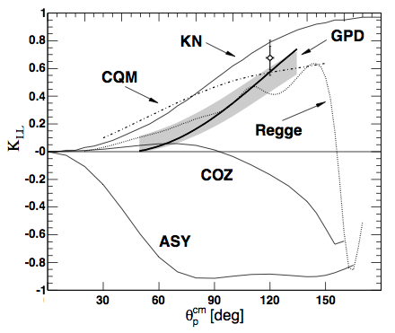
Test RCS mechanism
D. J. Hamilton, et al., Phys. Rev. Lett. 94, 242001 (2005)
Fanelli
Handbag and pQCD mechanisms give very different predictions for polarization transfer asymmetry K_{LL}, K_{LT}
(HANDBAG)
JLab e99114
(pQCD)
first arrow: incident photon helicity
second arrow: recoil proton polarization
(pQCD)
Compton form factors :
GPDs
JLab result for K_{LL}
Results are in agreement with leading quark model at energy regime
Additional measurements are needed to test consistency with GPDs at different angle and where u,t,s are large unambigously

Slide 5
WACS with Real Photons
Fanelli
WACS: Wide Angle (cm frame) Compton Scattering
Intensity of γ/e in terms of energy
Calorimeter
Dipole
mixed e-γ beam
polarized incident
bremsstrahlung
photon beam
High energy photon polarized as electrons
Compton scattering
K_{LL}, K_{LT}
(R_{A}, R_{V}, R_{T})
Analyzing Power Ay
proton polarimeter
2 experiments same setup
P_{L}, P_{T},P_{N}=0
ep scattering
G_{E}/G_{M} proton

Slide 6
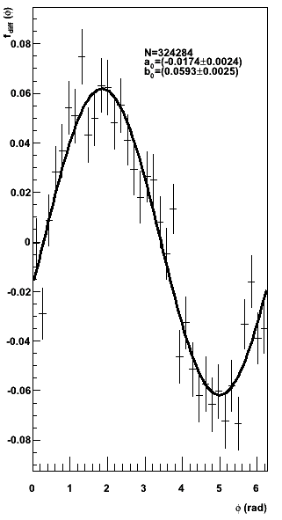
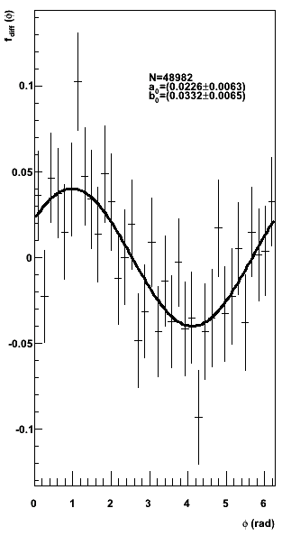
Proton precession and spin-orbit effect
Fanelli
precession
spin-orbit
detector
hut
y
z
x
HMS
ep scattering
information on polarization at FP and on Ay
Helicity-difference asymmetry at FP
Focal Plane
Helicity-sum distribution
information on false asymmetry terms
rcs scattering
N.B. spin and momentum precessions of proton in the magnet around
6

Slide 7
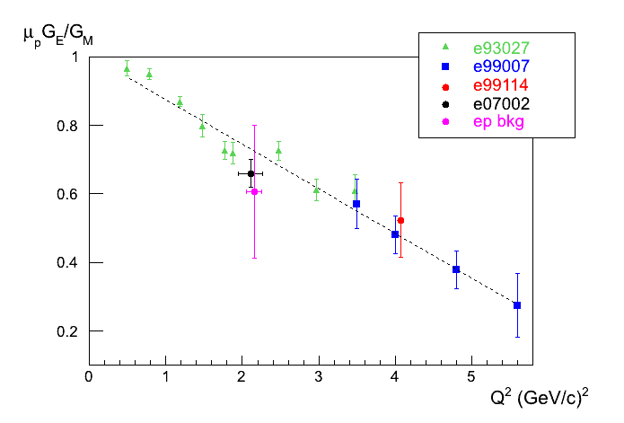
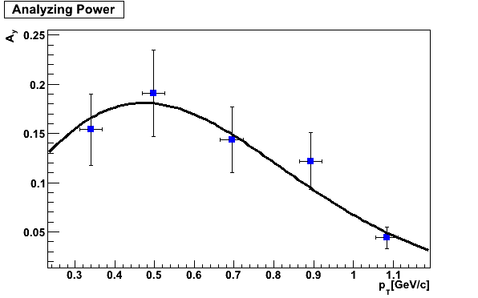
ep-scattering results and checks
Fanelli
Independent analysis
to check consistency with E07002
Back-propagation of polarization on FP
to Breit frame event by event,
taking advantage of
Maximum Likelihood method
P_{T}= -0.140 +/- 0.038
P_{L}= 0.474 +/- 0.037
raw polarization
P_{T}= -0.0190 +/- 0.0059
P_{L}= 0.0725 +/- 0.0057
Extract Ay
polarization including Ay
Consistent with independent extraction by preliminary Markov chain Monte Carlo using prior function
7

Slide 8
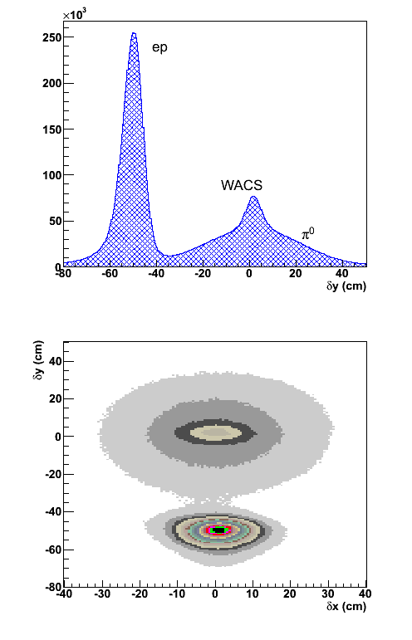
Selection of RCS events
Fanelli
2 body kinematics: proton 4 momentum HMS
expected photon 4 momentum BigCal
Main bkg sources
pion decay
elastic electron
Bethe-Heitler
expected and measured
coordinate difference in calorimeter
8

Slide 9
RCS preliminary results
Fanelli
Applying cut to select RCS events
and taking into account bkg contamination
(mostly from pion)
Considering Ay from dedicated ep scattering experiments
K_{LL}= 0.46 +/- 0.09
K_{LT}=-0.04 +/- 0.08
Very preliminary!!
Assuming pion polarization constant in region of interest
Back propagating to proton helicity rest frame from CM at proton scattering angle direction
Back propagating to Lab
Wigner
rotation
Precession
9

Slide 10
Conclusions
Fanelli
We presented the preliminary results on polarization transfer in the JLab Real Compton Scattering experiment E07-002 at 7.5<s<8.5 GeV², 2.0<-t<2.5 GeV², 3.5<-u<4.5 GeV² and at θ^{cm}~70°
The 3 Mandelstam variables s,t,u are large enough to expect the factorization condition be satisfied
The very preliminary measurement of K_{LL}=0.46 +/- 0.09 seems inconsistent with current GPD based models (by more than 2σ)
Nevertheless, as predicted in GPD-models, K_{LL} is positive
Optimization of analysis and full study of systematics is underway
10

Slide 11
Thanks for your attention…

Slide 12
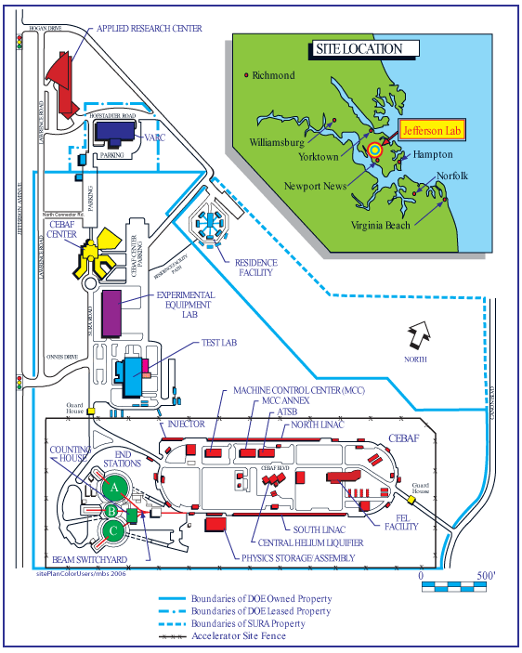
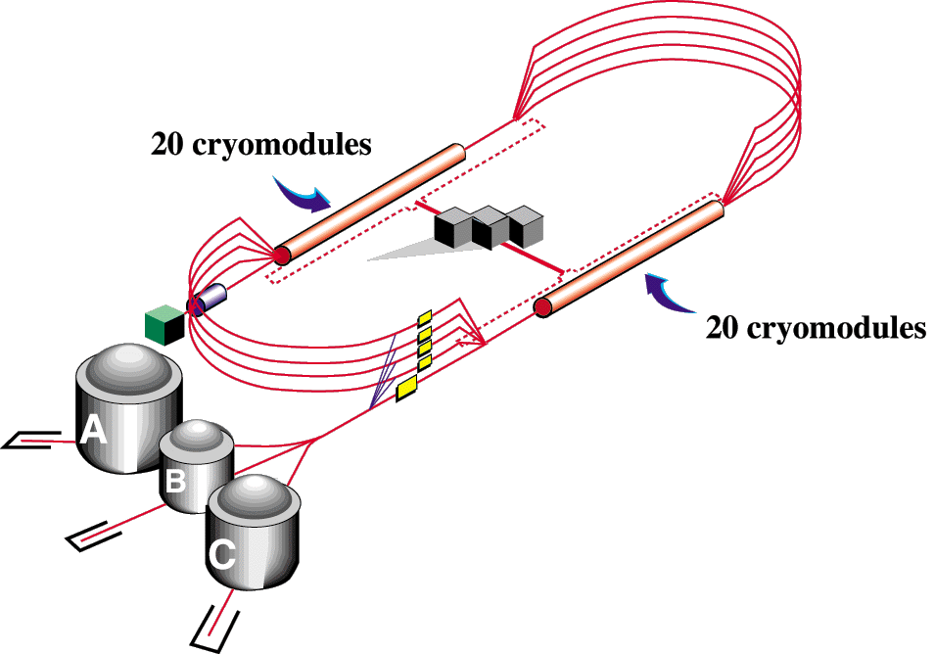
JLab Accelerator Facility
Fanelli
6 GeV CEBAF (< 2013)
Max Current: 200 μA
Max Energy: 0.8 - 5.9 GeV
Long. Polarization: 85%

Slide 13
Handbag model
Fanelli
(non polarized
cross-section)
Elastic
form factors
Compton
form factors
Huang et al.
Eur. Phys. J. C 23,
301–310 (2002)

Slide 14
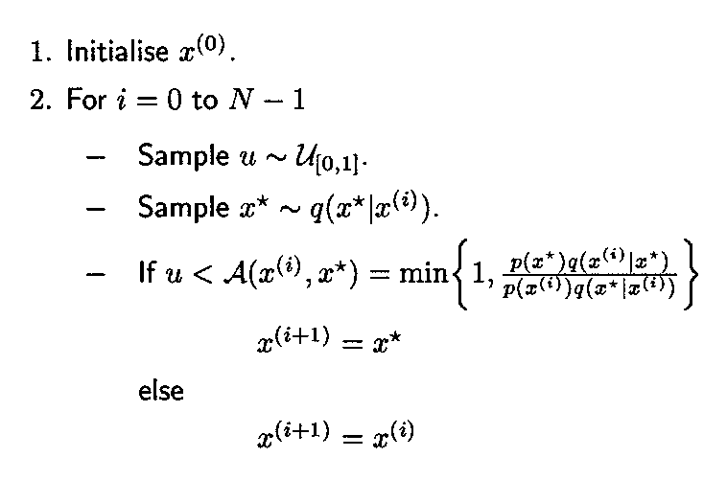
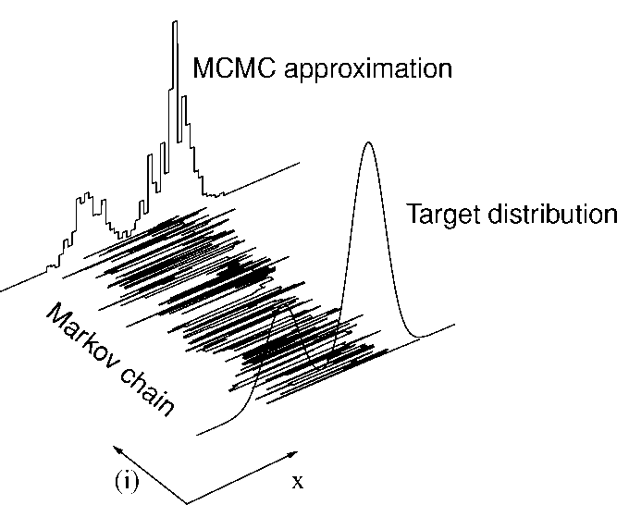
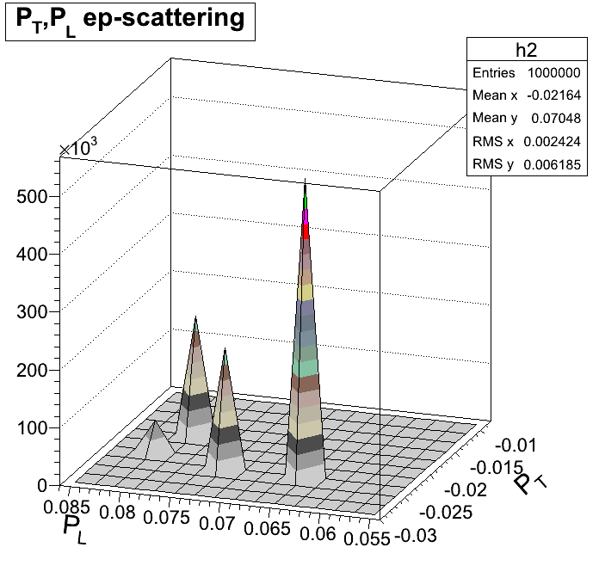

MCMC/1
Fanelli
MCMC: take advantage of likelihood
Bayesian approach:
Likelihood ratio
Prior ratio:
all theoretical information encoded here (e.g. Pn=0)

Slide 15
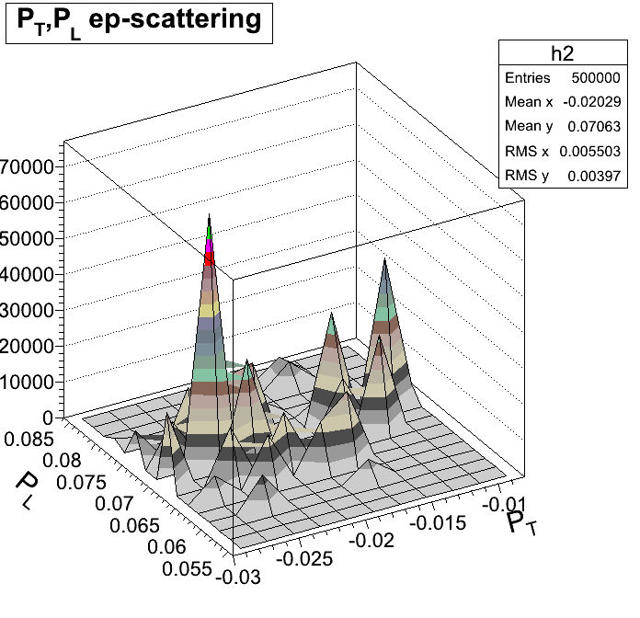
MCMC/2
INPC13-Florence
Fanelli
MCMC using uniform prior function
for all 3 components
MCMC using uniform prior function with P_{N}=0 (Born approximation)
posterior function
of PT, PL
posterior function
of PT, PL
(at momenta >3GeV² one should consider
2-photon exchange contribution)

