Slide 1

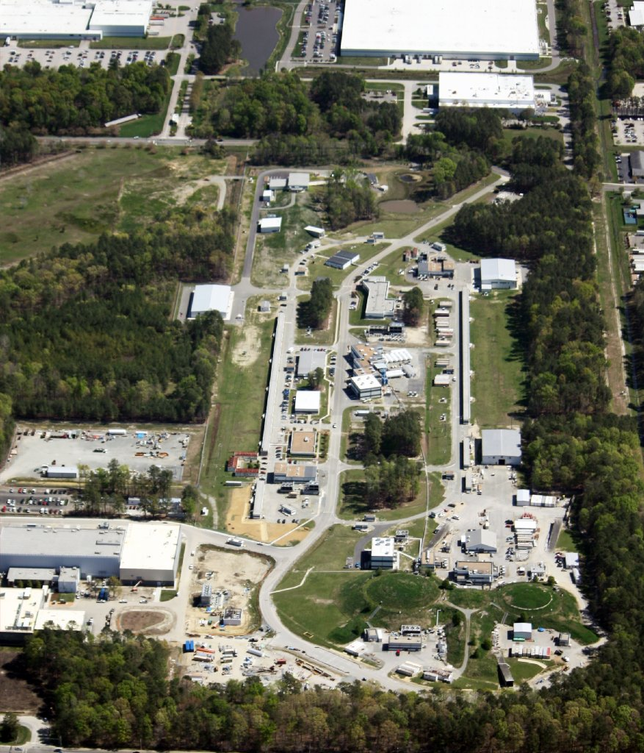
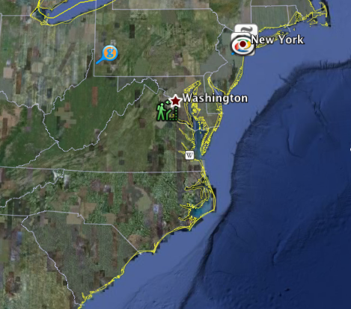
Exotic Hybrid Meson Spectroscopy with the GlueX detector at JLab
June 3, 2013
David Lawrence JLab
Newport News, Virginia

Slide 2


Exotic Hybrid Mesons
S₂
Conventional meson has quantum numbers determined only by constituent quarks
S₁
L
Hybrid meson has some quantum properties due to contributions from the “glue”
S = S₁ + S₂
J = L + S
P = - (-1)^{L}
C = (-1)^{L+S}
J^{PC} = 0⁻⁺, 0⁺⁺, 1⁺⁺, 1⁺⁻, 2⁻⁺, 2⁺⁺
J^{PC} = 0⁻⁺, 0⁺⁺, 0⁺⁻, 1⁺⁺, 1⁻⁺, 1⁺⁻, 2⁻⁺, 2⁺⁺, 2⁺⁻
J^{PC} = 0⁻⁺, 0⁺⁺, 0⁺⁻, 1⁺⁺, 1⁻⁺, 1⁺⁻, 2⁻⁺, 2⁺⁺, 2⁺⁻
“exotic” states

Slide 3
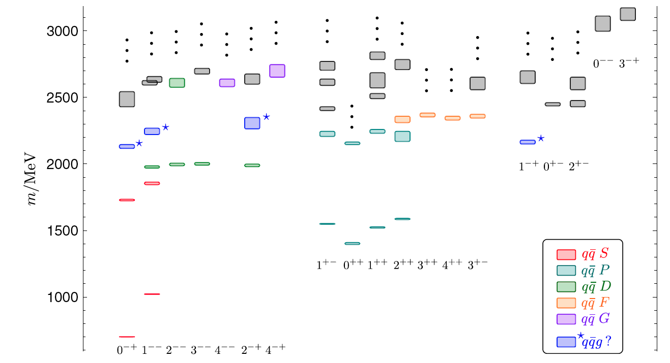
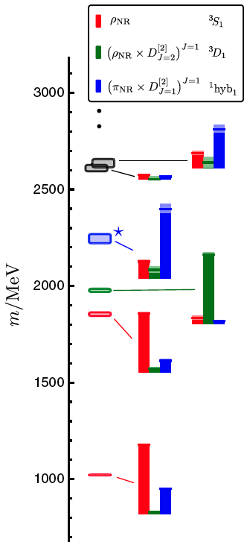
Meson Spectroscopy from LQCD
Exotic J^{PC}
normal mesons
hybrid
Isovector mesons, m_{π}~700 MeV
Dudek PRD 83 (2011) 111502
Dudek PRD 84 (2011) 074023
Notes:
All quarks have same mass
Pinned at omega mass to convert to MeV

Slide 4
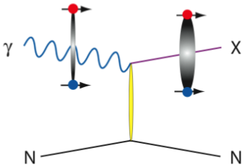
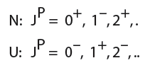
Photo-production of Exotic Hybrids
High energy real* photons incident on a liquid Hydrogen target
Recent LQCD calculations indicate similar radiative decay widths for charmonium hybrids as for normal mesons**
  (i.e. photo-production rates of hybrids should be similar to that of non-hybrid mesons)
Photons have spin-1 component allowing easier production of exotics compared to pion beams where a spin flip must occur
Linear polarization of incident photon allows us to distinguish naturalities of the exchange particle
linear polarization:
parity of exchange particle
p
detectable final state
p
9GeV linearly polarized
hybrid meson
* not virtual
(mixed charged and neutral)
**Dudek PRD 79 (2009) 094504

Slide 5
Amplitude Analysis
generated waves
1⁻⁺ exotic wave
generated with 1.6% relative strength
Corresponds to 3.5 hours GlueX data, full detector simulation and reconstruction

Slide 6








The JLab 12GeV Upgrade
6 GeV CEBAF
12 GeV CEBAF
11 GeV CEBAF
Upgrade magnets and power supplies
CHL-2
Two 1.1GV linacs
Two 0.6 GV linacs
Enhanced capabilities
in existing Halls
See Larry Cardman’s talk in session I2 this afternoon for more details on 12GeV upgrade and JLab’s overall physics program
Notes:
help me

Slide 7

Aerial photon taken April 6, 2012
Hall-D Complex
Electron beam accelerator
  continuous-wave
  (1497MHz, 2ns bunch
  structure in halls)
  Polarized electron beam
  Upgrading to 12GeV
  (from 6GeV)
  70 μA max @ 12Gev
  (200μA max @ 6GeV)

Slide 8
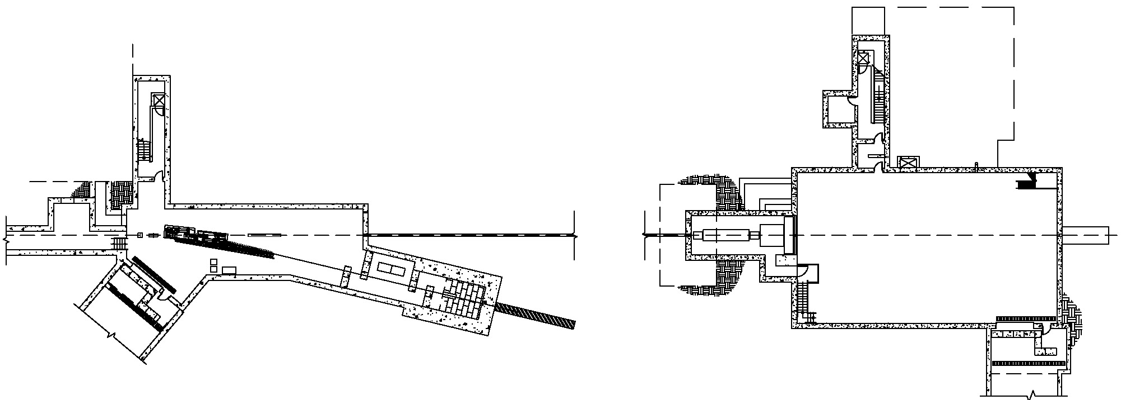
Photon beam and experimental area
Tagger
area
Hall D
North linac
Electron
Beam dump
Diamond
Radiator
East arc
Counting
House
Coherent Bremsstrahlung
photon beam
Pair
Spectrometer
Photon
Beam dump
Top View
75 m
12 GeV
e⁻
Solenoid-
Based detector
Collimator
Electron beam / dump
Tagger Area
Collimator Cave
Experimental
Hall D
Selection θ<25µr
polarized photons
Radiation e⁻ Z→ γ e⁻ Z
Target,
Spectrometer
Notes:
Lower radiation having tagger in separate building

Slide 9
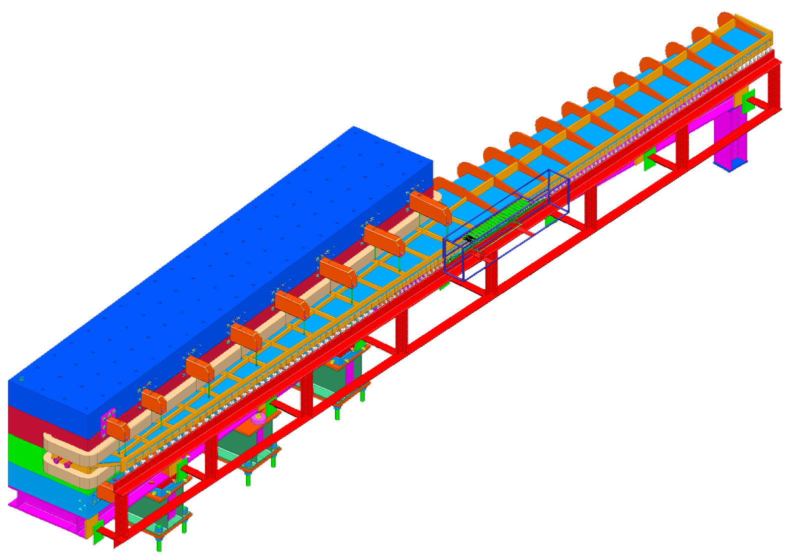
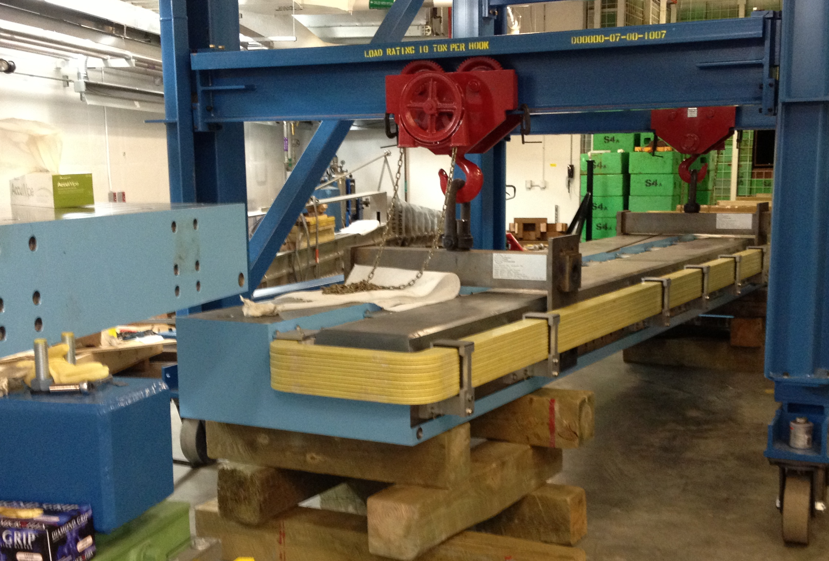
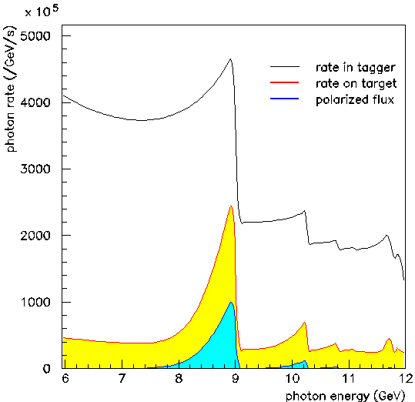
The Photon Tagger
photon
e⁻
12m long vacuum chamber
e⁻
1.5T dipole magnet
Microscope (Coherent Peak)
Scintillating fibers
SiPMs light sensors
120 readout channels
Tagger magnet installation
e⁻
4
Electron beam
20μm diamond radiator
Fabrication at UConn
Fixed Array (Eγ ~ 3-11.6 GeV)
Small scintillators
R9800 photomultipliers
Capable of 10⁸γ/s
on target
(ΔEγ=8.4-9GeV)
nominal
tagging
interval
Fabrication at CUA
Thinning and testing of thin crystals
UConn thinned a diamond to 40µm, ~25µr
GlueX goal is 20μm
Notes:
Collimator cuts black curve down to yellow

Slide 10
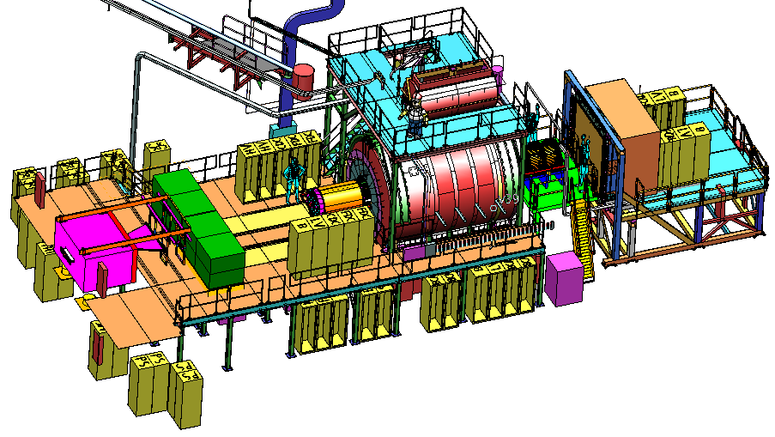
The GlueX Detector
2.2 Tesla
Solenoid
2.2T superconducting solenoidal magnet
Fixed target (LH₂)
10⁸ tagged γ/s (8.4-9.0GeV)
hermetic
γ beam
TOF
time of flight
SC
start counter
Charged particle tracking
Central drift chamber (straw tube)
Forward drift chamber (cathode strip)
Calorimetry
Barrel Calorimeter (lead, fiber sandwich)
Forward Calorimeter (lead-glass blocks)
PID
Time of Flight wall (scintillators)
Start counter
Barrel Calorimeter
Notes:
Boxes are electronics racks with no electronics

Slide 11
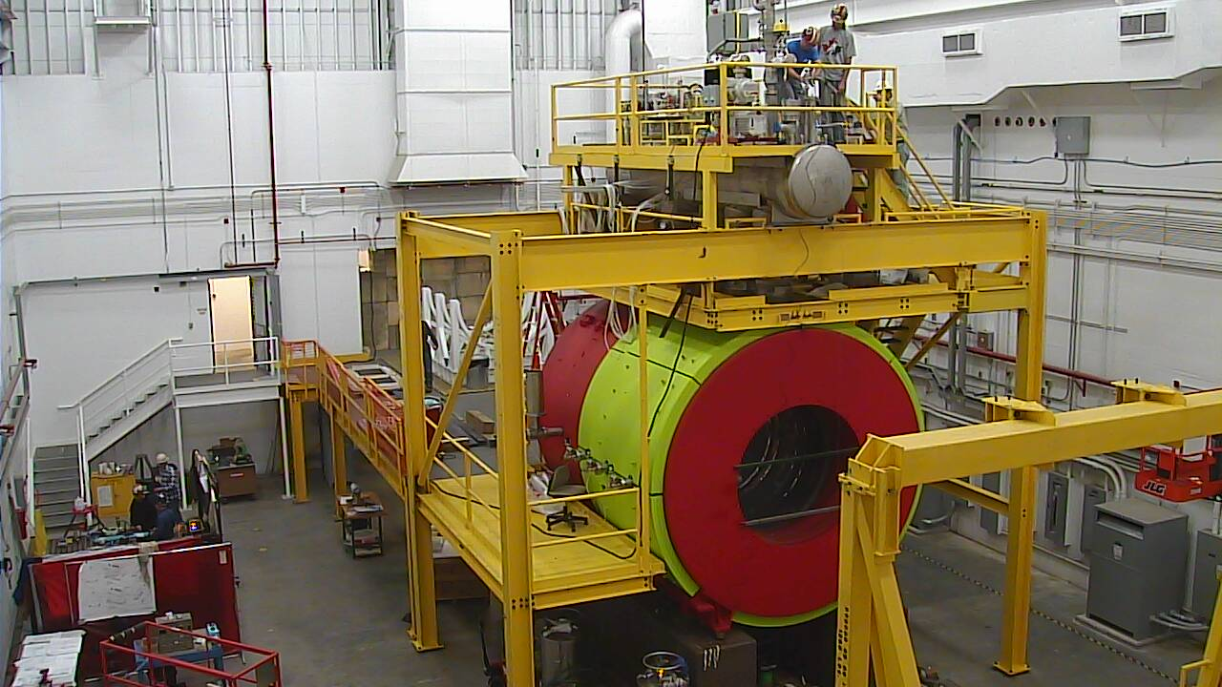
Solenoid: testing in progress
Used for LASS at SLAC, for MEGA at Los Alamos, refurbished for GlueX
Four separate coils, all different, “Cryo-stable” design
Bore ID=185cm, length 400cm, Bmax=2.2T
Full energy at 1500A is ~30 MJ
Field strength increases toward the downstream end of the magnet

Slide 12
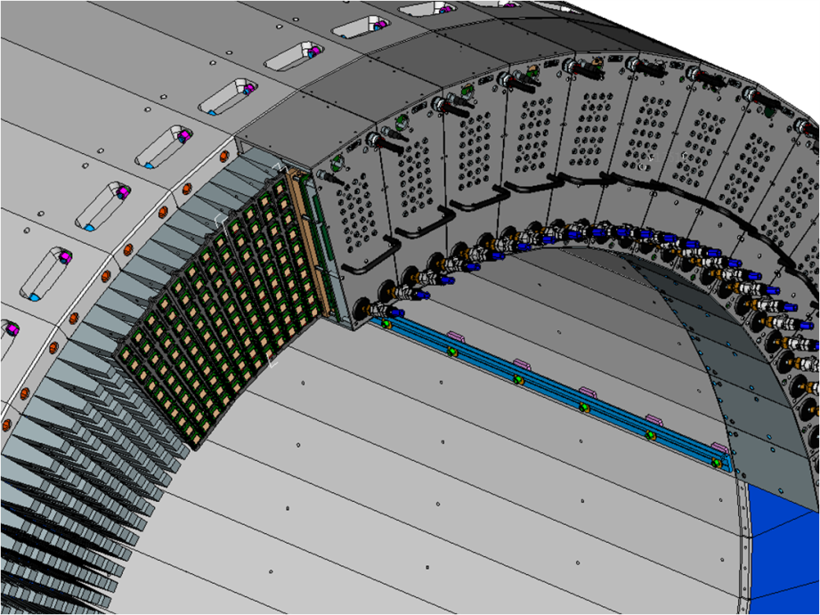
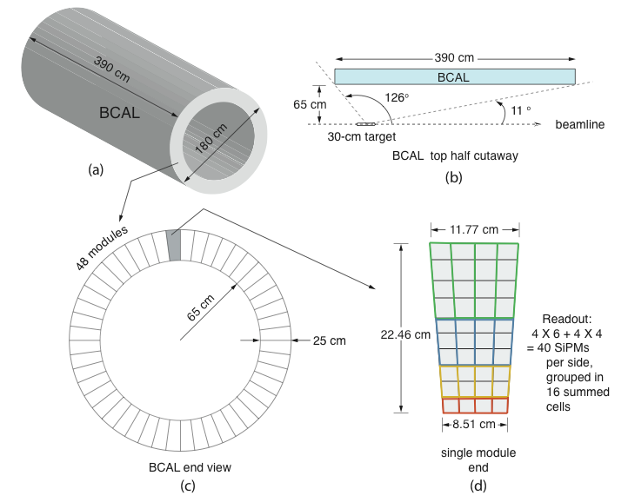
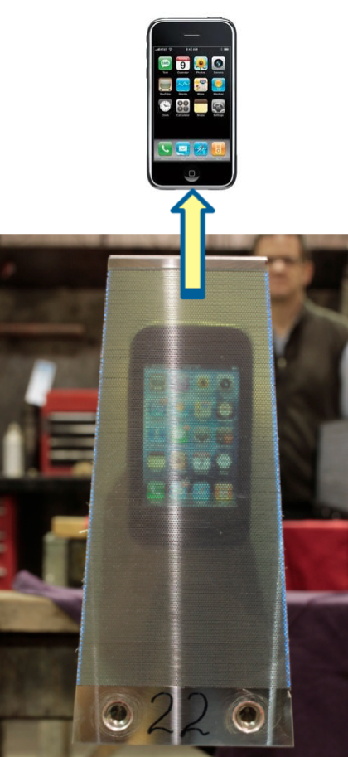
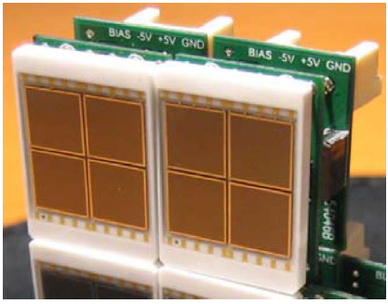
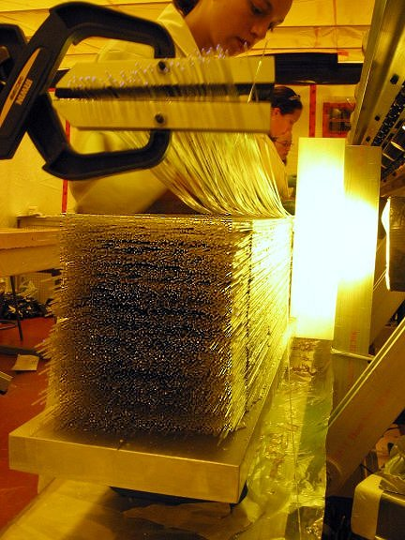
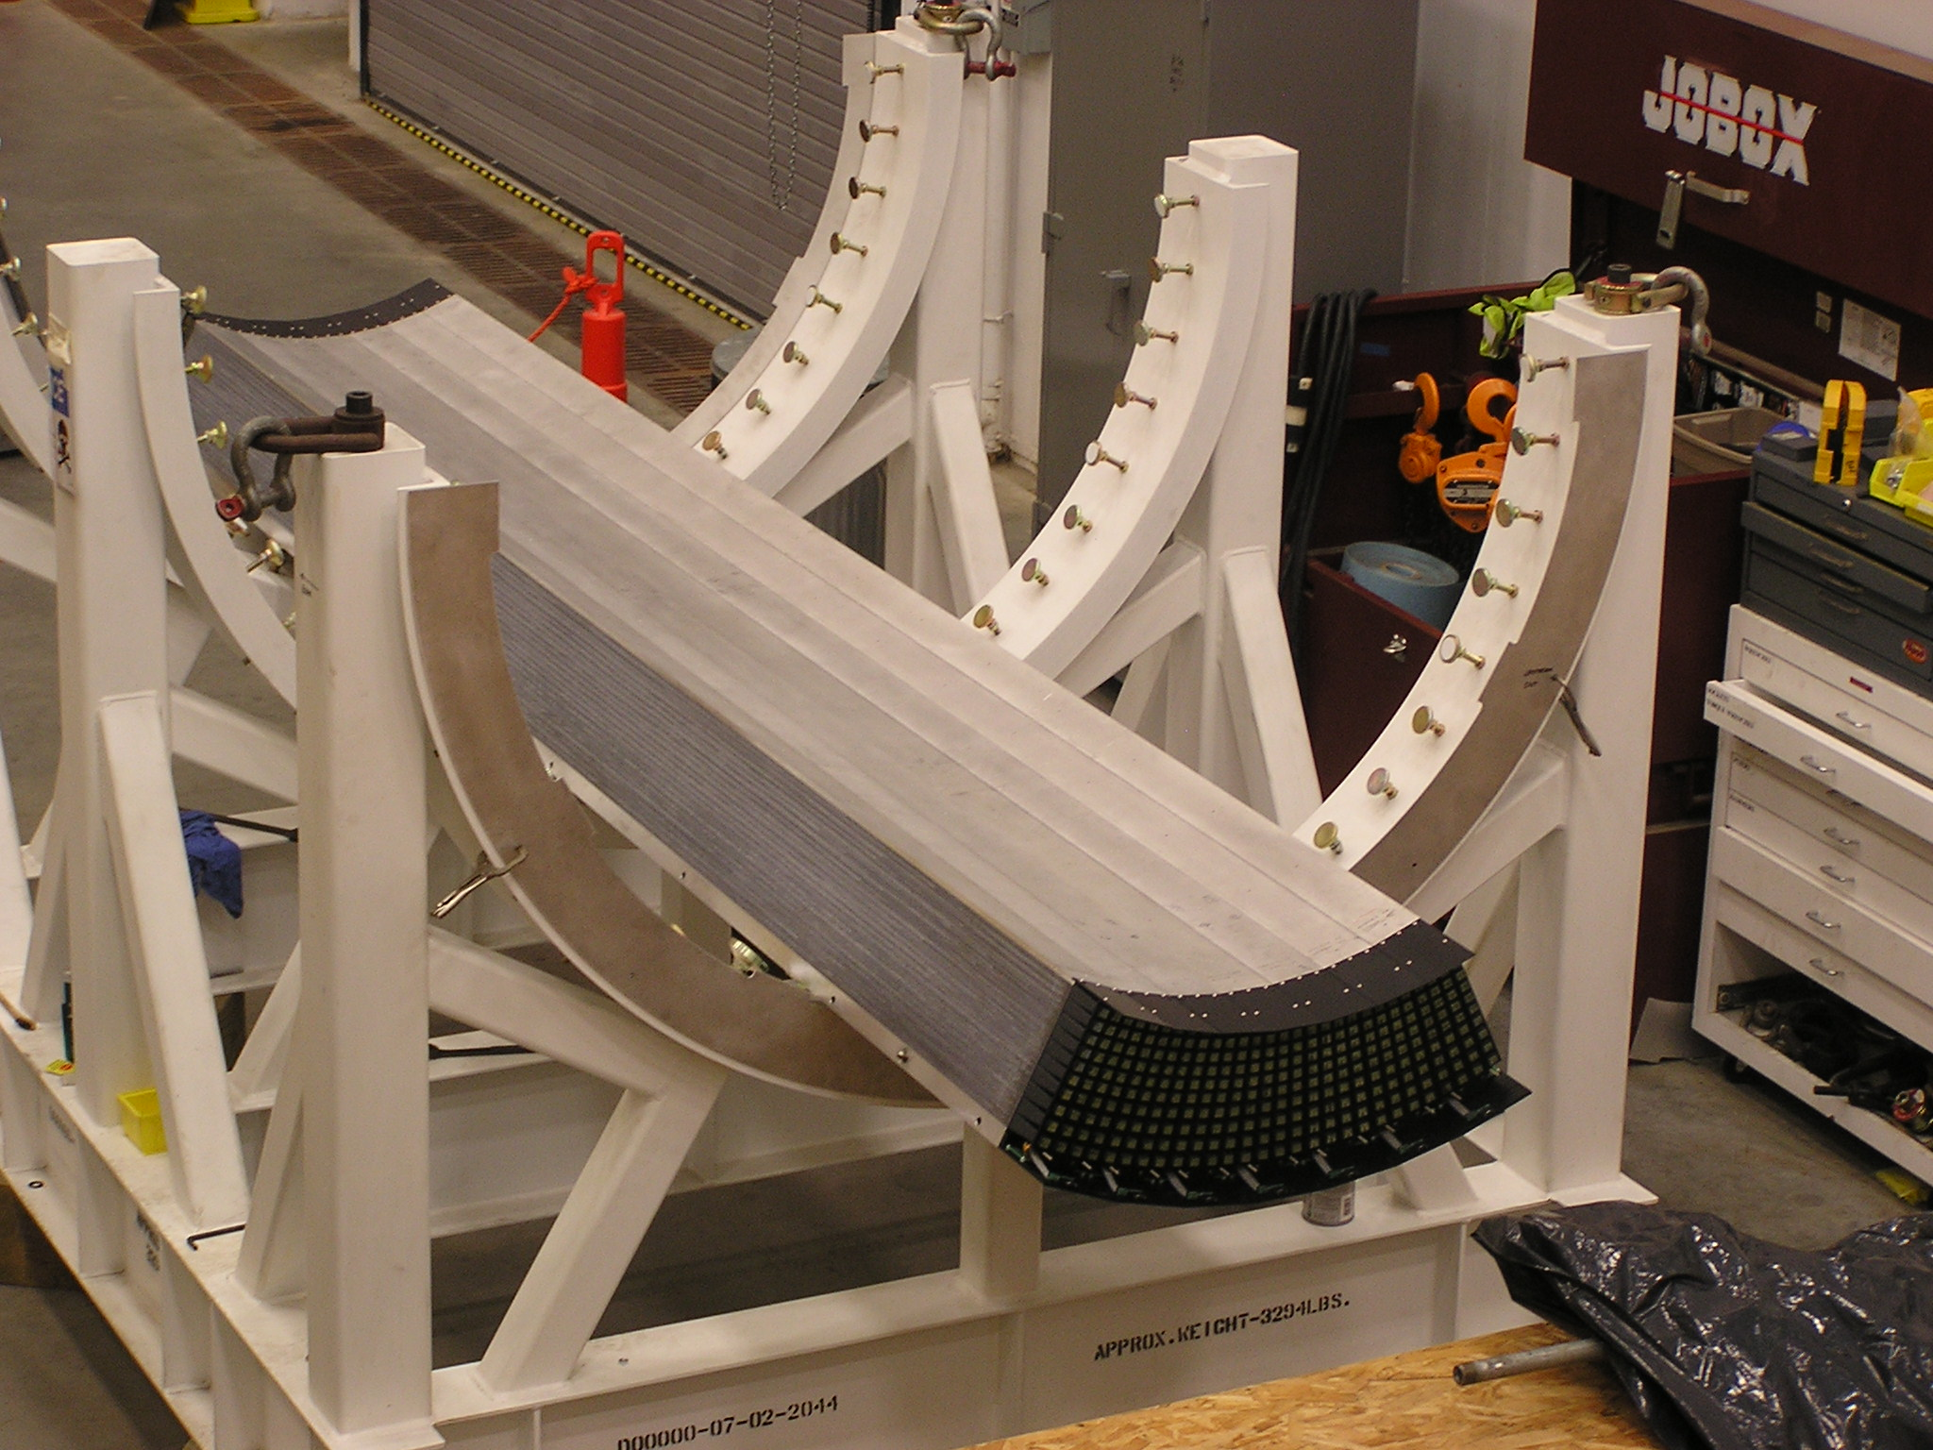
BCAL: Barrel Calorimeter
BCAL design modeled after KLOE EMC
48 modules (phi sectors)
Readout unit
Light guides
SiPMs
Immune to
magnetic fields!
12 mm
Completed BCAL module. The iPhone is placed against the opposing surface of the 4 meter module.
BCAL module under construction. Approximately 30k plastic fibers are used in 191 layers to make one module.
Pb/Sc/Glue = 37/49/14 % (by volume)

Slide 13
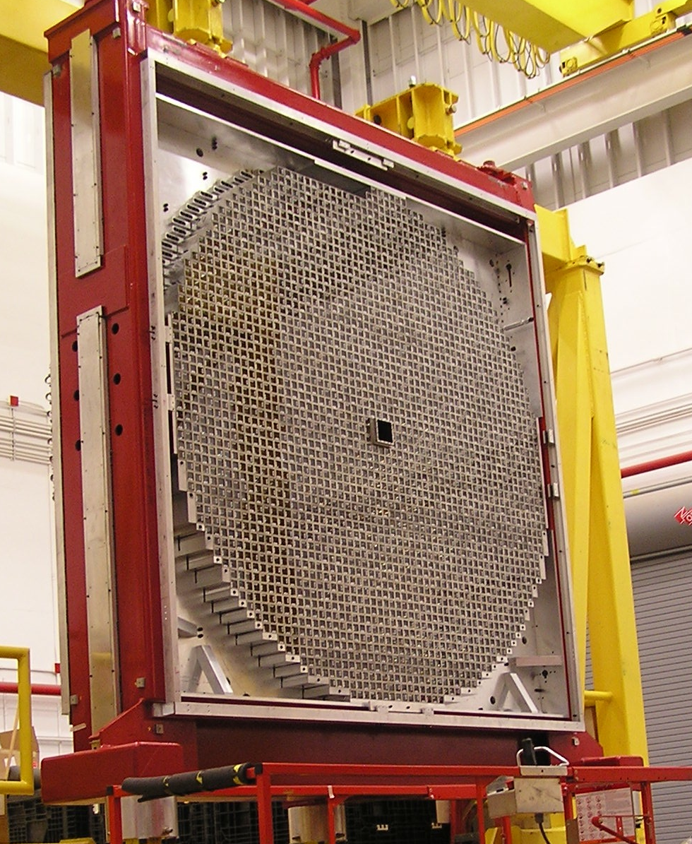
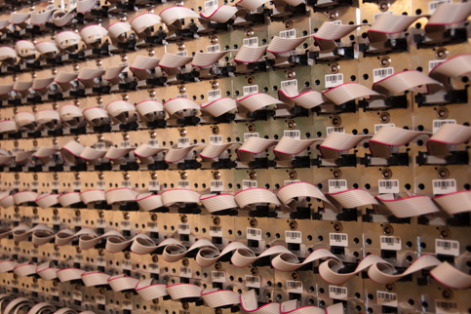
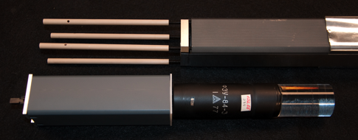
Forward Calorimeter
Lead Glass Calorimeter
2800 lead glass F8-00 blocks 4x4x45cm³
PMTs FEU84-3
Cockroft-Walton bases
Fabricated at Indiana University
Beam test with e⁻ in Hall B, 2012
σ_{E}/E=20% at 100 MeV – as expected
Calorimeter assembled in Hall D
Cockroft-Walton bases under test at IU
Single parts for module assembly

Slide 14
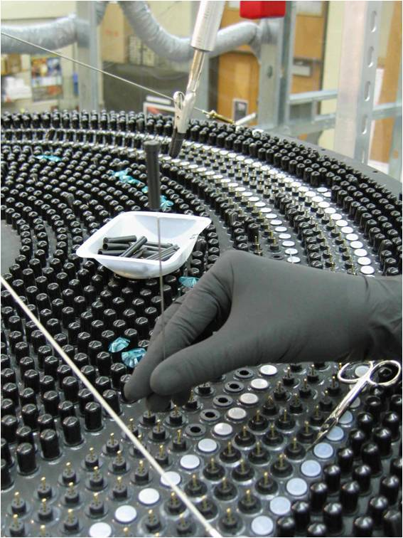
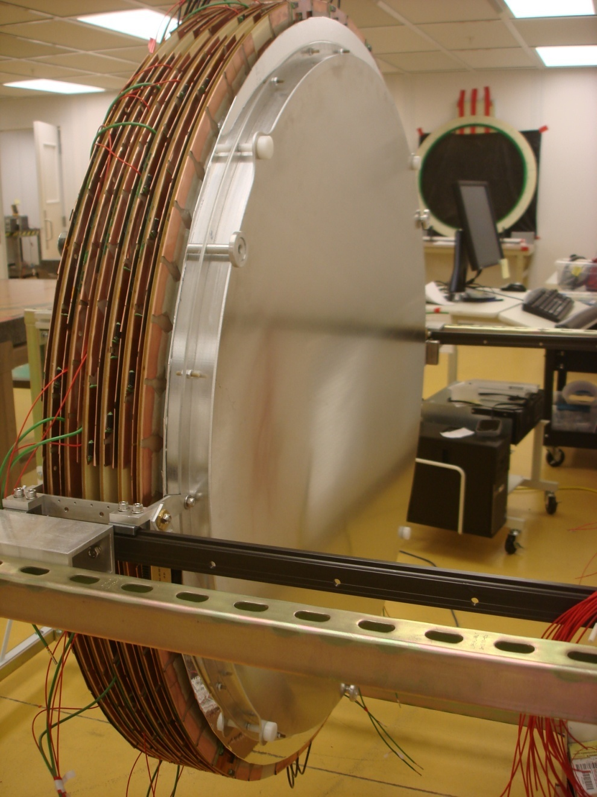
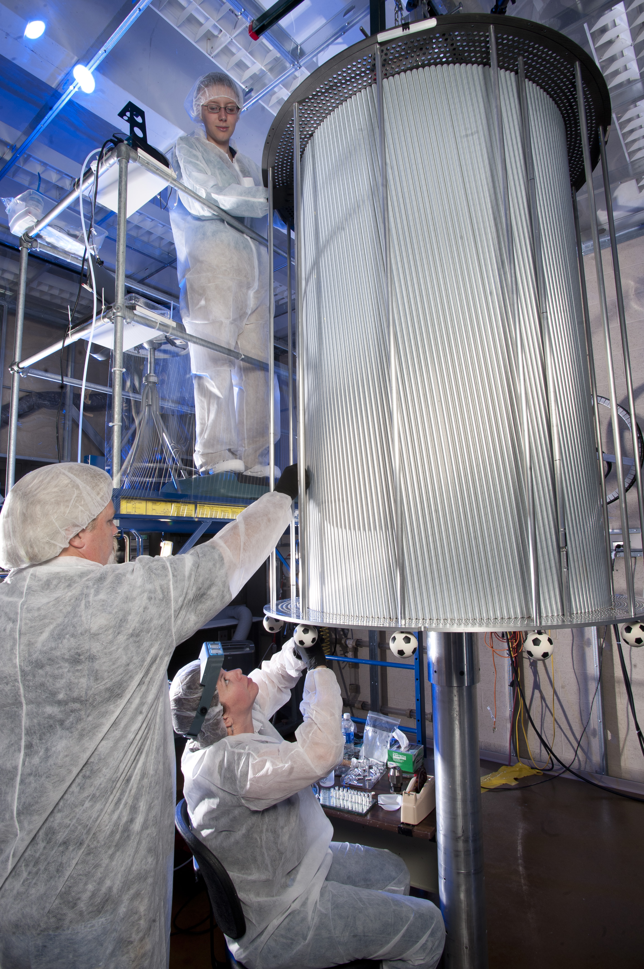
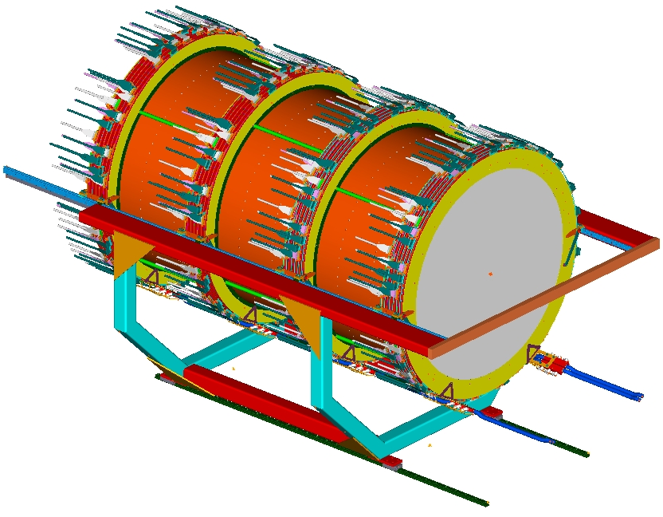
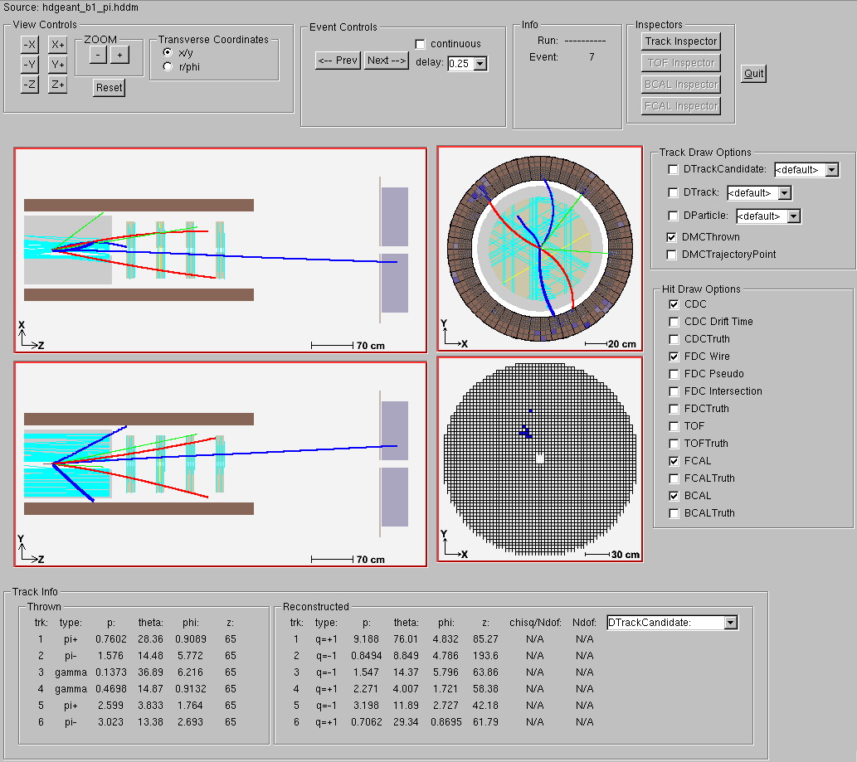
Charged Particle Tracking
Central Drift Chamber (CDC):
Gas mixture: ~60/40 Ar/CO₂
Angular Coverage: 6º-155º
3500 straw tubes r=8mm
dE/dx for p < 450 MeV/c
Readout: FADC-125MHz
Resolution: σ_{rφ} ~ 150 μm
σ_{z}~1.5 mm
28 layers total
stereo layers: +/- 6⁰
Forward Drift Chamber (FDC):
Gas Mixture: 40/60 Ar/CO₂
Angular Coverage: 1º – 30º
Readout:
2300 anode wires → F1TDC
10200 cathode strips → FADC-125
3 measured projections per plane
Resolution: 200μm wires
200μm strips
A Forward Drift Chamber (FDC) being tested in the lab. The GlueX detector will have 4 of these custom made chambers.
4 packages × 6 planes
The Central Drift Chamber (CDC) being constructed at Carnegie Melon University. Construction is done with the device in the vertical position, but it will be turned sideways for installation.
Cables

Slide 15
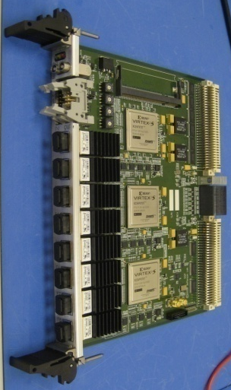
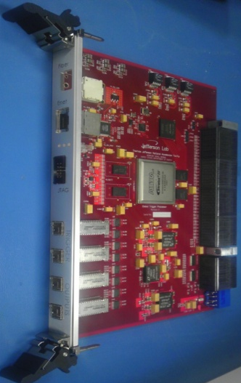
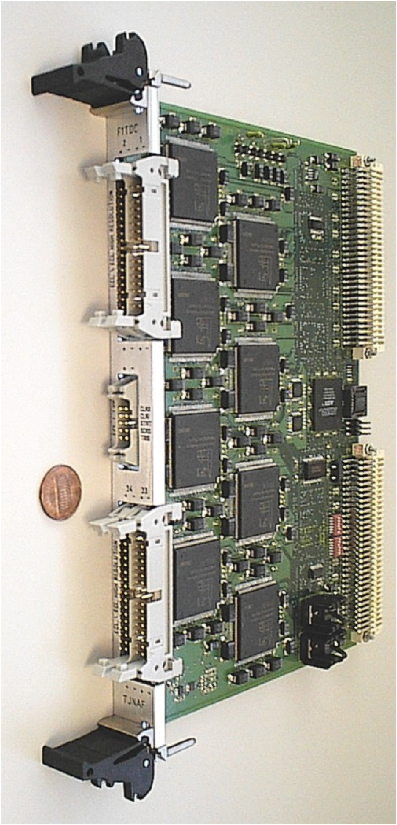
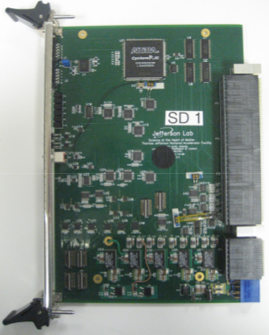
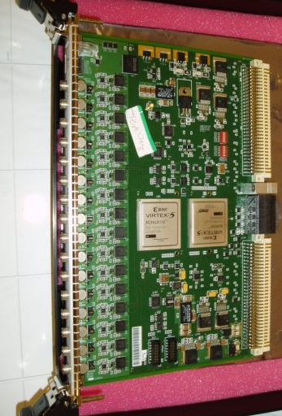
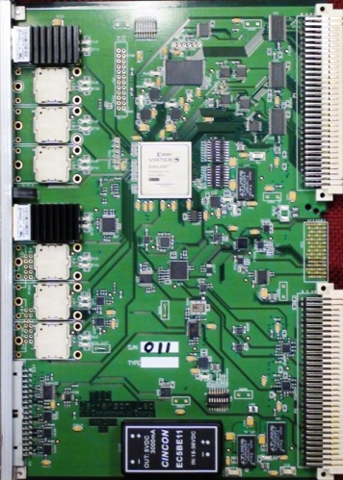
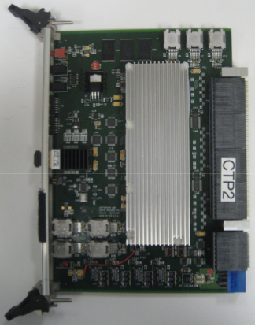
Electronics and Data Rates
Electronics
All digitization electronics are fully pipelined (VME64x-VXS)
  F1TDC (60 ps, 32 ch. or 115 ps 48 ch.)
  125 MHz fADC (12 bit, 72 ch.)
  250 MHz fADC (12 bit, 16 ch.)
    - integrated into L1 trigger
Trigger latency ~3 μs
3GB/s readout from front
end
300MB/s to mass storage
3PB/yr to tape
Sub-system Processor
Global Trigger Processor
F1TDC
250MHz Flash ADC
Trigger Interface
Signal distribution board
Crate Trigger Processor

Slide 16
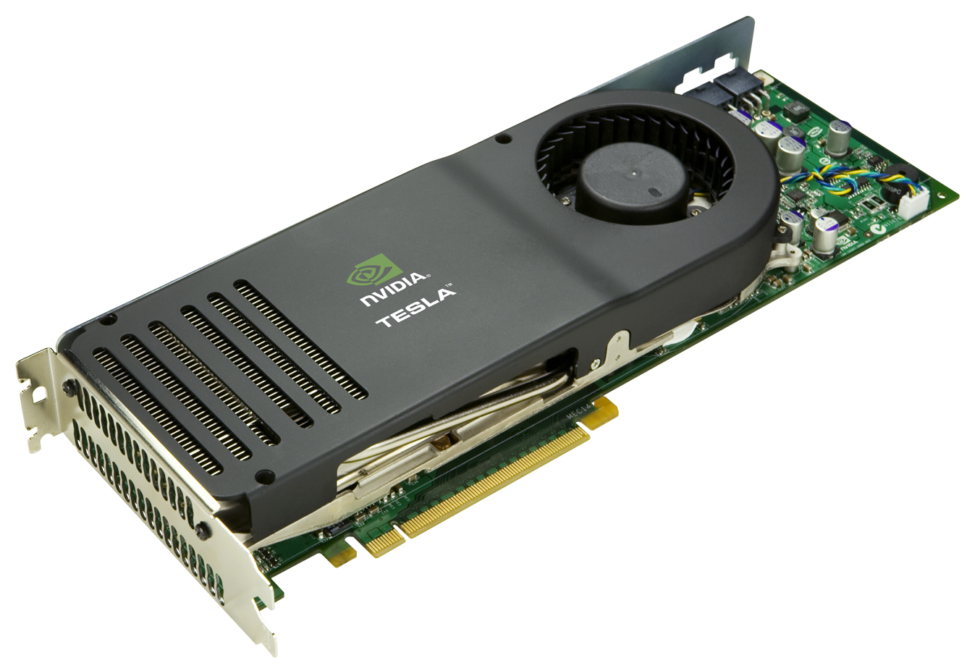
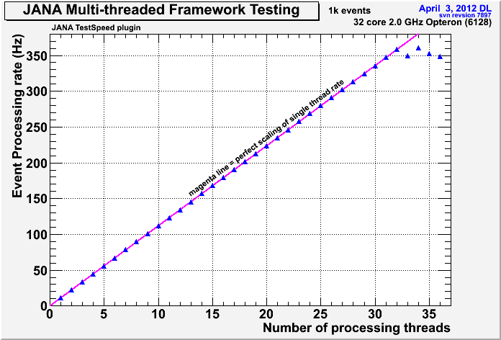
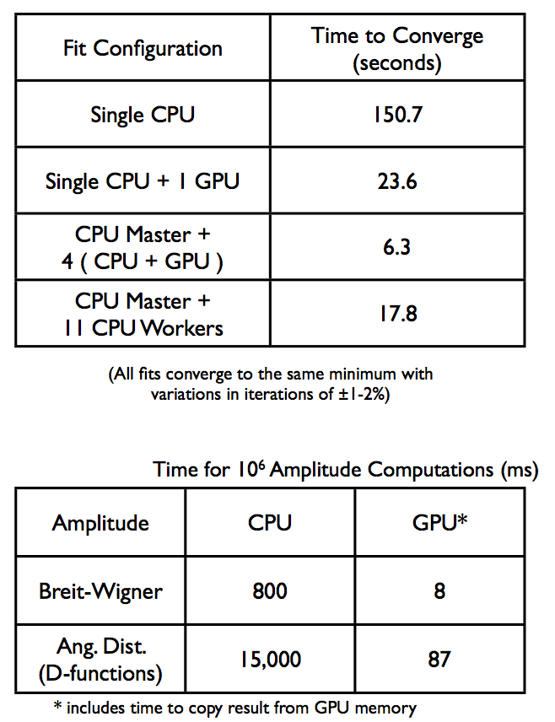
Offline Computing
Multi-threaded event reconstruction
Amplitude Analysis on GPUs

Slide 17
Summary
GlueX: Search for exotic hybrid mesons
  Map exotic hybrid spectrum with polarized photon beam up to up to M ~ 2.8 GeV with sensitivities of a few percent of the total cross section.
  The civil construction and accelerator are >90% complete and the experimental equipment is 50-60% obligated.
Schedule
    Accelerator commissioning is planned for Oct 2013
  Hall-D detector commissioning starts in Oct 2014
  Production data taking in 2015
Other physics
  Approved:
    Precision measurement of η radiative decay width via Primakoff Effect
  Proposed:
    An initial study of mesons and baryons containing strange quarks with GlueX (arXiv:1305.1523)
    Measuring the Charged-π Polarizibility in the γγ → π+π− Reaction
    Symmetry Tests of Rare η Decays to All-Neutral Final States:
    The JLab η Factory (JEF) Experiment

Slide 18
Backup Slides

Slide 19
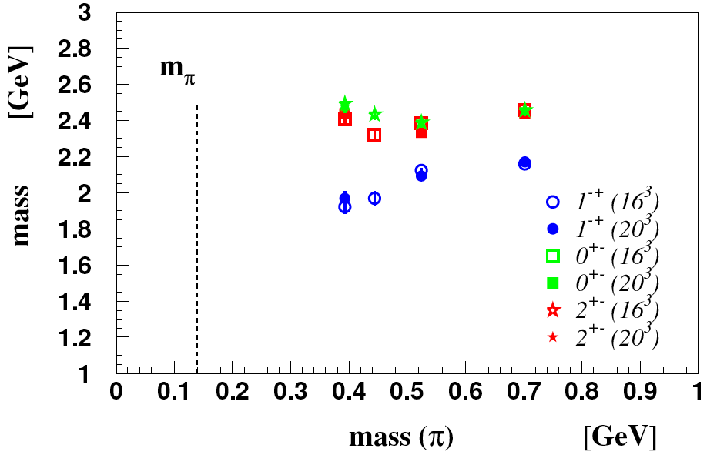
Extrapolation to physical mass
At m_{π}=400 MeV, mass (1⁻⁺) ~ 1.9 GeV, mass (0⁺⁻) ~ 2.5 GeV

Slide 20
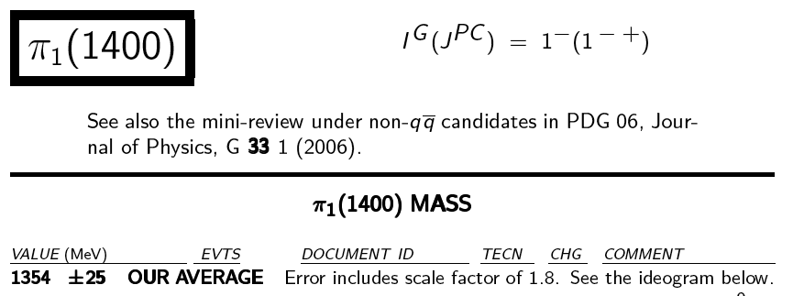
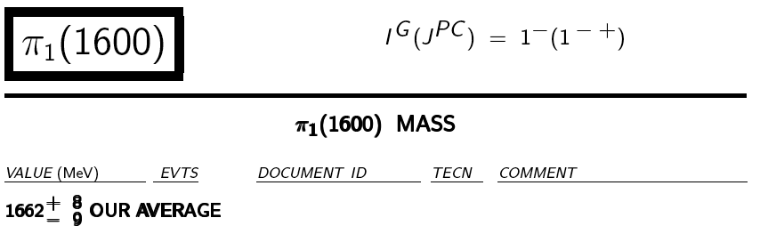
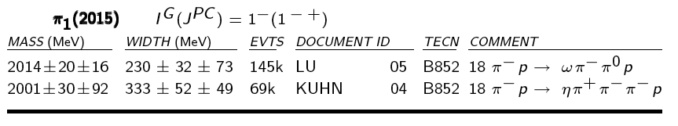
Experimental evidence for 1⁻⁺ exotic hybrids
Unlikely Hybrid
Dynamical origin?
May be hybrid
Challenge in 3π
to separate exotic π₁ from π₂
Cleaner η’π signal
Listed among “further states” Needs confirmation

Slide 21
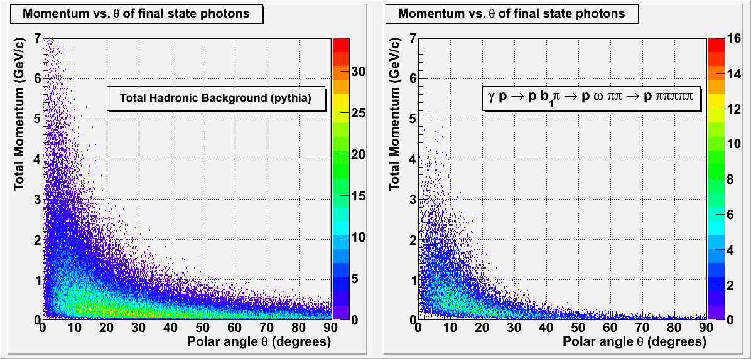
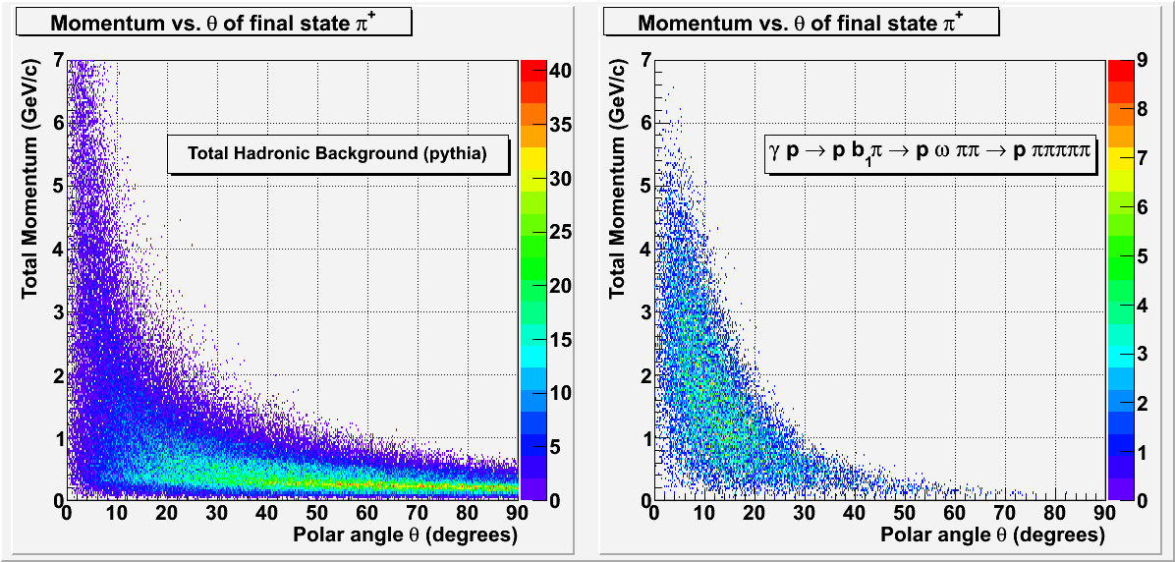
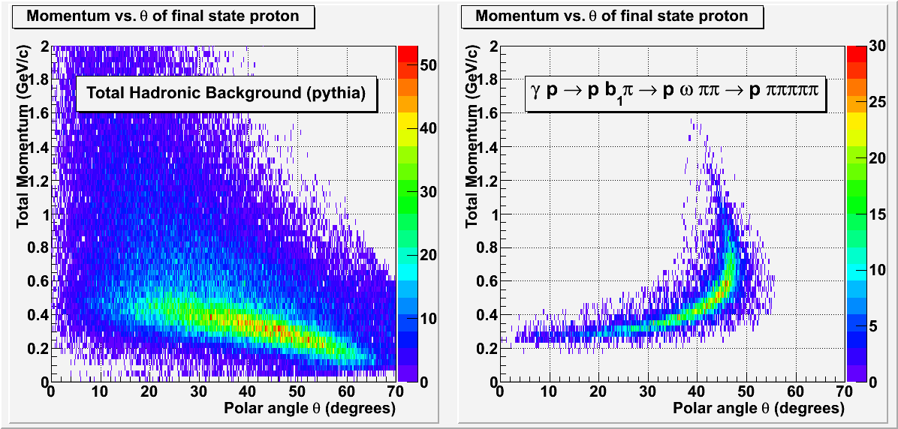
Exotic Hybrid Decays
γ
γ
The exotics will tend to decay into an s-wave meson and a p-wave meson
Multiple generations of decays will occur before reaching a set of particles long-lived enough to be detected
Two examples of the possible decay chain of “X”
π⁺
π⁺
(“X” will have a lifetime on the order of 10⁻²⁰ seconds)
detectable final state
9GeV linearly polarized
hybrid meson
(mixed charged and neutral)
p
p

Slide 22

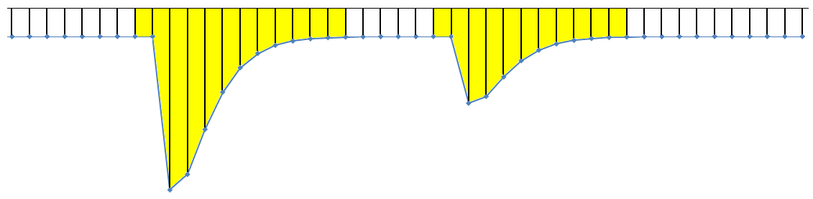

Modern method of signal capture: all pipeline
Gigabit
Serial
Trigger
Data
200 KHz L1 trigger rate
Trigger Pulse
Pre-Processing
250MHz
Sample Clock
Capture Window
Energy & Time Algorithms
Event #1
Event #2
VME
Readout
detector
signal
FADC
12-bit
ADC Sample Pipeline
Physics
‘Event’
Trigger Input
Trigger #1
Trigger #2
250MHz Flash ADC stores digitized signal in 8μs circular memory
Trigger data contains detailed information useful for cluster finding, energy sum, etc.
“Event” trigger extracts a window of the ADC data for pulse sum and time algorithms
Hardware algorithms provide a huge data reduction by reporting only time & energy estimates for readout instead of raw samples

Slide 23
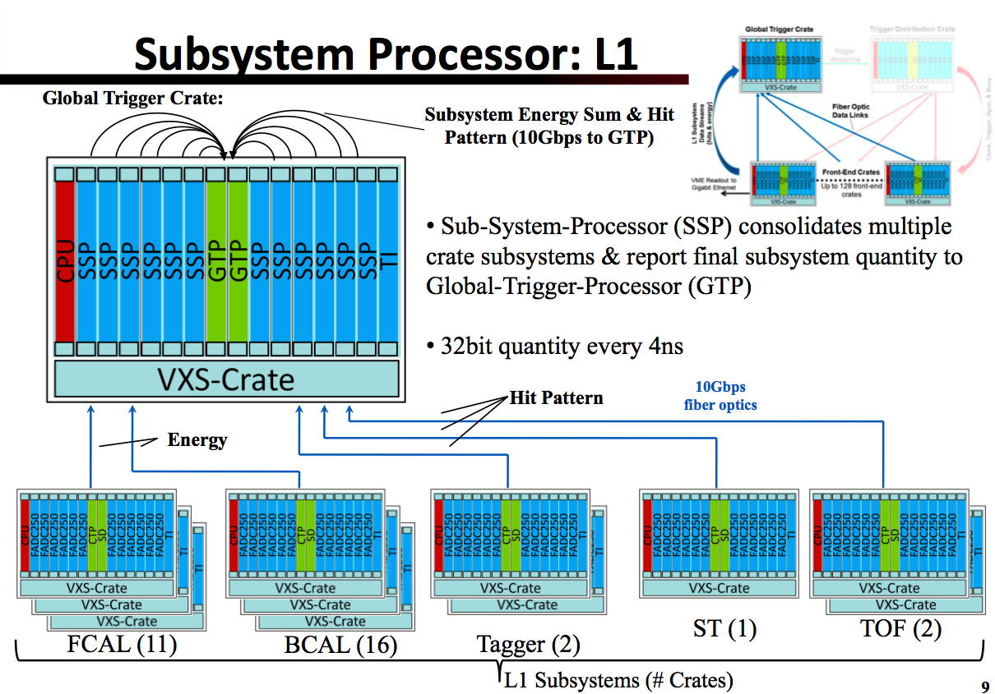
Trigger System
slide stolen from C. Cuevas’ talk at May 2010 GlueX Collab. Meeting

Slide 24
GlueX Data Rates
David Lawrence, Jefferson Lab
 | Front End DAQ Rate | Event Size | L1 Trigger Rate | Bandwidth to mass Storage
GlueX | 3 GB/s | 15 kB | 200 kHz | 300 MB/s
CLAS12 | 0.1 GB/s | 20 kB | 10 kHz | 100 MB/s
ALICE | 500 GB/s | 2,500 kB | 200 kHz | 200 MB/s
ATLAS | 113 GB/s | 1,500 kB | 75 kHz | 300 MB/s
CMS | 200 GB/s | 1,000 kB | 100 kHz | 100 MB/s
LHCb | 40 GB/s | 40 kB | 1000 kHz | 100 MB/s
STAR | 50 GB/s | 1,000 kB | 0.6 kHz | 450 MB/s
PHENIX | 0.9 GB/s | ~60 kB | ~ 15 kHz | 450 MB/s
private comm.
JLab
CHEP2007 talk
Sylvain Chapelin
LHC
BNL
*
**
* Jeff Landgraf Private Comm. 2/11/2010
** CHEP2006 talk Martin L. Purschke. current capability is 800MB/s peak, 500MB/s sustained (priv. comm. 2/14/2010)

Slide 25
Hall D: Detector Design Parameters
Capability | Quantity | Range
Charged particles | Coverage | 1º < θ < 160º
 | Momentum Resolution (5º-140º) | σ_{p}/p = 1 − 3%
 | Position resolution | σ ~ 150-200 μm
 | dE/dx measurements | 20 < θ < 160º
 | Time-of-flight measurements | σ_{ToF} ~ 60 ps; σ_{BCal} ~ 200ps
 | Barrel time resolution | σ_{t} ^{γ} < (74 /√E 33) ps
Photon detection | Energy measurements | 2º < θ < 120º
 | LGD energy resolution (E > 60 MeV) | σ_{E}/E = (5.7/√E 2.0)%
 | Barrel energy resolution (E > 60 MeV) | σ_{E}/E =(5.54/√E 1.6)%
 | LGD position resolution | σ_{x,y,} ~ 0. 64 cm/√E
 | Barrel position resolution | σ_{z} ~ 0.5cm /√E
DAQ/trigger | Level 1 | < 200 kHz
 | Level 3 event rate to tape | ~ 15 kHz
 | Data rate | 300 MB/s
Electronics | Fully pipelined | 250 / 125 MHz fADCs, TDCs
Photon Flux | Initial: 10⁷ γ/s | Final: 10⁸ γ/s
Page 25

Slide 26
Detector Rates
Avg. number of hits per L1-trigger event
Total bytes per signal event by digitizer type
Detector | E.M. | Hadronic Eγ<8.0GeV | Hadronic Eγ>8.0GeV
Start Counter | 2.7 | 3.2 | 4.0
BCAL | 6.19 | 83.6 | 112.2
FCAL | 11.5 | 8.9 | 17.9
TOF | 32.3 | 28.7 | 38.8
CDC | 49.9 | 62.7 | 70.5
FDC anode | 28.9 | 28.3 | 46.9
FDC cathode | 275.8 | 269.9 | 444.6
Tagger | 25 | 25 | 25
Detector | Nhits | bytes/hits | header bytes
F1TDC | 285 | 4 | 548
FADC-125 | 1518 | 8 | 752
FADC-250 (wihout timing) | 180 | 4 | 808
FADC-250 (with timing) | 18 | 8 | 700
Average size of all L1 triggered events: 15kB
(Event Size for L1 triggered Eγ>8.0GeV : 16.5kB)
Front-end data rate for high luminosity running
15kB/event * 200k events/sec = 3GB/sec
For high luminosity running, Level-3 trigger will reject 90% of events
For low luminosity running, all events will be kept.
Data rate to tape: 300MB/sec

Slide 27
A single γ p ➔ pb₁π event
Final state: p π⁺ π⁺ π⁻ π⁻ πº

Slide 28
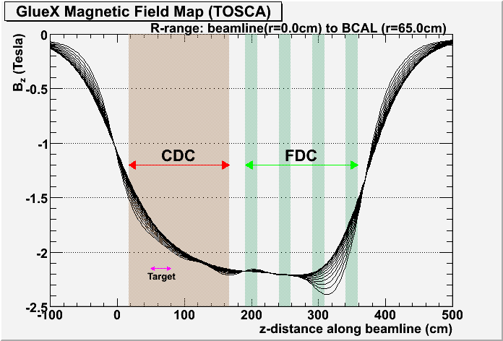
Inhomogeneous Magnetic Field Map (φ-symmetric)

Slide 29
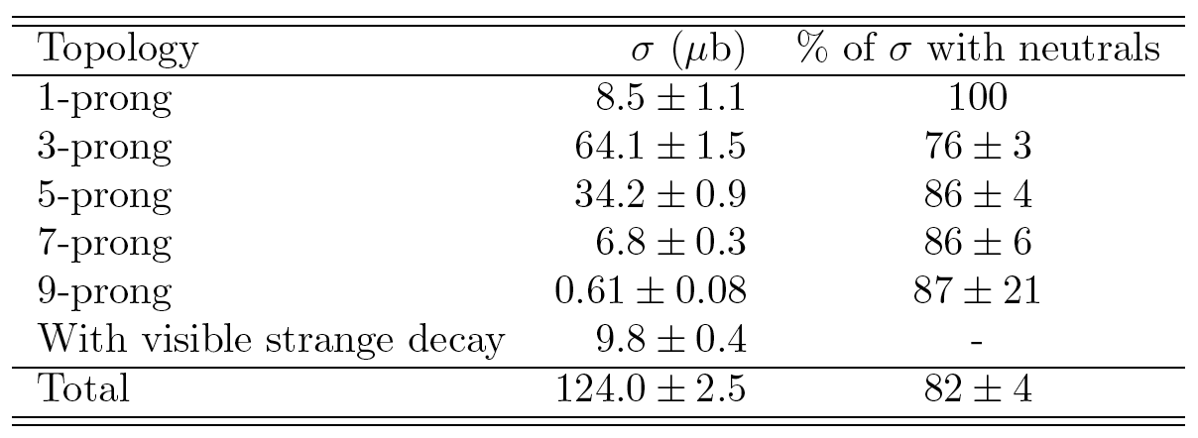
Photoproduction
Decomposition of total cross section E_{γ} = 9.3 GeV
Approximately 70% of total cross section in the energy region E_{γ} ~ 7-12 GeV has multiple neutrals and is completely unexplored

Slide 30
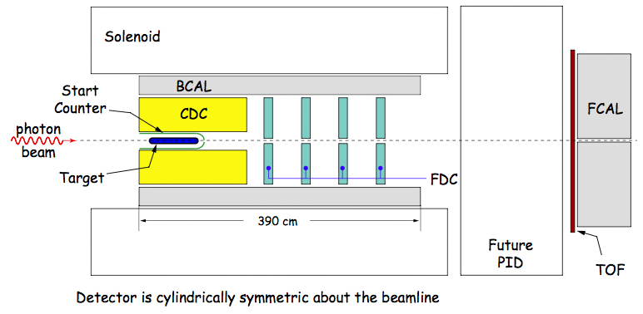
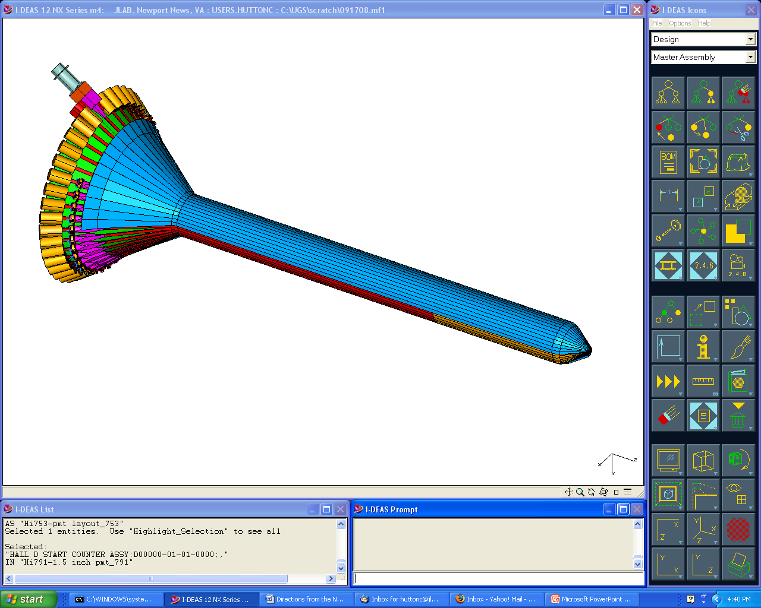
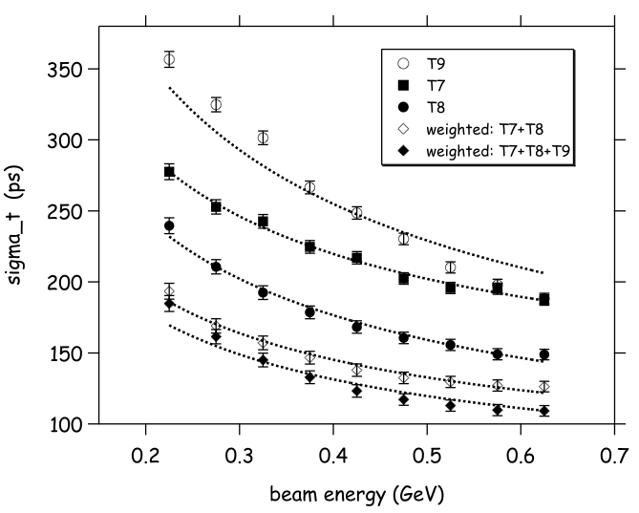




Particle ID
Particle ID is done primarily through time of flight with some help from dE/dx in chambers. Space is left in design for a future PID detector.
Beam Test Data
Expected Separation
~200 ps
Start Counter
Barrel Calorimeter
40 scintillators
300 ps (w/tracking)
Used for start-up
σ_{diff} (ps)
~80 ps
CDC dE/dx
Forward TOF
σ_{diff} (ns)
πp separation <450MeV/c
πK separation <275MeV/c

