Slide 1



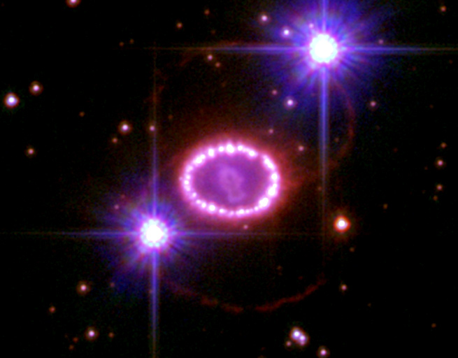
Low-energy enhancement of nuclear γ strength and its impact on astrophysical reaction rates
Ann-Cecilie Larsen, Post doc, OCL/SAFE, University of Oslo
Funding from the Research Council of Norway, project no. 205528
International Nuclear Physics Conference 2013, Florence, 2-7 June 2013

Slide 2
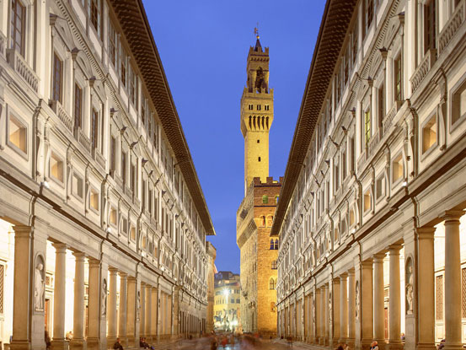
Collaborators
The Oslo group: T. K. Eriksen, F. Giacoppo, A. Görgen, M.Guttormsen, T. W. Hagen, P. Koehler, H. T. Nyhus, J. Rekstad, T. Renstrøm, S. J. Rose, I.E. Ruud, S. Siem, and G. M. Tveten; technical staff: J. C. Müller, E. A. Olsen, A.Semchenkov and J. Wikne
Stephane Goriely, Université Libre de Bruxelles
Sotirios Harrisopulos, NCSR “Demokritos”
Alexander Voinov, Ohio University
Lee Bernstein and Darren Bleuel, Lawrence Livermore National Lab
Mathis Wiedeking, iThemba LABS
Angela Bracco, Franco Camera, Silvia Leoni, Nives Blasi, Benedicte Million, INFN Milano
Ronald Schwengner, HZDR Dresden
Stefan Frauendorf, University of Notre Dame
Rick Firestone, Lawrence Berkeley National Lab
Jonathan Wilson and Baptist Leniau, IPN Orsay
Frank Gunsing, CEA Saclay
Milan Krticka, Charles University
Notes:
LaBr3: 12 mill counts; NaI: 66 mill counts. Per NaI detector 3 mill counts, per LaBr3 detector, 2 mill counts. Remember high threshold on CFD for LaBr3

Slide 3
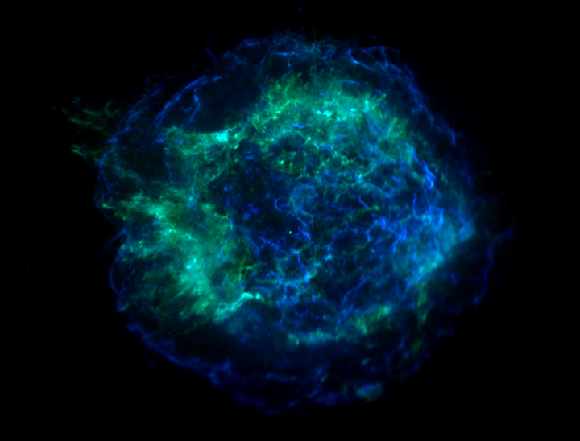
Outline
Introduction
Experiments @ OCL
Low-energy enhancement in γ strength
Cd and Fe isotopes – new data
Calculated (n,γ) reaction rates
Summary & future plans
Notes:
LaBr3: 12 mill counts; NaI: 66 mill counts. Per NaI detector 3 mill counts, per LaBr3 detector, 2 mill counts. Remember high threshold on CFD for LaBr3

Slide 4
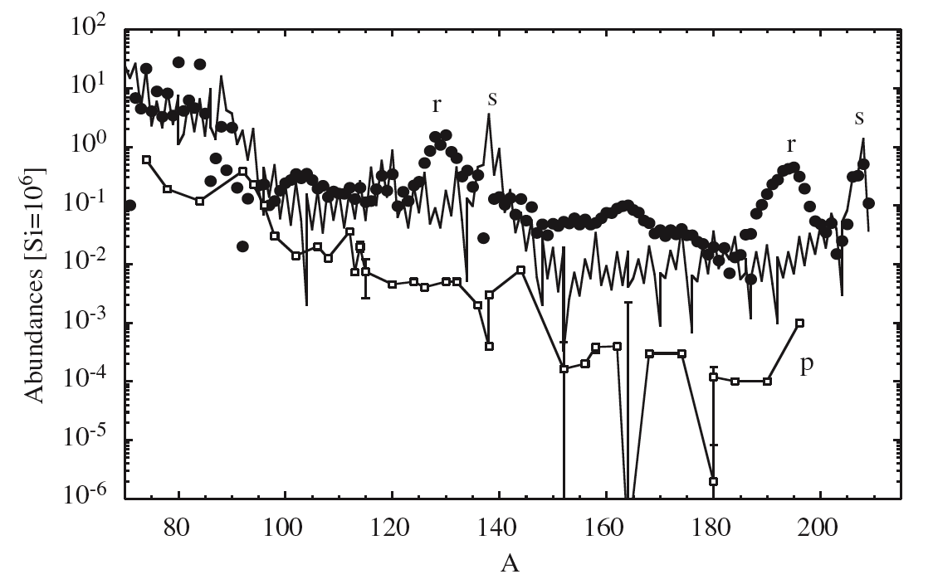
Heavy-element abundances and
Maxwellian-averaged reaction rates
M. Arnould, S. Goriely, and K.Takahashi,
Phys. Rep. 450, 97 (2007)
In large network calculations (r-process):
≈ 5000 nuclei, ≈50 000 cross sections
OMP
Level density
Gamma strength function

Slide 5
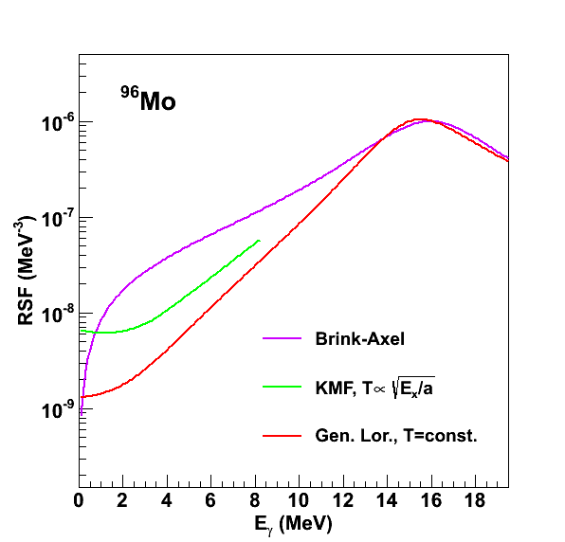
Nuclear γ strength function
A measure on the average, nuclear electromagnetic response, directly related to reduced transition probabilities B(XL) and γ-transmission coefficients
Fruitful concept in the quasi-continuum/continuum region (high level density)
E_{x}
⁹⁶Mo
No universal, theoretical description
for all mass regions and phenomena!
γ strength function (MeV⁻³)
g.s.
Gamma energy (MeV)

Slide 6
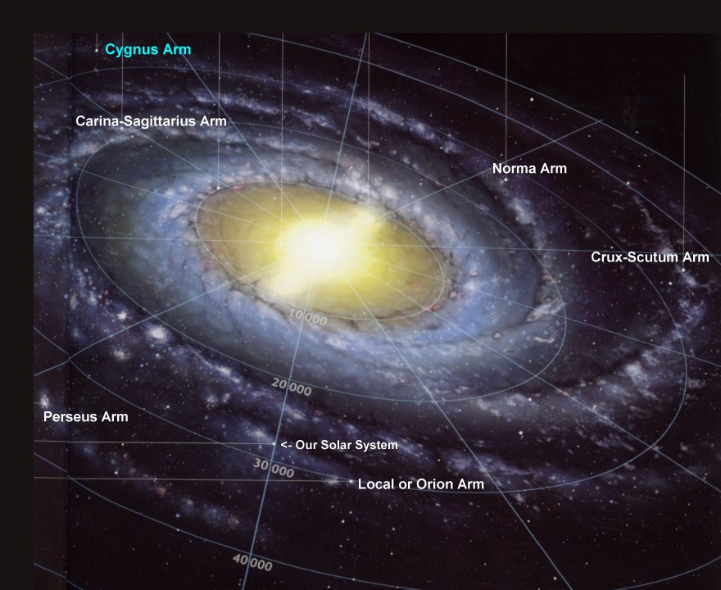
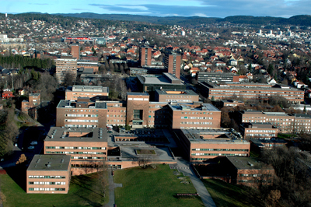

Experiments @ OCL

Slide 7
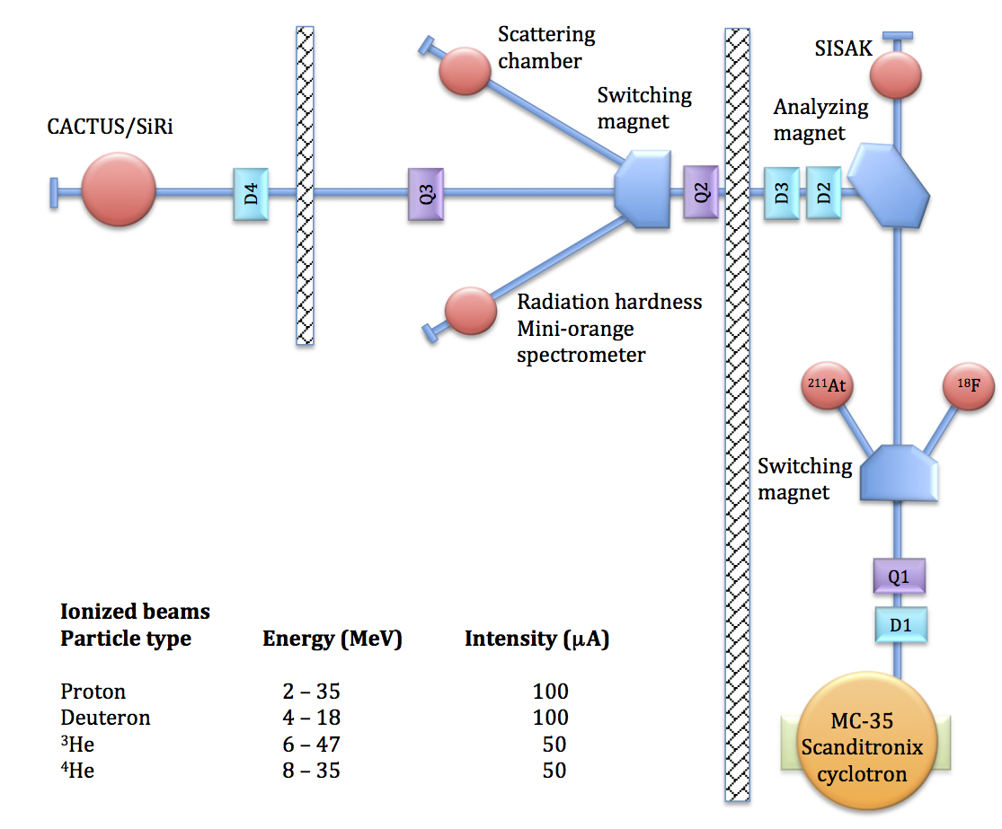
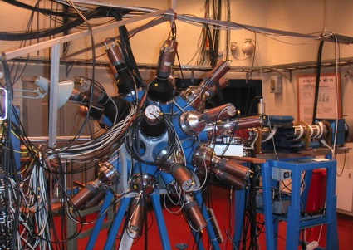
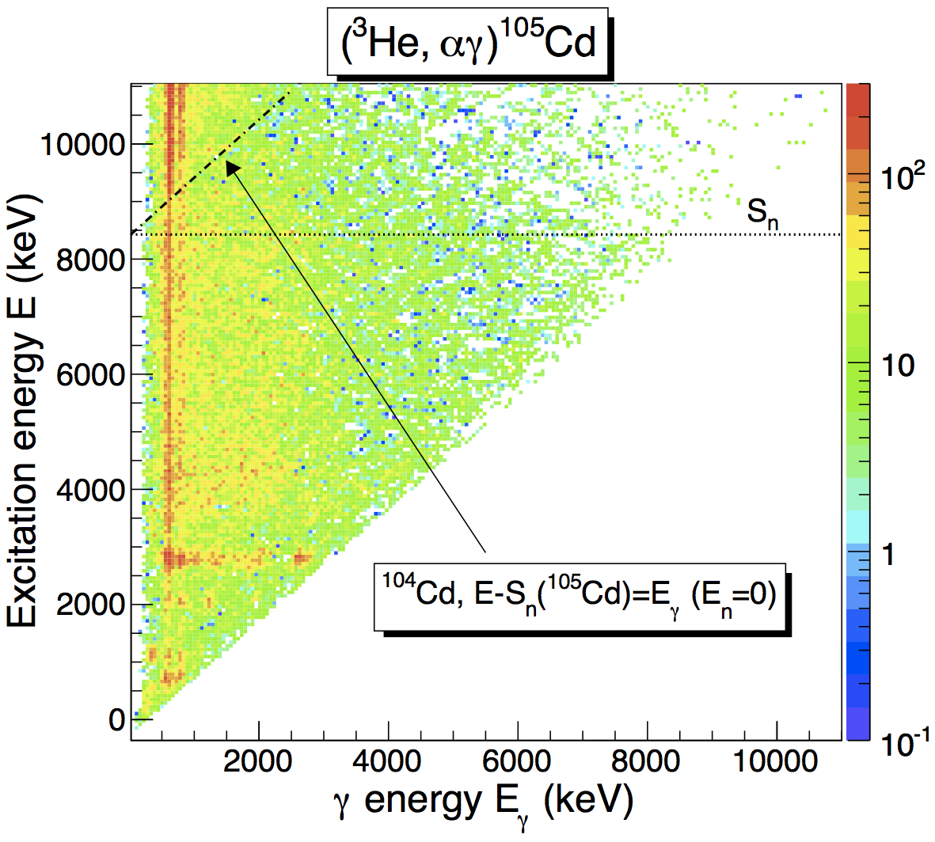
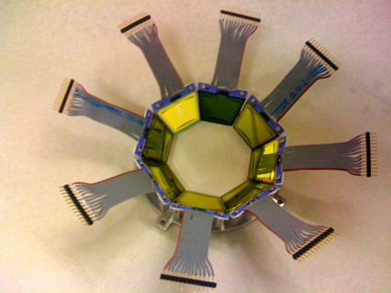
Experiments @ OCL
CACTUS: 28 collimated NaI(Tl) gamma detectors (efficiency 15.2%)
Oslo method (crash-course version)
1) Unfold γ spectra [M. Guttormsen et al., NIM A 374, 371 (1996)]
2) Obtain distribution of primary γ rays [M. Guttormsen et al., NIM A 255, 518 (1987)]
3) Extract level density & γ strength from primary γ matrix
[A. Schiller et al., NIM A 447, 498 (2000)]
Systematic-error analysis: A.C. Larsen et al., PRC 83, 034315 (2011)
Talk of M. Guttormsen on Monday [NS084] + poster of Francesca Giacoppo [NS077]
For references and to download the published data, see
http://www.mn.uio.no/fysikk/english/research/about/infrastructure/OCL/compilation/
SiRi: 8x8 Si ΔE-E particle detectors
(≈9% of 4π)
NaI(Tl)
α
Si ΔE-E
telescope
³He
40 – 54º
Target nucleus

Slide 8
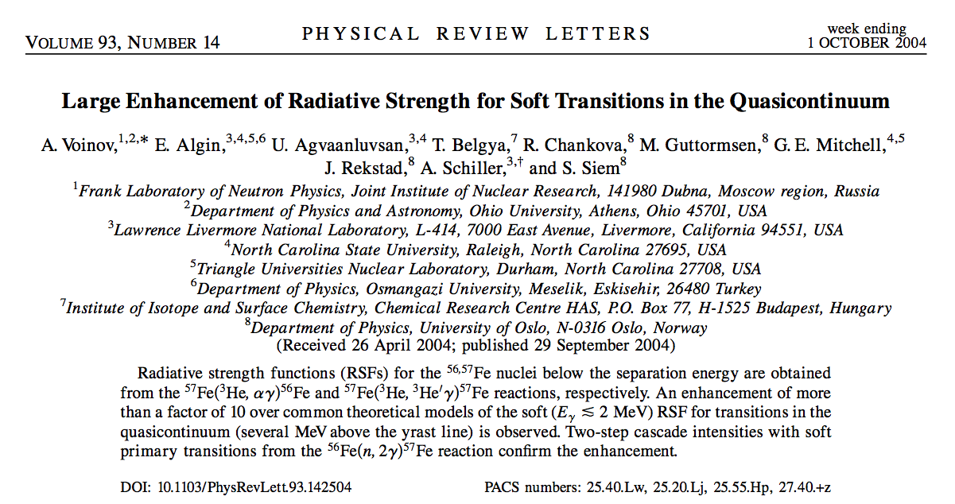
First discovery of low-energy enhancement

Slide 9
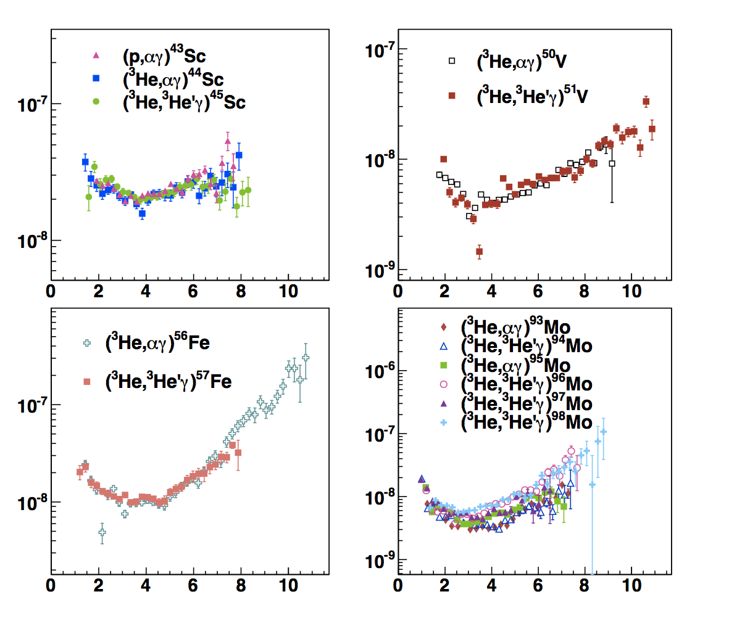
Oslo data on low-energy enhancement
^{56,57}Fe:
Voinov et al., PRL 93, 142504 (2004)
⁹³⁻⁹⁸Mo:
Guttormsen et al., PRC 71, 044307 (2005)
^{50,51}V:
Larsen et al., PRC 73, 064301 (2006)
⁴³⁻⁴⁵Sc:
Larsen et al., PRC 76, 044303 (2007)
Bürger et al., PRC 85, 064328 (2012)
⁴⁴⁻⁴⁶Ti:
Larsen et al., PRC 85, 014320 (2012)
Syed et al., PRC 80, 044309 (2009)
Guttormsen et al., PRC 83, 014312 (2011)
Gamma strength (MeV⁻³)
Gamma energy (MeV)

Slide 10
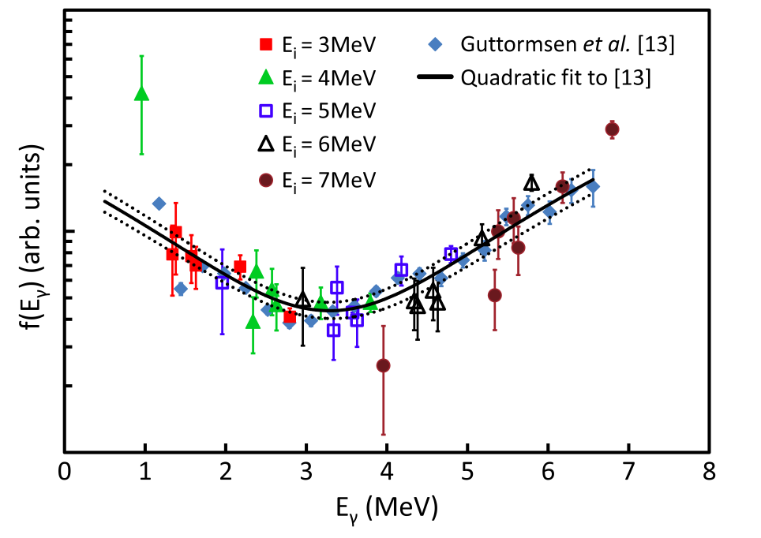
Berkeley data on low-energy enhancement
M. Wiedeking, L. A. Bernstein et al., PRL 108, 162503 (2012)
Proton-γ-γ correlations from the ⁹⁴Mo(d,p)⁹⁵Mo reaction
(experiment at Berkeley National Lab).
Ge detectors. Completely model-independent!

Slide 11
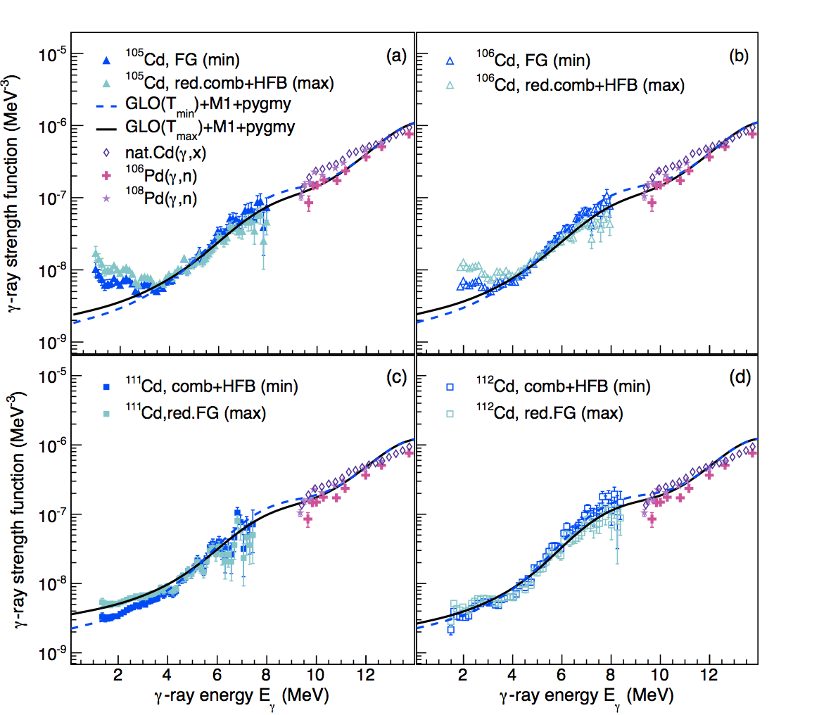
Cd isotopes – transitional region?
¹⁰⁵Cd
¹⁰⁶Cd
¹¹¹Cd
¹¹²Cd
A.C. Larsen et al., Phys. Rev. C 87, 014319 (2013)

Slide 12
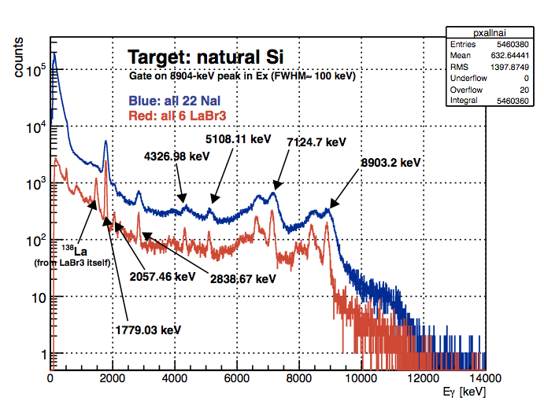
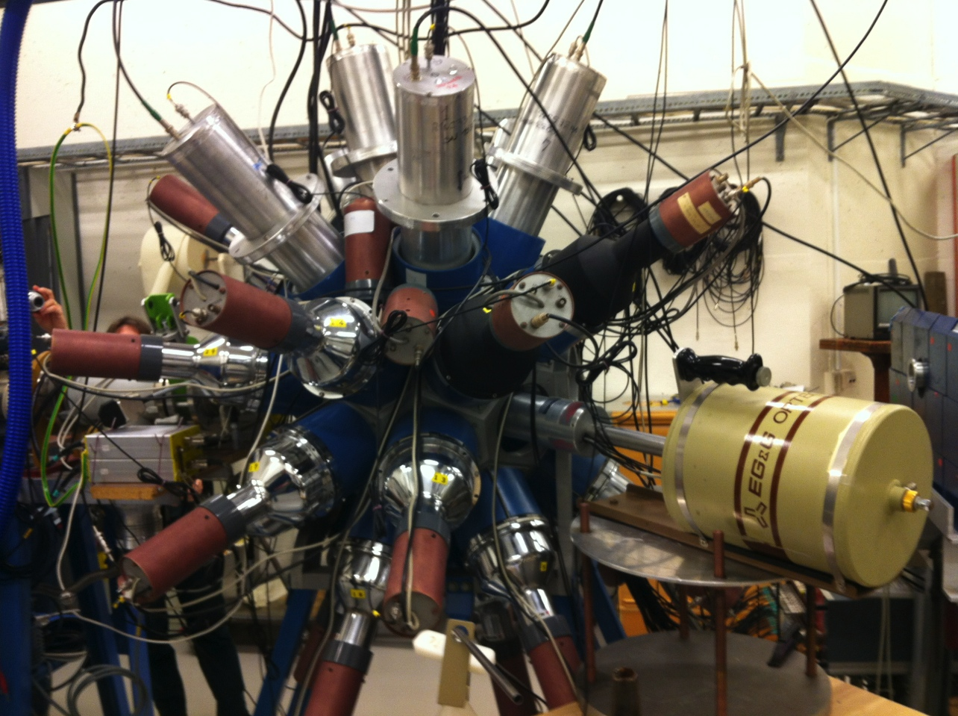
LaBr₃(Ce) experimental campaign – ^{56,57}Fe
March 2 – 12, 2012: ^{56,57}Fe(p,p’), E_{p} = 16 MeV
CACTUS:
6 LaBr₃(Ce), 3.5” x 8”
22 NaI(Tl), 5” x 5”
Special thanks to the INFN Milan group:
Angela Bracco, Franco Camera, Silvia Leoni,
Nives Blasi, and Benedicte Million

Slide 13
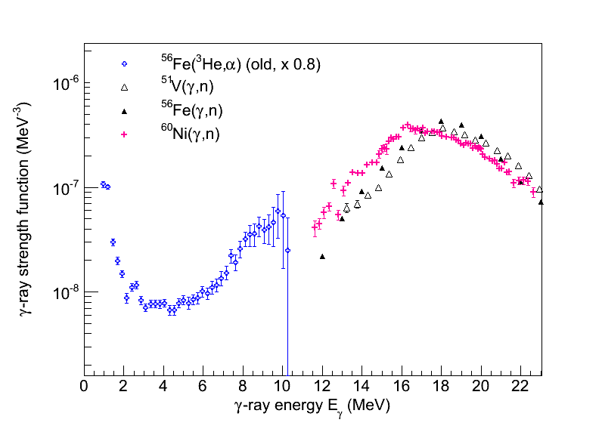
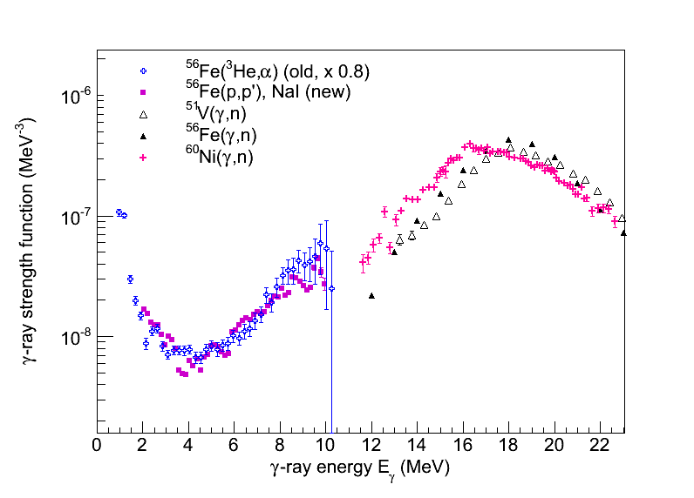
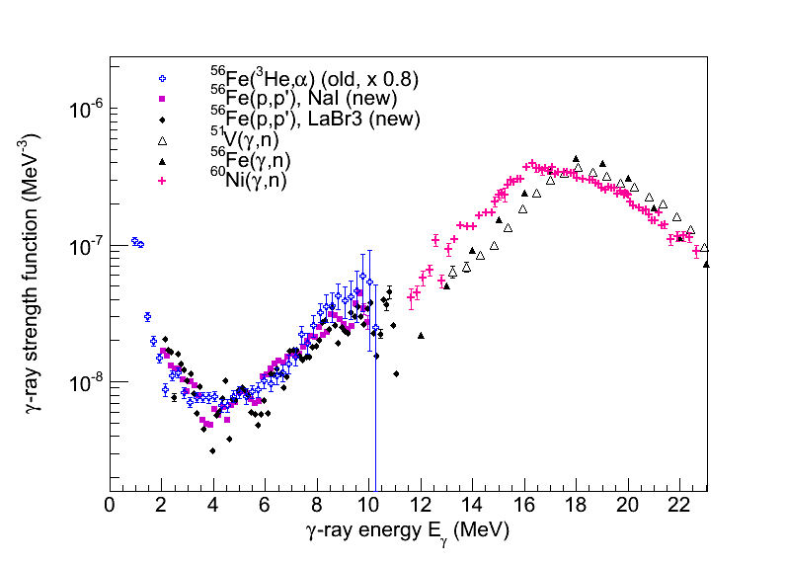
Gamma strength function, ⁵⁶Fe
STILL A BIT PRELIMINARY!
Notes:
LaBr3: 12 mill counts; NaI: 66 mill counts. Per NaI detector 3 mill counts, per LaBr3 detector, 2 mill counts. Remember high threshold on CFD for LaBr3

Slide 14
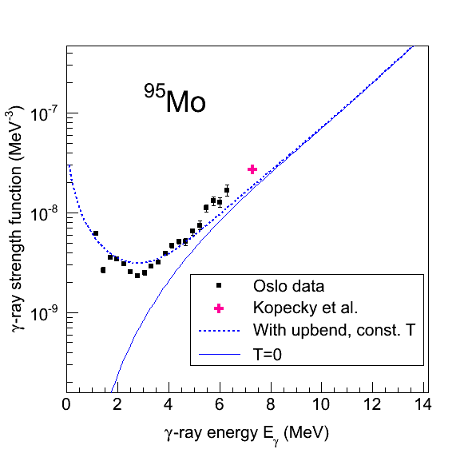
Possible impact on (n,γ) rates for n-rich nuclei
(n,γ), T = 1 x 10⁹ K
Rate (upbend)/Rate (no upbend)
Assuming E1 character of enhancement!
A.C. Larsen and S. Goriely, Phys. Rev. C 82, 014318 (2010)

Slide 15
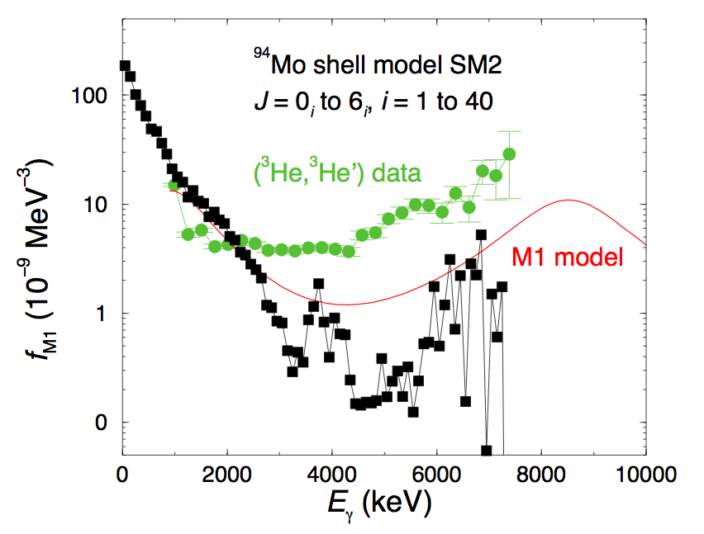
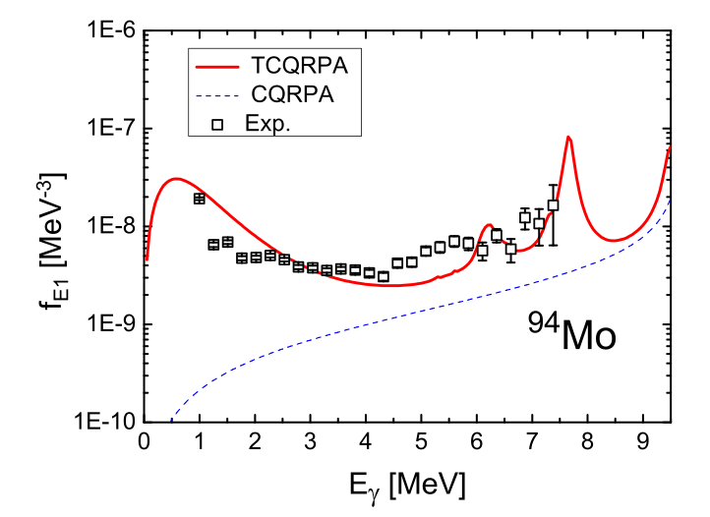
New calculations on the market
Enhanced E1 strength – Elena Litvinova and
Nicolay Berov [arXiv:1302.4478v1, Feb 2013]
Enhanced M1 strength – Ronald Schwengner,
ACL, Stefan Frauendorf [in preparation, 2013]

Slide 16

Summary & future plans
Low-energy enhancement in γ strength
Cd: transitional region?
New data on ⁵⁶Fe, LaBr₃crystals from Milan => confirms enhancement in Fe
Possible influence on reaction rates, n-rich nuclei
Open questions:
Mechanism of the enhancement?
Electromagnetic character and multipolarity?
For which nuclei is it present (n-rich nuclei)?
Radioactive beams!
HIE-ISOLDE proposal on ^{66,68}Ni approved (spokespersons Sunniva Siem & Mathis Wiedeking)
Rate (upbend)/Rate (no upbend)
Many thanks for listening!
Notes:
LaBr3: 12 mill counts; NaI: 66 mill counts. Per NaI detector 3 mill counts, per LaBr3 detector, 2 mill counts. Remember high threshold on CFD for LaBr3

