Slide 1
Pre-equilibrium α-particle emission as a probe to study α-clustering in nuclei
O.V. Fotina¹, S.A. Goncharov¹, D.O. Eremenko¹, O.A. Yuminov¹, S.Yu. Platonov¹,
V.L. Kravchuk², F. Gramegna², T. Marchi², M. Cinausero²,
M. D'Agostino³, M. Bruno³, G. Baiocco³, L. Morelli³, M. Degerlier⁴
for the NUCL-ex and HECTOR collaboration
¹ Lomonosov Moscow State University Physics Department, SINP, Moscow, Russia
² INFN, Laboratori Nazionali di Legnaro, Legnaro, Italy
³ Dipartimento di Fisica, University of Bologna and INFN sezione di Bologna, Italy
⁴ University of Nevsehir, Science and Art Faculty, Physics Department, Nevsehir, Turkey
Skobeltsyn Institute of Nuclear Physics Lomonosov Moscow State University

Slide 2
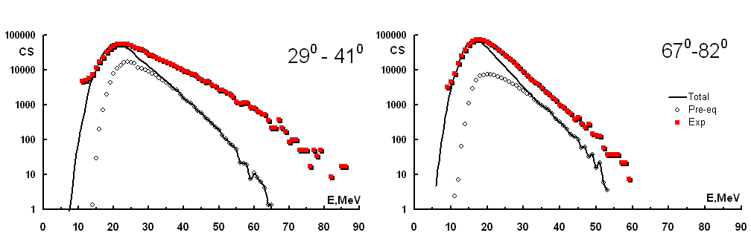
¹⁶O+¹¹⁶Sn
250 MeV
250 MeV
130 MeV
130 MeV

Slide 3
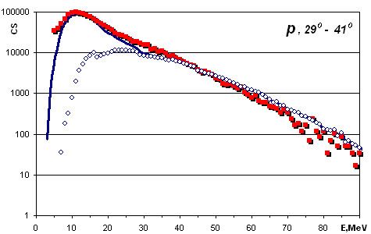
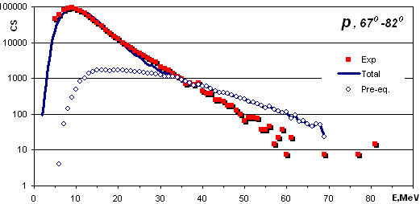
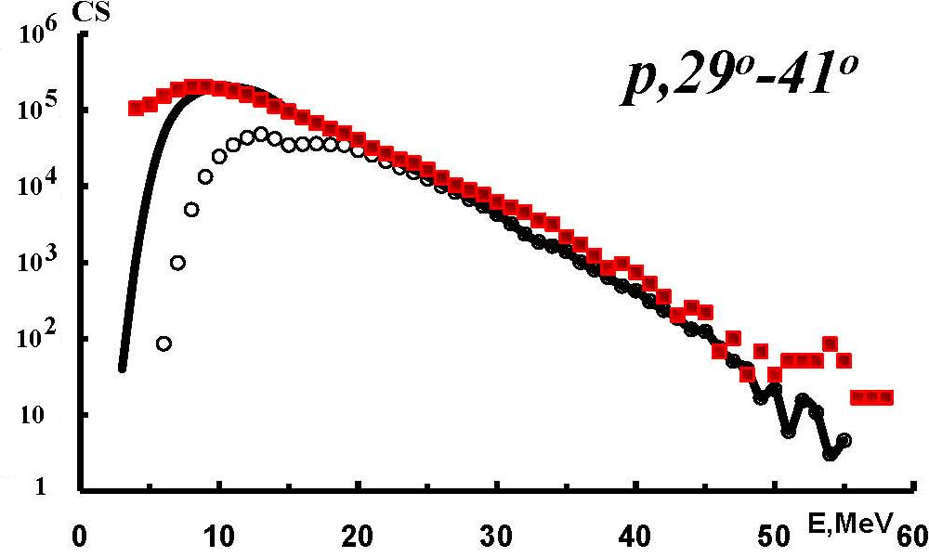
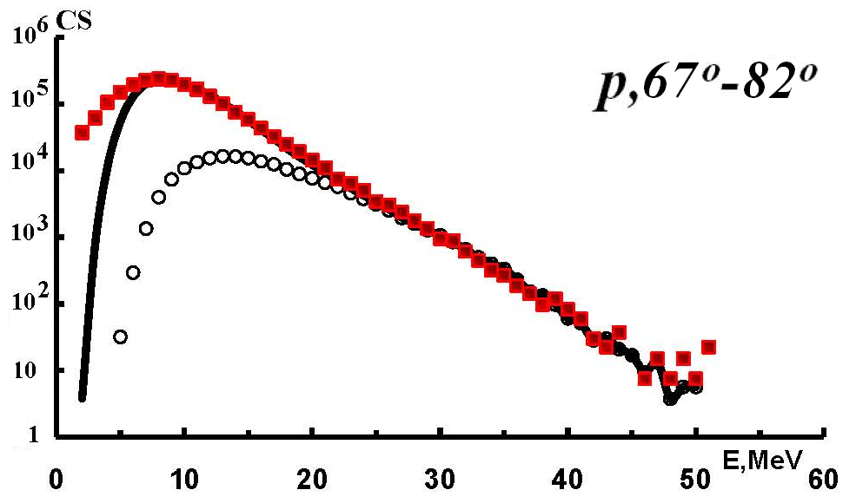
Illustration
E(¹⁶O)=250 MeV
¹⁶O+¹¹⁶Sn
E(¹⁶O)=130 MeV

Slide 4
Pr
Tar
n
p
A₀-X_{pr}
(E’,J’)
α
Compound Nucleus
or
Non-Equilibrium Processes
If Non-Equilibrium Processes
Then n, p, α (E, J, θ)
A₁
(E,J)
E kinetic energy of escaping particles;
J angular momentum of particles.
θ particle escaping angels,
A₃
(E,J)
Hybrid exciton model based on Griffin’s exciton model
Probabilities of all CN deexcitation process were estimated within Hauser-Feshbach model
A_{er}
(E,J)
code PACE

Slide 5
The Model Brief Description
In the Griffin’s exciton model of nuclear reactions, relaxation of the compound to equilibrium is described by the master equation:
Case A
Case B
The generalized master equation takes form :
dσ/dΩ is the free differential nucleon-nucleon scattering cross section
The initial condition for this equation is
(where H is the Heavyside function)

Slide 6
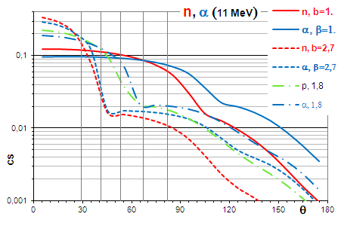
β parameter What affect this value? (Case B)
Vertical lines is the range of GARFILD angles
β parameter is a strong parameter !!

Slide 7
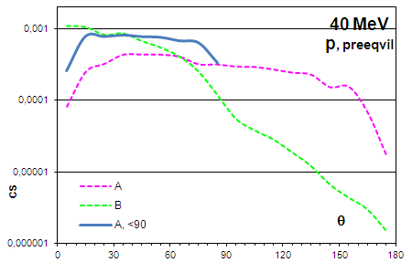
Theta (for p)

Slide 8
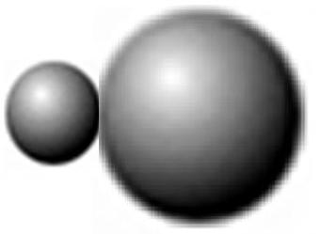
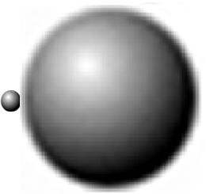
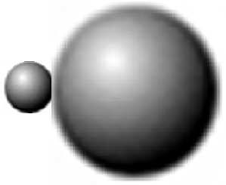
Start conditions Possible α clustering configurations in ¹⁶O nucleus
?
100-N%
N%
nO=16p+0(1)h
nC=12p+0(1)h
nα=4p+0(1)h
If EnO=250MeV, then Enα+ EnC=(250-Bα- EClas)MeV
but Enα − ? and EnC − ?

Slide 9
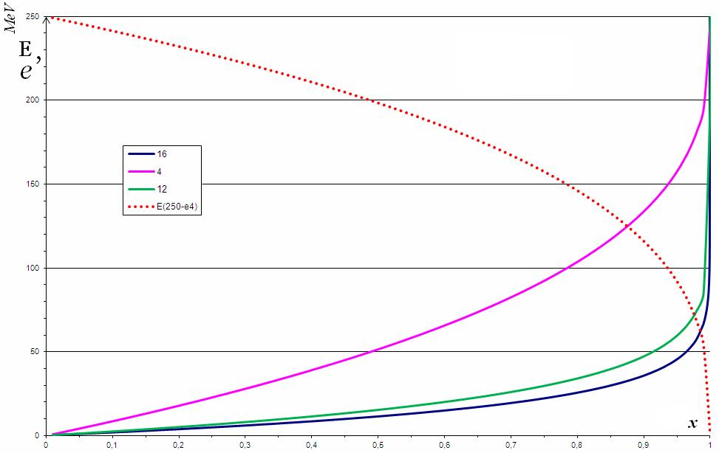
Blann model (2000)
e – clusters energy, and x – random number
?

Slide 10
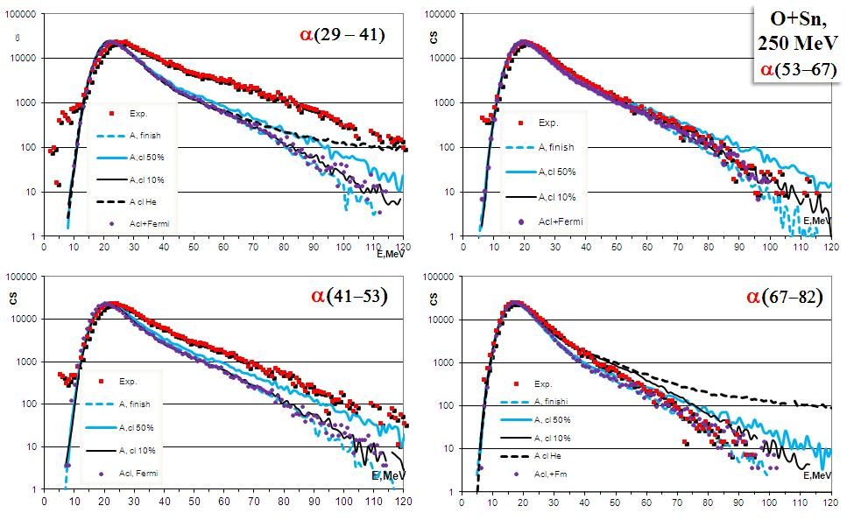
Preliminary Result for α

Slide 11
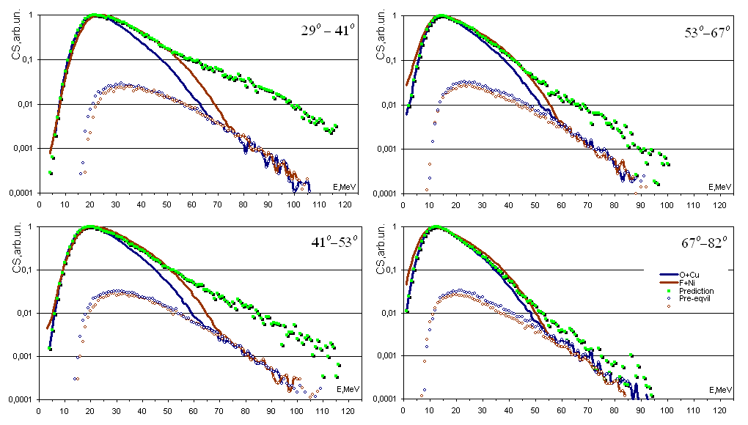
α, ¹⁶O+⁶⁵Cu→⁸¹Rb, E_{O}=256 MeV (16 MeV/u); E*=208,9 MeV ¹⁹F+⁶²Ni →⁸¹Rb, E_{F}=304 MeV (16 MeV/u); E*=239,9MeV ( in lab)

Slide 12
Thank you for your attention

Slide 13
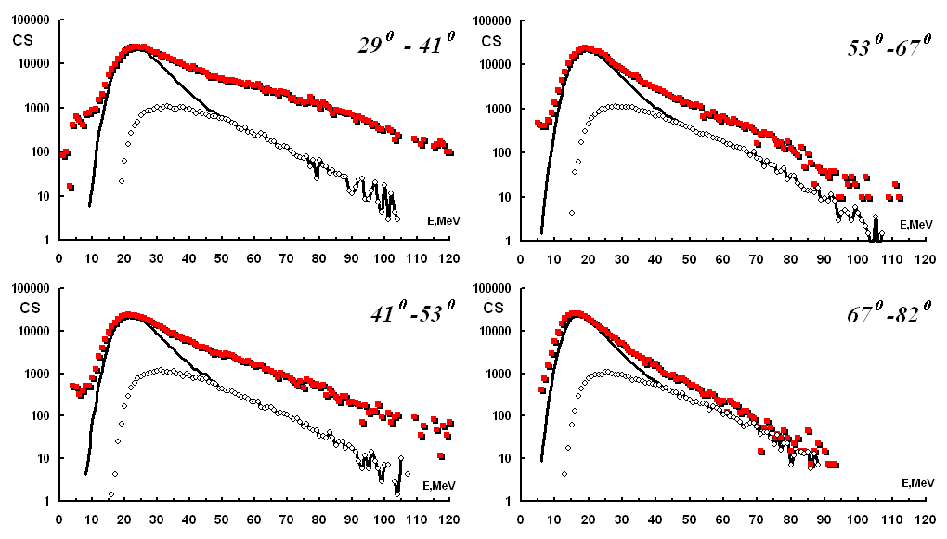
Double differential spectra for α particles for the 250 MeV ¹⁶O+¹¹⁶Sn reaction.
(Cross-Section (CS) in arbitrary units) Experimental data are shown in red. Open circles show the pre-equilibrium part of the spectra. The continuous line is the sum of evaporative plus pre-equilibrium contribution from the calculation [1-3].
[1] O.V. Fotina et al., Int. Journ. Mod. Phys. E, (2010).
[2] D.O. Eremenko et al., Phys. Atom. Nucl. 65, 18 (2002).
[3] O.V. Fotina et al., Phys. Atom. Nucl., (2010).

Slide 14
Double differential spectra for α particles for the 130 MeV ¹⁶O+¹¹⁶Sn reaction.
Symbols are the same as in (on) the previous slide .
The significant increase observed in the yield of the secondary alpha particles at small angles in the pre-equilibrium part of spectra may be, in fact, connected with the presence of a-cluster in the ¹⁶O projectile nucleus. A confirmation of this effect can be obtained comparing the secondary alpha particles emitted in fusion reactions where a clustering projectile (for example ¹⁶O) and projectile without alpha clusterization (¹⁹F) are used. These data have been shown to provide an important testing ground for the theoretical models
14

Slide 15
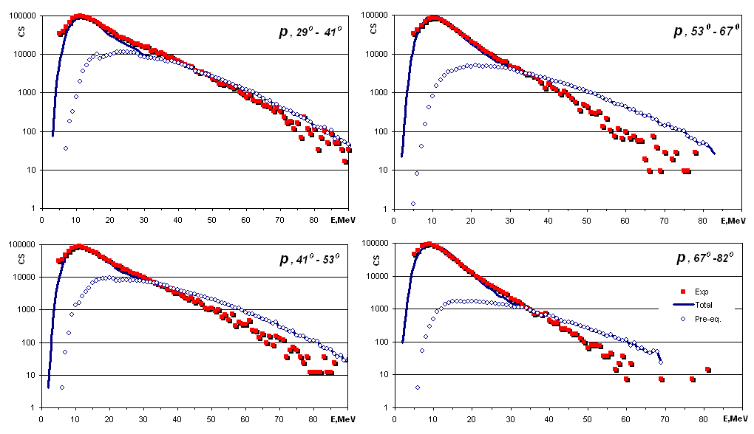
Illustration
E(¹⁶O)=250 MeV
¹⁶O+¹¹⁶Sn

Slide 16
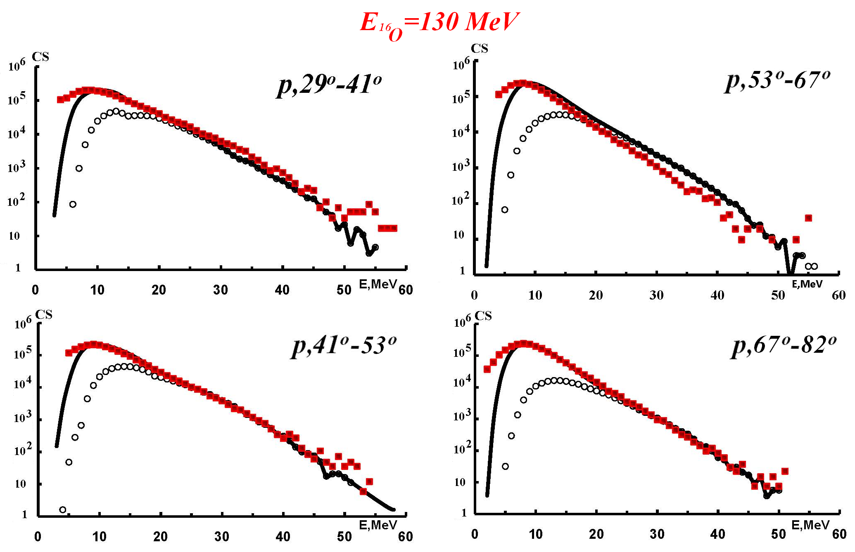
Illustration
¹⁶O+¹¹⁶Sn

Slide 17
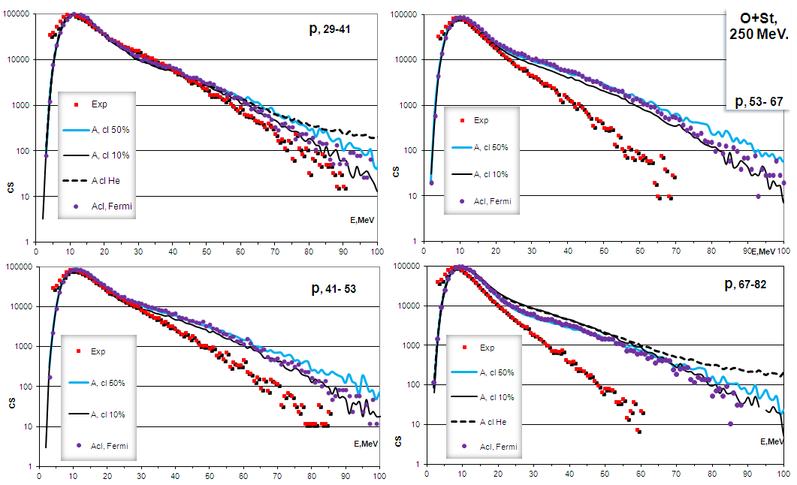
Preliminary Result for p

Slide 18
Figure 1: Double differential spectra (Cross-Section (CS) in arbitrary units) for α particles for the 250 MeV ¹⁶O + ¹¹⁶Sn reaction.
Experimental data are shown in red. Other lines - the results of estimates for different probabilities α-clustering in nuclei

Slide 19
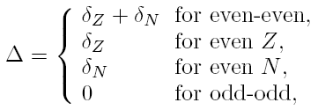

Slide 20
Pre-equilibrium emission :
Theoretical Model
Evaporative (statistical) emission:
The method of analysis of heavy-ion reactions is based on the statistical theory of nuclear reactions using Monte-Carlo simulation of a number of characteristics of nucleus disintegration (modified PACE2 code):
decay channel (n, p, alpha, gamma or fission);
kinetic energy of escaping particles;
particle escaping angels, and (or) angular momentum of emitting particles.
Probabilities of all process were estimated within Hauser-Feshbach model
To describe the relaxation processes in the nuclear system produced in the fusion reaction Hybrid exciton model based on Griffin exciton model was used {J.J. Griffin, Phys. Rev. Lett., 478, p 478 (1966)}.
In the Hybrid exciton model, the state of the nuclear system produced by collision of bombarding particle and target nucleus is determined by the exciton number n = p + h, where p is a number of particles located above the Fermi energy and h is a number of holes located under the Fermi energy, and by excitation energy E*. The exciton number can be determined from the empirical trend (N. Cindro et al., Phys. Rev. Lett. 66(1991)868 ).
More detailed description of using method can be found in O.V. Fotina, et al. Phys. of Atomic Nuclei, Vol. 73, No 1, 2010, p. 1317 and ref. therein
We regard as free parameter next values n, k, g.
k is parameters, connected with transition matrix element <|M|²> and determined of the transition rate of emission particle into continuum with energy ε_{b}. This parameter was varied in wide region from 200 to 800 MeV³.
The single particle level density g is connected with the level density parameter in the Fermi-gas model by relation g = 6a/ π². For variation of values g we used Fermi-gas model and level-density phenomenological model {A.V. Ignatyuk, K.K. Istekov, and G.N. Smirenkin, [Yad. Fiz., 29, 875 (1979)] Sov. J. Nucl. Phys. 29, 450, 1979
And n is mentioned above exciton number. The initial exciton configuration (p₀,h₀) from which the equilibration process starts is the free parameter of the model. In our calculations we used next of the initial exciton configurations: n₀ = (16p,1h) ( ¹⁶O+⁶⁵Cu) and n₀ = (19p,1h) ( ¹⁹F+⁶²Ni) .

Slide 21
Abstract
The method of description of the pre-equilibrium alpha-particle emission during the non-equilibrium stage of the nuclear reactions is discussed. An approach was developed to describe the double differential spectra of secondary particles formed in heavy ions reactions. Griffin model of non-equilibrium processes was used to account for the non-equilibrium stage of the compound system formation. Simulation of de-excitation of the compound system was carried out using the Monte – Carlo method. Fission and γ-ray emission were also considered after equilibration. Analysis of the probabilities of neutron, proton and α-particle emission was performed both at equilibrium, and in the pre-equilibrium stages of the process. The theoretical modeling which takes into account the possible influence of the cluster structure in the projectile nucleus excited by collision will be discussed together with the comparison between simulated and experimental double differential cross sections of p, α-particles for the E =250MeV ¹⁶O +¹¹⁶Sn reaction, where different clusterization probabilities have been considered.
International Nuclear Physics Conference INPC2013: 2-7 June 2013, Firenze, Italy

Slide 22
Case A (angular dependency by optic. model)
We propose to investigate the alpha-particle emission from hot ⁸¹Rb nucleus, formed in the reactions with alpha-cluster ¹⁶O projectile on ⁶⁵Cu target and with non alpha-cluster ¹⁹F projectile on ⁶²Ni target, using the GARFIELD and RCo detection arrays. The main goal of the proposal is to measure the pre-equilibrium alpha-particle emission for the two systems indicated above in order to extract information about the influence of alpha-clustering in the ¹⁶O projectile on alpha-particles production during the non-equilibrium stage of the nuclear reactions.

