Slide 1
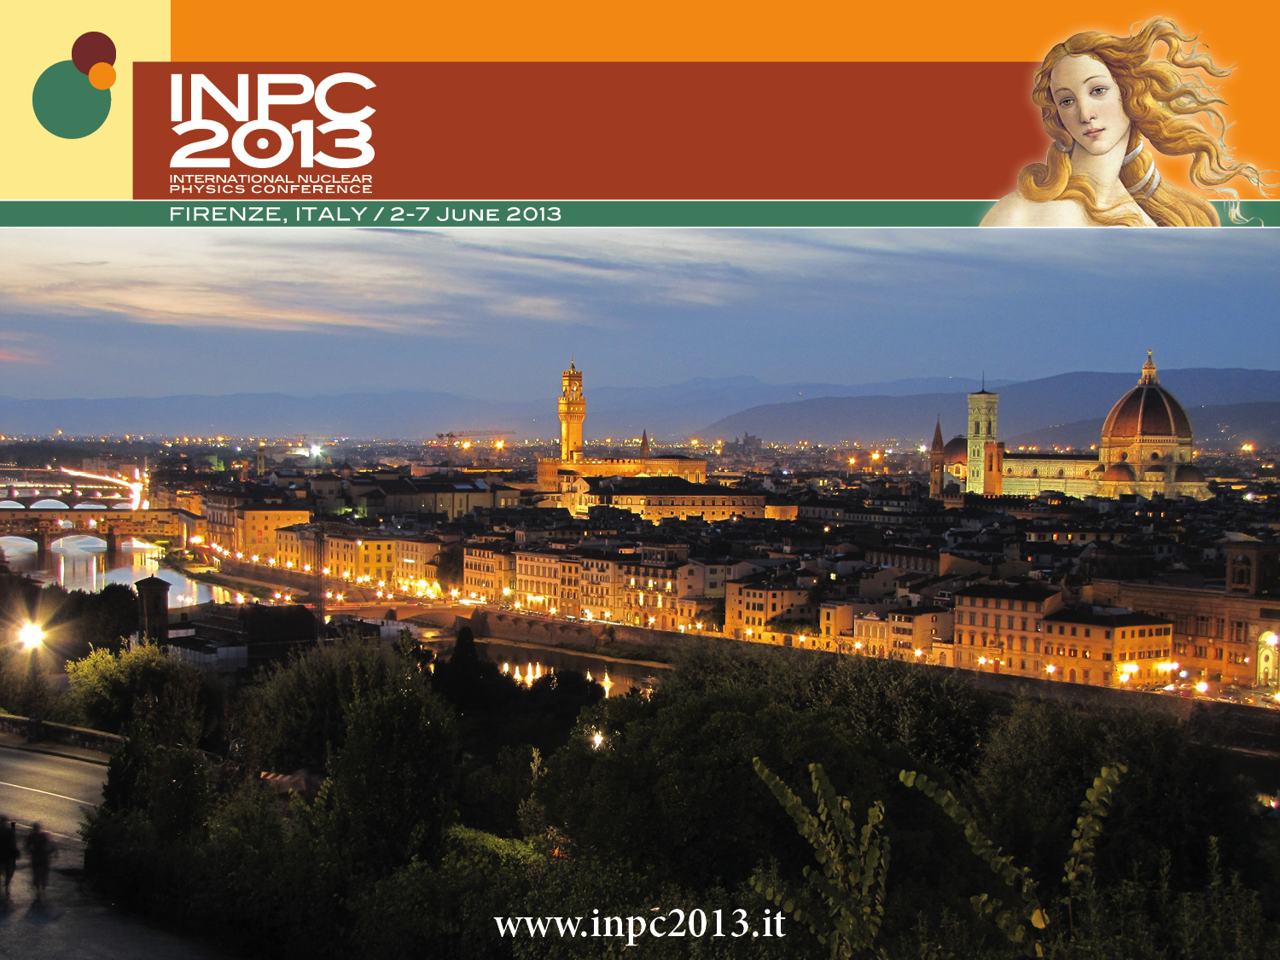
Nuclear Physics techniques
for Cultural Heritage
and environmental monitoring
P.A.Mandò
Università & INFN,
Firenze
Notes:
1

Slide 2
The association of Nuclear Physics to matters such as
Cultural Heritage
or
environmental protection
sounds probably surprising, and the applications in these fields are not always so well known

Slide 3
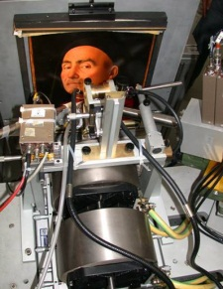
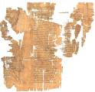
Main contributions of Nuclear Physics in the fields of Cultural Heritage and environmental protection
material composition measurements with Ion Beam Analysis (IBA)
and X Ray Fluorescence (XRF)
radiocarbon (¹⁴C) measurements, for archaeological dating and carbon component origin in atmospheric aerosols
3
Notes:
3

Slide 4
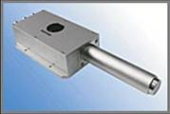

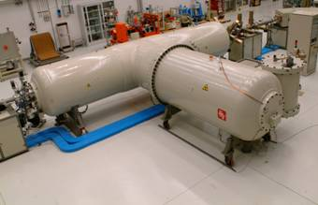
Ion Beam Analysis (IBA)
Material composition analysis through the “bombardment” of a particle beam from an accelerator
  typically protons or alphas (energy of some MeV)
Radiation detection and spectral analysis
Emission of radiation of characteristic energies (X-rays, γ, particles…)
particle beam
particle accelerator

Slide 5
Ion Beam Analysis (IBA)

Slide 6
PIXE: Particle Induced X-Ray Emission
ΔE
X-ray
E_{X} = ΔE
X-ray energy is characteristic of the element

Slide 7
Ion Beam Analysis (IBA)
X ray emission (PIXE)
a
secondary particles emission or inelastic scattering of incident ions
elastically scattered particles (PESA)
gamma ray emission (PIGE)

Slide 8
Pros of IBA techniques
NON destructive, NON invasive, NO damage
widely multi-elemental
(simultaneous detection of almost all elements)
reliable quantitative analysis and great sensitivity
information also on layer structure if present, as is often the case e.g. in C.H. artefacts
micro-analysis (≡ high space resolution) is possible

Slide 9
Why material analysis for C.H.?
great importance for:
attribution and authentication
understanding technological skills in the past
learning about materials used in a given period and production area→ proving e.g. trade exchanges from other areas, if the detected materials are known to be locally unaivalable
detecting deterioration processes
deciding for appropriate restoration techniques and materials

Slide 10
Why material analysis for environmental problems?
Aerosols, i.e. the fine particles suspended in the atmosphere (the “famous” PM – Particulate Matter)
Determining its composition (not only its concentration) is crucial for
evaluating its direct impact on human health
identifying the pollution sources, each characterised by given compositions of the directly or indirectly produced PM
therefore, deciding the most effective actions to prevent pollution problems

Slide 11
Radiocarbon (¹⁴C)
¹⁴C is a naturally occurring radioactive isotope of Carbon, wish is present in atmosphere in a very small concentration, ~10⁻¹²
this is the result of an equilibrium between continuously “disappearing” by radioactive decay and being continuosly produced in the troposphere (15-18 km altitude) by cosmic rays
when formed, it oxidizes to ¹⁴CO₂ and as such spreads throughout the atmosphere, down to the ground level

Slide 12
Radiocarbon (¹⁴C)
Through various metabolic mechanisms,
ALL LIVING ORGANISMS PARTICIPATE IN THIS EQUILIBRIUM
and have therefore in their tissues the same ¹⁴C concentration
UNTIL LIVING

Slide 13
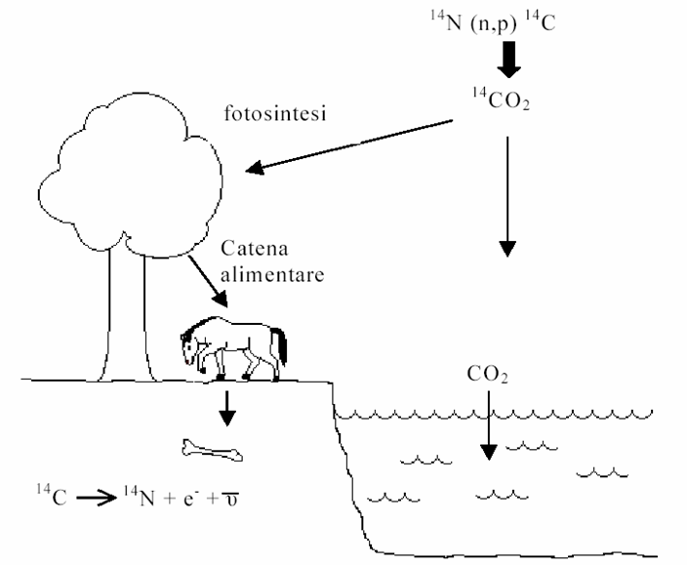
Radiocarbon (¹⁴C)
photosynthesis
food chain

Slide 14
Radiocarbon (¹⁴C)
Starting from the death of the organism, the radioactive decay of ¹⁴C is no more compensated by any uptake; there are no mechanisms of in-situ production; thus, its concentration decreases continuously after death, at a well known rate given by the radioactive decay law

Slide 15
Radiocarbon (¹⁴C)
· 10⁻¹²
¹⁴R(t) = ¹⁴R₀ · e ^{–t/τ}
with ¹⁴R₀ = 1.18 10⁻¹² and τ = 8266 y
t = τ · ln [¹⁴R₀ / ¹⁴R(t)]
¹⁴R (¹⁴C/¹²C ratio)
time from death (years)

Slide 16
Why measuring ¹⁴C for C.H.?
Most important method for
dating all materials of organic origin
(date ≡ time from the death
of the organism of origin)
Therefore:
absolute chronological reconstruction of archaeological sequences
authentications of works of art
compatibility of alleged relics with their attribution

Slide 17
Why measuring ¹⁴C in aerosols?
The carbon component is a large fraction of aerosols
Schematically, it can have a “natural” or a “bad” man-induced component (e.g. combustion of fossil fuels)
The latter has zero ¹⁴C, the former has the ¹⁴C concentration characteristic of the living organisms
Therefore, the radiocarbon concentration in aerosols is an indirect measurement of the fraction of the “bad” anthropogenic component of carbon

Slide 18
Radiocarbon (¹⁴C)
Also nuclear are the techniques for measuring ¹⁴C residual concentrations
the now dominant technology is
Accelerator Mass Spectrometry (AMS)

Slide 19
The challenge of AMS
Attaining a huge sensitivity
still keeping high precision
Indeed, ultra-low ¹⁴C concentrations (down to 10⁻¹⁵) must be measured with
small uncertainty
(e.g.: 0.5% error on concentration → 40 years on age)
Accelerator Mass Spectrometry can do that
.. in addition, only requiring tiny quantities of material
(few milligrams, or even less, are sufficient)

Slide 20
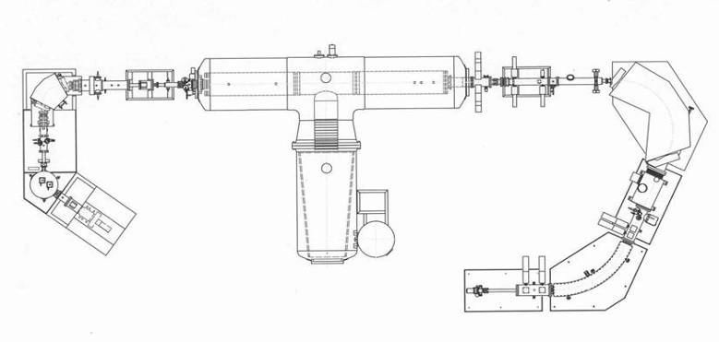
Measuring ¹⁴C with AMS
Stripping at HV terminal (eliminates interference of ¹³CH, ¹²CH₂)
Tandem accelerator
Analysis and detection systems
Multi-sample source
Negative ion source (eliminates interference of ¹⁴N)
Magnetic + electrostatic analysis + detection systems of high energy ions (remove residual interferences)

Slide 21
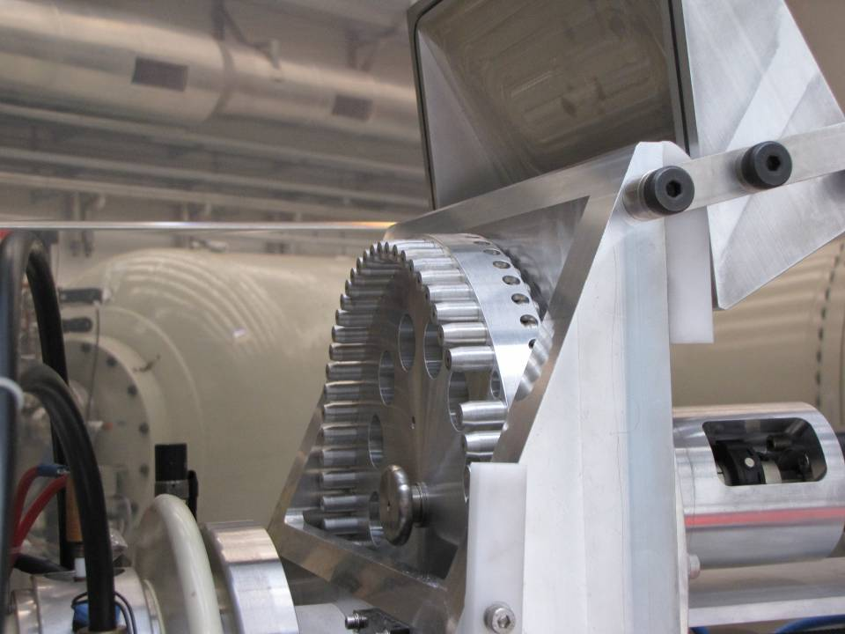
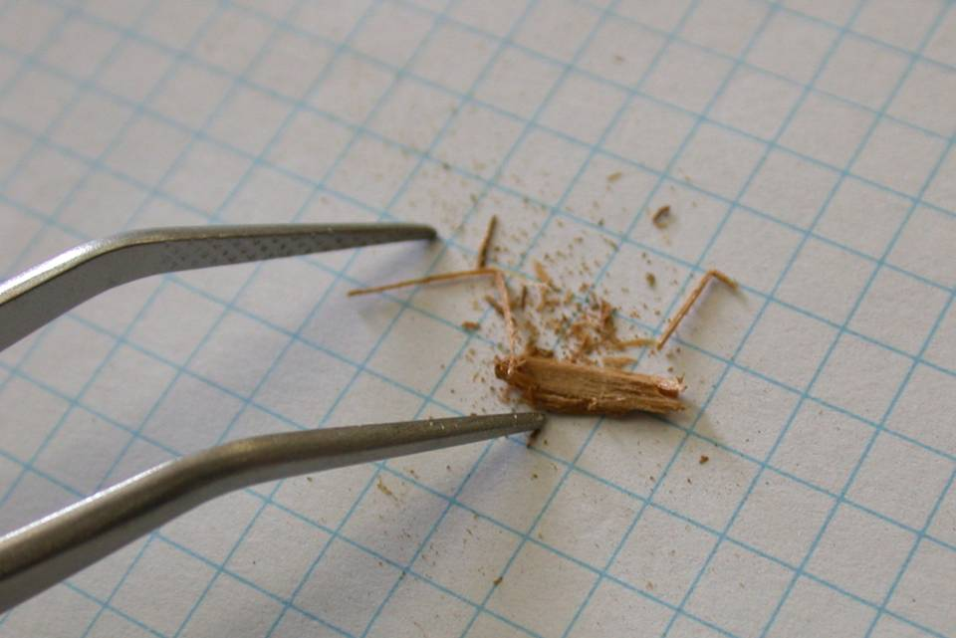
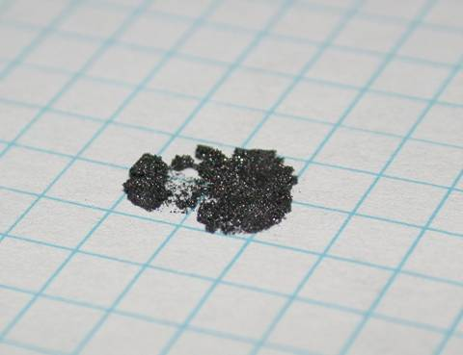

Slide 22
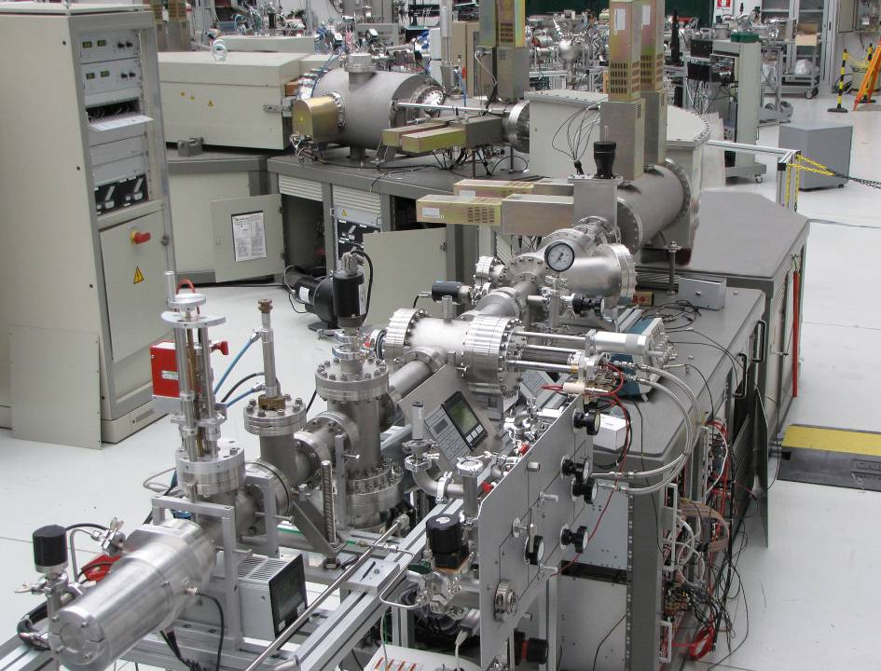
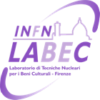
22

Slide 23

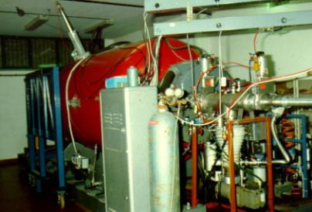
In Florence....
long standing tradition with PIXE
(and IBA in general) applied to Cultural Heritage and environmental monitoring
This applied physics activity
started during the Eighties
with an old 3 MV Van de Graaff
single-ended accelerator
Until then, basic nuclear physics activities had been still
carried out with this accelerator
Since the mid 1980’s its “research goals” were changed to applications using Ion Beam Analysis
Notes:
23

Slide 24
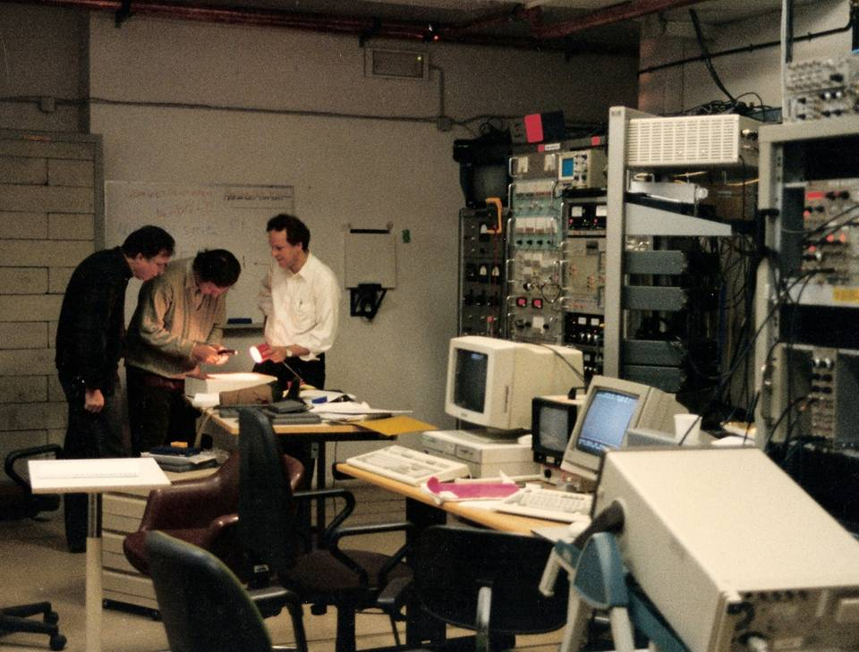

Slide 25
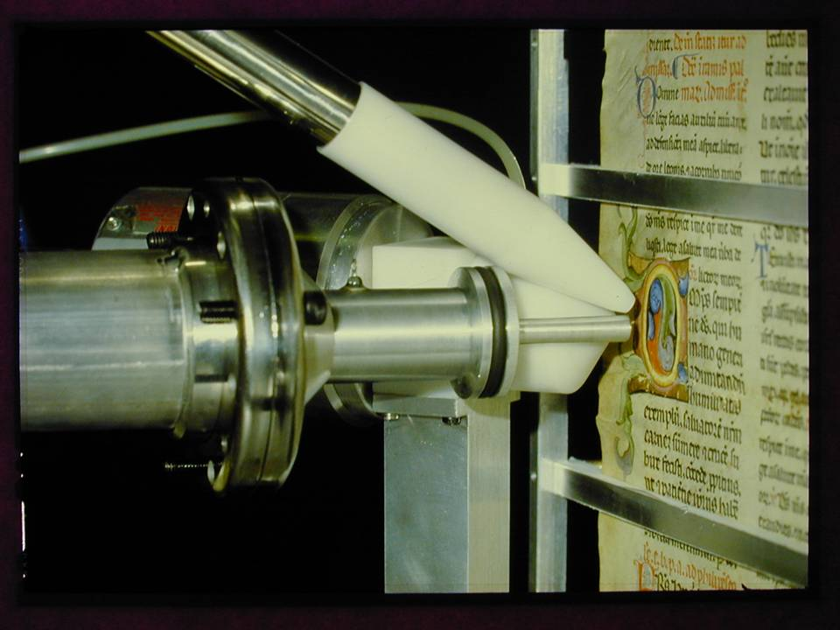

Slide 26
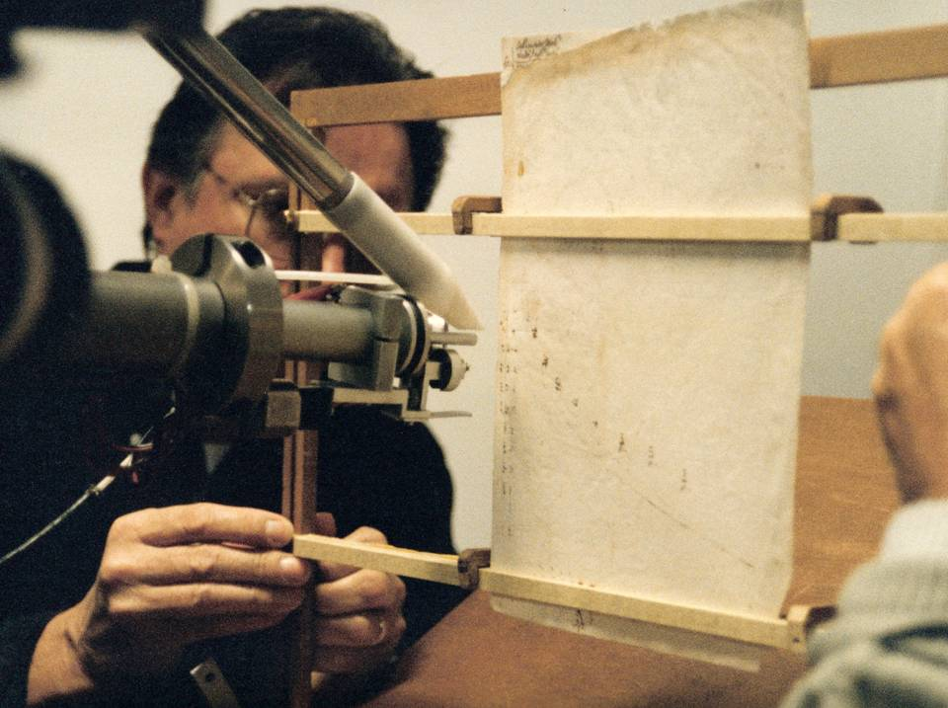

Slide 27
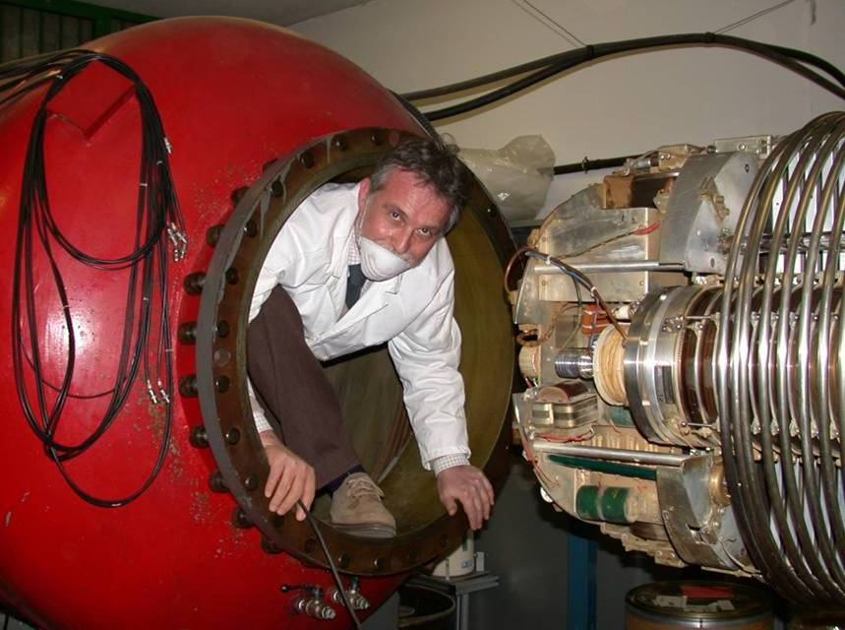

Slide 28
2001-2003
move of the Physics Department and INFN Unit to a new campus
INFN and University create a new lab
new 3 MV Tandetron, designed from the beginning to perform Accelerator Mass Spectrometry (AMS) for ¹⁴C measurements, besides IBA
the new laboratory, LABEC, is operational in May 2004
Notes:
28

Slide 29
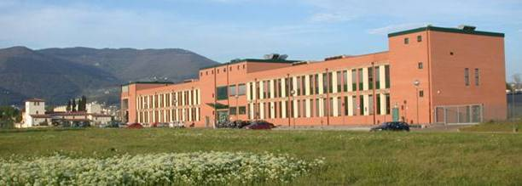
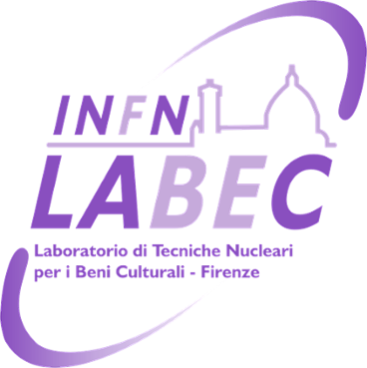


Slide 30
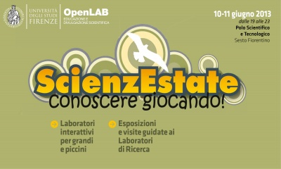
LABEC will be open to public on the occasion of

Slide 31
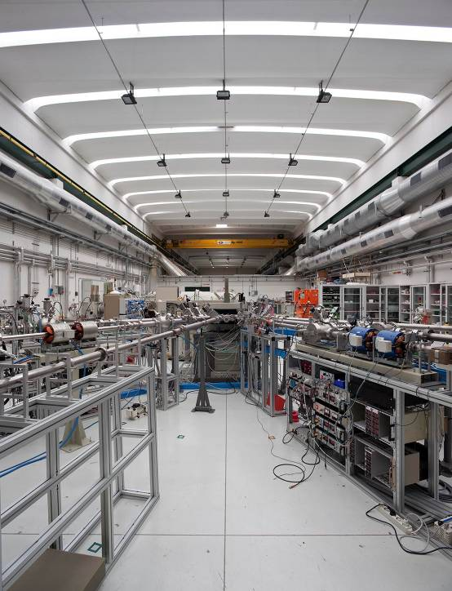
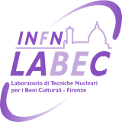
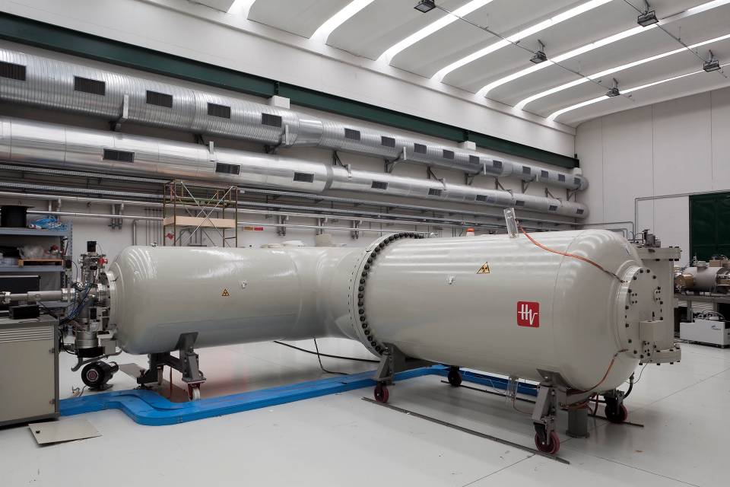
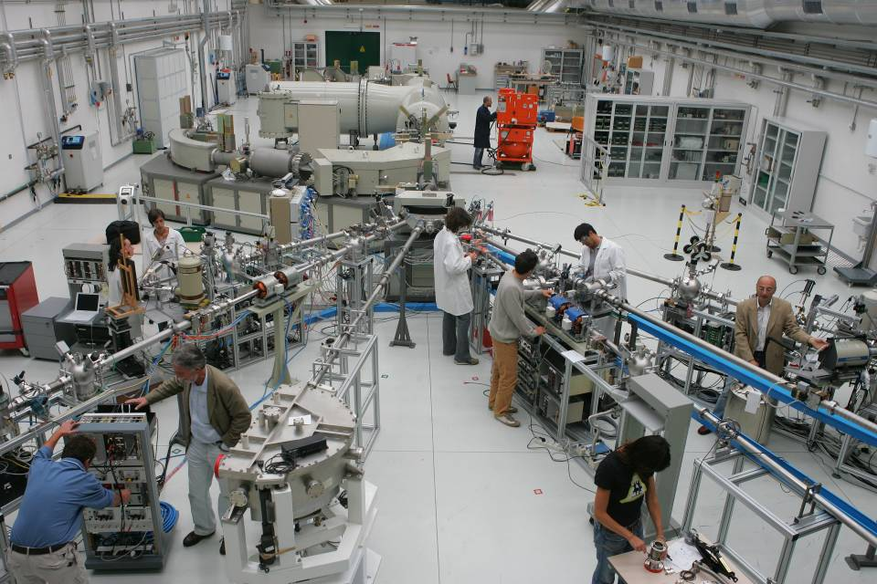

Slide 32
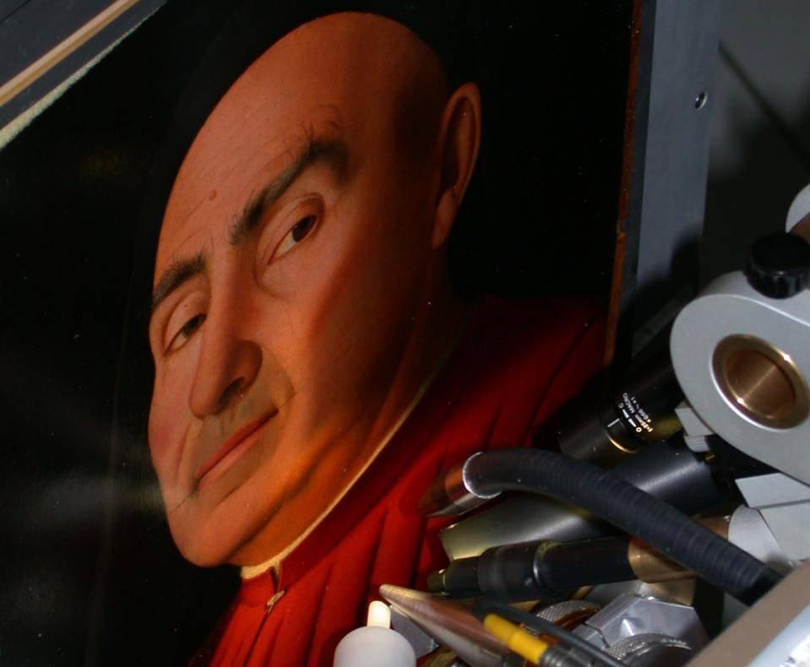
Ion Beam Analysis techniques for Cultural Heritage
Notes:
32

Slide 33
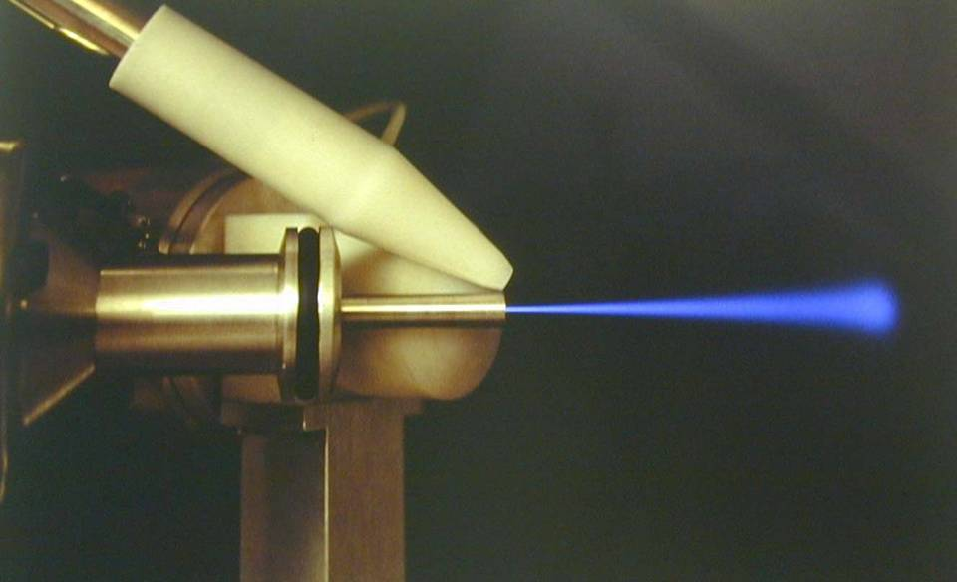
An essential feature to perform IBA for C.H.
the external-beam setup
1 cm

Slide 34
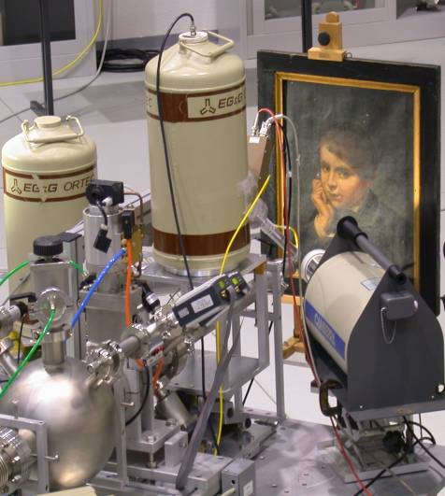
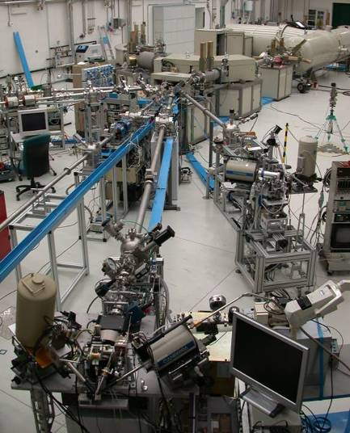
At LABEC, two dedicated external beamlines
beam size defined by collimation (Ø 0.2 ÷ 1 mm)
strong focusing system, quadrupole doublet (Ø 8÷10 μm)

Slide 35
Using external beam set-ups we have investigated with no damage whatsoever the quantitative composition of a large variety of artworks
Notes:
35

Slide 36
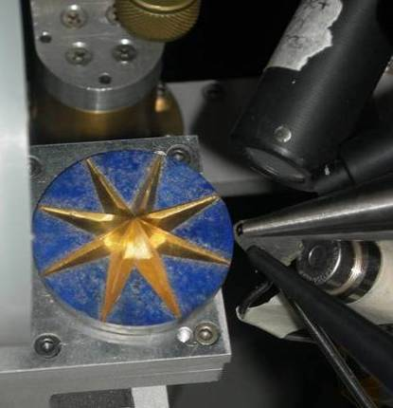
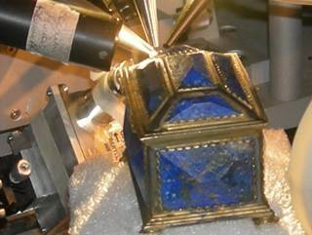
Analysis of semiprecious stone artefacts,
“Disc with star”, and jewel case, from “Collezione Medicea di Pietre Ornamentali”, Natural History Museum, Florence

Slide 37
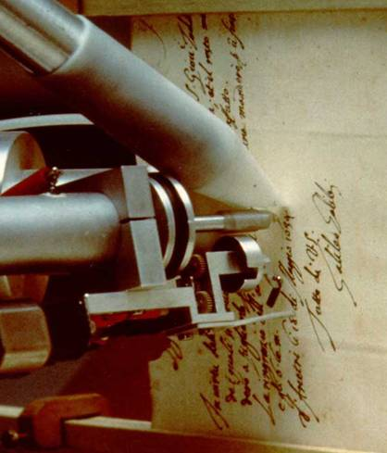
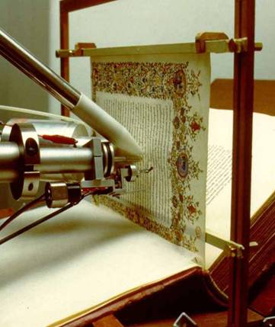
...ancient illuminated manuscripts,
...historical documents,
External-beam PIXE analysis of the frontispiece of Pl.16,22 (XV century, Biblioteca Laurenziana in Florence)
Inks in Galileo’s manuscripts (Florence National Library) analysed by external PIXE
Notes:
37

Slide 38
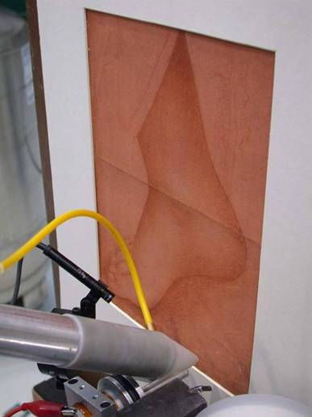
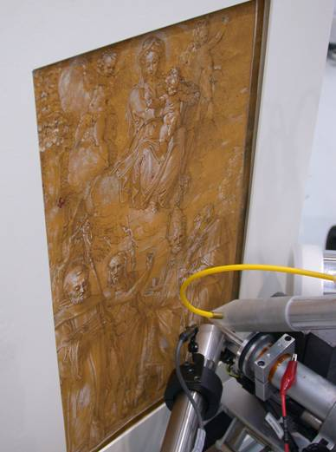
...drawings,
PIXE-PIGE analysis of a drawing on prepared paper, by Leonardo or his school
PIXE-PIGE analysis of a drawing on prepared paper, school of Verona, XVI cent.
Notes:
38

Slide 39
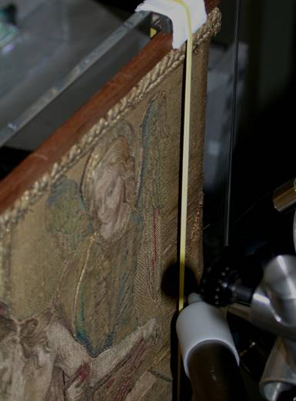
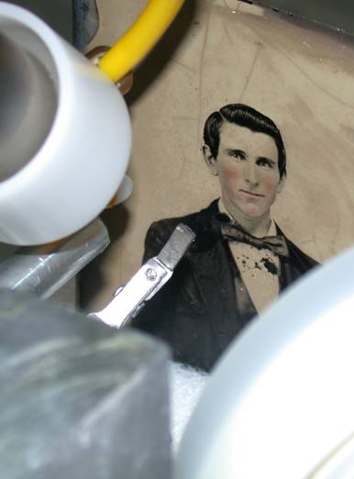
…ancient embroideries,
…early photographs
Micro-PIXE and –PIGE analysis of gold threads of a Renaissance embroidery based on a cartoon by Raffaellino del Garbo
PIXE-PIGE analysis of a print on metal plate of the XIX century
Notes:
39

Slide 40
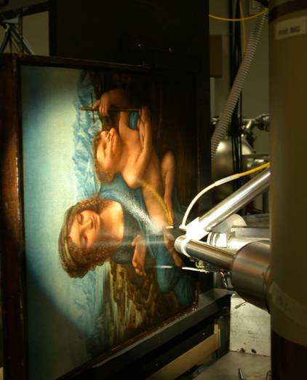
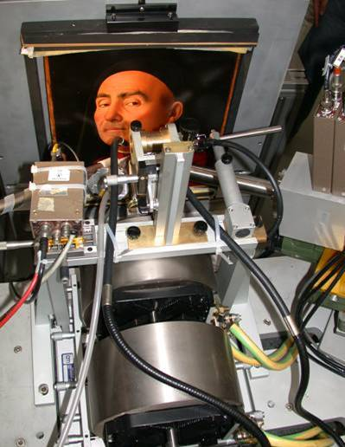
...paintings on wood or canvas
Differential PIXE and PIGE analysis of the
Madonna dei Fusi by Leonardo
Micro-PIXE and -PIGE analysis of the
“Ritratto Trivulzio” by Antonello da Messina
Notes:
40

Slide 41
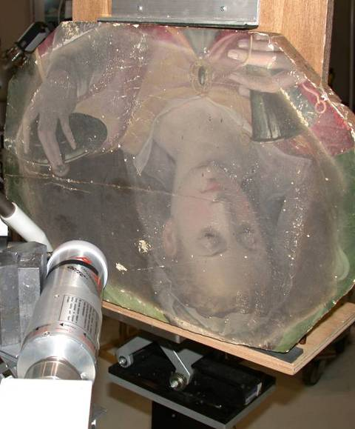
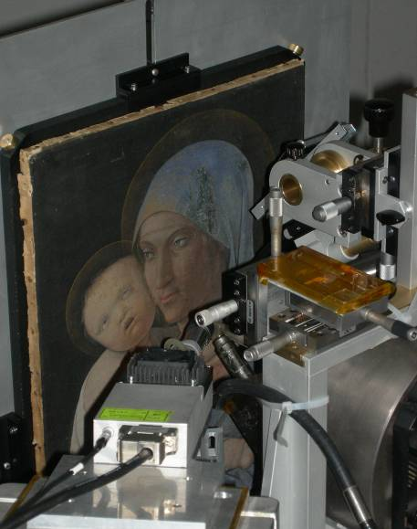
Giorgio Vasari
Tavoletta with S.Lucia, from Pala Albergotti, Arezzo
Andrea Mantegna
Madonna col Bambino, oil on canvas, Accademia Carrara di Bergamo
Notes:
41

Slide 42
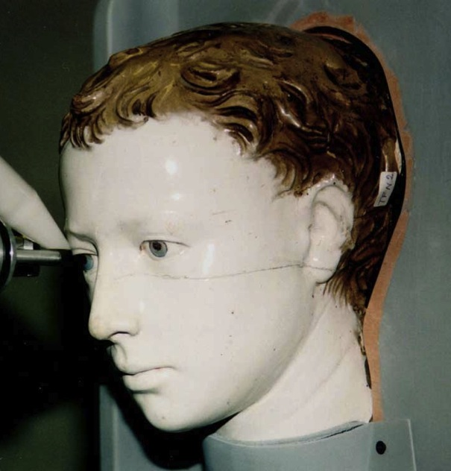
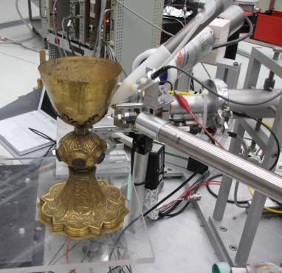
...glazed terracottas,
...metal artefacts
External PIXE analysis of the “Ritratto di fanciullo” by Luca Della Robbia – before restoration at the Opificio delle Pietre Dure in Florence
PIXE and PESA analysis of some gilded chalices from the Museum of Casa Siviero, Florence

Slide 43
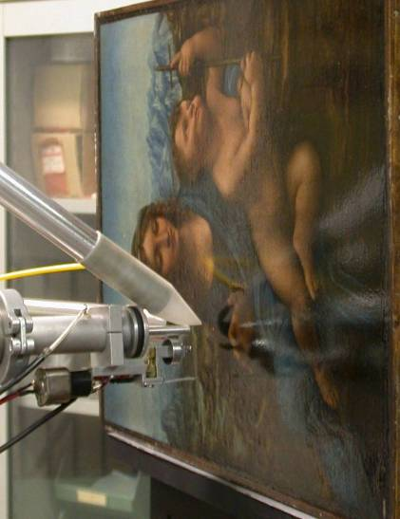
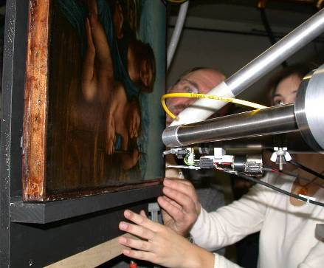
The “Madonna dei Fusi” by Leonardo: composition and stratigraphy of the paint layers by differential PIXE and PIGE analysis
Collaboration with the
Opificio delle Pietre Dure (Florence)

Slide 44
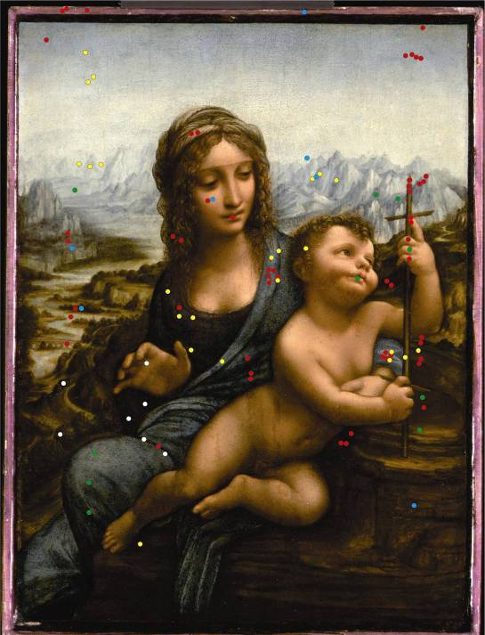
Leonardo da Vinci
“Madonna dei Fusi” (1501)
(ex-Reford version)
oil on wood, 50x36 cm²
(private collection)
interdisciplinary project, aimed at discovering the “secrets” of Leonardo’s painting techniques by non-destructive analysis, with different scientific techniques
IBA
Measured spots during some beam-times at the old accelerator (3 MeV max. proton energy)

Slide 45
Differential PIXE
Measurements on the same spot with different beam energies
a
b
c
E₁
E₂
exploiting the different ranges at different particle energies, one can get information on which elements belong to the surface layers and which to the deeper ones
E₃
E₃ <
E₂ <
E₁
Information on layers structure (up to 100-200 μm from surface) obtained without picking up samples!

Slide 46
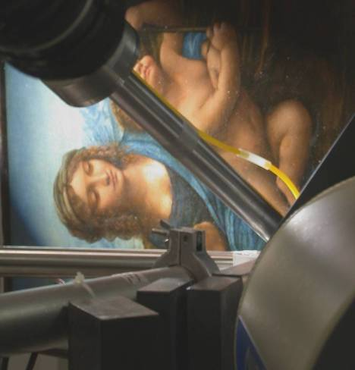
Combining differential PIXE and PIGE allowed us:
pigments identification
information on the arrangement of layers
Si det.
Ge det.
beam
PIXE + PIGE
detectors
Nuclear Instruments & Methods B239 (2005), 71
X-Ray Spectrometry, vol.34,4 (2005), 306
Nuclear Instruments & Methods B219-220 (2004),48

Slide 47
2.8 MeV
Pb
Na-γ
Original blue area
Fe
Ca
2.8 MeV
lapis-lazuli + lead white
Pb
Na-γ
Fe
Ca
PIXE
PIGE
Restored blue area
2.8 MeV
Zn
Co
Pb
cobalt blue + zinc white
Fe
Ca

Slide 48
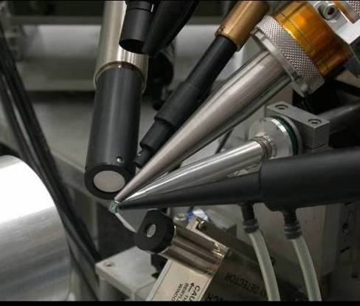
External scanning microbeam line
< 10 μm beam size on target
magnetic scan of areas within the window aperture
list-mode (E,x,y) DAQ
includes detection systems for PIXE, PIGE,
backward and forward particle scattering,
beam
ion induced luminescence (IBIL)
Nuclear Instruments & Methods A 576 (2007), 266
Nuclear Instruments & Methods B 190 (2002), 276

Slide 49


2 mm
Diagnostics of ink elements distribution in a XVII century document
2 mm
damage precursor?
max
min

Slide 50
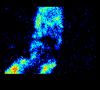
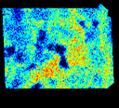
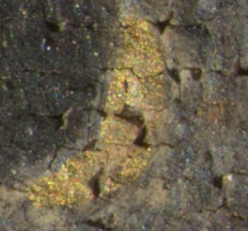









Mantegna, Madonna col Bambino (1460)
Accademia Carrara (Bergamo)
2 mm
Au L_{α}
Pb L_{α}
Sn K
Fe
2 mm
Au L_{α}
Si
Al
Pb L_{α}

Slide 51

AMS ¹⁴C dating at LABEC
Distribution of analysed materials

Slide 52



Etruscan site diggings in Southern Tuscany
River sediments – the Abak Creek layers in Ethiopia
Archaeological diggings in downtown Florence (Palazzo Vecchio and surroundings)
Notes:
52

Slide 53




Artemidorus papyrus
The frame of a tryptic by Ambrogio Lorenzetti
The Rosano Crucifix
Notes:
53

Slide 54



AMS dating of St.Francis’ relics in Cortona and Florence
Nuclear Instruments & Methods B266 (2008), 2251
Notes:
54

Slide 55
Results
55

Slide 56
2
Notes:
56

Slide 57
Exploiting the effect of nuclear explosions in atmosphere during the cold war
Reference curve for the Boreal Emisphere
pMC (percent of Modern Carbon)
57

Slide 58
Many intersting applications in forensics and biology,
but these large variations of ¹⁴C concentration during the past 60 years might also be exploited to discover recent fakes of contemporary art, claimed instead to have been produced during e.g. the first half of the XX century

Slide 59
May ¹⁴C be used
to date contemporary art?
Nuclear Instruments & Methods B 294 (2013), 662

Slide 60

Yes...if the painting support is only compatible with a later period...
A canvas sample from a painting initially attributed to Fernand Legér
200
190
129.05 ± 0.68 pMC
180
170
Legér died in 1955!
160
150
pMC
140
130
120
110
100
90
1940
1945
1950
1955
1960
1965
1970
1975
1980
1985
1990
1995
2000
year AD

Slide 61




Atmospheric Aerosol
solid and liquid particles with a diameter from 10⁻³ to 10² μm
(PM ≡ Particulate Matter)
natural or anthropic sources
direct or secondary origin
Impact on health
Impact on climate changes
Impact on Cultural Heritage

Slide 62


What is needed to study aerosols (PM)
A wealth of data concerning:
concentration and composition
size distribution
optical properties
time and space evolution
Identification and quantification of PM emission sources
Contribution to strategies of pollution abatement to improve air quality
Contribution to climatic models to evaluate the role of atmospheric aerosol in the “radiative forcing”

Slide 63
Research projects of the LABEC group
Local impact:
Study of PM10, PM2.5 e PM1 in Tuscany (PATOS, PATOS 2)
and in the most important Italian cities
Global impact:
EPICA - European Project for Ice Coring in Antarctica
TALDICE - TALos Dome Ice CorE
ANDRILL - Antarctic Geological Drilling
AMMA - African Monsoon Multidisciplinary Analysis
MAIL - Marine Aerosol in the Island of Lampedusa
DIRIGIBILE ITALIA (multidisciplinary study of climate change in the Arctic region)
Environmental monitoring in sites relevant for Cultural Heritage
Indoor pollution/ personal exposure:
HEARTS - Health Effects And Risks of Transport Systems

Slide 64


Measurements of “daily” samples
Sequential Samplers
PM₁ PM_{2.5} PM₁₀
47 mm
Multiple sample-holder
Beam scan over the filter to average the whole collection area
Notes:
Analizzare tanti campioni raccolti con campionatori standard per lunghe campagne di misura
Fondamentale per ottenere risultati rappresentativi e affidabili
(spesso studi poco seri sui giornali)
QUESTE SLIDES SUI SETUP TE LE MANDA PIù BELLINE MASSIMO

Slide 65



Measurements of “hourly” samples
Continuous sampler (“streaker”)
PM2.5÷10
PM2.5
Beam size: 1 mm x 2 mm, corresponding to the impact area of one hour sampling
Kapton foils
Nuclepore
100 mm
Notes:
Oraio solo con PIXE,
fondamentale per sorgenti

Slide 66
Hour-by-hour trend (V.le Gramsci, Firenze):
Cu e Zn, tracers of traffic

Slide 67


Industrial emissions
Industrial emissions at Montelupo Fiorentino:
artistic glass and ceramics production
Bla bla
Notes:
Emissioni industriali notturne

Slide 68


Impact of tourists on Cultural Heritage Cortile del Michelozzo
(Palazzo Vecchio)
Bla bla
closed to visitors
Notes:
Risollevamento (elementi del suolo) durante le ore del giorno dovuto a visitatori
(non c’è infatti per il primo dell’anno)
Ti può fare comodo come collegamento ai BBCC

Slide 69


July 9-10, 2006: fireworks to celebrate Italian soccer team victory at the World Championship

Slide 70
PATOS Project
PM10 average composition
urban backgr.
urban traffic
urban backgr.
regional backgr.
urban backgr.
urban backgr.
Notes:
Caratterizzazione media chimica
Soil dust e marino con pixe
E traccianti importanti di sorgenti ... Slide dopo

Slide 71
Identification of pollution sources through multivariate statistical models
Daily samples, Capannori (Lucca), 2005-2006
Notes:
Identificazione sorgenti tramite modelli statistici
Esempio riportato:
Sito più inquinato
E quale è la sorgente più importante quando si hanno superamenti? combustione della legna!!!!
Come siamo sicuri?
Slide dopo

Slide 72

Saharan dust
important contribution in the Mediterranean area
one should distinguish its contribution from
the one of pollution sources (also for legal regulations)
Notes:
Tema importante su cui pixe è unica perchè vede bene tutti i crostali
Ad es. In questo episodio il pm10 ha superato il limite dei 50 ug/m3 in tutta la regione e il contribuuto del sahara è stato più del 50% e quindi determinante (sconto comunità europea)

Slide 73


Slide 74


Slide 75
Contribution to exceeding the limits of PM10
Saharan dust
other components
PM10 concentration (μg/m³)
Indeed, Saharan dust was sometimes the reason for exceeding the limit in June. However, other events of limit exceeding are due to other sources
Notes:
Puoi saltare

Slide 76
Not only accelerator-based techniques
XRF (X Ray Fluorescence) exploits the same principle of PIXE, i.e. the emission of characteristic X rays, to get information on elemental composition
In XRF it is however a beam of primary e.m. radiation, rather than of particles, to produce inner shell ionisation (by photoelectric effect)

Slide 77


The transportable XRF spectrometer of LABEC
X Ray Spectrometry, Vol.40 (2011), p.107
● data acquisition, He flow, X-Y-Z displacement and video camera remotely controlled (via Ethernet)
Controller
Measurement head
● 2 X ray tubes (30 kV max, 1 mA max) with two different anodes (typically Mo e Ti; W if needed)
● interchangeable collimators; typical beam diameter 0.5 mm
● SDD detector
● helium flow in front of both tubes and detector
● 2 laser beams for accurate positioning

Slide 78

Affresco della Resurrezione
Piero della Francesca
Sansepolcro,
Museo Civico
Notes:
78

Slide 79

79

Slide 80

Crucifix by Maestro di Figline
Santa Croce
Notes:
80

Slide 81

Santa Croce, Bardi and Peruzzi Chapels cycle of frescoes by Giotto
Notes:
81

Slide 82

Madonna del Granduca
Raffaello
Galleria Palatina
Notes:
82

Slide 83


The Chimera of Arezzo
Museo Archeologico Firenze
83

Slide 84
Beato Angelico, Crocifissione Capitolare, San Marco, Firenze

Slide 85
Thank you for your attention!
Notes:
85

