Slide 1
Relativistic EOS for Supernova Simulations
H. Shen Nankai University, Tianjin, China
申虹 南開大学 天津 中国
In collaboration with
H. Toki RCNP, Osaka University, Japan
K. Sumiyoshi Numazu College of Technology, Japan
K. Oyamatsu Aichi Shukutoku University, Japan

Slide 2
Contents
Introduction
Models used for EOS
New version of EOS tables
Λ hyperon effects
Summary

Slide 3

Introduction
nuclear physics
astrophysics
supernova explosion
proton-neutron star cooling
neutron star properties
.
.
.
unstable nuclei
equation of state
neutron star matter: charge neutrality; β equilibrium; T~0
supernova matter: charge neutrality; fixed fractions; T≠0
what is the status of EOS ?
For neutron stars, there are many EOS’s, but…
For supernovae, there are only a few EOS’s available

Slide 4
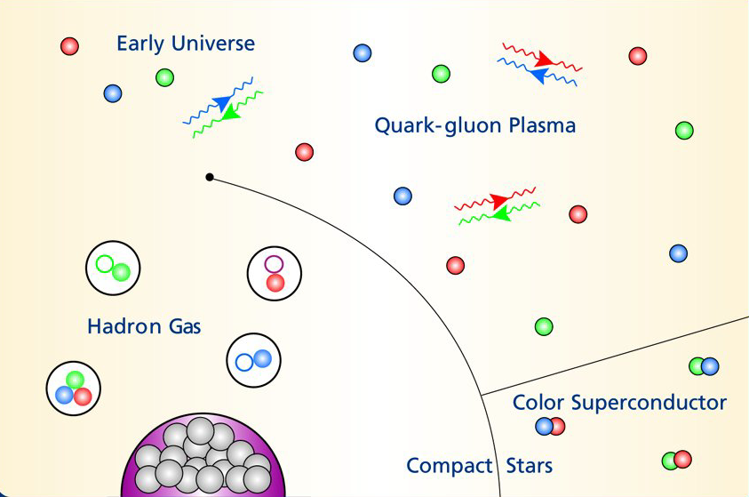
EOS for supernovae
wide range
temperature (T):
0 ~ 100 MeV
proton fraction (Yp):
0 ~ 0.6
density (ρ_{B}):
10⁵ ~ 10¹⁶ g/cm³
Temperature
Nuclei
Density

Slide 5
Models used for EOS
. . .
. . . .
. . .
. . . .
. . .
. . .
. .
. . .
. .
. . .
. .
. . .
uniform matter
proton
neutron
electron
at high density
.
RMF (relativistic Mean Field)
. .
. . . .
.
. . . .
. .
. . .
. .
. .
. . .
.
. .
. .
. . .
nuclei
alpha
proton
neutron
electron
non-uniform matter
at low density
.
RMF + Thomas-Fermi approximation

Slide 6
Why prefer the RMF theory ?
nuclear many-body methods
nonrelativistic
relativistic
Shell Model
Skyrme-Hartree-Fock (SHF)
Brueckner-Hartree-Fock (BHF)
...
Relativistic Mean-Field (RMF)
Relativistic Hartree-Fock (RHF)
Relativistic Brueckner-Hartree-Fock (RBHF)
...

Slide 7
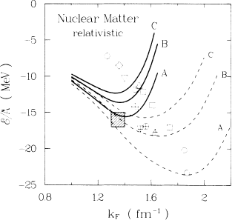
Relativity is important !
RBHF
natural explanation
of spin-orbit force
BHF
natural explanation
of three-body force
relativity
good saturation
of nuclear matter
Brockmann, Machleidt, Phys. Rev. C 42 (1990) 1965

Slide 8
What is the RMF theory ?
Relativistic Mean Field Theory (RMF)
mean-field approximation: meson field operators are replaced
by their expectation values
no-sea approximation: contributions from the negative-energy
Dirac sea are ignored
Applications
flavor SU(2) flavor SU(3)
infinite matter: nuclear matter strange hadronic matter
finite system: nuclei hypernuclei

Slide 9
Comparison with nuclear data
2157 nuclei
L.S.Geng, H.Toki, J.Meng, Prog. Theor. Phys. 113 (2005) 785

Slide 10
Relativistic Mean Field Theory
Lagrangian
TM1 parameter set
Lagrangian
Equations
Mean-Field Approximation
Calculate everything such as

Slide 11
Thomas-Fermi approximation
* body-centered cubic lattice
* parameterized nucleon distribution
* RMF input
minimize free energy
assume states
favorable state

Slide 12
Thomas-Fermi approximation
parameterized nucleon distribution
H.Shen, H.Toki, K.Oyamatsu, K.Sumiyoshi, Nucl. Phys. A637 (1998) 435

Slide 13
Check the parameterization
Self-consistent Thomas-Fermi approximation
Lagrangian
Equations

Slide 14
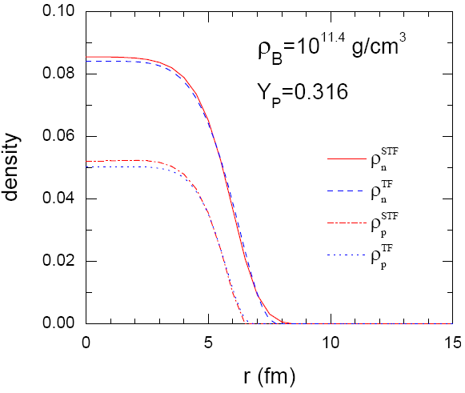
Self-consistent Thomas-Fermi approximation

Slide 15
New version of EOS tables
EOS1 (1998-version, nucleon)
Shen, Toki, Oyamatsu, Sumiyoshi, Prog. Theor. Phys. 100 (1998) 1013
EOS2 (2010-version, nucleon)
Shen, Toki, Oyamatsu, Sumiyoshi, Astrophys. J. Suppl. 197 (2011) 20
EOS3 (2010-version, nucleon+Λ)
Shen, Toki, Oyamatsu, Sumiyoshi, Astrophys. J. Suppl. 197 (2011) 20
http://physics.nankai.edu.cn/grzy/shenhong/EOS/index.html
http://user.numazu-ct.ac.jp/~sumi/eos/index.html

Slide 16
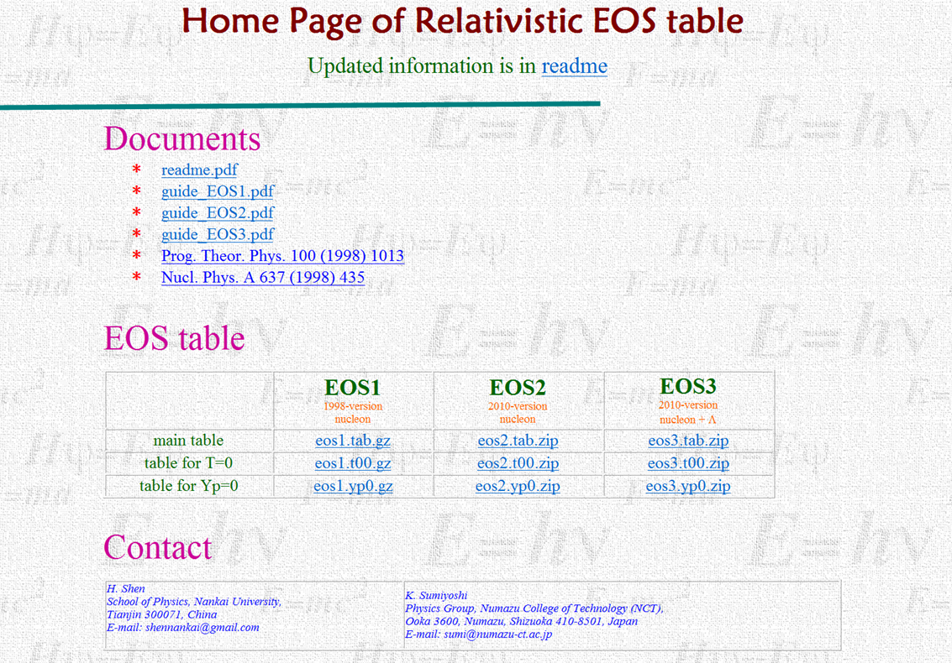
http://physics.nankai.edu.cn/grzy/shenhong/EOS/index.html

Slide 17
Comparison between EOS tables
T number of points is increased; upper limit is extended;
equal grid is used
Yp linear grid is used; upper limit is extended
ρ_{B} upper limit is extended; equal grid is used

Slide 18
Phase diagrams

Slide 19
Distributions in non-uniform matter

Slide 20
Heavy nuclei in non-uniform matter

Slide 21
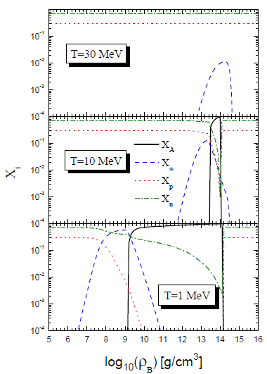
Fractions of components
with Λ hyperons

Slide 22
Effects of Λ hyperons
non-nucleonic degrees of freedom
hyperons: Λ, Σ, Ξ
boson condensates: π, Κ
quarks: u, d, s

Slide 23
EOS for supernovae with hyperons
C. Ishizuka, A. Ohnishi, K. Tsubakihara, K. Sumiyoshi, S. Yamada,
J. Phys. G 35 (2008) 085201

Slide 24
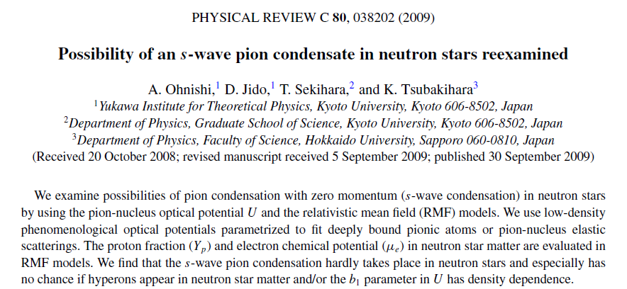
Pion condensate

Slide 25
Experimental information
scattering experiments
hypernuclear data
NN scattering data > 4000
YN scattering data ~ 40
no YY scattering data
single-Λ hypernuclei > 30
double-Λ hypernuclei ~ 4
single-Σ hypernuclei ~ 1

Slide 26
Hypernuclear Chart
O. Hashimoto, H. Tamura, Prog. Part. Nucl. Phys. 57 (2006) 564

Slide 27
Neutron star matter with hyperons
include baryon octet
√
?
?
?
Y.N.Wang, H.Shen, Phys. Rev. C 81 (2010) 025801

Slide 28
Hypernuclei in the RMF model
Single-Λ hypernuclei
H.Shen, F.Yang, H.Toki, Prog. Theor. Phys. 115 (2006) 325

Slide 29
Hypernuclei in the RMF model
Double-Λ hypernuclei
H.Shen, F.Yang, H.Toki, Prog. Theor. Phys. 115 (2006) 325

Slide 30
EOS2
EOS3
Effects of Λ hyperons

Slide 31
Summary
Relativity is important at high density
New versions of EOS tables are available
EOS2, EOS3
Λ hyperon can soften EOS at high density
Exotic phases are quite uncertain

