Slide 1
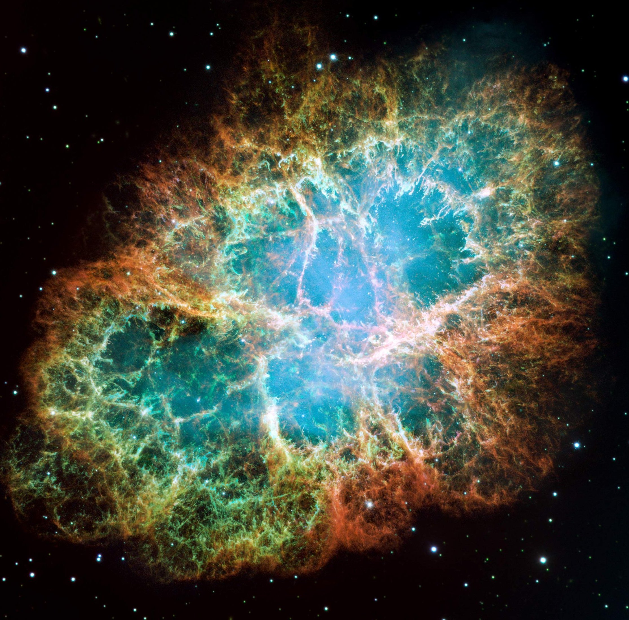


Institut d’Astronomie et d’Astrophysique
Université Libre de Bruxelles
Stellar electron-capture rates
on nuclei
based on Skyrme functionals
Anthea F. FANTINA
E. Khan (IPN Orsay)
G. Colò (University of Milan)
N. Paar, D. Vretenar (University of Zagreb)
INPC 2013
Firenze, Italy, 02 – 07 June 2013

Slide 2
Outline
Motivation
Introduction
- Electron-capture in Type II SN
The model
Results
- Electron-capture cross sections
- Electron-capture rates
Conclusions & Outlook
2

Slide 3

Motivations
Weak processes crucial all along the life of a star
Electron-capture and beta decays crucial in pre-supernova phase
determines electron fraction Y_{e} and entropy s in the core
formation of neutron-rich nuclei
Electron-capture governes the deleptonization phase
Y_{e} at trapping
shock wave formation
In this work: calculations on Fe and Ge isotopes
Janka et al., Phys. Rep. 442, 38 (2007)
3

Slide 4
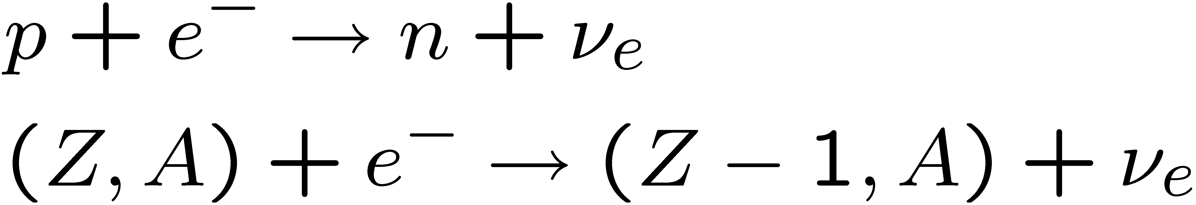
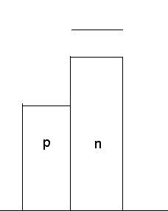
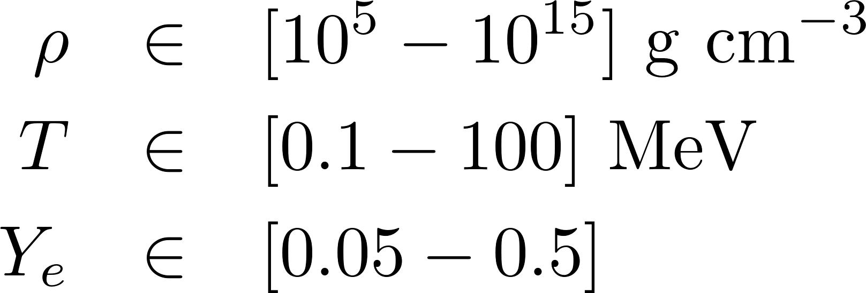
Introduction: electron-capture
on free protons
on nuclei
Condition during supernova collapse:
Δ_{N} ≈ 3 MeV
μ_{n}
μ_{p}
capture allowed!
Electron capture on free protons: quite well known!
Electron capture on nuclei: requires knowledge of nuclear structure → difficult!
4

Slide 5
Electron-capture rates:
(some) exsisting calculations (1)
Fuller et al. 1982, 1985
Fuller, ApJ 252, 741 (1982)
Fuller, Fowler, and Newmann, ApJ 293, 1 (1982) ;
ApJ Suppl. 48, 279 (1982); ApJ 252, 715 (1982);
ApJ 293, 1 (1985)
- Two-level transition at T ≠ 0 - IPM
- GT transition on nuclei suppressed for Z < 20, N ≥ 40
→ Capture on free protons dominates in SN collapse
But… missing:
- thermal excitations
- configuration mixing
for a review, e.g. Langanke & Martinez-Pinedo, Rev. Mod. Phys. 75, 819 (2003)
5

Slide 6
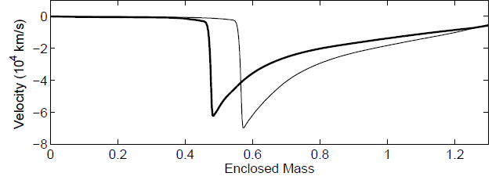
Electron-capture rates:
(some) exsisting calculations (2)
Langanke et al. 2000, 2001
Langanke and Martinez-Pinedo, ADNDT 79, 1 (2001)
Martinez-Pinedo, Langanke, and Dean, ApJ SS 126 ,493 (2000)
Langanke, Kolbe, and Dean, Phys. Rev. C 63, 32801 (2001)
- Shell Model Monte Carlo (SMMC)
- Hybrid model (SMMC + RPA)
→ Capture on nuclei dominates in SN collapse
  new pre-supernova model
  ( Heger et al. Phys. Rev. Lett. 86, 1678 (2001) )
  new “hybrid” rates in hydro codes
  results in smaller homologous core
Hix et al., Phys. Rev. Lett. 91, 201102 (2001)
6

Slide 7
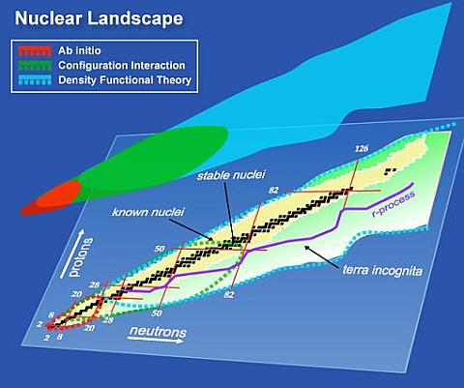
Electron-capture rates:
(some) exsisting calculations (3)
Mean-field based models:
  Paar et al., Phys. Rev. C 80, 055801 (2009) : FTSHF + RPA
  Skyrme Hartree-Fock + charge-exchange RPA
  Niu et al., Phys. Rev. C 83, 045807 (2011) : FTRRPA
  Relativistic RPA
  Dzhioev et al., Phys. Rev. C 81, 015804 (2010) : TQRPA
    thermal quasi-particle RPA
  Sarriguren, Phys. Rev. C 87, 045801 (2013) :
  deformed Skyrme Hartree-Fock + QRPA
→ not yet implemented in astrophysical codes
Bertsch et al., SciDAD Rev. 6 (2007)
7

Slide 8
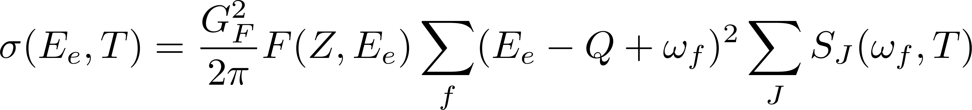
The FTSHF + FTRPA model (1)
FTSHF → single-nucleon basis, occupation factors and wave function of initial state
FTRPA (charge-exchange) → excitation energies, amplitude for transition strengths
( Paar et al., PRC 80, 055801 (2009) )
N.B.: The model is self-consistent: both HF eqs. and RPA matrix
based on the same Skyrme functional
Cross-section for electron-capture in 0.5 < T < 2 MeV range:
Brink hp.!
8

Slide 9
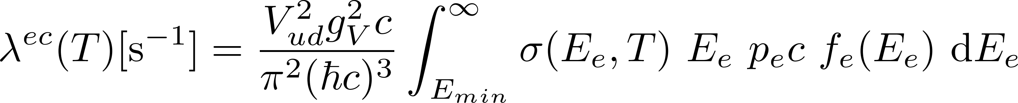
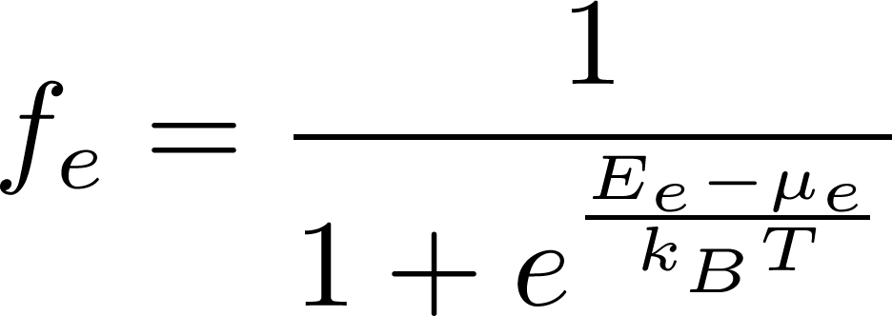
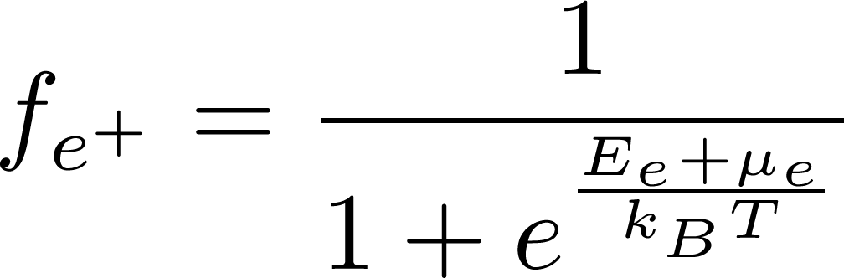
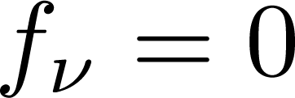
The FTSHF + FTRPA model (2)
Electron-capture rates:
Fermi Dirac
chemical potential calculated from electron density:
9

Slide 10
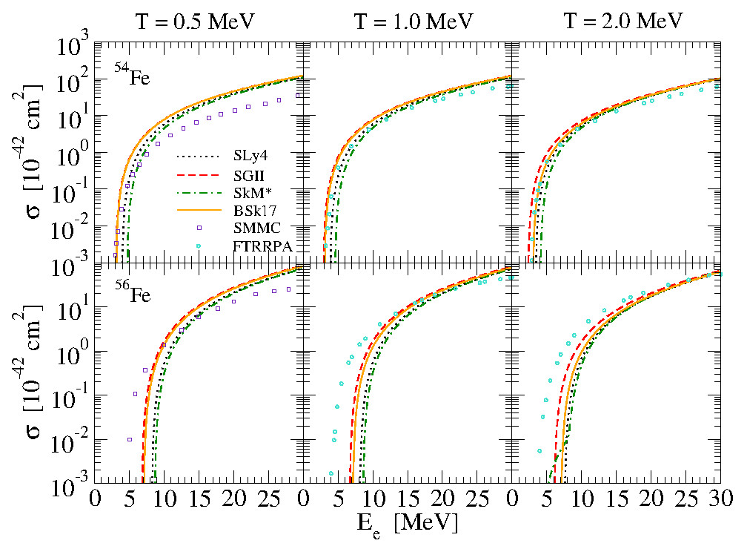
Electron-capture cross sections (Fe)
Fantina et al., Phys.Rev. C 86, 035805 (2012)
10

Slide 11
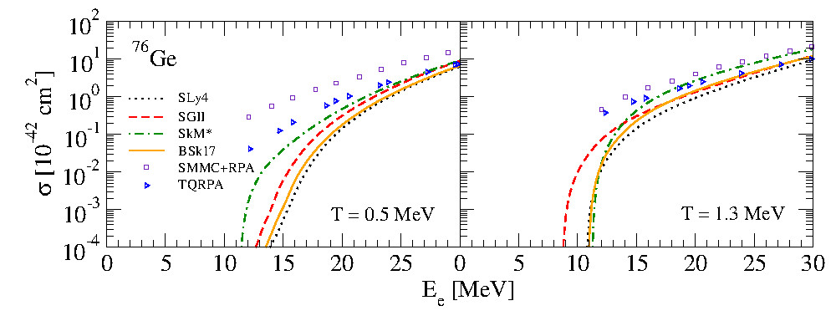
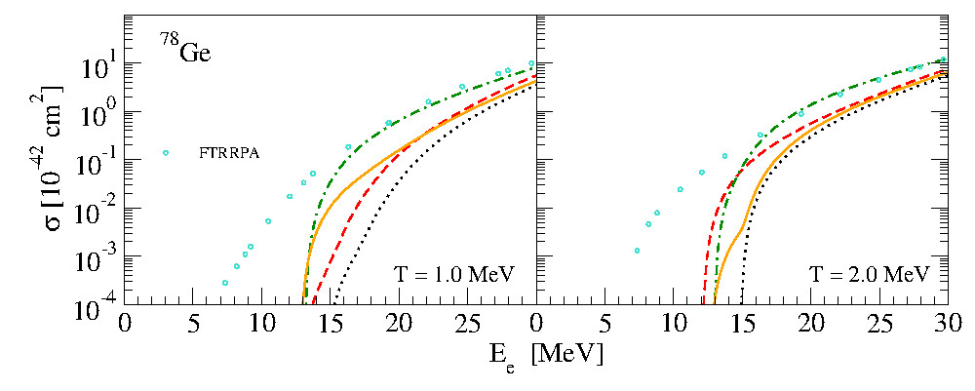
Electron-capture cross sections (Ge)
Fantina et al., Phys.Rev. C 86, 035805 (2012)
11

Slide 12
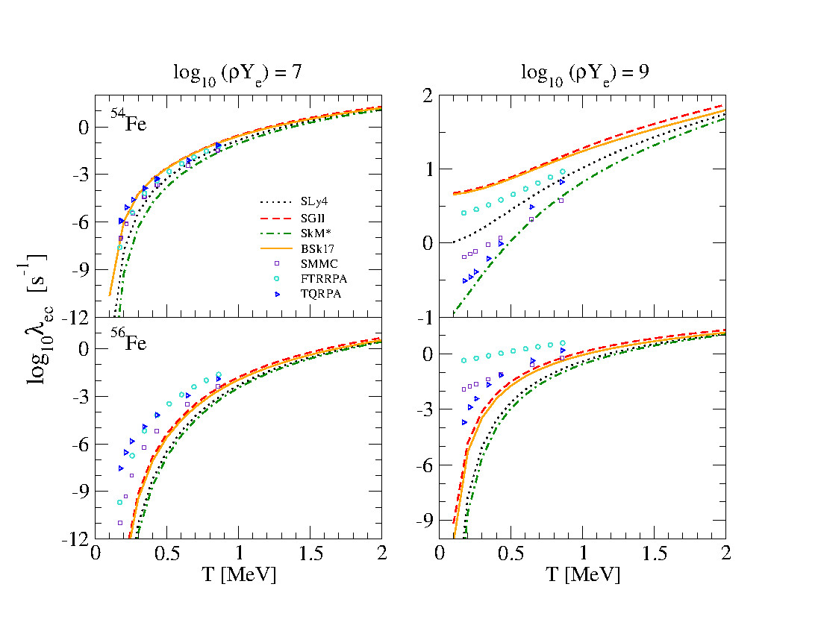
Electron-capture rates (Fe)
Fantina et al., Phys.Rev. C 86, 035805 (2012)
12

Slide 13
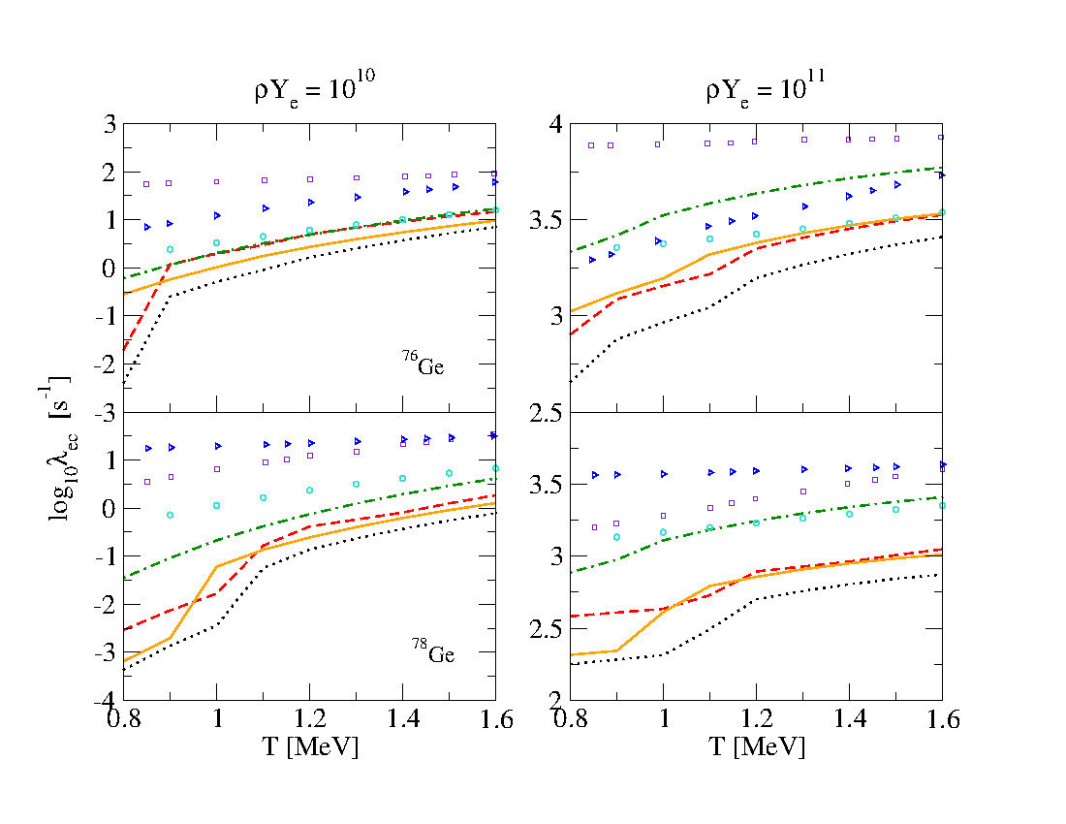
Electron-capture rates (Ge)
Fantina et al., Phys.Rev. C 86, 035805 (2012)
13

Slide 14
Conclusions & Outlooks
First calculation of electron-capture rates for stellar conditions
within fully self-consistent approach
Calculations on some isotopes (^{54,56}Fe and ⁷⁰⁻⁸⁰Ge)
Total spread evaluated at about 2 orders of magnitude
Choose “best” functional(s) → constraints from e.g. β-decay experiments
More systematic calculations on an ensemble of nuclei → TABLES
Application to astrophysics → implementation in stellar codes
(e.g. core-collapse supernova)
14
Notes:
M vs R with rotation
716Hz: fastest PSR

Slide 15
Thank you

