Slide 1


⁸B production in the reaction ⁶Li(³He,n)⁸B via neutron angular distribution measurement
V.L. Kravchuk¹, T. Marchi^{1,2}, G. Collazuol², M. Cinausero¹, F. Gramegna¹, G. De Angelis¹, G. Prete¹, E. Wildner³, V. Palladino⁴, M. Mezzetto²
¹ INFN Laboratori Nazionali di Legnaro (Italy)
² INFN and Dipartimento di Fisica e Astronomia Università di Padova (Italy)
³ CERN, Geneva
⁴ INFN and Dipartimento di Scienze Fisiche Università di Napoli (Italy)
M. Cinausero INPC2013 Firenze , 2-7 June 2013

Slide 2
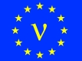
The Context: Design of next generation neutrino facilities in Europe
EUROnu Design Study (2008-2012) Next generation, high intensity neutrino oscillation facilities in Europe
T.R. Edgecock et al., Phys. Rev. ST AB 16, 021002 (2013)
Super Beam: neutrinos from the decay of π (high intensity conventional neutrino beam)
Neutrino Factory: neutrinos from the decay of μ⁺ and μ⁻ beams in a storage ring
Beta Beam: neutrinos from the decay of β emitting isotopes stored in a ring

Slide 3
The Beta Beam concept
(Courtesy E. Wildner)
Aim: production of (anti-)neutrino beams from the beta decay of radio-active ions circulating in a storage ring with long straight sections.
Beta-decay at rest
  ν−spectrum well known from the electron spectrum
  Reaction energy Q typically of a few MeV
Accelerate parent ion to relativistic γ_{max}
  Boosted neutrino energy spectrum: E_{ν} ≤ 2γQ
  Forward focusing of neutrinos: θ ≤ 1/γ
Pure electron (anti-)neutrino beam!
  Depending on β⁺- or β⁻ - decay we get a neutrino or anti-neutrino
  Two different parent ions for neutrino and anti-neutrino beams
Possible physics applications of a beta-beam
  Primarily neutrino oscillation physics and CP-violation (high energy)
  Cross-sections of neutrino-nucleus interaction, sterile neutrinos (low energy)

Slide 4
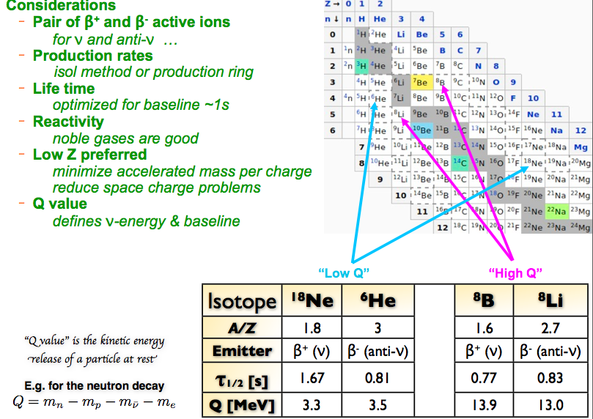
Choice of isotopes
(Courtesy E. Wildner)

Slide 5
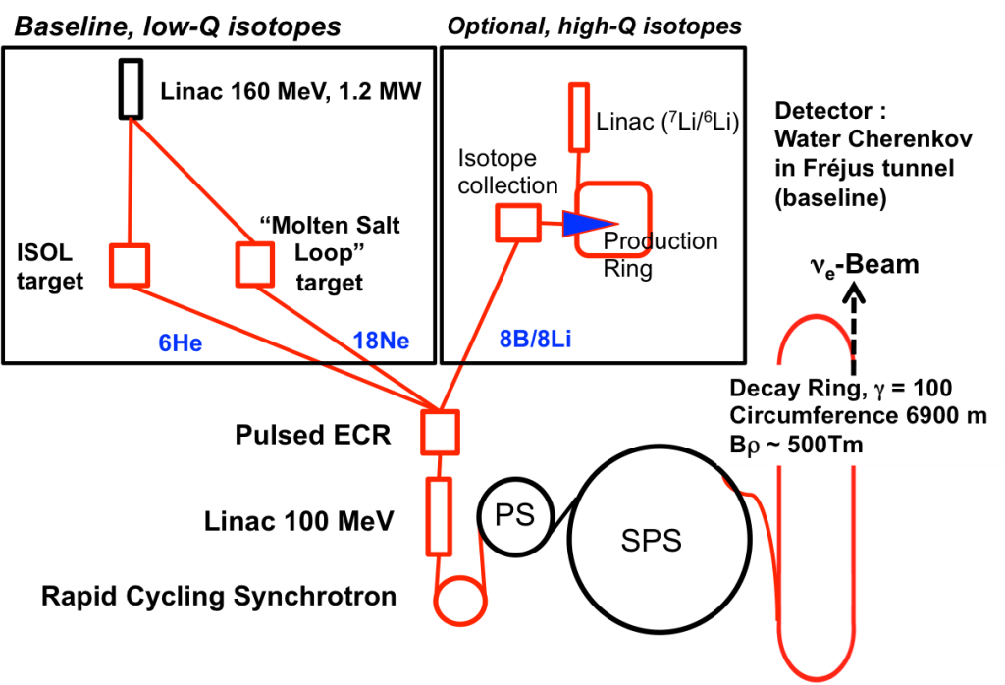
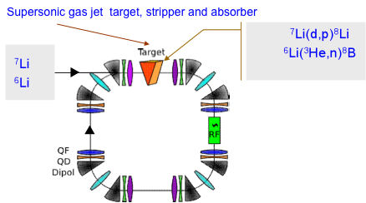
The Problem: ⁸B production cross section
C. Rubbia et al., Nucl. Instr. and Meth. A 568 (2006) 475

Slide 6
The Problem: ⁸B production cross section
C.R. McClenahan and R.E. Segel PRC 11 (1975) 370
R.E. Marrs D. Bodansky, E.G. Adelberger, PRC 8 (1973) 427
P. Van Der Merwe et al., NPA 103 (1967) 474
From Positron Counting Technique
From Neutron Time-of-Flight measurement

Slide 7
The Problem: ⁸B production cross section
C.R. McClenahan and R.E. Segel
Phys. Rev. C 11 (1975)
page 376
Previous experiments using two different experimental techniques give very different results for the ⁸B production cross section varying by a factor of 3
Experimental errors are quite large varying in the range of 15-30%
The aim of the present work is to perform an accurate high-statistics measurement of the ⁸B production cross section and angular distribution

Slide 8
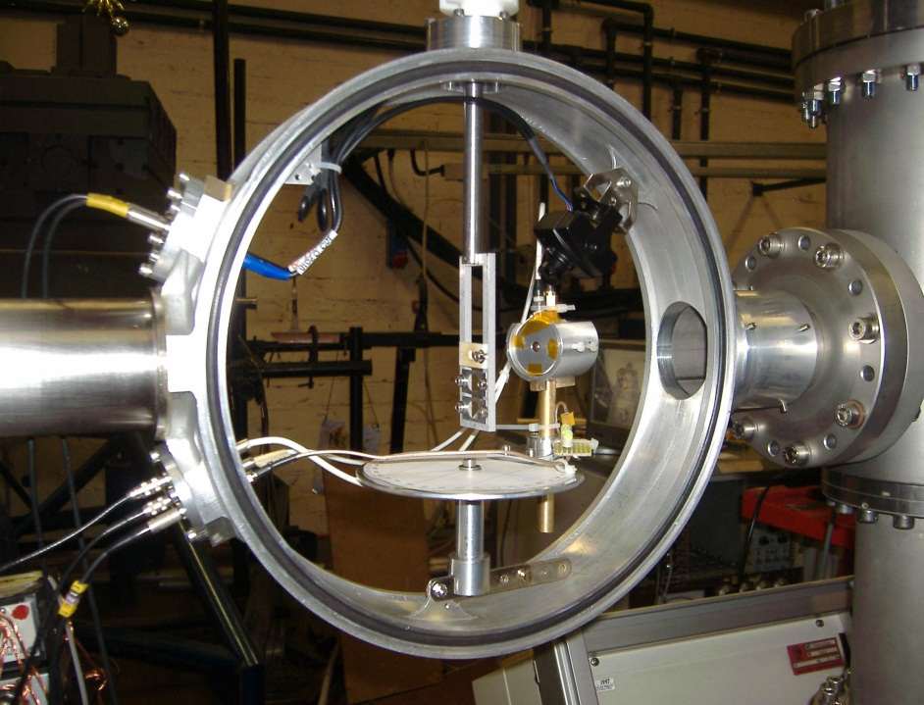
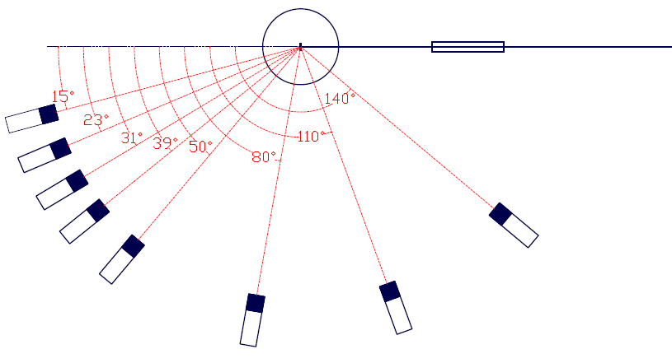
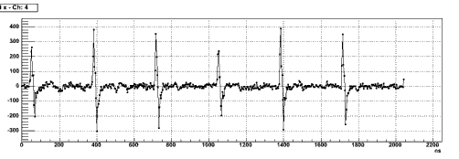
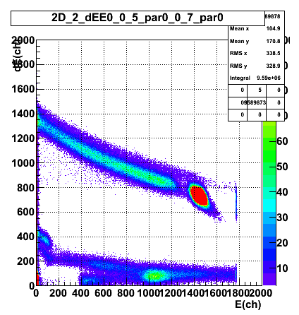
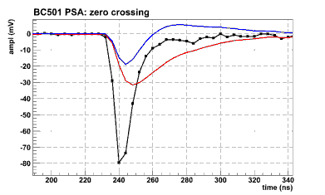
The Experimental set-up: The TOF Apparatus
( See also R. Depalo et al. Today Session E3 NA)
6 MeV ³He+⁶Li → ⁸B + n
40 pnA, pulsed beam 333 ns rep. rate with 2 ns resolution
ΔE (15 μm) – E (200 μm) Silicon Telescope
pickup
beam
1
2
3
4
8
5
³He
2 m Flight path
ΔΩ ≈ 3 mSr
Δθ ≈ ±2º
6
7
¹H
8 BC501 detectors covering angles from 15º to 140º in LAB
⁶LiF (500 μg/cm²) on Au (500 μg/cm²)
Background measurements: 1)⁷LiF (500 μg/cm²) on Au (500 μg/cm²) 2)¹²C (70 μg/cm²) & 3) without target
Rutherford scattering of the beam on the Au backing is used as normalization to determine the ⁸B production absolute cross section

Slide 9
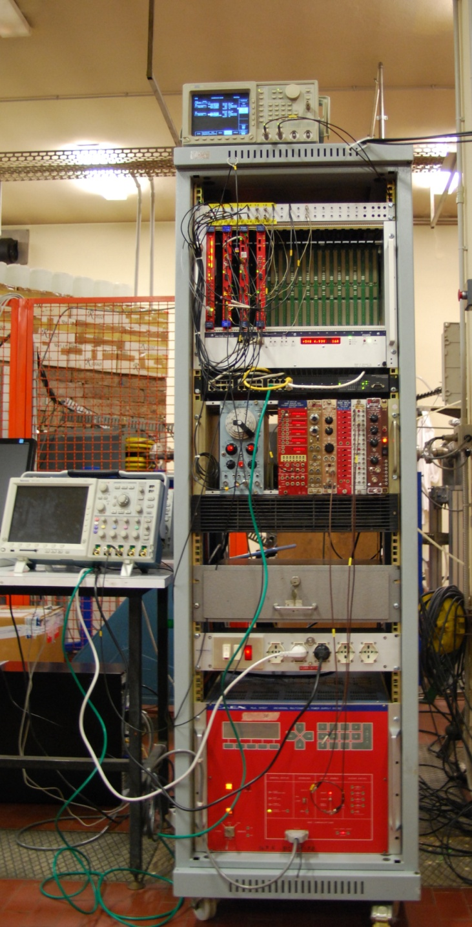
The Experimental set-up: The Digital Electronics
2 V1720 digitizer from CAEN (12 bit, 250 MS/s) in the 8 channels VME version communicating with a standard PC via a VME bridge (CAEN V1718).
Digitizers + bridge
The software used for acquisition is a customized version of CAEN WaveDump, able to handle and synchronize two or more digitizers.
Ancillary NIM electronics
Three different kinds of information are expected to be obtained processing the scintillator signals: the energy release of the impinging particle, its time of flight and the pulse shape discrimination between neutrons and gammas.
Data are processed using algorithms able to perform RC/CR filters and CFD emulator. A proper baseline subtraction is computed from the raw data
HV System
Waveforms collected in binary format are later unpacked into ROOT Trees for the following analysis.

Slide 10
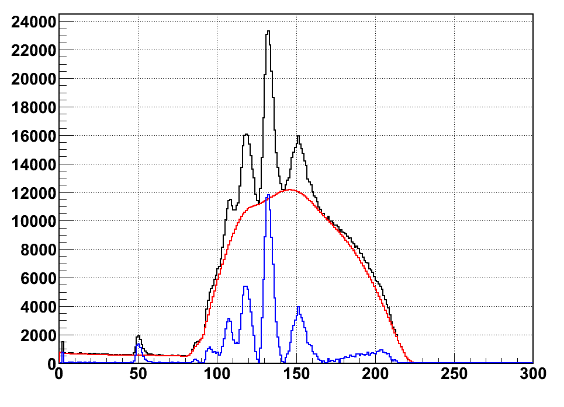
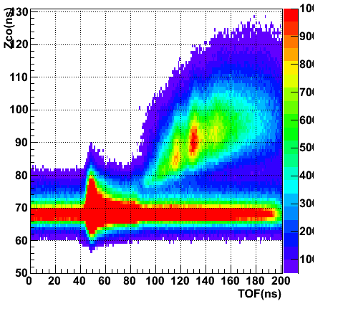
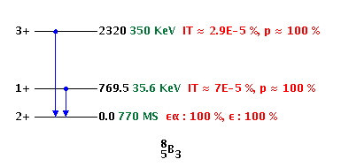
The Data Analisys: Neutron Spectra Analisys
Neutron TOF Spectrum θ_{Lab} = 15º
⁸B_{g.s.}
Counts
¹²C(³He, n)¹⁴O
⁸B*
n
γ
⁹B*
⁶Li(³He,np)⁷Be
Zero-crossing time (ns)
⁹B_{g.s.}
γ
TOF (ns)
Two-body kinematics (LISE)
g.s.
Neutron Energy (MeV)
1st exc.
Laboratory angle (deg)

Slide 11
The Data Analisys: Angular distributions and total cross section
SANREMO MC simulations
(INFN Bari)
Neutron angular distributions
g.s.
Efficiency
dσ/dΩ (mb/Sr)
Neutron Energy (MeV)
1st exc.
Total cross section | Reference
(58 ± 7) mb (g.s.) (35 ± 7) mb (1st exc.) | Our results
75 mb (g.s.) | DWUCK4 calculation
(20 ± 3) mb | Positron counting
≅65 mb | Neutron TOF
CM angle (deg)
Theoretical Calculations with code DWUCK4
“Zero Range Knock-out Distorted Wave Born Approximation”
S.A. Goncharov, Moscow State University, Russia

Slide 12
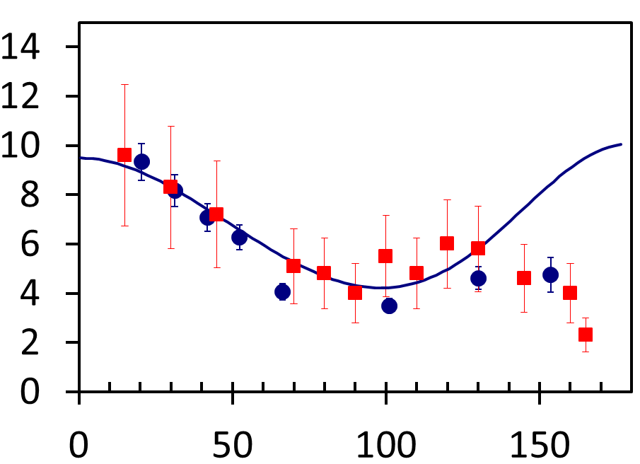
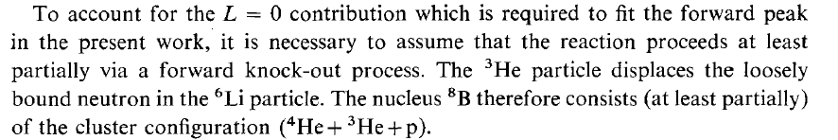

The Data Analisys: Comparison with previous data
Neutron angular distributions
This work
P. Van Der Merwe et al., NPA 103 (1967) 474
dσ/dΩ (mb/Sr)
CM angle (deg)
Double stripping or knock out reactions?

Slide 13
Theoretical predictions: Evolution of the cross section with increasing beam energy
Predictions of the DWUCK4 code
at different ³He beam energies
Only ground state
σ (mb) | ³He energy (MeV)
75 | 5.8
85 | 10
79.5 | 15
74 | 20
66 | 25
dσ/dΩ (mb/Sr)
CM angle (deg)
C.R. McClenahan and R.E. Segel PRC 11 (1975) 370
2 mb
σ(mb)
20 mb
³He energy (MeV)

Slide 14
Conclusions and Perspectives
We have performed High-Statistic Experiments measuring absolute cross section and angular distribution of the ⁶Li(³He,n)⁸B reaction
We obtained for the first time the neutron angular distribution for the population of the first excited state of ⁸B
The results show a cross section value 3 times higher than the one obtained using the positron counting technique in agreement with older experimental results obtained with the same Time of Flight technique
Preliminary DWBA calculations needs to be refined and the reaction mechanism has to be better understood
DWBA calculations performed for higher ³He bombarding energies (10, 15, 20 and 25 MeV) suggest a small variation of the total cross section with energy in contrast with the positron counting technique experimental results
Experiments with neutron Time of Flight technique at higher beam energies are needed to clarify these discrepancies

Slide 15
Back up slides

Slide 16
The Data Analisys: Angular distribution and total cross section
Theoretical Calculations with code DWUCK4
“Zero Range Knock-out Distorted Wave Born Approximation”
S.A. Goncharov, Moscow State University, Russia
Two-body kinematics (LISE)
E_{3He}=5.8 MeV
reverse (E_{6Li}=11.6 MeV)
dσ/dΩ (mb/Sr)
⁸B Energy (MeV/u)
direct
⁸B Laboratory angle (deg)
Neutron emission angle in CM (deg)
Total cross section | Reference
(58 ± 7) mb | Our result
75 mb | DWUCK4 calculation
≅65 mb | E_{3He}=5.6 MeV (neutron TOF)
n Laboratory angle (deg)
direct
reverse
⁸B Laboratory angle (deg)

Slide 17
The Data Analisys: Angular distribution and total cross section
Theoretical Calculations with code DWUCK4
“Zero Range Knock-out Distorted Wave Born Approximation”
S.A. Goncharov, Moscow State University, Russia
Two-body kinematics (LISE)
E_{3He}=5.8 MeV
reverse (E_{6Li}=11.6 MeV)
dσ/dΩ (mb/Sr)
⁸B Energy (MeV/u)
direct
⁸B Laboratory angle (deg)
⁸B emission angle in CM (deg)
Total cross section | Reference
(58 ± 7) mb | Our result
75 mb | DWUCK4 calculation
≅65 mb | E_{3He}=5.6 MeV (neutron TOF)
n Laboratory angle (deg)
direct
reverse
⁸B Laboratory angle (deg)

Slide 18
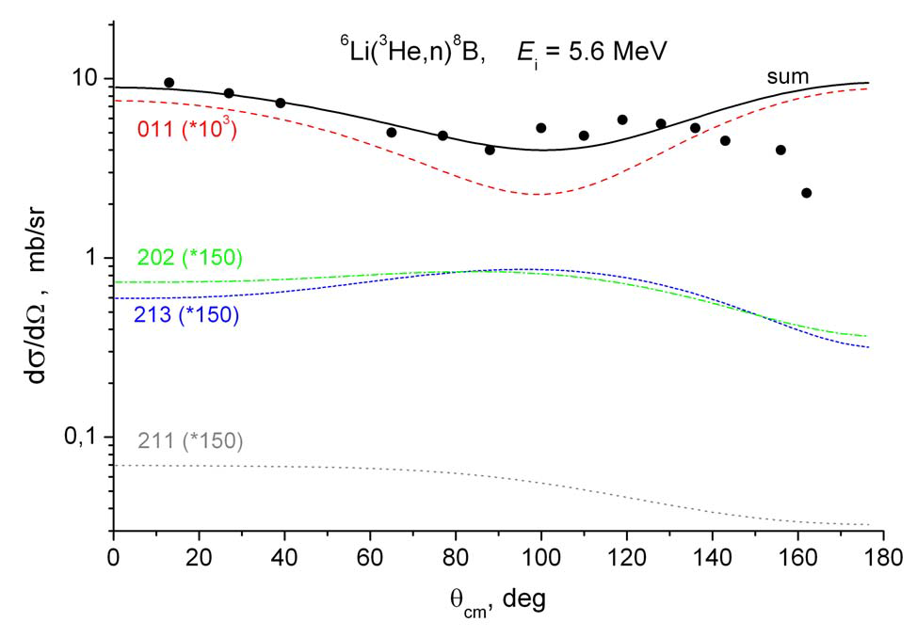
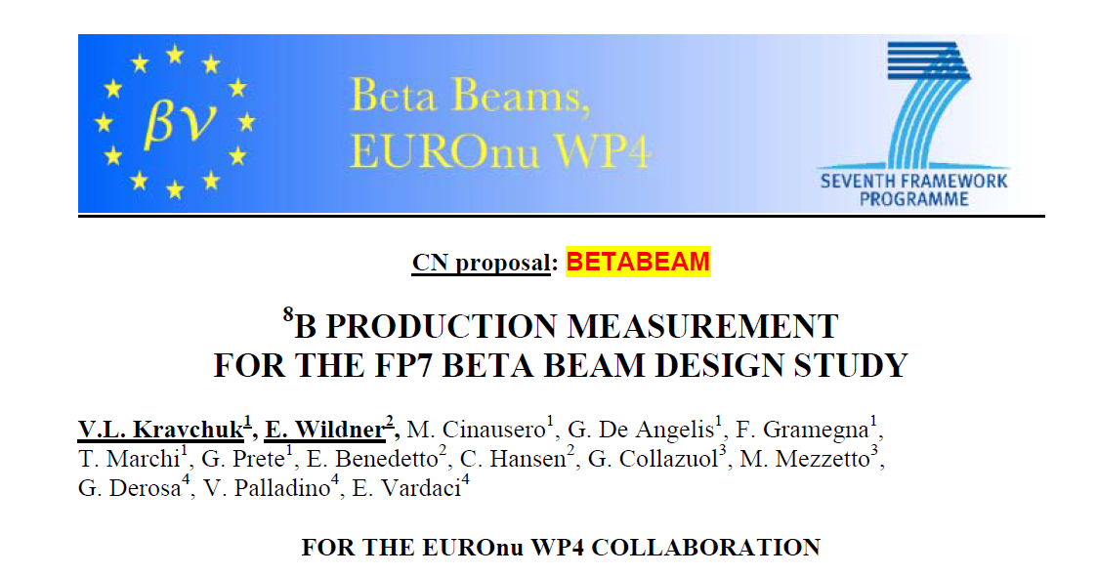
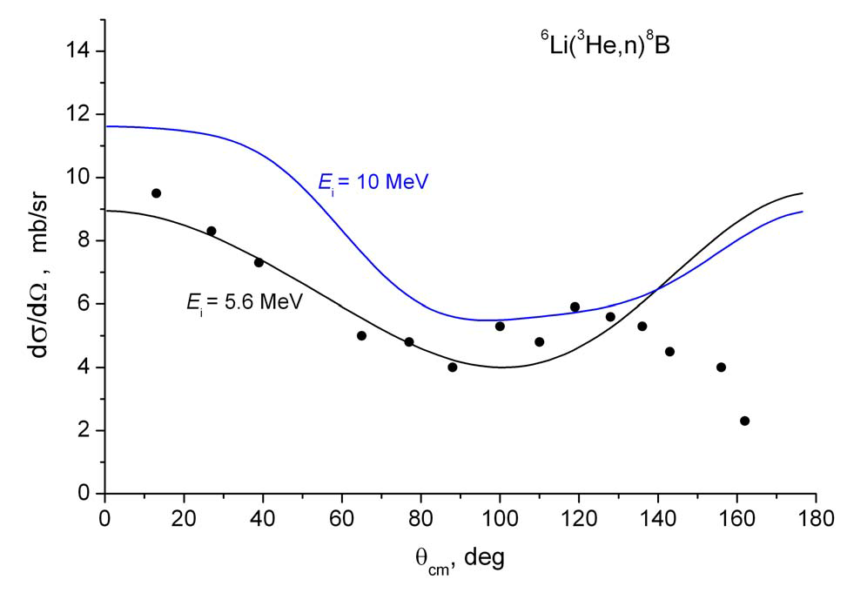
DWBA Calculations for the original CN Proposal @ LNL
Data points are from P. Van Der Merwe et al., NPA 103 (1967) 474

