Slide 1

Present and future
World new facilities
for radioactive ion (isotope) beams
T. Motobayashi
(RIKEN Nishina Center)
RI (radioactive isotope) beams in nuclear physics studies
extension in the nuclear chart
experiments with RI beams
“new generation” facilities e.g. RIKEN RIBF
fragmentation-based facilities
ISOL-based (reacceleration) facilities
Discussions and summary
c.f. dedicated talks in “I” sessions
Notes:
25+5 / about 18 slides

Slide 2
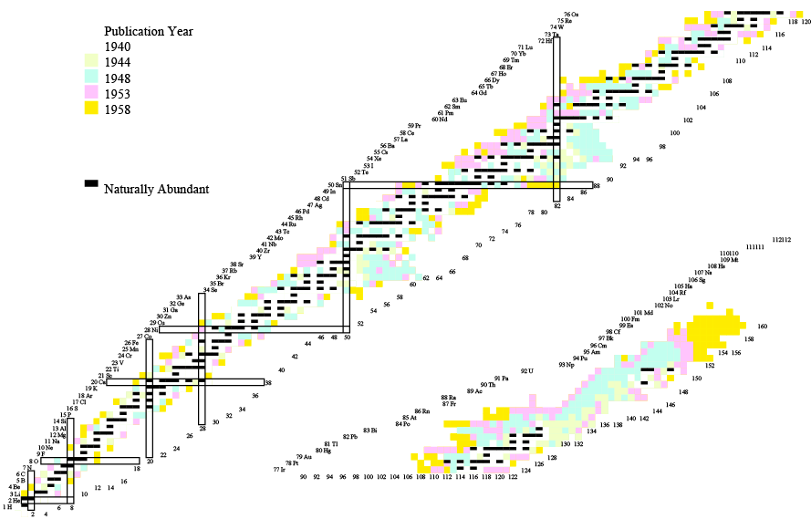
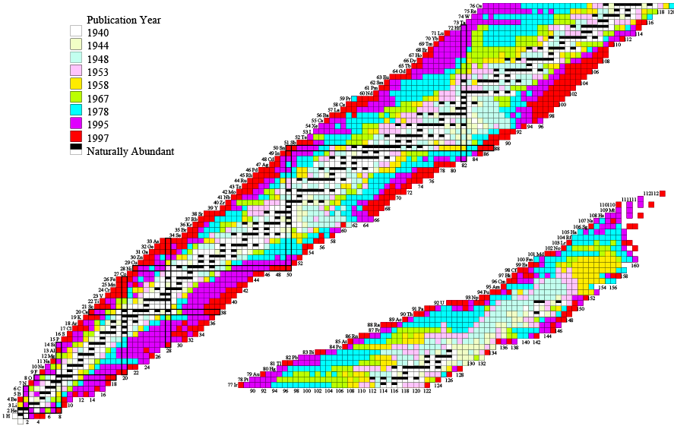
Expansion of the nuclear chart -- RI beams contribute in recent yeras.
~1958
2008
2008
original: M. Lewitowiz

Slide 3
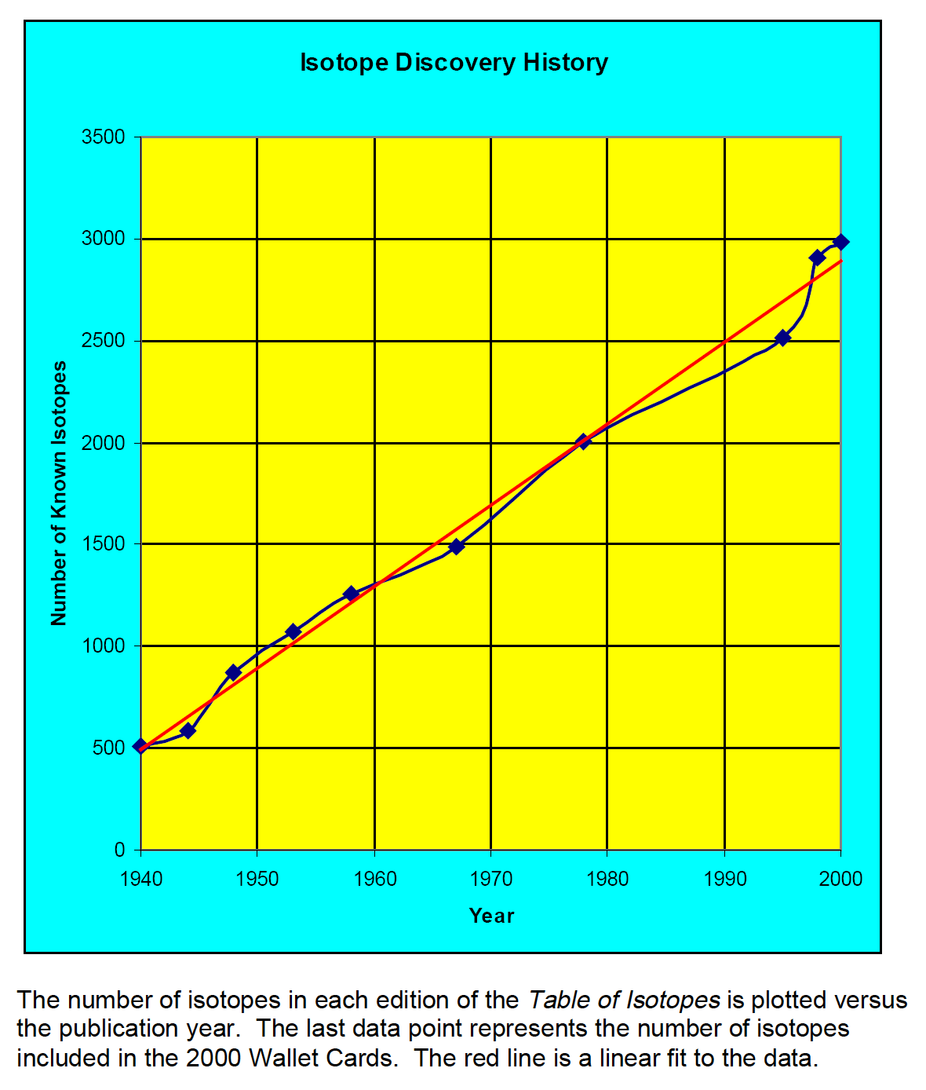
4000
3000
Number of known nuclei
“new generation”
RI beam facilities
０
1940
1940

Slide 4
4000
15th INPC (1983)
3000
Number of known nuclei
“new generation”
RI beam facilities
RI beam
LBL in 1985 “Fragmentation” method Louvain la Neuve in 1989 “ISOL” method
RIKEN in 1990 “Fragmentation” method
c.f. GANIL
０
1940
２０００
Reactions with short-lived nuclei
Delivery of short-lived nuclei
c.f. π beam (1951)

Slide 5
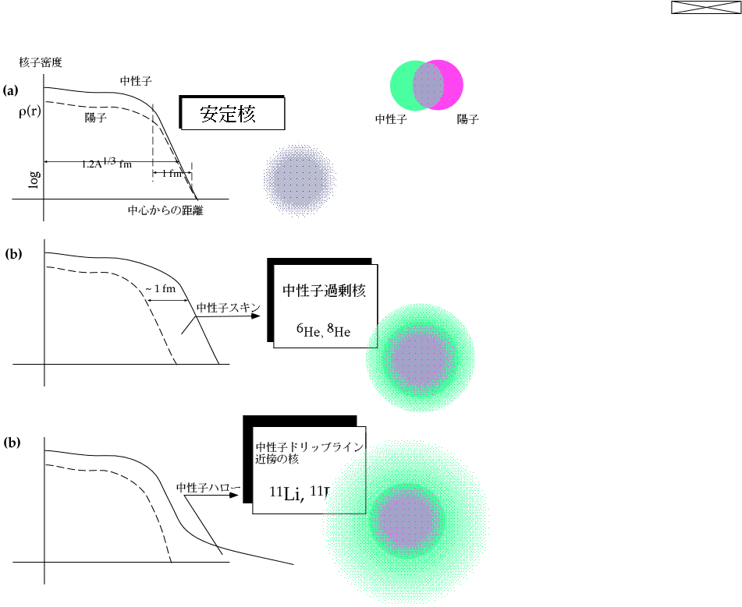
Neutron halo was found in the first RI-beam experiments -- interaction cross section
n p
Fragmentation at 800 MeV/nucleon
Tanihata et al., Phys. Lett. B 160, 380 (1985); following papers
Neutron halo
in ¹¹Li, ¹¹Be
By I. Tanihata.

Slide 6
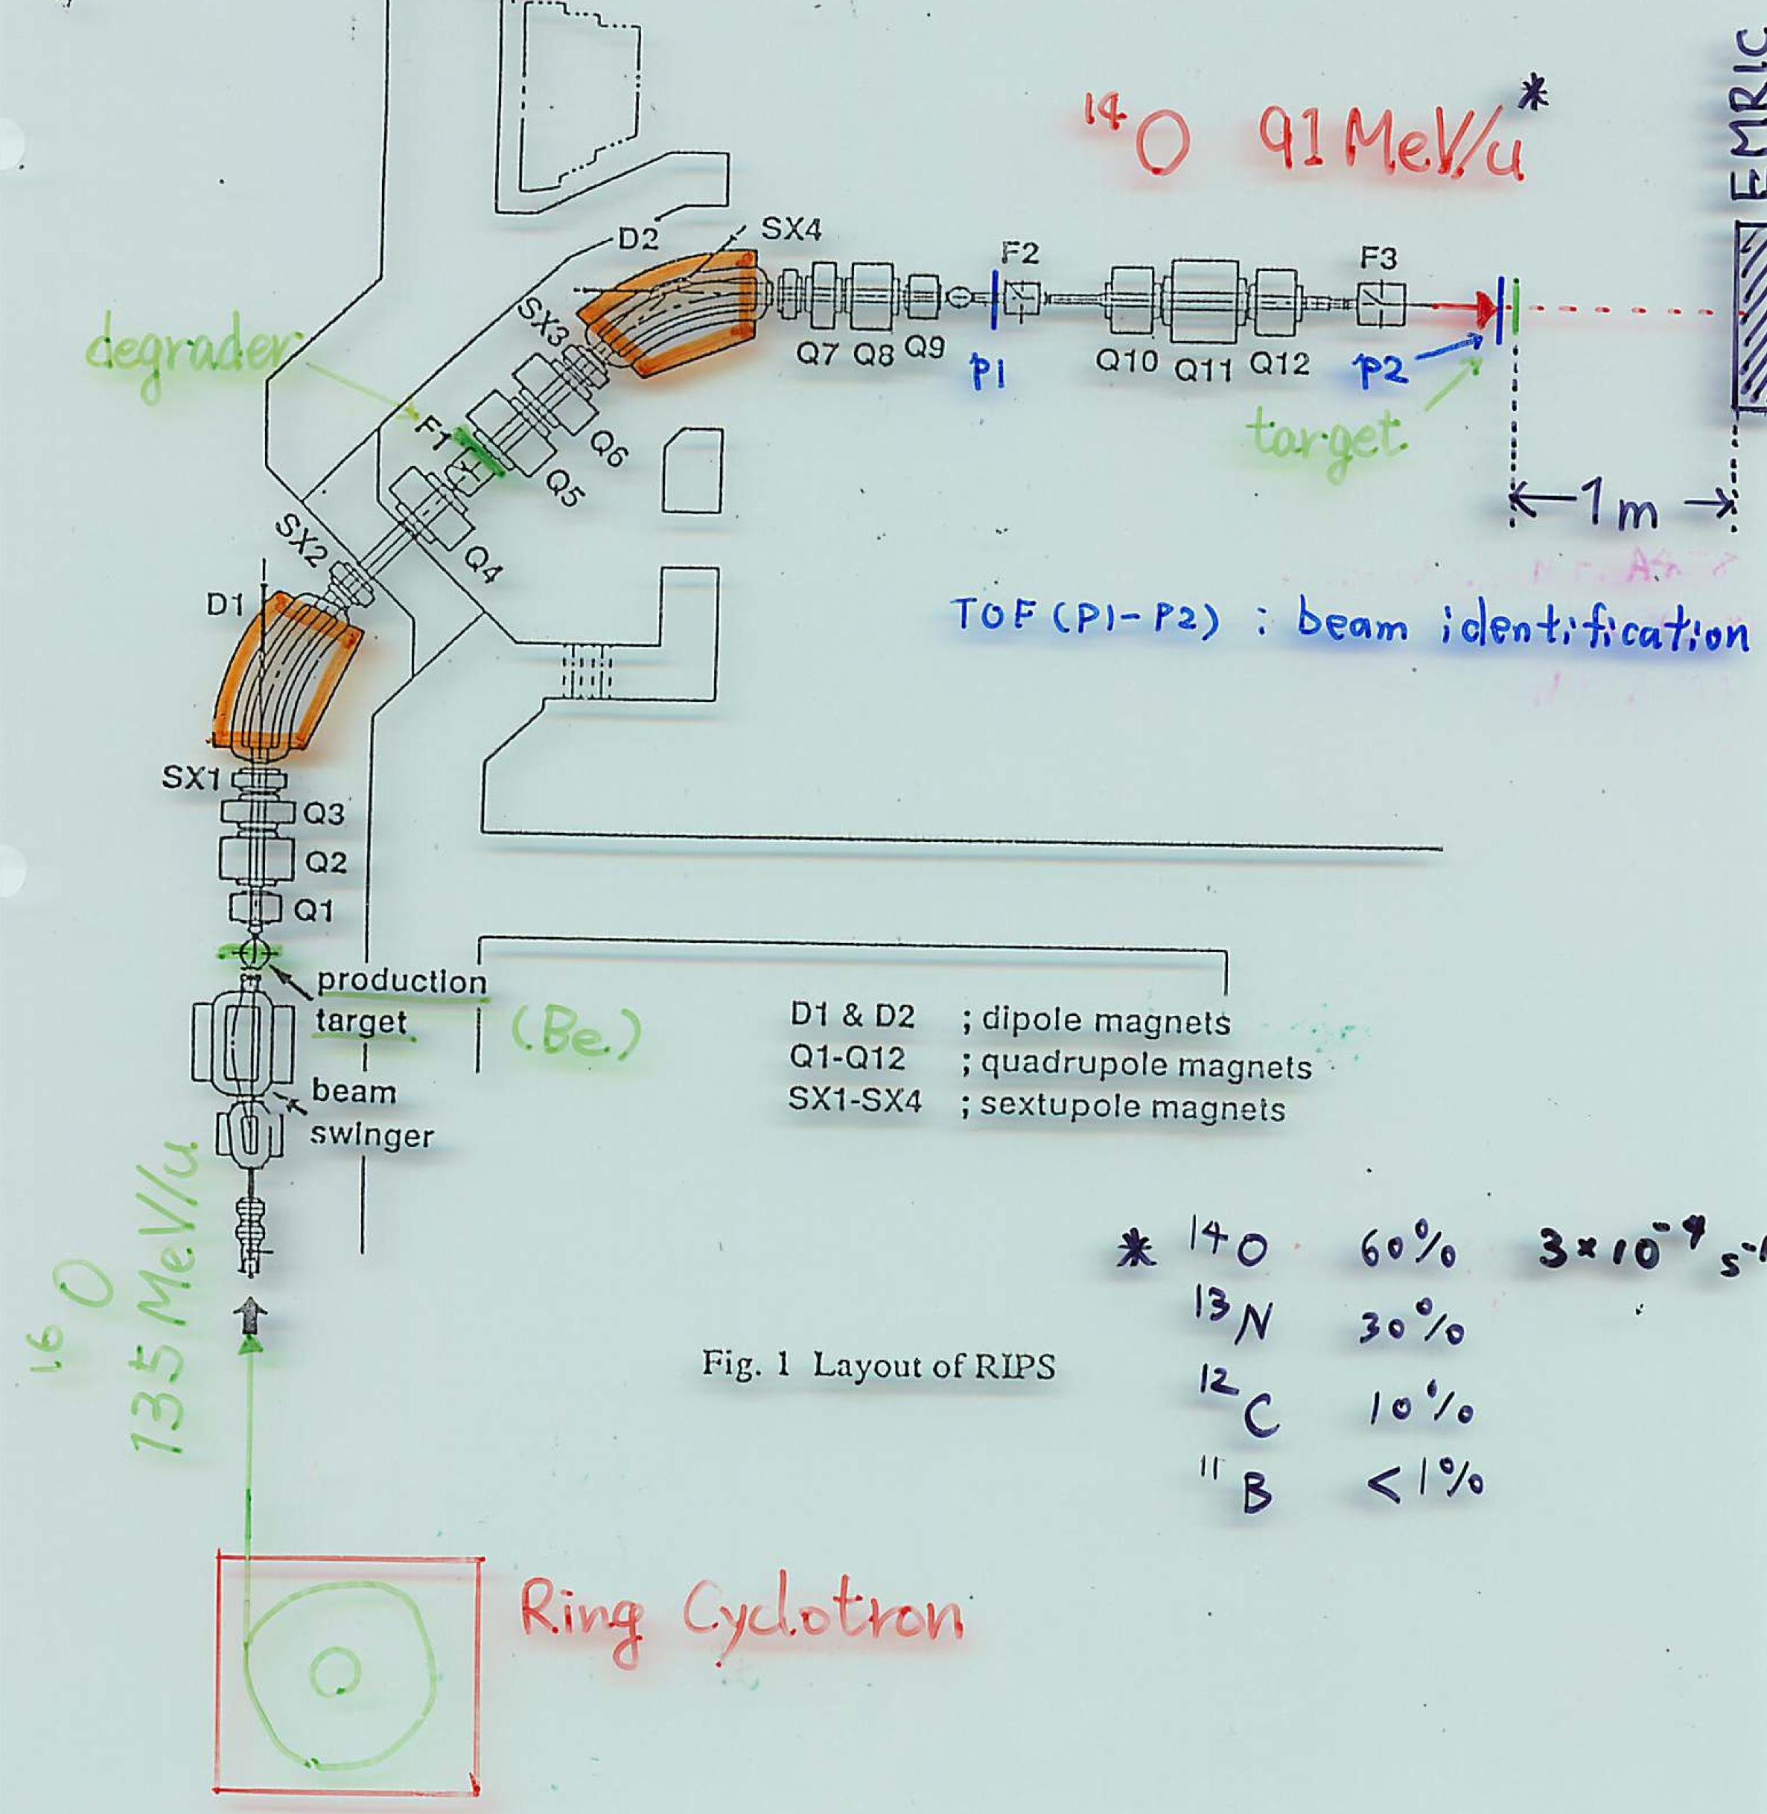
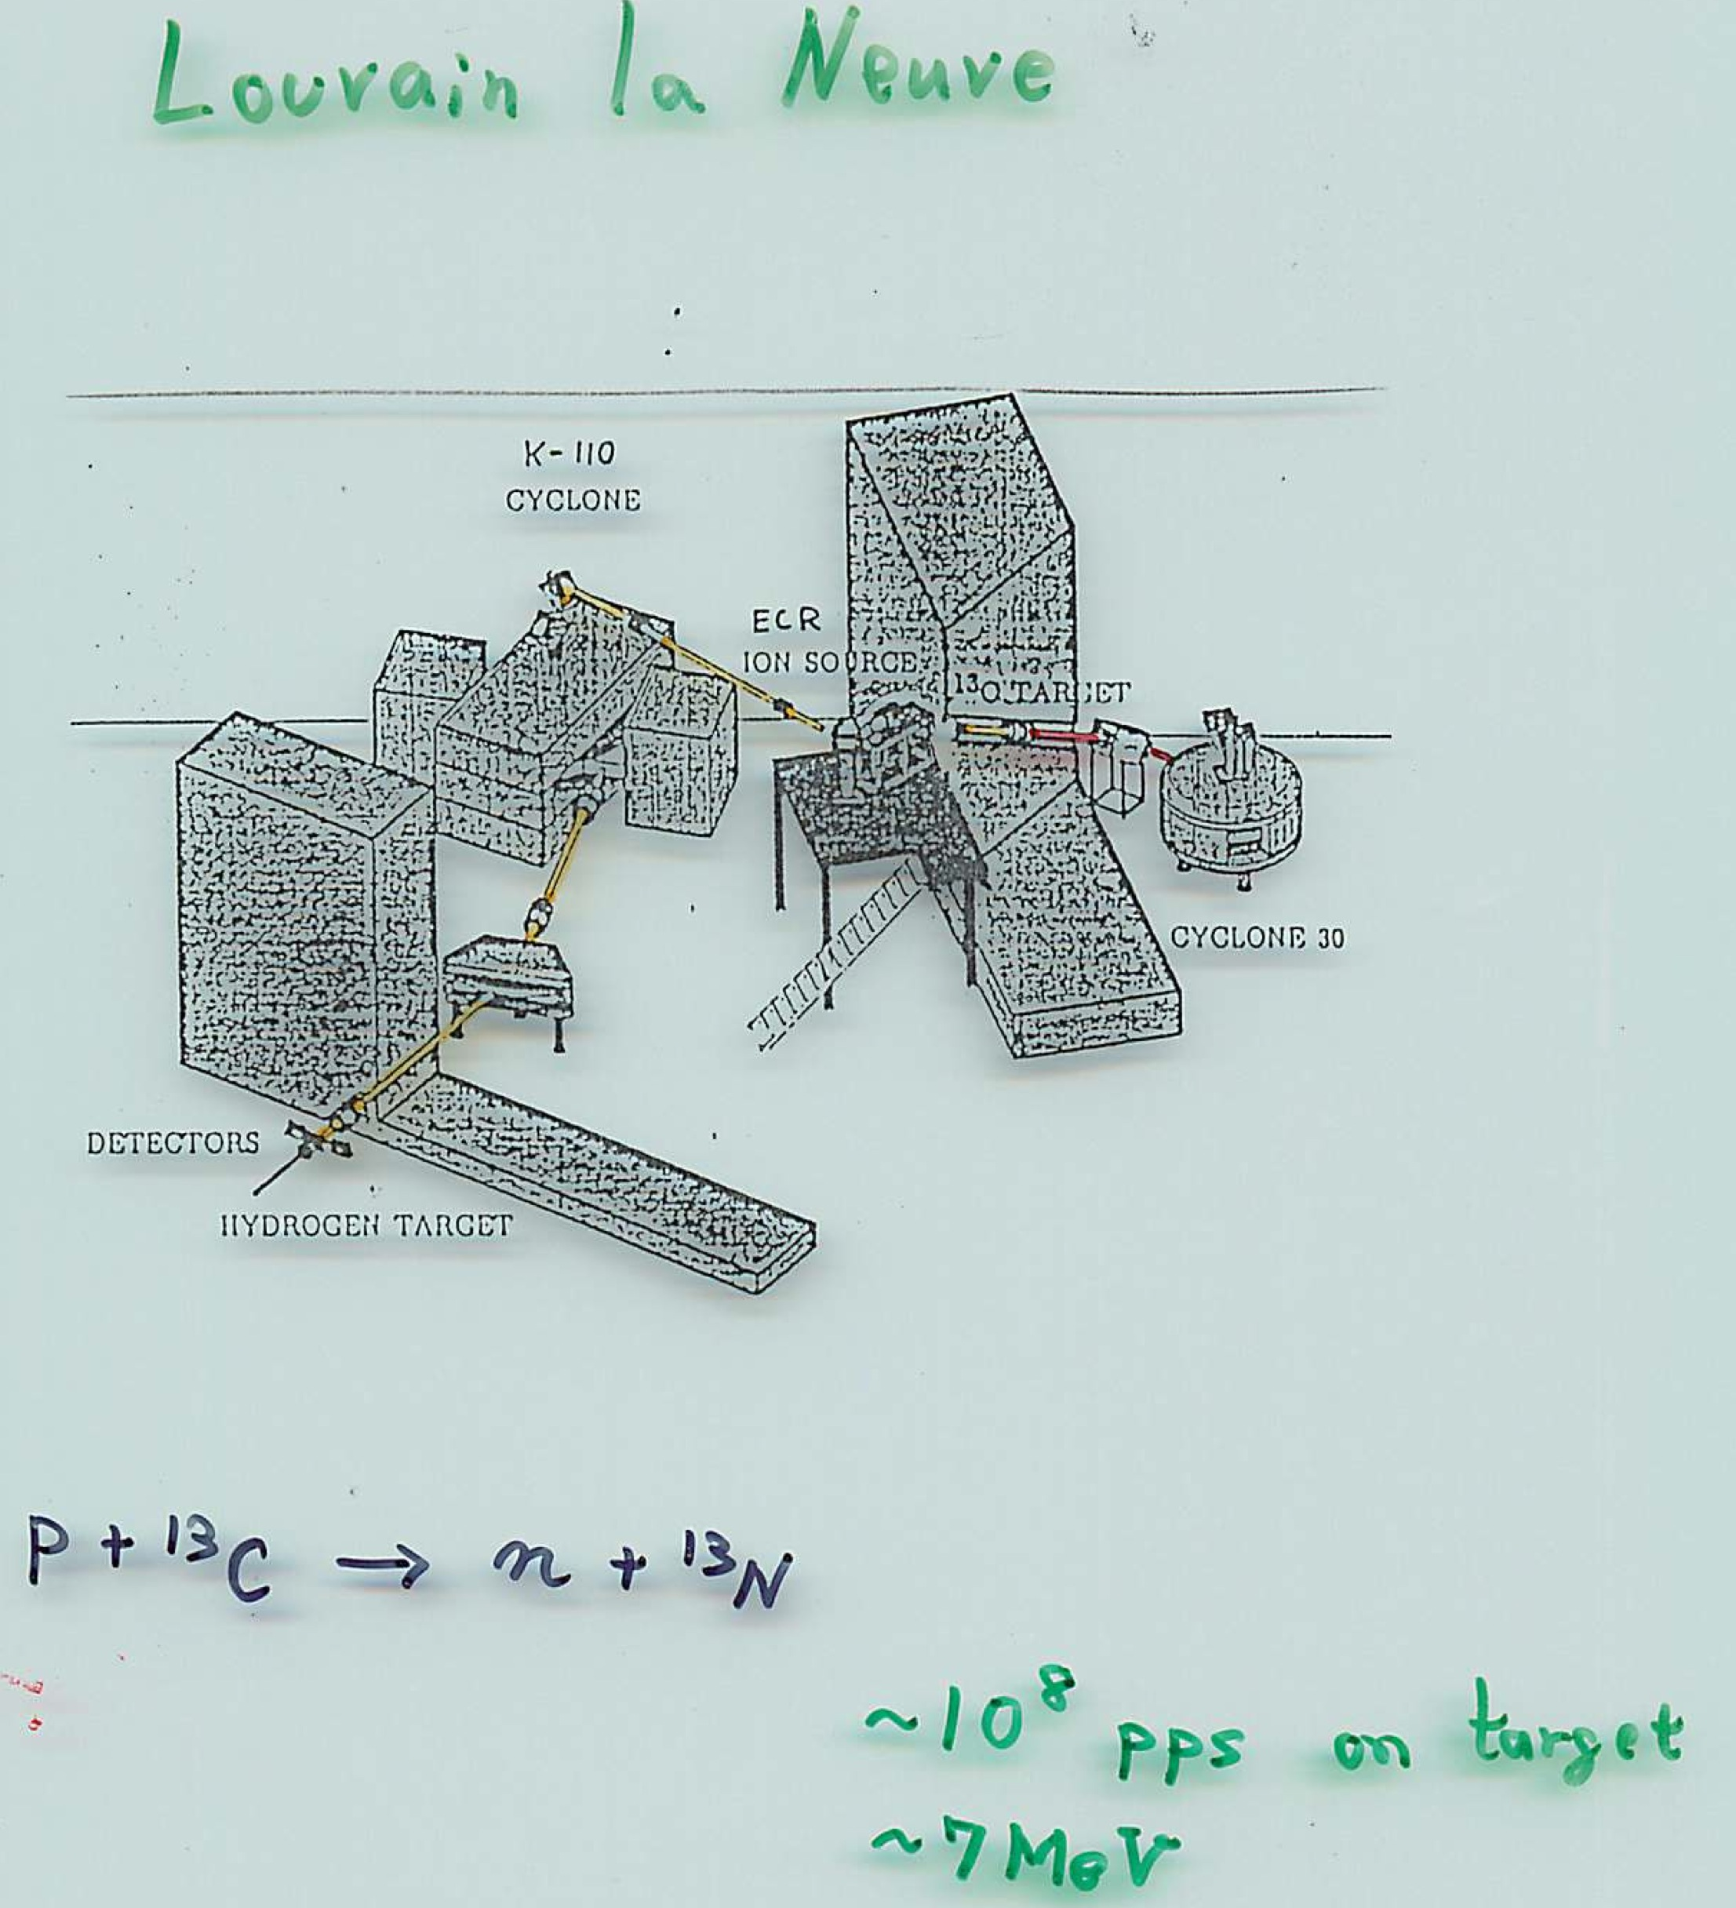
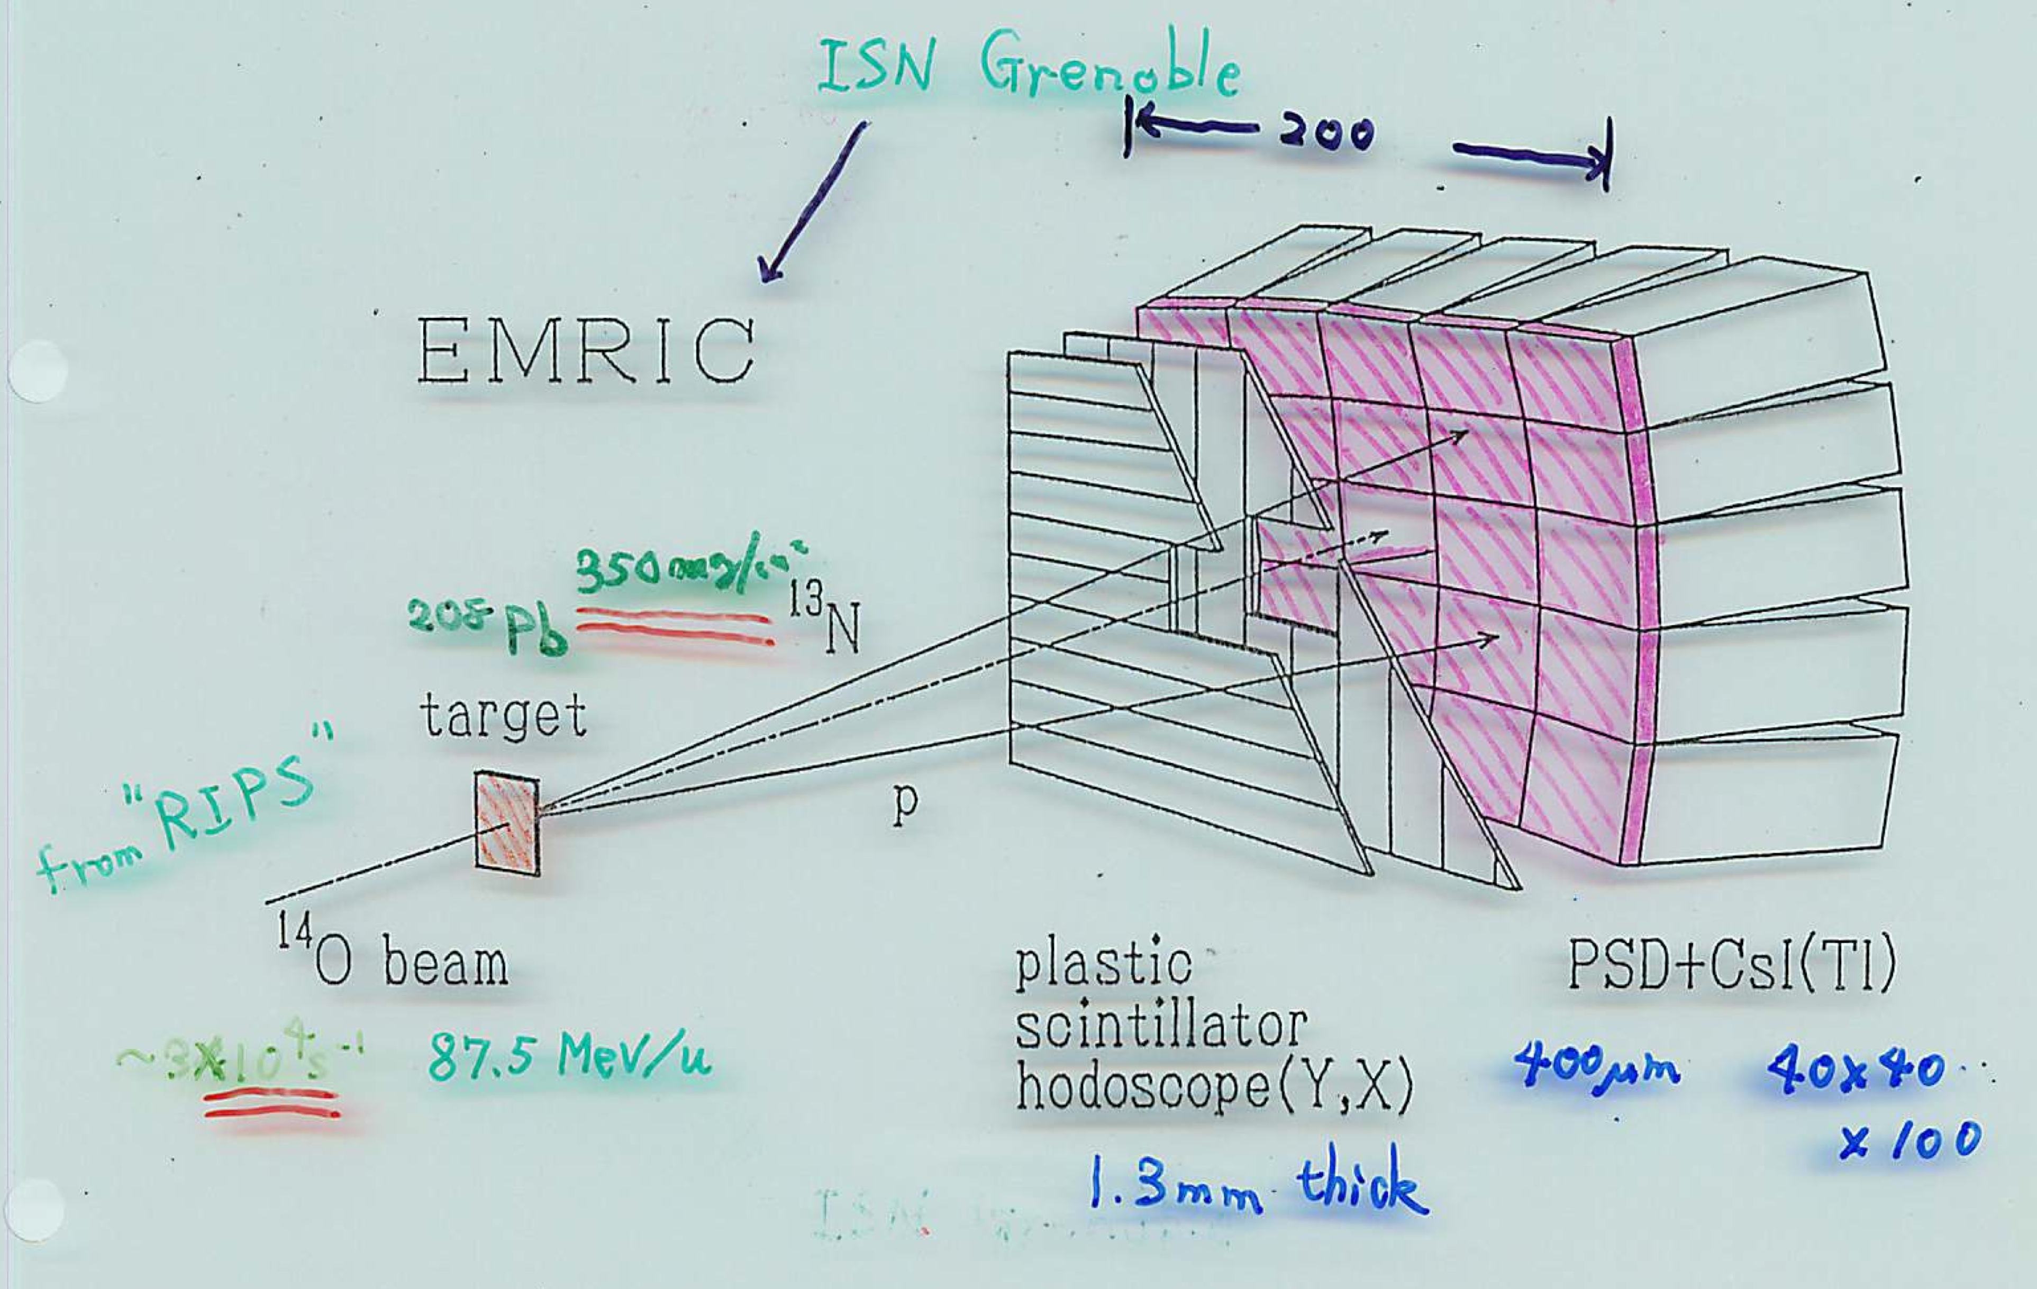
Two early experiments with RI beams are for the astrophysical reaction ¹³N(p,γ)¹⁴O
Direct measurement
¹³N+¹H → ¹⁴O+γ
Louvain la Neuve
fragmentation
RIKEN
Coulomb
dissociation
direct capture
Decrock et al., Phys. Rev. Lett. 67, 808 (1991)
91AMeV
Motobayashi et al.,
Phys. Lett. B 264, 259 (1991).
Coulmob
dissociation
¹⁴O+Pb
¹³N+p+Pb
RIKEN
ISOL - reacceleration

Slide 7
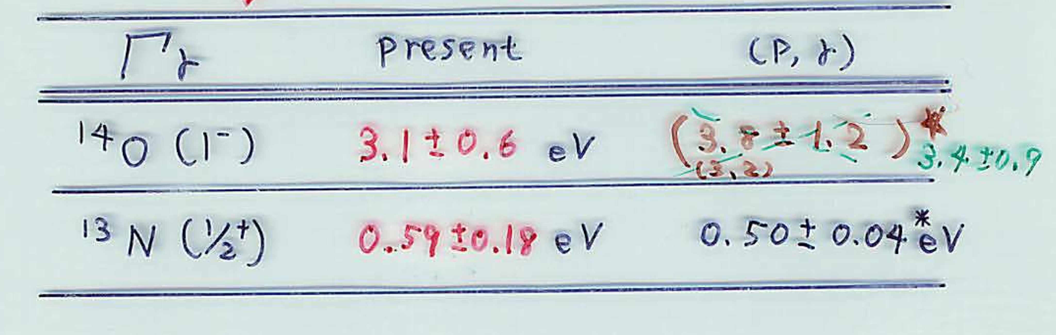
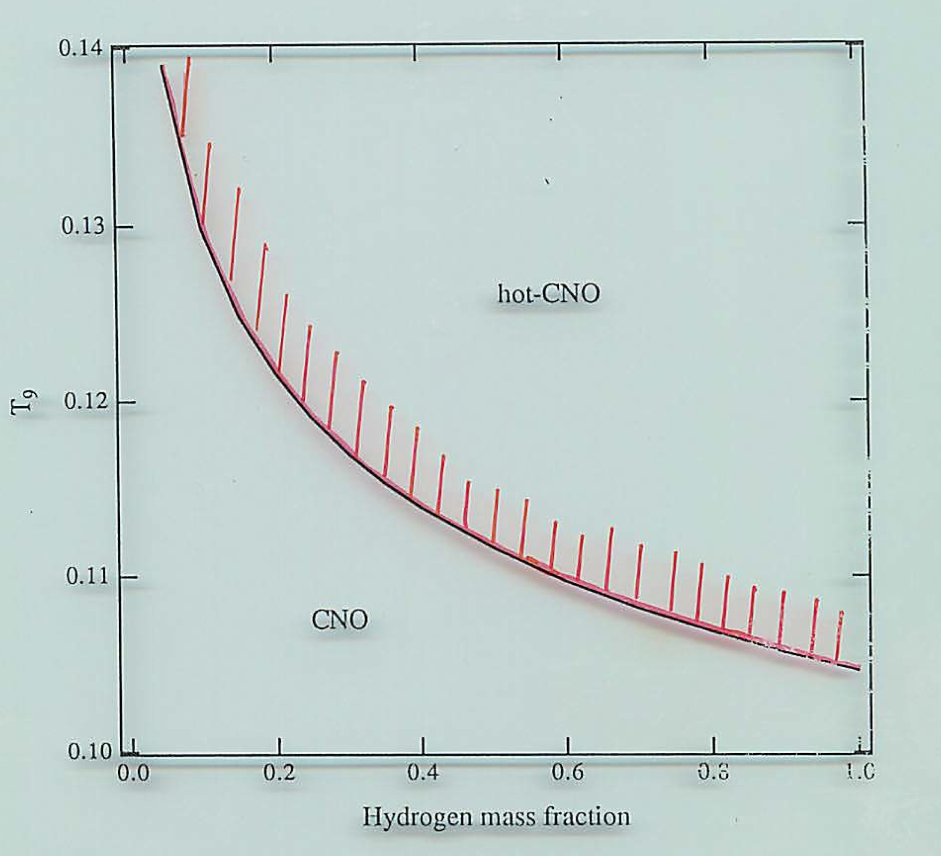
Results by direct capture / Coulomb dissociation agree. ➔CNO-hot CNO boundary
¹²C(p,γ）¹³N
reaction rate ← ωΓ_{γ}、E₀
ρ=5x10³ g/cm³
¹³N(p,γ)¹⁴O
¹³N(β⁺)¹³C
Notes:
40 min. = 30+10?
about 21 slides
At present and in future
Other institutes

Slide 8
Motivations of studying unstable nuclei ⬅ RI beams
nuclear structure
halo, skin, ….
new shell structures / collectivity
e.g. disappearance / appearance of magic numbers
explosive burning – nuclear astrophysics
reaction involving unstable nuclei
mass (Q value), half-life, …

Slide 9
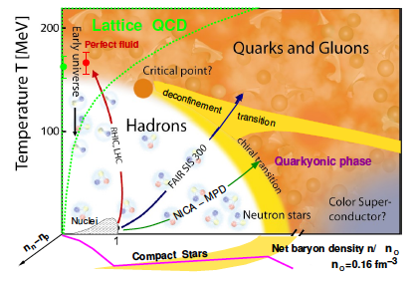
Motivations of studying unstable nuclei ⬅ RI beams
nuclear structure
halo, skin, ….
new shell structures / collectivity
e.g. disappearance / appearance of magic numbers
explosive burning – nuclear astrophysics
reaction involving unstable nuclei
mass (Q value), half-life, …
asymmetric nuclear matter
Naïve approach:
neutron-rich nuclei (by RI beams)

Slide 10
Motivations of studying unstable nuclei ⬅ RI beams
nuclear structure
halo, skin, ….
new shell structures / collectivity
e.g. disappearance / appearance of magic numbers
explosive burning – nuclear astrophysics
reaction involving unstable nuclei
mass (Q value), half-life, …
asymmetric nuclear matter
fundamental symmetries
applications
Naïve approach:
neutron-rich nuclei (by RI beams)

Slide 11
RI (radioactive isotope) beams enable (since 1985):
extension in the nuclear chart
reaction experiments
LBL (fragmentation – fast beams)
LLN (ISOL-reacceleration – low E beams)
Notes:
25+5 / about 18 slides

Slide 12
RI (radioactive isotope) beams enable (since 1985):
extension in the nuclear chart
reaction experiments
LBL, GANIL, RIKEN, MSU, GSI, IMP, …. (fragmentation – fast beams)
LLN, REX-ISOLDE, SPIRAL, ISAC.. (ISOL-reacceleration – low E beams)
➔ nuclear structure / explosive burning / asymmetric matter ..
Notes:
25+5 / about 18 slides

Slide 13
RI (radioactive isotope) beams enable (since 1985):
extension in the nuclear chart
reaction experiments
LBL, GANIL, RIKEN, MSU, GSI, IMP, …. (fragmentation – fast beams)
LLN, REX-ISOLDE, SPIRAL, ISAC.. (ISOL-reacceleration – low E beams)
➔ nuclear structure / explosive burning / asymmetric matter ..
Needs for new-generation (dedicated) facilities
with high-intensity (or to go farther away from the stability)
Notes:
25+5 / about 18 slides

Slide 14
RI (radioactive isotope) beams enable (since 1985):
extension in the nuclear chart
reaction experiments
LBL, GANIL, RIKEN, MSU, GSI, IMP, …. (fragmentation – fast beams)
LLN, REX-ISOLDE, SPIRAL, ISAC.. (ISOL-reacceleration – low E beams)
➔ nuclear structure / explosive burning / asymmetric matter ..
Needs for new-generation (dedicated) facilities
with high-intensity (or to go farther away from the stability*)
RIKEN RIBF (in operation)
FAIR, FRIB, HIAF,
Spiral2, SPES, HIE-ISOLDE, ALTO, ARIEL, BRIF, EURISOL….
Beijing ISOL, ANURIB…
RAON,
c.f. dedicated talks in “I” sessions
* r process nuclei
Notes:
25+5 / about 18 slides

Slide 15
RI (radioactive isotope) beams enable (since 1985):
extension in the nuclear chart
reaction experiments
LBL, GANIL, RIKEN, MSU, GSI, IMP, …. (fragmentation – fast beams)
LLN, REX-ISOLDE, SPIRAL, ISAC.. (ISOL-reacceleration – low E beams)
➔ nuclear structure / explosive burning / asymmetric matter ..
Needs for new-generation (dedicated) facilities
with high-intensity (or to go farther away from the stability*)
RIKEN RIBF (in operation)
* e.g. to reach r-process nuclei
Notes:
25+5 / about 18 slides

Slide 16
Secondary Beam Intensity with primary ⁴⁸Ca beams
Intensity increase at RIKEN RIBF --- old (1990-) v.s. new (2007-) facility
Previous (RIPS) achieved (BigRIPS 2009) gain
²²C 6 mcps 10 cps 1,700 ➔ 3,600 (2012)
³⁰Ne 0.2 cps 300 cps 1,500
³¹Ne 20 c/4days 10 cps 1.7x10⁵
³²Ne 5 cps
⁴²Si 15 cps
⁴⁴S 4x10⁴ cps
Aoi

Slide 17
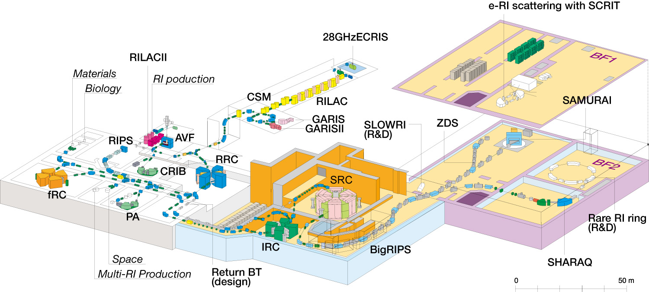
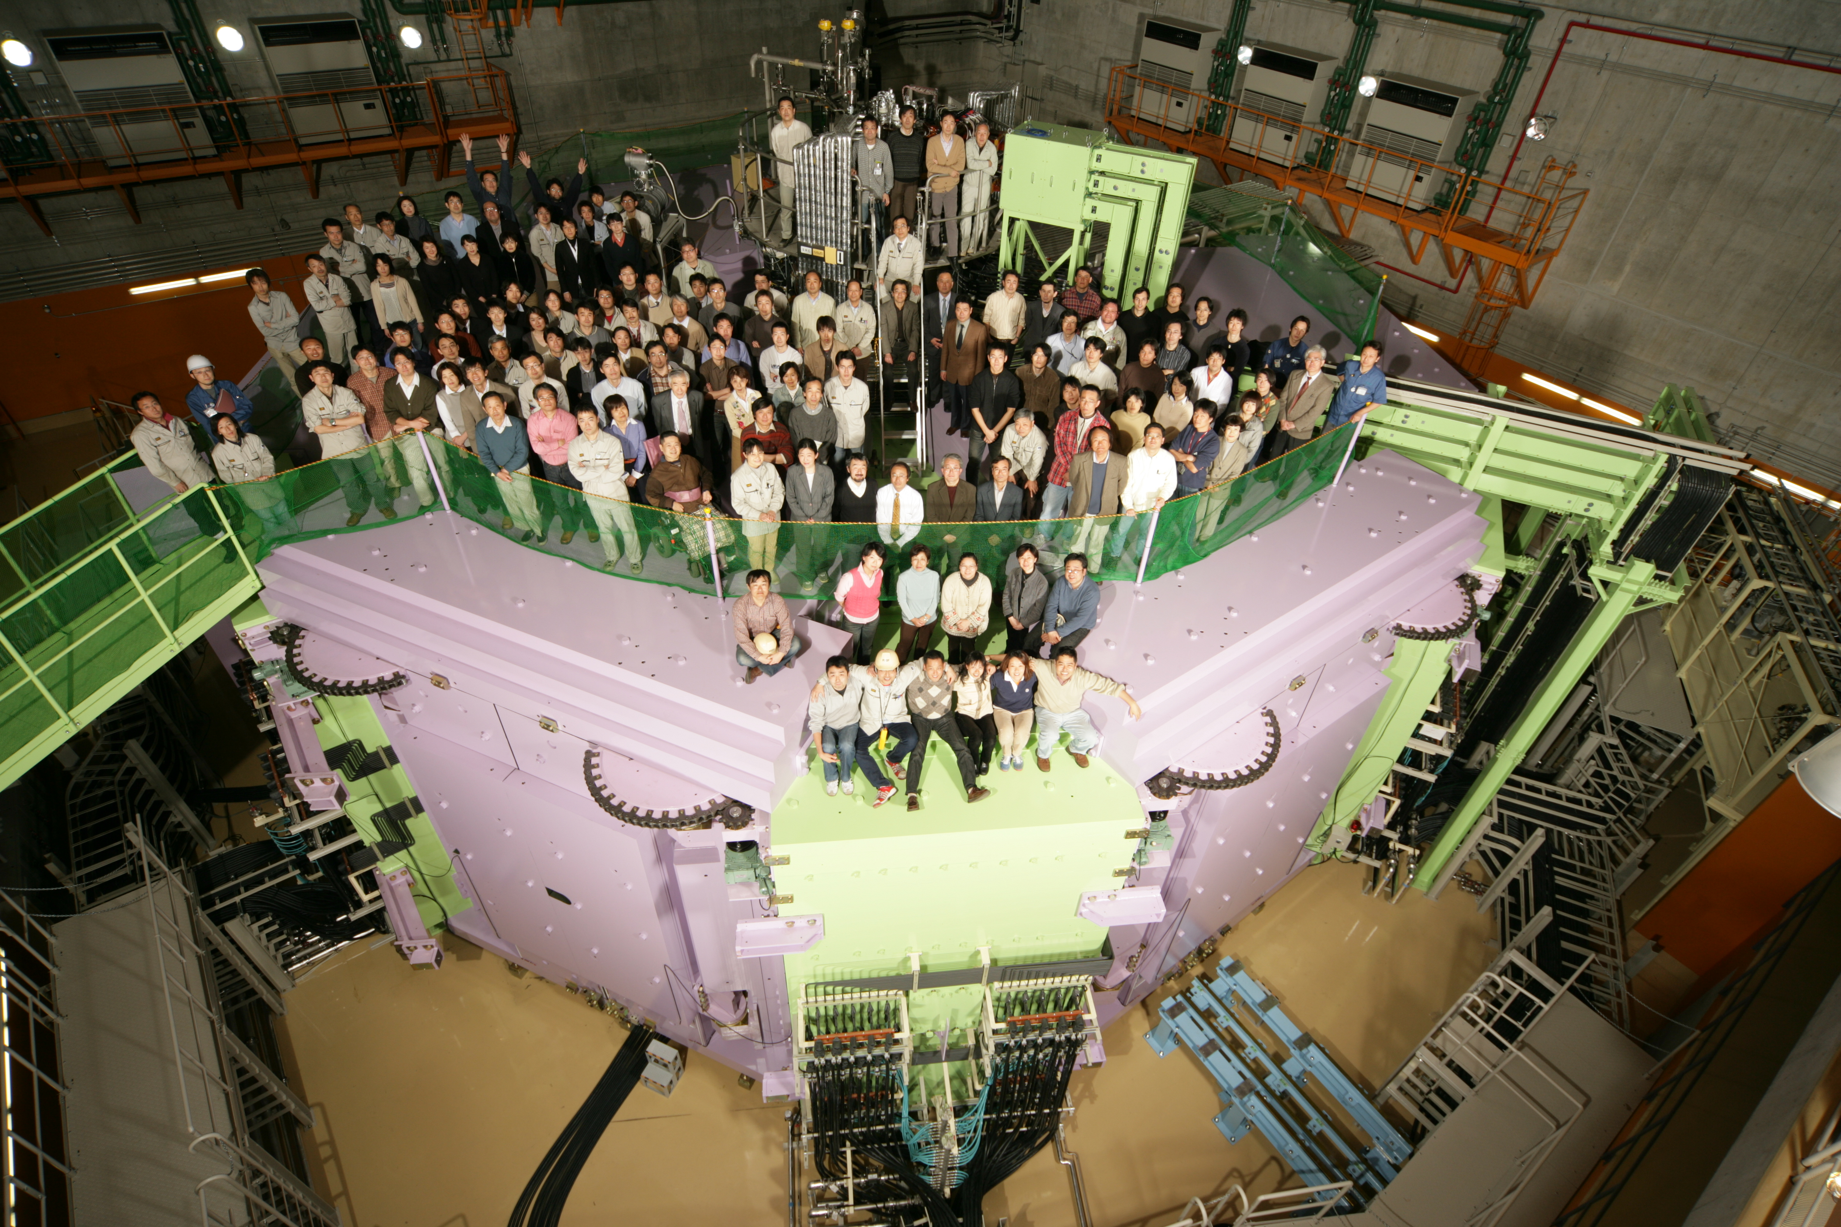
RIKEN RIBF (RI Beam Factory) -- fragmentation-based RI bems (1990- / 2007-)
RIBF – a new generation RIB facility in operation
with world highest capability of providing RI beams in coming years!
BigRIPS (2007-)
~200 MeV/nucleon
RIPS (1990-)
~50 MeV/nucleon
(construction)
SRC (8300 t)
(construction)
160 M$
400 M$
(R&D)
345 MeV/nucleon
up to U (2006-)
135 MeV/nucleon
for light nuclei (1986-)
experimental
equipment

Slide 18
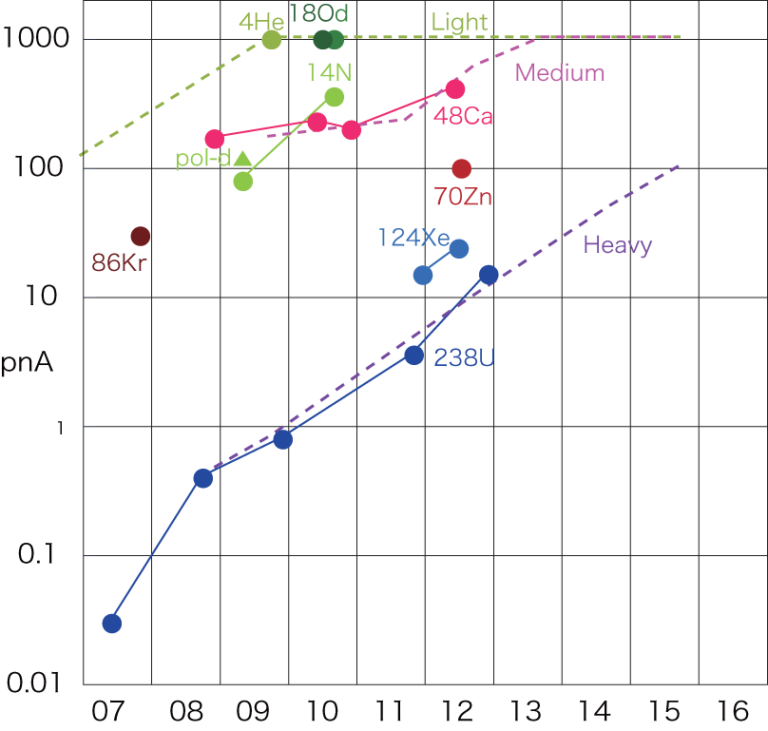
RIKEN RIBF (RI Beam Factory) -- fragmentation-based RI bems (1990- / 2007-)
RIBF – a new generation RIB facility in operation
with world highest capability of providing RI beams in coming years!
Evolution of beam intensities at RIBF
Okuno, Fukunishi, Kamigaito,
Prog. Theor. Exp. Phys. 03C002 (2012).
BigRIPS (2007-)
~200 MeV/nucleon
RIPS (1990-)
~50 MeV/nucleon
(construction)
10¹¹ pps
SRC (8300 t)
Max. beam power: 7 kW
→ ~20 kW by 2015
(construction)
160 M$
400 M$
(R&D)
345 MeV/nucleon
up to U (2006-)
135 MeV/nucleon
for light nuclei (1986-)
experimental
equipment
Year

Slide 19
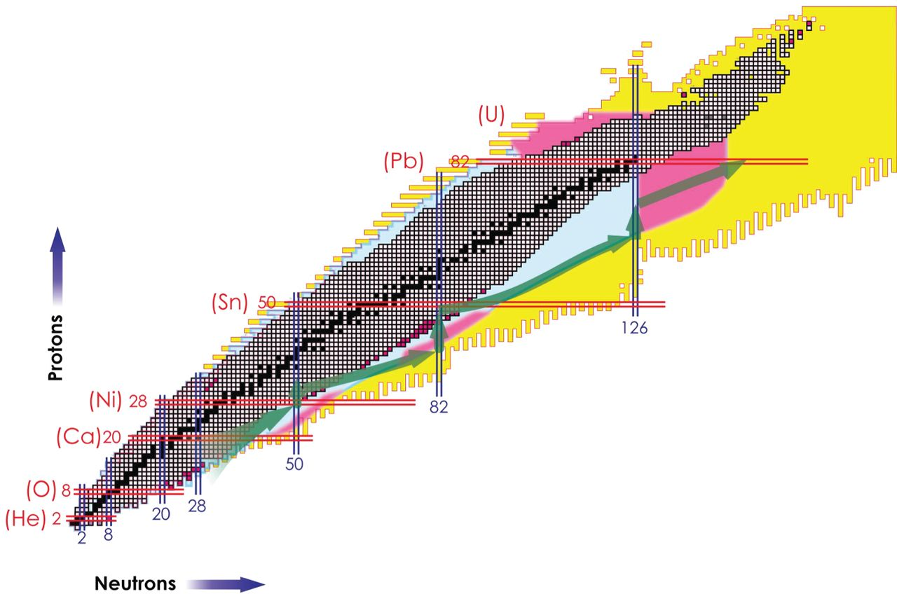

Nuclear chart potentially covered by RIKEN RIBF （new-generation facility)
■ fission + fragmentation of 238U beams
■ fragmentation of other beams
1 particle per day by 1pμA primary beam (80 kW max.)
Motobayashi T , and Sakurai H Prog. Theor. Exp. Phys. 2012;2012:03C001
© The Author(s) 2012. Published by Oxford University Press on behalf of the Physical Society of Japan.
Notes:
Nuclear chart potentially covered by RIBF. The nuclei shown in purple-red (by the in-flight fission and projectile fragmentation of uranium beams) and light blue (by the fragmentation of other beams) indicate those with a production rate higher than 1 particle per day, expected with a primary-beam intensity of 1 particle μA.

Slide 20
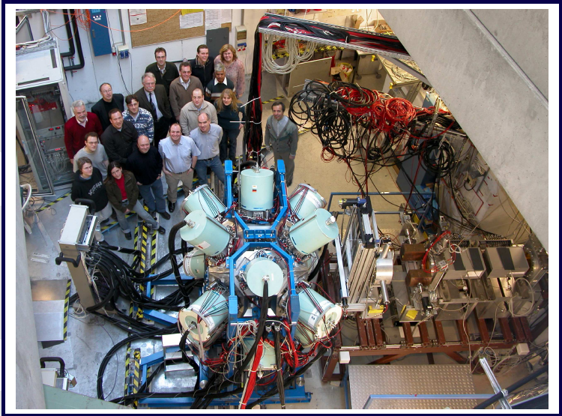
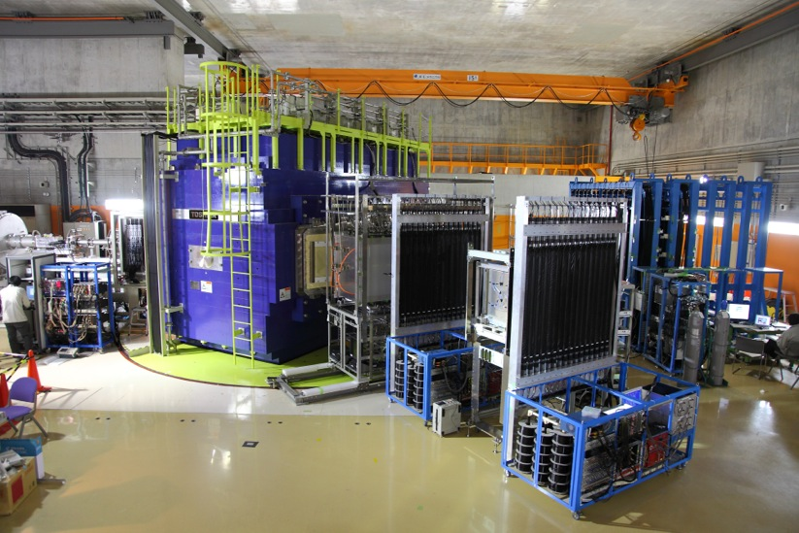
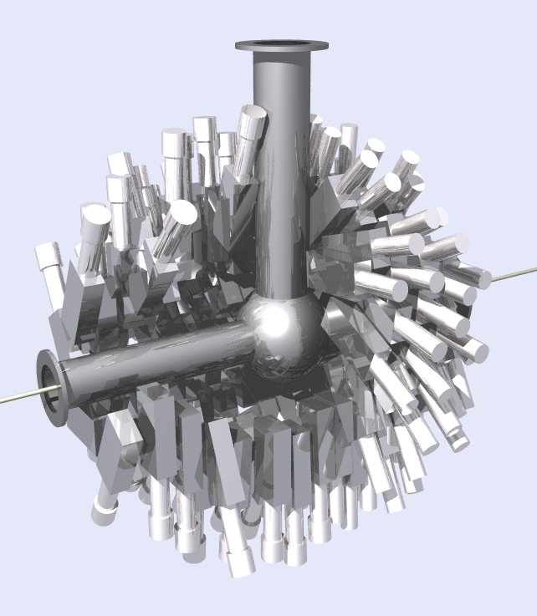
Equipment and detectors in RIKEN RIBF
(construction)
EURICA
(construction)
DALI2
(construction)
(R&D)
(construction)

Slide 21
RI (radioactive isotope) beams enable (since 1985):
extension in the nuclear chart
reaction experiments
LBL, GANIL, RIKEN, MSU, GSI, IMP, …. (fragmentation – fast beams)
LLN, REX-ISOLDE, SPIRAL, ISAC.. (ISOL-reacceleration – low E beams)
➔ nuclear structure / explosive burning / asymmetric matter ..
Needs for new-generation (dedicated) facilities
with high-intensity (or to go farther away from the stability)
RIKEN RIBF (in operation)
FAIR, FRIB, HIAF,
Spiral2, SPES, HIE-ISOLDE, ALTO, ARIEL, BRIF, EURISOL….
Beijing ISOL, ANURIB…
RAON,
Notes:
25+5 / about 18 slides

Slide 22
Requirements to conduct world class experiments
Beam intensity increase:
  Primary beams: x 100 – x 1000
  (3*10¹¹ uranium ions and
  2*10¹³ protons per spill)
  Secondary beams:
  x 10.000
Beams:
  Anti protons
  Protons to uranium
  RIBs
Beam quality:
  Cooled anti proton beams
  Cooled, intense RIBs
Beam pulse structure:
extreme short pulses to
quasi continuous
~20kW (1.5 GeV/nucleon)
2018 data taking starts (in part)
Modularized start version

Slide 23
RI (radioactive isotope) beams enable (since 1985):
extension in the nuclear chart
reaction experiments
LBL, GANIL, RIKEN, MSU, GSI, IMP, …. (fragmentation – fast beams)
LLN, REX-ISOLDE, SPIRAL, ISAC.. (ISOL-reacceleration – low E beams)
➔ nuclear structure / explosive burning / asymmetric matter ..
Needs for new-generation (dedicated) facilities
with high-intensity (or to go farther away from the stability)
RIKEN RIBF (in operation)
FAIR, FRIB, HIAF,
Spiral2, SPES, HIE-ISOLDE, ALTO, ARIEL, BRIF, EURISOL….
Beijing ISOL, ANURIB…
RAON,
Notes:
25+5 / about 18 slides

Slide 24
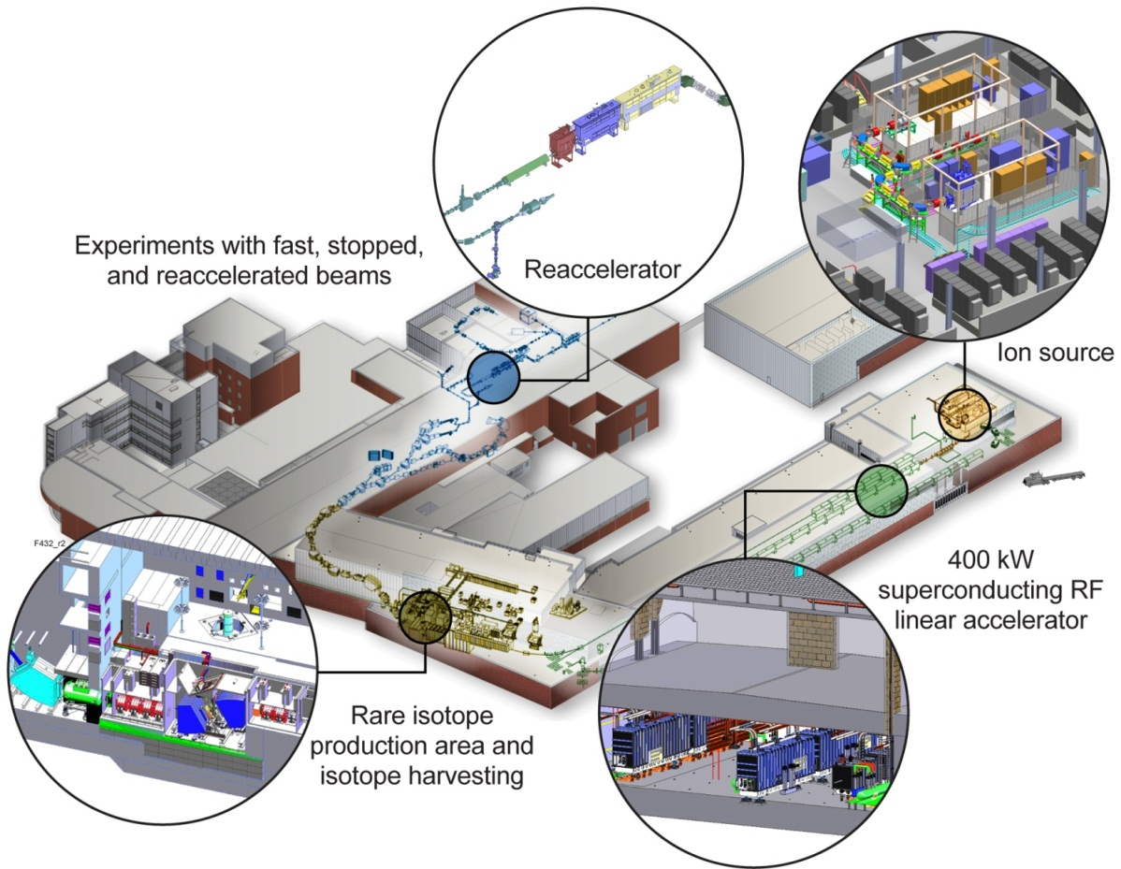
Facility for Rare Isotope Beams, FRIB
Key Feature is 400kW beam power for all ions
At least 200 MeV/u ²³⁸U beam energy – higher for lighter beams
Separation of isotopes in-flight
Fast, stopped and reaccelerated beams (12 MeV/u)
Managed for completion in 2020

Slide 25
RI (radioactive isotope) beams enable (since 1985):
extension in the nuclear chart
reaction experiments
LBL, GANIL, RIKEN, MSU, GSI, IMP, …. (fragmentation – fast beams)
LLN, REX-ISOLDE, SPIRAL, ISAC.. (ISOL-reacceleration – low E beams)
➔ nuclear structure / explosive burning / asymmetric matter ..
Needs for new-generation (dedicated) facilities
with high-intensity (or to go farther away from the stability)
RIKEN RIBF (in operation)
FAIR, FRIB, HIAF,
Spiral2, SPES, HIE-ISOLDE, ALTO, ARIEL, BRIF, EURISOL….
Beijing ISOL, ANURIB…
RAON,
Notes:
25+5 / about 18 slides

Slide 26
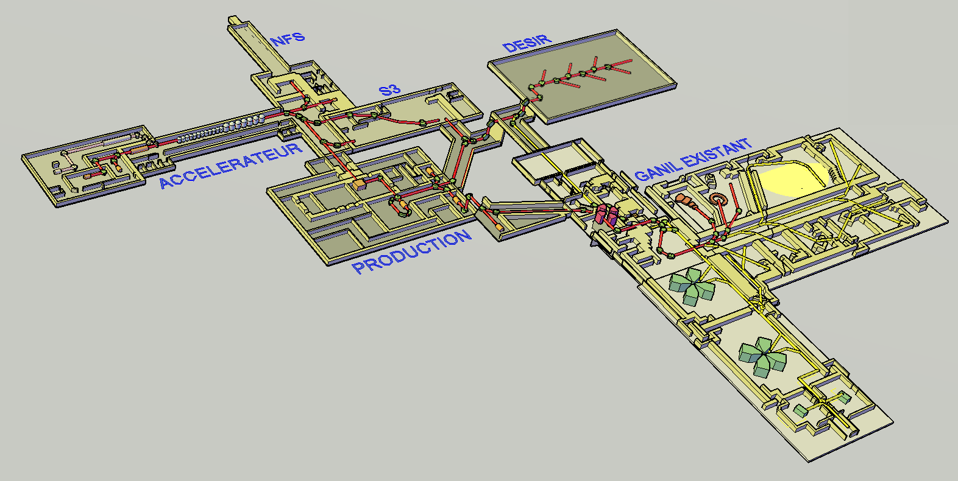
Existing GANIL facility &
SPIRAL2 under construction
fragmentation / ISOL
Caen, France
ISOL
Phase 1: High intensity stable beams + Experimental rooms (S³ + NFS)
Phase 2: High-intensity low-energy (DESIR) & post-accelerated Radioactive Ion Beam facility
CIME cyclotron RIB at 1-20 AMeV (up to 9 AMeV for FF)
NFS
DESIR
Phase 1
S3
Current GANIL/SPIRAL1 facility
SPIRAL2 LINAC
LINAC:
33 MeV p,
40 MeV d (5mA)
14.5 A.MeV HI (1mA)
RIB production hall
Phase 2
~2018 -
200kW
RIB Production Cave
Up to 10¹⁴ fiss./sec.
DESIR Low-energy RIB facility
Cost of SPIRAL2: 210 M€ + 40 M€ spectrometers & detectors
Notes:
For those who don’t know what SPIRAL2 is, Let me start by a brief description of the project. Here you have the layout of this facility which will be constructed in two phases. The first phase which is presently in construction is based …
Attached to this fisrt phase, two new experimental are also under construction : one dedicated to NFS and the other which will host the new S3 spectrometer, I will describe later.
The second phase which in the detail design phase, will concern the production building …. New DESIR facility recentky funded …
This facility will deliver in a near future, both high intensity stable beams and and intensity of radioactive beams.
Here you have the layout of the facility

Slide 27
RI (radioactive isotope) beams enable (since 1985):
extension in the nuclear chart
reaction experiments
LBL, GANIL, RIKEN, MSU, GSI, IMP, …. (fragmentation – fast beams)
LLN, REX-ISOLDE, SPIRAL, ISAC.. (ISOL-reacceleration – low E beams)
➔ nuclear structure / explosive burning / asymmetric matter ..
Needs for new-generation (dedicated) facilities
with high-intensity (or to go farther away from the stability)
RIKEN RIBF (in operation)
FAIR, FRIB, HIAF,
Spiral2, SPES, HIE-ISOLDE, ALTO, ARIEL, EURISOL….
Beijing ISOL, ANURIB…
RAON,
Notes:
25+5 / about 18 slides

Slide 28
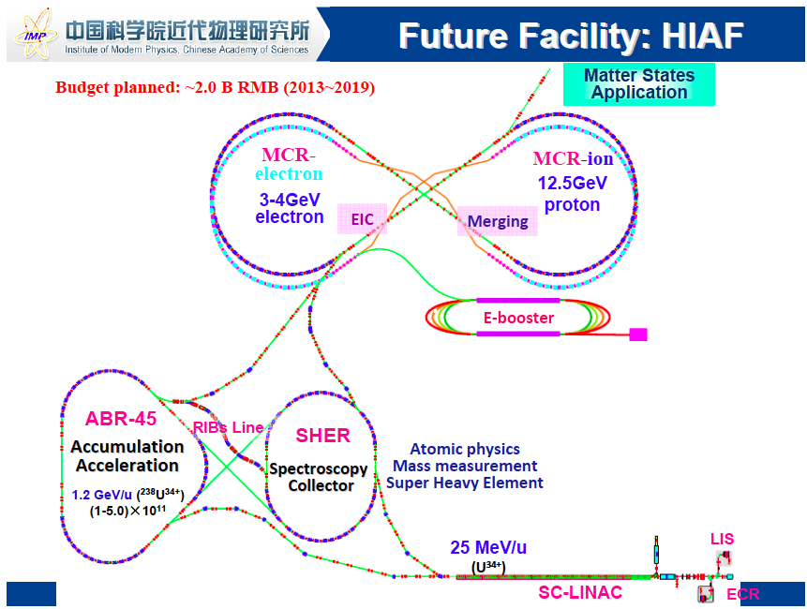
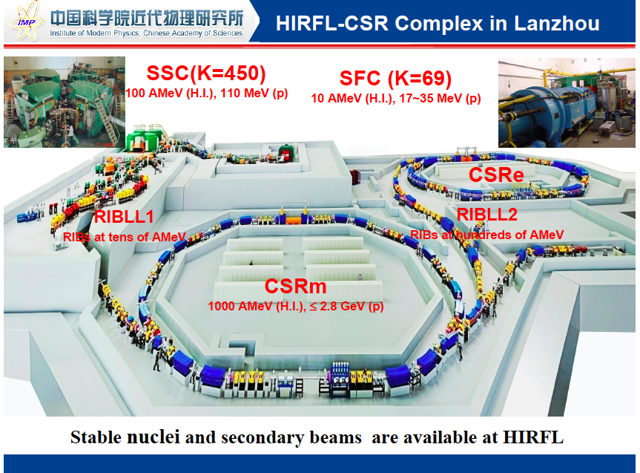
20kW

Slide 29
RI (radioactive isotope) beams enable (since 1985):
extension in the nuclear chart
reaction experiments
LBL, GANIL, RIKEN, MSU, GSI, IMP, …. (fragmentation – fast beams)
LLN, REX-ISOLDE, SPIRAL, ISAC.. (ISOL-reacceleration – low E beams)
➔ nuclear structure / explosive burning / asymmetric matter ..
Needs for new-generation (dedicated) facilities
with high-intensity (or to go farther away from the stability)
RIKEN RIBF (in operation)
FAIR, FRIB, HIAF,
Spiral2, SPES, HIE-ISOLDE, ALTO, ARIEL, EURISOL….
Beijing ISOL, ANURIB…
RAON,
c.f. dedicated talks in “I” sessions
Notes:
25+5 / about 18 slides

Slide 30
RAON
Korea
LEBT
ECR-IS
(10keV/u, 12 pμA)
 | Driver Linac |  |  |  | Post Acc. | Cyclotron
Particle | H⁺ | O⁺⁸ | Xe⁺⁵⁴ | U⁺⁷⁹ | RI beam | proton
Beam energy(MeV/u) | 600 | 320 | 251 | 200 | 18.5 | 70
Beam current(pμA) | 660 | 78 | 11 | 8.3 | - | 1000
Power on target(kW) | > 400 | 400 | 400 | 400 | - | 70
RFQ (300keV/u, 9.5 pμA)
MEBT
SCL1 (18.5 MeV/u, 9.5 pμA)
Driver Linac
Chg.
Stripper
SCL2 (200 MeV/u, 8.3 pμA for U⁺⁷⁹)
(600MeV, 660 μA for p)
ISOL
Target
μSR, Medical
MEBT
RFQ
CB
HRMS
IF Target
SCL1 (Post Acc.)
RF Cooler
Cyclotron
(p, 70 MeV, 1mA)
IF system
Post Accelerator
IF Separator
Atomic Trap
Gas Catcher
ECR-IS
ISOL system

Slide 31
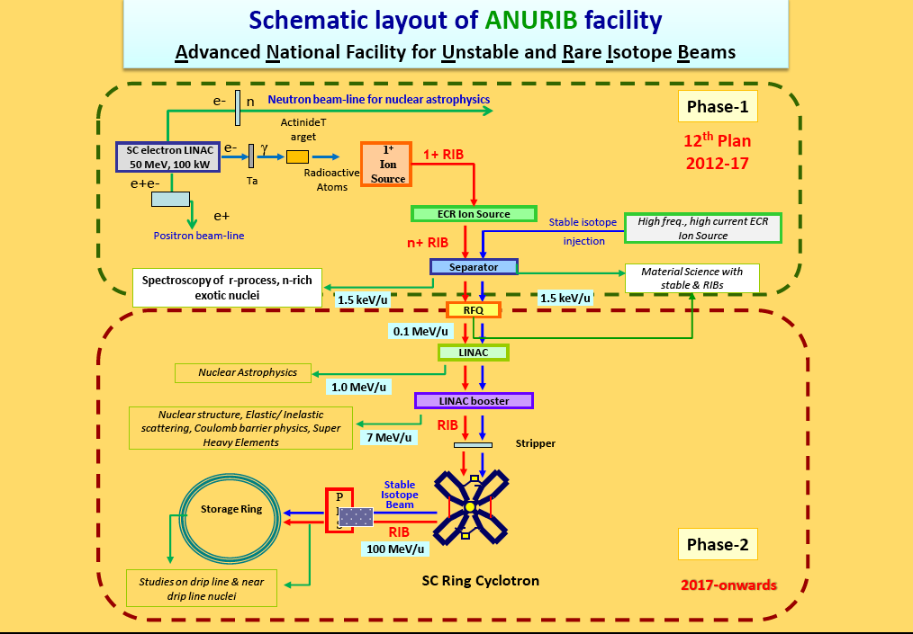
India

Slide 32

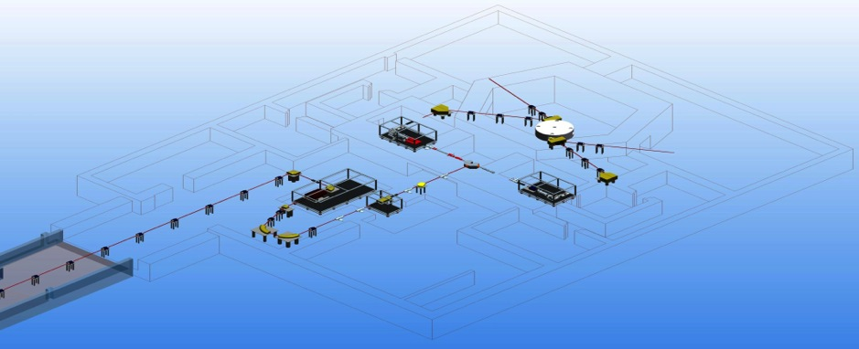
SPES ISOL facility @LNL
A second generation ISOL facility for neutron-rich ion beams and an interdisciplinary research center
Proton induced fission on UCx
10¹³ fission/s - 8 kW on direct target
Selective Production of Exotic Species
ISOL target 1 (8kW)
Proton driver
Proton and neutron applications
Charge Breeder
HV platform 260kV
Exotic beam transfer to PIAVE-ALPI
Beam cooler
ISOL target 2
High Resolution Mass Spectrometer
Notes:
The SPES project is part of the INFN Road Map for the Nuclear Physics, it is supported by both LNL (Legnaro) and LNS (Catania). The SPES project is based on the ISOL method with an UCx Direct Target able to sustain around 10 kWatt. The primary proton beam is delivered by a driver of at least 40 MeV energy and 200 microA current. Neutron-rich radioactive beams will be produced by Uranium fission at an expected fission rate in the target in the order of 10¹³ fissions per second. The key feature of SPES is to provide high intensity and high-quality beams of neutron-rich nuclei to perform forefront research in nuclear structure, reaction dynamics and interdisciplinary fields like medical, biological and material sciences. The exotic isotopes will be re-accelerated by the ALPI superconducting linac at energies of 10AMeV and higher, for masses in the region of A=130 amu, with an expected rate on the secondary target of 10⁸ pps.

Slide 33






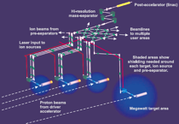

ISOL Roadmap in EUROPE
2 MeV/n (A=130)
10-20 kW
TODAY
LNS - EXCYT
SPIRAL –
2014-2025
10¹³⁻¹⁴ fission/s
10 MeV/n (A=130)
100-200 kW
> 10¹⁵ fission/s
100 MeV/n (A=130)
3x 100 kW direct target
1x 5 MW 2-step target
FROM 2025

Slide 34
ISOL Roadmap in EUROPE
Expected beam power of “new” RIB facilities
2 MeV/n (A=130)
10-20 kW
TODAY
LNS - EXCYT
SPIRAL –
2014-2025
10¹³⁻¹⁴ fission/s
10 MeV/n (A=130)
RIKEN RIBF
100-200 kW
> 10¹⁵ fission/s
100 MeV/n (A=130)
3x 100 kW direct target
1x 5 MW 2-step target
FROM 2025

Slide 35
Questions for new/future RIB facilities
Budget
construction → delay / running → backlogs
Choice of accelerators
Production scheme
other production methods for reacceleration-scheme*
two-step fragmentation? ⬅ fragmentation cross sectiion
Roadmaps
in Asia?
For difficult elements in the energy region for transfer, fusion .. (~10 MeV/nucleon)
deceleration of fast beams
gas catcher + reacceleration
ion source development
Notes:
25+5 / about 18 slides

Slide 36
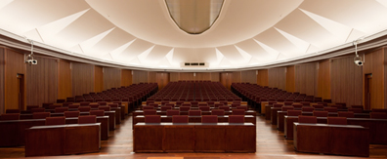
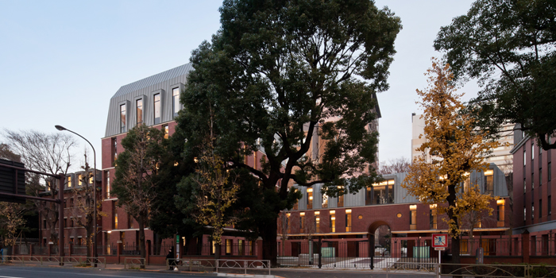
ARIS2014 (Advances in Radioactive Isotope Science) * - 2nd of the ARIS series, Sister of EMIS -
1-6 June 2014
ITO International Research Center (in the campus of University of Tokyo)
Public lectures on 1 June
Flagship conference on exotic nuclei / radioactive ion beams
Former ENAM + RNB (in its science part)
Hosts: RIKEN Nishina Center
The University of Tokyo (CNS)
Supported by IUPAP
First notice was sent in March.
1st circular and web page soon..

Slide 37
Summary
RI (radioactive isotope) beams in nuclear physics studies
extension in the nuclear chart
experiments with RI beams
“new generation” facilities e.g. RIKEN RIBF
fragmentation-based facilities
ISOL-based (reacceleration) facilities
Thanks:
Angela Bracco, Brad Sherrill, Christoph Scheidenberger, Dinesh Kumer Srivastava
Guoqing Xiao, Jeon Dong-O, Marek Lewitowicz, ……
Notes:
25+5 / about 18 slides

Slide 39
RIKEN RIBF (RI Beam Factory) -- fragmentation-based RI bems (1990- / 2007-)
RIBF – a new generation RIB facility in operation
with world highest capability of providing RI beams in coming years!
BigRIPS (2007-)
~200 MeV/nucleon
RIPS (1990-)
~50 MeV/nucleon
(construction)
SRC (8300 t)
(construction)
160 M$
400 M$
(R&D)
345 MeV/nucleon
up to U (2006-)
135 MeV/nucleon
for light nuclei (1986-)
experimental
equipment

