Slide 1



Meson Spectroscopy in the
Light Quark Sector
Raffaella De Vita
INFN –Genova
Notes:
In this talk I will give an overview of meson spectroscopy in the sector of light quarks, discussing the present status and perspectives of this field

Slide 2

Why Hadron Spectroscopy
Most of the visible mass of the universe is due to hadrons, in particular to the protons and neutrons that form the atomic nucleus
Hadrons have an internal structure being made of quarks: known quark configurations are baryons, made of tree quarks and mesons, made of quark-antiquark pairs
Quark masses account only for a small fraction of the nucleon mass: ~ 1%
  m_{q} ~ 10 MeV
  m_{N} ~ 1000 MeV
  while the remaining fraction is to to the force that binds the quarks: QCD
QCD with its rules and constraints determines the mass and spectrum of hadrons and makes the world as we know it
nucleon quarks
Notes:
It’s therefore QCD with its rules and constraints that determines the mass and spectrum of hadrons and makes the world around us as we know it

Slide 3
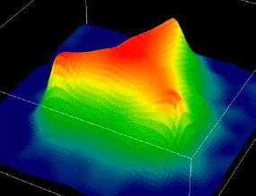
Hadrons and QCD
Studying the hadron properties and the rules of QCD is crucial to reach a deep understanding of the structure of matter
Hadrons are color neutral systems made of quarks and gluons but…
  What is the internal structure and what are the internal degrees of freedom of hadrons?
  What is the role of gluons?
  What is the origin of quark confinement?
  Are 3-quarks and quark-antiquark the only possible configurations
Meson spectroscopy is a key tool to investigate these issues
<< 0.1 fm
0.1 – 1 fm
> 1 fm
π
p
Quarks and Gluons
Effective Degrees of Freedom
Mesons & Baryons
Notes:
CAMBIARE la FIGURA (vedi ROLF)

Slide 4
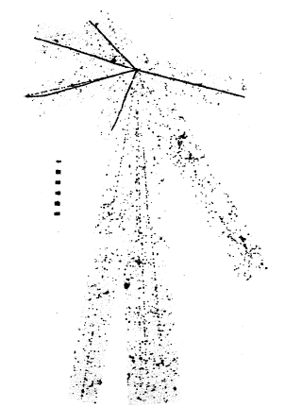
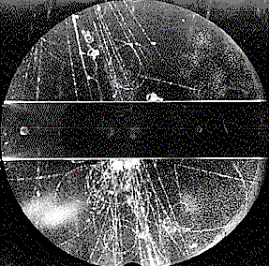
Meson Spectroscopy
Mesons are the simplest quark bound states, i.e. the best benchmark to understand how quarks interact to form hadrons
Historically, the study of meson properties led to some of the most relevant discoveries in particles physics
G.D. Rochester and C.C. Butler, Nature 160 (1947) 855.
in 1947 the discovery of the pion by Powell, Occhialini and Lattes
in the same year, the discovery of strange particles by Rochester and Butler
the interpretation of the φdecay to KK by Zweig and others in 1963
the discovery of the J/ψ in 1974
…
K⁰
π⁺
After many years, meson spectroscopy remains a very active field and a precious source of information for the understanding of quark-gluon interaction
π⁻
C.F.Powell, Nobel Lecture,
11th December 1950

Slide 5
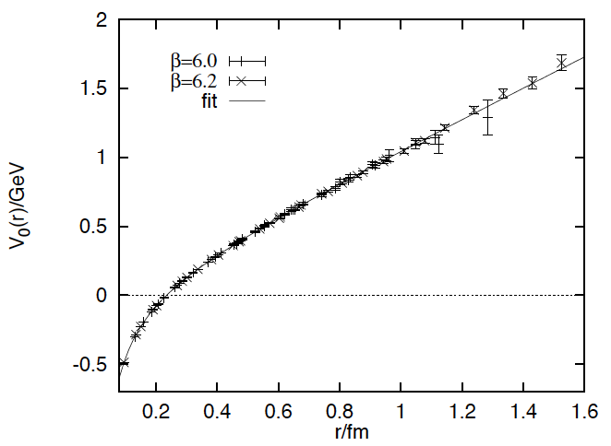
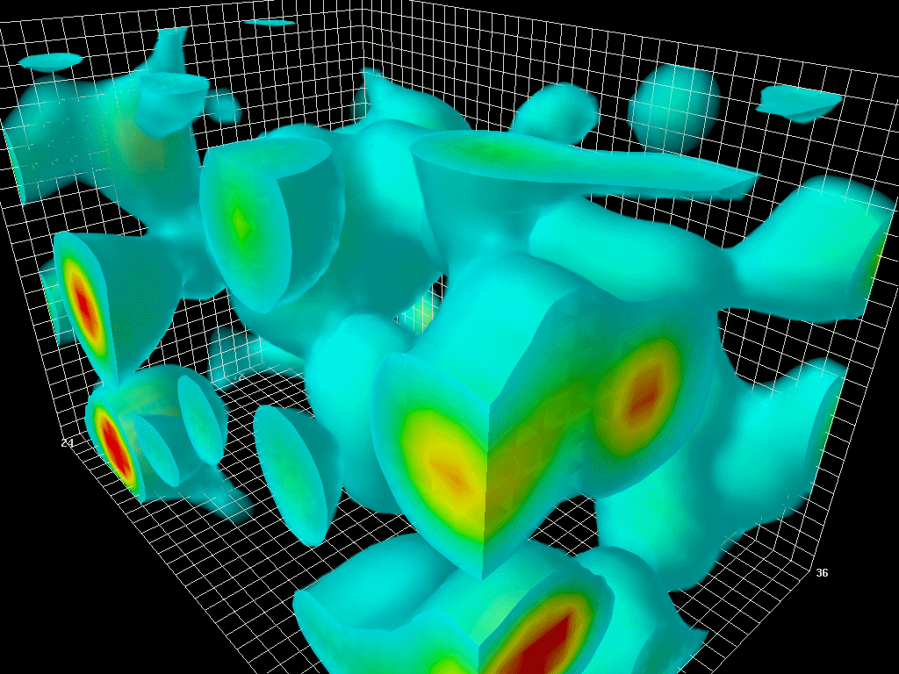
Meson Spectroscopy
Goal of modern meson spectroscopy is to answer these fundamental questions of QCD, studying the spectrum of mesons and searching for exotic states
D. Leinweber: LQCD visualization of the QCD vacuum
S. B. Bali et al., PRD56 (1997)
Light quark mesons (uds):
sensitive to chiral symmetry breaking and vacuum condensate effects
probe the strong force at larger distances (confinement)
Heavy quark mesons (cbt):
can be describe with non-relativistic potential models
probe the strong force at smaller distances where short-range color interaction dominates
Notes:
The animations to the right and above illustrate the typical four-dimensional structure of gluon-field configurations averaged over in describing the vacuum properties of QCD. The volume of the box is 2.4 by 2.4 by 3.6 fm, big enough to hold a couple of protons. Contrary to the concept of an empty vacuum, QCD induces chromo-electric and chromo-magnetic fields throughout space-time in its lowest energy state. After a few sweeps of smoothing the gluon field (50 sweeps of APE smearing), a lumpy structure reminiscent of a lava lamp is revealed. This is the QCD Lava Lamp. The action density (top) and the topological charge density (right) are displayed. The former is similar to an energy density while the latter is a measure of the winding of the gluon field lines in the QCD vacuum.

Slide 6
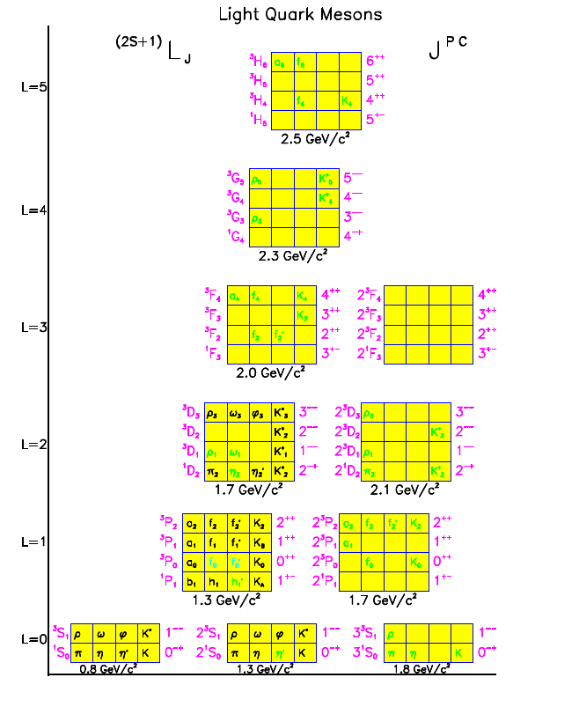
Light Quark Mesons
First indications on the meson spectrum are given by the Constituent Quark Model:
S₁
Quark-antiquark pairs with total spin S=0,1 and orbital angular momentum L
SU(3) flavor symmetry
A nonet of states with the same quantum numbers, J^{PC}, for each value of L and S
L
S₂
Great success in describing the lower mass states
A number of predicted states is not experimentally observed and assignments are uncertain:
failure of the model?
limitations in the experimental techniques?
…
Yellow: expected meson states
Black: established states
Green: tentative assignments

Slide 7



Beyond the quark model…Exotics
QCD tells us that bound states have to be color neutral but does not prohibit the existence of state with unconventional quark-gluon configurations as tetraquarks, glueballs or hybrids
Several phenomenological models predict the existence of such states and give indications of masses and decays
Supporting evidence is provided by Lattice QCD calculations
Experimental evidence has been searched in many laboratories
  X(3872) observed at B-factories interpreted as tetraquark
  Indication of hybrids below 2 GeV reported by several experiments
  …
If unambiguously confirmed, these state would provide the mean to further investigates aspects of QCD as confinement and gluonic excitations
regular meson
tetraquarks
glueball
hybrid

Slide 8
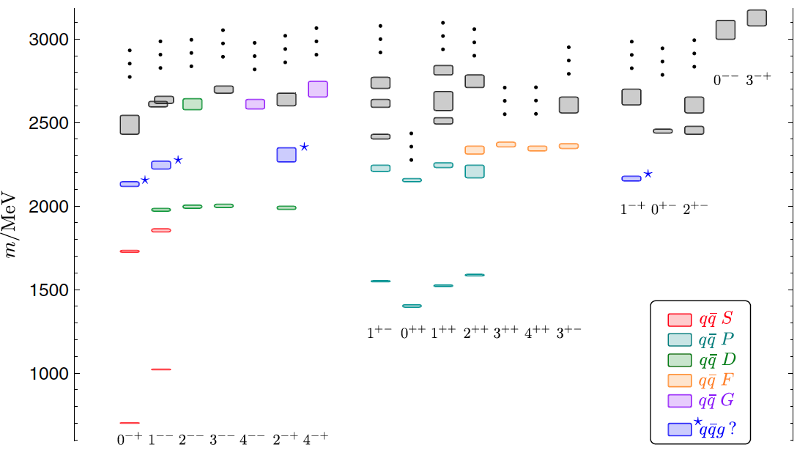
Lattice QCD
J. Dudek et al., Phys. Rev. D84, 074023 (2011)
Predictions of the meson spectrum from Lattice QCD are now available
exotics
Good reproduction of the regular meson spectrum
Indication of the existence of states with high gluonic content
normal mesons
isovector mesons, m_{π}~700 MeV
Notes:
Nowadays, a better guidance in the meson spectroscopy studies than the simple quark model is given by lattice QCD
Spectrum of isovector mesons extracted in [14] with a pion mass of700 MeV. Masses (in MeV) are averages
over two computed volumes, <eth>2:0 fm?3, <eth>2:5 fm?3. Box size indicates the statistical uncertainty on the extracted mass. Ellipses indicate
that there may be heavier states in that JPC but we did not determine them reliably in [14]. States are color-coded by assigned L-wave
supermultiplet as described in the text. States colored grey could not be assigned to an L-wave supermultiplet.

Slide 9

Meson Spectroscopy in the World
Many experiments in the world have studied and are studying the meson spectrum in the light-quark sector using different production processes
proton-antiproton annihilation:
Crystal Barrel at CERN, Panda at GSI, ...
e⁺ e⁻ annihilation:
LEP, Babar at SLAC, Belle at KEK, KLOE at Frascati, CLEO at Cornell, BES at Beijing, KLOE-II, Belle II at SuperKEKB, …
proton-proton scattering:
WA experiments at CERN, GAMS at Protvino, LHC, …
pion beams on fixed target:
E852 at BNL, VES at Protvino, COMPASS at Cern, …
photoproduction experiments:
CLAS at Jefferson Lab, GlueX and CLAS12 at Jefferson Lab

Slide 10
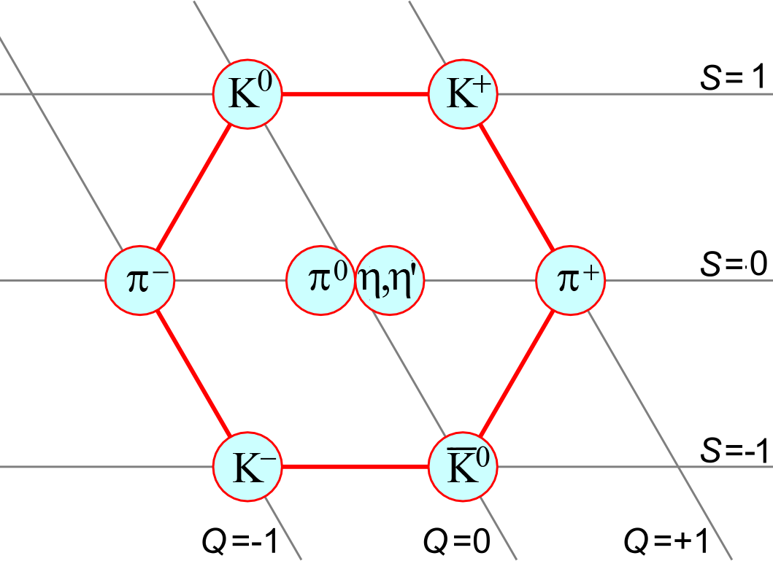
Scalar Mesons
Scalars are fundamental states because they represent the Higgs sector of strong interaction:
same quantum numbers of the QCD vacuum
responsible for chiral symmetry breaking
K*⁰
K*⁺
a₀⁻
a₀⁰
f₀,f₀’
a₀⁻
f₀(2000)
K*(1950)
K*⁻
K*⁰
mass (MeV)
f₀(1710)
?
f₀(1500)
The scalar meson nonet should be composed by a₀(I=1),K* (I=1/2), f₀ and f₀’(I=0), with the a₀ as lightest state and the f₀’ showing a large strange content
At present, given the I=1 and I=1/2 states that have been identified, there is an excess of I=0 states
f₀(1370)
K*(1430)
a₀(1450)
f₀(980)
a₀(980)
?
K*(800)
f₀(600)
I=0 I=1/2 I=1
isospin
Notes:
Scalar meson are some of the more intriguing bound states in QCD. They have in fact a fundamental role being the equivalent of the Higgs boson in QCD. They have the same quantum number of the QCD vacuum condensate and the lowest mass state the so-called f0(600) was known as sigma before being considered as the field in linear sigma model that breaks chiral symmetry giving mass to the goldstone bosons of QCD.
The scalar sector present however some very interesting puzzles because even if several states have been identified the interpretation of they structure in terms of constituents is still quite unclear and assignments in the quark model classification at most tentative.
Open issues involved both the lowest lying states that should form the first nonet….
For masses below 2 GeV, there two I=1 and two I=1/2 states that are (reasonably) well identified and could be part of two nonets.
In the same mass range there are 5 I=0 states. 4 could complete the nonets leaving a glueball candidate

Slide 11
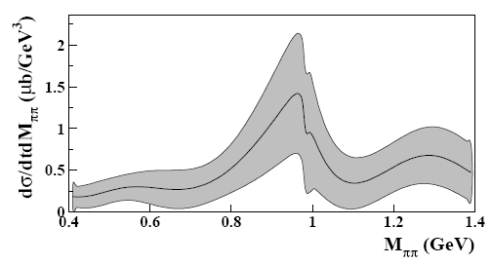
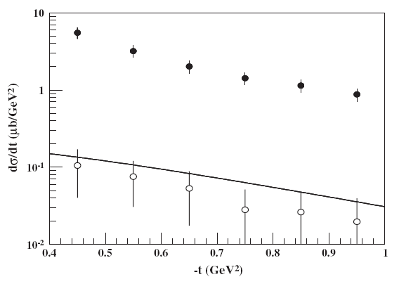
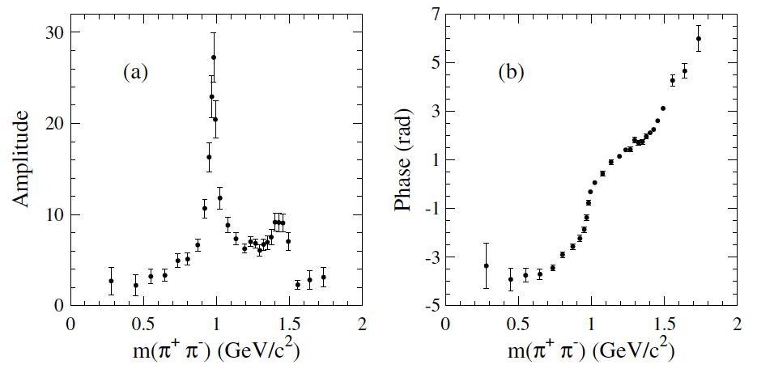
The f₀(980) meson
The f₀(980) is one of the lowest mass scalar and isosinglet candidate of the first nonet:
➔ Unusual mas hierarchy of the multiplet (f₀(980) almost degenerate with a₀(980)) and decays led to propose these states as TETRAQUARKs
f₀(980)
CLAS
CLAS, PRL 102, 102001 (2009)
Detailed measurement of the S wave around the resonance mass needed to determine the nature of this state
Photoproduction cross section
BABAR, PRD79, 032003 (2009)
BABAR
S- wave amplitude and phase
High precision data from BES, KLOE, BABAR, CLAS and others now available can shed light on this puzzle
f₀(980)
Notes:
Parlare della f0 con riferimento a CLAS e KLOE

Slide 12
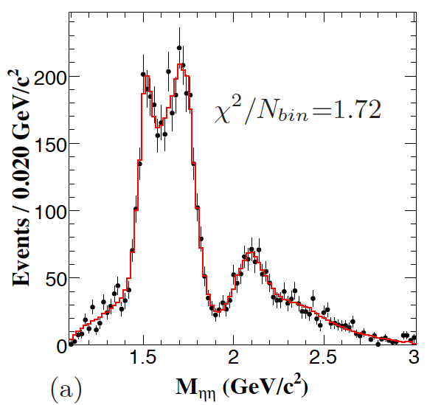
Higher mass scalars
Abundance of I=0 states with unexpected decay patterns between 1.3 and 2 GeV led to speculate about the presence of a glueball in this sector
f₀(1370)
f₀(1500)
f₀(1710)
f₀(2100)
…
Lower two states seen first by Crystal Barrel
Higher mass states seen by WA102 and BES
Discrepancies between different experimental observations
High statistics/high precision data needed!
BES, arXiv:1301.0053, to appear in PRD
New high statistics data set from BESIII in Beijing:
clear structures in the ηη mass spectrum from J/ψ radiative decays
full partial wave analysis to isolate S wave contribution
f₀(1710) and f₀(2100) are dominant scalars
f₀(1500) exists (8.2σ)
f₀(1710) and f₀(2100) strength ~10x larger than f₀(1500)
Additional data expected in the near future from this and other experiments can lead to a full understanding of the scalar sector
Notes:
Parlare delle recenti misure di BES ecc.

Slide 13
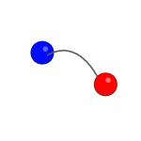
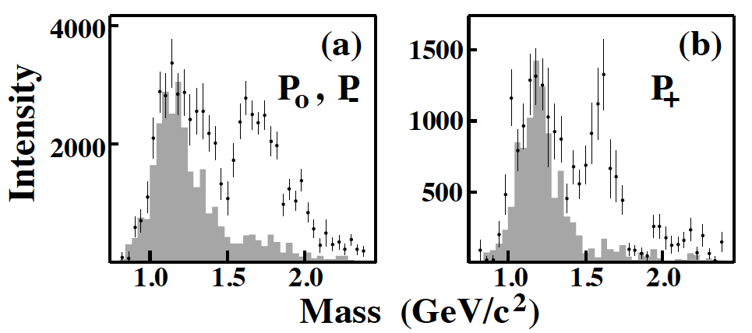
Search for Hybrids
  Ideal benchmark to study quark-quark interaction and excitations of the glue
  Existence of hybrids states is supported by several theoretical models and by lattice QCD calculations
  Recent studies indicate the lightest states could have mass below 2 GeV and “exotic” quantum numbers J^{PC}=1⁻⁺
q
q
BNL-E852
  Most debated experimental evidence is related to the so-called π₁(1600):
  observed in several decay modes (ρπ, η’π, f₁π, b₁π) including decays to L=1-L=0 meson pairs as predicted by the flux tube model
  observations reported by different experiments (E852,VES,COMPASS) but with different production mechanisms
  presence of resonant signal still requires confirmation
Mass (GeV)
Notes:
Existence of hybrid mesons (qqg) is not yet firmly established:
LQCD predicts existence of exotic hybrids with masses below 2 GeV
signals for exotic hybrids have been reported by various experiments but evidence is not yet fully convincing

Slide 14
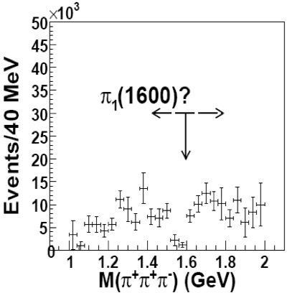
The exotic π₁(1600)
π
π
π
X
π
exotic signal
p
p
Exotic signal reported by BNL-E852 experiment in the analysis of the 3 pion final state
Opposite findings reported by the CLAS Collaboration in photo-production
BNL-E852
leakage from non-exotic wave
J^{PC}=1⁻⁺
P₊ or M^{ε}=1⁺ natural-parity exchange
P_{0,-} or M^{ε}=0⁻,1⁻ unnatural-parity exchange
Significant intensity in the 1⁻⁺ wave with clear phase motion with respect to the 2⁻⁺
CLAS
Notes:
The BNL… experiment found significant strength in the exotic 1-+ wave that could not be explained as leakage from other no-exotic waves and interpreted this strength as associated to a resonance with mass and width… Quite opposite findings were reported by the CLAS Collaboration in photoproduction of the 3pi final state state. As the production process is different one may argue that this results in apparent contradiction could be explained as due to different mechanism that allow the production of the exotic in the case f the BNL experiment and not for the CLAS one. However this also calls for further investigation and this is one of the goals of ongong experiments such as COMPASS

Slide 15
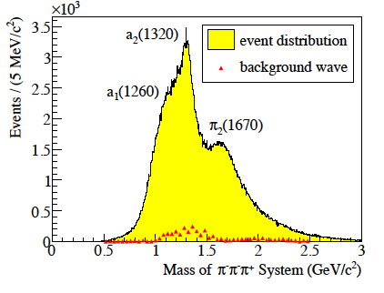
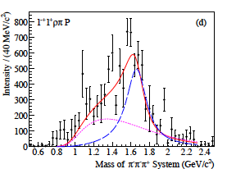
Ongoing searches
Experimental investigation continues at COMPASS at CERN SPS with 192 GeV pion beam on nuclear targets
Positive observation reported from the analysis of 2004 pilot run on lead
π₁(1600)?
Analysis of 2008 run (96 M events) will allow better control of background processes
High quality results expected
Notes:
Compass, an experiment in progress at the CERN sps using 192 GeV pions on nuclear targets, has an intensive meson spectroscopy program and as part of this activity as also looked for further confirmation of the existence of the p1(1600) in the 3pi final state. Analysis is in progress but the first results that were released from the analysis of the 2004 pilot run sow already some interesting indications. The plot on the right shows the 3pi mass spectrum with clear structures associated to known meson state. A full partial wave analysis of these data allowed the extraction of the exotic wave shown in the bottom graphs that was interpreted as evidence for a resonance with mass and width compatible with the already observe pi1. While the accuracy of this results is not yet enough to claim the discovery, the analysis of the full data set is in progress; the high statistics will allow to have better control of background processes and is expected to givein high quality results.

Slide 16
Meson Spectroscopy in the World
Many experiments in the world have studied and are studying the meson spectrum in the light-quark sector using different production processes
proton-antiproton annihilation:
Crystal Barrel at CERN, Panda at GSI, ...
e⁺ e⁻ annihilation:
LEP, Babar at SLAC, Belle at KEK, CLEO at Cornell, KLOE at Frascati, BES at Beijing, KLOE-II, Belle II at SuperKEKB,…
proton-proton scattering:
WA experiments at CERN, GAMS at Protvino, LHC, …
pion beams on fixed target:
E852 at BNL, VES at Protvino, COMPASS at Cern, …
photoproduction experiments:
CLAS at Jefferson Lab, GlueX and CLAS12 at Jefferson Lab
Notes:
The solution of this as of other puzzling issues in meson spectroscopy cannot come from a single experiment but only through a coherent effort of many experiment providing consistent results.
In addition to reviewing the ongoing experimental searches it’s therefore also very important to look at what will happen in the future. In this list of experiments I showed before, I’ve indicate in orange the experiments that are in progress… and in ted the one that are planned to start in the next few years… While Panda and Belle II will look primarily at the heavy quark sector, the experiments at Jefferson Lab will focus on the light quark sector and are expected to become one of the primary actors in this fields

Slide 17
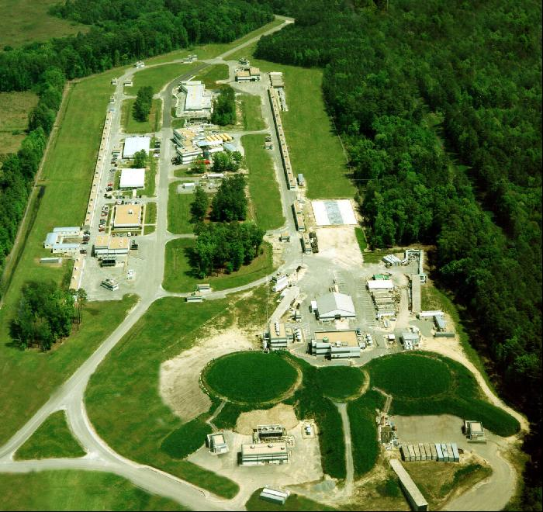
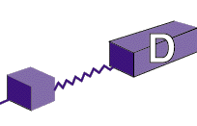
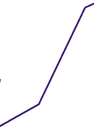

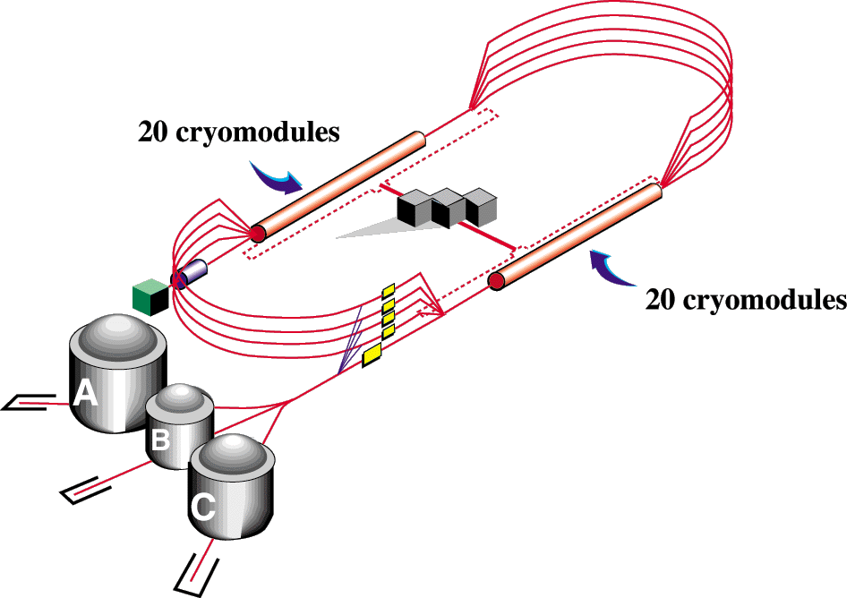

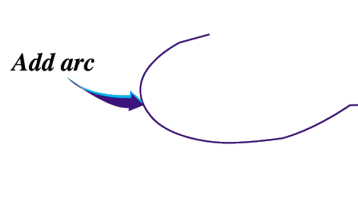


Jefferson Laboratory
Continuous Electron Beam Accelerator Facility (CEBAF):
a superconducting electron machine based on two linacs in racetrack configuration
presently being upgraded to 12 GeV
Construction of the new Hall D
CHL-2
Upgrade of the arc magnets
High electron polarization
Beam Power: 1MW
Beam Current: 90 µA
Max Enery Hall A-C: 10.9 GeV
Max Energy Hall D: 12 GeV
Upgrade of the instrumentation of the existing Halls
Notes:
Compattare con quella dopo

Slide 18
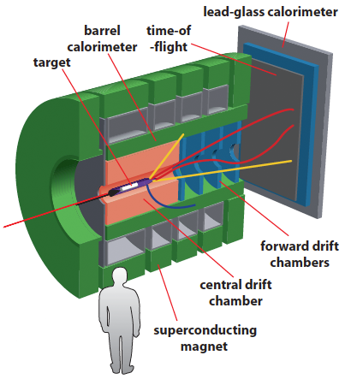
CLAS12 and GLUEX
Meson spectroscopy is one of the main topics that will be studied with the Jlab 12 GeV upgrade. Key elements are:
High intensity tagged photon beams
Detectors with large acceptance and good particle identification capabilities
GlueX in Hall D CLAS12 in Hall B

Slide 19
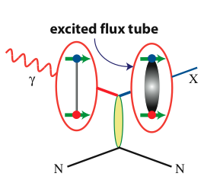
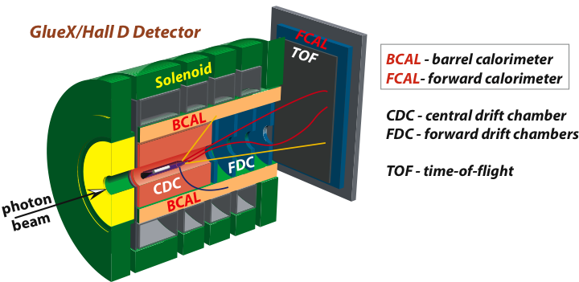
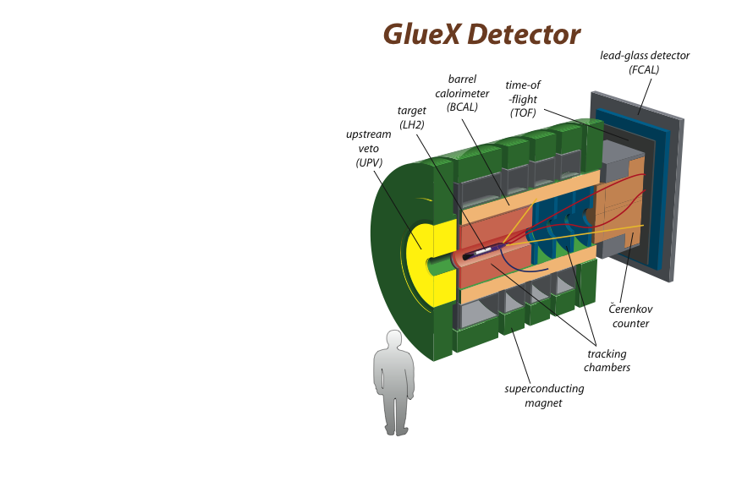
The GlueX Experiment
Barrel
Calorimeter
(Bcal)
Time-of-flight
(TOF)
Pb-glass detector (Fcal)
Target
(LH₂)
Hermetic detection of charged and neutral particles in solenoid magnet:
Photon beam produced by coherent Bremsstrahlung on diamond radiator
Initial Flux 10⁷ g/s
18,000 FADCs
4,000 pipeline TDCs
20 KHz L1 trigger
300 MB/s to tape
Tagger Spectrometer
(Upstream)
Tracking
(Cathode strips
Drift chambers
Straw tubes)
D. Lawrence’s talk
Superconducting 2 T solenoid

Slide 20
The CLAS12 Experiment
Quasi-real photoproduction on proton target:
Detection of multiparticle final state from meson decay in the large acceptance spectrometer CLAS12
Detection of the scattered electron for the tagging of the quasi-real photon in the novel Forward Tagger
Electromagnetic calorimeter (PbWO)
Micromegas Tracker
Physics goals:
Detailed mapping of the meson spectrum up to 2.5 GeV
Investigation of strangeonium and strangeness rich states
Search for exotics
Scintillation Hodoscope

Slide 21
Summary
✱ Meson spectroscopy is a key field for the understanding of fundamental questions in hadronic physics as what is the origin of the nucleon mass and what is the role of gluons
✱ Primary focus of the research activity in this field is to establish the quark-antiquark bound state spectrum and search for exotic configurations
✱ Experiments all over the world are collecting high statistics high precision data, providing new insight in the meson spectrum
✱ The new experimental data with the support of recent theoretical developments can lead physicists to solve one of the most intriguing puzzles in hadronic physics

Slide 23
Mesons in the Quark Model
In the quark model meson are quark-antiquark bound states.
The two constituents can pair giving total spin S=0 (singlet) or S=1 (triplet) and have a non zero orbital angular momentum L
The resulting bound states are classified according to their J^{PC} where
Not all the J^{PC} combinations are allowed:
0⁺⁺ 0⁺⁻ 0⁻⁺ 0⁻⁻ 1⁺⁺ 1⁺⁻ 1⁻⁺ 1⁻⁻ 2⁺⁺ 2⁺⁻ 2⁻⁺ 2⁻⁻ 3⁺⁺ 3⁺⁻ 3⁻⁺ 3⁻⁻ …
S₁
L
S₂
P=(-1)^{L+1}
C=(-1)^{L+S}
For each combination of J^{PC}, SU(3) flavor symmetry predicts the existence of a nonet (8⨁1) of degenerate states
J^{PC}= 0⁻⁺ ⇒ (π,K,η,η’)
1⁻⁻ ⇒ (ρ,K*,ω,Φ)
1⁺⁻ ⇒ (b₁,K₁,h₁,h₁’)
...

Slide 24
Hybrids and Exotics
Another category of unconventional mesons are hybrids, i.e. states with qqg configuration
In the flux tube model, hybrids arise from excitations of the flux tube that connects the quark and antiquark
The excited flux tube carries non-zero angular momentum that contribute to the quantum numbers of the new system
Excitation of the flux tube leads to a new spectrum of hadrons that can have both regular and exotic quantum numbers
J^{PC} = 0⁻⁺,0⁺⁻,1⁺⁺ , 1^{--,},1⁻⁺,1⁺⁻,2⁻⁺,2⁺⁻
For each J^{PC} combination a nonet of states is expected
Masses of the lower states are predicted to be around 2 GeV
Normal meson:
flux tube in ground state
m=0, PC=(-1)^{S+1}
q
q
Hybrid meson:
flux tube in excited state
m=1, PC=(-1)^{S}
q
q

Slide 25

Glueballs Searches
Production of glueballs is expected to be favored in glue-rich channels:
J/Ψ radiative decay
Proton-antiproton annihilation
Central Production
M₁
After emission of a photon, the cc pair annihilates into gluons. Radiative decays are of the order of 6% of the total width. BES experiment in Bejiing.
Annihilations usually involves quark rearrangements but can also produce several gluons. Crystal Barrel experiment at CERN.
The two initial particles exchange virtual particles remaining unchanged. At high energy the process become diffractive and is dominated by exchange of pomerons, effective particles with high gluonic content.
WAXX experiments at CERN and GAMS in Protvino
c
G
M₂
c
p
M
M₁
G
p
M₂
p
M₁
G
M₂
p

Slide 26
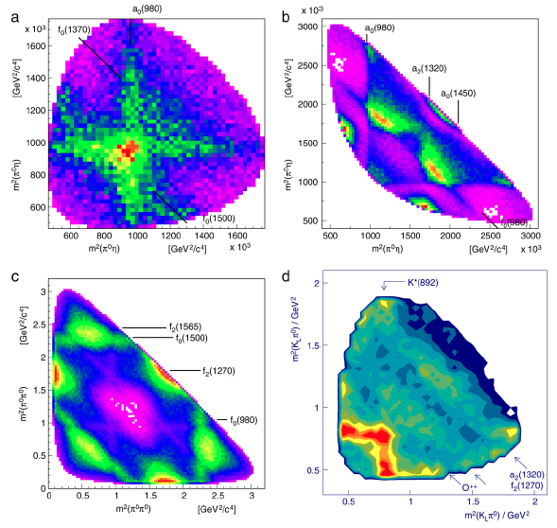
Experimental Evidence
The lightest glueball is expected to be a scalar (J^{PC}=0⁺⁺)
One of the most significant results in this sector obtained by Crystal Barrel Collaboration at LEAR
In case of two identical pseudo-scalar meson in the final state, these can combine to give
I^{G}J^{PC}=(0⁺)(0⁺⁺) and (0⁺)(2⁺⁺)
i.e. f₀ and f₂ states
Notes:
Crystall barrel: discovery of the f0(1500), consolidation of evidence for f0(1370), discovery of a0(1450) and completion of nonet

Slide 27
Experimental Evidence
Good description of the 4 Dalitz plot with two isoscalar states:
Partial decays seems inconsistent with the glueball picture but also with regular meson expectations
Large branch to 4π is indicative of nn nature
 | f₀(1370) | f₀(1500)
Γ_{tot} | 275±55 | 130±30
Γ_{ππ} | 21.7±9.9 | 44.1±15.4
Γ_{ηη} | 0.41±0.27 | 3.4±1.2
Γ_{ηη’} |  | 2.9±1.0
Γ_{KK} | 5.2-28.4 | 8.1±2.8
Γ_{4π}/Γ_{tot} | 0.80±0.05 | 0.76±0.08
Notes:
Crystall barrel: discovery of the f0(1500), consolidation of evidence for f0(1370), discovery of a0(1450) and completion of nonet

Slide 28
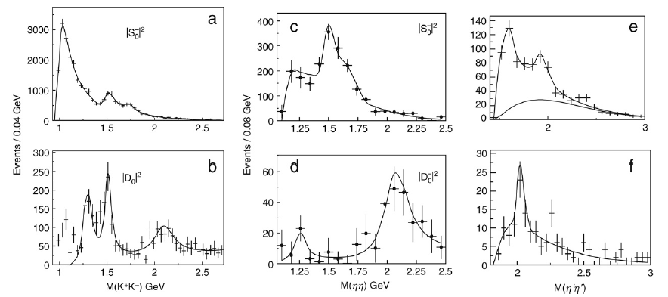
Experimental Evidence
The f₀(1370) and f₀(1500) have also been observed by the WA102 Collaboration in central production at 450 GeV. They also observed a signal for the f₀(1710), previously seen by Crystal-Ball at SLAC in radiative J/y decays.
A coupled analysis of ππ and KK final states indicated the dominance of the KK decay mode, suggestive of an ss nature
No signal was observed by Crystal Barrel
L=0
L=2
Notes:
Crystall barrel: discovery of the f0(1500), consolidation of evidence for f0(1370), discovery of a0(1450) and completion of nonet

Slide 29
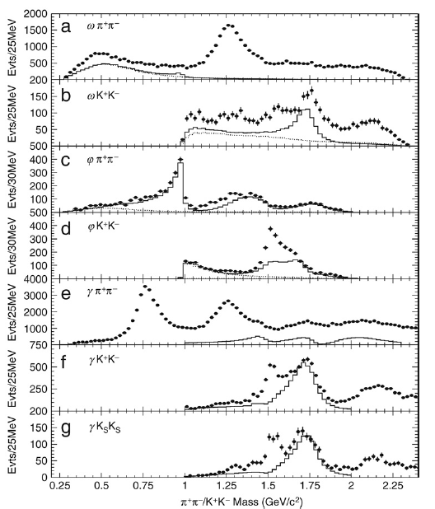
Experimental Evidence
Central production at CERN WA102
Confirmation of the f₀(1370) and f₀(1500) and evidence for the f₀(1710), previously seen by Crystal-Ball at SLAC in radiative J/y decays.
A coupled analysis of ππ and KK final states indicated the dominance of the KK decay mode, suggestive of an ss nature
J/Ψ decays at BES
Evidence for the f₀(1500), f₀(1710) and f₀(2000)
Study of J/ψ → ωX and J/ψ→φX (flavor tagging reactions):
A possible signal for the f₀(1710) is seen in ωKK and not in φKK.
A broad signal in φππ around 1790 is found (??)
Notes:
Crystall barrel: discovery of the f0(1500), consolidation of evidence for f0(1370), discovery of a0(1450) and completion of nonet

Slide 30
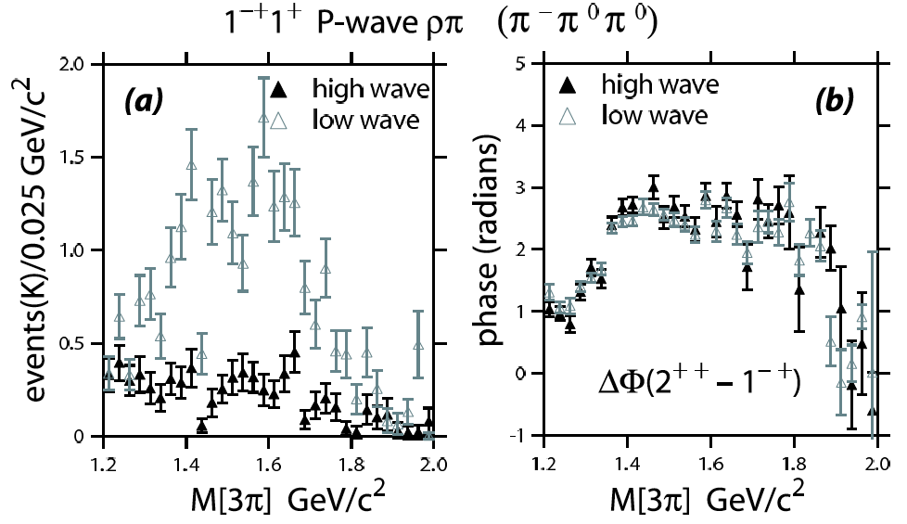
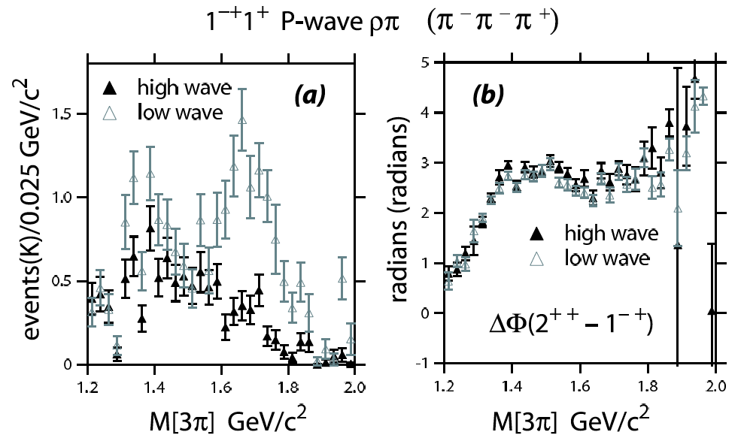
π₁(1600) in E852 at BNL
The E852 data for 3 pion production were reanalyzed by an independent group using more statistics (x10) and higher number of waves in the PWA
New analysis results did not show evidence for the π₁(1600)
Most of the exotic wave strength is re-absorbed in known decays of the π₂(1670)
π₂(1670)→ρπ (L=3)
π₂(1670)→ρ₃π
π₂(1670)→(ππ)_{S}π
a₃ decays
a₄(2040)
…
A. Dzierba et. al., PRD 73 (2006) 072001
Notes:
Existence of hybrid mesons (qqg) is not yet firmly established:
LQCD predicts existence of exotic hybrids with masses below 2 GeV
signals for exotic hybrids have been reported by various experiments but evidence is not yet fully convincing

Slide 31
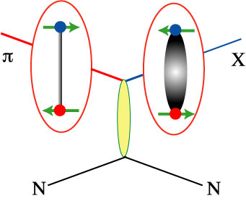
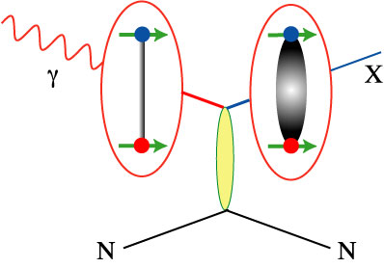
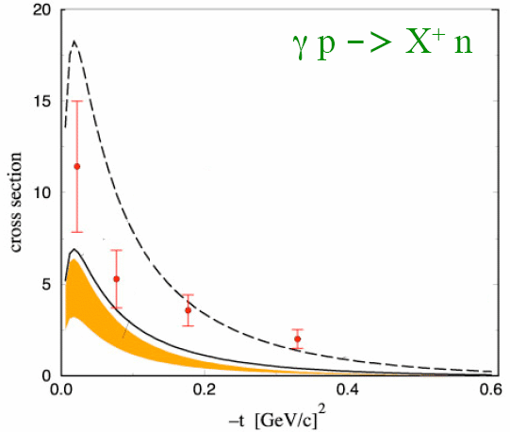
Exotics in Photoproduction
Photoproduction: exotic J^{PC} are more likely produced by S=1 probe
Pion Beam
Photon Beam
Quark spins
anti-aligned
J^{PC} = 1⁻⁻ , 1⁺⁺
Quark spins
already aligned
J^{PC} = 0⁺⁻ , 1⁻⁺ , 2⁺⁻
Knowledge of the photon polarization can be used as a filter in the PWA
A. Szczepaniak and M. Swat, Phys. Lett. B516 (2001) 72
Production rate for exotics is expected to be comparable to regular mesons
regular mesons @ E_{g} = 5GeV
X = a₂
Few data (so far) but expected similar production rate as regular mesons
Exotic meson @ E_{g} = 8GeV
X = p₁(1600)

Slide 32
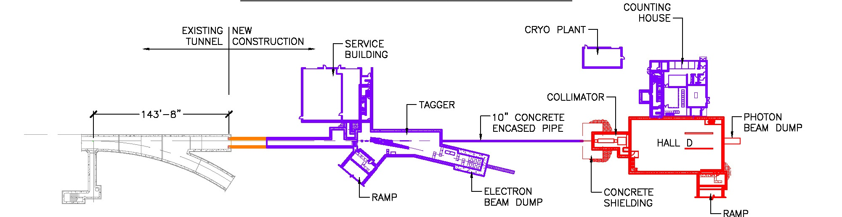
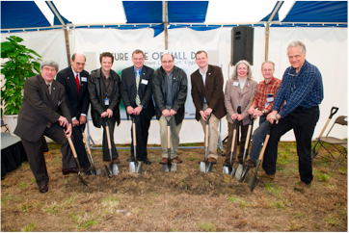
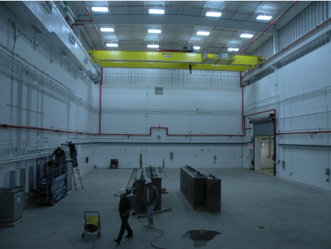
The Hall D Complex
electron beam
~100 meters
Groundbreaking, April 2009
In the Hall, February 2011

Slide 33
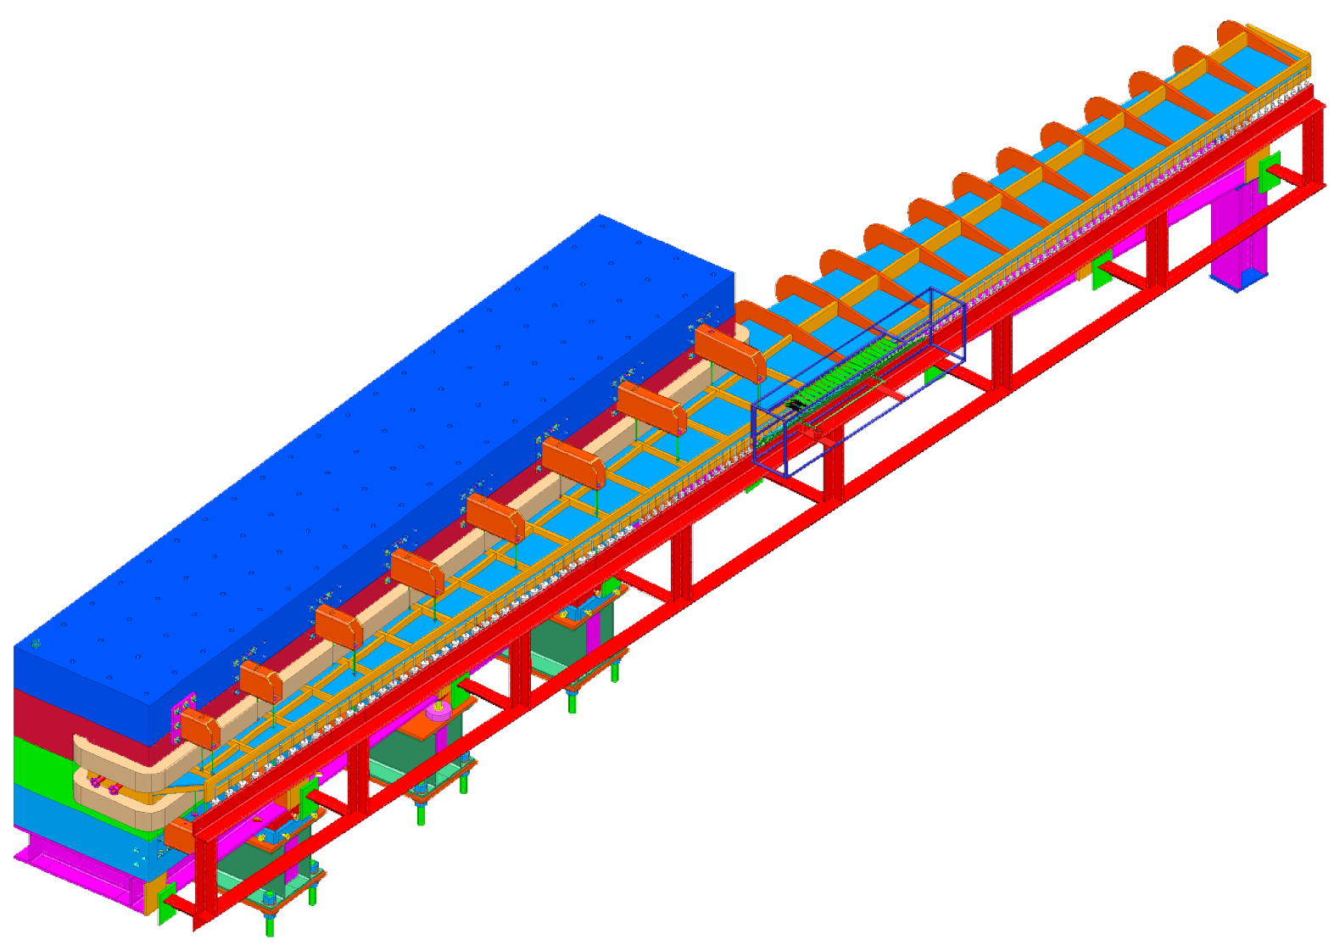
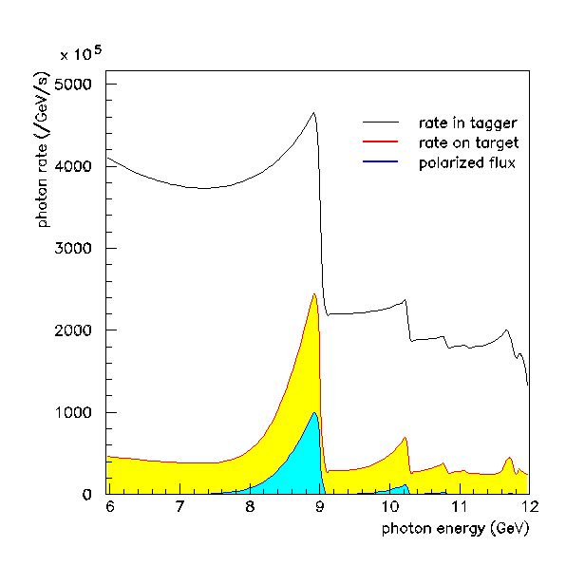
The Hall D Photo Beam
Microscope:
Movable to cover different energy ranges
100 x 5 scintillating fibers (2mm x 2mm)
800MeV covered by whole microscope
100MHz tagged γ/sec on target
~8MeV energy bite/column
Photon Polarization:
20 μm diamond radiator
Coherent peak is linearly polarized
~40% polarization with peak @ 9GeV
Peak location tunable with
diamond angle
Crucial to simplify PWA!!
12m long vacuum chamber
1.5 T dipole magnet
coherent bremsstrahlung spectrum
Fixed array hodoscope:
190 scintillators
50% coverage below 9GeV γ
100% coverage above 9GeV γ
Tags 3.0-11.7 GeV γ
~30MeV energy bite/counter
3.5 – 17 MHz/counter
e⁻
20μm diamond radiator

Slide 34
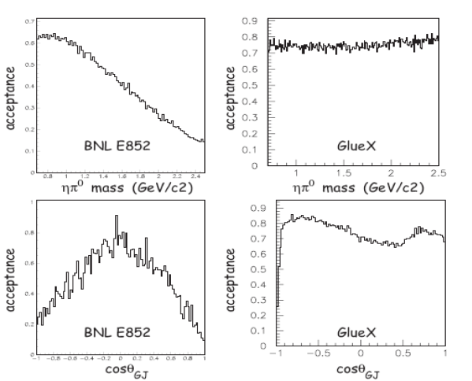
Expected performance
Design Goal: high and uniform acceptance
Comparison of acceptance plots between BNL E852 and GlueX in a sample channel:
high and uniform
acceptance in invariant mass and Gottfried-Jackson angles.

Slide 35
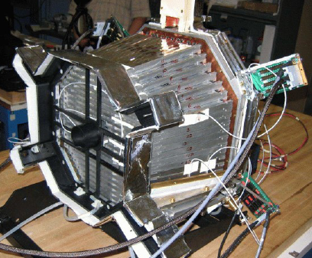
The CLAS12 Forward Tagger
Electron detection via Calorimeter+Tracker+Veto
Forward
Tagger
calorimeter to determine the electron energy with few % accuracy → homogenous PbWO₄ crystals
tracker to determine precisely the electron scattering plane and the photon polarization → micromegas
veto to distinguish photons from electrons → scintillator tiles with WLS fiber readout
CLAS12
e⁻
γ*
e⁻
p
Forward Tagger
E’ | 0.5-4.5 GeV
ν | 7-10.5 GeV
θ | 2.5-4.5 deg
Q² | 0.007 – 0.3 GeV²
W | 3.6-4.5 GeV
Photon Flux | 5 x 10⁷ g/s @ L_{e}=10³⁵
PbWO4 Calorimeter
424 Crystals

Slide 36
Experiment Layout
Calorimeter
Tracker
Scintillation Hodoscope
Moller Shield

Slide 37
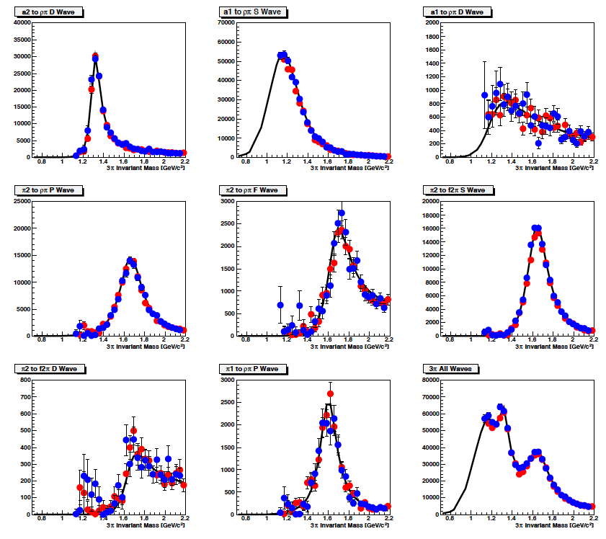
PWA in CLAS12
a₂→ρπ D-wave
a₁→ρπ S-wave
a₁→ρπ S-wave
In preparation for the experiment, PWA tools are being developed and tested on pseudo data (Monte Carlo) for different reactions as γp→nπ⁺π⁺π⁻
π₂→ρπ P-wave
π₂→ρπ F-wave
π₂→f₂π S-wave
Test for 2 t bins:
line: generated wave
|t|=0.2 GeV²
|t|=0.5 GeV²
As a function of M_{3π}
π₂→f₂π D-wave
π₂→f₂π P-wave
3π all wave
The CLAS12 detector system is intrinsically capable of meson spectroscopy measurements

Slide 38
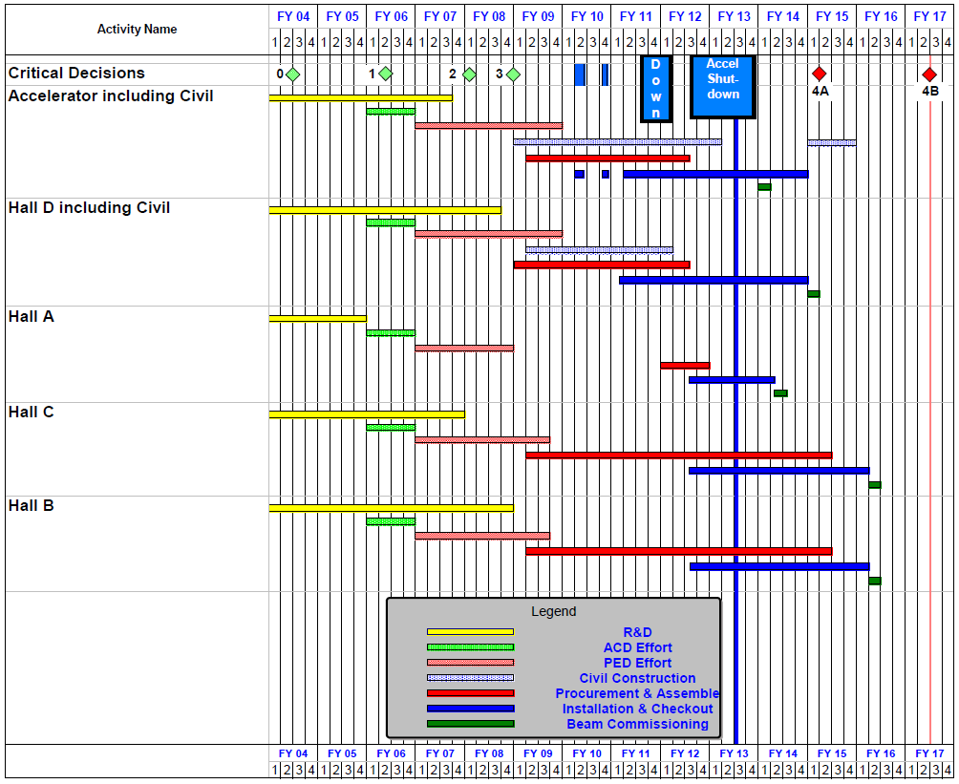
12 GeV Program Schedule
Hall D/Gluex commissioning starts October 2014
• Hall B/CLAS12 commissioning starts January 2016

Slide 39
Future Challenges
High statistics, high quality data sets are expected to be collected in the near future to continue the study of meson spectroscopy
These will give access to low cross-section channels and multi-particle decay modes that could not be studied before
New challenges will have to be faced:
Analysis and Computing:
    full partial wave analysis of the new data sets demand for large computing power both for data analysis and Monte Carlo simulation
    new, optimized PWA codes with built-in support for GPUs are been developed by the experimental collaborations
Amplitudes Parameterization and Theoretical Input:
    Most of existing PWA codes are based on the isobar model
    Extraction of small waves (<10%) requires higher level of sophistication
    Strict collaboration between theorists and experimentalist is needed:
      INT Workshop on Hadron Spectroscopy, Seattle, November 9-13 2009
      ECT* Workshop on Amplitude Analysis in Hadron Spectroscopy, Trento, January 10-14 2011
      …
      Jefferson Lab Advanced Study Institute, Williamsburg, May 31- June 13 2012
      ATHOS12 Workshop on New Partial Wave Analysis Tools for Next Generation Hadron Spectroscopy Experiments, Camogli, June 19-22 2012

