Slide 1
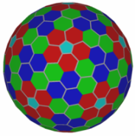
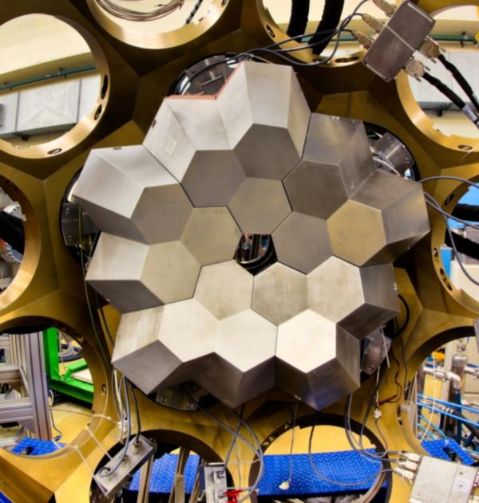
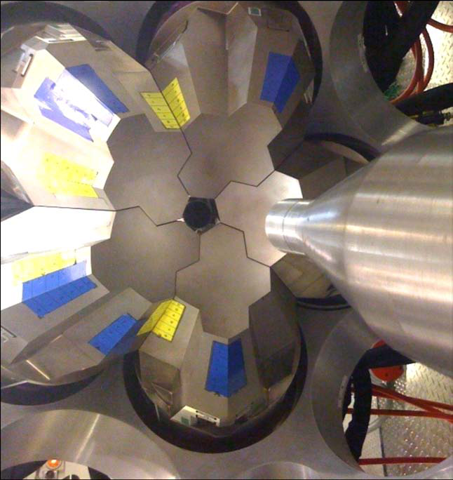
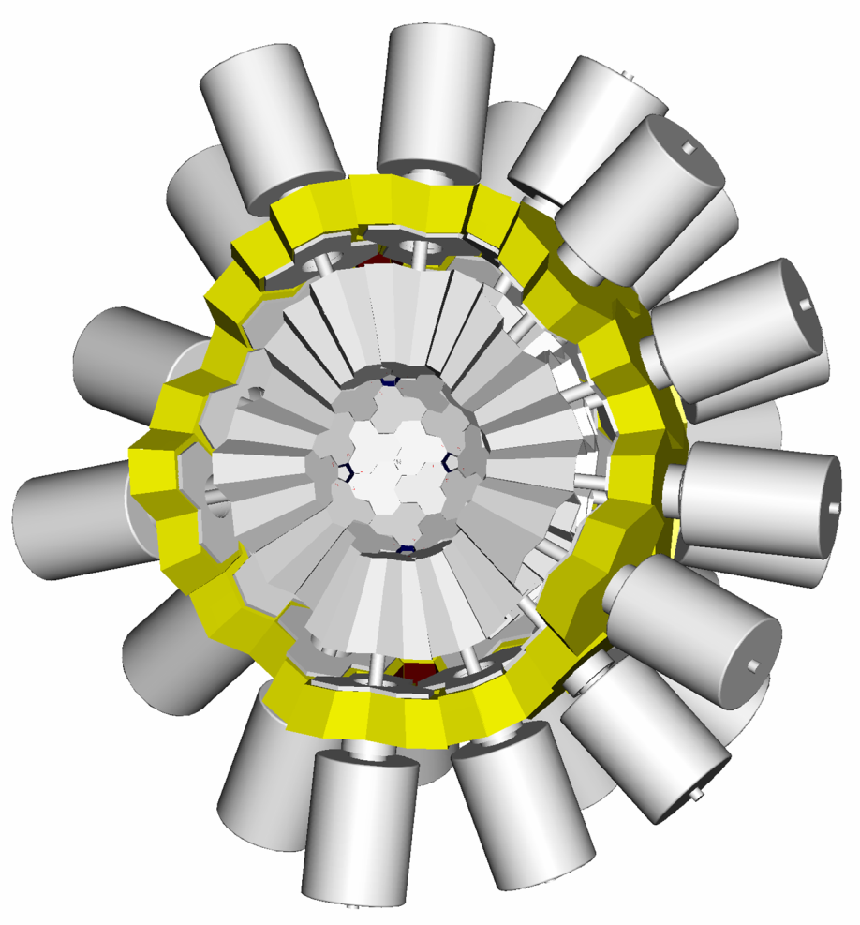

Nuclear Structure with
Gamma-ray Tracking Arrays
Dino Bazzacco
INFN Padova

Slide 2
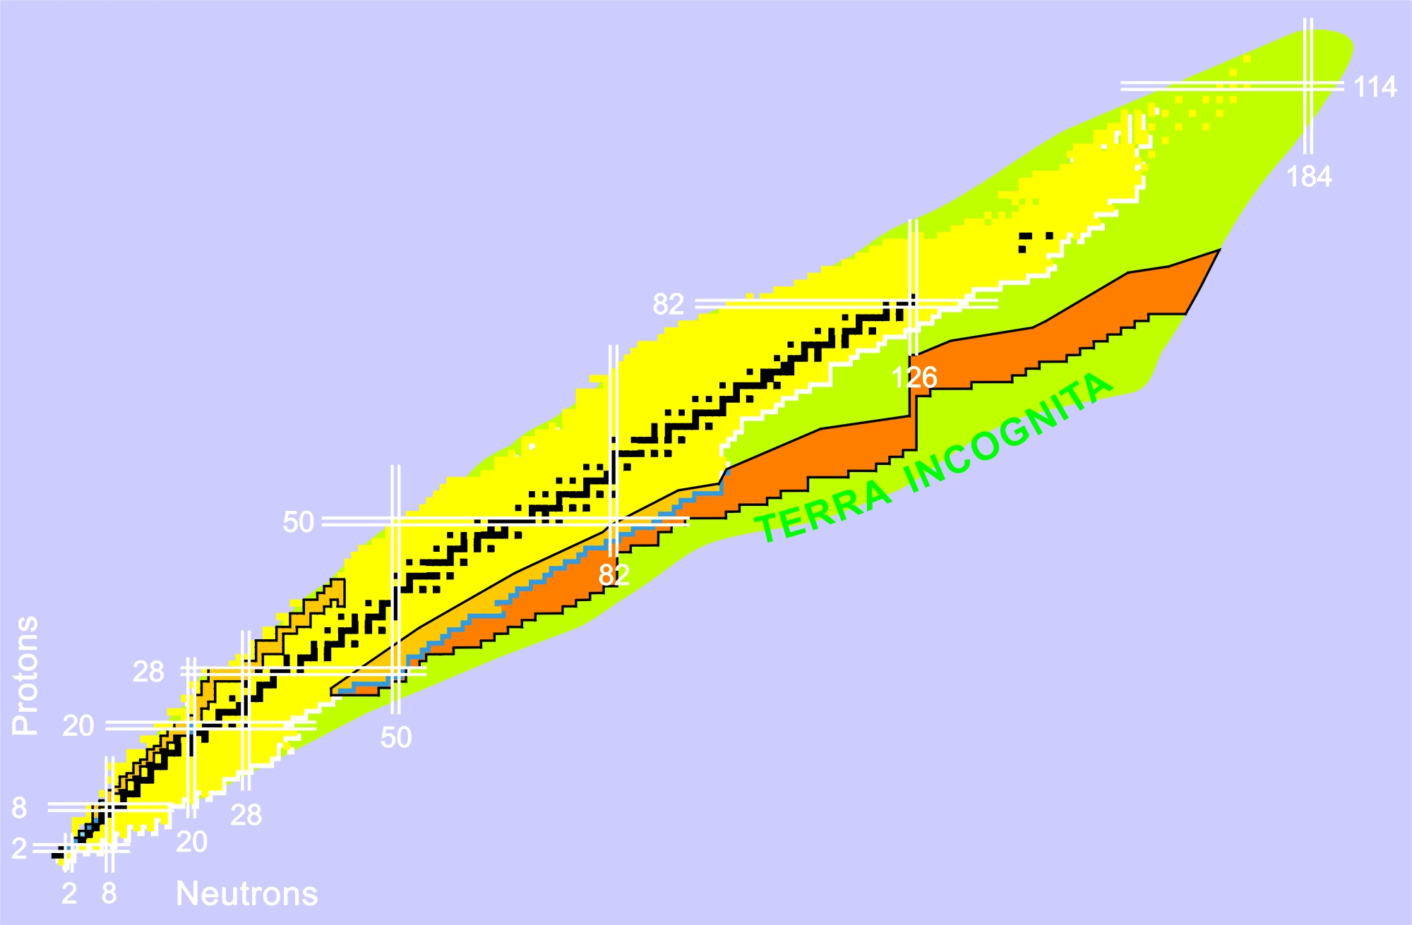
Challenges in Nuclear Structure
Shell structure in nuclei
Structure of doubly magic nuclei
Changes in the (effective) interactions
Shape coexistence
Transfermium nuclei
Proton drip line and N=Z nuclei
Spectroscopy beyond the drip line
Proton-neutron pairing
Isospin symmetry
Nuclear shapes
Exotic shapes and isomers
Coexistence and transitions
¹⁰⁰Sn
Neutron-rich heavy nuclei (N/Z → 2)
Large neutron skins (r_{ν}-r_{π}→ 1fm)
New coherent excitation modes
Shell quenching
⁴⁸Ni
^{132+x}Sn
⁷⁸Ni
Nuclei at the neutron drip line (Z→25)
Very large proton-neutron asymmetries
Resonant excitation modes
Neutron Decay

Slide 3
Experimental Conditions and Challenges at Radioactive Beam Facilities
Low intensity for the nuclei of interest
High background levels
Large Doppler broadening
High counting rates
High γ-ray multiplicities
Beyond the capability of the best
Compton-suppressed Detector Arrays
Need of advanced
general-purpose
instrumentation
High efficiency
High sensitivity
High throughput
Ancillary detectors

Slide 4
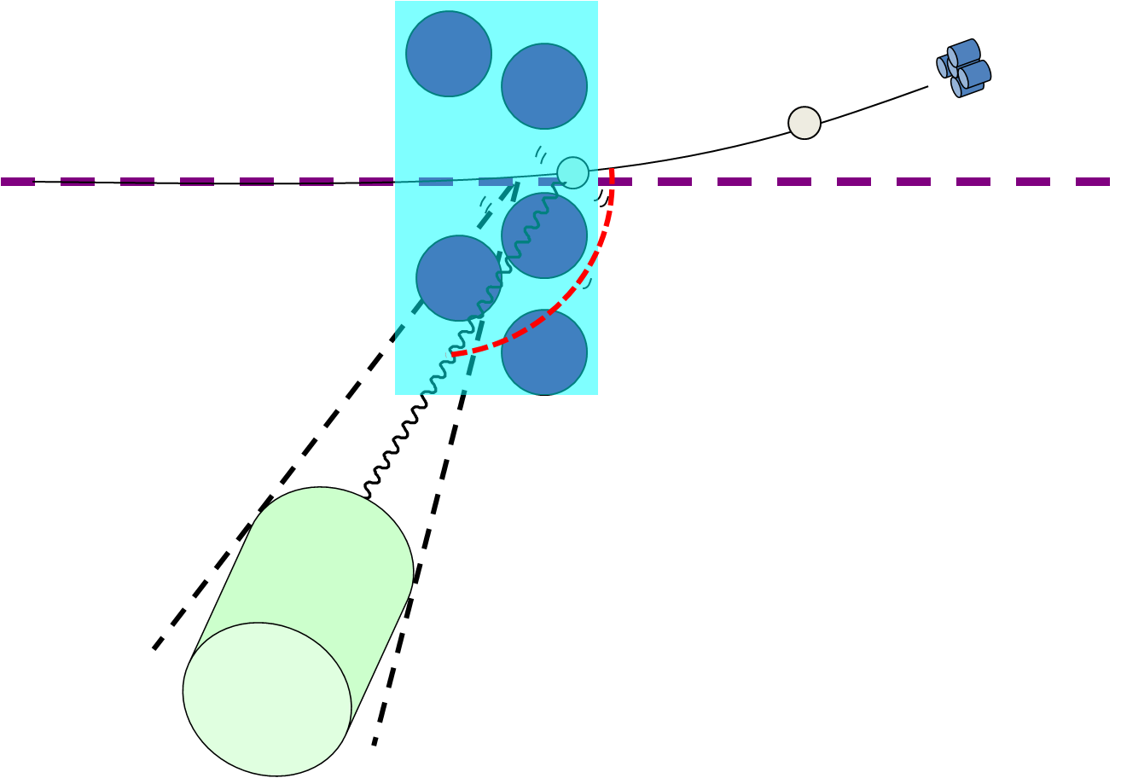
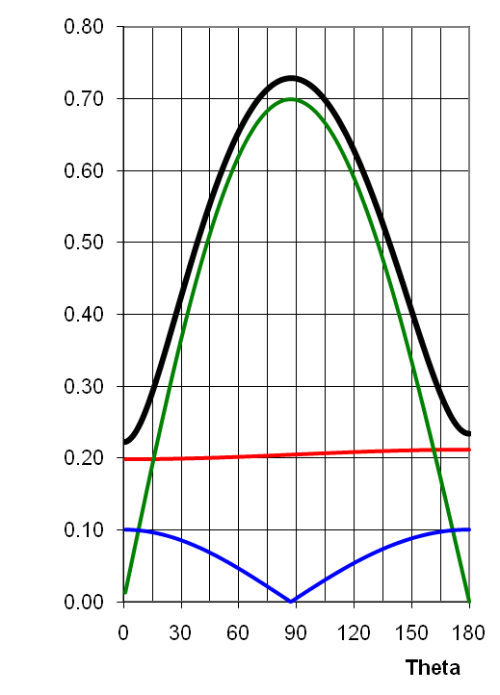
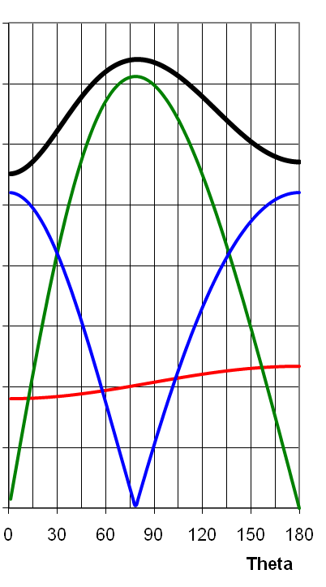
Effective Energy Resolution
E_{γ} 1 MeV
ΔE_{lab} 2 keV
β(%) 5±0.01 20±0.005
ΔΘ(deg) 8 2
ΔE_{γ}/E_{γ} (%)
Opening
Recoil
Intrinsic

Slide 5
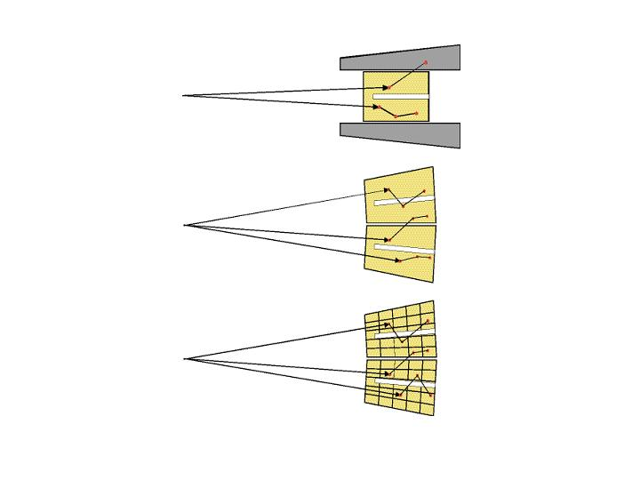
Motivation of γ-ray tracking
Compton Suppressed
ε_{ph} ~ 10%
N_{det} ~ 100
50% of solid angle taken by the AC shields
large opening angle ➔
poor energy resolution at high recoil velocity
Ω ~ 40%
θ ~ 8º
Ge Sphere
ε_{ph} ~ 50%
N_{det} ~ 1000
Ω ~ 80%
θ ~ 3º
too many detectors needed to avoid summing effects
opening angle still too big for very high recoil velocity
Tracking Array
Ω ~ 80%
θ ~ 10º
Smarter use of Ge detectors
segmented detectors
digital electronics
timestamping of events
analysis of pulse shapes
tracking of γ-rays
ε_{ph} ~ 50%
N_{det} ~ 100
Pulse Shape Analysis θ_{eff} ~ 1º
Gamma-ray Tracking N_{eff} ~ 10000
from Calorimetric to Position Sensitive operation mode

Slide 6
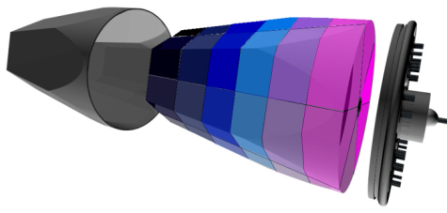
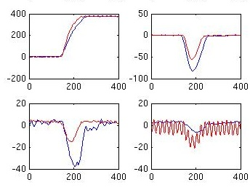
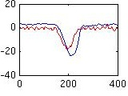
Position-sensitive Operation Mode and Gamma-ray Tracking
Event building
of time-stamped hits and ancillaries
Highly segmented
HPGe detectors
Global level
Local level
•
•
•
Identified
interaction points
Reconstruction of
γ-rays from the hits
•
•
•
γ
•
•
(x,y,z,E,t)_{i}
Synchronized digital electronics to digitize (14 bit, 100 MS/s) and process the 37 signals generated by crystals
Pulse Shape Analysis
of the recorded waves
Readout Raw Data
(10 kB/evt/crystal)
Analysis of gammas
and correlation with other detectors
HARDWARE
SOFTWARE

Slide 7
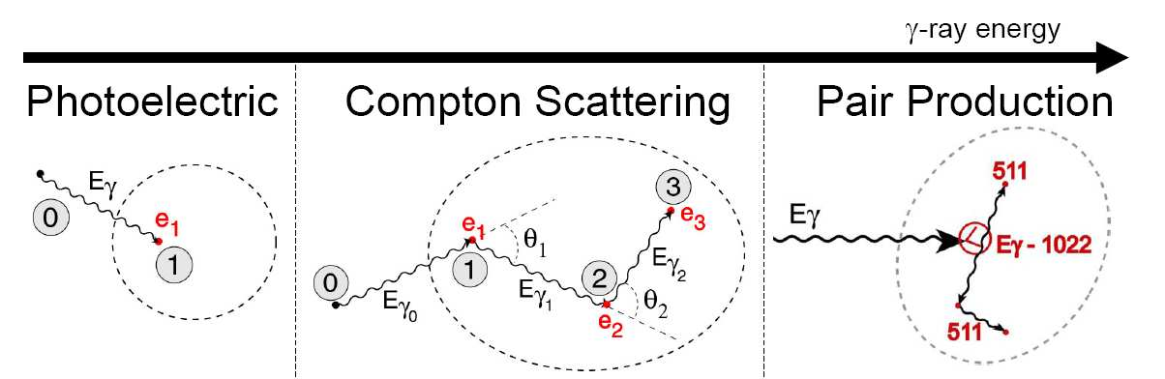

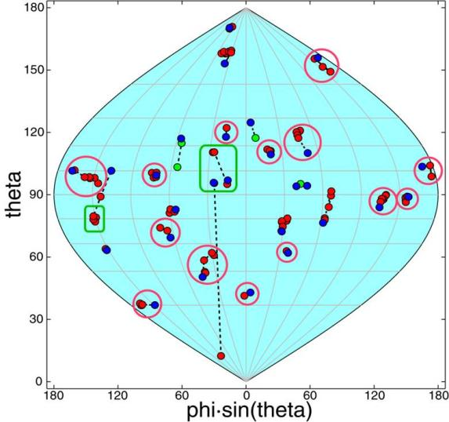
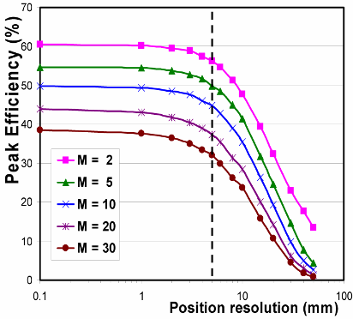
Reconstruction of gammas rays
100 keV
10 MeV
γ-ray energy
High-multiplicity simulated event
Efficiency depends on position resolution
M_{γ} = 30
Position resolution (FWHM, mm)

Slide 8
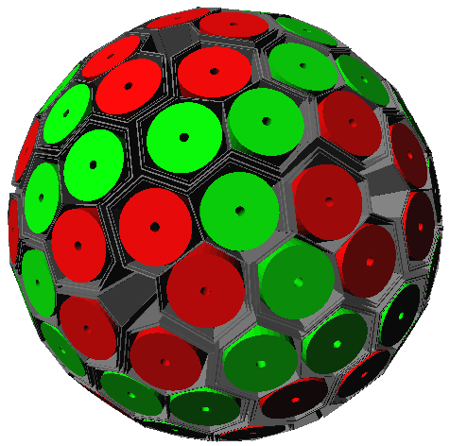
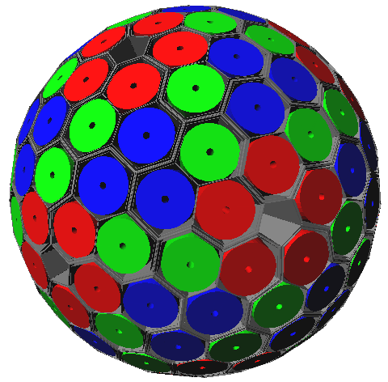
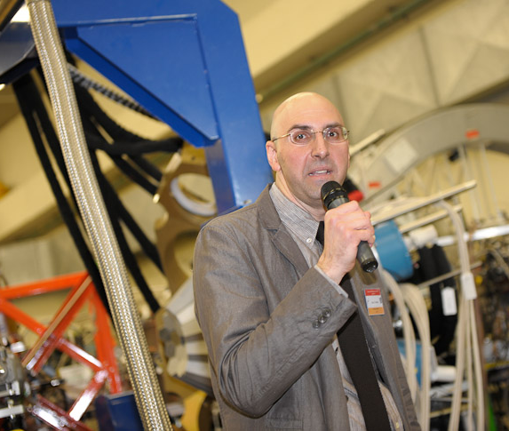
Two Suitable Geodesic Configurations
Configuration | “small” | “big”
# of hexagonal crystals | 120 | 180
# of crystal shapes | 2 | 3
# of clusters | 30 | 60
Covered solid angle (%) | 78.0 | 78.4
Germanium weight (kg) | 230 | 370
Centre to crystal-face (cm) | 18.5 | 23.5
Signal channels | 4440 | 6660
Efficiency at M_{γ} = 1 (%) | 36.4 | 38.8
Efficiency at M_{γ} = 30 (%) | 22.1 | 25.1
P/T at M_{γ} = 1 (%) | 51.8 | 53.2
P/T at M_{γ} = 30 (%) | 43.4 | 46.1
120 crystals ➔ GRETA
Monte Carlo and simulations by Enrico Farnea
180 crystals ➔ AGATA
Notes:
Enrico a precious colleague and fantastic person departed/deceased on April 14

Slide 9
Status after ~10 years of development pursued by the AGATA and GRETA collaborations
Germanium detectors
Electronics and DAQ
  Fully digital systems with common clock and time-stamping
  Real time trigger (timestamp based in AGATA)
  Coupling to EDAQ of Auxiliary detectors based on timestamp
Pulse Shape Analysis
Gamma-ray Tracking
Problems encountered
  Cross Talk ➔ solved
  High counting rates ➔ solved by digital electronics
  Neutron damage ➔ solved by PSA
Early implementations: AGATA Demonstrator and GRETINA
  Performance
  Evolution

Slide 10
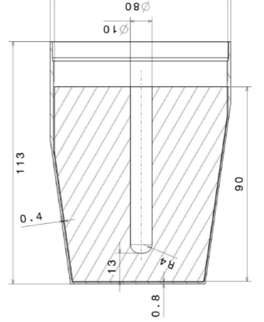
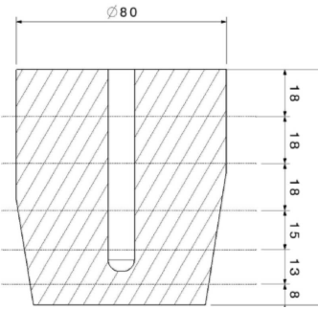
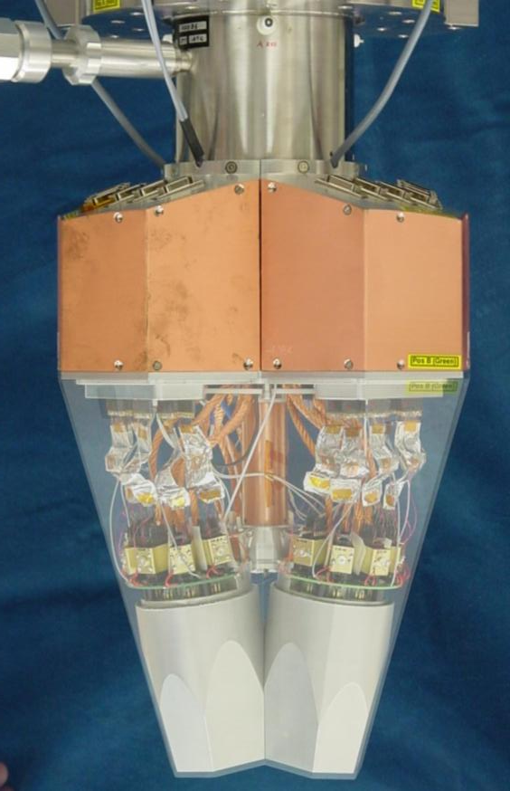
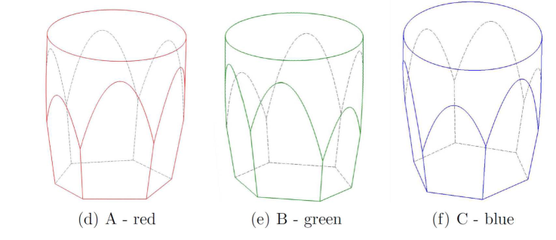
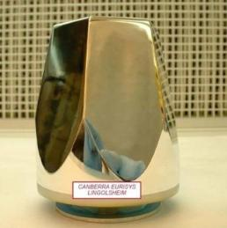
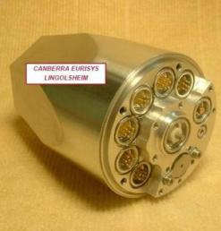
AGATA detectors
80 mm
90 mm
6x6 segmented cathode
Volume ~370 cc Weight ~2 kg
(shapes are volume-equalized to 1%)
Cold FET for all signals
Energy resolution
Core: 2.35 keV
Segments: 2.10 keV
(FWHM @ 1332 keV)
A. Wiens et al. NIM A 618 (2010) 223
D. Lersch et al. NIM A 640(2011) 133
AGATA capsules
Manufactured by Canberra France
AGATA Asymmetric Triple Cryostat
Manufactured by CTT

Slide 11
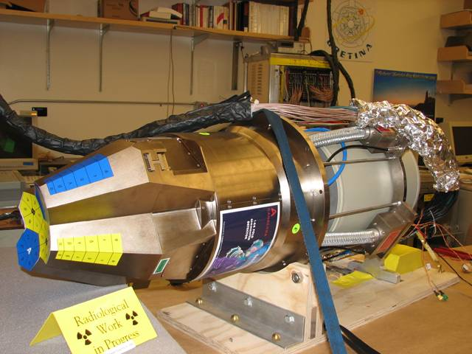
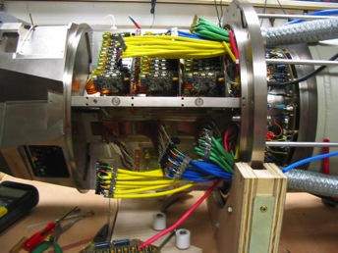
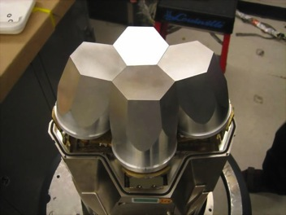
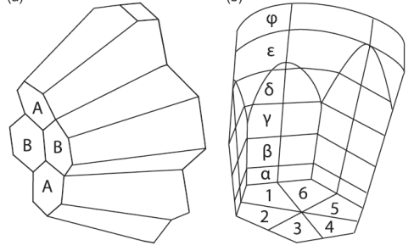
GRETINA Detectors
(Canberra/France)
A-type
36 segments/crystal
4 crystals/module
148 signals /module
Cores: Cold FETs
Segments: Warm FETs
B-type

Slide 12
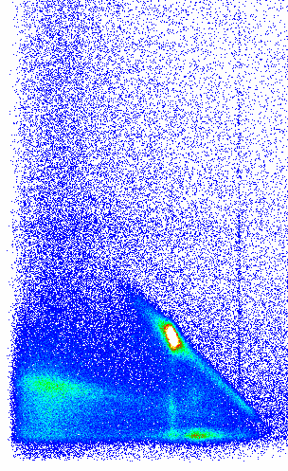
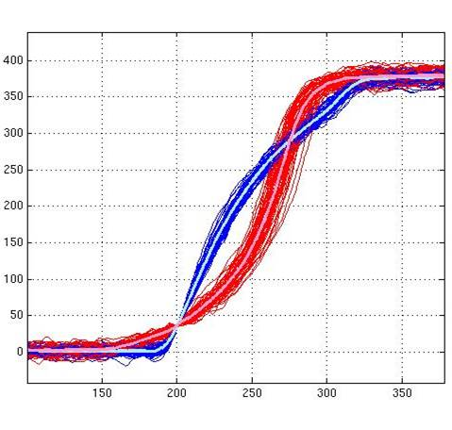
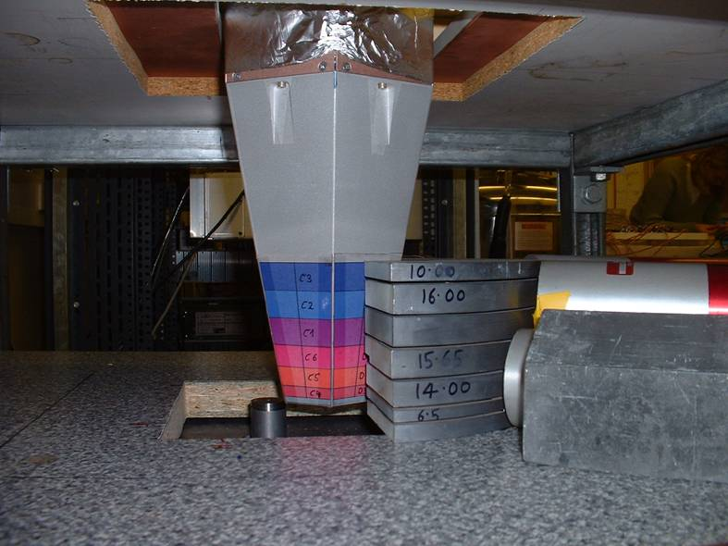
Scanning of Detectors
U. Liverpool
Ge Energy
920 MBq ¹³⁷Cs source
1 mm diameter collimator
NaI Energy
Region of
Interest
288keV
288 keV
374keV
374 keV
662keV
<110>
<010>
T30
T60
T90

Slide 13
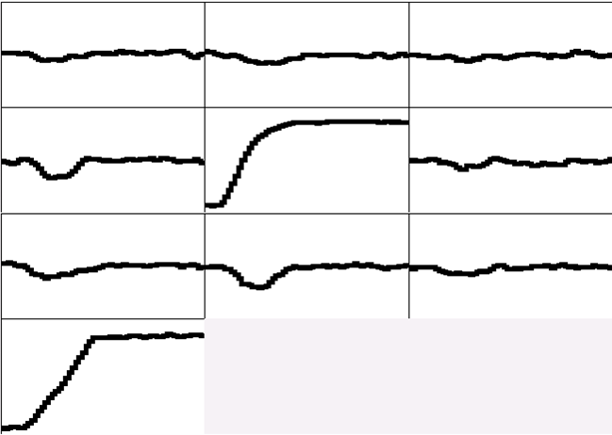
Pulse Shape Analysis concept
A3
A4
A5
B3
B4
B5
C3
C4
C5
CORE
measured
791 keV deposited in segment B4

Slide 14
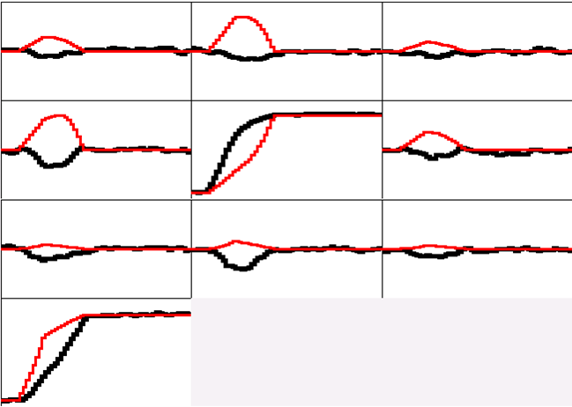
Pulse Shape Analysis concept
A3
A4
A5
B3
B4
B5
(10,10,46)
C3
C4
C5
y
CORE
C4
B4
measured
calculated
D4
A4
x
791 keV deposited in segment B4
E4
F4
z = 46 mm

Slide 15
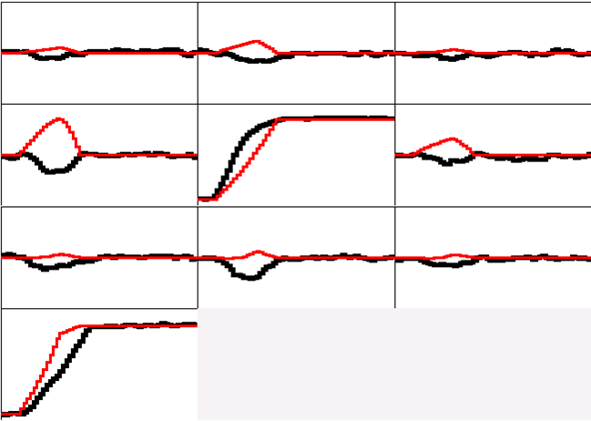
Pulse Shape Analysis concept
A3
A4
A5
B3
B4
B5
(10,15,46)
C3
C4
C5
y
CORE
C4
B4
measured
calculated
D4
A4
x
791 keV deposited in segment B4
E4
F4
z = 46 mm

Slide 16
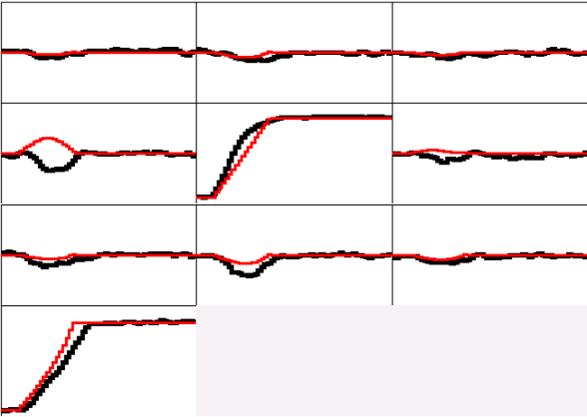
Pulse Shape Analysis concept
A3
A4
A5
B3
B4
B5
(10,20,46)
C3
C4
C5
y
CORE
C4
B4
measured
calculated
D4
A4
x
791 keV deposited in segment B4
E4
F4
z = 46 mm

Slide 17
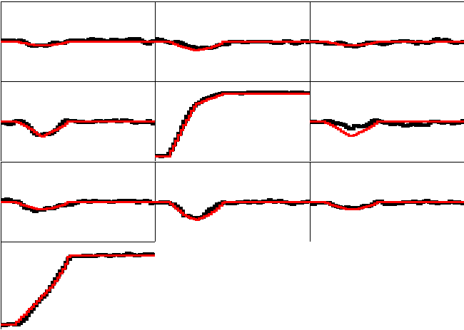
Pulse Shape Analysis concept
A3
A4
A5
B3
B4
B5
(10,25,46)
C3
C4
C5
y
CORE
C4
B4
measured
calculated
D4
A4
x
791 keV deposited in segment B4
E4
F4
z = 46 mm

Slide 18
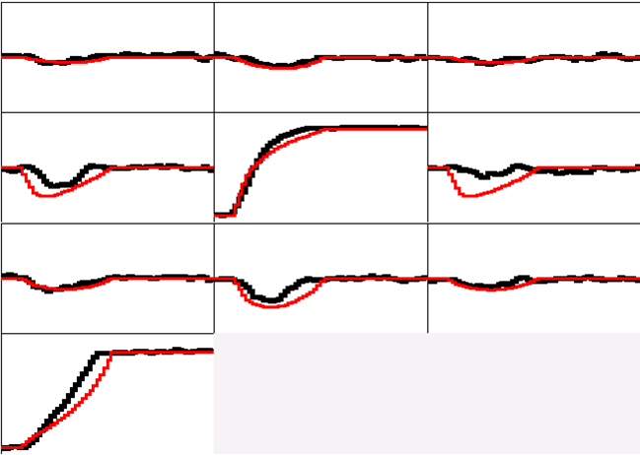
Pulse Shape Analysis concept
A3
A4
A5
B3
B4
B5
(10,30,46)
C3
C4
C5
y
CORE
C4
B4
measured
calculated
D4
A4
x
791 keV deposited in segment B4
E4
F4
z = 46 mm

Slide 19
Pulse Shape Analysis concept
A3
A4
A5
Result of
Grid Search
Algorithm
B3
B4
B5
(10,25,46)
C3
C4
C5
y
CORE
C4
B4
measured
calculated
D4
A4
x
791 keV deposited in segment B4
E4
F4
z = 46 mm

Slide 20
Pulse Shape Analysis Algorithms
8
Singular Value Decomposition
Adaptive Grid Search
6
Artificial Intelligence (PSO, SA, ANN, ...)
Full Grid Search
Position resolution (mm FWHM)
Genetic algorithm
now
4
Wavelet method
Least square methods
2
0
ms
s
hr
Computation Time/event/detector

Slide 21
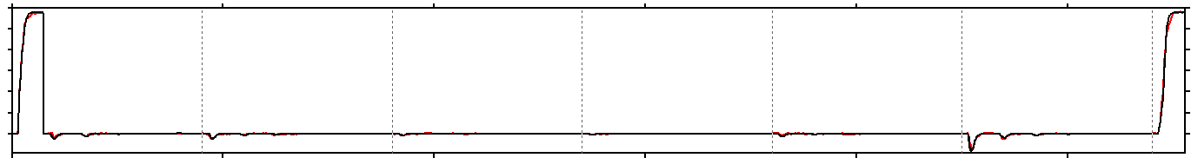
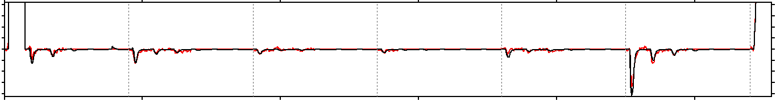
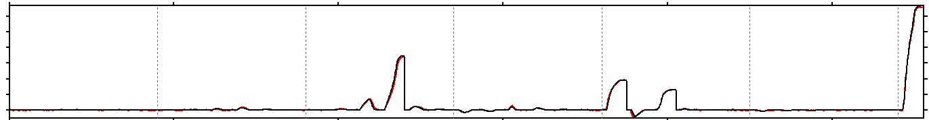
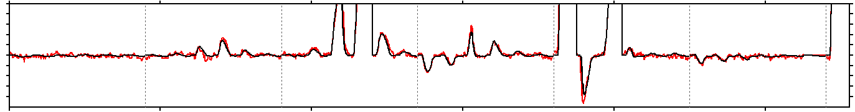
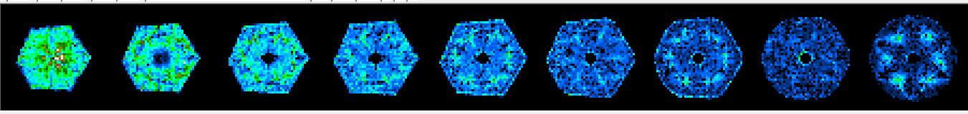
Examples of signal decomposition
Eγ = 1172 keV net-charge in A1
x10
1 A 6 1 B 6 1 C 6 1 D 6 1 E 6 1 F 6 CC
Eγ = 1332 keV net-charge in C4, E1, E3
x10
Tomography of interactions in the crystal: non uniformities due to PSA

Slide 22
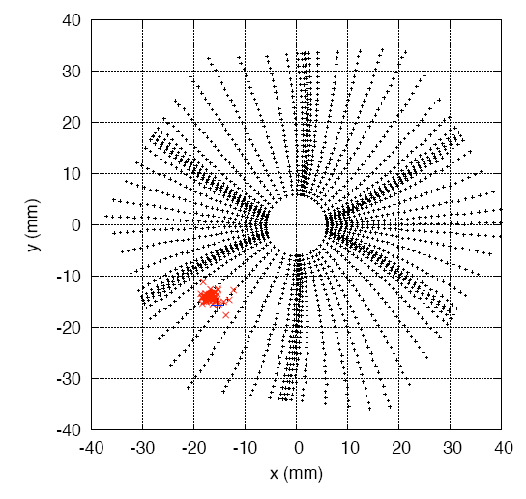
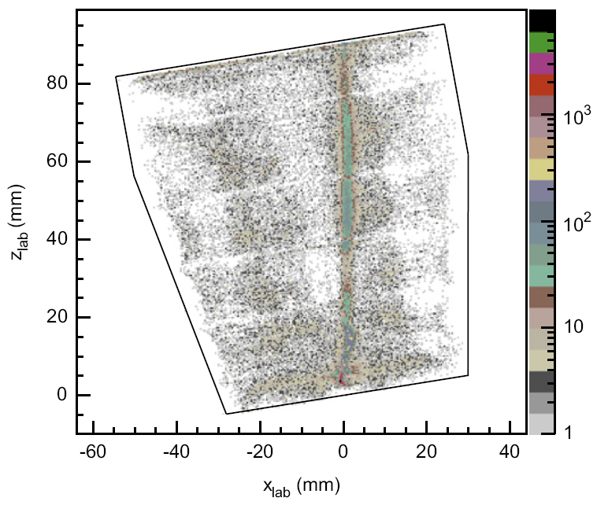
Position resolution (GRETINA)
Decomposition program, ORNL, LBNL
coincidence
σ_{x} = 1.2 mm, σ_{y} = 0.9 mm
σ = 1.9 mm (average of 18 crystals)
S. Paschalis et al, NIMA 709 (2013) 44–55

Slide 23
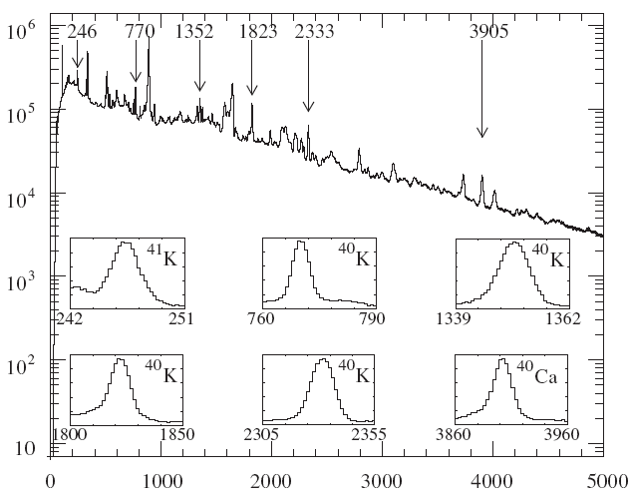
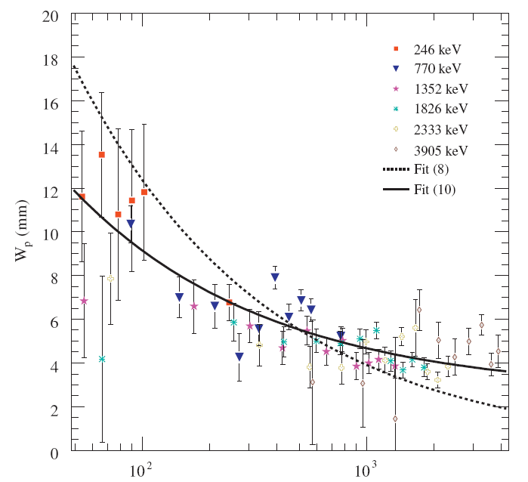
Position resolution (AGATA)
¹²C(³⁰Si,np)⁴⁰K at 64 MeV v/c = 4.8 %
Two target positions: 5.5 and 23 cm (-16 cm and +1.5 cm re center of array)
to remove systematic errors
Spectrum at short distance and used peaks
Position resolution of first hit (fwhm)
σ ~ 2 mm at 1 MeV
E_{γ} (keV)
E_{p1} (keV)
P.-A.Söderström, F.Recchia et al, NIMA 638 (2011) 96

Slide 24
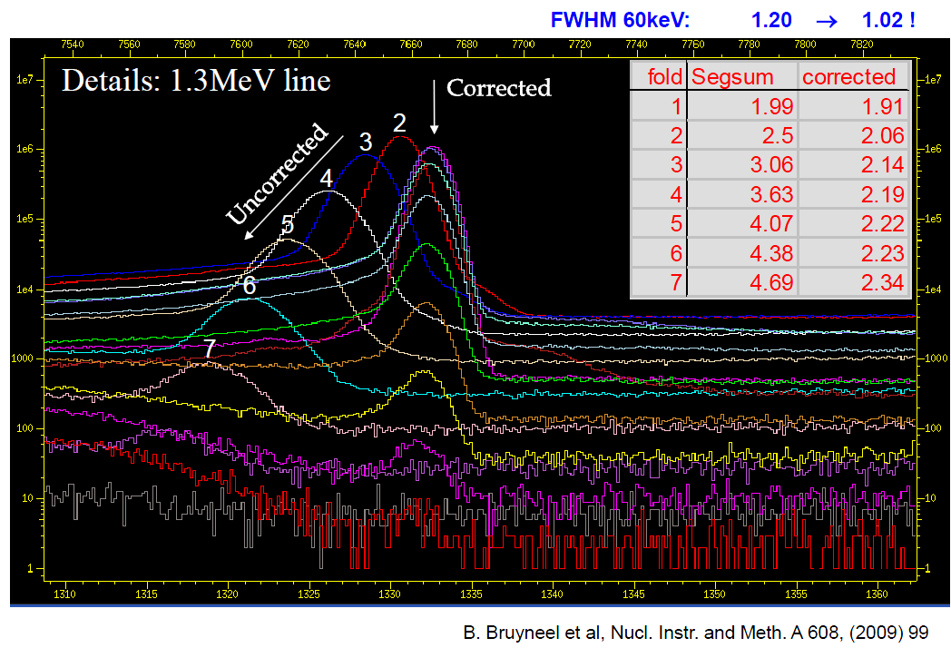
Cross talk correction: Results

Slide 25
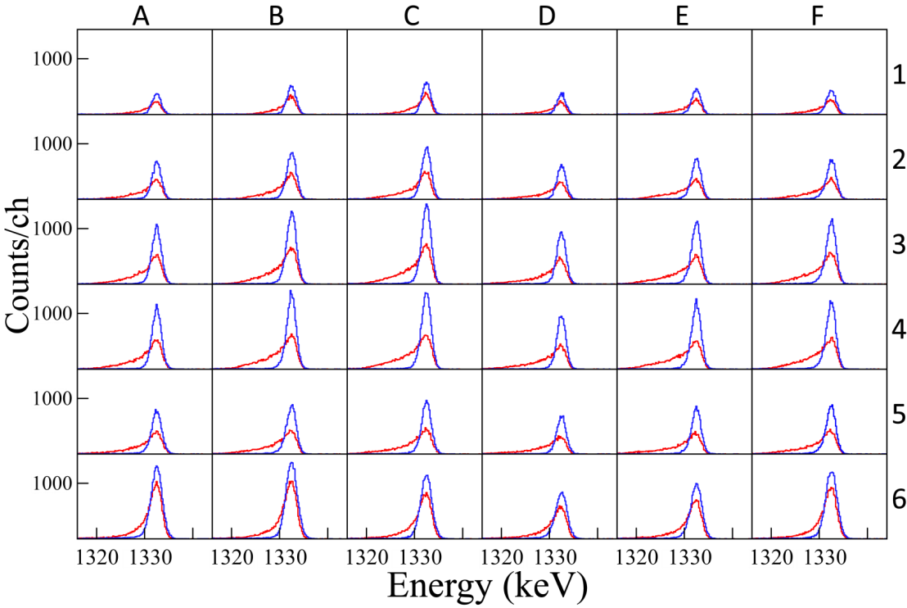
Correction of Radiation Damage
Line shape of the segments of an AGATA detector at the end of the experimental campaign at Legnaro (red)
The correction based on a charge trapping model that uses the positions of the hits provided by the PSA restores the a Gaussian line shape (blue)
B.Bruyneel et al, Eur. Phys. J. A 49 (2013) 61

Slide 26
First Gamma Tracking Arrays
AGATA Demonstrator
GRETINA
LNL, 2011
LBNL, 2011
15 crystals (out of 180); 5 Triple Clusters
Commissioned in 2009 at LNL (with 3 TC)
Experiments at LNL in 2010-2011
Now at GSI, working with 20-25 crystals
S. Akkoyun et al, NIMA 668 (2012) 26–58
28 crystals (out of 120); 7 Quadruple Clusters
Engineering runs started early 2011 at LBNL
Experiments at LBNL in 2011
Now at MSU, working with 28 crystals
S. Paschalis et al, NIMA 709 (2013) 44–55

Slide 27
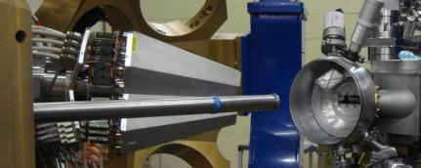
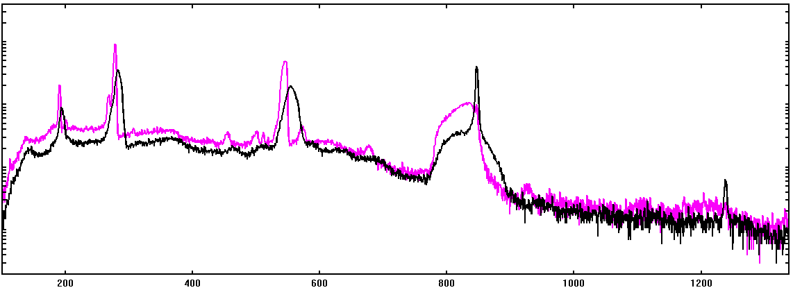



Doppler Correction
220 MeV ⁵⁶Fe → ¹⁹⁷Au (AGATA + DANTE)
Au recoils also seen by Dante
⁵⁶Fe 2⁺ → 0⁺
846.8 keV
⁵⁶Fe 4⁺ → 2⁺
1238.3 keV
4.8 keV FWHM
Original
Corrected
Doppler correction using
PSA (AGS) and tracking
FWHM = 3.5 keV
(3.2 keV if only single hits)
v/c 8%
E(2⁺) = 846.8 keV
Doppler correction using
center of hit segments
FWHM = 7 keV
Detector FWHM = 2.2 keV
Doppler correction using
center of crystals
FWHM ~20 keV
E_{γ} (keV)

Slide 28


GRETINA at BGS
September 7, 2011 – March 23, 2012
GRETINA – BGS coincidence
Data acquired using separate systems
Use time stamps to correlate data
I-Yang Lee

Slide 29




Doppler corrected spectra
Coulomb excitation: ⁵⁸Ni(¹³⁶Xe,¹³⁶Xe’)⁵⁸Ni
Corrected for ⁵⁸Ni
⁵⁸Ni 2⁺ 1454 keV
FWHM = 14 keV
2⁺→0⁺
⁵⁸Ni
Particle–γ angle (deg.)
2⁺→0⁺
¹³⁶Xe
4→2
Corrected for ¹³⁶Xe
¹³⁶Xe 2⁺ 1313 keV
FWHM = 8 keV
2⁺ →0⁺
¹³⁶Xe
Particle–γ angle (deg.)
2⁺→0⁺
⁵⁸Ni
4→2

Slide 30







AGATA at the GSI-FRS in-flight RIB
GSI-FRS
Lund-York-Cologne
CAlorimeter (LYCCA)
AGATA
12 weeks of beam
New FRS tracking detectors (>10⁶ s⁻¹ at S2, 10⁵s⁻¹ at S4)
New LYCCA-0 particle identification and tracking system
Higher SIS intensities and fast ramping 10⁹(U) to 10¹⁰ (Xe, Kr) ions/spill
IKP-Cologne Plunger (under construction)
HECTOR
ADC
Double Cluster
AGATA
First part of GSI campaign ended 21/11/2012
Four experiments performed , using up to 19 crystals:
- Coulomb Excitation of n-rich Pb, Hg and Pt isotopes
- Pygmy resonance excitation in ⁶⁴Fe,
- Isomer Coulex in ⁵²Fe
- Lifetimes in the heavy Zr-Mo region
+ M1 excitation in ⁸⁵Br, ¹³¹In + studies of HE background
Courtesy H-J. Wollersheim

Slide 31




Doppler-Correction of Uranium X-Rays
Technical Commissioning
Au target
X-rays
Au target
X-rays
U beam on Gold Target:
thickness 400 mg/cm²
U velocity at Target position:
v/c ≈ 0.5
U-atoms have x-rays around 100 keV
Doppler shift to 100 – 150 keV
U beam
X-rays
U beam
X-rays
AGATA
Position
Information
+
LYCCA
particle tracking
Doppler-
shift
correction
Courtesy Norbert Pietralla (INPC2013 talk, session B2); Analysis by Michael Reese

Slide 32



γγ capabilities
135 MeV ³²S → ¹¹⁰Pd (6 AGATA crystals)
The performance of AGATA using γ-ray tracking is comparable
to conventional arrays with a much larger number of crystals
¹³⁸Sm
6 gates on:
347keV,545keV,686keV,775keV,552keV,357keV
871 keV 22⁺ - 20⁺

Slide 33


⁶⁴Ge γ−γ, from ⁶⁵Ge on ⁹Be at v/c=0.4
plain singles
tracked
Reduction of Compton background by tracking allows – for the first time –
gamma spectroscopy with fast beams with spectral quality comparable to
arrays with anti-Compton shields.

Slide 34






Imaging of E_{γ}=1332 keV gamma rays
AGATA used as a big Compton Camera
Far Field Backprojection
All 9 detectors
One detector
Near Field Backprojection
All 9 detectors
One detector
Source at 51 cm ➔ Δx ~Δy ~2 mm Δz ~2 cm
F. Recchia, Padova

Slide 35




Polarization with AGATA crystals
Coulex test experiment with 2 AGATA clusters (6 crystals)
  ¹²C (32 MeV) on ¹⁰⁴Pd (2⁺ at 555.8 keV) and ¹⁰⁸Pd (2⁺ 433.9 keV)
  angular efficiency normalized on ¹³⁷Cs source (666.6 keV)
Similar study done at TU-Darmstadt using one AGATA crystal; hits placed at
center of fired segments (no PSA) ➔ B.Alikani et al. NIMA 675(2012)14
Large dataset taken at the end of the Legnaro campaign by P.G.Bizzeti with 2 facing
AGATA triple-clusters at 3 different distances to study the entanglement of 511 keV photons from the β⁺ ²²Na source.
AGATA-Demonstrator experiment Non-yrast octupole bands in the actinides ²²⁰Ra and ²²²Th by J.F.Smith and D.Mengoni
Presented by B.Melon Session A1, Monday
More details: D.Mengoni, Session I5, Thursday

Slide 36



From the Demonstrator to AGATA 1π
Plans for the next few years
LNL: 2009-2011
15 crystals (5TC)
Total Eff. ~6%
GSI: 2012-2014
25 crystals (5DC+5TC)
Total Eff.~10%
GANIL: 2014-2016
45 crystals (15 TC)
Total Eff. ~15%
Demonstrator + PRISMA
AGATA + FRS
AGATA+VAMOS
Talk by D.Mengoni
session I5, thursday
Talk by N.Pietralla
session B2, monday

Slide 37


GRETINA Science Campaigns
July 2012 - June2013
2013 - 2014
NSCL S800
ANL FMA
Single particle properties of exotic nuclei – knock out, transfer reactions.
Collectivity – Coulomb excitation, lifetime, inelastic scattering.
24 experiments approved for a total of 3351 hours.
Structure of Nuclei in ¹⁰⁰Sn region.
Structure of superheavy nuclei.
Neutron-rich nuclei – CARIBU beam,
deep-inelastic reaction, and fission.

Slide 38


Science campaign at NSCL:
July 2012 – June 2013
24 experiments approved: 3351 hours
S800
GRETINA
GRETINA
electronics
Talk by I-Y. Lee
I5, Thursday
GRETINA at target position of S800 spectrograph

Slide 39
Summary
AGATA (first phase) and GRETINA are constructed and commissioned.
Several problems have been successfully solved.
Number of detectors will increase over the next years.
Performance expected to improve over the years due to progress in electronics and data processing algorithms.
Physics Campaigns have been performed at LNL, GSI, LNBL, MSU
Physics Campaigns planned ANL, GANIL, MSU for the next years.
AGATA and GRETA/GRETA will be major instruments for the next generation of facility such as FAIR, FRIB, SPES, SPIRAL2, …
Gamma-ray tracking arrays will have a large impact on a wide area of Nuclear Physics.

