Slide 1
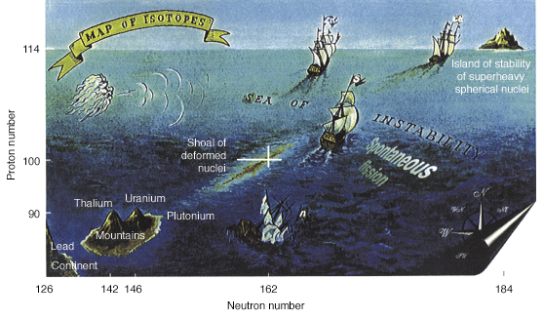
Exploring the Stability of Heavy Elements: First Measurement of the Fission Barrier of ²⁵⁴No
A. Lopez-Martens
CSNSM, IN2P3-CNRS & Université Paris Sud

Slide 2
Outline
Introduction & Motivation
Experimental Setup & Technique
Results
Conclusions & Perspectives

Slide 3
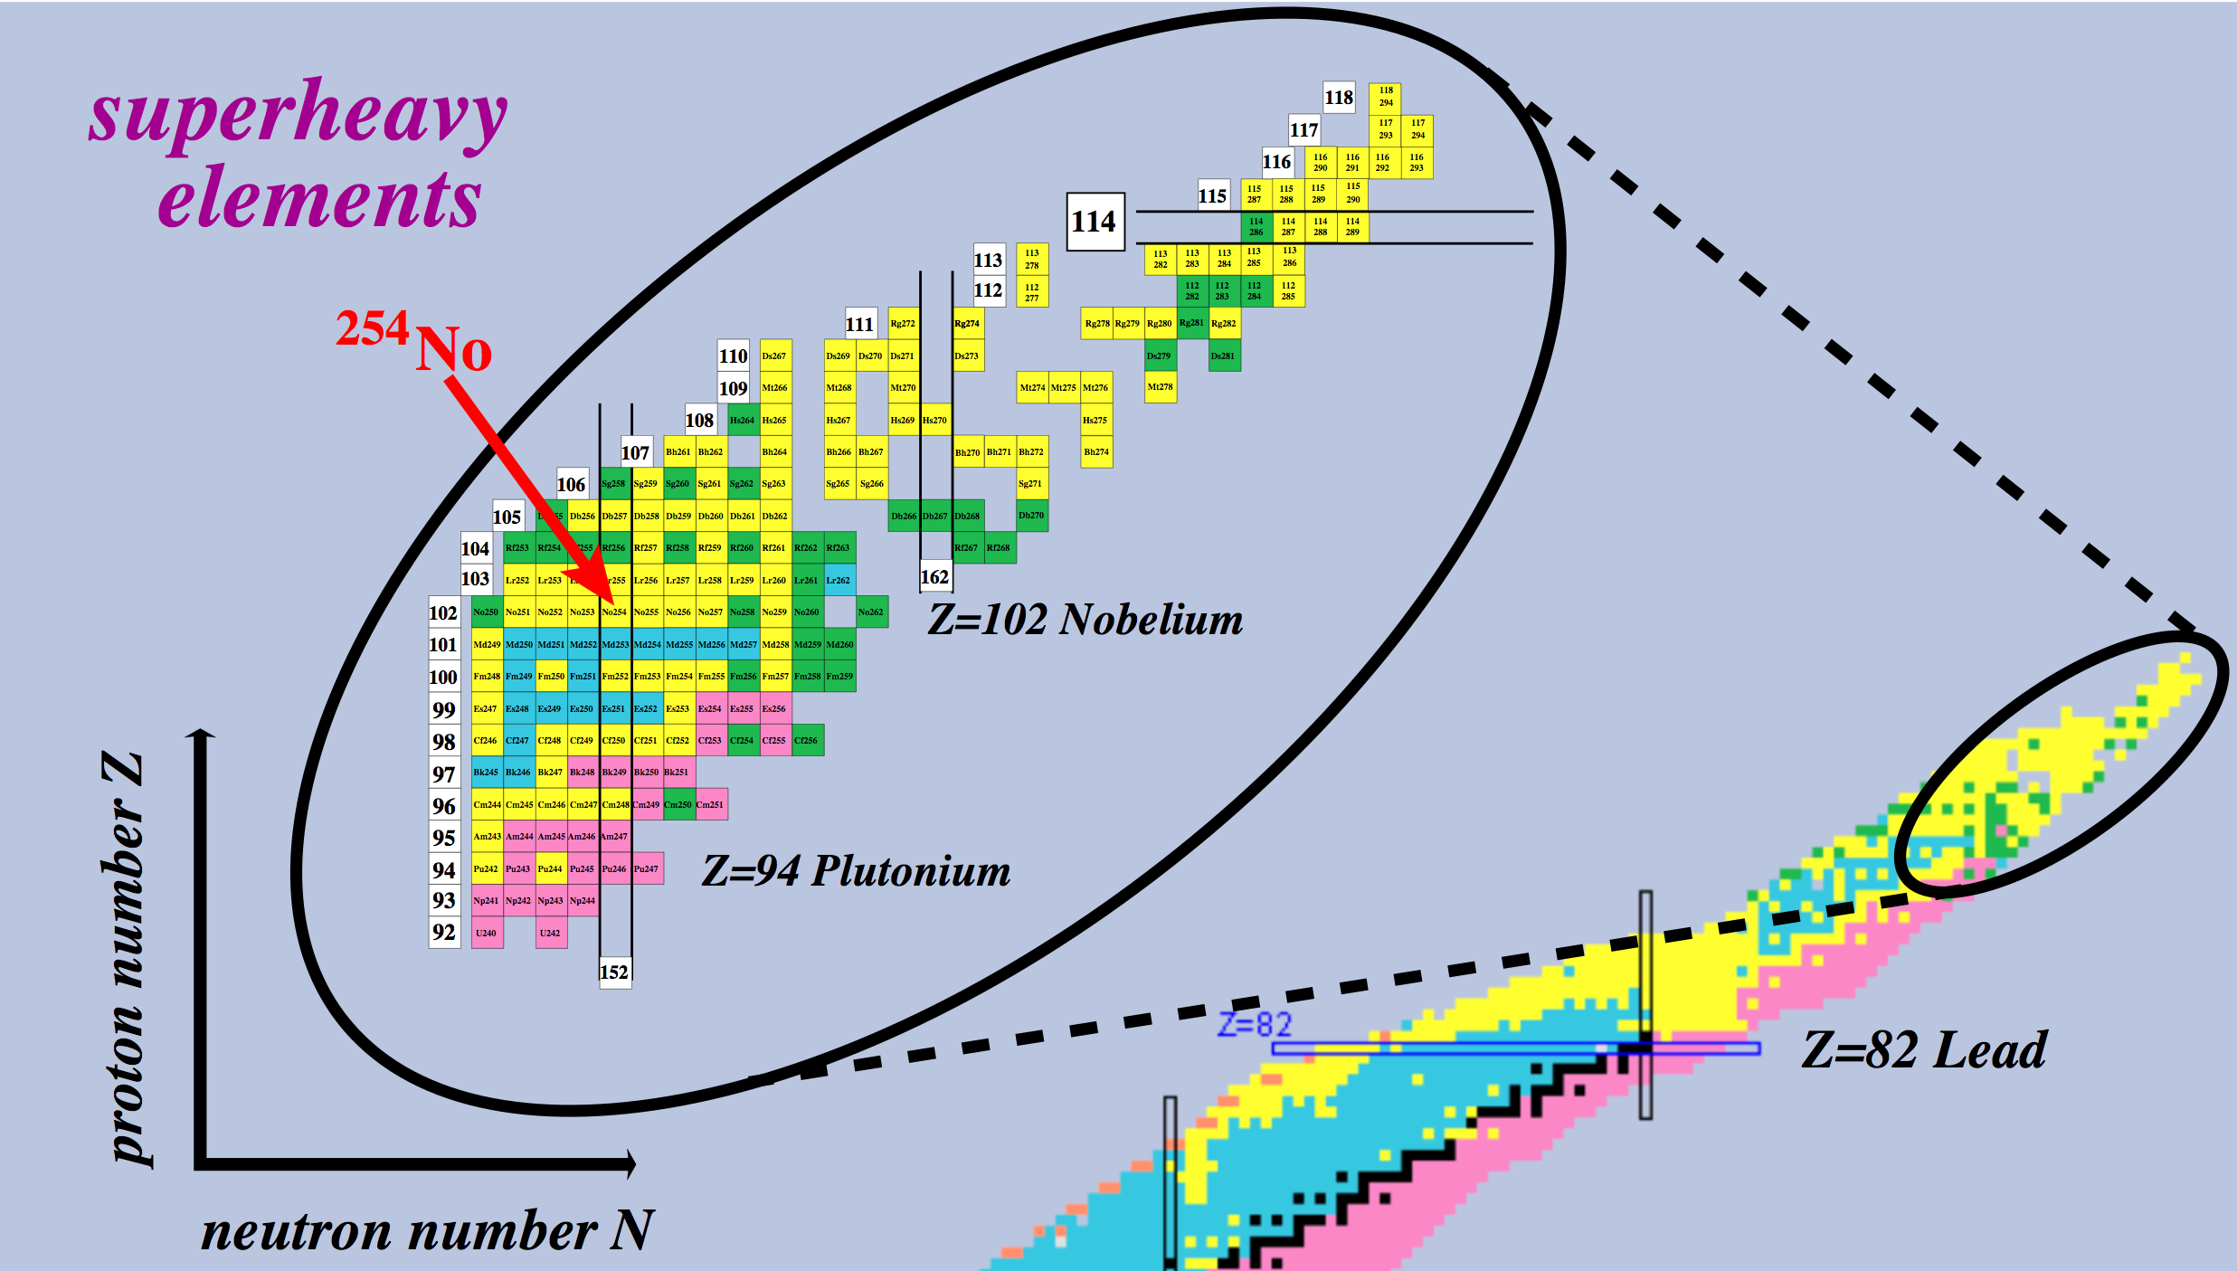
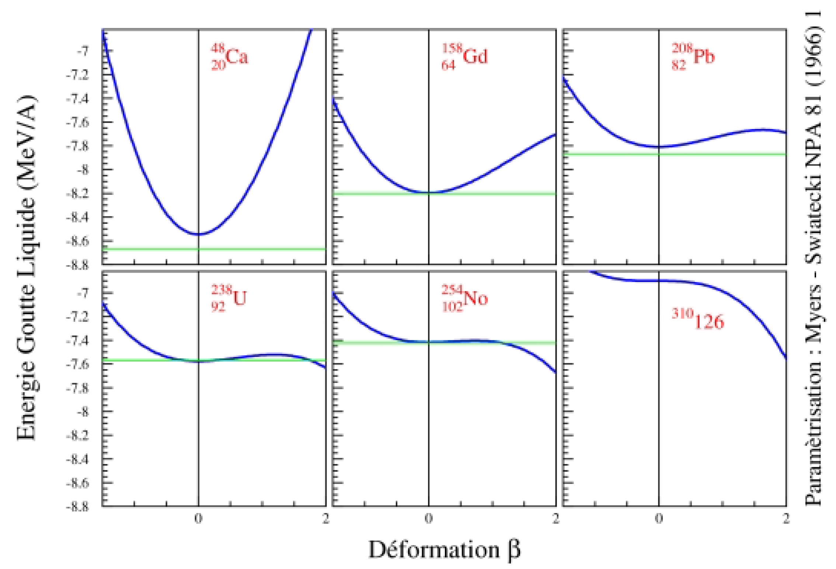
Setting the Scene
Parametrization: Myers & Swiatecki, Nucl. Phys. A 81 (1966) 1
Liquid Drop Energy (MeV/A)
Deformation

Slide 4
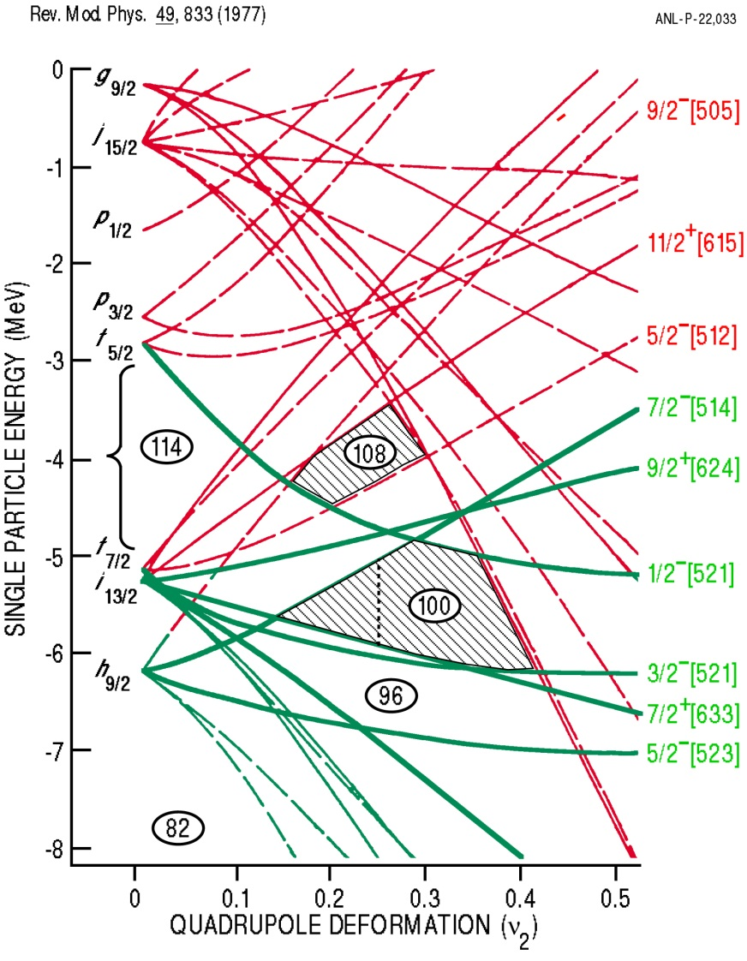
Stability of Heavy Elements
R. Chasman et al., Rev. Mod. Phys. 49, 833 (1977)
B_{f}
B_{f} = E_{saddle} - E_{gs}

Slide 5
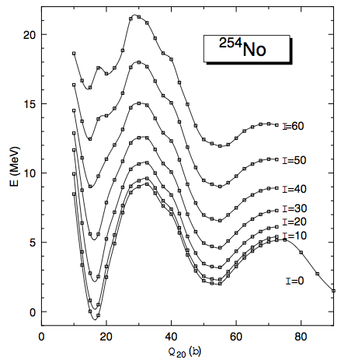
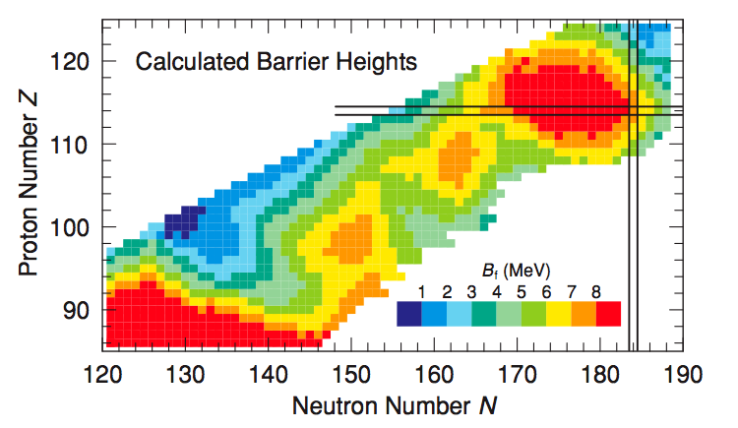
Theoretical fission barriers
J.L.Egido and L.M. Robledo Phys. Rev. Lett. 85 (2000)
P. Möller et al., Phys. Rev. C 79 (2009) 064304
²⁵⁴No; B_{f}(I=0)=6.76 MeV
B_{f}(I=0) = 8.66 MeV
ε=0.42 → β_{saddle}=0.5
Q₂₀=32.5 b→ β_{saddle} = 0.6
ℑ_{saddle} ~ 140 MeV⁻¹

Slide 6
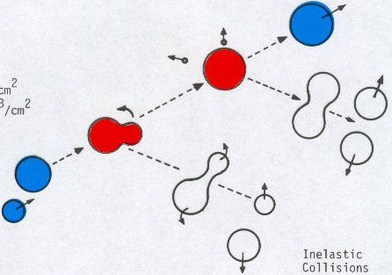
Why are high-spin properties important ?
If B_{f} were to disappear at finite spin, we would not be able to make heavy elements !
Evaporation Residue (ER)
Neutron
Compound Nucleus (CN)
Capture
Target
Fission
E, l
Projectile
Quasifission
Survival probability of the excited Compound Nucleus: Γ_{n}(l,E*), Γ_{f}(l,E*), Γ_{γ}(l,E*)

Slide 7
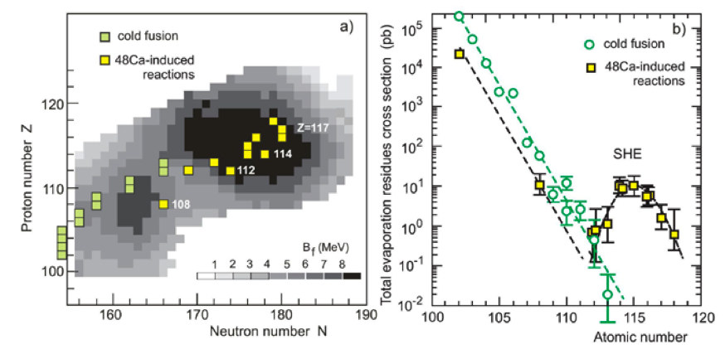
Enhanced cross sections
Y. Oganessain, Nuclear Physics News, Vol. 23 (2013)

Slide 8
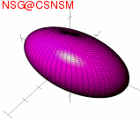
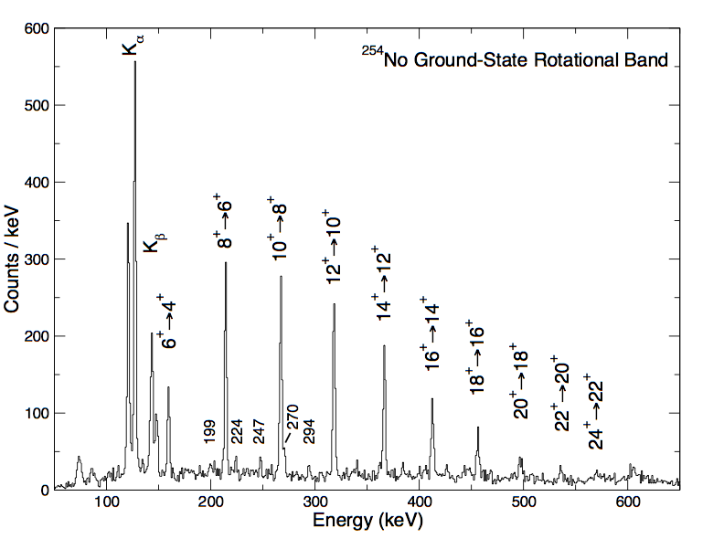
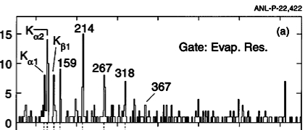
What Do We Know ?
unpublished, see also:
S.Eeckhaudt, P.T.Greenlees et al.,Eur. Phys. J. A 26 (2005) 227
P. Reiter et al., Phys. Rev. Lett. 82 (1999) 509
Discrete spectroscopy has demonstrated that heavy nuclei are very robust with respect to rotation

Slide 9
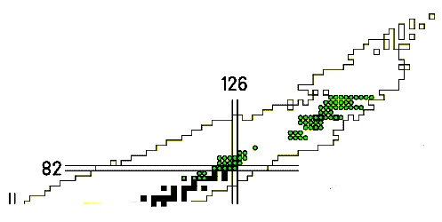
Experimental Fission Barriers
E*
Fission induced by direct reactions
Electromagnetic excitation & fission of relativistic
secondary beams
β-delayed fission
B_{f}
β
Available data on fission barriers, Z ≥ 80
(RIPL-2 library http://www-nds.iaea.org/ripl-2/ )
Unfortunately, these methods are not easily (if at all !) applicable to transfermium nuclei

Slide 10
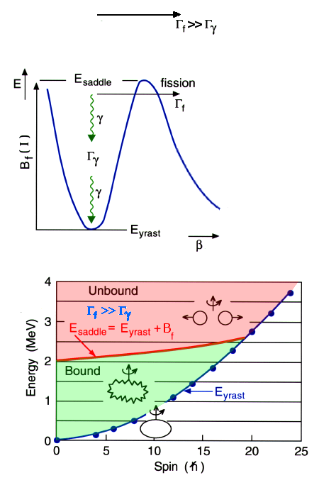
Entry-Distribution Method P. Reiter et al., Phys. Rev. Lett. 84 (2000) 3542
E_{1/2}(I)≈E_{saddle}(I)

Slide 11
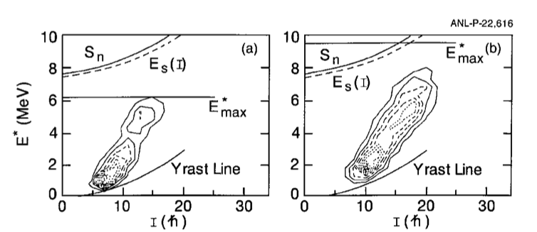
Entry Distribution Method: First Results
²⁰⁸Pb(⁴⁸Ca,2n)²⁵⁴No*
E_{beam}=215 MeV, E_{CN} ≈ 19.3 MeV
E_{beam}=219 MeV, E_{CN} ≈ 22.7 MeV
P. Reiter et al., Phys. Rev. Lett. 84 (2000) 3542
B_{f}(I=12)>5 MeV
Bulk of σ_{ER} @ high spin
Notes:
Emx= E_{CN}-Sn1-Sn2 = ECN-13.04 MeV
Sn(I) =E_{yrast}(I)+7.71 MeV

Slide 12
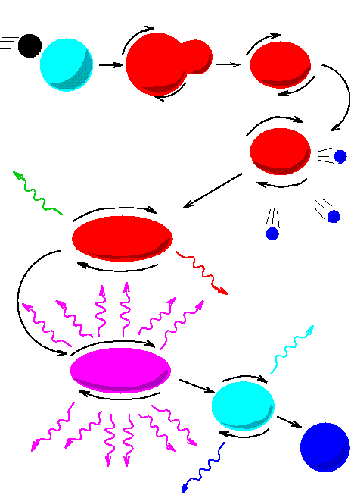
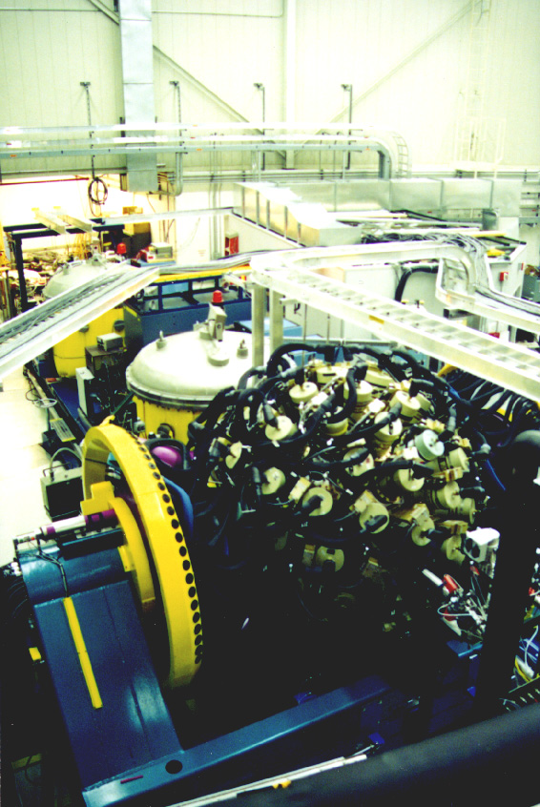
New Experiment
10 pnA ⁴⁸Ca beam, E_{beam} = 219 and 223 MeV
quasi-fission
focal plane detectors: trigger
Pb target:
0.5 mg/cm²
recoils
FMA
fission
GAMMASPHERE
ATLAS beam
photons detected by
GAMMASPHERE in
its calorimetric mode
Notes:
Q = 11+, as a 12.1 MHz (82.48 ns period) pulsed beam, 8.2 to 10.9 pnA
0.5 mg/cm thick with a 12 C front (0.04 mg/cmthick) and back (0.1 mg/cm2 thick) backing.
~15 and ~5 identified recoils/h
rotating target: The wheel was rotating at 500-600 rpm
DSSD 64x64 mm2 100 mu thick 160 strips on each side.
PPAC filled with isobutane C4H10 at 3 Torr. (9 MeV loss for a 35 MeV 254No ion).
A 0.007 mg/cmthick carbon foil was placed about 5 cm after the target for charge reset- ting. It brings the charge states back to an average Q ≈ 19 − 20 +

Slide 13
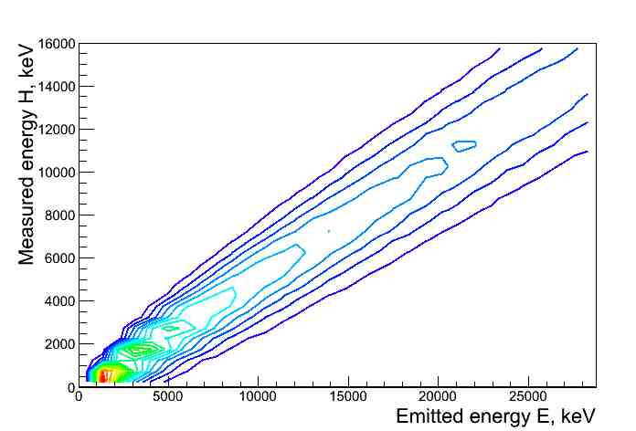
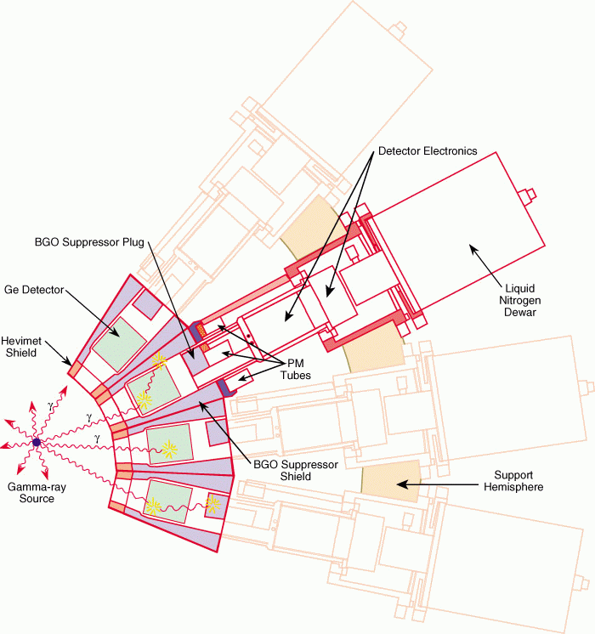
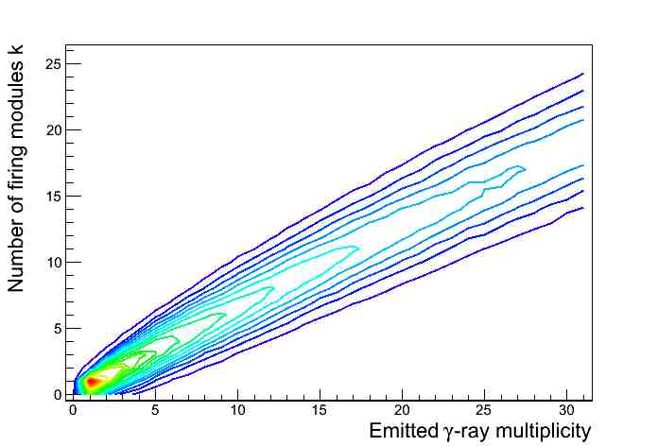
Calorimetric Measurement
ε_{gsfma250}=63%
module
probability of detecting a photon ~ 70%
ε(110 Ge)~10% ⇨ ε(110 [Ge+BGO] modules) ~78%
Measured energy
&
Number of firing detectors
Emitted energy
&
γ-ray multiplicity

Slide 14
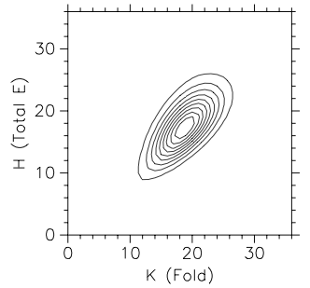
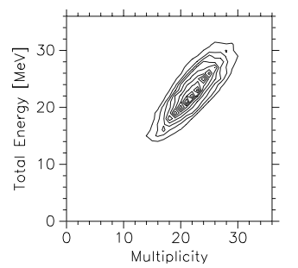
Unfolding Procedure
M. Jääskeläinen et al., Nucl. Instr. Meth. 204 (1983) 385
P. Benet, PhD thesis, Université Louis Pasteur, Strasbourg (1988)
?
Measured Energy (H)
Emitted Energy (E)
Emitted Energy (E)
Number of firing modules (k)
Emitted Multiplicity (M)
Emitted Multiplicity (M)
Transformation from (E,M) to (E*,I):
I= f(M) = ΔI × (M - N_{stat}) + ΔI_{stat} × N_{stat} + I_{ce}
E*=f(E) = E + E_{ce}
S. Eeckhaudt, P. Greenlees et al., R. Herzberg et al.,
S. Tandel et al., F. Hessberger et al., R. Clark et al.,

Slide 15
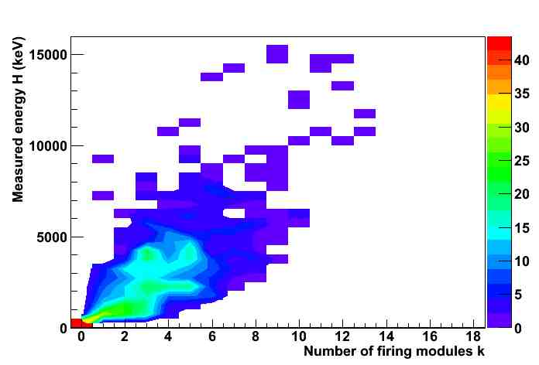
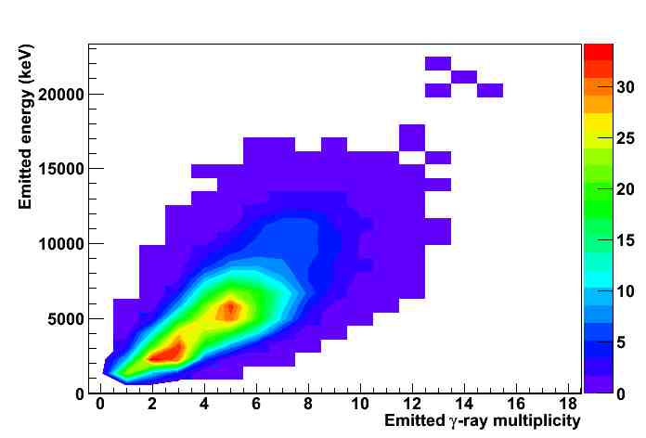
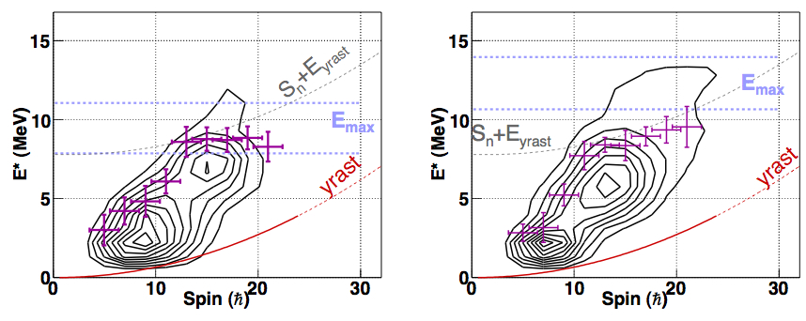
Entry distribution of ²⁵⁴No (1)
E_{beam}=219 MeV
E_{beam}=223 MeV, E_{CN}=25.4 MeV
E_{1/2}(I)

Slide 16
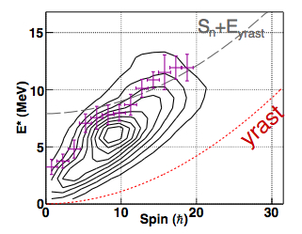
Entry Distribution of ²⁵⁴No (2)
E_{beam}=219 MeV
E_{beam}=223 MeV
E_{1/2}(I)
²²⁰Th
²⁵⁴No can sustain more E* & I at 223 MeV
no significant yield < 5
- tilted distribution
saturation in E_{1/2}

Slide 17
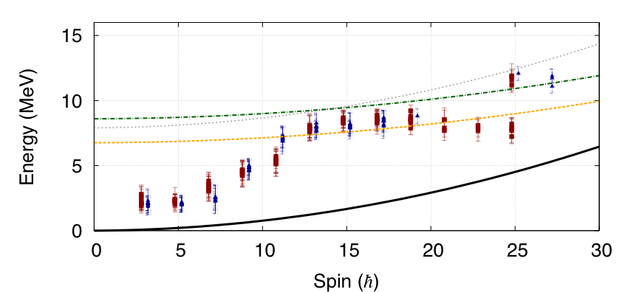
Barrier height
Egido & Robledo
Gogny HFB
E_{s}=B_{f}(0)+(1/2J_{s}) I(I+1)
J_{s}=140 MeV⁻¹
S_{n}
219 MeV
223 MeV
E_{saddle} (MeV)
Möller
FRLDM + folded Yukawa
E_{s}=B_{f}(0)+(1/2J_{s}) I(I+1)
J_{s}=140 MeV⁻¹
Fit of E_{saddle}(I) in the saturated region:
B_{f}(20)=5.4(0.5) MeV
J_{s}=125(60) MeV⁻¹
B_{f}(0)=6.6(0.9) MeV
Notes:
Crancking approx: higher order effects such as changes in the gs or saddle deformations, changes in the shell energy and pairing occur at higher ang. momenta. Evidence for that is that 254No is a good rotor up to I=20 hbar (J changes by 10% from 0 to 20).
1.6 MeV = Eshell (220Th) (exp) - macro part =FRLD
254No Eshell=3.97 MeV (Moller at. Dat. NUcl. Data Tables 1995)

Slide 18
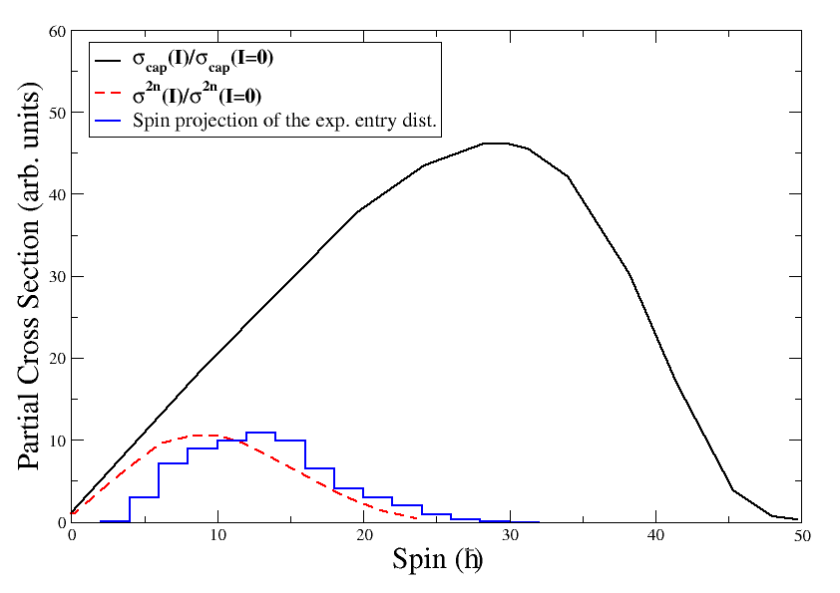
Conclusions & Perspectives
First measurement of the fission barrier in a heavy shell-stabilized element
- Probe of the reaction mechanism
theoretical curves taken from: V.I. Zagrebaev et al., Phys. Rev. C 65 (2001) 014607
depletion of low
partial waves
- Next scheduled study case: ²⁵⁵Lr (effect of the odd nucleon & K isomers)

Slide 19
Collaborators
G. Henning, T.L. Khoo, A. Lopez-Martens, D. Seweryniak, M. Alcorta,
M. Asai, B. B. Back, P. Bertone, D. Boiley, M. P. Carpenter, C. J. Chiara,
P. Chowdhury, B. Gall, P. T. Greenlees, G. Gurdal, K. Hauschild, A. Heinz, C. R. Hoffman, R. V. F. Janssens, A. V. Karpov, B. P. Kay, F. G. Kondev, S. Lakshmi, T. Lauristen, C. J. Lister, E. A. McCutchan, C. Nair, J. Piot,
D. Potterveld, P. Reiter, N. Rowley, A. M. Rogers, and S. Zhu

Slide 20
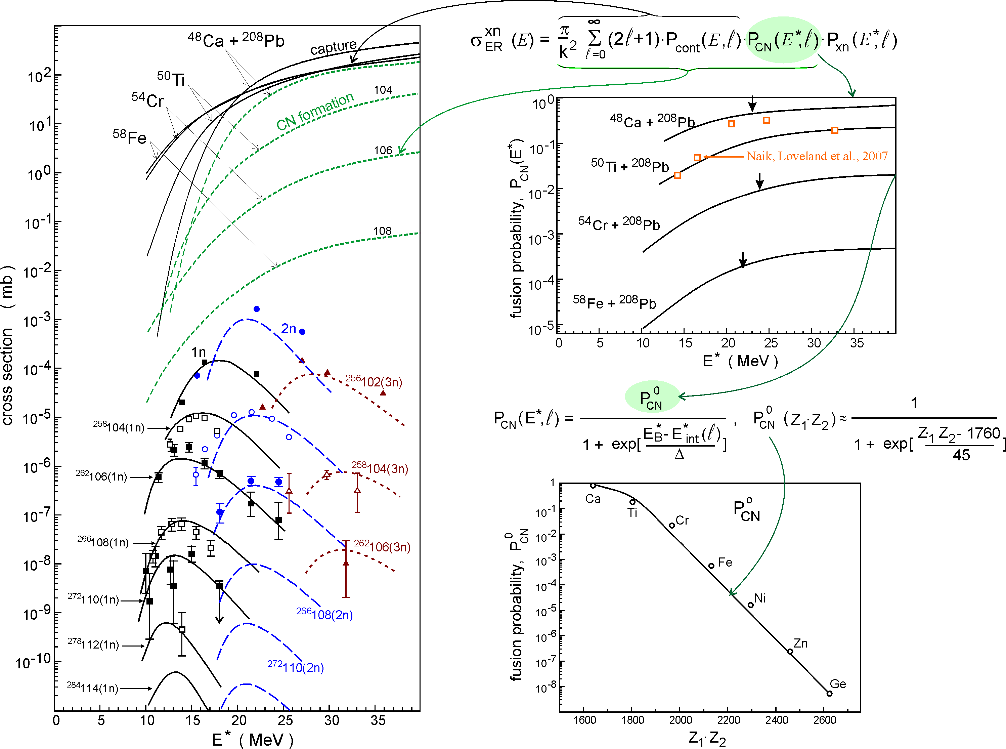
Production
taken from V.I. Zagrebaev, Fushe 2012
Notes:
for more symmetric reactions leading to heavy nuclei quasifission starts to suppress fusion at energies above the Coulomb barrier.
To reproduce excitation functions one has to introduce a fusion probability (dependence on E and fissility)

Slide 21
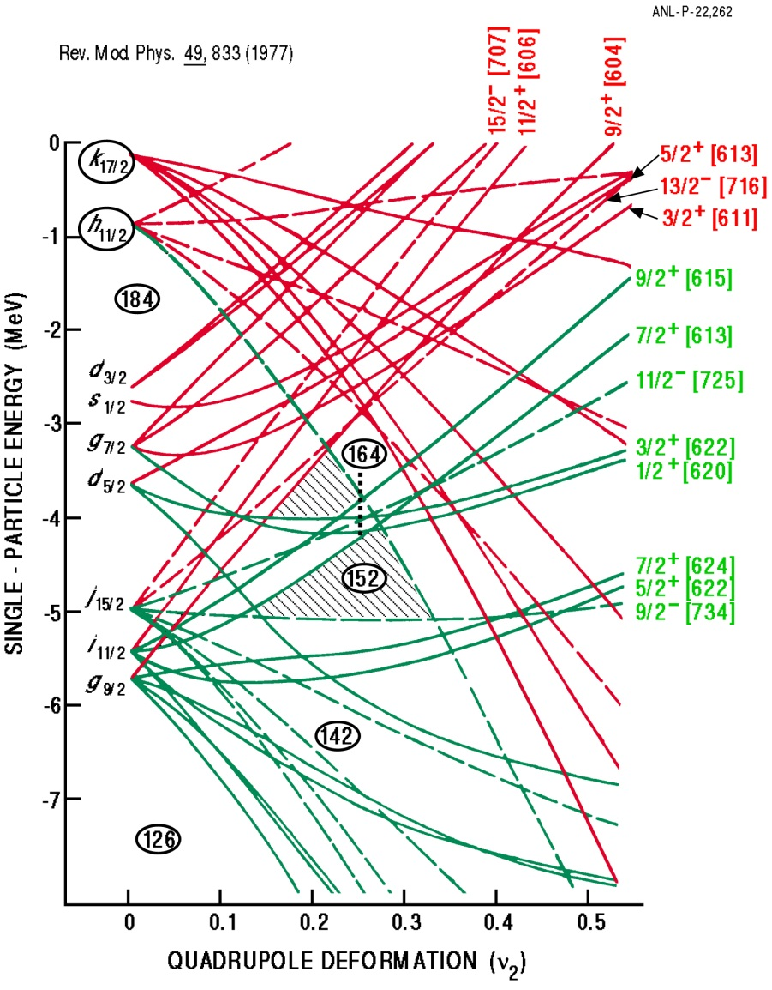
Orbitals at play
R. Chasman et al., Rev. Mod. Phys. 49, 833 (1977)

Slide 22
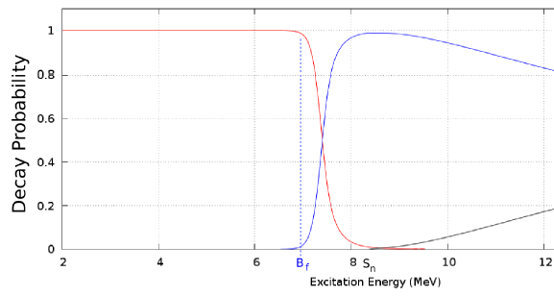
Decay widths and E_{1/2}
E*
neutron
E_{1/2}
fission
S_{n}
B_{f}
γ

Slide 23
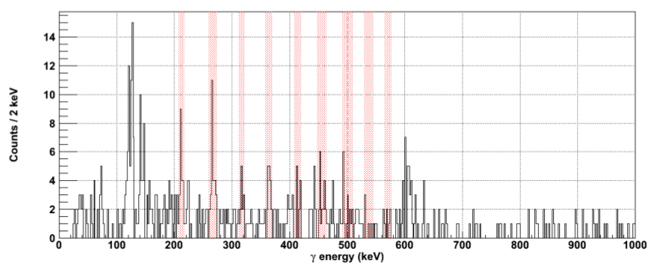
Discrete Spectroscopy
²⁵⁴No ground state rotational band (223 MeV)

Slide 24
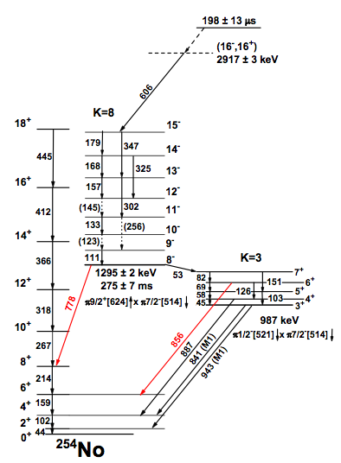
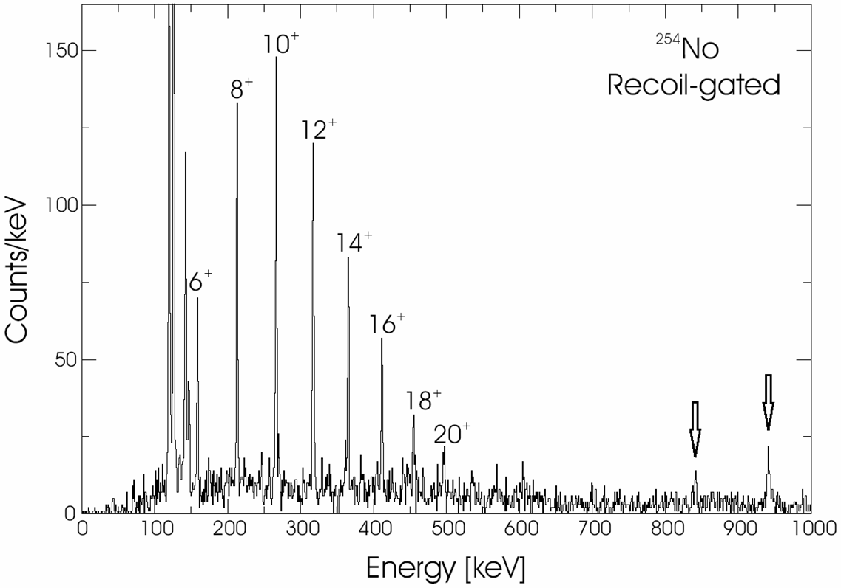
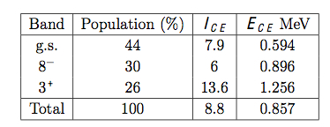
Known Level scheme of ²⁵⁴No
F. Hessberger et al., Eur. Phys. J. A (2010) 55
S. Eeckhaudt, PhD thesis and
S.Eeckhaudt, P.T.Greenlees et al.,Eur. Phys. J. A 26 (2005) 227
Notes:
842 and 943 represent 31(8) ad 86(14)% of the 8-6 transition in the band (only eff. correction).

Slide 25
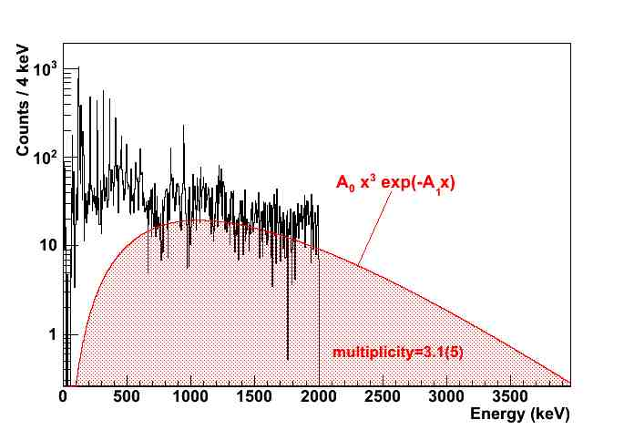
Statistical spectrum in ²⁵⁴No
unfolded, efficiency-corrected and binned Jurogam ²⁵⁴No spectrum
Notes:
152Dy/191MeV N = 3.0370 +- 0.0011
152Dy/184MeV N = 3.0510 +- 0.0024
152Dy/178MeV N = 3.0510 +- 0.0024124
Xe N = 3.0044 +- 0.0022
192Hg N = 3.1256 +- 0.0011
194 Hg N = 2.9691 +- 0.0015
174Hf 4.26 -> but “n=3” fit to spectrum yields nstat=3 (upper bound 4.3 which probably includes non statisticals as in 254No)

Slide 26
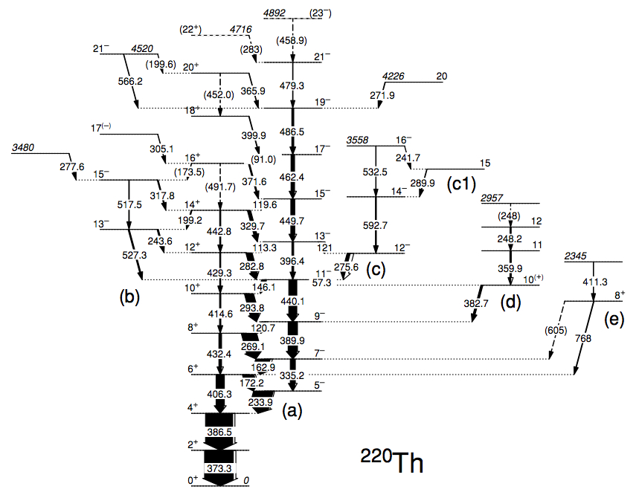
Known Level Scheme in ²²⁰Th
ΔI = 1.5
N_{stat}=4
ΔI_{stat}=0.25
I_{CE}=0.7
E_{CE}=110 keV
W. Reviol et al., Phys. Rev. C 74, 044305 (2006)

Slide 27
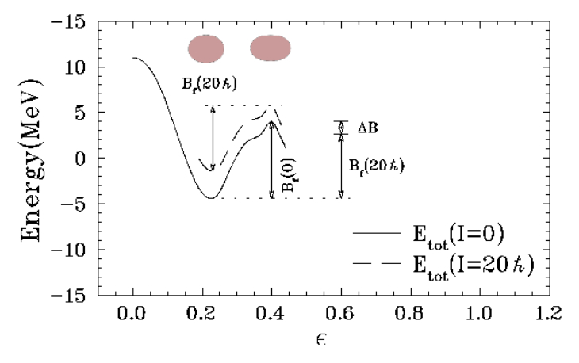
Survival of heavy nuclei at high spin
L.G. Moretto et al., Comment to P. Reiter et al., Phys. Rev. Lett. 84 (2000) 3542
B_{f}(I)-B_{f}(0) =ΔB= E_{gs}(I) x Δℑ/ℑ_{saddle}
small since the gs of
transfermium nuclei
is already deformed
Notes:
in lighter nuclei the saddle is controlled by the liquid drop and occurs at large def.
In transfermium the saddle occurs at only sllightly grater def. than the gs (due to the anti-shell immediately following the deformed minimum).

Slide 28
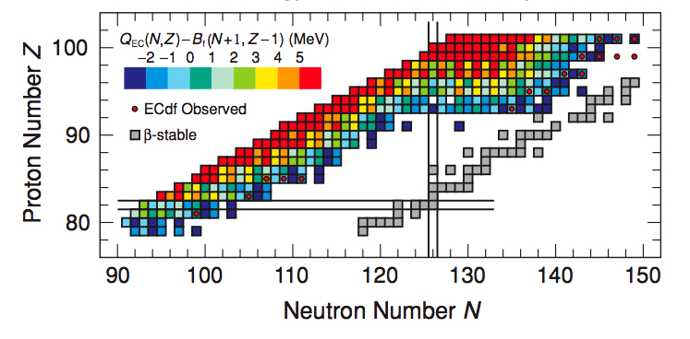
Calculated energy window for EC-delayed fission
P. Möller et al., Phys. Rev. C 79 (2009) 064304

Slide 29
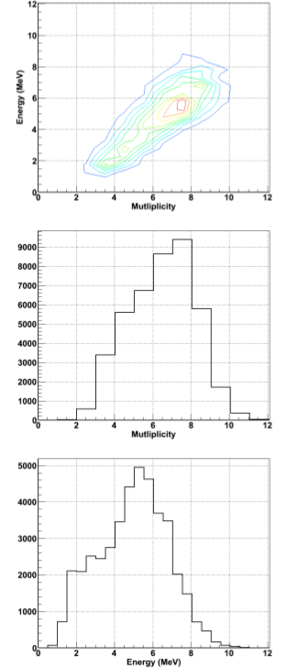
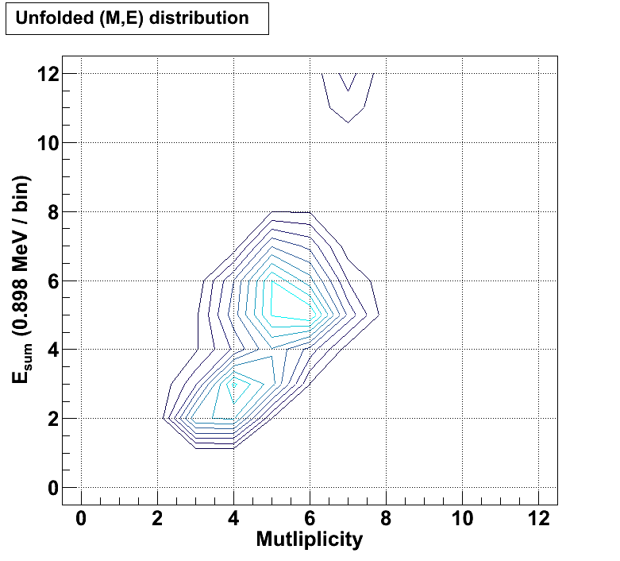
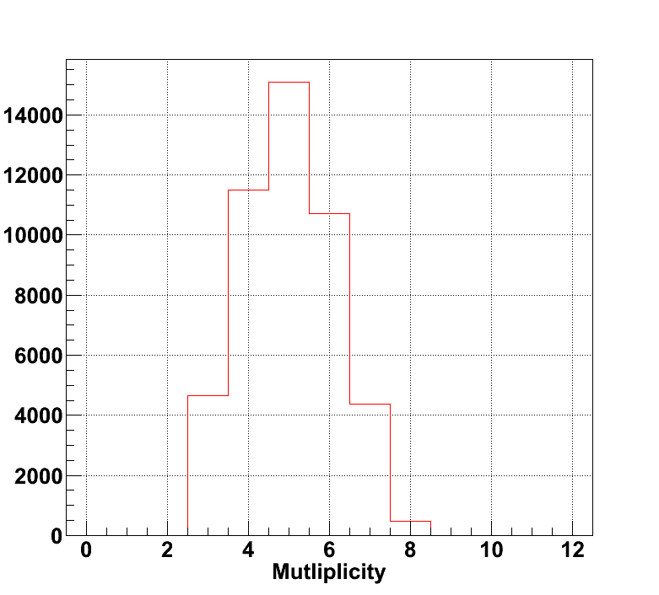
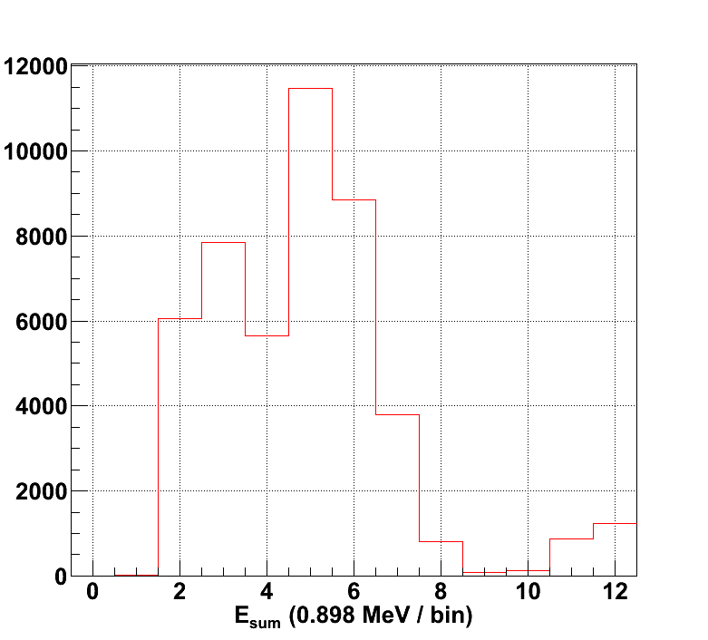
Comparison gsfma55/gsfma250

Slide 30
Single particle states - how well do models do ?
I. Ahmad et al., Phys. Rev. C 71 (2005) 054305
D. Seweryniak et al., Nucl. Phys. A 834 (2010) 357c

