Slide 1
^{2,3}H(⁶⁶Ni,^{67,68}Ni)¹H transfer reaction using T-REX and MINIBALL
Jytte Elseviers
And the ISOLDE collaboration

Slide 2
Outline Motivation Experimental Setup Preliminary Results: ⁶⁷Ni,⁶⁸Ni Conclusion & Outlook
Outline
Motivation
Why ⁶⁸Ni?
Experimental Setup
Results
Proton-gamma coincidences
Excitation energy spectrum
Conclusion & Outlook

Slide 3
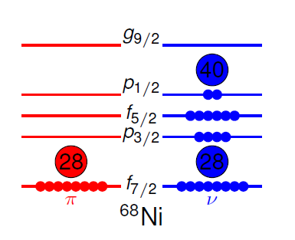
Outline Motivation Experimental Setup Preliminary Results: ⁶⁷Ni,⁶⁸Ni Conclusion & Outlook
Motivation
⁶⁸Zn
⁶⁹Zn
⁷⁰Zn
⁷¹Zn
⁷²Zn
⁷³Zn
40
⁶⁵Cu
⁶⁶Cu
⁶⁷Cu
⁶⁸Cu
⁶⁹Cu
⁷⁰Cu
⁷¹Cu
⁷²Cu
Z = 28
⁶⁴Ni
⁶⁵Ni
⁶⁶Ni
⁶⁷Ni
⁶⁸Ni
⁶⁹Ni
⁷⁰Ni
⁷¹Ni
⁶³Co
⁶⁴Co
⁶⁵Co
⁶⁶Co
⁶⁷Co
⁶⁸Co
⁶⁹Co
⁷⁰Co
28
N = 40
g_{9/2}
⁶⁸Ni: shell closure at Z = 28, subshell closure at N = 40
Doubly magic?
Contradictory results
Evolution of single-particle strength around Z=28
Notes:
Properties that are typical for a doubly magic nucleus
high excitation energy and low B(E2: 2⁺-0⁺) for the first excited 2⁺ state
0⁺ level as first excited state ^{[4]}
properties of its neighboring nuclei that can be described as particles/holes coupled to a ⁶⁸Ni core
However
magic properties arise due to the fact that N = 40 separates the positive parity g_{9/2} orbital from the negative parity pf shell
recent mass measurements have not revealed a clear shell gap
Specific role of the N = 40 (and Z = 28) not yet understood

Slide 4
Outline Motivation Experimental Setup Preliminary Results: ⁶⁷Ni,⁶⁸Ni Conclusion & Outlook
Motivation
²H(⁶⁶Ni,⁶⁷Ni)¹H and ³H(⁶⁶Ni,⁶⁸Ni)¹H
Q = 3.58 MeV Q = 5.12 MeV
2155
815
(5/2⁻)
2155
5⁻
2849 0.86ms
2743
2⁺
709
2743
2512 E0
1724
478
1724
0⁺
2512
313
2033
9/2⁺
1007 12.6 μs
2⁺
1770 E0
2033
5/2⁻
694
0⁺
1770 276ns
694
0⁺
0
1/2⁻
0
⁶⁸Ni
⁶⁷Ni
Main aim of experiment:
Study the ground state structure (⁶⁸Ni x ν⁻¹)
Determination of spin and parity of excited states
Identification of d_{5/2} positive parity states (across N=50)
Main aim of experiment:
Identify the 0⁺ states
Confirm the proposed 0⁺ assignment for 2512keV
Disentangle the structure and mixing of the 0⁺ states
Notes:
Through the experimental study of the single-particle character of the ground and first excited states of 67Ni, by means of 2H(66Ni,p)67Ni reactio,n, we will be able to verify wether we can state that 67Ni can be considered as a dominant 68Ni core plus one neutron hole. And it will give some indictation of the degree to which N=40 can be considered as a proper subshell closure.

Slide 5
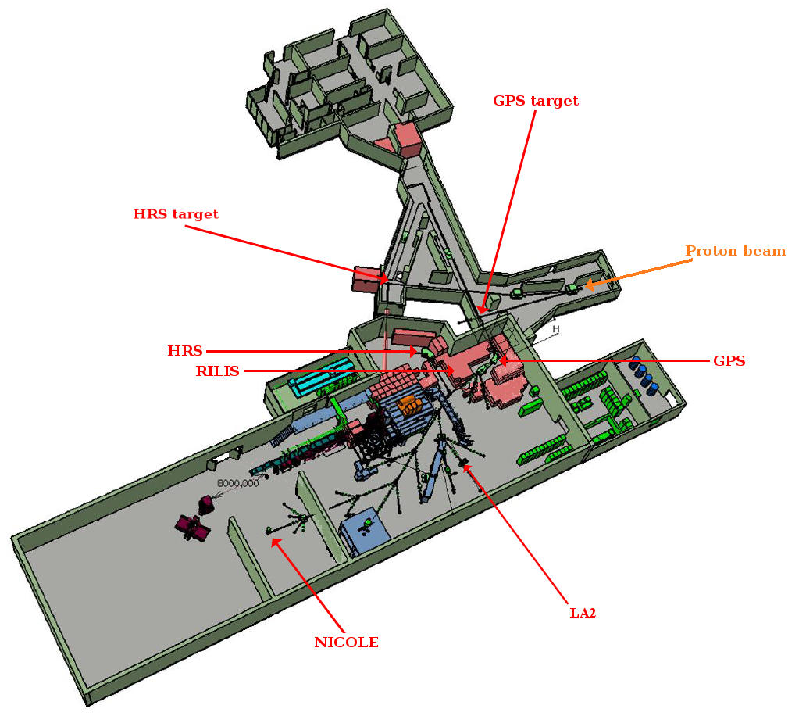
Outline Motivation Experimental Setup Preliminary Results: ⁶⁷Ni,⁶⁸Ni Conclusion & Outlook
Experimental Setup
ISOLDE, CERN
Post acceleration by REX
Detection of particles: T-REX
Detection of γ rays: MINIBALL
²H(⁶⁶Ni,⁶⁷Ni)¹H: ³H(⁶⁶Ni,⁶⁸Ni)¹H:
- 2.85 MeV/u - 2.6 MeV/u
- ∼3.0 x 10⁶ pps - ∼2.0 x 10⁶ pps
- Beam purity >99% - Beam purity >95%
- 100 μg/cm² CD₂ target - 500 μg/cm² ³H loaded Ti target
- Measurement time: ∼130h - Measurement time: ∼ 100h

Slide 6
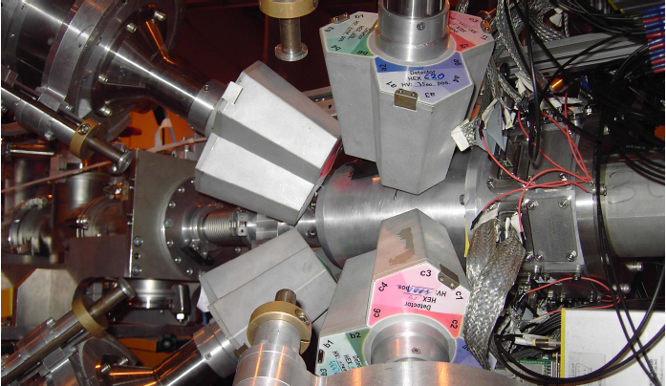
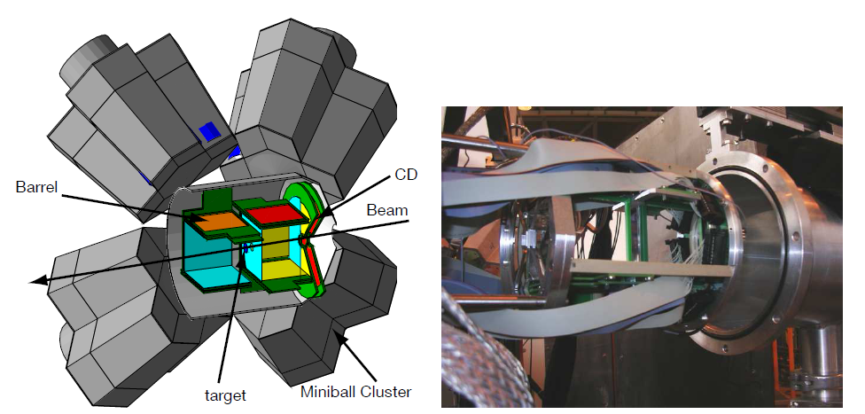
Outline Motivation Experimental Setup Preliminary Results: ⁶⁷Ni,⁶⁸Ni Conclusion & Outlook
Experimental Setup
8 ΔE-E_{rest} barrel detectors (ΔE: 16 resistive strips)
2 ΔE-E_{rest} CD detectors (ΔE: 16 radial and 24 annular strips)
covered θ_{lab} range: 8° to 28° (Fw CD), 28° to 78° and 102 to 152° (Barrel) and 152 to 172° (Bw CD)
8 Miniball clusters
Each cluster: 3HPGe crystal
Each crystal: 6-fold segmented
6% efficiency at 1MeV

Slide 7
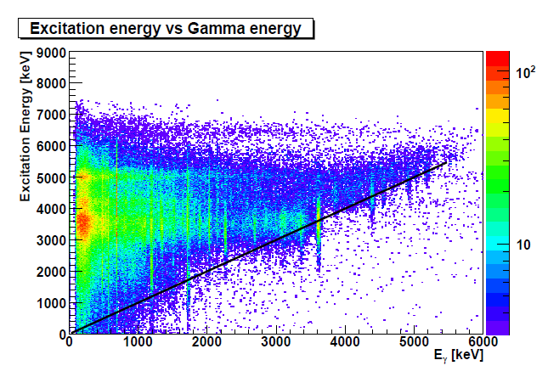
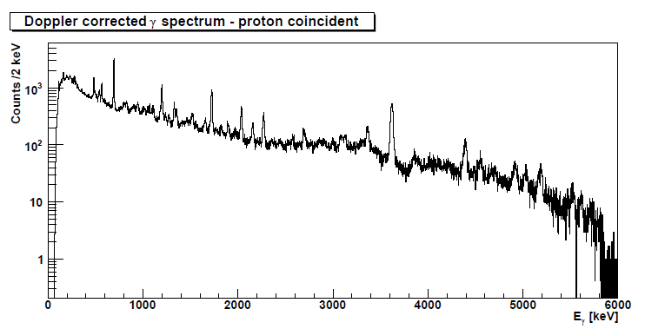
Outline Motivation Experimental Setup Preliminary Results: ⁶⁷Ni,⁶⁸Ni Conclusion & Outlook
Preliminary Results: ⁶⁷Ni
Proton-Gamma Coincidences
Very rich proton-gated γ spectrum
Possibilities for p-γ-γ coincidences
Notes:
Eerst eexcvsgamma tonen en zeggen dat er veel grondtoestand transities zijn. Dan projectie maken en p-g tonen

Slide 8
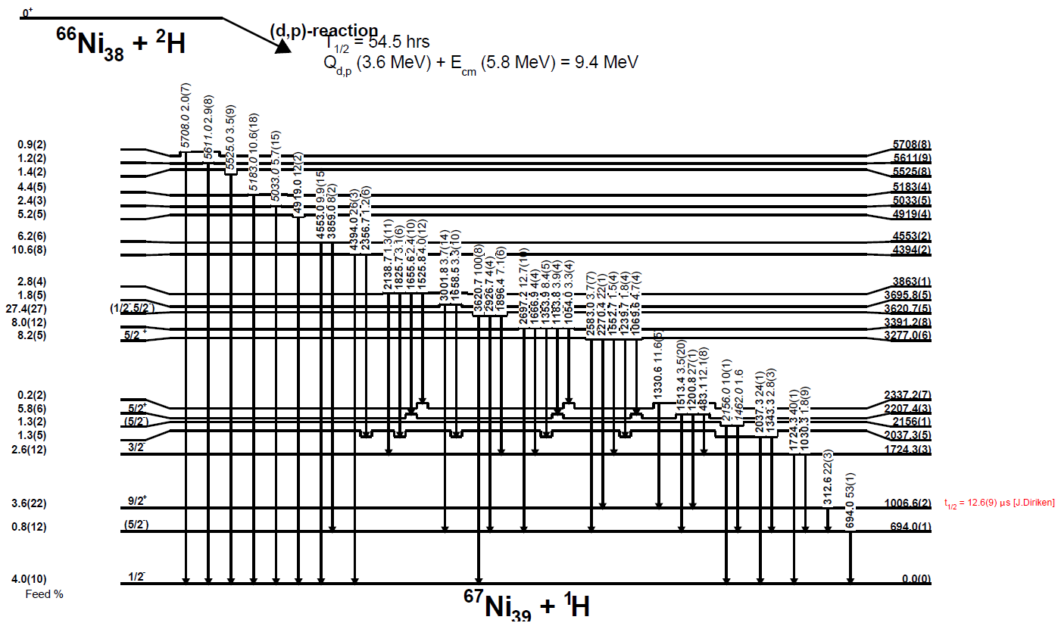
Outline Motivation Experimental Setup Preliminary Results: ⁶⁷Ni,⁶⁸Ni Conclusion & Outlook
Preliminary Results: ⁶⁷Ni
Level scheme
Notes:
Important result: identification of 5/2+ and 5/2+ (neutron excitations above the N=50 shell gap, d5/2 )

Slide 9
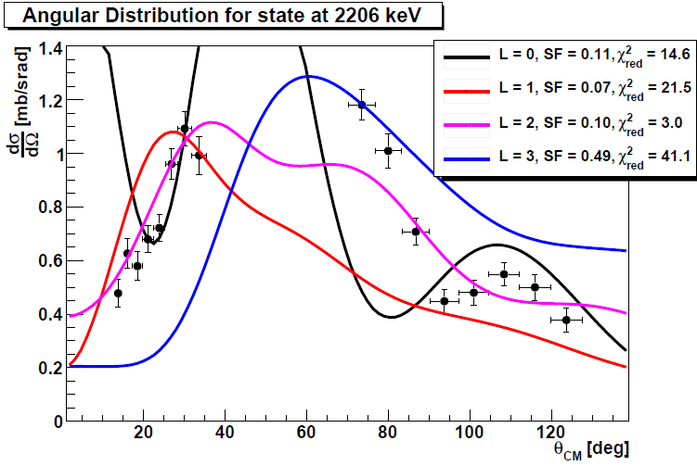
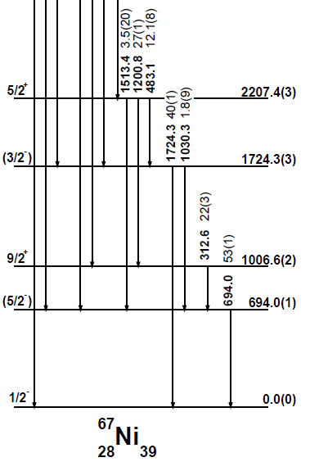
Outline Motivation Experimental Setup Preliminary Results: ⁶⁷Ni,⁶⁸Ni Conclusion & Outlook
Preliminary Results: ⁶⁷Ni
Level scheme
Gamma ray spectroscopy
Proton spectra
Combination of excitation energy and gamma ray spectroscopy
Angular distribution constructed by also gating on gamma rays
Notes:
L = 2 duidelijkst, l=0 en l =3 kan op lage hoeken uitgeschakeld worden. L=2 duidelijkst door X². Because of L=2, we expect d3/2 or d5/2 (3/2+ or 5/2+)
Verder belangrijk in niveauschema, we see a lot of ground state transitions, but the level at 2.207MeV does not decay to ground state, thus it cannot be a 3/2+. Further, the strongest transition goes to 9/2+ (E2).

Slide 10
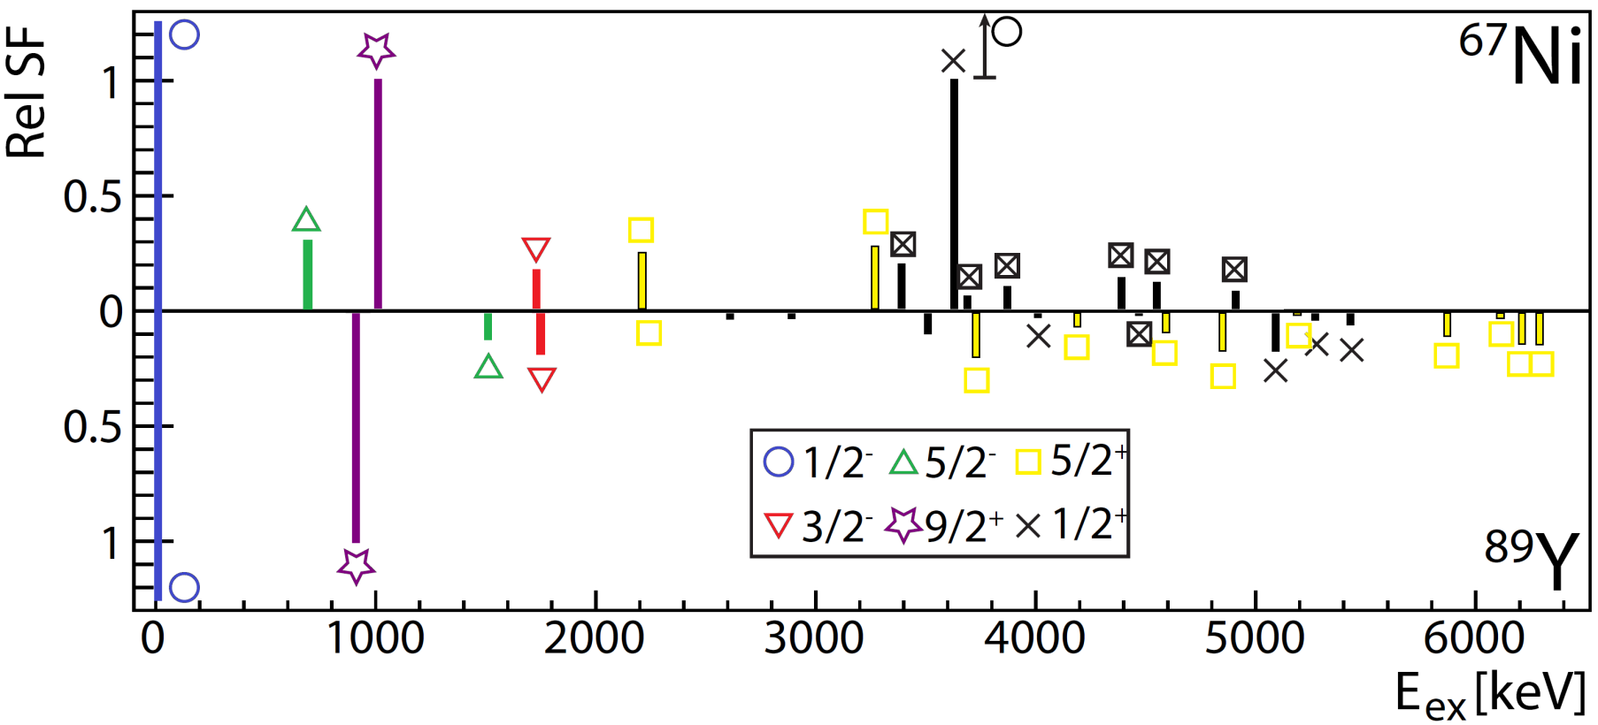
Outline Motivation Experimental Setup Preliminary Results: ⁶⁷Ni,⁶⁸Ni Conclusion & Outlook
Preliminary Results: ⁶⁷Ni
Comparison with ⁸⁹Y (Z=39, N=50): ⁸⁸Sr(³He,d)⁸⁹Y [1]
Spectroscopic factors relative to g_{9/2}
Z = 50 shell gap is more pronounced and stronger in the ⁹⁰Zr mass region (compared to N = 50 in the ⁶⁸Ni region)
[1] G. Vourvopoulos et al., Nucl. Phys. A 174, 581 (1971)

Slide 11
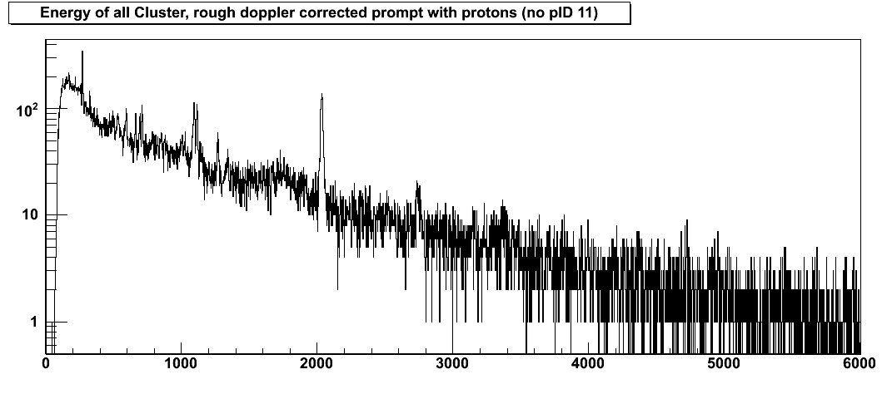
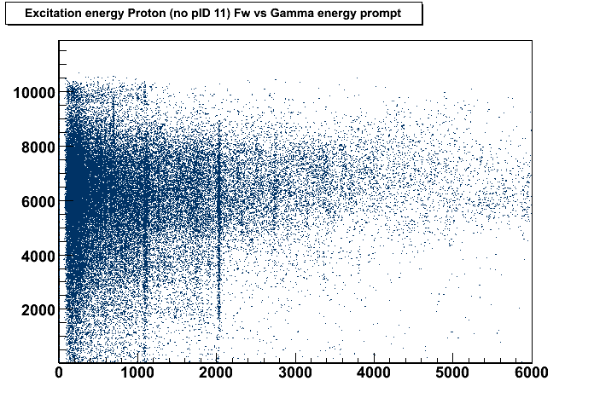
Outline Motivation Experimental Setup Preliminary Results: ⁶⁷Ni,⁶⁸Ni Conclusion & Outlook
Preliminary Results: ⁶⁸Ni
1115
3149
(4⁺)
272
(4⁻)
3121
Proton-Gamma Coincidences
815
5⁻
2743
2849 0.86ms
Counts/2keV
709
2⁺
2512 E0
2743
478
4₁⁺ → 2₁⁺ 1115keV
0⁺
2512
2₁⁺ → 0₁⁺ 2033keV
2033
2⁺
2033
1770 E0
0⁺
1770 276ns
0⁺
0
⁶⁸Ni
E_{γ} [keV]
No possibilities for p-γ-γ coincidences
Limited number of ground state gamma rays
Most of the feeding to states between 5-9 MeV
Excitation Energy [keV]
background
E_{γ} [keV]
Notes:
Belangrijk om te zeggen, veel minder grondtoestand transities. Enkel 2.034MeV.

Slide 12
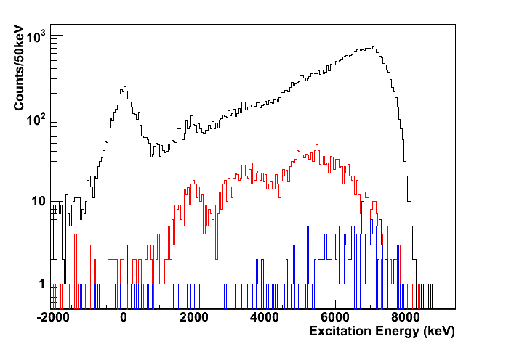
Outline Motivation Experimental Setup Preliminary Results: ⁶⁷Ni,⁶⁸Ni Conclusion & Outlook
Preliminary Results: ⁶⁸Ni
815
5⁻
2849 0.86ms
2743
2⁺
709
2743
2512 E0
Excitation Energy Spectrum
478
0⁺
2512
Backward direction (90°-180°)
2033
2⁺
1770 E0
2033
0⁺
1770 276ns
0⁺
0
⁶⁸Ni
Strong population of ground state
Direct population of 2₁⁺ state at 2033 keV
Black: protons
Red: prompt proton gamma coincidences
Blue: random proton gamma coincidences
Notes:
Nadruk leggen op populatie naar grond toestand, geen 02+, wel 21+

Slide 13
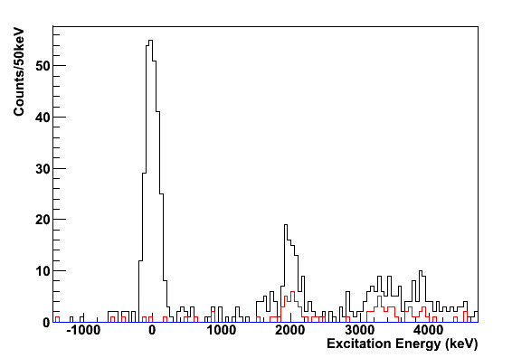
Outline Motivation Experimental Setup Preliminary Results: ⁶⁷Ni,⁶⁸Ni Conclusion & Outlook
Preliminary Results: ⁶⁸Ni
815
5⁻
2849 0.86ms
2743
2⁺
709
2743
2512 E0
Excitation Energy Spectrum of CD Detector
478
0⁺
2512
2033
2⁺
1770 E0
2033
0₁⁺
0⁺
1770 276ns
0⁺
0
⁶⁸Ni
2₁⁺
Direct population of 2₁⁺ state = 30(3)%
0₂⁺ at 1662(41)keV
Direct population of 0₂⁺ state = 5(1)%
(relative to 100% gs feeding)
0₂⁺
Black: protons
Red: prompt proton gamma coincidences
Blue: random proton gamma coincidences
Notes:
02+ not coincident with gamma rays

Slide 14
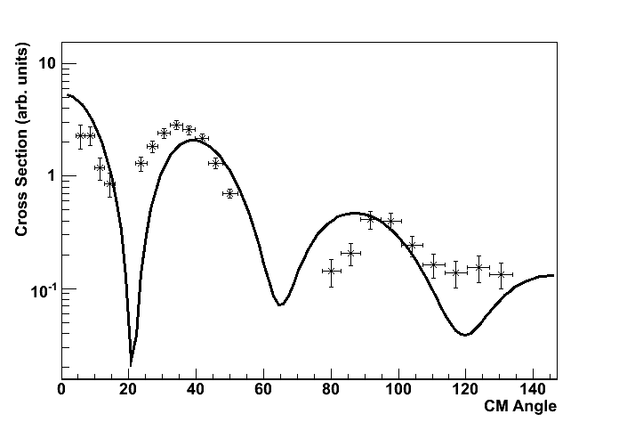
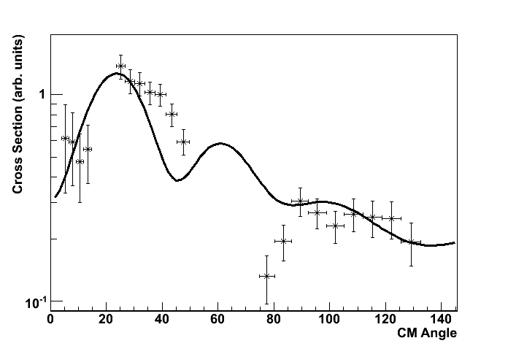
Outline Motivation Experimental Setup Preliminary Results: ⁶⁷Ni,⁶⁸Ni Conclusion & Outlook
Preliminary Results: ⁶⁸Ni
815
5⁻
2849 0.86ms
2743
2⁺
709
2743
2512 E0
Angular Distributions:
First attempts with FRESCO
478
0⁺
2512
2033
2⁺
1770 E0
2033
0⁺
1770 276ns
Ground state
0⁺
0
L = 0
⁶⁸Ni
2⁺ state at 2033keV
L = 2

Slide 15
Outline Motivation Experimental Setup Preliminary Results: ⁶⁷Ni,⁶⁸Ni Conclusion & Outlook
Conclusion & Outlook
Conclusion
Information from proton-gamma coincidences and angular distributions
²H(⁶⁶Ni,p)⁶⁷Ni
d_{5/2} states are identified
relative to the g_{9/2} strength, about 50% of the d_{5/2} single-particle strength observed at two ‘low’ energy levels
different from the ⁹⁰Zr (Z=40) region
³H(⁶⁶Ni,p)⁶⁸Ni
strong population of ground state
feeding to the 2₁⁺ state observed
very weak population of 0₂⁺ state
Outlook
New transfer experiments with higher energy at HIE-ISOLDE

Slide 16
Outline Motivation Experimental Setup Preliminary Results: ⁶⁷Ni,⁶⁸Ni Conclusion & Outlook
Conclusion & Outlook
Thank you for your attention!

Slide 17
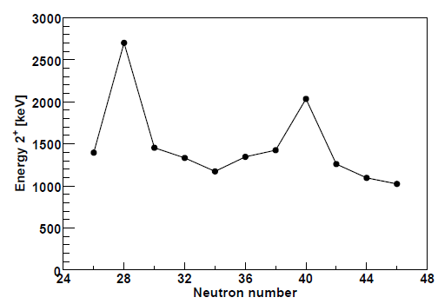
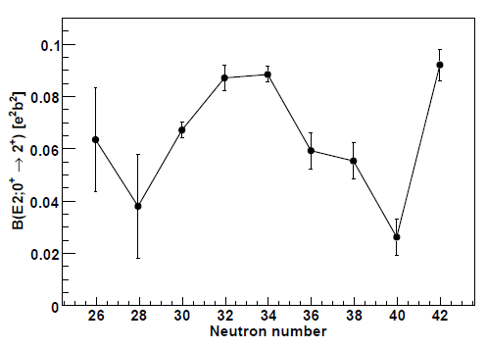
Outline Motivation Experimental Setup Preliminary Results: ⁶⁷Ni,⁶⁸Ni Conclusion & Outlook
Motivation
[1]
[2,3]
Properties that are typical for a doubly magic nucleus
high excitation energy and low B(E2: 2⁺-0⁺) for the first excited 2⁺ state
0⁺ level as first excited state ^{[4]}
properties of its neighboring nuclei that can be described as particles/holes coupled to a ⁶⁸Ni core
[1] R. Broda et al., PRL74, 868(1995), [2] O. Sorlin et al., PRL88, 092501(2002), [3] N. Bree et al., PRC78, 047301(2008), [4] M. Bernas et al., PLB113, 279(1982).

Slide 18
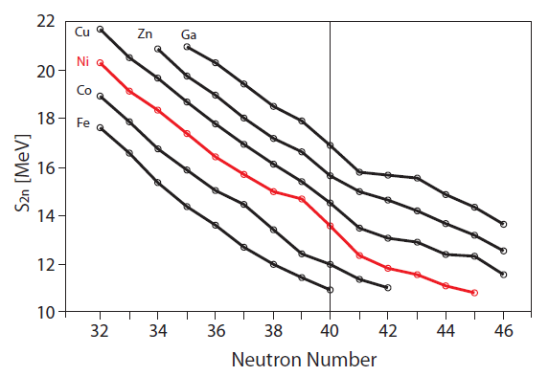
Outline Motivation Experimental Setup Preliminary Results: ⁶⁷Ni,⁶⁸Ni Conclusion & Outlook
Motivation
[1]
40
28
However
magic properties arise due to the fact that N = 40 separates the positive parity g_{9/2} orbital from the negative parity pf shell
recent mass measurements have not revealed a clear shell gap
Specific role of the N = 40 (and Z = 28) not yet understood
[1] S. Ramahan et al., EPJA34, 5(2007)

Slide 19
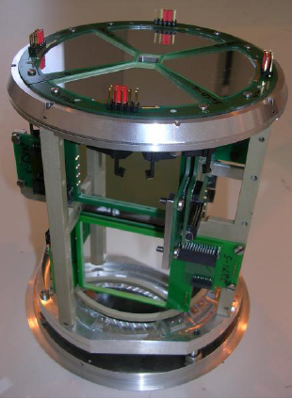
Outline Motivation Experimental Setup Preliminary Results: ⁶⁷Ni,⁶⁸Ni Conclusion & Outlook
Experimental Setup
T-REX
[1]
8 ΔE-E_{rest} barrel detectors (ΔE: 16 resistive strips)
2 ΔE-E_{rest} CD detectors (ΔE: 16 radial and 24 annular strips)
covered θ_{lab} range: 8° to 28° (Fw CD), 28° to 78° and 102 to 152° (Barrel) and 152 to 172° (Bw CD)
Target: Tritium loaded Titanium (40μg/cm² ³H)
- Radioactive target and radioactive beam
- Target ladder put at +2000V to avoid e- on Si detectors
[1] V. Bildstein et al., Eur. Phys. J A 48, 85(2012)

Slide 20
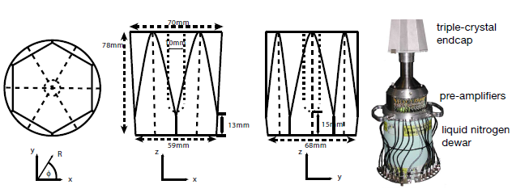
Outline Motivation Experimental Setup Preliminary Results: ⁶⁷Ni,⁶⁸Ni Conclusion & Outlook
Experimental Setup
MINIBALL
8 Miniball clusters
Each cluster: 3HPGe crystal
Each crystal: 6-fold segmented
6% efficiency at 1MeV

Slide 21
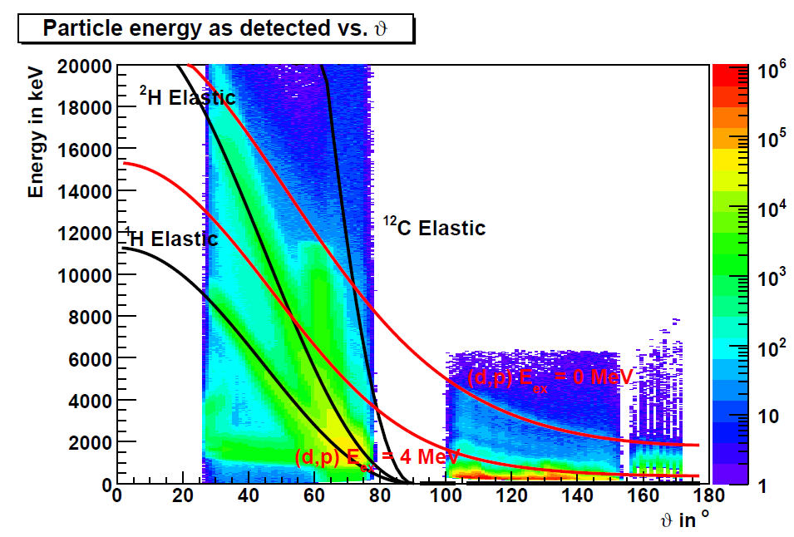
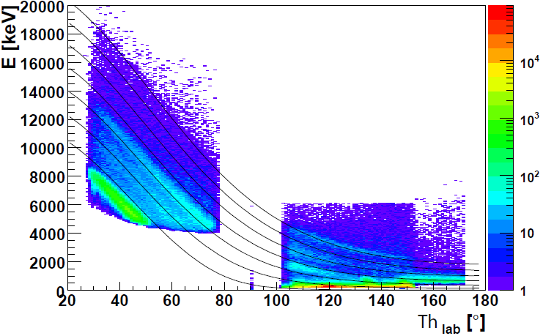
Outline Motivation Experimental Setup Preliminary Results: ⁶⁷Ni,⁶⁸Ni Conclusion & Outlook
Preliminary Results: ⁶⁷Ni
Particle Identification
²H(⁶⁶Ni,⁶⁷Ni)¹H
Q = 3.58 MeV
Protons
0 MeV
6 MeV
Population of states up to 6 MeV, strong feeding around 3.6 MeV
Notes:
From the energy of the protons we can deduce the excitation energy in 67,68Ni

Slide 22
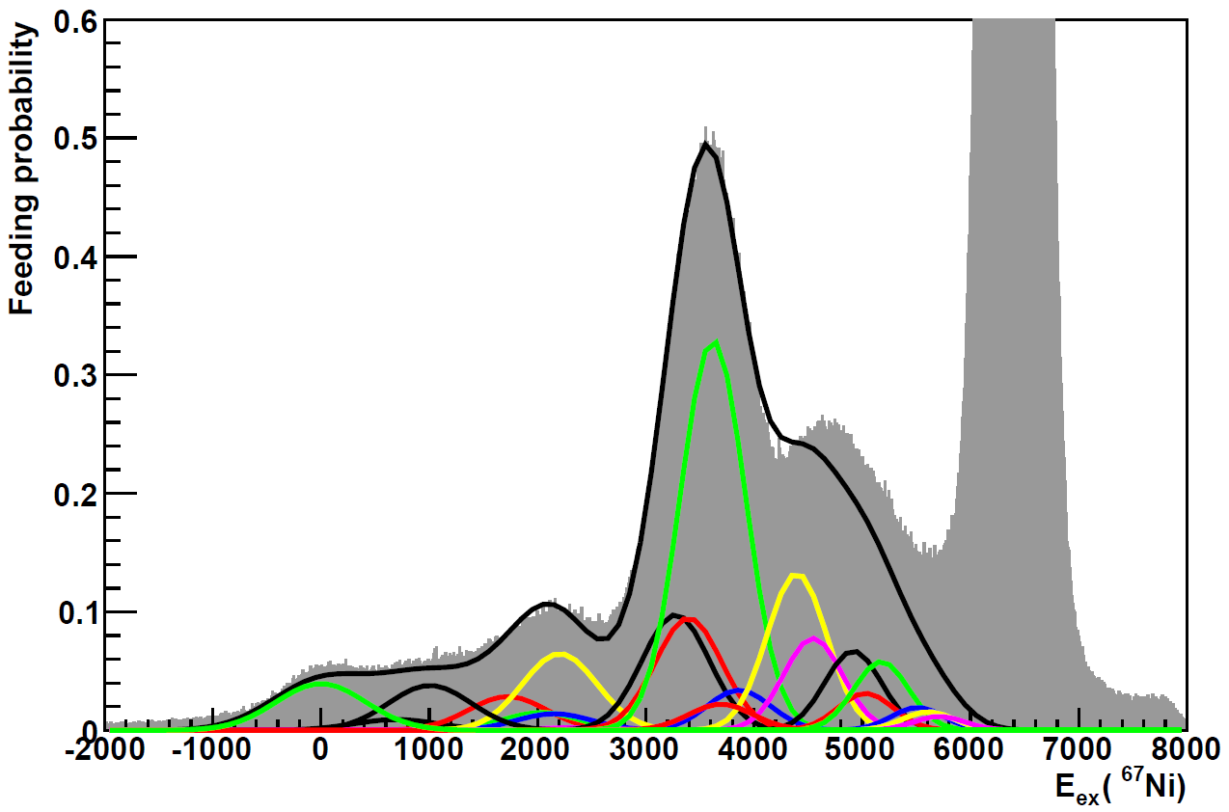
Outline Motivation Experimental Setup Preliminary Results: ⁶⁷Ni,⁶⁸Ni Conclusion & Outlook
Preliminary Results: ⁶⁷Ni
Excitation Energy Spectrum
Elastically scattered protons
Colors: feeding to all different levels populated in ⁶⁷Ni
Notes:
To show that our level scheme is complete.

Slide 23
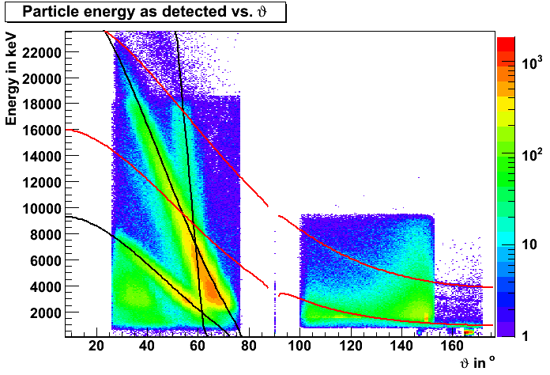
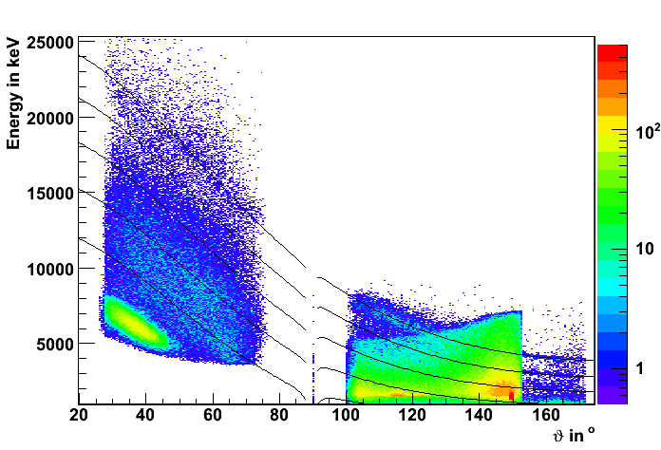
Outline Motivation Experimental Setup Preliminary Results: ⁶⁷Ni,⁶⁸Ni Conclusion & Outlook
Preliminary Results: ⁶⁸Ni
Particle Identification
³H(⁶⁶Ni,⁶⁸Ni)¹H
Q = 5.12 MeV
Protons
³H Elastic
¹⁶O Elastic
¹H Elastic
(t,p) E_{ex} = 0 MeV
0 MeV
(t,p) E_{ex} = 6 MeV
8 MeV
Population of states up to 9 MeV, strong feeding around 5-8 MeV and the ground state

Slide 24
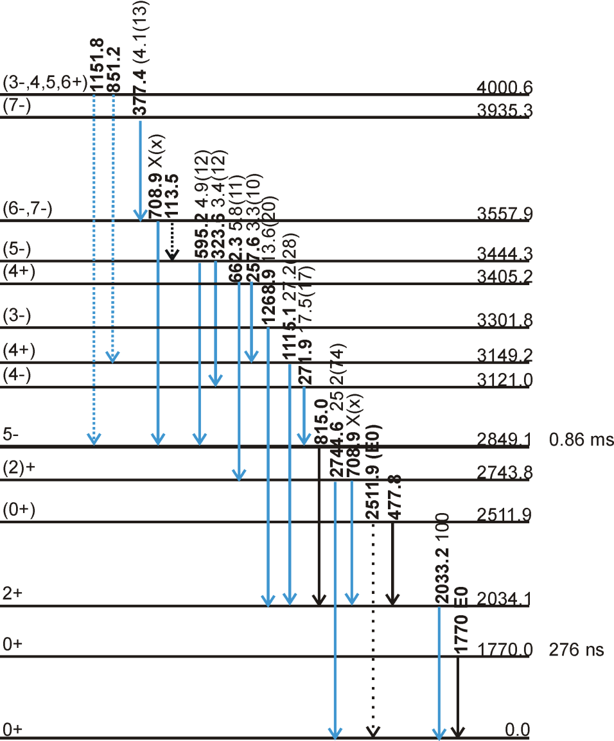
Outline Motivation Experimental Setup Preliminary Results: ⁶⁷Ni,⁶⁸Ni Conclusion & Outlook
Preliminary Results: ⁶⁸Ni
Level scheme
Many γ rays to 5⁻ isomer
No feeding to 0₂⁺ and 0₃⁺ state at 1770 keV and 2511 keV
⁶⁸Ni
Notes:
Looks like feeding up to 4 MeV, but actually most feeding goes to 5-8MeV

Slide 25
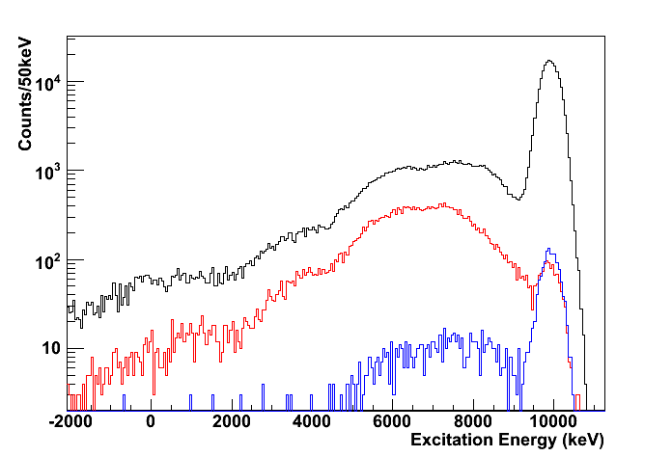
Outline Motivation Experimental Setup Preliminary Results: ⁶⁷Ni,⁶⁸Ni Conclusion & Outlook
Preliminary Results: ⁶⁸Ni
815
5⁻
2849 0.86ms
2743
2⁺
709
2743
2512 E0
Excitation Energy Spectrum
478
0⁺
2512
Forward direction (0°-90°)
2033
2⁺
1770 E0
2033
0⁺
1770 276ns
Elastically scattered protons
0⁺
0
Backward direction (90°-180°)
⁶⁸Ni
Black: protons
Red: prompt proton gamma coincidences
Blue: random proton gamma coincidences
Most of the feeding to states between 5-9 MeV
Direct population of 2₁⁺ state at 2033 keV

Slide 26
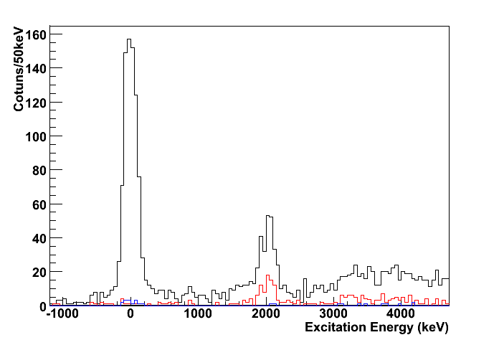
Outline Motivation Experimental Setup Preliminary Results: ⁶⁷Ni,⁶⁸Ni Conclusion & Outlook
Preliminary Results: ⁶⁸Ni
815
5⁻
2849 0.86ms
2743
2⁺
709
2743
2512 E0
Excitation Energy Spectrum of CD Detector
478
0⁺
2512
2033
2⁺
1770 E0
2033
0₁⁺
0⁺
1770 276ns
0⁺
0
⁶⁸Ni
2₁⁺
0₂⁺
Direct population of 2₁⁺ state = 30(3)%
0₂⁺ at 1662(41)keV
Direct population of 0₂⁺ state = 5(1)%
(relative to 100% gs feeding)
Black: protons
Red: prompt proton gamma coincidences
Blue: random proton gamma coincidences

Slide 27
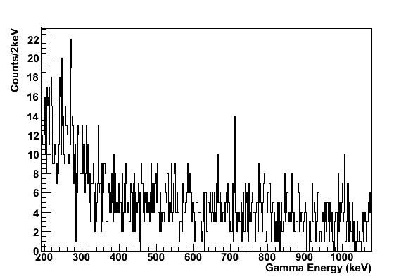
Outline Motivation Experimental Setup Preliminary Results: ⁶⁷Ni,⁶⁸Ni Conclusion & Outlook
Preliminary Results: ⁶⁸Ni
815
5⁻
2849 0.86ms
2743
2⁺
709
2743
2512 E0
478
0⁺
2512
2033
2⁺
1770 E0
2033
0⁺
1770 276ns
478keV
0⁺
0
⁶⁸Ni
Direct population of 0₃⁺ state <1.5%
Direct population of 2₂⁺ < 1.4%
(relative to 100% gs feeding)

Slide 28
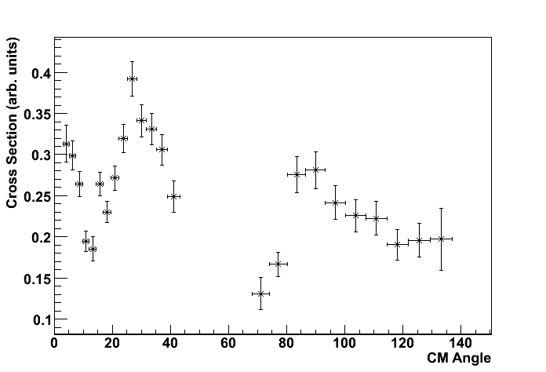
Outline Motivation Experimental Setup Preliminary Results: ⁶⁷Ni,⁶⁸Ni Conclusion & Outlook
Preliminary Results: ⁶⁸Ni
Angular Distributions
‘state’ at 5250keV
PRELIMINARY
0⁺ states at high excitation energy?

Slide 29
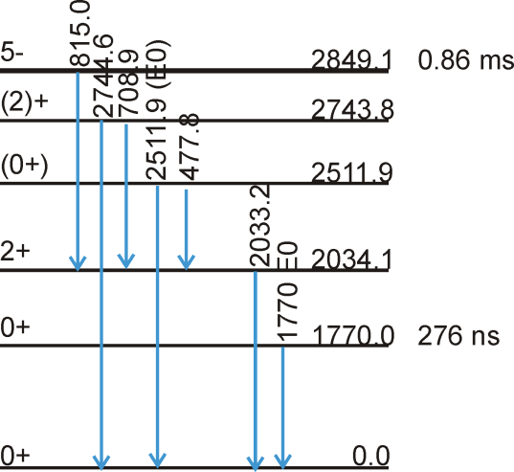
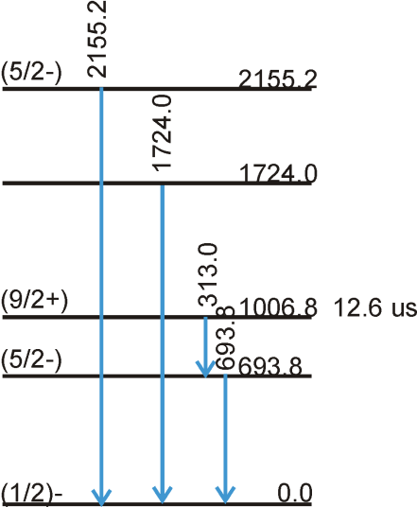
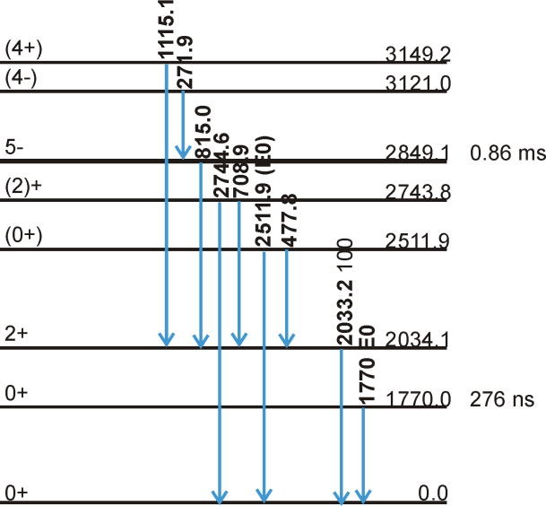
815
5⁻
2849 0.86ms
2743
2⁺
709
2743
2512 E0
478
0⁺
2512
2033
2⁺
1770 E0
2033
0⁺
1770 276ns
2155
(5/2⁻)
2155
0⁺
0
1724
⁶⁸Ni
⁶⁸Ni
1724
1115
313
(4⁺)
272
3149
9/2⁺
1007 12.6 μs
(4⁻)
3121
5/2⁻
694
694
815
5⁻
2743
2849 0.86ms
709
2⁺
2512 E0
2743
478
1/2⁻
0
0⁺
2512
⁶⁷Ni
⁶⁷Ni
2033
2⁺
2033
1770 E0
0⁺
1770 276ns
0⁺
0
⁶⁸Ni

