Slide 1
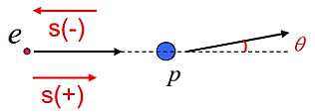
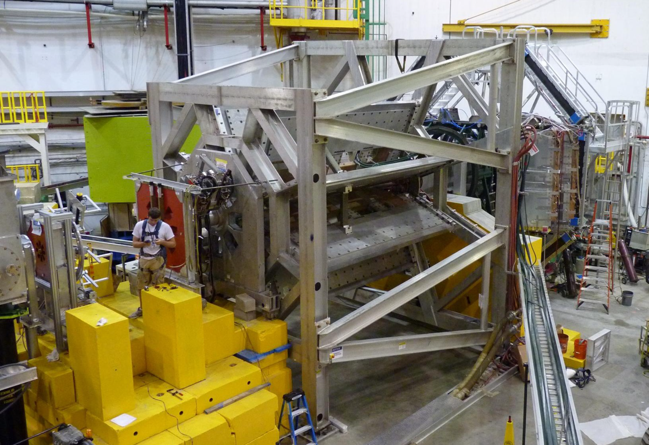
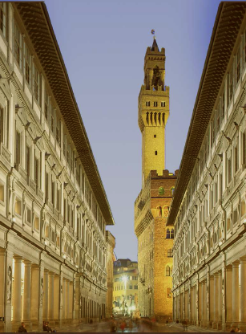
Early Results from the Qweak Experiment
Greg Smith
(for the Qweak Collaboration)
INPC 2013, Florence
June, 2013

Slide 2
Status
The Qweak Experiment finished successfully
Precise measure of ep scattering asymmetry at low Q²
2 years in situ, ~1 year of beam
Commissioning run analyzed
~ 4% of total data collected
Results presented here:
1st Determination of Q_{w}(p), C_{1u}, C_{1d}, & Q_{w}(n)
Remainder of experiment still being analyzed
Expect final result by end of 2014
Expect final result will have ~5* better precision
Should come close to proposed goal (4% msr of Q_{w}(p))

Slide 3
Determining Q_{w}(p)
Z₀
EM (PC) + neutral-weak (PV)
where σ± is ep x-sec for e’s of helicity ±1
This Experiment

Slide 4
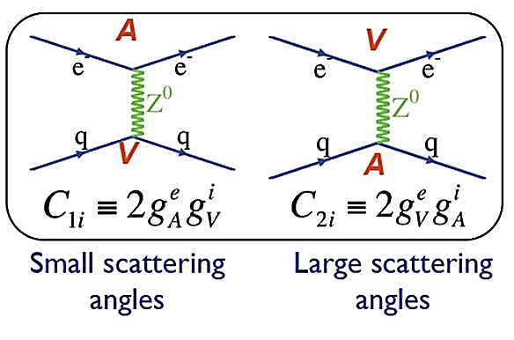
The Weak Charges
Q_{w}(p) is the neutral-weak analog of the proton’s electric charge
The Standard Model makes a firm prediction of $Q_{W}^{p}:$
Q-weak is particularly sensitive to the quark vector couplings $C_{1u}$ & $C_{1d}$
 | Q_{EM} | Weak Vector Charge
u quark | 2/3 | -2C_{1u} = $1−\frac{8}{3}\sin^{2}θ_{w}≈1/3$
d quark | -1/3 | -$\text{2}\text{C}\text{1}\text{d}\text{ =}−1+\frac{4}{3}\sin^{2}θ_{w}≈−2/3$
p (uud) | +1 | $$1−4 \sin^{2}θ_{w}≈0.07$$
n (udd) | 0 | $≈$ -1
General: Q_{w}(Z,N) = -2{C_{1u}(2Z+N) + C_{1d}(Z+2N)}
Ex: Q_{w}(p) = -2(2C_{1u} + C_{1d}) (this experiment)
Uses higher Q² PVES data to constrain hadronic corrections (about 20%)
Ex: Q_{w}(¹³³Cs) = -2(188C_{1u} + 211C_{1d}) (APV)
Latest atomic corrections from PRL 109, 203003 (2012)
Combining Qw(p) and Qw(¹³³Cs) → C_{1u} & C_{1d} , Q_{w}(n)

Slide 5
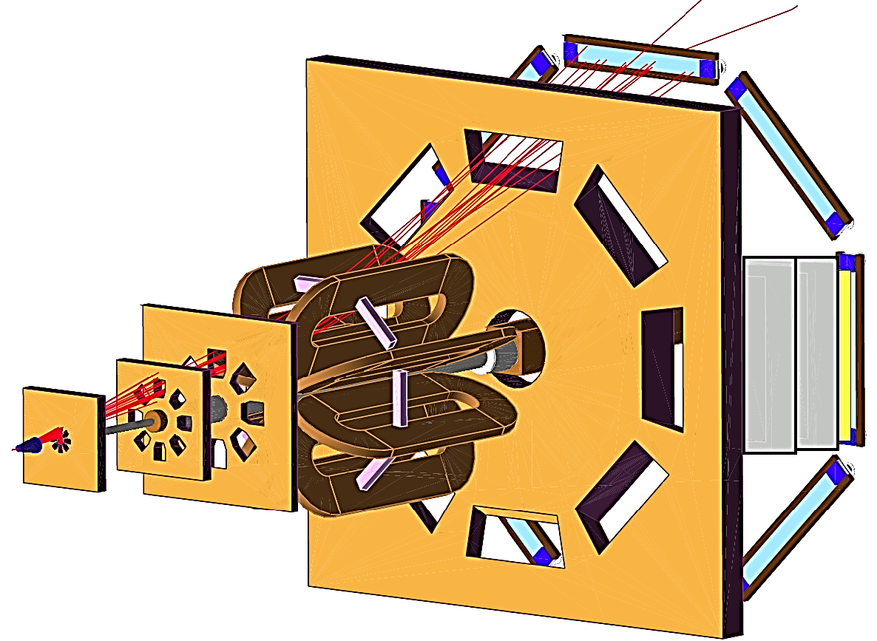
Qweak Apparatus
Quartz Cerenkov Bars
Parameters:
E_{beam}= 1.165 GeV
<Q²> = 0.025 GeV²
<θ> = 7.9° ± 3°
φ coverage = 50% of 2π
I_{beam} = 180 μA
Integrated rate = 6.4 GHz
Beam Polarization = 88%
Target = 35 cm LH₂
Cryopower = 3 kW
Horizontal
Drift Chambers
Electron beam
Trigger Scintillator
LH₂ Target
Vertical Drift Chambers
Collimators
Red = low-current tracking mode only
Toroidal Magnet
Spectrometer

Slide 6
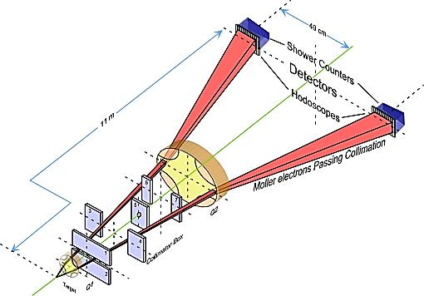
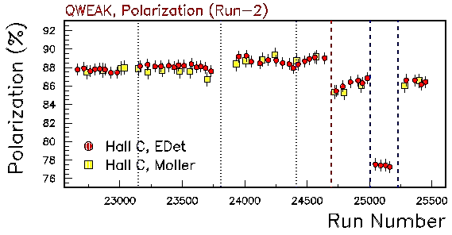
Precision Polarimetry
Qweak requires ΔP/P ≤ 1%
Strategy: use 2 independent polarimeters
Use existing <1% Hall C Møller polarimeter:
Low beam currents, invasive
Known analyzing power provided by polarized Fe foil in a 3.5 T field.
Møller Polarimeter
Use new Compton polarimeter (1%/h)
Continuous, non-invasive
Known analyzing power provided by circularly-polarized laser
Preliminary
Compton Polarimeter
Compton
Moller

Slide 7
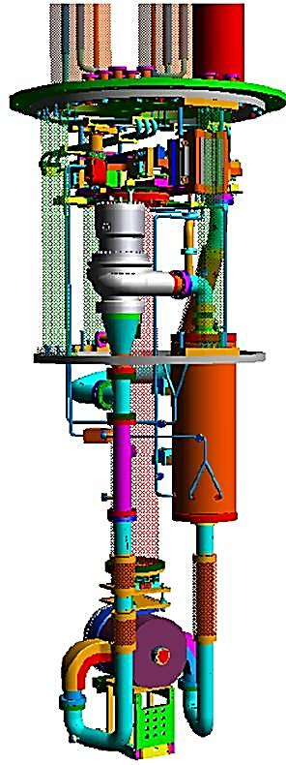
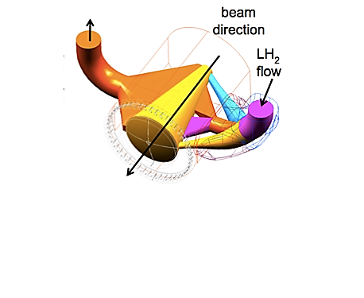
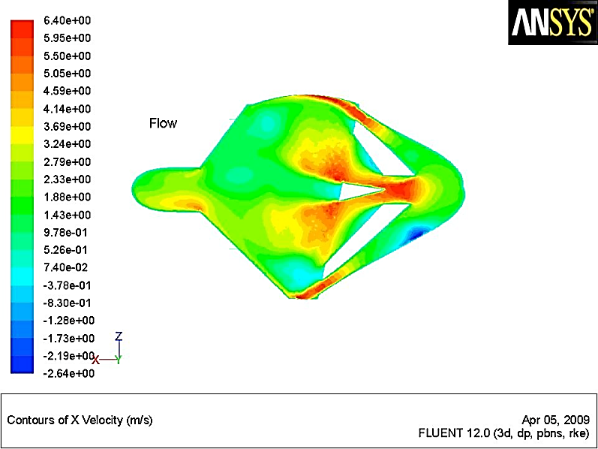
Target Design
World’s highest power cryogenic target ~3 kW
Designed with computational fluid dynamics (CFD) to reduce density fluctuations
I_{Beam} = 180 uA
L = 35 cm (4% X₀)
P_{beam} = 2.2 kW
A_{spot} = 4x4 mm²
V = 57 liters
T = 20.00 K
P ~ 220 kPa
Centrifugal pump
(15 l/s, 7.6 kPa)
3 kW Heater
3 kW HX utilizing
4K & 14K He coolant
Fluid velocity
35 cm cell (beam interaction volume)
Solid Tgts
beam
beam

Slide 8
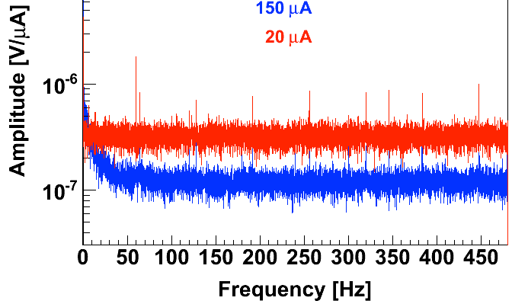
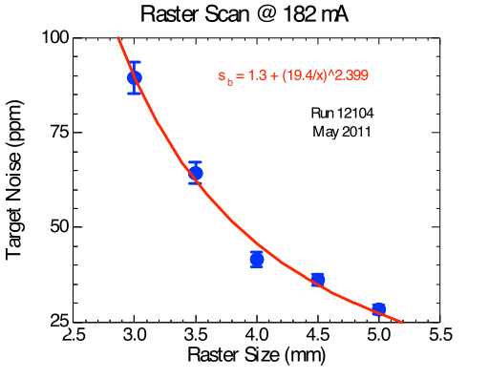
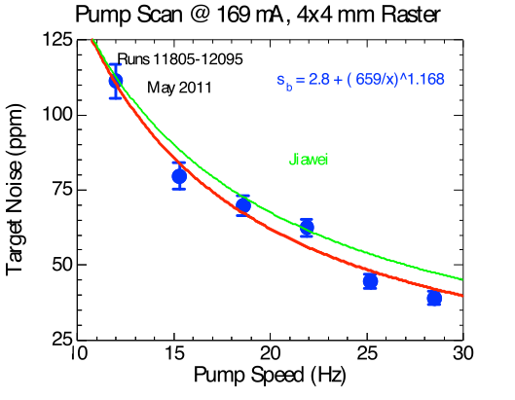
Target Performance
FFT of noise spectrum
Measured helicity correlated target noise.
At 960 Hz reversal rate, the target noise (< 50 ppm) is very small compared to our measured helicity quartet ( ) asymmetry width (~230 ppm).
(statistical power ~ ${{∆A}_{quartet}}/{\sqrt{N_{quartets}}}$ ).
Need fast reversal!
±
±
±
±
µ
µ
____ assumes 1/f
46 ppm at 182 µA, 4x4 mm² raster!
42 ppm at 169 µA, 4x4 mm² raster!

Slide 9
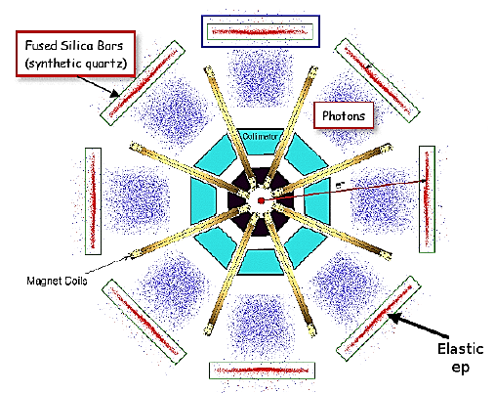
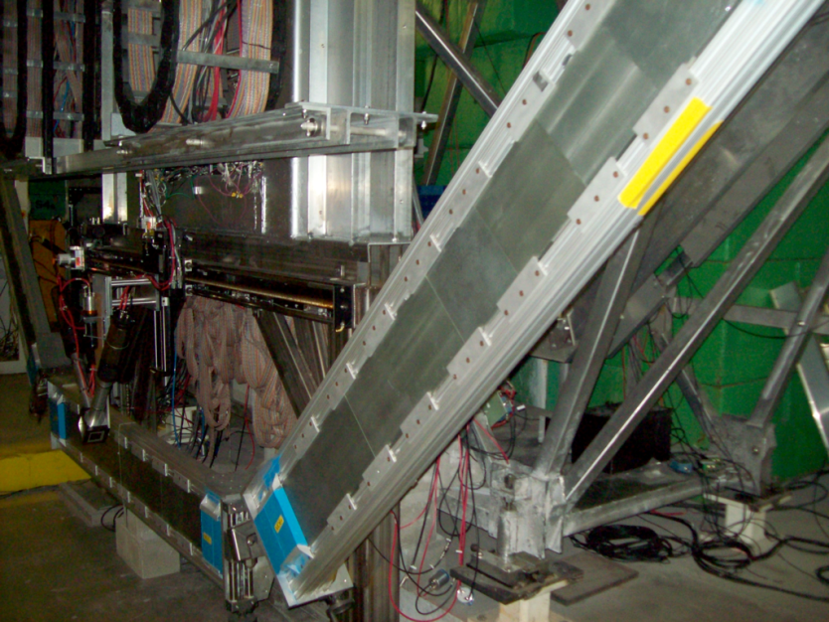
Quartz Cerenkov Detectors
Quartz
Bars
Azimuthal symmetry maximizes rate and decreases sensitivity to HC beam motion, transverse asymmetry.
Spectrosil 2000: Eight bars, each 2 m long, 1.25 cm thick
Rad-hard
Non-scintillating, low-luminescence
Simulation of MD face:
Radial
direction
Azimuthal direction
Measured
Radial
direction
Azimuthal direction
Yield 100 pe’s/track with 2cm Pb pre-radiators
Resolution limited by shower fluctuations.

Slide 10
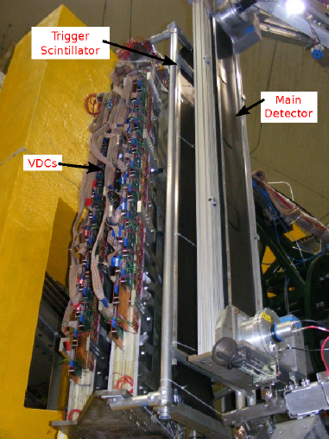
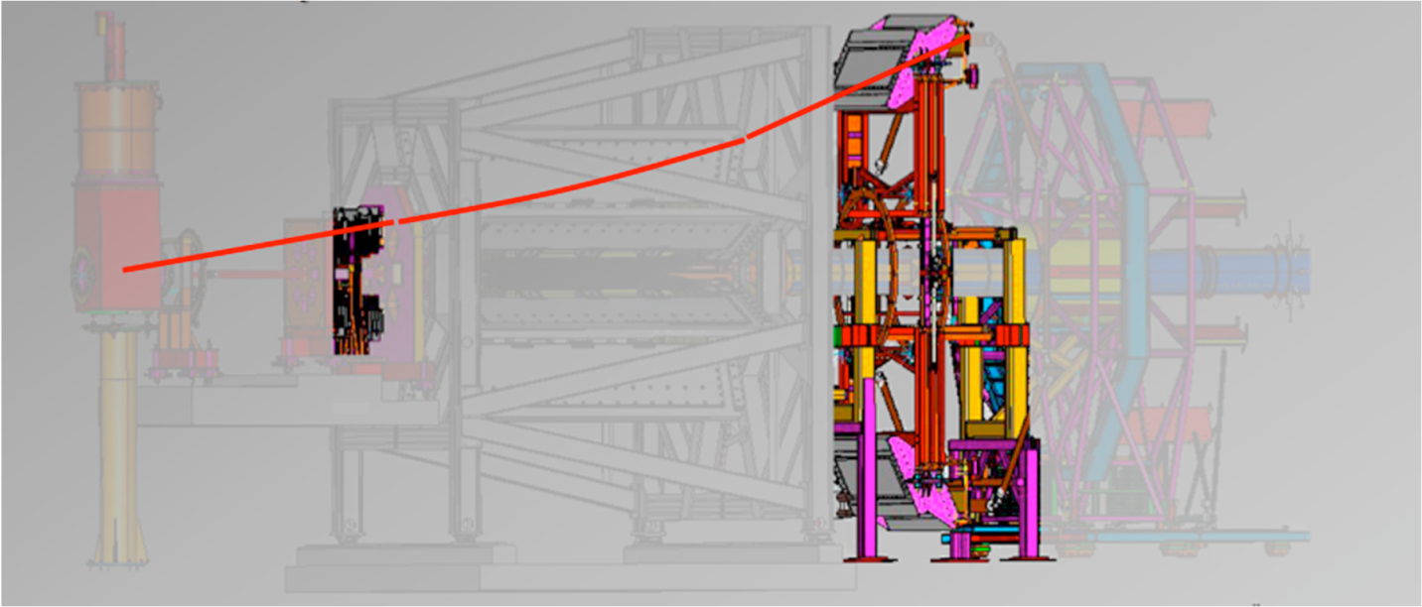
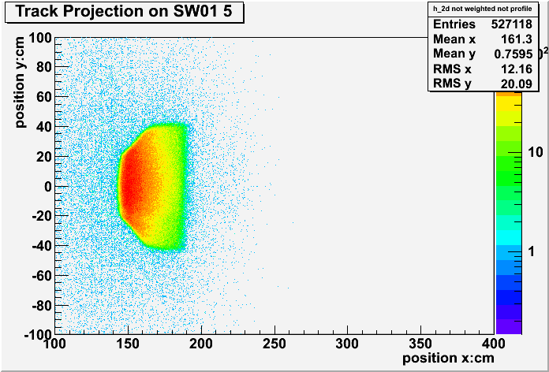
Determining the Kinematics
Required uncertainty on Q² is 0.5%
Combination of tracking and simulation
HDCs before magnet to msr θ
Q² = 2E² (1-cosθ) / [1 + E/M(1-cosθ)]
VDCs & trigger scintillators after magnet to msr light weighted Q² across quartz bars
azimuthal
radial

Slide 11
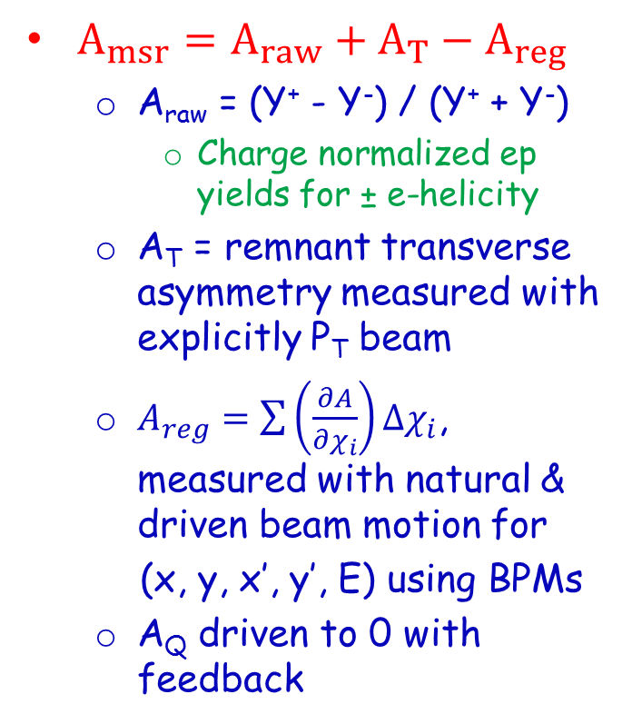
Constructing the Asymmetry
False Asymmetries
Backgrounds

Slide 12
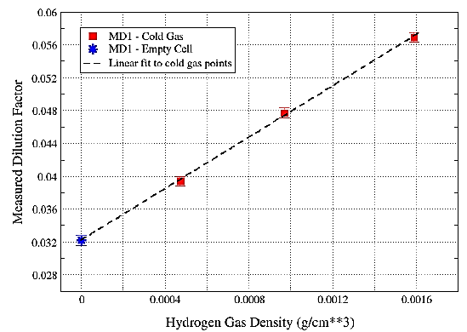
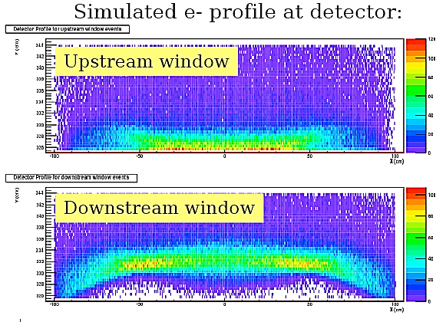
Ex:/ Aluminum Window Background
Large A & f make this our largest correction. Determined from explicit measurements using Al dummy tgts & empty H₂ cell.
Asymmetry measured from thick Al targets
Measured asymmetry agrees with expectations from scaling.
Dilution from windows measured with empty target (actual tgt cell windows).
Corrected for effect of H₂ using simulation and data driven models of elastic and QE scattering.

Slide 13
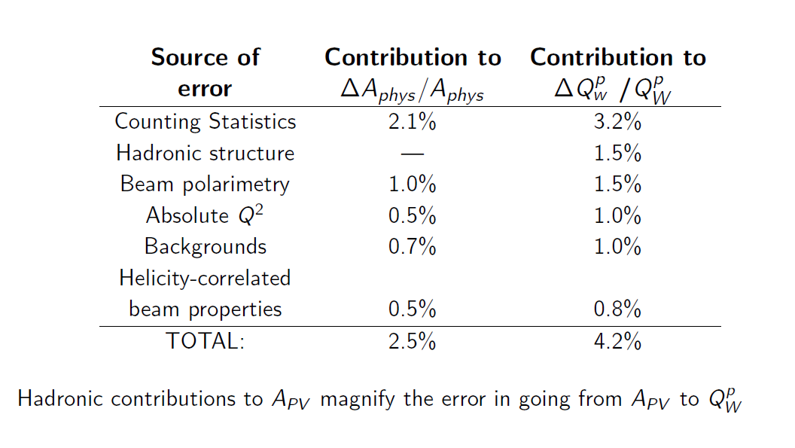
Uncertainty Goals

Slide 14
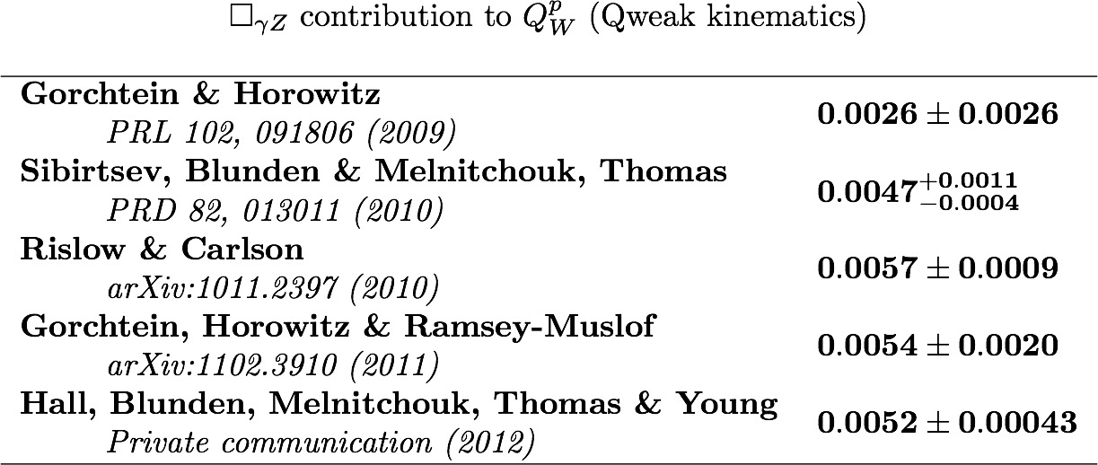
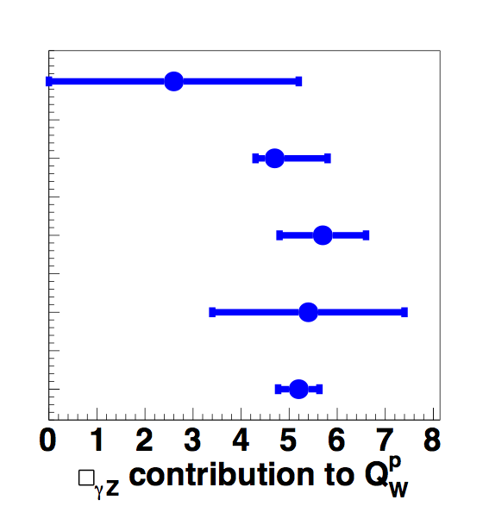
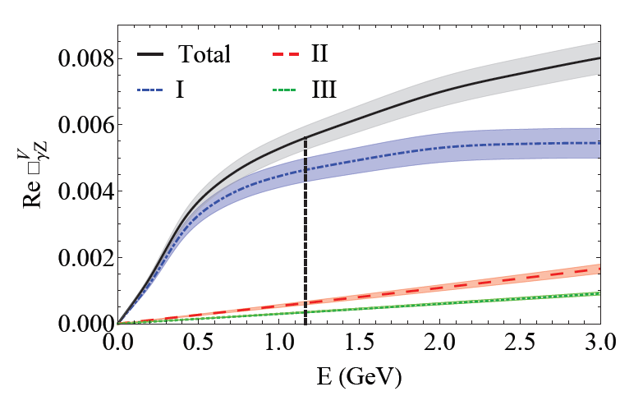
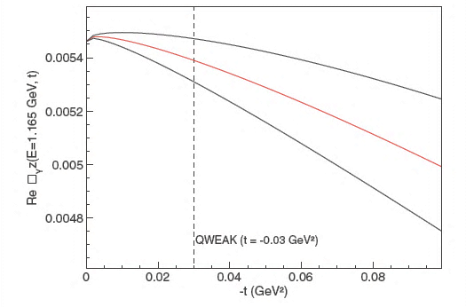
Electroweak Corrections
~7% correction
PRD 83, 13007 (2011)
PRC 84, 015502 (2011)
arXiv:1304:7877 (2013)
(calculation constrained by PVDIS data)
Calculations are primarily dispersion theory type
error estimates can be firmed up with data!
Qweak: inelastic asymmetry data taken at W ~ 2.3 GeV, Q² = 0.09 GeV²
E Dependence
Q² Dependence

Slide 15
Global PVES Fit Details
5 free parameters ala Young, et al. PRL 99, 122003 (2007):
Employs all PVES data up to Q²=0.63 (GeV/c)²
On p, d, & ⁴He targets, forward and back-angle data
SAMPLE, HAPPEX, G0, PVA4
Uses constraints on isoscalar axial FF
Zhu, et al., PRD 62, 033008 (2000)
All data corrected for E & Q² dependence of
Hall et al., arXiv:1304.7877 (2013) & Gorchtein et al., PRC84, 015502 (2011)
Effects of varying Q², θ, & λ studied, found to be small
$$G_{A}^{Z}$$
□_{γZ} RC

Slide 16
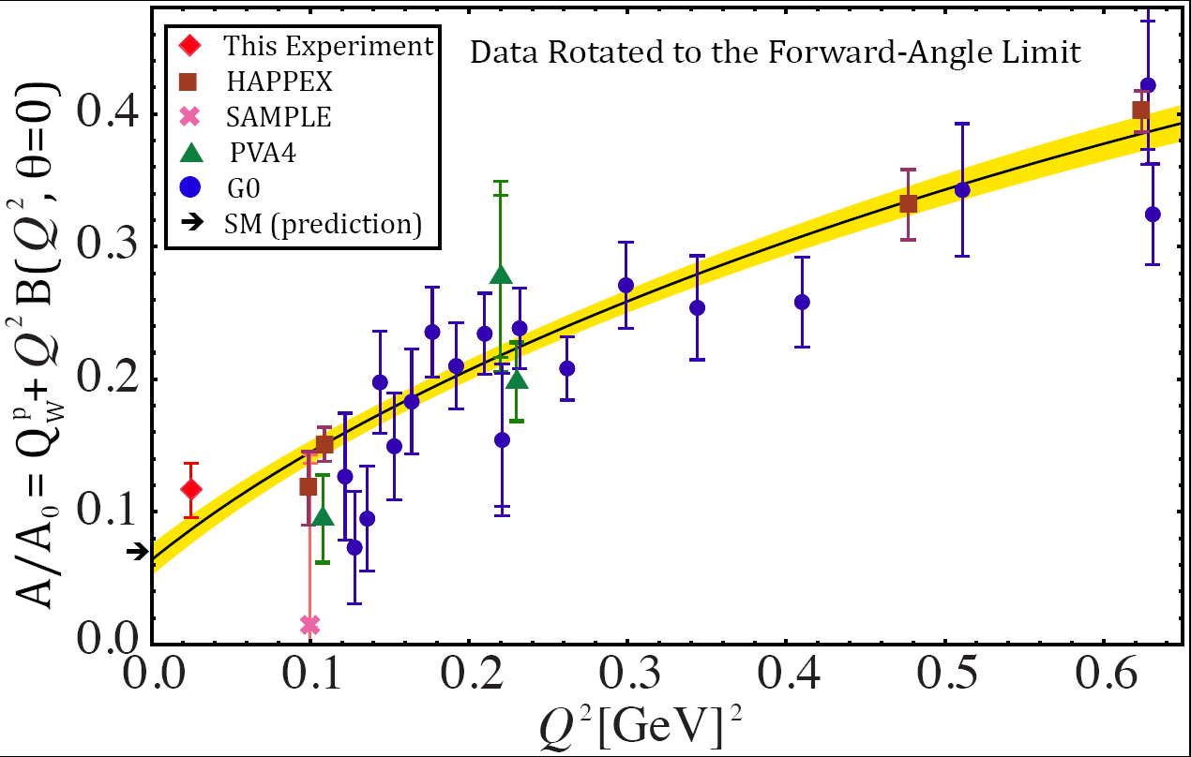
Global fit of Q²<0.63 (GeV/c)² PVES Data
A = -279 ± 35 ± 31 ppb
Q_{W}(p) = 0.064 ± 0.012
(only 4% of all data collected)
SM value = 0.0710(7)

Slide 17
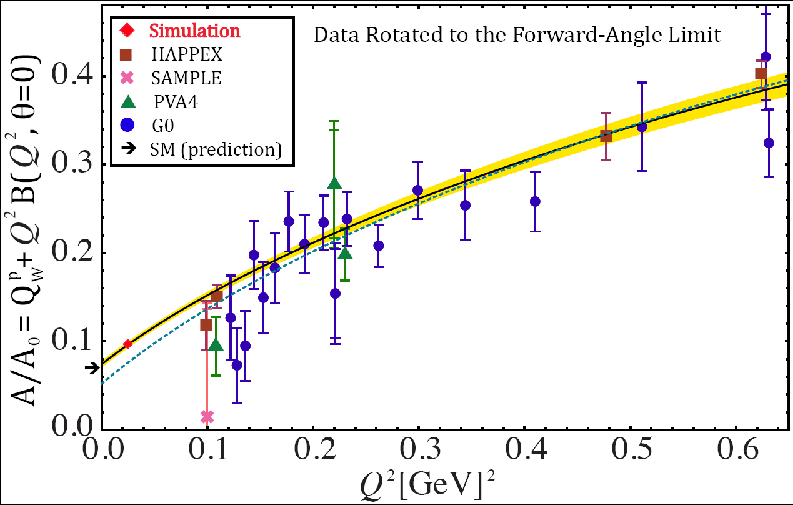
Estimated Fit Uncertainties with Final Result (Assuming SM Value)
Fit without this experiment (large error band not shown)

Slide 18
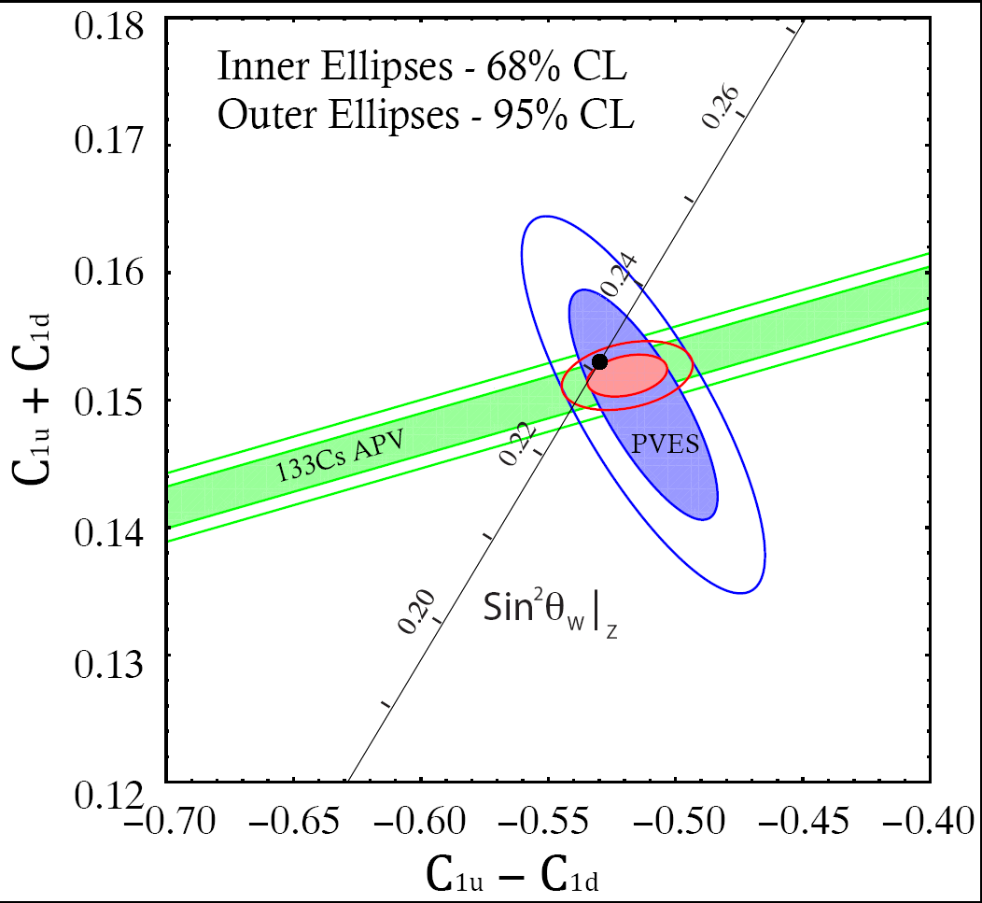
PVES & APV Combined Result
Q_{W}(p) = -2(2C_{1u} + C_{1d}) = 0.064 ± 0.012
(only 4% of data)
SM value = 0.0710(7)
APV + PVES
Combined Result
SM
C_{1u} = -0.184 ± 0.005
C_{1d} = 0.336 ± 0.005
(only 4% of data)
Q_{W}(n) = -2(C_{1u} + 2C_{1d}) = -0.975 ± 0.010
(only 4% of data)
SM value = -0.9890(7)

Slide 19
Summary
Measured A_{ep} = -279 ± 35 (statistics) ± 31 (systematics) ppb
Smallest & most precise ep asymmetry ever measured
First determination of Q_{W}(p):
Q_{w}(p)= 0.063 ± 0.012 (from only 4% of all data collected)
(SM value = 0.0710(7))
New physics reach λ/g = ½( √2 G_{F} ΔQ_{W})^{-1/2} = 1.1 TeV
First determination of Q_{W}(n) = -2(C_{1u} + 2C_{1d}):
By combining our result with APV
Q_{w}(n)= -0.975 ± 0.010 (SM value = -0.9890(7))
Expect to report results with ~5 times smaller uncertainties in about a year
Expected physics reach of ~ 2.3 TeV.
SM test, sensitive to Z’s and LQs

Slide 20
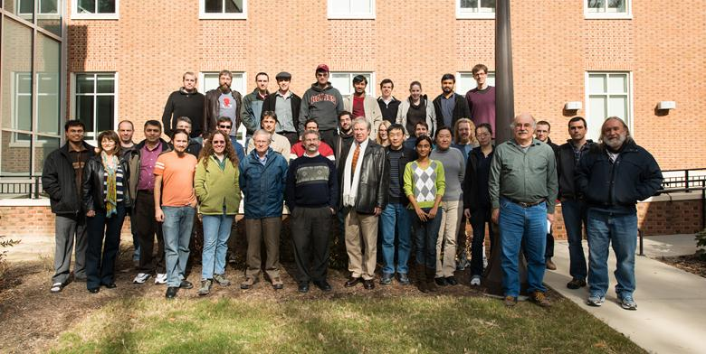
The Qweak Collaboration
95 collaborators
23 grad students
10 post docs
23 institutions:
JLab, W&M, UConn, TRIUMF, MIT, UMan., Winnipeg, VPI, LaTech, Yerevan, MSU, OU, UVa, GWU, Zagreb, CNU, HU, UNBC, Hendrix, SUNO, ISU, UNH, Adelaide
D.S. Armstrong, A. Asaturyan, T. Averett, J. Balewski, J. Beaufait, R.S. Beminiwattha, J. Benesch,
F. Benmokhtar, J. Birchall, R.D. Carlini¹, J.C. Cornejo, S. Covrig, M.M. Dalton, C.A. Davis,
W. Deconinck, J. Diefenbach, K. Dow, J.F. Dowd, J.A. Dunne, D. Dutta, W.S. Duvall, M. Elaasar,
W.R. Falk, J.M. Finn¹, T. Forest, D. Gaskell, M.T.W. Gericke, J. Grames, V.M. Gray, K. Grimm, F. Guo, J.R. Hoskins, K. Johnston, D. Jones, M. Jones, R. Jones, M. Kargiantoulakis, P.M. King, E. Korkmaz,
S. Kowalski¹, J. Leacock, J. Leckey, A.R. Lee, J.H. Lee, L. Lee, S. MacEwan, D. Mack, J.A. Magee,
R. Mahurin, J. Mammei, J. Martin, M.J. McHugh, J. Mei, R. Michaels, A. Micherdzinska, K.E. Myers,
A. Mkrtchyan, H. Mkrtchyan, A. Narayan, L.Z. Ndukum, V. Nelyubin, Nuruzzaman, W.T.H van Oers,
A.K. Opper, S.A. Page¹, J. Pan, K. Paschke, S.K. Phillips, M.L. Pitt, M. Poelker, J.F. Rajotte,
W.D. Ramsay, J. Roche, B. Sawatzky,T. Seva, M.H. Shabestari, R. Silwal, N. Simicevic, G.R. Smith²,
P. Solvignon, D.T. Spayde, A. Subedi, R. Subedi, R. Suleiman, V. Tadevosyan, W.A. Tobias, V. Tvaskis, B. Waidyawansa, P. Wang, S.P. Wells, S.A. Wood, S. Yang, R.D. Young, S. Zhamkochyan
¹Spokespersons ²Project Manager Grad Students
Notes:
Only using lh2 statistics
Black line – day 27 cut-off
Note: our 2.1% goal isn’t here

