Slide 1



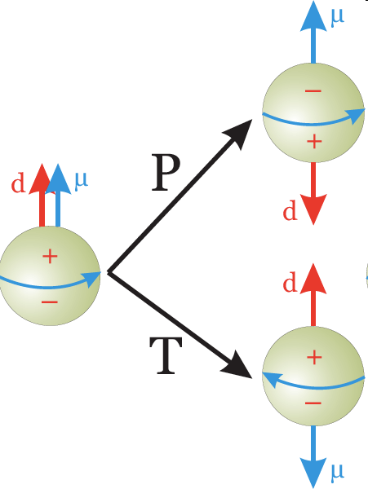
Parity and time-reversal
violation in A=2-4 nuclei
R. Lazauskas (IPHC Strasbourg), Y.H. Song, V. Gudkov (South Carolina U.), T.S. Park

Slide 2

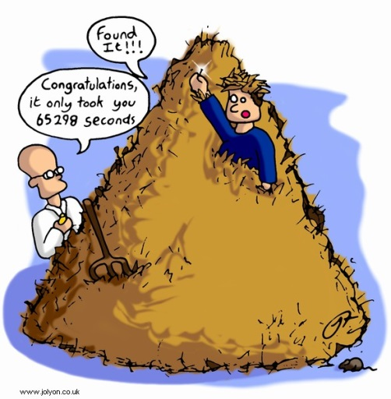
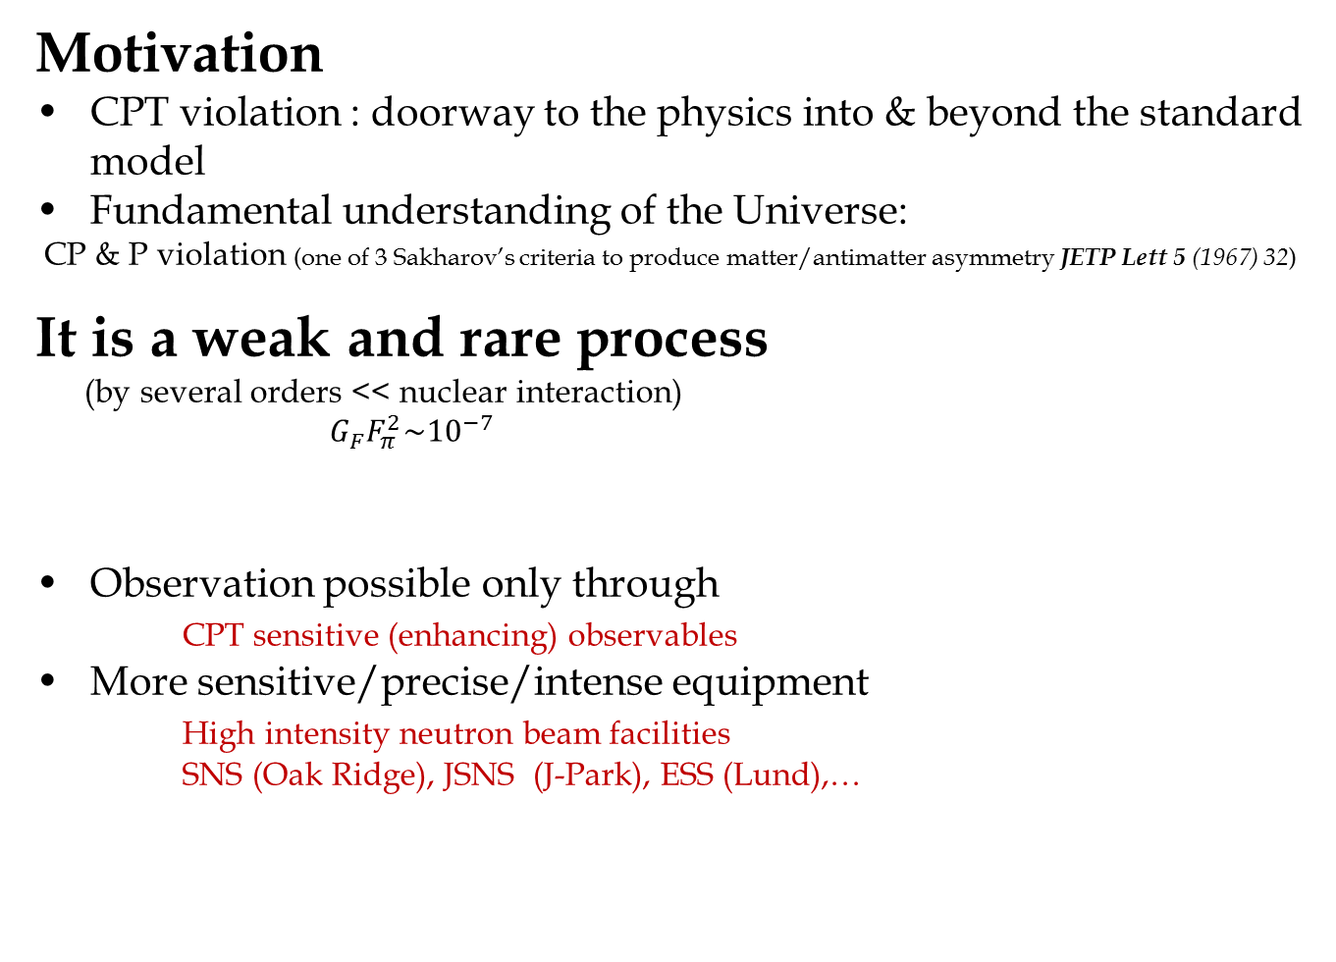
Introduction
Motivation
CPT violation : doorway to the physics into & beyond the standard model
Fundamental understanding of the Universe:
CP & P violation (one of 3 Sakharov’s criteria to produce matter/antimatter asymmetry JETP Lett 5 (1967) 32)
It is a weak and rare process
(by several orders << nuclear interaction)
$G_{F}F_{π}^{2}\sim {10}^{−7}$
Observation possible only through
CPT sensitive (enhancing) observables
More sensitive/precise/intense equipment
High intensity neutron beam facilities
SNS (Oak Ridge), JSNS (J-Park), ESS (Lund),…
R. Lazauskas (IPHC Strasbourg), Y.H. Song, V. Gudkov (South Carolina U.)

Slide 3
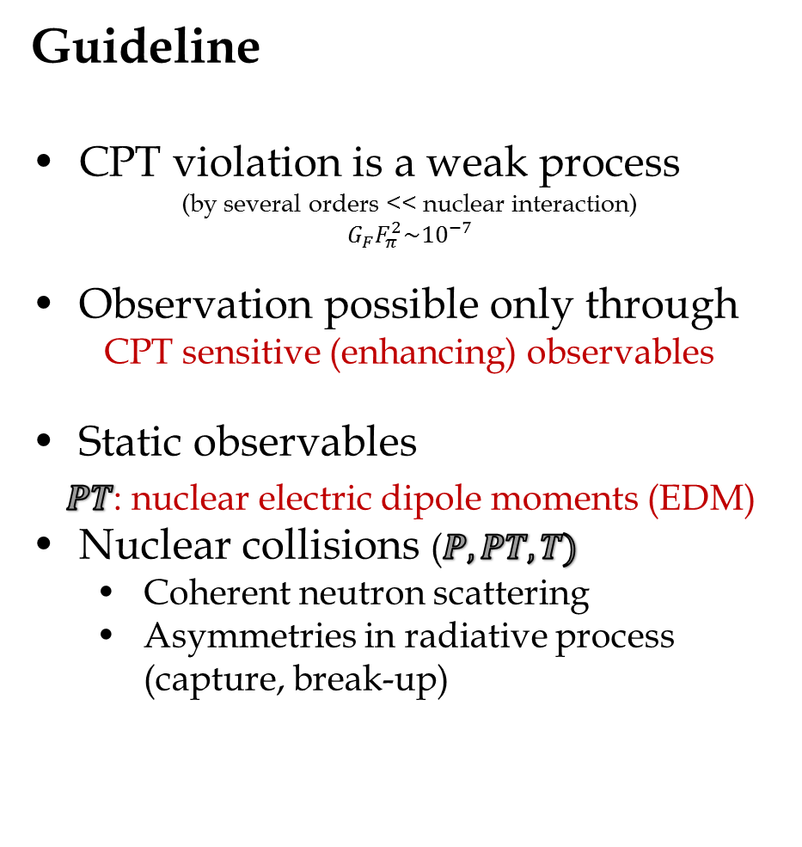

Introduction
, Proton scattering, …
Photon asymmetry and circular polarization
Photon helicity dependence
R. Lazauskas (IPHC Strasbourg), Y.H. Song, V. Gudkov (South Carolina U.)

Slide 4
Introduction
Two possible observables for scattering of polarized neutron:
Difference in cross section parallel-antiparallel to some axis
Neutron spin rotation angle around this axis (impossible for protons)
 | Correlation |  | n spin rotation axis
TP
TP
TP
4
R. Lazauskas (IPHC Strasbourg), Y.H. Song, V. Gudkov (South Carolina U.)
Notes:
4

Slide 5
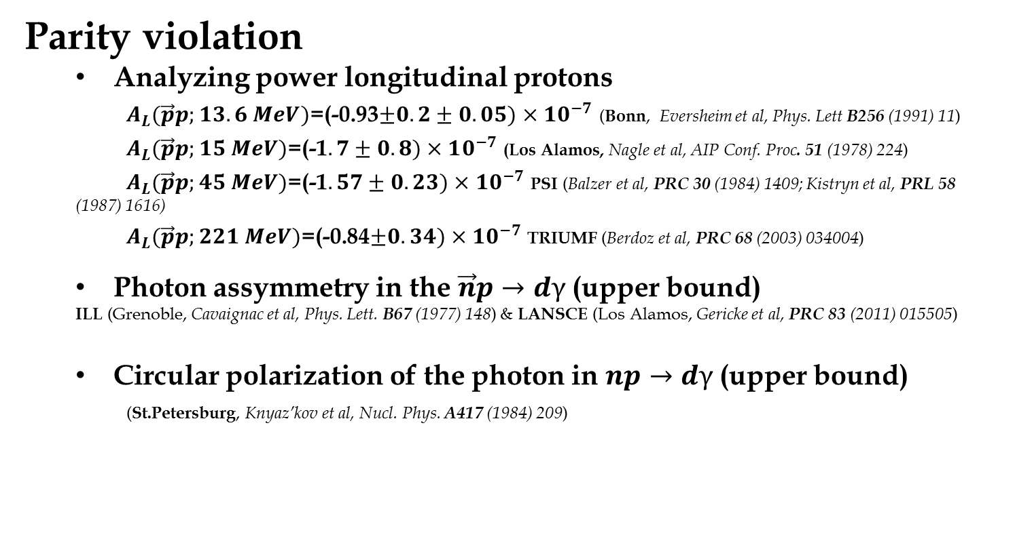
Existing few-body data
Parity violation
  Analyzing power longitudinal protons
  $A_{L}(\vec{p}p;13.6 MeV)$=(-0.93$±0.2±0.05)×10^{−7}$ (Bonn, Eversheim et al, Phys. Lett B256 (1991) 11)
  $A_{L}(\vec{p}p;15 MeV)$=(-1$.7±0.8)×10^{−7}$(Los Alamos, Nagle et al, AIP Conf. Proc. 51 (1978) 224)
  $A_{L}(\vec{p}p;45 MeV)$=(-1$.57±0.23)×10^{−7}$PSI (Balzer et al, PRC 30 (1984) 1409; Kistryn et al, PRL 58 (1987) 1616)
  $A_{L}(\vec{p}p;221 MeV)$=(-0.84$±0.34)×10^{−7}$TRIUMF (Berdoz et al, PRC 68 (2003) 034004)
  Photon assymmetry in the $\vec{n}p→dγ$(upper bound)
  ILL (Grenoble, Cavaignac et al, Phys. Lett. B67 (1977) 148) & LANSCE (Los Alamos, Gericke et al, PRC 83 (2011) 015505)
  Circular polarization of the photon in $np→dγ$(upper bound)
  (St.Petersburg, Knyaz’kov et al, Nucl. Phys. A417 (1984) 209)
Otherwise heavier systems…
(see review Haxton, arxiv:1303.4132v2)
5
R. Lazauskas (IPHC Strasbourg), Y.H. Song, V. Gudkov (South Carolina U.)
Notes:
5

Slide 6
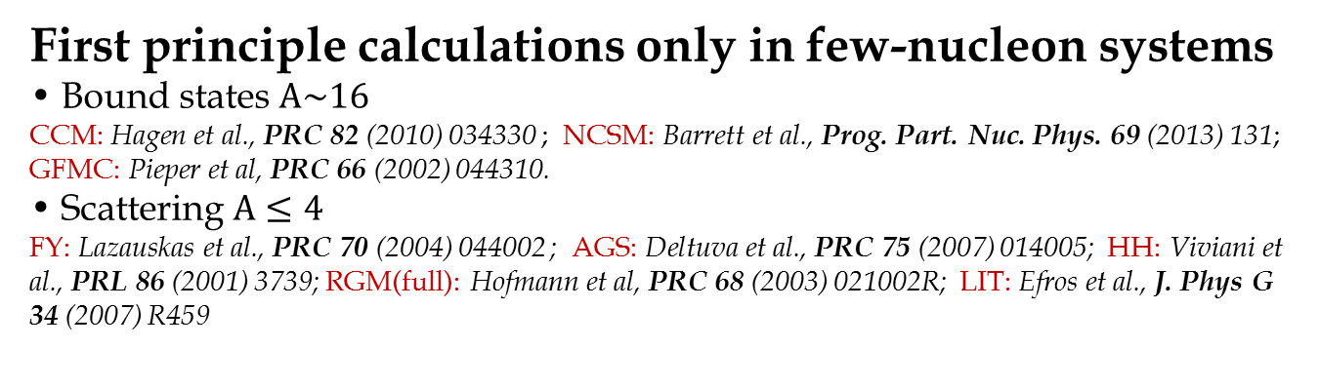
Theory status
Can these effects be calculated in a clean way?
Error control?
M~
6
R. Lazauskas (IPHC Strasbourg), Y.H. Song, V. Gudkov (South Carolina U.)
Notes:
6

Slide 7

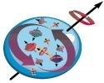
Theory ingredients
Can these effects be calculated in a clean way?
Error control?
M~
Wave functions
Strong interaction:
Rigorous solution possible for accurate and realistic nuclear Hamiltonians, containing 2N forces: Paris, Nijm II, AV18, Reid, CD Bonn, χEFT N3LO,… +3N forces: UIX, Tucson- Melbourne,…
Solution of the underlying QM problem to obtain w.f. via:
FY, HH, AGS, LIT, RGM(full)… if bound state only: CC,NCSM,GFMC
Curent operators
Related with strong interaction (Gauge invariance) but only longitudinal part
Determine from QCD (craziness)
Base on the theoretical models => fit unknown model constants
Weak, EM field
?
ρ
7
R. Lazauskas (IPHC Strasbourg), Y.H. Song, V. Gudkov (South Carolina U.)
Notes:
7

Slide 8
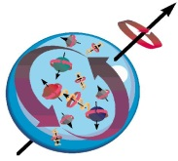

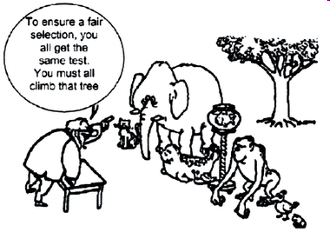
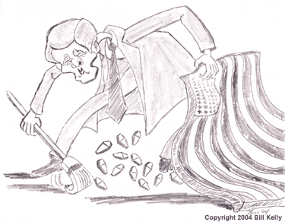
Current operators
π
Guideline
Writedown the most general Lagrangian
Derive from it potential
Retain most important terms
Weak field
?
ρ
Models
Meson-exchange theory: select the most important meson-exchange diagrams for p,r, w..
DDH (B. Desplanques et al.:, Ann. Phys. (N.Y.) 124 (1980) 449)
Pionless EFT: select the most important Lagrangian terms (lowest momenta), fit low energy constants (LECs) S.-L. Zhu, et al.:, Nucl. Phys. A748, 435 (2005), L. Girlanda, Phys. Rev. C 77, 067001 (2008).
Pionic EFT: retain lightest mesons + pionless EFT procedure S.-L. Zhu, et al.:, Nucl. Phys. A748, 435 (2005)
EFT procedure: S. Weinberg, Phys. Lett. B 251 (1990) 288 ; Nucl. Phys. B363 (1991) 3;
P.F. Bedaque et al, Ann. Rev. Nucl. Part. Sci. 52 (2002) 339
8
R. Lazauskas (IPHC Strasbourg), Y.H. Song, V. Gudkov (South Carolina U.)
Notes:
8

Slide 9
S. Weinberg, Phys. Lett.
S. Weinberg, Phys. Lett.
S. Weinberg, Phys. Lett.
B251
B251
B251
, 288 (1990); Nucl. Phys.
, 288 (1990); Nucl. Phys.
, 288 (1990); Nucl. Phys.
, 3 (1991); Phys. Lett.
, 3 (1991); Phys. Lett.
, 3 (1991); Phys. Lett.
B363
B363
B363
B295
B295
B295
, 114 (1992).
, 114 (1992).
, 114 (1992).
HBχEFT* currents: counting scheme
Degrees of freedom: nucleons & chosen heavy mesons (π,ρ, ω, Δ, ☹) + high energy part parametrization
Expansion parameter = Q/ Λχ
Q : typical momentum scale; Λχ : m_{N} ~ 4π f_{π} ~ 1 GeV .
L = L₀ + L₁ + L₂ + ☹ with L_{n} ~ (Q/Λχ)^{n}
Weinberg’s power counting rule for irreducible diagram
π
Weak field
?
ρ
S. Weinberg, Phys. Lett. B 251 (1990) 288 ; Nucl. Phys. B363 (1991) 3; P.F. Bedaque et al, Ann. Rev. Nucl. Part. Sci. 52 (2002) 339
9
R. Lazauskas (IPHC Strasbourg), Y.H. Song, V. Gudkov (South Carolina U.)
[3]
[3]
[3]
P.F. Bedaque and U. van Kolck, Ann. Rev. Nucl. Part.
P.F. Bedaque and U. van Kolck, Ann. Rev. Nucl. Part.
P.F. Bedaque and U. van Kolck, Ann. Rev. Nucl. Part.
Sci.
Sci.
Sci.
52
52
52
, 339 (2002).
, 339 (2002).
, 339 (2002).
Notes:
9

Slide 10
How it works
Wave functions
  Apart π-tail, NN potentials are very different (Unitary transform preserving S-matrix (or NN-data); W. N. Polyzou et al, Few-Body Systems 9 (1990) 97)
  Off-shell properties of available potentials very different => Model-dependence??
10
R. Lazauskas (IPHC Strasbourg), Y.H. Song, V. Gudkov (South Carolina U.)
Notes:
10

Slide 11
How it works
Wave functions
  Apart π-tail, NN potentials are very different (Unitary transform preserving S-matrix (or NN-data); W. N. Polyzou et al, Few-Body Systems 9 (1990) 97)
  Off-shell properties of available potentials very different => Model-dependence??
Model-dependence in short-range region:
  Can be visualized by a cutoff-dependence
  Difference in short-range physics is well described by local contact operators
  We expect that …
    Values of LECs: Λ-dependent, NN-model dependent
    Net matrix element: Λ-independent
Model-dependence in long-range region:
  Long-range part of ME: governed by the effective-range parameters (ERPs) such as binding energy, scattering length, effective range etc
  In two-nucleon sector, practically no problem (realistic potentials are fitted to reproduce 2N data)
  In A ≥3, things are not quite trivial…
11
R. Lazauskas (IPHC Strasbourg), Y.H. Song, V. Gudkov (South Carolina U.)
Notes:
11

Slide 12
Example: EM M1 transitions
Thermal n+²H->³H+γ capture process
Model | σ_{nd} [mb] | -R_c | ²a_{nd} [fm] | B (³H) [MeV]
Av18 | 0.680(3) | 0.435 | 1.266 | 7.623
Av18+UIX | 0.478(3) | 0.458 | 0.598 | 8.483
INOY | 0.498(3) | 0.465 | 0.551 | 8.483
I-N3LO | 0.626(2) | 0.441 | 1.101 | 7.852
I-N3LO+UIX* | 0.477(2) | 0.468 | 0.634 | 8.482
E1-N3LO | 0.688(4) | 0.438 | 1.263 | 7.636
E4-N3LO | 0.609(4) | 0.448 | 1.024 | 7.930
E5-N3LO | 0.879(8) | 0.411 | 1.781 | 7.079
Exp. | 0.508(15) | 0.420(30) | 0.65(4) | 8.482
12
R. Lazauskas (IPHC Strasbourg), Y.H. Song, V. Gudkov (South Carolina U.)
Notes:
12

Slide 13
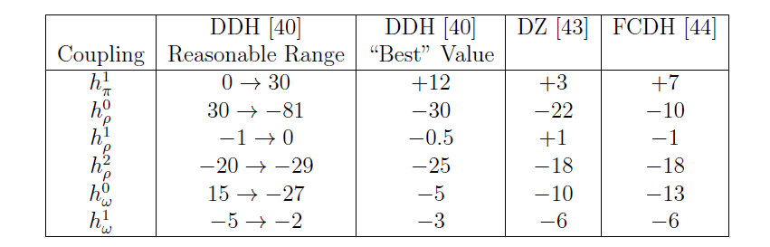

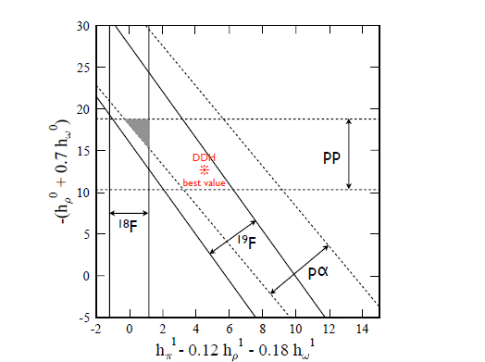
Watch out!!
DDH: B. Desplanques et al., Ann. Phys. (NY) 124, 449 (1980).
DZ: V.M. Dubovik et al., Ann. Phys. (NY) 172, 100 (1986).
FCDH: G.B. Feldman et al, Phys. Rev. C43, 863 (1991).
(figure from Haxton, arxiv:1303.4132v2)
13
R. Lazauskas (IPHC Strasbourg), Y.H. Song, V. Gudkov (South Carolina U.)
Notes:
13

Slide 14
What to do?
Use the same input: NN+NNN strong interaction + weak interaction (current).
Retain consistency as much as possible (Gauge invariance) between current <=> NN+NNN strong interaction
Accurate solution for this input, calculation of the relevant transition matrix elements
Determine possible correlations (πEFT interesting tool)
Calculate relevant transition matrix elements for experimentally measurable, independent set of observables => determine LEC’s of weak interaction model
Use these LEC’s to made predictions
14
R. Lazauskas (IPHC Strasbourg), Y.H. Song, V. Gudkov (South Carolina U.)
Notes:
14

Slide 15
3-body Observables
Partial wave decomposition
n
n
l_{n}
R-matrix defined by l_{n} and (j_{d}s_{n})_{S} quantum numbers (S=1/2 or 3/2) at low p_{n}
p
For n-d scattering one has:
For low energy neutrons only transitions with smallest l_{n} values must be
considered
15
R. Lazauskas (IPHC Strasbourg), Y.H. Song, V. Gudkov (South Carolina U.)
Notes:
15

Slide 16
3-body Observables
Two possible observables for scattering of polarized neutron:
Neutron spin rotation angle around this axis (impossible for protons)
n
Difference in cross section parallel-antiparallel to some axis
n
l_{n}
p
 | Correlation
TP
TP
TP
16
R. Lazauskas (IPHC Strasbourg), Y.H. Song, V. Gudkov (South Carolina U.)
Notes:
16

Slide 17
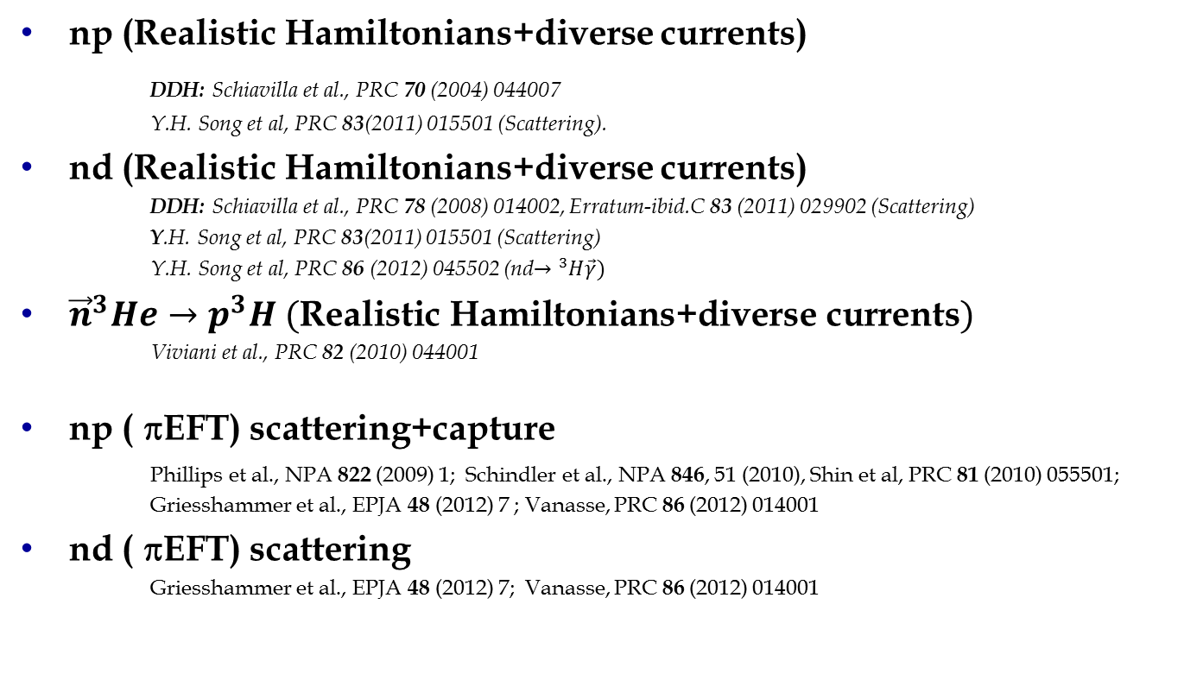
Parity violation
np (Realistic Hamiltonians+diverse currents)
DDH: Schiavilla et al., PRC 70 (2004) 044007
Y.H. Song et al, PRC 83(2011) 015501 (Scattering).
nd (Realistic Hamiltonians+diverse currents)
DDH: Schiavilla et al., PRC 78 (2008) 014002, Erratum-ibid.C 83 (2011) 029902 (Scattering)
Y.H. Song et al, PRC 83(2011) 015501 (Scattering)
Y.H. Song et al, PRC 86 (2012) 045502 (nd$→{}_{}^{3}H\vec{γ})$
${\vec{n}}^{3}He→p^{3}H (\text{Realistic} \text{Hamiltonians}\text{+}\text{diverse} \text{currents})$
Viviani et al., PRC 82 (2010) 044001
np ( πEFT) scattering+capture
Phillips et al., NPA 822 (2009) 1; Schindler et al., NPA 846, 51 (2010), Shin et al, PRC 81 (2010) 055501; Griesshammer et al., EPJA 48 (2012) 7 ; Vanasse, PRC 86 (2012) 014001
nd ( πEFT) scattering
Griesshammer et al., EPJA 48 (2012) 7; Vanasse, PRC 86 (2012) 014001
R. Lazauskas (IPHC Strasbourg), Y.H. Song, V. Gudkov (South Carolina U.)
Notes:
17

Slide 18
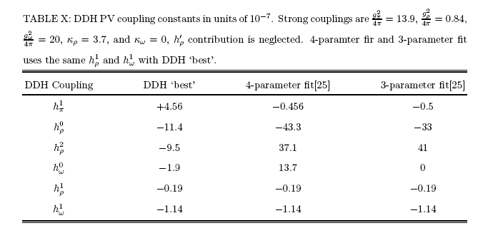

Parity violation
π
Weak field
?
ρ
J. D. Bowman,
http://www.int.washington.edu/talks/WorkShops/int_07_1/.
np case: (0.46 -0.74)*10⁻⁸ rad cm⁻¹ (R. Schiavilla et al.,Phys.Rev. C70 (2004) 044007)
18
R. Lazauskas (IPHC Strasbourg), Y.H. Song, V. Gudkov (South Carolina U.)
Notes:
18

Slide 19
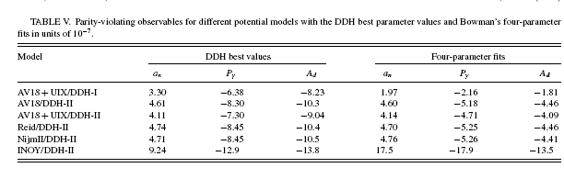

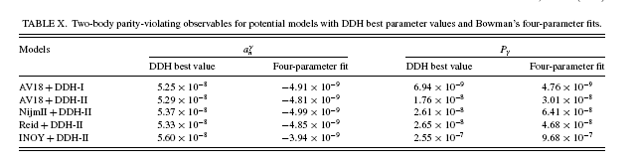
Parity violating n+d capture
Observables: polarization of the emitted photon (P_{γ})
photon assymetry in relation to neutron (a_{n})
& deutron (A_{d})
Important model-dependence!!!
Some model dependence already visible for np (short range physics Pγ dominated by ω & ρ mesons)
R. Lazauskas (IPHC Strasbourg), Y.H. Song, V. Gudkov (South Carolina U.)
Notes:
19

Slide 20
Parity violating n+d capture
ε_{3/2} amplitude for nd
ε₁ amplitude for np
R. Lazauskas (IPHC Strasbourg), Y.H. Song, V. Gudkov (South Carolina U.)
Notes:
20

Slide 21

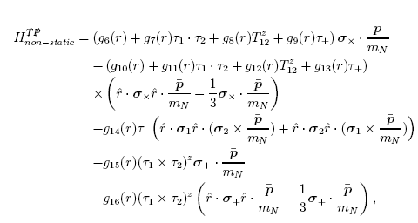
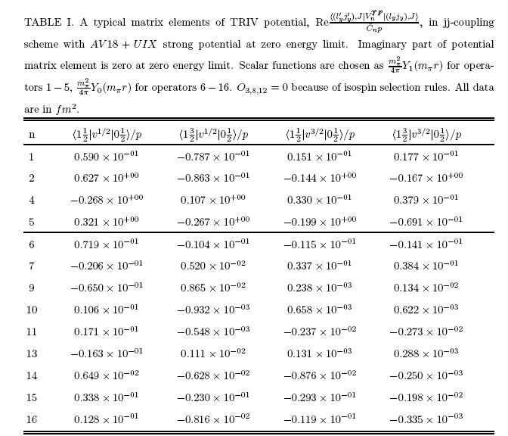
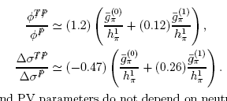
P&T violation
π
Weak field
?
More terms from EFT:
ρ
Contributing mesons
π(140 ), I^{G}(J^{πC}) = 1⁻(0⁻⁺)
η(550), I^{G}(J^{πC}) = 0⁺(0⁻⁺)
ρ(770), I^{G}(J^{πC}) = 1⁺(1⁻⁻)
ω(782), I^{G}(J^{πC}) = 0⁻(1⁻⁻)
If we retain only pions:
From EDM measurements g/h<10⁻³
R. Lazauskas (IPHC Strasbourg), Y.H. Song, V. Gudkov (South Carolina U.)
Notes:
21

Slide 22
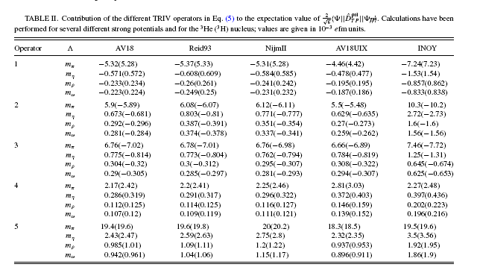
P&T violation (EDMs)
Y.H. Song et al, PRC 87 (2013) 015501
Discrepency with results of: I. Stetcu, C.-P. Liu et al., Phys. Lett. B 665, 168 (2008)!!
Also studied within EFT by de Vries et al, PRC (2011) 065501
Important model-dependence, already at π−level!!!
R. Lazauskas (IPHC Strasbourg), Y.H. Song, V. Gudkov (South Carolina U.)
Notes:
22

Slide 23
P&T violation (EDMs)
R. Lazauskas (IPHC Strasbourg), Y.H. Song, V. Gudkov (South Carolina U.)
Notes:
23

Slide 24
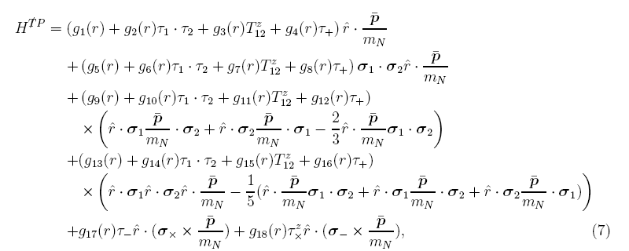

TVPC case
π
Weak field
Contributing mesons
Pion exchange does not contribute
(M. Simonius, Phys. Lett., B58, 147 (1975))
ρ(770), I^{G}(J^{πC}) = 1⁺(1⁻⁻)
h1(1170), I^{G}(J^{πC}) = 0⁻(1⁺⁻)
?
ρ
24
R. Lazauskas (IPHC Strasbourg), Y.H. Song, V. Gudkov (South Carolina U.)
Notes:
24

Slide 25
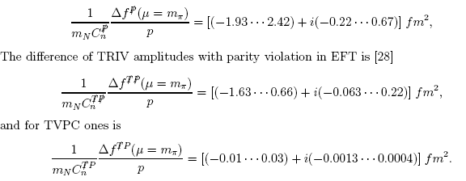
Comparison
π
Weak field
?
ρ
According to EFT, one gets following estimates at E_{cm}=100 keV:
Δφ
Δσ
25
R. Lazauskas (IPHC Strasbourg), Y.H. Song, V. Gudkov (South Carolina U.)
Notes:
25

Slide 26
Summary/Perspectives
χEFT proved to be efficient for EM few-body reactions
Extensive analysis of P & T violating processes has been performed for low energy n-p, n-d, n-³He systems
These reactions might be explored in order to improve our knowledge of P & T coupling constants
Strong model dependence of matrix elements, it is still believed EFT can handle it
TO DO
Higher energies, heavier systems n-⁴He
p-d, p-³He, p-³H, p-⁴He cases
Determine independent set of observables
Acknowledgements: The numerical calculations have been performed at IDRIS (CNRS, France). We thank the staff members of the IDRIS computer center for their constant help.
26
R. Lazauskas (IPHC Strasbourg), Y.H. Song, V. Gudkov (South Carolina U.)
Notes:
26

