Slide 1
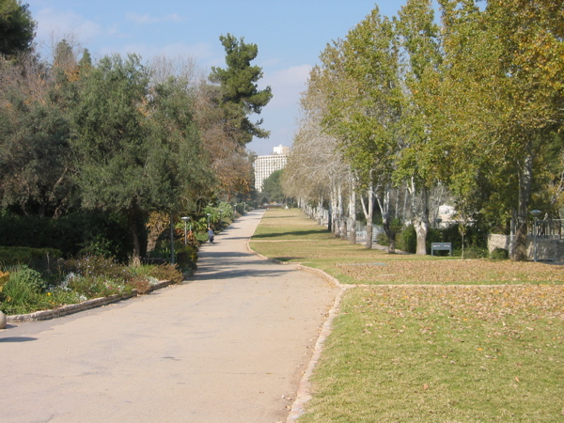


Low-energy neutrino* reactions in nuclei
*and other weak and rare
Doron Gazit
doron.gazit@mail.huji.ac.il

Slide 2
Weak and rare interactions in nuclei
Nuclear properties:
β-decays
GT transitions
Astrophysical phenomena:
Supernovae II
Nucleosynthesis
Limits of the standard model:
Studies of QCD
0νββ decays,
WIMPs
Accurate, parameter free predictions of interactions of probes with nuclei are needed

Slide 3

Introduction
Low energy electromagnetic reaction

Slide 4
Introduction
Low energy weak reaction

Slide 5
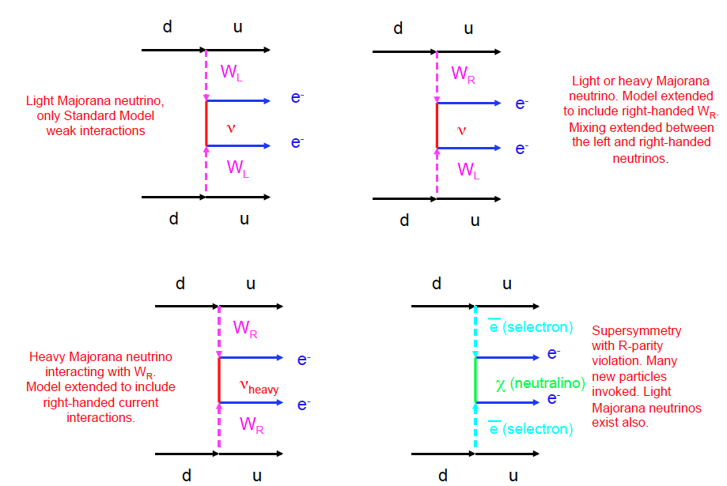
Introduction
Neutrino-less double beta-decay
Figure taken from P. Vogel

Slide 6
Introduction
Neutralino (WIMP candidate) scattering off a nucleus

Slide 7
“All happy families are alike, every unhappy family is unhappy in its own way”
Low energy reactions

Slide 8
“All happy families are alike, every unhappy family is unhappy in its own way”
Low energy reactions
Probe current of known symmetry
Nuclear current of the same symmetry
Scattering operator
Currents in the nucleus

Slide 9
Low energy nuclear reactions induced by an external probe
Same symmetry will induce the same structure of the nuclear current.
Differences lie in coupling constants.
The currents are reflections of the symmetries and properties of the nuclear interaction, in particular can be used to characterize the elusive three nucleon force.
Thus, one can relate electro-weak properties and reaction rates with non-trivial properties not only of the target, but also of the fundamental theory leading to its structure!

Slide 10
Calculating nuclear reactions:
QCD
Practically impossible due to the non-perturbative character of QCD in low energy!
Wave functions
Scattering operator
Nuclear current
Nuclear Matrix Element

Slide 11
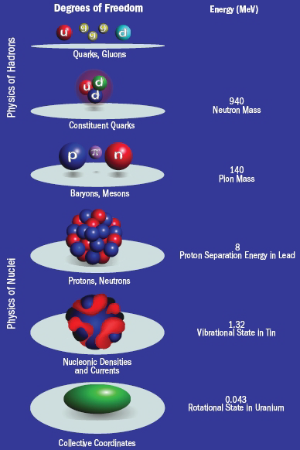
χEFT approach for low-energy nuclear reactions:
QCD
Λ~4πf_{π}
Low energy EFT
Q~m_{π}
Chiral EFT Lagrangian
Nuclear potential
Nöther current
Wave functions
Nuclear
current
Nuclear Matrix Element

Slide 12
Chiral Effective Field Theory
In QCD – an approximate chiral symmetry:
  The u and d quarks are (almost) massless (~5-10 MeV).
    Chiral EFT Lagrangian is built of all terms with chiral symmetry, with nucleons and pions as explicit dof.
    Expansion in (Q/Λ)
  Why is it useful:
    Chiral symmetry is equivalent to the electro-weak gauging!
    Thus, Nöther currents of the chiral symmetry will couple to the electro-weak probe!
  Minus: Issues with power counting!

Slide 13
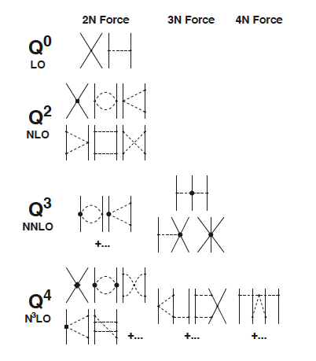
Forces in χEFT
The leading order NNN forces are at N²LO.
They include 2 new contact parameters.
No new parameters at N³LO.
Weinberg, van Kolck, Ordonez, Meissner, Epelbaum, Nogga, Bernard, Kaiser, Krebs, Machleidt, Entem…

Slide 14
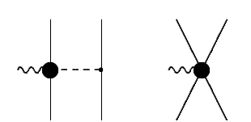
χPT axial weak currents to O(Q³)
Single nucleon current
1 pion exchange
Contact term
O(Q⁰), O(Q²)
O(Q³)
T.-S. Park et al, Phys. Rev. C 67, 055206 (2003); DG PhD thesis arXiv: 0807.0216

Slide 15
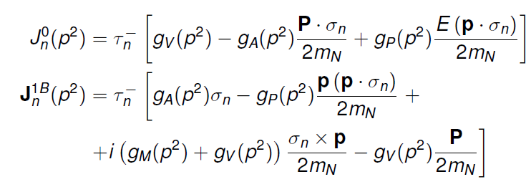
χPT axial weak currents to O(Q³)
Single nucleon current
1 pion exchange
Contact term
O(Q⁰), O(Q²)
O(Q³)
T.-S. Park et al, Phys. Rev. C 67, 055206 (2003); DG PhD thesis arXiv: 0807.0216

Slide 16
χPT axial weak currents to O(Q³)
Single nucleon current
1 pion exchange
Contact term
O(Q⁰), O(Q²)
O(Q³)
Fermi operator
Gamow-Teller operator
T.-S. Park et al, Phys. Rev. C 67, 055206 (2003); DG PhD thesis arXiv: 0807.0216

Slide 17
χPT axial weak currents to O(Q³)
Single nucleon current
1 pion exchange
Contact term
O(Q⁰), O(Q²)
O(Q³)
Nucleon-pion interaction,
NO new parameters
Contact term
T.-S. Park et al, Phys. Rev. C 67, 055206 (2003); DG PhD thesis arXiv: 0807.0216

Slide 18
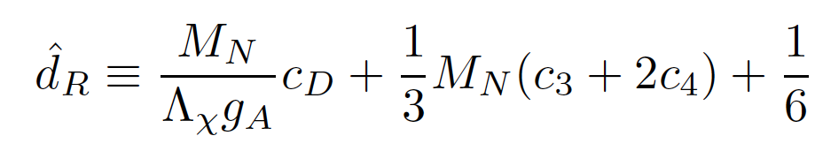
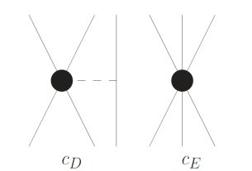
χPT axial weak currents to O(Q³)
Single nucleon current
1 pion exchange
Contact term
O(Q⁰), O(Q²)
O(Q³)
Nucleon-pion interaction,
NO new parameters
Contact term
Gårdestig, Phillips, Phys. Rev. Lett. 98, 232301 (2006); DG, Quaglioni, Navratil, Phys. Rev. Lett. 103, 102502 (2009).
T.-S. Park et al, Phys. Rev. C 67, 055206 (2003); DG PhD thesis arXiv: 0807.0216

Slide 19
χEFT approach for low-energy EW nuclear reactions:
QCD
Low energy EFT
Chiral EFT Lagrangian
Nuclear potential:
Need to fix two LECs: C_{D} , C_{E}
Nöther current:
Need to fix one LEC: C_{D}
Wave functions
EW
current
Nuclear Matrix Element

Slide 20
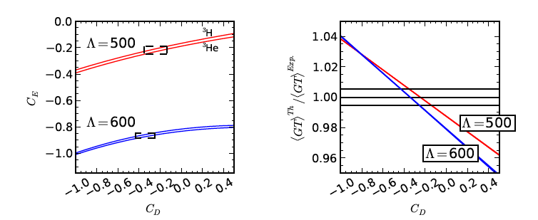
A prediction of ⁴He
Question: How good is the “microscopic” approach to nuclear physics?
Strategy:
Use triron (³H) β-decay and binding energy to completely fix the Nuclear model.
Predict the properties of ⁴He
Predict other observables.
⁴He binding energy χEFT prediction
DG, Quaglioni, Navratil, Phys. Rev. Lett. 103, 102502 (2009), Lupo, DG, Barnea (2013)

Slide 21
Chiral-EFT allows Low energy Unification of:
Strong Interaction, and the interaction of
Electro- weak probes with matter.
*Leads to precision physics at N²LO

Slide 22
The decay of a muonic ³He
10%
³He
p+2n
70%
20%
³He(μ⁻,ν_{μ}) p+2n
³He(μ⁻,ν_{μ}) d+n
³He(μ⁻,ν_{μ}) ³H
In order to probe the weak structure of the nucleon, one has to keep the nuclear effects under control.
Accurate measurement + controlled calculation = reality check !
Ackerbauer et al, Phys. Lett. B417, 224 (1998).

Slide 23
Calculation
DG, Phys. Lett. B666, 472 (2008),
Marcucci et al., Phys. Rev. C 83, 014002 (2011).
- Expect advances in error-estimates soon!

Slide 24
Constraints on the weak structure of the nucleon from muon capture on ³He
Vector
Magnetic
Second class currents
Axial
Induced
Pseudo-Scalar

Slide 25
Induced pseudo-scalar:
From muon capture on proton [Czarnecki, Marciano, Sirlin, PRL 99, 032003 (2007); V. A. Andreev et. al., PRL 99, 032004(2007)]:
This work:
χPT [Meissner, Bernard, Keiser]:

Slide 26
Induced Tensor:
From QCD sum rules:
Experimentally [Wilkinson, Nucl. Instr. Phys. Res. A 455, 656 (2000)]:
This work:

Slide 27
Induced scalar (limits CVC):
Experimentally [Severijns et. al., RMP 78, 991 (2006)]:
This work:
χEFT based direct calculations of reactions is a promising new direction
to study properties of the nucleon and thus of QCD

Slide 28
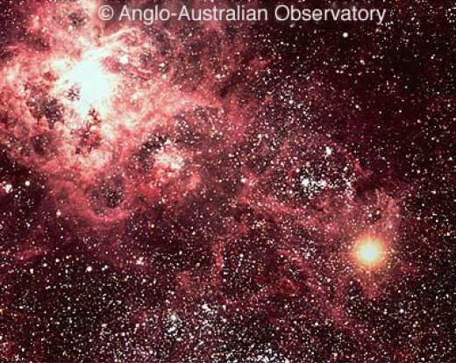
Neutrino interaction with A=3,4 nuclei in Supernovae
Core collapse supernovae are giant explosions of massive stars.
99% of the energy released is carried away by neutrinos, thus the phenomena inside are sensitive to neutrino interactions with matter.
SNe are the probable site for r-process nucleosynthesis.
Supernova 1987A
Neutrino cross sections are too small to measure…
Need parameter free calculations…
DG, Barnea Phys. Rev. C 70, 048801 (2004); Phys. Rev. Lett. 75, 192501 (2007); Nucl. Phys. A 790, 356 (2007); Few Body Syst. (2008).
O’Connor, DG, Horowitz, Schwenk, Barnea, Phys. Rev. C 75, 055803 (2007).
DG, PhD. thesis, arXiv: 0807.0216 (2007).

Slide 29
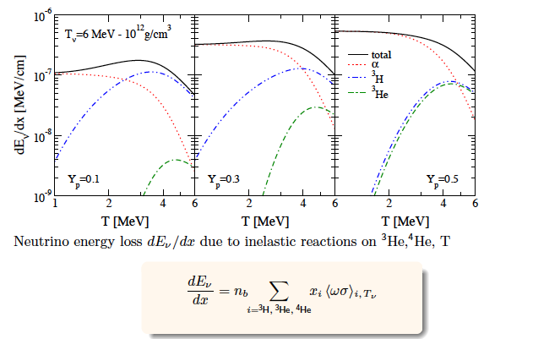
Energy deposition near neutrinosphere

Slide 30
Neutrinos and light nuclei in SNe
A=3 nuclei can have a substantial influence on phenomena near the neutrinosphere.
Arcones et. al show an effect of A=2, 3 nuclei on:
  ν-spectra.
  ν-nucleosynthesis
On the process of producing “usable” cross-sections for
Astrophysical simulations.

Slide 31
To Medium-mass nuclei Land
Direct searches of dark matter, and 0νββ experiments,
use nuclei as detectors
What is the size of an expected signal?
How can one extract microscopic data from the experiment?
How does one move from the known/hypothesized fundamental theory
in the quark level, to the nuclear level?

Slide 32
χEFT inspired description of reaction
Single nucleon current
1 pion exchange
Contact term
O(Q⁰), O(Q²)
O(Q³)
Nuclear model (still uncontrolled) uncertainties (need to use effective SM interactions).
Large computational cost.
Use some approximation – normal order χEFT 2-body currents
Menendez, DG, Schwenk, Phys. Rev. Lett. 107, 062501 (2011)
Menendez, DG, Schwenk, Phys. Rev. Lett. 107, 062501

Slide 33



Normal ordering of 2-body currents
Axial contribution
leading GT
Short-range
Long-range
Pseudo-scalar relative momentum contribution
Pseudo-scalar c.m. momentum contribution
Leading pseudo-scalar
P-dependence

Slide 34
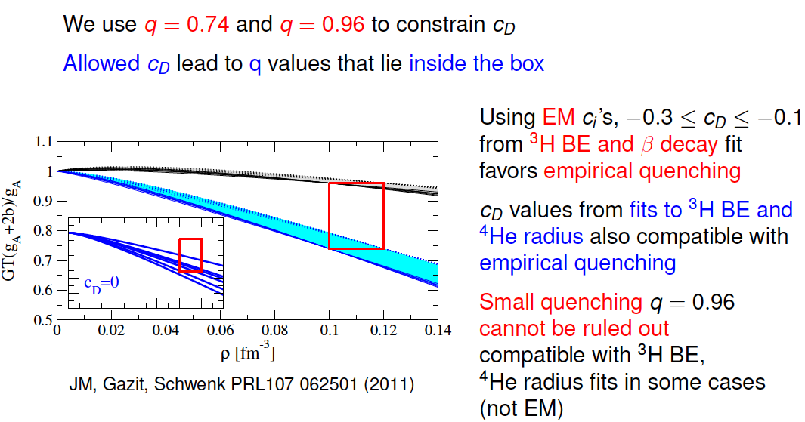
Short range contributions to GT and quenching
Menendez, DG, Schwenk, PRL 107, 062501 (2011)

Slide 35
GT p dependence
Menendez, DG, Schwenk, PRL 107, 062501 (2011)

Slide 36
Neutrino-less double beta decay
Double β-decay only appears when regular β-decay is energetically forbidden or hindered by large J difference.

Slide 37
Neutrino-less double beta decay
0νββ decay needs also massive Majorana neutrinos ➔ detection would prove Majorana nature of neutrinos.
Nuclear Matrix element, biggest uncertainty due to g_{A}:
Relevant momentum transfer: p~100MeV.
Common debate:
Is g_{A} quenched at these momenta?

Slide 38
relevant p for 0νββ ME
Menendez, DG, Schwenk, Phys. Rev. Lett. 107, 062501 (2011)

Slide 39
0νββ Matrix elements predictions
Menendez, DG, Schwenk, Phys. Rev. Lett. 107, 062501 (2011)

Slide 40
Conclusions for 0νββ ME

Slide 41
Spin-dependent WIMP scattering on nuclei
More than 20% of the energy density of the Universe is understood as dark matter.
Promising candidates are WIMPs, such as neutralinos.
This has spurred direct detection of cold dark matter via elastic scattering off nuclei, requiring detailed knowledge of the response to WIMP induced currents in nuclei.
This presents a challenging problem, because even if the coupling of to quarks is known, it needs to be evaluated at the nucleus level in the nonperturbative regime of quantum chromodynamics
Chiral EFT provides an ideal theoretical framework since the typical momentum transfers in direct dark matter detection are of the order of 100 MeV/c.

Slide 42
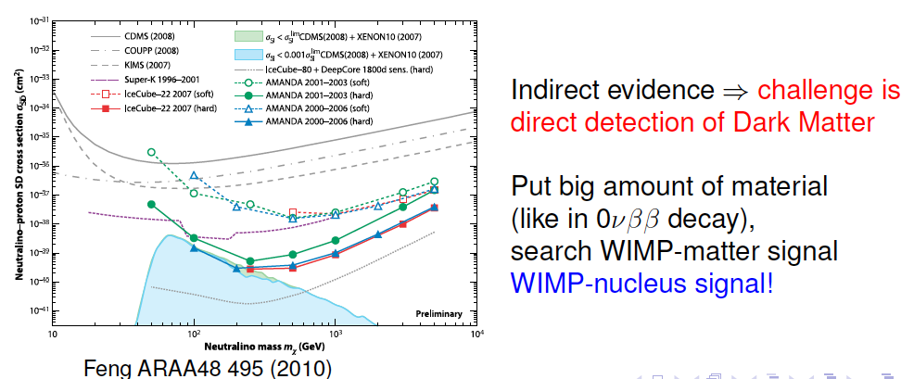
Dark matter

Slide 43


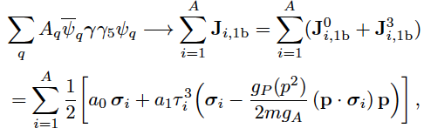
WIMP-nucleus scattering
Spin dependent
At low energies:
Spin dependent:
When moving to the nucleon level:
In the nucleus level the isovector part has 2b corrections – identical to a weak neutral current!
Spin independent
Isoscalar
Isovector
Menendez, DG, Schwenk, Phys. Rev. D 86, 103511 (2012).

Slide 44
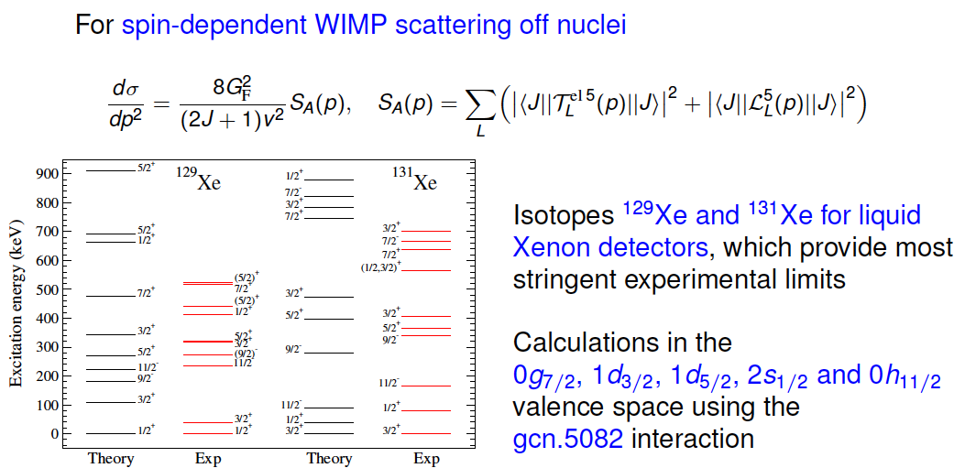
Spin dependent WIMP scattering
Menendez, DG, Schwenk, Phys. Rev. D 86, 103511 (2012).

Slide 45
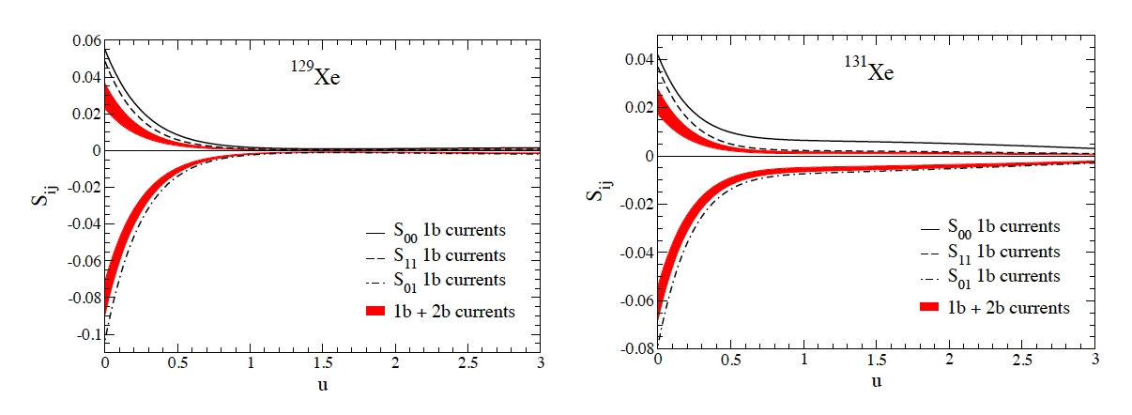
Spin dependent WIMP scattering
Klos, Menendez, DG, Schwenk (2013)

Slide 46
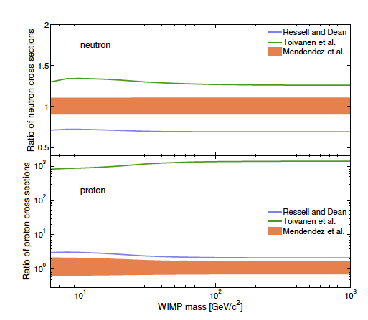
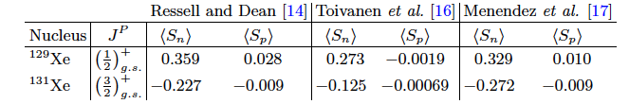
Comparison between nuclear calculations
Xenon100 coll., arXiv:1301.6620 (2013)
Ressel, Dean, Phys. Rev. C 55, 535 (1997)
Toivanen et al, Phys. Rev. C 79, 044302 (2009)
Menendez, DG, Schwenk, Phys. Rev. D 86, 103511 (2012).

Slide 47
Summary
Using χEFT to calculate reactions with nuclei is useful:
Constrain the Nuclear interaction and structure.
Extract microscopic information about the fundamental theory and its symmetries, and probe the limits of the standard model.
Predict in-medium evolution of nuclear properties.
Predict reactions of astrophysical importance.
Nuclear theory is in the process of building a unified fundamental understanding of reactions and structure,
which can shed light on many mysteries in physics.

