Slide 1

D. Frekers
Experimental results on
ββ decay matrix elements
or
still some surprises in nuclear physics
KVI (NL), RCNP(JP), TRIUMF(CAN)

Slide 2
OUTLINE
talk about
1) ββ -decay & nuclear ββ decay matrix elements
(some suprises in nuclear physics)
  charge-exchange reactions (d,²He) and (³He,t)
    ⁴⁸Ca, ⁶⁴Zn, ⁷⁶Ge , ⁸²Se, ⁹⁶Zr, ¹⁰⁰Mo ,
    ¹¹⁶Cd, ^{128/130}Te, ¹³⁶Xe , ¹⁵⁰Nd
    (KVI, RCNP)
2) electron-capture & radioactive-ion traps
(TRIUMF)

Slide 3
β⁻β⁻ decay
never 0⁺
EC
(odd-odd)
0⁺
(Z+1,N-1)
(even-even)
(Z,N)
β⁻
β⁻β⁻
neutron-rich
0⁺
(even-even)
(Z+2,N-2)
2νβ⁻β⁻ decay:
0νβ⁻β⁻ decay:

Slide 4
Quick reminder of neutrino mass problem
2 extra Majorana phases
known quantities:

Slide 5
Neutrino mass scenarios:
1) degenerate:
m_{ν}
m₁
m₂
m₃
best of all cases
2) normal hierarchy:
m₃
m_{ν}
= zero!! for:
m₂
m₁
3) inverted hierarchy:
m_{ν}
m₂
if inverted hierarchy were determined
(LHC, SN-ν, precision oscillation)
THEN:
or the neutrino is a Dirac particle
m₁
NME important
m₃

Slide 6
NME
2νβ⁻β⁻ decay
q-transfer like ordinary β-decay
(q ~ 0.01 fm⁻¹ ~ 2 MeV/c)
only allowed decays possible

Slide 7
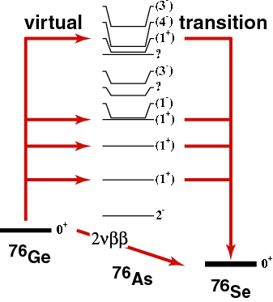
!!
exp
favorable:
High Q-value
High Z
Unfavorable:
high neutron excess
  (because of Pauli-Blocking)
p
n
p
n

Slide 8
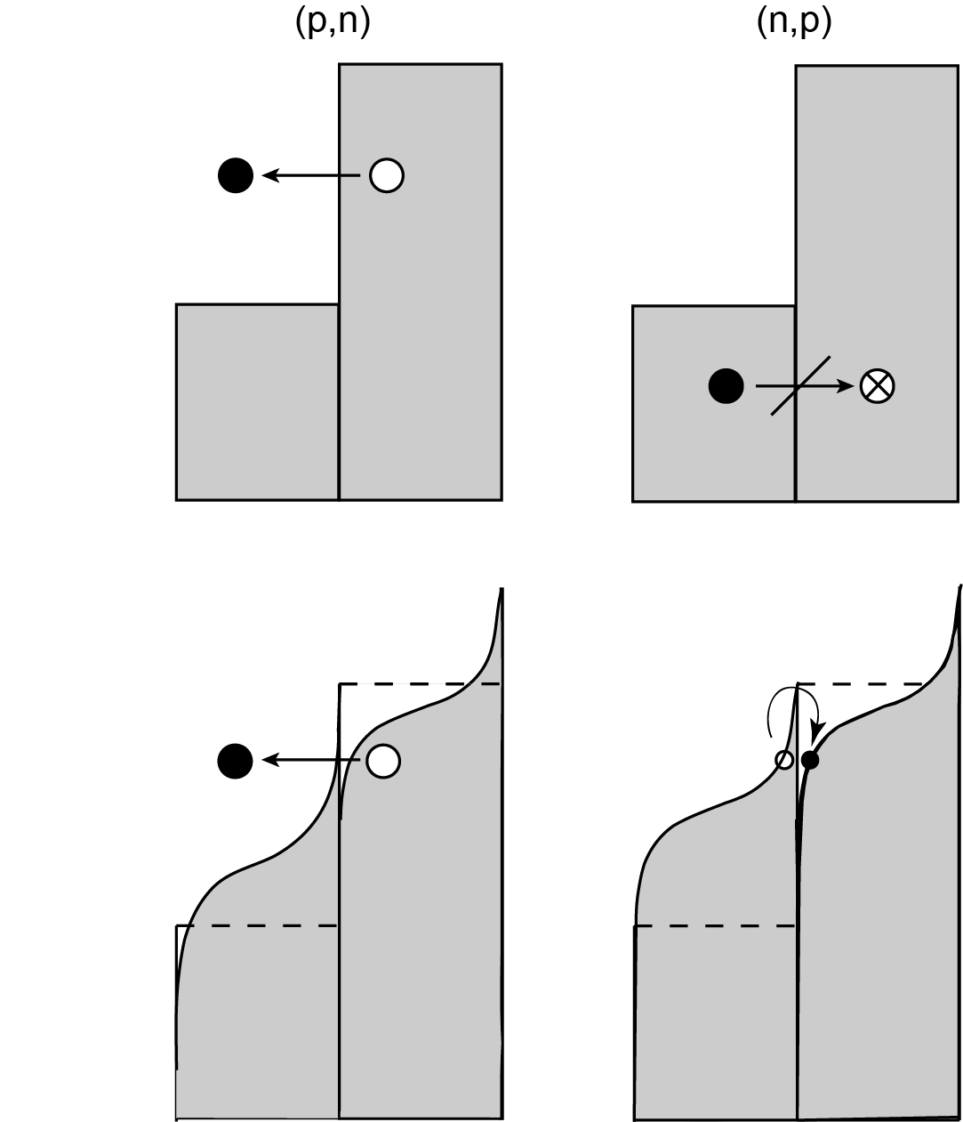
A layman‘s sketch of thePauli-blocking
remember: GT requires Δħω=0 !!
Extreme case:
(p,n) completely open
(n,p) completely blocked
Soft surface case:
(p,n) still largely open
(n,p) still largely blocked
yet probabilities could be finite
but tiny
FSQP-model (Ejiri 2009,2012)
large
small

Slide 9
To note:
two sequential & „allowed“ β⁻-decays
  of „Gamow-Teller“ type
„first-“ oder „higher order forbidden“
  decays negligible
Fermi–transitions don‘t contribute
  (because different isospin-multiplet)
accessible thru charge-
exchange reactions in
(n,p) and (p,n) direction
( e.g. (d,²He) or (³He,t) )

Slide 10
NME
0νβ⁻β⁻ decay
neutrino enters as virtual particle,
q~0.5fm⁻¹ (~ 100 MeV/c)
degree of forbiddeness weakened

Slide 11
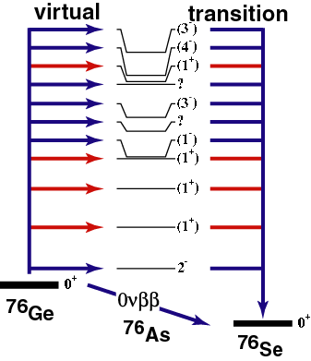
!!
Mass of Majorana-ν !
theory
indepnt. of (A,Z)
(except for magic nuclei)
To note:
„first-“ or „higher order forbidden“
  transitions important
Fermi –transitions important
Pauli-blocking largely lifted
high Q-value, high Z important
NOT accessible thru
charge-exchange reactions

Slide 12
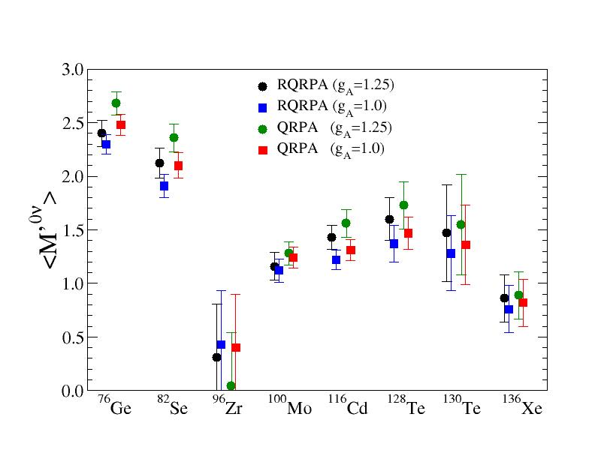
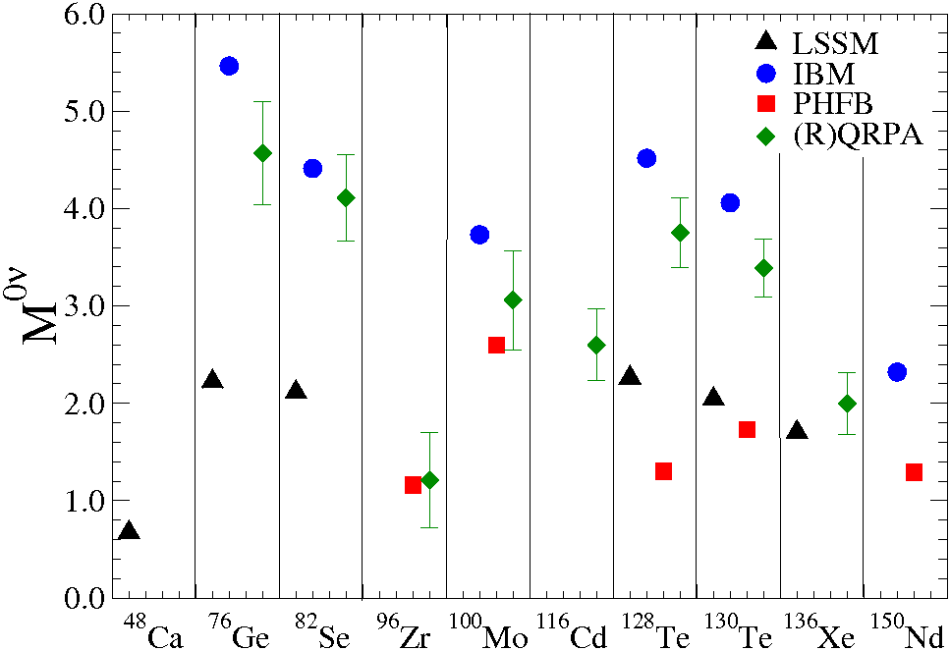
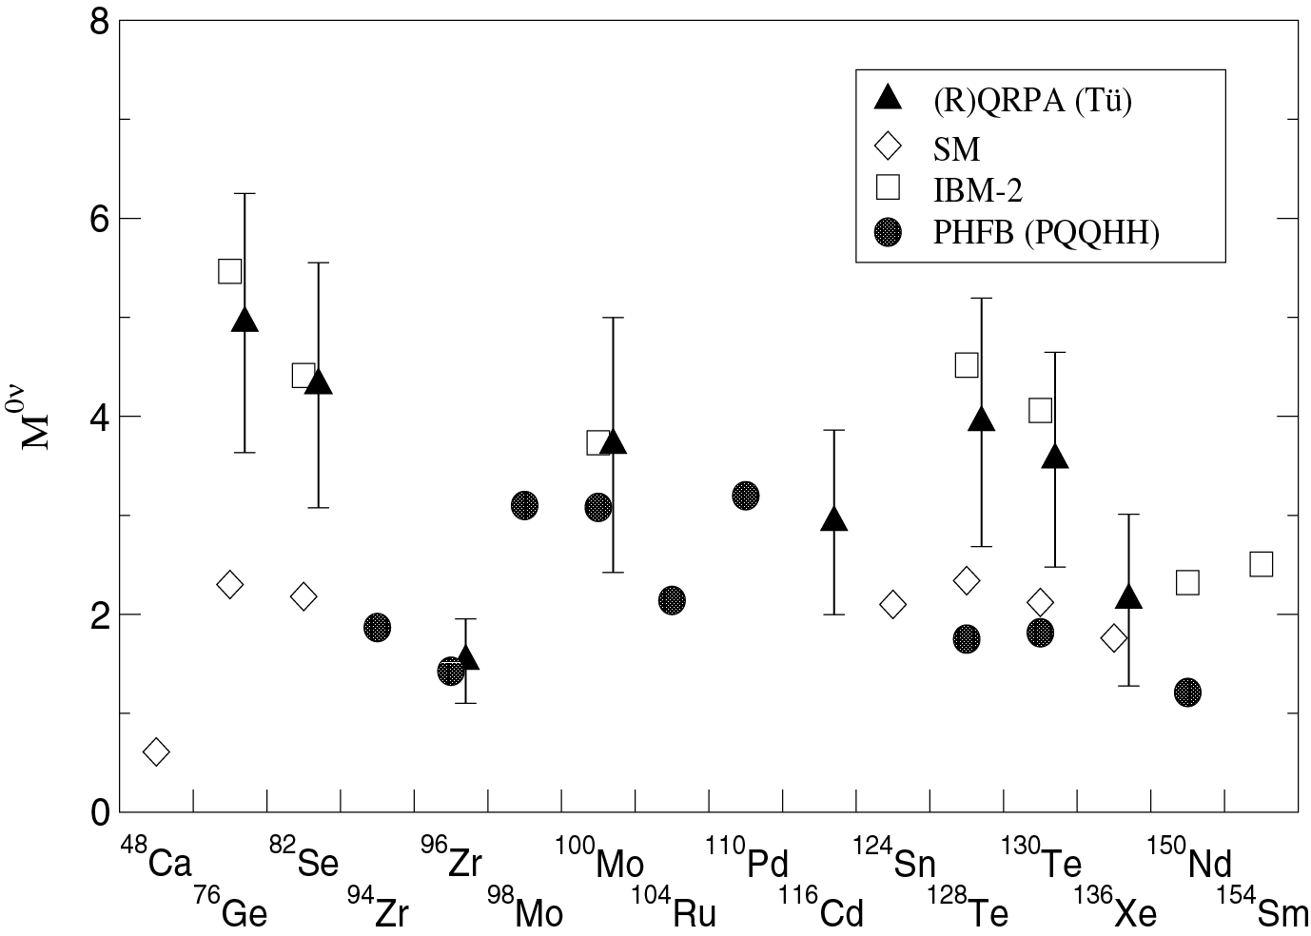
Neutrinoless Double Beta Decay Nuclear Matrix Elements
V.Rodin, A. Faessler, F. Šimkovic, P. Vogel, PRC 68 (2003) 044303;
Situation 2011

Slide 13
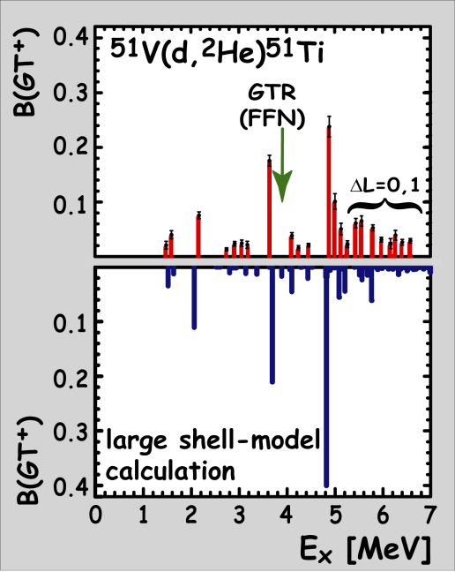
The message after many years of expmlt studies of 2νββ!! -NME
In all cases the low-energy part of GT-excitation makes up most of the NME.
The GT giant resonance has little to no effect on NMEs (Pauli-blocked from the 2nd leg).
A large difference of the nuclear shape between mother and grand-daughter leads to a suppression of the NME (case: ⁷⁶Ge).
There are some very special and simple cases (⁹⁶Zr, ¹⁰⁰Mo). ¹⁰⁰Mo has the LARGEST of all NMEs !! Why ??
What is wrong with ¹³⁶Xe – why is it so stable ? It has the smallest of all NMEs !! Why ??
What is the effect of 2n-pair in ^{128,130}Te ?
Finally: There is a level of disappointment
about theoretical models !! Note: στ is the
simplest of all excitations!! → BUT
  expmtl. low-energy GT⁺ / GT⁻
  distribution poorly described, except
  GT-resonance contribution to NMEs
  is overestimated
  Yet, final number OK.
Martinez-Pinedo
Martinez-Pinedo

Slide 14
Back to 2νββ decay and charge-exchange reactions

Slide 15
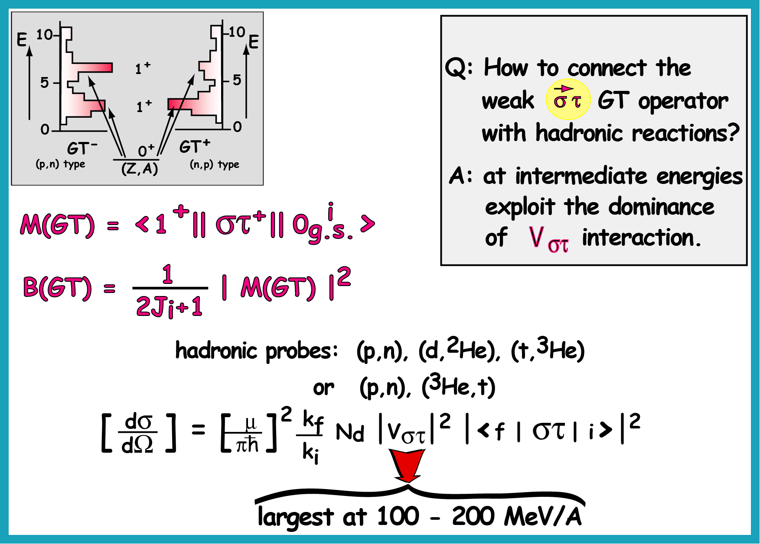
-
(n,p),
300

Slide 16
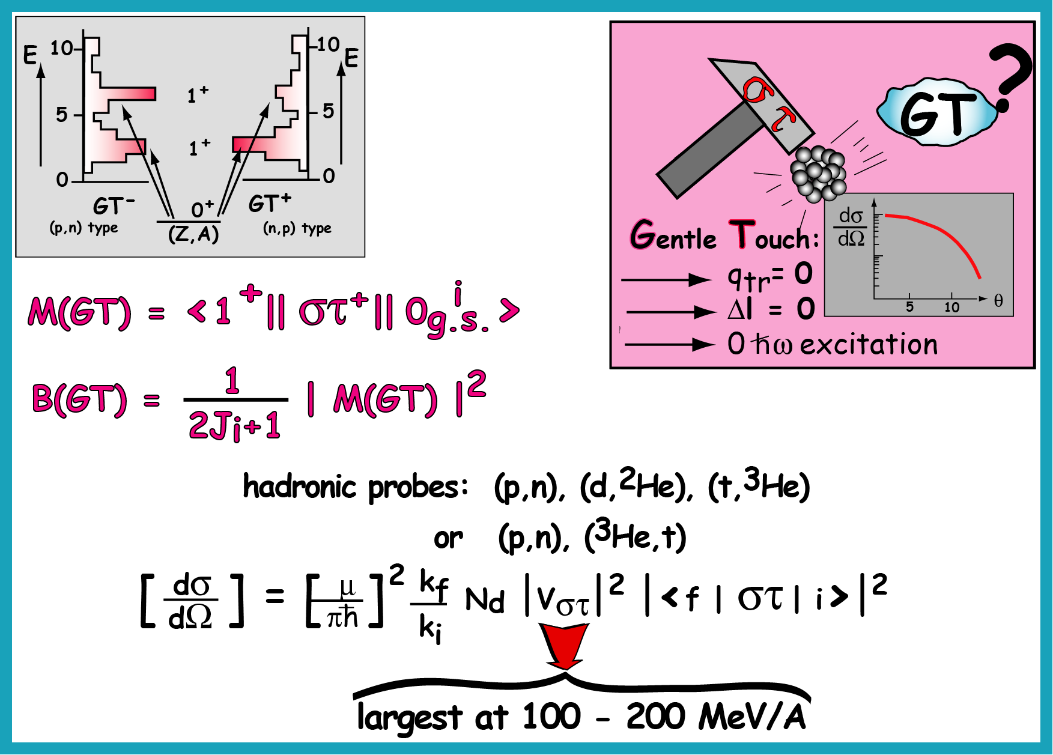
-
(n,p),

Slide 17
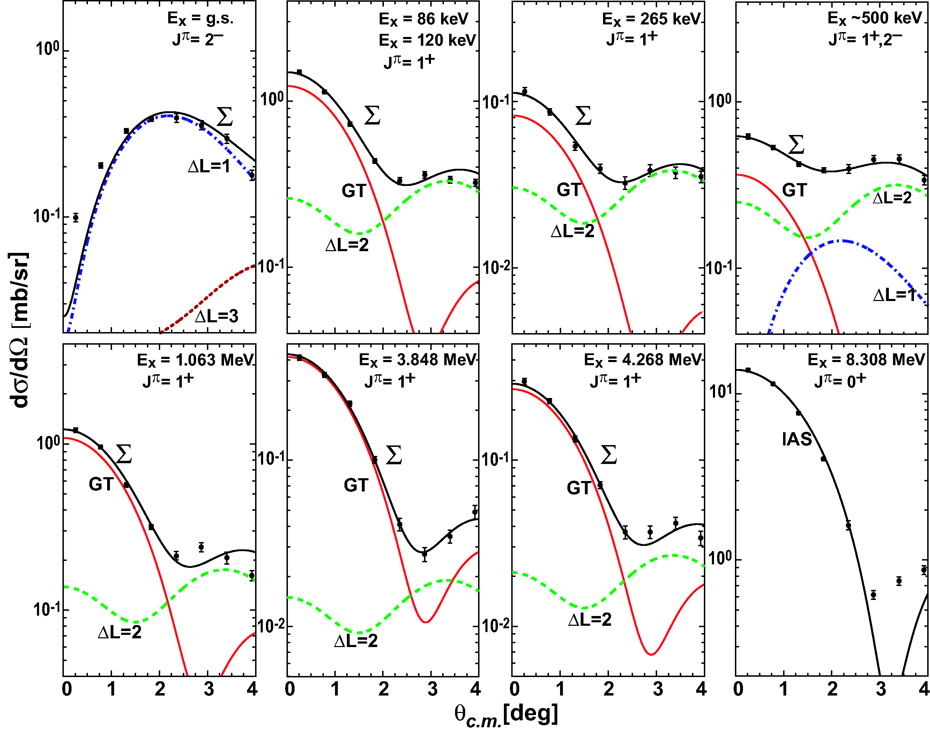
examples
⁷⁶Ge-⁷⁶As
2⁻
1⁺
1⁺
1⁺
1⁺
1⁺
1⁺
0⁺

Slide 18
⁷⁶Ge
the most important
ββ-decaying nucleus
Resolution is the key issue !!!

Slide 19
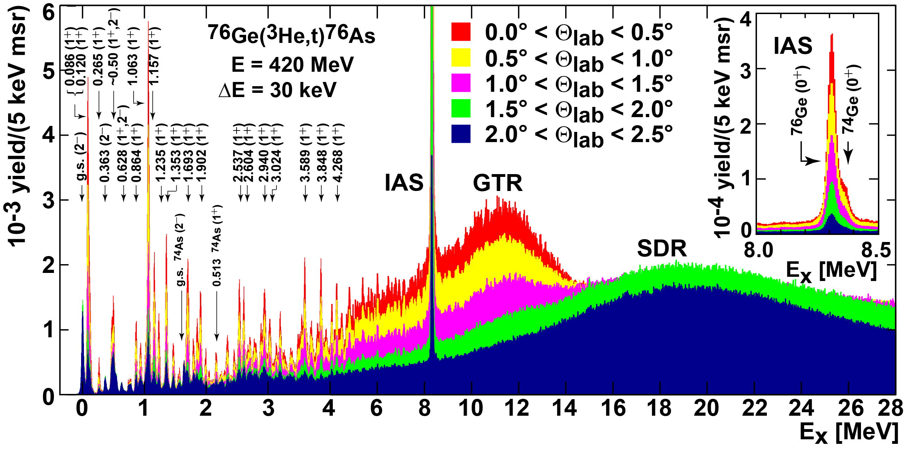
about 70 !! individual levels up to 5 MeV !!!

Slide 20
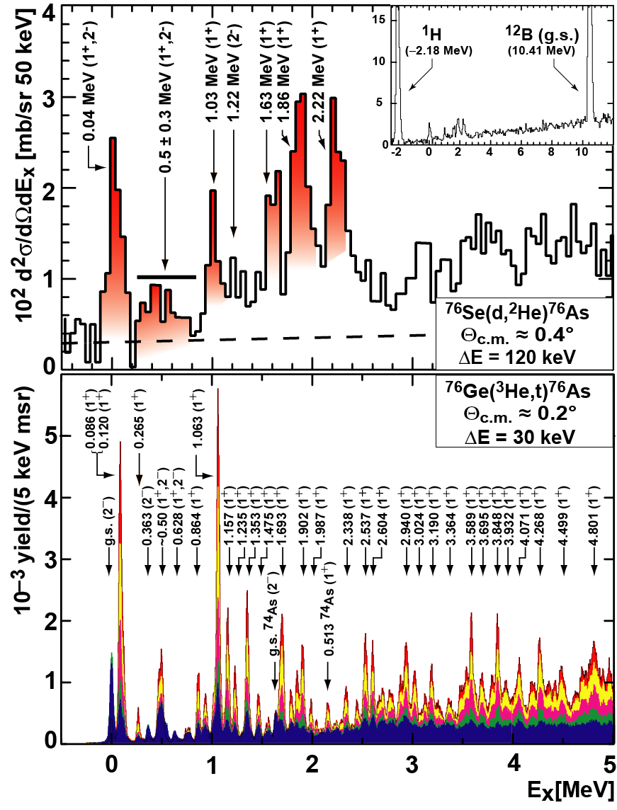
an
anticorrelation
of strength
(very similar to ⁴⁸Ca)
! ! ! ! ! ! !
An effect of the
difference of
deformation ??
⁷⁶Se:
oblate
(β₂ ~ −0.2)
⁷⁶Ge:
moderately
oblate/ prolate
(β₂ ~ 0.1)

Slide 21

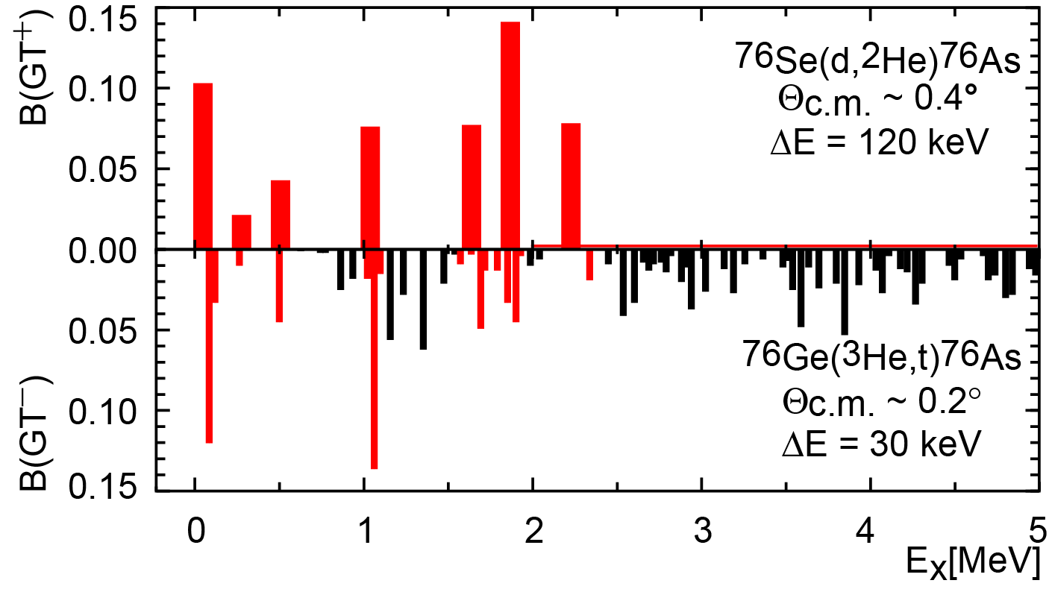
about 70 !! individual levels
up to 5 MeV !!!
???? anticorrelation ????
an effect of the difference of deformation ??
⁷⁶Ge
⁷⁶Se
moderately
oblate/ prolate
(β₂ ~ 0.1)
oblate
(β₂ ~ −0.2)

Slide 22
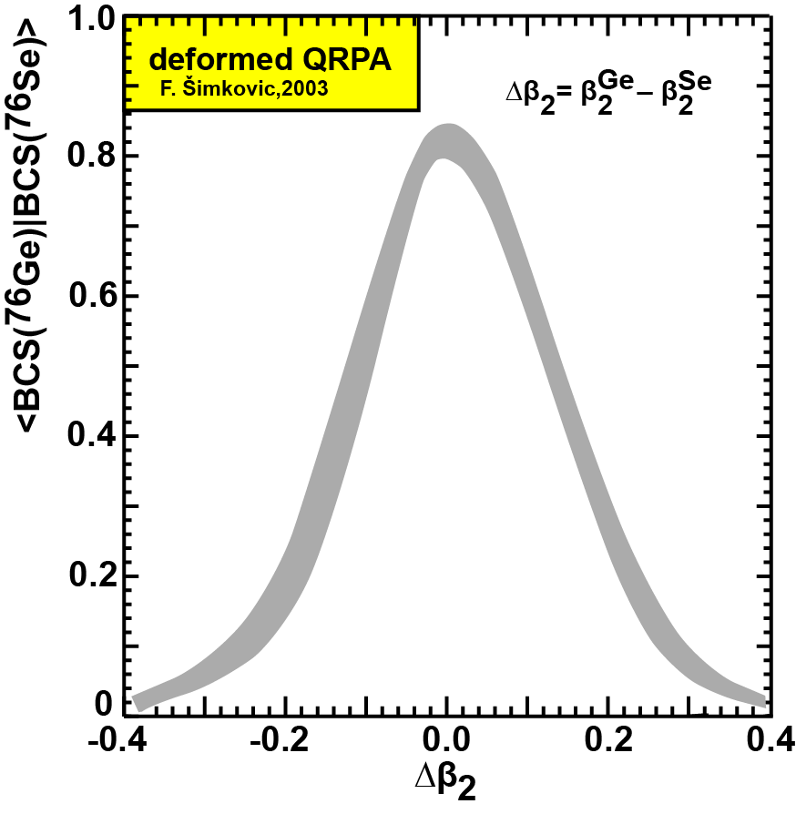
taken from F. Simkovic et al.
(cf also P. Sarriguren et al., PRC67,44313 (2003))
Intrinsic deformation
seems to affect the
2νββ-ME, however,
it is the difference of deformation between mother and daughter and not their absolute values which counts.
Exp‘lly the deformation
seems to manifest itself
in a state-by-state
mismatch, rather than
an overall reduction of
B(GT)‘s.

Slide 23
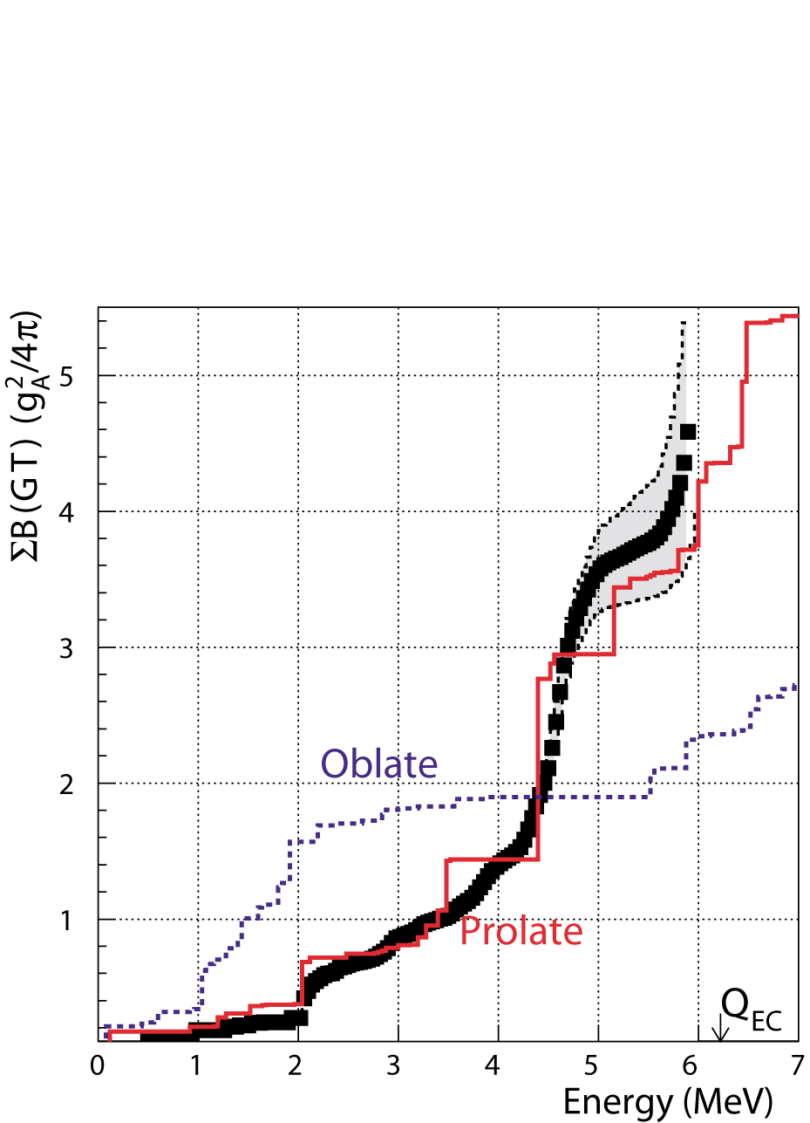
E. Nacher, et al. PRL 92, 232501 (2004).
76-Sr
prolate
or
oblate

Slide 24
with bckgnd correlation
0.23(7)
0.18(2)
no bckgnd correlation
triplet of states:
0.044, 0.082, 0.12 MeV
Low-E part of M_{DGT} makes up
~100(+)% of 2νββ-ME
M_{DGT} = 0.12 + 0. 01 MeV⁻¹
T_{1/2} = (2.1 + 0.1) x 10²¹ yr
No need for GT giant resonance contribution
(note: 0.06 MeV⁻¹ are due to low-E triplet, which may not be correlated!!)

Slide 25
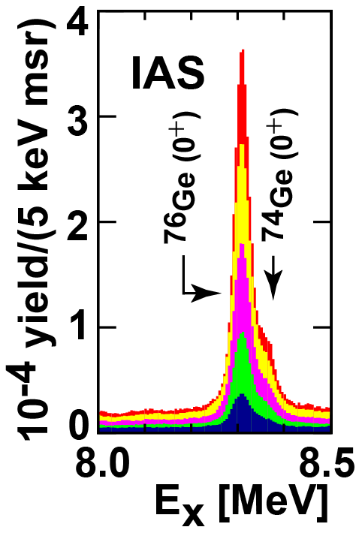
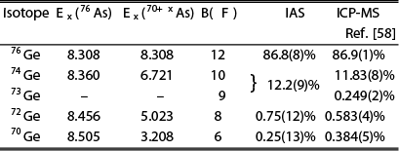
A side-note on isobaric analog states
(IAS = replica of the initial g. s.)

Slide 26
⁹⁶Zr
the most neutron-rich
Zr-isotope N-Z=16

Slide 27
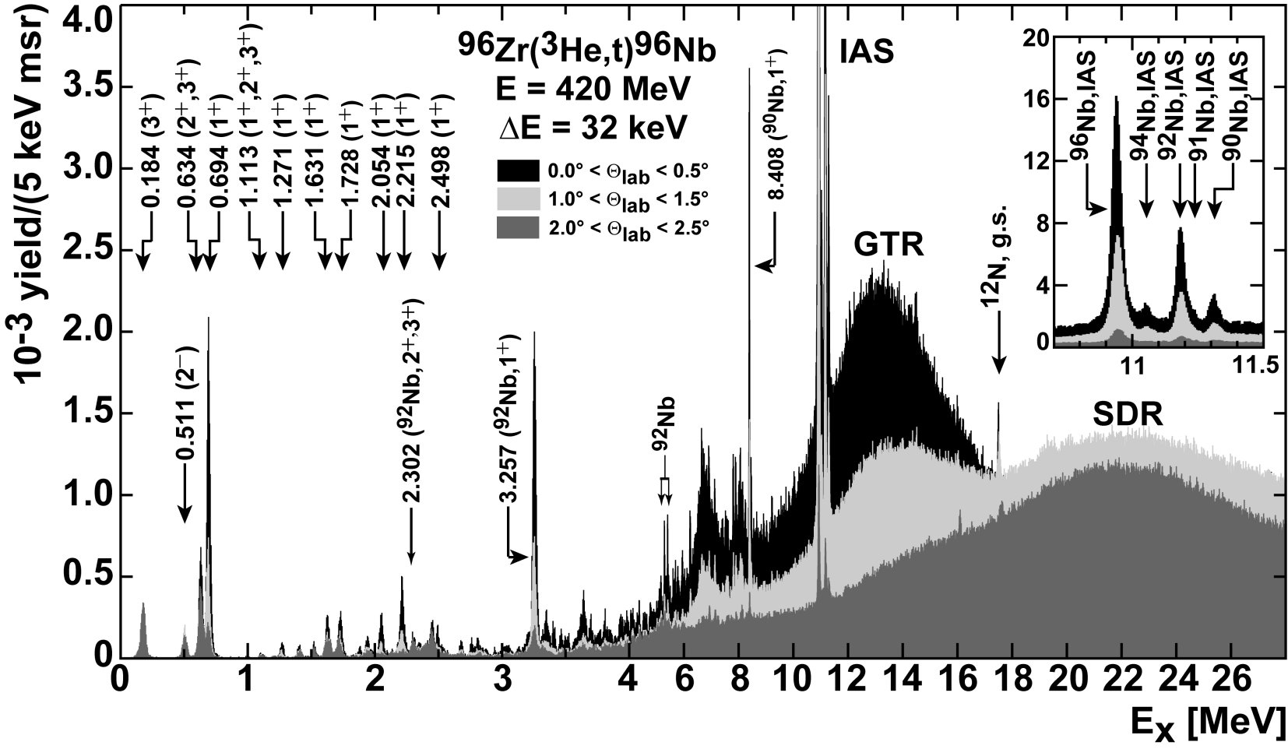

Slide 28
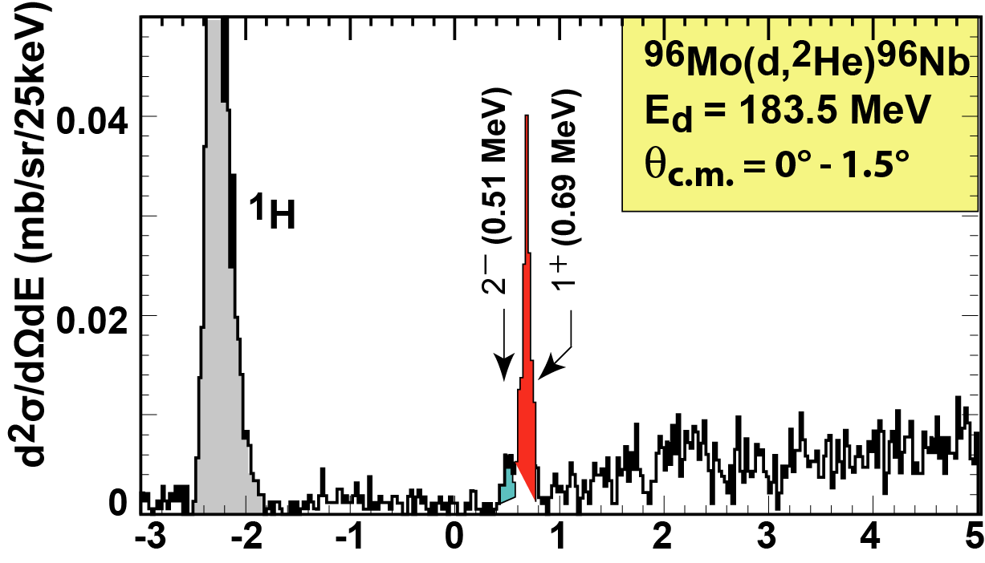
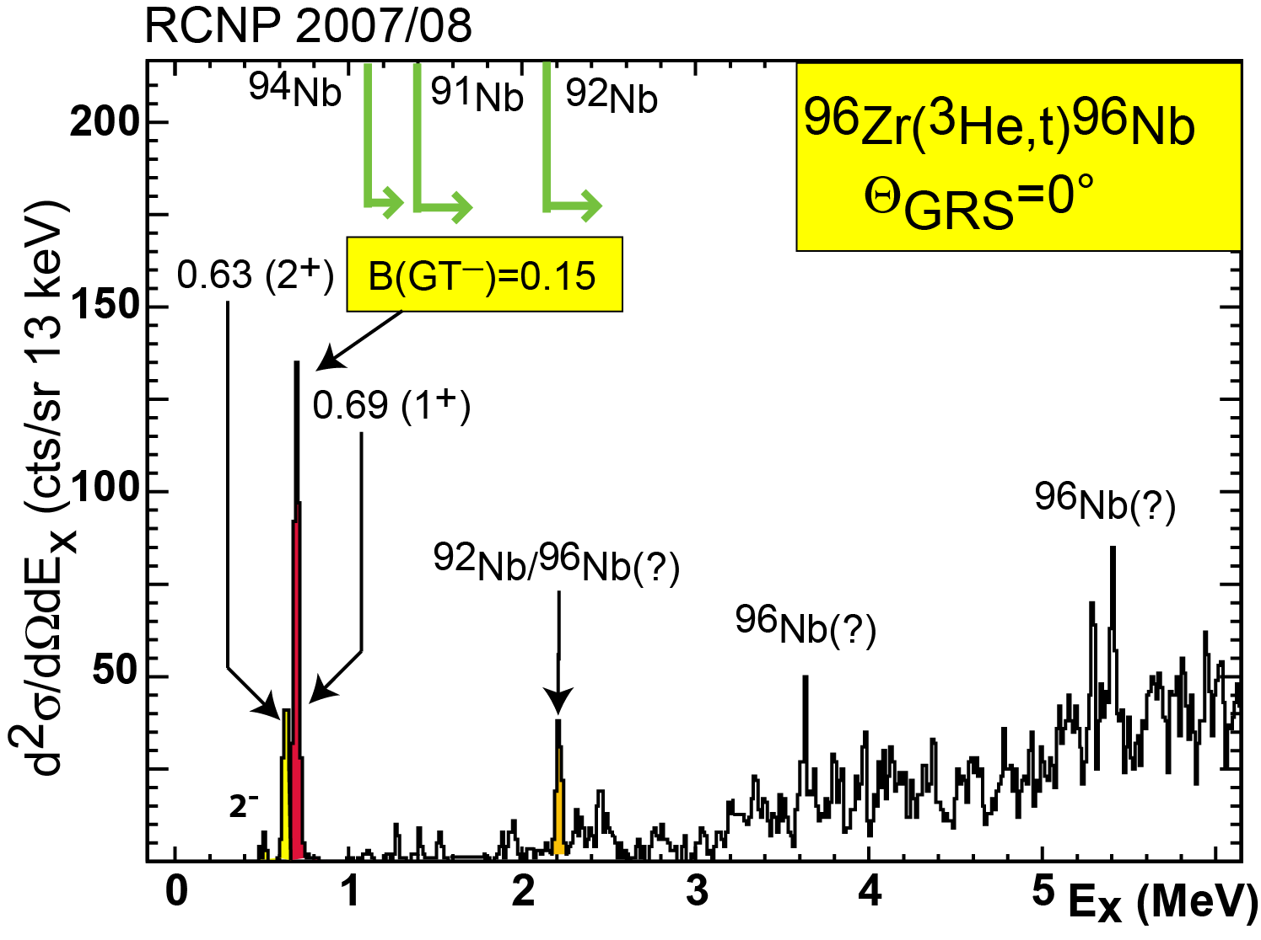
(d,²He)
(³He,t)
Ex (MeV)
B(GT⁺) = 0.3
B(GT⁻) = 0.15
Fascination:
With this 1 level only:

Slide 29
¹⁰⁰Mo
Important for
ββ-decay
solar neutrino detector
(Q=-168 keV)
SN-neutrino detector
SN-neutrino temperature

Slide 30
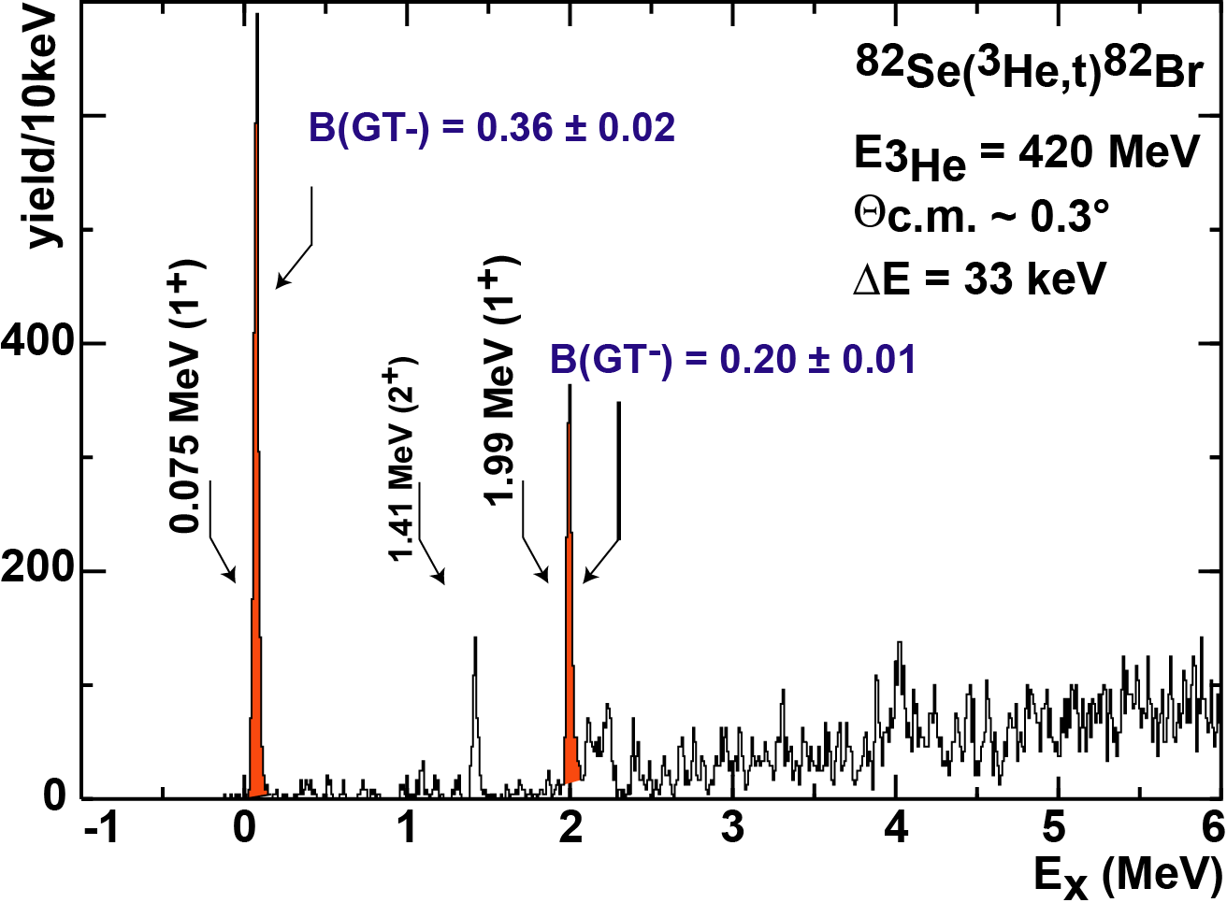
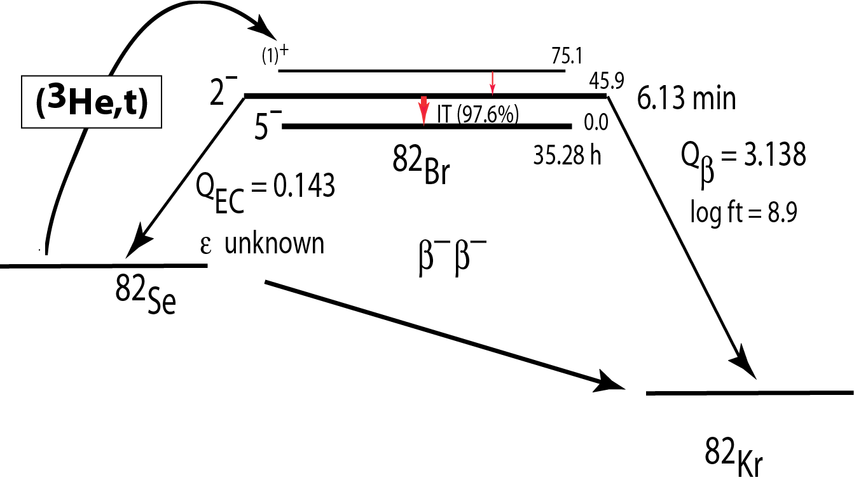

Slide 31
¹⁰⁰Mo
Important for
ββ-decay
solar neutrino detector
(Q=-168 keV)
SN-neutrino detector
SN-neutrino temperature

Slide 32
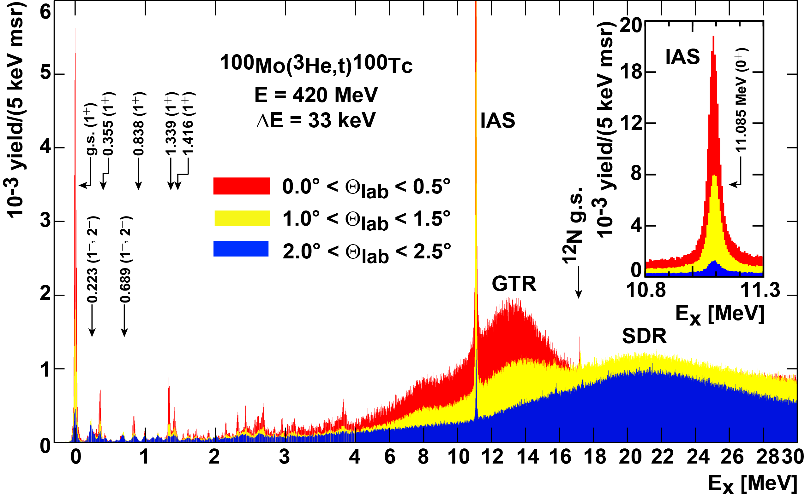
almost entire GT strength
concentrated in ground-state
¹⁰⁰Mo

Slide 33

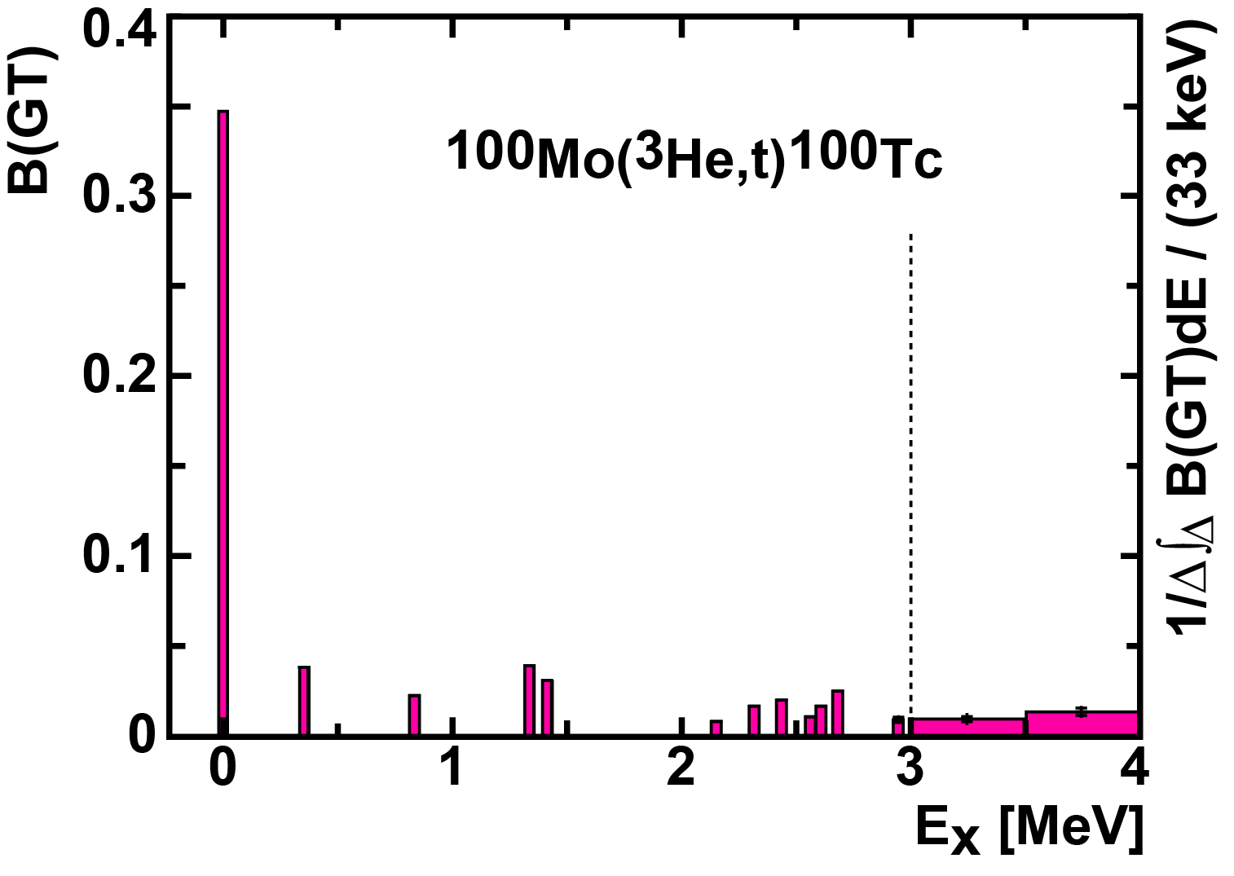
¹⁰⁰Mo
entire low-energy GT⁻strength
is concentrated in
ONE
single state only (i.e.the g.s.)
with β⁻ logft
No need for GT giant resonance

Slide 34
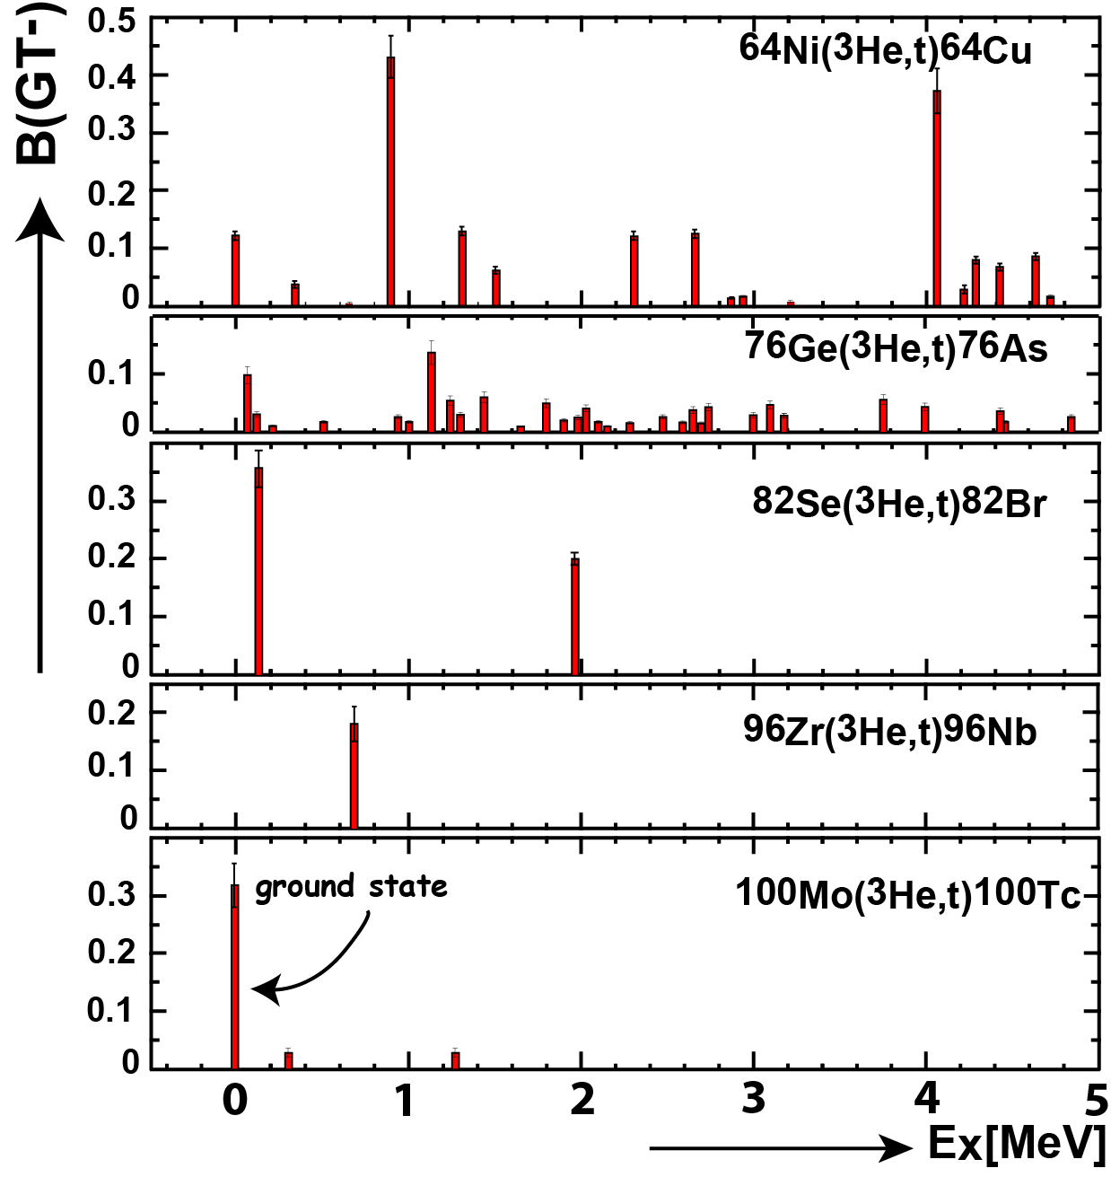
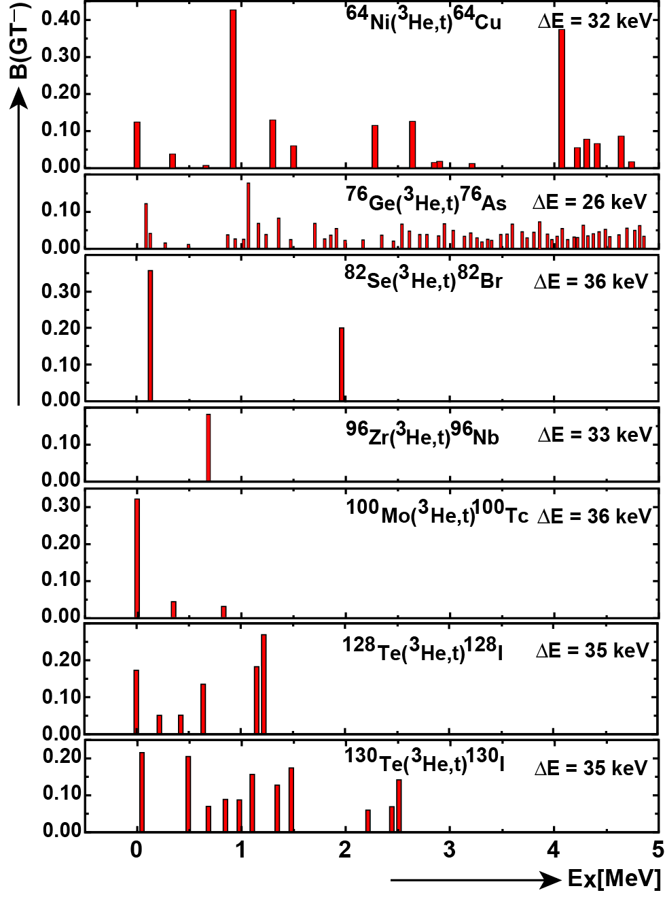
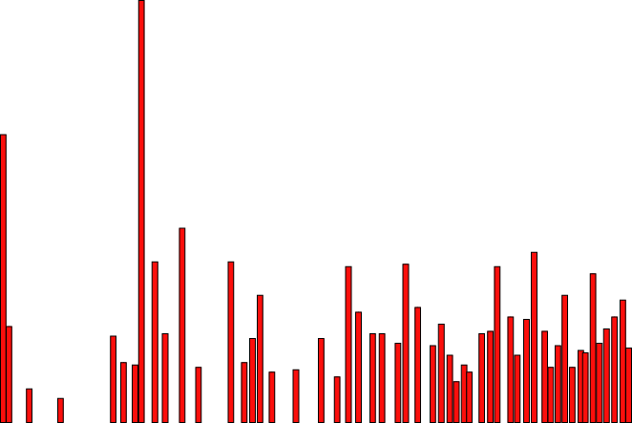
⁶⁴Zn(εε, εβ+)
⁷⁶Ge(β⁻β⁻)
⁸²Se(β⁻β⁻)
⁹⁶Zr(β⁻β⁻)
reduced
spreading
of GT
strength
¹⁰⁰Mo(β⁻β⁻)
¹²⁸Te(β⁻β⁻)
¹³⁰Te(β⁻β⁻)

Slide 35
^{128,130}Te

Slide 36
¹²⁸Te - ¹³⁰Te
¹³⁰Te
¹²⁸Te
from
geochem. ratio
→ decay of ¹²⁸Te is accelerated by factor 2 !!

Slide 37
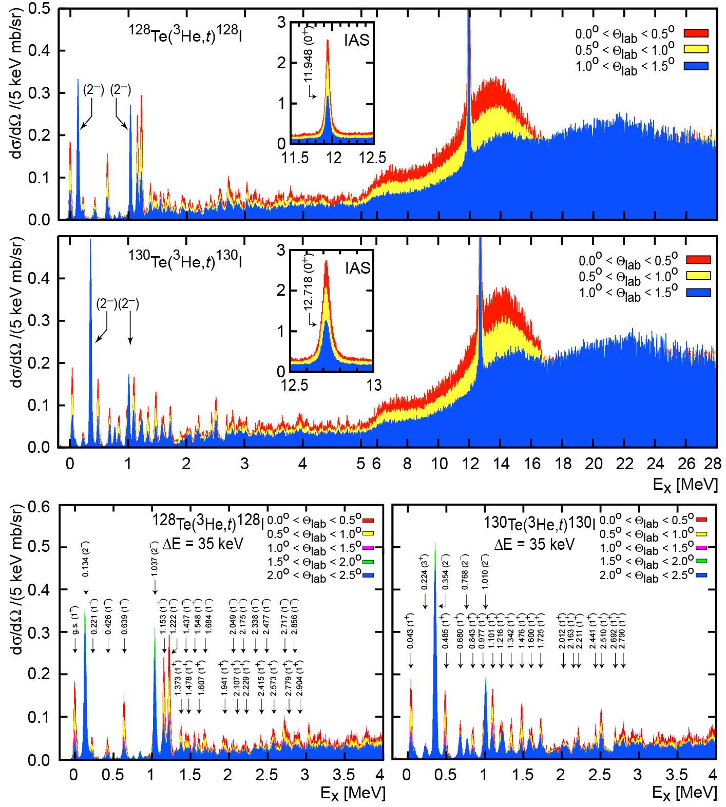
¹²⁸Te
¹³⁰Te
¹²⁸Te
¹³⁰Te
qualitatively equal
&
moderately fragmented

Slide 38
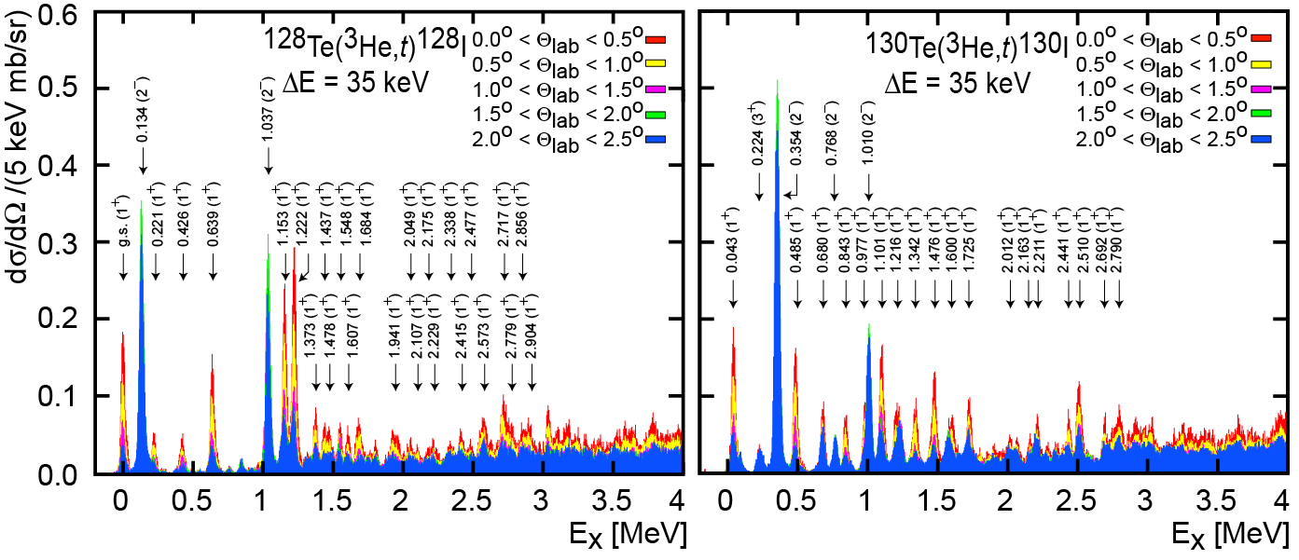
¹²⁸Te
¹³⁰Te
adding a neutron pair:
little change at low energies
state at 1.2 MeV tends to dilute

Slide 39
¹²⁸Te
¹³⁰Te
adding a neutron pair:
little change at low energies
state at 1.2 MeV tends to dilute

Slide 40
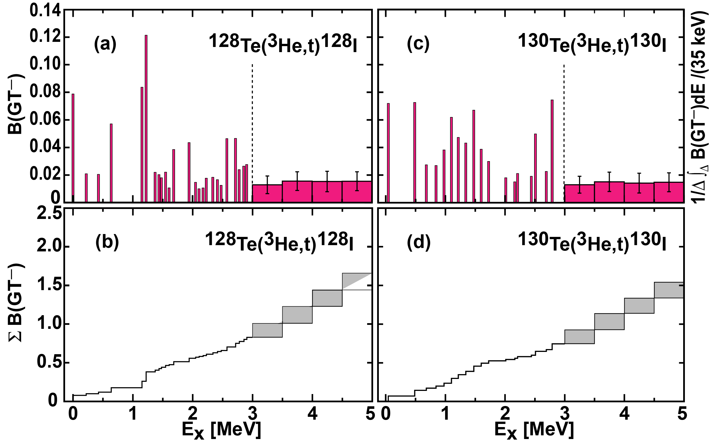
¹²⁸Te
¹³⁰Te
(slightly more fragmented)

Slide 41
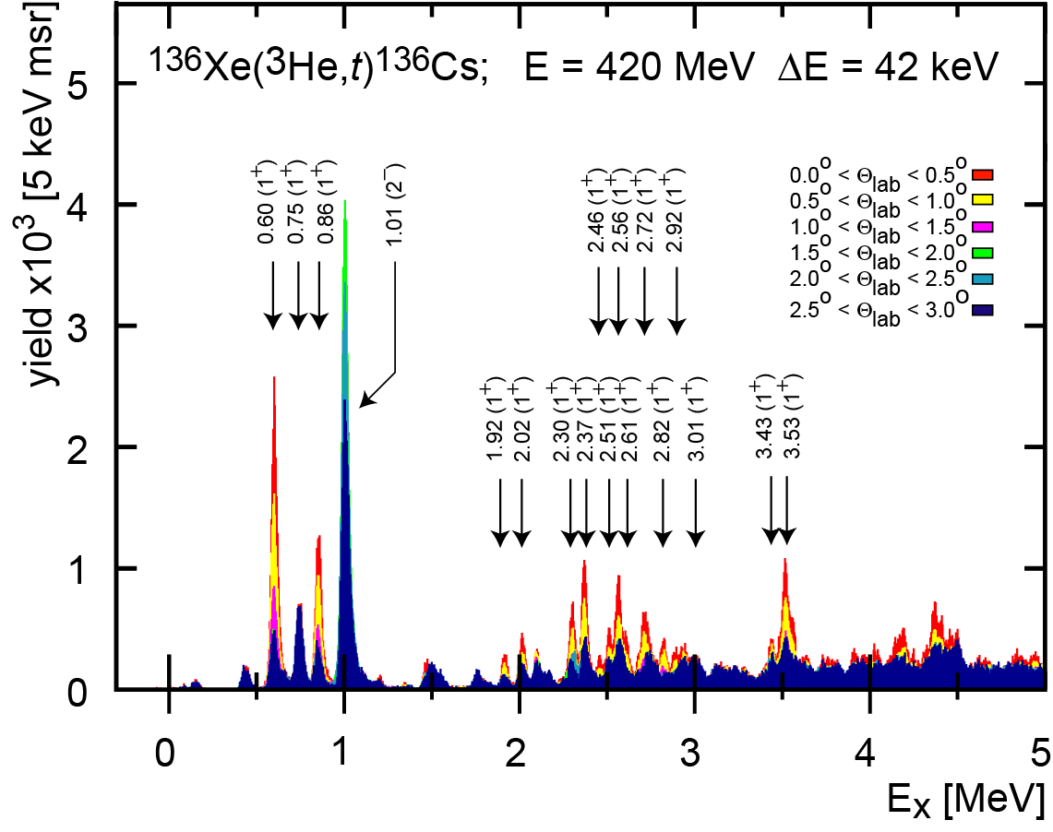
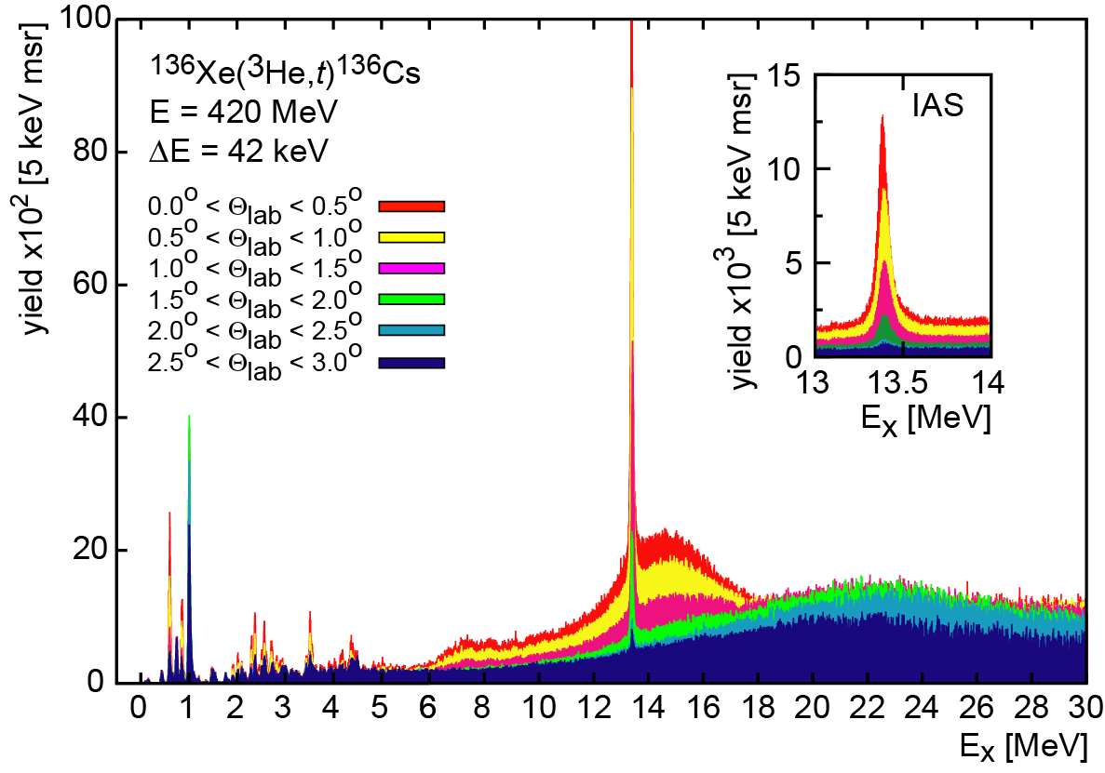
¹³⁶Xe

Slide 42
¹³⁶Xe

Slide 43
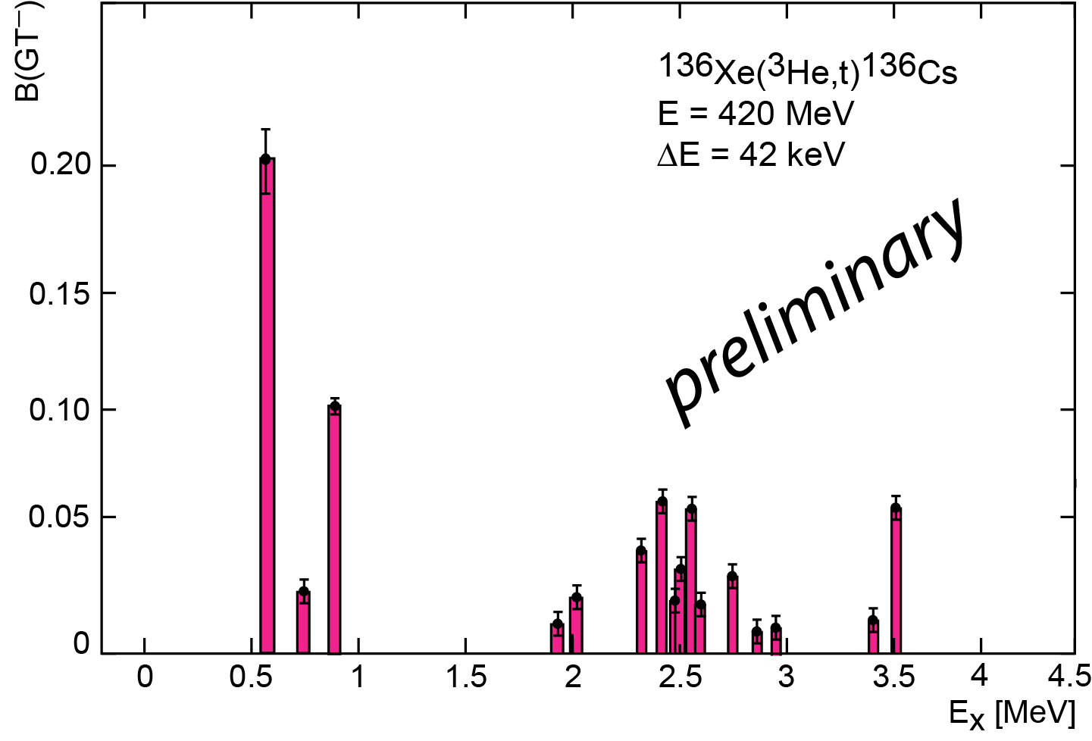
How big is the matrix element?
−
preliminary
+

Slide 44
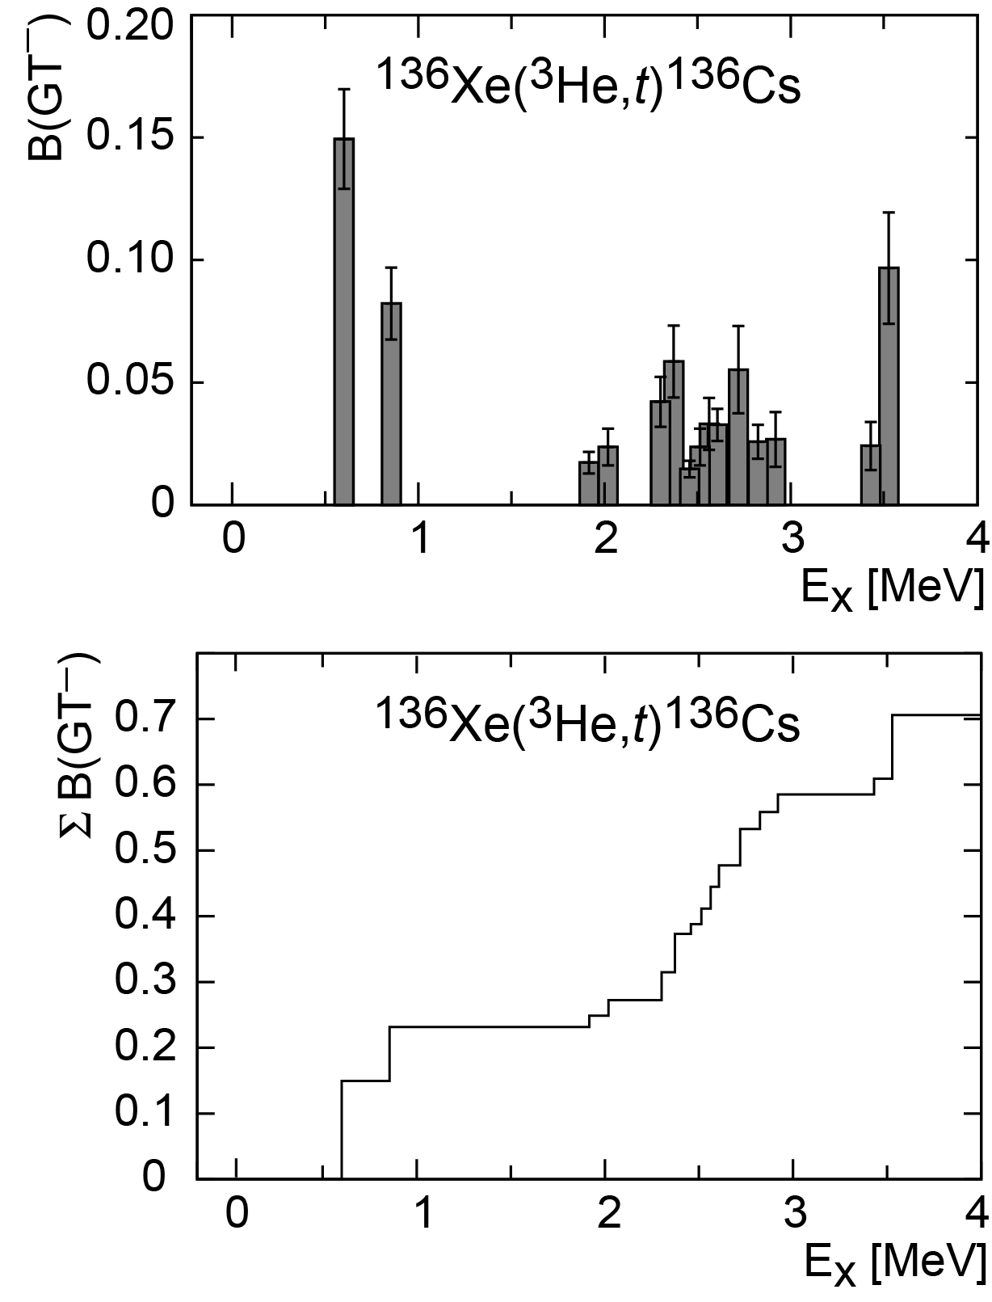
How big is the matrix element?
−
+
scenario-1
all positive sign —>
Unlikely (in our paper Puppe-PRC-2011)
BUT
scenario-2
sign(clst-1) = - sign (clst-2)
Likely (in our paper Puppe-PRC-2011)

Slide 45
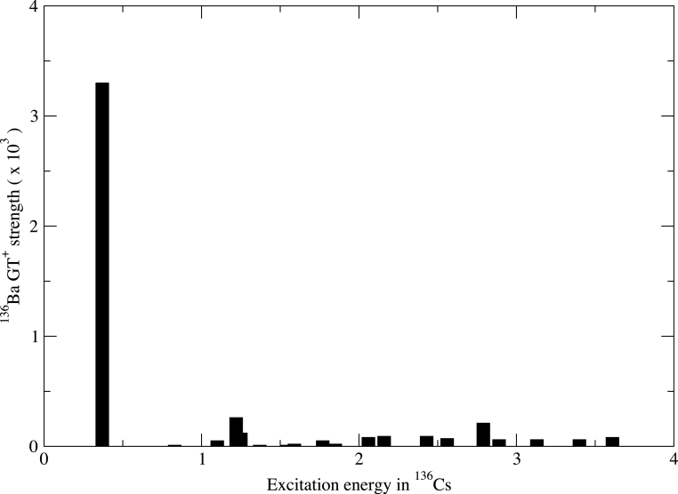
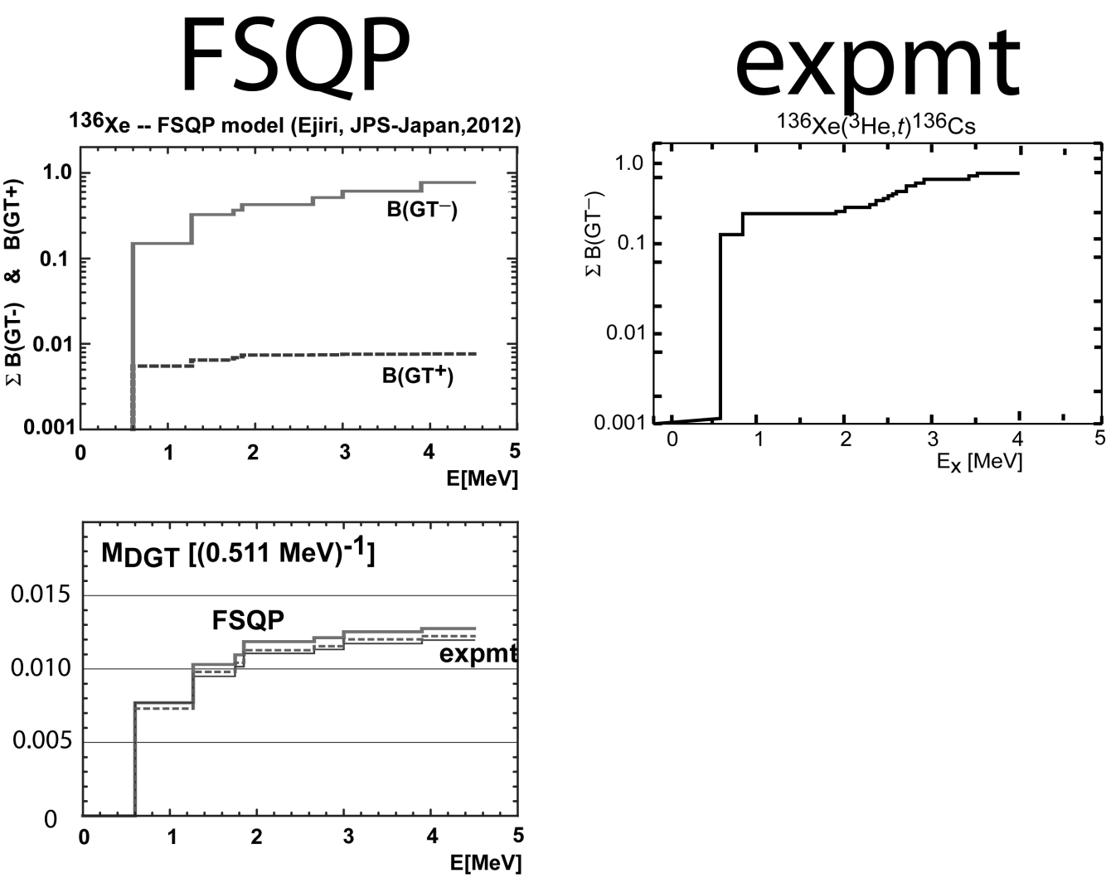
A. Poves:
NO cancellation !!
There is no B(GT⁺) strength,
except for the lowest 1⁺ state
3x10⁻³
H. Ejiri:
Shell model and the
FSQP DO provide
an explanation for
the pathologically
long half-life

Slide 46
Conclusion
1
Chargex reactions are a powerful tool to determine the 2νββ NME
(d,²He) (t,³He) → „GT⁺ leg“ & (³He,t) → „GT⁻ leg“
high resolution is essential.
2
The difference between the intrinsic deformation of mother and daughter nucleus seems to cause „state-by-state mismatch“ of B(GT)‘s --------→ How big is the effect on the 0νββ NME ??
3
In all cases the low energy part of the GT distribution seems to be most relevant for the 2ν decay
even „Single-State-Dominance“ for ⁹⁶Zr und ¹⁰⁰Mo
Would this be true for the 0νββ decay as well ?
4
There is an increased urgency to improve theoretical models

Slide 47
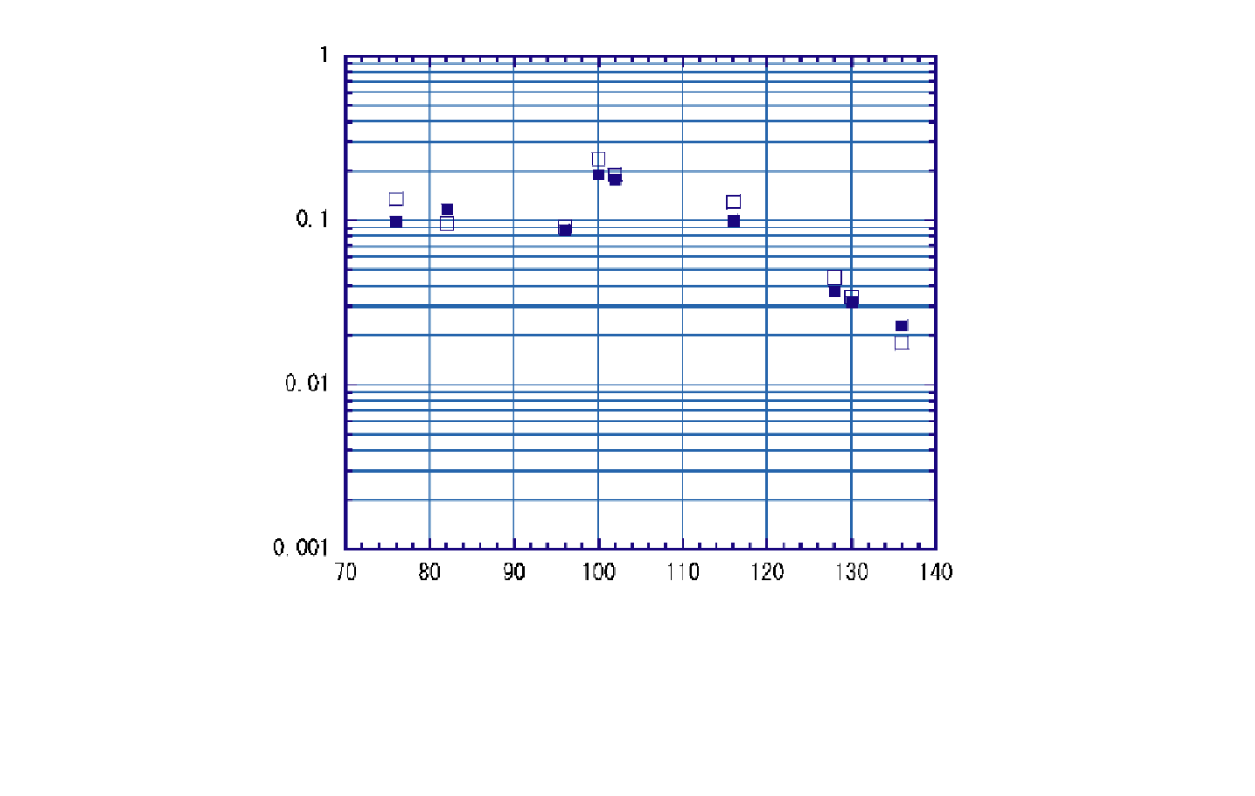
1
0.1
M^{2ν}(exp) vs. M^{2ν}(FSQP)
0.01
0.001
70
80
90
100
110
120
130
140
A

Slide 48





In-trap spectroscopy at the
TITAN facility for EC-rates
of intermediate ββ-decay nuclei

Slide 49
Motivation
Determination of the electron-capture branching ratios (ECBRs) for the odd-odd intermediate nuclei in ββ-decay
ECBRs provide information about the g.s. properties of the nucl. wave function connected to ββ-decay (2ν,0ν)
experimental data as input to theoretical models for calculating NMEs!
Novel approach to measure small branching ratios using in-trap decay spectroscopy

Slide 50
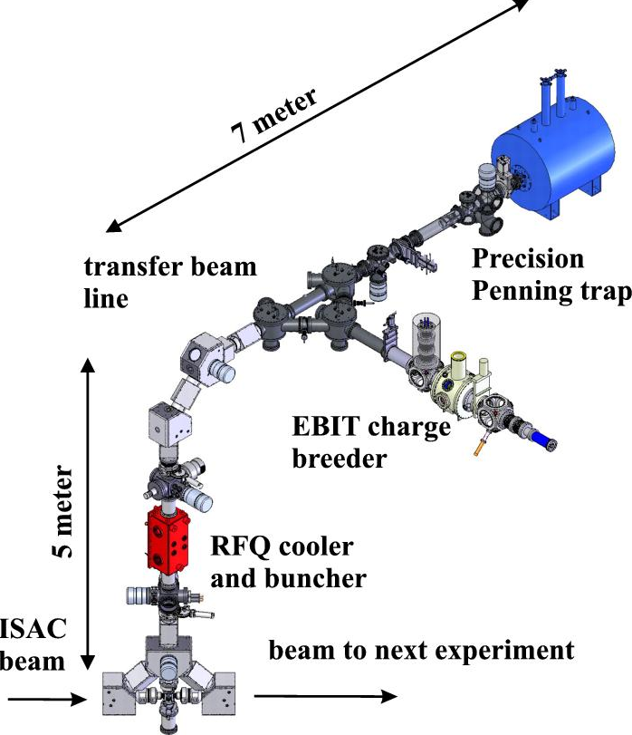
TITAN – TRIUMF’s Ion Trap for Atomic and Nuclear science
Measurement Penning Trap (MPET)
Mass determination by measuring the cyclotron frequency
Cooler Penning Trap (CPET)
For cooling the HCI beam with protons or electrons
Radiofrequency Quadrupole (RFQ)
accumulates, cools
& bunches ion beam
Electron Beam Ion Trap (EBIT)
charge breeds ions
and used as spectroscopy ion trap for TITAN-EC

Slide 51

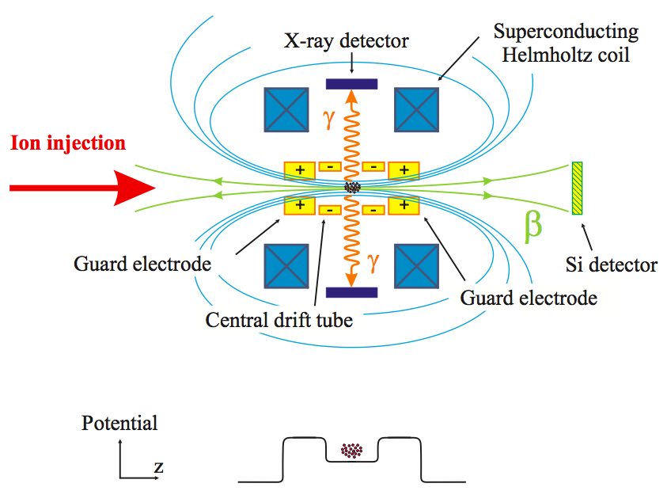
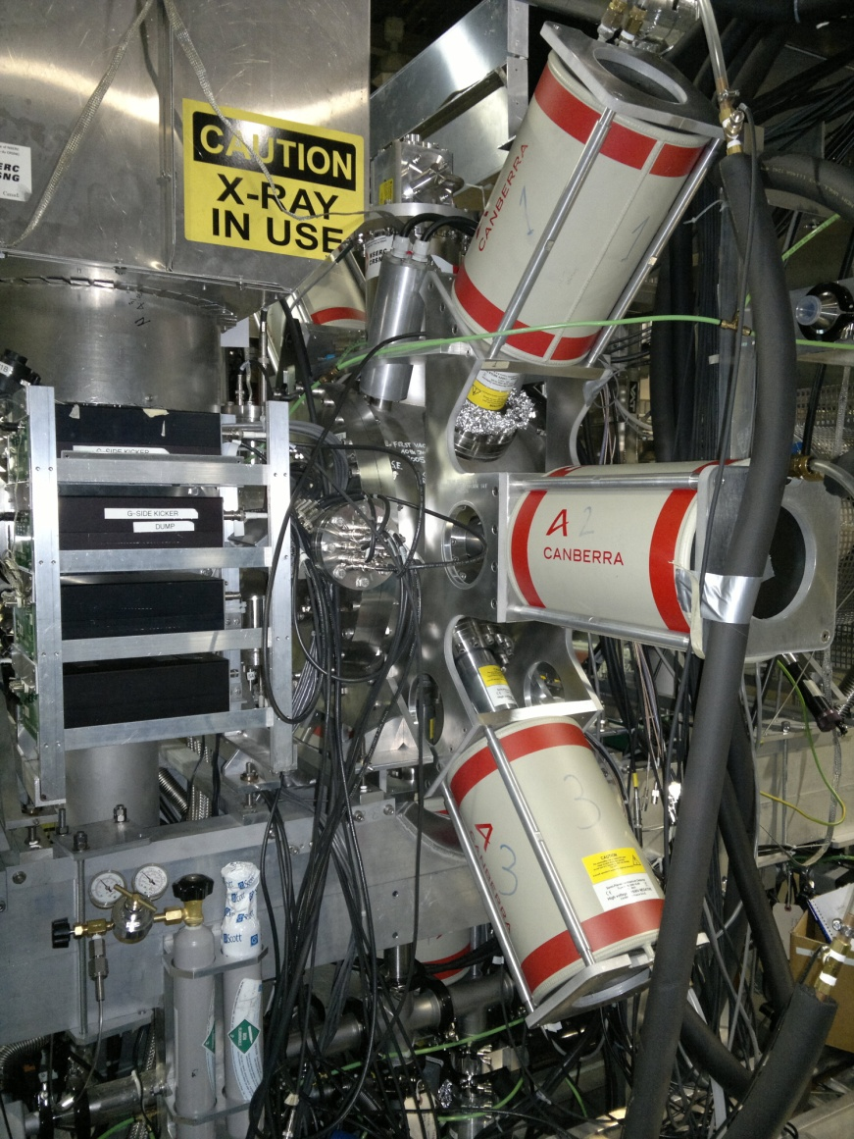
TITAN-EC setup
B-field up to 6T
Advantages of the TITAN-EC program:
Pure and intense ion beams from ISAC
No isobaric contamination of the sample
No X-ray absorption
Open trap access for 7 X-ray detectors
Spatial separation of X-rays and β⁻ by B-field
→ Potential to measure extremely (<10⁻⁵) small ECBRs

Slide 52

¹²⁴Cs run in Nov. 2012
performance test of the new setup
¹²⁴Cs (I(EC)~10%)
Beam composition:¹²⁴Cs,
^{124m}Cs,¹²⁴In, ^{124m}In
6 SiLi detectors (shielded with CuPb), 1 HPGe operational
charge bred to 27+ in EBIT with e-beam
for best ion-cloud confinement
minimize trapping
losses!
Used isotope with strong EC-branch
¹²⁴Cs yield with UCx target: 10⁷
¹²⁴In yield: an order of magnitude less than ¹²⁴Cs
Charge bred to 27+ with EBIT for best confinement
511 keV (181%) successfully suppressed, due to B-field → reduction of Compton BG created inside the EBIT

Slide 53

Time dependence
ADC time stamp for each event
Characterize contaminants (¹²⁴In) & isomers (^{124m}Cs)
Long trapping times, small trapping losses
¹²⁴Xe X-rays dominant after ca. 10s
γ-lines from ^{124m}Cs and ¹²⁴In disappear
half-life determination as an additional feature
2 different analytical
fitting methods:
Time-independent
Time-dependent

Slide 54
X-ray fitting (time-independent)
trapping-time independent:
Gauss fits to entire spectrum (0-20sec t_{trap})
peak intensities (NNDC) & energies fixed
area of ^{124m}Cs & ¹²⁴Sn (g.s.) γ’s used to norm. area of ^{124m}Cs & ¹²⁴Sn X-rays
X-rays from 3 different isobars:
¹²⁴Sn
¹²⁴Cs
¹²⁴Xe
Preliminary

Slide 55

Compton scattering characterization
Compton edge from 102.91 keV ^{124m}In appears under
X-ray region!
Generate splines function to describe the background

Slide 56
X-ray fitting (time-dependent)
Preliminary
trapping-time dependent:
all T_{1/2} are free
parameters
T_{1/2Compt} identical to T_{1/2}
fit to the time-dependent Gauss funct. ~ exp(-λt)
→ T_{1/2}
peak intensities & energies fixed (NNDC (correct?))
^{124m}Cs/^{124g}Cs=1/10
3s
30s
6s
→ Integrals are consistent with time-independent method ←

Slide 57
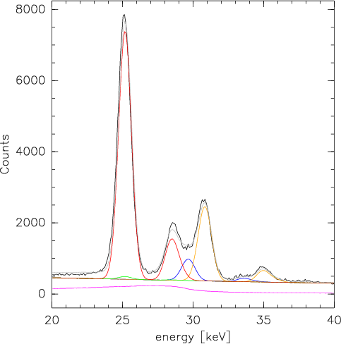

Time-dependent fits
longer trapping times → fit deteriorates because of statistics
Need to improve our understanding of background time-dependence
Residuals

Slide 58
Half-lives
T_{1/2} of ¹²⁴Cs g.s. agrees with lit. val.
feeding from ^{124m}Cs (30.8, 35.8 keV) included
T_{1/2}(^{124m}In) also agrees with lit. val.
Preliminary
# of data points limited by statistics for ¹²⁴Cs g.s. (29.6, 33.8 keV)
syst. uncertainties (e.g. trapping losses) not yet included
Preliminary

Slide 59
ECBR normalization
normalization via 354 keV γ-ray branch of the β-decay
complicated by:
Compton edge at 340 keV from 511 keV traces
low statistics (low detector eff’cy of ~0.1% at 354 keV)
Residuals
Preliminary
Fit values:
σ=0.70±0.09
→ (res.1.5keV)
area=339±35

Slide 60
Summary
TITAN-EC employs a novel technique of ion-trap decay spectroscopy to measure ECBRs of intermediate odd-odd nuclei in ββ-decay
ECBRs are important for g.s. properties of the nucl. wave function connected to the NMEs in ββ-decay (2ν,0ν)
Successful proof of principle run in Nov. 2012
Charge breeding to q=27 for better ion cloud confinement demonstrated
BG reduction due to B-field (β+ and e- from inside trap) demonstrated
Identification of contaminants by time dependence demonstrated
Outlook:
Measurement of ¹¹⁰Ag and ¹⁰⁰Tc with ECBRs between
10⁻³ to 10⁻⁵ (3-4 orders of magnitude sensitivity increase)

Slide 61
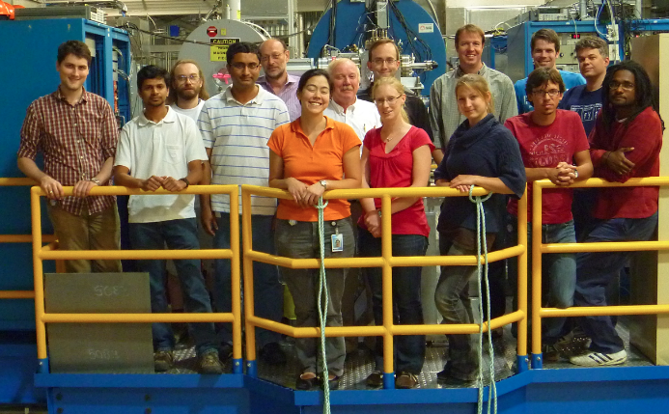



Many thanks to the TITAN group at TRIUMF!

Slide 62
THANK YOU FOR YOUR ATTENTION!

Slide 63
Backup
¹²⁴In isomer T_{1/2} agrees with lit. value
¹²⁴In g.s. T_{1/2} determination not possible almost no ¹²⁴In g.s. in the spectra

Slide 64
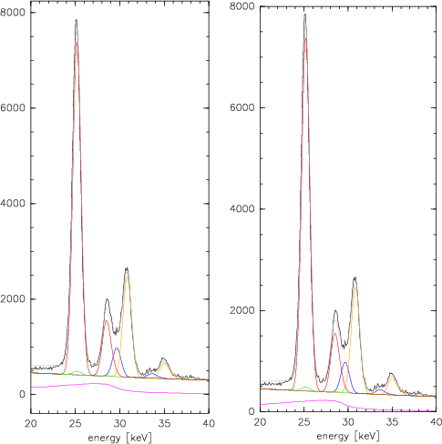

Slide 65
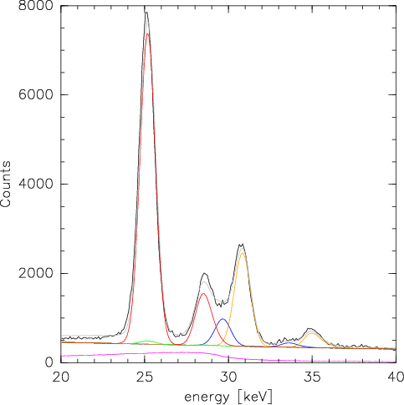

Slide 66
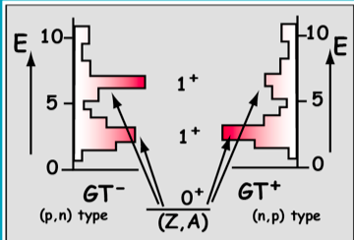
2νββ Nuclear Matrix Elements
The GT type matrix elements can be determined experimentally through charge-exchange reactions or for ground-state transitions through EC or single β- decay of the intermediate odd-odd nuclei.
2νββ decay half-life combines a phase space factor and the ββ decay NME:
GT transitions are mediated by στ± operator; connects same initial and final states as β-decays
Hadronic probes: Charge exchange reactions at intermediate energies and q ≈ 0
(n,p)-type: (d,²He) or (t,³He) for GT⁺ (KVI, Groningen)→ isospin raising
(p,n)-type: (³He,t) for GT⁻ (RCNP, Osaka) ⁻ → isospin lowering
Largest at 100 – 200 MeV/A

Slide 68
Summary
ββ−decay is at forefront of exp. research in sub-atomic physics, since observation of 0νββ would allow to extract ν-mass
NMEs accessible via CER or for gs-transitions through EC or single β- decay of the intermediate odd-odd nuclei
TITAN-EC exp. at the TRIUMF facility will use a novel technique involving a spectroscopy ion trap to measure ECBRs of intermediate odd-odd in ββ-decay → contribute to knowledge of NMEs
Proof of principle run in Nov. 2012
Charge breeding to q=27⁺ for better confinement successful
BG reduction by CuPb shielding (ambient) in combination with B-field (β+ and e- from inside the trap)
ADC time stamp → Possibility to determine/reduce contaminants (¹²⁴In) and isomers & determine half-lives
Challenging analysis

Slide 69

TITAN-EC
Double-beta decay and ion traps
TRIUMF
Westfälische
Wilhlems-Universität Münster
Institut für Kernphysik

Slide 70
Electron capture branching ratios for the odd-odd intermediate nuclei in ββ decay using TITAN-trap
Objectives:
  experimental determination of nuclear matrix elements for 2νββ decay and 0νββ decay
  Test ground-state wave function and properties (allowed and first –order forbidden decays)
  - constrain theories on β⁻ decay and EC
Technique:
  measurement of K-shell EC X-rays using radioactive ions (i.e. intermediate nuclei) trapped in an ion trap (EBIT)
Advantages:
  no backing material, i.e. no absorption
  high-purity sample
  background-free situation, i.e. precision and sensitivity

Slide 71
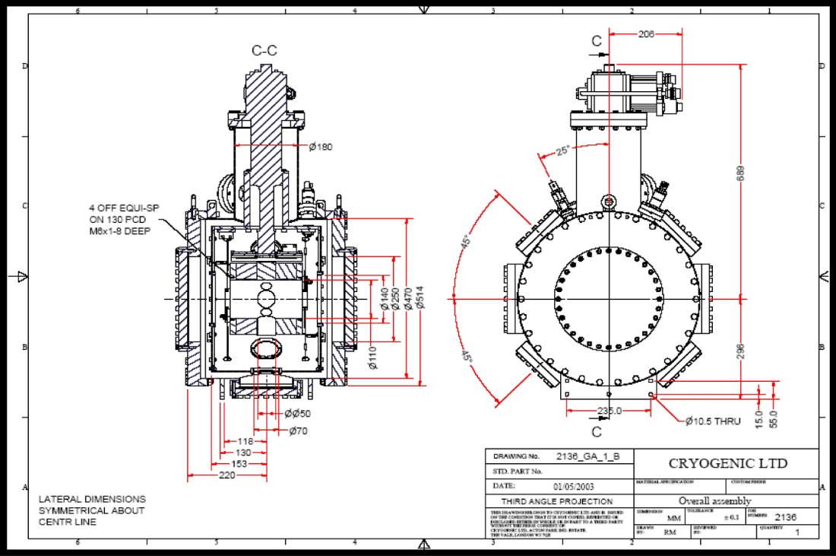
Experiment for EC using EBIT
holding 7 ports for X-ray detectors

Slide 72
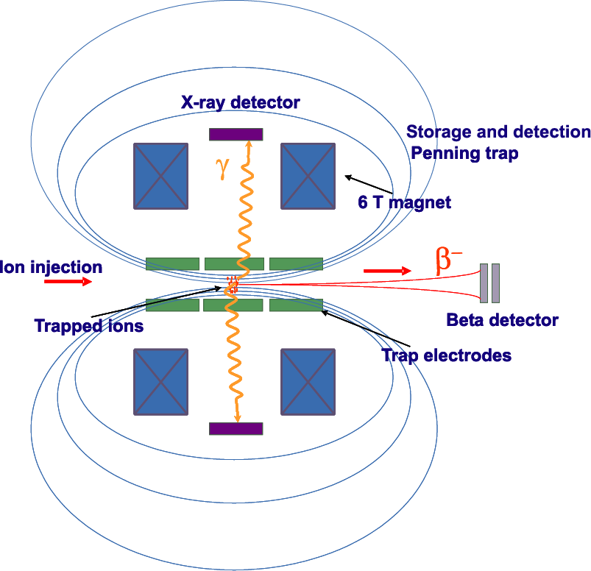
Experiment for EC using EBIT
7 X-ray detectors
2.1% solid angle
(can be increased)
6T magnetic field
carrierless suspension
of ions in UH vacuum
10⁵ – 10⁶ ions per load
holding times: minutes or hours possible
Electrons from β-decay (10⁶ times more intense than
EC) are giuded away to the exit of the trap and can
be used for monitoring by a channeltron

Slide 73
example

Slide 74
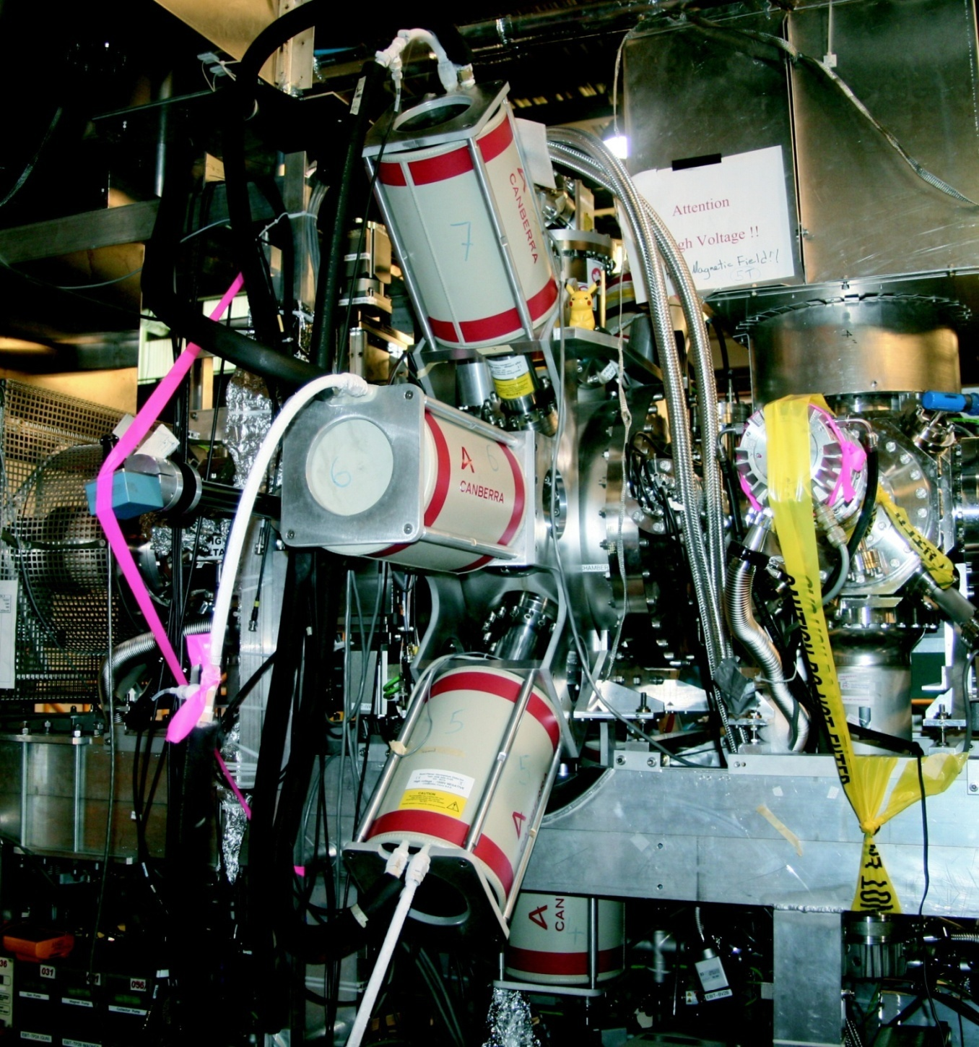
TITAN – ECBR
Setup with 7 SiLi
X-ray counters

Slide 75
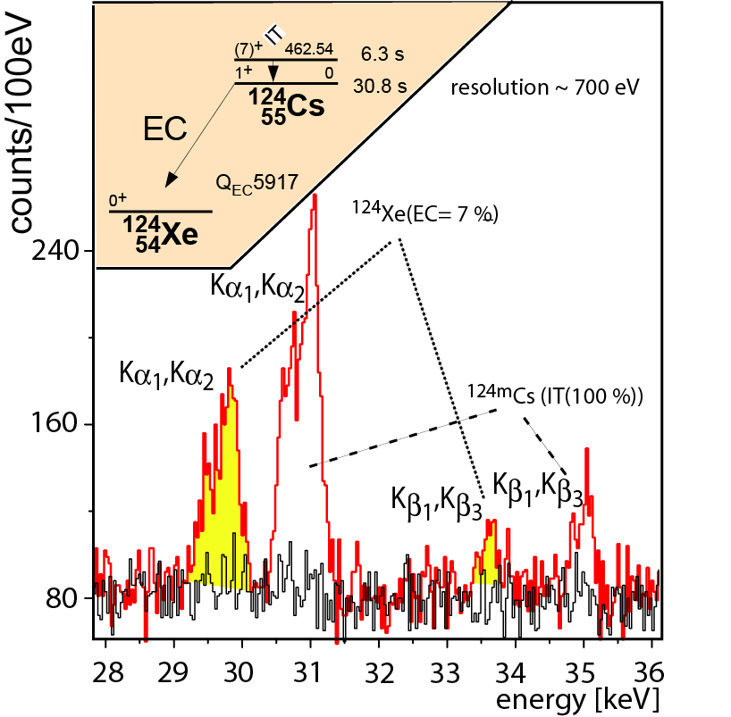
TRIUMF- measurement
radioactive ¹²⁴Cs ions
trapped in a Penning trap
(first meas‘nt of X-rays
from trapped ions ever)

Slide 76
trapping of radioactive 116-In in the TITAN ion trap
X-ray from the internal conversion of the 6- isomer decay

Slide 77
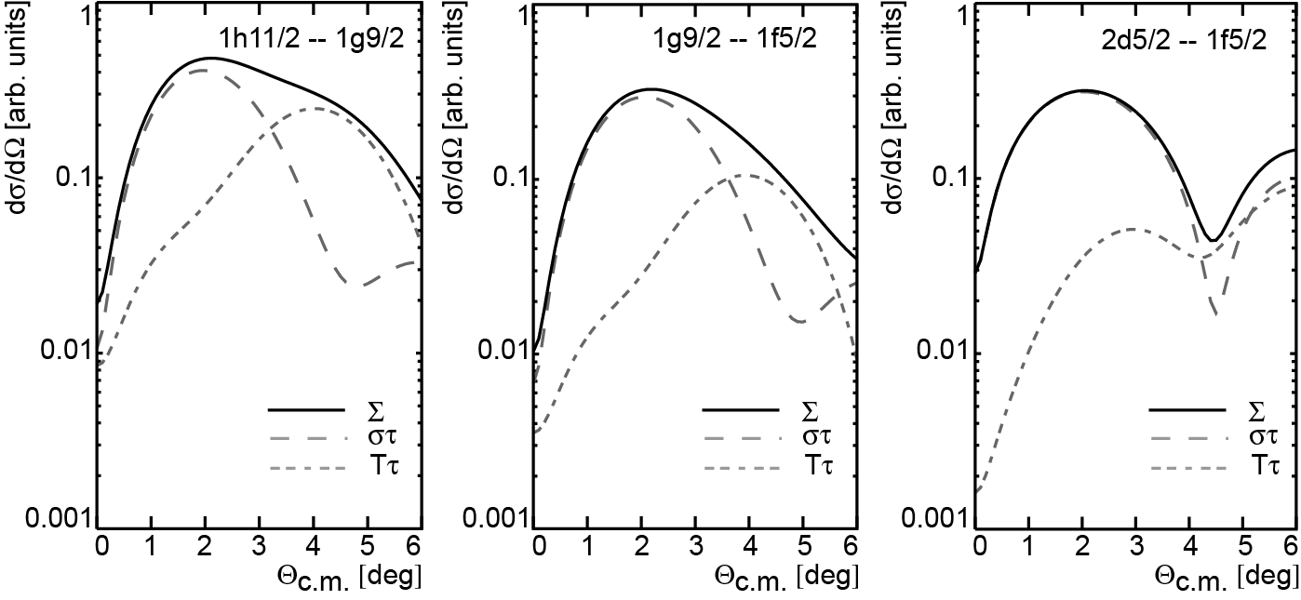
Study of 2⁻ excitations in
charge-exchange reactions
the maximum of the x-section is
indeed governed by the στ-interaction

Slide 78
The SAGE and GALLEX
neutrino problem

Slide 79
The SAGE and GALLEX neutrino problem
Remember:
SAGE and GALLEX were the two solar neutrino
detectors for low-energy (pp) neutrinos !!
2) detection material 60t Ga
3) reaction: ⁷¹Ga (ν_{e}, e⁻)⁷¹Ge (Q=232 keV)
4) signature:
!

Slide 80


SAGE / GALLEX
solar ν spectrum
(Bahcall-Pinsonneault)
pp
⁷¹Ga (ν_{e},e⁻)⁷¹Ge
(Q=232 keV)
Expected rate: ~ 132 SNU
SAGE: 65.4 ± 3.0 SNU
GALLEX: 73.4 ± 7.2 SNU
⁸B
Water-Č
hep
Calibration with ⁵¹Cr (³⁷Ar) ν-source
⁵¹Cr
E_{ν} | transition | BR
747.3 keV | K-EC → ⁵¹V g.s. | 81.6 %
752.1 keV | L-EC → ⁵¹V g.s. | 8.5 %
427.1 keV | K-EC → ⁵¹V* (320) | 8.95 %
432.0 keV | L-EC → ⁵¹V* (320) | 0.9 %
(ν_{e},e⁻)

Slide 81

Results of calibration
# meas‘d evts/ # exp‘d evts
experiment | source | ratio
GALLEX | ⁵¹Cr | 0.882±0.078
SAGE | ⁵¹Cr | 0.95± 0.12
SAGE | ³⁷Ar | 0.79±0.10
average | ³⁷Ar, ⁵¹Cr | 0.87±0.05
Bahcall, Phys. Rev. C56, 3391 (1997):
Bahcall: 5.1
Possible solutions:
efficiencies of detectors
neutrino x-section
sterile neutrinos with small L/E,
i.e. L_{osc}~ cm – m & m_{ν} ~ eV–10 eV
denied
may be
who knows

Slide 82




Slide 83




Checking the neutrino x-section
Structure of the excited states in ⁷¹Ge
⁷¹Ga(³He,t)⁷¹Ge @ 420 MeV (RCNP, April 2011)
Result:
Cont‘btn from
= 7.2 ± 2.0%
GT
GT
GT

Slide 84

Checking the neutrino x-section
2) The ft-value of ⁷¹Ge (EC)
Problem:
how to measure the EC Q-value ?
ν
⁷¹Ge
!
⁷¹Ga
EC 232 keV
In 1/10⁴ cases the EC decay is
accompanied by a photon (int‘nl bremsstrahlung, IB-EC)
the end-point spectrum is sensitive to
  the neutrino mass → of course!!
end-point energy determines the Q-value (Q_{EC})
BUT:
nobody really knows how the end-point spectrum
looks like – esp‘lly near Q_{EC} − (E(K_{α}) ~ 8–10 keV).
Q: Are atomic excit‘ns / de-excit‘ns decoupled from IB??
and what are these excitations in case of IB-EC

Slide 85
Conditions for IB detection
Need extremely strong sources
  ( ~ 10¹⁰ – 10¹¹ Bq) (thru (n,γ) activation)
Extreme activity of K-shell X-rays precludes use
  of internal source (i.e. activation of detector)
Extreme pile-up components to deal with
Unknown background conditions after activation
Need precise knowledge of efficiencies
Corollary:
None of the IB-EC experiments
on ⁷¹Ge were intended for an
exact meas‘nt of the Q-value
Saraf et al., PR91, 1216 (1953)
Blisi et al., Nuov. Cim. 11, 290 (1955)
Žlimen et al., PRL 67, 560 (1991)
DiGrigorio et al., PRC47, 2916 (1993)
Lee et al., PRC51, 2779 (1995)
„17 keV“-neutrino

Slide 86


Example:
Lee et al., PRC51, 2779 (1995)
IB-spectrum
data / fit
„17 keV“-neutrino
Quoted:
Q_{EC}=232.65 ± 0.15 keV

Slide 87




Example:
IB-spectrum
DiGrigorio et al., PRC 47, 2916 (1993)
Quoted:
Q_{EC}=232.1 ± 0.1 keV
data / fit
Pile-up studies
„17 keV“-neutrino
normalised to →

Slide 88


Example:
Žlimen et al., PRL67, 560 (1991)
data / fit
IB-spectrum
Quoted:
Q_{EC}=229.0 ± 0.5 keV, m_{Hν}=17.2 keV
B(1S) = 10.367 keV (of daughter!!)

Slide 89
⁷¹Ga/⁷¹Ge Q-value measurement expmt
(TITAN setup)
TRIUMF

Slide 90

Production of radioactive isotopes @ ISAC/TRIUMF
ISAC:
Highest yields for On-Line
facilities, can go up to 100μA@500MeV DC proton
Ion-sources:
Surface ⎭
Resonant-Laser source⎭
Negative, off-line test ⎭
ECR, on-line tests and checks ⎭
Targets:
High power targets ⎭
Actinide targets:
Plan to run tests 2012

Slide 91



TITAN-TRIUMF’s Ion Trap for Atomic & Nuclear science
1. radioactive beam provided by ISAC
2. transfer to EBIT (charge breeding - to highly-charged ions)
3. transfer to Penning trap (frequency meas’mnt via TOF)

Slide 92
⁷¹Ga/⁷¹Ge Q-value measurement expmt
(TITAN MPET and EBIT)
TRIUMF
Issues:
1) need ⁷¹Ga beam AND radioactive ⁷¹Ge beam ( ~ 10⁷–10⁸ p/s)
by spallation with 500 MeV (30μA) p-beam on Ta target.
2) separation of ⁷¹Ga / ⁷¹Ge by laser-ionization /surface ionization
3) transport beam to mass measurment setup (30m)
4) Increase charge-state by charge-breeding ions to
Ne-like charge-states
  beam-1 → pure ⁷¹Ga charge-state 21⁺
  beam-2 → pure ⁷¹Ge beam for charge-state 22⁺
  eliminates effectively ⁷¹Ga
  Scheme ensures:
  high isobaric purity !!! & high precision Δm/m ~ 1/q

Slide 93
Principle of mass measurements with Penning trap
single ion injection into trap
confinement by B-field + static E-field
excitation with cyclotron frequency
trap opening & transfer to kinetic energy
→ time-of-flight measurement
cyclotron frequency:
precision:
depends on
charge state !!
mass:

Slide 94

both ion species, laser-ionized, charge-bred 21+,
excitation time 78 ms
We observe that
the mass difference between ⁷¹Ge and
⁷¹Ga is close to the literature value
(surprising)
Q_{EC} = 233.7 +/- 1.2 keV

Slide 95
Conclusion about the SAGE/GALLEX problem:
nuclear physics aspect of ν x-section has been investigated
with high precision
Contribution from excited states: 7.2±2%
(5.1% →Bahcall) amplifies the discrepancy
Q_{EC} - value is close to the Bahcall value (he was lucky), new
value only reduces contribution from excited states to 6.5%
The observed SAGE/GALLEX discrepancy
is NOT due to any
unknowns in Nuclear Physics

Slide 97


Slide 98


Many thnx to
RCNP - group

Slide 99


Slide 100
The problem of 0ν-NME:
  there is little experimental support
  the infamous parameter g_{pp}
  the single decay properties (β⁻, EC) cannot be described consistently
  the g.s. nuclear wave function is not correct
The 2νββ decay NME is the testing ground
for nuclear models

Slide 101
Charge-exchange reactions
  ⁴⁸Ca published data → (d,²He) and (³He,t)
  ⁶⁴Zn published data → (d,²He) and (³He,t)
  New data from RCNP
  ⁷⁶Ge fully construct 2νββ-matrix element
  ⁸²Se one „leg“ of 2νββ-matrix element
  ⁹⁶Zr fully construct 2νββ-matrix element
  ¹⁰⁰Mo one „leg“ of 2νββ-matrix element
  ^{128,130}Te one „leg“ of 2νββ-matrix element
  ¹³⁶Xe one „leg“ of 2νββ-matrix element

Slide 102

⁴⁸Ca(³He,t) angular distribution (examples)

Slide 103
⁴⁸Ca
Resolution is the issue !!!!

Slide 104




Slide 105

Nemo-III
Can one do better ?

Slide 106


Slide 107







RCNP - Osaka

