Slide 1




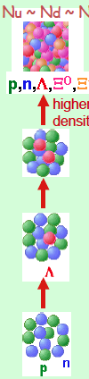
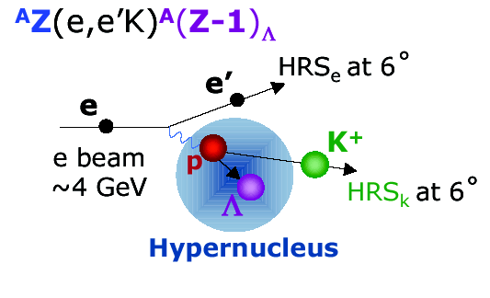
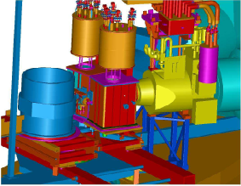
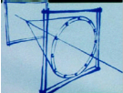
High-Resolution Hypernuclear Spectroscopy at JLab. Results and perspectives
F. Garibaldi – INPC 2013 – Firenze – June 4 - 2013
Tohoku
Hypernuclei: A quick introduction
Electroproduction of hypernuclei
and Experimental challenges
Hypernuclear Physics at Jefferson Lab Hall A
Prospectives (Proposal to the Jlab PAC by the Jlab hyp. Phys. Coll.)
Summary and Conclusions

Slide 2




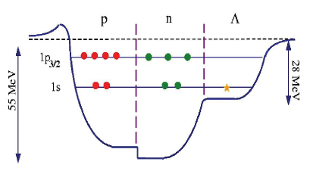
HYPERNUCLEAR PHYSICS
Hypernuclei are bound states of nucleons with a strange baryon (L)
Extension of physics on N-N interaction to system with S#0
Internal nuclear shell
are not Pauli-blocked
for hyperons
Spectroscopy
This “impurity” can be used as a probe to study both the structure and properties of baryons in the nuclear medium and the structure of nuclei as baryonic many-body systems
Ideal laboratory to study
☹-N interaction, Charge Symmetry Breaking, L binding energy, limits of mean field description, the role of 3 body interaction in hypernuclei and neutron stars….

Slide 3
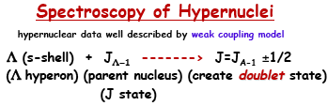
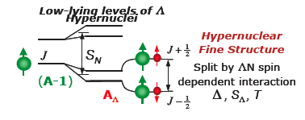
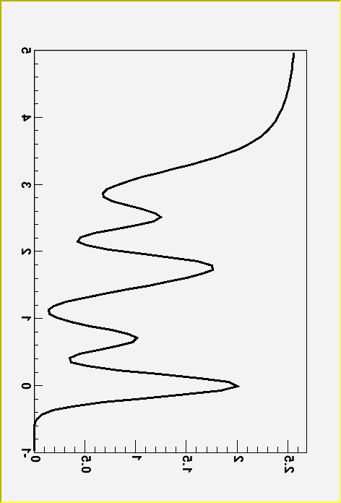
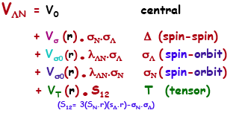
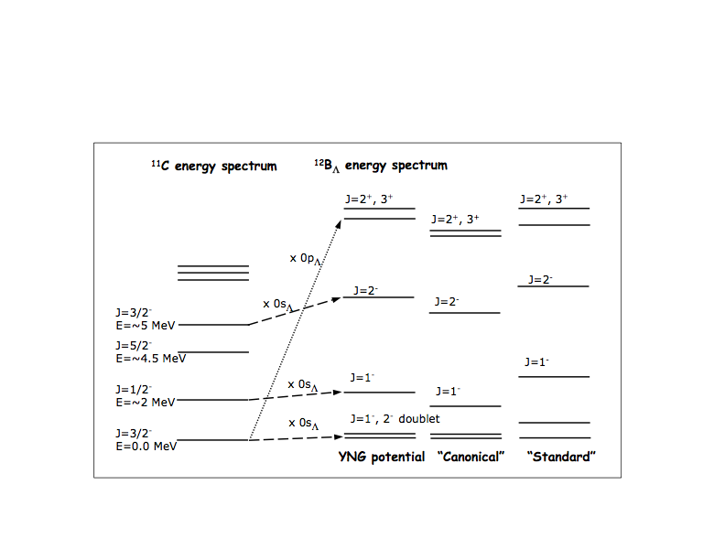
LN interaction
V
(r)
D
S_{L}
S_{N}
T
Each of the 5 radial integral (V, D, S_{L} , S_{N}, T) can be phenomenologically determined from the low lying level structure of p-shell hypernuclei
✔ most of information is carried out by the spin dependent part
✔ doublet splitting determined by D, s_{L}, T

Slide 4
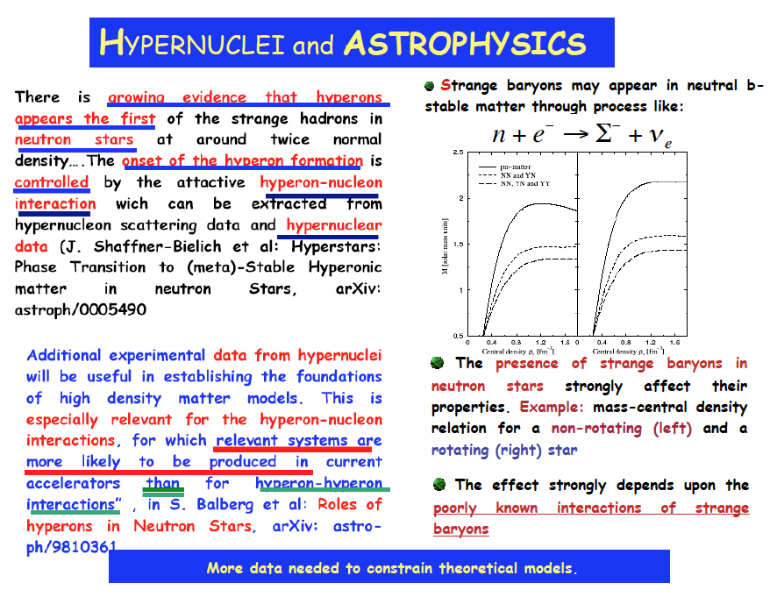
The observation of a very heavy pulsar (M=1.97(4) solar masses, Demorest et al. Nature 467 1081 (2010), severely constraints the equation of state at high densities with implications for possible hypernuclear components.
Further information on contributions of non nucleonic degrees of freedom from experiments are important

Slide 5
ELECTROproduction of hypernuclei
e + A -> e’ + K⁺ + H
in DWIA (incoming/outgoing particle momenta are ≥ 1 GeV)
- J^{m}(i) elementary hadron current in lab frame (frozen-nucleon approx)
- c_{g}virtual-photon wave function (one-photon approx, no Coulomb distortion)
- c_{K}– distorted kaon w. f. (eikonal approx. with 1st order optical potential)
-Y_{A}(Y_{H}) - target nucleus (hypernucleus) nonrelativistic wave functions (shell model - weak coupling model)

Slide 6
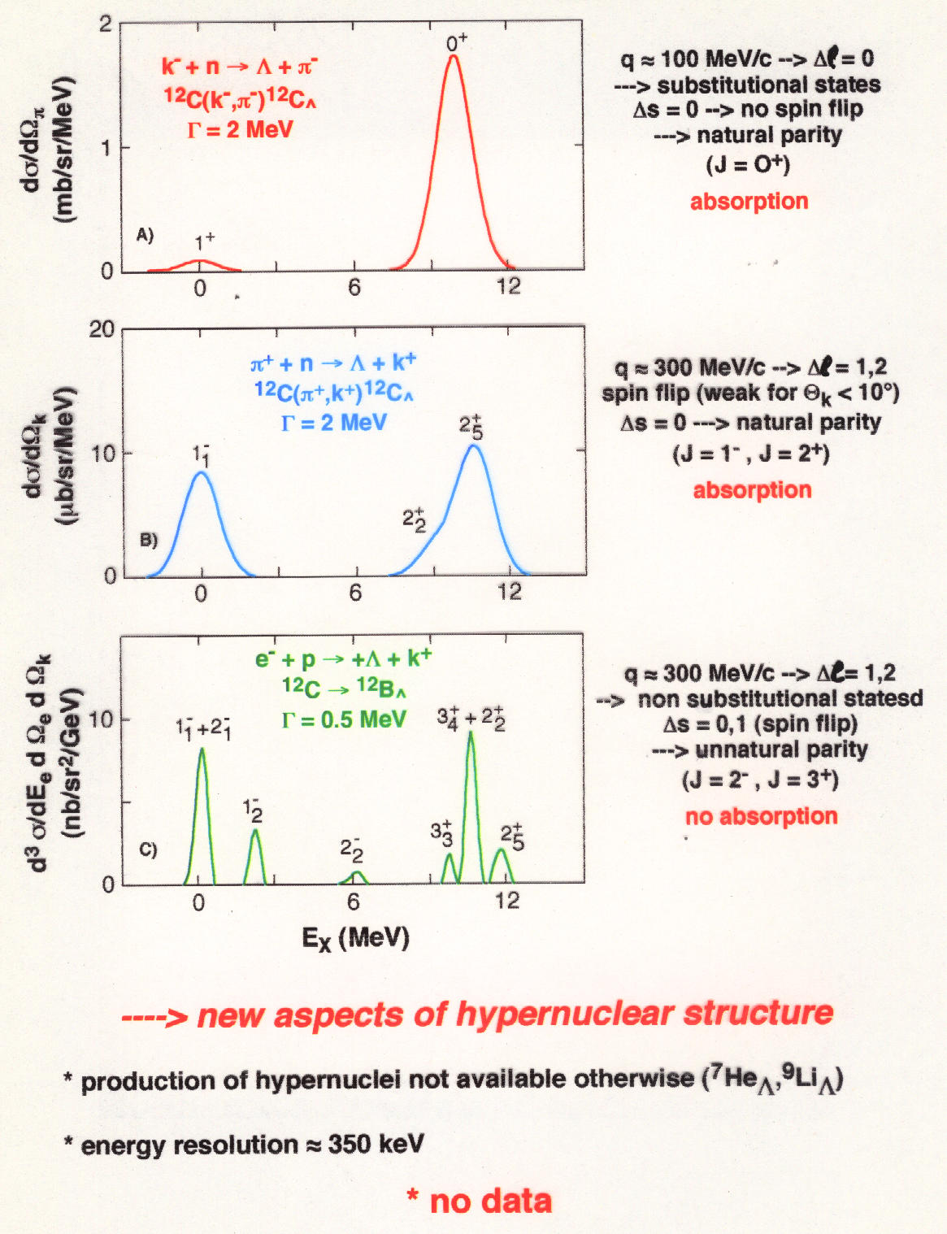
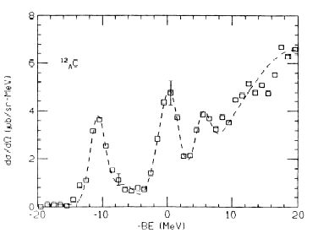
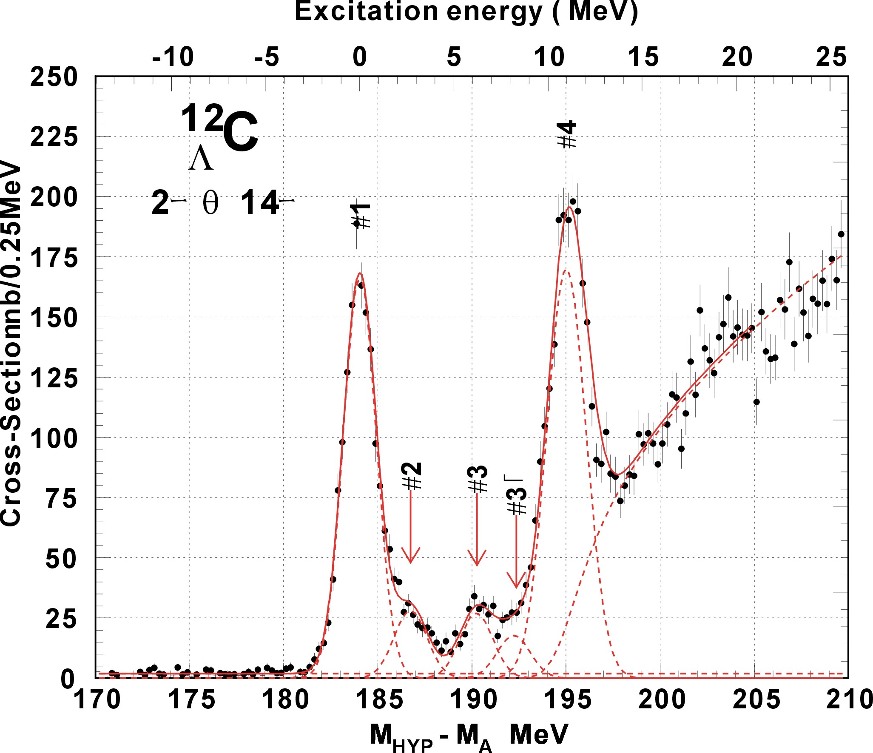
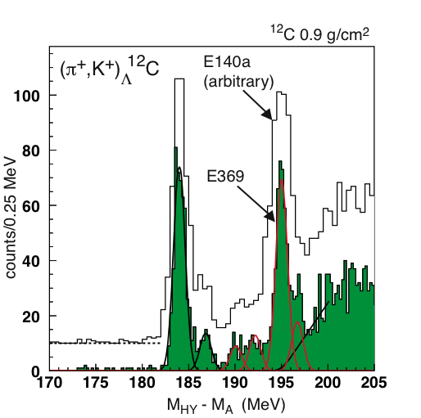
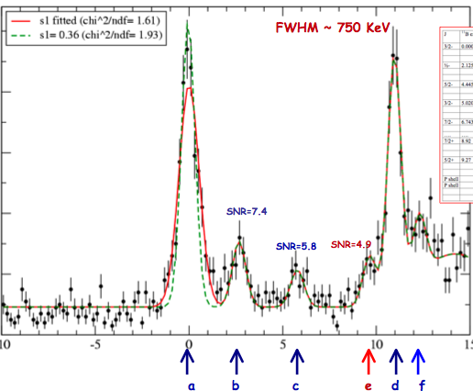
BNL 3 MeV
KEK336 2 MeV
Improving energy resolution
~ 1.5 MeV
and
using electromagnetic probe
635 KeV
635 KeV
new aspects of hyernuclear structure
High resolution, high yield, and systematic study is essential
production of mirror hypernuclei
energy resolution ~ 500 KeV

Slide 7
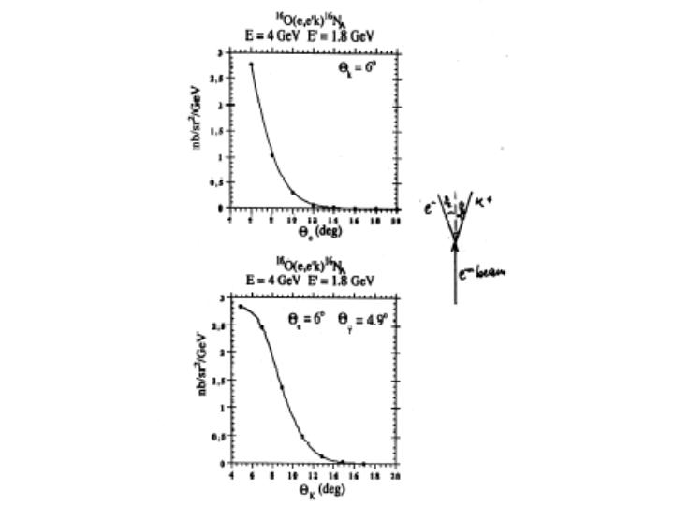
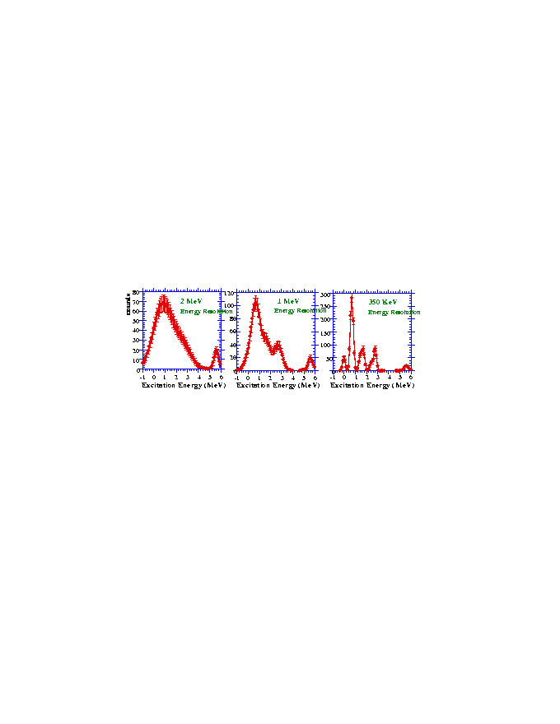
reasonable counting rates
forward angle
DE_{beam}/E : 2.5 x 10⁻⁵
2. DP/P : ~ 10⁻⁴
3. Straggling, energy loss…
septum magnets
~ 600 keV
good energy resolution
do not degrade HRS
minimize beam energy instability
“background free” spectrum
unambiguous K identification
High P_{k}/high E_{in} (Kaon survival)
RICH detector

Slide 8

Kaon collaboration
JLAB Hall A Experiment E94-107
E94107 COLLABORATION
  A.Acha, H.Breuer, C.C.Chang, E.Cisbani, F.Cusanno, C.J.DeJager, R. De Leo, R.Feuerbach, S.Frullani, F.Garibaldi*, D.Higinbotham, M.Iodice, L.Lagamba, J.LeRose, P.Markowitz, S.Marrone, R.Michaels, Y.Qiang, B.Reitz, G.M.Urciuoli, B.Wojtsekhowski, and the Hall A Collaboration
  and Theorists: Petr Bydzovsky, John Millener, Miloslav Sotona
¹⁶O(e,e’K⁺)¹⁶☹N
¹²C(e,e’K⁺)¹²☹
Be(e,e’K⁺)⁹☹Li
H(e,e’K⁺)☹⁰
E_{beam} = 4.016, 3.777, 3.656 GeV
P_{e}= 1.80, 1.57, 1.44 GeV/c P_{k}= 1.96 GeV/c
q_{e} = q_{K} = 6°
W  2.2 GeV Q² ~ 0.07 (GeV/c)²
Beam current : <100 mA Target thickness : ~100 mg/cm²
Counting Rates ~ 0.1 – 10 counts/peak/hour
E-98-108. Electroproduction of Kaons up to Q2=3(GeV/c)2 (P. Markowitz, M. Iodice, S. Frullani, G. Chang spokespersons)
E-07-012. The angular dependence of ¹⁶O(e,e’K⁺)¹⁶N and H(e,e’K⁺)L (F. Garibaldi, M.Iodice, J. LeRose, P. Markowitz spokespersons) (run : April-May 2012)

Slide 9
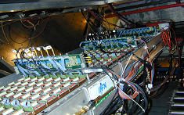
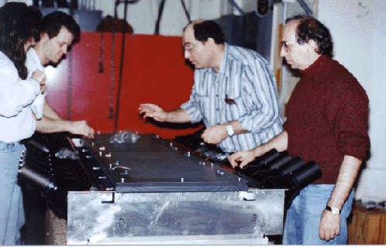
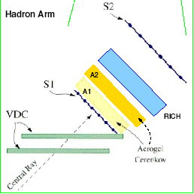
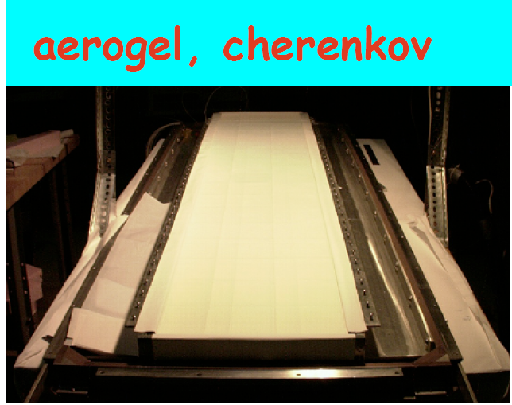
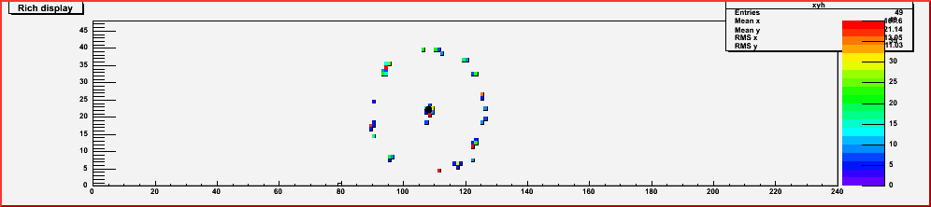
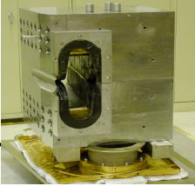
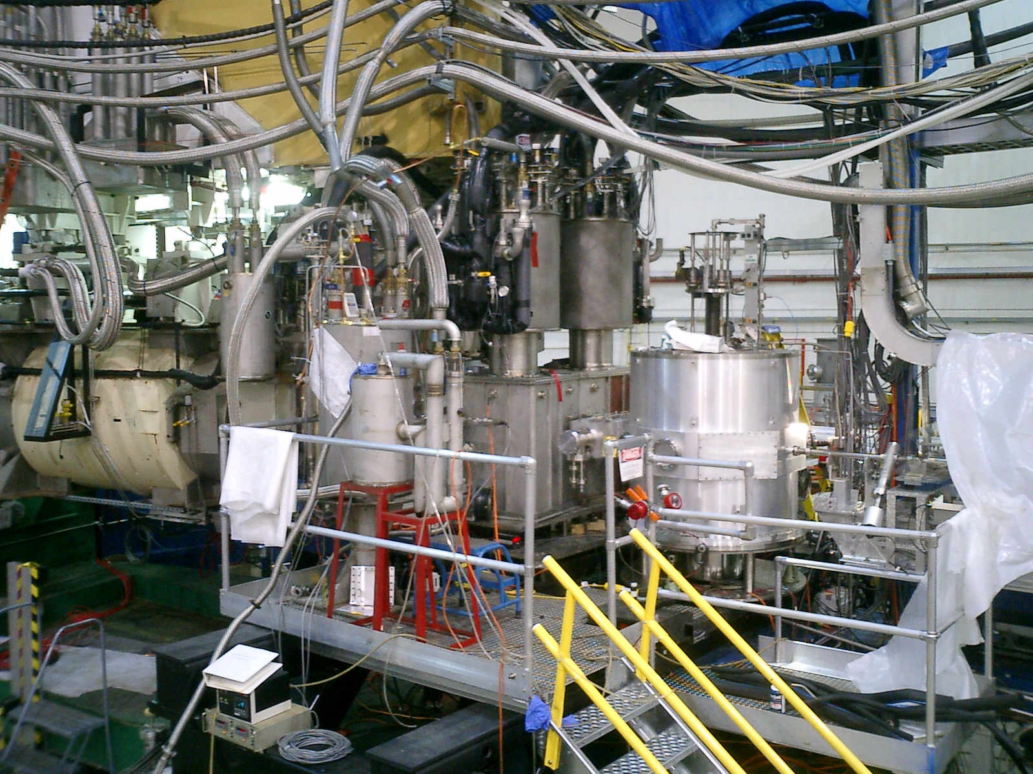
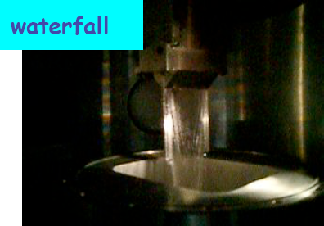
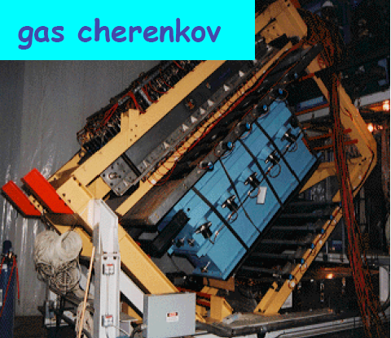
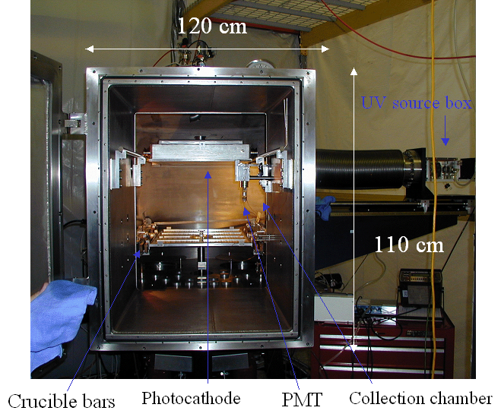
Hall A deector setup
RICH Detector
aerogel first generation
hadron arm
septum magnets
aerogel second generation
electron arm
To be added to do the experiment

Slide 10
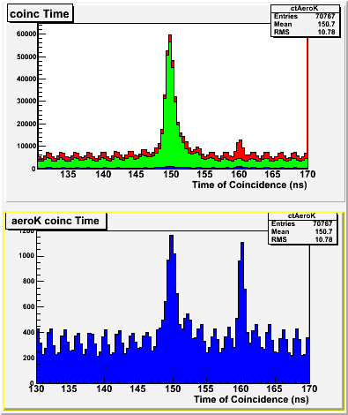
The PID Challenge
Very forward angle ---> high background of p and p
TOF and 2 aerogel in not sufficient for unambiguous K identification !
Kaon Identification through Aerogels
p_{h} = 1.7 : 2.5 GeV/c
p
p
All events
k
k
p
p
AERO1
n=1.015
AERO2
n=1.055
k
Pions = A1•A2
Kaons = A1•A2
Protons = A1•A2

Slide 11
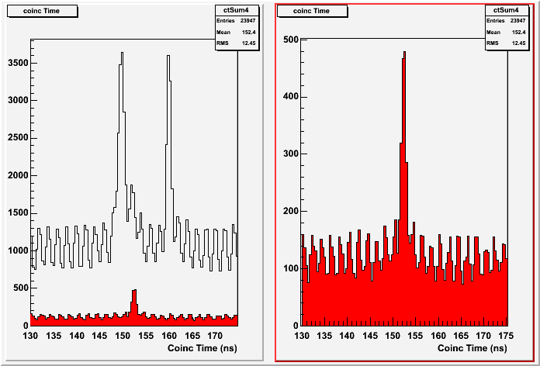
RICH – PID – Effect of ‘Kaon selection
Coincidence Time selecting kaons on Aerogels and on RICH
AERO K
AERO K && RICH K
p
P
K
Pion rejection factor ~ 1000

Slide 12
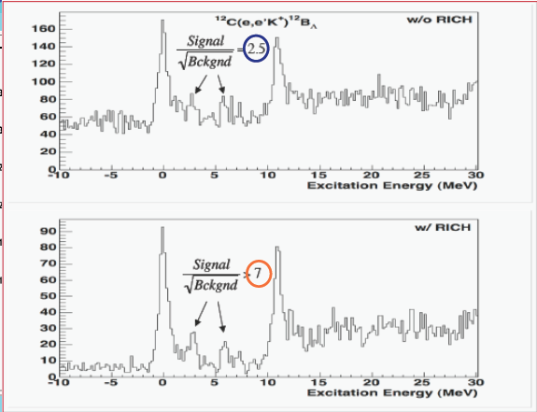
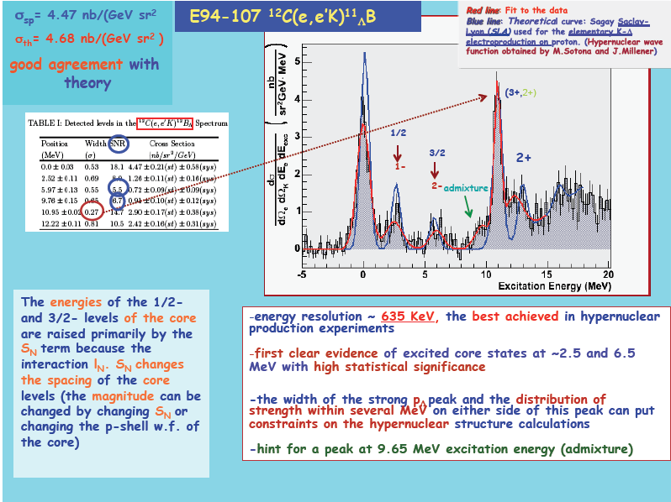
¹²C(e,e’K)¹²B_{L} M.Iodice et al., Phys. Rev. Lett. E052501, 99 (2007)

Slide 13
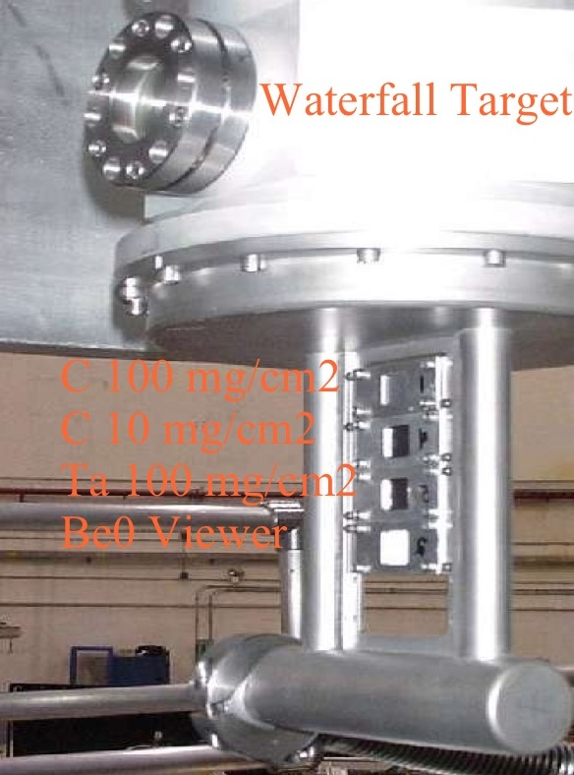
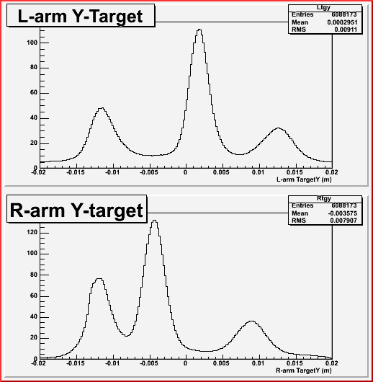
The WATERFALL target: reactions on ¹⁶O and ¹H nuclei
Be windows
H₂O “foil”
H₂O “foil”

Slide 14
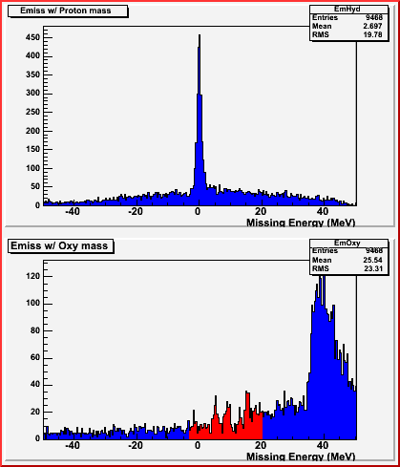
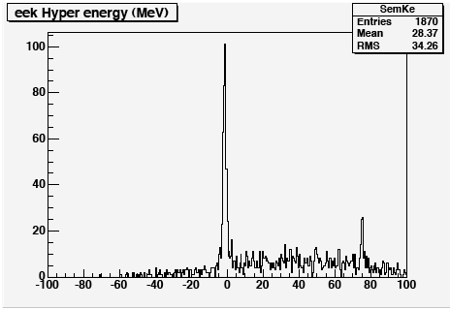
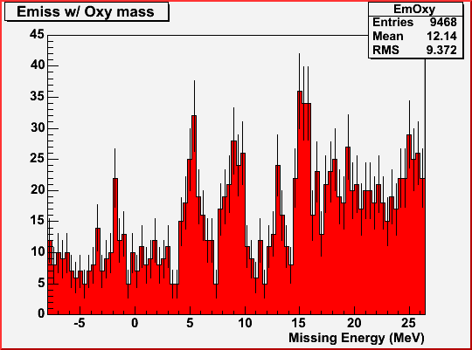
Results on the WATERFALL target - ¹⁶O and ¹H
¹H (e,e’K)L
¹H (e,e’K)L,S
L
Energy Calibration Run
S
¹⁶O(e,e’K)¹⁶N_{L}
Water thickness from elastic cross section on H
Precise determination of the particle momenta and beam energy
using the Lambda and Sigma peak reconstruction (energy scale calibration)

Slide 15
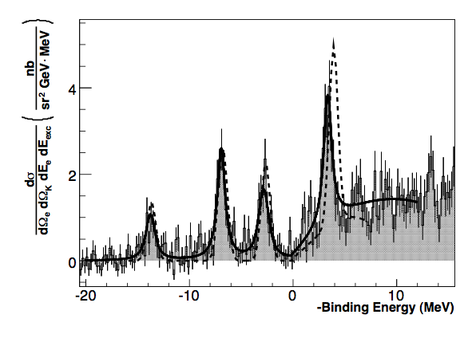
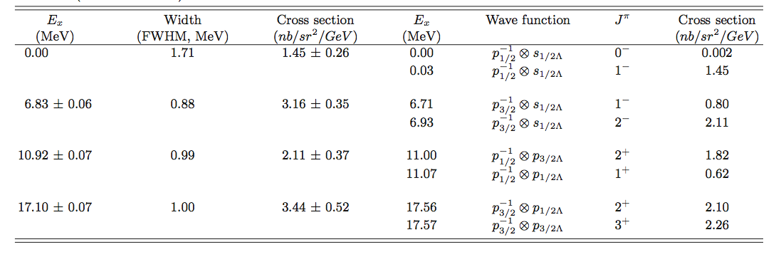
Results on ¹⁶O target – Hypernuclear Spectrum of ¹⁶N_{L}
Fit 4 regions with 4 Voigt functions
c²_{/ndf} = 1.19
Theoretical model based on :
SLA p(e,e’K⁺)☹ (elementary process)
☹N interaction fixed parameters from KEK and BNL ¹⁶☹O spectra
Four peaks reproduced by theory
The fourth peak (☹ in p state) position disagrees with theory. This might be an indication of a large spin-orbit term S☹
0.0/13.760.16

Slide 16
Results on ¹⁶O target – Hypernuclear Spectrum of ¹⁶N_{L}
Fit 4 regions with 4 Voigt functions
c²_{/ndf} = 1.19
Binding Energy B_{L}=13.76±0.16 MeV
Measured for the first time with this level of accuracy
(ambiguous interpretation from emulsion data; interaction involving L production on n more difficult to normalize)
Within errors, the binding energy and the excited levels of the mirror hypernuclei ¹⁶O☹ and ¹⁶N☹ (this experiment) are in agreement, giving no strong evidence of charge-dependent effects
0.0/13.760.16

Slide 17
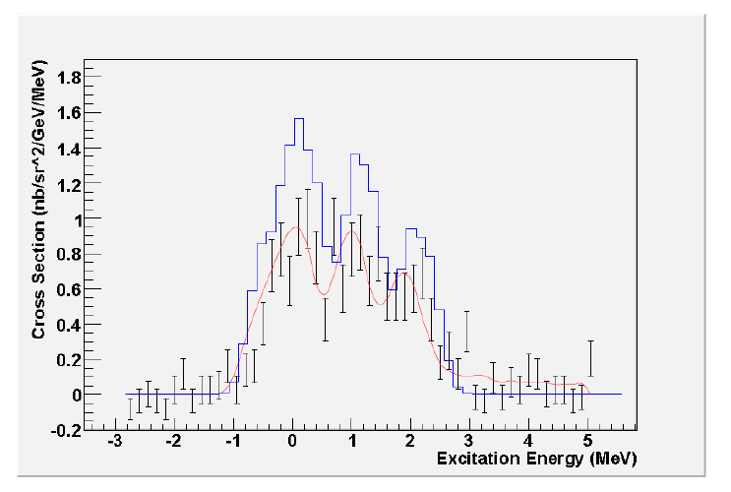
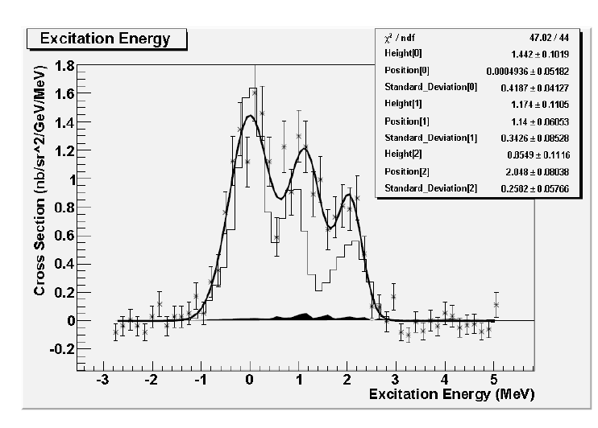
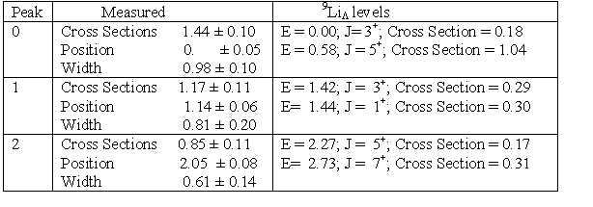
⁹Be(e,e’K)⁹Li_{L}
Experimental excitation energy vs Monte Carlo Data
(red curve) and vs Monte Carlo data with radiative
Effects “turned off” (blue curve)
Radiative corrected experimental excitation energy vs theoretical data (thin curve). Thick curve: three gaussian fits of the radiative corrected data
Radiative corrections do not depend on the hypothesis on the peak structure producing the experimental data

Slide 18
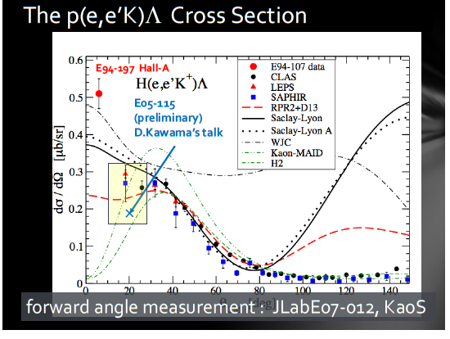
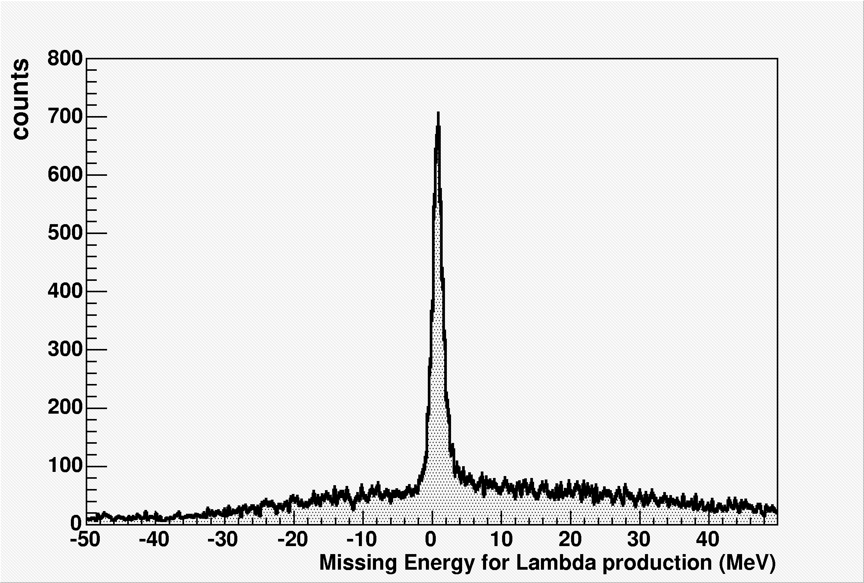
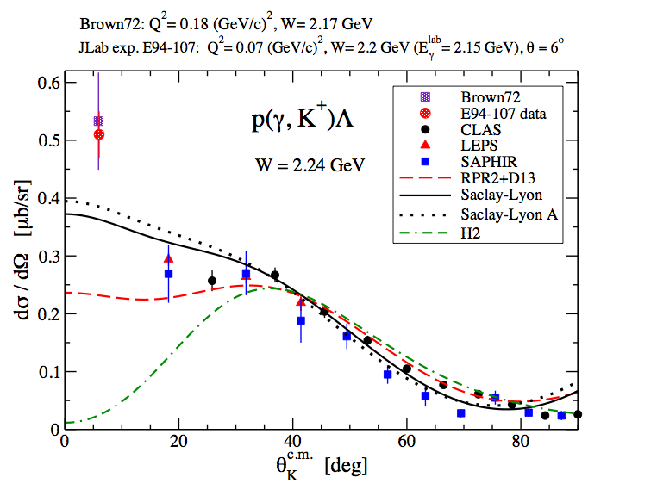
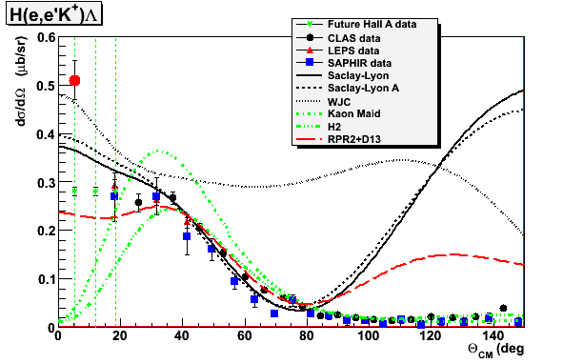
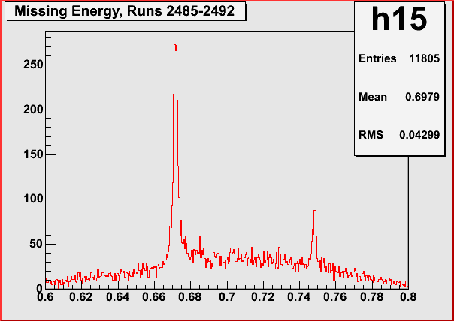
Results on H target – The p(e,e’K)L Cross Section
p(e,e'K⁺)L on Waterfall
Production run
W=2.2 GeV
p(e,e'K⁺)L on LH₂ Cryo Target
Calibration run
Expected data from E07-012, study the angular dependence of
p(e,e’K)L and ¹⁶O(e,e’K)¹⁶N_{L}
at low Q²
➔ None of the models is able to describe the data over the entire range
➔ New data is electroproduction – could longitudinal amplitudes dominate?

Slide 19
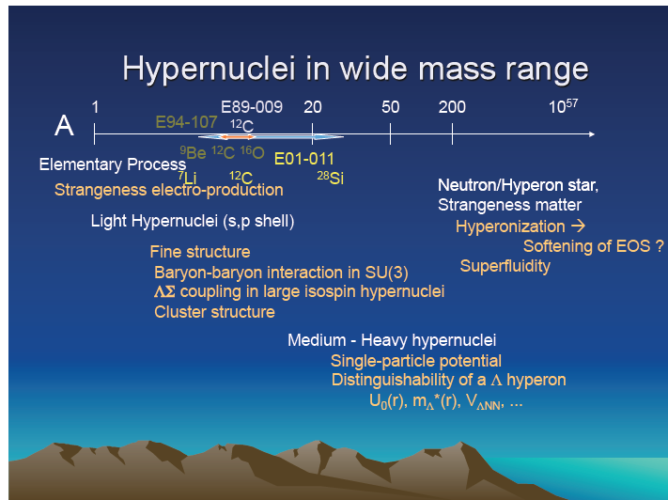
Hypernuclear spectroscopy prospectives at Jlab
Collaboration meeting - F. Garibaldi – Jlab 13 December 2011
Future mass spectroscopy
Decay Pion Spectroscopy to Study ☹-Hypernuclei

Slide 20
New proposal to the PAC of Jefferson Lab
. Elementary kaon electroproduction
. Spectroscopy of light Λ-Hypernuclei
. Spectroscopy of medium-heavy Λ-Hypernuclei
. Spectroscopy of heavy Λ-Hypernuclei
. π decay spectroscopy
They provide invaluable information on
ΛN interaction
Charge Symmetry Breaking (CSB) in the Λ-N interaction
Limits of the mean field description of nuclei and hypernuclei
Λ binding energy as a function of A for different nuclei than those probed with hadrons and structure of tri-axially deformed nucleus using a Λ as a probe.
Energy level modification effects by adding a Λ
- The role of the 3 body ΛNN interaction in Hypernuclei and Neutron Stars

Slide 21
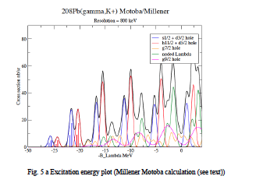
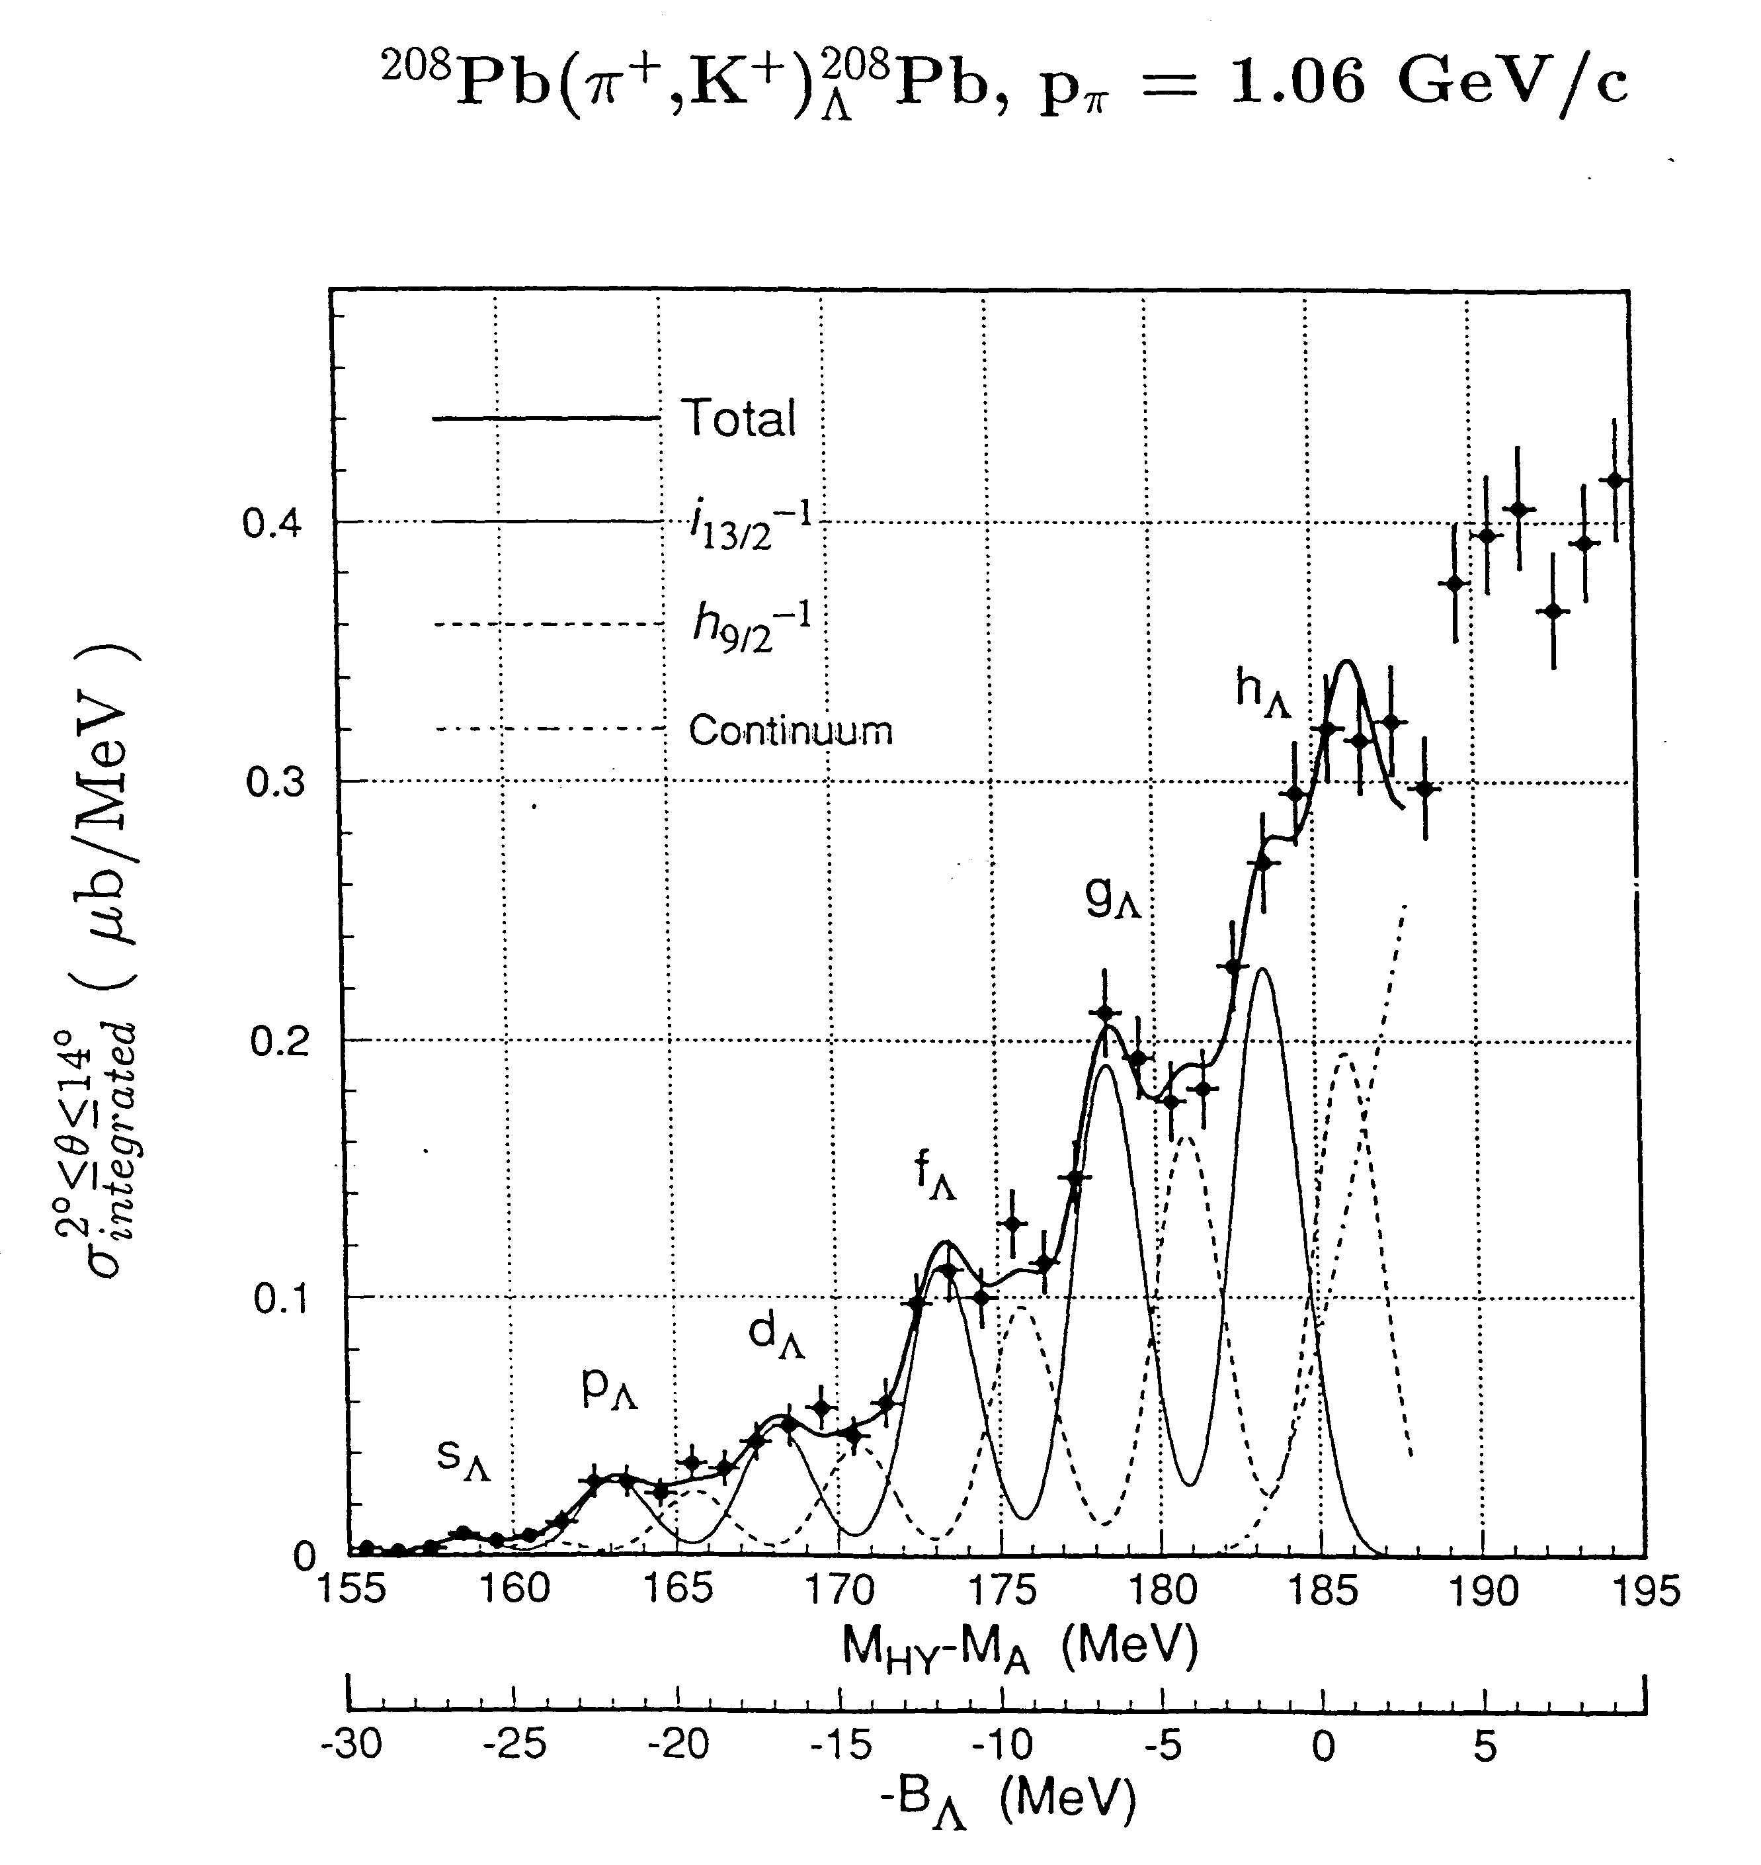

Millener-Motoba calculations
particle hole calulation, weak-coupling of the Λ hyperon to the hole states of the core (i.e. no residual Λ-N interaction).
Each peak does correspond to more than one proton-hole state
- Interpretation will not be difficult because configuration mixing effects should be small
- Comparison will be made with many-body calculations using the Auxiliary Field Diffusion Monte Carlo (AFDMC) that include explicitely the three body forces.
- Once the Λ single particle energies are known the AMDC can be used to try to determine the balance between the spin dependent components of the ΛN and ΛNN interactions required to fit Λ single-particle energies across the entire periodic table.

Slide 22

Appearence of hyperons brings the maximum mass of a stable neutron star down to values incompatible with the recent observation of a star of about two solar masses.
It clearly appears that the inclusion of YNN forces (curve 3) leads to a large increase of the maximum mass, although the resulting value is still below the two solar mass line.
A precise knowledge of the level structure can, by constraining the hyperon-nucleon potentials, contribute to more reliable predictions regarding the internal structure of neutrons stars, and in particular their maximum mass
It is a motivation to perform more realistic and sophisticated studies of hyperonic TBF and their effects on the neutron star structure and dynamics, since they have a pivotal role in this issue

Slide 23
Conclusions
E94-107 Hallla at Jlab : “systematic” study of p shell light hypernuclei
The experiment required important modifications on the Hall A apparatus.New experimental equipment showed excellent performance.
Data on ¹²C show new information. For the first time significant strength and resolution on the core excited part of the spectrum
Prediction of the DWIA shell model calculations agree well with the spectra of ¹²B_{L} and ¹⁶N_{L} for L in s-state. In the p_{L} region more elaborate calculations are needed to fully understand the data.
Interesting results from ⁹Be
Elementary reaction needs further studies
More to be done in 12 GeV era (few body, Ca-40,Ca-48,, π decay spectroscopy)

Slide 24
Backup slides

Slide 25
YN, YY Interactions and Hypernuclear Structure
Free YN, YY interaction
Constructed from limited hyperon scattering data
(Meson exchange model: Nijmegen, Julich)
G-matrix calculation
YN, YY effective interaction in finite nuclei
(YN G potential)
Hypernuclear properties, spectroscopic information
from structure calculation (shell model, cluster model…)
Energy levels, Energy splitting, cross sections
Polarizations, weak decay widths
high quality (high resolution & high statistics) spectroscopy plays a significant role

Slide 26
Hypernuclear investigation
Few-body aspects and YN, YY interaction
  Short range characteritics ofBB interaction
  Short range nature of the LN interaction, no pion exchange: meson picture or quark picture ?
  Spin dependent interactions
  Spin-orbit interaction, …….
  LS mixing or the three-body interaction
Mean field aspects of nuclear matter
  A baryon deep inside a nucleus distinguishable as a baryon ?
  Single particle potential
  Medium effect ?
  Tensor interaction in normal nuclei and hypernuclei
  Probe quark de-confinement with strangeness probe
Astrophysical aspect
  Role of strangeness in compact stars
  Hyperon-matter, SU(3) quark-matter, …
  YN, YY interaction information

Slide 27


S_{L}, p⁻¹ states are weakly populated - small overlap of the corresponding single particle wave functions of proton and lasmbda. For L in higher s.p. states overlap as well as cross sections increases being of the order of ~ 1 nb.

Slide 28

208
208

Slide 29

208
208
208
We have to evaluate pion and proton background and fine tune it with data from (e,e’p)Pb

Slide 30
M. Iodice, F. Cusanno et al, High resolution spectroscopy of ¹²B_{L} by electroproduction, PRL 99, 052501, (2007)
F.Cusanno,G.M.Urciuoli et al,High resolution spectroscopy of ¹⁶N_{L}by electroproduction,PRL 202501, (2007)
M. Coman, P. Markowitz, K. A. Aniol, et al.Cross sections and Rosenbluth separations in 1H(e,e’ K+) Lambda up to Q 2=2.35 GeV2, Phys. Rev C 81 (2010), 052201
P.Markowit et al. Low Q2 Kaon Elecroproduction, International Journal of Modern Physics E, Vol. 19, No. 12 (2010) 2383–2386
G.M. Urciuoli, F. Cusanno et al. High resolution Spectroscopy of ⁹Li_{L} in preparation
(Archival paper) High Resolution 1p shell Hypernuclear Spectroscopy…, next year)
F. Garibaldi et al. Nucl. Instr. and Methods A 314 (1992) 1.(Waterfall target)
E. Cisbani et al. Nucl. Instr. and Methods A 496 (2003) 30 (Mirrors for gas Cherenkov detectors)
M. Iodice et al. Nucl. Instr. and Methods A 411 (1998) (Gas Cherenkov detector)
R. Perrino et al. Nucl. Instr. and Methods A 457 (2001) 571 (Aerogel Cherenkov detector)
L. Lagamba et al. Nucl. Instr. and Methods A 471 (2001) 325 (Aerogel Cherenkov detector)
F. Garibaldi et al. Nucl Instr Methods A 502 (2003), 255 (RICH Hall A)
F. Cusanno et al. Nucl Instr Methods Nucl Instr Meth A 502 (2003), 117 (RICH Hall A)
M. Iodice et al, Nucl Instr Meth A 553 (2005), 231 (RICH Hall A)
E. Cisbani et al. Nucl Instr Methods Nucl Instr Meth A 595 (2008), 44 (RICH Hall A and evaporation techniques)
G. M. Urciuoli et al. Nucl Instr Meth A 612 (2009), 56 (A Method for Particle Identification with RICH Detectors based on the χ2 Test)
G. M. Urciuoli et al. Software optics Hall A spectrometers (in preparation) (another on sup. Septa?)
G. M. Urciuoli et al. Radiative corrections for……. (in preparation)

Slide 31
Very preliminary commments by Sotona on Be
The underlying core nucleus ⁸Li can be a good canditate for some unexpected behaviour. In this unstable (beta decay) core nucleus with rather large excess of neutral particles (% neutrons + Lambda against 3 protons only); the radii of distribution of protons and neutrons are rather different
There are at least two measurement on radioactive beams of neutron (Rn) and matter (Rm) radius of the distribution
Rn Rm
2.67 2.53
2.44 2.37
(Liatard et al., Europhys. Lett. 13(1990)401, (Obuti et. al., Nucl. Phys. A609(1996)74)
Any calculation of the cross section depends on the exact value of matter distribution via single-particle wavefunction of the lambda in ⁹Li-lambda hypernucleus.
About the shift of the position of the second and third hypernuclear doublet., this discrepancy can be used as a valuable information on the structure of underlying ⁸Li core.

Slide 32



