Slide 1


International Nuclear Physics Conference 2013
6th July 2013, Firenze
Strange Light Nuclei
Strange
1. Unusual or surprising, especially in a way
that is difficult to explain or understand
Λ
α
n
n
2. having strangeness degree of freedom
(only for physists)
Satoshi N. Nakamura, Tohoku University

Slide 2
Lattice QCD
Modarn baryon Interaction models
QCD
Baryon Interaction
Quark degree of freedom
SU_{f}(3) Symmetry
Nuclear Force
Hyperon Force
Lots of NN scattering data
Limited YN/YY scattering data
Established Calculation Tech.
Fadeev, ChPT,
Cluster Model
Shell Model
Mean Field
Nuclear Structure
Nuclear Structure
Normal/Exotic nuclei
Hypernuclei

Slide 3
s-shell hypernuclei in 20th Century
³_{Λ}H
⁴_{Λ}H
⁵_{Λ}He
Core + Λ
Akaishi D2 B_{Λ}(⁴_{Λ}H) = 0.69MeV
B_{Λ}
Akaishi D2 B_{Λ}(⁵_{Λ}He) = 3.01MeV
⁴_{Λ}H Underbound
Dalitz B_{Λ}(⁵_{Λ}He) = 5.46MeV
⁵_{Λ}He Overbound
Data from emulsion experiments
R.H.Dalitz et al. NPB47 (1972) 109.
D.H.Davis, 50 years of hypernuclear physics
I. The early experiments, NPA754 (2005) 3.

Slide 4

ΛN -ΣN coupling is important
Λ
n
Σ⁺
n
Σ⁰
n
p
p
n
p
p
p
${\left.​\right|}_{Λ}^{4}\left.He\right\rangle =φ_{Λ}\left(\vec{r}\right){\left.​\right|}^{3}\left.He\right\rangle +\sqrt{\frac{2}{3}}φ_{Σ^{+}}\left(\vec{r}\right){\left.​\right|}^{3}\left.H\right\rangle$-$\sqrt{\frac{1}{3}}φ_{Σ^{0}}\left(\vec{r}\right){\left.​\right|}^{3}\left.He\right\rangle$
B.F. Gibson et al., PRC 6 (1972) 741,
J. Dabrowski, PRC 8 (1973) 835.

Slide 5
ΛN-ΣN coupling and s-shell HY
K.S.Myint, Y.Akaishi et al. NPA684(2001)592.
Theingi, K.S.Myint, Y.Akaishi arXiv:1211.5719
³_{Λ}H
⁴_{Λ}H
⁴_{Λ}He
⁵_{Λ}He
0
0.13
0.69
B_{Λ}
0.99
1.24
2.04
2.39
3.12
Λ
p
n
Λ
p
Λ
n
Effective ΛNN force
n
n
p
p
Λ
p
n
Unbalance of isospin
p
n

Slide 6

Charge Symmetry Breaking Effect of ΛN interaction
1⁺
0.24 MeV
0.35 MeV
0⁺
⁴_{Λ}H
Λ
n
Λ
n
⁴_{Λ}He
n
p
p
p
Coulomb effect is small.
Charge Symmetry Breaking
cf) B(³H)-B(³He)-ΔB_{c} = 764-693 = 71 keV

Slide 7

Three-body ΛNN force
Modern Yakubovsky and ChPT-NLO calculations were performed but
they cannot explain A=4, T=1/2, hypernuclei. (A.Nogga, HYP2012)
π
π
Σ
N Λ N
ΛΣ mass difference ~ 80 MeV < NΔ mass difference ~ 300MeV
M(Σ⁺) < Μ(Σ⁰) < Μ(Σ⁻), ΔΜ(Σ⁻−Σ⁺)∼8MeV
Consistent understanding of 0⁺, 1⁺ of ⁴_{Λ}H, ⁴_{Λ}He
Phenomenological potential :
A.R.Bodmer&Q.N.Usmani, PRC 31(1985)1400.

Slide 8
B_{Λ} of light hypermultiplets
No reported B_{Λ}
Exp. Data : Emulsion
⁷_{Λ}He
Λ
α
¹⁰_{Λ}Be
n
⁴_{Λ}H
n
67 events
1 event
Λ
n
Λ
α
⁷_{Λ}Li*
n
p
Λ
167 events
n
α
α
p
n
¹⁰_{Λ}B
⁴_{Λ}He
p
98 events
Λ
Λ
⁷_{Λ}Be
α
Λ
15 events
n
p
p
α
α
p
Experimental B_{Λ}
Δ_{CSB}
p
10 events
Hiyama et al. PRC80.054321
PTP in press.

Slide 9
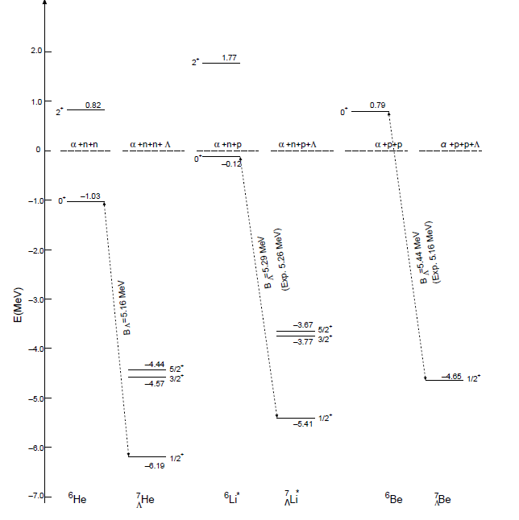
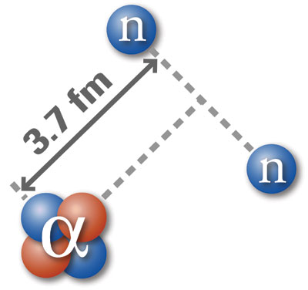
⁷_{Λ}He = ⁶He + Λ
behaves like glue
⁶He : 2n halo
E.Hiyama et al. PRC 80, 054321 (2009)

Slide 10
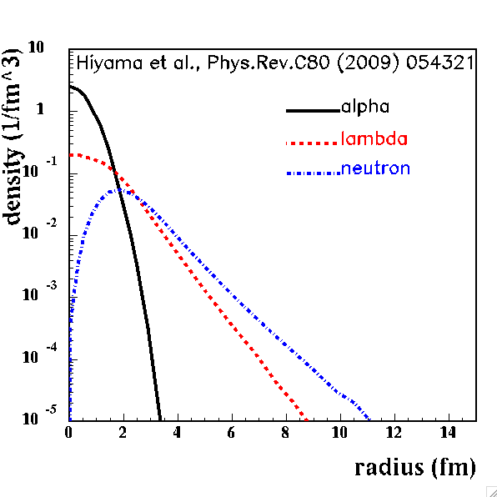
⁷_{Λ}He Density Distributions
2n
α
Λ
Λ
n
α
n

Slide 11
Production of Hypernuclei
n to Λ
s-quark exch.
(K⁻,π⁻)
No ⁷He target
⁷He(K⁻,π⁻) ⁷_{Λ}He
s,sbar pair cre.
⁷He(π⁺,K⁺) ⁷_{Λ}He
(π⁺,K⁺)
(e,e’K⁺)
p to Λ
⁷Li(e,e’K) ⁷_{Λ}He

Slide 12
Characteristics of (e,e’K) HY study
Electromagnetic production
  Less Section
  Huge e’ Background
  Signal/Noise, Detector
Convert Proton to Lambda :
Iso-multiplet HY by (π,K), (K,π)
Absolute energy calibration with Λ and Σ⁰ masses
Coincidence Measurement (e’, K⁺)
Limited Statistics
DC beam is necessary
High quality primary beam
    High energy resolution (< 1MeV)
    Thin enriched target

Slide 13
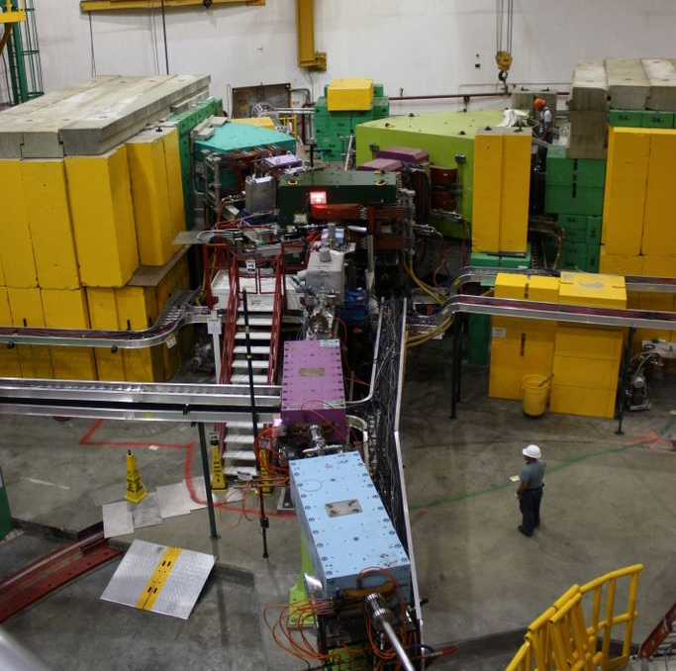
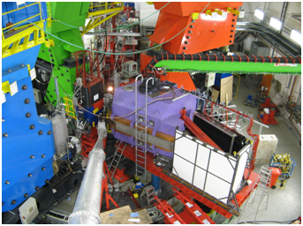
Facilities for
(e,e’K⁺) Hypernuclear study
HES
HKS
JLab Hall-A HRS+HRS (2004)
F. Garibaldi (HN016)
JLab Hall-C
HNSS (2000)
HKS (2005)
HKS+HES (2009)
Mainz MAMI-C A1 KaoS (2008-)
A. Esser (NF026)

Slide 14
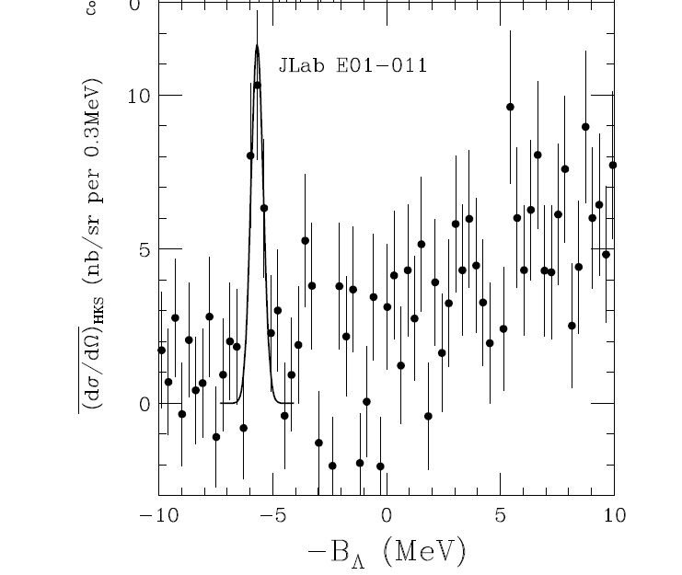
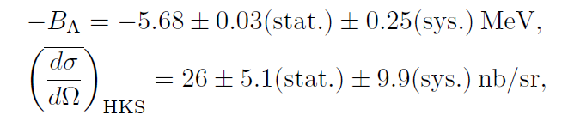
⁷Li(e,e’K⁺)⁷_{Λ}He
First observation of ⁷_{Λ}He w/ good statistics
Last missing information of
A=7 hypernuclear iso-triplet
FWHM 0.63 MeV
JLab E01-011 collaboration,
SNN et al., Phys. Rev. Lett. 110 (2013) 012502.

Slide 15
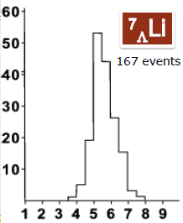

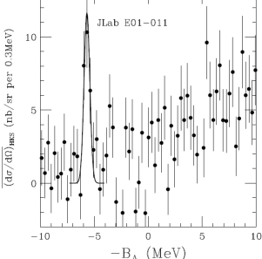
A=7 Hypernuclear iso-triplet
Jlab E01-011(HKS)
emulsion + γ
⁷_{Λ}He
⁷_{Λ}Li*
⁷_{Λ}Be
Λ
Λ
Λ
α
α
p
α
p
n
n
n
p

Slide 16
A=7 Hypernuclear iso-triplet w/CSB
Jlab E01-011(HKS)
Assumed CSB potential may be too naïve.
New measurements on A=4 systems are necessary.
emulsion + γ
⁷_{Λ}He
⁷_{Λ}Li*
⁷_{Λ}Be
Λ
Λ
Λ
α
α
p
α
p
n
n
n
p

Slide 17
Light hypernuclei
³_{Λ}H
⁴_{Λ}H
⁴_{Λ}He
⁵_{Λ}He
⁶_{Λ}H
⁷_{Λ}He
0
0.13
B_{Λ}
0.99
1.24
2.04
2.39
3.12
CSB
5.8
5.68+0.03+0.25
JLab E01-011
Theingi, K.S.Myint, Y.Akaishi arXiv:1211.5719

Slide 18
New Data from FINUDA
³_{Λ}H
⁴_{Λ}H
⁴_{Λ}He
⁵_{Λ}He
⁶_{Λ}H
⁷_{Λ}He
0
0.13
0.69
B_{Λ}
0.99
1.24
FINUDA
E. Botta (HN005)
2.04
2.39
3.12
M.Agnello et al., PRL 108 (2012) 042501.
NPA 881 (2012) 269.
4.0+1.1
5.8
5.68+0.03+0.25
JLab E01-011
Theingi, K.S.Myint, Y.Akaishi arXiv:1211.5719
M.Agnello et al. Nucl. Phys. A 881 (2012) 269.
B.F.Gibson, I.R.Afnan Nucl. Phys. A , DOI 10.1016/j.nuclphysa.2013.02.017
A.Gal and D.J.Millener, arXiv 1305.6716

Slide 19
New Data from FINUDA
³_{Λ}H
⁴_{Λ}H
⁴_{Λ}He
⁵_{Λ}He
⁶_{Λ}H
⁷_{Λ}He
0
0.13
0.69
B_{Λ}
0.99
1.24
FINUDA
E. Botta (HN005)
2.04
2.39
3.12
M.Agnello et al., PRL 108 (2012) 042501.
NPA 881 (2012) 269.
4.0+1.1
5.08
5.8
5.68+0.03+0.25
JLab E01-011
Theingi, K.S.Myint, Y.Akaishi arXiv:1211.5719
M.Agnello et al. Nucl. Phys. A 881 (2012) 269.
B.F.Gibson, I.R.Afnan Nucl. Phys. A , DOI 10.1016/j.nuclphysa.2013.02.017
A.Gal and D.J.Millener, arXiv 1305.6716

Slide 20
New Data from FINUDA
³_{Λ}H
⁴_{Λ}H
⁴_{Λ}He
⁵_{Λ}He
⁶_{Λ}H
⁷_{Λ}He
0
0.13
0.69
B_{Λ}
0.99
Theoretical discussion
A. Gal (HN015)
1.24
FINUDA
E. Botta (HN005)
2.04
2.39
3.12
M.Agnello et al., PRL 108 (2012) 042501.
NPA 881 (2012) 269.
4.0+1.1
5.8
5.68+0.03+0.25
JLab E01-011
Theingi, K.S.Myint, Y.Akaishi arXiv:1211.5719
M.Agnello et al. Nucl. Phys. A 881 (2012) 269.
B.F.Gibson, I.R.Afnan Nucl. Phys. A , DOI 10.1016/j.nuclphysa.2013.02.017
A.Gal and D.J.Millener, arXiv 1305.6716

Slide 21
New Data from FINUDA
³_{Λ}H
⁴_{Λ}H
⁴_{Λ}He
⁵_{Λ}He
⁶_{Λ}H
⁷_{Λ}He
0
0.13
0.69
J-PARC E10
H. Sugimura (HN044)
B_{Λ}
0.99
Theoretical discussion
A. Gal (HN015)
1.24
FINUDA
E. Botta (HN005)
2.04
2.39
3.12
4.0+1.1
5.8
5.68+0.03+0.25
JLab E01-011
Theingi, K.S.Myint, Y.Akaishi arXiv:1211.5719
M.Agnello et al. Nucl. Phys. A 881 (2012) 269.
B.F.Gibson, I.R.Afnan Nucl. Phys. A , DOI 10.1016/j.nuclphysa.2013.02.017
A.Gal and D.J.Millener, arXiv 1305.6716

Slide 22
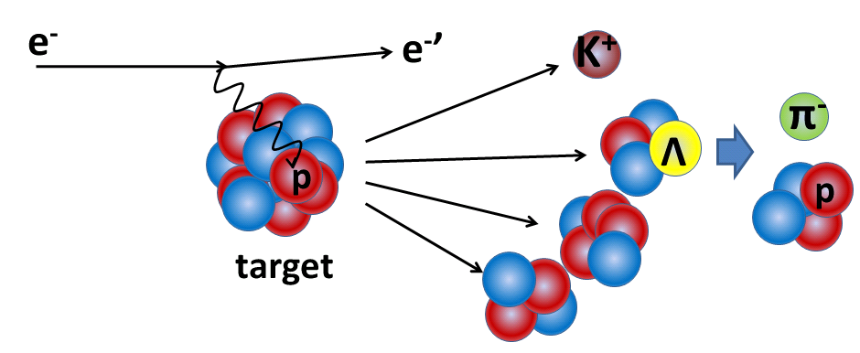
Decay π Spectroscopy of electro-produced HY
Study of ⁴_{Λ}H ground state
Tag
M_{π} , p_{π}
M_{HYP}
M_{ncl}
spectrometer
(FWHM~100keV/c)
deduce mass

Slide 23
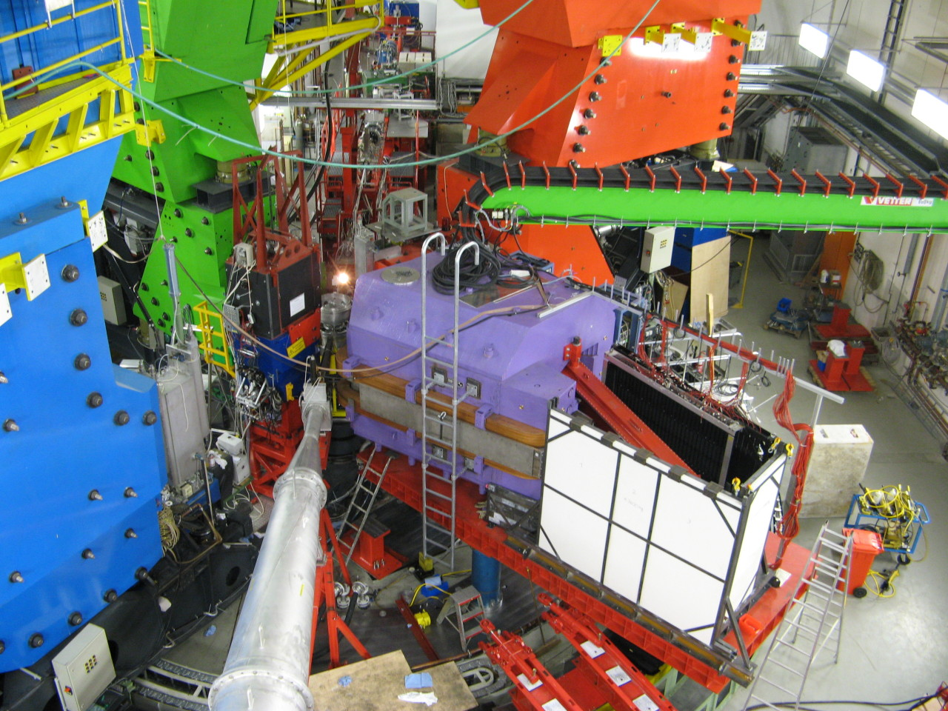
Kaos at MAMI-C (Mainz Univ.)
π⁻
Pilot experiments
performed
at MAMI-C
in 2011 and 2012
K⁺

Slide 24
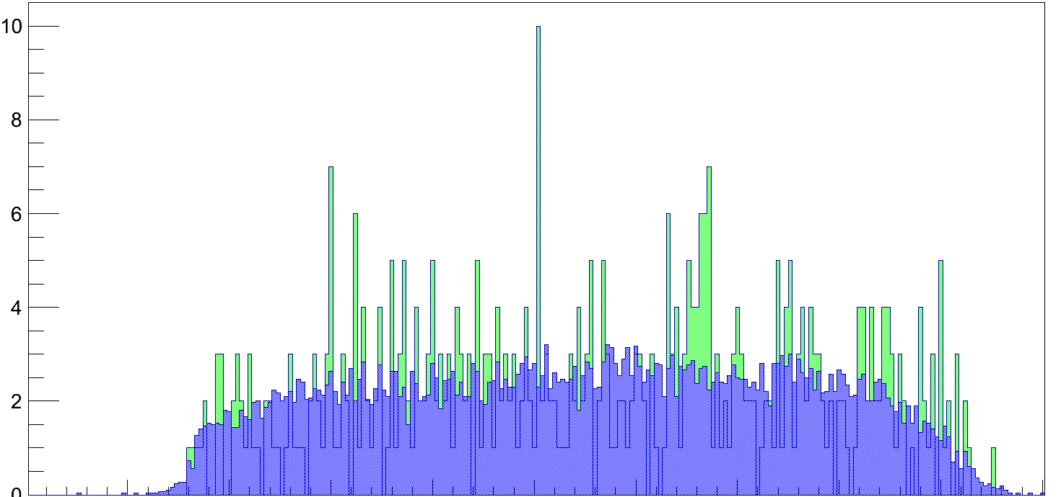
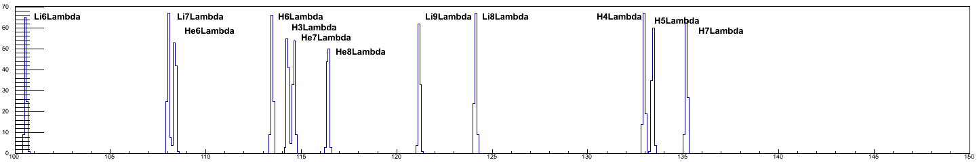
π⁻ spectrum tagged by K⁺
A1 Hypernuclear Collaboration
Very preliminary
Kaos + Spek-C (2011)
Pion momentum : Not calibrated
⁴_{Λ}H
Expectation
Collaboration is now working to finalize spectra including data taken in 2012.

Slide 25
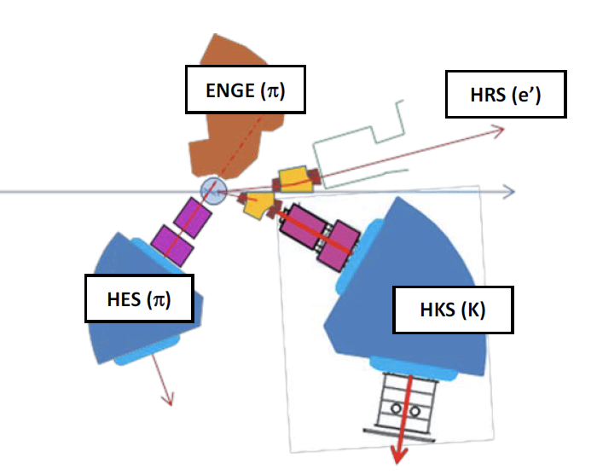
New Experiment at Jlab
(PR12-13-002)
Proposed to PAC40 : A Study with High Precision
on the Elecro-production of the Λ and Λ -Hypernuclei in the Full Mass Range
By JLab hypernuclear Collaboration = previous Hall-A HY + HKS-HES (Hall-C)
Decay π spectroscopy & ⁴He(e,e’K⁺) ⁴_{Λ}H are parts of program.

Slide 26
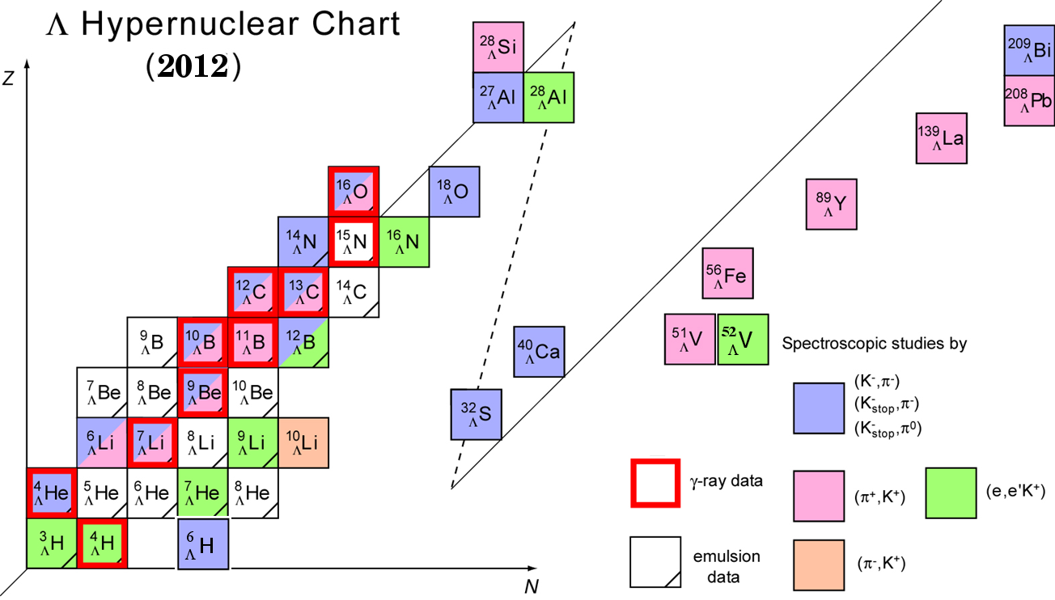
Present Status of
Λ Hypernuclear Spectroscopy
²⁷
_{Λ}
_{Λ}
Tl
Mg
²⁰⁸
⁴⁸
¹²
_{Λ}
_{Λ}
B
Sc
⁴⁰
_{Λ}
⁴⁰
_{Λ}
⁴⁴
_{Λ}
⁴⁸
K
_{Λ}
K
K
K
_{Λ}
⁴
H
[ΛΝ]
Λ
Updated from: O. Hashimoto and H. Tamura, Prog. Part. Nucl. Phys. 57 (2006) 564.

Slide 27
Summary
Emulsion data provided s-shell hypernuclei data.
ΛΝ−ΣΝ coupling is important to understand them.
Binding energy of ⁷_{Λ}He_{gs} was determined by the (e,e’K⁺) hypernuclear spectroscopy at JLab with newly developed HKS-HES .
Observation of ⁶_{Λ}H by FINUDA collaboration triggered active discussion.
Study of decay of electro-produced hypernuclei has began at MAMI-C. (⁴_{Λ}H will be studied).
New experimental efforts are on going at JLab, Mainz, J-PARC.
Light hypernuclei are still strange!

