Slide 1




Recent progress in EDF-based methods
applied to nuclear properties.
E. Khan

Slide 2
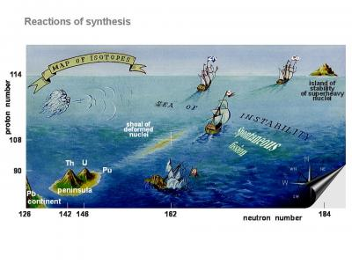
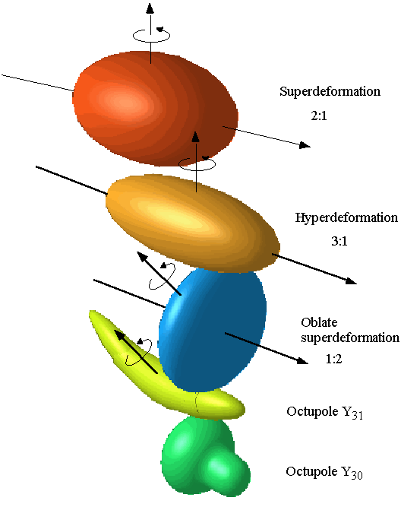
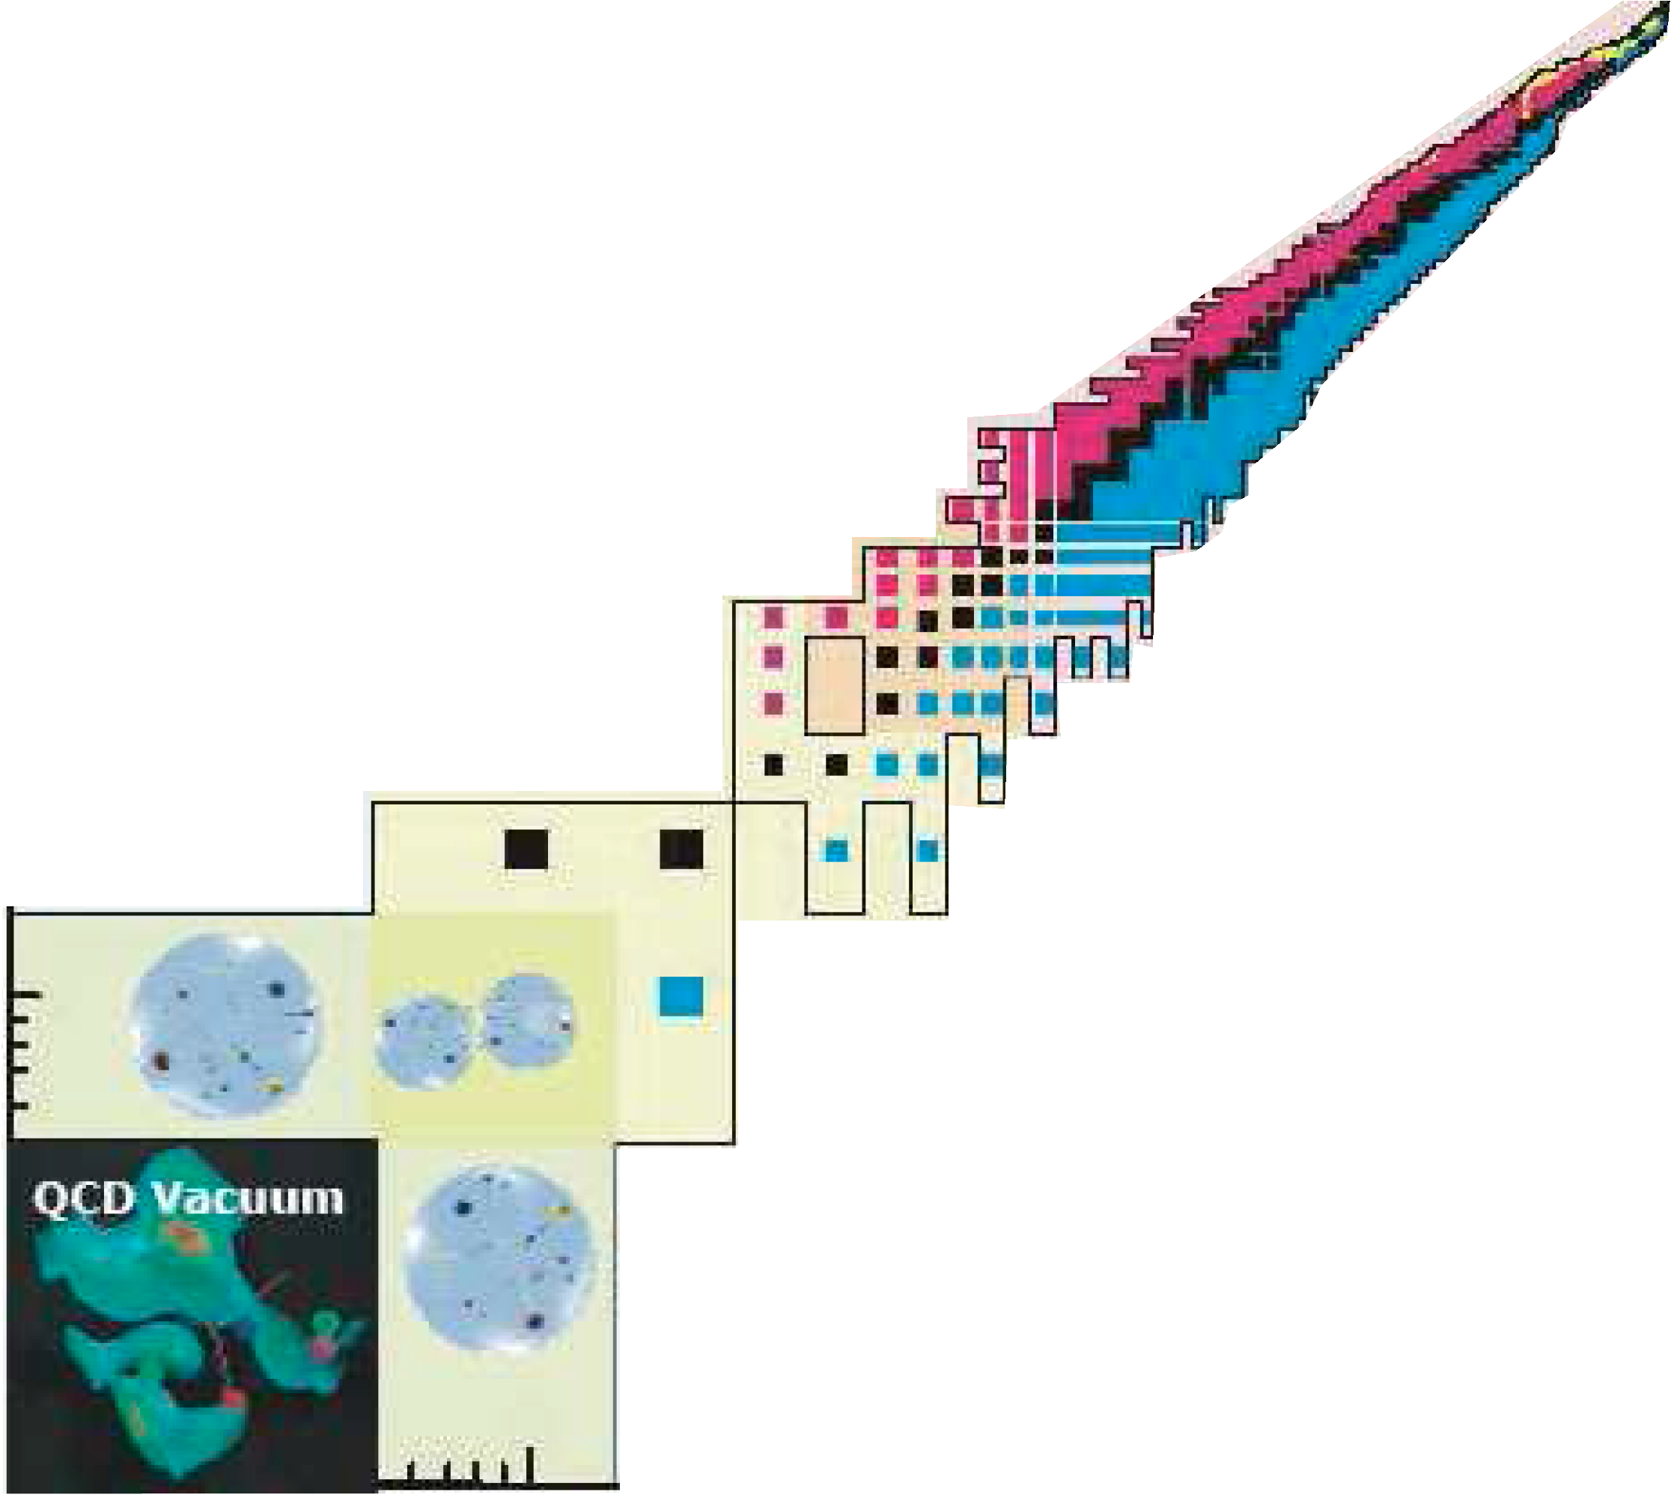
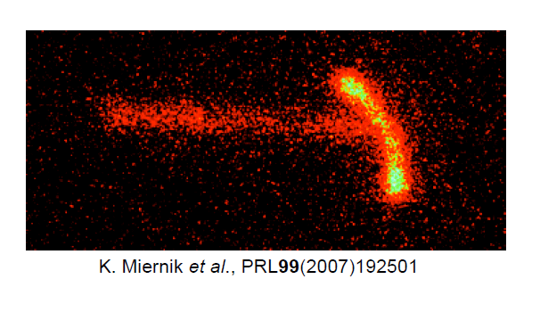

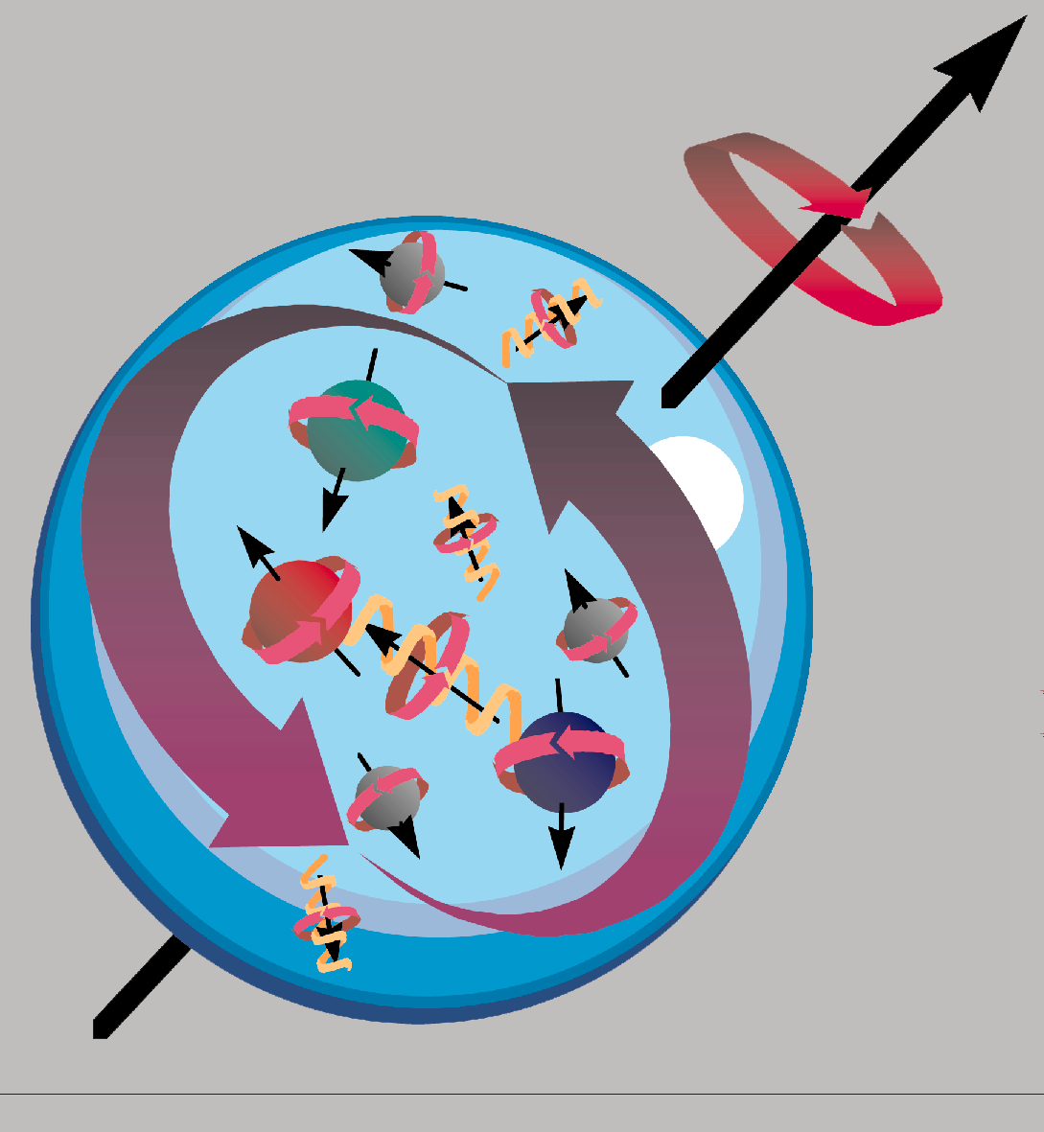
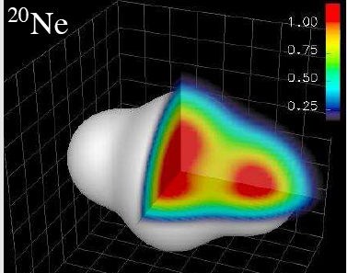
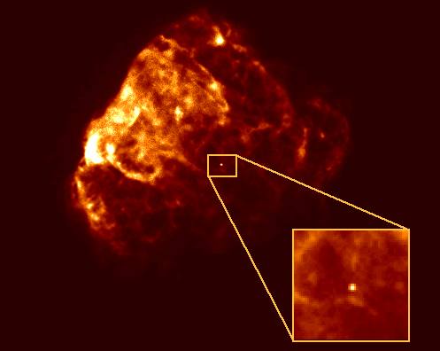
Protons
100
Terra
incognita
10
1
Neutrons
1
10
100
>1000

Slide 3
The nucleus’ phenomenology
A
Neutron star
Infinite matter
1
>1000
+Dynamics:
Excitation
Decay
Reaction
100
Quantum Liquid drop
2
10
Cluster
3
1
Nucleon

Slide 4
1
Nuclear matter & neutron stars

Slide 5
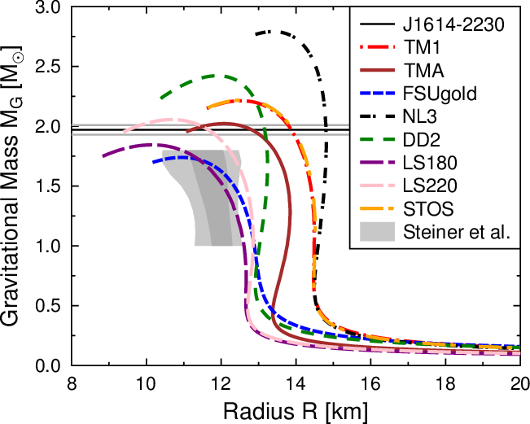
Nuclear matter in space
Matthias Hempel
ITP Franckfurt
K=180 MeV
K=220 MeV

Slide 6
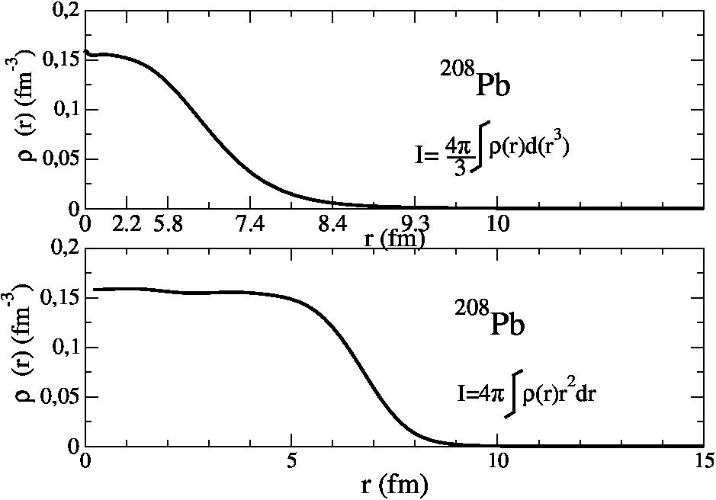
Saturation ?
Surface: 2/3 of nucleons in ²⁰⁸Pb
Saturation density area may not be the most probed
Notes:
Let us ask a simple question: do we really probe matter at saturation at first order when measuring observables in nuclei ?
Take example of 208Pb: used to the density : large saturation density area.
But it is only a minority of the nucleoons: X scale which constant integration step

Slide 7
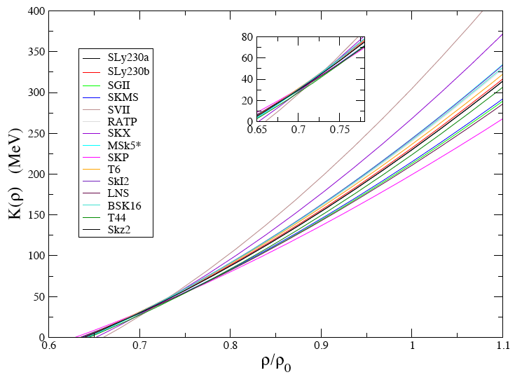
The nuclear incompressibility
K∞
M
E. Khan et al. PRL109(2012)092501
Good correlation between M and the GMR centroid
Notes:
Analog to the slope of n eos constraining the n skin

Slide 8
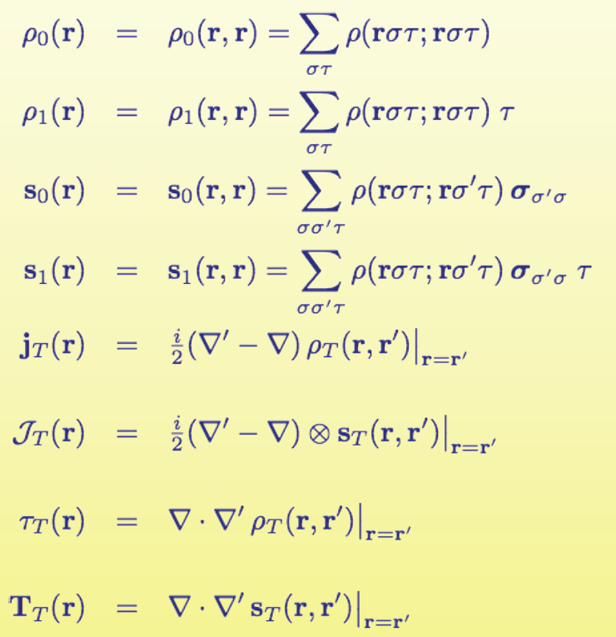
Constraints on functionnals
240
Selection of Skyrme EDF
from nuclear matter constaints
16
5
Macroscopic
constraints
Microscopic
constraints
K∞, L, …
m*, 2M, …
M. Dutra et al. PRC85(2012)035201

Slide 9
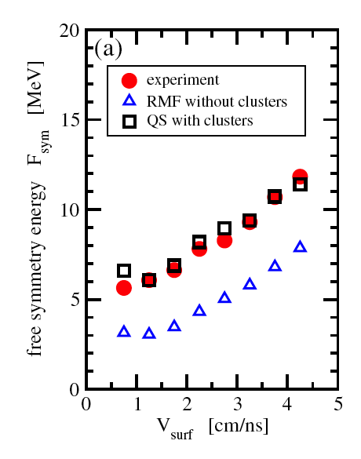
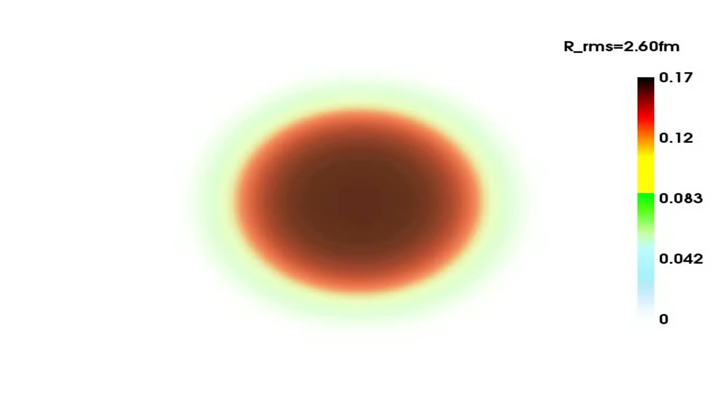
Clusters in low density nuclear matter
RHB-DDME2
Explosion of ¹⁶O
J.B. Natowicz et al. PRL104(2010)202501
Clusters in EoS better describe experiment
Data from heavy ion collision

Slide 10
2
Quantum liquid

Slide 11
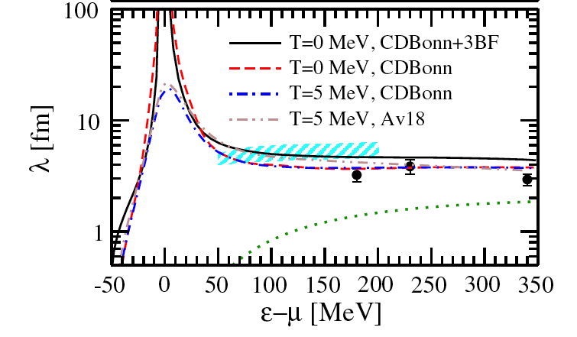
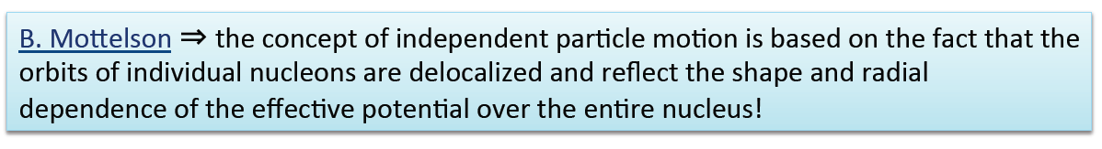
A quantum liquid feature
Mean free path
A. Rios & V. Soma PRL108(2012)012501
r₀
b

Slide 12
Improvements in predicting exotic nuclei:
From 1995 …
D. Lunney et al., ENAM 1995 (Arles)

Slide 13
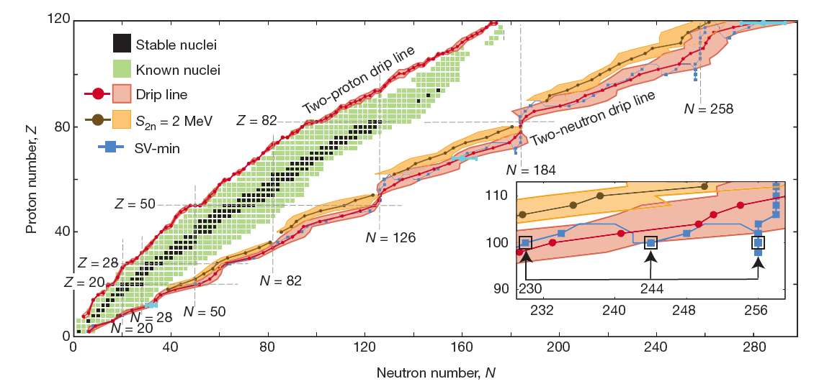
To 2012
J. Erler et al. Nature 486(2012)509
EDF error bar estimate (syst and stat)
6900± 500_{syst} nuclei with Z<121
UNEDF0,1: functionnals designed using data on deformed nuclei, excitations, …

Slide 14
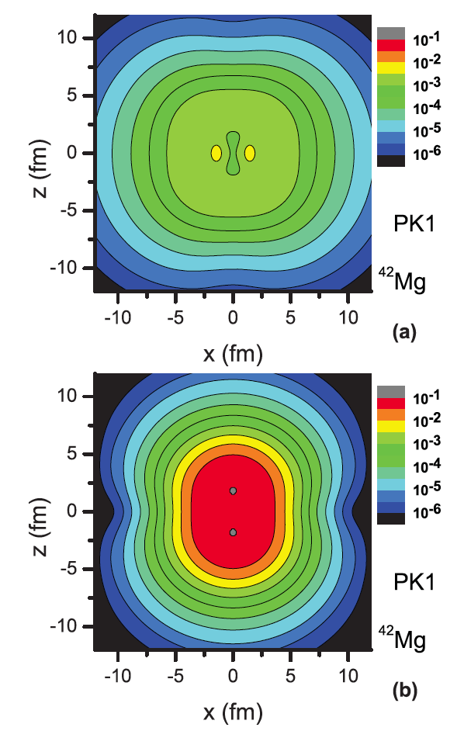
Heavy halo nucleus close to the dripline
Relativistic + pairing + deformation + continuum
⁴²Mg
Oblate n halo
Prolate n core
L. Li et al., PRC85(2012)023312

Slide 15
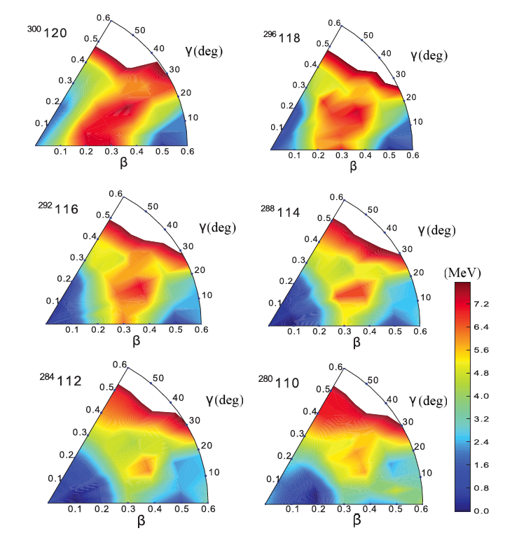
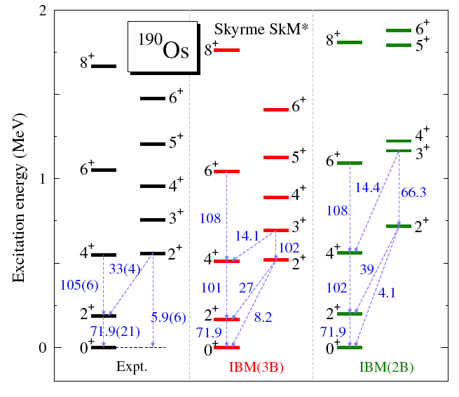
Nuclear shapes
3 body
No 3 body
K. Nomura et al., PRL108(2012)132501
V. Prassa et al., PRC86(2012)024317

Slide 16
3
Clusters

Slide 17
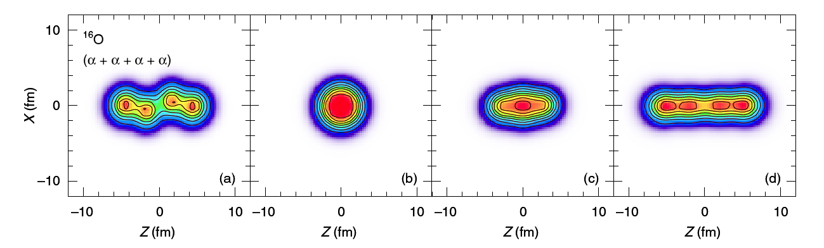
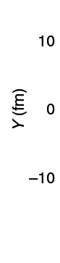
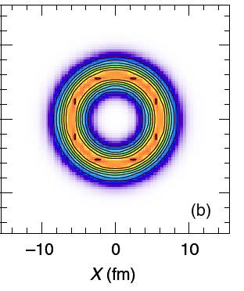
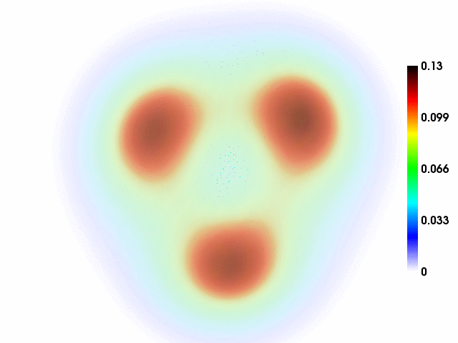
EDF approach to cluster states
¹⁶O
⁴⁰Ca
~15ħω
~60ħω
Skyrme cranked 3D HF
Stabilisation at high-spin excited states
T. Ichikawa et al., PRL107(2011)112501
T. Ichikawa et al., PRL109(2012)232503
¹²C
DDME2 RHB

Slide 18

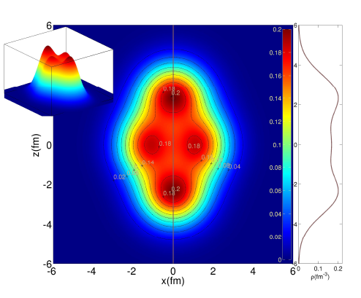
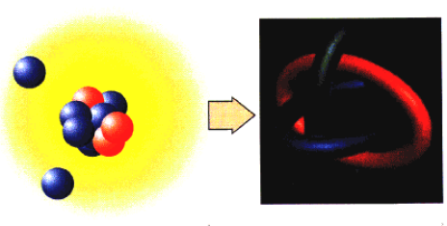
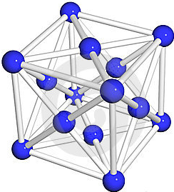
Nuclear states
Halo
Quantum
liquid
Cluster
Crystal
α = b/r₀
b
b
b
b
r₀
r₀
r₀
J.-P. Ebran et al., Nature 487(2012)341
Notes:
Unified description of various nuclear states : order them halo, cluster, quantum liquid
Hypothetical cristal states (only in neutronssatr crust because of coulomb frustration (long range of the coulomb interaction combined by the low density imposed by gravitation sdrives to coulomb cristal with intercluster distance of about
10 fm)

Slide 19
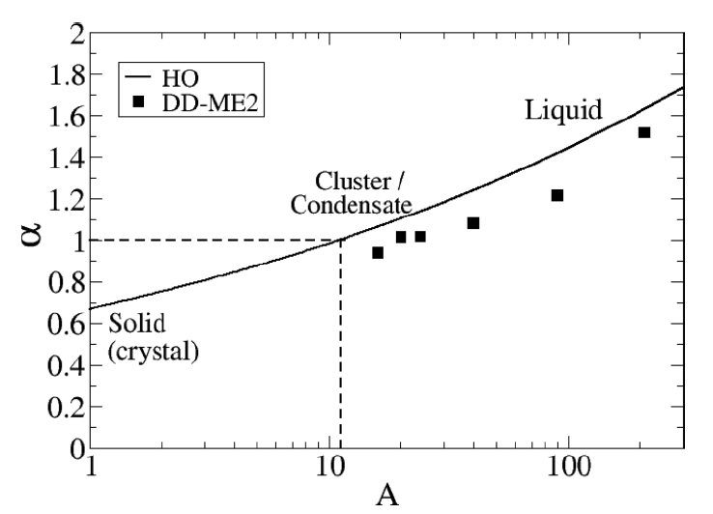
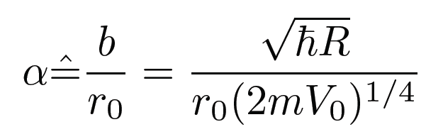
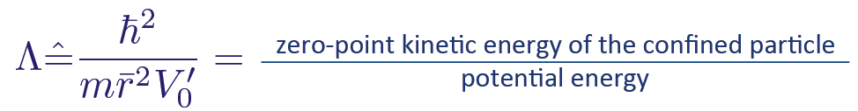
From a nuclear crystal to a nuclear liquid
α = b/r₀
J.-P. Ebran et al., PRC87(2013)044307
B. Mottelson: quantality Λ
In finite nuclei: localisation α

Slide 20
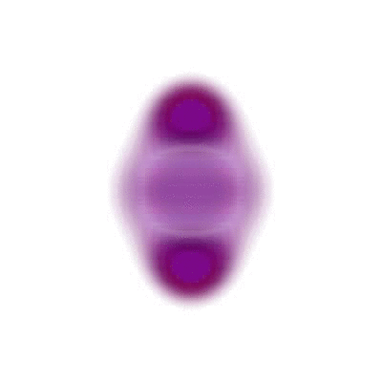
4
Excitations
²⁰Ne
D. Peña Arteaga (RQRPAz)

Slide 21
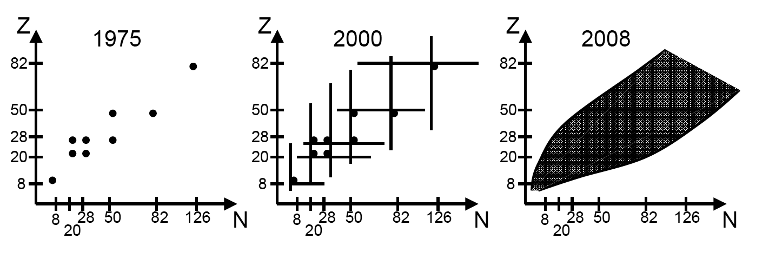
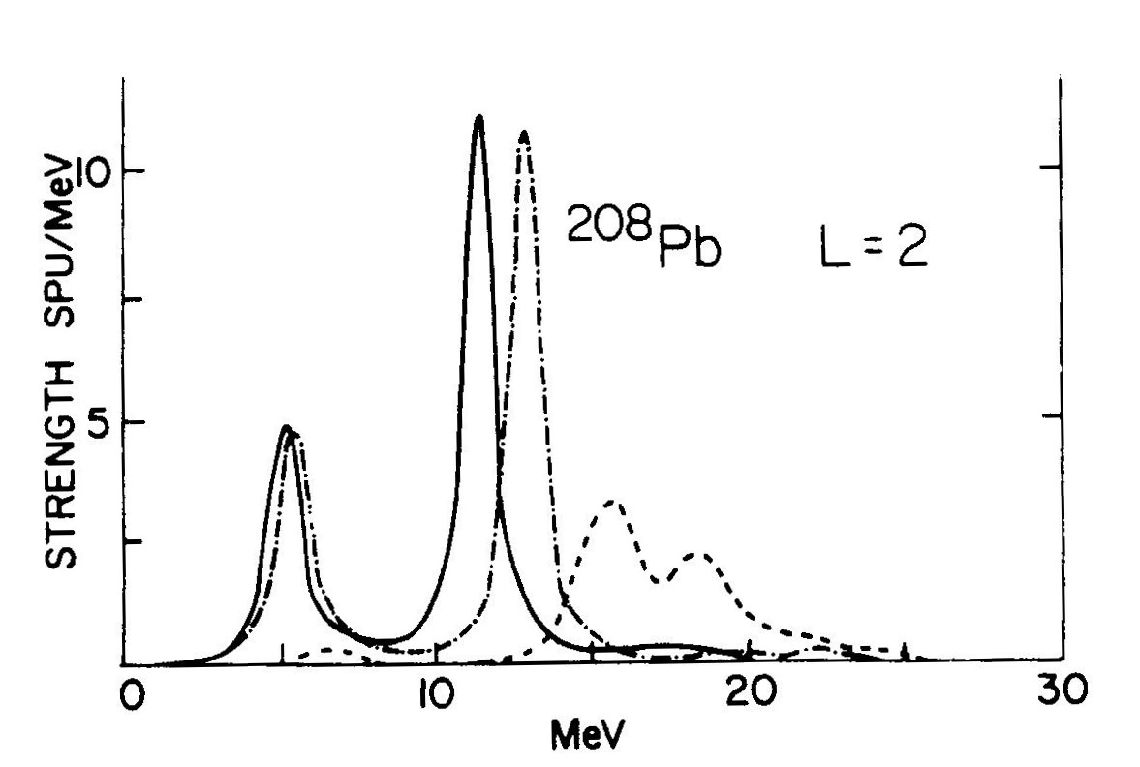
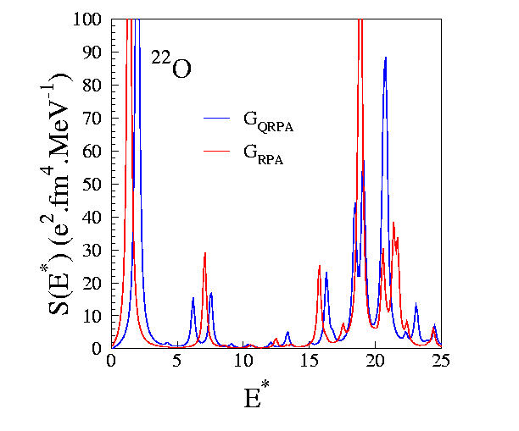
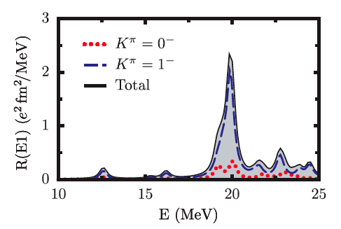
Nuclear excitations: microscopic description
L=2
Notes:
First: are microspcoic models able to predict the GMR withonly paramter the EDF ?
1975: doubly magic
2000: superfluidity
Only in 2008: possible on all nuclei : deformation

Slide 22
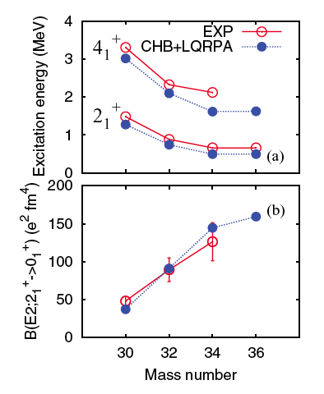
First excited states
Mg
N. Hinohara et al., PRC84(2011)061302(R)

Slide 23
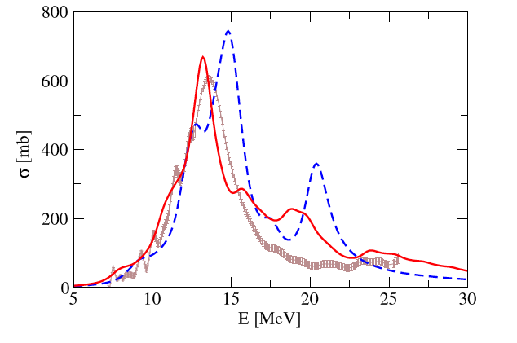
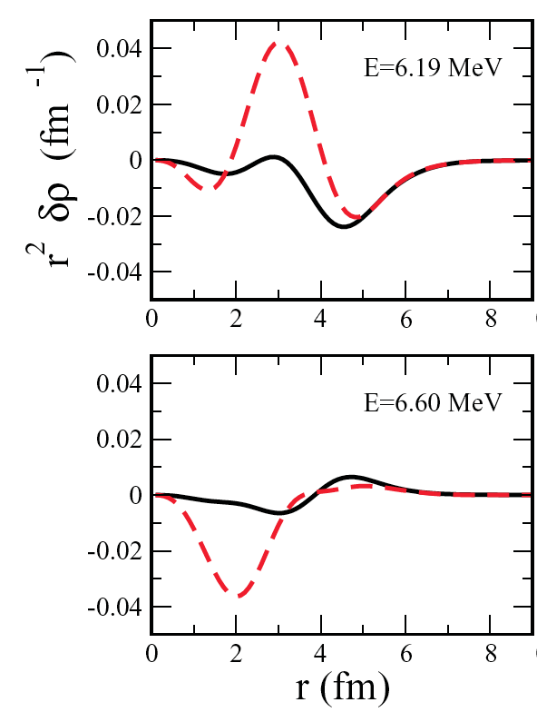
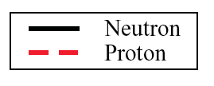
Dipole and low energy modes
Photoabsorption
²⁰⁸Pb
beyond RPA
RPA
⁴⁸Ca
N. Lyutorovich et al., PRL109(2012)092502
Relativistic:
E. Litvinova et al., PRL105(2010)022502
Nuclear matter:
K. Moghrabi et al., PRL105(2010)262501
Soft E1 mode more complex than pygmy
D. Gambacurta et al., PRC84(2011)034301
M.Martini et al., PRC83(2011)034039
Low energy quadrupole collectivity
C. Walz et al., PRL106(2011)062501
Soft non-collective monopole mode
E. Khan et al., PRC84(2011)051301

Slide 24
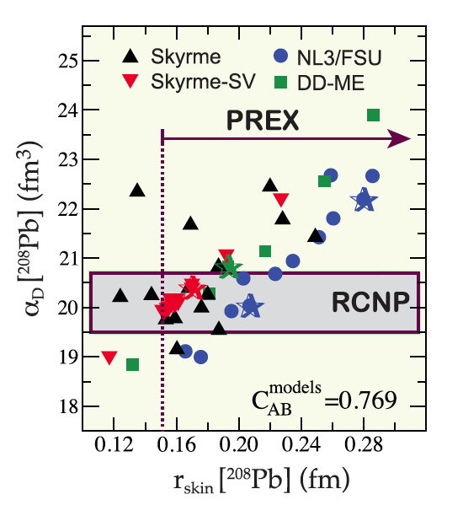
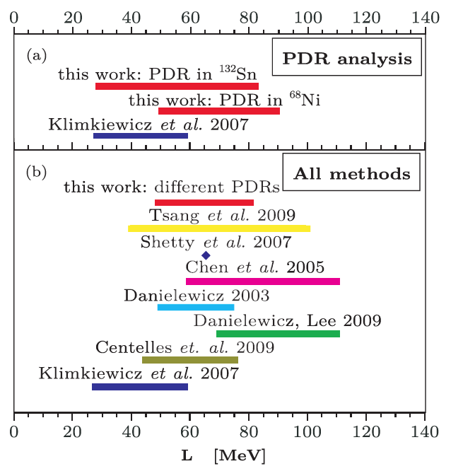
Neutron skin: from polarisability to symmetry energy
A. Carbone et al., PRC81(2010)041301(R)
J. Piekarewicz et al., PRC85(2012)041302(R)
P.-G. Reinhard & W. Nazarewicz, PRC81(2010)051303
Correlation between the neutrons skin and the density dependence of the symmetry energy
B.K. Agrawal et al., PRL109(2012)262501
X. Roca-Maza et al., PRL106(2011)252501

Slide 25
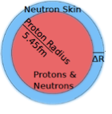
Neutron skin: from polarisability to symmetry energy
dipole response
α_{D}
R_{skin}
L (EoS)

Slide 26
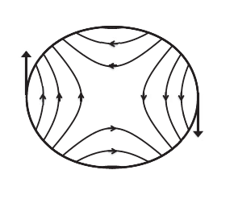
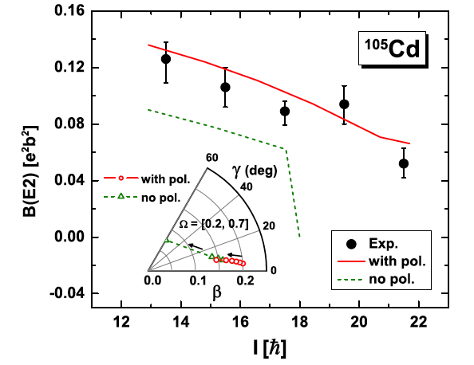
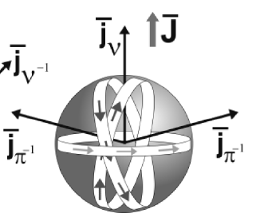
More exotic modes
Antimagnetic rotation
Tidal waves
¹⁰²Pd
A.D. Ayangeakaa et al., PRL110(2013)102501
P.W. Zhao et al., PRL107(2011)122501

Slide 27
5
Decays & Reactions

Slide 28
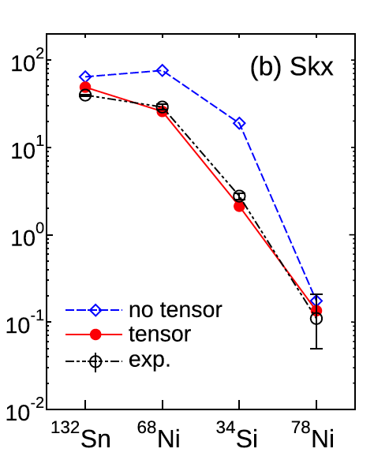
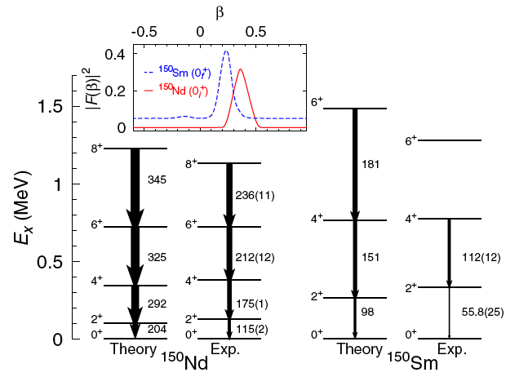
Weak decays
β decay half life
F. Minato & C.L. Bai., PRL110(2013)122501
T. R. Rodriguez and G. Martinez-Pinedo PRL105(2010)252503
Effect of the tensor force on β decay
2β0ν with EDF

Slide 29
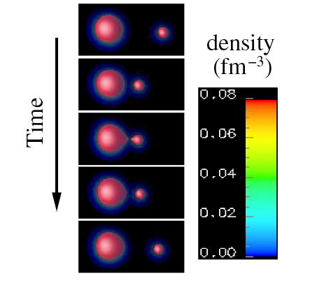
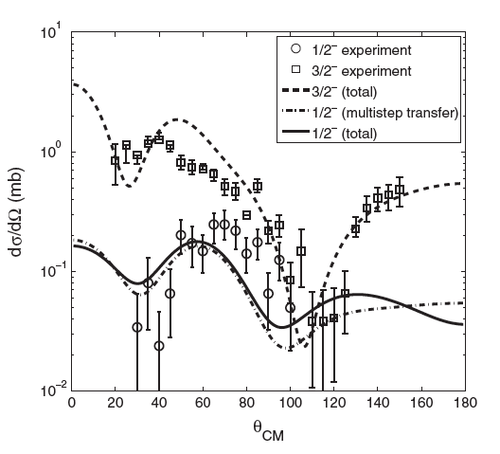
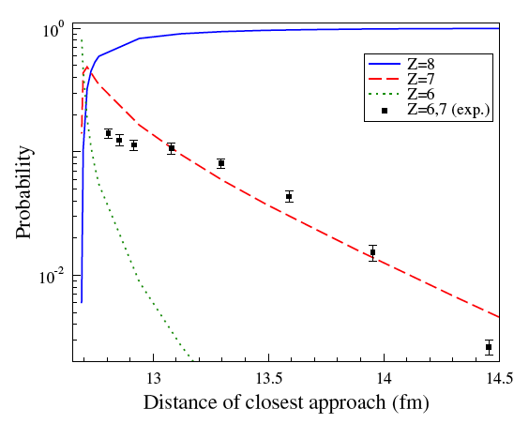
Structure & reaction unification
2n transfer from ¹¹Li
p transfer in¹⁶O+²⁰⁸Pb
G. Potel et al., PRL105(2010)172502
C. Simenel, PRL105(2010)192701
Phonon coupling, pairing and halo

Slide 30
Outlooks
Better link between EoS and nuclear observables
Universal description of nuclear states: clusters & quantum liquid
Accurate predictions of nuclear landscape, shapes and excited states
New modes : soft and more exotic ones
Strong improvements in weak decays
Unification between structure and reaction becomes accessible
7) Promising improvements of methods: DME and EFT, 3 Body, particle projection …

Slide 31
Methodology
EDF topics
(2010) to 2013 (since INPC2010)
Focus on nuclear phenomenon (not technical improvement alone, see title)
(PRL) or (Nature) or (top 10% year-renormalised-quotation in PRC, JPG, NPA)
Sufficient condition but not necessary (it’s my 25 min. talk)

Slide 32
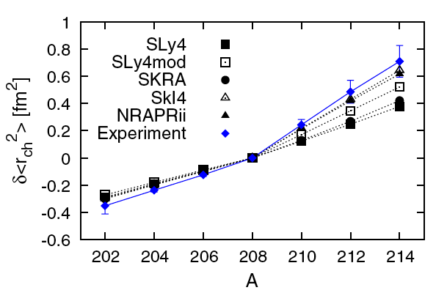
A new view on isotope shift: pairing origin
1i_{11/2} instead of 2g_{9/2}
P.M. Goddard et al., PRL110(2013)032503

