Slide 1
Kaon and Anti-Kaon in Nuclear Matter
Laura Fabbietti
Technische Universität München and
Excellence Cluster Universe

Slide 2
Kaon and Anti-Kaon in Nuclear Matter
Equation of State of nuclear matter -> compressibility
Kaon in nuclear Matter
Results at ‚large‘ densities
Elementary collisions
Antikaon in nuclear Matter
Results at ‚large‘ densities
Λ(1405) and kaonic bound states
Connection to Neutron stars
Hyperon appereance

Slide 3
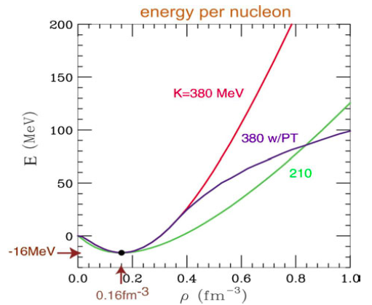
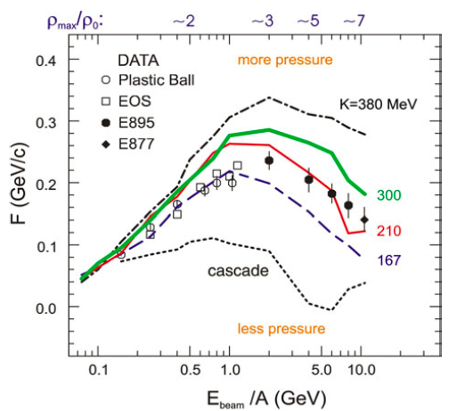
EOS and Heavy Ion Collisions
P. Danielewicz
nucl-th/0512009
The compressibility parameter
No single EOS allows for a description of all sideward data
Still a SOFT EOS is preferred
K~200 MeV from Giant-Dipole measurement
SOFT: K<290 MeV
Hard : K>290 MeV

Slide 4
Role played by K⁺ at 2-3 ρ₀
P Subrata et al. Phys.Rev. C64 (2001) 042201
Ni+Ni @ 1 AGeV
Largest K⁺ production in correspondence of the largest reached density
K⁻: depends on the production process: strangeness exchange is slighlty ‚retarded‘
φ/K- Ratio
Large Absorption for K⁻ HADES Phys.Rev.C80:025209,2009
Idea: Test the compressibility of nuclear matter using K⁺ yields in two different colliding systems as a function of the energy

Slide 5
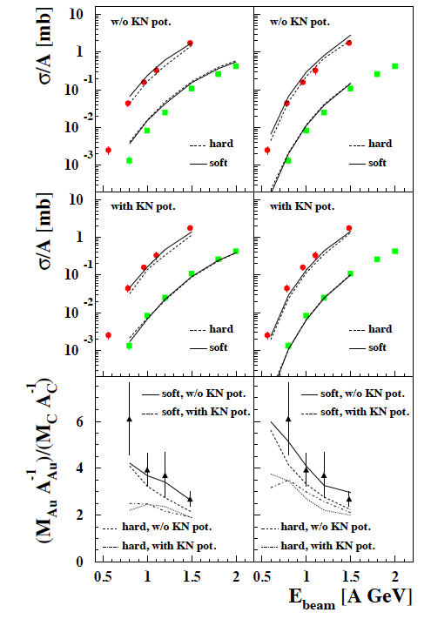
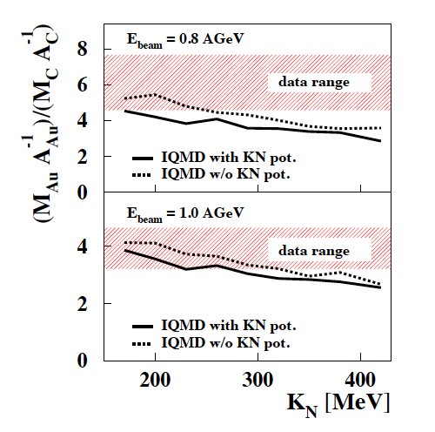
Role played by K⁺ at 2-3 ρ₀
C+C, Au+Au @ 0.5-1.5 AGeV
KaoS Phys.Rev.C75:024906,2007
Interplay between compressibility and potential

Slide 6
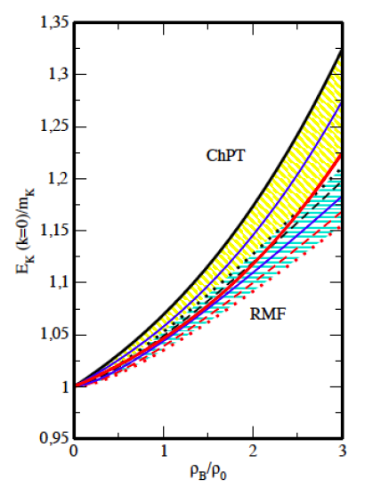
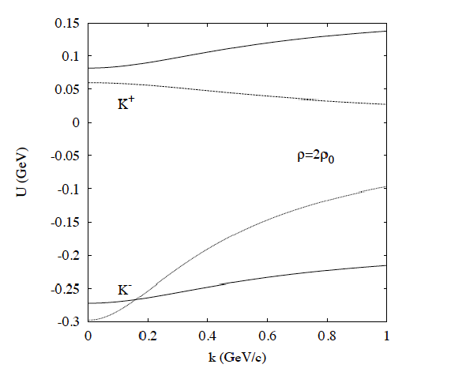
Kaons properties in Matter
How to describe the properties of Kaon in nuclear matter?
Effective Chiral Lagrangian with Kaons and Nucleons as degree of Freedom
Mean Field Dynamics
E= 35 MeV @ ρ=ρ₀, p=0
C. Fuchs Progr. In Part and Nucl. Phys. 56 (2006) 1-103
For Kaons
Vector potential attractive for K⁻ repulsive for K⁺
Scalar potential, ~300-450 MeV, same for K⁺ and K⁻
IM<<Re -> No K⁺ absorption

Slide 7
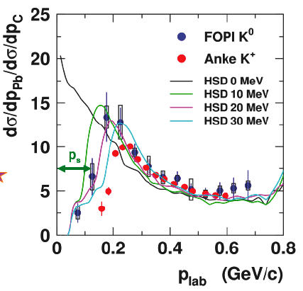
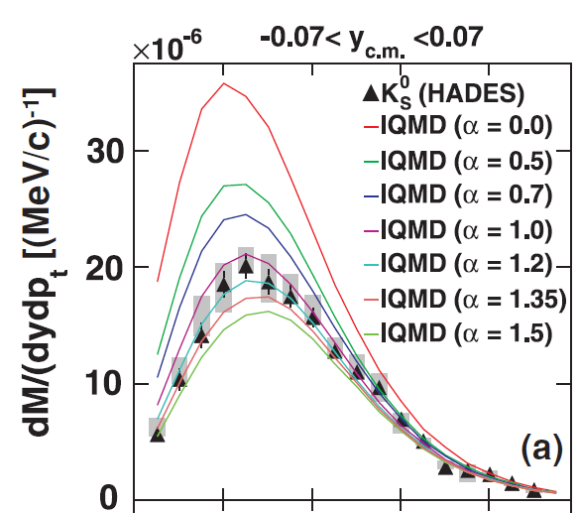
K⁰_{S} ; Momentum Analysis
Low momenta K⁰_{s} in Pb are suppresed
K⁰_{s} are accelerated before they leave the nucleus because of a repulsive force
U_{opt} = +20 ±5 MeV fit the data best
HADES Ar+KCl 1.76 A GeV
HADES Collaboration (G. Agakishiev et al.),
Phys. Rev. C 82, 044907 (2010)
U_{opt} = +39 -2 + 8 MeV fit the data best
But...
Which is ways too simple

Slide 8
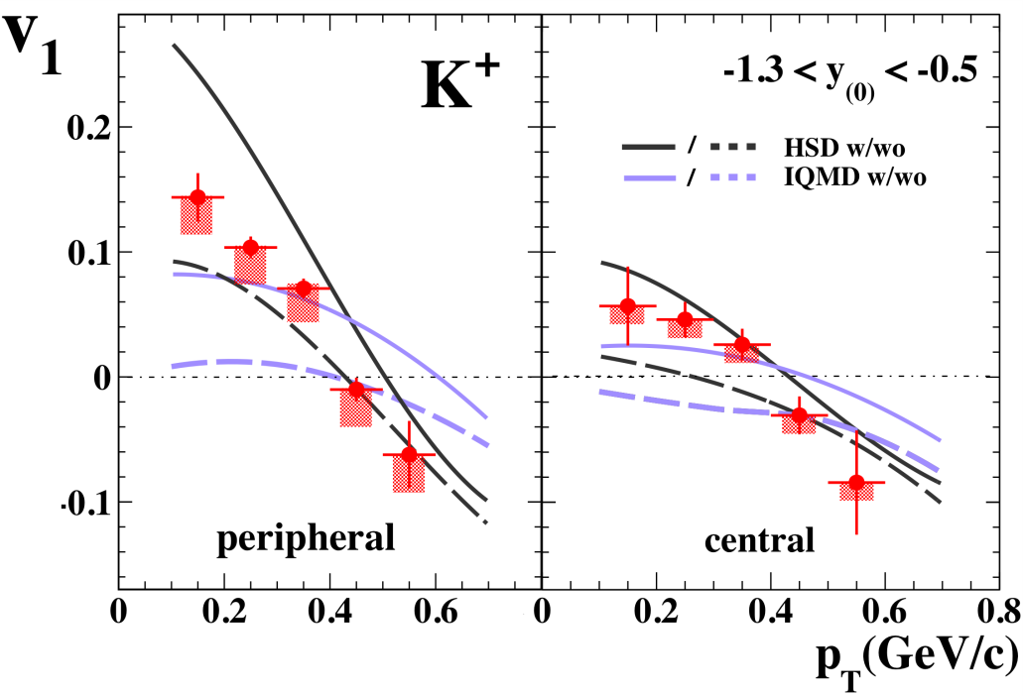
Kaon Flow
Phys. Rep. 510 119 (2012)
FOPI, submitted to PLB
Ni+Ni 1.9 AGeV
Models predict the highest sensitivity to a potential for v₁ at backwards rapidities
Not conclusive
Potential ~20 MeV
Other ways?
Elementary cross-section NN, πN, ΔN, N*N
(Role of Resonances as a function of the energy)
Angular Distributions
Interferences???

Slide 9
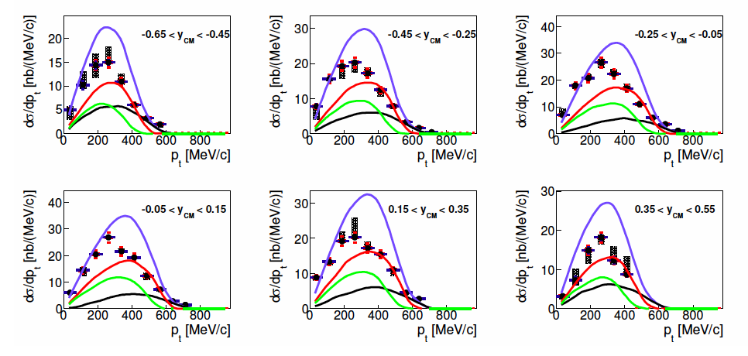
K⁰_{S} from p+p@ 3.5GeV
First understand p+p and p+n reactions
Exclusive measurements of some production channels
Kaon-Nucleon scattering
3-4-5 body decays, inclusive fits to kinematic variables ( including angular distributions)
GiBUU -> Resonance Model
preliminary

Slide 10
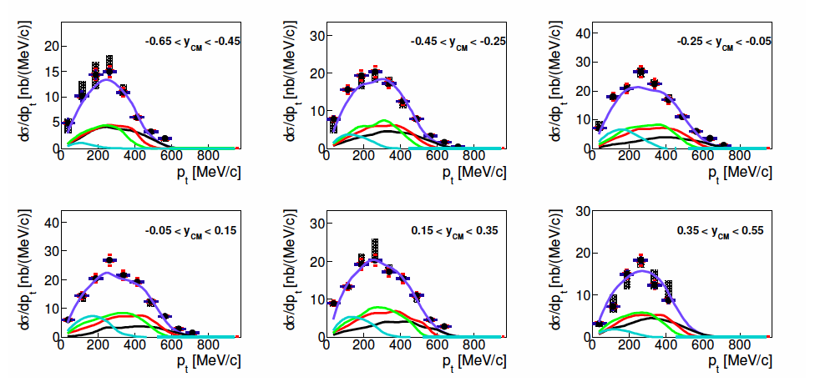
K⁰_{S} from p+p@ 3.5GeV
preliminary
Dominant contribuation from Δ++

Slide 11
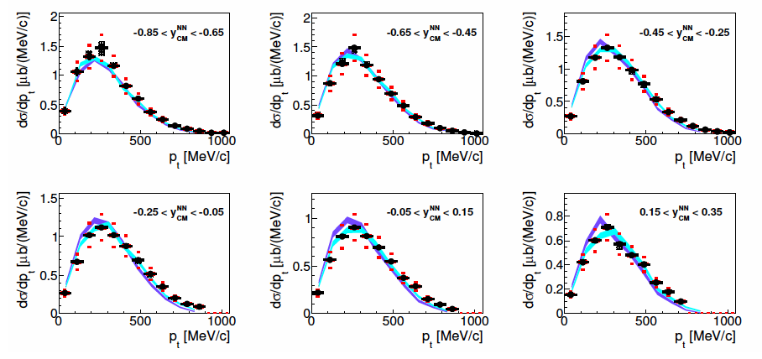
K⁰_{S} from p+A@ 3.5GeV
p+p -> p+n via Isospin rules
(systematic variation of the np cross-sections within ± 20%)
Data better described includig the Chiral potential mentioned before

Slide 12
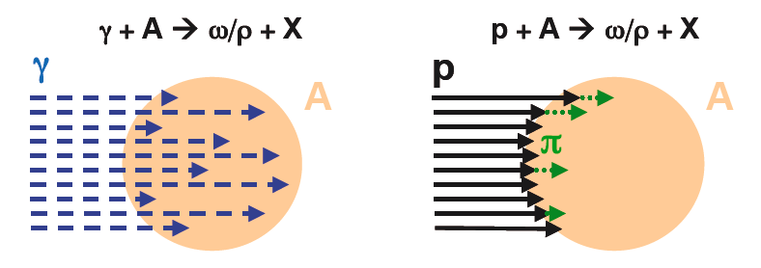
Production Cross-Section
π+A-> φ/K⁺K⁻ +X
π
A
Low Interaction Probability
-> Production in the whole volume
Strong Interaction
-> Production close the surface
-> Production of secondary π
-> Production on the surface
σ(prod)~A
σ(prod)~A^{0.8}
σ(prod)~A^{2/3}+..
This is more Model Dependent!!
SIS18 @ GSI, π @ 1-2 GeV/c -> HADES

Slide 13
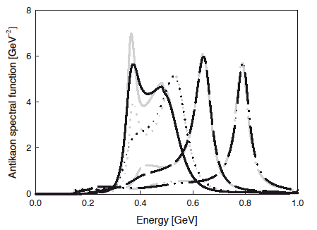
Antikaons in Matter
C. L. Korpa and M. F. M. Lutz Acta Phys.Hung.A22:21-28,2005
In cold nuclear medium
K spectral function, constraints from KN scattering
Absorption, Coupling to resonances
Cant really use low density theorem here...
-> In General attractive Interaction
p= 200MeV/c
p= 400MeV/c
p=0
p= 600 MeV/c
Resonances: Σ(1385)⁰ Λ(1405)
1200 1300 1400 1500
Thresholds Σπ KN
MeV 1327-1337 1432-1437

Slide 14
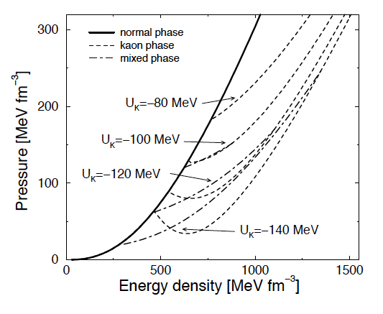
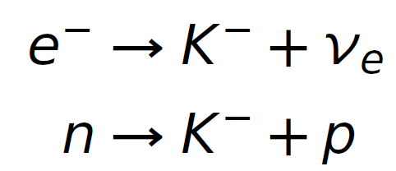
Antikaons inside Neutron stars
J. Schaffner and I. N. Mishustin
Phys. Rev. C 53, 3 (1996)
A. Ramos, J. Schaffner-Bielich and J. Wambach nucl-th/0011003
EOS for Kaon condensate
In case m_{K}-* < μ_{e}
reduces Fermi pressure and softens EOS

Slide 15
AntiKaon Flow
FOPI, submitted to PLB
Ni+Ni 1.9 AGeV
Models predict the highest sensitivity to a potential for v₁ at backwards rapidities
<U_{K}>~-50 MeV
Not conclusive
Other ways?
HADES measured Au+Au @ 1.25 AGeV
->~3500 K⁻

Slide 16
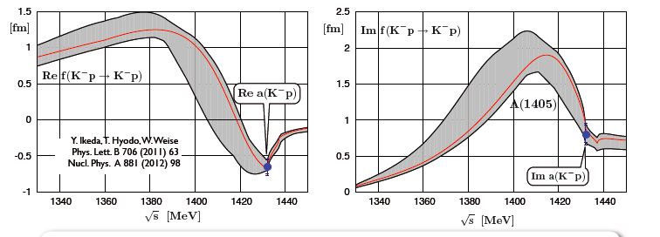
Kaonic Hydrogen and scattering Data
SIDDHARTA experiment @LNF : Kaonic Hydrogen, most precise measurement of the K⁻p scattering length at the threshold
SIDDHARTA, Phys. Lett. B 697 (2011) 199. SIDDHARTA, Phys. Lett. B 681 (2009) 310.

Slide 17
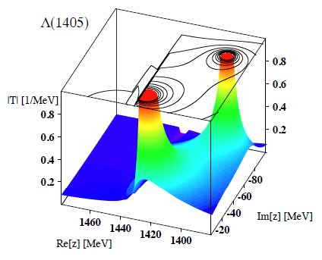
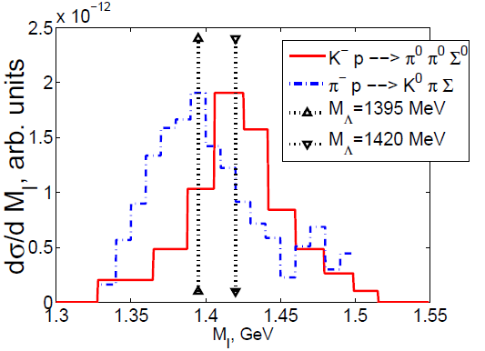
Dynamical generation of Λ(1405)
Two poles in complex energy plane:
m₁=1420 MeV (narrow quasi bound KN state)
m₂=1390 MeV (broad resonance in Σπ)
Experimental Λ(1405) in Σπ spectrum:
K⁻+p reactions excite mainly1420 pole
π⁻+p reactions excite mainly 1390 pole
→ Λ(1405) correlated with KN dynamics!
Solve coupled channel equation based on chiral dynamics
(hadrons are the degrees of freedom)
Prog.Part.Nucl.Phys. 67 (2012) 55-98
Phys.Rev.Lett. 95 (2005) 052301

Slide 18
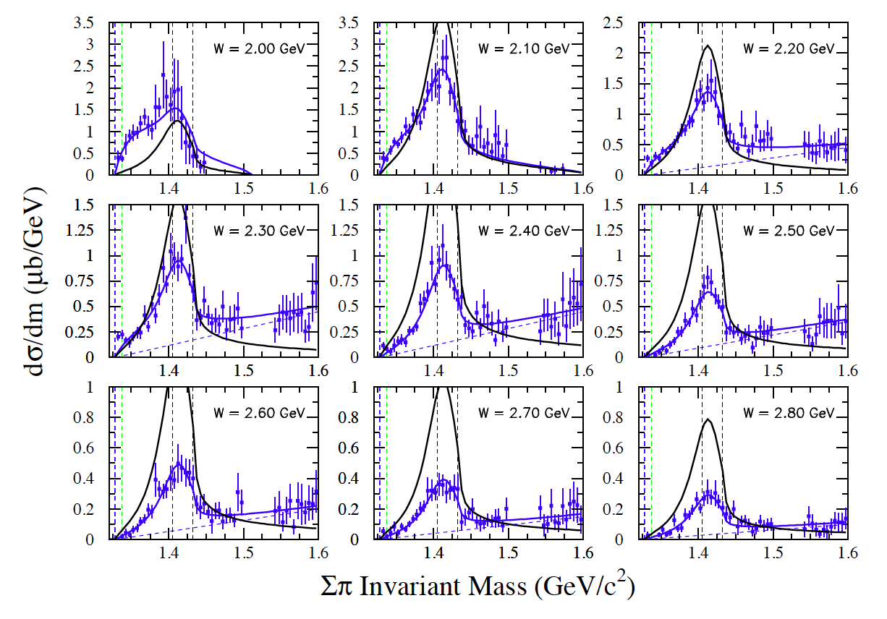
Λ(1405) from γ+p Collisions
γ+p ->Λ(1045)->(Σ⁰π⁰)

Slide 19
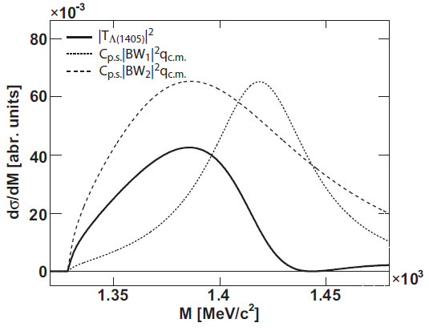
Λ(1405) from p+p Collisions
HADES coll. Phys. Rev. C 87, 025201 (2013)
J. Siebenson and L.F. in preparation
Data are described by a combination of the two poles with a large contribution by the πΣ channel!
2
1
1405
Poles in agreement with results in
T. Hyodo, W. Weise Nucl.Phys. A881 (2012) 98-114

Slide 20
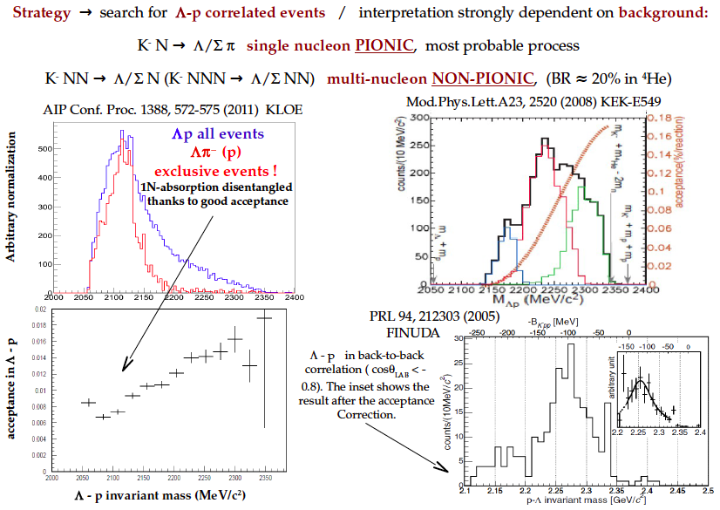
Search for K⁻pp bound states via K⁻ absorption
? 2N Abs.
? 1N Abs.

Slide 21
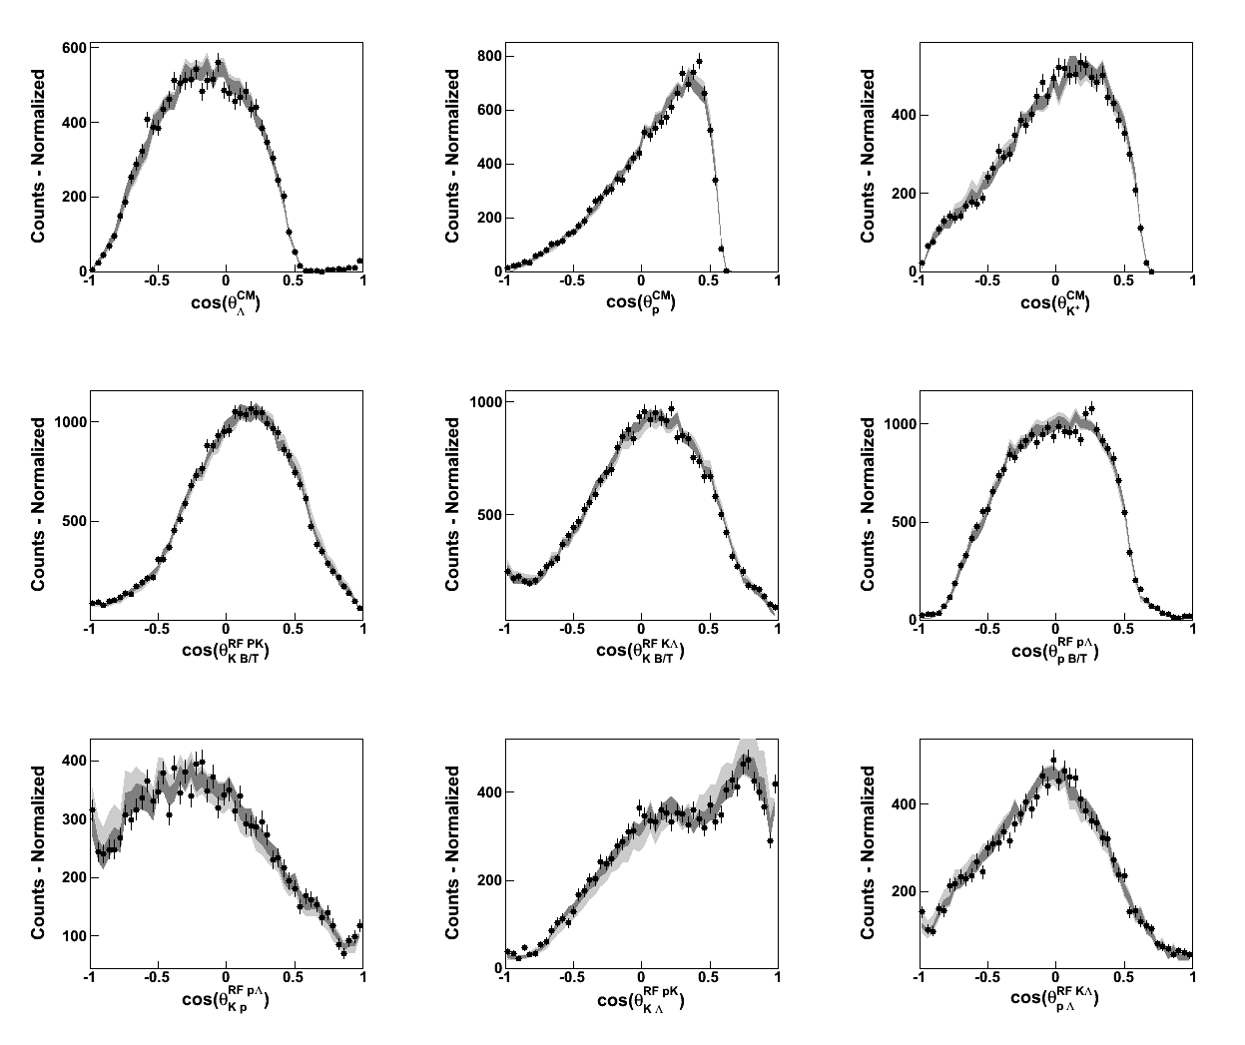
PWA Analysis of the p+p -> pK⁺Λ
HADES DATA
http://pwa.hiskp.uni-bonn.de/
A.V. Anisovich, V.V. Anisovich, E. Klempt, V.A. Nikonov and A.V. Sarantsev
Eur. Phys. J. A 34, 129152 (2007)
p+p@ 3.5GeV
work in progress
Using N* cocktail and non-resonant terms
Upper limit for
p+p -> ppK⁻ +K⁺

Slide 22
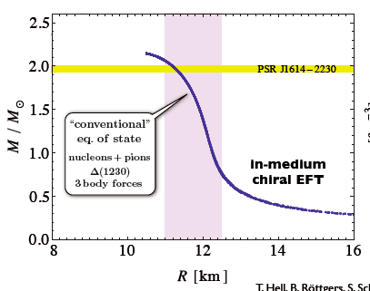
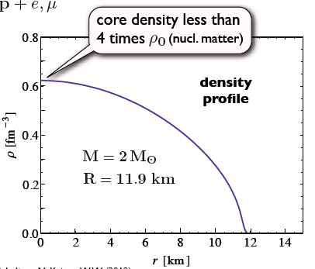
Only Nucleons in Neutron Stars
Private communication W. Weise
EOS gets softer
From the EOS to the Mass-Radius relationship through the TOV equations:

Slide 23
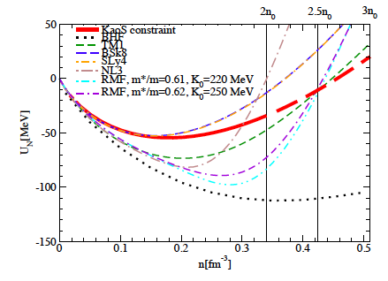
Small Neutron Stars and Hyperon Appereance
The heavy-ion results constrain nuclear matter at densities relevant to light neutron stars
On the other hand..
J. Schaﬀner-Bielich, NPA 804 (2008)
Sagert, Tolos, Chaterjee, Schaffner-Bielich /PhysRevC.86.045802
Measure the radius of Stars with
M< 1.4 M
What about Hyperons?
Pt /Y, PWA, Resonances and..
Λp correlations in cold nuclear matter

Slide 24
Summary
Kaons: Flow Observables, Pt analysis indicate a repulsive potential 20-40 MeV @ρ0
Elementary reactions used as reference to tune cross-sections, angular distribution and resonance contribution
p+A (future π+A) solid ground to test different potential model as a function of the momentum
AntiKaons: needs for Models that describes the Λ(1405) results -> entangled with the Antikaon-Nucleon interaction
Kaonic bound states: measure the 1N and 2N absorption exclusively
PWA: example of pK⁺Λ (also in π+p / π+d)
Cold Matter first: π+A Absorption measurement
Hyperons: they could still have impact on neutron stars. Study them first in cold nuclear matter

Slide 25
Our Λ(1405) signal
HADES coll. Phys. Rev. C 87, 025201 (2013)
Channel | Cross section
p+p → Λ(1405)+p+K⁺ | µb
p+p → Σ(1385)⁰+p+K⁺ | µb **
p+p → Λ(1520)+p+K⁺ | µb
p+p → Σ⁻+Δ⁺⁺(1232)+K⁺ | µb
p+p → Σ⁺+π⁻+p+K⁺ | µb
** from Hyperfine Interact. 210 (2012) 45-51

Slide 26
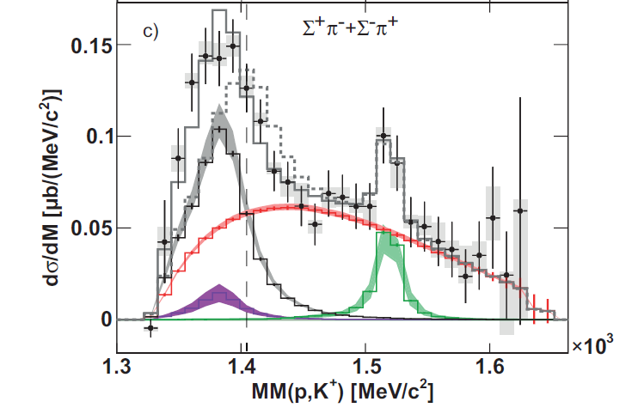
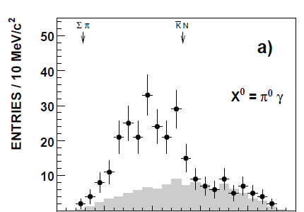
Λ(1405) in different experiments
Phys.Rev. C87 (2013) 025201
Nuclear Physics B129 (1977) 1-18 Nucl.Phys. A835 (2010) 325-328
p+p 4.3 GeV/c
K⁻+d 0. 68 – 0.84 GeV/c
γ+p 1.77<p_{γ}<1.99
Physics Lett. B660(2008)
p+p 3.65GeV/c
1405 MeV
Different masses in different experiments
Confirms two pole structure of Λ(1405)
In our case: large coupling to Σπ resonance at 1390 MeV ?

Slide 27
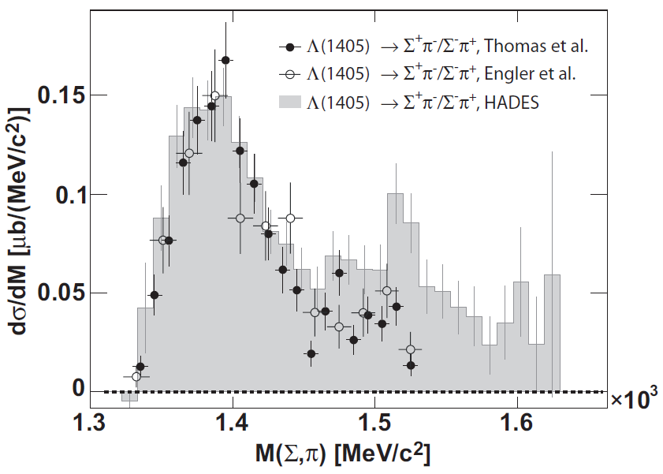
Λ(1405) in different experiments
Nucl.Phys. B56 (1973) 46-51, Phys.Rev.Lett. 15 (1965) 224
Comparison of our data to π⁻+p (1.69 GeV/c)
data shows similarities

Slide 28
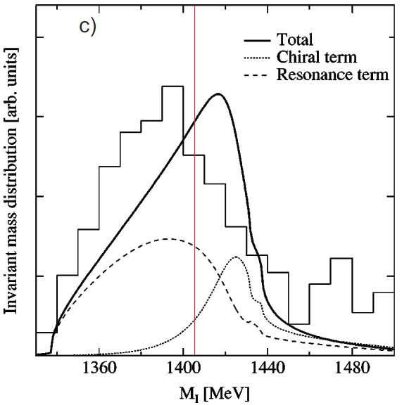
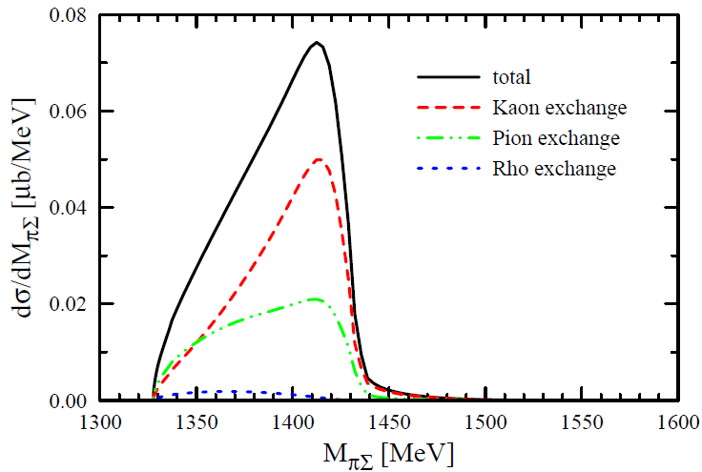
Λ(1405) in different experiments
Nucl.Phys. B56 (1973) 46-51, Phys.Rev.Lett. 15 (1965) 224
π⁻+p (1.69 GeV/c)
Phys.Rev. C68 (2003) 065203
p+p (3.65 GeV/c)
Comparison of our data to π⁻+p (1.69 GeV/c)
data shows similarities
BUT: Theory (chiral ansatz) predicts large contribution from 1420 MeV pole
→ Λ(1405) peaks above 1400 MeV/c²
Eur.Phys.J. A34 (2007) 405-412

Slide 29
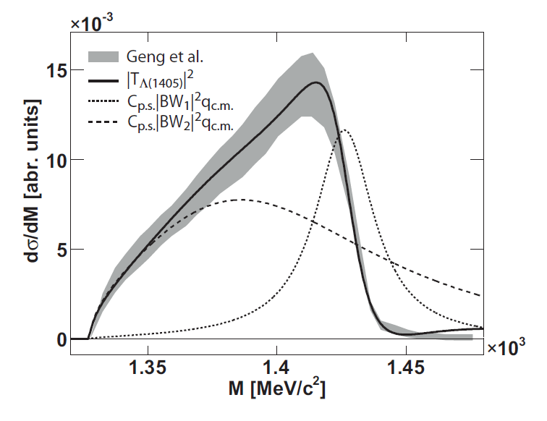
2. Possible explanation for Λ(1405) signal
2. Double pole nature of Λ(1405) and include interference effects with non-resonant channels
Assumption:
Parameterize Λ(1405) as coherent sum of two Breit-Wigner functions with
C_{p.s.} the available phase space
q_{c.m.} the decay momentum for πΣ
Constrain m_{0,i} and Γ_{0,i} from latest Weise calculations
(Nucl.Phys. A881 (2012) 98-114)
Fit Oset calculation for p+p data with this parameterization and determine m_{0,i} and Γ_{0,i}, ϕ₁ and A₁/A₂
1
2

Slide 30
2. Possible explanation for Λ(1405) signal
2. Double pole nature of Λ(1405) and include interference effects with non-resonant channels
Assumption:
This Λ(1405) signal might interfere with the non-resonant background in our data.
Fit data simultaneously with following functions:

Slide 31
2. Possible explanation for Λ(1405) signal
2. Double pole nature of Λ(1405) and include interference effects with non-resonant channels
Assumption:
This Λ(1405) signal might interfere with the non-resonant background in our data.

Slide 32
2. Possible explanation for Λ(1405) signal
2. Double pole nature of Λ(1405) and include interference effects with non-resonant channels

Slide 33
Remarks
* The p+p → Σ⁻+Δ⁺⁺(1232)+K⁺ reaction is a very probable candidate for the non-resonant part of the Σ⁻ + π⁺ + p +K+ spectrum and has differrent quantum numbers then the Λ(1405) contribution. This does not lead to interferences
* Why should both charged decay channels interfere in the same way?
* Why we dont see any shift in in p+p -> Σ(1385)⁺ + K⁺ +n or for the Λ(1520)
* p+p(@3.5GeV) ->π+p+p/π+π+p+p Incoherent analysis of 14 N* with angular distribution reproduce perfectly the data and is consistent with dilepton yield. This looks like small room for interferences..

Slide 34
3. Possible explanation for Λ(1405) signal
3. Double pole nature of Λ(1405) and no interference effects with non-resonant channels.
Assumption:
Λ(1405) signal does not interfere with non-resonant background
Fit data simultaneously with following functions:

Slide 35
3. Possible explanation for Λ(1405) signal
3. Double pole nature of Λ(1405) and no interference effects with non-resonant channels.
Assumption:
Λ(1405) signal does not interfere with non-resonant background
Fit data simultaneously with following functions:
Mass and width values are directly determined from fit to the HADES data.
Constraints on m_{0,i} and Γ_{0,I} are again taken from Weise results
m_{0,1}=Re(z₁)=1424⁺⁷₋₂₃ MeV
Γ_{0,1}=2*Im(z₁)=52⁺⁶₋₂₈ MeV
m_{0,2}=Re(z₂)=1381⁺¹⁸₋₆ MeV
Γ_{0,2}=2*Im(z₂)162⁺³⁸₋₁₆ MeV

Slide 36
3. Possible explanation for Λ(1405) signal
3. Double pole nature of Λ(1405) and no interference effects with non-resonant channels.
Assumption:
Λ(1405) signal does not interfere with non-resonant background

Slide 37
3. Possible explanation for Λ(1405) signal
3. Double pole nature of Λ(1405) and no interference effects with non-resonant channels.
2
1

Slide 38
3. Possible explanation for Λ(1405) signal
3. Double pole nature of Λ(1405) and no interference effects with non-resonant channels.
New Assumption:
Constraints on m_{0,i} and Γ_{0,I} are taken from Mai results
(Nucl.Phys. A900 (2013) 51 - 64)
Jido et al.
Mai et al.
m_{0,1}=Re(z₁)=1424⁺⁷₋₂₃ MeV
Γ_{0,1}=2*Im(z₁)=52⁺⁶₋₂₈ MeV
m_{0,2}=Re(z₂)=1381⁺¹⁸₋₆ MeV
Γ_{0,2}=2*Im(z₂)162⁺³⁸₋₁₆ MeV
m_{0,1}=Re(z₁)=1428⁺²₋₁ MeV
Γ_{0,1}=2*Im(z₁)=16⁺⁴₋₄ MeV
m_{0,2}=Re(z₂)=1497⁺¹¹₋₇ MeV
Γ_{0,2}=2*Im(z₂)150⁺¹⁸₋₁₈ MeV

Slide 39
3. Possible explanation for Λ(1405) signal
3. Double pole nature of Λ(1405) and no interference effects with non-resonant channels.
New Assumption:
Constraints on m_{0,i} and Γ_{0,I} are taken from Mai results
(Nucl.Phys. A900 (2013) 51 - 64)
Jido et al.
Mai et al.
m_{0,1}=Re(z₁)=1424⁺⁷₋₂₃ MeV
Γ_{0,1}=2*Im(z₁)=52⁺⁶₋₂₈ MeV
m_{0,2}=Re(z₂)=1381⁺¹⁸₋₆ MeV
Γ_{0,2}=2*Im(z₂)162⁺³⁸₋₁₆ MeV
m_{0,1}=Re(z₁)=1428⁺²₋₁ MeV
Γ_{0,1}=2*Im(z₁)=16⁺⁴₋₄ MeV
m_{0,2}=Re(z₂)=1497⁺¹¹₋₇ MeV
Γ_{0,2}=2*Im(z₂)150⁺¹⁸₋₁₈ MeV

Slide 40
3. Possible explanation for Λ(1405) signal
3. Double pole nature of Λ(1405) and no interference effects with non-resonant channels.
New Assumption:
Constraints on m_{0,i} and Γ_{0,I} are taken from Mai results
(Nucl.Phys. A900 (2013) 51 - 64)

Slide 41
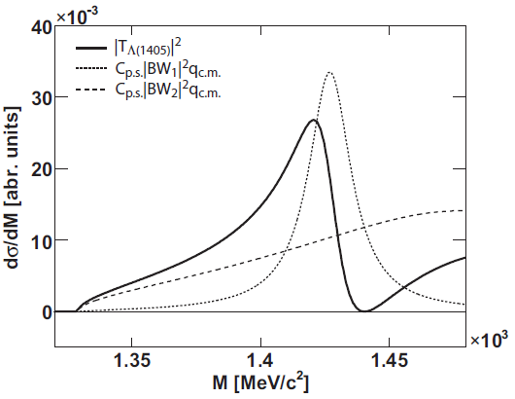
3. Possible explanation for Λ(1405) signal
3. Double pole nature of Λ(1405) and no interference effects with non-resonant channels.
1
2

