Slide 1
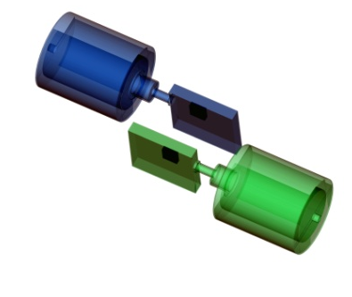
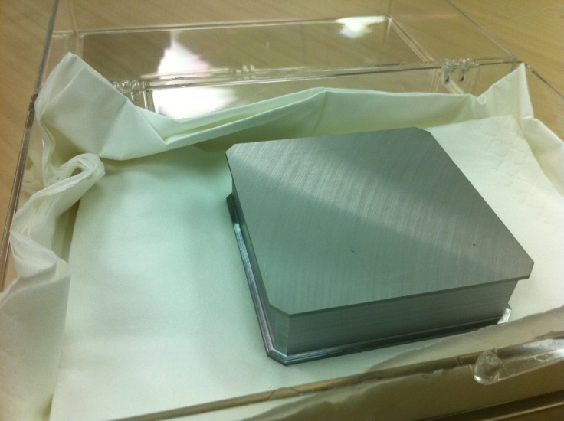
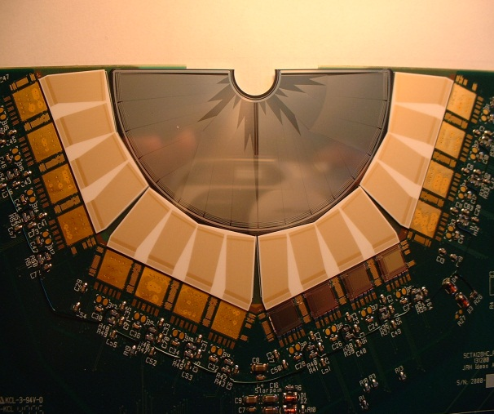




Imaging devices for medicine and security
Andy Boston
ajboston@liv.ac.uk

Slide 2
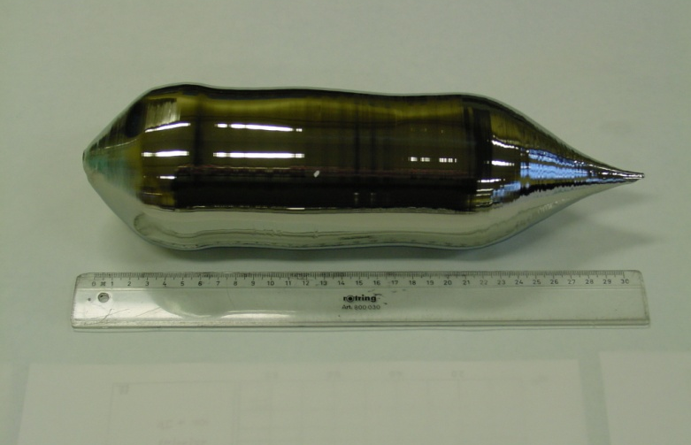

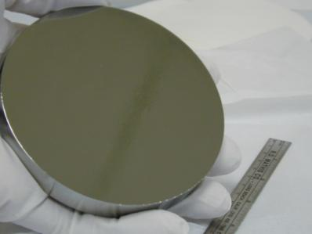
Outline of presentation
Focus on ionising radiation and gamma-rays
  What are the challenges?
  What detector technology can we consider?
  Select example projects & links to fundamental research
  The future prospects

Slide 3
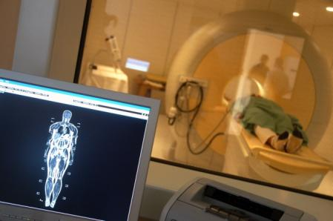
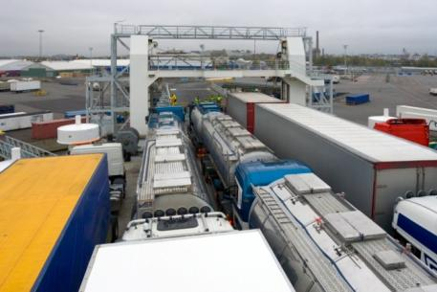
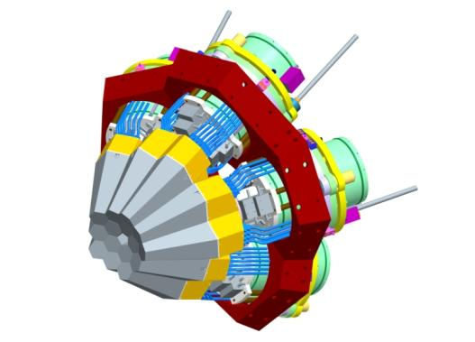

KNOWLEDGE EXCHANGE
Scientific Research
Applications
Medical
Security
e.g. AGATA
Gamma-ray Tracking
Imaging
Environment

Slide 4
What are the challenges?
In Nuclear Medicine:
  Know the energy
  Want the location over a small field of view
  Need to cope with high count rates
  Multimodality applications (eg PET/CT)
  Image fusion

Slide 5
What are the challenges?
In Nuclear Security :
  Don’t know the energy & a broad range
  Want the location over a large field of view
  Need to cope with wide range of count rates
  Image fusion

Slide 6
What are the detector requirements?
Ideally would want:
  Good energy resolution (Good light yield/charge collection) < few %
  High efficiency (High Z)
  Position resolution
  Timing resolution
Detector materials:
  Semiconductors (Si, Ge, CdZnTe)
  Scintillators (LaBr₃, CsI(Tl), NaI(Tl), BaFl, BGO, LYSO…)

Slide 7
What are the detector requirements?
Need to know the location of the radiation:
  Use a mechanical collimator (Anger Camera)
  Use positron annihilation for LoRs
  Use other electronic collimation
Range of energies:
  Medical 141 keV – 511 keV
  Security 60 keV – 2 MeV
Operating environment:
  B-fields? Microphonics? High temperature?

Slide 8
Medical Imaging
Focus on SPECT
How it works and the opportunities

Slide 9
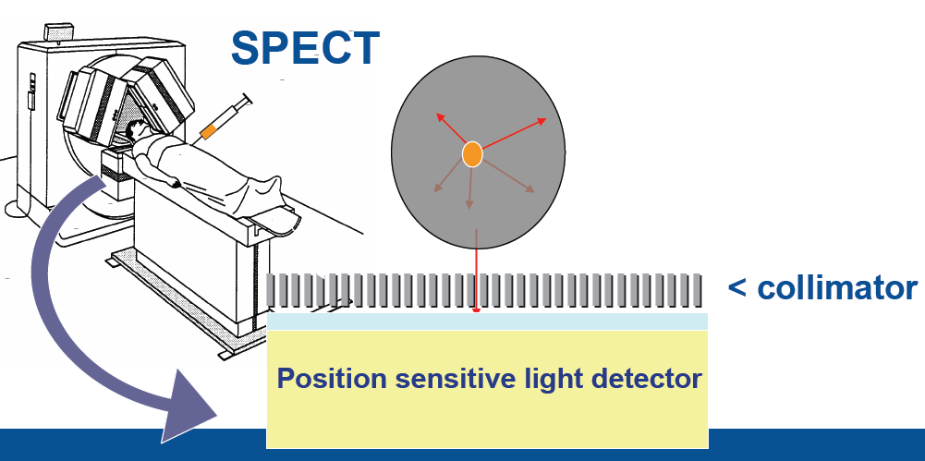
What is SPECT?
8 mSv typical dose
Functional imaging modality

Slide 10
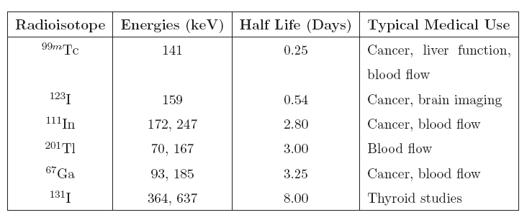
^{What SPECT Radionuclides?}
t_{1/2}=65.94h
t_{1/2}=6.01h
141 keV
9×10⁻⁵%
2.1×10⁵y
>99%
stable

Slide 11





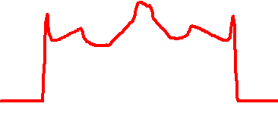
Tomographic Imaging
The sinogram is what we aim to measure
  - Measure of intensity as a function of projection, θ and position, r
  - Often seen plotted as a 2d grey scale image
x
θ
y
r
f(x ,y)
p(r , θ)
Measured result – “Sinogram”
(256 projections, 363 positions per projection)
Note : We measure from 0 to 180°
Underlying source distribution
“Shepp-Logan Phantom”

Slide 12
SPECT : Problems/Opportunities
Technical
Collimator Limits Spatial Resolution & Efficiency
Collimator is heavy and bulky
Energy of radioisotope limited to low energy
NaI:Tl Dominant for >40 Years...
MRI → Existing PMTs will not easily operate
Would like to be able to image a larger
fraction of events.
Common radionuclides: ^{99m}Tc, ¹²³I, ¹³¹I

Slide 13
ProSPECTus
Next generation Single Photon Emission Computed Tomography
Nuclear Physics Group, Dept of Physics, University of Liverpool, Nuclear Physics & Technology Groups, STFC Daresbury Laboratory, MARIARC & Royal Liverpool University NHS Trust

Slide 14
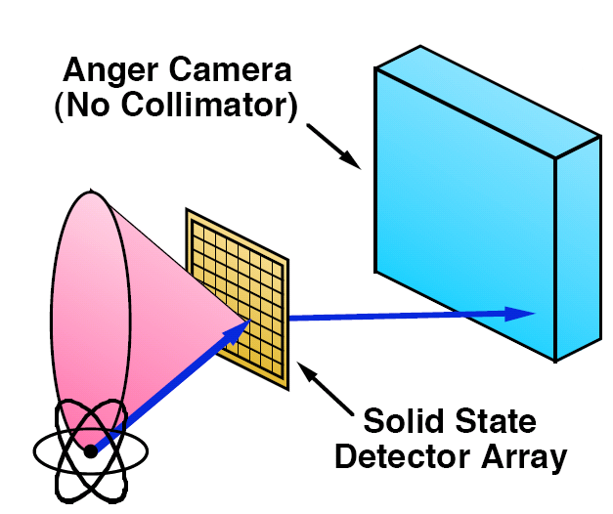
ProSPECTus: What is new?
ProSPECTus is a Compton Imager
Radical change → No mechanical collimator
Utilising semiconductor sensors
Segmented technology and PSA and digital electronics (AGATA)
Image resolution 7-10mm → 2-3mm
Efficiency factor ~10 larger
Simultaneous SPECT/MRI

Slide 15

What’s different?
Conventional SPECT
Compton camera
Source
E₀
Gamma rays detected by a gamma camera
Inefficient detection method
Incompatible with MRI
2D information
Gamma rays detected by a Compton camera
Positions and energies of interactions used to locate the source
3D information.
Factors that limit the performance of a Compton Imager:
Energy resolution, Detector position resolution, Doppler Broadening

Slide 16
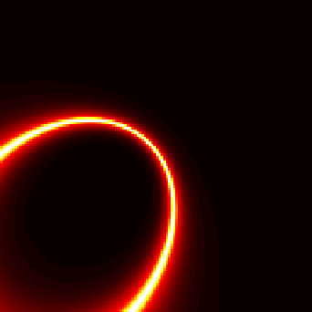
Research : Compton Imaging
Compton Cones of Response projected into image space

Slide 17
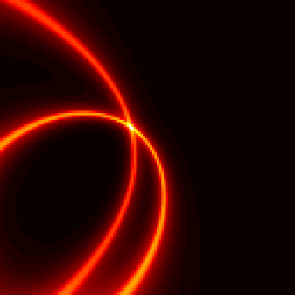
Research : Compton Imaging
Compton Cones of Response projected into image space

Slide 18
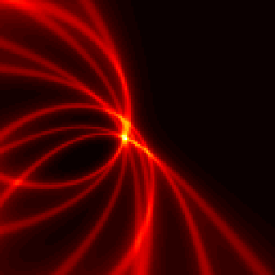
Research : Compton Imaging
Compton Cones of Response projected into image space

Slide 19
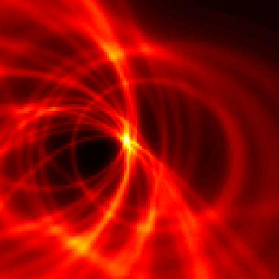
Research : Compton Imaging
Compton Cones of Response projected into image space

Slide 20
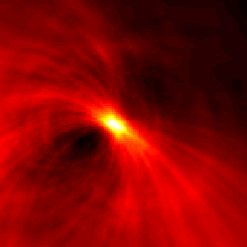
Research : Compton Imaging
Compton Cones of Response projected into image space

Slide 21
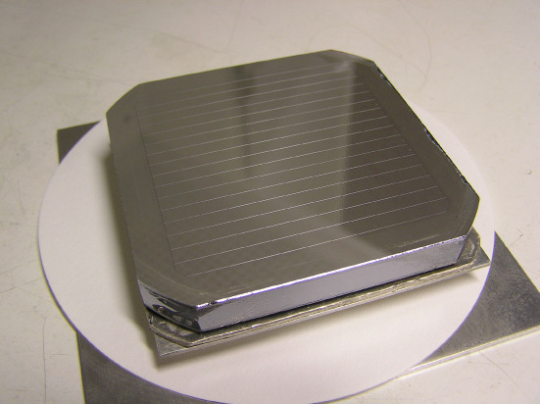
System Configuration
GEANT4 simulations L. Harkness
1cm
2cm
Total Coincident ~3.49%
SPECT ~ 0.025% (typical value)
Factor of ~140
141keV
Event Type | %
Single / Single | 2.23
Single / Multiple | 0.33
Multiple / Single | 0.61
Multiple / Multiple | 0.04
Not absorbed | 0.28
5cm
2cm
Si(Li)
Ge
Ortec & SemiKon

Slide 22

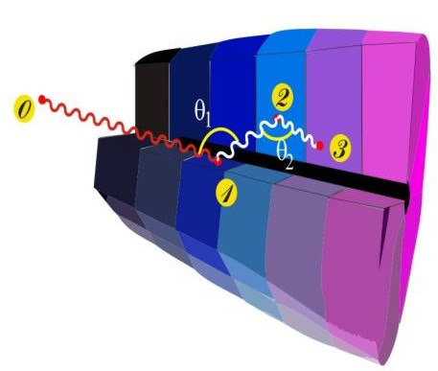
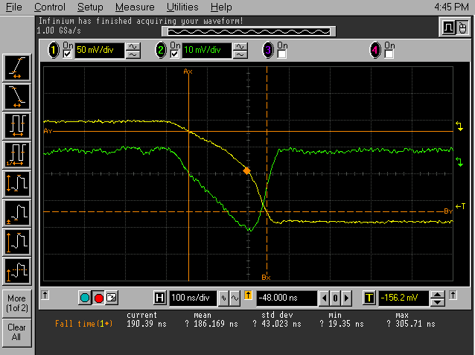
Ingredients of γ-Tracking
4
1
Identified
interaction points
Reconstruction of tracks
e.g. by evaluation of permutations
of interaction points
Highly segmented
HPGe detectors
(x,y,z,E,t)_{i}
γ
·
·
·
Pulse Shape Analysis
to decompose
recorded waves
·
2
3
Digital electronics
to record and
process segment signals
reconstructed γ-rays
Notes:
What has to be done to perform tracking
What are the ingredients
Detectors highly segmented, encapsulated, cryostats
Electronics Digital
PSA to extract Energy Time and Position
Algorithm development particularly for position
Area where effort is required Thorsten Kroell. See him.
Tracking algorithms, reconstruction of the events for full array
Obtain full energy
Many technical development in all areas.

Slide 23
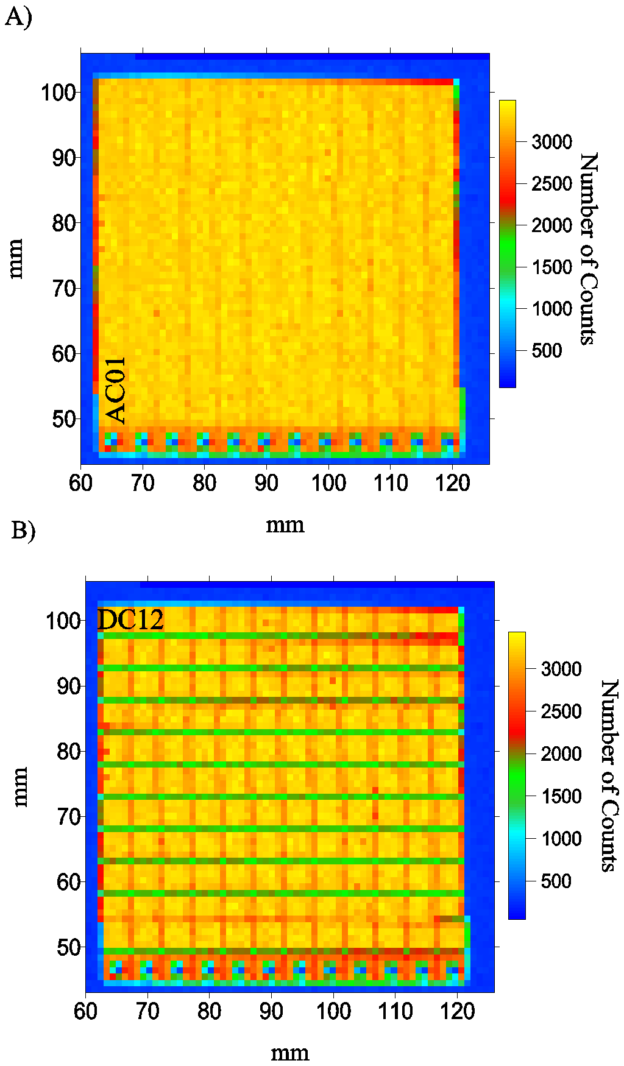
Utilise characterised sensors
Am-241 AC x-y surface intensity distribution
AC01 AC12
DC12
DC1
Uniformity of response for planar germanium crystals.

Slide 24
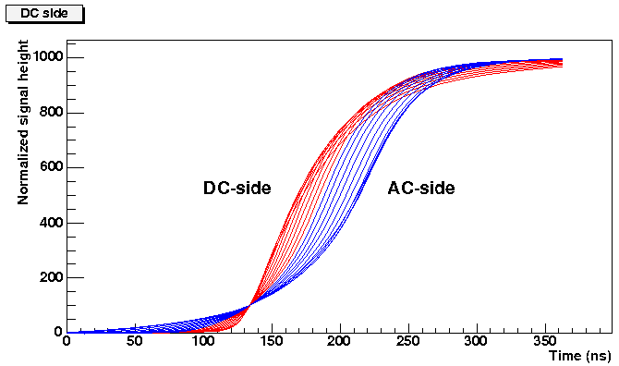
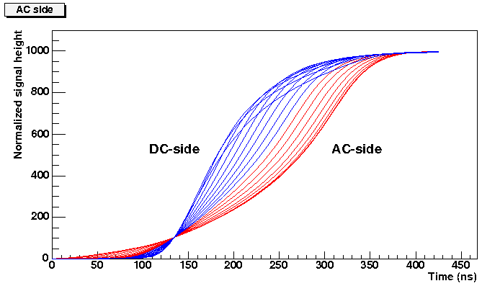
Utilise unique pulse shape response
“superpulse” pulse shapes for ¹³⁷Cs (662 keV) events versus depth
DC signals
AC signals
DC signals
AC signals

Slide 25
Image Reconstruction Algorithms
Sensors have excellent energy & position information.
Uniformity of sensor response
Optimise existing:
  Analytical
  Iterative
  Stochastic
Requirement for GPU acceleration

Slide 26
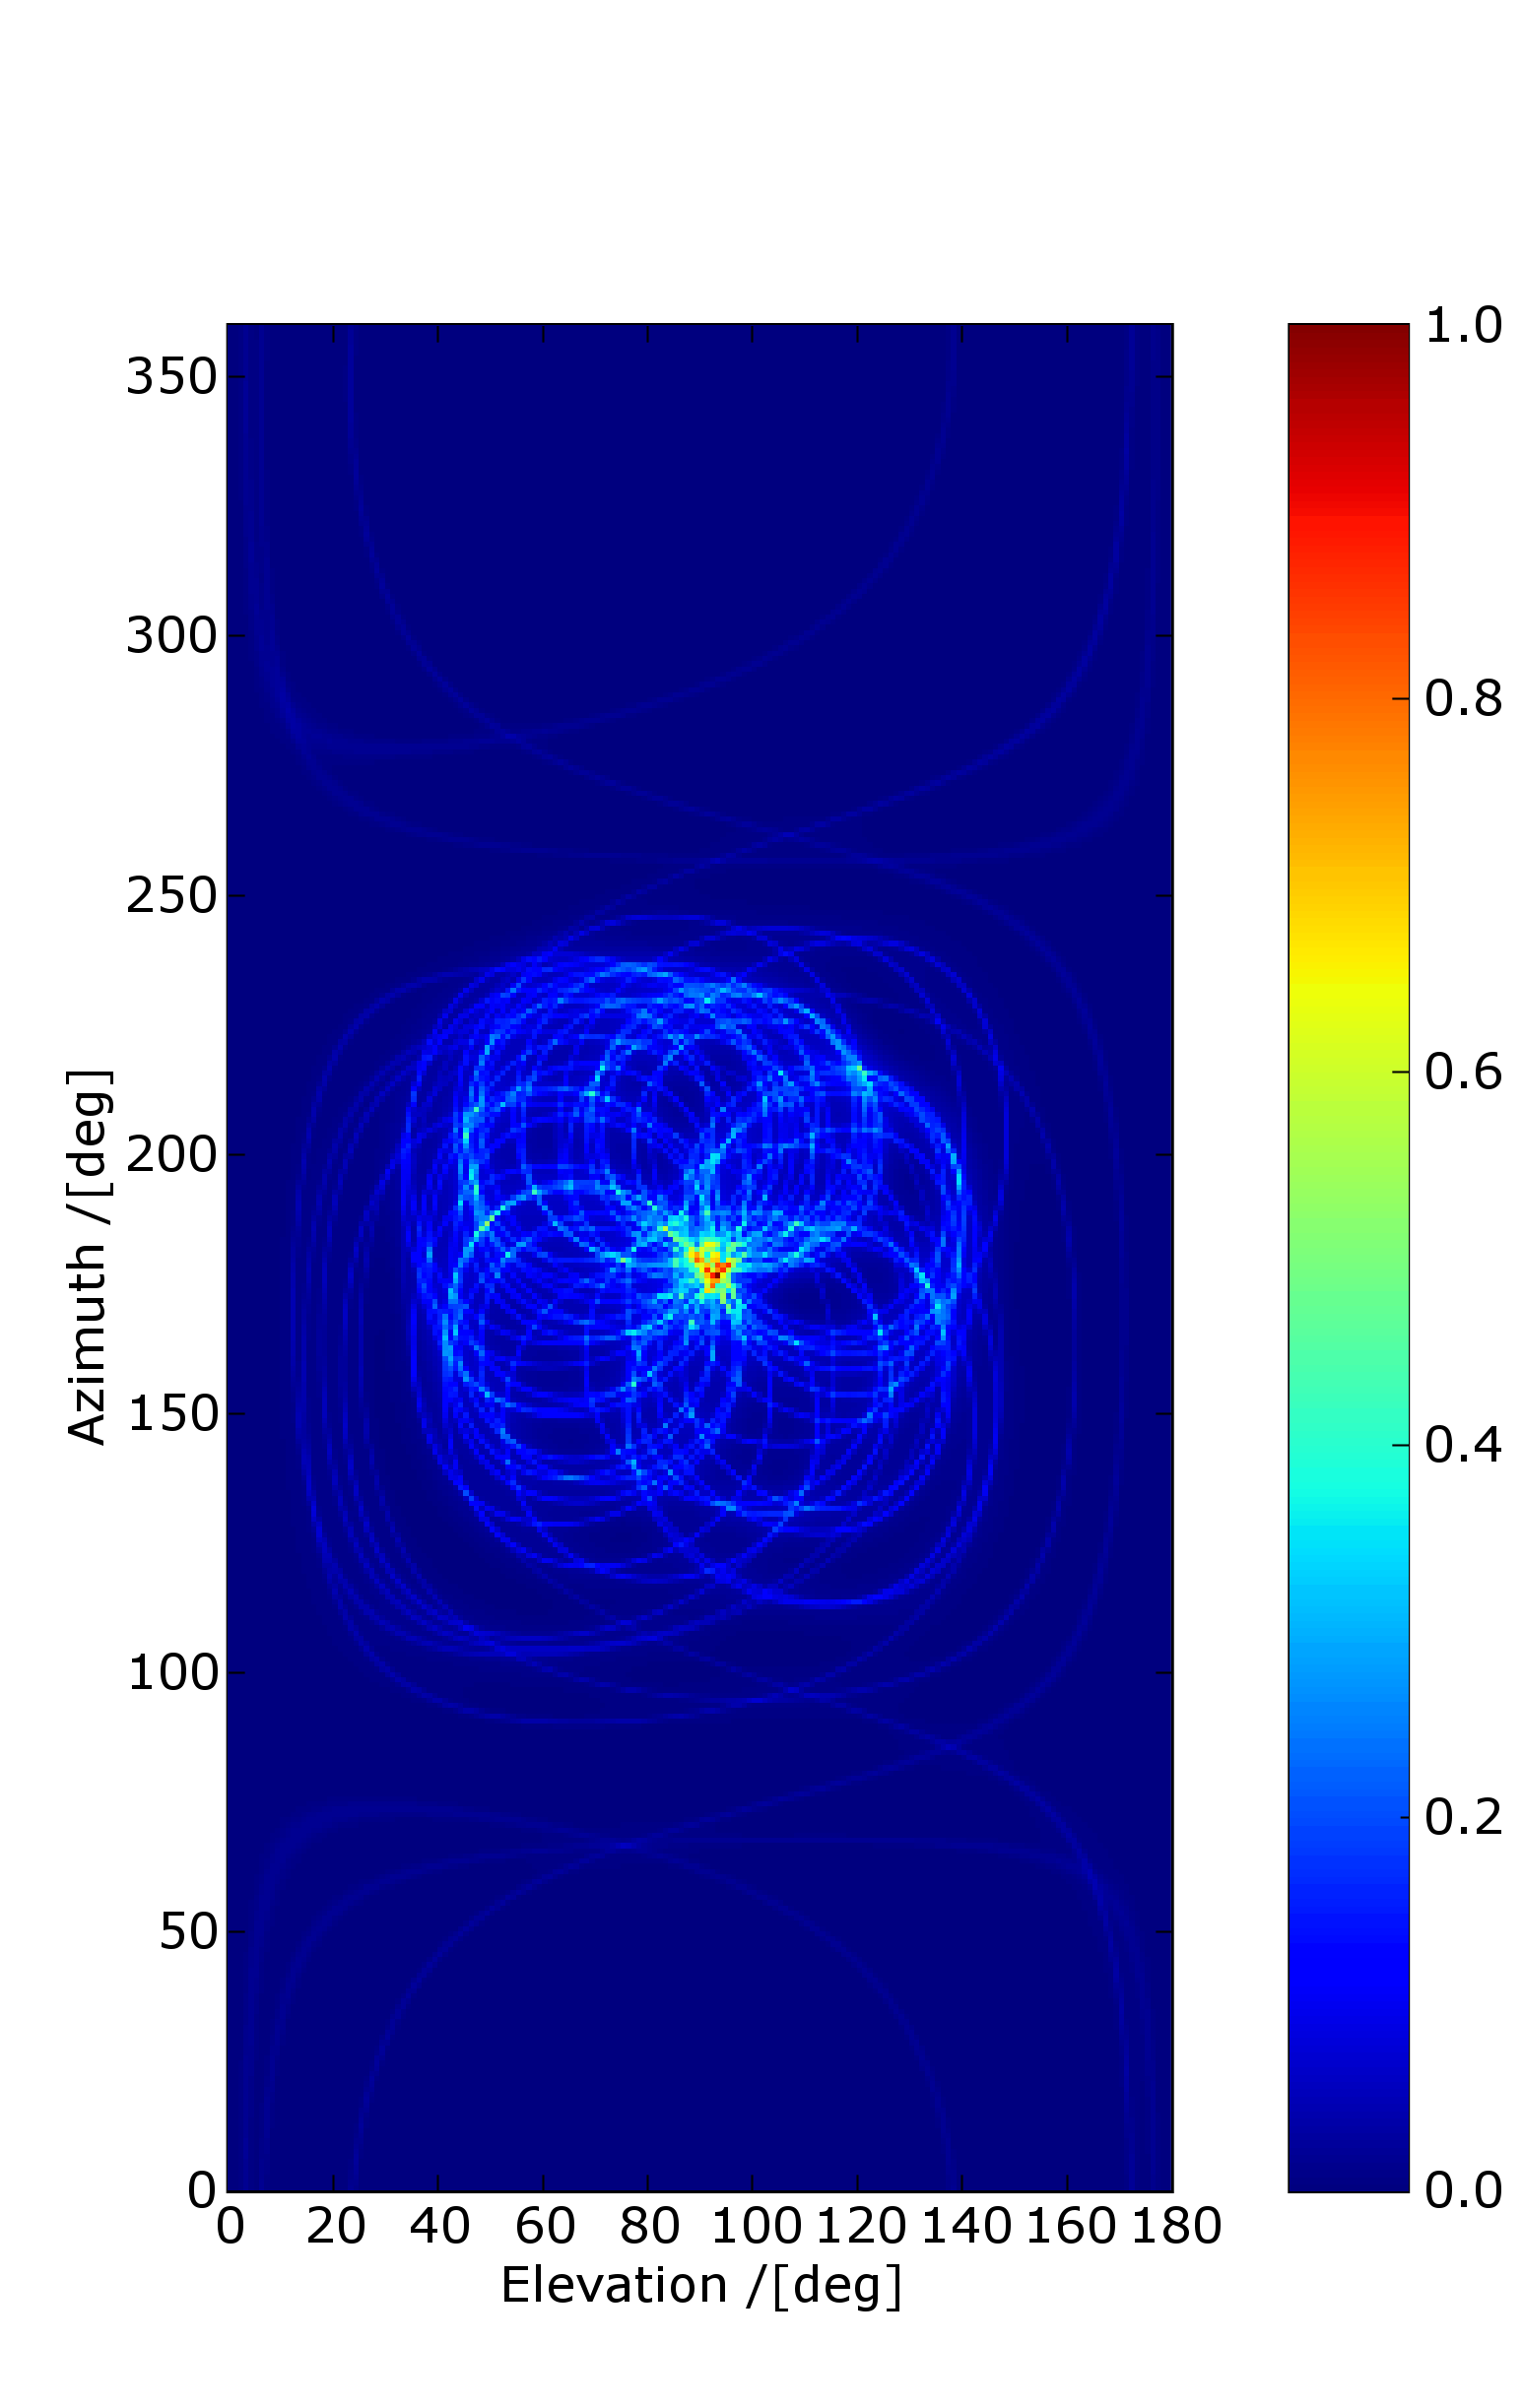
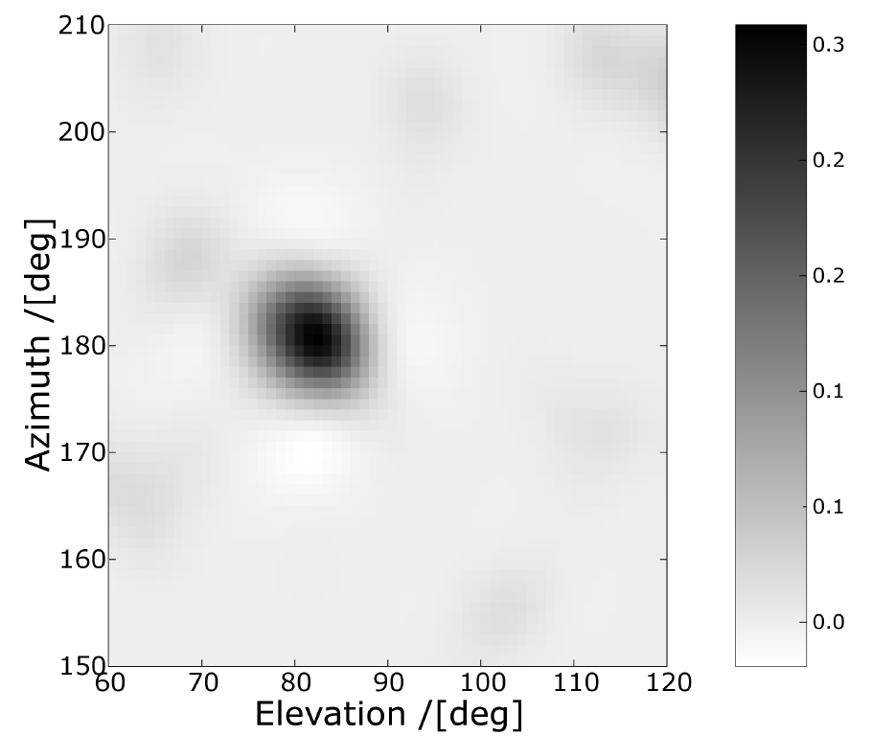
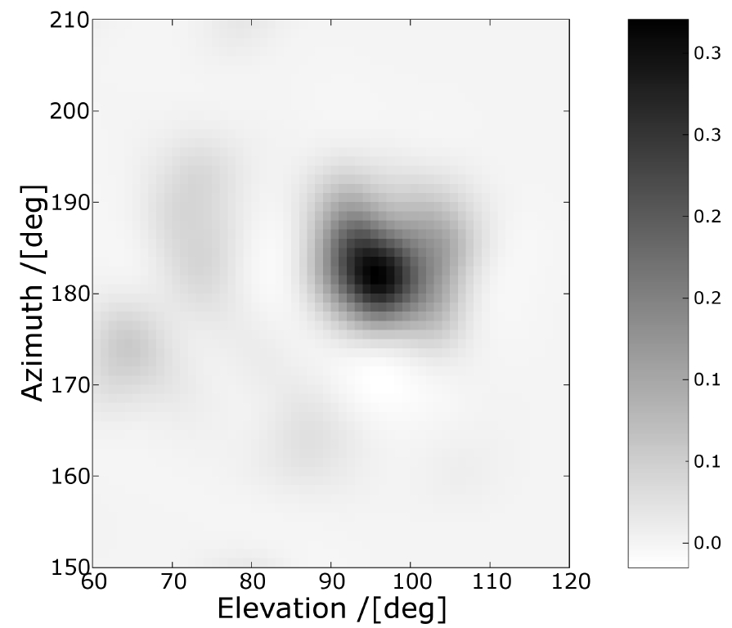
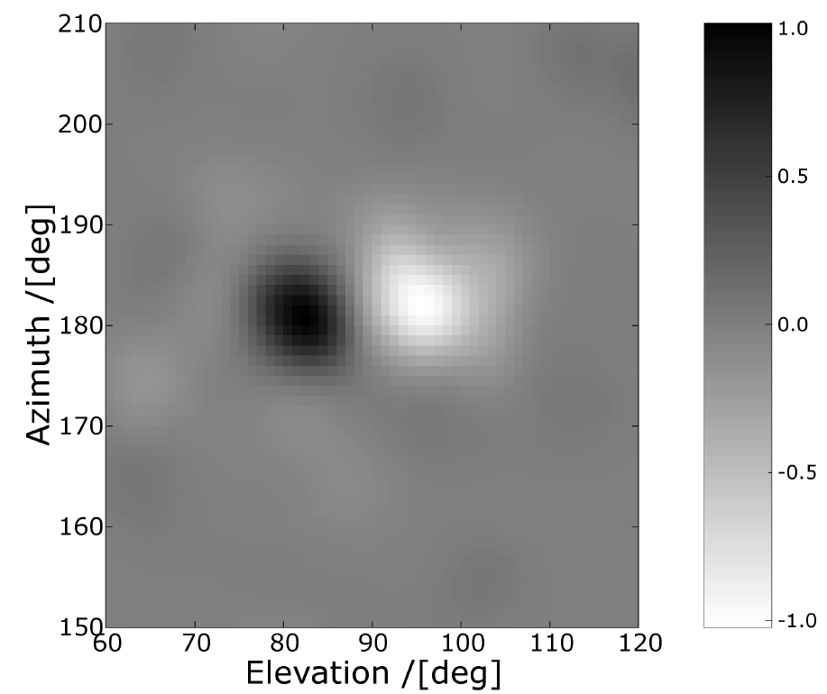
Compton Imaging
Multi-nuclide imaging
~7º Angular Resolution FWHM, central position
¹⁵²Eu E = 1408 keV
²²Na E = 1274 keV
¹⁵²Eu
2cm source separation
No PSA (5x5x20)
Cone back projection

Slide 27
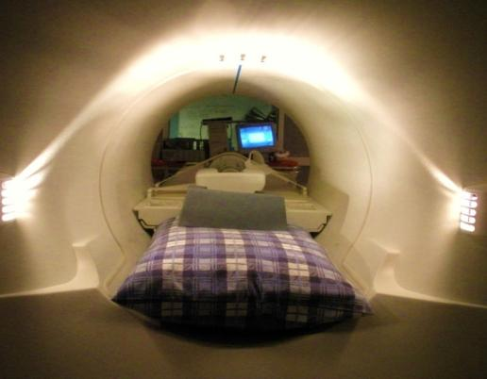
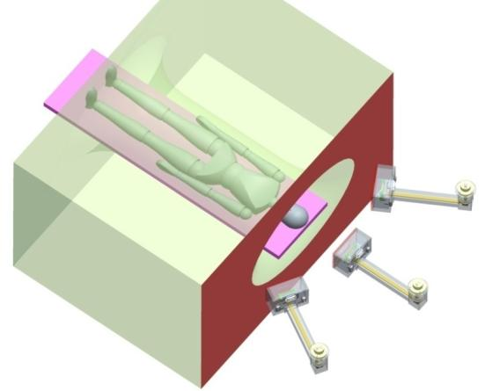
MRI compatibility & Status
Test existing gamma-ray detector in an MRI scanner
Does the detector cause distortions in the MRI image? No
Does the MRI system degrade the detector performance? In certain positions (which can be minimised)
Encouraging results!

Slide 28
What are the next steps?
Immediate priorities
We have an integrated Compton Gamma camera optimised for <500keV
Demonstrate sensitivity with phantoms
Trials including clinical evaluation
For the future:
Consider electron tracking Si scatterer
Possible use of large CZT analyser (requires large wafer material with 1cm thickness)

Slide 29
Security Imaging
SNMs and other threats
Coded aperture systems (low energy)
Focus on wide FOV and variety of stand off distances
Compton cameras

Slide 30
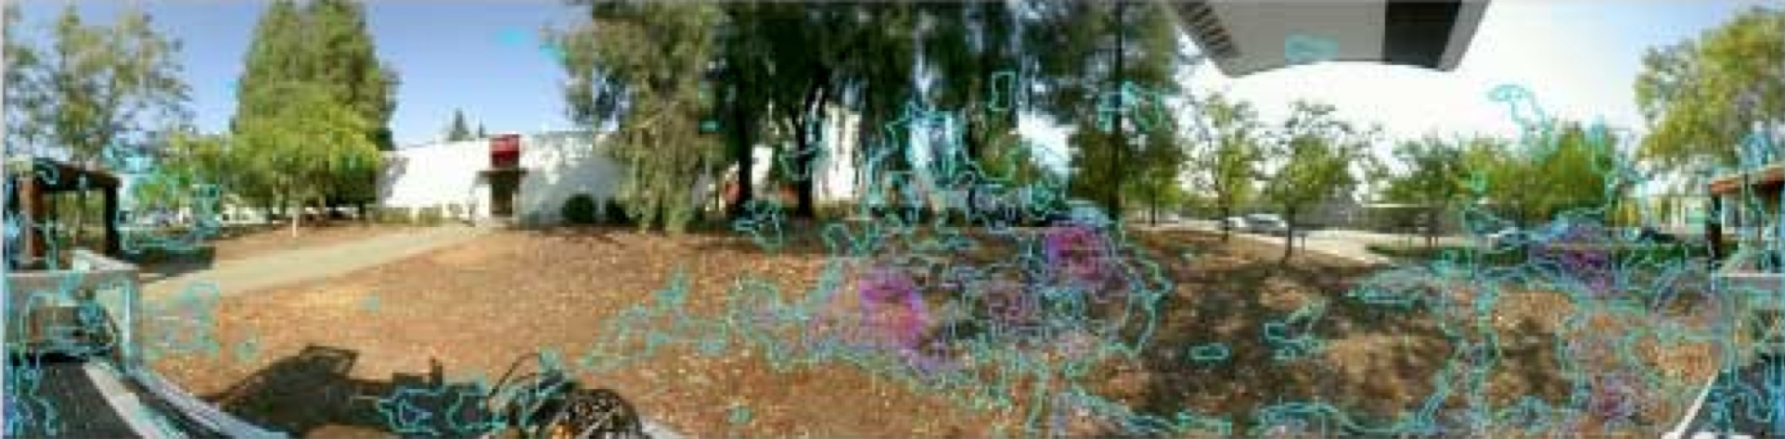
Location and Identification…
Courtesy K. Vetter LBL (work @ LLNL)
The ability to locate and identify radioactive material with high precision
Quantification of waste into low/intermediate/high brackets
Wide range of activities from ~37kBq -> MBq
There are many open challenges and opportunities

Slide 31
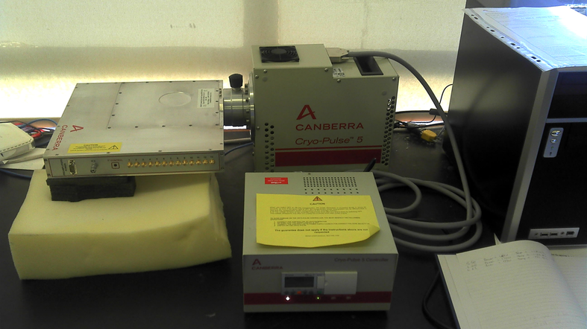
Si(Li) + Ge Cryogenic solutions
Mechanically cooled
Battery powered
Work in collaboration with Canberra

Slide 32
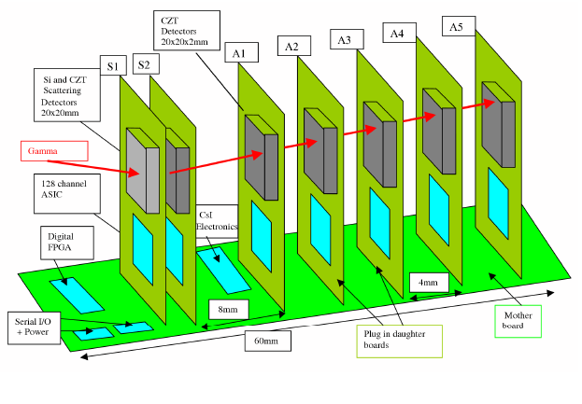
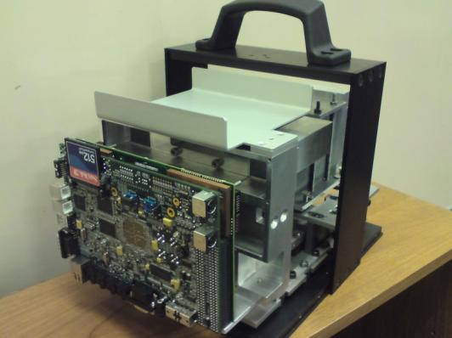
CZT Room temperature: PorGamRayS
A portable gamma-ray spectrometer with Compton imaging capability (60keV – 2MeV)
Gamma-ray spectroscopy/imaging with CZT detectors. Pulse Shape Analysis to refine spatial resolution and correct charge collection issues

Slide 33
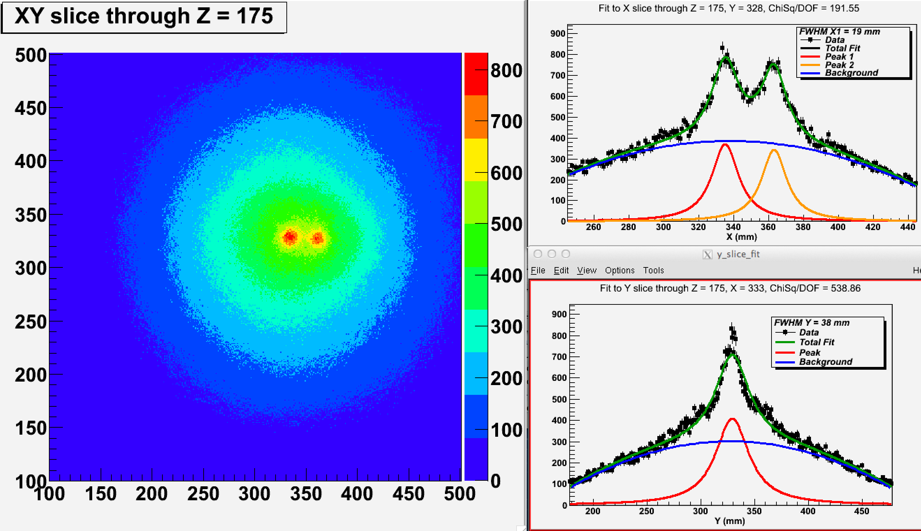
¹³⁷Cs example image with CBP
370 kBq @ 5cm standoff 19mm FWHM

Slide 34
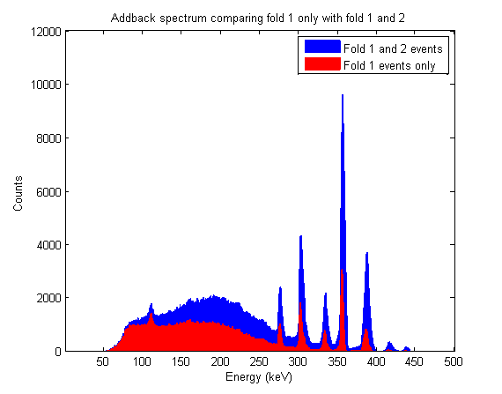
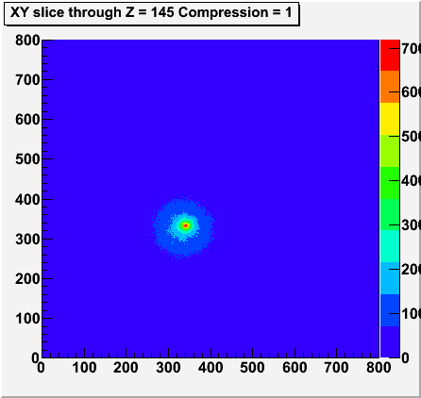
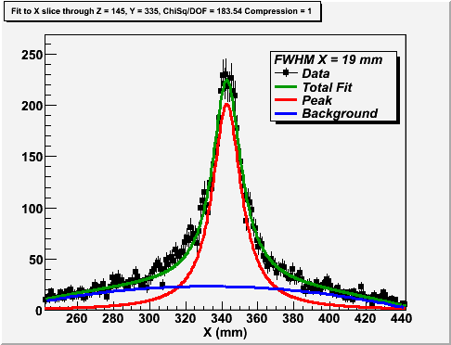
¹³³Ba example image with CBP
340 kBq @ 5cm standoff
19mm FWHM

Slide 35
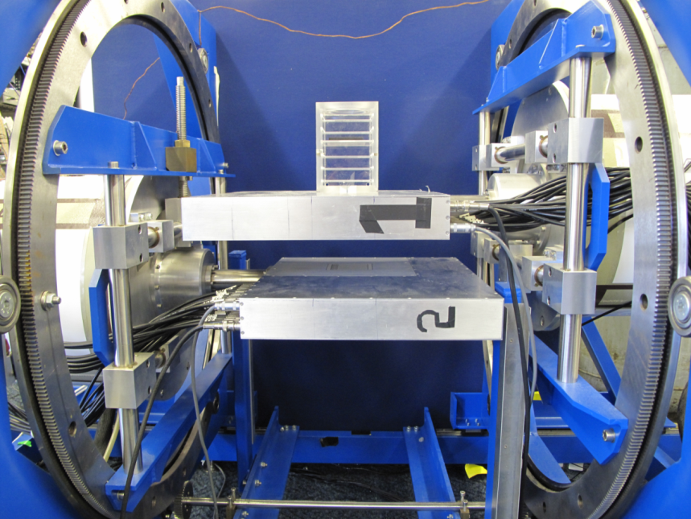
Compton Imaging
Use of the SmartPET detectors in
Compton Camera configuration
Typical measurements:
10μCi ¹⁵²Eu
6 cm from SPET 1
Source rotated
Zero degrees in 15º steps up to 60º
Detector separation
3 – 11cm in 2cm steps
Gates set on energies
2 sources ¹⁵²Eu and ²²Na
at different x and y

Slide 36
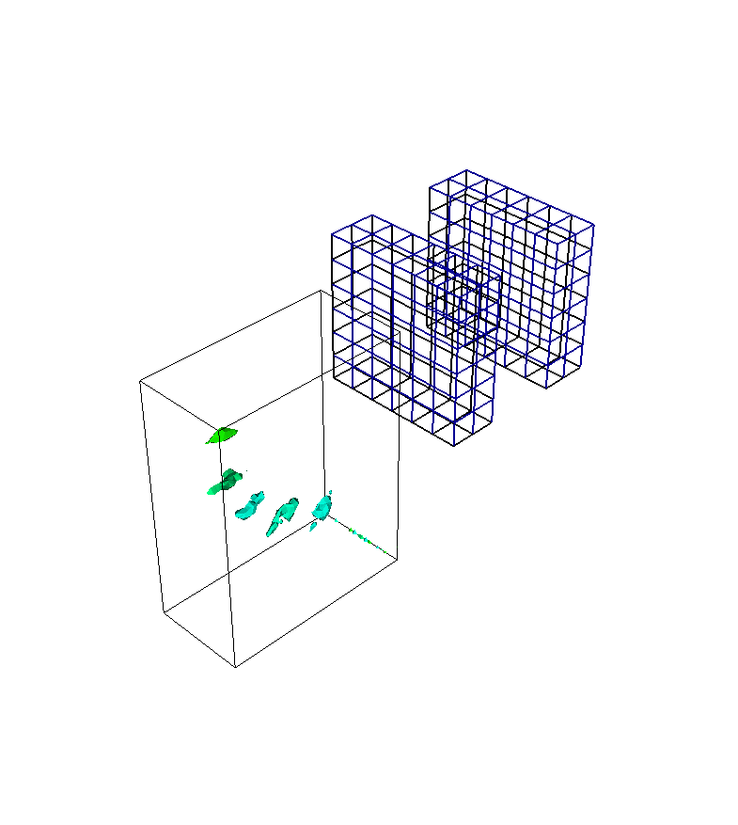
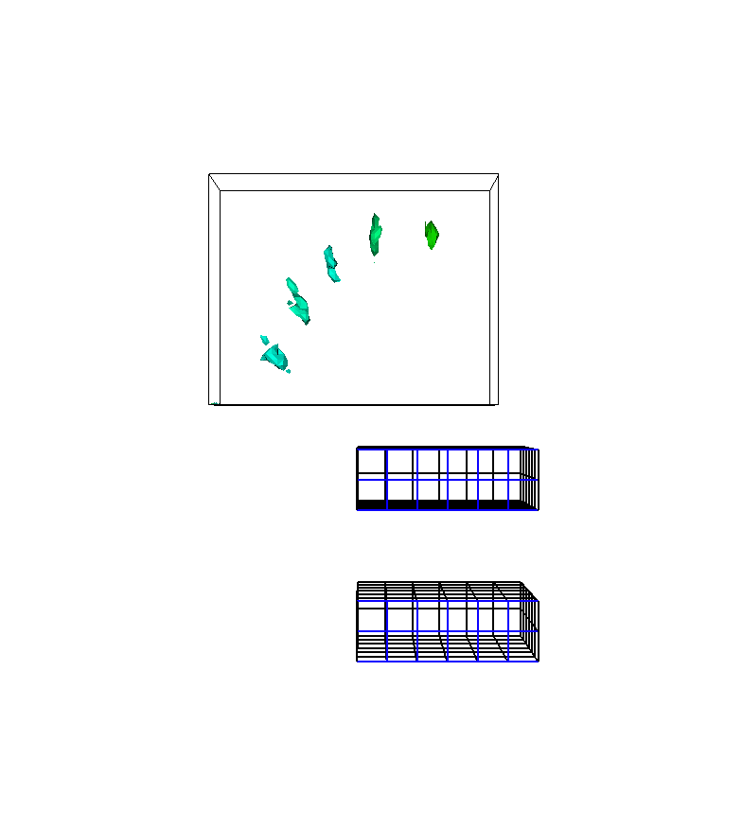
Compton Camera measurements (Ge/Ge)
E = 1408 keV, 30 keV gate
6 cm source to crystal
30 mm crystal to crystal
No PSA (5x5x20)
Iterative reconstruction
FWHM ~ 8mm

Slide 37
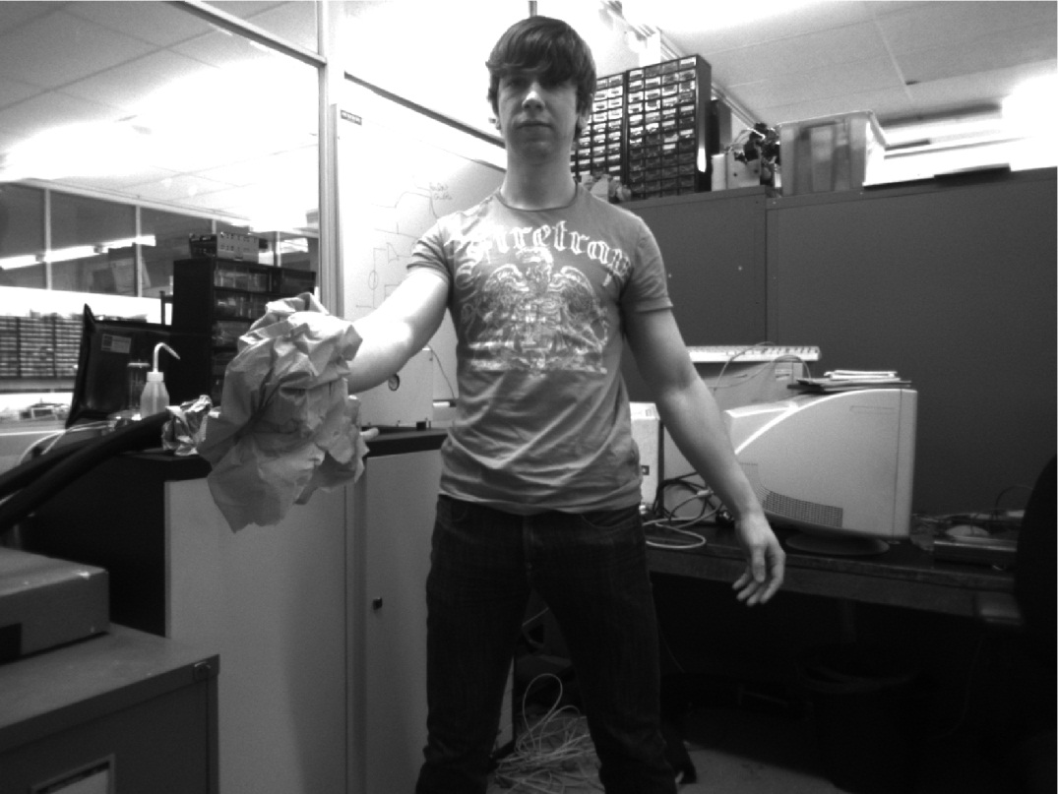
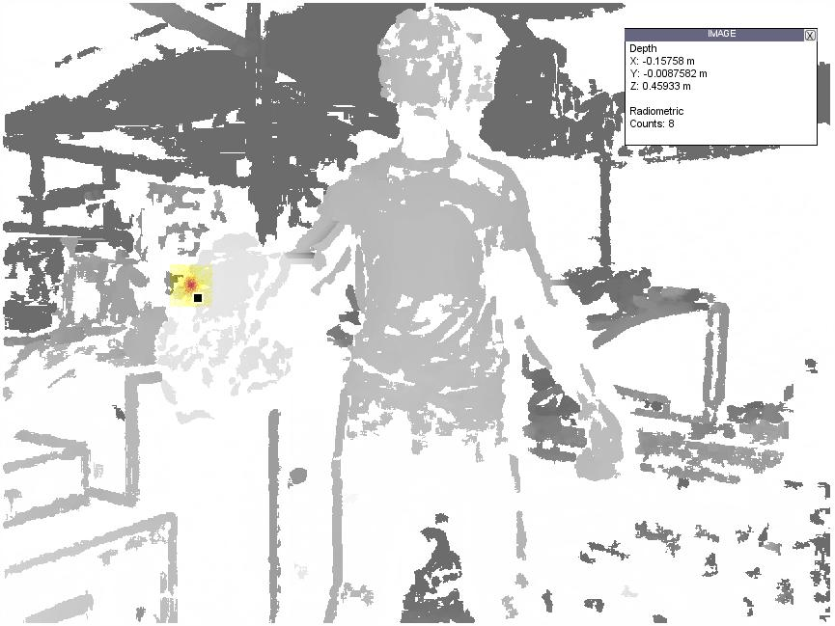

Stereoscopic Optical Image Fusion
1.5m standoff
A Compton Camera provides 3D source location
Utilise a 3D optical imager
Bubblebee 3 camera head

Slide 38
The next steps
A number of preclinical and field trails are under way.
Utilise e-tracking to reduce the uncertainty in the final image
Improved image reconstruction
Simplified electrode structure
Further use of room temperature sensors

Slide 39
Imaging devices for medicine and security
Andy Boston
ajboston@liv.ac.uk

