Slide 1
Nuclear structure experiments beyond the neutron dripline
²⁶O
¹⁵Be
^{19,21}C
Unbound – resonance observed known to be unbound

Slide 2
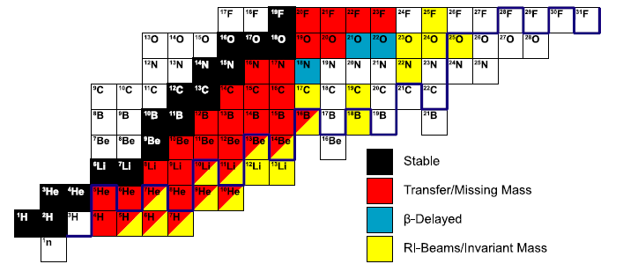
Measured neutron unbound resonances
O
26
C
21
Be
15
T. Baumann, A. Spyrou, and M.T., Rep. Prog. Phys. 75 (2012) 036301

Slide 3
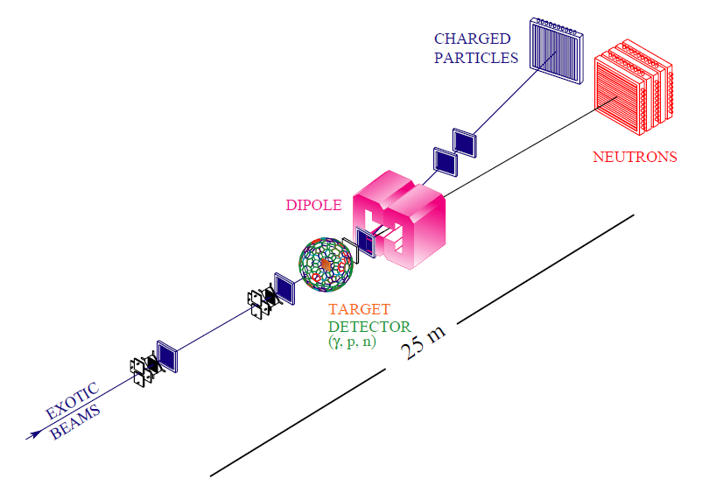
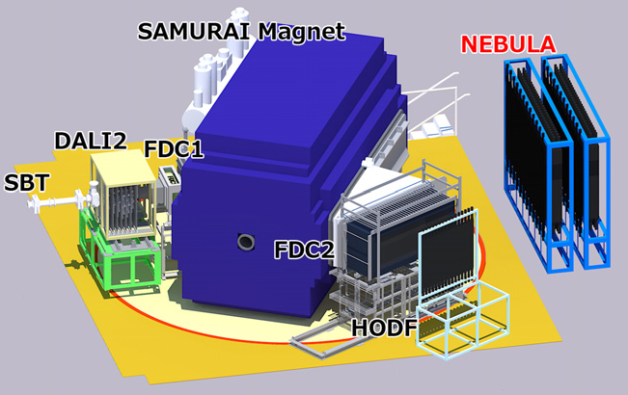
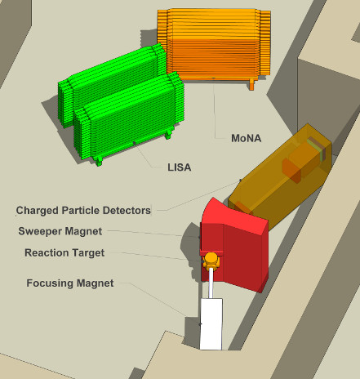
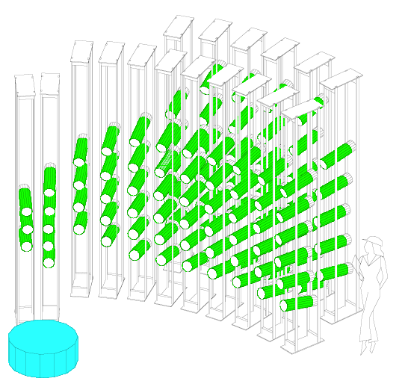
Radioactive beams / invariant mass experimental setups
ALADIN/LAND
SAMURAI/ NEBULA
Sweeper/MoNA-LISA
DeMoN
B, Jonson, Phys. Rep. 389 (2004) 1
T. Aumann and T. Nakamura, Phys. Scr. T152 (2013) 014012
J. L. Lecouey, Few-Body Systens 34 (2004) 21

Slide 4
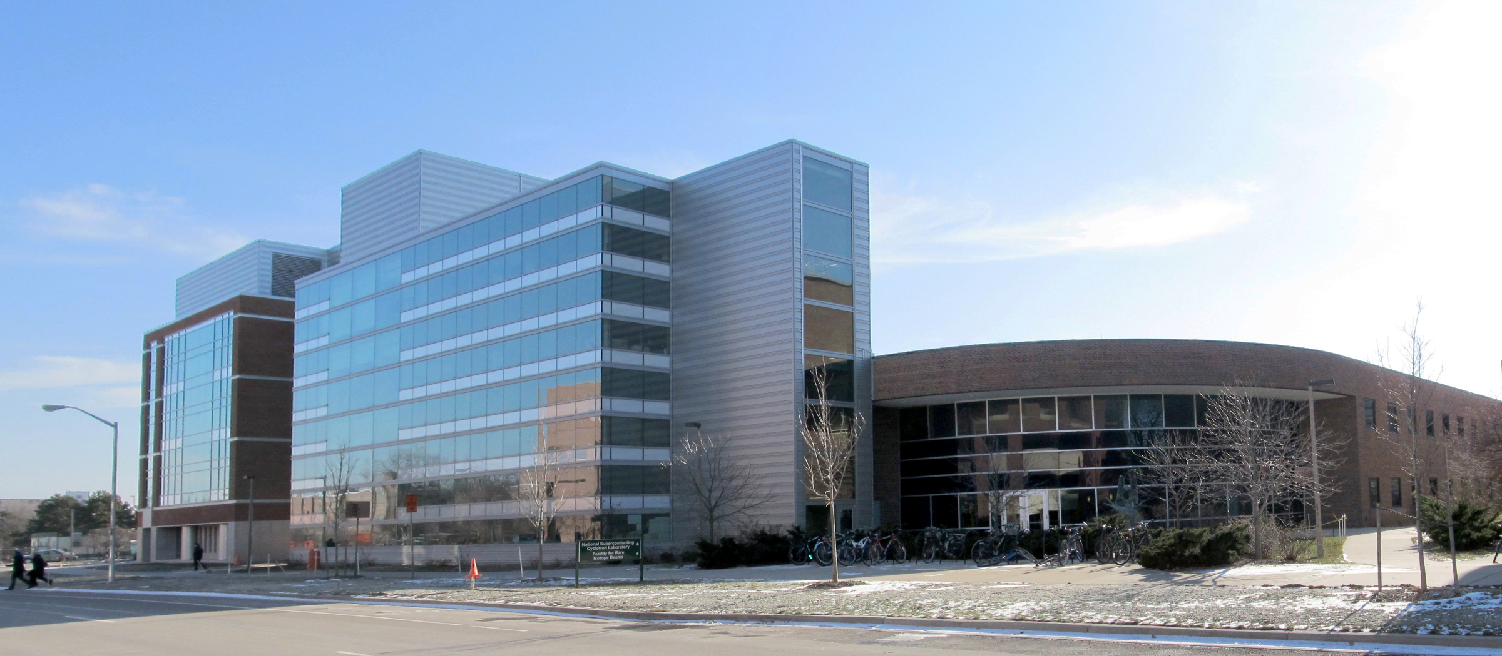
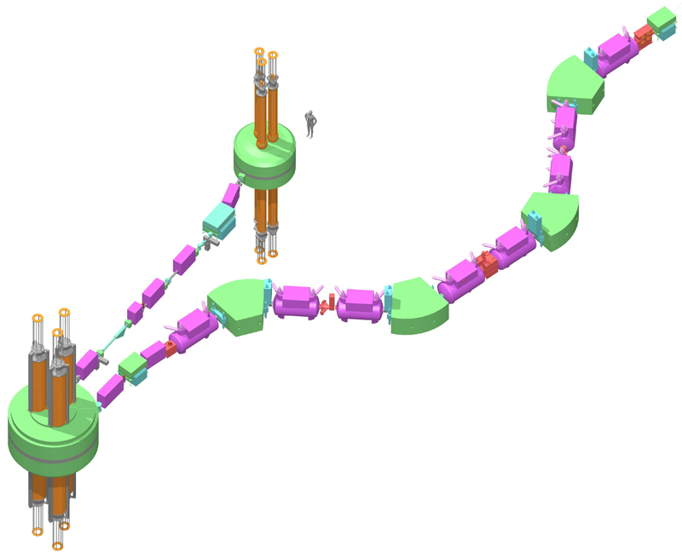
National Superconducting Cyclotron Laboratory
National user facility
>700 users
FRIB users organization has >1300 members
Located on the campus
of Michigan State University
38 faculty
31 research associates
66 graduate students
Site for the Facility for Rare Isotope Beams (FRIB)
Coupled Cyclotron Facility

Slide 5
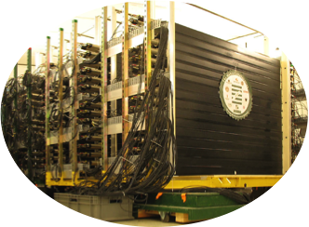
Modular Neutron Array (MoNA) at NSCL
MoNA Collaboration
Augustana College, IL
Central Michigan University, MI
Concordia College, MN
Florida State University, FL
Gettysburg College, PA
Hampton University, VA
Hope College, MI
Indiana University at South Bend, IN
Michigan State University, MI
Ohio Wesleyan University, OH
Wabash College, IN
Western Michigan University, MI
Westmont College, CA

Slide 6
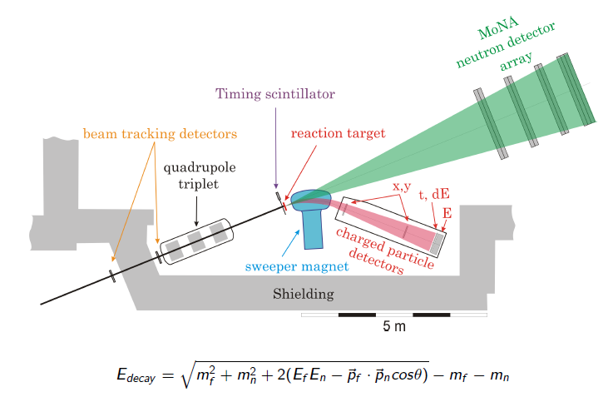
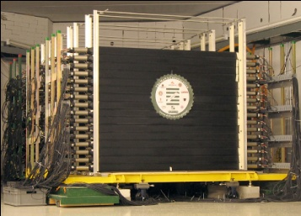
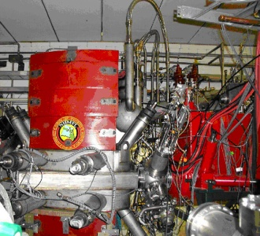
Invariant Mass Spectroscopy
⁹Be(²⁶F,²⁵O)X
²⁴O + n
Neutrons
Fragments (²⁴O)
Secondary Beam (²⁶F)

Slide 7
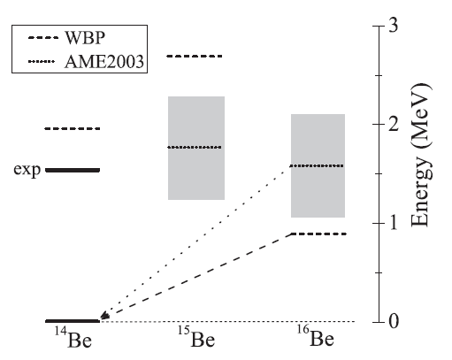
Predicted scheme for ¹⁵Be and ¹⁶Be

Slide 8
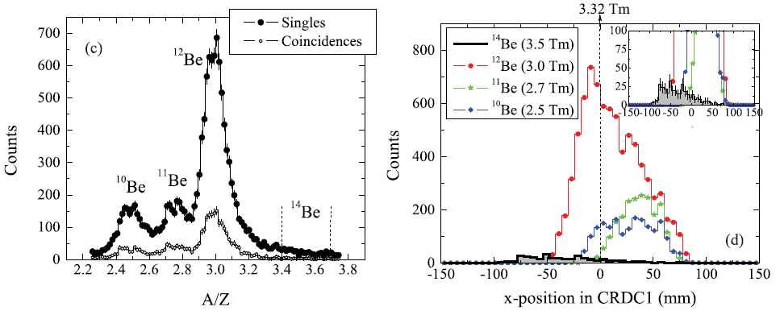
Search for ¹⁵Be
Two-proton removal from ¹⁷C at 55 MeV/u to populate ¹⁵Be
No evidence for ¹⁴Be+n
A. Spyrou et al., Phys. Rev. C 84 (2011) 044309

Slide 9
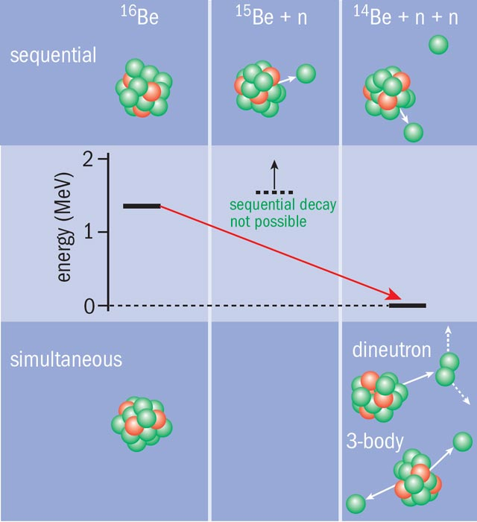
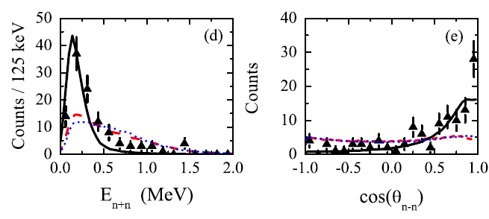
Two-neutron emitter ¹⁶Be
E_{decay} = 1.35(10) MeV
Γ_{decay} = 800⁺¹⁰⁰ keV
−200
dineutron
sequential
three-body
see also,
M. Marques et al., PRL 109 (2012) 239201
A. Spyrou et al., Phys. Rev. Lett. 108 (2012) 102501 CERN Courier, May 2012

Slide 10
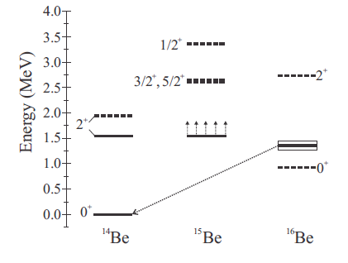
Missing 5/2⁺ state in ¹⁵Be
???
5/2⁺
3/2⁺
di-neutron

Slide 11
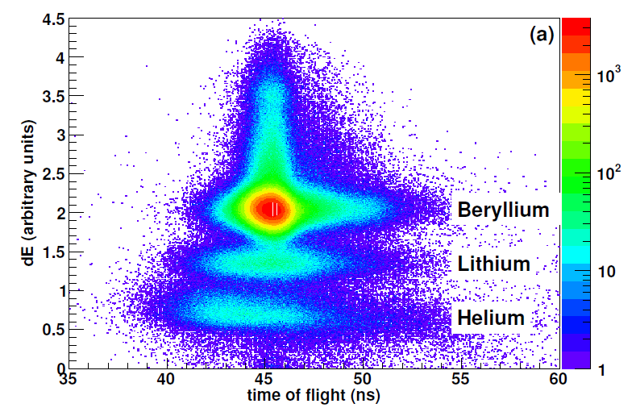
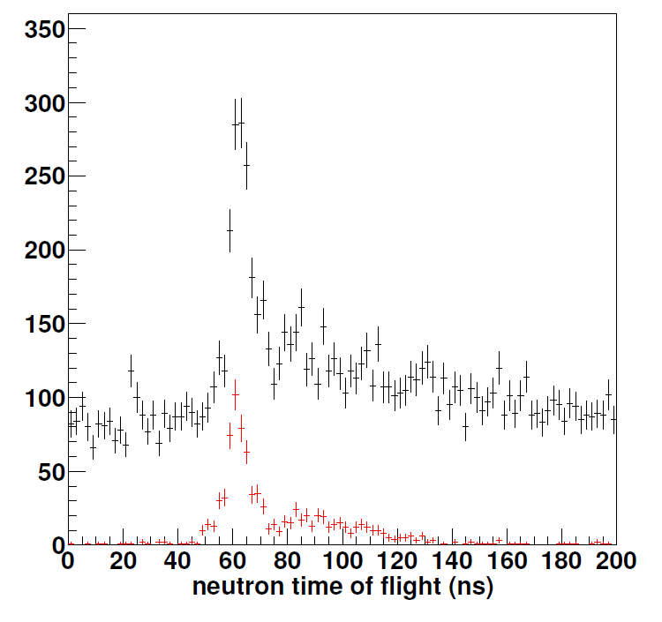
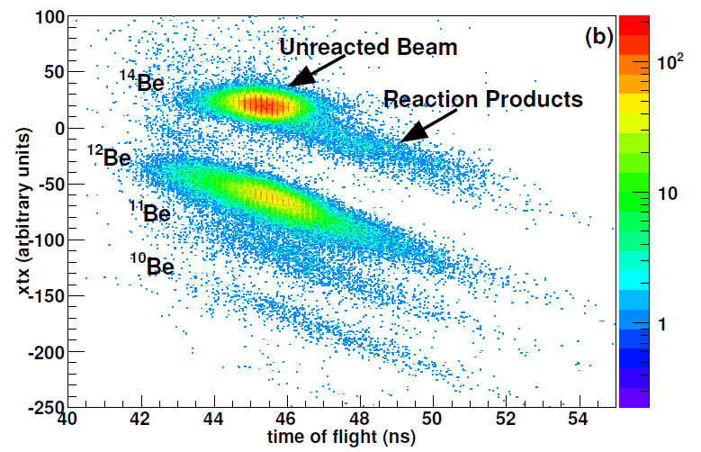
¹⁴Be(d,p)¹⁵Be
Element identification
Neutron identification
Isotope identification
J. Snyder et al., Phys. Rev. C (2013) submitted

Slide 12
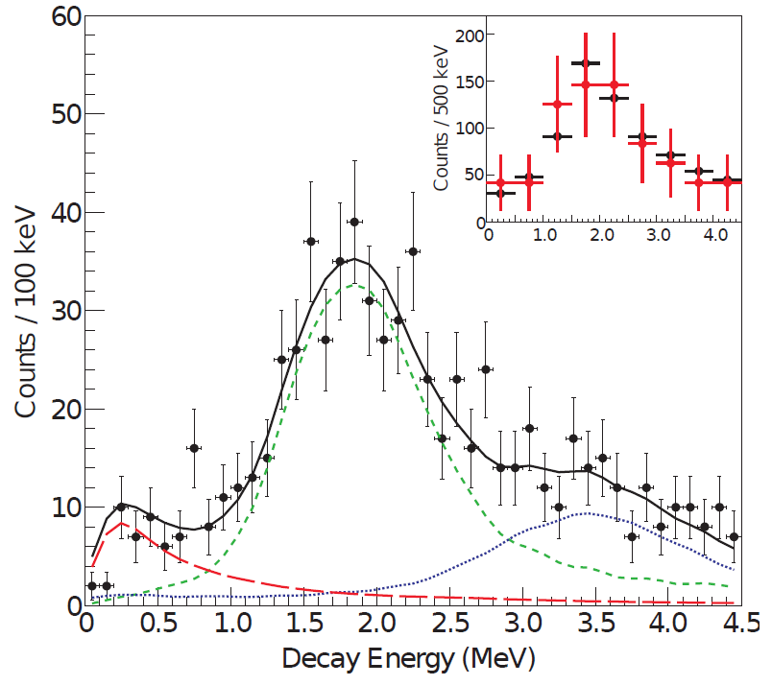
¹⁵Be decay energy spectrum
E_{decay} = 1.8(1) MeV
Γ_{decay} = 575(200) keV
J. Snyder et al., Phys. Rev. C (2013) submitted

Slide 13
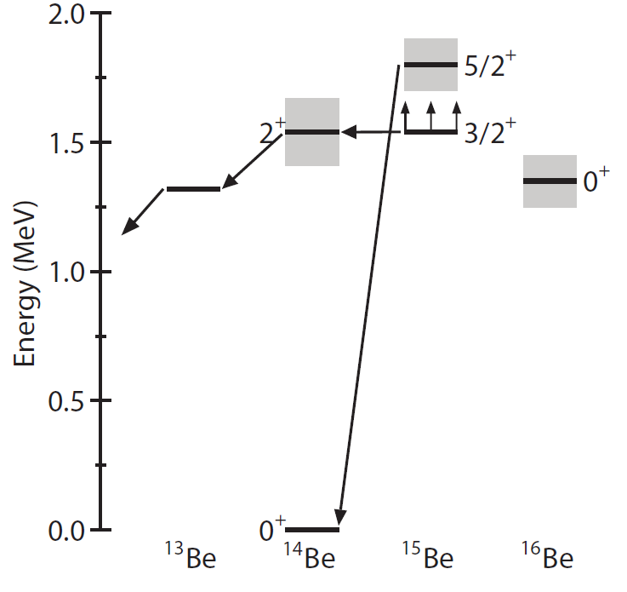
¹⁵Be decay scheme
First identification of ¹⁵Be
5/2⁺ state is not necessarily the ground state
3/2⁺state decays by 3-neutron emission to ¹²Be

Slide 14
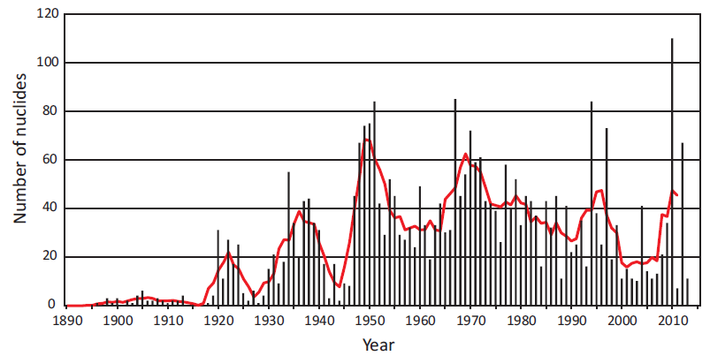
Discovery of isotopes
¹⁵Be is the 12th new isotope discovered in 2013
M. Thoennessen, Rep. Prog. Phys. 76 (2013) 056301
http://www.nscl.msu.edu/~thoennes/isotopes

Slide 15
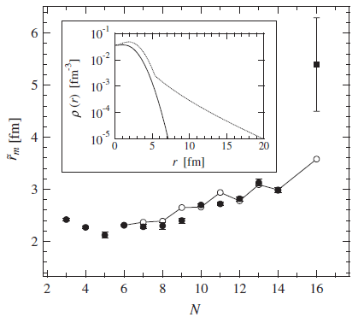
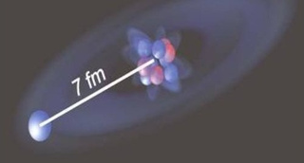
Halo nucleus ²²C
Two-neutron halo in ²²C
Dominant ν2s²_{1/2} configuration
S_{2n} = −0.14(46) MeV or 0⁺³²⁰ keV
Separation energy depends on virtual s_{1/2} state in subsystem ²¹C
−0
Carbon-22 Is Shockingly Huge And Shockingly Stable
http://io9.com/5468244
K. Tanaka et al., Phys. Rev. Lett. 104 (2010) 062701
L. Gaudefroy et al. Phys. Rev. Lett. 109 (2012) 202503

Slide 16
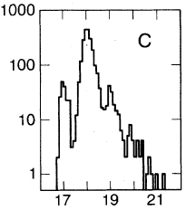
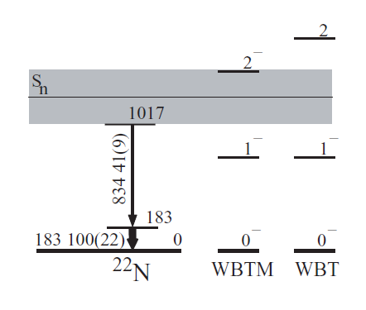
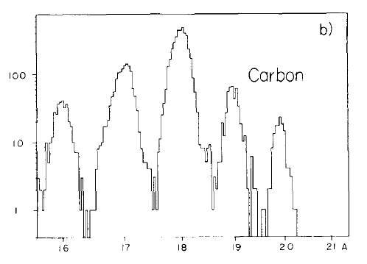
Search for ²¹C
Ground state of ²²N is probably 0⁻
“evidence for the possible particle stability of ²¹C”
J.D. Stevenson and P.B. Price, Phys. Rev. C 24 (1981) 2102
“²¹C is particle instable”
D. Sohler et al., Phys. Rev. C 77 (2008) 044303
Proton removal reaction from ²²N should populate ²¹C s_{1/2} state
M. Langevin et al., Phys. Lett. B 150 (1985) 71

Slide 17
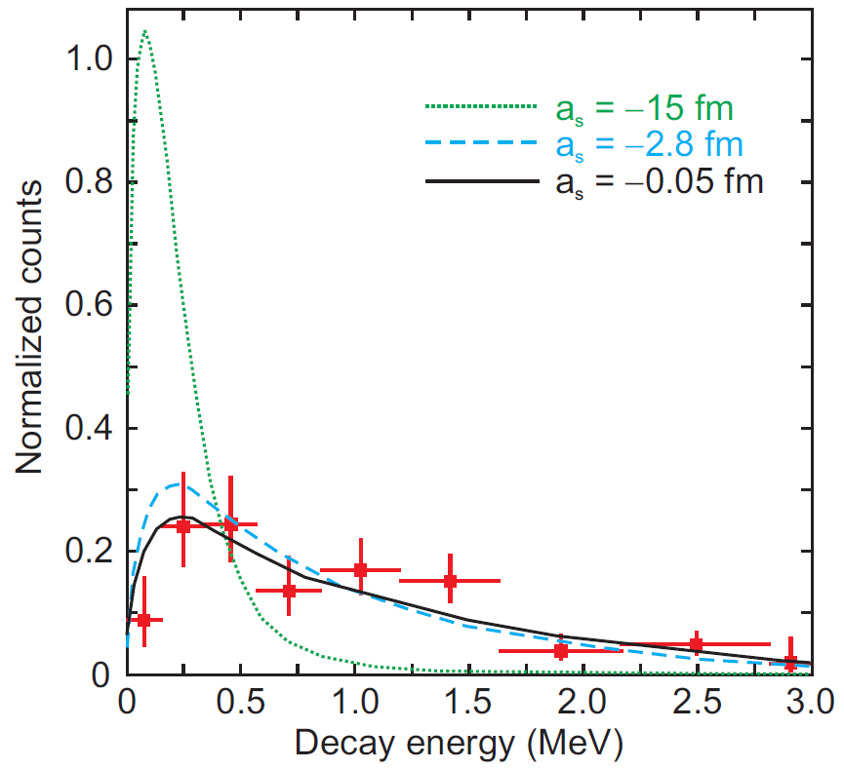
²²N(-1p)²¹C
|a_{s}| < 2.8 fm
No evidence for low-lying state
a_{s} = −15 fm ~ S_{n} = −100 keV
S_{n} −400 keV
<
~
S. Mosby et al., Nucl. Phys. A909, 69 (2013)

Slide 18
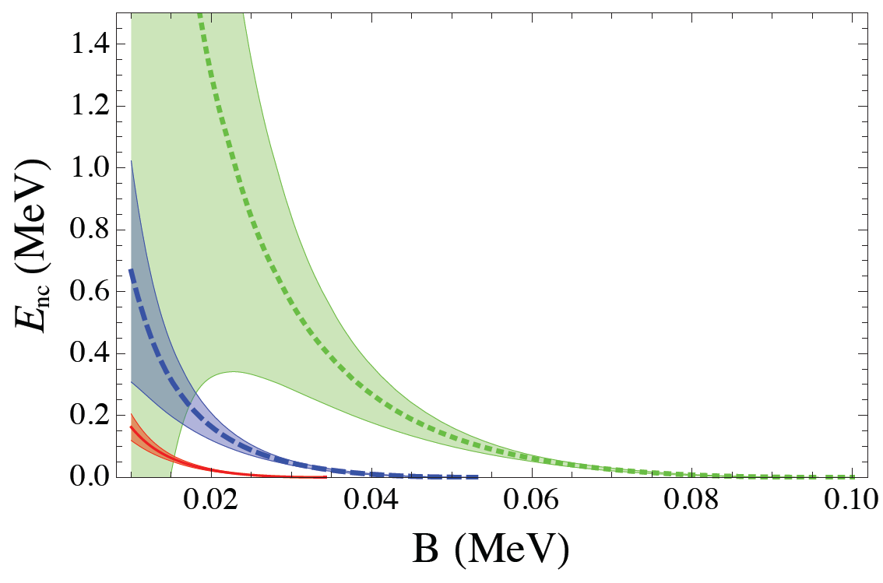
²²N(-1p)²¹C
S_{2n} < 320 keV (exp.)
S_{2n} < 220 keV [1]
S_{2n} < 50 keV [2]
S_{2n} < 120 keV [3]
S_{2n} < 100 keV [4]
<r> (²²C):
4.5 fm
5.4 fm
6.3 fm
From present measurement:
S_{2n} 40 keV
<
from ref. [4]
~
[1] H.T. Fortune and R. Sherr, Phys. Rev. C 85 (2012) 027303
[2] S.N. Ershov, J.S. Vaagen, and M.V. Zhukov, Phys. Rev. C 86 (2012) 034331
[3] M.T. Yamashita et al., Phys. Lett. B 715 (2012) 282
[4] B. Acharya, C. Ji, and D.R. Phillips, arXiv:1303.6720 (2013)

Slide 19
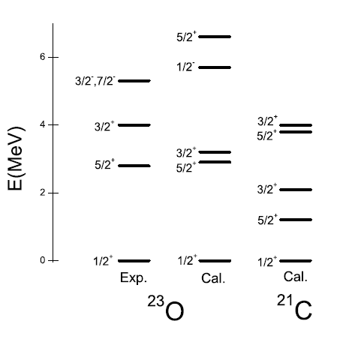
Search for ²¹C
²¹C still not observed
First excited 5/2⁺ state predicted at ~1 MeV
This state can be populated with the transfer reaction ²⁰C(d,p)²¹C
C.-X. Yuan et al., Chin. Phys. C 33 (2009) 55

Slide 20
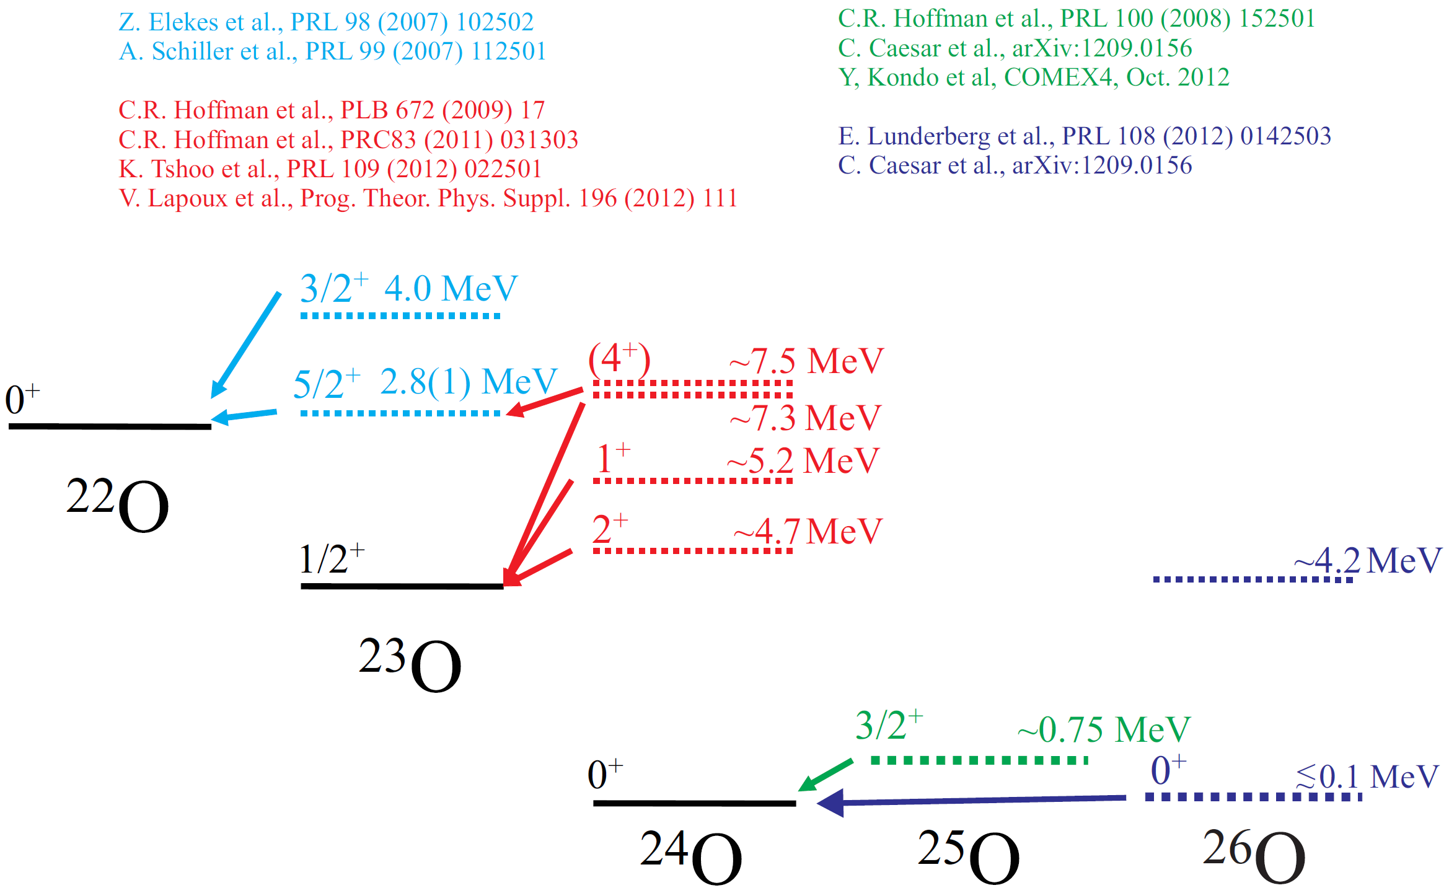
Spectroscopy of neutron-rich oxygen isotopes

Slide 21
Populating ²⁶O in one-proton removal reactions from ²⁷F
E. Lunderberg et al., Phys. Rev. Lett. 108 (2012) 142503

Slide 22
Reconstructing ²⁶O
E. Lunderberg et al., Phys. Rev. Lett. 108 (2012) 142503

Slide 23
Identifying real two-neutron events
Causality cuts:
Δv = 7 cm/ns
Δ d = 25 cm
+50
E_{rel} = 150 keV
−150
E. Lunderberg et al., Phys. Rev. Lett. 108 (2012) 142503

Slide 24
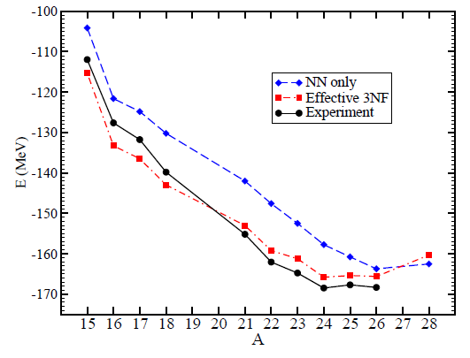
Coupled cluster calculations
G. Hagen et al., Phys. Rev. Lett. 108 (2012) 242501

Slide 25
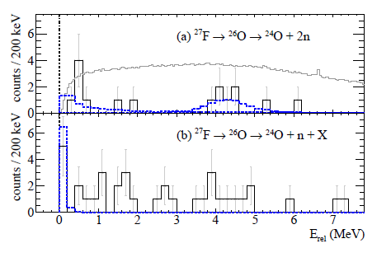
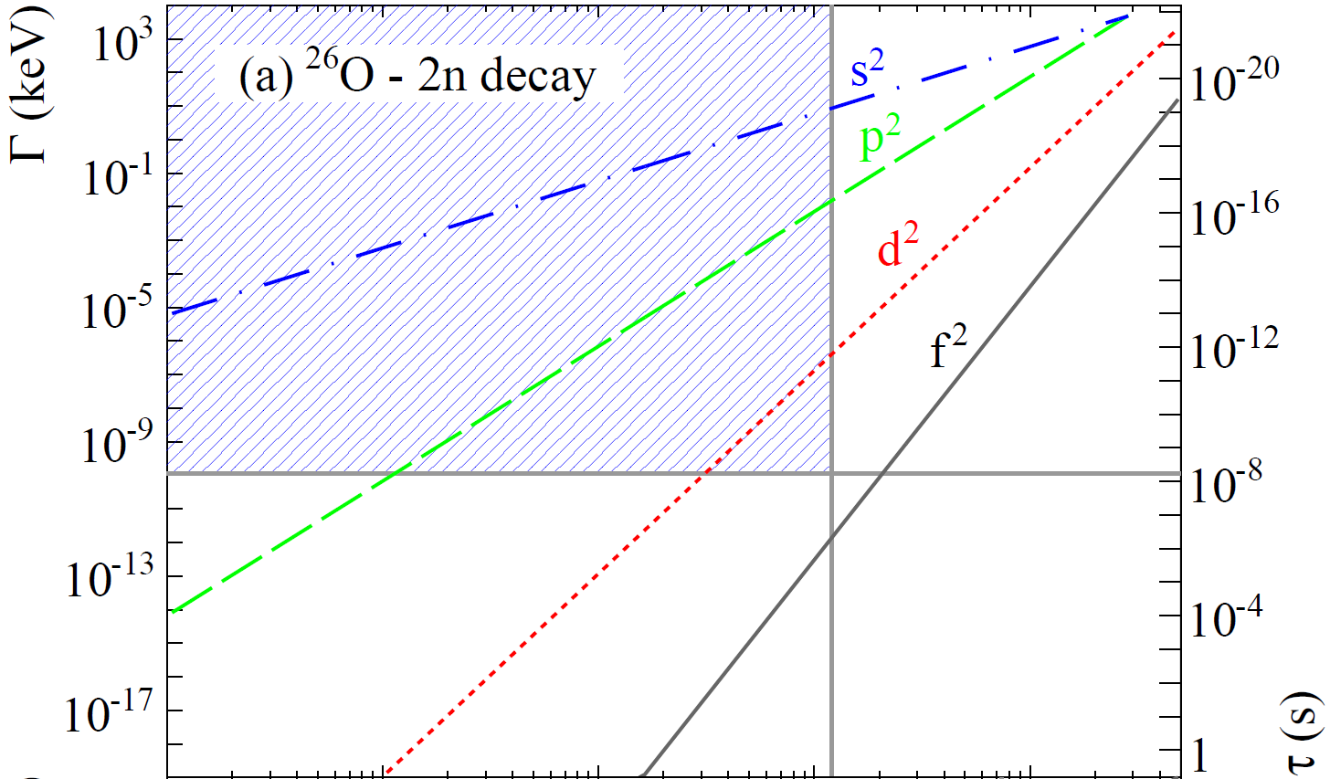
Results confirmed by R³B-LAND
E_{rel} < 120 keV
Lifetime limit: τ < 5.7 ns
C. Caesar et al., arXiv:1209.0156
L.V. Grigorenko et al., Phys. Rev. C 84 (2011) 021303

Slide 26
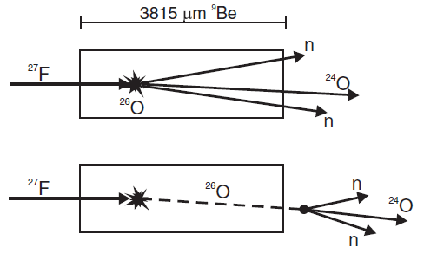
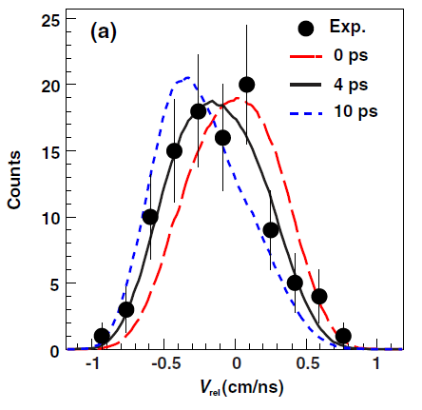
Lifetime measurement
improved lifetime limit: τ < 5.5 ps
Lifetime: τ = 4.5^{+1.1} (stat) ±3 (syst) ps
−1.5
82%C.L. for possible finite two-neutron radioactivity lifetime
Z. Kohley et al., Phys. Rev. Lett. 110 (2012) 152501

Slide 27
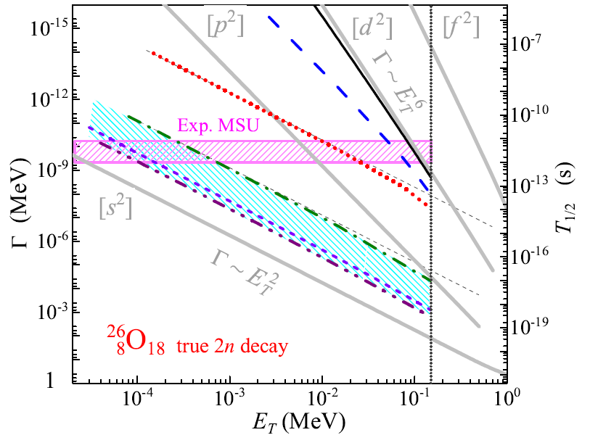
New lifetime calculations
“realistic theoretical limits”
E_{T} < 1 keV
L.V. Grigorenko, I.G. Mukha, and M.V. Zhukov, arXiv:1304.4901

Slide 28
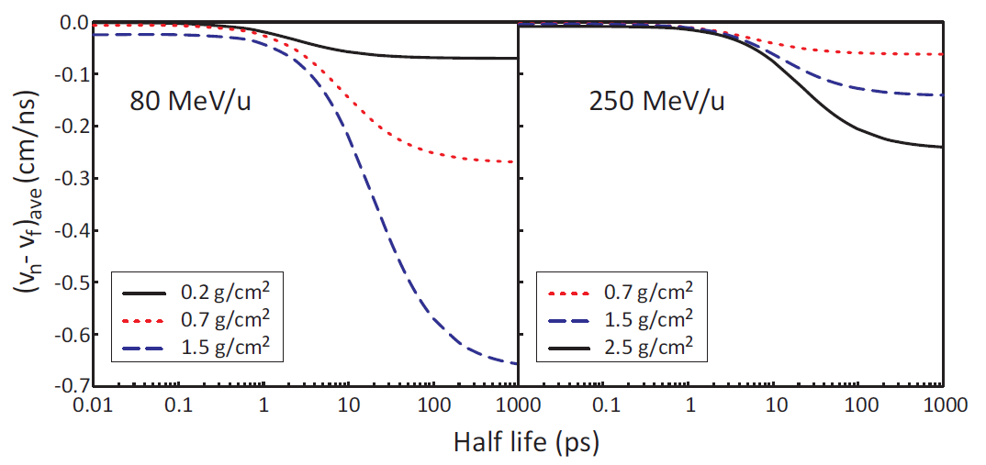
Improved lifetime measurements
Influence of beam energy and target thickness on lifetime sensitivity

Slide 29
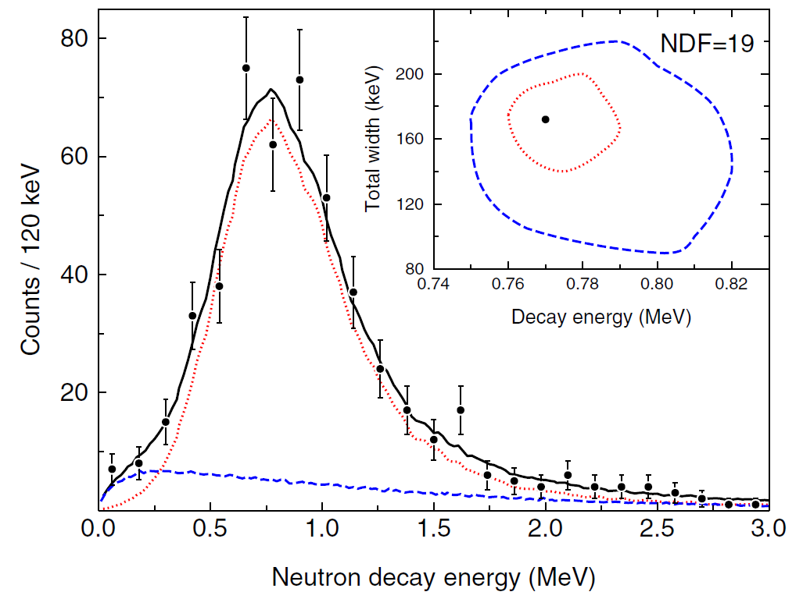
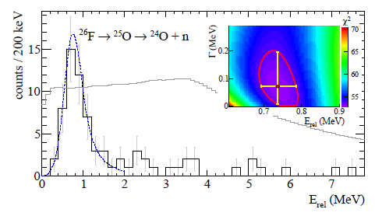
Limits of beam intensity
GSI
~80counts/100keV
~15counts/200keV
MSU
C.R. Hoffman et al.,
Phys. Rev. Lett. 100 (2008) 152502
C. Caesar et al., arXiv:1209:0156v2

Slide 30
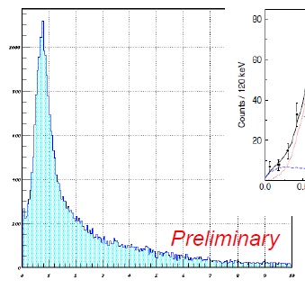
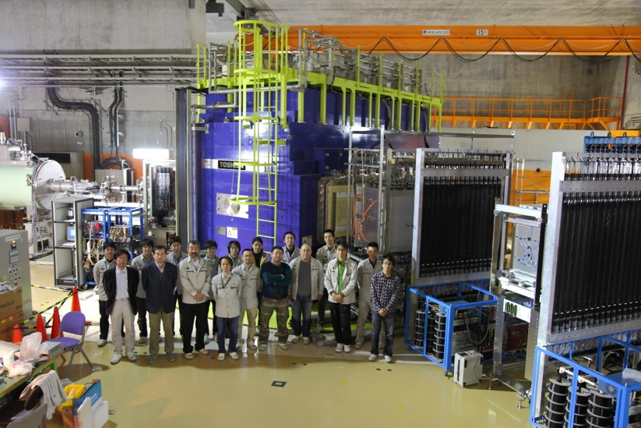
Recent results from RIBF on ²⁵O
>1100counts/50keV
RIKEN
Factor of ~25 intensity increase compared to MSU
Y. Kondo et al., COMEX4, Oct.2012

Slide 31
Potential for discovery of two new isotopes…
^{25,26}O
²⁴N
²³C
Unbound – resonance observed known to be unbound

Slide 32
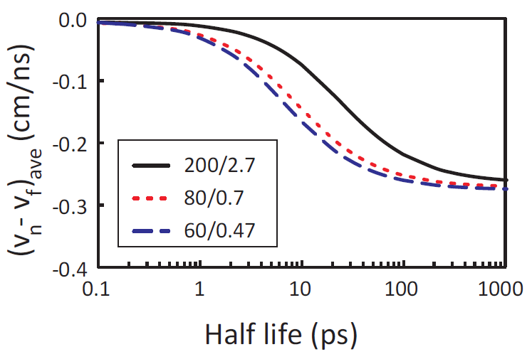
Improved limit from RIKEN data?

Slide 33
Conclusions
Neutron decay spectroscopy is an effective tool to explore nuclei at and beyond the neutron dripline
Discovery of ¹⁵Be; confirmation of direct two-neutron decay of ¹⁶Be
Limit on two-neutron separation energy of ²²C from non-observation of ²¹C
“Indications” of two-neutron radioactivity in ²⁶O

