Slide 1
Proton Computed Tomography system: recent results and upgrade status
M. Bruzzi^{1,2*}, M. Bucciolini^{2,3}, G. A. P. Cirrone⁴, C. Civinini², G. Cuttone⁴, D. Lo Presti^{5,6}, S. Pallotta^{2,3}, C. Pugliatti^{5,6}, N. Randazzo⁵, F. Romano^{4,7}, V. Sipala^{8,9}, M. Scaringella¹, C. Stancampiano^{5,6}, C. Talamonti^{2,3}, M. Tesi¹, E. Vanzi¹⁰, M. Zani^{2,3}
¹Physics Department, University of Florence, Italy
²INFN - Florence Division, Italy
³Dipartimento di Scienze biomediche, sperimentali e cliniche, University of Florence, Florence, Italy
⁴INFN - Laboratori Nazionali del Sud, Catania, Italy, ⁵INFN - Catania Division, Italy
⁶Physics Department, University of Catania, Catania, Italy
⁷Centro Studi e Ricerche e Museo Storico della Fisica, Rome, Italy
⁸Chemistry and Pharmacy Department, University of Sassari, Sassari, Italy
⁹INFN Cagliari Division, Italy
¹⁰ SOD Fisica Medica, Azienda Ospedaliero-Universitaria Careggi, Firenze, Italy
* Spokesperson
M. Bruzzi,, International Nuclear Physics Conference INPC2013: 2-7 June 2013, Firenze, Italy

Slide 2
Outline
Introduction: proton therapy and proton imaging
Proton imaging apparatus
  Tracker
    Single module architecture
    Detector
    VLSI front-end
  Calorimeter
    Crystal YAG:Ce
    Electronic readout
    Trigger system
First results with proton beam
Conclusions
M. Bruzzi,, International Nuclear Physics Conference INPC2013: 2-7 June 2013, Firenze, Italy

Slide 3
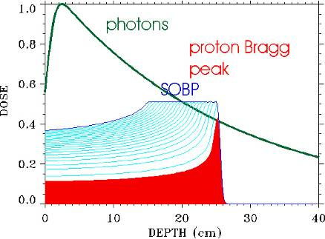
Proton therapy
The proton therapy is a good clinical treatment for cancer as it permits to obtain a dose distribution extremely conform to the target volume.
The Bragg peak shape ensures that healthy tissues in front of and beyond the tumor are not damaged.
Through the weighted superposition of proton beams of different energies it is possible to deposit a homogenous dose in the target region using only a single proton beam direction.
(Spread Out Bragg Peak -SOBP).
M. Bruzzi,, International Nuclear Physics Conference INPC2013: 2-7 June 2013, Firenze, Italy

Slide 4
proton Computed Tomography: why?
In proton therapy treatments is important to know:
Patient positioning:
Currently performed using X-rays radiography in previous phase
pCT allows better accuracy and
single phase positioning / treatments
Dose Calculation:
Currently performed using X-rays computed tomography
Problem: protons and photons have
different interaction with matter
pCT uses protons directly for dose calculation
The error intrinsic in this conversion (due to μ(η_{e},Z) dependency on atomic number and electron density) is the principal cause of proton range indetermination (3%, up to 10 mm in the head)‏
[Schneider U. (1994), Med Phys. 22, 353]

Slide 5
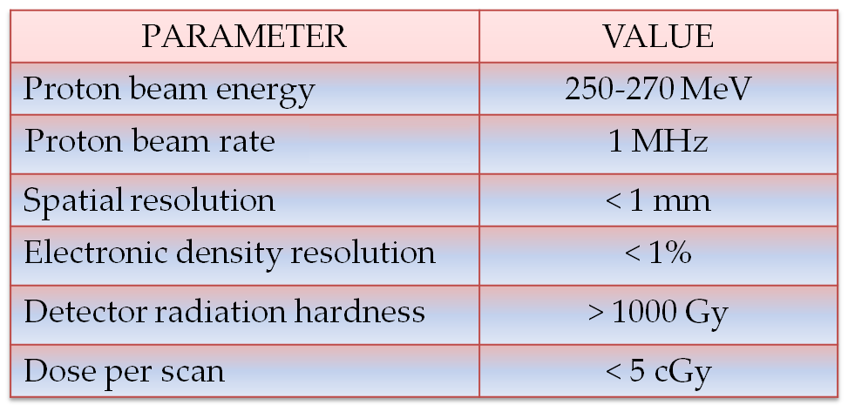
Parameters of pCT
Problem: protons, because the multiple Coulomb scattering, don’t move in straight line.
M. Bruzzi,, International Nuclear Physics Conference INPC2013: 2-7 June 2013, Firenze, Italy

Slide 6
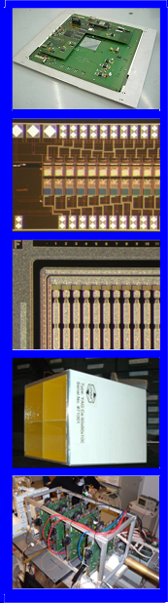
THE “PRoton IMAging (PRIMA) PROJECT”
pCR apparatus oriented to pCT
  PROGRAM
  Design and manufacture a high-performance prototype for proton radiography and tomography.
  Develop suitable imaging algorithms;
  Validate the pCR/pCT system with pre-clinical studies
  Conceive an upgraded prototype for pre.clinical studies
  - Hardware and data acquisition;
  - Reconstruction algorithms.
M. Bruzzi,, International Nuclear Physics Conference INPC2013: 2-7 June 2013, Firenze, Italy

Slide 7
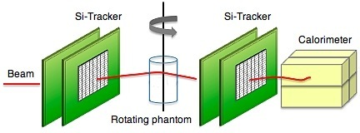
Concept
y
x
z
P₁
P₂
P₃
P₄
proton Computed Radiography and Tomography
Reveal the track of the single proton using a silicon telescope
Measure the residual energy of the proton using a calorimeter
Reconstruct the most likely path of the single proton
pCR for different projections with a rotating gantry
Single event information can be processed by reconstruction algorithms to produce tomographic images.
M. Bruzzi,, International Nuclear Physics Conference INPC2013: 2-7 June 2013, Firenze, Italy

Slide 8
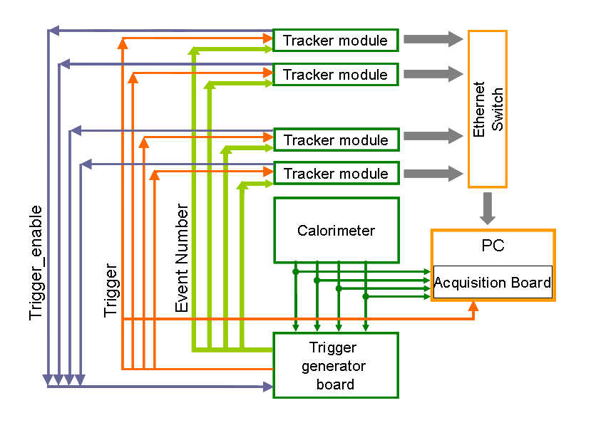
Architecture of the pCT apparatus
M. Bruzzi,, International Nuclear Physics Conference INPC2013: 2-7 June 2013, Firenze, Italy

Slide 9
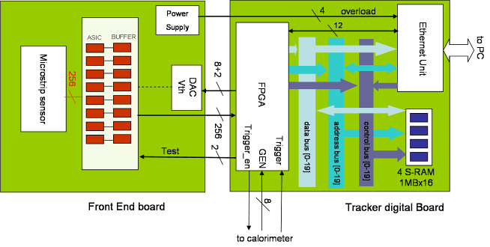
Tracker module architecture
To achieve a read-out rate of 1 MHz a fully parallel digital strip readout system has been developed
Eight 32-channel VLSI front-end chips acquire the detector signals and sends data in parallel to an FPGA (Xlinx Spartan-3AN) which performs zero suppression and moves data to a buffer memory (~5x10⁵ events).
An Ethernet commercial module is use both for data transfer to the central acquisition PC and to control the tracker module DAQ parameters
M. Bruzzi,, International Nuclear Physics Conference INPC2013: 2-7 June 2013, Firenze, Italy

Slide 10
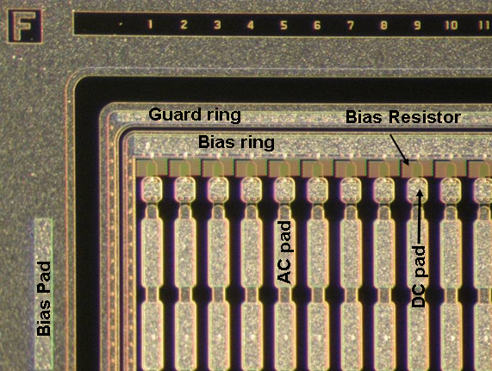
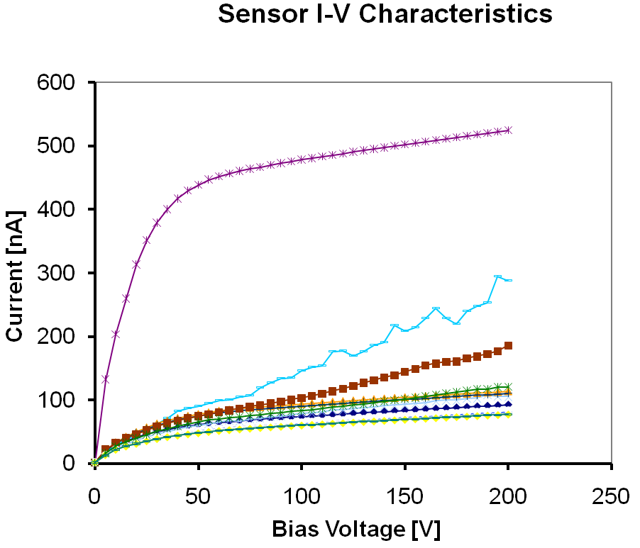
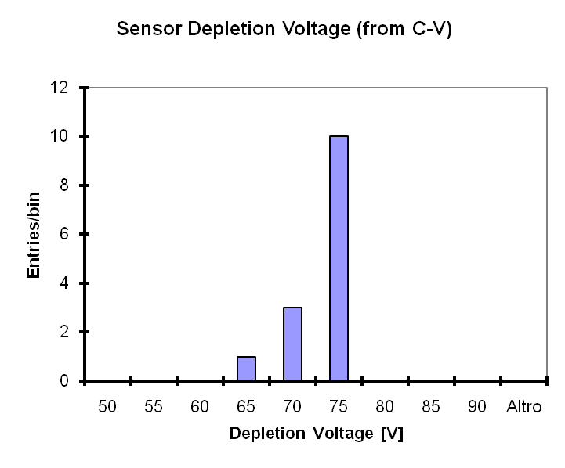
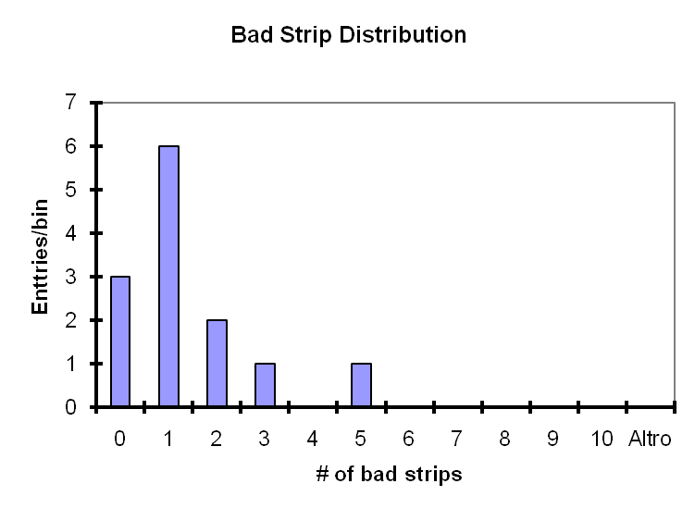
Silicon strip detector
Manufactured by Hamamatsu Photonics
53x53 mm²
p+-on-n strips
256 ch, 200 μm pitch
200 μm thickness
(To reduce the multiple scattering
in the detector while keeping
a good sensitivity to protons)
Vfd = 65-75V
M. Bruzzi,, International Nuclear Physics Conference INPC2013: 2-7 June 2013, Firenze, Italy
Notes:
10
10

Slide 11
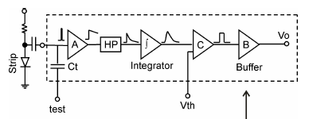
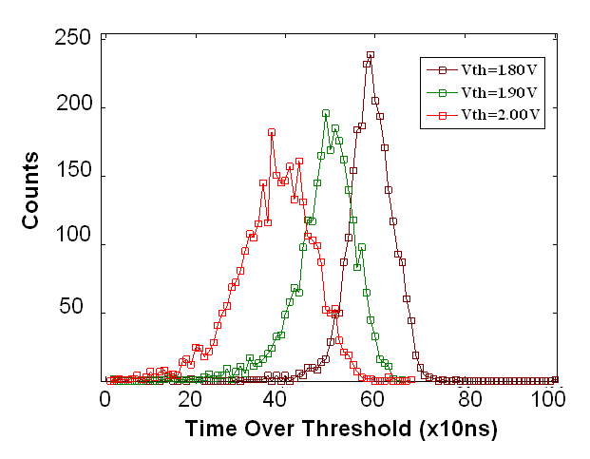
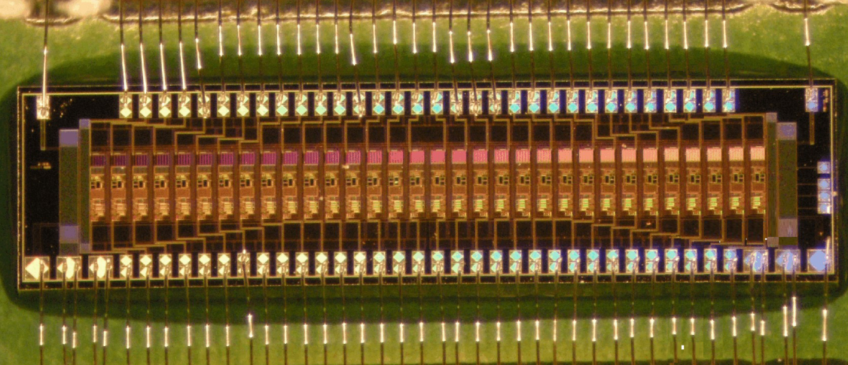
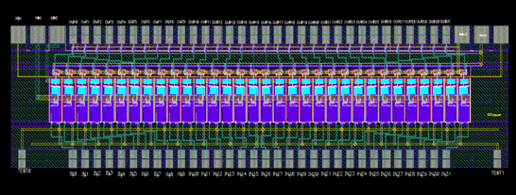
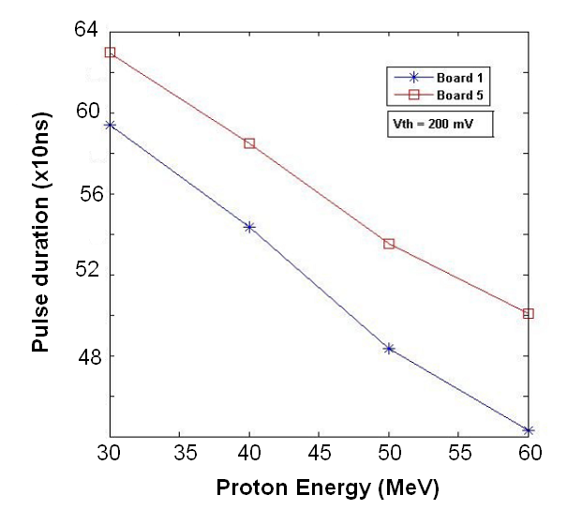
VLSI front-end description
AMS 0.35u CMOS Technology
1.6 mm x 6 mm
32 channels
Power dissipation = 14,5 mW @ chan
Vcc = +3.3 V
M. Bruzzi,, International Nuclear Physics Conference INPC2013: 2-7 June 2013, Firenze, Italy

Slide 12
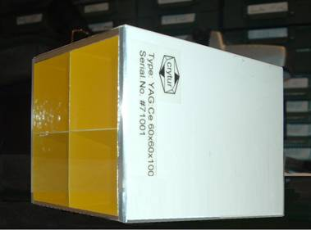
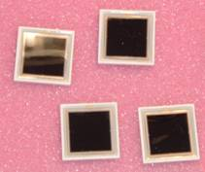
Calorimeter
4 YAG:Ce scintillating crystals
Each crystal 30 x 30 mm² x 100mm
4 Photodiode 18 mm x 18 mm
4 commercial front-end (Charge Sensitive Amplifier & shaper )
YAG:Ce properties
PHYSICAL PROPERTIES
Density [g/cm³] | 4.57
Hygroscopic | No
Chemical formula | Y₃Al₅O₁₂
LUMINESCENCE PROPERTIES
Wavelength of max. emission [nm] | 550
Decay constant [ns] | 70
Photon yield at 300k [10³ Ph/MeV] | 40-50
M. Bruzzi,, International Nuclear Physics Conference INPC2013: 2-7 June 2013, Firenze, Italy

Slide 13
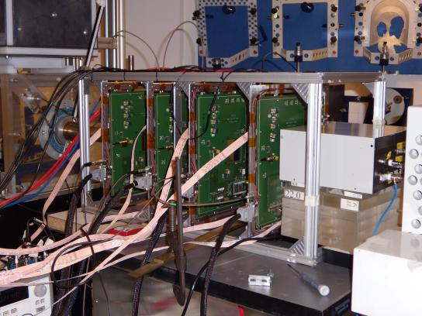
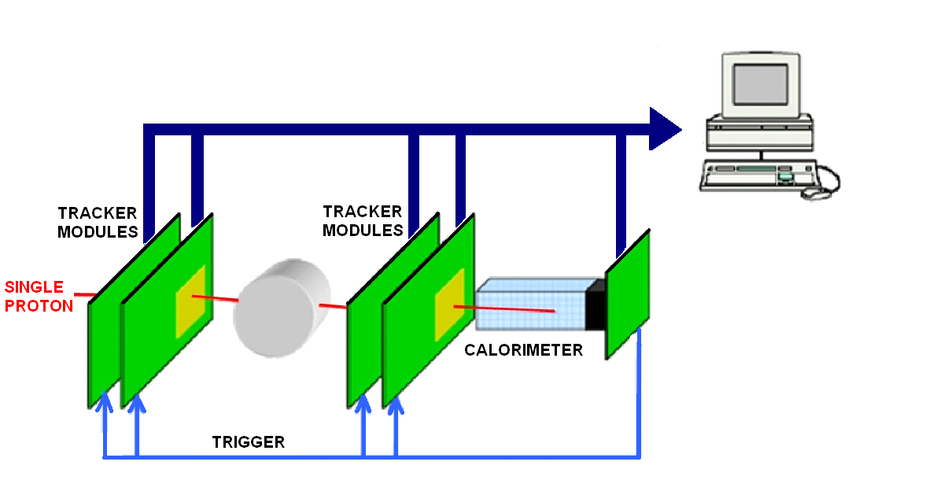
pCT system designed and manufactured by the PRIMA INFN CSN5 collaboration
Entry and Exit
position and direction
4 x-y TRACKER MODULES
1 CALORIMETER
Residual Energy
M. Bruzzi,, International Nuclear Physics Conference INPC2013: 2-7 June 2013, Firenze, Italy

Slide 14
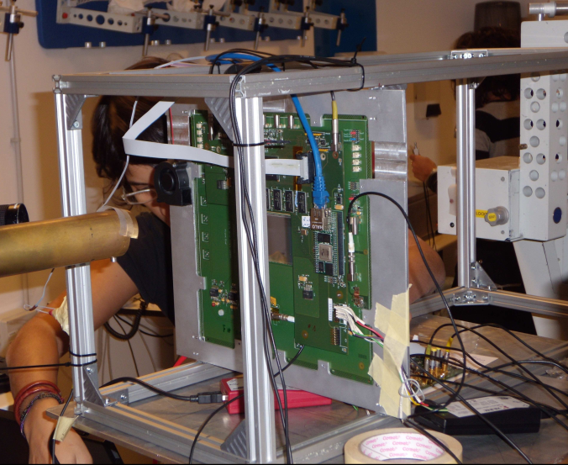
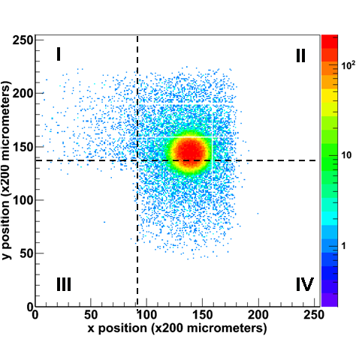
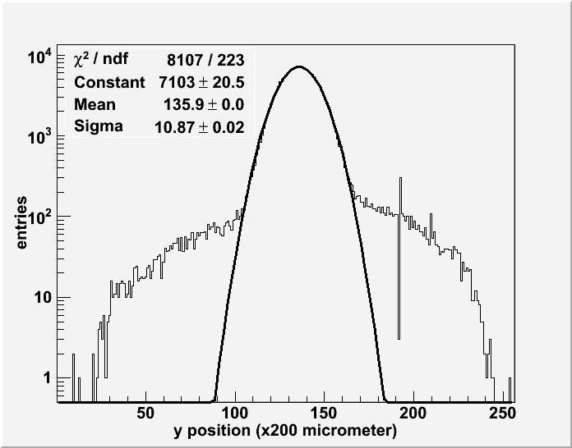
First tests: one x-y plane with YAG:Ce calorimeter (I)
INFN LNS p 60MeV
GOAL: to test the functionality of the architecture.
A x-y tracker plane has been coupled with the calorimeter. The test has been performed at LNS with 60MeV proton beam.
Collimator was used ( Ø 5mm ). Rate 1-50kHz
Counting map ( 1 crystal not connected)
Data projection
M. Bruzzi,, International Nuclear Physics Conference INPC2013: 2-7 June 2013, Firenze, Italy

Slide 15
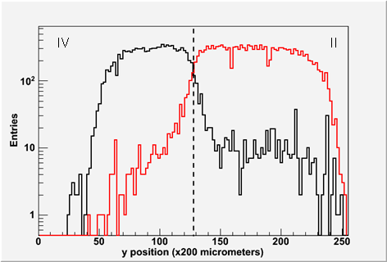
First tests: one x-y plane with YAG:Ce calorimeter (II)
INFN LNS p 60MeV
Correlation between tracker and calorimeter data
→ collimator removed from the beam pipe
Map of events triggered by crystals II (red) and IV (black)
Data projection
Good correlation !
M. Bruzzi,, International Nuclear Physics Conference INPC2013: 2-7 June 2013, Firenze, Italy

Slide 16
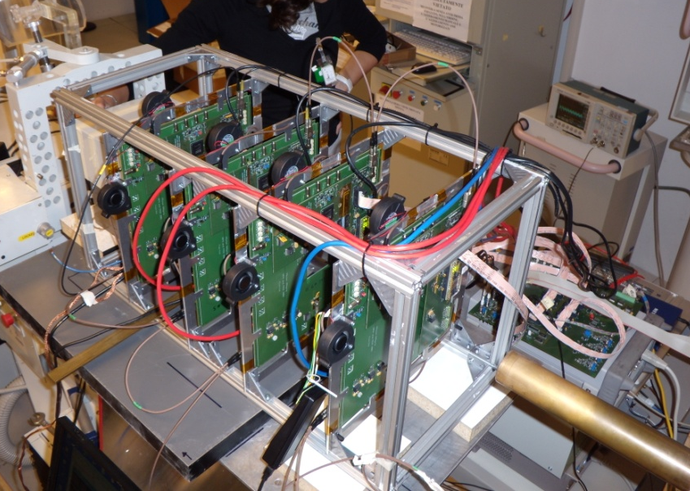
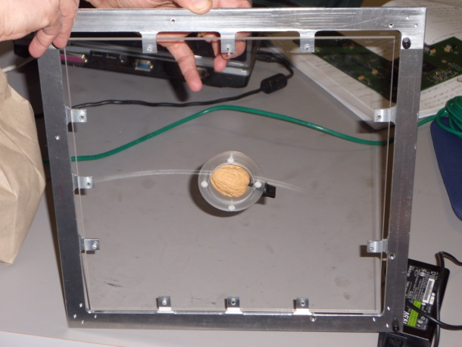
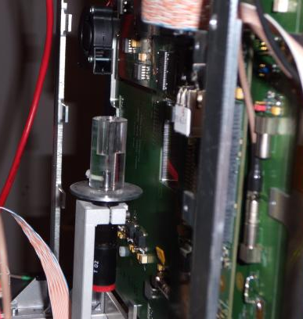
First tests: Complete apparatus
INFN LNS p 60MeV
Alignment test
Radiography of a non homogeneous phantom
radiographies at different angles for first tomographic reconstruction
Tracker: 4 x-y planes
Beam
Calorimeter
M. Bruzzi,, International Nuclear Physics Conference INPC2013: 2-7 June 2013, Firenze, Italy

Slide 17
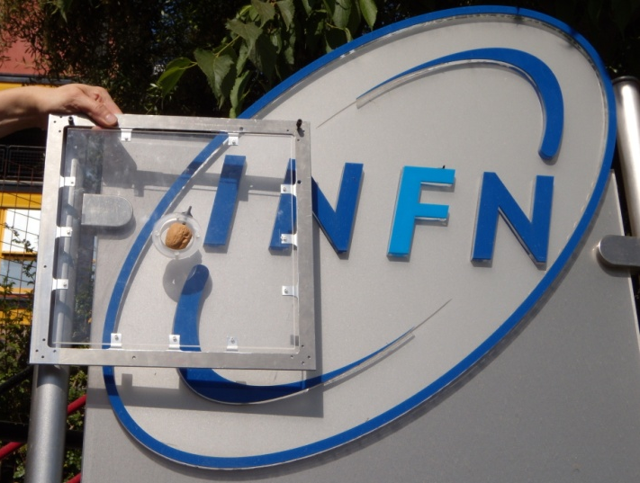
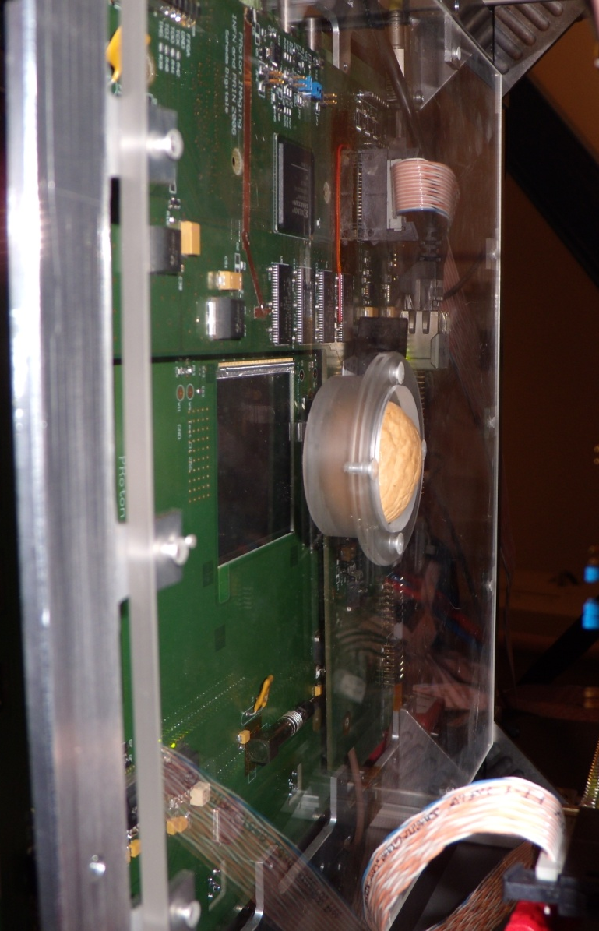
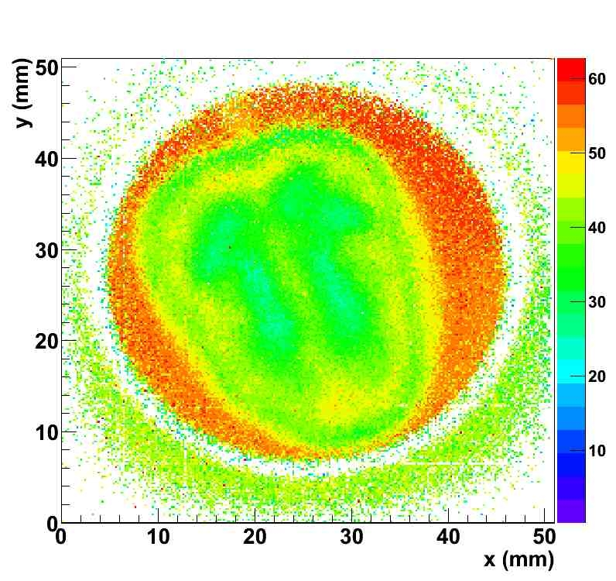
First tests: Radiography of a walnut
INFN LNS p 60MeV
M. Bruzzi,, International Nuclear Physics Conference INPC2013: 2-7 June 2013, Firenze, Italy

Slide 18
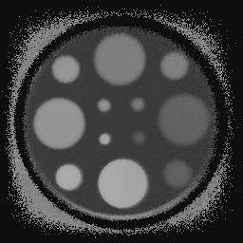
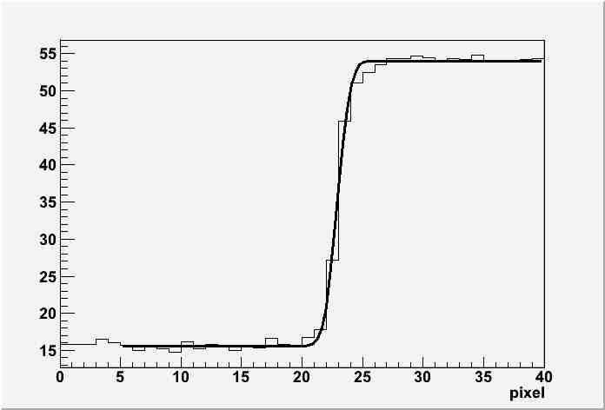
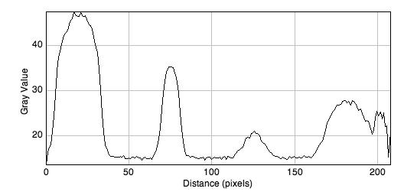
First radiography tests with complete apparatus
INFN LNS p 60MeV
P1 P2 P3 P4
y
x
One cluster in each plane
Cut on difference between “entrance“ and “exit” angles
Sigma=0.170 ± 0.09mm
FWHM = 0.400± 0.212mm
Residual energy (MeV)
M. Bruzzi,, International Nuclear Physics Conference INPC2013: 2-7 June 2013, Firenze, Italy

Slide 19
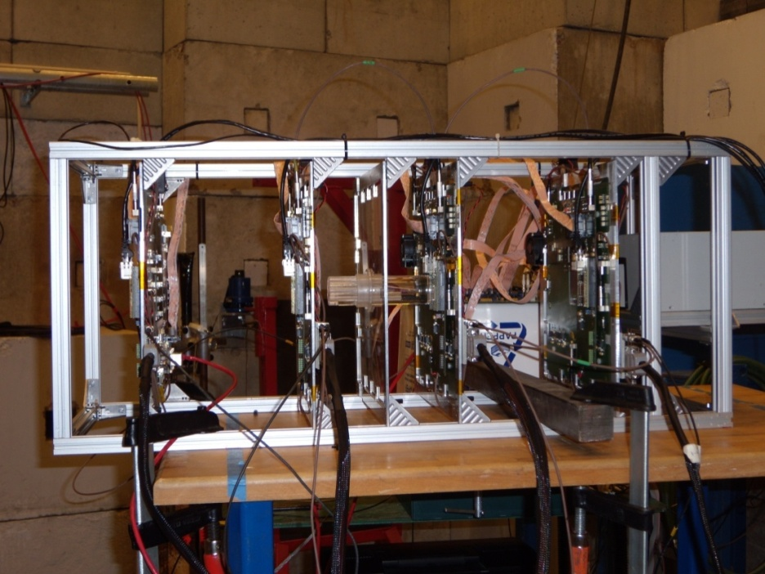
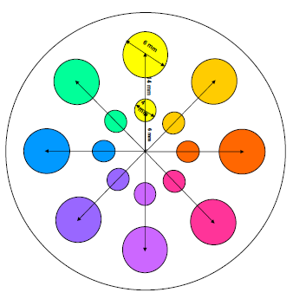


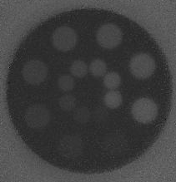
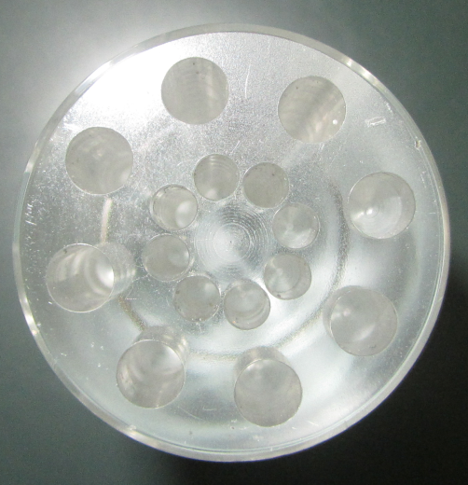
First radiography tests with complete apparatus
Svedberg Laboratory Uppsala p 180MeV
Pmma cylindrical phantom with holes
14 cm total thickness
Not to scale
Hole thickn. (cm)
1
4,5
1,5
6
2,3
8
3,3
10
pCT prototype mounted on
180 MeV protons beam line
Radiography without filtering
M. Bruzzi,, International Nuclear Physics Conference INPC2013: 2-7 June 2013, Firenze, Italy

Slide 20
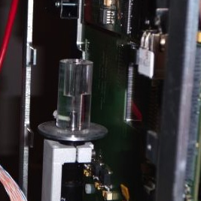
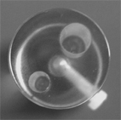
First Tomography tests with complete apparatus
INFN LNS p 60 MeV
  PMMA phantom: diameter 2 cm, height 4 cm – holes φ 4&6 mm, length 2 cm 36 projections (10 degrees steps)
2 cm
M. Bruzzi,, International Nuclear Physics Conference INPC2013: 2-7 June 2013, Firenze, Italy

Slide 21
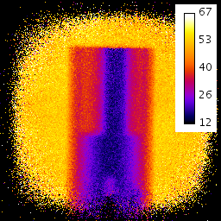
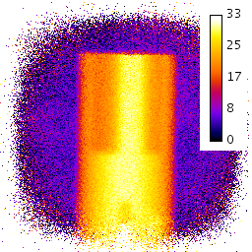
Data Analysis: Tomographic equation
Definition of the tomographic equation (Wang, Med.Phys. 37(8), 2010: 4138)
«projection»
Unknown stopping power distribution (at E₀)
Evaluation of the “projection” term (through numerical integration starting from NIST tables and using the measured E_{res})
E_{res}
Wang projection
Mean measured residual energy plotted at P3 plane
Corresponding Wang projections
Vanzi E. et al. The PRIMA collaboration: preliminary results in FBP reconstruction of pCT data, in press on Nucl. Instrum. Meth A.
M. Bruzzi,, International Nuclear Physics Conference INPC2013: 2-7 June 2013, Firenze, Italy

Slide 22
Data Analysis: Rebinning
We defined a plane parallel to detector’s planes passing through the phantom axis. Plane is sampled in a 256 x 256 matrix, 200µm pixel size. For each event, associated projection bin is determined by the intersection of the line connecting P2 and P3 impact points with the plane.
P2
P3

Slide 23
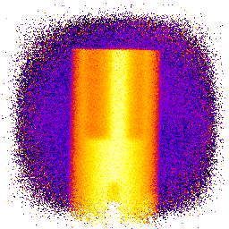
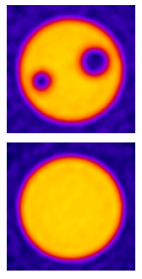

Tomographic reconstruction: first results
Butterworth filter: order 2,
cut-off 20/128 of the Nyquist freq.
Good quality images without cuts: possibility of reducing acquisition times and dose in patient procedures
Vanzi E. et al. The PRIMA collaboration: preliminary results in FBP reconstruction of pCT data, in press on Nucl. Instrum. Meth A.
M. Bruzzi,, International Nuclear Physics Conference INPC2013: 2-7 June 2013, Firenze, Italy

Slide 24
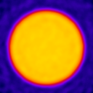
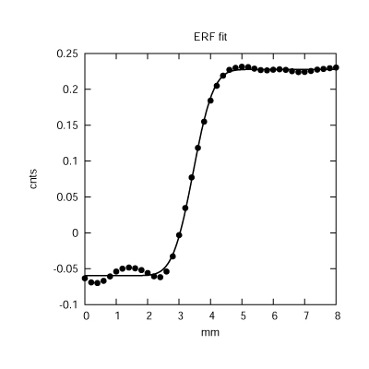
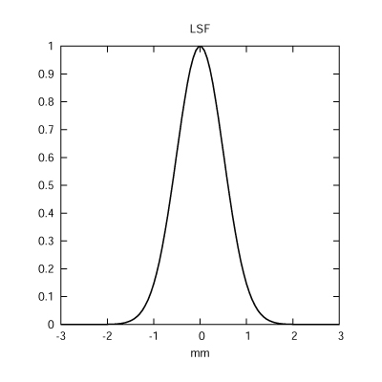
Resolution Evaluation
The edge of the phantom is fitted with an erf function on 20 slices in the homogeneous region.
The derivative of the erf function is a Gaussian function that describes the Line Spread Function (LSF) of the imaging system.
FWHM=0.9±0.1mm
Noise=2.4%
The mean FWHM of the LSF over the 20 slices was evaluated and used to quantify resolution.
Mara Bruzzi Riunione RDH 22 Aprile 2013 Roma

Slide 25
Upgrade: the pre-clinical prototype
A new prototype based on the same technology, to meet pre-clinical demands now under development
Increase 4x of the active area
On-line data acquisition
Data rate up to 1 MHz
Rectangular shape to perform tomography in slices
Tracker:
top
X2 FE
X4 FE
4x1 silicon detectors
5x20 cm² active area
Calorimeter:
7x2 YAG crystals
6x21 cm² active area
X1 FE
X3 FE
Scaringella M. et al. The PRIMA collaboration:, in press on Nucl. Instrum. Meth A.
M. Bruzzi,, International Nuclear Physics Conference INPC2013: 2-7 June 2013, Firenze, Italy

Slide 26
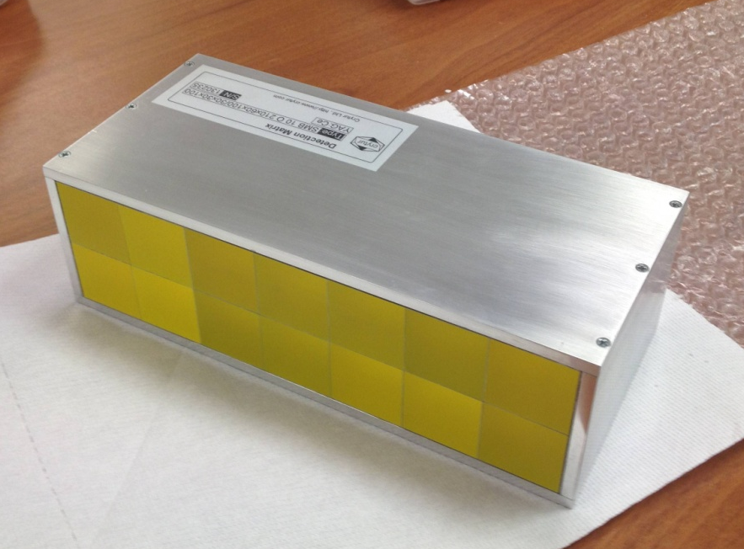
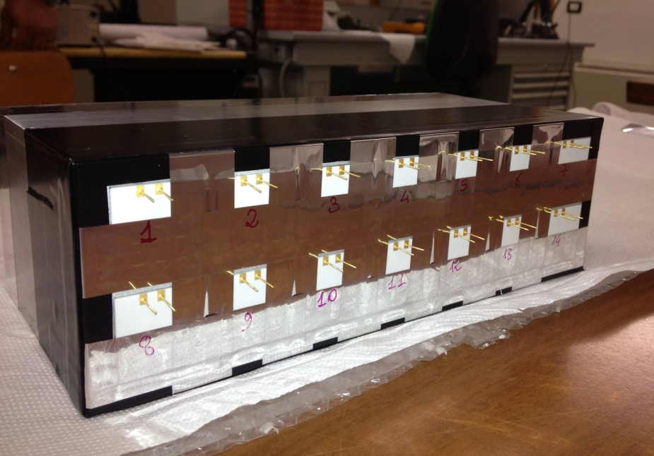
Upgrade: the upgraded calorimeter
7x2 YAG:Ce scintillating crystals 30 x 30 mm² x 100mm each. Photodiodes assembled . Now under test (RDH)
M. Bruzzi,, International Nuclear Physics Conference INPC2013: 2-7 June 2013, Firenze, Italy

Slide 27
Conclusions
A pCT apparatus has been designed and built by the PRIMA Collaboration INFN CSN5 based on:
  Silicon microstrip detectors 5x5 cm² active area
  YAG:Ce cristal calorimeter
The prototype has been tested under proton beams with energies up to 180 MeV with promising results.
First tomographic images were reconstructed with FBP with encouraging results. Even using the information on two planes only and without cuts on events good quality images were obtained.
A new prototype with larger area (5x20 cm²) is under development for pre-clinical validation.
Future progress in WP3 RDH Project INFN CSN5.
M. Bruzzi,, International Nuclear Physics Conference INPC2013: 2-7 June 2013, Firenze, Italy

