Slide 1
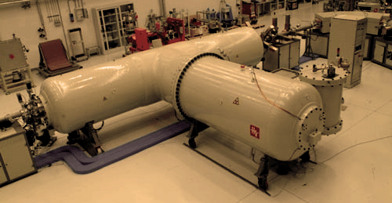


Nuclear-related techniques at LABEC for the analysis of atmospheric aerosols
S.Nava, G. Calzolai, M. Chiari, F.Lucarelli, M. Giannoni,
M. Fedi, L. Giuntini, L. Carraresi, F. Taccetti
INFN - Florence, Italy
and Physics Dept. - University of Florence, Italy
http://labec.fi.infn.it

Slide 2
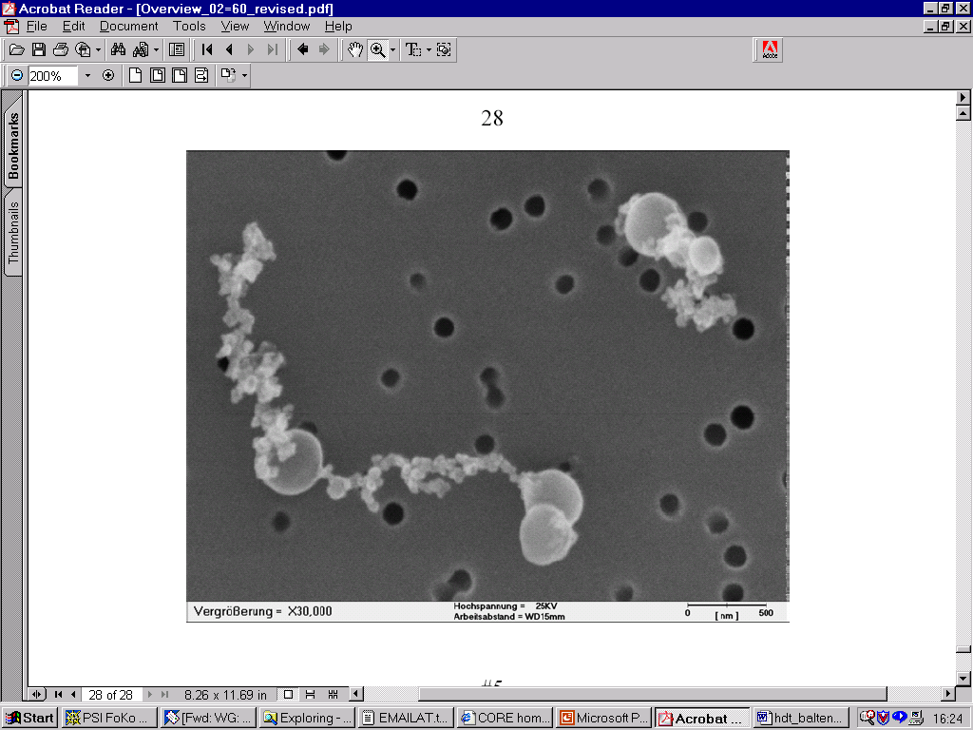
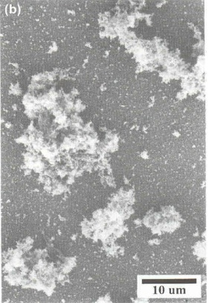
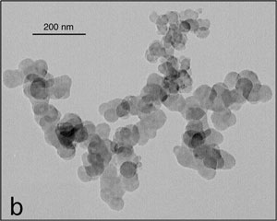
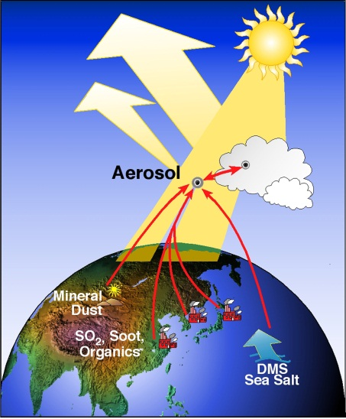
Atmospheric aerosol
Complex system of solid and liquid particles
(diameter from a few nm to 100 μm)
origin: primary or secondary
Impact on human health
Modificatication of atmosphere properties (effects on climate, visibility, etc.)
Particles size and composition
Aerosol sources
Need to measure the concentration, composition and particle size as a function of time, with a good spatial resolution: a lot of (small) samples to be analysed by fast, sensitive, quantitative, multielemental techniques

Slide 3
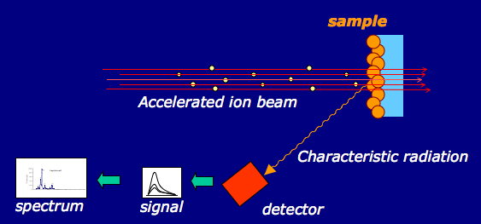
Ion Beam Analysis (IBA)
Multielemental
Not destructive
Particle Induced X-ray Emission (PIXE): Z>10
Particle Induced Gamma-ray Emission (PIGE): B, Li, Na, Mg, Al
Elastic Scattering (EBS and PESA): H, C, N, O

Slide 4
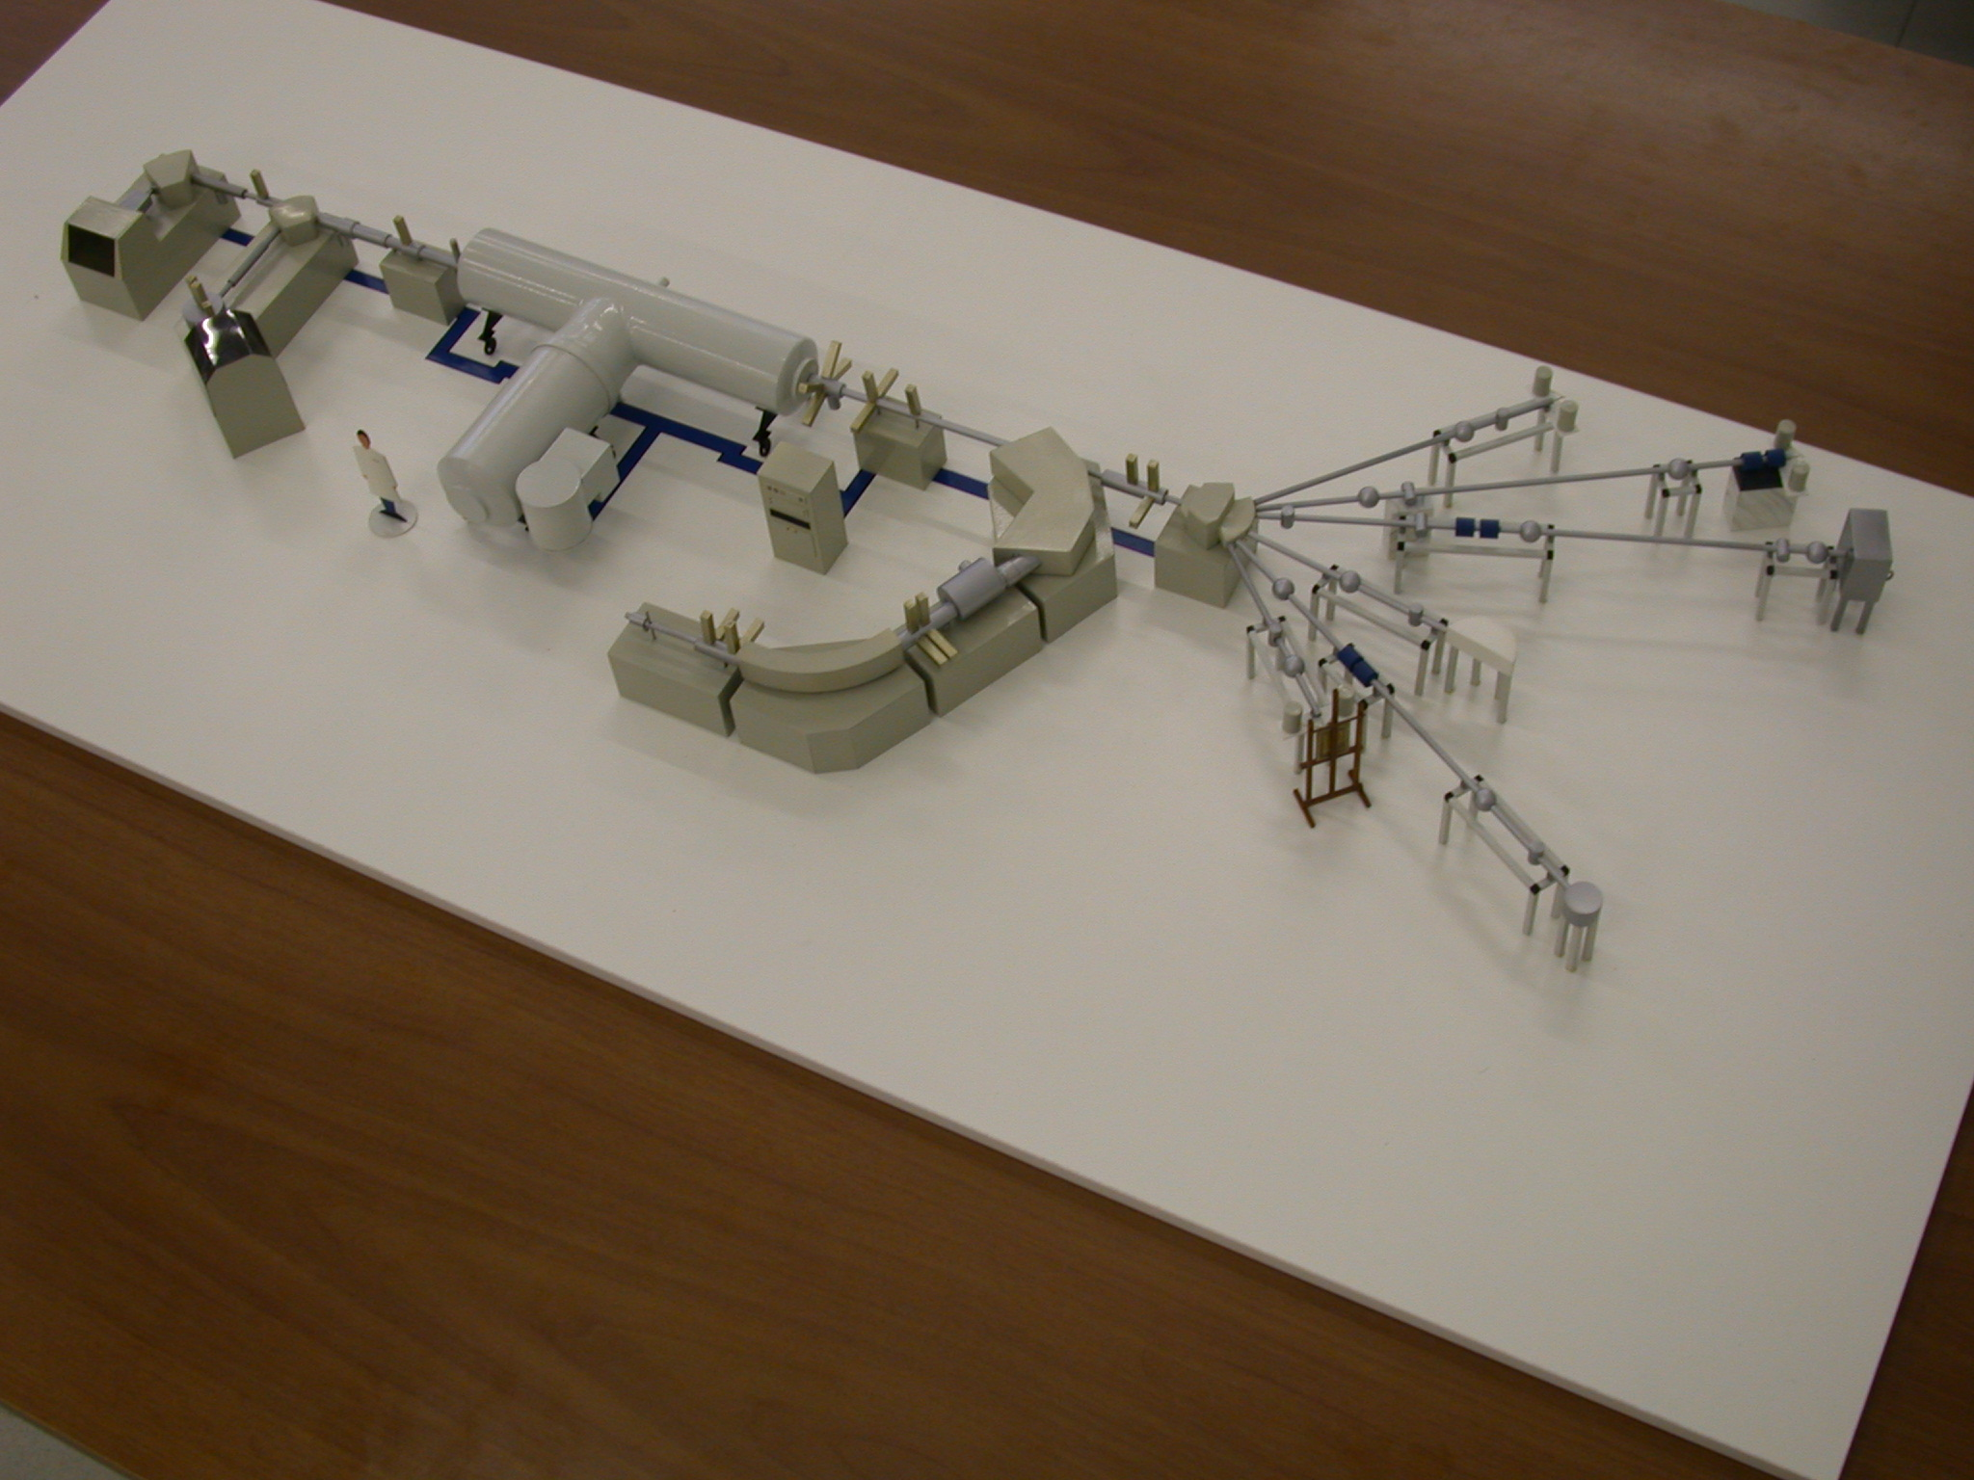

Aerosol measurements @ LABEC
+HV (3MV)
external beam for PIXE-PIGE on aerosol samples:
elements Z>10
External microbeam
ion sources
Pulsed beam facility
Multi-angle scattering chamber
AMS spectrometer:
14C on the carbonaceous component
External beam for culturale heritage applications
tandetron scheme
in vacuum
elastic scattering:
H, C, N, O
http://labec.fi.infn.it

Slide 5
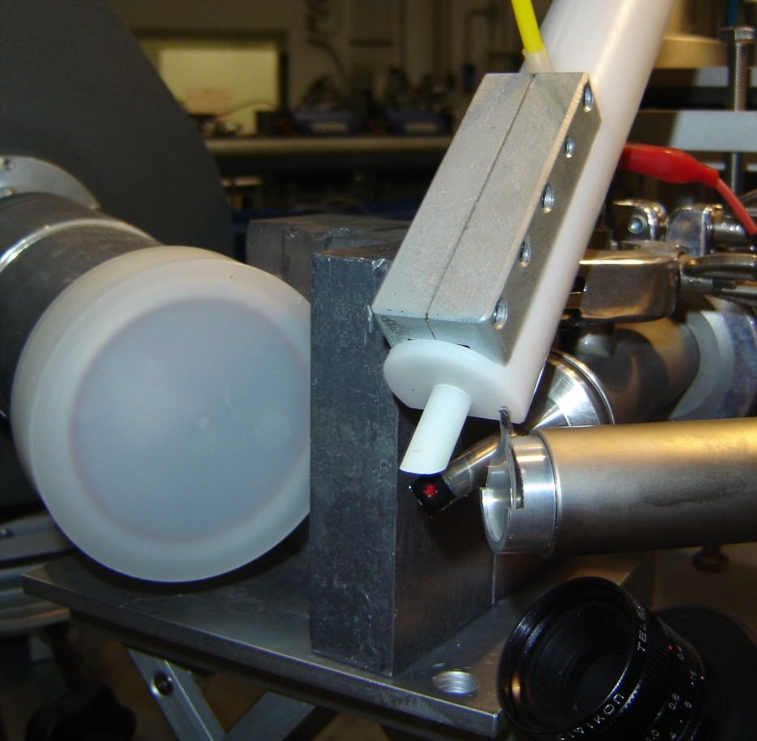
Aerosol PIXE-PIGE set-up
He
EXTERNAL SET-UP
two X-ray detectors
Proton deflector
SDD “SMALL” Detector (X < 6 keV)
8 μm Be window
10 mm², 300 μm, 145 eV
SDD “BIG” Detector
(X > 4 keV)
25 μm Be + 450 μm Mylar 80 mm², 450 μm, 165 eV
HPGe Detector(γ)
60 x 23 mm, 28%
1 keV @1.33 MeV
Both Si(Li) sobstituted by Silicon Drift Detectors (SDD)
Very good energy resolution at moderate Peltier cooling (-10°C)
High counting rates (up to ~50-100 kHz)
(Lucarelli et al., XRS 2013)

Slide 6
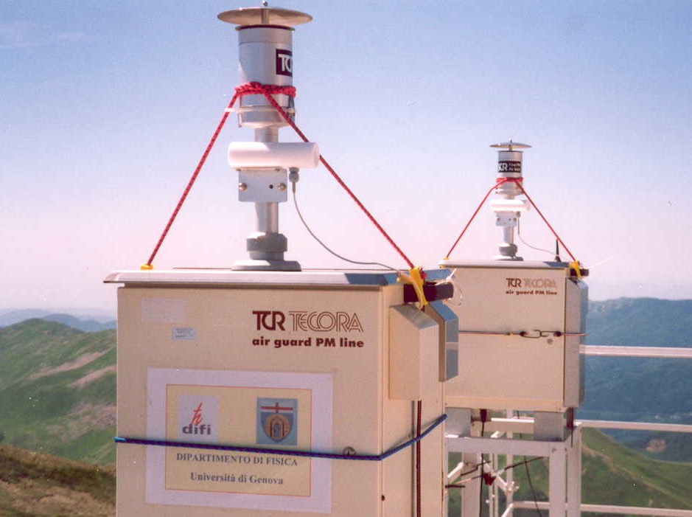

PM_{x} daily samples
“daily samples”
PM₁ PM_{2.5} PM₁₀
Sequential samplers
47 mm
Multi-target holder
Sample scanning
i ~ 30-200 nA, ~ 0.5-3 minutes per sample
Si
Small SDD
Fe
Big SDD
PM10 on Teflon (CF2) filters
50 nA - 2 min.
V
Pb
Br
S
Mn
Al
Ca
Ti
Mg
Ni
Zn
Rb
K
Cr
Sr
Na
Cu
Zr
keV
keV
Daily samples collected in 1 year 1-2 days

Slide 7
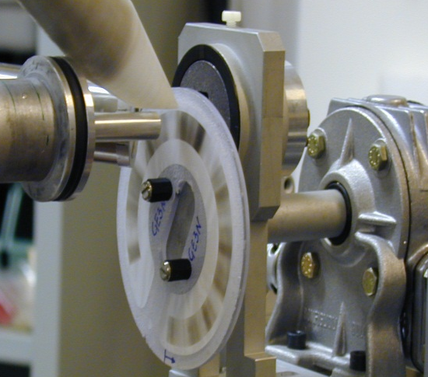
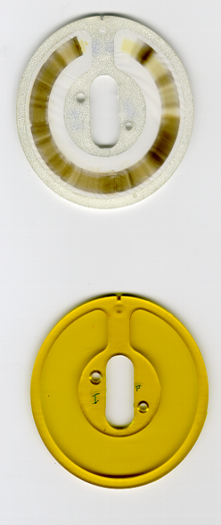
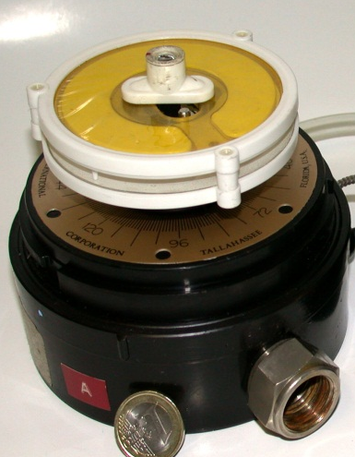
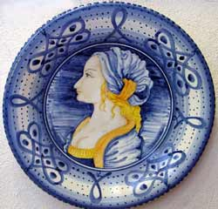
Aerosol hourly samples
Streaker continuous sampler
Coarse fraction PM2.5÷10
Beam size corresponding to
1 hour of sampling
Kapton
i ~ 100 - 300 nA
~ 1-3 min./spot
Fine fraction PM2.5
1 week of hourly 3-9h samples (168 h) meas.
Nuclepore
Very useful as most particulate matter emissions and their atmospheric dilution processes change within a few hours
Example:
artistic glass production at Montelupo Fiorentino (FI)
μg/m³

Slide 8
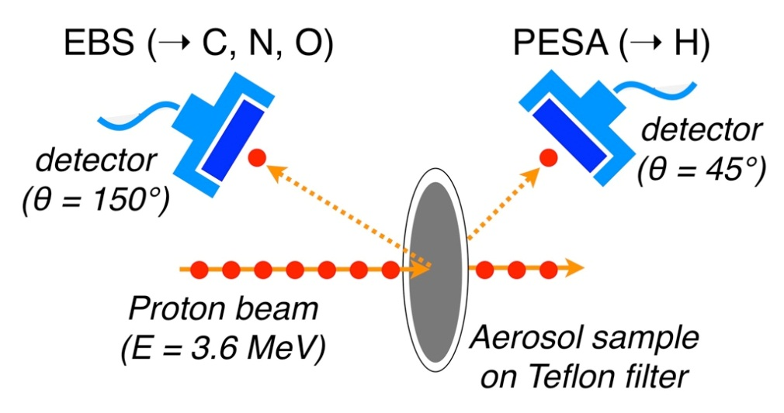
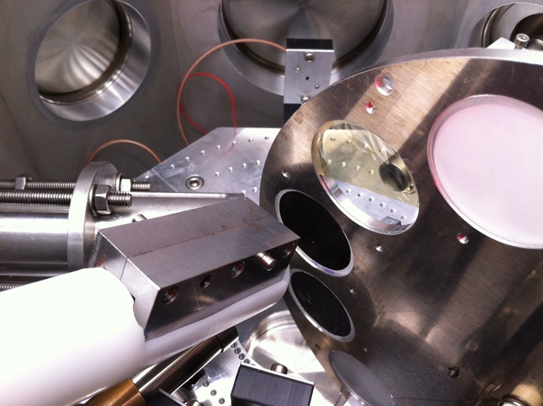
Proton elastic scattering techniques
Scattering chamber for EBS-PESA-PIXE measurements @ LABEC
C, N, O and H measured by EBS (Elastic Backscattering Spectroscopy) and PESA (Particle Elastic Scattering Analysis)
All the aerosol mass is reconstructed by IBA!
PM10
Example of IBA mass closure
Montelupo Fiorentino (2002-2003)
(Chiari et al., XRS 2005)

Slide 9
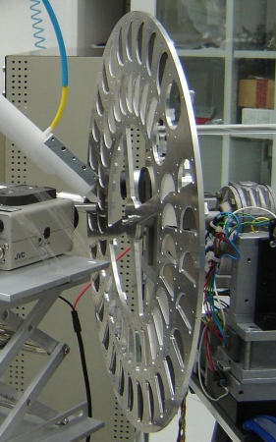
Integrated approach with
complementary chemical techniques
PIXE (PIGE, EBS, PESA)
→ elemental concentrations
  Thermo-optical analysis
  → TC, EC, OC
TEFLON FILTER
QUARTZ FILTER
IC
→ inorganic ions
HR-ICPMS
→ soluble
component of metals
  GC & GC-MS
  → PAHs and n-alkanes

Slide 10
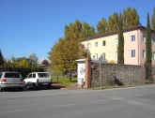
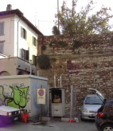
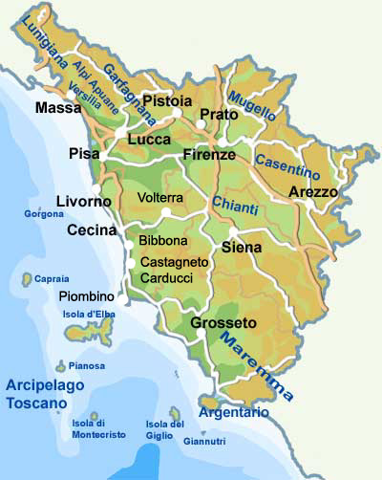
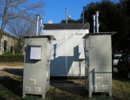
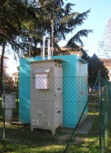
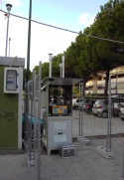
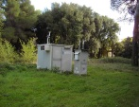
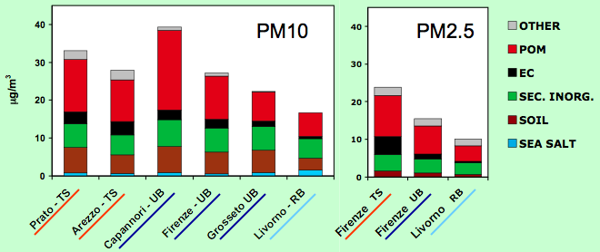
PATOS
  Capannori
  Prato
  Firenze
First extensive field campaign for the study of PM in Tuscany (Italy)
two 1-year sampling campaigns:
- PM10 (2005-2006)
- PM2.5 (2008-2009)
  Arezzo
  Grosseto
  Livorno
Average chemical composition

Slide 11
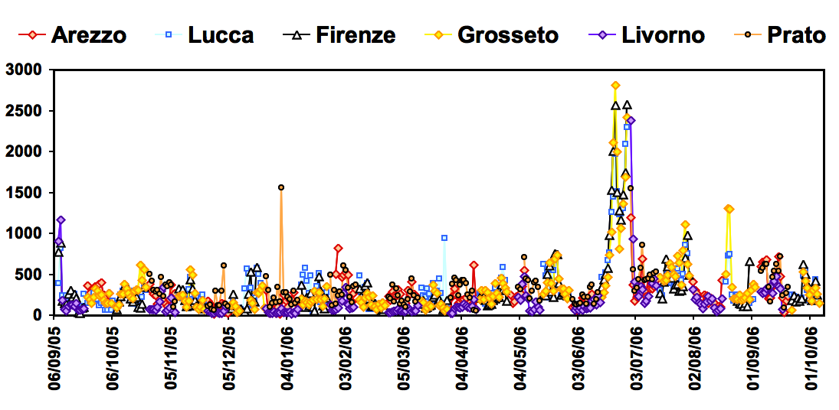
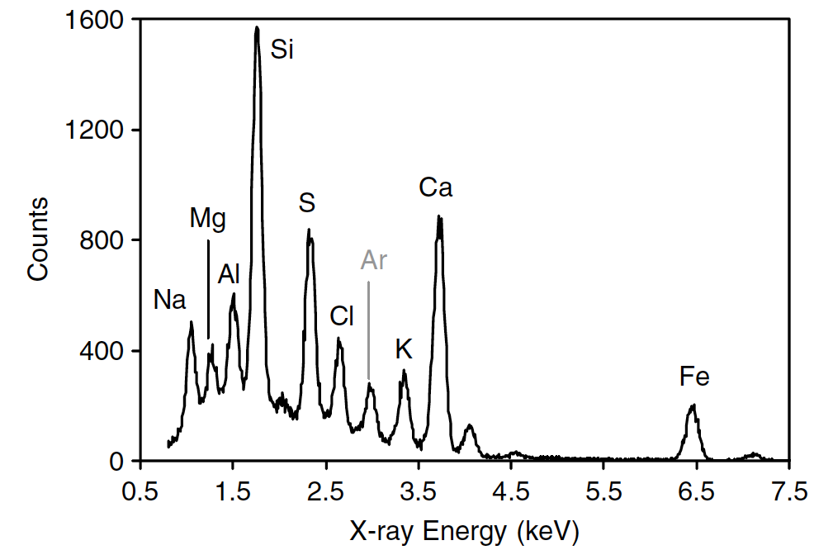
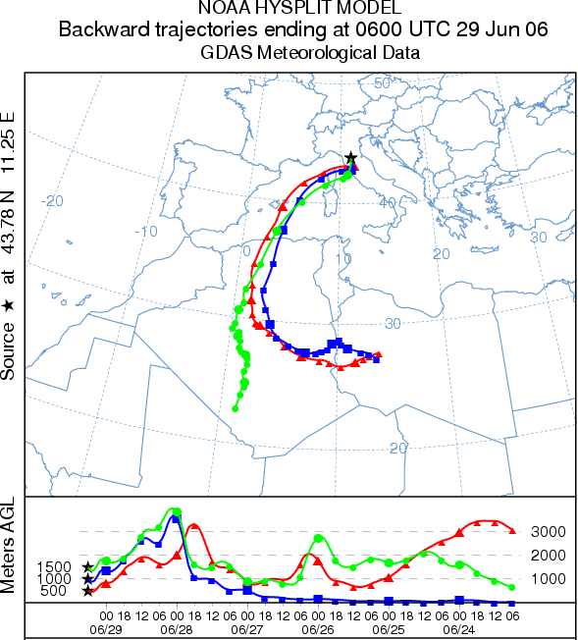
Saharan intrusions
Important contribution to PM in southern Europe
European legislation specifies that PM10 limit values are not to be applied to events defined as natural, which include “long-range transport from arid zones”
Field campaigns followed by IBA analysis, together with atmospheric/meteorological data, may provide an effective method to trace the contribution of desert dust to PM10 quality standards
Al concentration (ng/m³)
SDD detector
30 sec.
ng/m³
High sensitivity for mineral dust elements (Na, Mg, Al, Si, K, Ca, Ti, Mn, Fe, Sr)
~ half minute/sample is sufficient

Slide 12
Contribution to PM10 and limit overcomings
From measured concentrations of crustal elements it is possible to calculate the contribution of Saharan dust to PM10 and to determine which limit exceedances are due to this component
Firenze (2005-2006)
mineral dust (soil)
other components (PM10 – soil)
PM10 concentration (μg/m³)
soil =1.35 Na + 1.7 Mg + 1.9 Al + 2.1 Si + 1.4 Ca + 1.4 Fe + 1.7 Ti + 1.2 K
(Nava et al, ATM.ENV. 2012)

Slide 13
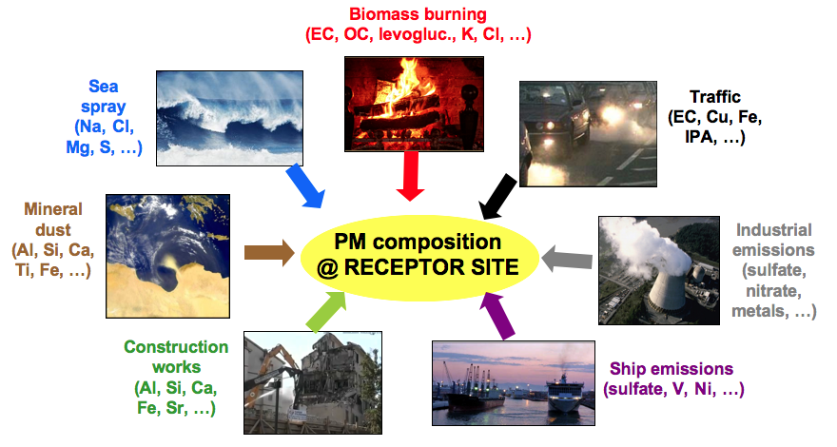
Source Apportionment by receptor models
Several important source markers can be detected by IBA
The PM composition is a combination of the compositions of the aerosols emitted by the different sources
By multivariate statistical analysis, like Principal Component Factor Analysis and Positive Matrix Factorization, it is possible to identify aerosol sources and quantify their impact.

Slide 14
Source apportionment results
Important contribution of biomass burning in the most polluted sampling site of PATOS
Confirmed by hourly data
K and Cl highly correlated
(r = 0.95)
Periodic pattern with peaks starting at about 18:00 and lasting during the night
ng/m³

Slide 15
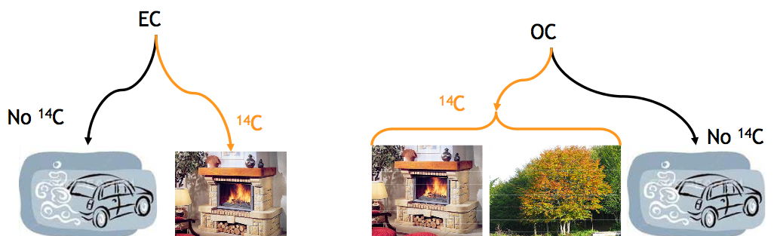
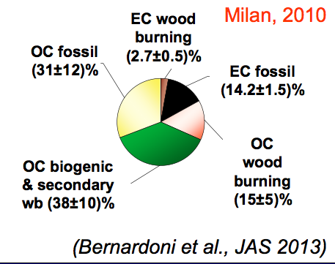
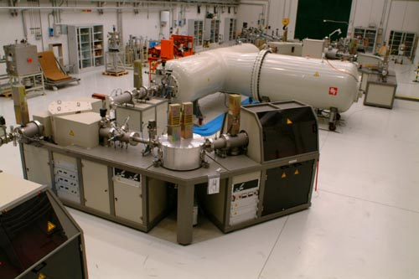
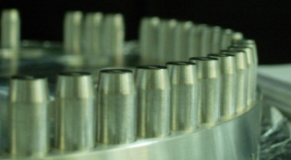
Source Apportionment by ¹⁴C-AMS
Elemental Carbon
Organic Carbon
modern
fossil
modern
fossil
EC/OC
(Calzolai et al. NIMB 2012)

Slide 16
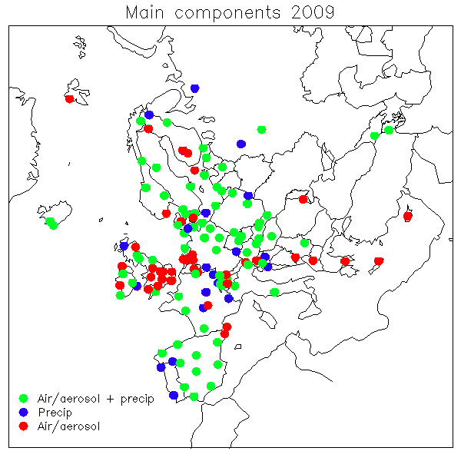

European projects
EMEP
European Monitoring and Evaluation Programme
Convention on Long-range Transboundary Air Pollution
two 1 month intensive campaings in 2012-2013 in 15 sites to measure PM₁₀ chemical composition with special emphasis on mineral dust, to assess the contribution of natural episodes
~ 1000 daily samples analysed by PIXE
Testing and Development of air quality mitigation measures in Southern Europe
1-year long field campaigns in 4 urban areas in 2013:
Barcelona (Spain), Athens (Greece), Porto (Portugal), Florence (Italy),
chemical characterization of PM10 and PM2.5 and source apportionment
~ 1000 daily samples and ~ 32 streaker samples (~5000 points) by PIXE
Notes:
16

Slide 17
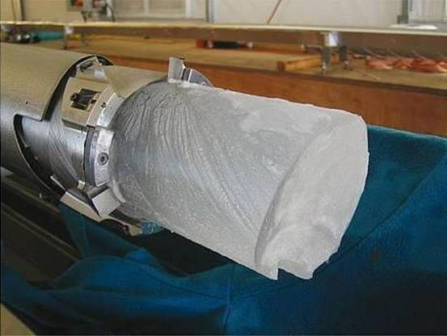
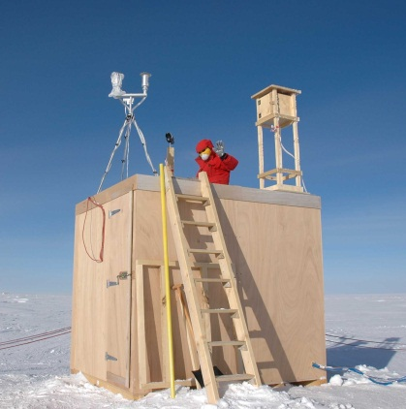
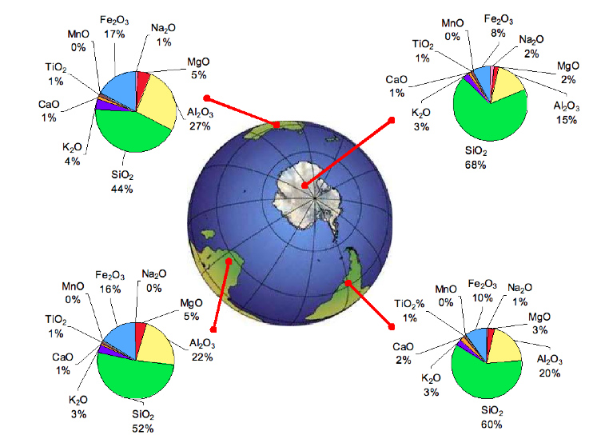
Particulate matter in polar areas
PIXE-PIGE analysis of very small samples:
  present-day PM (Artic and Antarctic)
  mineral dust particles archived in ice core samples (DomeC, Antarctica)
(Marino et al., NIMB 2008, Marino et al., GRL 2009)
Dust particles are deposited over Antarctica after long-range transport from continental areas.
PIXE-PIGE results show that ice dust composition during cold stages is similar to the composition of southern South-American sediments, while it relevantly differs from Australian and the South-African ones.
(Lucarelli et al., XRS 2011)
ICE DUST
(COLD STAGES)
SEDIMENTS

Slide 18
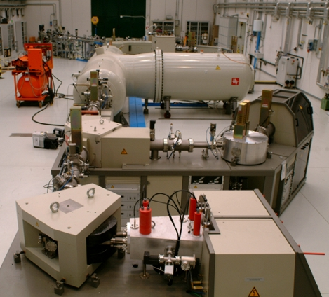

Thank you for the attention!!!

