Slide 1
Development of a Compton Camera
for online range monitoring
of laser-accelerated proton beams
via prompt-γ detection
Peter G. Thirolf, LMU Munich
motivation: laser ion acceleration at Garching for
bio-medical applications (CALA project)
→ requires online monitoring and dosimetry
→ measure prompt γ rays from nuclear reactions
development of a Compton Camera with electron
tracking capability:
→ design specifications via simulations
→ prototype laboratory setup and characterization tests

Slide 2
Laser-driven Proton Acceleration:
Studies of (pre-) clinical applicability
DLC foil
aperture
D+ D-
Kapton foil
I.
phantom/
sample
ATLAS laser
(60 J, 20 fs, 3 PW, 1-5 Hz)
mini-
quadrupoles
aperture or
spectrometer plate
Range Monitoring / Online-Dosimetry
within phantom/patient
Detection of prompt γ-rays

Slide 3
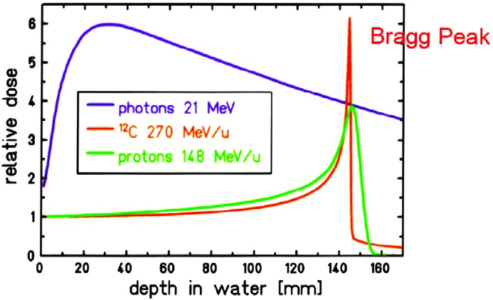
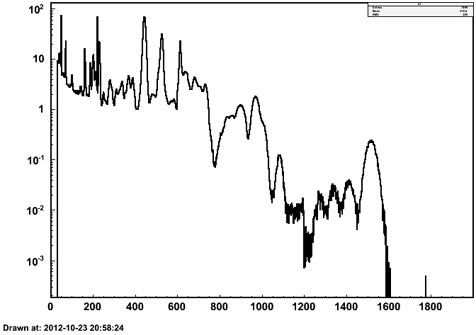
Prompt gamma emission from
proton beam on biomedical sample
advantage of hadron therapy:
Bragg peak
key issue:
localization of Bragg peak
within sample
approach: prompt γ emission
from nuclear reactions
50 cm
p
H₂O
Ø 10 cm
Counts / GeV/ incident p
irradiation of water phantom
with 100 MeV protons
(FLUKA simulation):
4.4 MeV ¹²C
5.2 MeV ¹⁵N, ¹⁵O
6.1 MeV ¹⁶O
ca. 0.042 γ / primary proton
ca. 10⁸ protons (16 pC) per laser pulse
→ ca. 4.2.10⁶ γ/laser pulse
0 2 4 6 8 10 12 14 16 18
Energy [MeV]
Notes:
3
3

Slide 4
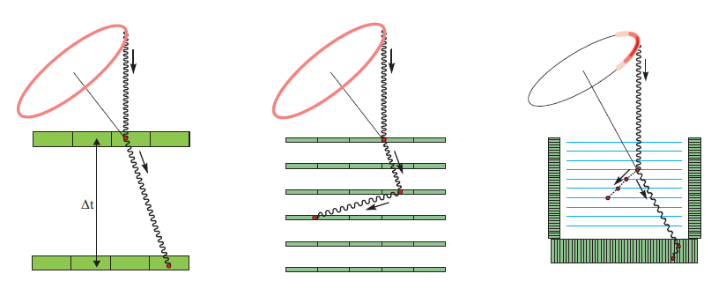
Principle of a Compton Camera
γ tracking:
γ and electron tracking:
Compton
cone
Compton
arc
Ε_{γ}
Ε_{γ} ≥ 1 MeV
θ
θ
Scatterer/
Tracker
ΔΕ_{γ}
ε
Ε_{e ,} e_{e}
E‘_{γ} , e_{γ}
E‘_{γ} , e_{γ}
Absorber
exploit kinematics of Compton scattering:
measure ΔE_{γ},E’_{γ} and directions e_{γ} of scatter + absorption process:
→ γ source origin can be restricted to a cone surface
additional electron tracking of direction e_{e} and energy E_{e} :
→ origin of γ can be restricted to an arc
→ reconstruction of incompletely absorbed γ events possible
Notes:
4
4

Slide 5
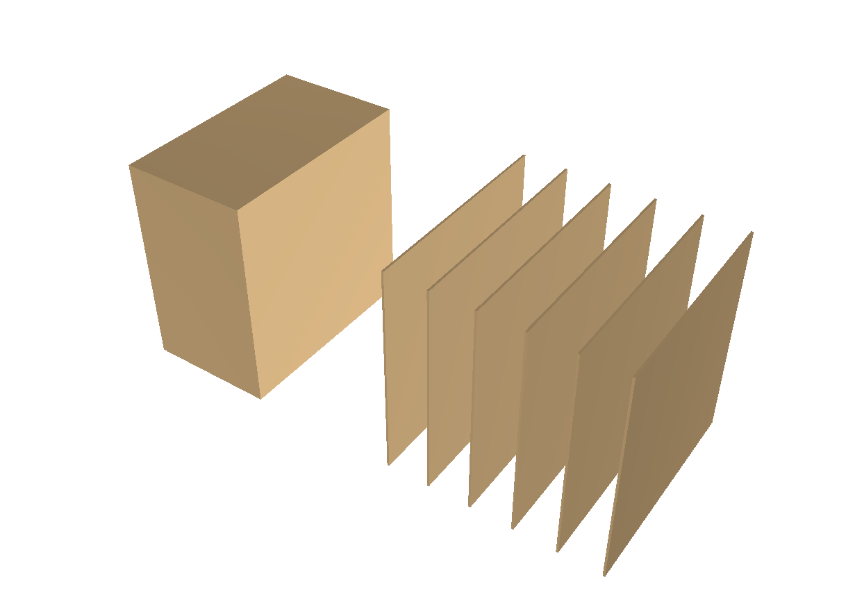
Compton Camera Design
Scatterer/Tracker:
double-sided silicon strip
detectors (DSSSD)
active area 50 x 50 mm²
thickness :
300 μm or 500 μm
128 strips on each side
pitch size 390 μm
Absorber:
LaBr₃ scintillator
→ active volume:
50 x 50 x 30 mm³
multi-anode PMT:
Hamamatsu 9500
256 Pixel (3 x 3 mm²);
presently combined to
64 Pixel (6 x 6 mm²)
γ and electron tracking:
Absorber:
LaBr₃
(+ PMT)
Scatterer/Tracker:
DSSSD
e⁻
y
x
γ
z
85 mm
50 mm
10 mm each
γ point source:
isotropic,
E_{γ}: 0.5 - 6 MeV

Slide 6
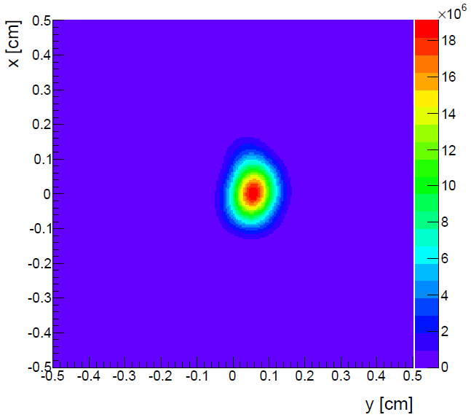
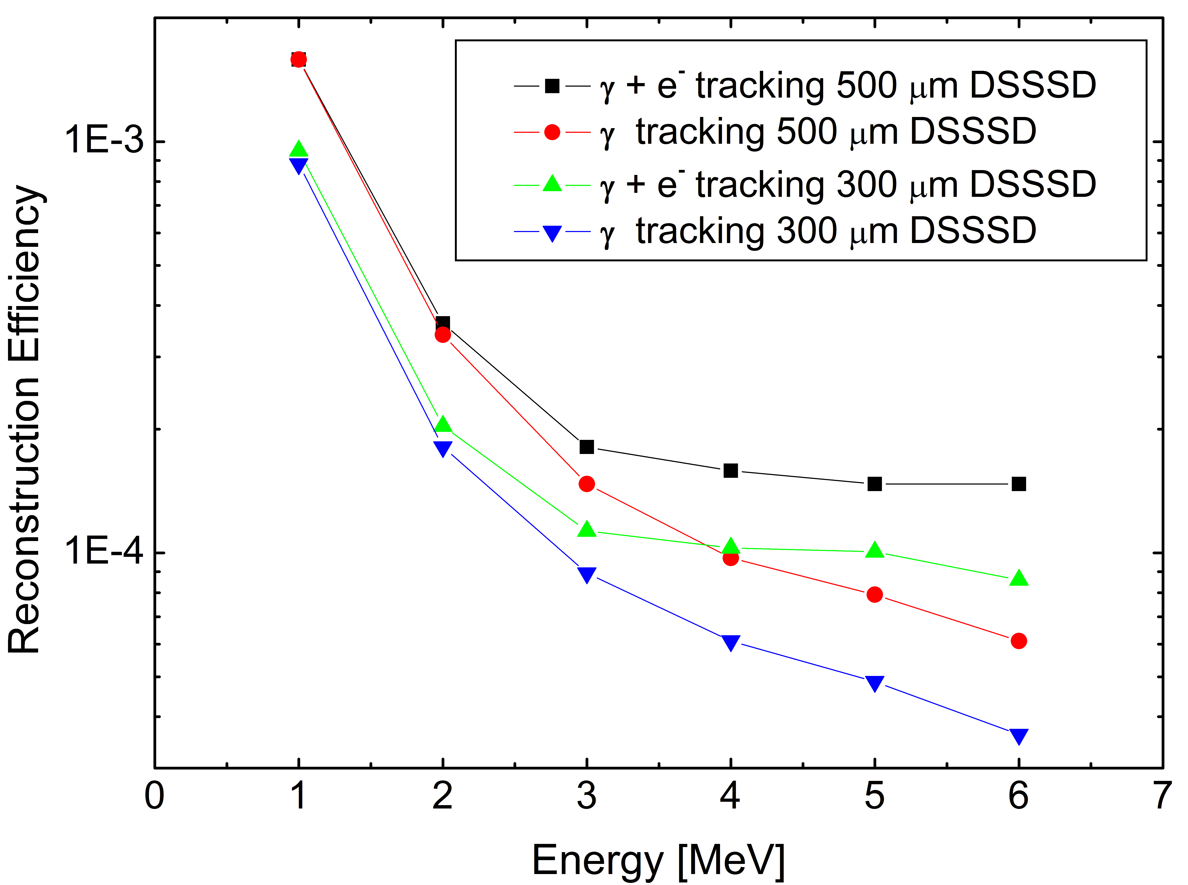
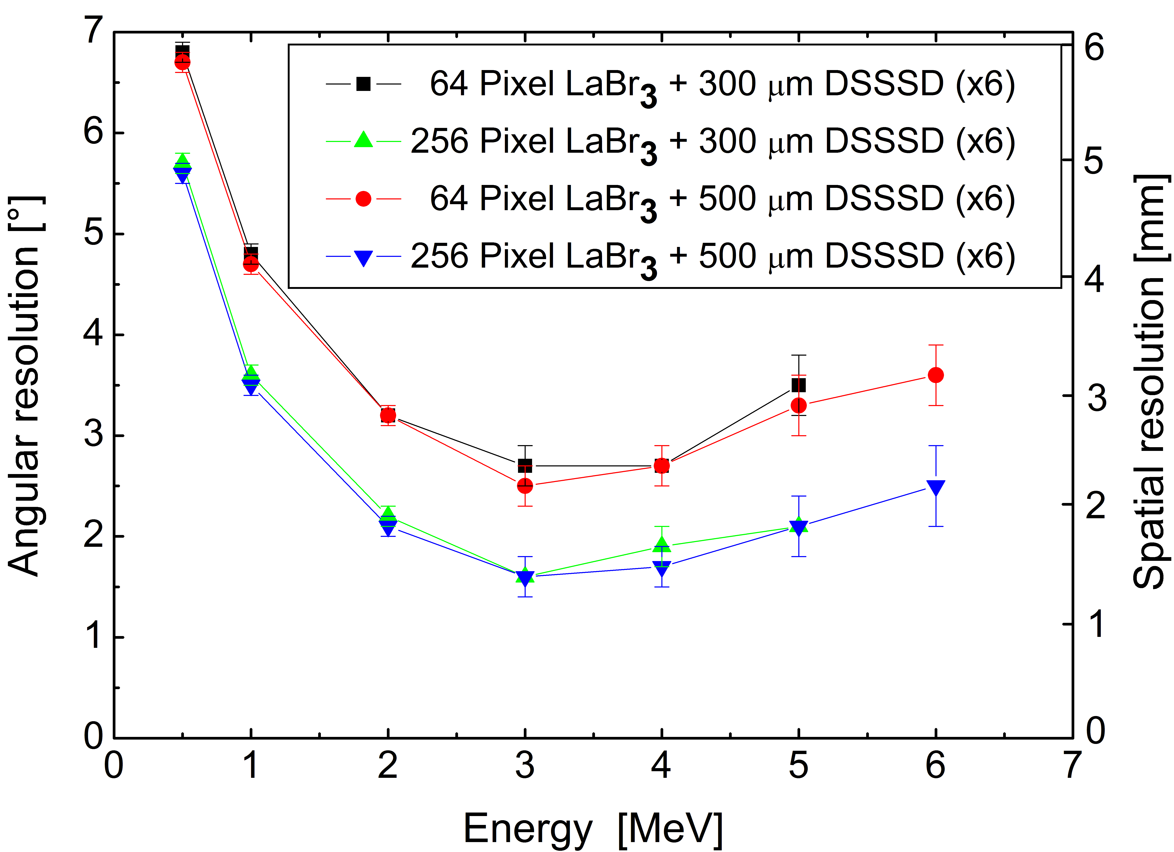
Compton Camera Design Simulations
simulation/reconstruction tool: MEGAlib
→ Monte Carlo simulation (based on Geant4)
→ event reconstruction
→ image reconstruction (LM-ML-EM algorithm)
5 MeV
30 iterations,
50 events
simulation for tracker/absorber specifications:
γ + e tracking, 500 μm
300μm Si
γ + e tracking, 300 μm
500μm Si
γ tracking, 500 μm
300μm Si
γ tracking, 300 μm
500μm Si
64 pixel (6x6mm²)
γ +e
full absorption
γ
256 pixel (3x3mm²)
n_{DSSSD}=6
γ tracking ; source - tracker: 50 mm
d=500 μm + electron tracking:
→ improved efficiency
6x6 mm² → 3x3 mm² pixel:
spatial resolution improves by ≥50 %

Slide 7
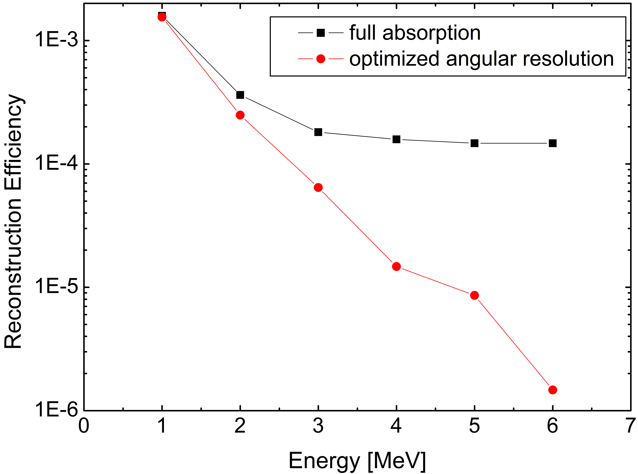
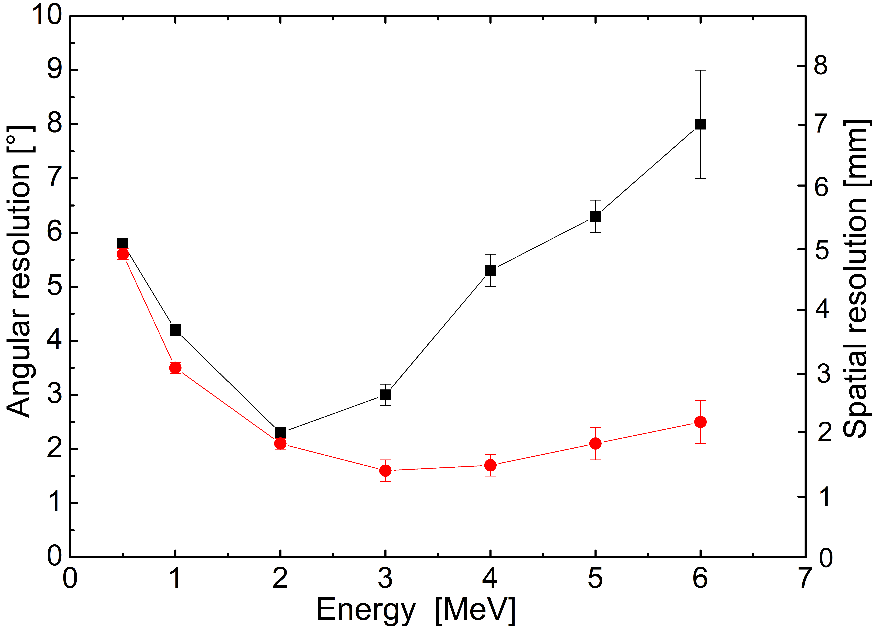
Reconstruction Properties
reconstruction efficiency:
angular resolution:
6x 500 μm, 3x3 mm² pixel
source – tracker: 50 mm
- ε ≈ 10⁻³ – 10⁻⁵ (@ 1- 5 MeV for optimum resolution)
- angular resolution ≈ 2º – 2.5º (@ 2-6 MeV)
Notes:
7
7

Slide 8
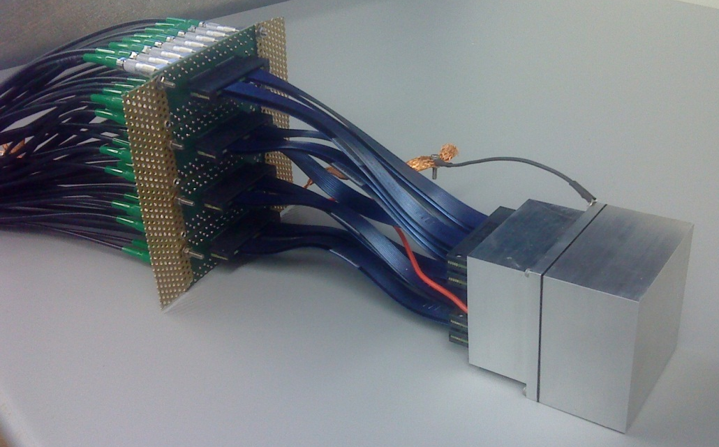
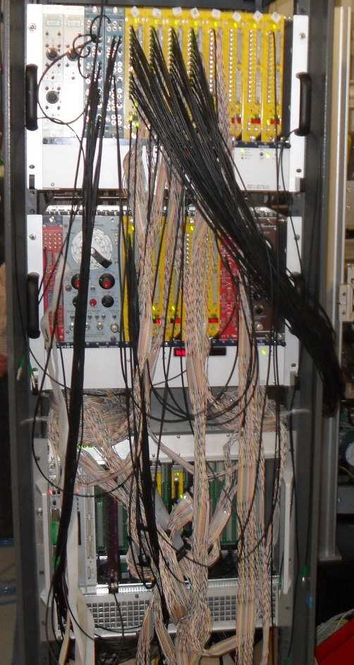
Compton Camera: Absorber
LaBr₃ crystal (Saint Gobain):
→ active area 50 x 50 x 30 mm³.
PMT: Hamamatsu H9500.
→ 256 fold multi-anode .
64 channels
PMT
LaBr₃
signal processing:
start version: 64 pixel (6x6 mm²)
upgrade: 256 pixel (3x3 mm²)
→ fast amplifier + CFD
(Mesytec MCFD-16, 16 ch.)
→ charge-sensitive digital
converter (Mesytec, 32 ch. QDC)

Slide 9
Spatial Resolution
light distribution: ¹³⁷Cs (662 keV), collimated source (Ø 1 mm)
(background corrected, gain matching: PMT uniformity, electronics)
pixel,Y
pixel,Y
pixel,Y
pixel, x
pixel, X
pixel, X
pixel, X
: source position
Point Spread Function:
final goal:
- scan with 0.5 mm grid
- resolution ca. 1 mm
(FWHM of radial
charge distribution)
Charge [a.u.]
r [mm]

Slide 10
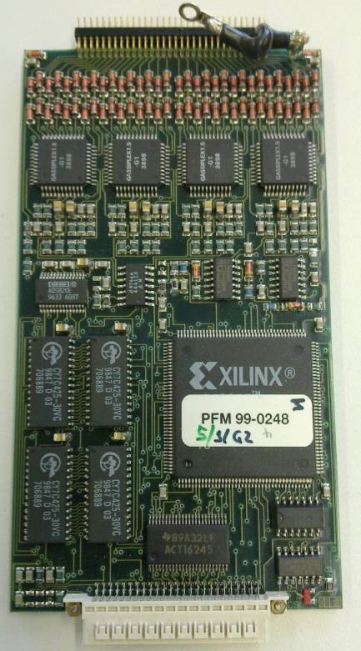
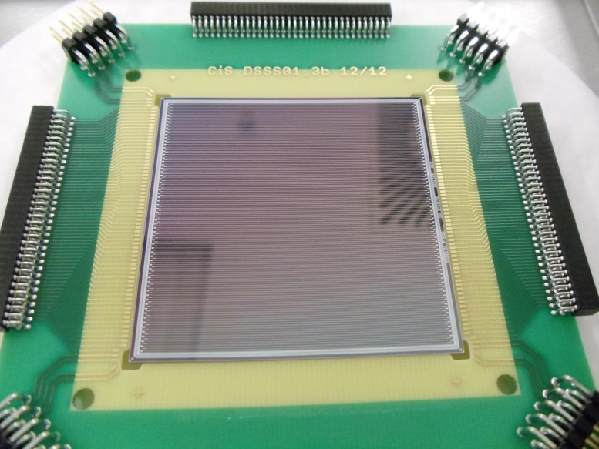
Compton Camera Scatter Detectors
1
2
Adapter
board
VME readout controller
Gassi-plex (64 ch.)
3
4
6x 256 channels
Scatterer/Tracker:
double-sided silicon strip
detectors (DSSSD)
active area 50 x 50 mm²
thickness : 500 μm
128 strips on each side
pitch size 390 μm
stack of 6 modules
DSSSD
AC
Gassi-plex
AC
A
C
Gassi-plex
Wafer
AC
2x 64 strips/
side
Gassi-plex
Gassiplex (4x16 ch. ASIC):
→ charge-sensitive preamp → shaper
→ digital discriminator
→ track & hold-stage
multiplexed ADC

Slide 11
Conclusions and Outlook
Compton camera for online monitoring and dosimetry via prompt γ ’s:
- system designed to allow for (γ + electron) tracking
- spatial resolution: ~ 1.7 mm @ 5 MeV and 50 mm distance to source
- reconstruction efficiency (optimum resol.): ~ 10⁻⁵ @ 5 MeV
prototype setup and characterization:
- absorber characterized:
LaBr₃ with multi-anode PMT (6x6mm² pixel, upgrade: 3x3mm²)
- scatterer designed, prototype just received:
6x DSSSD, (500 μm, 50x50 mm², 2x128 ch.)
next steps: - laboratory commissioning of scatter/tracker part
- online tests of complete Compton camera (E_{p}=20-150 MeV)

Slide 12
Thanks to …
LMU Munich: C. Lang, S. Aldawood, D. Habs, M. Gross,
R. Lutter, H. van der Kolff, J. Bortfeld,
K. Parodi
TU Munich: L. Maier, R. Gernhäuser
SSL Berkeley: A. Zoglauer
Thank you for your attention !

