Slide 1
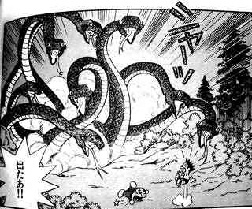
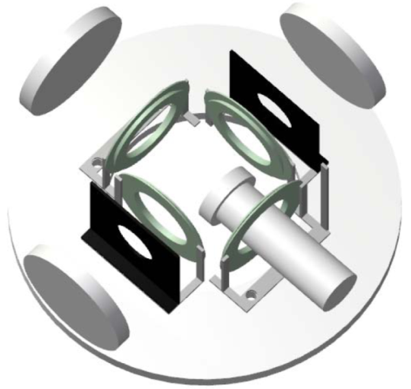
INPC2013 @ Florence, Italy 2013 6/2-7
Laser Spectroscopy of RI atoms
stopped in superfluid helium
“OROCHI”
(Optical RI atom Observation in Condensed Helium as Ion-catcher)
Tokyo Metropolitan University
Takeshi Furukawa
from “DRAEMON” vol. 22, by FUJIKO, F. Fujio

Slide 2
What is “OROCHI” ?
INPC2013 , 2013 6/2-7, T. Furukawa
- Nuclear Laser spectroscopy:
effective, … but difficult for low yield exotic RIs.
To measure the nuclear spins & moments in exotic nuclei
“Laser spectroscopy in superfluid helium (He II)”
“OROCHI ”
Optical RI-atom Observation in Condensed Helium as Ion-catcher
Ion beam
RI beam
Separator
(i.e. BigRIPS in RIKEN)
> 50 MeV/u
Target
Accelerator
(i.e. SRC in RIKEN)
Radiowave
or
Microwave
Laser
He II
Zeeman structure
Hyperfine structure
((((((
Nuclear spin
Nuclear moment
Laser Induced
Fluorescence

Slide 3
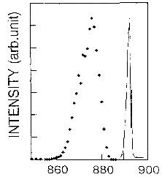
Advantage in He II
We use He II
INPC2013 , 2013 6/2-7, T. Furukawa
to trap the atoms efficiently,
also
to reduce the b.g. photons.
(
① largely blue-shifted
Atomic absorption spectra in He II
② widely broadened
¹³³Cs atomic spectra in He II
in vacuum
He II
Laser
emission
Intensity (arb.unit)
absorption
Detector
wavelength: λ_{LIF} ≠ λ_{laser}
光波長 (nm)
Suppress background count
Wavelength (nm)
Reduction:10⁻¹⁰ - 10⁻¹³

Slide 4
Double resonance spectroscopy
INPC2013 , 2013 6/2-7, T. Furukawa
Measurement of atomic sublevel structure
：Double resonance spectroscopy
Expected spectrum
In the case of Zeeman splitting in alkali atoms
1st step : optical pumping
2nd step: double resonance
I_{LIF}
atoms
m = +3/2
m = +3/2
m = +3/2
laser
No level
P_{1/2}
P_{1/2}
P_{1/2}
B
σ⁺
σ⁺
σ⁺
σ⁺
σ⁺
σ⁺
rf frequency
/ Magnetic field
X
X
D1 Line
X
D1 Line
((((((
((((((
LIF Intensity…
S_{1/2}
S_{1/2}
S_{1/2}
decreased gradually
rf-resonance
rf
m = -1/2
m = +1/2
(LIF : Laser Induced Fluorescence)
m = -1/2
m = +1/2
m = -1/2
m = +1/2
[I_{LIF}] ∝ 1 - P_{z}

Slide 5
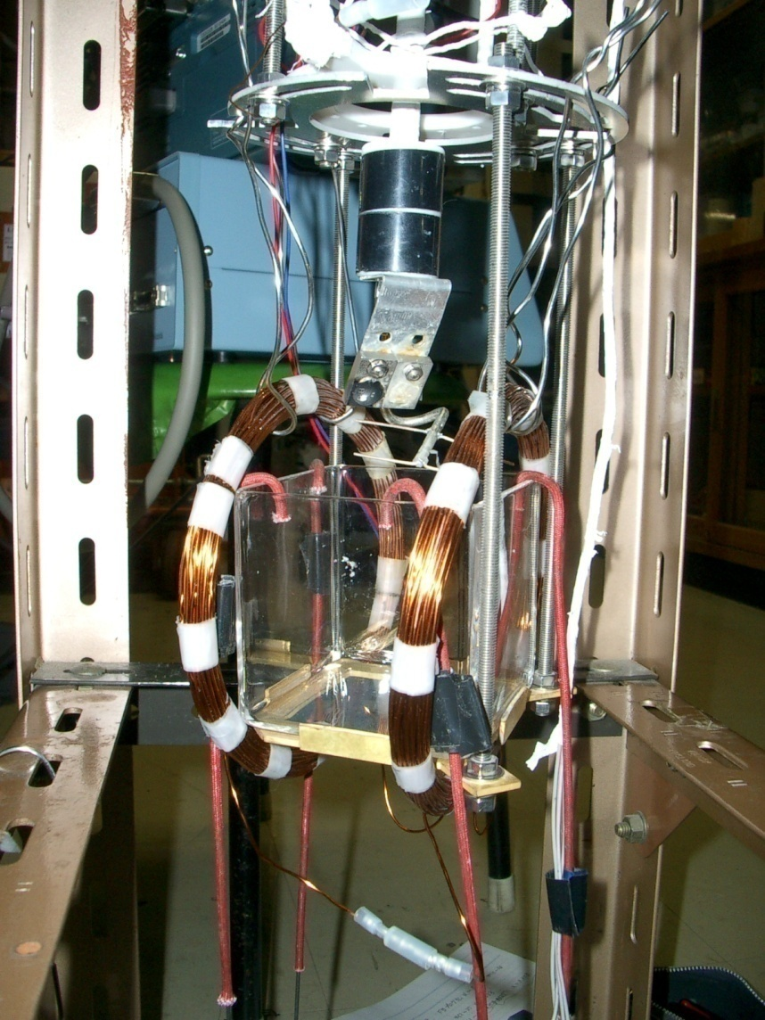
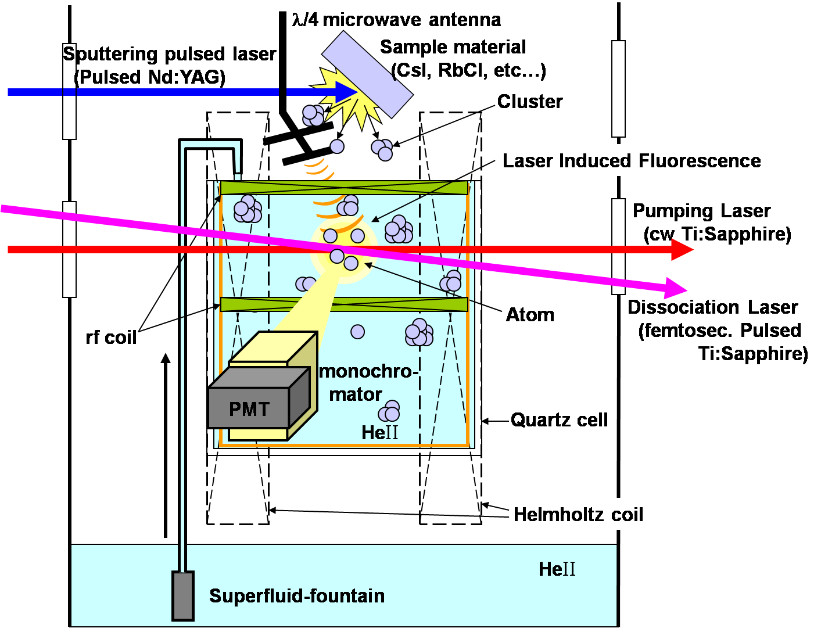
So far, feasibility test with stable isotopes
INPC2013 , 2013 6/2-7, T. Furukawa
Introducing atoms in He II by laser sputtering
Stable isotopes of Rb, Cs, Ag and Au

Slide 6
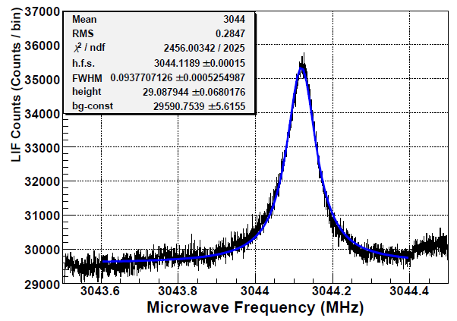
Nuclear spin & moment determination
INPC2013 , 2013 6/2-7, T. Furukawa
atomic sublevel structure
hyperfine
splitting
Zeeman
splittings
Zeeman resonance of Rb isotopes
Hyperfine resonance of ⁸⁵Rb
I_{85Rb} = 2.6(1)
→ 5/2
I_{87Rb} = 1.55(5)
→ 3/2
Δν_{Zmn} = g_{F} m_{B} B / h
μ_{I}^{85Rb} (μ_{N})
=
2.8(MHz)×B(Gauss)
This work (from A_{HeII})
1.357 83 (7) μ_{N}
(2I+1)
Nuclear spin
evaluated (from A_{vacuum})
1.358 071(1) μ_{N}
literature value (NMR)
1.353 351 5 μ_{N}
Polarization ：~90 % (Cs), ~40 %(Rb)
~85 % (Ag and Au)
T. F., Hyperfine Interactions 196, 191 (2009)
T. F. Doctoral thesis, Osaka Univ. (2007)

Slide 7
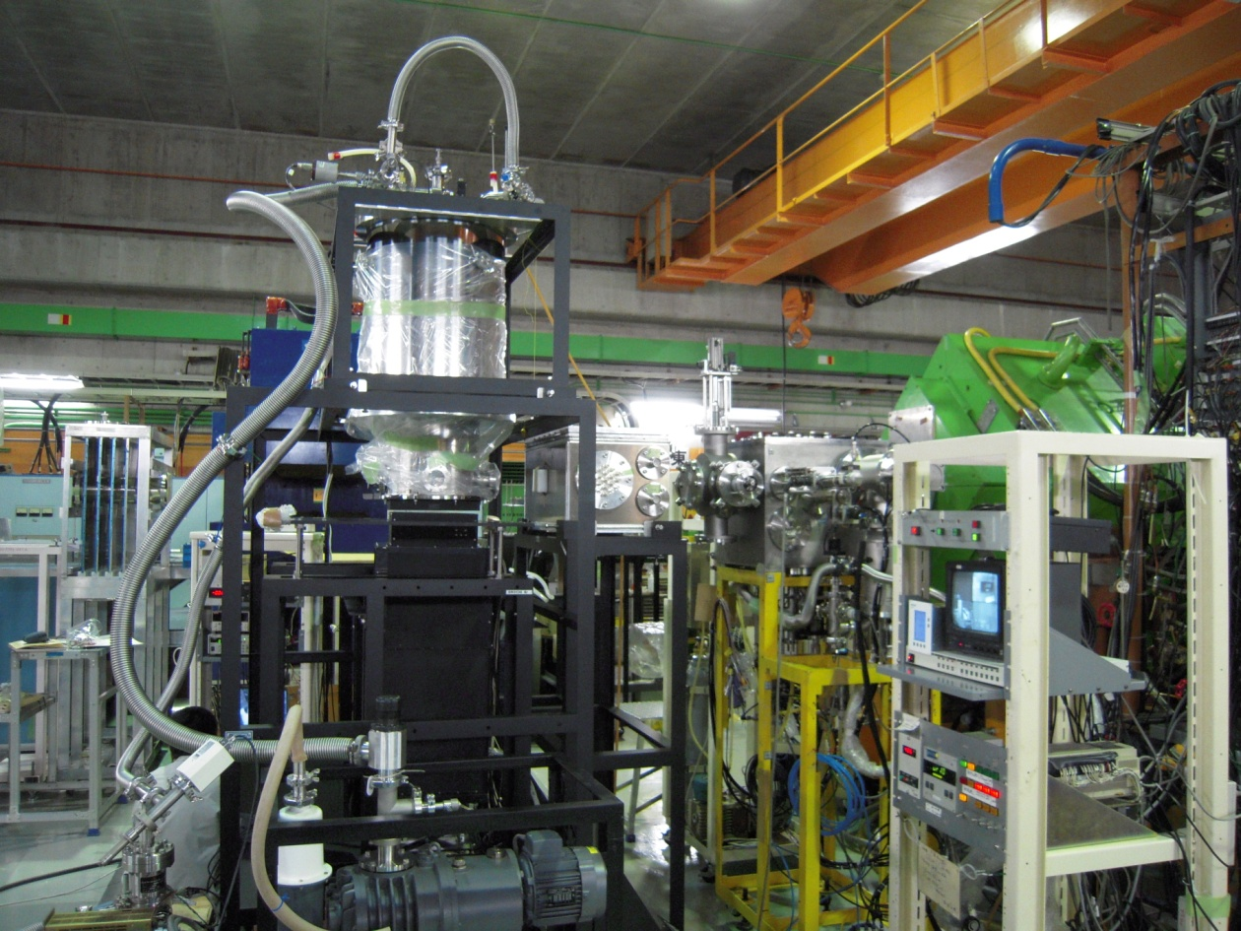
Feasibility test with Rb ion beams
INPC2013 , 2013 6/2-7, T. Furukawa
Next step: Using energetic ion beams
^{84, 85}Rb (< 50 MeV/u) from RIKEN RIPS beam line
cryostat
Cryostat
laser
Rb beam from RIPS
10⁴⁻⁵ pps = 0.01pnA
Rb beam
Photo-detection system
Photo-detection system
- large Fresnel lens x 3
- Interference filter x 2
- Cooled Photomultiplier tube

Slide 8
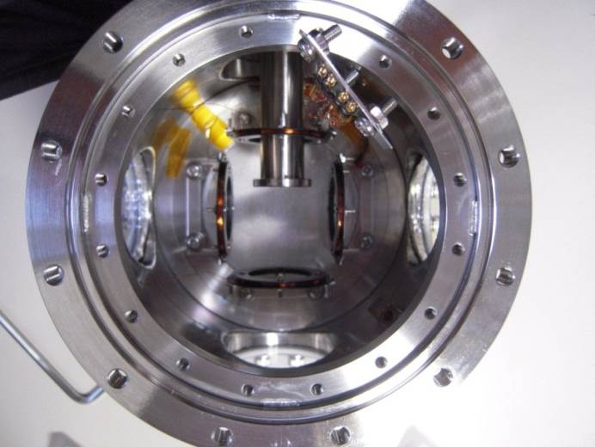
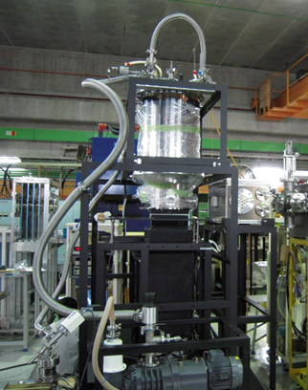

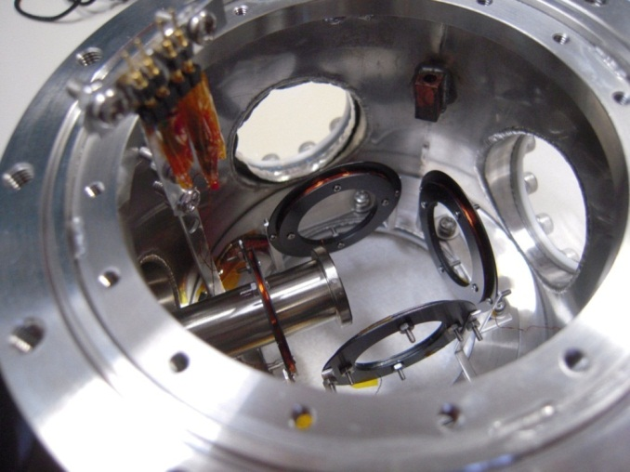
Inner Cryostat
INPC2013 , 2013 6/2-7, T. Furukawa
Ti:Sa Laser
780nm, 100mW
Optical
window
RF coil
Havar foil
(20 μm)
B₀ coil
Rb beam
Optical
window
T_{He} = 1.8 K

Slide 9
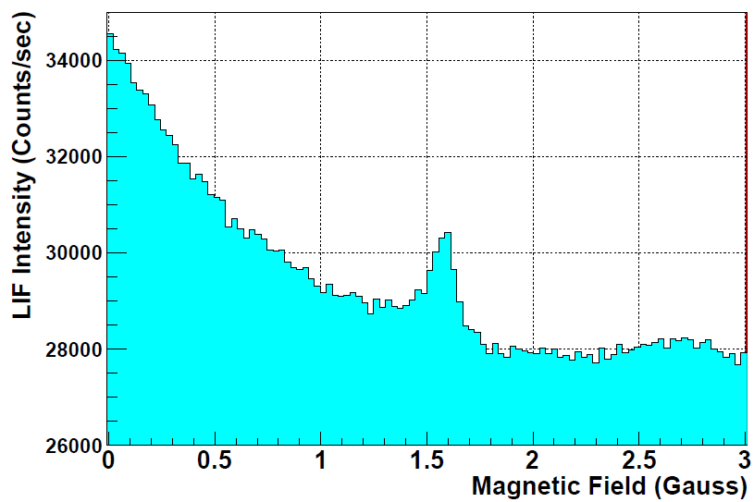
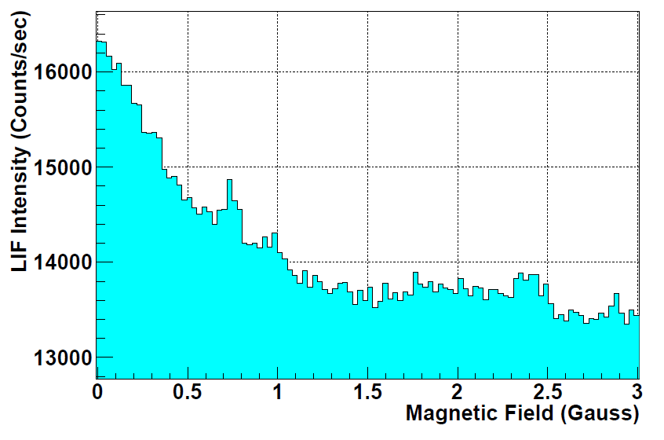
Observed spectra (preliminarily)
INPC2013 , 2013 6/2-7, T. Furukawa
By sweeping applied magnetic field strength
(not the frequency of radiowave)
Peak with B = 0
⁸⁴Rb, I ^{π}=2⁻
⁸⁵Rb, I ^{π}=5/2⁻
⁸⁵Rb, I ^{π}=5/2⁻ ?
⁸⁴Rb^{m}, I ^{π}=6⁻ ?
⁸⁵Rb: 8.6 x 10⁴ pps,
15 min. measurement
Frequency 1.5 MHz
⁸⁴Rb: 5.7 x 10⁴ pps,
30 min. measurement
Frequency: 1.0 MHz
B = 0:
Atoms can not conserve their polarization
All the atoms can emit the LIF

Slide 10
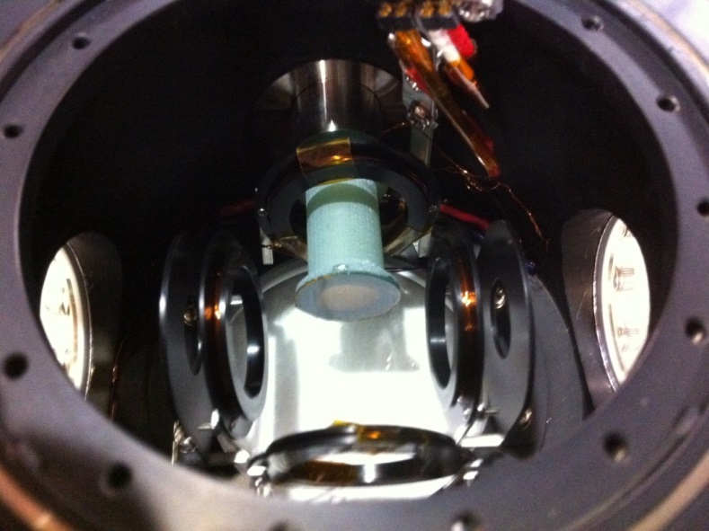
Improvement for the next experiment
Small resonance peak:
due to insufficient rf power
absorbed to the metallic beam window
(Stainless steel and Havar)
⁸⁵Rb
Made new beam window
by non-metallic FRP and Kapton foil
Next experiment: scheduled on next month
for measuring the hyperfine/Zeeman structures of ^{84,86}Rb
- required RI yields: -10³ pps

Slide 11
Summary & Future
INPC2013 , 2013 6/2-7, T. Furukawa
“OROCHI ”
Optical Radioisotope-atom Observation in Condensed Helium as Ion-catcher
・We developed the new laser spectroscopy method “OROCHI” for exotic RIs
far from stability, by using superfluid helium (He II) as a stopper of RI beam
and host matrix of laser spectroscopy.
・ We have successfully demonstrated the feasibility with energetic RI beams.
Zeeman resonances from ^{84,85}Rb atoms injected into He II whose intensity
as the order of 10⁴ pps have been observed.
・ We will upgrade some of our experimental setups and improve the overall
efficiency. The required RI intensity for one-day measurement is now estimated
as 10³ pps. We will reduce it to less than 10 pps with the improvement of setups.
・Next, we will measure the hyperfine structure of radioisotope ^{84,86}Rb in He II
in next month. After that we will apply it to exotic RI of feasible elements,
for example Ag, Au and Fr in near future.

Slide 12




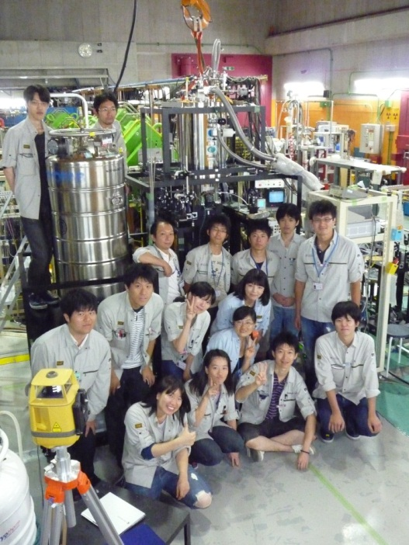





Collaboration
INPC2013 , 2013 6/2-7, T. Furukawa
Spokesperson:
Takeshi Furukawa (Tokyo Metropolitan University), Yukari Matsuo (Hosei University)
Email: takeshi@tmu.ac.jp
RIKEN：
X.Yang, H. Ueno, Y. Ishibashi, M. Wada, T. Sonoda, Y. Itou ,
T. Kobayashi, S. Nishimura, M, Nishimura, K. Yoneda, S. Kubono
CYRIC, Tohoku Univ.:
T. Wakui, T. Shinozuka
Osaka Univ.:
T. Fujita, T. Shimoda
Meiji Univ.:
K. Imamura, Y. Yamaguchi,
Y. Mitsuya, S. Arai, M. Muraoka
Tokyo Gakugei Univ.:
H. Tetsuka, Y.Tsutsui,
Y. Ebara, M. Hayasaka,
Tokyo institute of Technology:
Y. Ichikawa, K. Asahi, N. Yoshida,
H. Shirai, Y. Kondo
Tokyo Univ. of Agriculture and Tech.：
A. Hatakeyama
CNS, Univ. Tokyo:
Y. Oshiro

Slide 13

INPC2013 , 2013 6/2-7, T. Furukawa
Thank you for your attention.

Slide 15
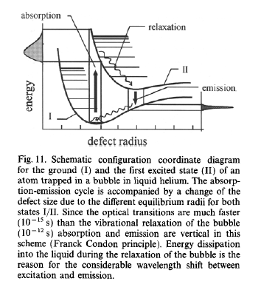
Atomic Spectra in He II
INPC2013 , 2013 6/2-7, T. Furukawa
・Need more energy → blue shifted abs. spectrum
・Different atom-He distance → broadened spectra
＋
excited
state
e⁻
ground
state
He II
Energy potential
deform
Atom-He distance
absorb
radiate
deform

Slide 16
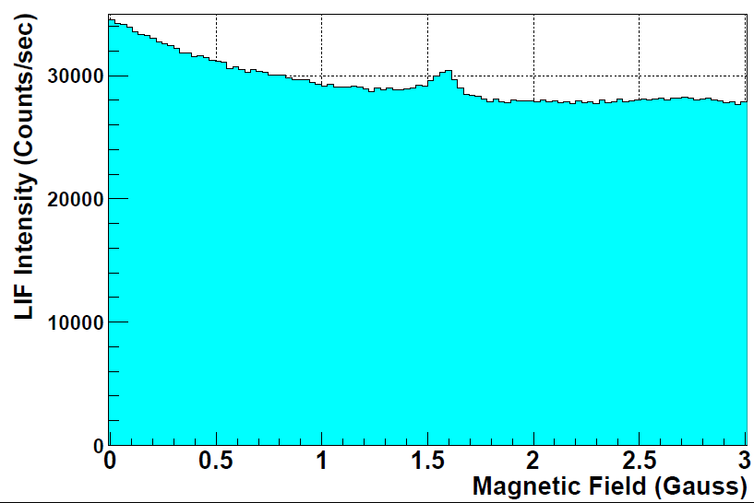
INPC2013 , 2013 6/2-7, T. Furukawa
B.G. from unpolarized atoms
Preliminarily
B.G. from stray laser light
- Increase polarization of atoms
- Increase rf power
- Reduce remaining stray laser light
- Reduce stray magnetic field
- Reduce convection flow in He II

Slide 17
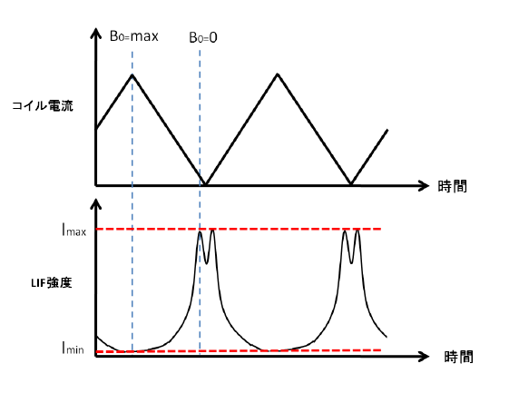
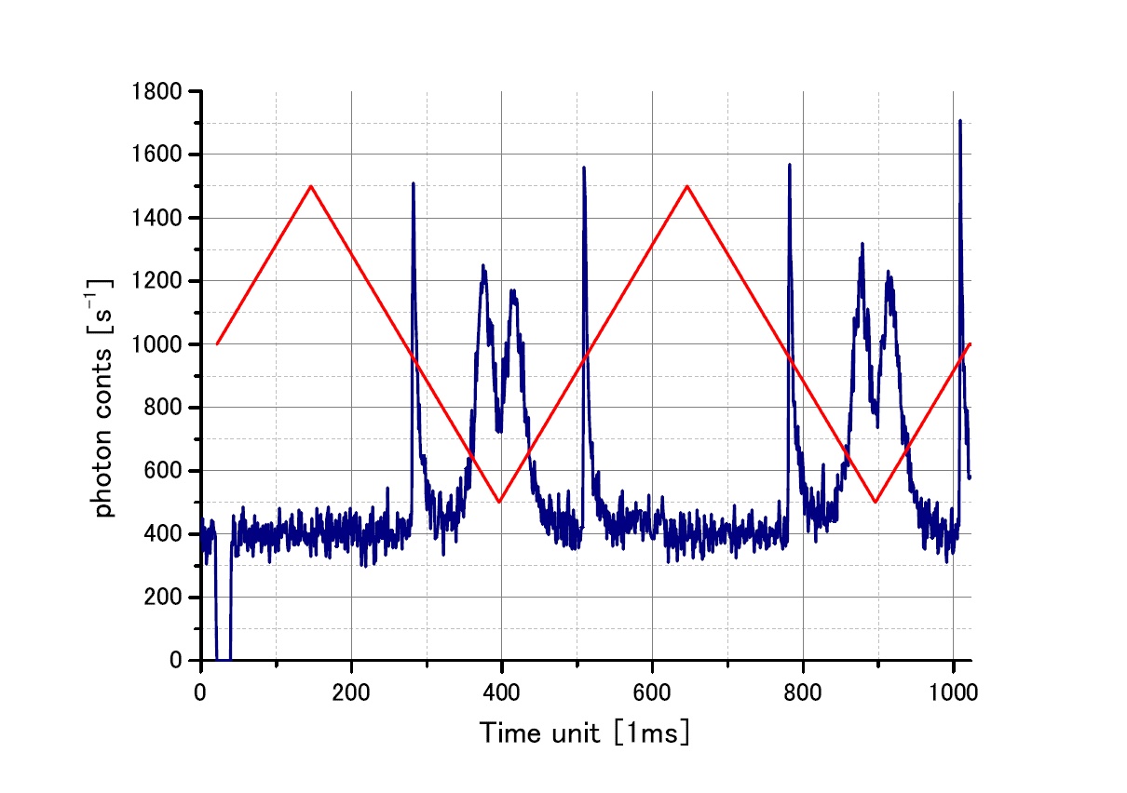
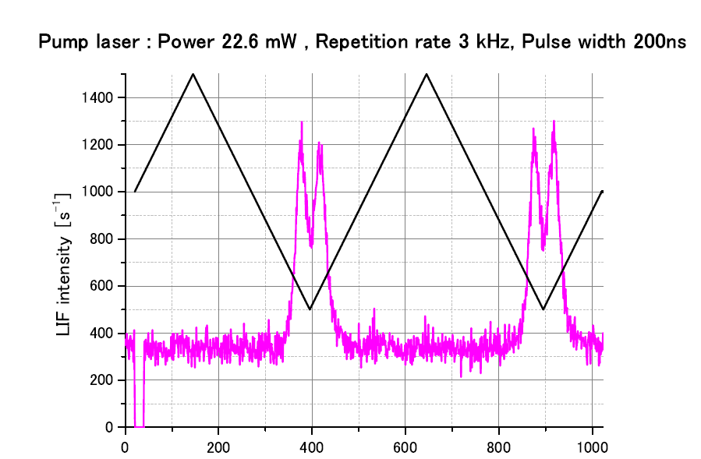
Optical-Detected Magnetic Resonance
INPC2013 , 2013 6/2-7, T. Furukawa
B
B
B_{room}
B
B
Sweeping magnetic field strength…
B_{coil}: Max = Large polarization
B_{coil}
B_{coil}
B_{coil}
((((((
((((((
B_{coil}: 0 = Small polarization
rf
With applying rf field …
B_{coil}
max
B_{coil}: hν_{rf}/g_{F}μ_{B} = Resonance
B_{coil}
0
In the case of stable Au atoms
Coil current
(applying RF with the frequency 2 MHz)
time
LIF intensity
time
Preliminarily

Slide 18
Optical pumping in He II
INPC2013 , 2013 6/2-7, T. Furukawa
Produce the polarization on stable isotopes in He II
Polarization ：~90 % (Cs), ~40 %(Rb)
~85 % (Ag and Au)
Polarization switched (in the case of Cs atoms)
Polarization: increased
LIF intensity: decreased
Linearly
polarized
Circularly
polarized
T. Furukawa et al., Phys. Rev. Lett. 96, 095301 (2006)
T. Furukawa et al., Physica E 43, 843 (2011)

Slide 19
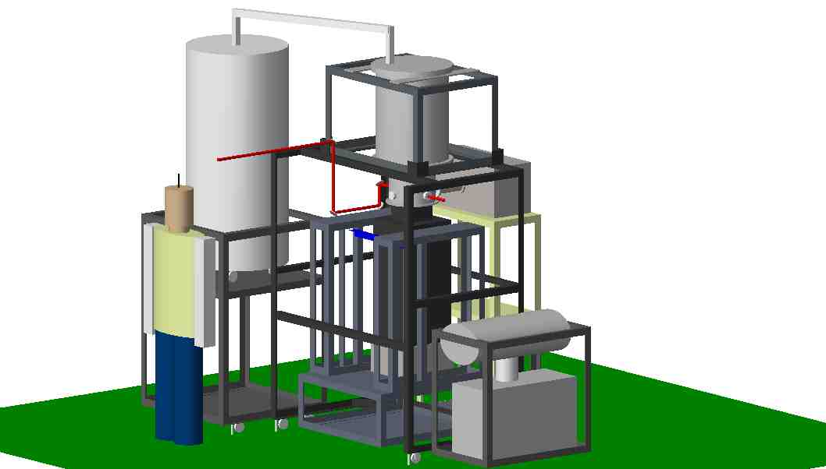
Feasibility test with Rb ion beams
INPC2013 , 2013 6/2-7, T. Furukawa
Next step: Using energetic ion beams
^{84, 85}Rb (< 50 MeV/u) from RIKEN RIPS beam line
cryostat
laser
Rb beam
Photo-detection system

