Slide 1



INPC
Firenze
June 4 (3-7), 2013
Fukushima Nuclear Power Plant Accident
and
Nuclear Physicists
Takaharu Otsuka
University of Tokyo / MSU

Slide 2
Very brief summary of what happened
3.11 14:46:18 The big earthquake occurred with the magnitude 9.0
The biggest in the recorded history of Japan
18,564 people dead or missing
Economical loss ~16-25 10¹² yen ~ 1.2-2 10¹⁰ Euro
No major damage to the Fukushima Power Plant of TEPCO
(Tokyo Electric Power Corp.) :
all reactors were stopped by the normal emergency procedure
as planned
Electric power supply from outside was lost,
as one of the power-cable towers has fallen
(one of the major “miscalculations” made by TEPCO)
Emergency power generators with diesel engines started
to work normally

Slide 3
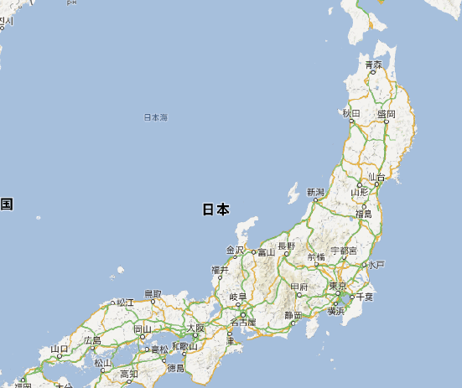
Fukushima prefecture:
Rural area
Population low
Many big power plants
10 nuclear
4 oil
2 coal
all by TEPCO
Earthquake
started here
Fukushima
prefecture
~ 200 km
Tokyo Metropolitan

Slide 4
Fukushima Dai-Ichi (First) Power Plant (BWR)
No. 1 No. 2 No. 3 No. 4
Type Mark-1 Mark-1 Mark-1 Mark-1
Power (MWe) 460 784 784 784
Press. Vessel (RPV)
Max. Pressure 8.24MPa 8.24MPa 8.24MPa 8.24MPa
Max. Temp. 300℃ 300℃ 300℃ 300℃
Container (D/W)
Max Press. 0.38MPa 0.38MPa 0.38MPa 0.38MPa
Max Temp. 140℃ 140℃ 140℃ 140℃
Op. since 1971,3 1974,7 1976,3 1978,10
Emerg. Gen. 2 2 2 2
There are Reactors 5 and 6 which have survived partly due to higher elevation.

Slide 5
Very brief summary of what happened (cont’d)
3.11 ~16:00 Tsunami came also to the Nuclear Power Plant
wave height 13.1 m, higher than the bank prepared up to 5.7 m wave
(warning before the quake, unfortunate timing or bad management)
Emergency diesel generators all stopped due to sea water
(placed in the basement, American design against hurricane)
-> No cooling water in long term for reactors and storage pools
which were kept heated by decay heat
20:30 Reactor No.2 ’s cooling system stopped (battery gone)
22:50 Core uncovery, fuel melting feared for Rector No. 2
by NISA (Nuclear and Industrial Safety Agency)
3.12 1:20 Pressure high in Reactor No. 1 container vessel
15:36 Hydrogen Gas Explosion in Reactor No. 1, later more explosions
20:32 Sea water is put into Reactor No. 1, but this was too late

Slide 6
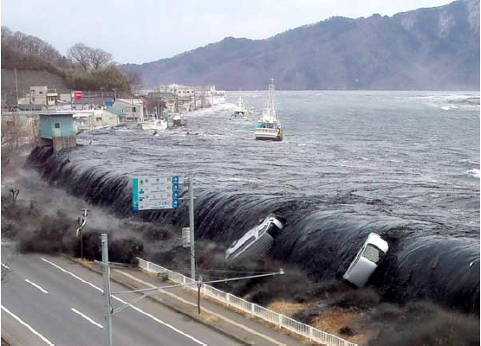
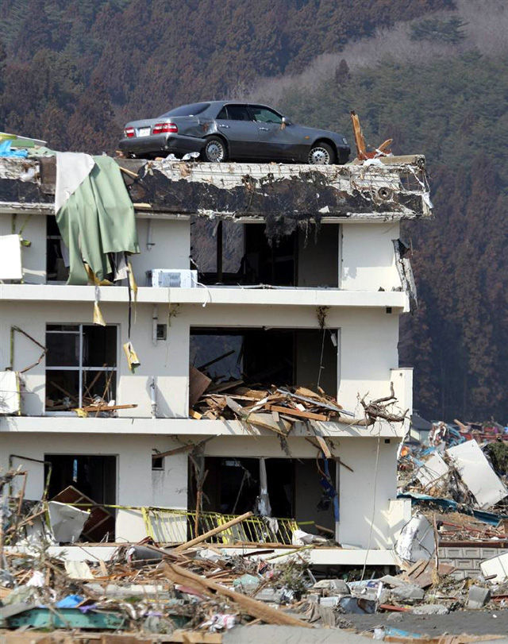
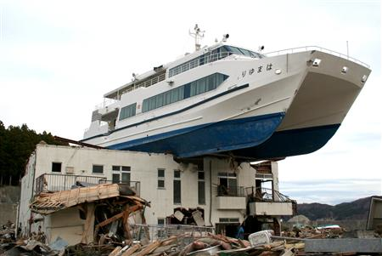
Huge Tsunami came
with 10m height
(30 m at the end of bay,
for instance).

Slide 7
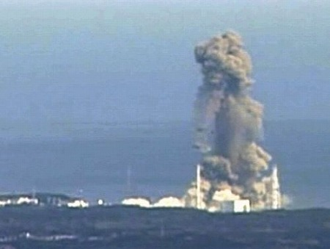
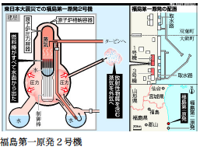

Slide 8
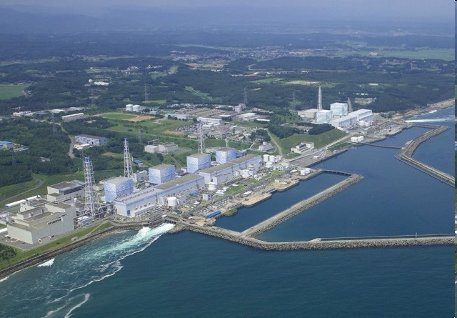
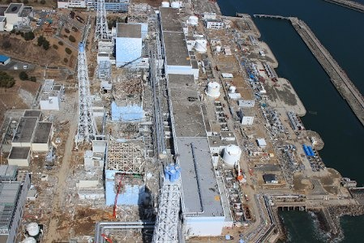
Fukushima Dai-Ichi (First)
Power Plant
before the Earthquake
Reactors No. 5 & 6
Reactors No. 1 - 4
after the Earthquake

Slide 9
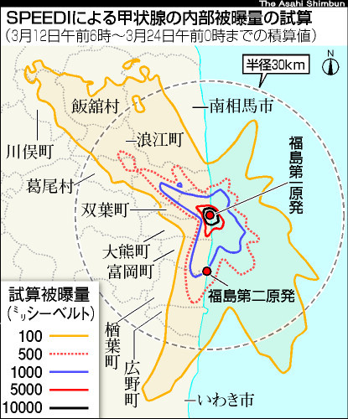
Fuel rods were damaged by high temperature. Fission products, e.g., ¹³¹I, ^{134,137}Cs,
in fuel rods leaked into water, and were evaporated into air. They leaked further to
outside air as the containers were damaged by explosions and high pressure.
Contamination was not simple at all.
Simulation of the thyroid
internal exposure dose
by the code SPEEDI based on
the air flow and rain.
This was not used for the evacuation of
inhabitants by the government.
The reason (by the government) was that
the absolute magnitude was unknown.
This has become a general problem,
as to how scientific information should
be publicized at emergency/disaster.
-> Being discussed in Science Council.
Exposure dose
(mSv)

Slide 10
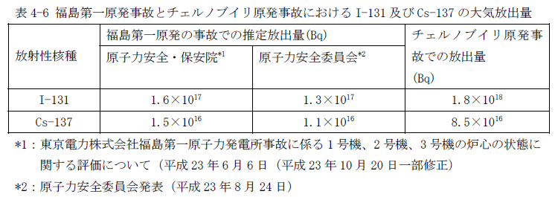
Radioactivity put into the air was about 1/10 of that of Chernobyl
Chernobyl
These numbers have been verified recently by United Nations
Scientific Committee on the Effects of Atomic Radiation (UNSCEAR)
Chernobyl : About 15 kids may have died due to ¹³¹I in milk.
No death has been reported due to Cs isotopes.
Need to clarify radioactive contaminations of people and environment of Fukushima

Slide 11
Nuclear Physicists right after the earthquake
Headquarter : RCNP (Research Center for Nuclear Physics), Osaka University
Tanihata, Fujiwara, Tamii, Hosaka, ….
Mar 12, 14, 15 Hydrogen Gas explosion
Mar 16 meeting @ RCNP on the possibility of nuclear physicist’s
contribution
Mar 20 meeting on planning to send nuclear physicists to Fukushima
Mar 21 1st team arrived at Fukushima for screening of human body
Mar 23 2nd team
Mar 24-30 measurement especially for thyroid gland
¹³¹I harmful particularly for kids (serious in Chernobyl）
Mar 25 3rd team
Areas in and near Tokyo were suffering quakes and lack of electricity

Slide 12
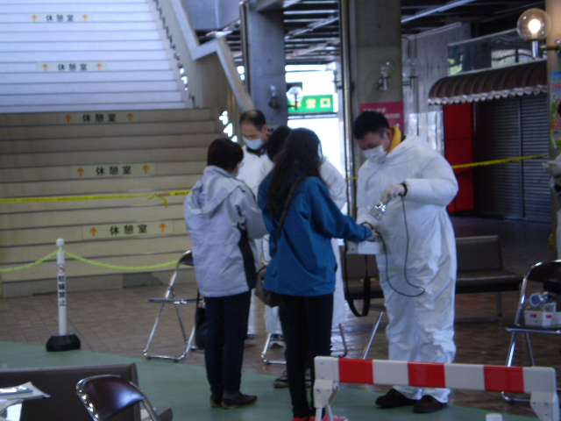
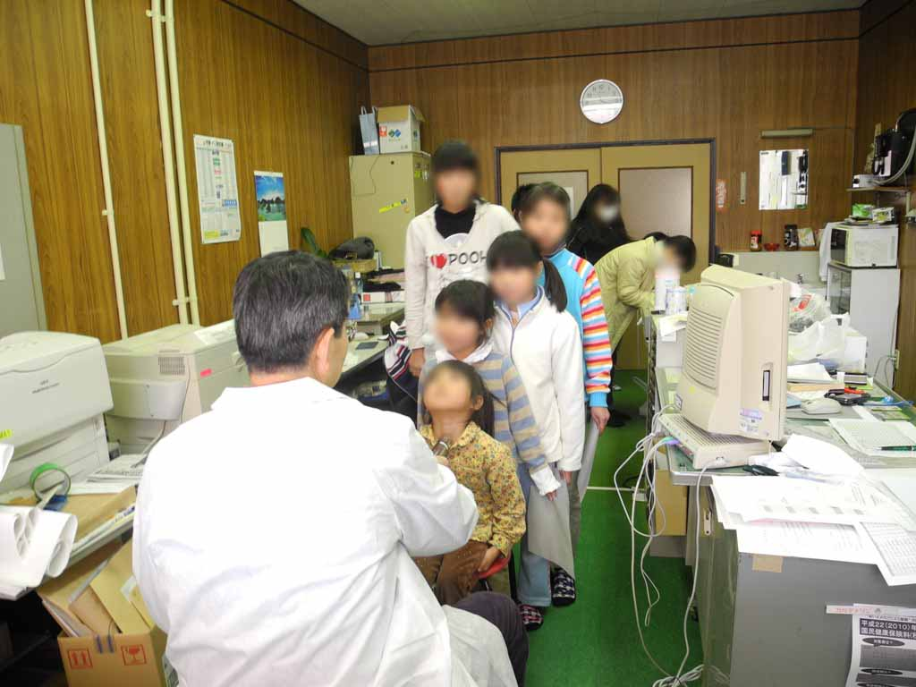
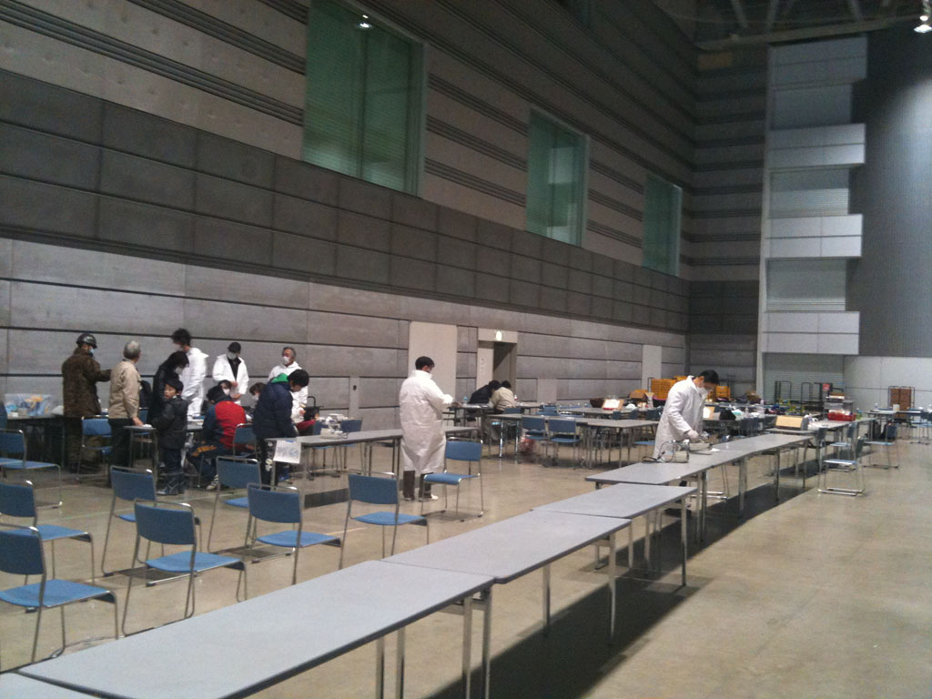
Scene from the screening of human bodies
Kouriyama 2011.3.22
Screening of Thyroid for kids
(under 20 yrs) by NaI scintilater
Kawamata 2011.3.24
1-2 minutes/person by GM survey
meter
Kouriyama 2011.3.23

Slide 13
初期における放射線計測 radiation measurement at early stage
date # of staffs location # of screened persons thyroid gland screening
3/21 1人 福島市あづま総合体育館 ~ 380人
3/22 8人 郡山市総合体育館 298人
3/23 5人 郡山ビッグパレット 226人
3/24 5人 川俣町山木屋出張所 ~ 250人 ~80人
8人 川俣町保険センター 257人 39人
3/25 13人 川俣町保険センター 255人
3/26 8人 いわき市保健所 729人 49人
7人 川俣町保険センター 240人
3/27 16人 いわき市保健所 922人 86人
3/28 10人 川俣町保険センター ~ 500人 230人
3/29 7人 川俣町保険センター ~ 500人 253人
3/30 3人 川俣町保険センター 0人 156人
2人 飯舘村 312人
3/31 4人 郡山ビッグパレット 217人
4/ 1 3人 郡山ビッグパレット 245人
4/ 2 5人 郡山市総合体育館 173人
4/ 3 6人 郡山市総合体育館 185人
4/ 4 4人 郡山市総合体育館 137人
4/ 5 4人 郡山市総合体育館 126人
4/ 6 4人 いわき市 勿来高校 114人
4/ 7 3人 郡山ビッグパレット 118人
4/ 8 4人 いわき市 勿来高校 80人
4/ 9 5人 川俣町体育館 163人
TOTAL
20days 135person・day ~ 6,100人 ~ 890人
（incl. collaborations with other groups）
46 nuclear physicists
total dose ~ 5-10μSv/day

Slide 14
Measurement of soil samples from Fukushima
１．University people’s voluntary activity
「環境放射線核物理・地球科学合同会議
(Nuclear Physics-Geoscience Joint Forum on Environmental Radiation)」
was formed in April
To measure gamma rays from ¹³¹I, ^{134,137}Cs contained in surface soil
by using Germanium detectors
Pilot study before big operation -> protocol
２．National project by MEXT、 cooperation with JAEA
Protocol must be unified, well tested, internationally acceptable
Prompt simultaneous and systematic operation
Soil is property of individual, local community or nation
-> public framework was essential
Positive cooperation by local community was needed

Slide 15
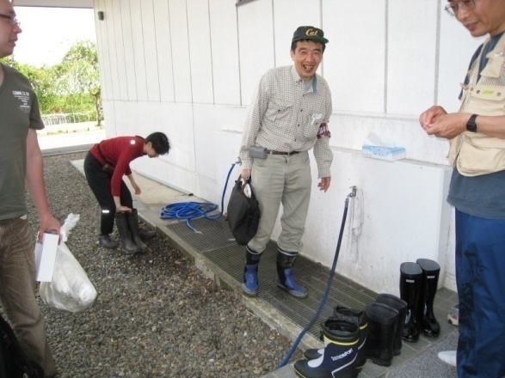
Protocol : Soft soil sample
Prof. Onda from Tsukuba
Revision : Put into plastic bag,
mix well, return to U8 container

Slide 16
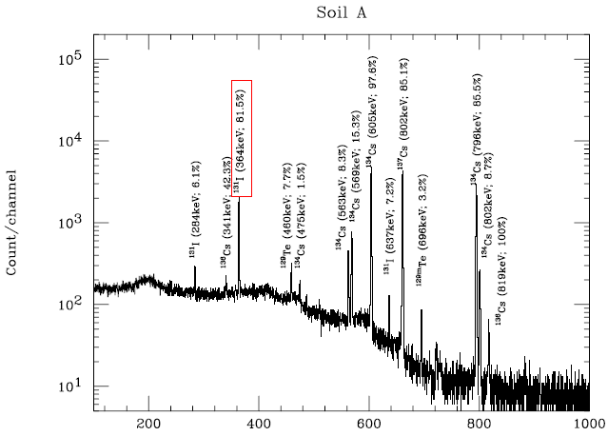
May 2, 2011

Slide 17
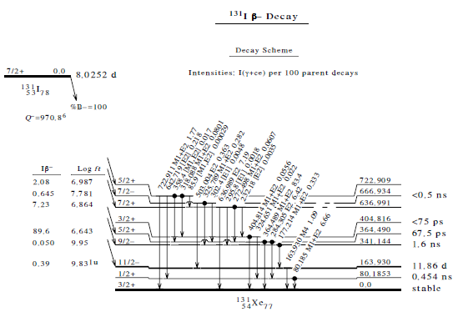

Slide 18
放射線量等分布マップにおける土壌採取地点
Location of soil sampling
One location from each box
別紙２
10 km mesh
2 km mesh
背景図：電子国土
※測定範囲及び測定メッシュの間隔については、今後の自治体との調整の中で変更あり

Slide 19
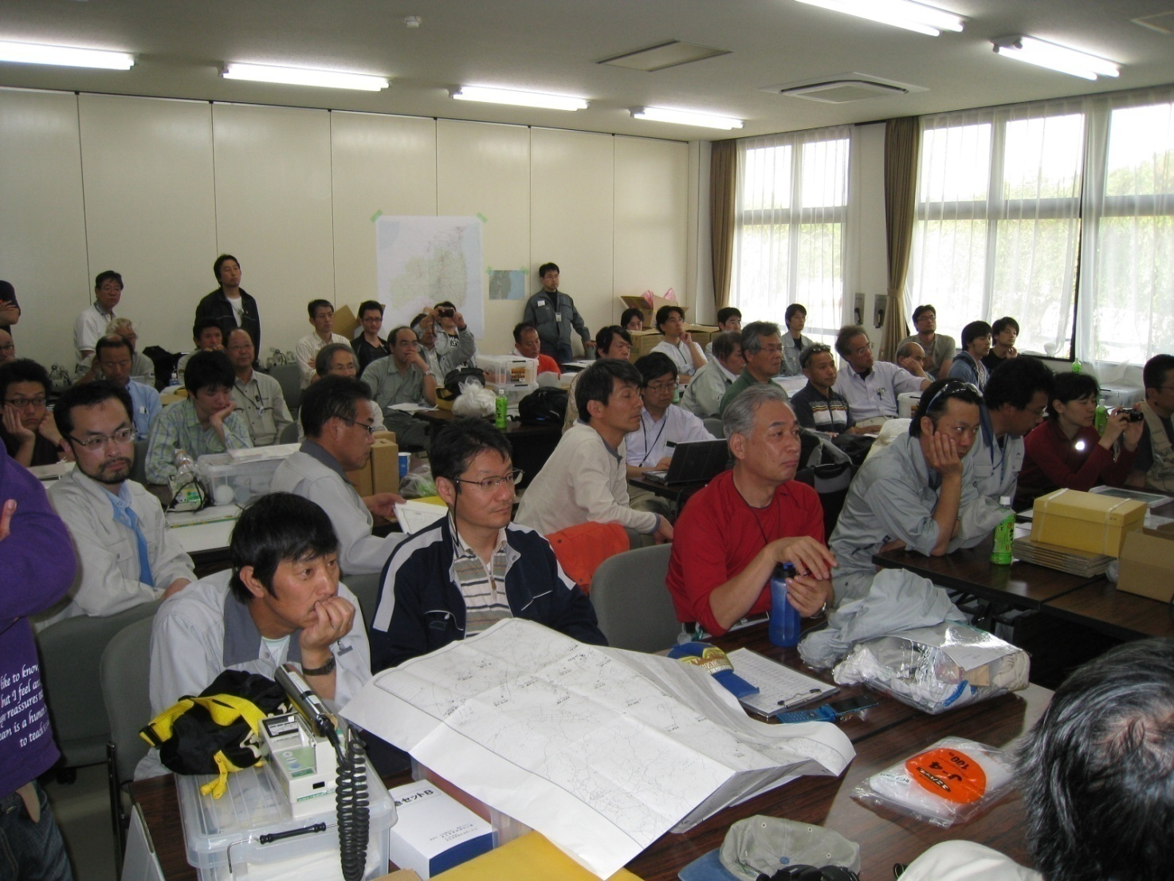
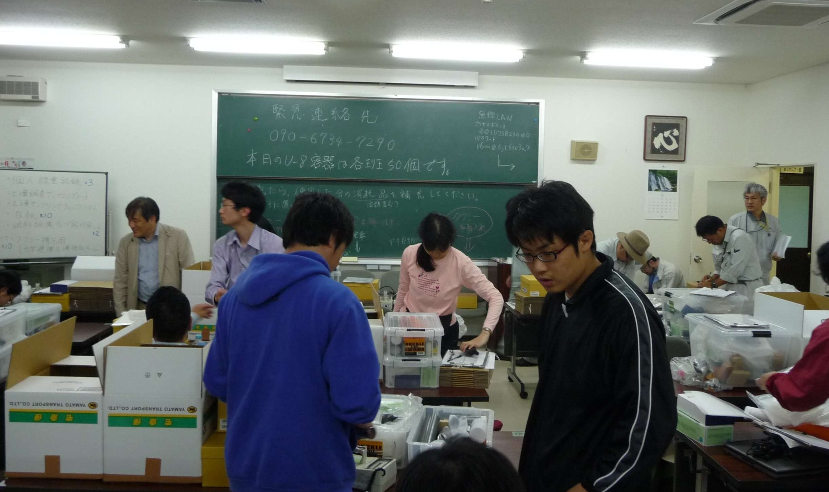
Morning
On site meeting
After return from sample taking

Slide 20
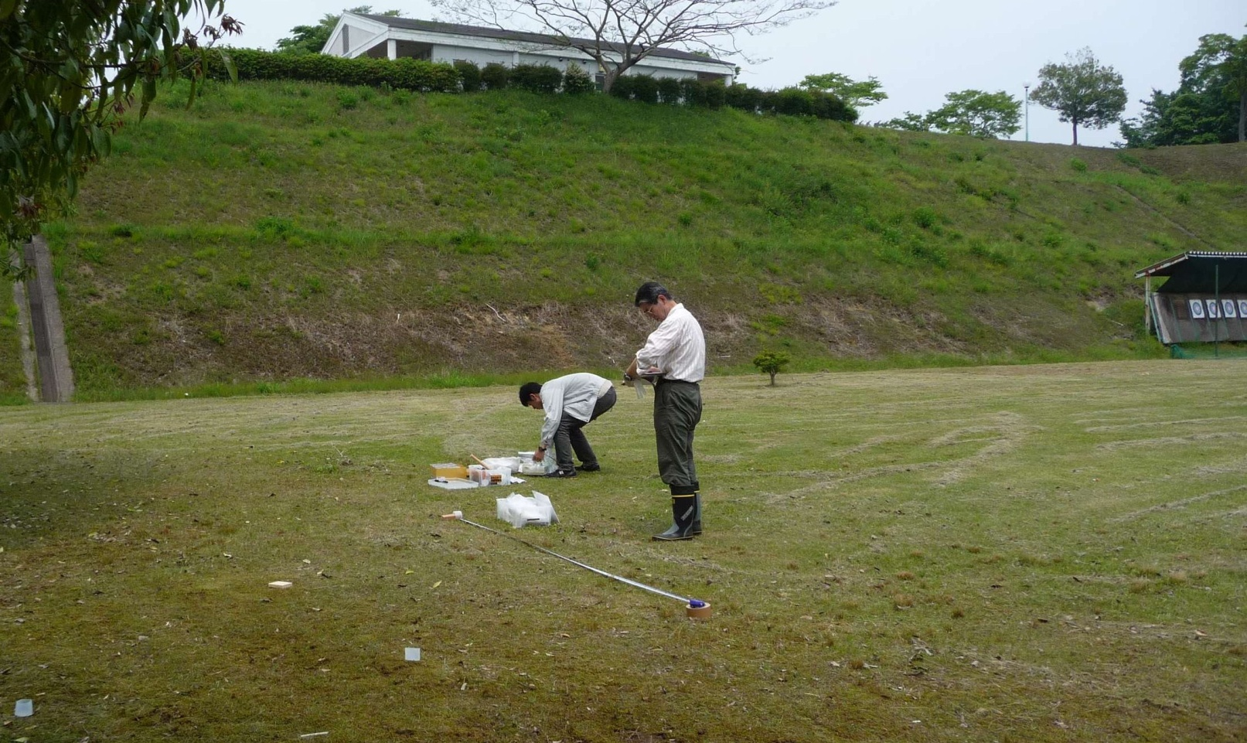
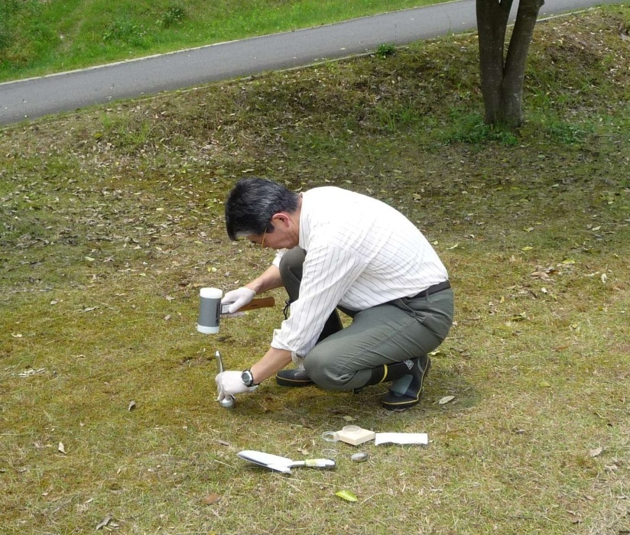
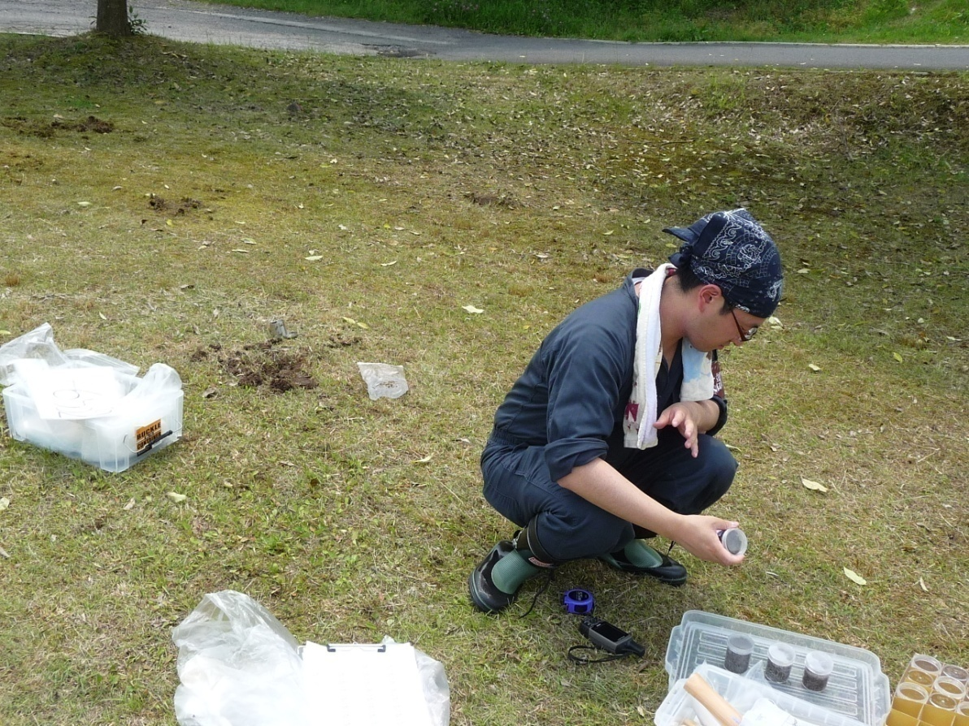
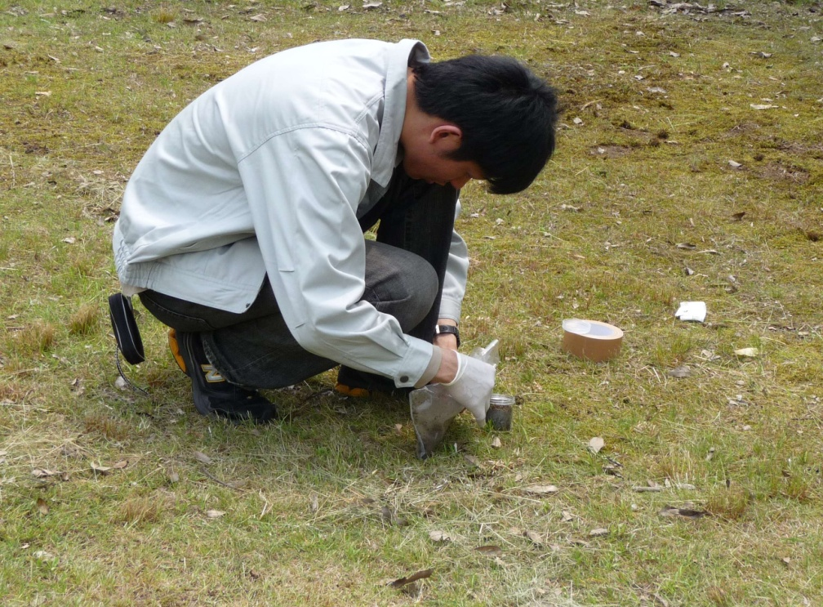
Putting plastic into
the ground
Sample taking June 5, Tanakura
U8 container to plastic bag
Three U8 containers

Slide 21
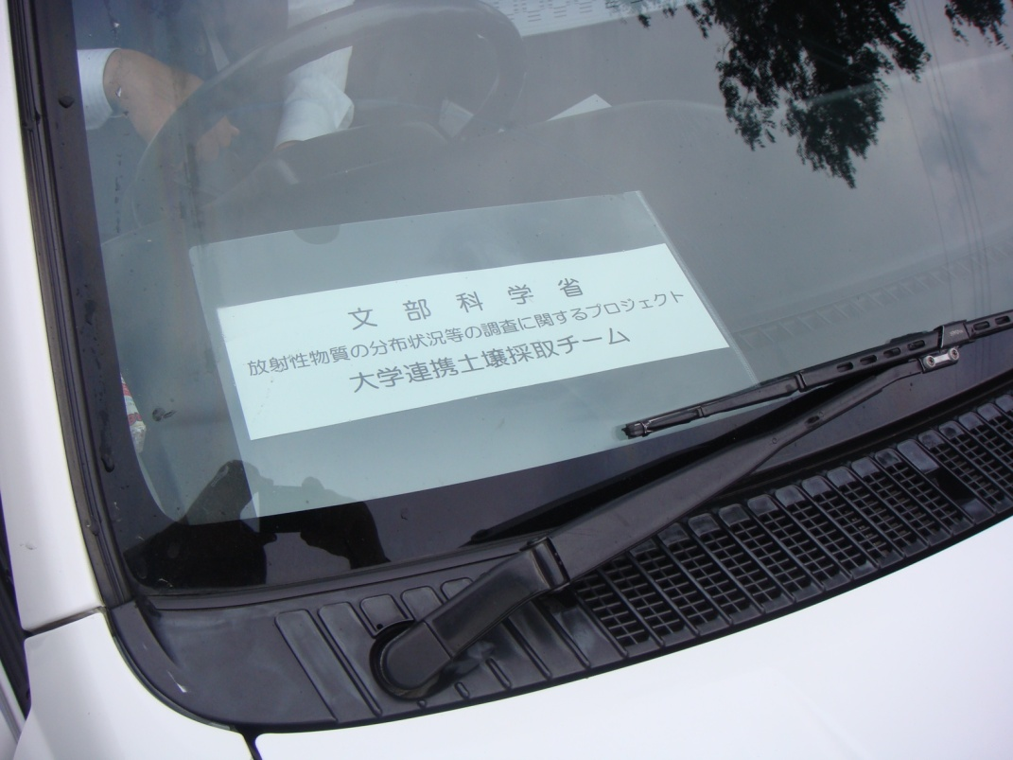
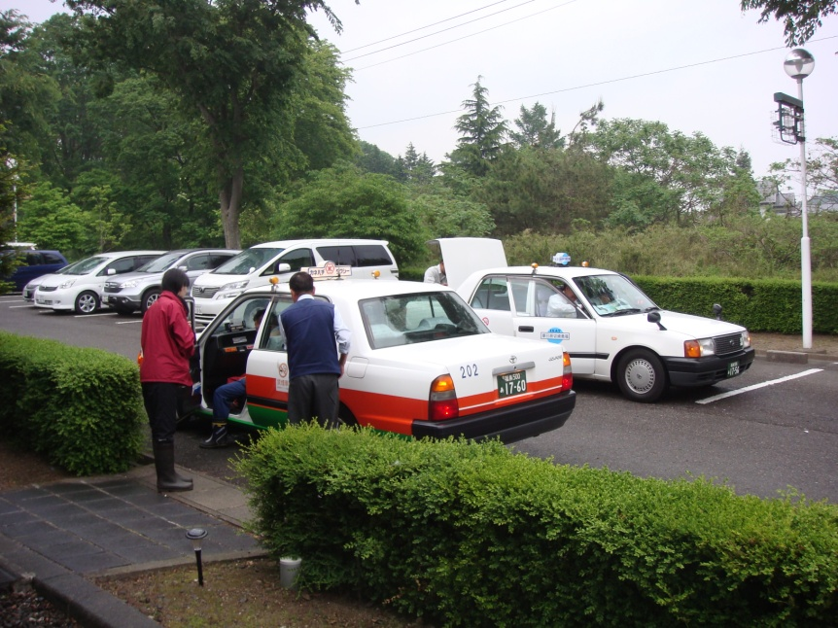
２2００ locations × ５ samples
30 teams for about two weeks since June 6, 2011
１ team ＝３ scientists ＋ taxi driver ４～１０ location / day

Slide 22
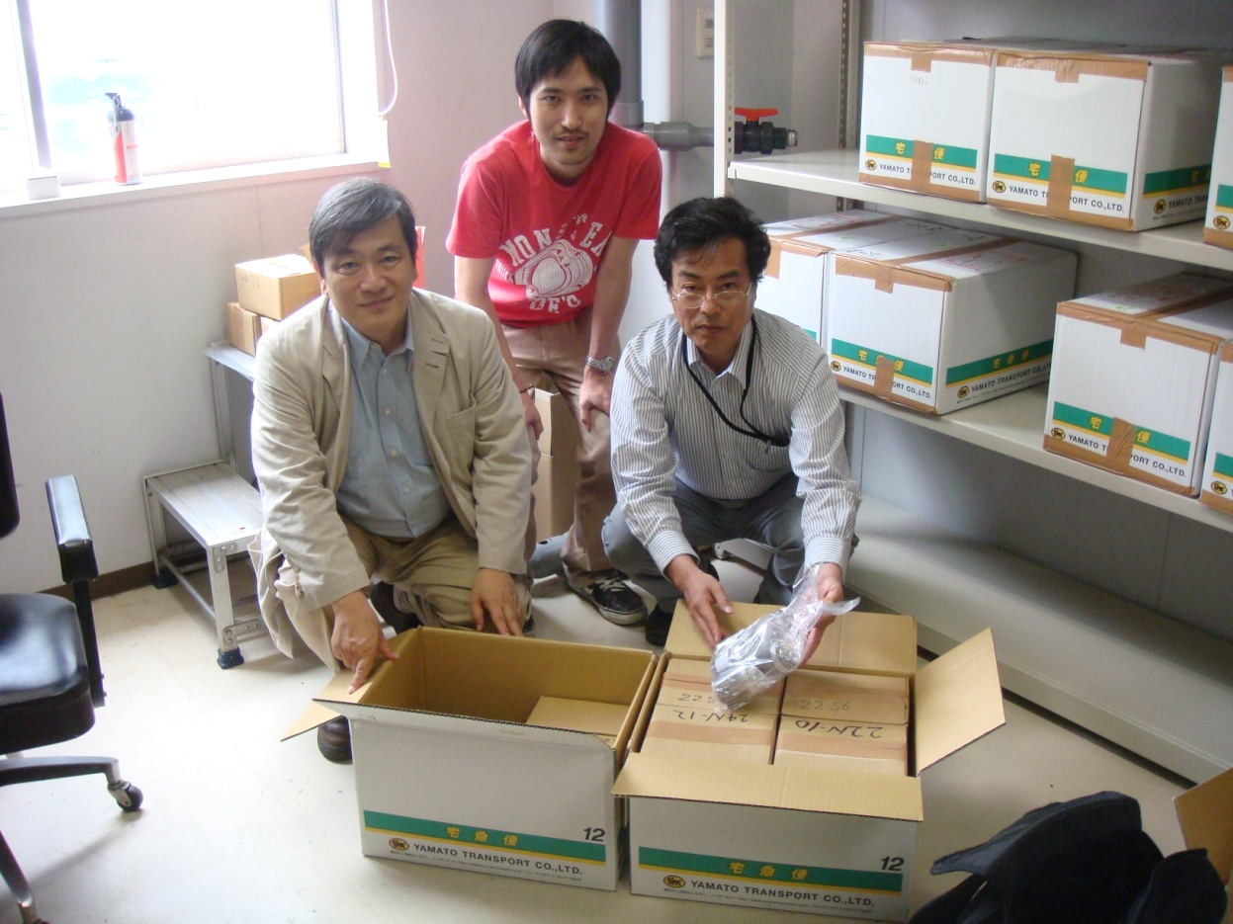
Gamma-ray measurements of 11,000 samples : universities + JAEA
About half → universities
They were sent first to CNS (U. Tokyo) for checking of site and date, recovering lost information if any, and assigning to actual measuring groups.
Cross checks were made.
9 cartons everyday
( 50 samples/carton)
After check and
recovery of missing
Information, if any
20 groups over Japan

Slide 23
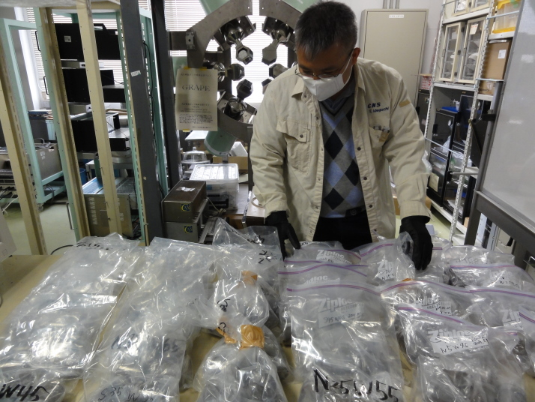
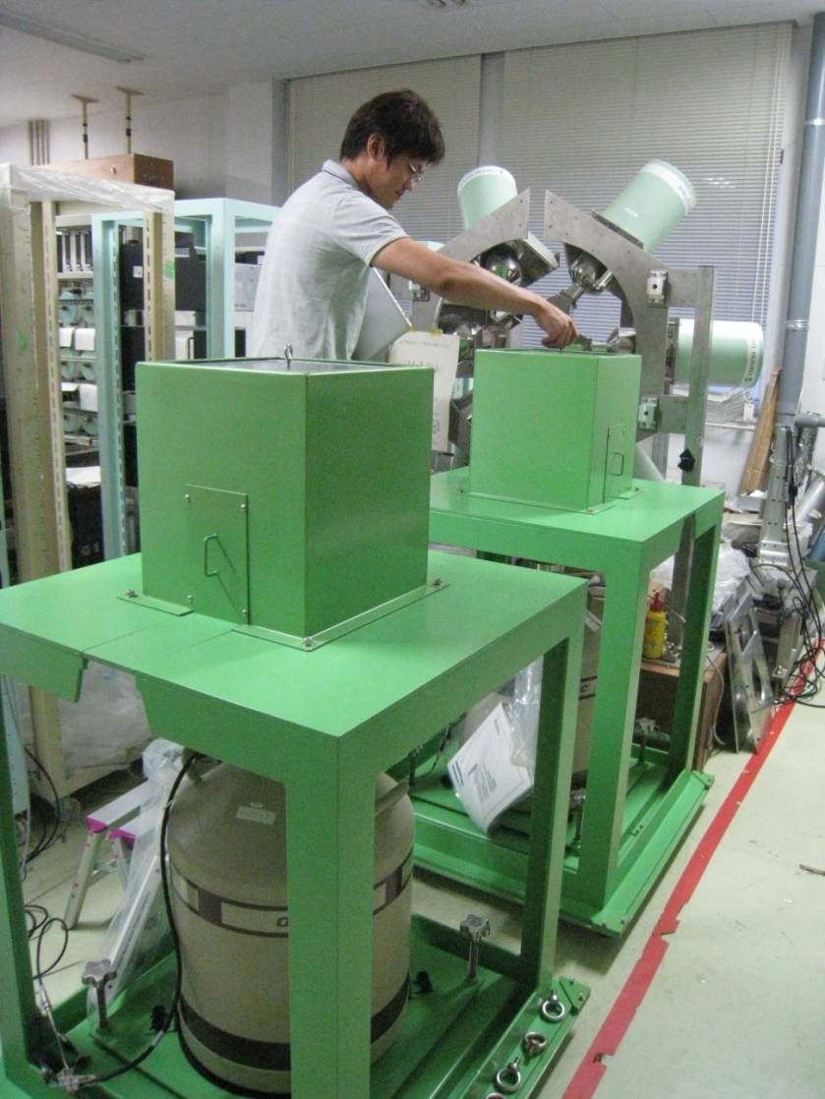
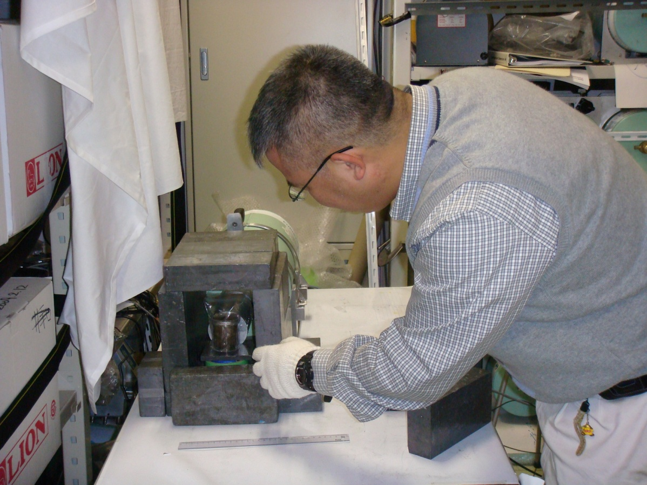
Soil samples just arrived
Germanium detectors with
shield from natural background
Measurement
U8 container

Slide 24
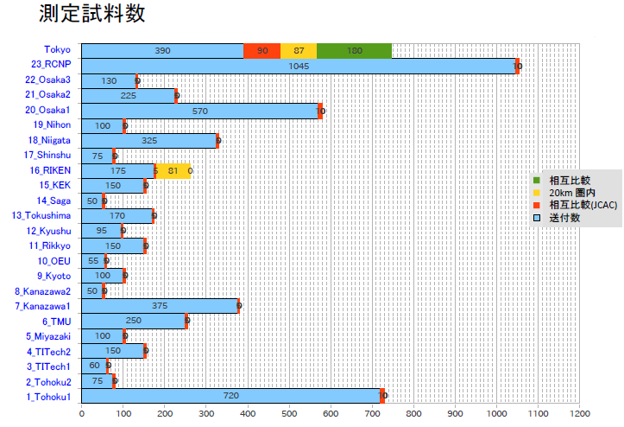
# of samples measured at each institute
Cross-checked by CNS after university groups
Taken inside 20km from the plant
Sent to JCAC (Japan Chemical Analysis Center)
for cross check

Slide 25
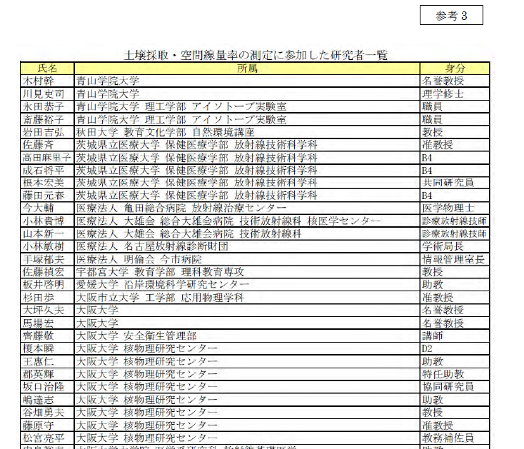
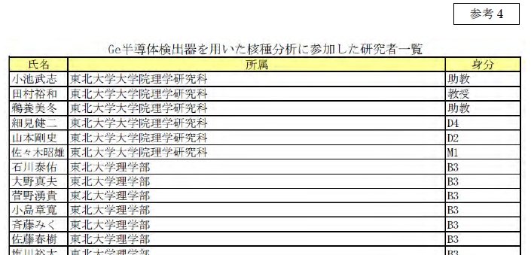
Sample taking : ４０９ scientists with all names (incl. students)
Measurement : ２１ institutions ３４０ scientists with all names (incl. students)

Slide 26
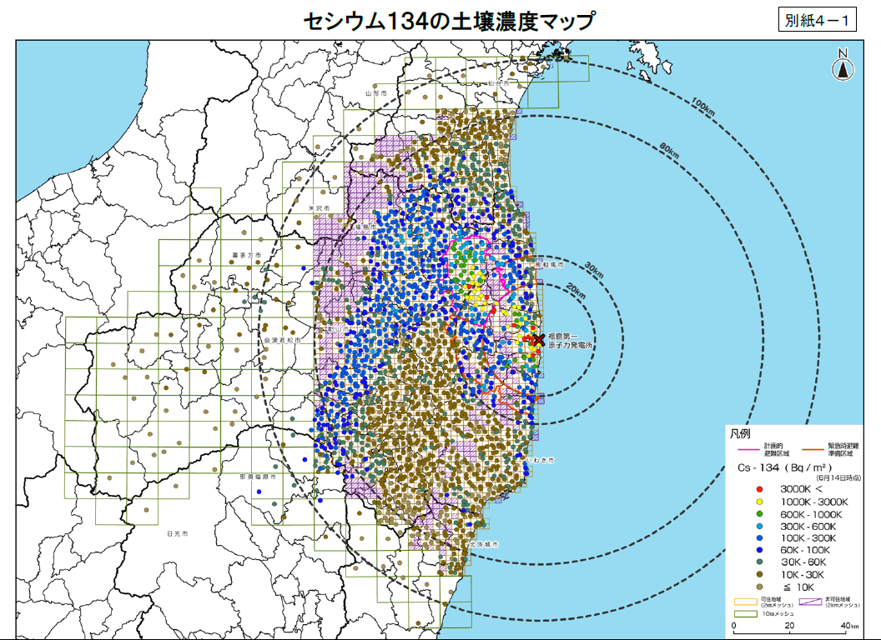
Radioactivity per area from ¹³⁴Cs
Bq/m²

Slide 27

Radioactivity per area from ¹³⁷Cs
Bq/m²

Slide 28
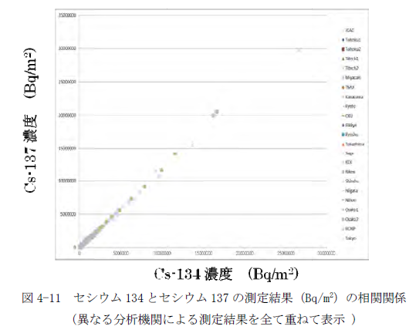
Most important scientific result
Cs-134 decay rate
= 0.92
¹³⁷Cs
Cs-137 decay rate
(normalized to June 14, 2011)
Half life Cs-134 2 years
Cs-137 ３０ years
Useful to distinguish from bomb tests
by US, USSR, UK, France and China
¹³⁴Cs

Slide 29
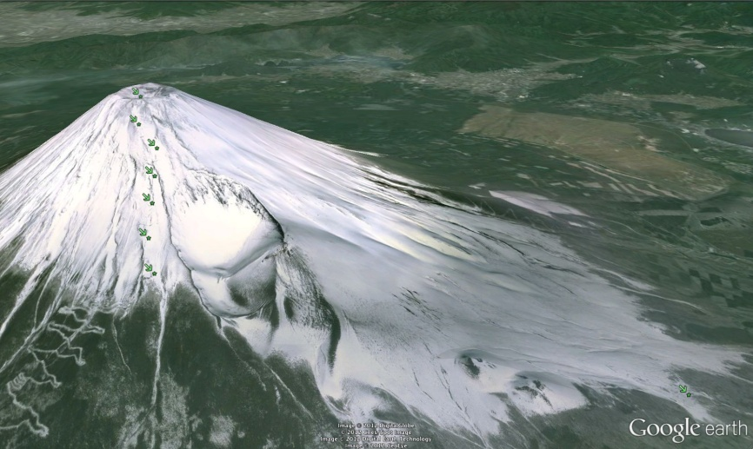
Radioactivity on at Mt. Fuji
by T. Saito, Osaka Univ.
basically zero
Both only at lower elevation

Slide 30
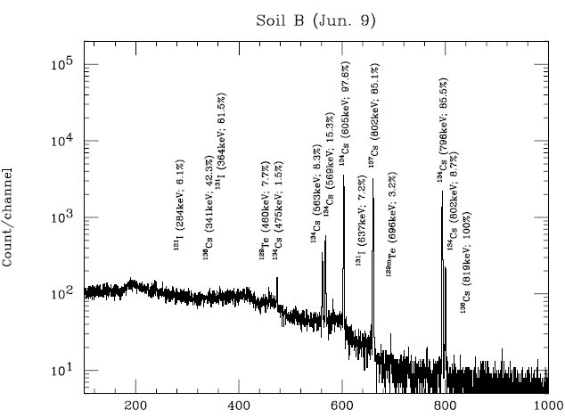
May 2
However,
¹³¹I was gone
June 9

Slide 31
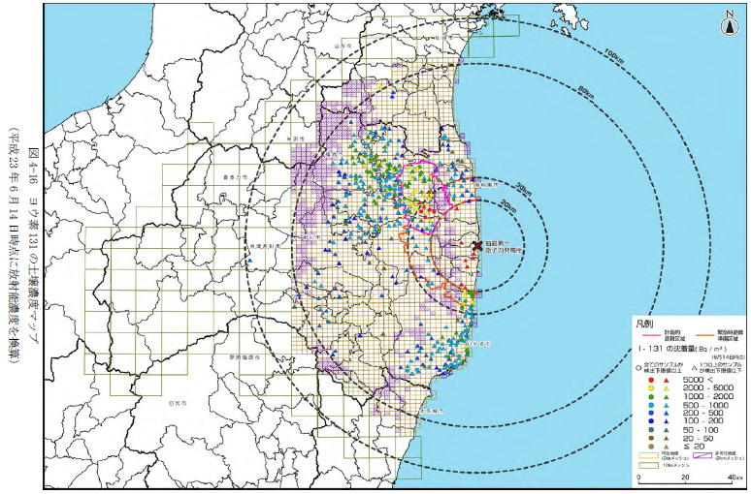
too late for ¹³¹ I (half life : 8days)
gamma ray from the decay of ¹³¹I is
buried by Compton gammas
from the decays of Cs isotopes
¹³¹ I
Bureaucracy needs some steps
→ prompt action was impossible
But we need administrative
endorsement for large-scale operation
→ Need for the framework
for quick scientific action scheme
Bq/m²

Slide 32
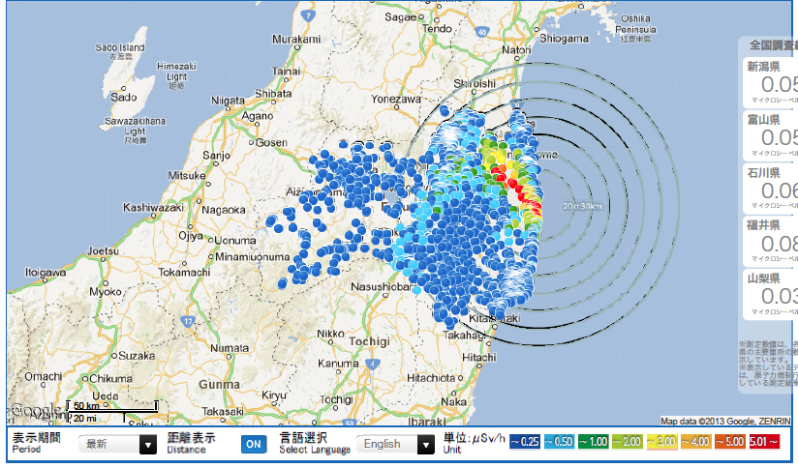
Present situation

Slide 33
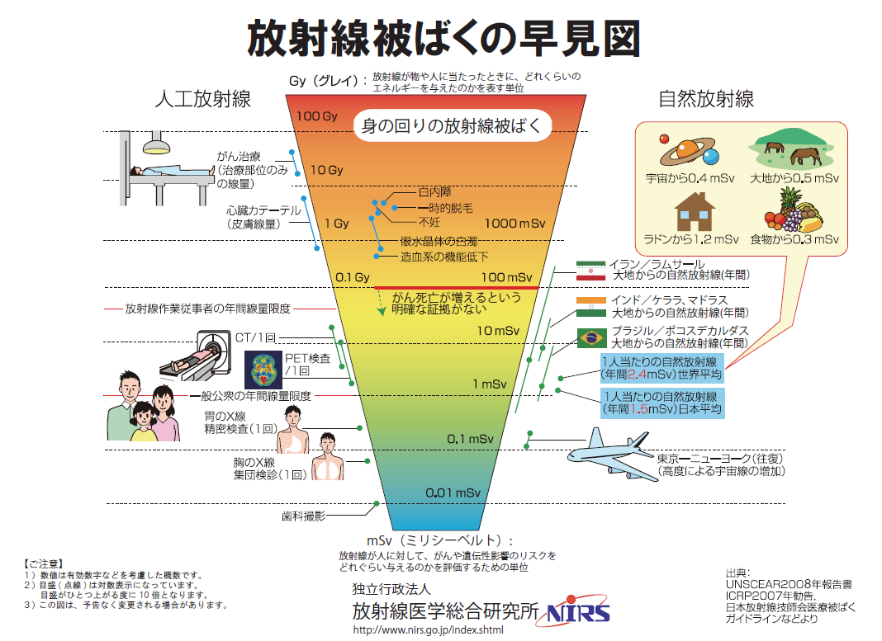
ICRP :
International Commission
on Radiological Protection
Radiation dose and its effect
my annual dose
world average
20 mSv/y (body)
upper limit of
normal citizen
(ICRP 20-100)
-> 3.8 μSv/h (air)
Japan average

Slide 34
What happened for agricultural products
by Prof. T. Nakanishi,
School of Agriculture and Life Sciences, UT

Slide 35
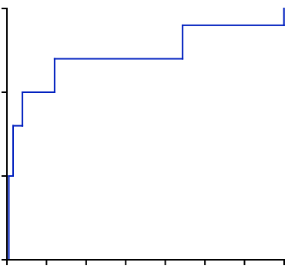
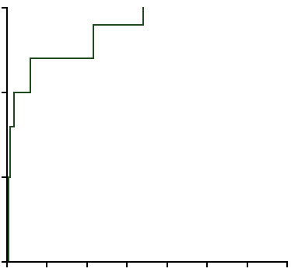
SKIN DEEP
Soil contamination is limited to the top few centimeters of fields around Fukushima.
0
-5
Depth from soil surface (cm)
¹³⁴Cs
¹³⁷Cs
-10
-15
0
10000
20000
30000
Total radioactive caesium levels (Bq/kg)

Slide 36
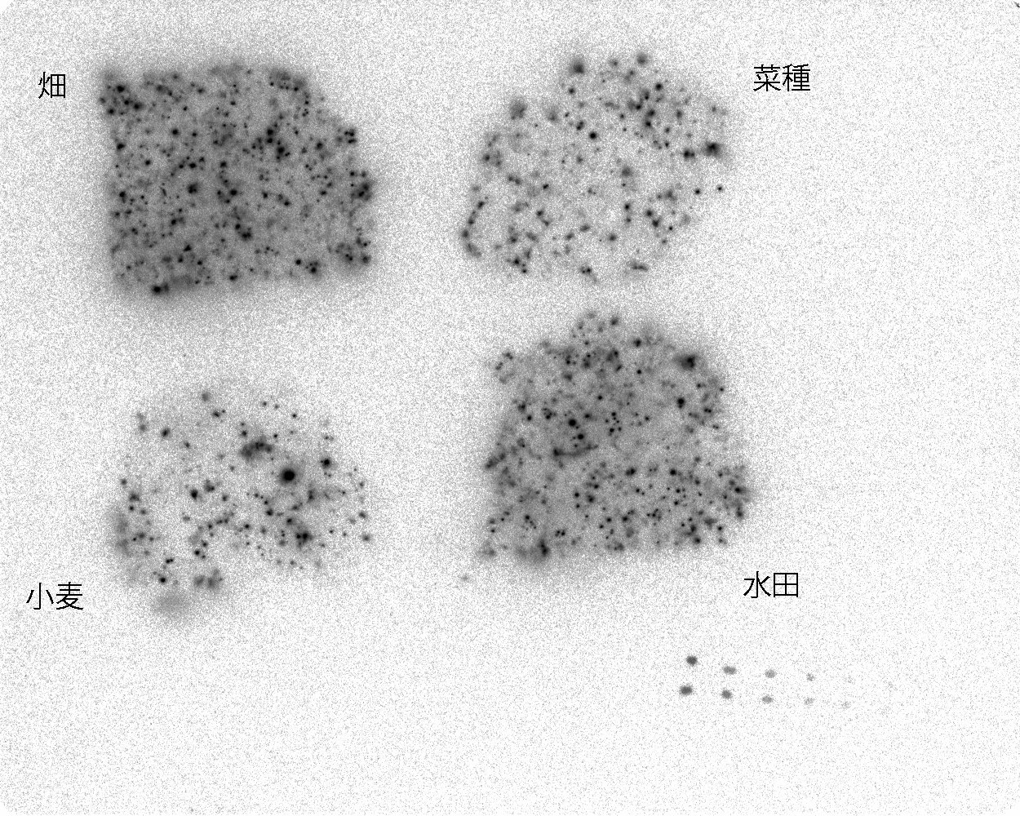
Contaminated soil in Koriyama in Fukushima
Wet soil
15g each 24h exposure to IP
① soil 50000Bq/kg
② paddy soil
37000Bq/kg
③ Soil for weat
7000Bq/kg
④ Soil for vegitable
800Bq/kg
①
④
Std.spots
¹³⁴Cs &¹³⁷Cs
（from0.0625Bq/spot）
③
②
Once Cs is caught by soil, it never leaves.

Slide 37
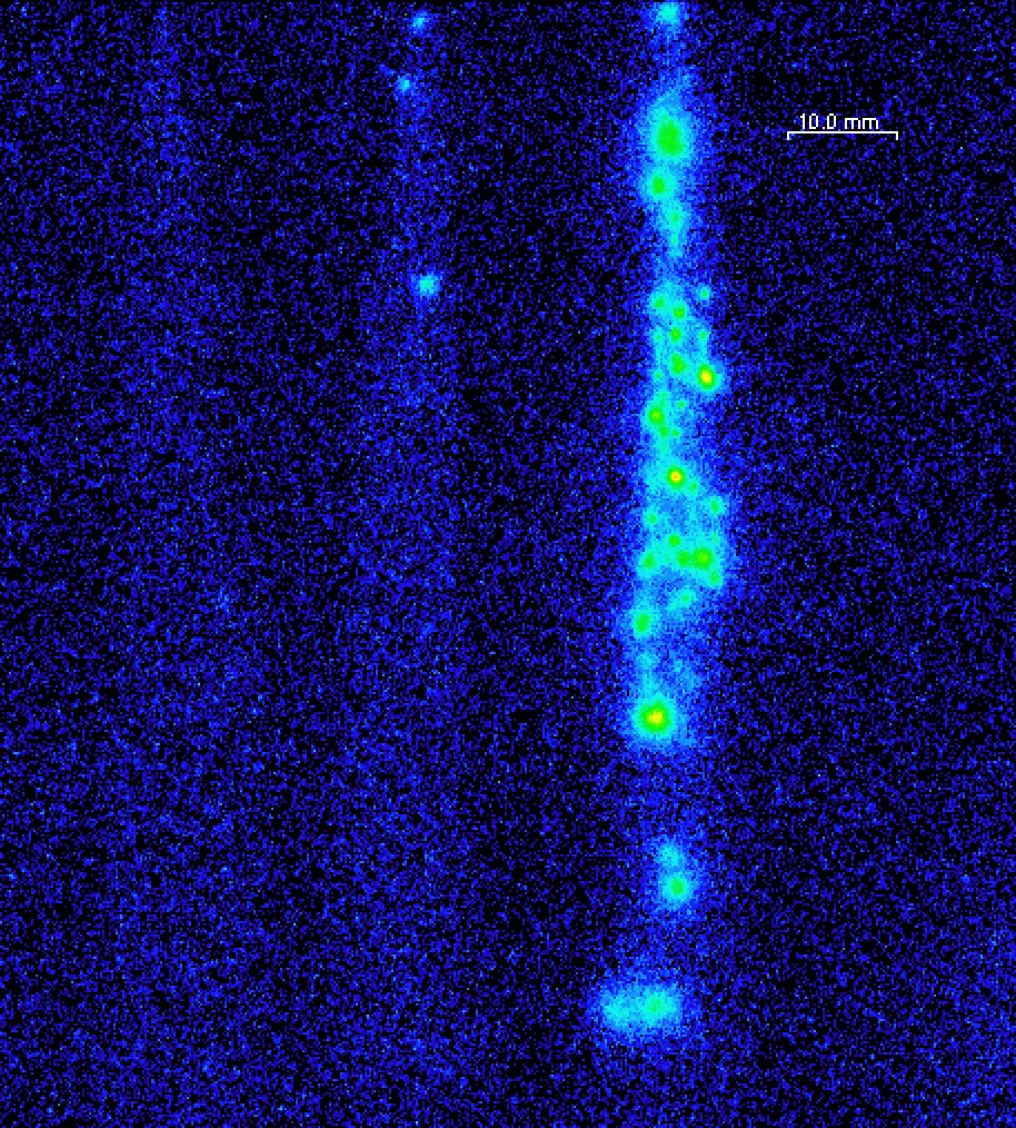
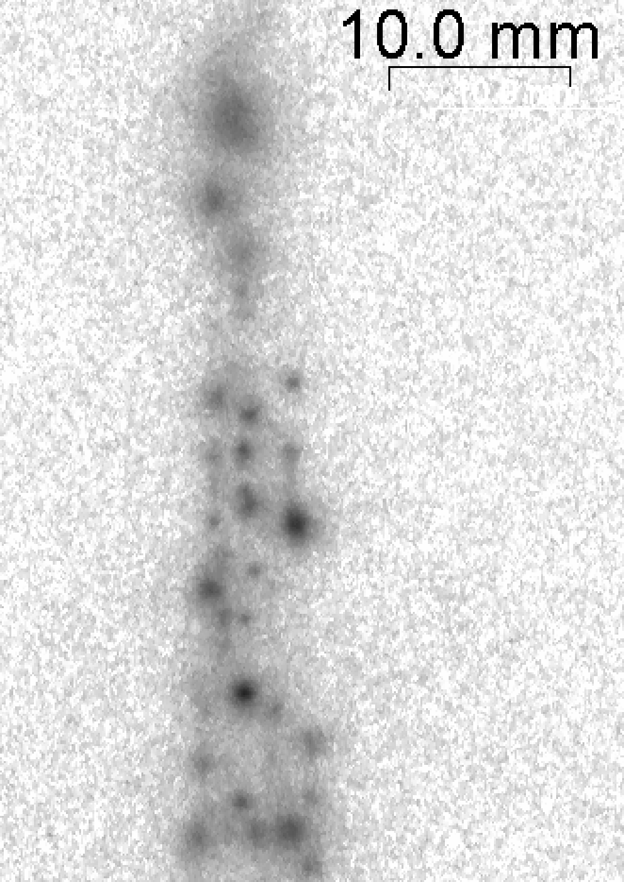
Radioactivity image of leafs
New
leaf
Time of
Fall out
Most of the radioactivity was found in the leaf expanded at the time of the fall out.
Notes:
前の図の拡大像です。
2ヶ月経っても古い葉に降ってきて吸着した放射性核種はしっかり吸着されたままです。
葉脈が殆ど見られないということは、他の葉への転流量は非常に少ないのではないかと推測されます。
ただ、スポットは見方によっては葉脈に沿っているようにも見受けられますので転流は全く無い訳ではないと考えられます。
事故後に展開した葉にスポット状に見られる放射能はその後降ってきた（粉塵？）ものか、イメージングをとる際に誤ってコンタミさせてしまったのかは判りませんが、転流では無いと思われます。

Slide 38
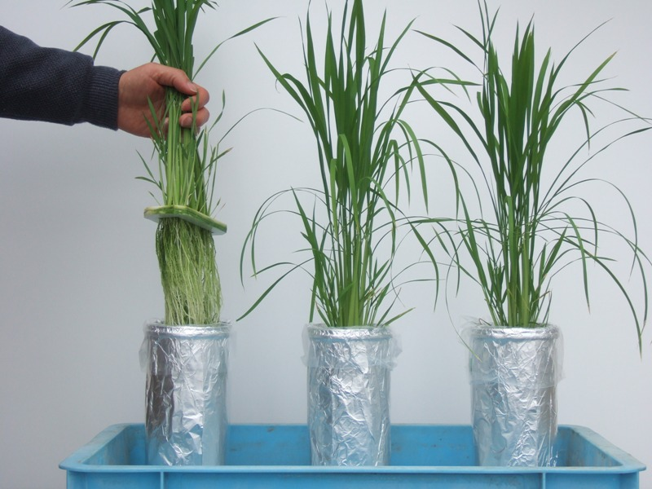
¹³⁷Cs absorption in water culture
76 Bq/kgDW
590Bq/kgDW
5700Bq/kgDW
If there is only water (water culture), rice absorbs a lot of Cs.
0.1Bq/l
1Bq/l
10Bq/l
Notes:
イネは水耕をすると効率良く放射性セシウムを吸収する
イネ用の水耕液（イネに必要な肥料成分を溶かした水）に、昨年春に降下した放射性セシウムを溶かして、イネを２６日間栽培
水耕液の放射性セシウム濃度は、０．１、 １、 １０ベクレル／リットルの３段階とした
参考 水における放射性セシウムの検出
限界は、１ベクレル／リットル程度
検出限界（約１ベクレル／リットル）以下の濃度であっても、茎葉部に数百ベクレルのセシウムの蓄積が生じる
０．２ベクレルの水からの放射性セシウムの吸収は、１００００ベクレルの土壌からの吸収に匹敵する

Slide 39
Remarks
Nuclear power plant accident (Details have not been disclosed.)
Fatal mismanagement of TEPCO. Could have been avoided.
Radioactivity ~1/10 of Chernobyl, still terrible but less.
Fukushima + Pacific ocean. No direct emission of FP, e.g., Sr.
Nuclear physicists made important contributions in many ways.
- screening of human being for ¹³¹I + …
- measurement of soil samples for ^{134,137}Cs (+ ¹³¹I) → data base
409 scientists for sample taking, 340 (21 institutions) for measurements
→ Gauge (¹³⁴Cs/¹³⁷Cs) to distinguish Fukushima accident from bomb tests
Present situation
Radiation is lower now, less than 4 μSv/h for most of the areas
No patients due to radioactivity at present and probably in future (also UNSCEAR)
Cs isotopes are kept in soil
Agricultural products can be safe, even if the soil is somewhat contaminated
Surveys continue for human body (←Hayano), environment (←CNS) and food
Scheme for contributions of scientists at the time of major disaster (SCJ)

