Slide 1

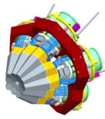


The AGATA DEMONSTRATOR at
Legnaro National Laboratory
D. Mengoni
Università and INFN Padova - ITALY
for the AGATA collaboration
International Nuclear Physics Conference
Florence 2nd- 7th June 2013
Notes:
1
Most of the work which I’m going to talk about, couldn’t exist
without his efforts and dedication
Today the contribution will focus on the AGATA project,
indeed a subarray of the whole spectrometer,
namely the AGATA demonstrator which was firstly installed at LNL,
for commissioning and physics campaign.

Slide 2
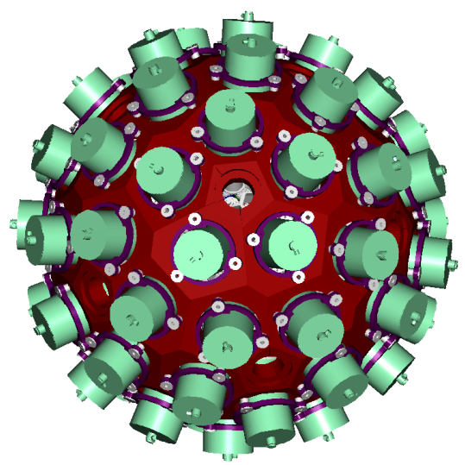
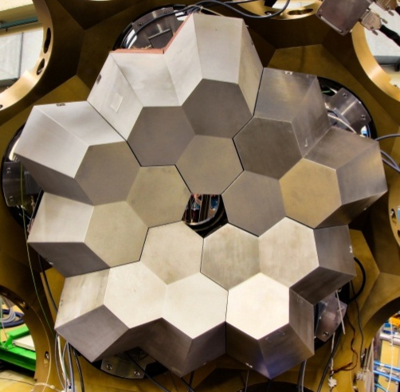
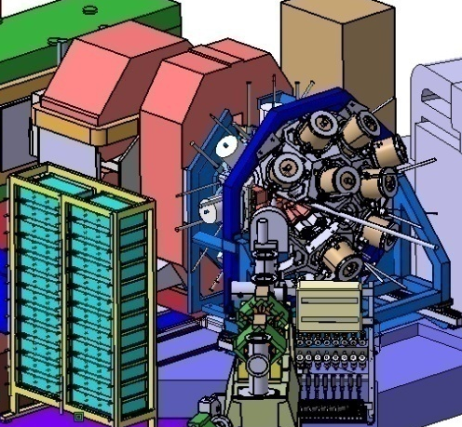
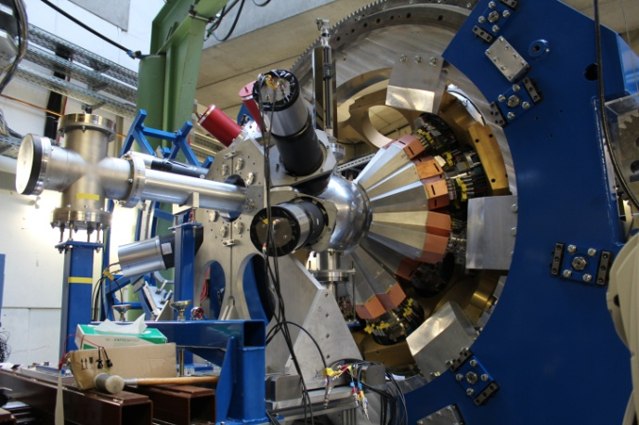

Advanced Gamma-ray Tracking Array
please refer to: D.Bazzacco TALK @INPC
2009 LNL
2
5TC
PRISMA
Eff~6%
3
4
1
5
~2014 GANIL
2012 GSI
15 TC
VAMOS
EXOGAM
Eff~20%
8TC
FRS
Eff>10%
please refer to: N.Pietralla TALK @INPC
Notes:
AGATA stands for …. Which means that the array has the ability of
tracking the single interacting photon, please refer to the presentation of
Dino during this INPC.The physics campaign has been split
into three parts to benefits of the properties of different facilities .
The first one as we will see at LNL, concluded, the second one, ongoing at GSI,
and the third one foreseen for GANIL in 2014.
Thereafter (2017?) the spectrometer might also take back again the road to LNL, at the time of SPES.

Slide 3
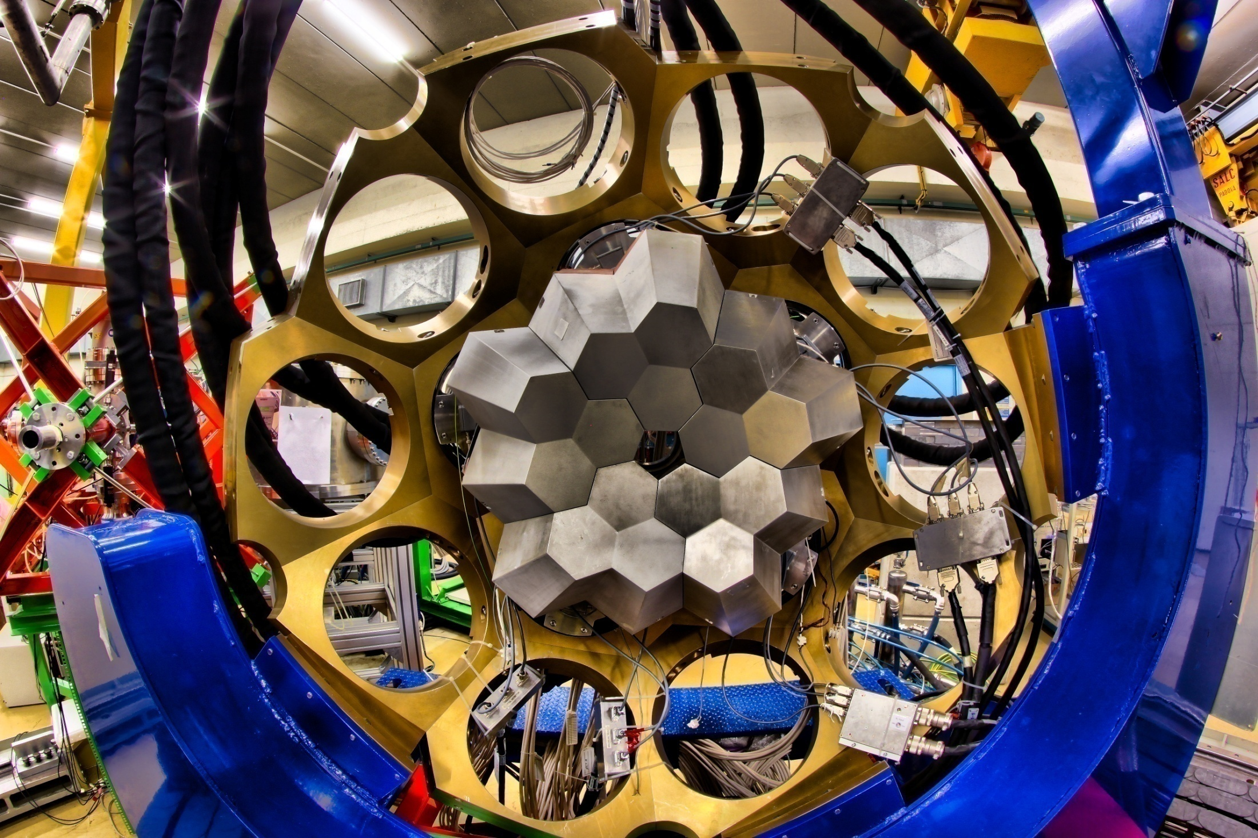
The first implementation of AGATA installed at LNL
β = 0
Notes:
This is AGATA at the time of the LNL installation, in all his beauty
(A beautiful flower indeed.) It consisted of
5ATC, 15 36 fold,>500 digital channels, PSA and Tracking online,
absolute efficiency,at the closer distance of~ 6%

Slide 4
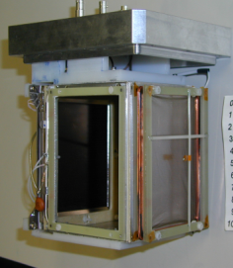
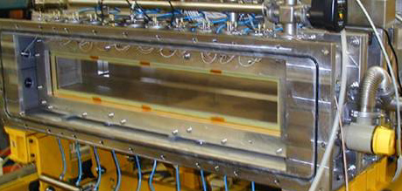
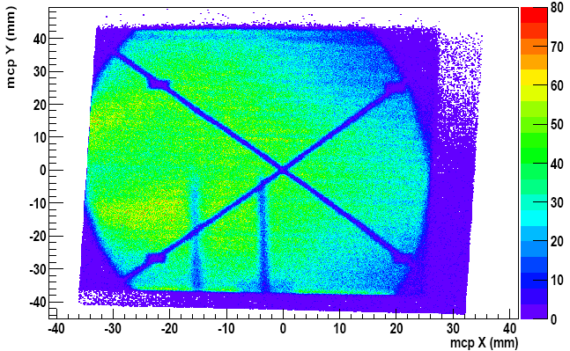
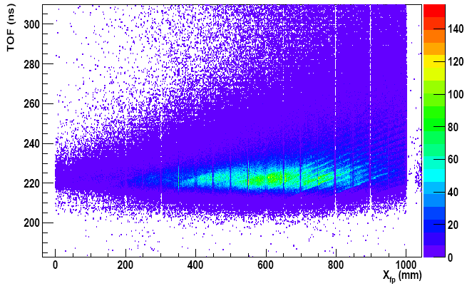
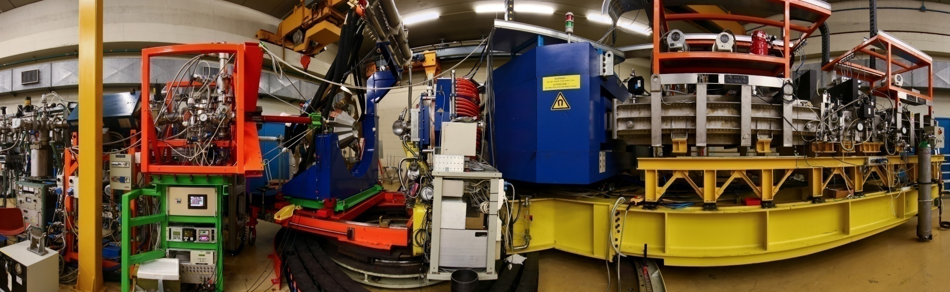
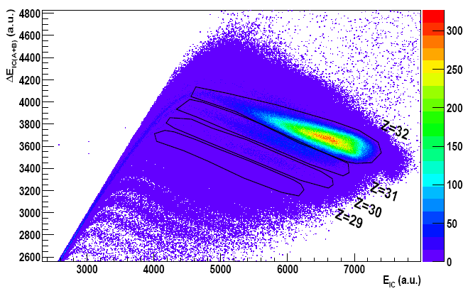
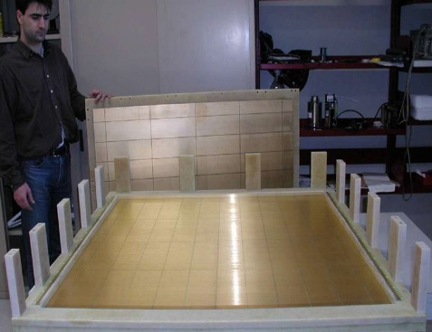
PRISMA: Tracking Magnetic Spectrometer
MCP Start Det.: X,Y & T_{I}
MWPPAC X,Y & T_{F}
10 sect.
6m TOF
Large acceptance Ω = 80 msr
ΔZ/Z ≈ 1/60 (Measured) IC
Energy ΔA/A ≈ 1/190 (Measured)
Acceptance ±20%
Max. Bρ = 1.2 T.m.
Ionisation Chamber ΔE - E
Notes:
The host site position was chosen to face the magnetic spectrometer PRISMA,
which, by a series of entrance and focal plane detector, is able
to fully discriminate in A,Z the incoming ion.

Slide 5
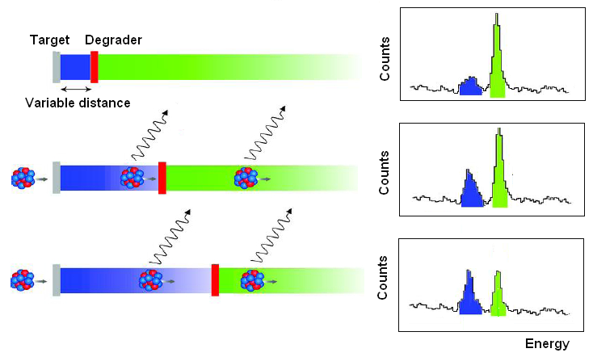
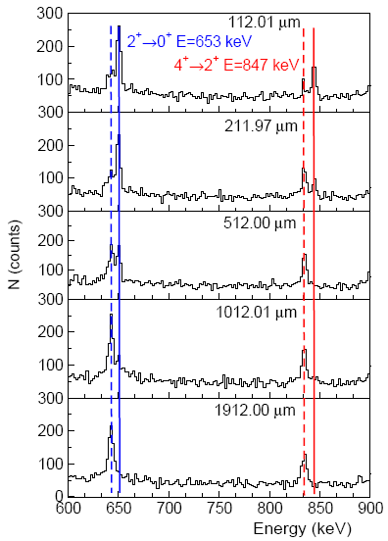
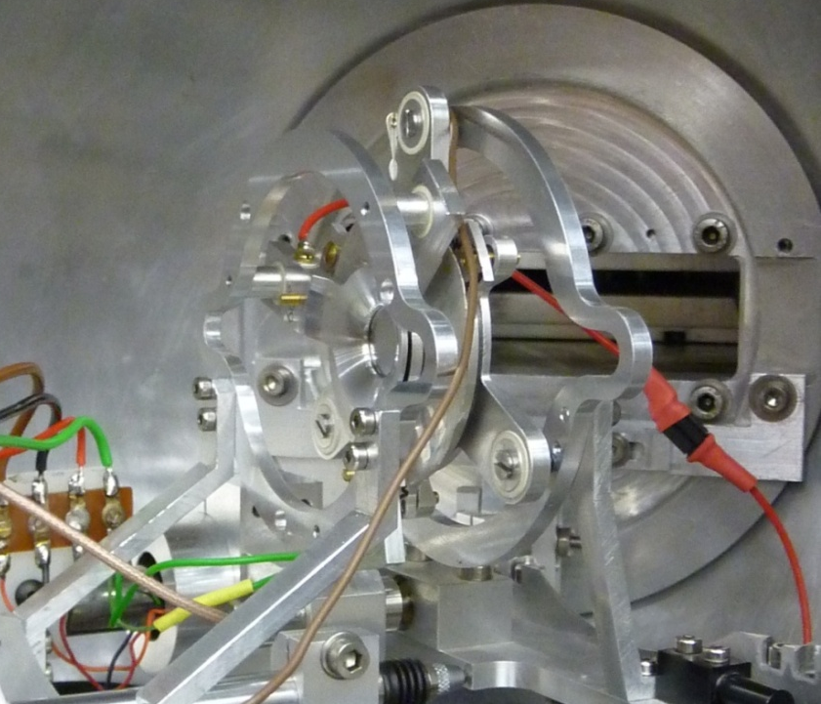
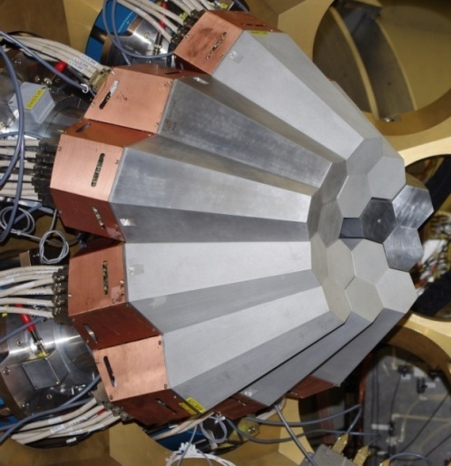
DIFFERENTIAL RDDS MEASUREMENTS AT LNL
⁷⁶Ge + ²³⁸U 577 MeV
⁷²Zn (-2p-2n)
Beam
Spectra at 50 kHz/capsule counting rate
E_{γ}
E’_{γ}
E’_{γ}
E_{γ}
β_{bef}~10%
β_{aft}~8.5%
RDDS
measurement
θ_{G}=55º
IKP University Köln
TU Darmstadt
PLUNGER
AGATA-PRISMA
Notes:
5
AGATA in such limited configuration, counting 5ATC,
can provide only 6% absolute efficiency,
but still an intrinsically high angular resolution, that reflects on
a sensational Doppler correction which up to relativistic
energies is expected to recover the HPGe detector intrinsic resolution.
For this reason, lifetime measurements , where the Doppler correction
–also in terms of available angle-
is fundamental to separate the two peaks, were a sort of flag experiment.

Slide 6
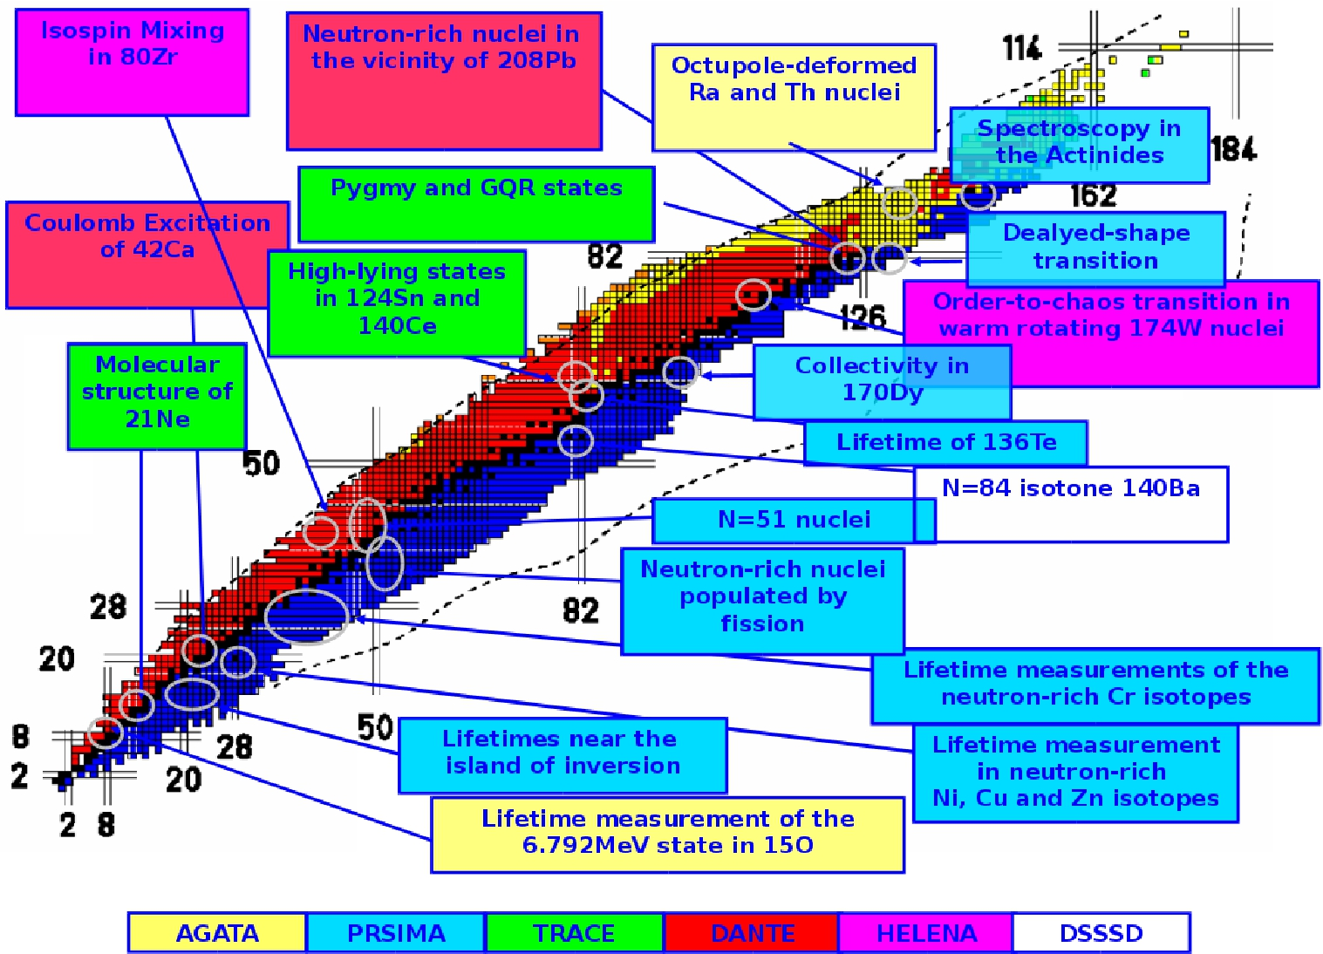
LNL EXPERIMENTS: 20 exps, 148 days, 3500 hs
Notes:
6
Over all 20 exps have been run, ranging from n- to p- rich nuclei from the light
15O and 21Ne up the spectroscopy of heavy Actinides. A variety of ancillary
detectors have been also employed, mostly PRISMA on the n-rich side for quasi-elastic,
MNT, deep inelastic induced fission and other ancillary detectors for Feand Coulomb
Excitation with stable or p-rich nuclei. These were TRACE, HELENA, HECTOR, DANTE..
6

Slide 7
LIFETIMES

Slide 8
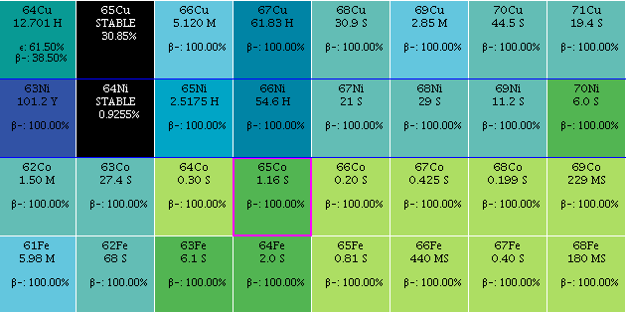
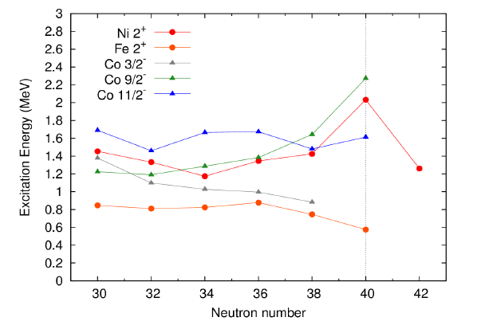


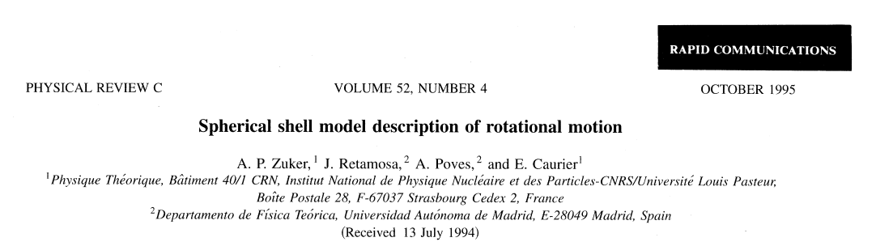
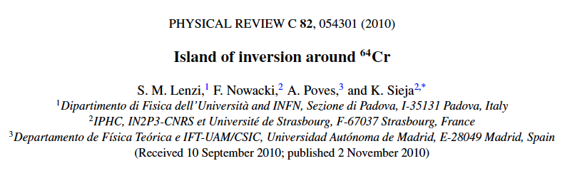
NEW ISLAND OF INVERSION AT N=40
Lifetime
please refer to: F.Recchia TALK @INPC
N=40
Energy
Spherical
Deformed
S. Lunardi et al., PRC76, 034303 (2007)
J. Ljungval et al., PRC 81, 061301(R) (2010)
W. Rother et al., PRL106, 022502 (2011)
d_{5/2}
50
quasi-SU3
Quasi-SU3
g_{9/2}
40
fp
ν
LNPS interaction
Spokepersons: J.J. Valiente-Dobon, S. Lenzi
Notes:
8
A prototype experiment for lifetime measurement is the following.
It aims at the investigation of the deformation while approaching the N=40.
The 68Ni is a spherical nucleus almost magic, yet, by removing few protons, in the
Fe isotopes deformation arises,
as results of the correlation emerging from the interaction of the g9/2 and d5/2 orbitals.
The mechanism is well explained by the LNPS interaction, in the reference.
This behavior has been partially observed also in the Energy observable of the Co isotopes,
between the two, where some states follow the spherical Ni and other the deformed Fe.

Slide 9
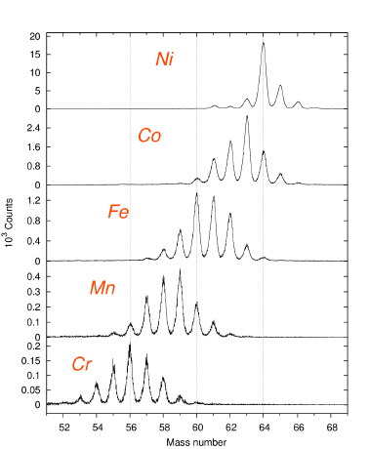
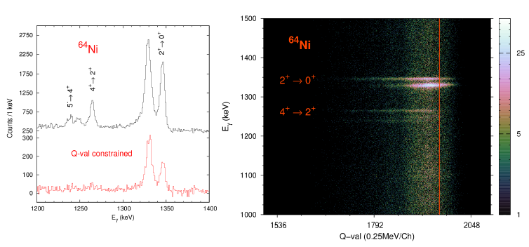
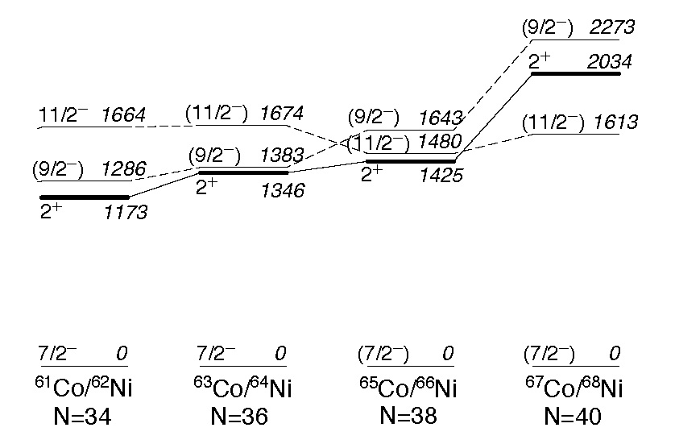
RDDS LIFETIME OF THE 11/2⁻ STATES
Lifetime
please refer to: V.Modamio TALK@INPC
⁶⁴Ni @ 460 MeV (TANDEM+ALPI)
²³⁸U target of 1.35 mg.cm⁻² + 4 mg.cm⁻² Nb Degrader
TKEL gate to reduce side feeding
Inversion of 9/2- and
11/2- in ⁶⁵Co agrees with the LSSM LNPS interaction results.
Due to the ⁶⁶Ni Quadrupole - f7/2
weak coupling
F. Recchia et al., PRC 85, 064305 (2012), V. Modamio et al., PRC (to be submitted)
Notes:
9
The infos has been enriched by studying the lifetime of the light 63,65Co,
through a MNT reaction of 64Ni on U.
After gating on the Qval to get rid of spurious gamma lines and
better control the entry point of the reaction
to avoid if possible any side feeding, the lifetime of the two 11/2 states
have been extracted . The result is in agreement
with the conclusion of the previous experiment.

Slide 10
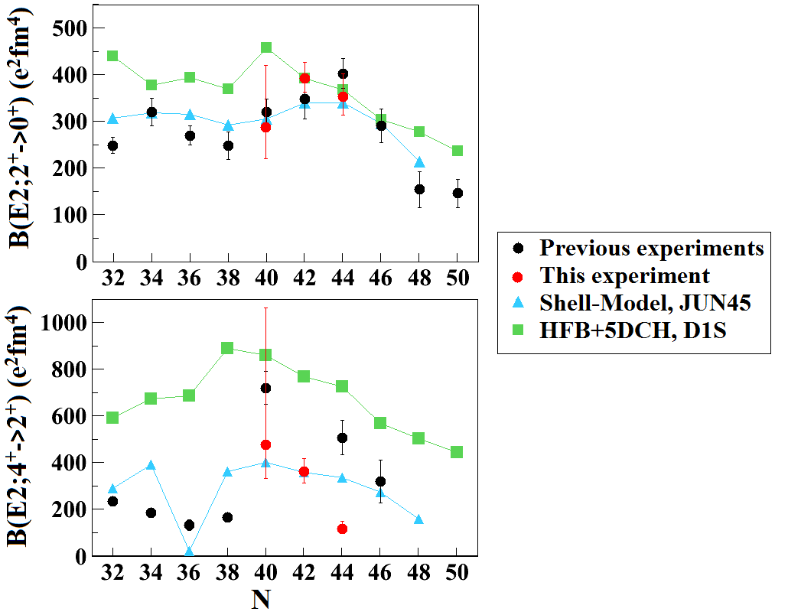
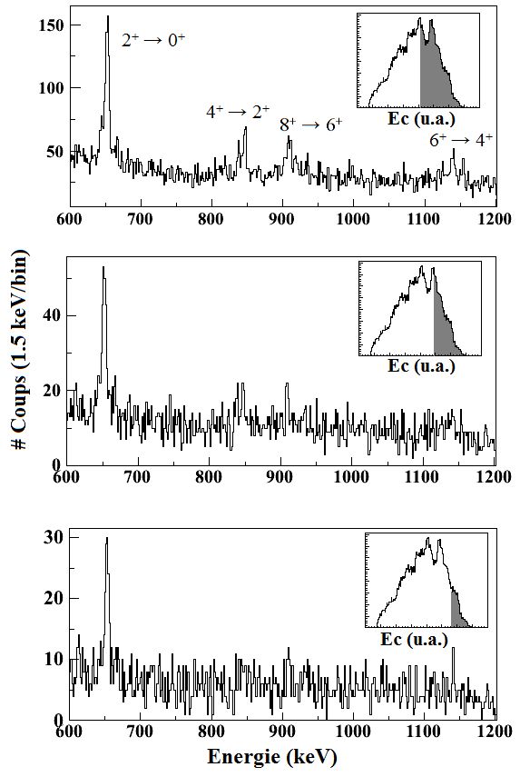
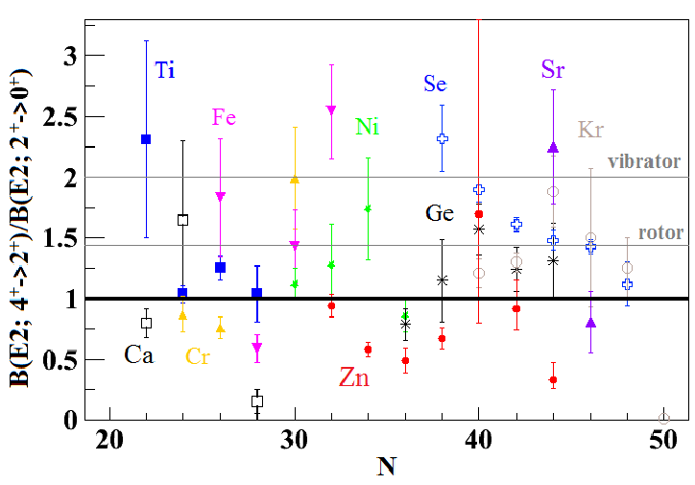
RESULTS ON ^{70,72,74}Zn
Lifetime
⁷²Zn Q_{val} gate
2+:maximum collectivity at N=42
Good agreement with previous results
4+: disagreement with previous results
Not reproduced by LSSM
Lowest B(4/2)<1
B(4/2) ~ seniority:
C.Louchart et al.submitted to PRC
Notes:
10
In a similar experiment Zn and Cu have been studied.
I only remark the main result obtained in the Zn.
Low-lying states,2+.4+,6+ (in same case) of 70,72,74Zn
have been populated and their lifetime extracted. The 2+ is
in good agreement with the systematic of the region and with LSSM calculations.
The 4+ instead doesn’t fit with the systematic and can’t be reproduced
by any calculation. Combining the two infos, one obtained the plot in figure:
the B(4/2) is the slowest in the region, signing a non collective character of Zn,
close to the Ni. Such trend finds a possible explanation if the seniority quantum number were valid.

Slide 11
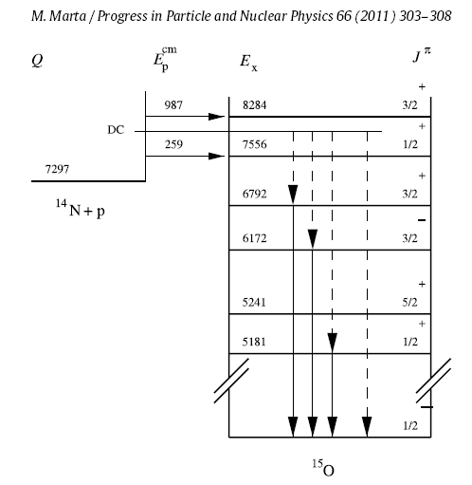
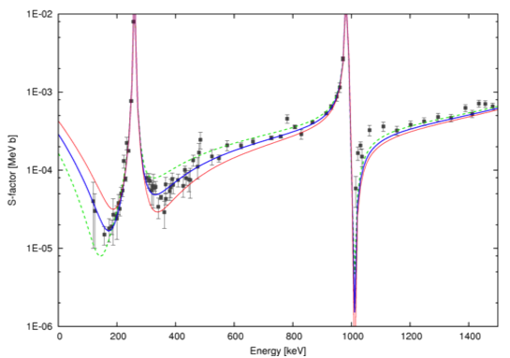
¹⁴N(p,γ)¹⁵O REACTION CROSS SECTION
Lifetime
C.Michelagnoli TALK @INPC
¹³C
(p,ϒ)
¹⁴N
¹⁷O
(p,α)
β⁺
(p,ϒ)
¹⁴N(p,γ)¹⁵O
is the
“bottle neck”
¹³N
¹⁵O
- 507 keV
(p,ϒ)
β⁺
¹²C
¹⁵N
(p,ϒ)
¹⁶O
(p,α)
Captures to different excited states in ¹⁵O contribute to the
cross-section.
The one to the gs in ¹⁵O is dominated by the tail of the sub-threshold resonance at
-507 keV (6.79 MeV state in ¹⁵O)
C.Angulo et al., NP A690 (2001) 755,
M.Marta et al., PR C78 (2008) 022802(R)
1.0 eV
0.8 eV
0.6 eV
Γγ (6792 keV) =
possible solution for the
“solar composition problem”
A.M.Serenelli et al., As.J.Lett. 705 (2009)
Notes:
11
FROM CATE: It has been pointed out by many authors here only some
examples of ref, that the astro S factor at 0 ener for the gs transition
is dominated by the tail of the st reson corresp to the 6.79 state 15O,
just to give u idea of what does it mean …
The (p,g) reaction on 14N is the slowest reaction in the CNO cycle a
nd thus of high astrophysics importance, in fact
it governs the overall rate of hydrogen burning in this cycle.
The reaction is important to disentangle the solar composition problem,
in particular the metallicity distribution along the solar volume.
The reaction rate is strongly affected by the sub-threshold resonance in the 15O.
Thus we performed an experiment using inverse kinematics,
14N on a deuterated target,
to extract the width of the resonance by measuring its lifetime.
11

Slide 12
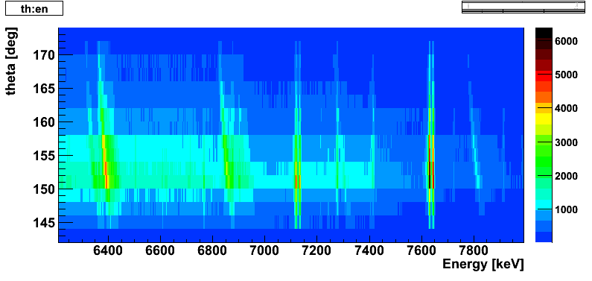
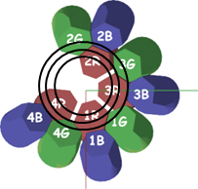
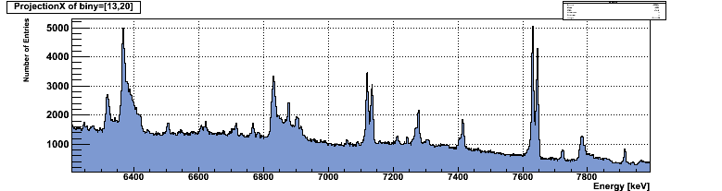
LIFETIME MEASUREMENT of 6.79 MeV in ¹⁵O
¹⁴N(²H,n)¹⁵O and ¹⁴N(²H,p)¹⁵N reactions @ 32 MeV (XTU LNL Tandem)
Direct lifetime measurement with 4 ATCs at backward angles (close to the beam-line)
With a tracking array, detected gamma-rays can be sorted in few degrees θ “slices” with a continuous distribution
¹⁵O 6.79 MeV
τ??
source(*)
¹⁵N 7.3 MeV
τ=0.65 fs
(*)
¹⁵N 8.3 MeV
τ=2 fs
C.Michelagnoli et al.
Notes:
12
NB: L’ energia dei calcoli non e`la «nostra», DWBA e CC calc in progress...
Vita media messa nella simul = 1fs
a voce di che stimiamo che con questa cinematica ecc. la nostra sensibilita`e`di circa 4 fs (preliminare)
The g-ray energy emitted from a slowyng down nucleus changes accordingly
with the velocity. To fully exploit theDSAM method the nucleus
must appreciably slow down within a time interval comparable
with the intended lifetime. In the case of AGATA the energy data
can be sorted as a function
of a CONTINUOS theta angle shows up the quality of collected data.
12

Slide 13
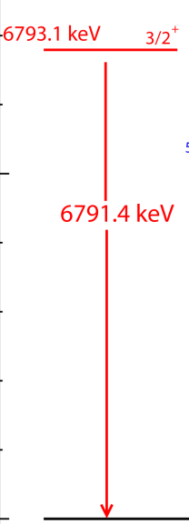
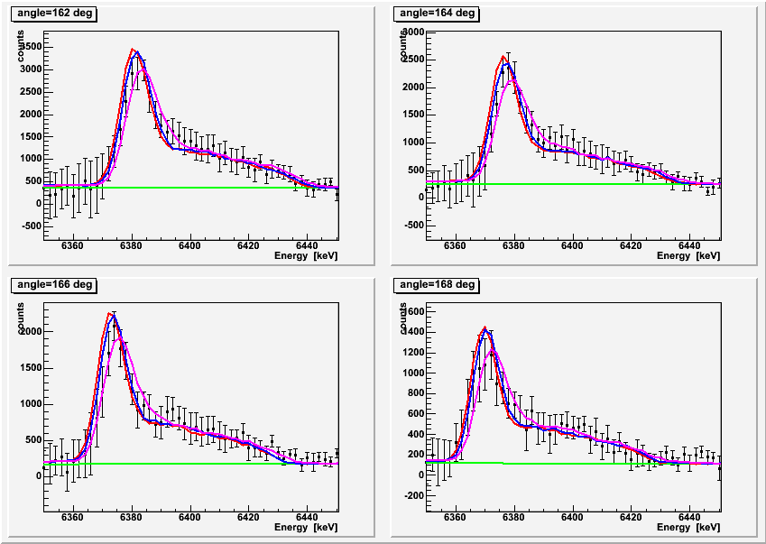
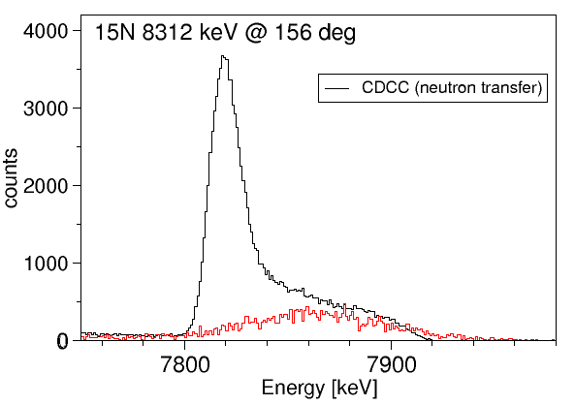
THE 6.79-MeV LEVEL IN ¹⁵O
Lifetime
0 fs
1.1 fs
4 fs
¹⁵O
further details:
C.Michelagnoli TALK @INPC
Transfer
+
CN reaction
Notes:
13
NB: L’ energia dei calcoli non e`la «nostra», DWBA e CC calc in progress...
Vita media messa nella simul = 1fs
a voce di che stimiamo che con questa cinematica ecc. la nostra sensibilita`e`di circa 4 fs (preliminare)
Further analysis has been performed by squeezing only few
degrees and comparing
such distribution with a MonteCarlo simulation where the physics events
were either from a transfer or a FE reactions, hence the smooth bump
on the right of a narrower peak. The overall sensitivity
which resulted from such analysis is a few fs.
13

Slide 14
Higher energy regime

Slide 15
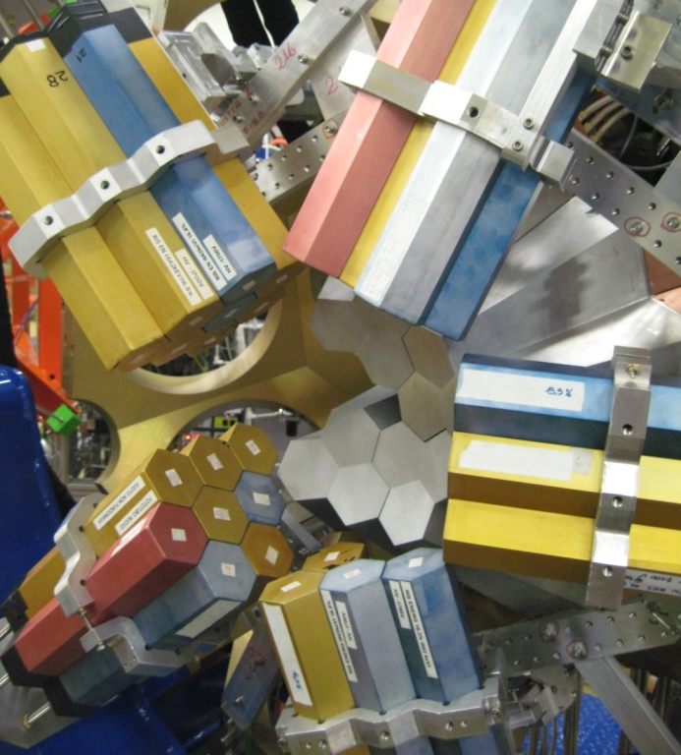

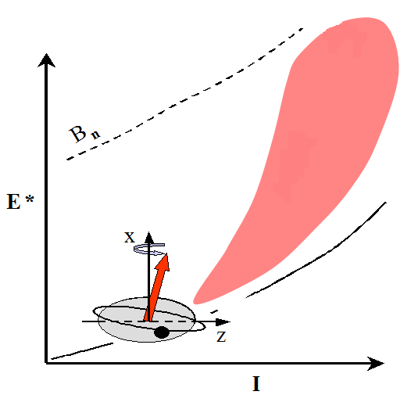
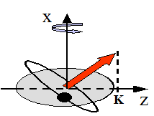
¹⁷⁴W: ORDER-TO-CHAOS TRANSITION
High TEmp
High-Spin Fusion Evaporation
⁵⁰Ti on ¹²⁸Te @ 217 MeV, I ≥ 60
4 Triple Clusters
2 and 3 folds:
ε_{2γ}=30%, ε_{3γ}=10%
(M_{γ} = 30)
Loss of selection rules on K with temperature
K–quantum number
γ− flow
Loss of K
K is robust at T=0
(K-isomers …)
27 detectors: 5 clusters of BaF₂ (3”×3”, exagonal)
Total solid angle: 25% of 4π
Total efficiency: 16% @ 500keV
Goal: populate ¹⁷⁴W at the highest possible spins (≥60ћ), in order to make the statistical fluctuation analysis of the ridge-valley structures in the γ-γ matrices, to estimate the number of low-K and high-K bands and their correlation
V. Vandone, S. Leoni, …
Milano University
V.Vandone et al.submitted to PLB
Notes:
We now move to high excitation energy and high collective states.
The first experiment refers to the Order=to=chaos transition.
Close to the Yrast line, the nucleus is a well ordered system,
with associated selection rules. With the excitation energy
the energy levels start to interact , the selection rules gradually vanish:
quantum numbers lose their meaning with the temperature.
The weakening of the selection rules can investigated
by studying the validity of the K quantum number.
A FE experiment was performed to populate low and high bands in 174W,
using a setup that combined AGATA with an array of BaF2

Slide 16
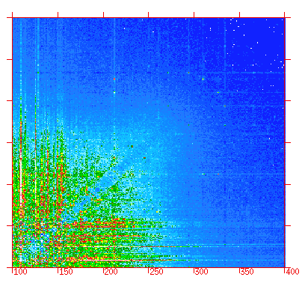
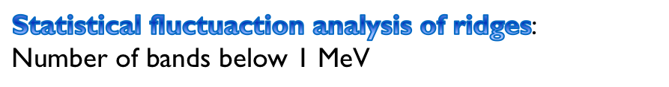
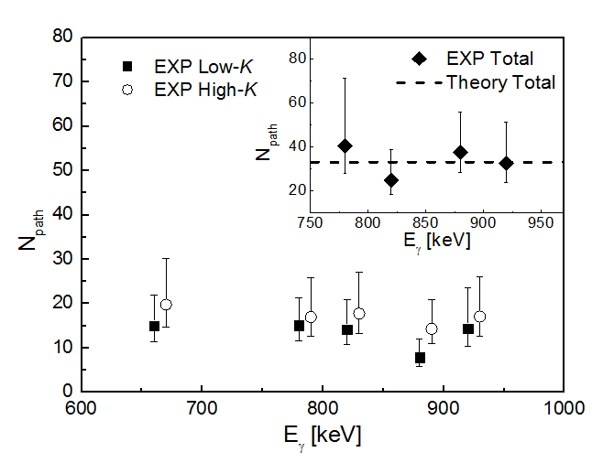
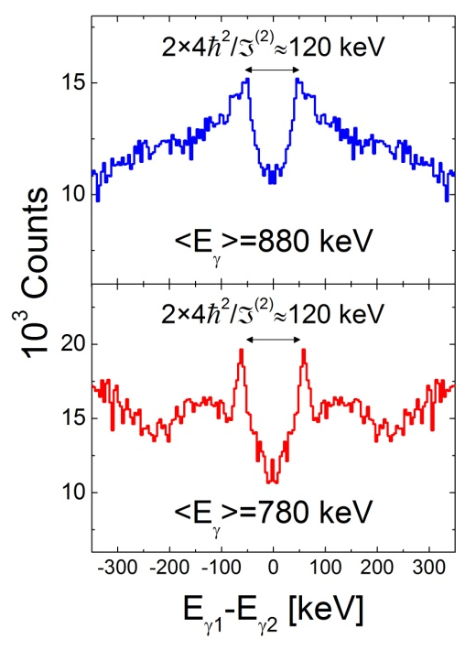
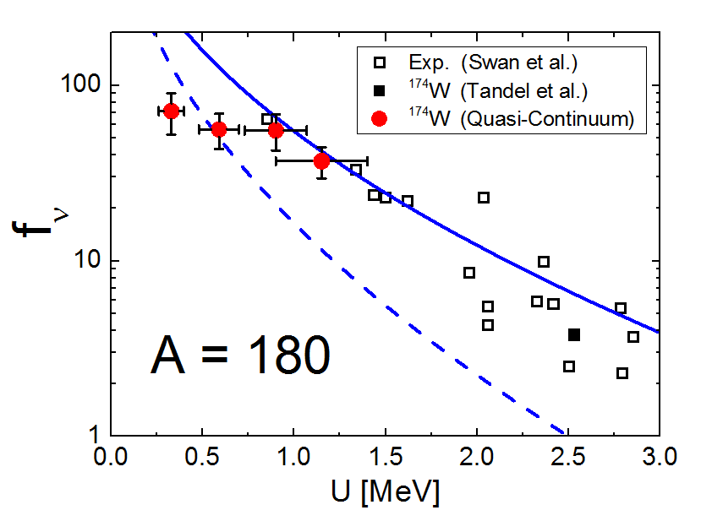
QUASI-CONTINUUM γ-γ MATRICES
High TEMP
1200
E_{γ2} [keV]
¹⁷⁴W
800
Similar number
Low-K and High-K
Bands
As in the only studied case of ¹⁶³Er
400
400
1200
E
γ
1
[keV]
Cut 45°
K-mixing due to
Temperature is the
Leading phenomenon
Progressive weakening
of selection rules on K
Notes:
RESULTS: Collecting the decay flux into gg matrix it is evident
that it exists a ridge-valley structure typical of rotational nuclei,
where the gap between
the most inner ridges proportional to the MoI of the band.
After subtracting the uncorrelated background and
known discrete transitions,
a FAM method has been pursued to reconstruction the bands
at least two-step long. Almost 30bands, equally distributed between H and L K bands.
The INTERPRETATION
1)Montestella code has been run to simulate the decay flux
from the residual entry distribution down to the yrast line, by competing E1 or E2.
The key feature of the code is that the energy levels are
calculated by the Cranked shell model for a nucleus of known
deformation and the decay takes into account the angular
momentum carried by the K quantum number. The E1 transition probability
is quenched by a factor which depends on the initial and intial k distribution.
To reproduce the experimental data, an hindrance factor must be assumed,
which is also a function of the temperature.

Slide 17
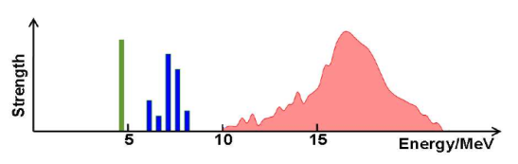

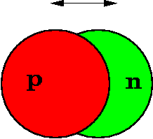
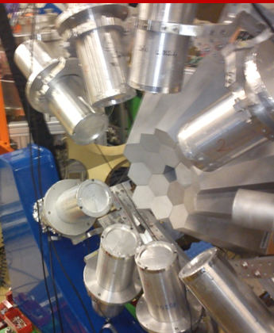
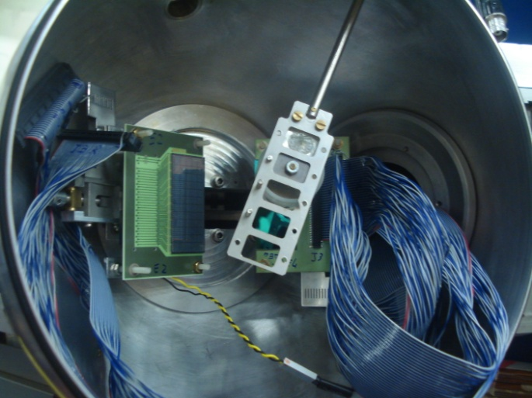
PHYSICS CASE
High E. states
Nuclear Structure information from the Low Energy part of the Electric Dipole response
Pygmy Dipole Resonance
The relevant energy window for (γ,n) reactions in the stellar photon bath is located in the vicinity of the PDR.
Giant Dipole Resonance
LOW ENERGY
HIGH ENERGY
Inelastic scattering of ¹⁷O @ 20 MeV/u on different targets + γ-rays in coincidence
please refer to: F.Crespi TALK @INPC
HECTOR+
TWO EXPERIMENTS PERFORMED:
Studied Nuclei: 208Pb 90Zr
R. Nicolini (Università di Milano /INFN)
D.Mengoni (Università di Padova/INFN)
Studied nuclei: 208Pb, 124Sn,140Ce
M. Kmiecik (IFJ PAN Kraków) ,
F. Crespi (Univ. di Milano/INFN)
TRACE
please see: F.Camera TALK @INPC
Notes:
Still considering the high-excitation response of the nucleus,
GQR and GDR, and specifically the strength concentrated in the low energy tail
were the PYGMY might appears, have been studied by using
the inelastic scattering of 17O on a series of targets, among which Pb,Zr,Sn and Ce
The setup consisted in the AGATA clusters coupled with an array of LaBr
and few highly segmented silicon telescopes from the TRACE array.
17

Slide 18
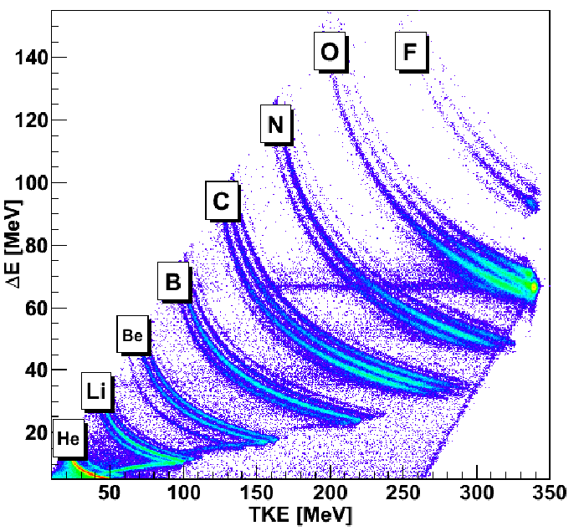
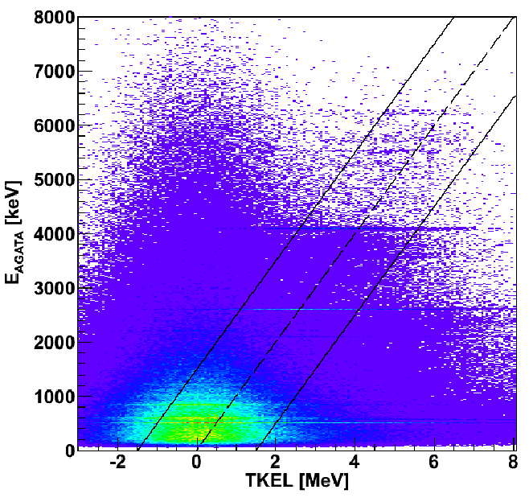



PRELIMINARY RESULTS: PYGMY in ²⁰⁸Pb
High E. states
N. Ryezayeva et al., PRL 89, 27 (2002) –
previous NRF Experiment
208Pb(γ, γ’ )
A. Tamii et al., PRL 107, 062502 (2011)
208Pb(p, p’)
One group of states with isoscalar character, the other with an isovector nature.
Strength
This expoeriment
AGATA
preliminary-
208Pb(17O,17O’γ)
Notes:
Centre: By gating on the scattered 17O and the TKEL -> peaks
in the region of GDR are pronounced. When the yields is extracted and
compared with gg’ and pp’, it is evident that different states respectively
in the isoscalar and isovector part of the GDR are selectively populated,
as also predicted well by QRPA.

Slide 19
POLARITAZION

Slide 20



POLARIZATION
COULEX TEST ^{104,108}Pd
NON-YRAST OCTUPOLE BAND ²²⁰Ra, ²²²Th (J.F.Smith , D.Mengoni)
POSITRONIUM ENTANGLEMENT β⁺ source ²²Na (P.G. Bizzeti)
Notes:
Another distinguished feature of a tracking array, which
thus strongly relays on the position resolution,
is the possibility to measure the polarization of
scattered gamma rays, with high sensitivity.
Three exp have been run on purpose, indeed any
exps could make their own “polarization measurement”.
The figure refers to the entanglement measurements
where two clusters were positioned as
facing each other in three distinct set of measurements.

Slide 21




PRELIMINARY RESULTS, COULEX
polarization
AGATA modules as Compton Polarimeters
Partially-polarized 555.8-keV and 433.9-keV lines in ¹⁰⁴Pd and ¹⁰⁸Pd [+unpolarized ¹³⁷Cs source].
Please refer to:
B.Melon TALK @INPC
GOSIA
Analyzing power: 6x10-3
Notes:
Partially polarized Gamma rays emitted at about 90
degrees with respect to the beam direction have been
collected by 2 ATC and subsequently all those who
scattered have been considered to extract
the analyzing power. The Compton formula can be simply
rewritten, Thus it depends on a
measurable quantity, a fit, and a coefficient with is a
ration between the polarization,
calculated here for Coulex, and the analyzing power,
which therefore can be extracted.

Slide 22
Summary and conclusions
One-year long commissioning campaign: Gamma ray-tracking concept works
Successful two-year long Physics campaign: Light/heavy masses, high spins and low-lying properties, etc.
Analysis of the experiments ongoing and some papers already submitted
Performance OF THE agata demonstrator IS PROMISING, MOSTLY iN COMBINATION WITH SEVERAL ANCILLARY DETECTORS
Notes:
22
Tra i paper ongoing citare high lying states e astrophysics
Already submitted, about to, or in preparation
Overall the performance of the demonstrator, with
or without ancillaries, were positive and very promising in
view of further increase in number of the detectors.

Slide 23


ACKNOWLEDGMENTS
Nuclear Instruments and Methods in Physics Research A 668 (2012) 26–58
and counting ….
Notes:
I’d like to thank all the contributors to the project, mostly listed in the referred paper, coming from 13 different countries and here ideally put under the collaboration flag.

Slide 25




Position Resolution from in-beam tests
³⁰Si@70MeV + ¹²C
Position of first interactions at AGATA nominal distance
³⁰Si@70MeV + ¹²C
Δθ
γ ray
Overall position resolution for three detectors and two distances
θ
Beam
Recoil
4 - 4.5 mm for Eγ above
1 MeV (σ = 2 mm).
P-A Söderström (Uppsala)
F. Recchia (INFN-PD)
NIM A 638 (2011) 96
Notes:
25
03/15/13 03/18/13
© 2007 Microsoft Corporation. All rights reserved. Microsoft, Windows, Windows Vista and other product names are or may be registered trademarks and/or trademarks in the U.S. and/or other countries.
The information herein is for informational purposes only and represents the current view of Microsoft Corporation as of the date of this presentation. Because Microsoft must respond to changing market conditions, it should not be interpreted to be a commitment on the part of Microsoft, and Microsoft cannot guarantee the accuracy of any information provided after the date of this presentation.
MICROSOFT MAKES NO WARRANTIES, EXPRESS, IMPLIED OR STATUTORY, AS TO THE INFORMATION IN THIS PRESENTATION.
25

Slide 26
1ATC performance from commissioning run
LSSM
Interaction from
E. Caurier et al.
PRC 75, 054317
Notes:
26

Slide 27



SHELL EVOLUTION IN Cu AND Zn ISOTOPES
Systematic variation of effective single-particle energies due to the tensor interaction
T. Otsuka et al. PRL 95, 232502 (2005)
πp_{5/2}×2⁺ (^{A-1}Ni)
7/2⁻
πp_{3/2}×2⁺ (^{A-1}Ni)
7/2⁻
ISOLDE
7/2⁻
Coulex ISOLDE
(πf_{7/2})⁻¹
LNL
πf_{5/2}
5/2⁻
Inversion of the f_{5/2} with the p_{3/2} in ⁷⁵Cu
1/2⁻
πp_{3/2}
3/2⁻
⁷¹Cu₄₂
⁷³Cu₄₄
⁷⁵Cu₄₆
⁷⁷Cu₄₈
presence of both single-particle and collective states at low energy
S. Franchoo et al., PRL 81, 3100(1998), I. Stefanescu et al., PRL 100, 112502 (2008) , K. Flanagan PRL, 103, 142501 (2009), J. M. Daugas PRC 81, 034304 (2010)
Spokepersons: E. Sahin, M. Doncel, A. Goergen
Notes:
27

Slide 28



CHARACTER OF THE 7/2⁻ STATE IN ⁷¹Cu
RDDS measurement: ⁷⁶Ge (577 MeV) + ²³⁸U (1.5 mg/cm²), Degrader Nb 4.17 mg/cm²
πp_{3/2}×2⁺ (Ni)
1190 keV
7/2⁻
(πf_{7/2})⁻¹
7/2⁻
981 keV
πp_{3/2}
3/2⁻
⁷¹Cu₄₂
τ=20+/-16ps
New approach for lifetime: normalization done with the number of ions (PRISMA)
LNPS interaction: shell-model calculations using an enlarged valence space:
pf-shell orbitals for protons and f_{5/2}, p_{1/2}, p_{3/2}, g_{9/2} and d_{5/2} orbitals for neutrons.
Complex wavefunctions
small changes in πp3/2 & p1/2
occupancies
LNL
ISOLDE
Analysis by M. Doncel, E. Sahin, C.Louchart
LSSM by K. Sieja et al.
Notes:
28

Slide 29



SHAPE TRANSITIONS IN Os ISOTOPES
Ph.R. John, V. Modamio, Zs. Podolyak, C. Wheldon, W. Korten
Energy Density Functionals –
D. Vretenar (Priv. Comm.)
Binding energy map βγ plane
ROTOR
P.D. Bond Phys. Lett. 130B, 167
g SOFT
Zs. Podolyàk et al. PRC79, 31305(R)
C. Wheldon et al. PRC63, 11304
Notes:
29

Slide 30




FIRST EVIDENCE OF ¹⁹⁶Os
⁸²Se + ¹⁹⁸Pt (2mg/cm²) at 426 MeV
BLF: β~10% FWHM: 0.5%
TLF: β~3% FWHM: 1.8%
Analysis by P.R. John
Notes:
30

Slide 31



COULEX ⁴²Ca (γ spectrum ⁴²Ca+²⁰⁸Pb)
COULEX ⁴²Ca (γ SPECTRUM ⁴²Ca+²⁰⁸Pb)
K. Hadyńska-Klęk et al.,
(Acta Phys. Pol B 42, 817 (2011))
899
2424

Slide 32


COULEX ⁴²Ca: SUPER DEFORMATION?
K. Hadyńska-Klęk et al., (accepted in Acta Phys. Pol B)
Zakopane Conference on Nuclear Physics 2012
Q² nuclear shape invariants determined by using the Quadrupole Sum Rules method

