Slide 1
Characterization of Large Volume 3.5" x 8" LaBr₃:Ce Detectors for the HECTOR⁺ array
F. Camera
University of Milano – INFN sez. of Milano
LaBr₃:Ce brief history
2001 – Discovery - Applied Physics Letter 79(2001)1573
≈ 2005 – 1” x 1” Commercially available
≈ 2006 – 3” x 3” Commercially available
≈ 2007 – 3” x 6” Commercially available
≈ 2008 – 3.5” x 8” Commercially available
- The History of LaBr₃:Ce started 10 years ago
The History of large volume LaBr₃:Ce started only 4-5 years ago
LaBr₃:Ce is a brand new scintillator
LaBr₃:Ce is the scintillator which has the best energy resolution (20 keV at 662 keV, a sub-nanosecond time resolution, almost perfect light yield proportionality and high efficiency (high density, effective ‘Z’ and large volume)

Slide 2
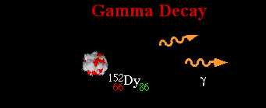

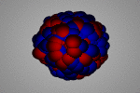
Physics Cases
Study of nuclear collective states
Measurements of the γ-decay from collective states
IVGDR
Measurement of low energy γ-rays (0-5 MeV) ⇒ Reaction Mechanism (E-res)
Measurement of high energy γ-rays (5-30 MeV) ⇒ Collective States (E-res, eff.)
Background and neutron rejection ⇒ Use of Radioactive Beams (T-res)

Slide 3
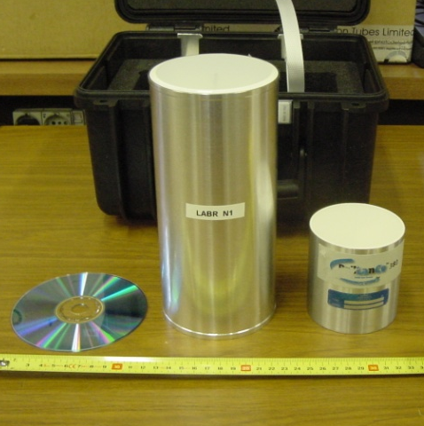
HECTOR⁺ Array
High efficiency portable scintillator detector array
8 Large Volume BaF₂ Detectors (14 x 17 cm)
36 Small Volume BaF₂ Detectors
10 large Volume LaBr₃:Ce detectors ( 9 x 20 cm)
A LaBr₃:Ce array, is capable to work in a standalone configuration but, when coupled to a radiation detection system, increases the efficiency and makes much more powerful the physics program of the detection system.
HECTOR+ has already measured in several laboratories
coupled to HPGe arrays
- AGATA @ LNL Low Lying pygmy and quadrupole states
      - AGATA @ LNL isospin mixing in ⁸⁰Zr
  - AGATA @ GSI (pygmy resonance on ⁶⁴Fe)
coupled to LAND @ GSI
coupled CACTUS @ OSLO
RIKEN, DEBRECEN.

Slide 4
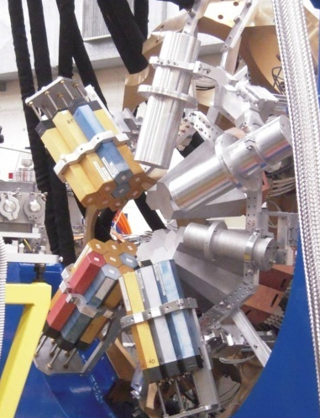
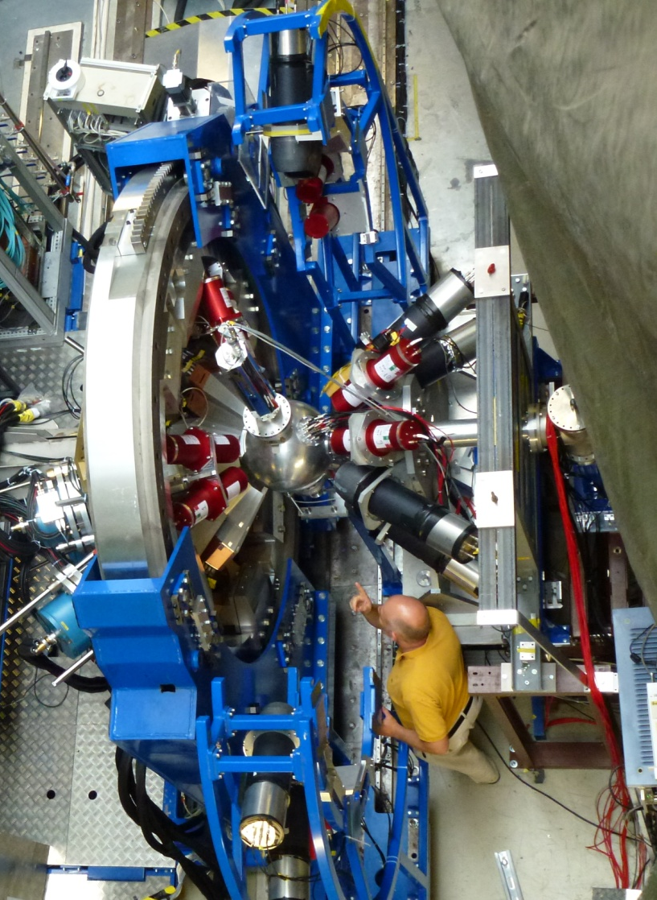
HECTOR⁺ Array
High efficiency portable scintillator detector array
8 Large Volume BaF₂ Detectors (14 x 17 cm)
36 Small Volume BaF₂ Detectors
10 large Volume LaBr₃:Ce detectors ( 9 x 20 cm)
A LaBr₃:Ce array, is capable to work in a standalone configuration but, when coupled to a radiation detection system, increases the efficiency and makes much more powerful the physics program
  HPGe arrays - AGATA @ LNL Low lying pygmy and qudrupole states
          in ²⁰⁸Pb, ¹²⁴Sn, …
  - AGATA @ GSI (pygmy resonance on ⁶⁴Fe)
  LAND @ GSI
  CACTUS @ OSLO
  RIKEN
AGATA-BaF₂-LaBr₃:Ce at LNL
PRESPEC-AGATA-LaBr₃:Ce at GSI

Slide 5
Characterization of Large Volume LaBr₃:Ce Detectors
Rise time
Pulse line-shape
Count Rate
Pulse distortion with γ-rays energy
Linearity in energy
Energy resolution and NON homogeneity
High energy gamma rays
Efficiency
The properties of large volume LaBr₃:Ce cannot be easily deduced from those of small crystals
Long mean free path of scintillation ligth (enhance Self Absorption )
Crystal non-homogeneities (change in light yield)
Efficiency vs. high energy γ-rays
High count rates
Large dynamic range (0.1 – 30 MeV)
Large PMT with more evident non idealities
- PMT, Voltage Divider, front end electronics, DAQ ⇒ not here discussed

Slide 6
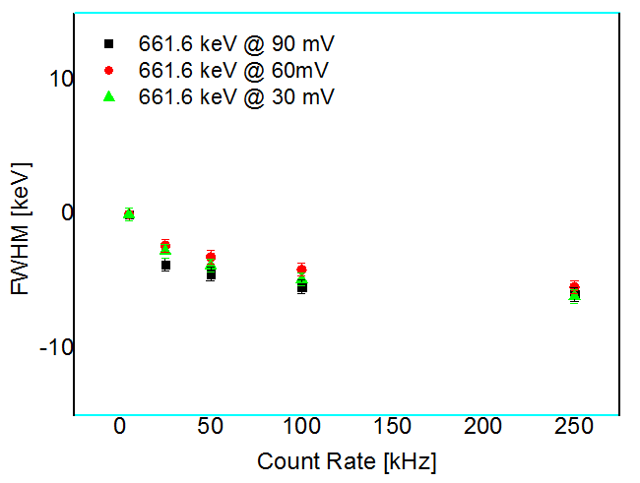
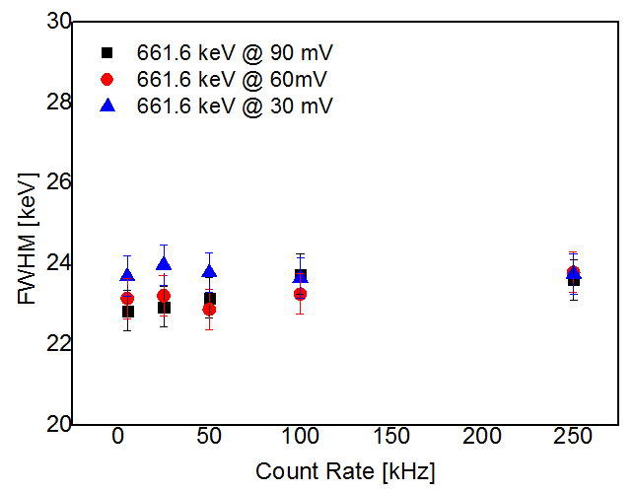
Characterization of Large Volume LaBr₃:Ce : Count Rate induced effects
898 keV line
898 keV line
The 898 keV peak centroid drifts less than 10 keV changing the rate from 1 to 250 KHz
- as the gain decreases , we verified that it is a temperature C.R. induced effects
The 898 keV peak energy resolution does not change with count rate
The signal have been digitized (8 bits 400 MHz bw 5 GHz Samp. Freq.) and analyzed
Note: not only the PMT but also the subsequent electronics, e.g. shaping amplifier, analog to digital converter, etc. may easily impair the LaBr₃:Ce detector performances, especially in case of high count rate of events and with lack of pile-up rejection
A. Giaz, et al submitted to NIM 2013

Slide 7
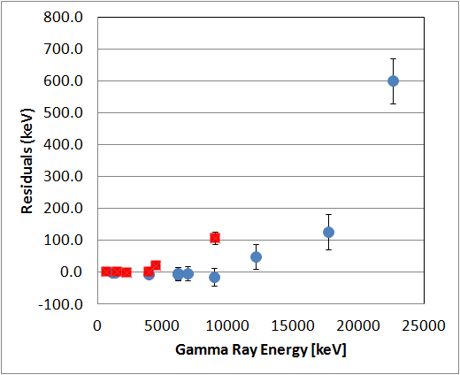
Characterization of Large Volume LaBr₃:Ce Detectors: Linearity in Energy
- It is a PMT + Voltage divider effect
Red Points
Passive Voltage Divider
Blue Points
LABRVD
Active Voltage Divider
HV (LABRV)= 790 V
HV (Passive VD) = 600 V
At 22.6 MeV the NON linearity is of the order of 3%
PMT Linear response fluctuates between ± 1% from tube to tube
A lower voltage garantees a linear response for γ-rays of higher energy

Slide 8
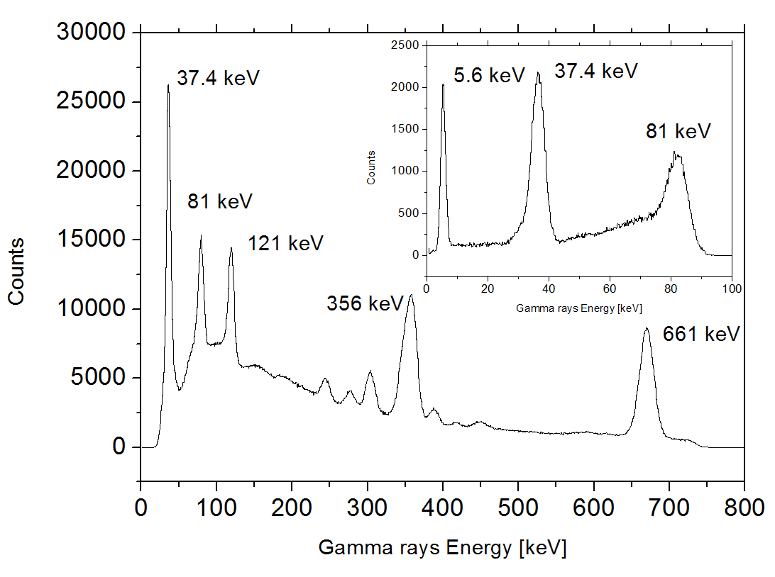
Characterization of Large Volume LaBr₃:Ce Detectors
Energy Spectra at 0.01 and 17.6 MeV
3.5” x 8” Large Volume LaBr3:Ce
Internal radiation + ¹³³Ba and ¹³⁷Cs source
⁷Li+p = ⁸Be target LiBO₂

Slide 9
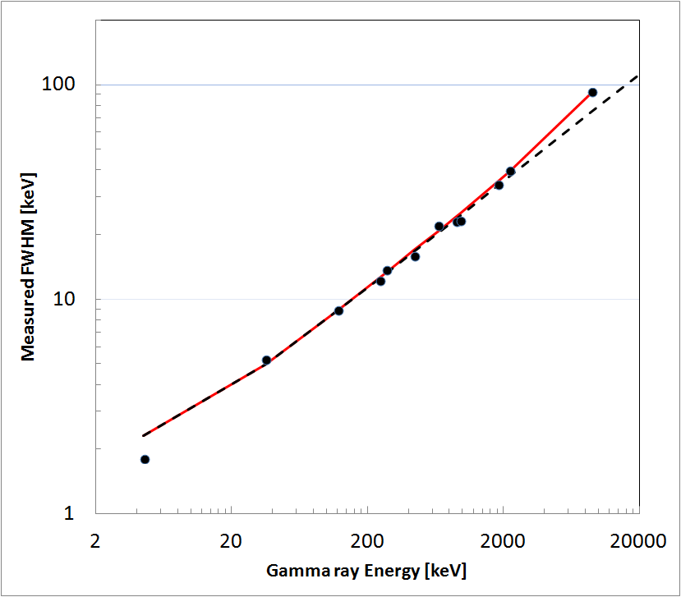
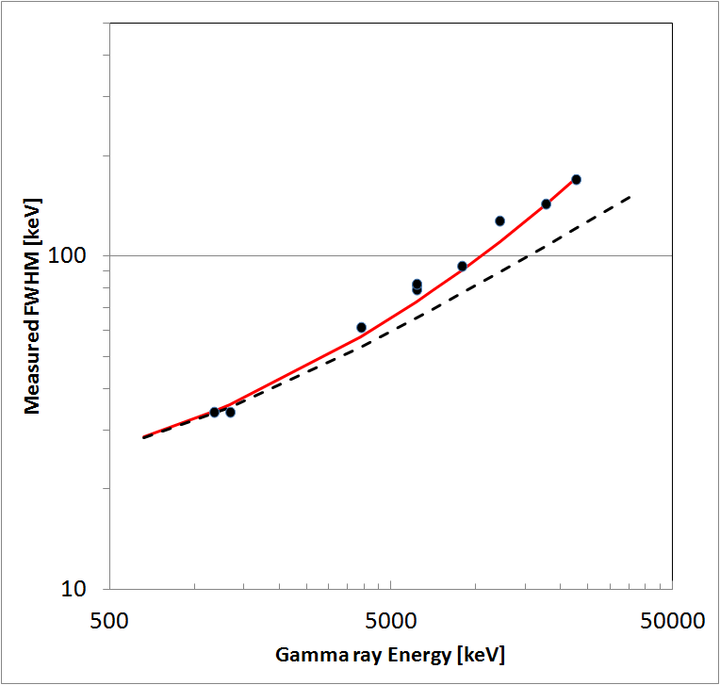
Characterization of Large Volume LaBr₃:Ce Detectors
Energy Resolution
Digital electronics (Milano Laboratory)
Analog electronics (Debrecen)
a ⇒ Electronic noise
b ⇒ Poisson Statistics
c ⇒ Drift, Temperature, NON homogeneities
A. Giaz, et al submitted to NIM 2013

Slide 10
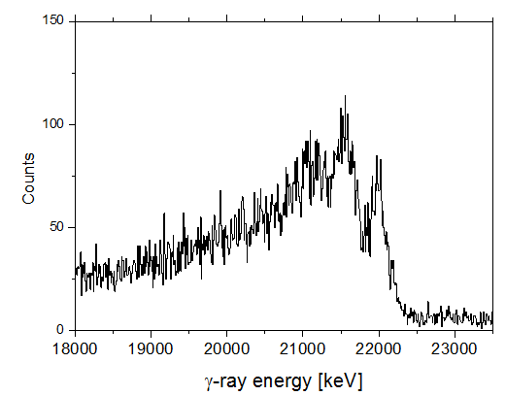
Unique Feature
LaBr₃:Ce detectors provide, at the same time, clean spectroscopic information from a few tens of keV up to tens of MeV, being furthermore able to clearly separate the full energy peak from the first escape one
This is particularly true for large volume detectors which have FEP efficiency for high energy γ-rays
Large volume LaBr₃:Ce detectors can perform spectroscopy of high energy γ-rays up to 30 MeV

Slide 11
Characterization of Large Volume LaBr₃:Ce Detectors: efficiency
1 detector
⁶⁰Co Source attached to the front face
Sum peak technique
GEANT Simulations
Source at 20 cm
One large volume 3.5”x8” LaBr3:Ce detector at 20 cm from target has ∼10% relative full energy peak efficiency for 10 MeV γ-rays.
A 10 detector large volume 3.5”x8” LaBr₃:Ce array placed 20 cm from the target has 1% absolute full energy peak efficiency for 10 MeV γ-rays.

Slide 12
Conclusions
HECTOR+ is a new and high performing array of large volume LaBr₃:Ce detectors
HECTOR+ can perform γ-rays spectroscopy of low-medium and high energy γ- rays at least up to 25 MeV
HECTOR+ is capable to work in a standalone configuration but, when coupled to a radiation detection system, increases the efficiency and makes much more powerful the physics program
HECTOR+ has already measured with AGATA in LNL and PRESPEC-AGATA@GSI
Thanks to
A. Giaz^{a,b}, L.Pellegri^{a,b}, S. Riboldi^{a,b}, F.C.^{a,b,**}, N. Blasi^{b}, C. Boiano^{b}, A.Bracco^{a,b},
S. Brambilla^{b}, S. Cerutiª, S.Coelli^{b}, F.C.L. Crespi^{a,b}, M.Csatlòs^{c}, A. Krasznahorkay^{c}, J.Gulyàs^{c}, S.Lodettiª, S. Fregaª, B. Million^{b}, A. Owens^{d}, F. Quarati^{d,*}, L.Stuhl^{c}, and O.Wieland^{b}
ª Università degli Studi di Milano, Physics Dept., Via Celoria 16, 20133 Milano, Italy
^{b} INFN Milano, Via Celoria 16, 20133 Milano, Italy
^{c} Institute of Nuclear Research of the Hungarian Academy of Sciences (ATOMKI), P.O. Box 51, H-4001, Debrecen, Hungary
^{d} SRE-PA, ESA/ESTEC, Keplerlaan 1, 2200AG Noordwijk, The Netherlands

Slide 13
Thank you for the attention

Slide 14
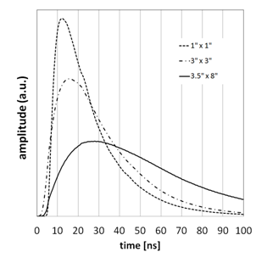
Characterization of Large Volume LaBr₃:Ce : Rise time
H6533 PMT
As energy resolution is the same in all these crystals (3-3.3% at 661 keV) self absorption inside the crystal is negligible
The time required to collect the scintillation light:
≈ 4 ns ⇒ 1” x 1” scintillator
≈ 7 ns ⇒ 3” x 3” scintillator
≈ 14 ns ⇒ 3.5” x 8” scintillator
A. Giaz, et al submitted to NIM 2013

Slide 15
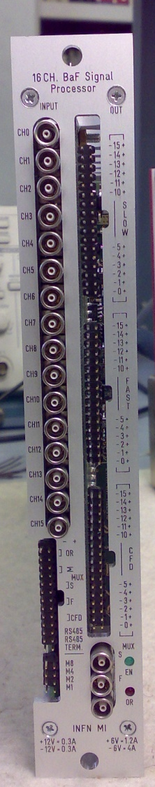
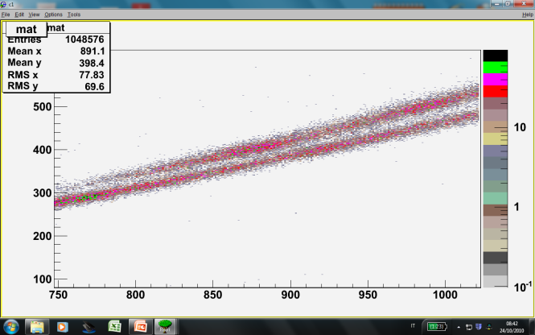
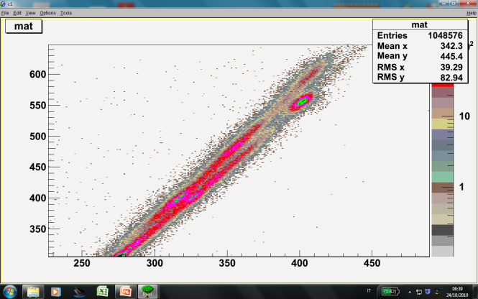
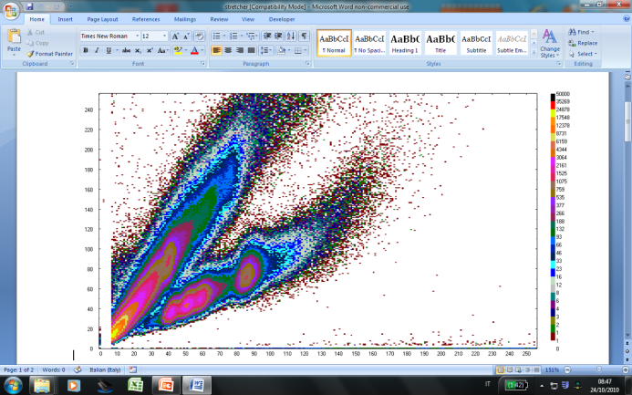
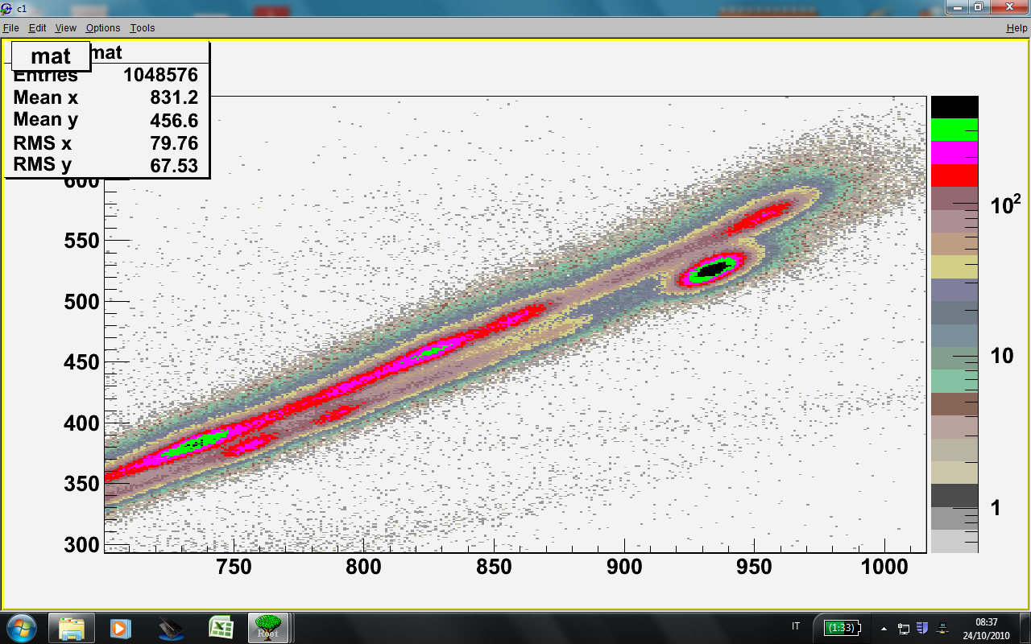
BaFPro (for BaF₂ and … also for LaBr₃::Ce)
Main functions
NIM standard module
16 channels
Fast output = 2µS Time to peak
Energy output = 2µS Time to peak
CFD resolution < 100pS
CFD OR output
Multiplicity Output
RS485 dedicated software control
Coarse & Fine Gain, CFD thresholds
1”x1”
2”x2”
3”x3”
C.Boiano IEEE CR 2009

Slide 16
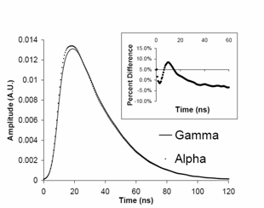
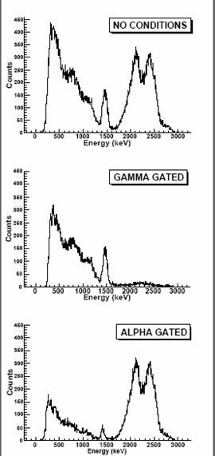
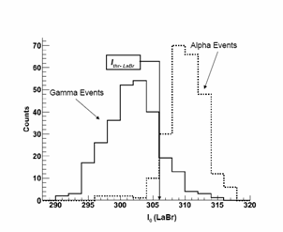
PSA in LaBr₃:Ce and LaCl₃:Ce
Digital Board 2 GHz 12 Bits
PSA
Algorithm
90% of particles
identified
F.C.L. Crespi et al NIMA 602 (2009) 520–524

Slide 17
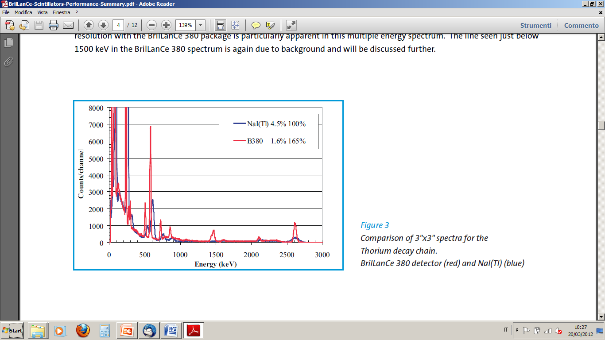
LaBr₃:Ce and NaI comparison (linearity)
Note:
NaI non linearity
P/B ratio
Saint Gobain 2009 documents

