Slide 1



SPES Project
Selective Production of Exotic Species
α
γ
β
δ
Gianfranco Prete LNL-INFN
On behalf of the SPES Collaboration

Slide 2
Develop a Neutron Rich ISOL facility delivering Radioactive Ion Beams at 10AMeV using the LNL linear accelerator ALPI as re-accelerator.
Develop a Direct ISOL Target based on UCx to reach 10¹³ Fission/s.
Use nuclear physics technology and accelerators for Applications in medicine and material science.
SPES project strategy
Exotic nuclei
ISOL facility for
Neutron rich nuclei by U fission 10¹³ f/s
high purity beam
Reacceleration up to >10 MeV/u
Applications
Proton and neutron facility for applied physics
Radioisotope produduction
& Medical applications
α
γ
β
δ

Slide 3
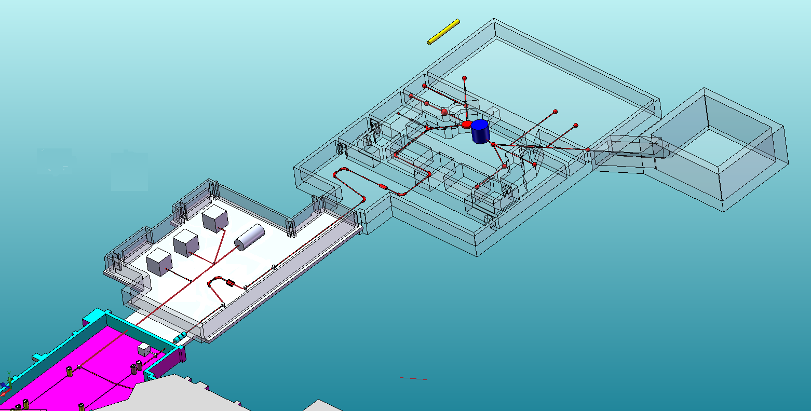

SPES layout
- 35-70 MeV variable energy
750 μA total p-current
two independent exits
10m
NEW infrastructure
CYCLOTRON
Radioisotopes for medical applications
Experimental hall
Proton and neutron irradiation areas
Possible expansion for ADS to study GEN4 reactor
ISOL FACILITY
Reaccelerated RIBs
Laboratori Nazionali di Legnaro
To ALPI Linac
Radioactive Ion Beams are reaccelerated by the superconductive linac ALPI

Slide 4

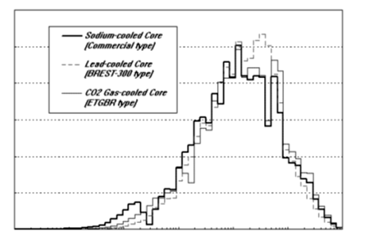
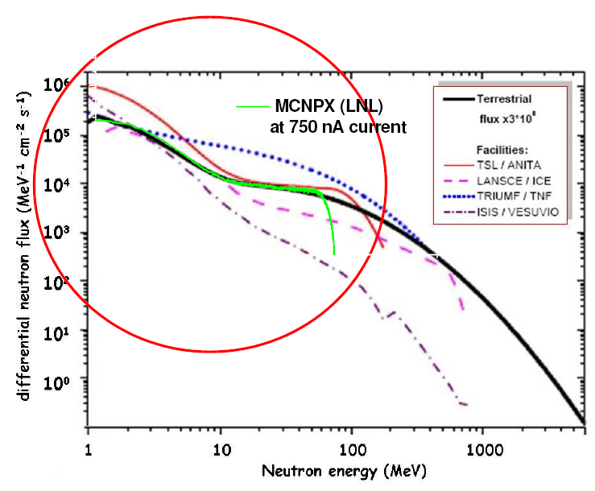
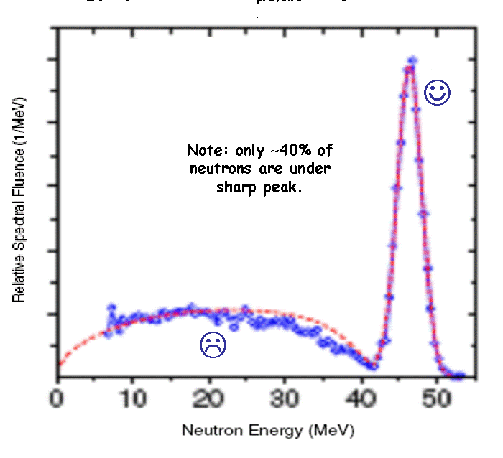
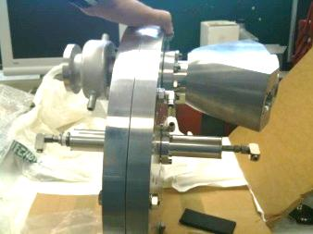
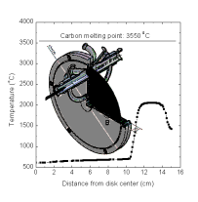
SPES-γ : cyclotron neutron facility
Union for Compact Accelerator-based
Neutron Sources
Integral neutron production at SPES Cyclotron
Proton beam= 70 MeV, 500 μA Target = W 5mm
Energy region (MeV) | Sn (n/s) ~ 6∙10¹⁴ s⁻¹ | Φ_{n} @ 2.5 m (n cm⁻² s⁻¹) | Φ_{n} @ 1 cm (n cm⁻² s⁻¹)
1 < E < 10 | ~ 5∙10¹⁴ s⁻¹ | 5×10⁸ | 3×10¹³
10 < E < 50 | ~ 1∙10¹⁴ s⁻¹ | 1×10⁸ | 6x10¹²
moderated n-spectra
Φ_{n}= ~ 1.0∙10¹¹ cm⁻²s⁻¹
p-beam 50MeV, 0.5mA
Single Event Effect facility
Quasi mono energetic n-spectra
Simulate terrestrial neutron flux (* 3 10⁸ )
p-beam: 70MeV 3μA
3 10⁵ n cm⁻²s⁻¹ p-beam: 70MeV 50μA
70 MeV protons on Pb-Be rotating composite target
Rotating target prototype

Slide 5
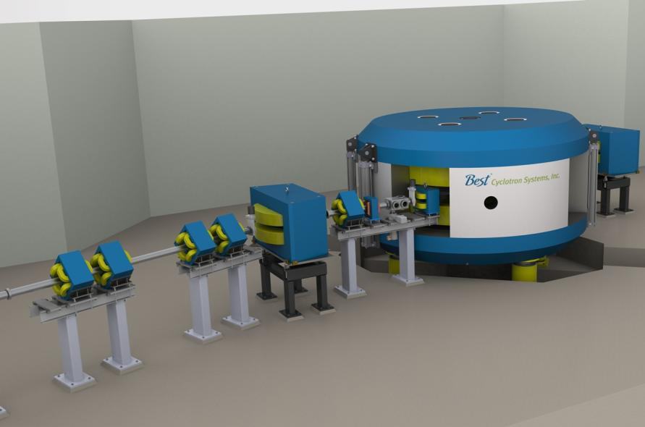
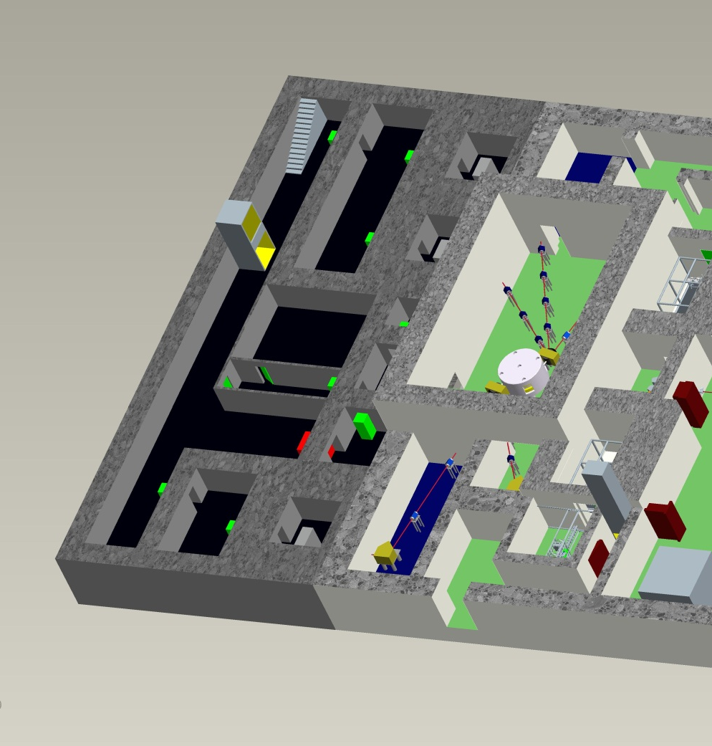
SPES-δ : LARAMED project
radionuclides for medicine
SPES cyclotron is similar to the ARRONAX one. It is well suited to produce innovative radioisotopes for medicine.
Aim is the production of
innovative radiopharmaceutical (e.g. Sr-82, I-124 Cu-64/Cu-67)
traditional radiopharmaceutical with new approaches (Tc-99m)
Partnership with industry is under discussion
LARAMED is under evaluation for dedicated fundibg by Italian Ministry of Research in the framework of the call “Progetti Premiali 2012”
Radionuclide | Target nucleus | Nuclear Reaction | Cross section (mbarns) | Needed energy (MeV)
⁶⁴Cu | Ni | ⁶⁴Ni(p,n) | ≈ 675 | 15
⁶⁸Ge | Ga | ⁶⁹Ga(p,2n) | ≈ 550 | 30
⁸²Sr | RbCl | ^{nat}Rb(p,4n) | ≈ 98 | 70
⁶⁷Cu | ZnO | ⁶⁸Zn(p,2p) | ≈ 10 | 70
⁴⁴Sc | Ca | ⁴⁴Ca(p,n) | ≈ 700 | 12
⁴⁷Sc | Ti | ⁴⁸Ti(p,2p) | ≈ 20 | 70

Slide 6
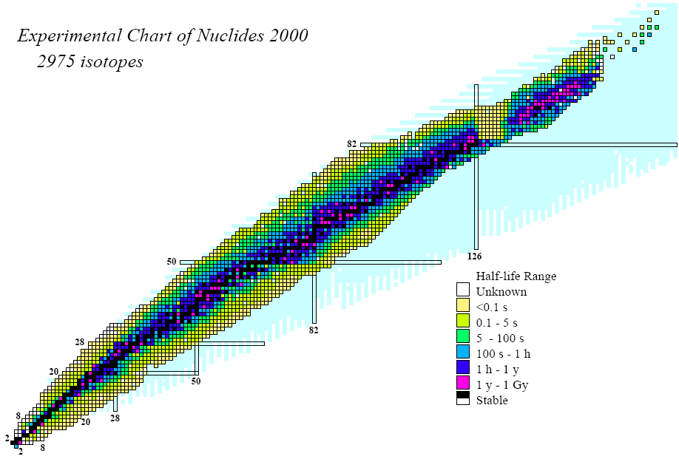
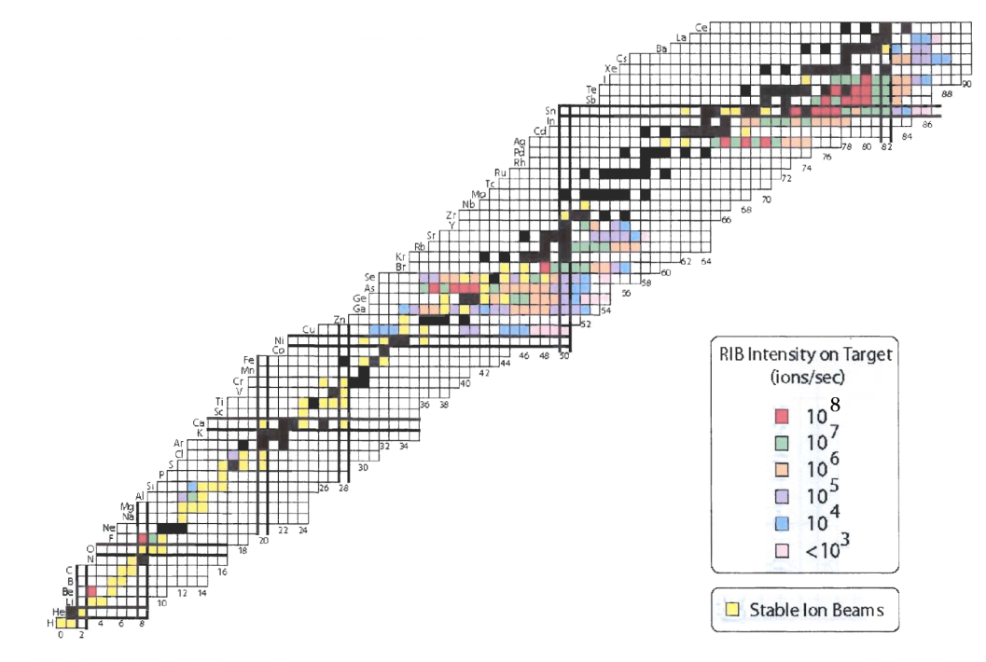
SPES α−β : Selective Production of Exotic Species
Production of Radioactive Beams by Uranium fission
Nuclear structure and reactions
  Reactions in very neutron-rich systems
  Decay spectroscopy
Astrophysics
  Reactions relevant to explosive nucleo-synthesis
ISOL science and technology
  RIB ion sources
  RIB production targets
  Enhance RIB quality
114
Super Heavy
stability ???
terra incognita
184
r-process path
SPES beams
Neutron Drip Line
Second Generation ISOL Facility

Slide 7
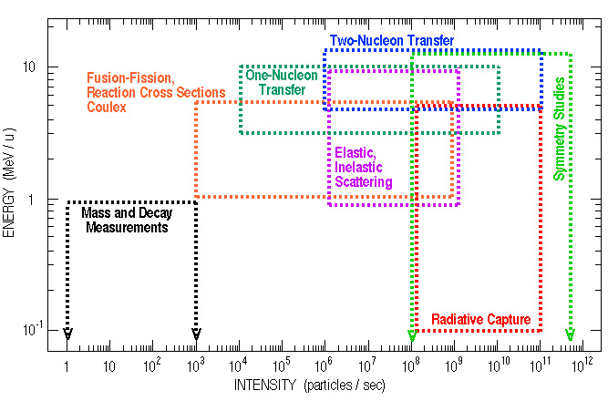
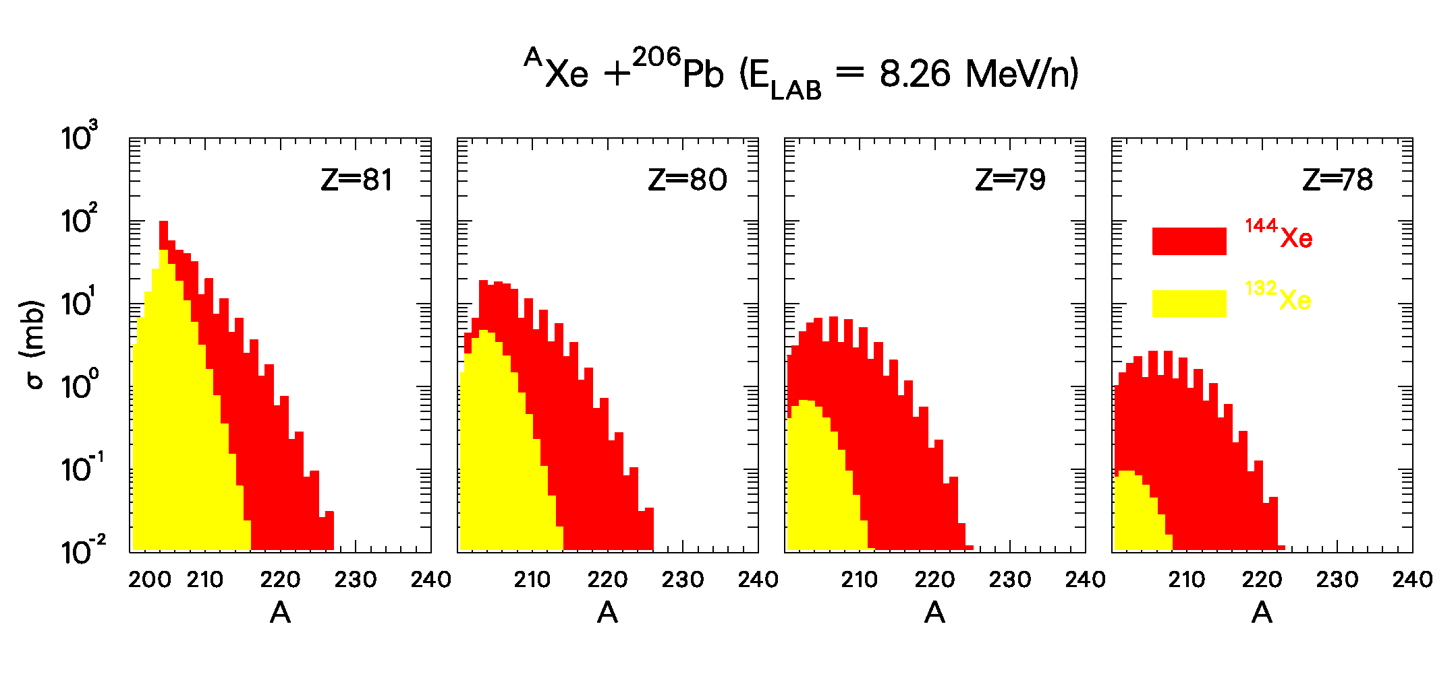
Neutron-rich radioactive beams and transfer reactions: a tool to investigate nuclei far from stability
SPES: 10¹³fission/s
E/A= 10AMeV, A=130
Target ²⁰⁶Pb
¹⁴⁴Xe
¹³²Xe
Coupled channel calculations (Grazing). G. Pollarolo
Beam: ¹³²Xe ¹⁴⁴Xe

Slide 8





ISOL Roadmap in EUROPE
Second generation 2014-2025 | 10¹³⁻¹⁴ fission/s 10 MeV/n (A=130) | Effective Mass resolution 1/20000
> 10¹⁵ fission/s
100 MeV/n (A=130)
Mass resolution 1/20000
FROM 2025
First generation ISOL facilities in EUROPE | Effective Mass resolution 1/4000 | RIBs AMeV | Reaccelerator
IGISOL Jyvaskyla | Gas catcher (New ISOL technique) |  | No reacc.
ALTO Orsay | Photo-fission on UCx target (5 10¹¹ f/s, n-rich beams) |  | No reacc.
CRC Louvain-la-Neuve | ⁶He, ⁷Be,¹⁰C, ¹¹C, ¹³N, ¹⁵O, ¹⁸Ne, ¹⁹Ne, ³⁵Ar | 0.2 - 10 | CYCLONE110
EXCYT LNS_Catania | ^{8, 9} Li, ^{20, 21}Na | 2 - 7 | TANDEM
SPIRAL_1 GANIL | HI fragmentation on graphite, about 50 beams | 2 - 20 | CIME _cyclotron
ISOLDE CERN | 1.4GeV proton induced spallation Fission. (UCx target, 4 10¹² f/s, neutron-rich beams) | 2 - 3 | REX_linac

Slide 9

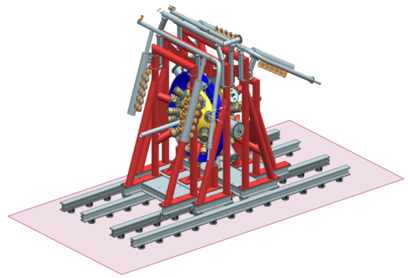

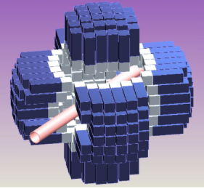
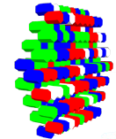
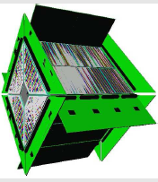
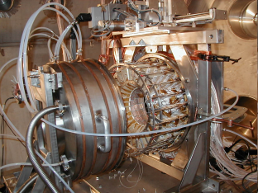
Letters of Intent for SPES
PRISMA
SPES2010 Workshop
(LNL- November 15th-17th, 2010)
24 LoI’s for reaccelerated exotic beams
International
collaborations:
Italy
Bulgaria
Hungary
France
Poland
Spain
Great Britain
Turkey
USA
Slovakia
Romania
Croazia
Russia
India
Germany
Canada
Transfer reactions with RIBs
Coulomb excitation with RIBs
Collective excitations of exotic nuclei (DDR, Pygmy resonances)
Effects of isospin in neutron-rich nuclei
Fusion-evaporation reactions with RIBs
GALILEO
*AGATA
Requested beams
*PARIS
*NEDA
RIPEN
**CHIMERA
TRACE
Definition of First Day Experiments:
Scientific priorities
Instrumentation development
RIB production
*Fazia
GARFIELD
*SPES-SPIRAL2 or european collaboration
** part of Chimera installed at SPES
http://web2.infn.it/spes/
Notes:
As a first call for the SPES physics, 24 letters of intent were presented by international collaborations focusing on transfer reactions, coulomb excitation, isospin effects and fusion-evaporation reactions with radioactive beams.
Up-to-date detectors are proposed for experiments, reshaping actual detectors at LNL like the PRISMA spectrometer or new gamma array like GALILEO, or performing campaign of measurements with new complex detectors under construction in European collaborations as AGATA, NEDA, PARIS and FAZIA.
The most requested beam is the 132Sn with the aim to study the shell evolution around the double magic numbers Z=50, N=82
A number of dedicated mini-workshop are on the way to define the First Day Experiments according to scientific priorities, instrumentation development and radioactive beam preparation.

Slide 10
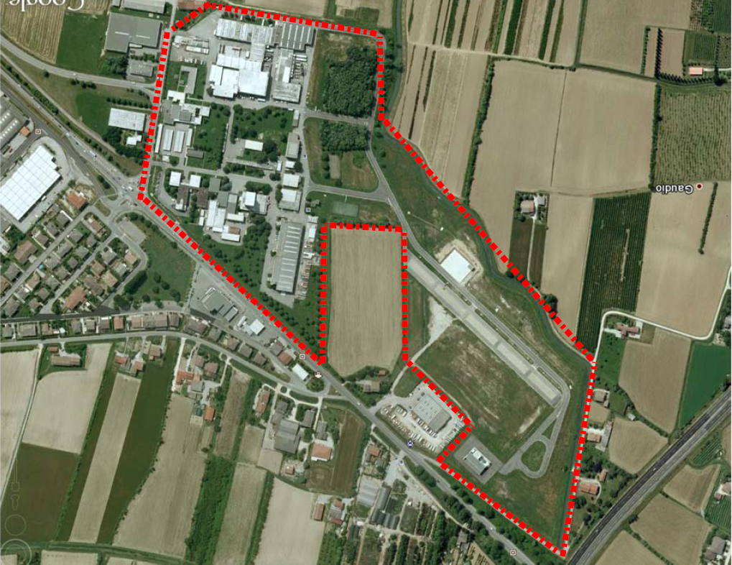
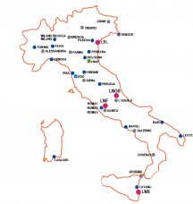
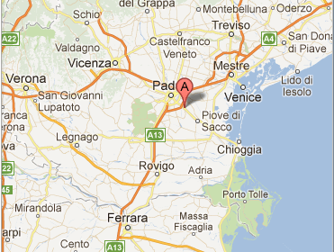
SPES Area
INFN-Laboratori Nazionali di Legnaro
Highway

Slide 11
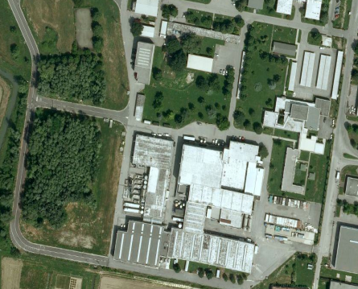
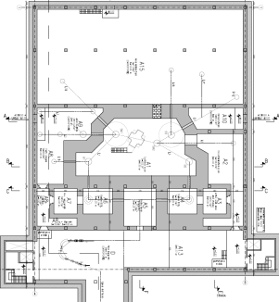
SPES Facility Layout
Exp. Halls
1&2
~ 54 x 67 m²
Tandem
CB
NC RFQ
Exp. Hall 3
ALPI

Slide 12
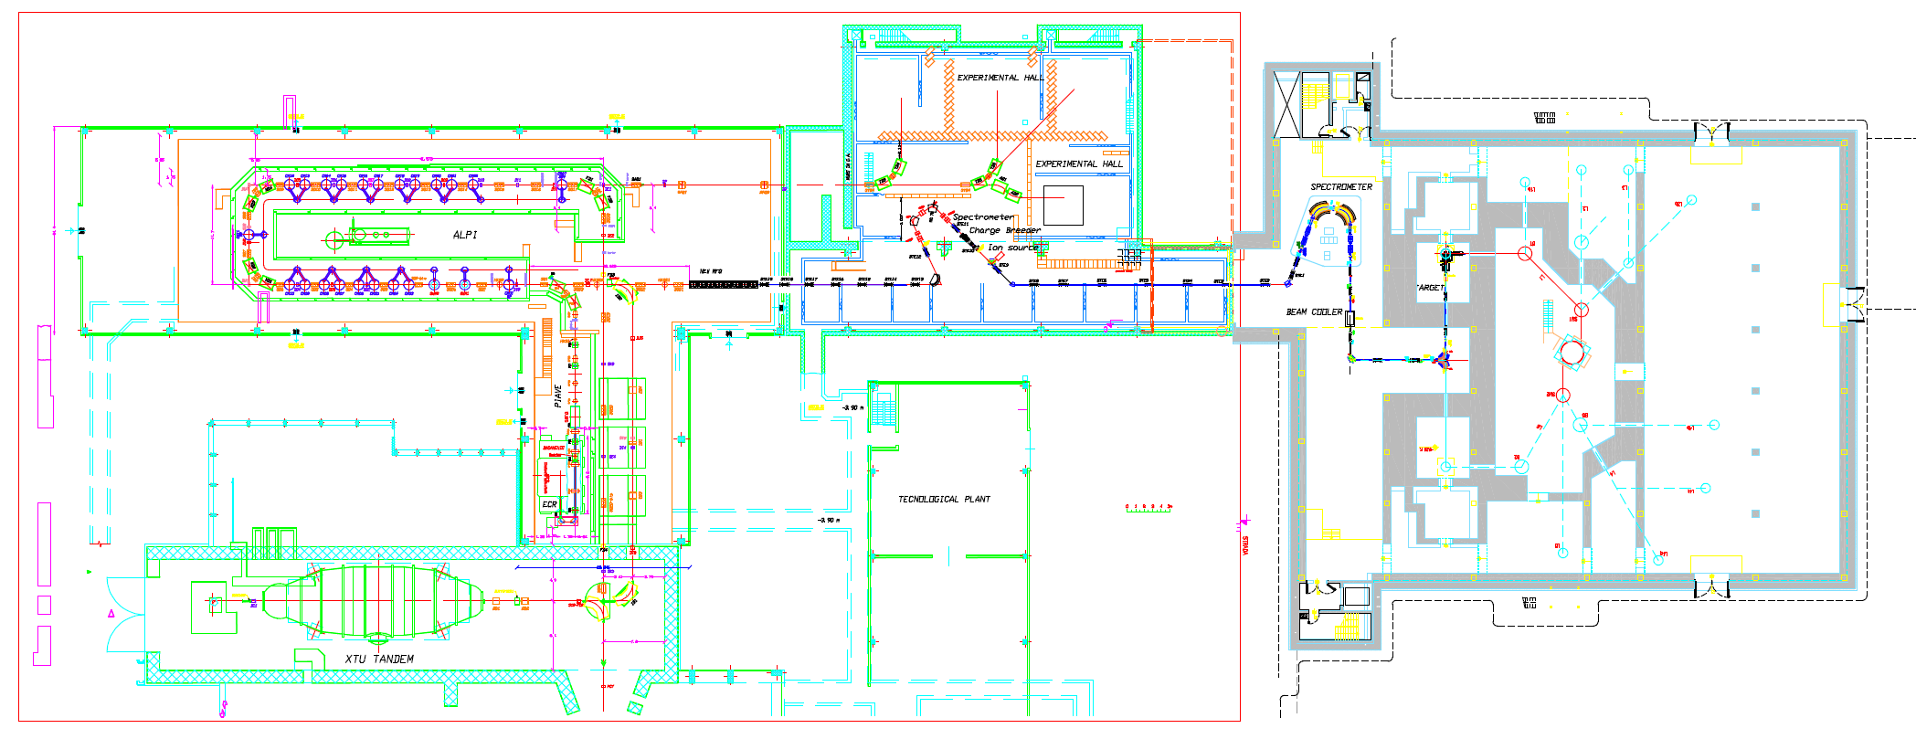
ALPI and SPES LAYOUT
215 meters
Two ISOL targets
Cyclotron
ALPI Linac
RFQ
83 meters
N+ RIB line
1+ RIB line
Charge Breeder & Medium Resolution Mass Separator DM/M=1/1000(DX=8mm)
High Resolution Mass Separator
DM/M= 1/40000
(DX=1.3 mm)
To allow this configuration the actual beam lines will be reshaffled. Works will start in September.
Four experimental areas will be available in experimental hall 3. RIBs can be transported in the other two halls too .

Slide 13
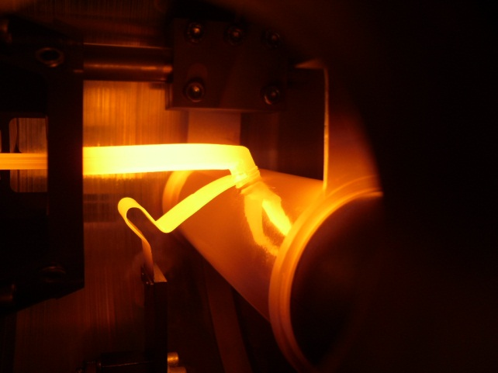
NEW DIRECT TARGET CONCEPT to operate with 10kW proton beam
The SPES choice: optimize the Direct Target design and material production to reach 10¹³ fissions/s
UCx= 7 disks, 4 cm dia, 1.3 mm (~30g total)
In target proton beam = 200 μA 40MeV
Target under operation at 2000ºC
Collaboration: LNL, ENEA-Bologna, Padova University (Eng, Chem)

Slide 14
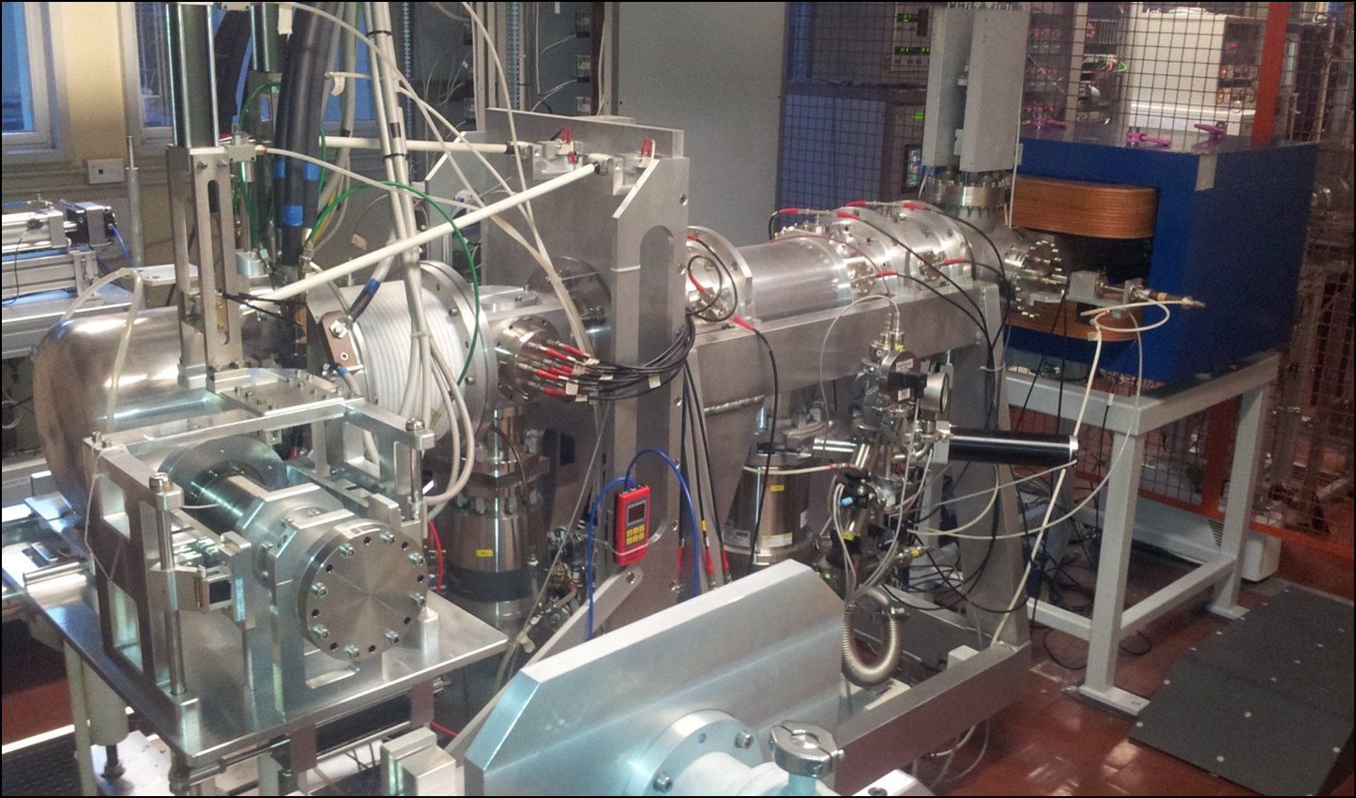
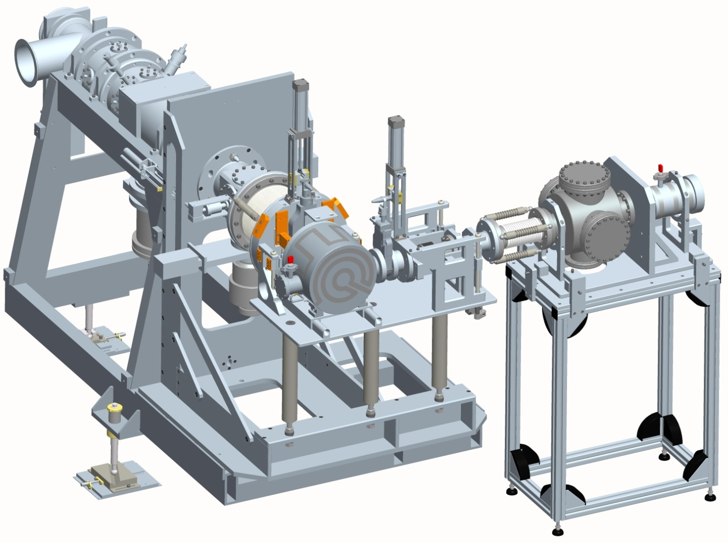
The SPES off-line Front end
(working since 2010)
Designed following updated version of ISOLDE front-end
30-40 kV platform
Wien Filter
Target
& Ion Source
Insulator
(30 kV)
Electrostatic
Steerer
Electrostatic
Quadrupoles
Beam Diagnostic 1

Slide 15
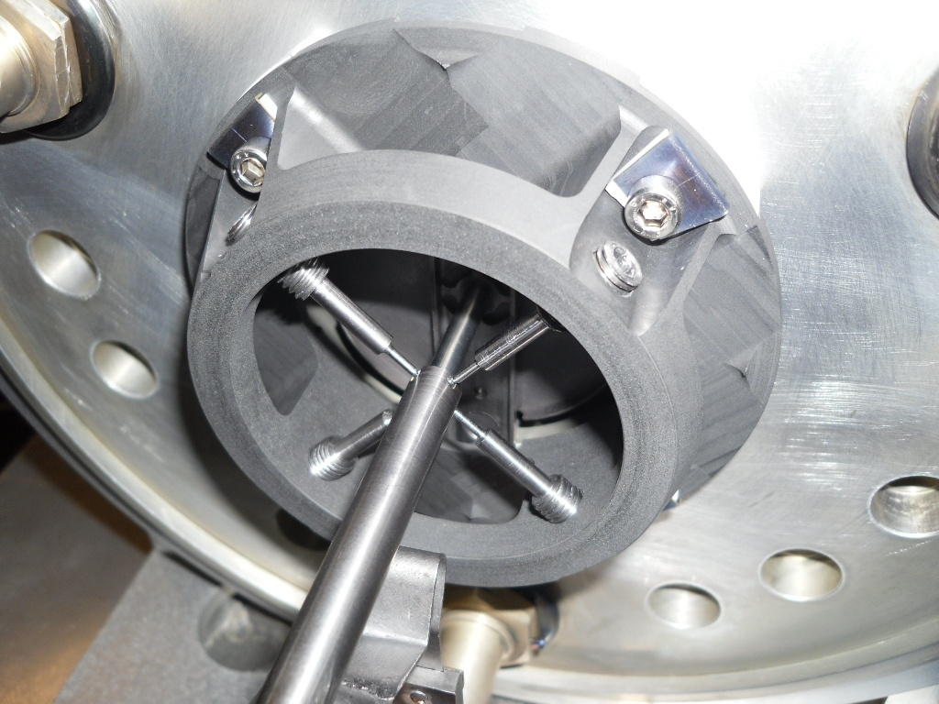
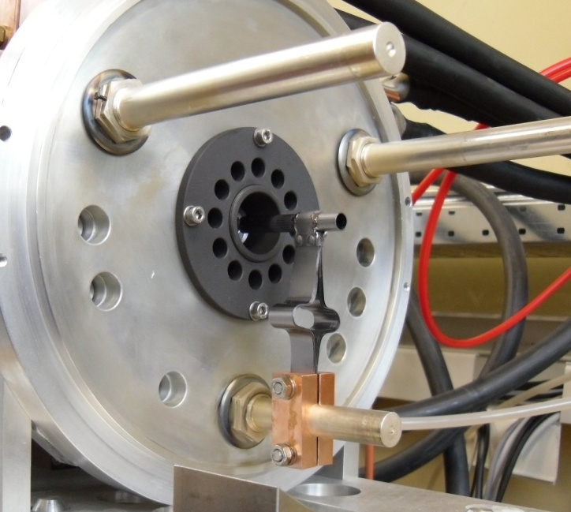
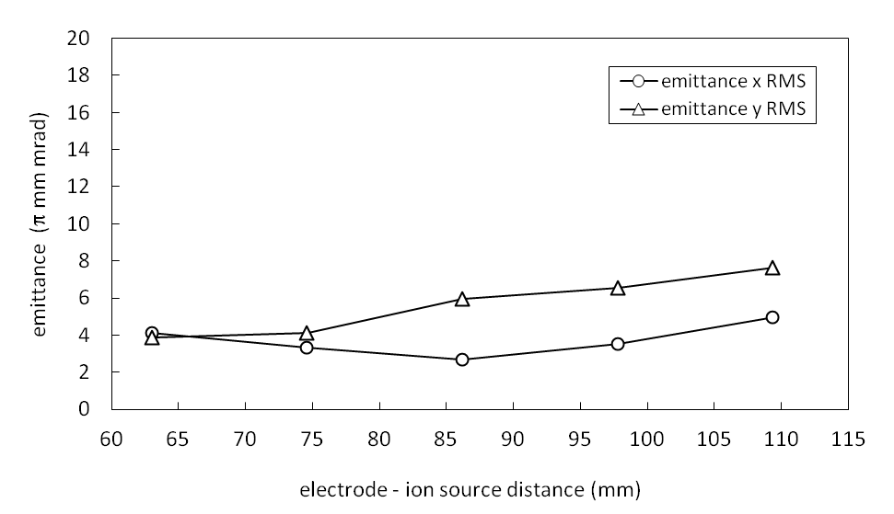
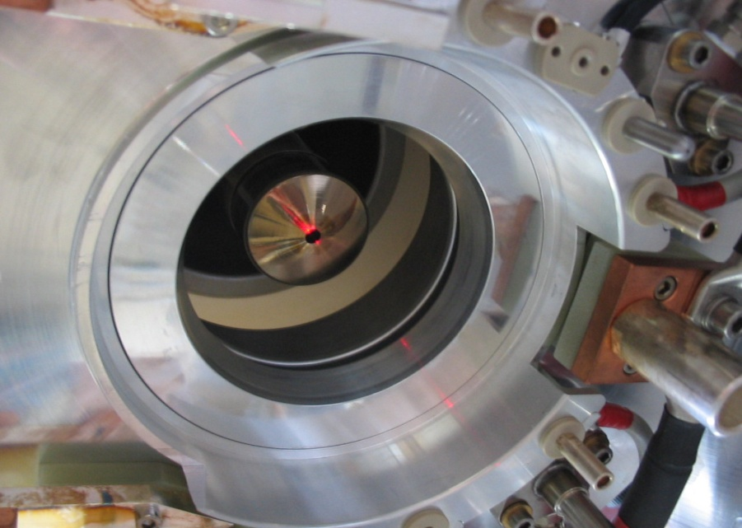
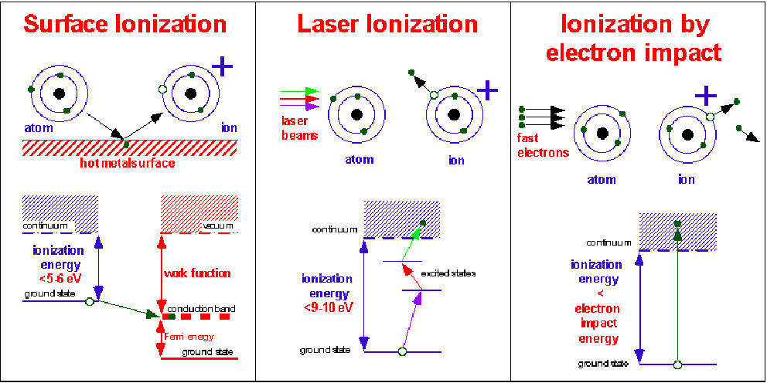
The SPES Ion Sources
Surface Ion Source (SIS)
Plasma Ion Source (PIS)
Bad volatility (NOT EXTRACTED)
Surface Ionization
H
1
He
2
3
4
Photo Ionization
5
6
7
8
9
10
Li
Be
B
C
N
O
F
Ne
11
12
Plasma Ionization
13
14
15
16
17
18
Na
Mg
Al
Si
P
S
Cl
Ar
K
19
Ca
20
Sc
21
Ti
22
V
23
Cr
24
Mn
25
Fe
26
Co
27
Ni
28
Cu
29
Zn
30
Ga
31
Ge
32
As
33
Se
34
Br
35
Kr
36
Rb
37
Sr
38
Y
39
Zr
40
Nb
41
Mo
42
Tc
43
Ru
44
Rh
45
Pd
46
Ag
47
Cd
48
In
49
Sn
50
Sb
51
Te
52
I
53
Xe
54
SIS (Cs beam)
Cs
55
Ba
56
La
57
Hf
72
Ta
73
W
74
Re
75
Os
76
Ir
77
Pt
78
Au
79
Hg
80
Tl
81
Pb
82
Bi
83
Po
84
At
85
Rn
86
Fr
87
Ra
88
Ac
89
Rf
104
105
106
107
108
109
110
111
112
Db
Sg
Bh
Hs
Mt
350 A
LASER Ion Source (LIS)
LNL and Pavia University
LPX200 XeCl excimer laser
Pulse. 15 ns λ=308 nm

Slide 16
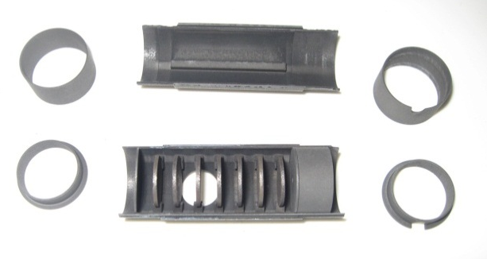
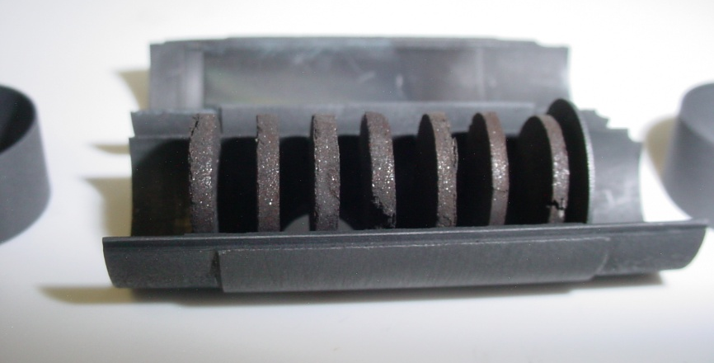
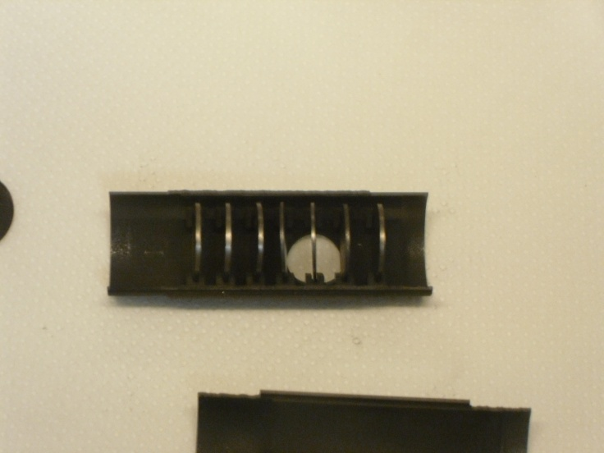
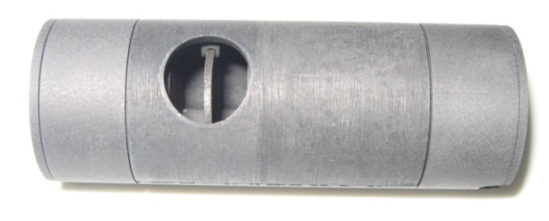
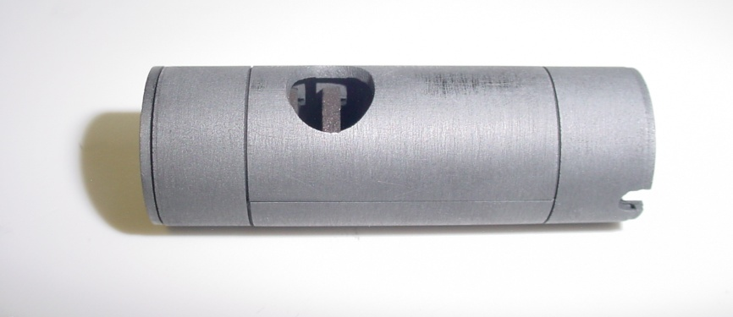
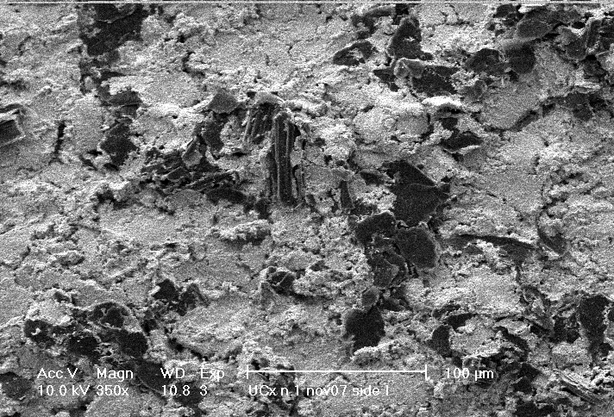
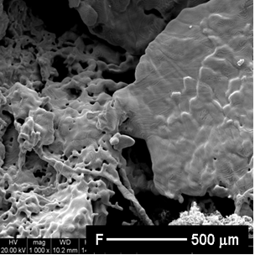
Target material production (ENSAR_ActiLab)
Study of the target porosimetry and isotopes production yield
2010 Test
Standard UC_{X}
2011 Test
Low density UC_{X}
2012 Test
Medium density UC_{X}
 | 2010 | 2011 | 2012
Density (g/cm³) | 4.25 | 2.59 | 6.38
Diameter (mm) | 12.50 | 13.07 | 12.91
Thickness (g/cm²) | 0.41 | 0.41 | 0.41
Calculated porosity (%) | 58 | 75 | 37
WP 02

Slide 17
UCx Target in-beam test
2010 Test
Standard UC_{X}
2011 Test
Low density UC_{X}
2012 Test
Medium density UC_{X}
To be tested
ORNL experiments 40 MeV, 50 nA protons, plasma ion source
Targets tested at 3 different T:
2000°C, 1800°C and 1600°C
20 elements, about 80 isotopes collected
Yield vs. half-life characterization

Slide 18
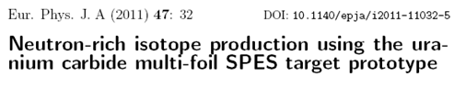
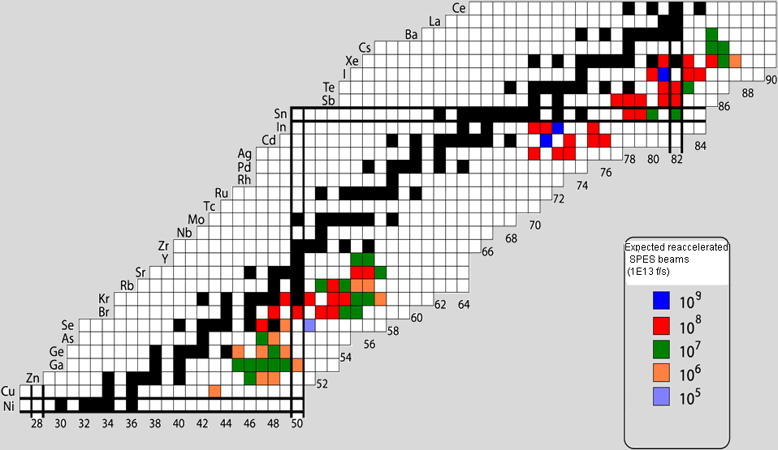
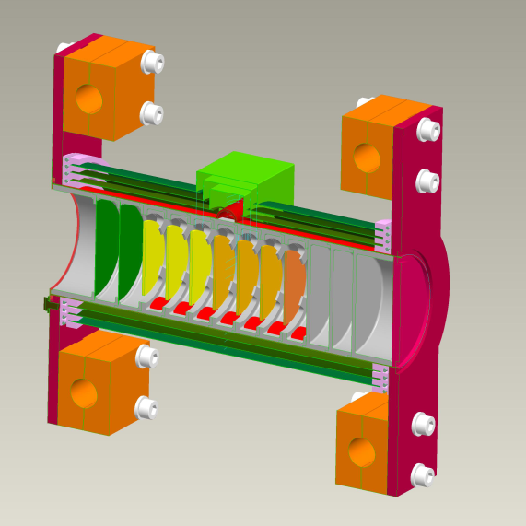
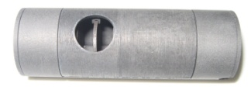
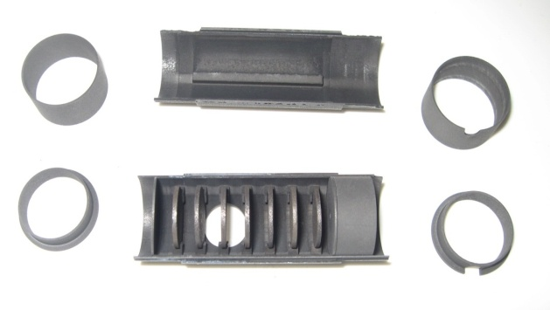
SPES Target
On-line Test experiment at HRIBF
Expected beam on target
Data scaled to: 200 microA proton current 2-5% transport efficiency
Proton energy = 40MeV
ISOL target operated at 2000ºC.
Ionization and extraction with 1+ Plasma Source.
Isotopes measured at tape system.
SPES target conceptual design
Proton beam
Target assembly
Windows
UCx targets
25 gr
dump

Slide 19
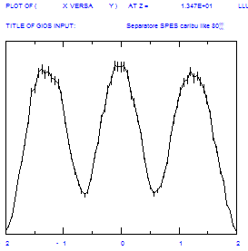
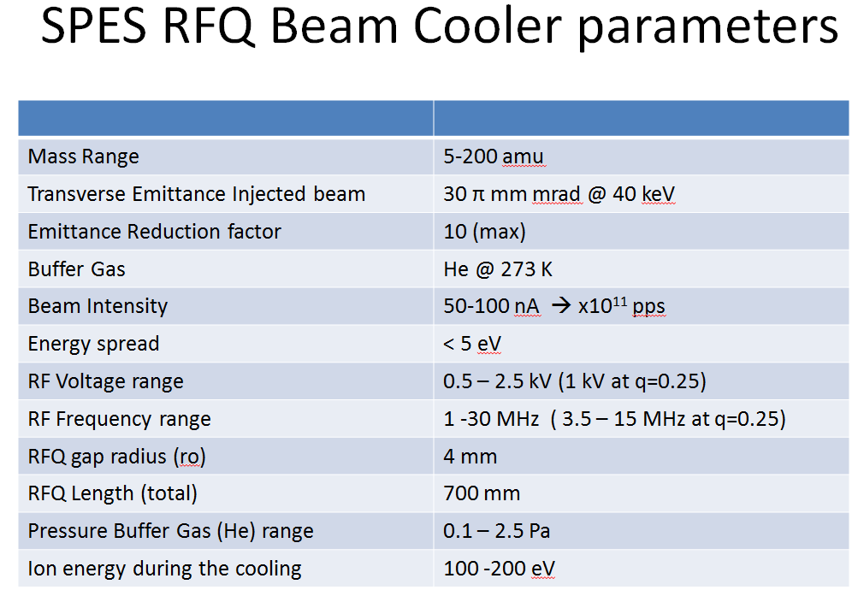
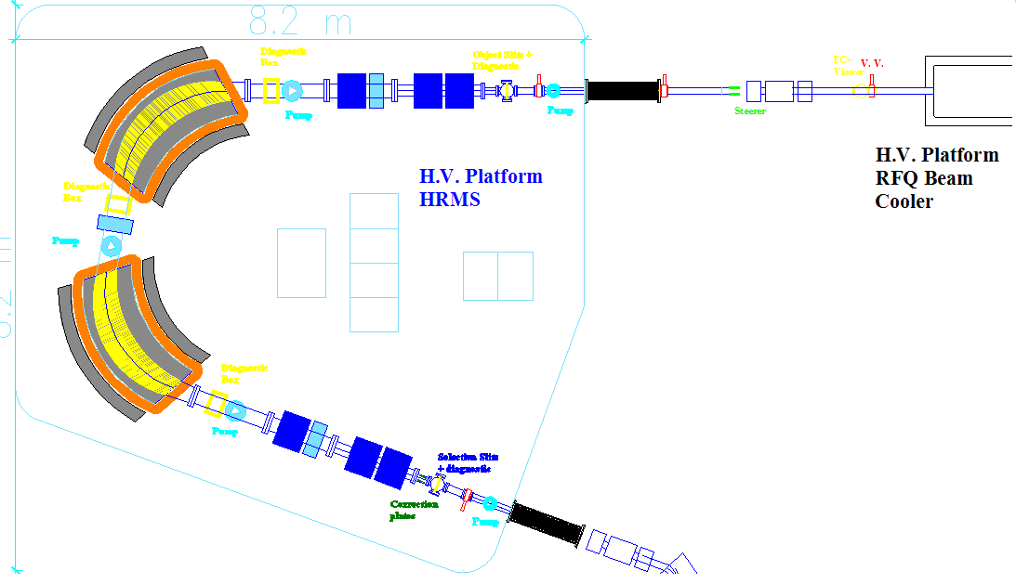
HRMS physics design
A scaled-up version of the separator designed by Cary Davids for CARIBU, Argonne
DM=2.5 10⁻⁵
3º order effects analysis (LNS-LNL)
Input parameters:
Energy= 260 KeV
Δθ=4 mrad
ΔE= ± 1.3 eV
Emittance=3π mm mrad
Mass resolution: 1/40000 (eng. design: 1/25000
1.3 mm
Typical voltage fluctuation frequency 200-300 Hz, <<10kHz
Plates to correct the voltage ripple of the H.V. platform
20 cm
10 cm
Plates gap 6 cm,
± 750 V to correct
± 5 V platform ripple

Slide 20
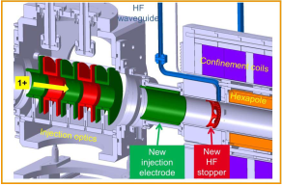
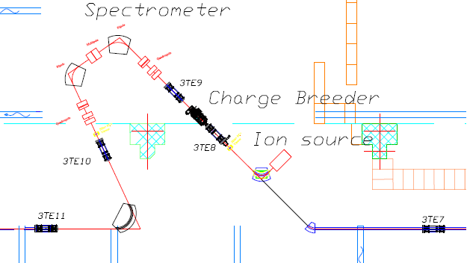


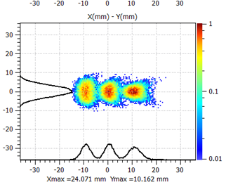
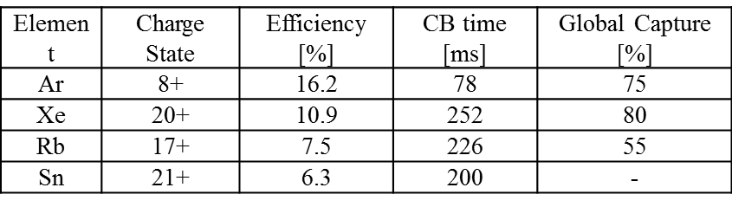
Charge Breeder
CB based on ECR technique
Developed by LSPC in the framework of LEA collaboration
Design 2013, construction 2014
DM/M~ 1/1000
Charge Breeder and Medium Resolution Mass Separator

Slide 21


NEW RFQ injector for ALPI
Energy 5.7 –> 727.3 [β=0.0395] KeV/A (A/q=7)
Beam transmission >95%, low RMS longitudinal emittance at output: 0.15 ns*keV/u.
Length 695 cm (7 modules) intervane voltage 63.8 – 85.8 kV
RF power (four vanes) 100 kW.
Mechanical design and realization, taking advantage of IFMIF experience (LNL, INFN_Pd, Bo, To).
First prototype construction: end 2013
Parameter (units) | Design Value
Operational mode | CW
Frequency (MHz) | 80.00
Injection Energy (keV/u) | 5.7 (β=0.0035)
Output Energy (keV/u) | 727 (β=0.0395)
Accelerated beam current (μA) | 100
Charge states of accelerated ions (Q/A) | 7 – 3
Inter-vane voltage V (kV, A/q=7) | 63.8 – 85.84
Vane length L (m) | 6.95
Average radius R₀ (mm) | 5.33 – 6.788
Synchronous phase (deg.) | -90 – -20
Focusing strength B | 4.7 – 4
Peak field (Kilpatrick units) | 1.74
Transmission (%) | 95
Output Long. RMS emittance (mmmrad) / (keVns/u)/(keVdeg/u) | 0.055 / 0.15 / 4.35
Mechanical layout of the RFQ tank module of about 1 meter.

Slide 22



The ALPI Superconductive-Linac
Superconductive linac based on QW resonators
(since 1995)
Up graded to
Veq ~ 50 MV
Pb/Cu to Nb/Cu spattered cavities (or bulk Nb cavities)

Slide 23

Upgraded ALPI layout
All Cavities from CR03 to CR07 at 4.5 MV/m.
Medium beta CR07 to CR18 at 4.5 MV/m.
High beta 6.5 MV/m for CR19-CR22.
Final Energy of 10 MeV/A (A/q=7)
Increase energy
Optimize transfer efficiency
Additional cryostats:
Increase total Energy
Cryostats relocated from PIAVE: reduce losses from 40% to 20%

Slide 24


70 MeV p Cyclotron
Main Parameters
Accelerator Type | Cyclotron AVF 4 sectors
Particle | Protons (H⁻ accelerated)
Energy | Variable within 30-70 MeV
Max Current Accelerated | 750 µA (52 kW max beam power)
Available Beams | 2 at the same energy (upgrade to different energies)
Max Magnetic Field | 1.6 Tesla
RF frequency | 56 MHz, 4th harmonic mode
Ion Source | Multicusp H⁻ I=15 mA, Axial Injection
Dimensions | Ф=4.5 m, h=1.5 m
Weight | 150 tons
Extraction scheme: stripping process (H⁻ → p)
Ottawa (Canada), April 2013

Slide 25

Cyclotron Schedule (2013-2014)
 | 2013 |  | 2014
 | II | III | I | II | III
Final Assembly and Testing
Factory Commissioning
Disassembly and Shipping
Installation at LNL
Commissioning at LNL
The Contract with BEST Theratronics provides for:
Cyclotron
High power beam transport line (SPES target)

Slide 26
SPES Project planning
The project planning has been remodulated according to several constraints:
Building construction
Cyclotron construction
Expected financial resources
SPES alpha: completely financed (19.3 Meuro)
Buildings and infrastructures
Cyclotron proton driver
ISOL Target prototype with surface and plasma sources
SPES-beta: partially financed
ISOL Target with Laser Source
Radioactive Ion Beam Transport
High resolution mass selection (HRMS and Beam Cooler)
Charge Breeder
RFQ for pre-acceleration
Superconducting ALPI accelerator upgrade
Safety and control systems
The first year of SPES-beta has been financed by Ministry of Research with 5.6 Meuro within the call “Premium projects 2011”.
Additional funding under evaluation for “Premium projects 2012”.

Slide 27
SPES Schedule May 2013
 | 2012 | 2013 | 2014 |  | 2015 | 2016 | 2017
Authorization to operate and safety | UCx 5μA
ISOL Target-Ion Sources development
ISOL Targets construction and installation
Building Construction | Executive project
Cyclotron Construction & commissioning | in | schedule
RFQ development and Alpi up-grade
Design of RIB transport & selection (HRMS, Charge Breeder, Beam Cooler)
Construction and Installation of RIBs transfer lines and spectrometer
Complete commissioning and first exotic beam
Full UCx authorization

Slide 28
Current status and overview
Letters of Intent: under discussion to select first-day-exp.
ISOL Target and Ion Source: working in off-line laboratory.
Layout for beam transfer and pre-acceleration: defined.
Authorizations ready for cyclotron operation.
Contract for cyclotron: signed November ‘10, final design accepted (June ’11), cyclotron under machining.
Building: financed (June ‘12), ground braking started.
Phase β partially financed (July ‘12)

Slide 29


SPES building site
June 4, 2013
Work in progress !!
May 9, 2013

