Slide 1
Measurements of βn-energy spectra with VANDLE
M. Madurga
University of Tennessee
Notes:
Title! No holfield.
First I want to thank the organizers to give me the opportunity of discussing our measurements of decay properties of neutron rich r-process nuclei

Slide 2
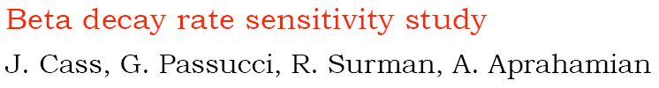
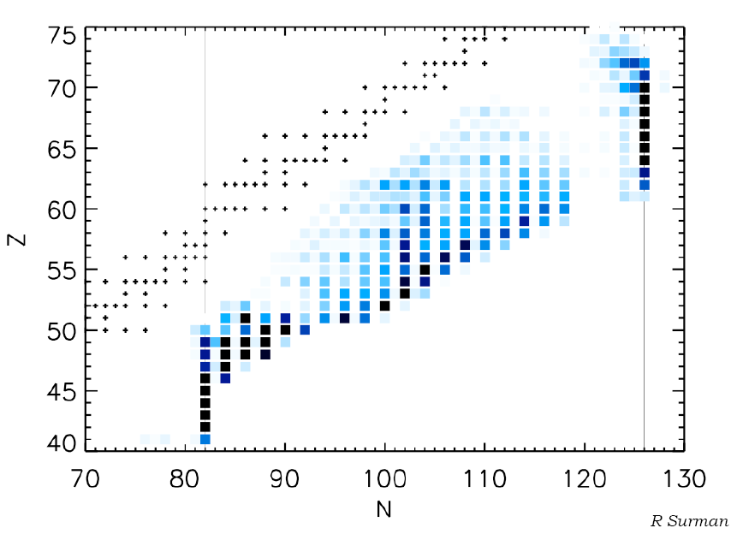
β-decay in hot r-process
0.01→1s⁻¹
10⁻⁴→0.01 s⁻¹
Change in abundance pattern
0.01→1 s⁻¹
Effect individual decay rates
Half-lives known today
+ FRIB
Notes:
I mentioned measurements of decay properties of r-process nuclei. If we take a look at the sensitivity study by R. surman and colaborators we see that the half lives of nuclei close to shell closures can affect the whole abundance pattern. However, iif we take a look at the half-lives known today we see that the most important nuclei are still unknown. Moreover the situation will improve once FRIB comes online, but many important nuclei will remain outside the reach of experimentalist. This stresses the need of not only experimental values, but of reliable theoretical extrapolations.

Slide 3

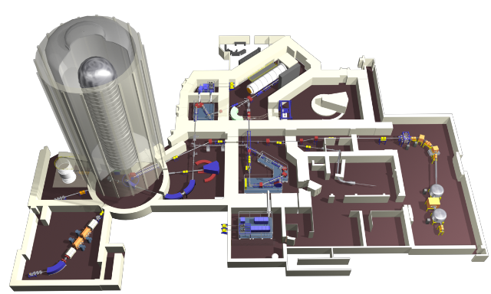
Holifield Radioactive Beam Facility
Intense beam (~10 μA) of (50MeV) protons on UCx targets
Isobar separation essential for success of the experiments !
IRIS-1/IRIS-2 platforms, negative and positive ions.
ORIC
IRIS-1
IRIS-2
LERIBSS
LIS

Slide 4
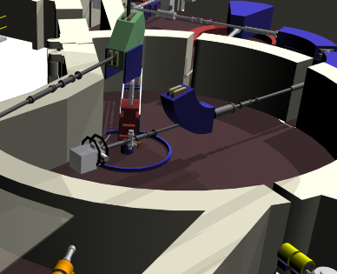
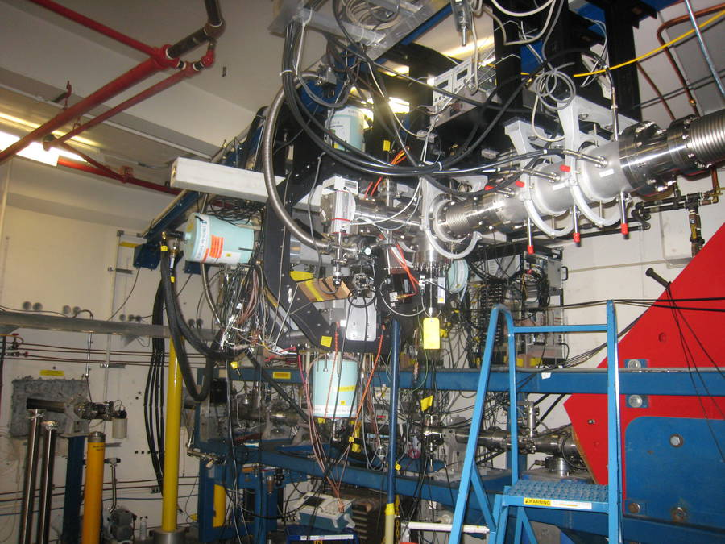
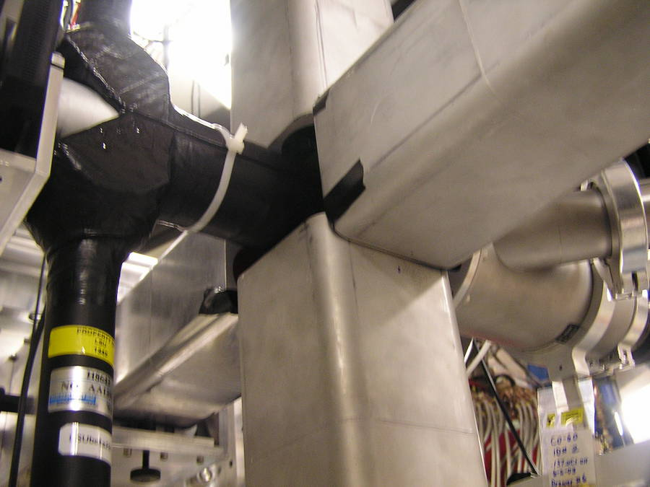
High Resolution Spectroscopy: the Clover Array for Radioactive Decay Studies
Radioactive species implanted in moving tape collector
Gamma-ray detection: 4 HPGe, ε= 6% at 1 MeV
Beta detection: 2 plastic scintillators, ε=60 %

Slide 5
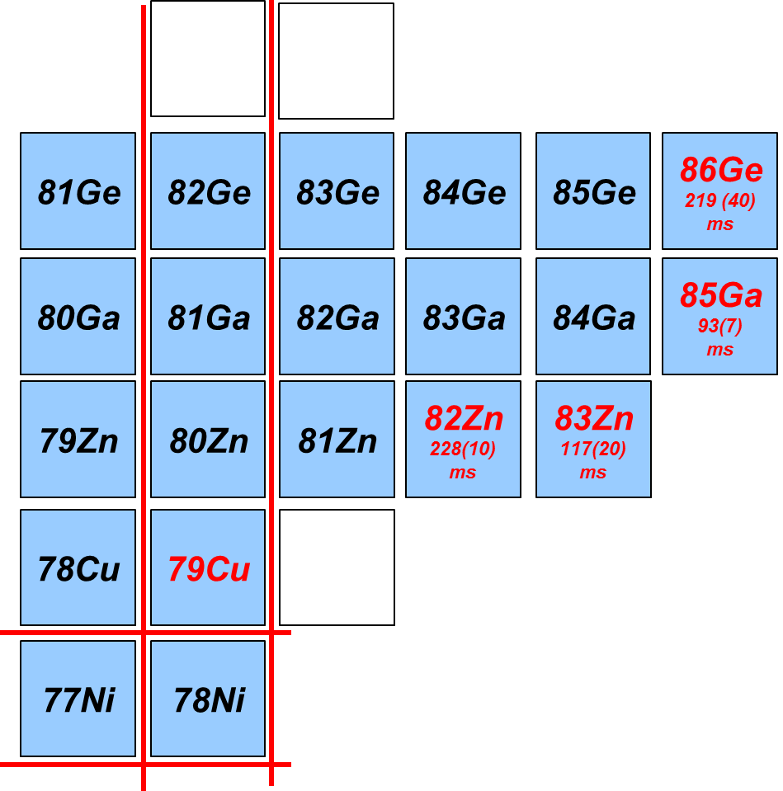
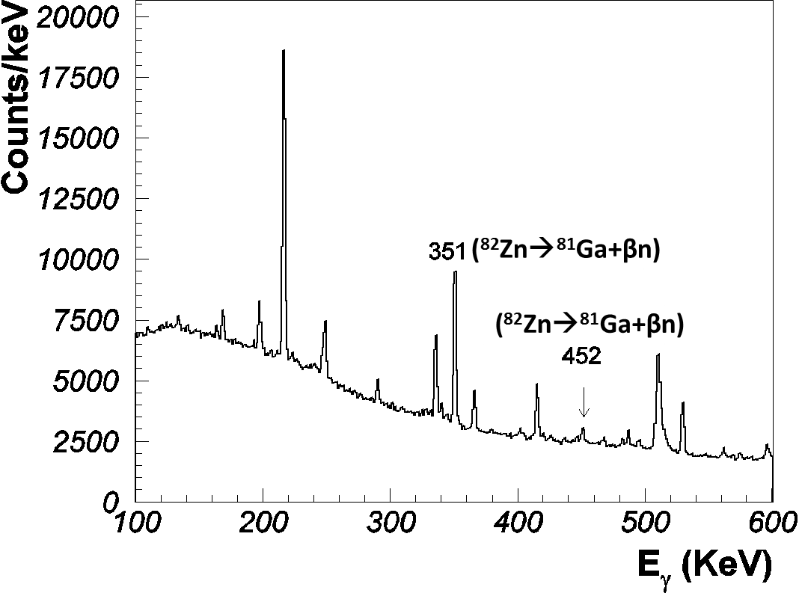
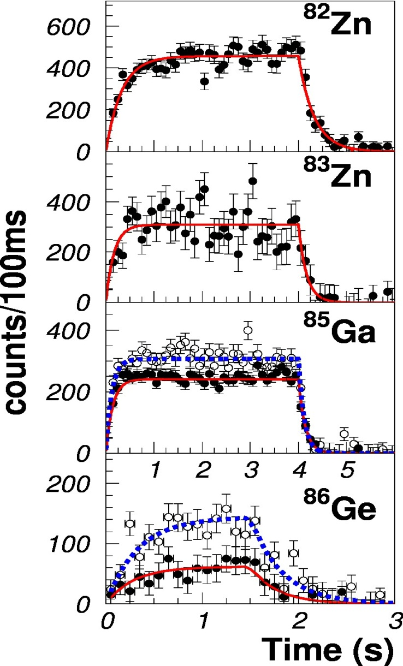
4 new half-lives measured at LeRIBSS
BEAM
ON
OFF
⁸²Zn
226(21) ms
79Cu
HRIBF ISOL rates (s⁻¹):
⁸²Zn ~ 50
⁸³Zn ~ 5
⁸⁵Ga ~ 40
⁸⁶Ge ~ 1
Half-lives measured to 10/20 % uncertainty.
⁸³Zn

Slide 6
How do the newly measured half-lives affect r-process path?
Courtesy of R. Surman
Single trajectory
Local effect in the A≈85 region
Similar effect observed in A ≈110
S. Nishimura et al., PRL 106, 052502 (2012)
+
Solar
FRDM + ff. gr. th.
LeRIBSS halflives

Slide 7
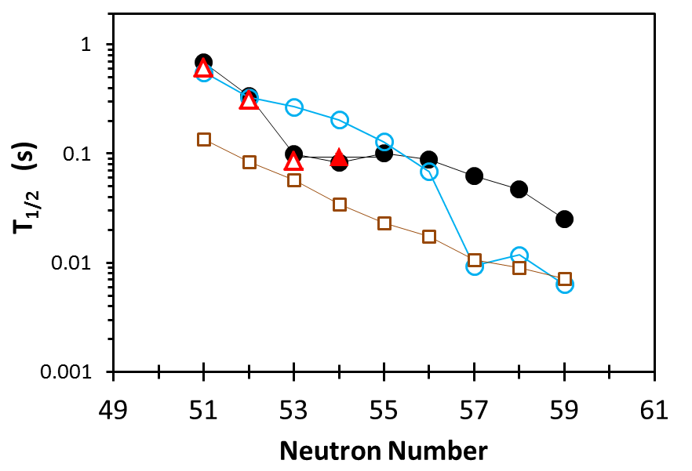
Benchmarking Ga half-lives
Courtesy of I.N. Borzov
DF3a+CQRPA
FRDM+ f.f. gr.th.
gr.th.
Exp. NUBASE
Exp. LeRIBSS
Experimental half-lives shorter than FRDM calculations
Better microscopic foundations!:
  new LeRIBSS half-lives validate calculation with g.s(πf_{5/2})

Slide 8
New calculated half-lives effect on r-process abundances
M.M. et al., PRL 109, 112501 (2012)
New Co, Ni, Cu, Zn, Ga, Ge and As half-lives
Changes affect the whole pattern!!
Models with robust microscopic foundations are required
`
+
Solar
FRDM + ff. gr. th.
I. Borzov halflives

Slide 9
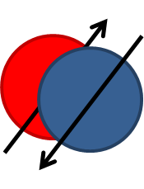
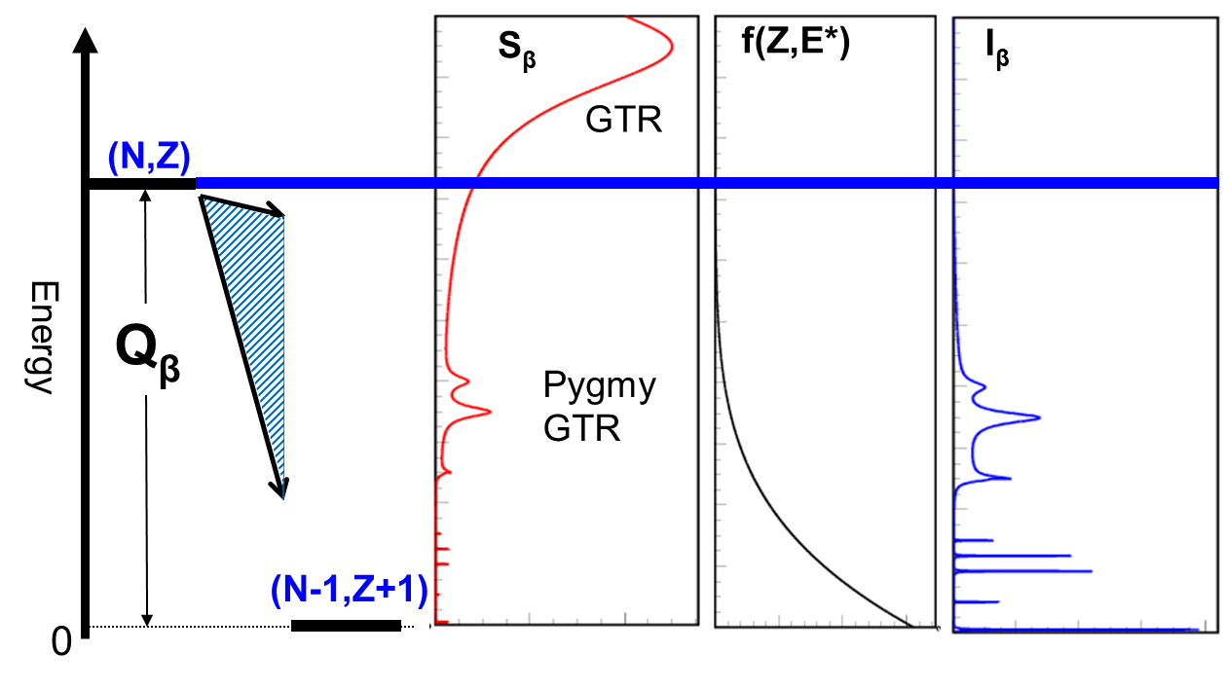
Beta decay of neutron rich nuclei
Neutron spectroscopy
S_{n}
Total absorption spectroscopy
Valence
High Resolution spectroscopy

Slide 10
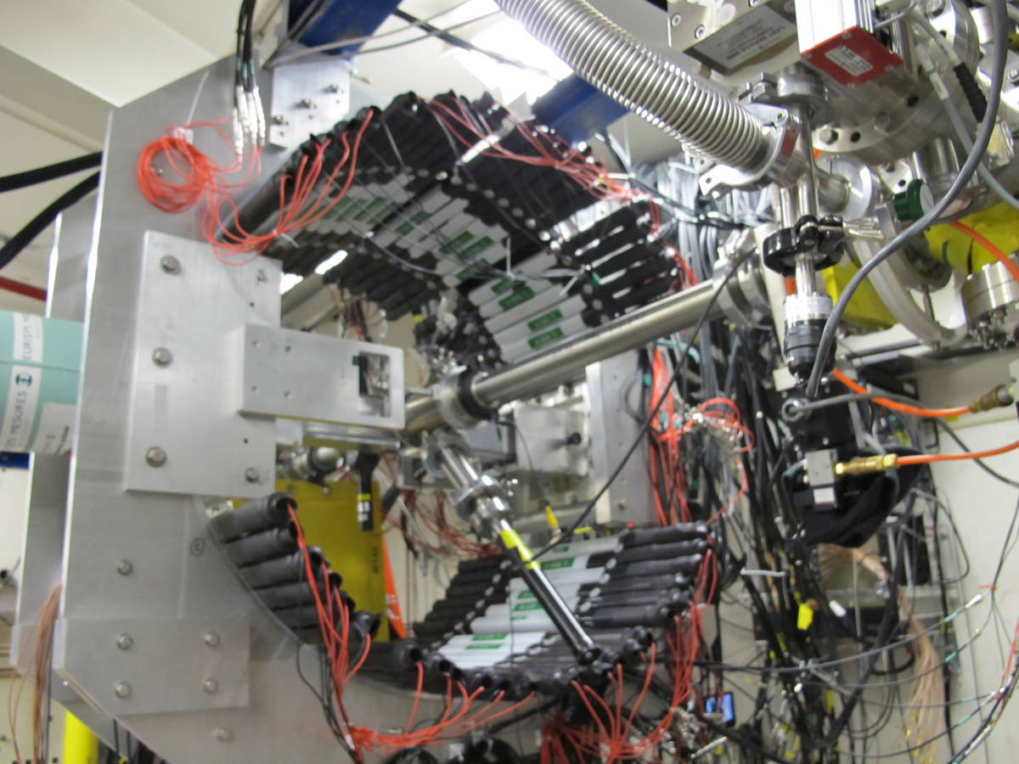
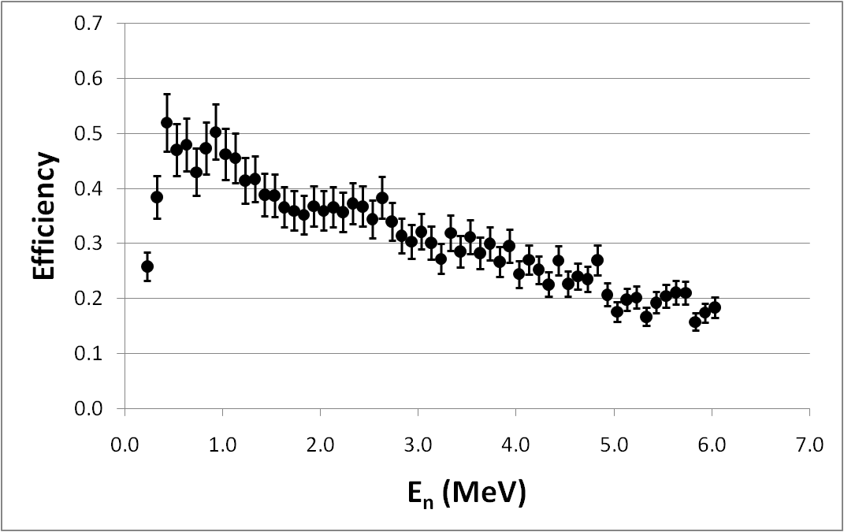
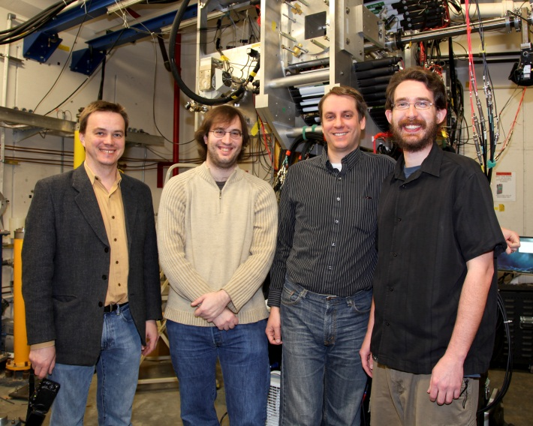
VANDLE at LeRIBSS:
The Versatile Array for Neutron Detection at Low Energies
Time of Flight detector
2 clovers, 3% efficient @ 1MeV
48 x 60 cm VANDLE bars
  45% efficiency/bar @ 1MeV
  Ω = 26% of 4π
  12% total efficiency @ 1MeV
Fully instrumented using XIA’s Pixie 16 digitizers
VANDLE efficiency calibration performed at Ohio university
Notes:
Real events will always have two pmt because attenuation length is linger than the bar

Slide 11
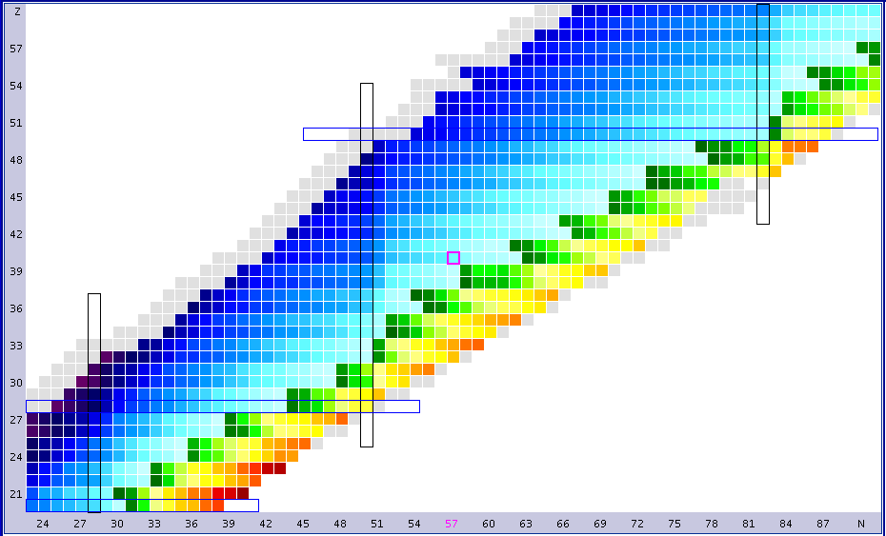
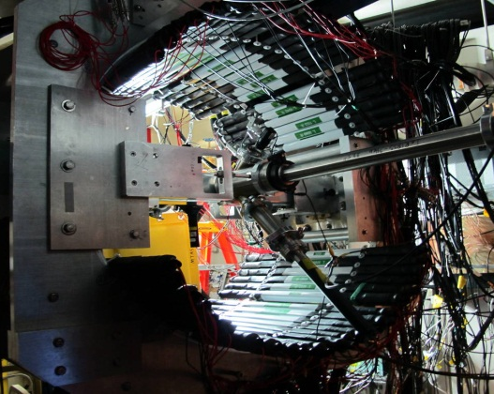
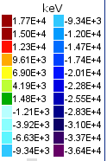

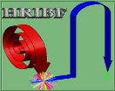







First scan of delayed neutron emitters studied
at the HRIBF/LeRIBSS in February 2012
Proton number
N=50
Z=50
Q_{β} – S_{n} <0
Neutron number

Slide 12
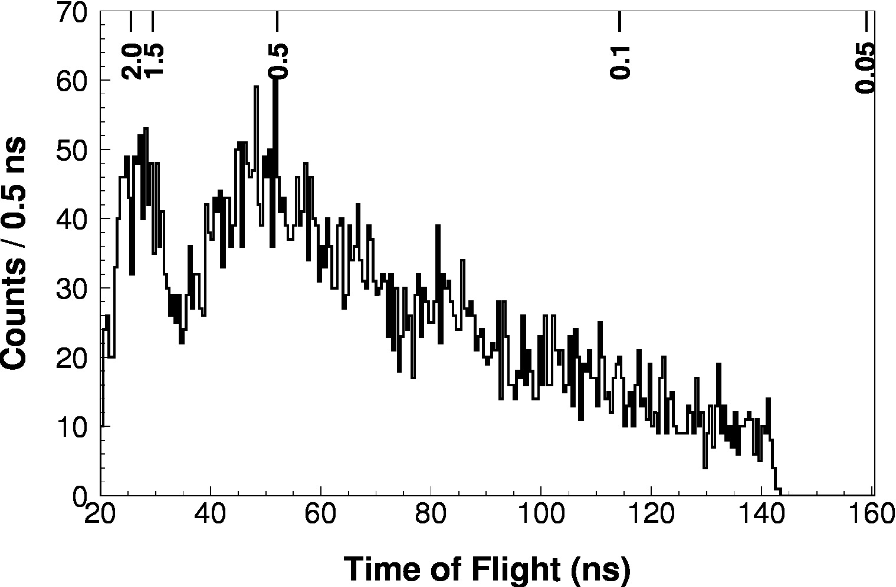
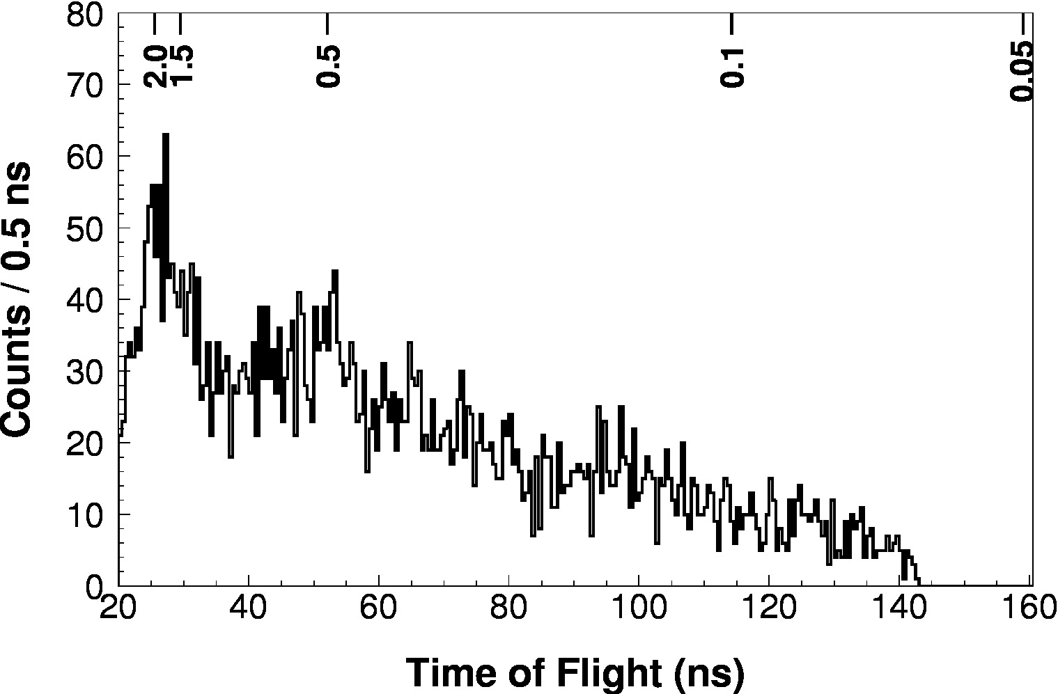
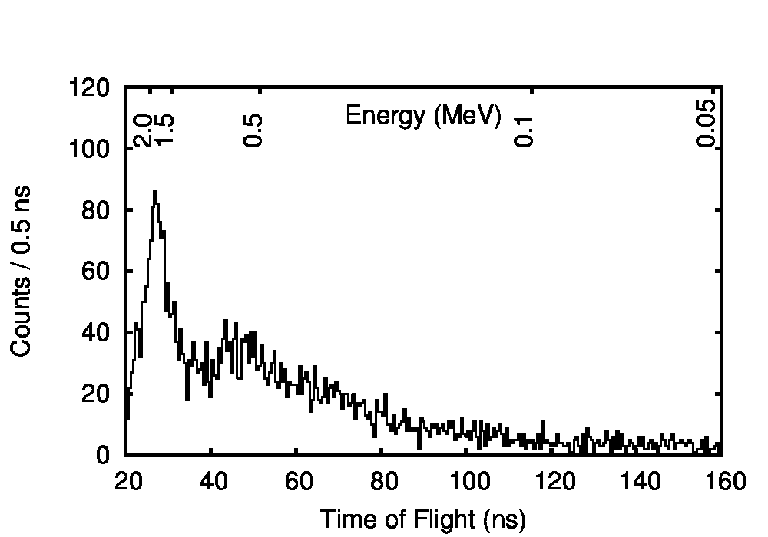
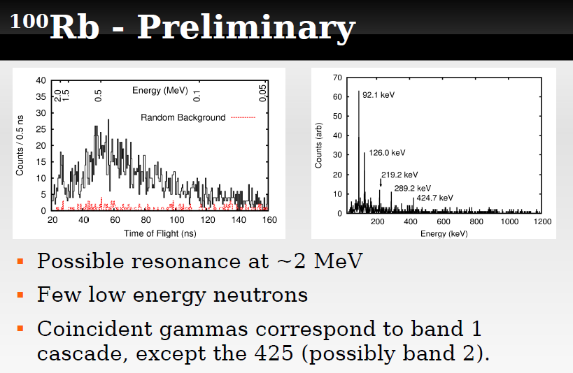
VANDLE 2012 campaign highlights
Z=51
⁷⁸Cu
¹³⁶Sb
N-Z
⁸⁴Ga
¹⁰⁰Rb
T_{1/2}=51ms

Slide 13
VANDLE highlights: Resonant decay of ⁸⁴Ga
PRELIMINARY!!
P_{n}=80(20)%
Literature 74(14)%
J.A. Winger et al., PRC 81, 044303 (2010)

Slide 14
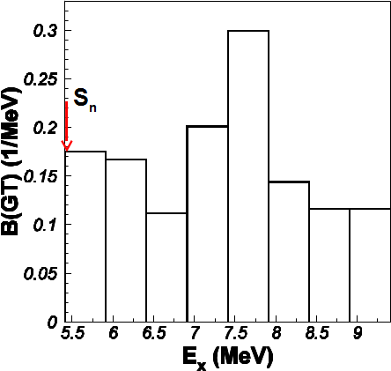
Preliminary Strength distribution
Cheating!: all neutron transitions feeding ⁸³Ge ground state

Slide 15
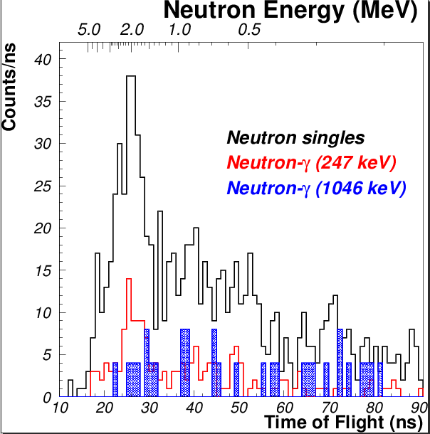
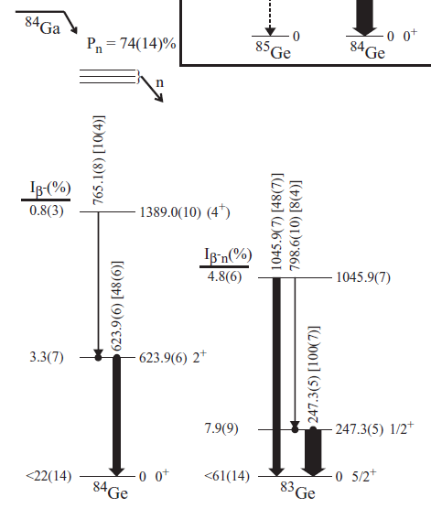
Neutron-Gamma coincidences
J.A. Winger et al., PRC 81, 044303 (2010)

Slide 16
Summary
⁸⁴Ga
First measurement of 4 decay half-lives of Zn, Ga and Ge isotopes.
Validated theoretical half-lives have a profound effect on r-process abundances
Models of beta decay require experimental input of decay strength
30 delayed neutron emitters studied at HRIBF
Neutron-Gamma coincidences are fundamental

Slide 17








People
ORNL support
C. Gross, C. Jost, A.J. Mendes II, D. Stracener
Decay Spectroscopy group
  L. Cartegni, R. Grzywacz, A. Kuzniak, D. Miller, S. Padgett, S. Paulauskas
  J.C. Batchelder, S. Liu, M. Wolinska-Cichocka. K. Rykaczewski, K. Miernik,
  C. Mazzochi, M. Karny, A. Korgul, S. Ilyushkin, J. Winger, W. Krolas,
  J.H. Hamilton, N. Brewster, A.V Ramaya, J.K. Hwang, E. Zganjar,
VANDLE colaboration
C. Matei and I. Spassova ORAU;
P.D. O'Malley, M. Howard, B. Manning, E. Merino, and J. Cizewski, Rutgers U.;
D. Bardayan, ORNL; C. Brune and T. Massey, Ohio U.;
F. Raiola, D. Walter, S. Ilyushkin, and F. Sarazin, Colorado School of Mines;
J. Blackmon, Louisiana State U

Slide 18
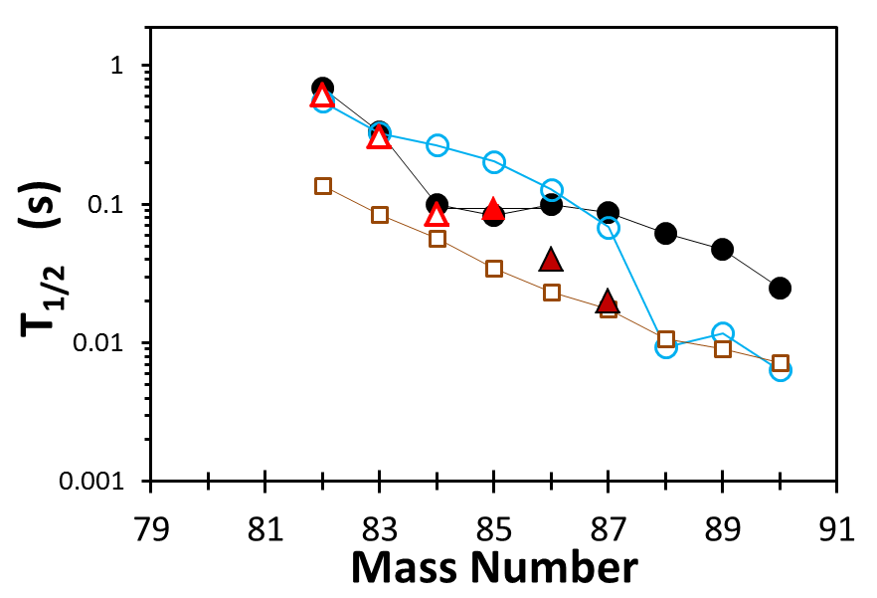
Benchmarking Ga half-lives
Courtesy of I.N. Borzov
DF3a+CQRPA
FRDM+ f.f. gr.th.
gr.th.
Exp. NUBASE
Exp. LeRIBSS
Exp. LeRIBSS+RIBF

Slide 19
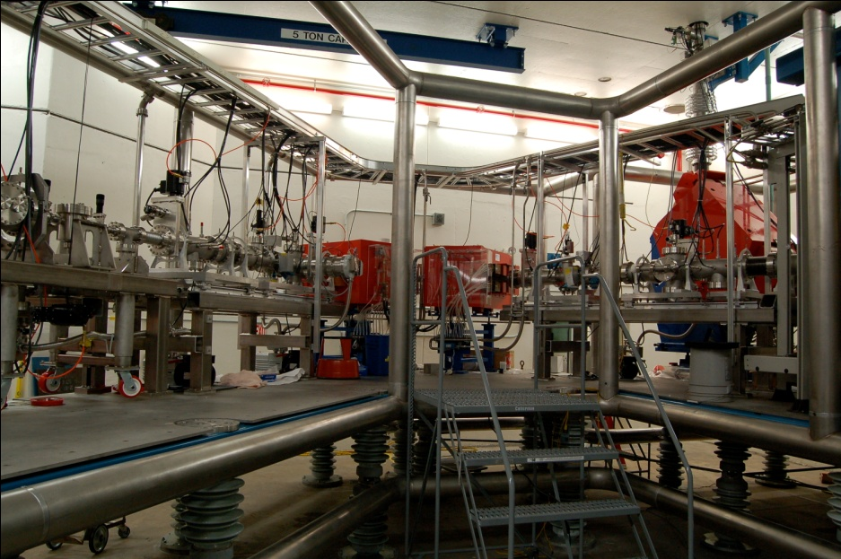
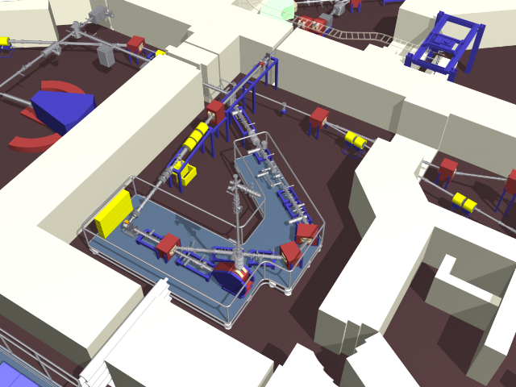
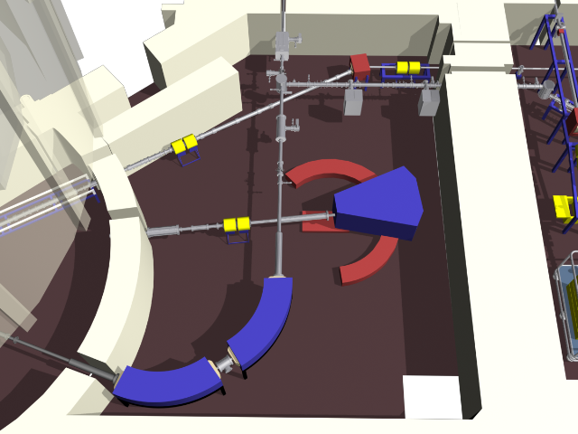
Injector for Radioactive Ion Species IRIS 2
ORIC proton beam
10-15 μA @ ~40MeV
BAM Mass analyzer
UC_{x} taget
Switcher
Isobar separator ~1/10 000

Slide 21
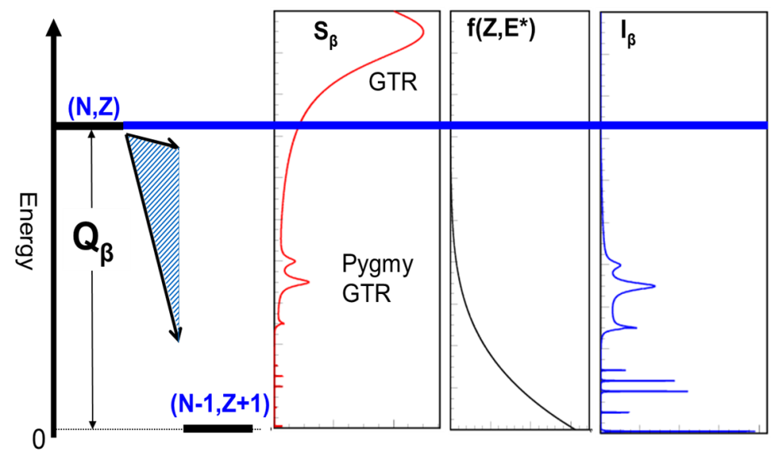
VANDLE highlights: Resonant decay of ⁸⁴Ga
9.0
8.0
E_{x} (MeV)
7.0
S_{n}
6.0
0.1
0.2
0.3
B(GT) (MeV⁻¹)

Slide 22
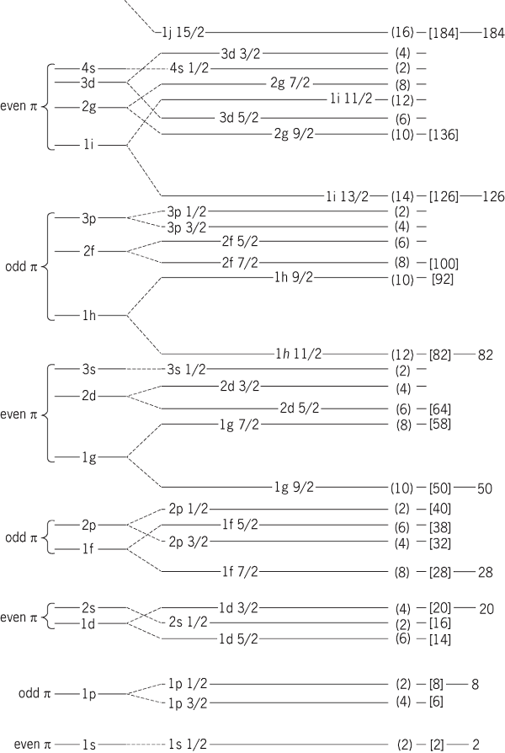
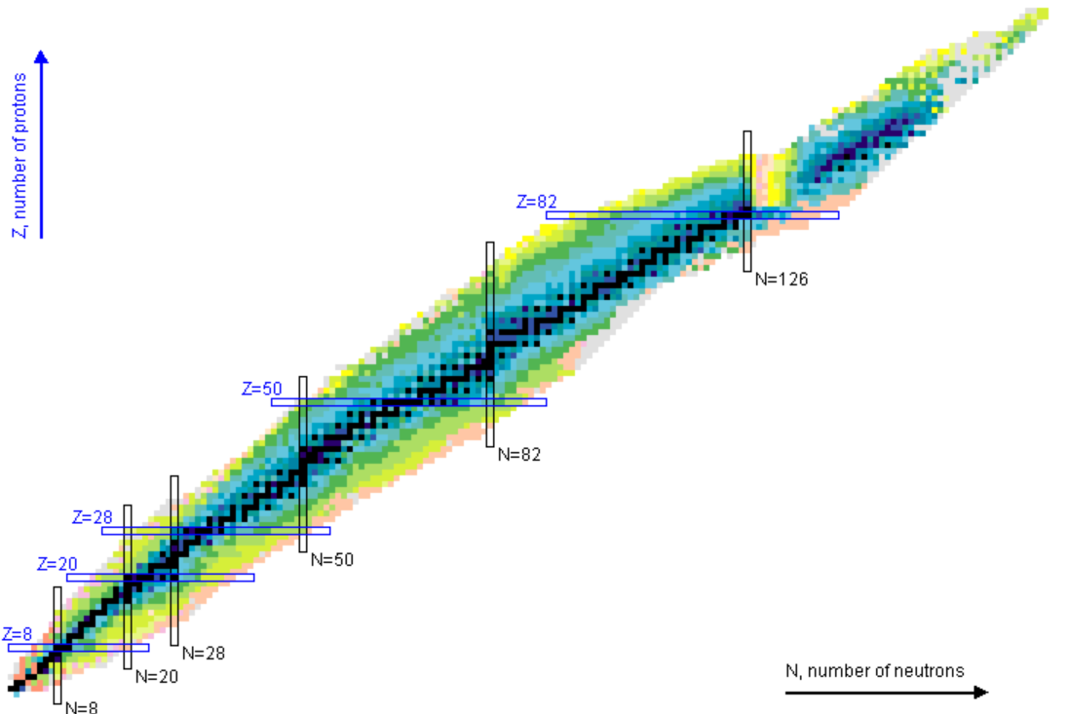
What nuclei will have core decay?

Slide 23
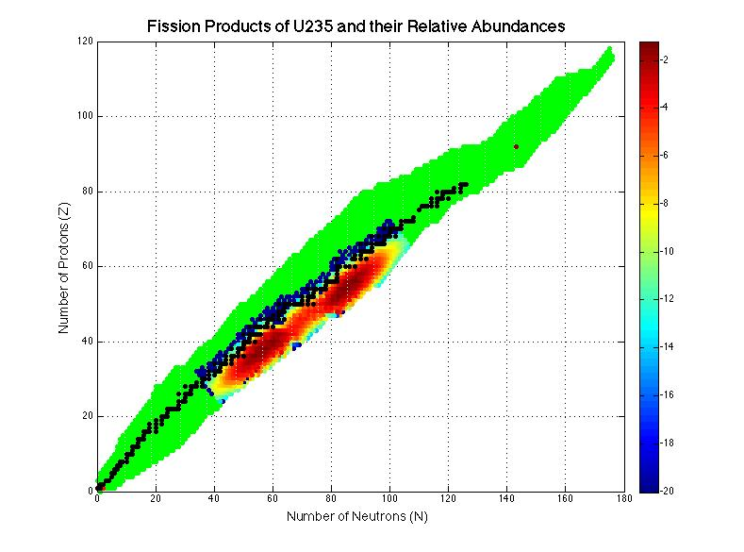
Fission products
Low yield!

Slide 24
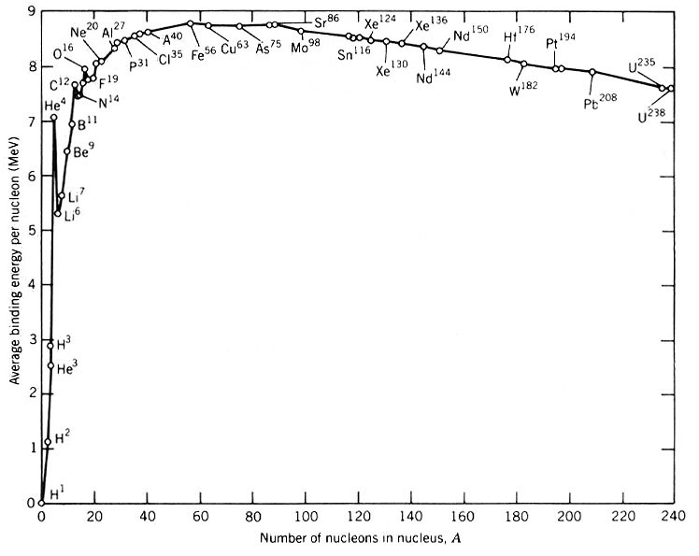

Slide 25

Beta decay of neutron rich nuclei
Neutron spectroscopy
S_{n}
Total absorption spectroscopy
High Resolution spectroscopy

Slide 26

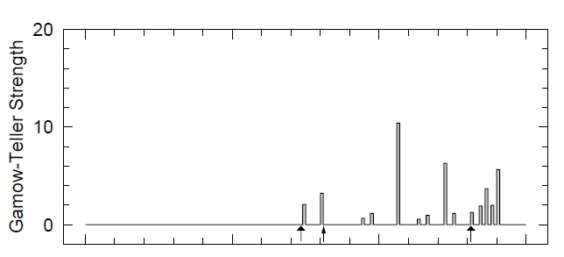
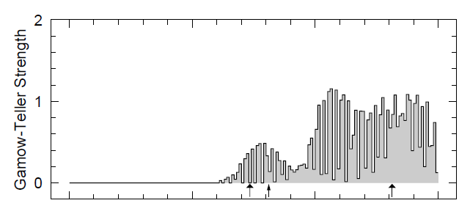
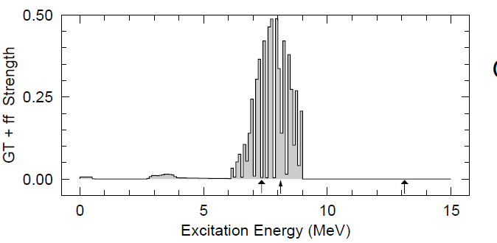
Modeling “integral values”
⁹²Rb β-decay
P. Moller, B. Pfeiffer and K.-L. Kratz, PRC 67 055802 (2012)
S_{n}
Q_{β}
1: Gamow-Teller from pure QRPA
P_{n} = 82.81 %
T_{1/2}=1.30 (h)
4: Experimental validation of GT resonance energy
2: Strength fragmentation.
P_{n} = 4.14 %
T_{1/2}=12.05 (min)
3: B(GT) + First Forbidden strength
P_{n} = 0.05 %
T_{1/2}=8.47 (s)

Slide 27
Beta decay as a tool to study nuclear properties
Studies possible at low production rates.
Very important exploratory role !
N,Z
betas
Z
gammas
`
N-1,Z+1
N

Slide 28
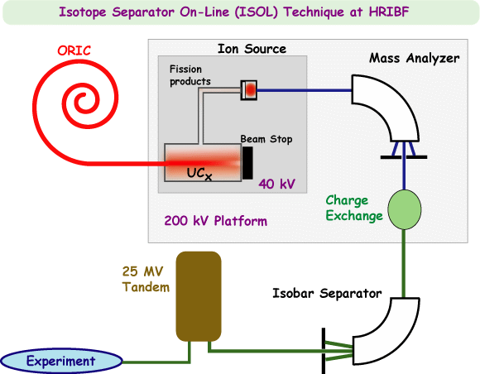
Studies of neutron-rich nuclei at HRIBF
Production and separation of neutron rich isotopes
“ISOL” technique - intense beam of light ions and thick targets. Effective utilization of the beam and the target material.
but … ion “so(u)rce(ry)”
Unique HRIBF capability
ISOBAR SEPARATOR !
enables selective studies
of ions with given A and Z.
Much easier to operate
than e.g. laser ion source !

Slide 29
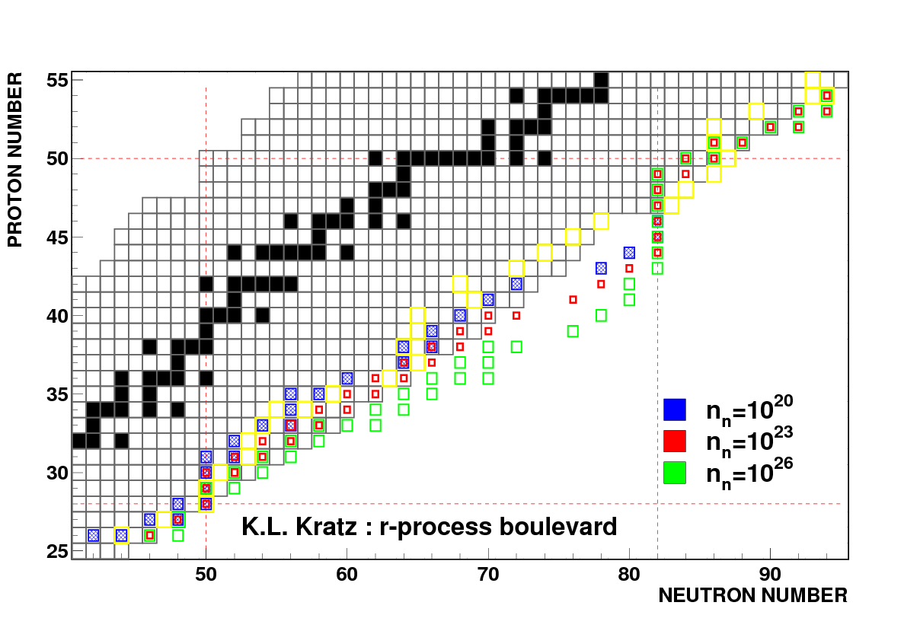
Half-lives in the vicinity of ⁷⁸Ni
Z=28 N=50 shell closures
Progenitors of r-process nuclei
Beta decay between different parity subshells:
  First forbidden transitions play a fundamental role in the half life
“Speeding-up the classical r-process”
P.Moeller et al. Phys. Rev. C 67, 055802 (2003)

Slide 30
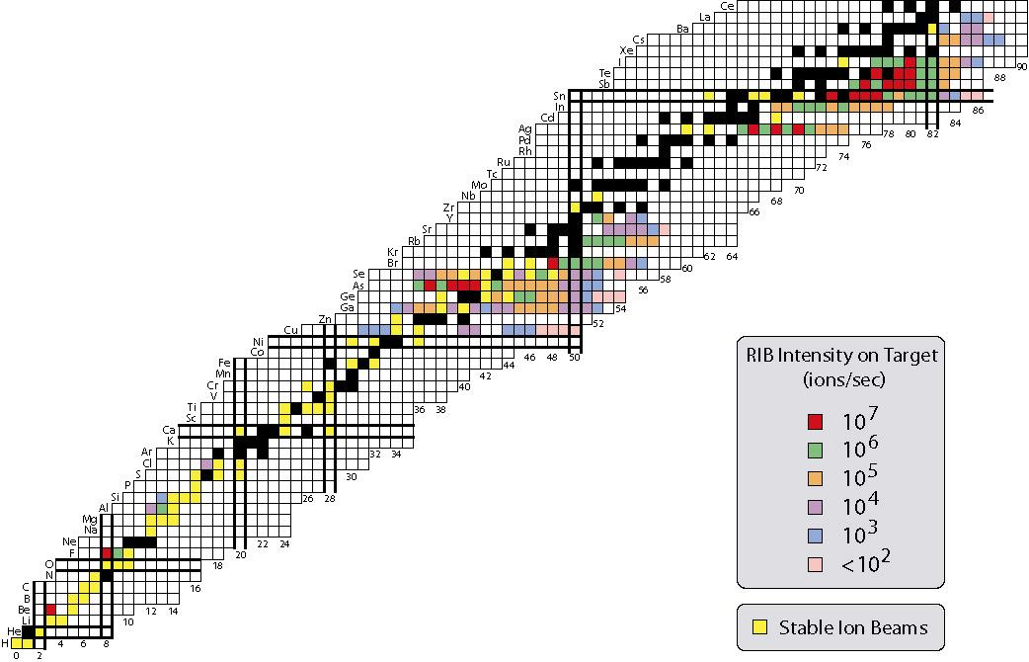
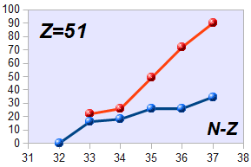
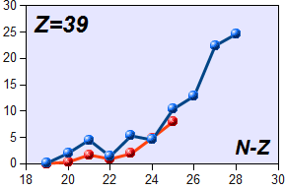
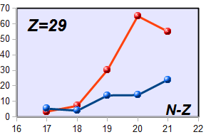
Predicting neutron branching ratios
Sb
Y
Kratz-Herman formula
Exp.
Cu
Microscopic details matter!
Large effect close to shell-closures → waiting points

Slide 31
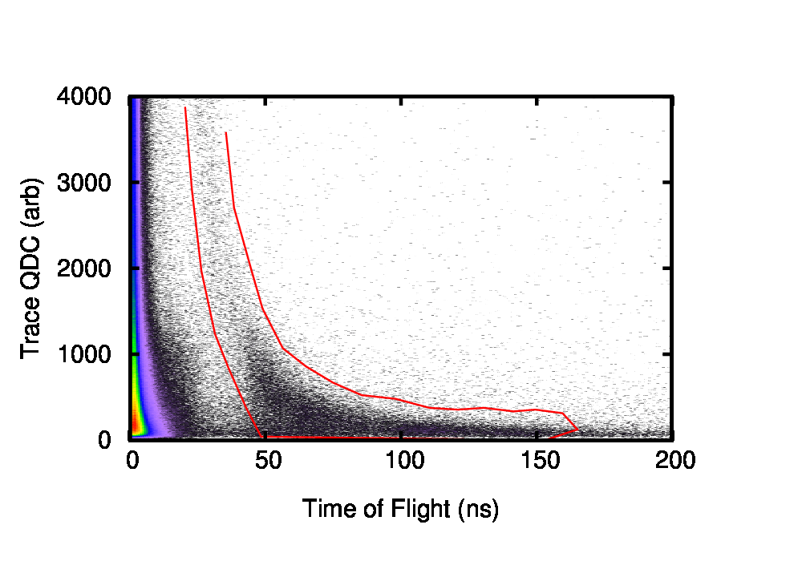
Light output vs Time of Flight:
Neutron gate
“Tail” of the gamma prompt removed
Cleaner low energy spectrum!!
Gamma prompt
Neutron gate

Slide 32
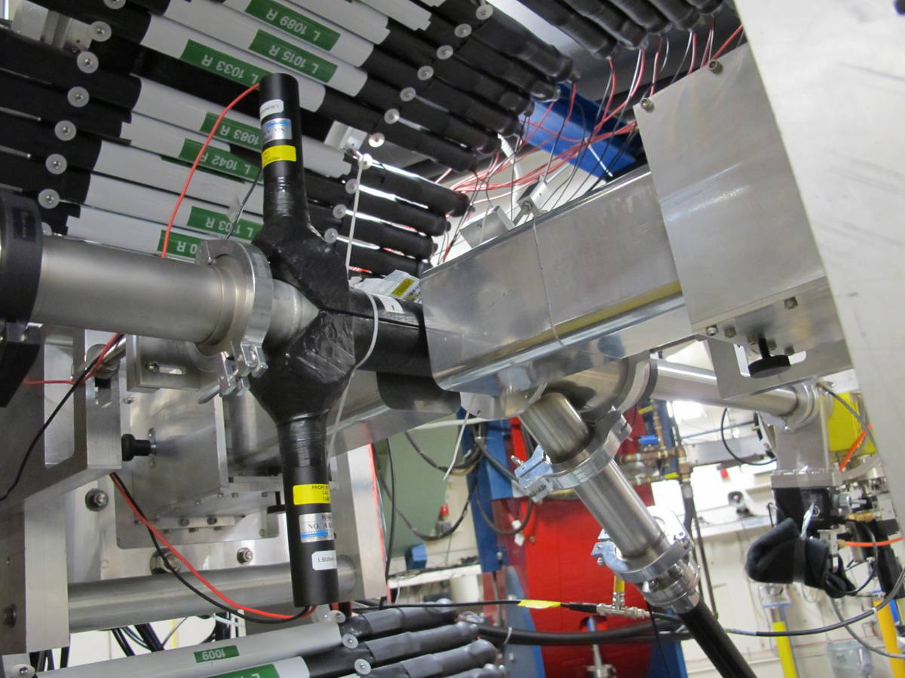
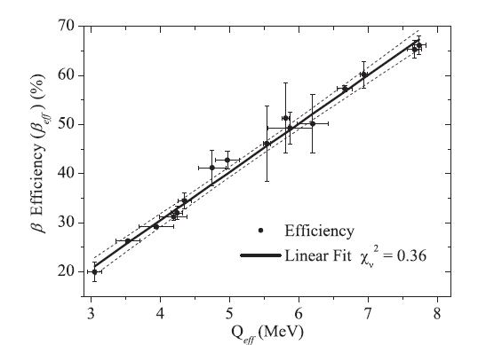
“Teething pains” of VANDLE
“Start” detector - outside the vacuum chamber (~ 1 MeV Qβn energy cutoff).
Large dimension of the detector affected final timing resolution (~3ns).
“Dirty” compromise between gamma-ray and neutron detection.
S. Ilyushkin

Slide 33
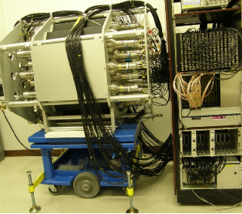

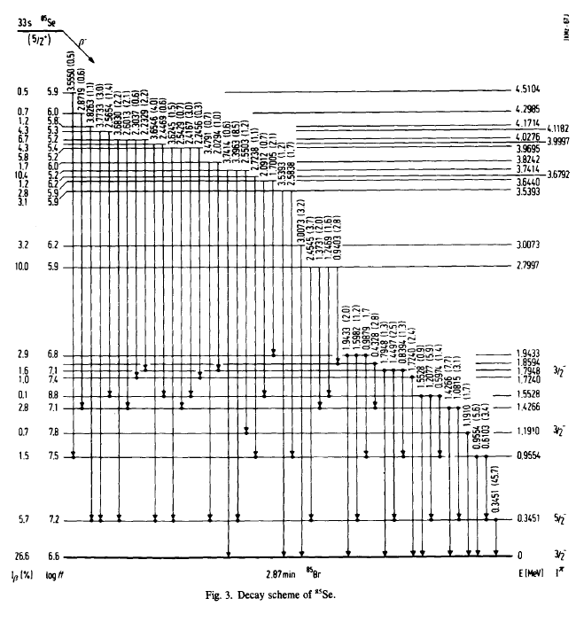
Beta decay of N=51 ⁸⁵Se @ ORNL
MTAS
data 2011
5.5 MeV
⁸⁵Se
J. Inorg. nucl. Chem. Vol. 42, 1387 (1980)
neutron activation
⁸⁵Br

Slide 34
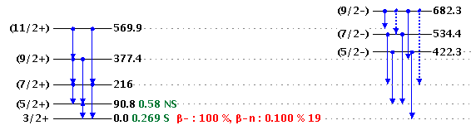
¹⁰⁰Rb at LeRIBSS: neutron emission populates rotational bands
Neutron gated γ spectrum

Slide 35

Decay of fission fragments @ TRIUMF
Proton number
N=50
x
Z=50
Q_{β} – S_{n} <0
x
Newly developed UC_{x} target opens the study of neutron-rich species around N=50 and N=82
Neutron number

Slide 36


Slide 37


Outlook: Experiment proposed at NSLC, LoI approved at TRIUMF
2 HPGe clovers
48 VANDLE bars = 12% efficient @ 1 MeV
New segmented plastic implantation detector (R. Grzywacz and M. Al-Shudifat)

Slide 38

Nuclear structure and the decay of N>50 nuclei “forbidden” and “allowed”
J. Winger et al., PRC 38, 285 (1988)
N=50
FF
υ
GT
Z=28
π

Slide 39



Benchmarking calculated half lives: beyond what is possible in current facilities
Zn
FRDM+ f.f. gr.th. (2003)
DF3a+CQRPA
Courtesy of I.N. Borzov
Exp. NUBASE
Exp. LeRIBSS
Ga
Ge

Slide 40
Year-one IRIS-2/LeRIBSS
Several short campaigns
Continuation of the IRIS-1 campaigns
with “ranging out”(2008)
^{76,77,78,(79)}Cu, ^{83,84,(85)}Ga
J.A. Winger et al. Phys. Rev. Lett. 102, 142502 (2009)
S.V.Ilyushkin et al. Phys. Rev. C 80, 054304, 2009.
J.A.Winger et al. Phys. Rev. C 81, 044303, 2010.
and LeRIBSS (2009)
^{79,80,81}Zn, ^{75,77}Cu
S. Padgett et al. Phys. Rev. C 82, 064314 (2010)
S.V.Ilyushkin, et al. Phys. Rev. C 83, 014322, (2011)
Positive (+) ions:
^{136,137}Sb
^{122,124,126}Ag
^{83,84}Ge
^{83,85}Ga
^{81,82,83}Zn
and (++)
^{158,160,162,164}Eu
IRIS-2
Negative ions:
^{73,74,78,79}Cu
^{87,93}Br
Molecules
(GeS,AsS)(+):
^{85,86}Ge,⁸⁷As

Slide 41

Neutron spectroscopy
For neutron rich isotopes the majority of the Q_{β} window can be above Sn!!

Slide 42
Summary and outlook
IRIS 2 commission great success! Clean, high intensity high quality data.
4 new half-lives of r-process relevant nuclei.
Validation of new theoretical model of beta-decay in the 78Ni region. Profound influence on beta decay rates
Neutron detection and TAS play a crucial role as we move farther away from stability.

Slide 43

Core excitation in N=51 isotones?
More in the talk by S. Padgett
J. Winger et al., PRC 38, 285 (1988)
P_{n}=12(4)% (7.5(3)% →30(13)%)
B. Pfeiffer et al., Prog. Nucl. Energy 41, 39 (2002).
P.Hosmer et al., PRC 82, 025806 (2010)

Slide 44

Beyond High Resolution Spectroscopy
Gamow Teller decay dominates @ high energy -→ core excitations
Are there 2p-2h core excited states, pygmy resonance?!
High excitation energy!!
  High efficiency gamma detector, MTAS

Slide 45


Decay spectroscopy of ⁸⁵Ga
2008
Rate(2011) = 400 x rate(2008)
Confirm 624 keV transition
107 keV
624 keV
February 2011
107 keV gate
624 keV gate
T_{1/2}=92(7) ms

Slide 46
⁸⁵Ga level scheme
Potential N=58 d5/2-s1/2 subshell?
86.5(5) ms
(5/2⁻)
⁸⁵Ga
}
βn = 65(30)%
(1/2⁺)
n
247
(3/2⁺)
(1/2⁺)
107
(5/2⁺)
(5/2⁺)
894
1430
⁸³Ge
787
806
⁸⁵Ge
701
1389
594
764
473
366
624
2⁺
107
624
A 107 keV E2 transition halflife ~1μs
The observed halflife of the 107 keV is < 100 ns
107
0
(5/2⁺)
0
0⁺
⁸⁵Ge
⁸⁴Ge
More details in poster by A. Korgul

Slide 47

Decay spectroscopy of ⁸²Zn
237(30) ms
0⁺
n
⁸²Zn
}
802
451
351
3/2⁻
362
351
0
0
5/2-
⁸²Ga
⁸¹Ga
351 (⁸²Zn→⁸²Ga*→⁸¹Ga*+n)
362 (⁸²Zn→⁸²Ga)
451
351 keV gate

Slide 48

Decay spectroscopy of ⁸³Zn
<100 ms
(5/2⁺)
⁸³Zn
}
n
?
249
140
?
109
109
0
0
⁸³Ga
⁸²Ga
109 keV gate
T_{1/2}=117(20) ms

Slide 49
Decay of ⁸⁶Ge
HOT OFF THE PRESS! Extra!
210(30) ms
0⁺
n
⁸⁶Ge
}
(⁸⁶Ge→⁸⁶As*)
111
351
102
111
0
0
⁸⁶As
⁸⁵As
(⁸⁶Ge→⁸⁶As*→⁸⁵As*+n)
T_{1/2}=210(30) ms
102
⁸⁶Se
⁸⁶Se
111 keV gate
102 keV gate

Slide 50

Ge Half-lives
Courtesy of I.N. Borzov
FRDM+ f.f. gr.th.
DF3a+CQRPA
DF3+CQRPA no πf_{5/2}
Exp. NUBASE
Exp. LeRIBSS
Experimental Half-lives shorter than calculations
R-process: job not finished!

Slide 51


β-decay strength suggests ⁷⁷Cu g.s. dominated by πf_{5/2}
(5/2⁻)
⁷⁷Cu
T_{1/2}=480(9) ms
(1/2⁻)
772.43
6.2(3) 6.2(36)
T_{1/2}=1.05 s
(9/2⁺)
114.72
6.79(13) 1.9(4)
(7/2⁺)
6.20(19) 7.6(31)
0
Log(ft)
I_{β} (%)
⁷⁷Zn
T_{1/2}=2.08 s

Slide 52
Neutron spectroscopy of Ni isotopes
⁷⁶Ni

Slide 53


Gamow-Teller decay in ⁸¹Zn
⁸¹Zn GT states at 4.3-4.8 MeV
⁸³Ge peak GT states at 4.0-4.3 MeV!!
J. Winger et al., PRC 38, 285 (1988)

Slide 54


Decay of Zn isotopes
Courtesy of F. Montes

Slide 55

Detector components

Slide 56





Pixie16 digitizer
150 MB/s/channel
Analog
Digital
total system load ~30 GB/s
DET
Energy
Trigger time
Original Signal
Nyquist filter
Digitization
FPGA shaping

Slide 57





Low threshold/High Efficiency Digital electronics for VANDLE
Energy calibration courtesy of I. Spassova & W.A. Peters

Slide 58


VANDLE efficiency measurement at Ohio University
Ohio method:
Collimated and normalized
²⁷Al(d,n) beam
²⁷Al(d,n)
Detector out of n-beam
2.4 μs @ 13 m =160 keV
Trigger threshold = 10 keVee

Slide 59


VANDLE efficiency
C. Sumithrarachchi et al., PRC 74, 024322(2006)
Threshold=25 keVee
MSU array
A. Buta et al.., NIM A 455 (2000) 412
TONNERRE
Courtesy of W.A. Peters

Slide 60


Frontier nuclear physics II: ⁷⁹Cu
detected ⁷⁹Cu ions:
NSCL 2005(2010): 754
HRIBF 2006: ~16 000
HRIBF 2011: ~158 000
~ 2 days exp
decay of N=50 ⁷⁹Cu to N=49 ⁷⁹Zn
single neutron-hole states in N=50

