Slide 1

New Neutrino-nucleus Reaction
Cross Sections at Solar, Reactor and Supernova Neutrino Energies
“Nuclear structure, Neutrinos and
Stellar nucleosynthesis”
Toshio Suzuki
Nihon University
INPC 2013
Firenze, June 4, 2013

Slide 2
Collaborators
M. Honmaª, B. Balantekin^{b}
T. Kajino^{c,d}, S. Chiba^{e}
T. Otsuka^{f}
ªUniversity of Aizu
^{b}Univ. of Wisconsin
^{c}National Astronomical Observatory of Japan
^{d}Department of Astronomy, University of Tokyo
^{e}Tokyo Institute of Technology
^{f}CNS and Dept. of Physisc, Univ. of Tokyo

Slide 3
・New shell-model Hamiltonians and successful description of
Gamow-Teller (GT) and spin-dipole (SD) strengths
SFO (p-shell): GT in ¹²C, ¹⁴C
Suzuki, Fujimoto, Otsuka, PR C69, (2003)
GXPF1J (fp-shell): GT in Ni isotopes
Honma, Otsuka, Mizusaki, Brown, PR C65 (2002); C69 (2004)
Suzuki, Honma et al., PR C79, (2009)
VMU (monopole-based universal interaction)
＊important roles of tensor force
・New ν-nucleus reaction cross sections
ν-¹²C and ν-¹³C with SFO
ν-⁵⁶Fe, ν-⁵⁶Ni and e-captures on Ni isotopes with GXPF1J
⁴⁰Ar (ν, e⁻) ⁴⁰K with VMU
・Nucleosynthesis in supernova explosion, ν-oscillation effects, low-energy (reactor, solar) ν detection

Slide 4
1. New Shell-Model Hamiltonians in p-shell and
Neutrino-induced Reactions on ¹²C and ¹³C
p-shell（p-sd） Cohen-Kurath+Millener-Kurath → SFO
[ p: CK (8-16)2BME, p-sd: MK, sd, p2-(sd)2: Kuo’s G-matrix]
Monopole terms in p1/2-p3/2 , T=0 enhanced：ΔV = -1.9 MeV
SFO: Suzuki, Fujimoto, Otsuka, PR C67, 044302 (2003)
Systematic improvements in the description of magnetic moments, reproduction of GT transitions in p-shell nuclei (¹²C, ¹⁴C) are obtained.
Proper tensor cmponents are taken into account:
attractive (repulsive) between p1/2-p3/2 (p1/2-p1/2, p3/2-p3/2)
Shell evolution toward drip-lines is explained:
magic number changes from 8 to 6 (¹³B -> ¹²Be -> ¹¹Li)

Slide 5
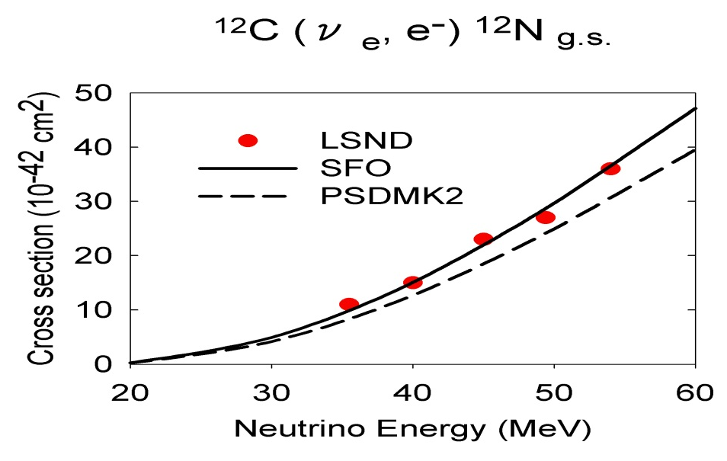
GT
SFO*: g_{A}^{eff}/g_{A}=0.95
B(GT: 12C)_cal = experiment
SFO
GT
HT: Hayes-Towner,
PR C62, 015501
(2000)
NCSM: Hayes-
Navratil-Vary,
PRL 91 (2003)
CRPA: Kolb-
Langanke-Vogel,
NP A652, 91
(1999)
PR C55, 2078 (1997)
Suzuki, Chiba, Yoshida,Kajino, Otsuka, PR C74, 034307, (2006).
spin-dipole states

Slide 6
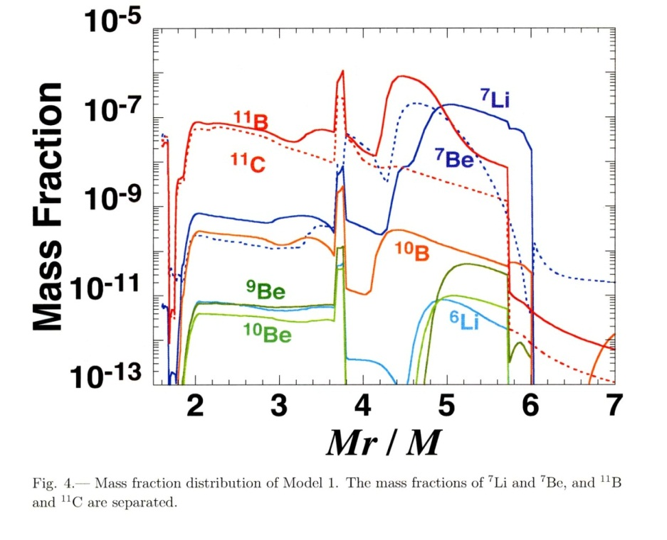
Nucleosynthesis processes of
light elements
Inner O/C He/C He/H H
Enhancement of ¹¹B and ⁷Li abun-dances in supernova explosions

Slide 7
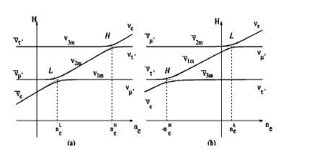
Normal hierarchy
Inverted hierarchy
ν oscillations
Increase in the rates of
charged-current reactions
4He(ν_{e},e⁻p)3He
12C(ν_{e},e⁻p)11C
in the He layer

Slide 8
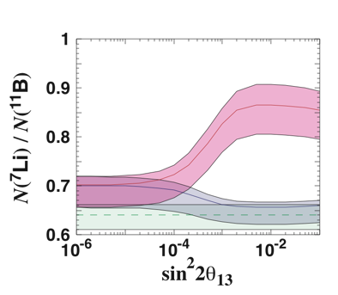
⁷Li/¹¹B Dependence on Mass Hierarchy and θ₁₃
N(⁷Li)/N(¹¹B)
Good indicator for neutrino oscillation parameters
Including uncertainties in neutrino temperatures
normal
(T_{νe}, T_{νe}, T_{νμ,τ}, E_{ν})
= (3.2, 5.0, 6.0, 3.0)
, (3.2, 4.8, 5.8, 3.0)
, (3.2, 5.0, 6.4, 2.4)
, (3.2, 4.1, 5.0, 3.5)
, (4.0, 4.0, 6.0, 3.0)
, (4.0, 5.0, 6.0, 3.0)
(MeV, MeV, MeV, ×10⁵³ergs)
inverted
no mix
Normal mass hierarchy and sin²2θ₁₃ > 0.002
Yoshida et al.,
PRL 96 (2006)
N(7Li)/N(11B) > 0.8
Possibility for constraining mass hierarchy and
lower limit of the mixing angle θ₁₃.
Neutrino experiments
Constraining upper limit of θ₁₃

Slide 9
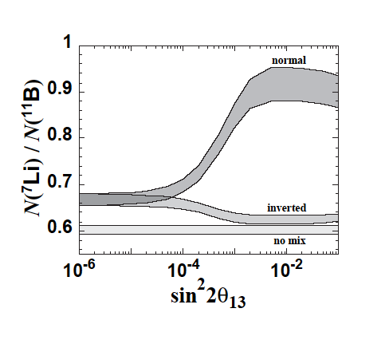
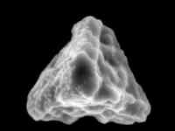
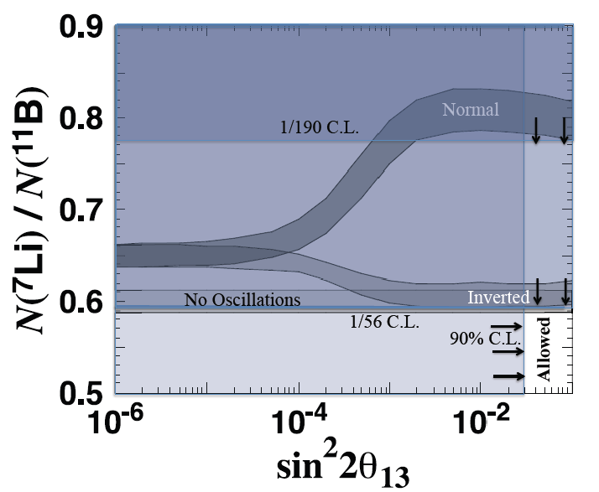
Supernova X-Grain Coinstraint
1
0.9
0.8
0.7
0.6
0.5
0.4
0.3
0.2
0.1
Mathews, Kajino, Aoki
And Fujiya, Phys. Rev.
D85,105023 (2012).
Normal Mass
Hierarchy
・T2K, MINOS (2011)
・Double CHOOZ,
Daya Bay, RENO
(2012)
sin²2θ₁₃ = 0.1
⁷Li/¹¹B-Ratio
Inverted Mass
Hierarchy
First Detection of
⁷Li/¹¹B in SN-grains
W. Fujiya, P. Hoppe, &
U. Ott, ApJ 730, L7 (2011).
“Inverted Mass Hierarchy”
is statistically more preferred !
74% ー Inverted
24% ー Normal
10⁻⁶ 10⁻⁵ 10⁻⁴ 10⁻³ 10⁻² 10⁻¹

Slide 10
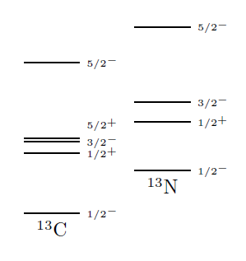
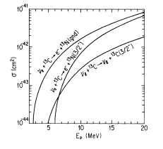
¹³C: attractive target for very low energy ν
ν-induced reactions on ¹³C
measure γ-decay
GT
GT transitions
GT
GT+IAS
Fukugita et al., PR C41 (1990)
p-shell: Cohen-Kurath
g_{A}^{eff}/g_{A} =0.69
Detector for solar ν

Slide 11
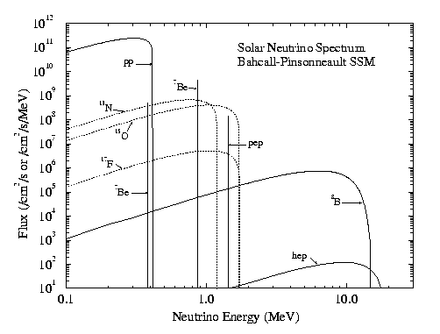
p-sd shell: SFO
Solar ν cross sections
folded over ⁸B ν spectrum
Suzuki, Balantekin, Kajino,
PR C86, 015502 (2012)

Slide 12
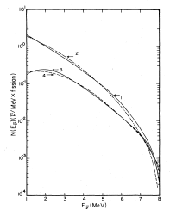
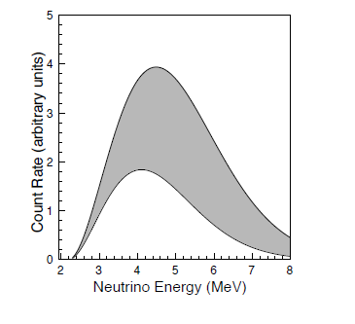
Vogel et al.

Slide 13
Partial cross sections of gamma and particle emissions

Slide 14
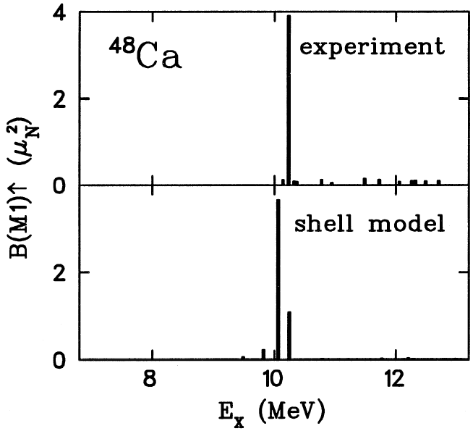
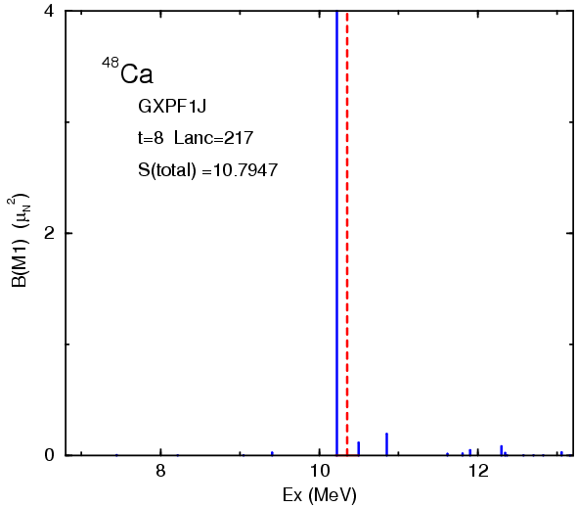
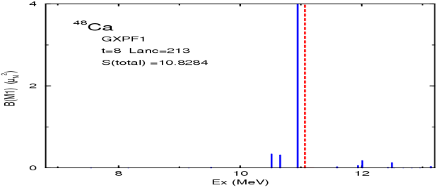
2. New Shell-model Hamiltonians in fp-shell and
Nuclear Weak Processes
GXPF1: Honma, Otsuka, Mizusaki, Brown, PR C65 (2002); C69 (2004)
KB3: Caurier et al, Rev. Mod. Phys. 77, 427 (2005)
○ KB3G A = 47-52 KB + monopole corrections
○ GXPF1 A = 47-66
・ Spin properties of fp-shell nuclei are well described
M1 strength
(GXPF1J)
B(GT₋) for ⁵⁸Ni
g_{A}^{eff}/g_{A}^{free}=0.74
Fujita et al.
g_{S}^{eff}/g_{S}=0.75±0.2
8-13MeV

Slide 15
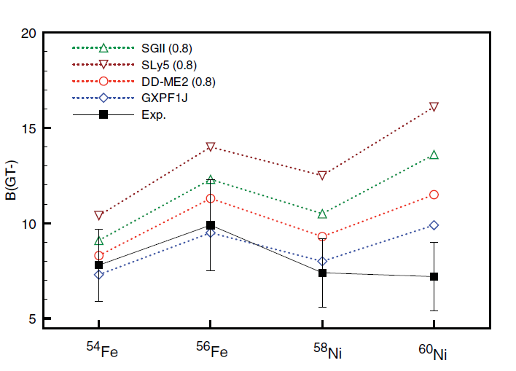
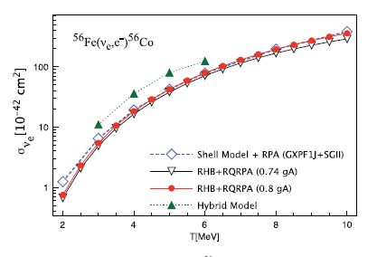
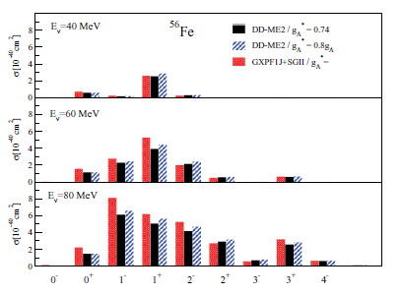
Shell-model vs. RQRPA
SM(GXPF1J)+RPA(SGII) 259 x10 ⁻⁴²cm²
RHB+RQRPA(DD-ME2) 263
RPA(Landau-Migdal force) 240
QRPA(SIII) 352
QRPA(G-matrix formalism) 174
KARMEN (DAR)

Slide 16

e-capture rates in
stellar environments
ρY_{e}=10⁹
10⁸
10⁷
Sasano et al.
PRL 107, 202501 (2011)
Suzuki, Honma, Mao, Otsuka, Kajino,
PR C83, 044619 (2011)

Slide 17
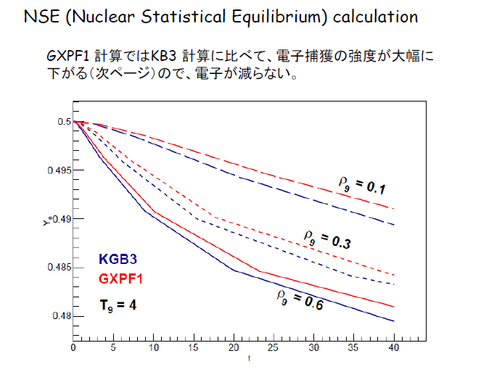
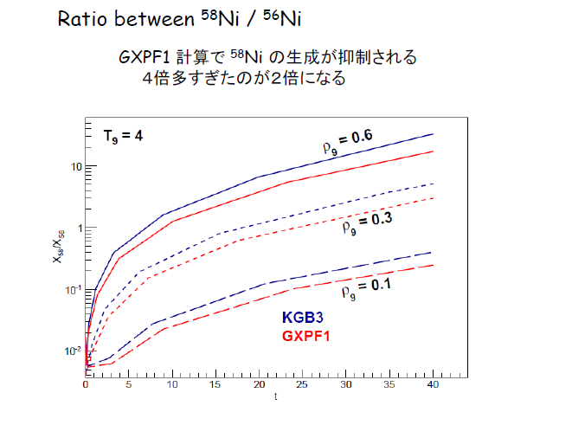
Type-Ia supernova explosion
Accretion of matter to white-dwarf from binary star
→ supernova explosion when white-dwarf mass > Chandrasekhar limit
→ ⁵⁶Ni (N=Z)
→ ⁵⁶Ni (e⁻, ν) ⁵⁶Co Y_{e} =0.5 → Y_{e} < 0.5 (neutron-rich)
→ production of neutron-rich isotopes; more ⁵⁸Ni
Decrease of e-capture rate on ⁵⁶Ni → less production of ⁵⁸Ni.
Problem of over-production of ⁵⁸Ni may be solved.
e-capture rates:
GXPF1J < KB3G
←→ Y_{e} (GXPF1J) > Y_{e} (KB3G)
Famiano

Slide 18
●Neutral current reaction on ⁵⁶Ni
B(GT)=6.2
(GXPF1J)
B(GT)=5.4
(KB3G)
large p emission
cross section
Synthesis of Mn in Population III Star
cf: HW02
gamma
p
n
Suzuki, Honma et al.,
PR C79, 061603(R)
(2009)

Slide 19
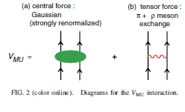
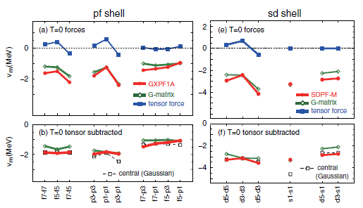
3. VMU= Monopole based
Universal Interaction
Monopole terms in V_{nn}
● Important roles of
tensor force
Otsuka, Suzuki, Honma, Utsuno,
Tsunoda, Tsukiyama, Hjorth-Jensen
PRL 104 (2010) 012501
tensor force:
bare≈renormalized

Slide 20
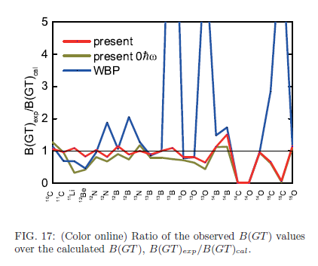
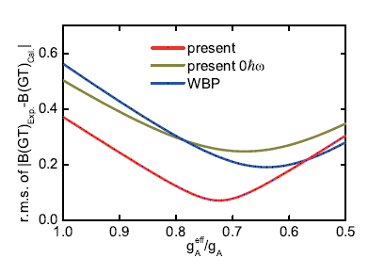
○ p-sd shell: VMU for p-sd,
Yuan, Suzuki, Otsuka, Xu, Tsunoda,
PR C85, 064324 (2012) .
p: SFO
sd: SDPF-M (Utsuno)
p-sd: VMU tensor = π+ρ,
2-body LS = σ+ρ+ω (M3Y)
central= renormalized VMU
○ sd-pf shell: ⁴⁰Ar (ν, e⁻) ⁴⁰K
SDPF-VMU-LS
sd: SDPF-M (Utsuno et al.)
fp: GXPF1 (Honma et al.)
sd-pf: VMU + 2-bpdy LS
(sd)⁻² (fp)² : 2hw
B(GT)
ν-⁴⁰Ar cross sections
Solar ν cross sections folded over ⁸B ν spectrum

Slide 21
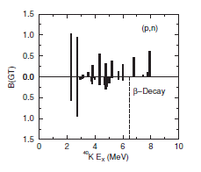
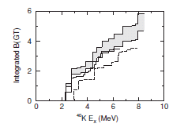
OOＯ
Ormand et al.
β-decay
(p,n) Bhattacharya et al., PR C80 (2009)

Slide 22
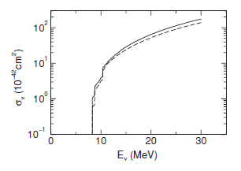
GT+IAS
E_{e} > 5 MeV : ICARUS
Solar ν cross sections folded over ⁸B
ν spectrum
(p,n)
β-decay
IAS: C0+L0 ≈[(q²-ω²)/q²]²×C ; ⁺ C0 only
GT: E₁⁵ +M1+C₁⁵+L₁⁵ ; ⁺ E₁⁵ only
⁺Ormand et al, PL B345, 343 (1995)
(p,n) Bhattacharya et al., PR C80, 055501 (2009)

Slide 23
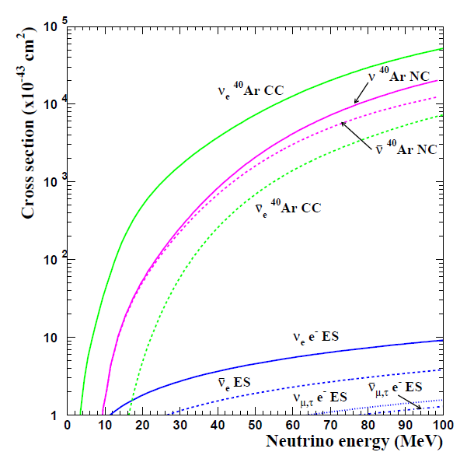
E. Kolbe, K. Langanke, G. Mart´ınez-Pinedo, and P. Vogel, J. Phys. G 29, 2569 (2003);
I. Gil-Botella and A. Rubbia, JCAP 10, 9 (2003).

Slide 24
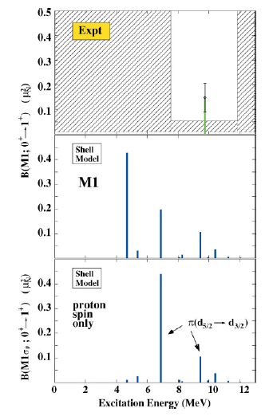
Neutral-current
M1
T=2 → T=2
q_{IV}=0.35 q_{IS}=0.7
Exp. B(M1)=0.148(59) μ_{N}²
Li et al, PR C73, 054306 (2006)

Slide 25
Summary
New ν –induced cross sections based on new shell-model Hamiltonians with proper tensor forces
(SFO for p-shell, GXPF1 for pf-shell)
・Good reproduction of experimental data for
¹²C (ν, e⁻) ¹²N, ¹²C (ν, ν’) ¹²C and ⁵⁶Fe (ν, e⁻) ⁵⁶Co
・Effects of ν-oscillations in nucleosynthesis
abundance ratio of ⁷Li/¹¹B → ν mass hierarchy
・ New ν capture cross sections on ¹³C by SFO
Enhanced solar ν cross sections compared to
Cohen-Kurath (p shell)
Detection of low-energy reactor anti-ν

Slide 26
GXPF1J well describes the GT strengths in Ni isotopes : ⁵⁶Ni two-peak structure confirmed by recent experiment
→ 1. Accurate evaluation of e-capture rates at
stellar environments
2. Large p-emission cross section for ⁵⁶Ni and
production of more ⁵⁵Mn in Pop. III stars
VMU for sd-pf-shell:
GT strength consistent with (p, n) reaction
→ new cross section for ⁴⁰Ar (ν,e⁻) ⁴⁰K induced
by solar ν
Suzuki and Honma, PR C87, 014607 (2013)

