Slide 1
Precise study of the supernova reaction ⁴⁰Ca(α,γ)⁴⁴Ti by activation and in-beam γ-spectroscopy
International Nuclear Physics Conference INPC2013: 2-7 June 2013, Firenze, Italy
04/06/2013
Konrad Schmidt^{1,2},
Shavkat Akhmadaliev¹, Michael Anders^{1,2}, Daniel Bemmerer¹, Konstanze Boretzky³, Antonio Caciolli⁴, Mirco Dietz^{1,2}, Zoltán Elekes¹, Zsolt Fülöp⁵, György Gyürky⁵, Roland Hannaske^{1,2}, Arnd R. Junghans¹, Michele Marta^{1,3}, Marie-Luise Menzel^{1,2}, Ronald Schwengner¹, Tamás Szücs⁵, Andreas Wagner¹, Louis Wagner^{1,2}, Dmitry Yakorev¹, and Kai Zuber²
¹HZDR
²TU Dresden
³GSI Darmstadt
⁴INFN Padua, Italy
⁵ATOMKI Debrecen, Hungary
Supported by (BE 4100/2-1)

Slide 2

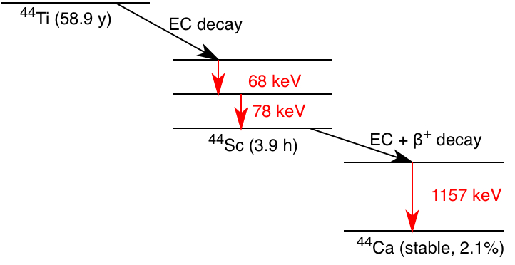
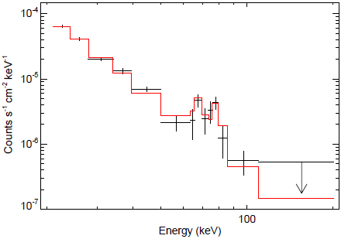
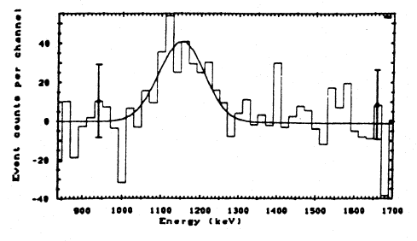
Supernova signal: ⁴⁴Ti in Cassiopeia A
Date: 30 Aug 2006
Satellite: Hubble
Depicts: Supernova remnant Cassiopeia A
Copyright: ESA/Hubble & NASA
Edit: Robert A. Fesen and James Long
2001 Vink et al.
by the Phoswich Detec-
tion System instrument
on BeppoSAX
2006 Renaud et al.
by IBIS/ISGRI on INTEGRAL
1994 Iyudin et al.
by COMPTEL on CGRO

Slide 3
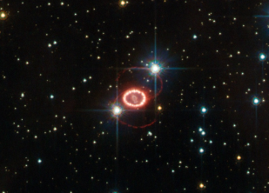
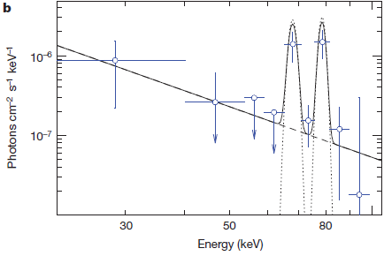
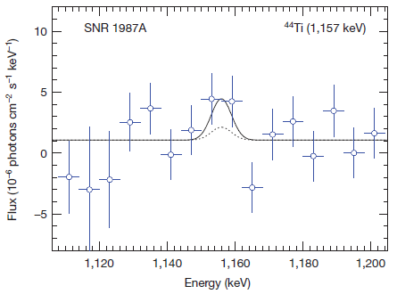
NEW: Supernova signal: ⁴⁴Ti in SNR 1987A
Date: 17 Oct 2012
Satellite: Hubble
Depicts: Supernova remnant 1987A
Copyright: ESA/Hubble & NASA
Strong background precludes their confident detection, only the flux at its upper limit is shown
2012 Grebenev et al.
by IBIS/ISGRI on INTEGRAL

Slide 4
Motivation
… but only two (Cas A and SN 1987A) are clearly seen in our Galaxy (transparent to γ-rays).
⁴⁴Ti is a sensitive probe of supernova models.
⁴⁰Ca(α,γ)⁴⁴Ti is dominating ⁴⁴Ti production.
Since 2006, there have been various experiments on ⁴⁰Ca(α,γ)⁴⁴Ti.
There are still discrepancies in the resulting reaction rates.

Slide 5
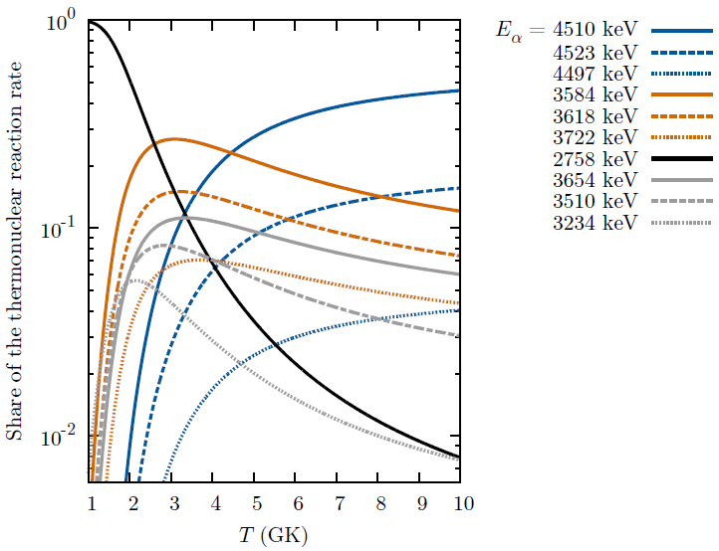

Most important resonances in the ⁴⁰Ca(α,γ)⁴⁴Ti reaction
this talk
under analysis, γ-counting in Felsenkeller Dresden
under analysis, 2nd beam time later this year
Approach:
Activation at high-intensity 3 MV Tandetron
γ-counting in Felsenkeller Dresden
Determination of resonance strengths ωγ

Slide 6
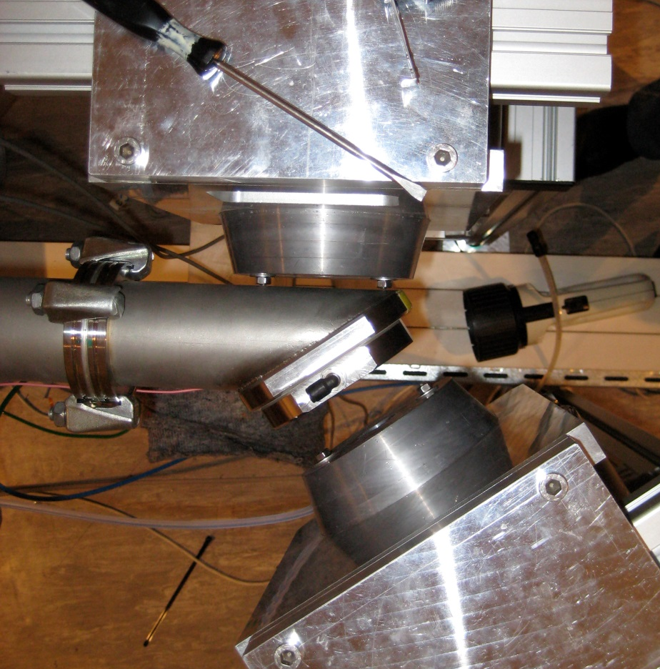
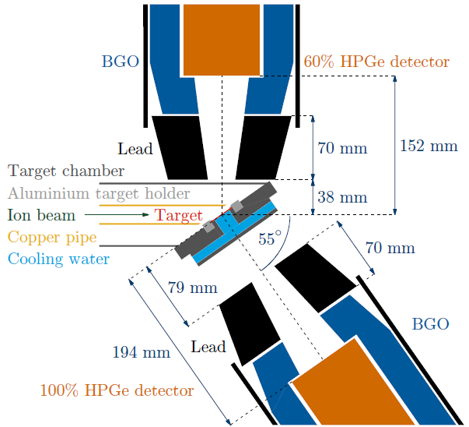




Setup at 3 MV Tandetron at HZDR
+
at 90°
+
at 55°
Photo and schematic view of the experimental setup used for the irradiations.
Target chamber has a pressure of 10⁻⁷ mbar.
Copper pipe serves as secondary electrons suppression.
Target holder is connected to a current integrator.

Slide 7
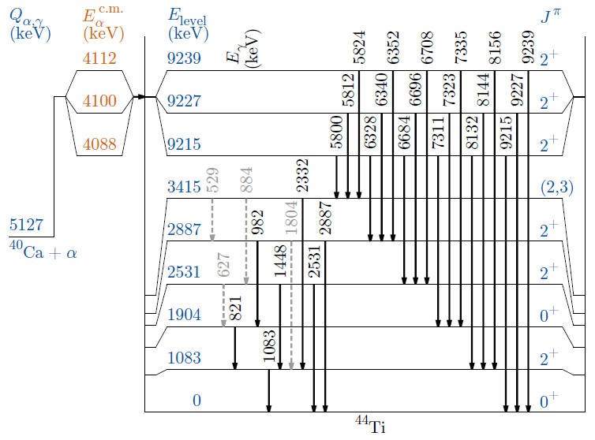
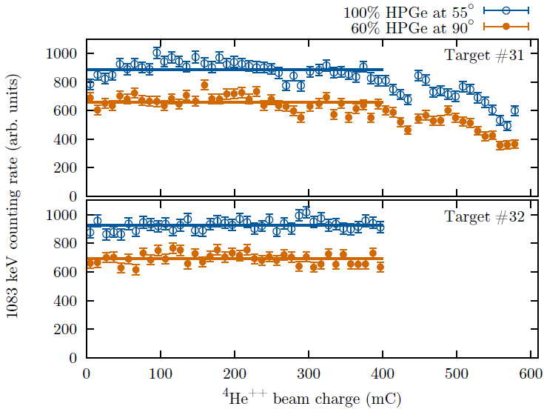
Reduced level scheme of ⁴⁴Ti and monitoring of the irradiations
During irradiation, the stability of the target was monitored using the most intensive γ-ray from the ⁴⁰Ca(α,γ)⁴⁴Ti reaction, the 1083 keV ray.
For target #31 the irradiation was stopped when the counting rate fell below 70%.
Integrating under the yield curves, the overall number of counts is reduced by 8.2% (assuming a conservative value of 20% relative uncertainty)
Target #32 was irradiated for 400mC, and no decrease of the counting rate was observed at all.

Slide 8
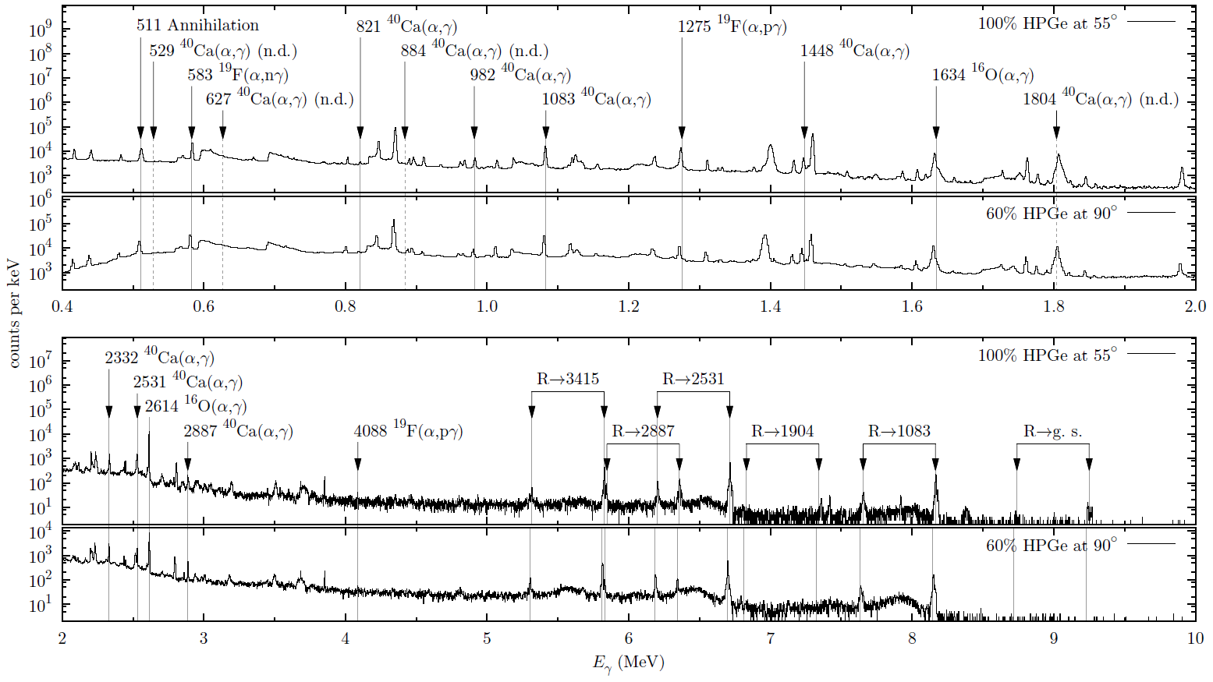
Alpha induced in-beam γ-ray spectra
Primary and secondary γ rays from the resonance triplet are shown.
Some contaminant γ rays from ¹⁹F and ¹⁶O can be seen.
Undetected ⁴⁰Ca(α,γ)⁴⁴Ti secondary γ rays have been marked with dashed lines and labeled as ”n.d.” (not detected) in the plot.

Slide 9
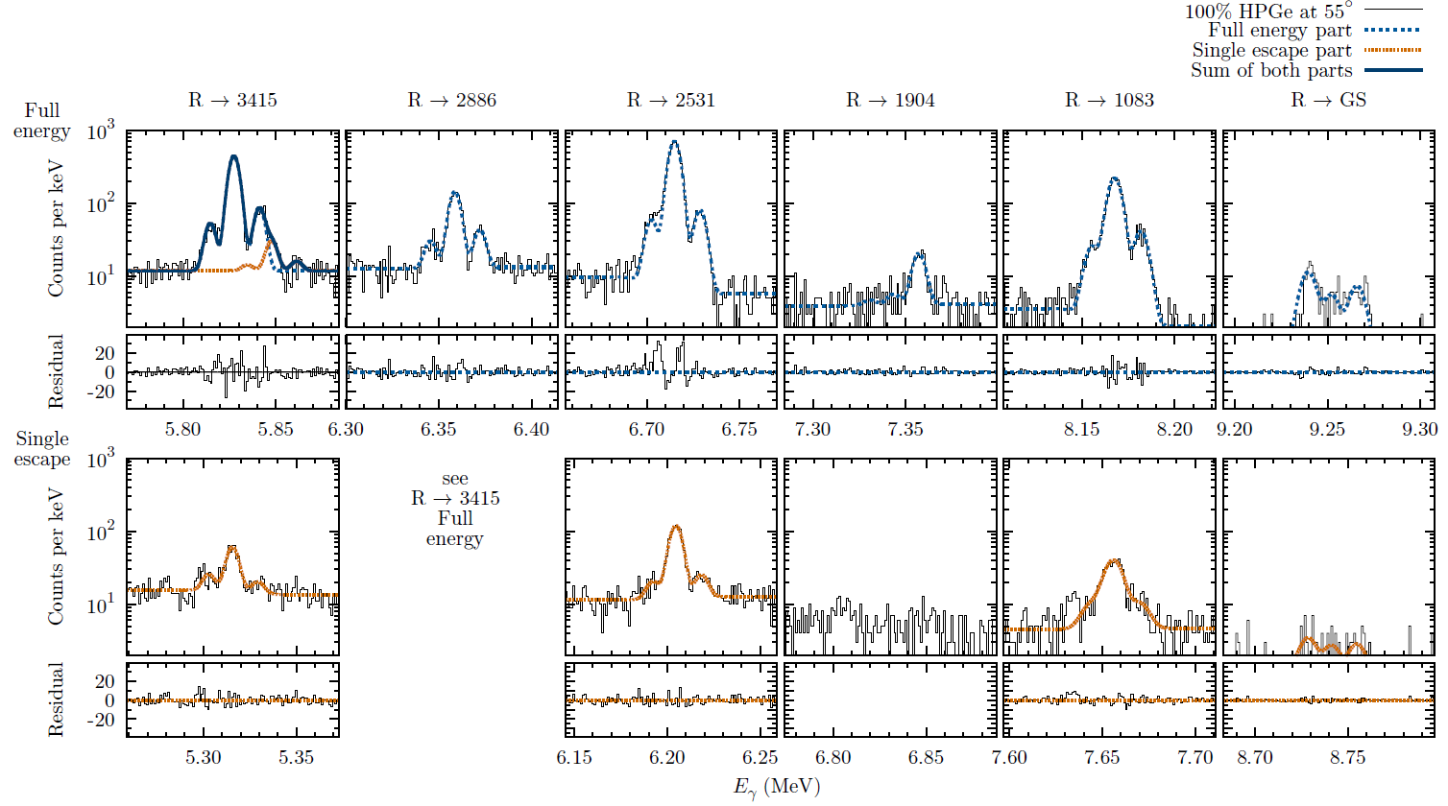
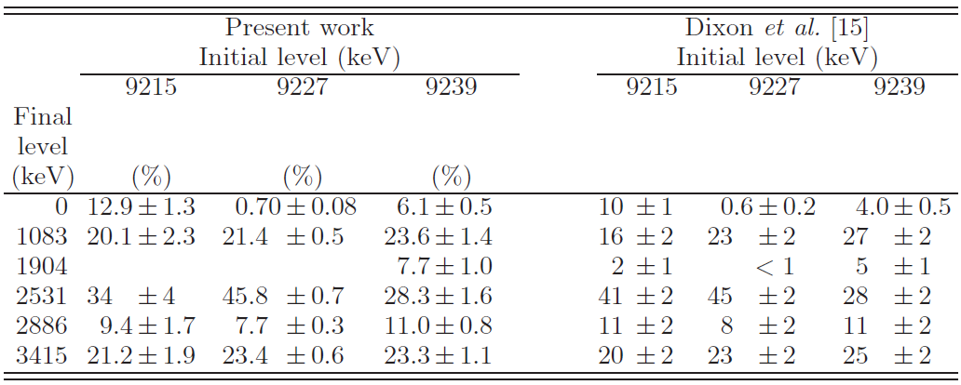
Primary γ-rays showing the triplet of resonances
γ-ray branching ratios observed at 55°.
For the 9227→1904 and 9215 → 1904 decays, the present data show only upper limits so the previous results are adopted instead.

Slide 10
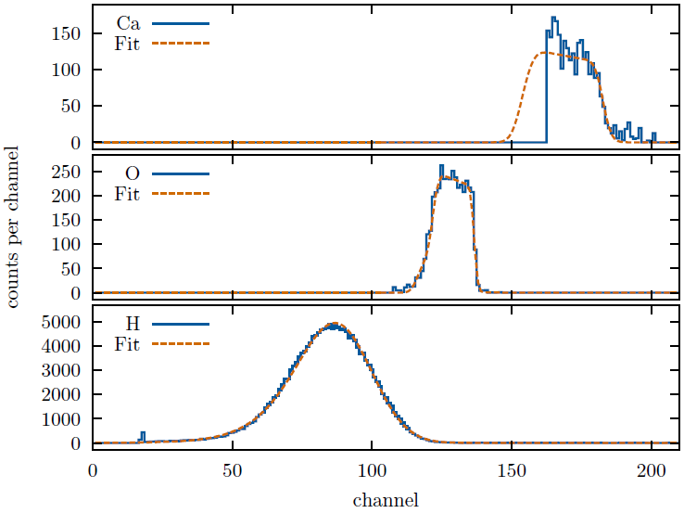
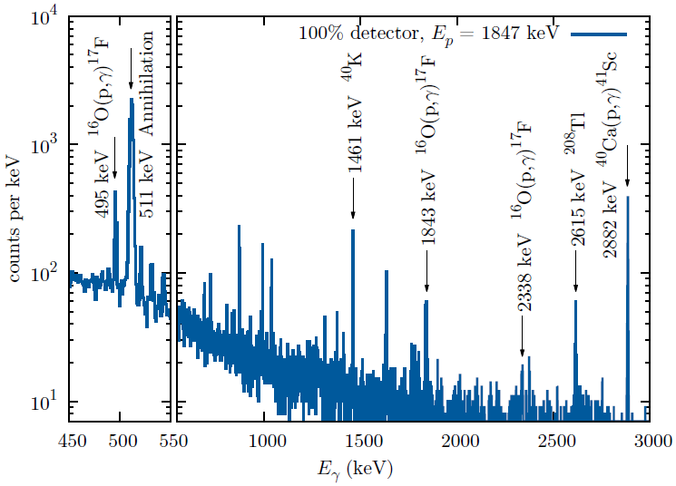
Stoichiometric ratio x in Ca(OH)_{x}
Two independent methodes have been used to determine the stoichiometric ratio x in Ca(OH)_{x}:
Elastic Recoil detection Analysis (ERDA): x₃₀ = 1.88 ± 0.21
From proton induced in-beam γ-ray spectrum, using ¹⁶O(p,γ)¹⁷F reaction (with 6% uncertainty
in σ by Mohr et al. 2012):
x₃₁ = 1.9 ± 0.6
x₃₂ = 1.8 ± 0.5

Slide 11
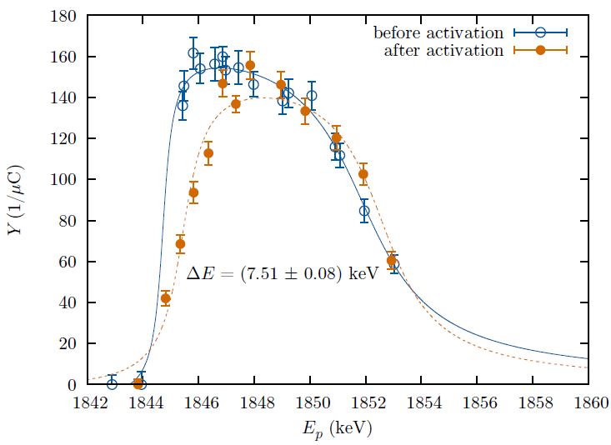
Target scans before and after the activation
Using the E_{p} = 1842 MeV resonance in the ⁴⁰Ca(p,γ)⁴¹Sc reaction.
Yield of the 2882 keV γ-ray is plotted as function of proton energy.
About 48 h activation with a current of 1.5 μA at the water cooled target.
Structure scans before and after activation have just minor differences.
Conclusion: target layer stays stable during the activation.

Slide 12
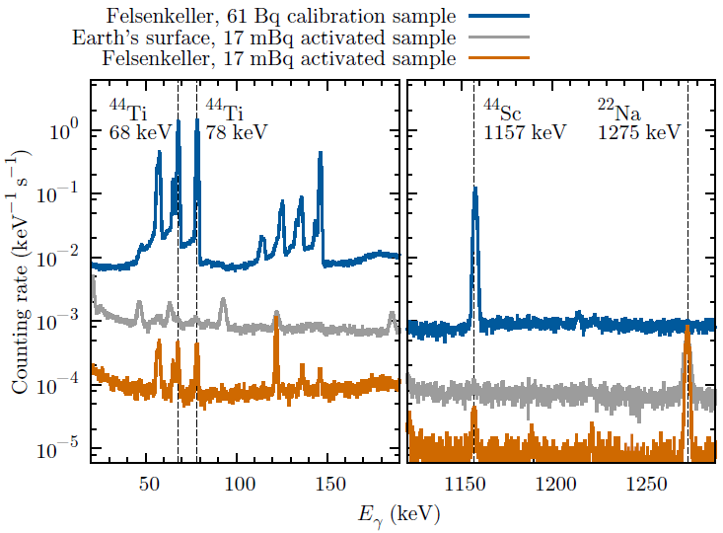
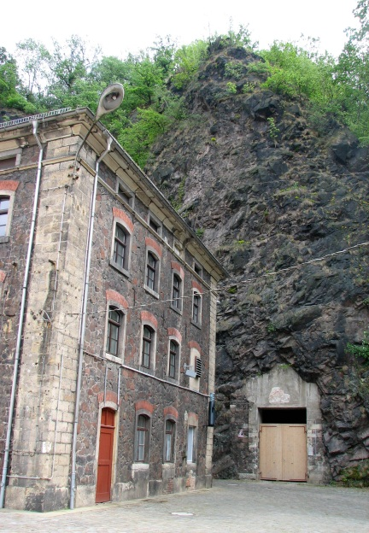
Offline spectra of ⁴⁴Ti samples
Spectra of ⁴⁴Ti samples, measured in a low-background counting facility at earth’s surface and in the ultra-low-background facility Felsenkeller Dresden.
After 68.4 h activation and 7 days counting, an activity of 17.1 ± 0.5 mBq was determined.

Slide 13
Summary
Astrophysically interesting resonances of the ⁴⁰Ca(α,γ)⁴⁴Ti reaction have been studied.
⁴⁴Ti activity has been measured in the underground laboratory Felsenkeller Dresden.
Sum and partial resonance strengths of 4.5 MeV triplet have been determined. Results from this work and from literature:
Samples, activated at weak resonances around 3.5 MeV are γ-counting in underground laboratory Felsenkeller Dresden.
Later this year there will be a second beam time at CENBG (high intensity alpha beam) to study very weak (ωγ < 0.02 eV) resonance at 2.8 MeV.
An AMS measurement of activated samples is in preparation.
ωγ [eV] | Reference | Technique
8.3 ± 1.7 | Dixon et al. 1980 | in-beam γ spectroscopy
8.8 ± 3.0 | Nassar et al. 2006 | AMS
7.6 ± 1.1 | Vockenhuber et al. 2007 | recoil detection
9.0 ± 1.2 | Robertson et al. 2012 | in-beam γ spectroscopy
8.4 ± 0.6 | Present work | activation and in-beam γ spectroscopy
E_{α} (keV) E_{x} (keV) | 4497 9215 | 4510 9227 | 4523 9239
Present work | 0.92 ± 0.20 | 6.2 ± 0.5 | 1.32 ± 0.24
Dixon et al. 1980 | 0.5 ± 0.1 | 5.8 ± 1.2 | 2.0 ± 0.4
Outlook

