Slide 1
Transfer vs. Breakup for the system ⁷Be + ⁵⁸Ni at Coulomb barrier energies
M. Mazzocco¹, D. Torresi¹, L. Acosta², A. Boiano³, C. Boiano⁴, N. Fierro¹, T. Glodariu⁵, A. Guglielmetti⁴, N. Keeley⁶, M. La Commara^{3,7}, I. Martel², C. Mazzocchi⁴, P. Molini¹, A. Pakou⁸, C. Parascandolo¹, V.V. Parkar², N. Patronis⁸, D. Pierroutsakou³, M. Romoli³, K. Rusek⁶, A.M. Sanchez-Benitez², M. Sandoli^{3,7}, C. Signorini¹, R. Silvestri^{3,7}, F. Soramel¹, E. Stiliaris⁹, E. Strano¹, L. Stroe⁵, K. Zerva⁸
¹Dipartimento di Fisica e Astronomia, Università di Padova and INFN - Padova, Italy ²Departamento de Fìsica Aplicada, Universidad de Huelva, Spain ³INFN - Napoli, Italy ⁴Dipartimento di Fisica, Università di Milano and INFN - Milano, Italy ⁵NIPNE, Romania ⁶Heavy Ion Laboratory, University of Warsaw, Warsaw, Poland ⁷Dipartimento di Scienze Fisiche, Università di Napoli, Italy ⁸Dept. of Physics, University of Ioannina, Greece ⁹Dept. of Physics,University of Athens, Greece
25th INPC 2013 – Firenze (Italy) – June 2-7, 2013

Slide 2
Physics Case
Topic: Interaction induced by light Radioactive Ion Beams (RIBs) at near-barrier energies.
Light RIBs are typically very weakly bound (S_{p}, S_{n}, S_{α} < 1.0 MeV) and may present peculiar features such as halo, neutron skin or a cluster structure.
All these properties strongly influence the reaction dynamics induced at energies around the Coulomb barrier.
New reaction mechanisms, such as for instance the breakup channel, may play a quite relevant role.

Slide 3
⁷Be (S_{α} = 1.586 MeV)
⁷Be represents an ideal case (among all light ions) where the interplay between different direct reaction channels can be addressed in detail.
Transfer and Breakup processes in ⁷Be produce one and two stable charged fragments, ³He and ⁴He, with similar masses (energy domains).
⁷Be simplifies life to experimentalists, since it avoids:
the difficult and low-efficiency detection of neutrons (n-halo ⁶He and ^{9,11}Be and n-skin ⁸He);
the emission of a weakly-bound fragment (⁶Li breaking-up into ⁴He + d);
the emission of a radioactive fragment (⁷Li, ⁸B);
the detection of stable fragments with different masses and energy domains (¹⁷F breaking-up into ¹⁶O + p).

Slide 4
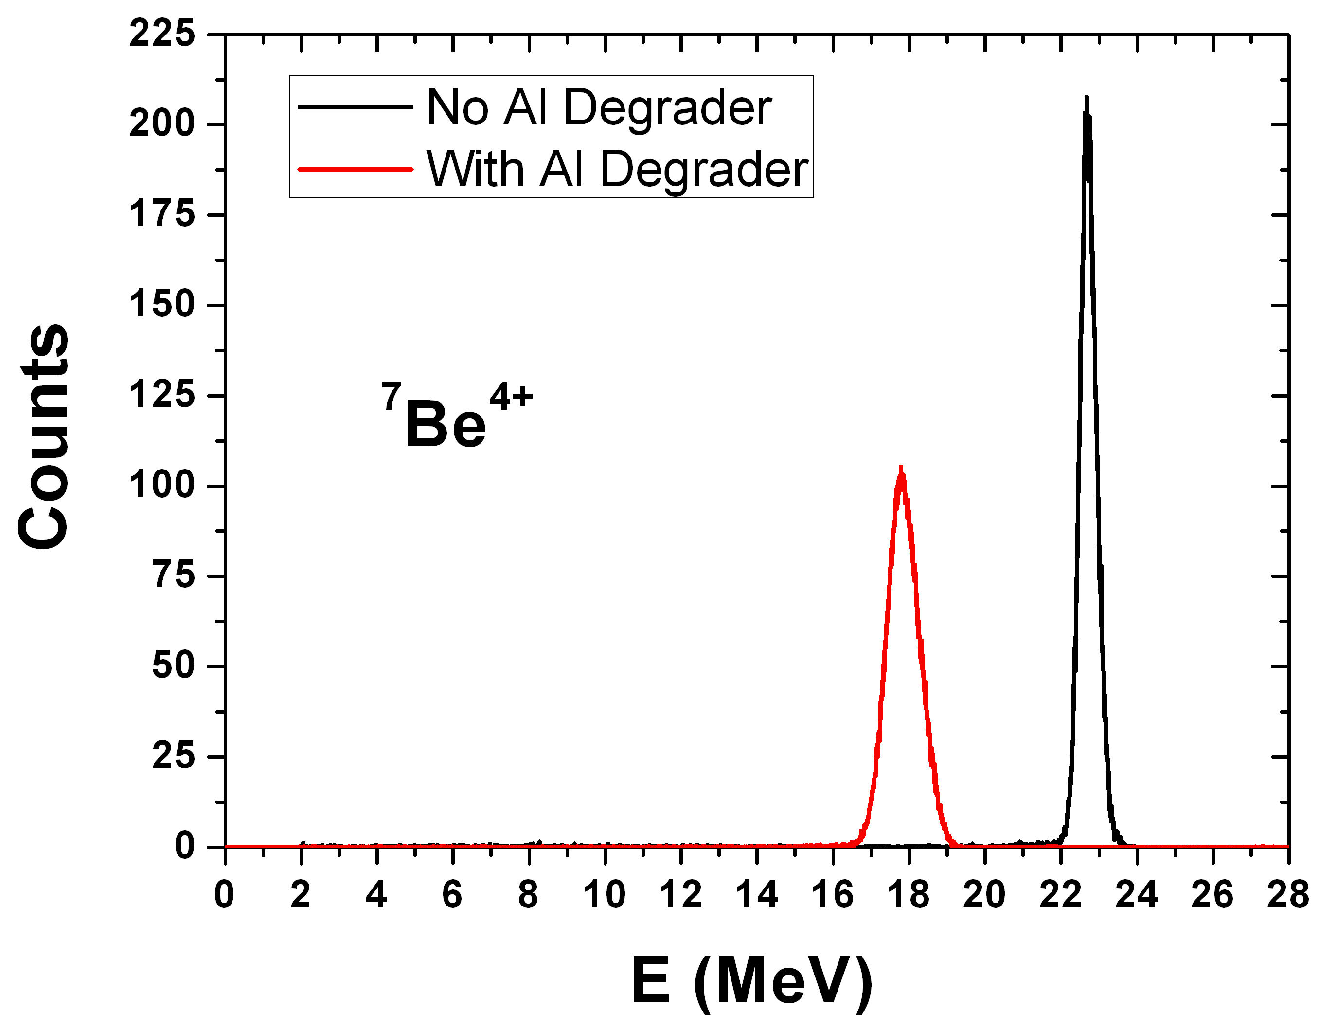
⁷Be RIB Production
Primary Beam: ⁷Li³⁺
E_{lab}= 34.2 MeV
i ~ 100-150 pnA on target
Target: H₂ Gas
p₁ = 1 bar, T₁ = 90 K
(t₁ ~ 1.35 mg/cm²)
Secondary Beam: ⁷Be⁴⁺
E₁ = (22.3 ± 0.4) MeV
Purity₁ ~ 100 %
Degrader: 10 μm Al
E₂ = (17.7 ± 0.5) MeV
Purity₂ ~ 100 %
Intensity: 2-3*10⁵ pps
The experiment performed with the facility
EXOTIC at INFN-LNL, now fully operational for the production of light weakly-bound RIBs,
such as ⁷Be, ⁸B and ¹⁷F, at INFN-LNL (Italy).

Slide 5
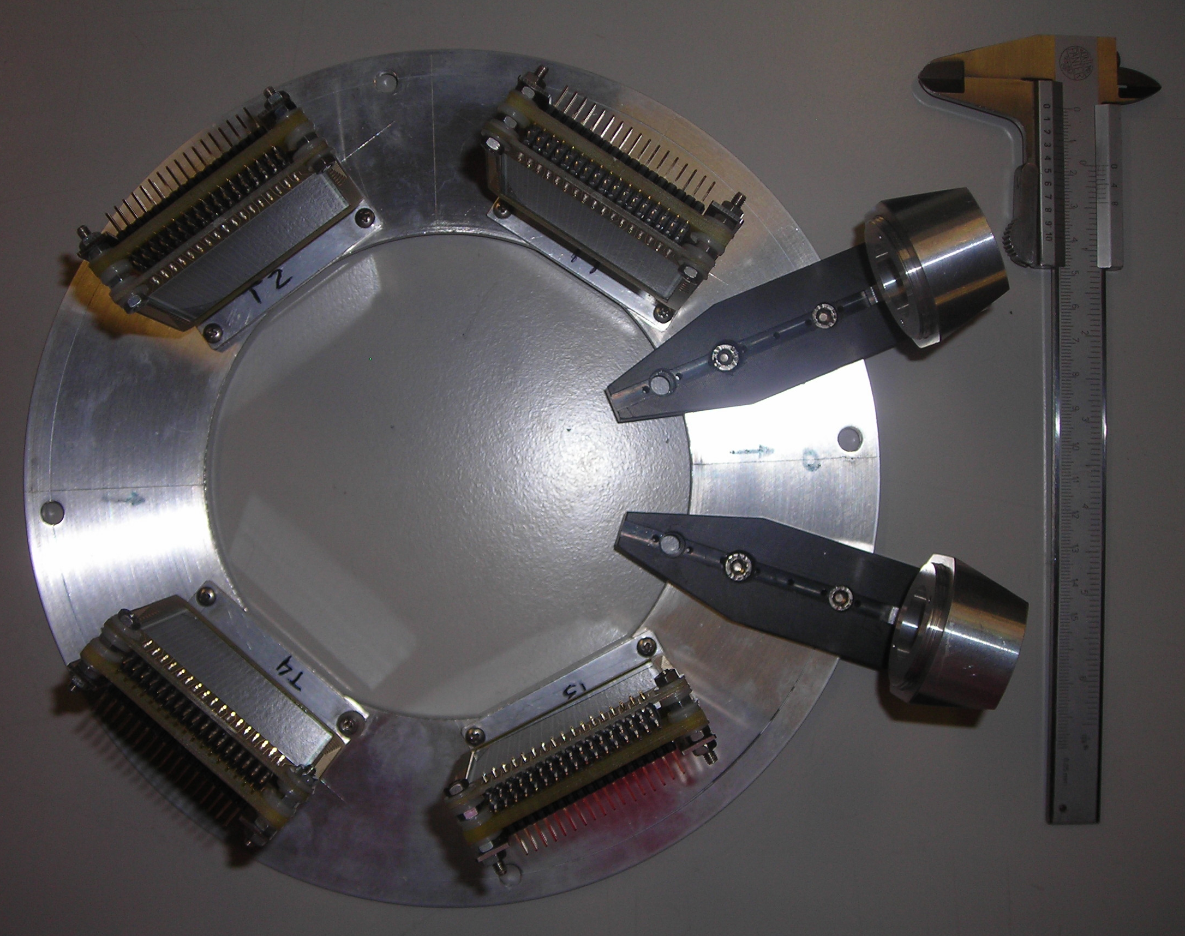
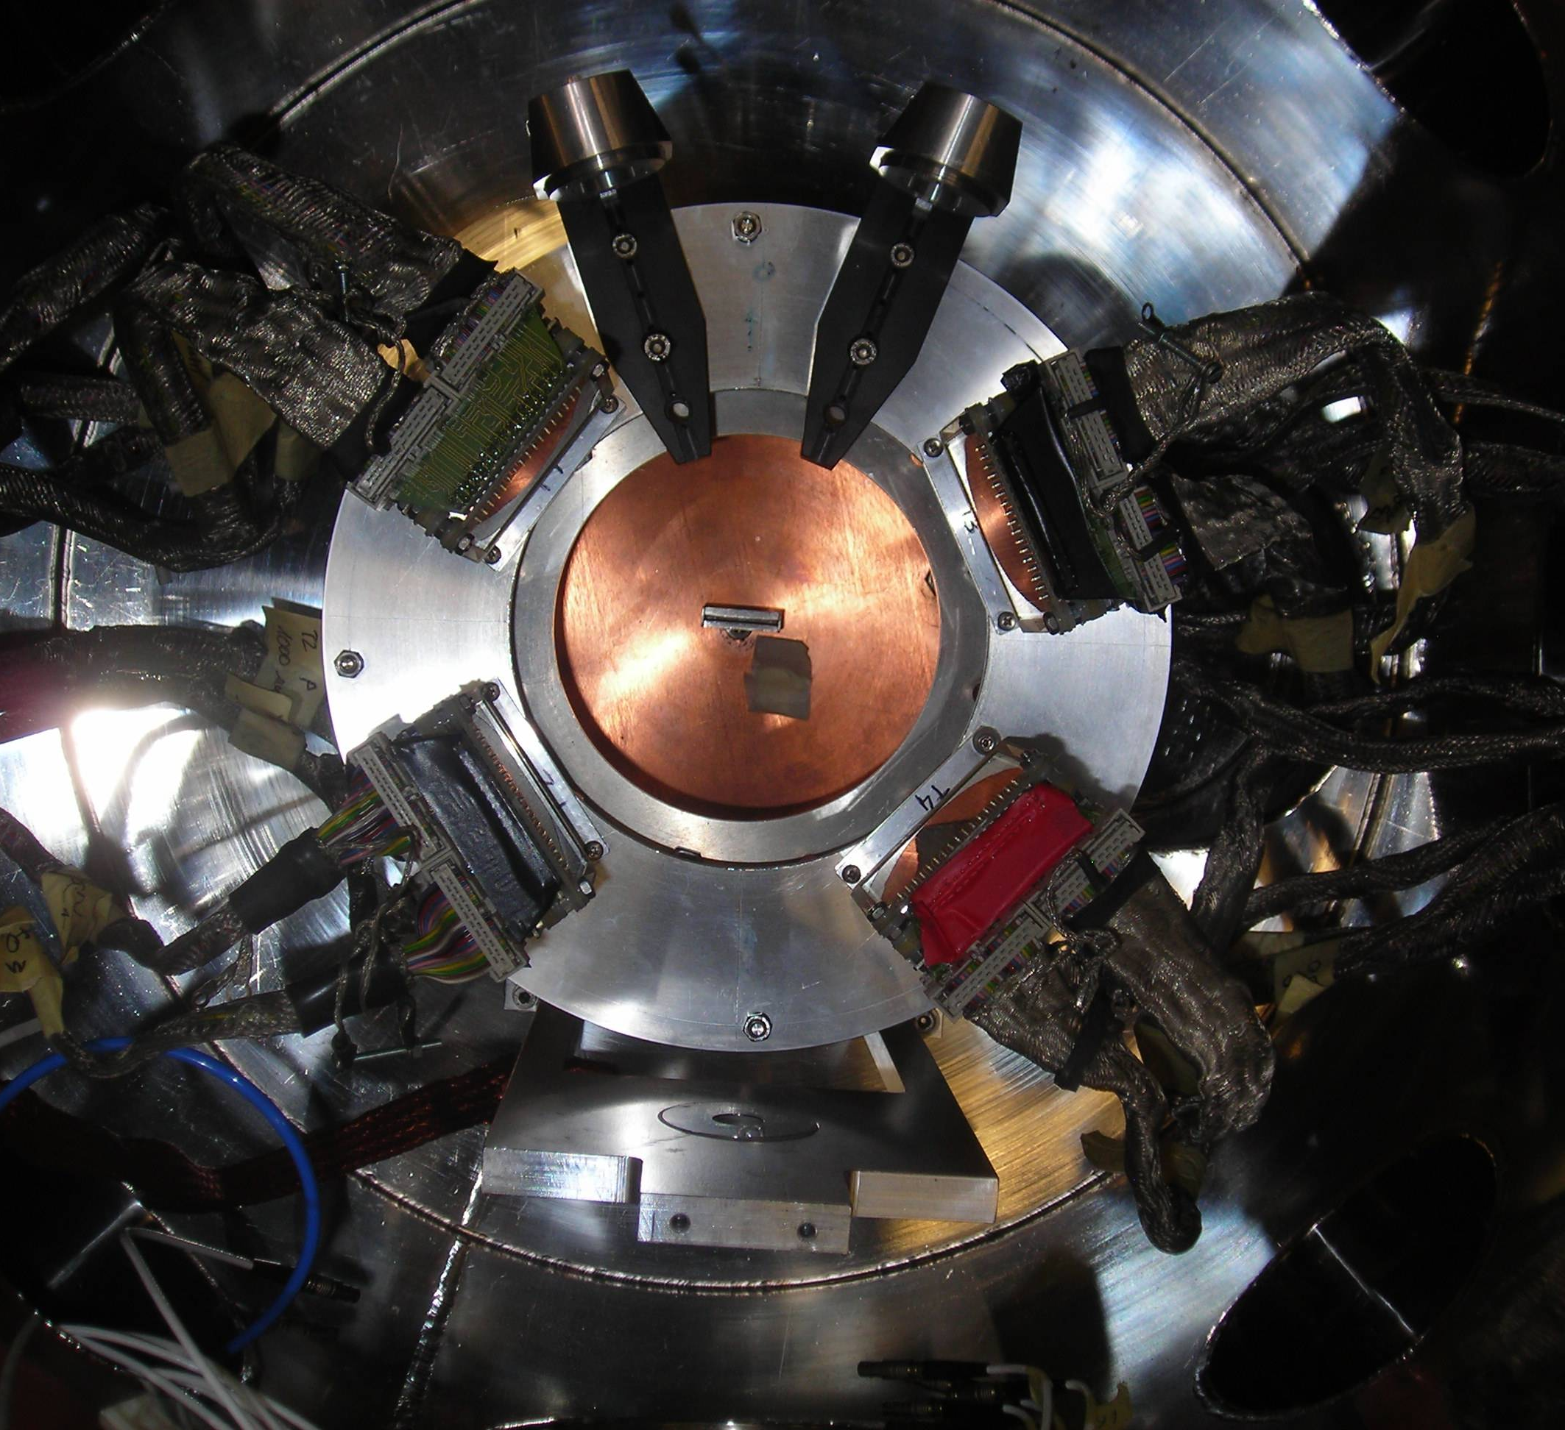
Experimental Set-Up: DINEX
DINEX ARRAY:
8 Silicon detectors arranged in 4 two-stage ΔE (40 μm) - E (1000 μm) telescopes.
Total solid angle coverage: ~10% of 4π sr.
EACH DETECTOR:
Active area: 48.5 mm x 48.5 mm.
The front and back sides are segmented in 16 strips, with a pitch size of 3 mm.
A.M. Sanchez-Benitez et al., J. Phys. G: Nucl. Part. Phys. 31, S1953 (2005)
BEAM
BEAM

Slide 6
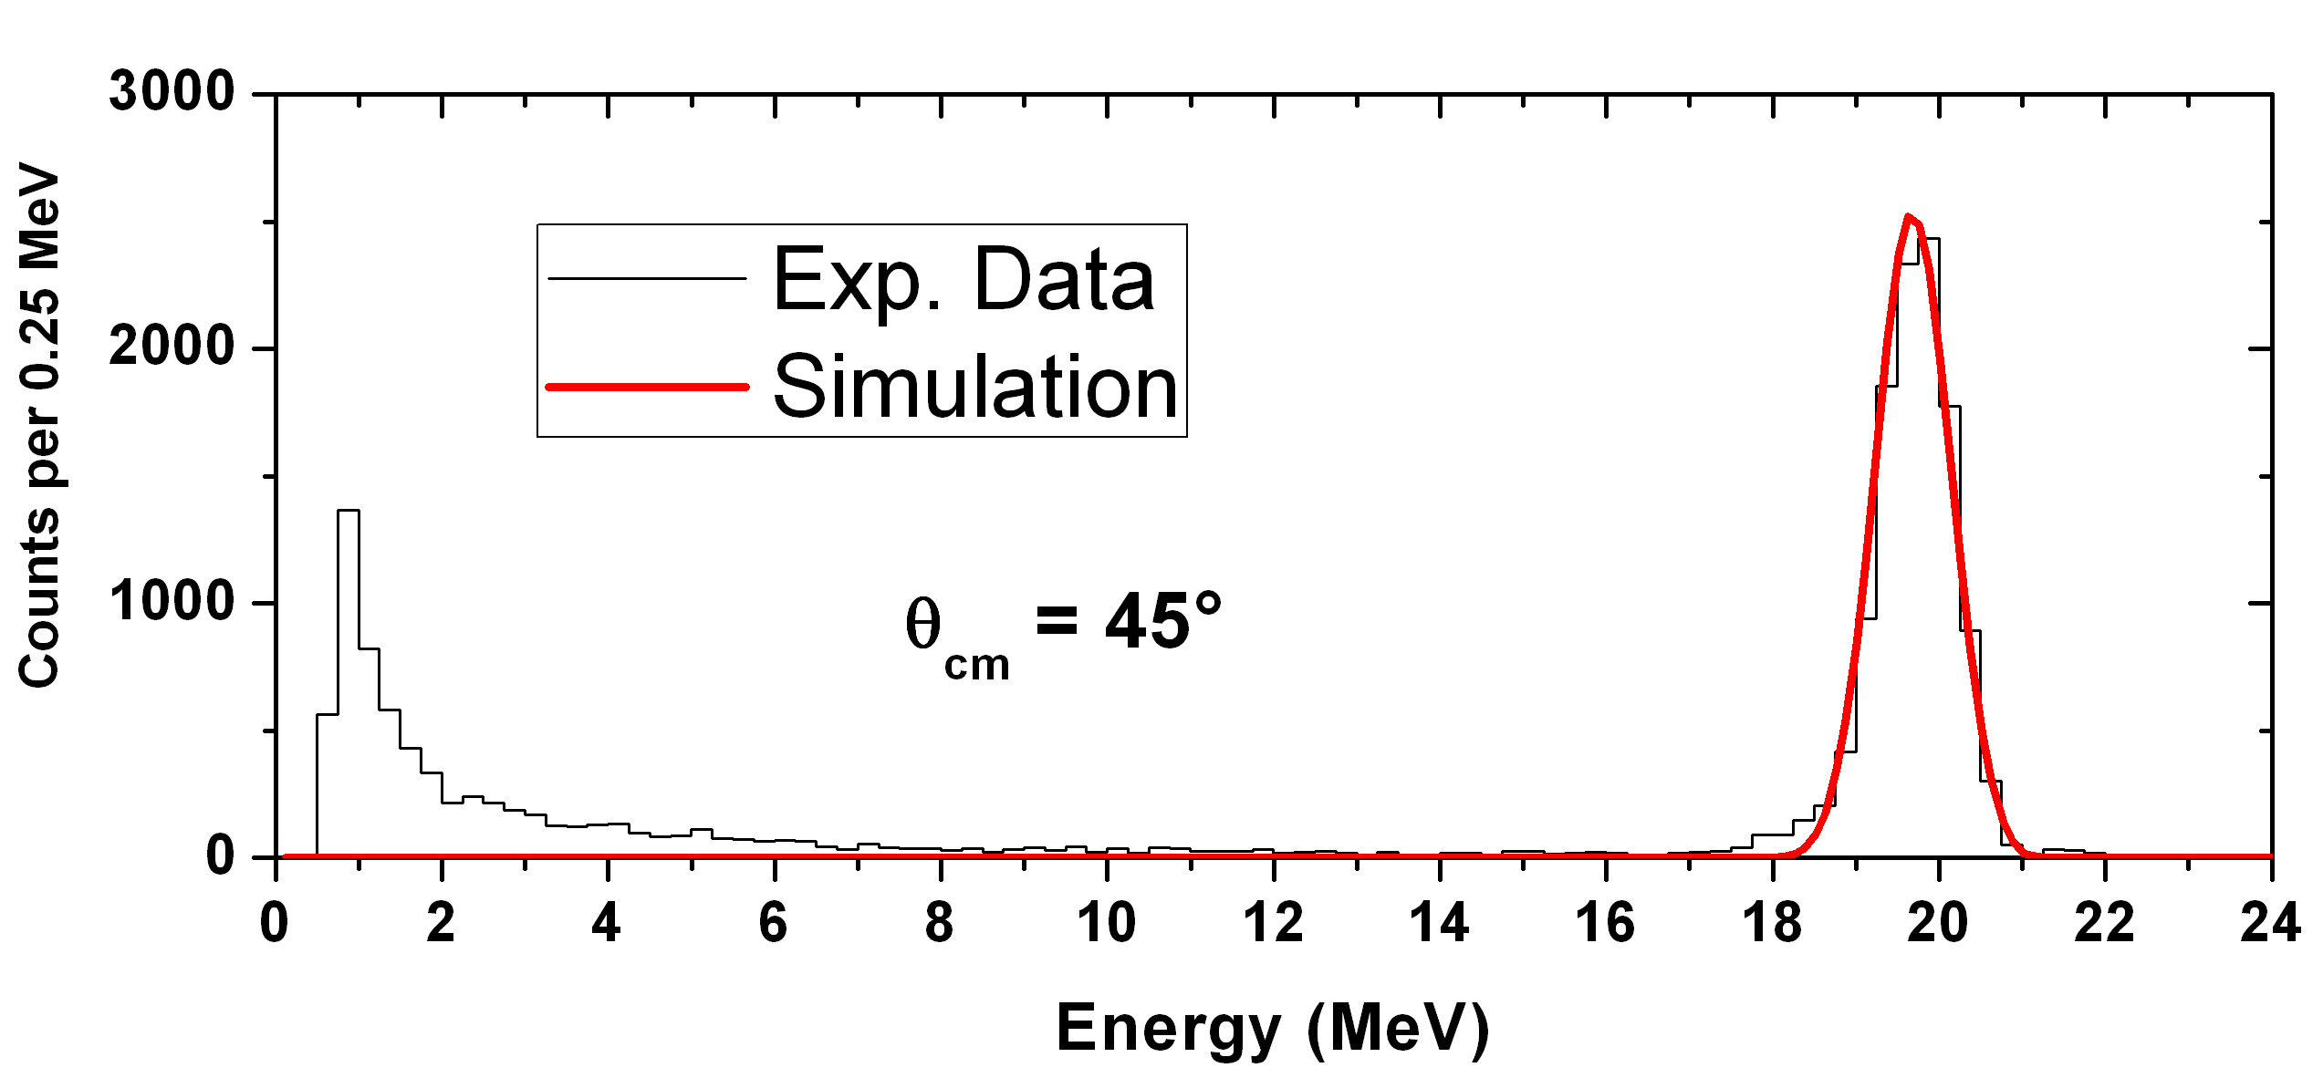
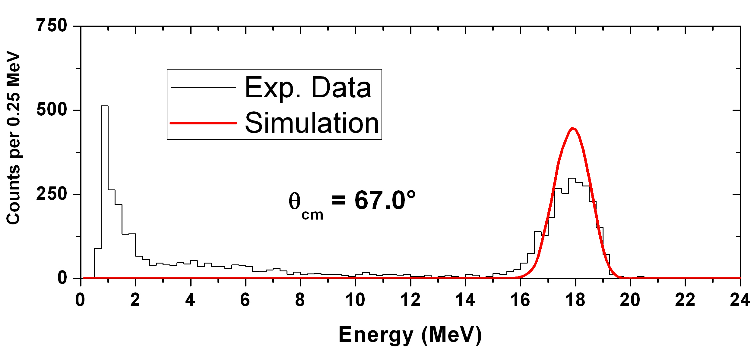
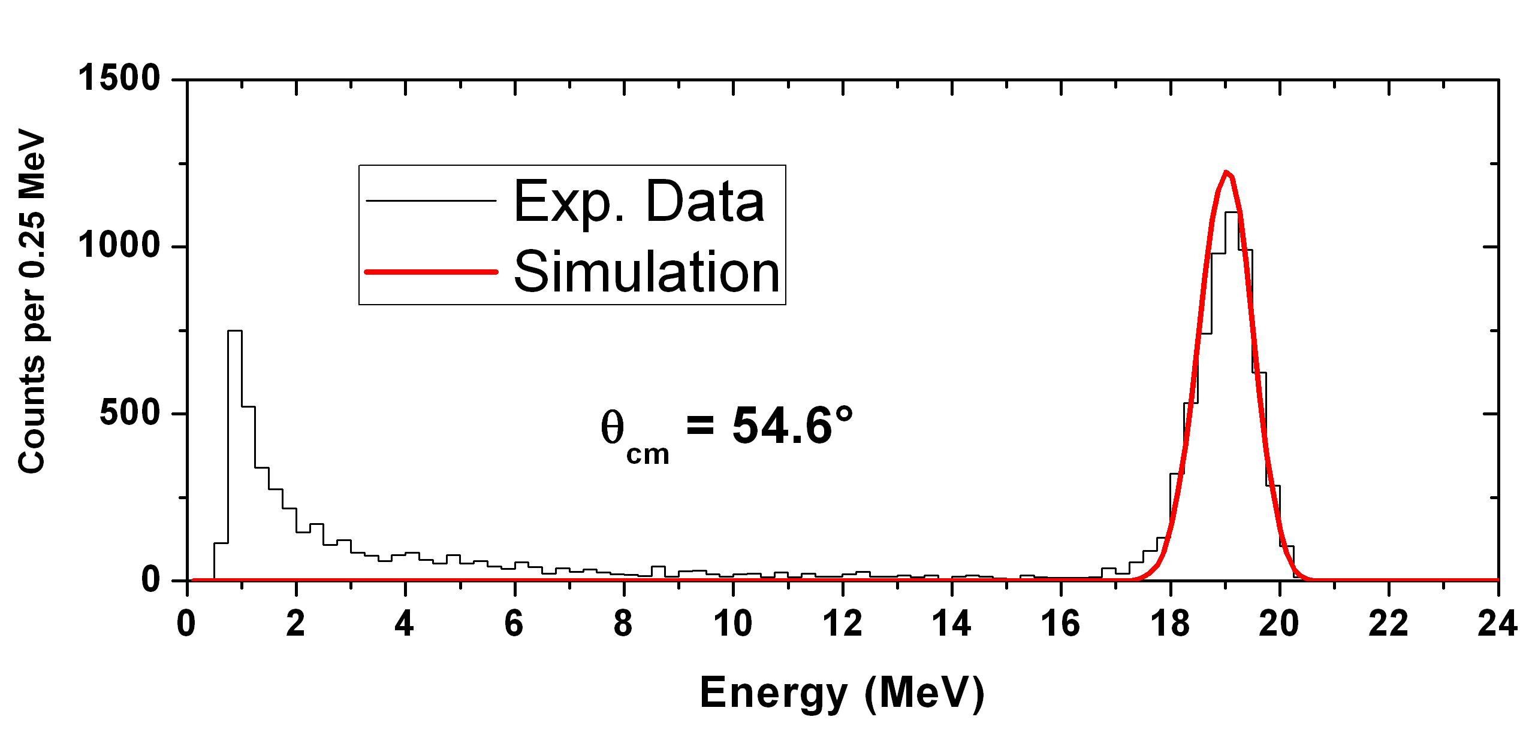
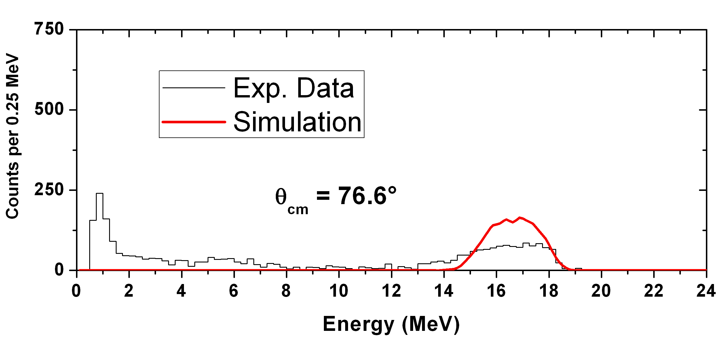
1st Step: Elastic Scattering
(Quasi-)elastic scattering angular distribution at 22.3 MeV
beam energy. The data collected at 17.7 MeV (already measured by E.F. Aguilera et al.) were used for self-consistency cross-checks.

Slide 7
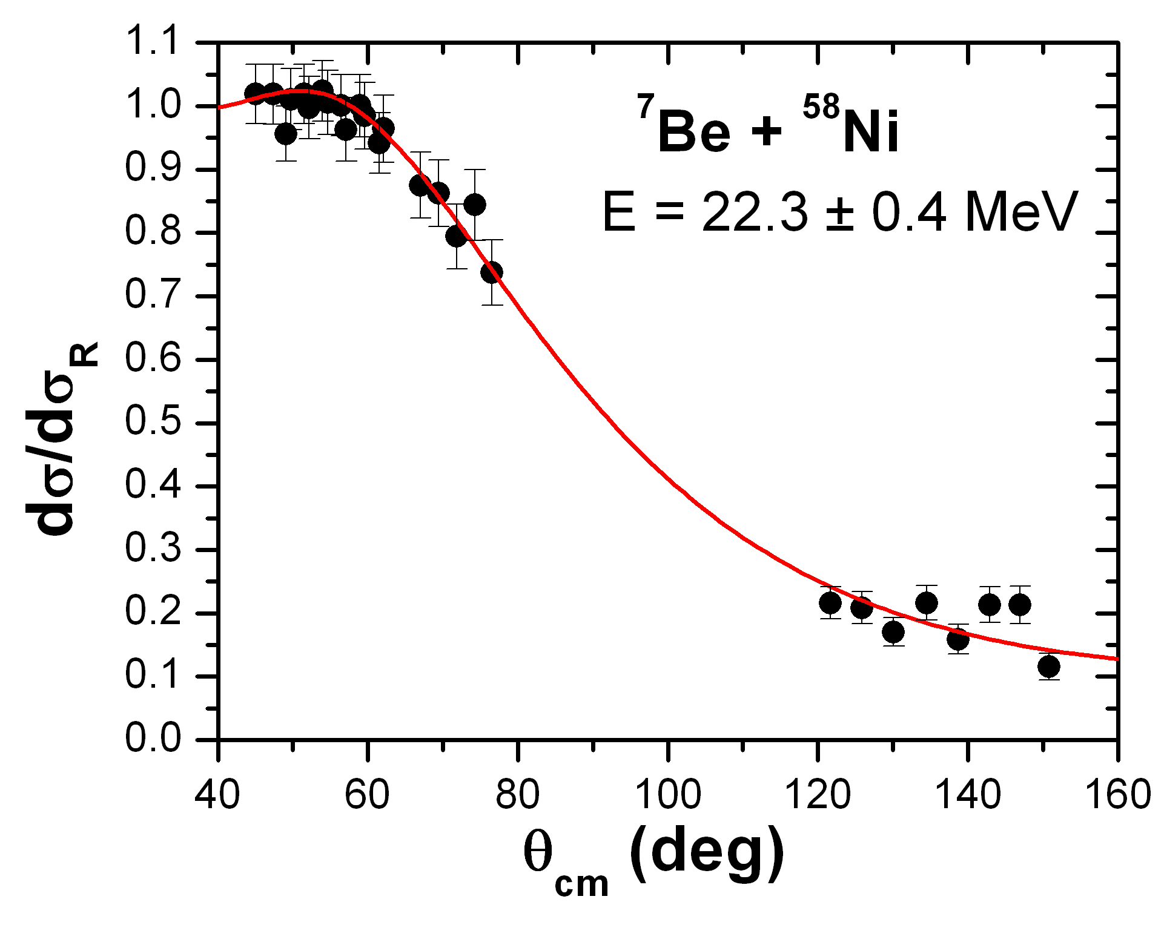
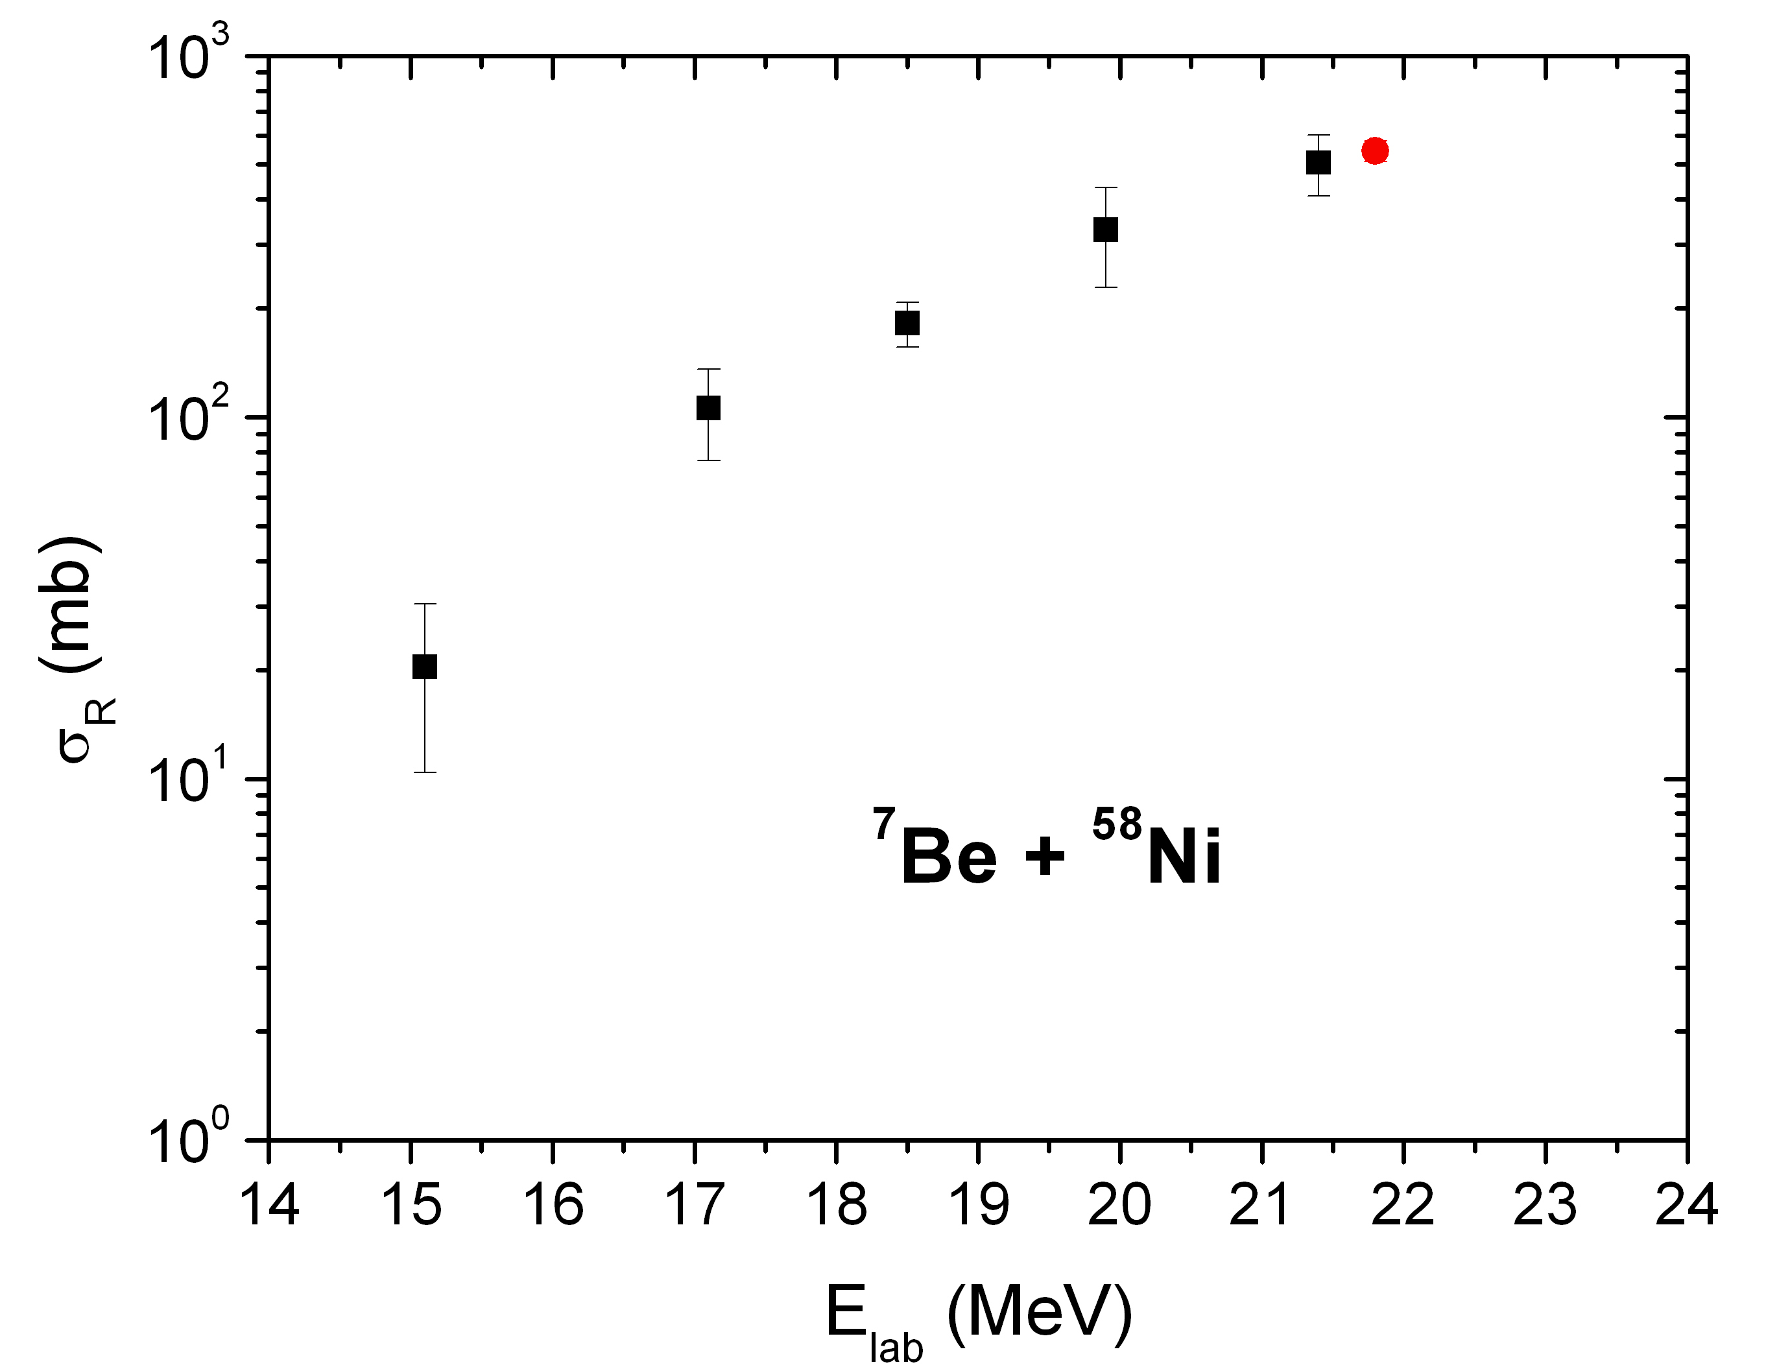
⁷Be + ⁵⁸Ni Reaction Cross Sections
The elastic scattering angular distribution was fitted within the optical model framework with the code FRESCO.
The reaction cross section (546 ± 36 mb) is in fairly good agreement with the trend individuated by the data at lower energies.

Slide 8
2nd Step: ³He and ⁴He Production
³He,⁴He
p,d,t
A fairly large charged particles production, mainly ¹H and ³He, ⁴He, was observed both at forward and backward angles.

Slide 9
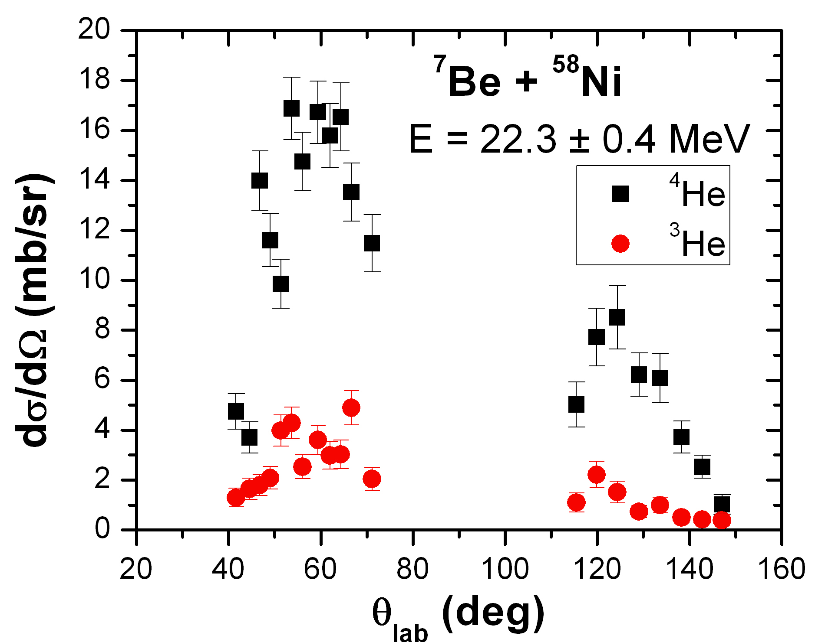
^{3,4}He Angular Distributions
⁴He ions are about 4-5 times more abundant than ³He.
The breakup channel ⁷Be → ³He + ⁴He is not the only reaction mechanism responsible for the ³He and ⁴He production.
What else? Transfer? Fusion?

Slide 10
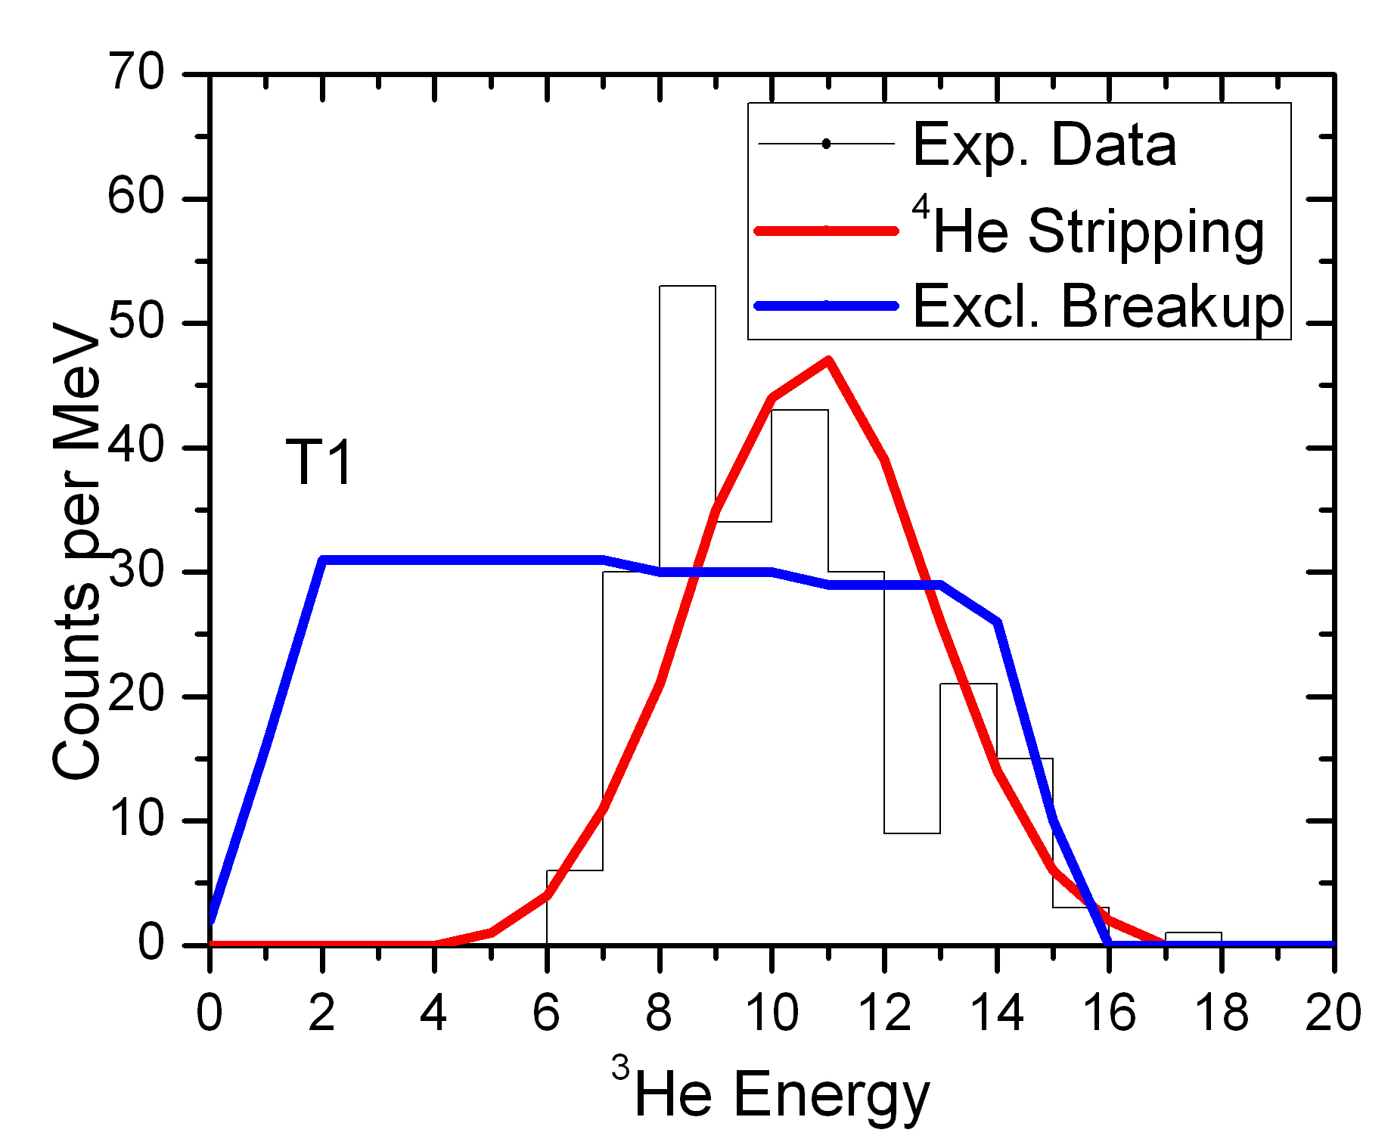
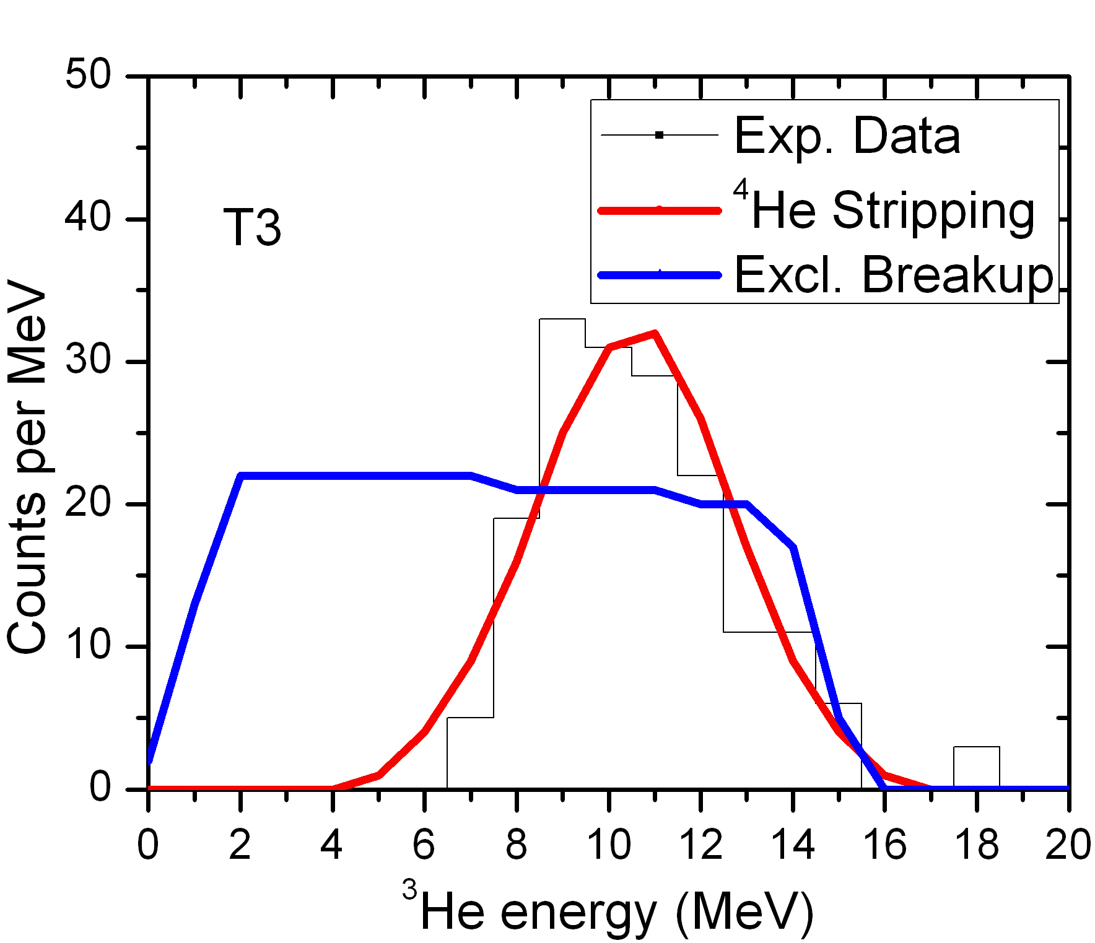
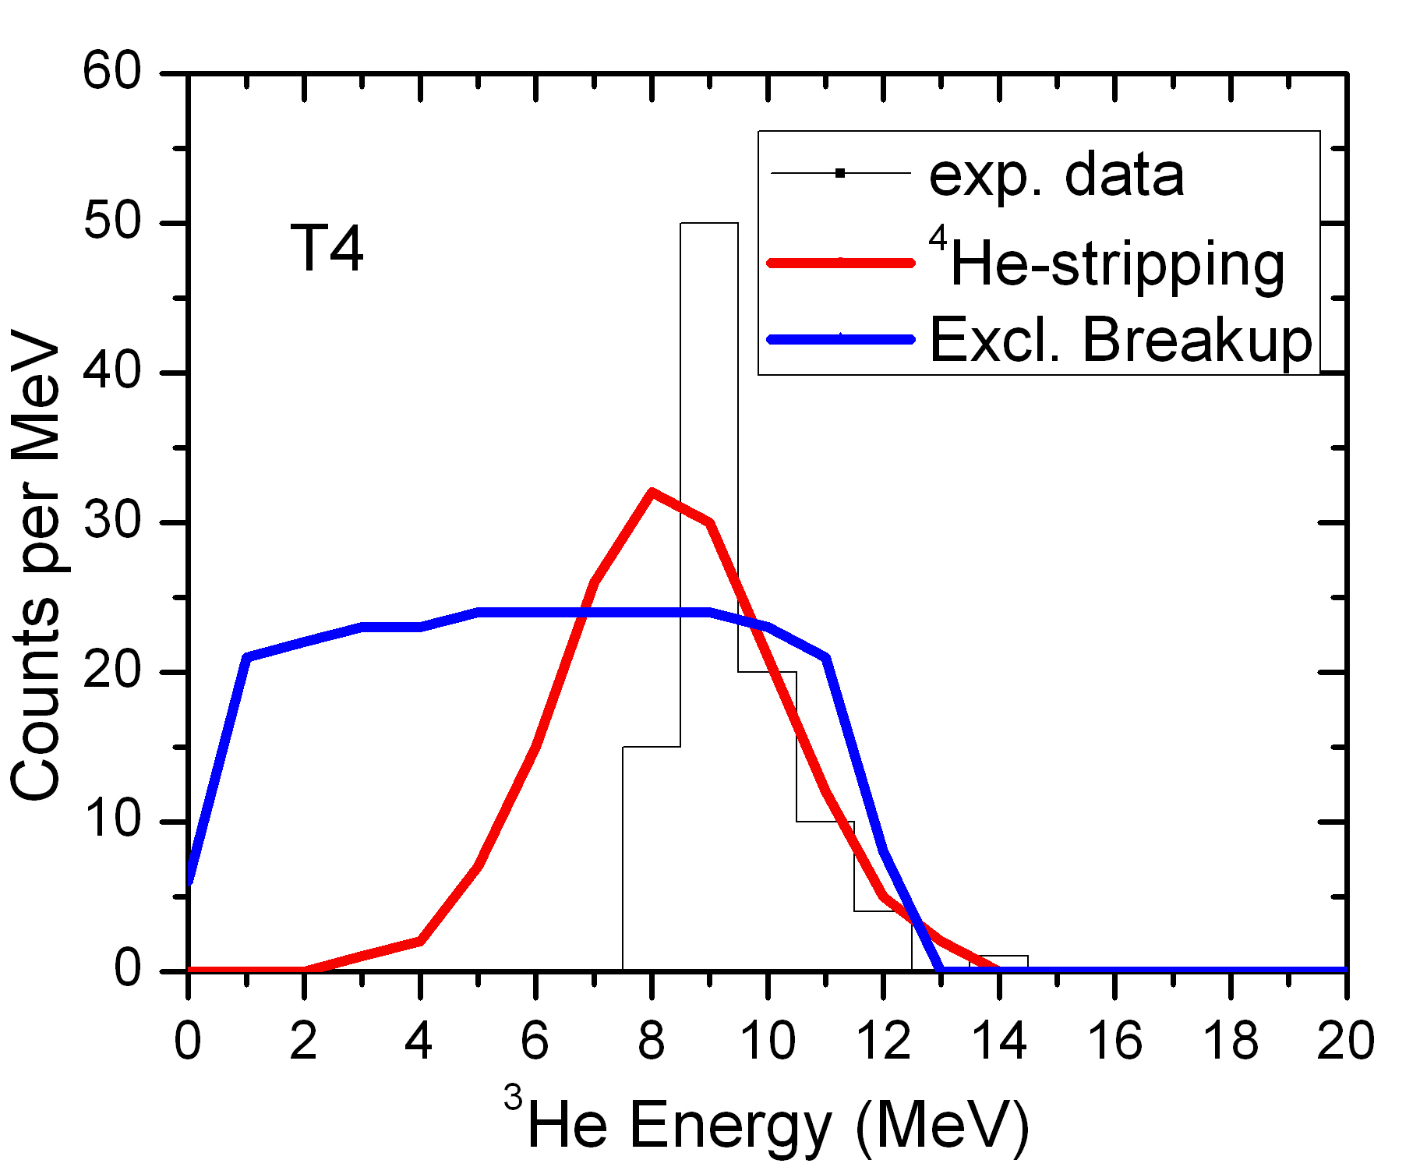
³He Energy Spectra
  ³He can be originated by two main processes:
  Exclusive Breakup: ⁷Be → ³He + ⁴He;
  ⁴He-Stripping: ⁷Be + ⁵⁸Ni → ³He + ⁶²Zn (Q_{val} = +1.78 MeV, E_{x} = 10.81 MeV).
³He energy spectra compatible with a ⁴He-Stripping process

Slide 11
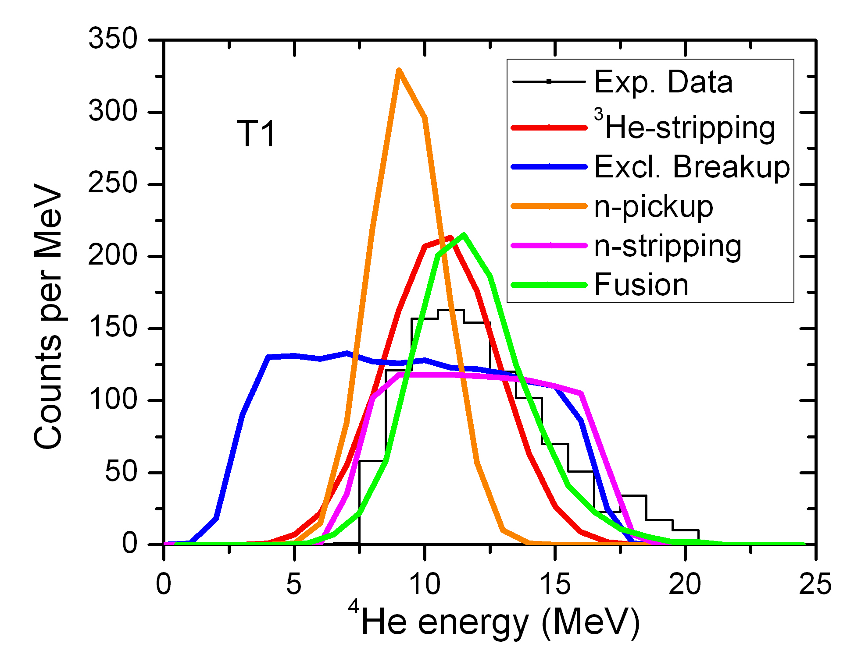
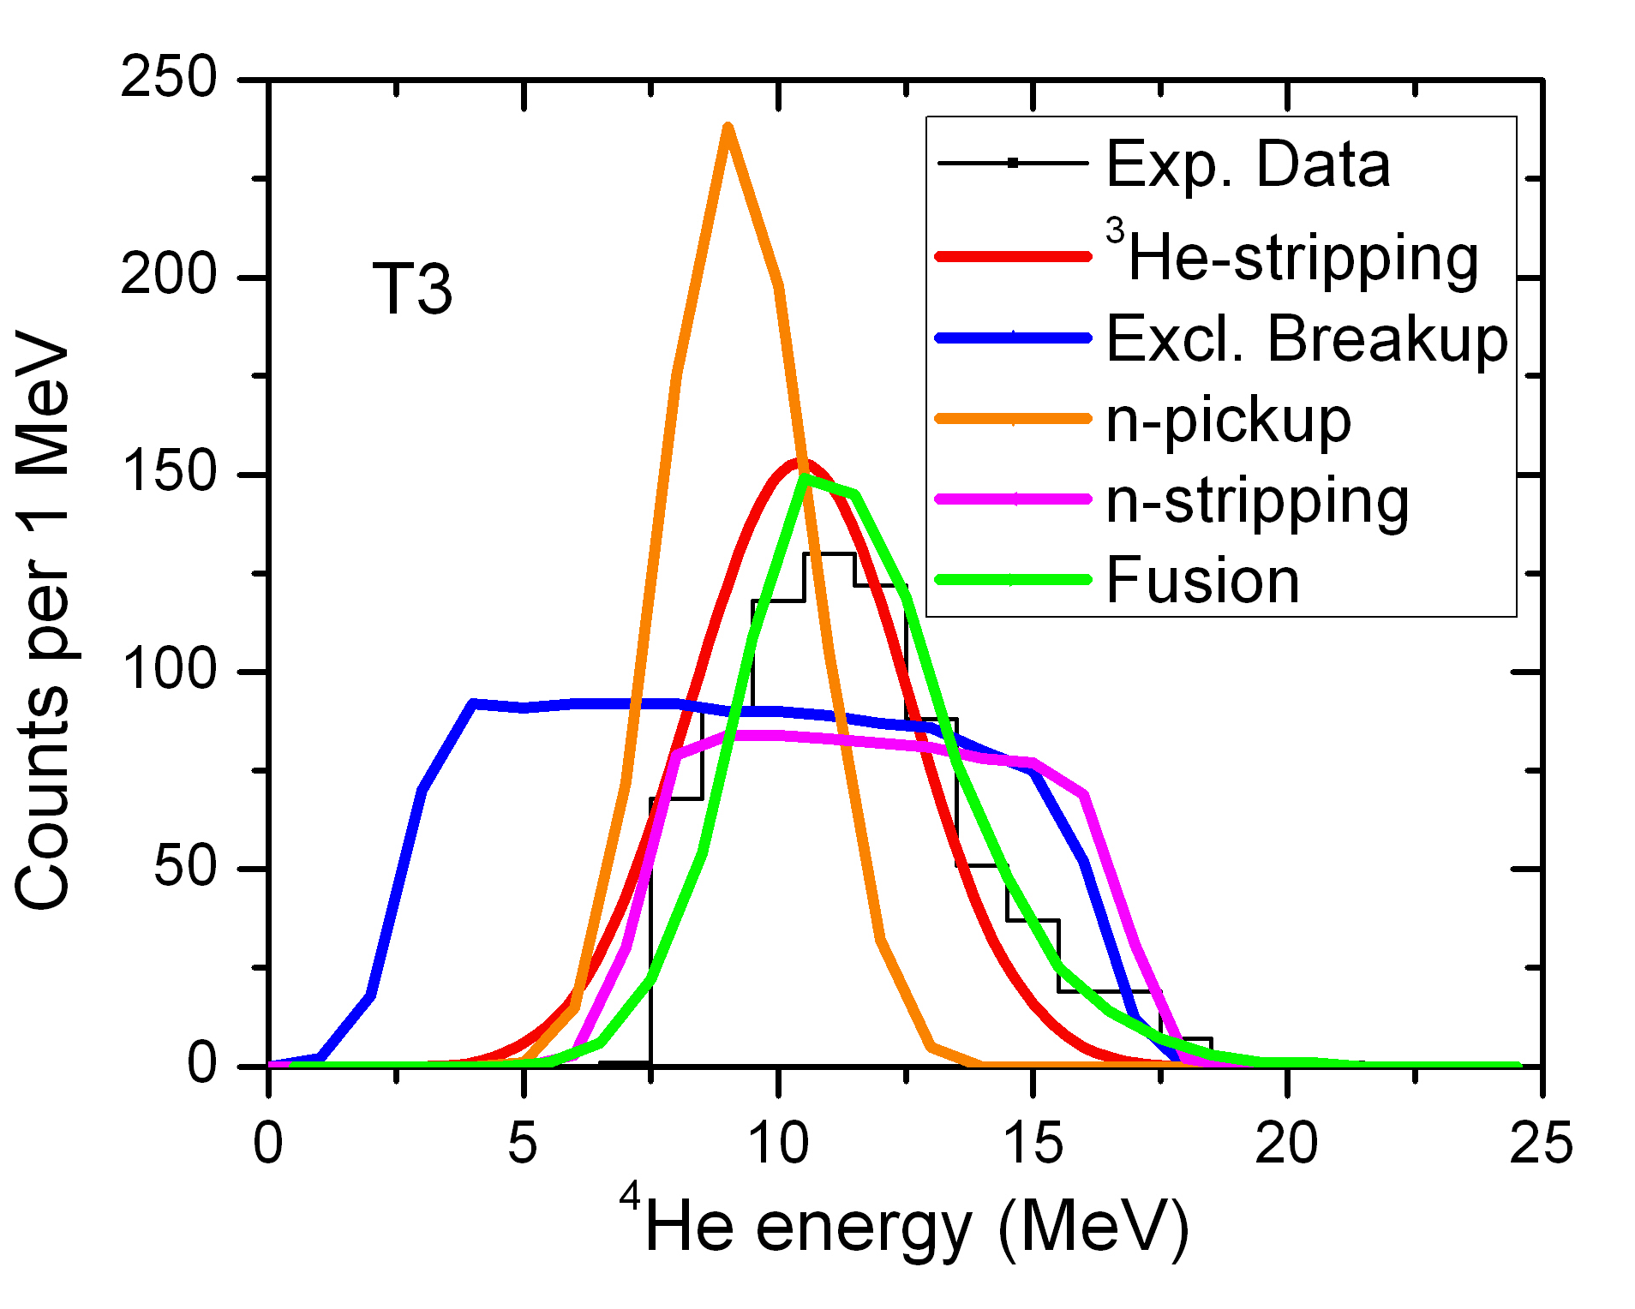
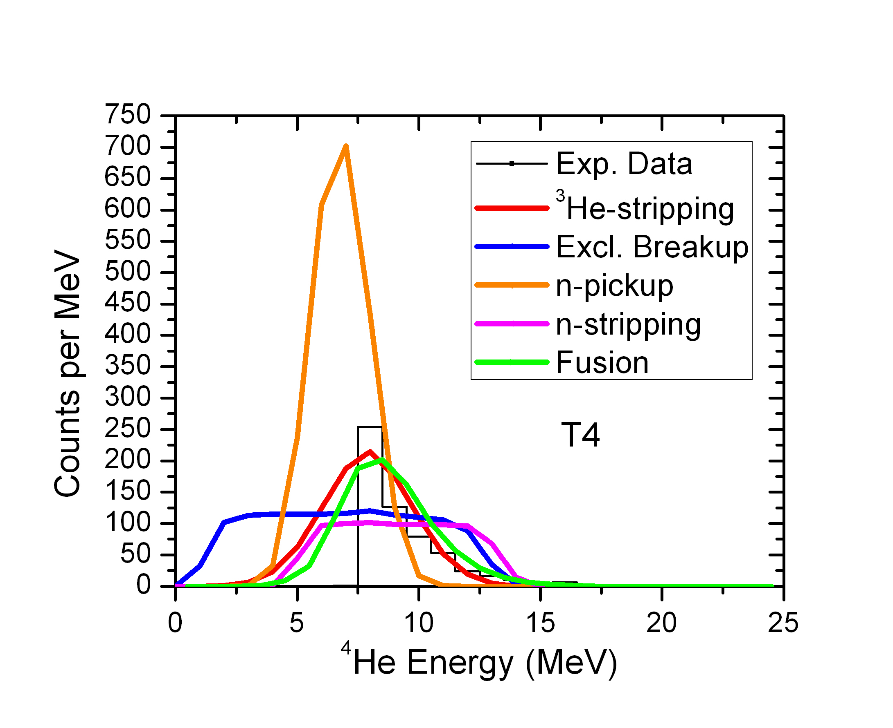
⁴He Energy Spectra
  ⁴He can be originated by several processes:
  Exclusive Breakup ⁷Be → ³He + ⁴He;
  ³He-Stripping: → ⁴He + ⁶¹Zn (Q_{val} = +9.46 MeV, E_{x} = 18.49 MeV).
  n-Stripping: → ⁶Be (= ⁴He+2p) + ⁵⁹Ni (Q_{val} = –1.68 MeV, E_{x} = 0 MeV);
  n-Pickup: → ⁸Be (= 2⁴He) + ⁵⁷Ni (Q_{val} = +6.68 MeV, E_{x} = 6.68 MeV);
  ⁴He evaporation after compound nucleus formation (Fusion).
Energy spectra are mainly compatible with ³He-Stripping and Fusion

Slide 12
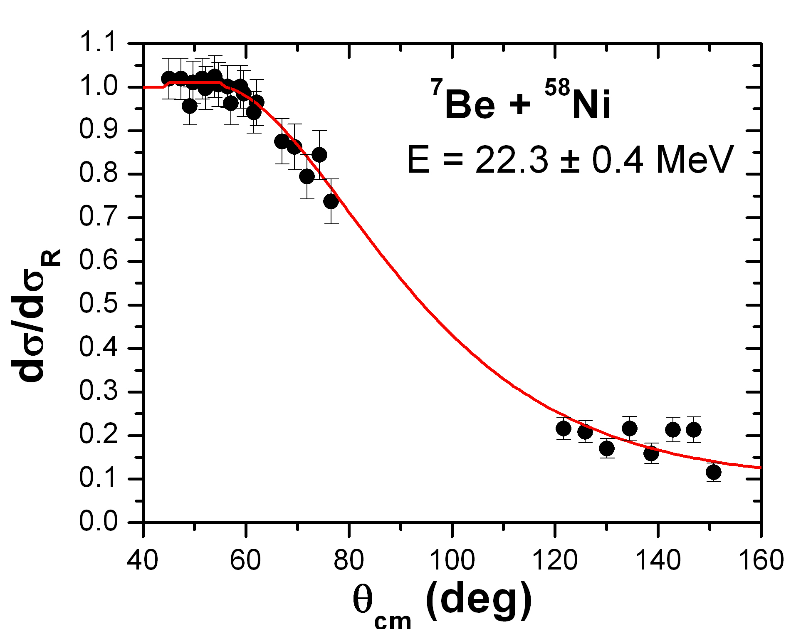
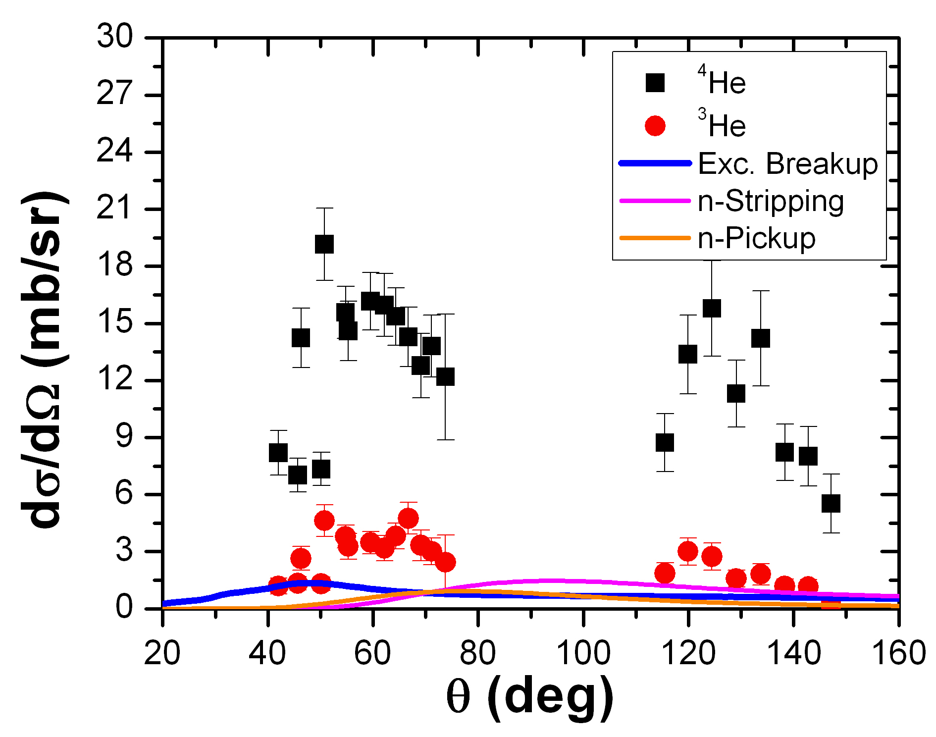
⁴He-Coincidences
Within the geometrical efficiency of the set-up, no detection of:
⁴He+³He (Exclusive Breakup) coincidences (σ < 3 mb);
⁴He+⁴He (n-Pickup) coincidences (σ < 6 mb);
⁴He+¹H (n-Stripping) coincidences (σ < 7 mb).
Theoretical (CDCC and DWBA) calculations (by N. Keeley):
Exclusive Breakup: 9.3 mb
n-Pickup: 5.8 mb
n-Stripping: 10.3 mb
Theoretical and experimental confirmation that ³He and ⁴He are mainly produced by other reaction mechanisms, ⁴He- and ³He-stripping (plus fusion?)

Slide 13
Summary
The interaction of the RIB ⁷Be with a ⁵⁸Ni target was investigated at two energies around the Coulomb barrier.
The reaction cross section, extracted from the elastic scattering measurement, is in good agreement with the trend of the data measured at lower energies by E.F. Aguilera.
A fairly large ⁴He (mainly) and ³He production has been observed at the higher secondary beam energy.
Detailed kinematics and theoretical model calculations suggest that ³He and ⁴He are mainly produced by transfer channels with (large) positive Q_{value}: ³He- and ⁴He-Stripping.
An overall theoretical description of the whole interaction mechanism is still missing, since in this energy range a proper description of the transfer-to-continuum is at the limit of present-day theoretical models.

Slide 14

E’ Finita la Commedia!

Slide 15
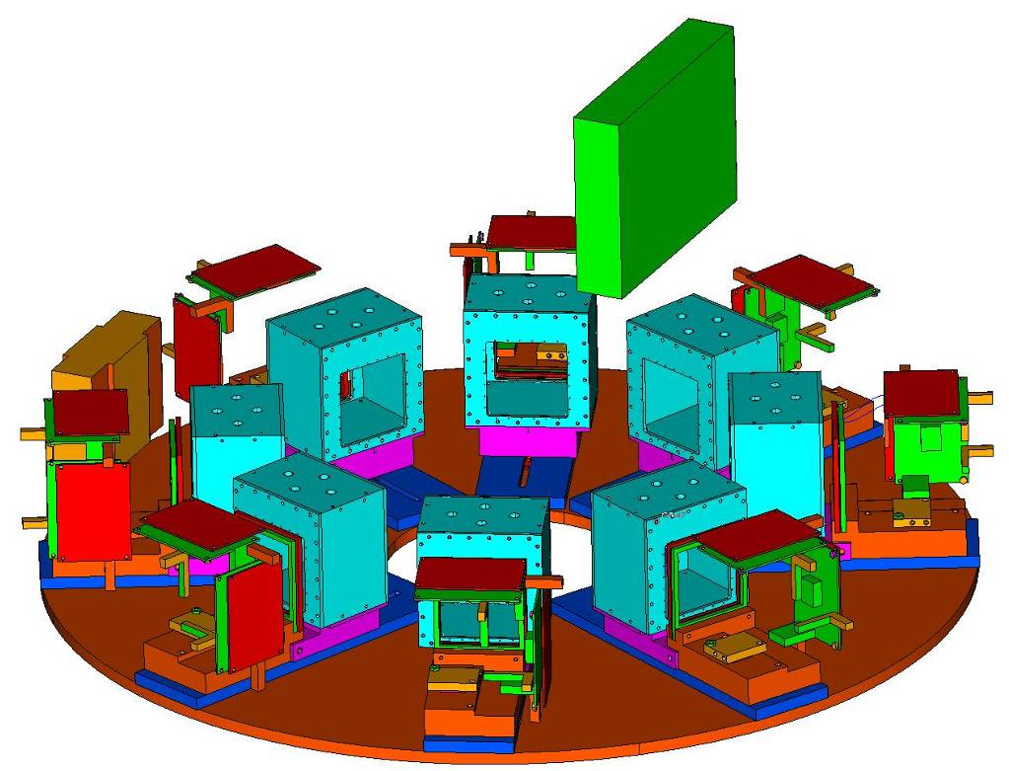
28th Jun – 5th July: ⁷Be + ²⁰⁸Pb
6 modules of EXPADES:
Active area: 62.3 mm x 62.3 mm
Solid Angle: ~2 sr (15% of 4π)
1st layer: Si DSSD (40-50 μm)
16 strips (x) x 16 strips (y).
2nd layer: Si DSSD (300 μm)
32 strips (x) x 32 strips (y).
Particle Identification: EXPADES is particularly suitable for detecting elastically scattered ⁷Be nuclei and ^{3,4}He reaction products.
 | E_{FORWARD} (MeV) | E_{BACKWARD} (MeV) | ΔE-E threshold for 50 um Si (MeV)
³He | 9.5 – 22.5 | 8.5 – 21.0 | 7.4
⁴He | 14.0 – 27.5 | 13.0 – 25.5 | 8.2
⁷Be | 33.5 – 39.0 | 28.0 – 31.0 | 22.2

Slide 16
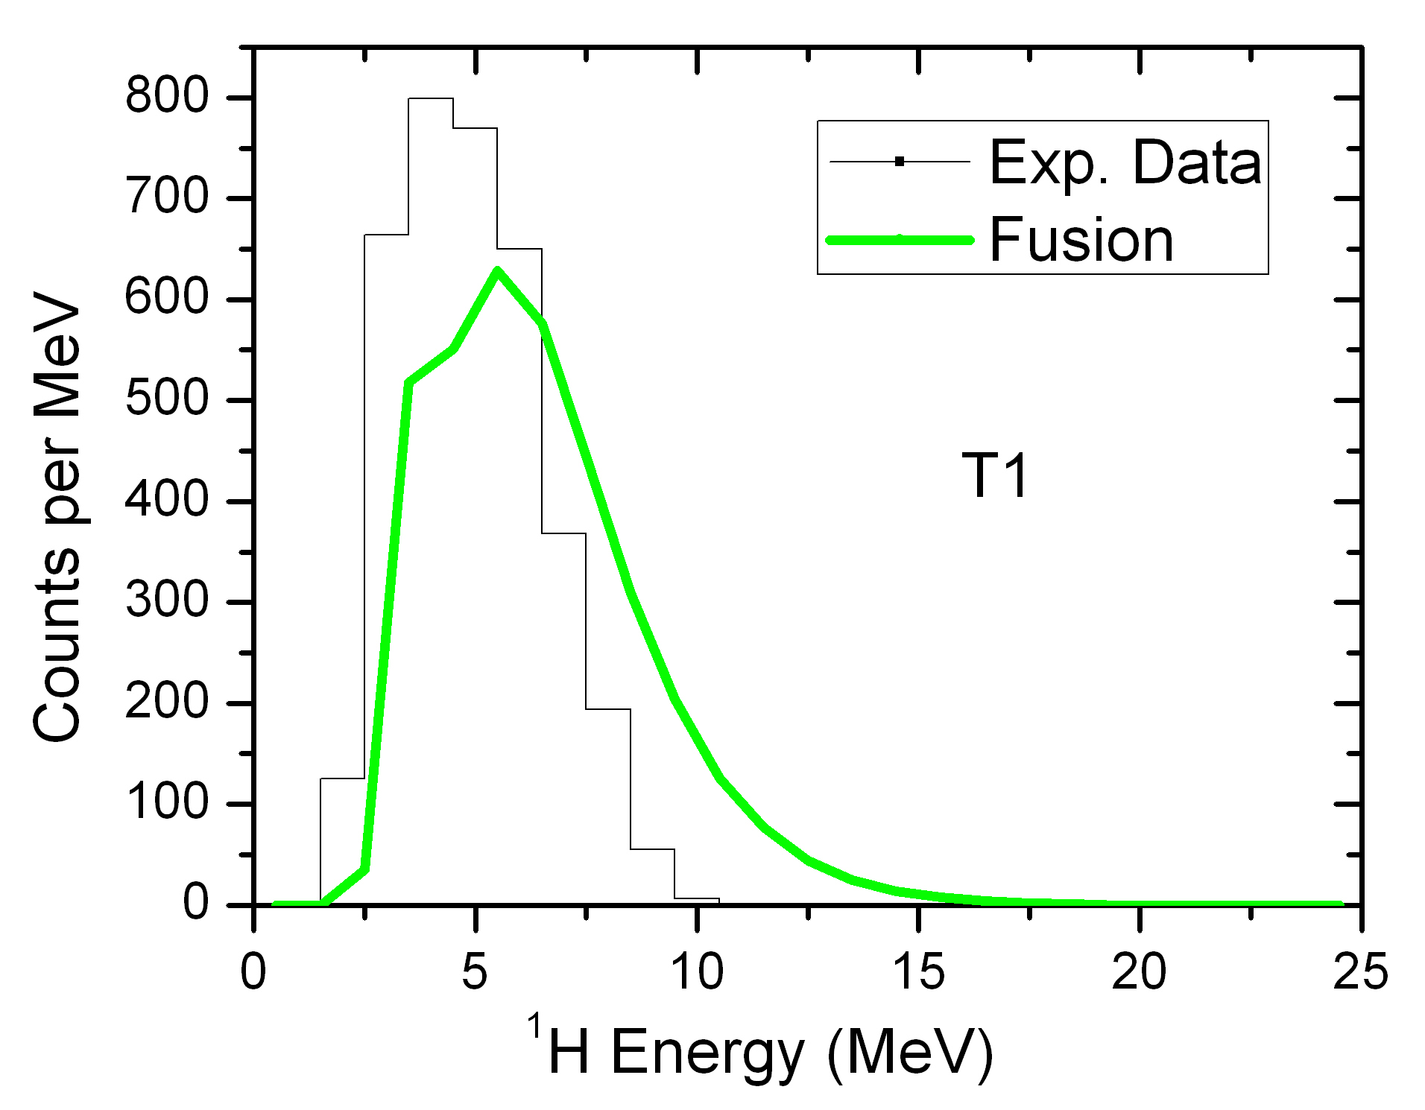
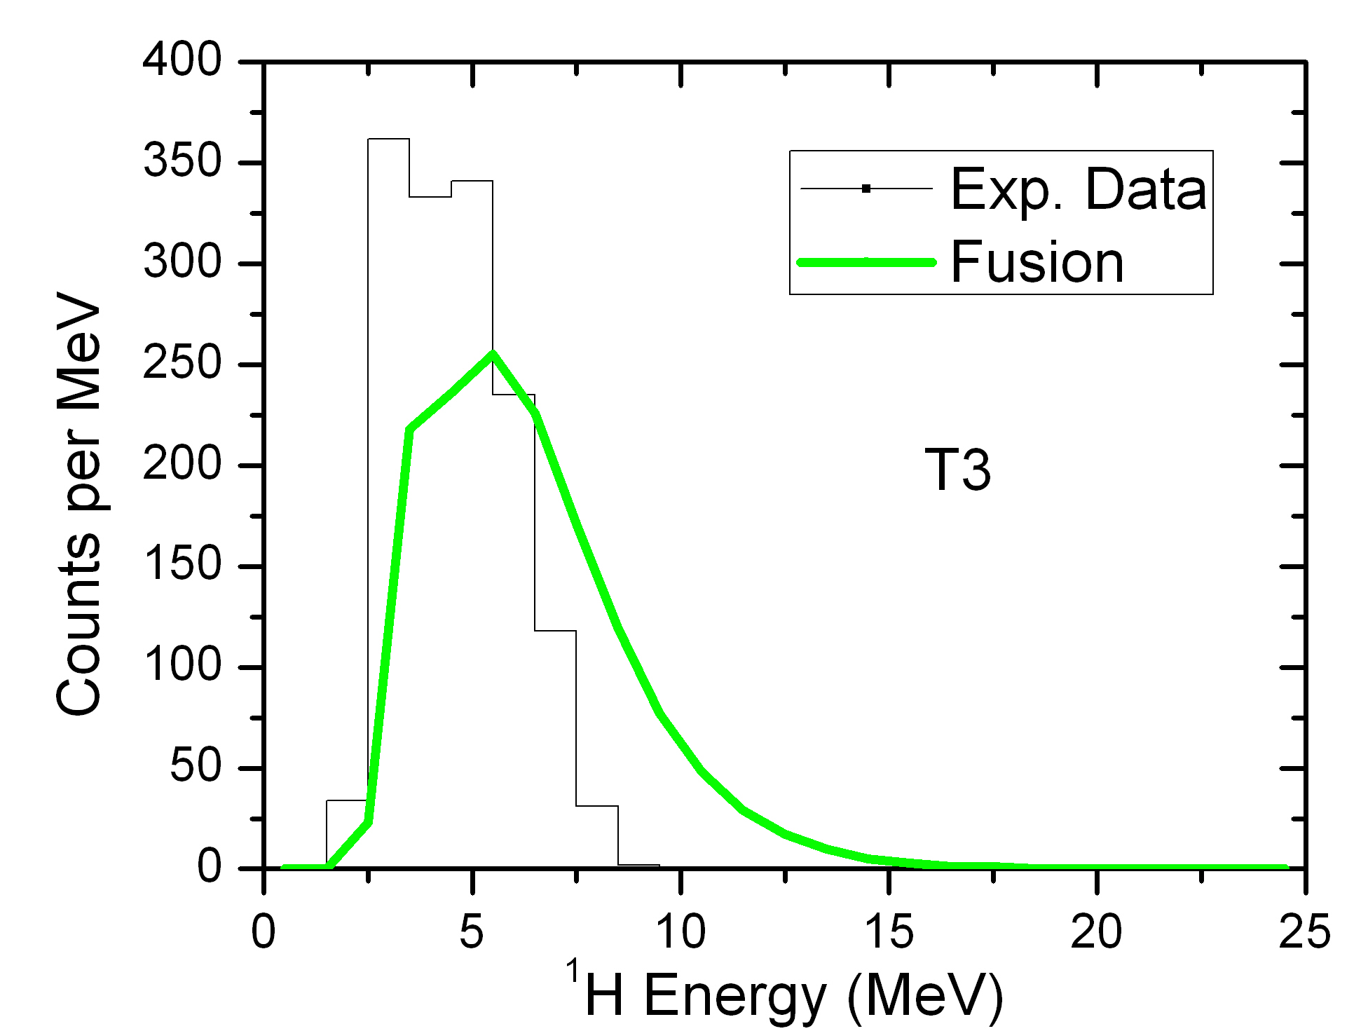
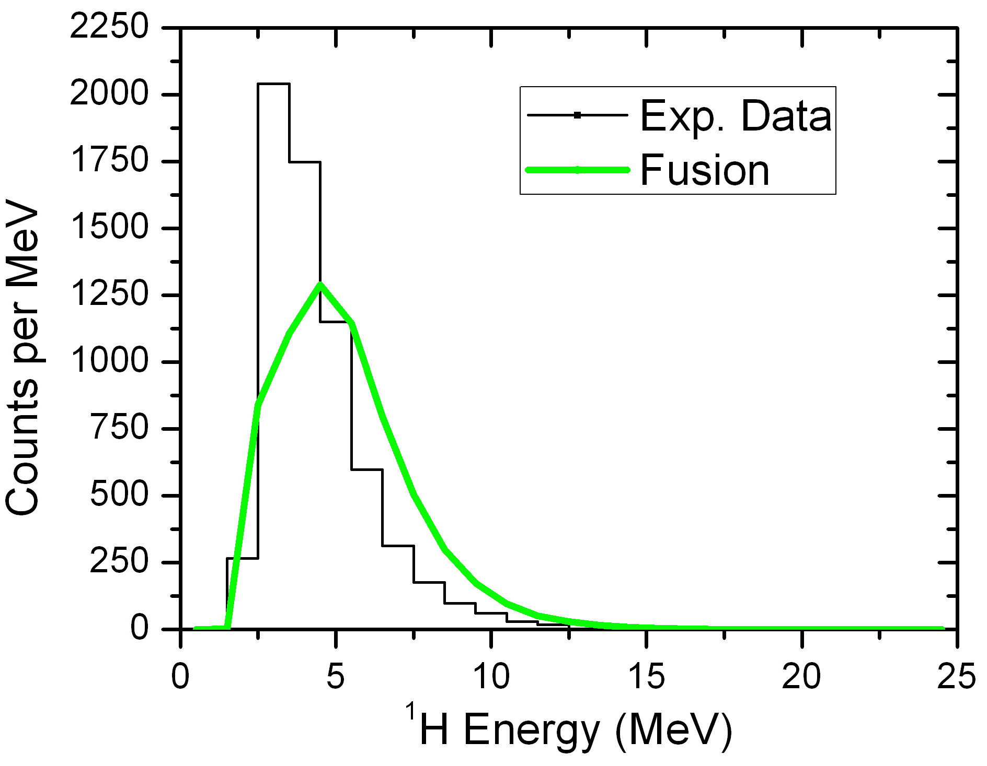
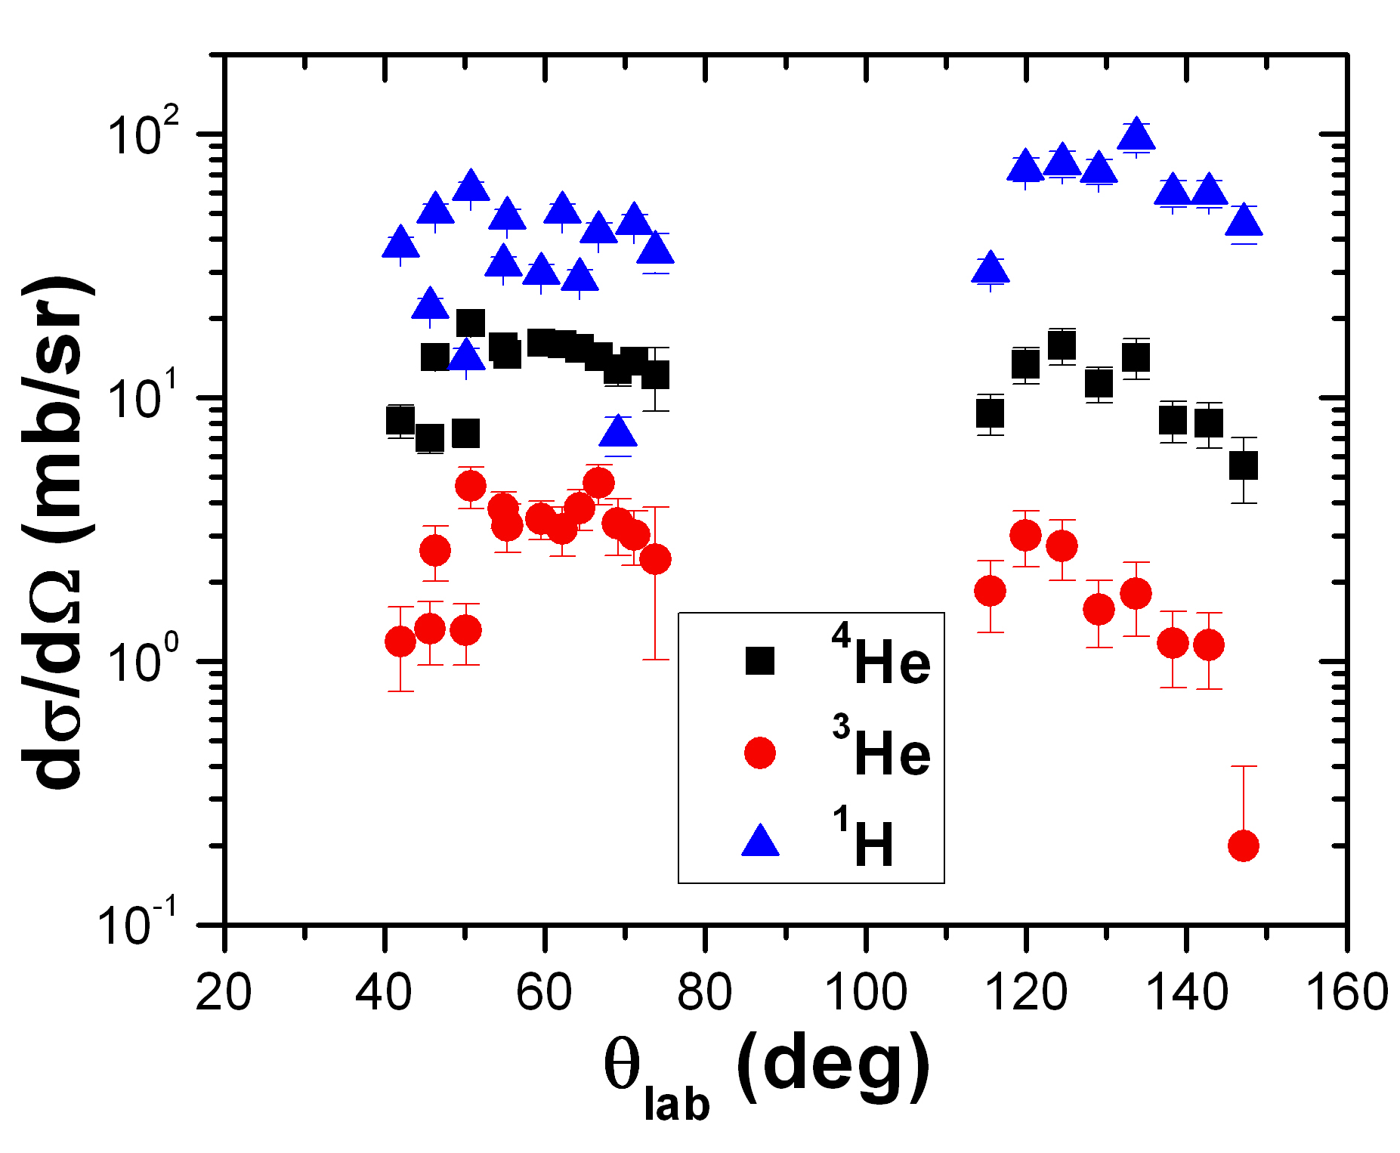
¹H Production
Large production yield of ¹H.
Energy spectra rather compatible with fusion.
The ¹H angular distribution shows an extra-yield at backward angles.

Slide 17
Experiment and analysis in collaboration with…
Padova/LNL - Italy
D. Torresi, N. Fierro, P. Molini, C. Parascandolo, C. Signorini, F. Soramel, E. Strano
Napoli - Italy
A. Boiano, M. La Commara, D. Pierroutsakou, M. Romoli, M. Sandoli, R. Silvestri
Milano - Italy
C. Boiano, A. Guglielmetti, C. Mazzocchi (Warsaw)
NIPNE (Bucarest) - Romania
T. Glodariu, L. Stroe
Huelva – Spain
I. Martel, A.M. Sanchez-Benitez, L. Acosta (Catania)
Ioannina – Greece
A. Pakou, N. Patronis, E. Stiliaris (Athens), K. Zerva

Slide 18
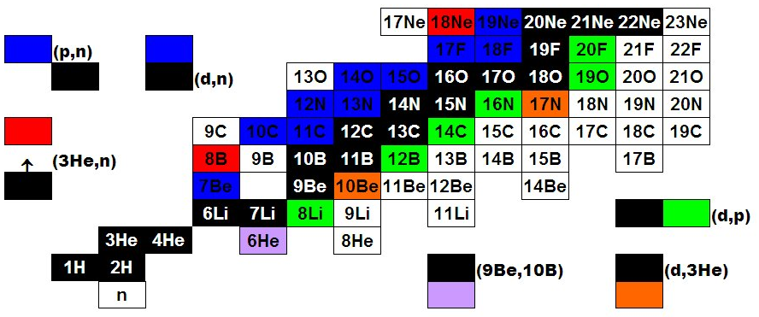
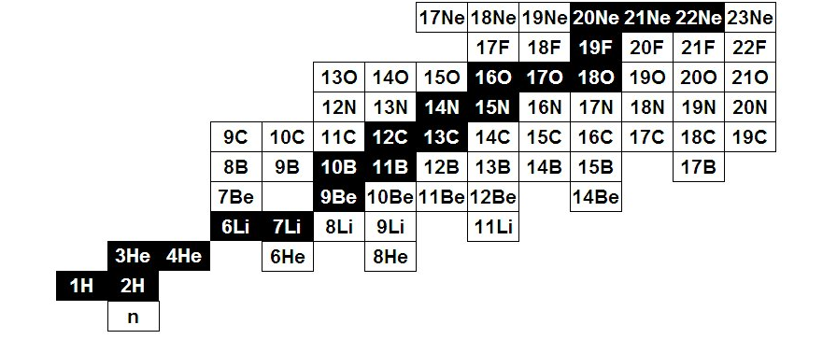
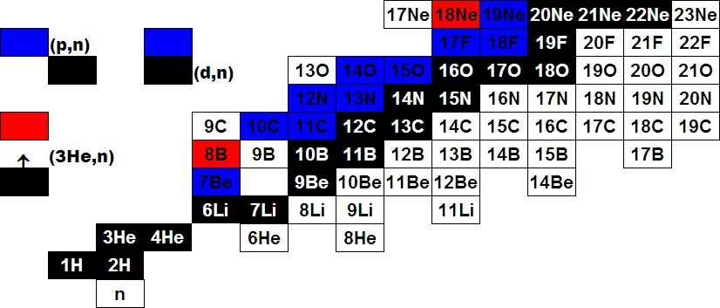
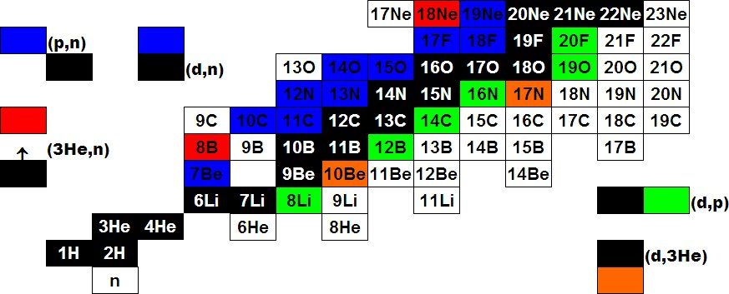
Light RIBs at EXOTIC
¹⁷F E = 3–5 MeV/u Purity: 93-96 % Intensity: ~ 10⁵ pps
⁸B E = 3 MeV/u Purity: 40-50 % Intensity: 10³ pps
⁷Be E = 3 MeV/u Purity: 99 % Intensity: 2-3*10⁵ pps

Slide 19
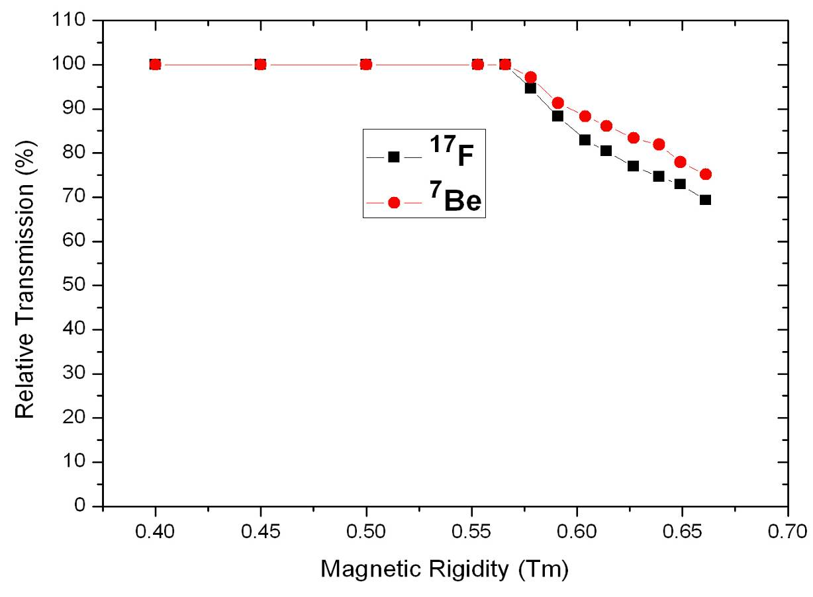
EXOTIC Upgrade (FIRB Project)
V_{b} ¹⁷F + ⁵⁸Ni
V_{b} ⁷Be + ²⁰⁸Pb
V_{b} ⁷Be + ⁵⁸Ni
V_{b} ¹⁷F + ²⁰⁸Pb
The transmission is limited by the maximum magnetic field applicable to the pole-tips of the middle quadrupoles of both triplets.
The upgrade (financed within the project FIRB cod. RBFR08P1W2_001) will increase the RIB maximum magnetic rigidity by + 15 %, thus providing:
Higher Transmission (and secondary beam intensity)
B-scaling of all ion-optical elements

Slide 20
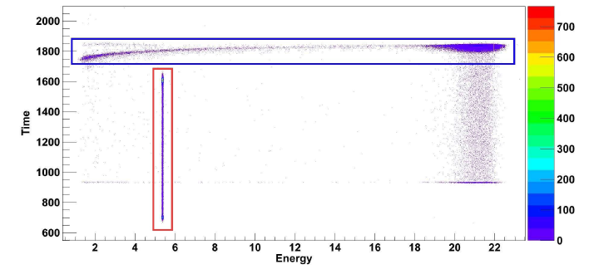
Experimental Data: ⁷Be + ⁵⁸Ni
Time-Correlated Events
Pulser (2 Hz)

Slide 21
⁷Be (S_{α} = 1.586 MeV)
Reactions on heavy target (²³⁸U):
Fusion-fission cross section: suppression at above-barrier energies.
ICF/Transfer/Breakup-fission cross section at 5 energies: 90% of the whole fission cross section at sub-barrier energies.
Prominent direct processes: ³He-transfer and α-transfer. R.Raabe et al, Phys. Rev. C 74, 044606 (2006)
Reactions on medium-mass target (⁵⁸Ni):
Reaction cross section measurement at 5 energies around the Coulomb barrier.
Similar behavior to ⁶Li+⁵⁸Ni.
E.F. Aguilera et al., Phys. Rev. C 79, 021601 (2009)

Slide 22
The Project EXOTIC
We laid out and developed a facility at the Laboratori Nazionali di Legnaro (LNL) of the INFN for the in-flight production of light weakly-bound Radioactive Ion Beams (RIBs).
The production mechanism employs inverse kinematics reactions with high intensity heavy-ion beams (delivered from the XTU-Tandem) impinging on light gas targets.
The commissioning of the facility was performed in 2004. F. Farinon et al., NIM B 266, 4097 (2008)
M. Mazzocco et al., NIM B 266, 4665 (2008)
The first “beam for experiment” was delivered in Feb. 2006. D. Pierroutsakou et al., EPJ ST 150, 47 (2007)
C. Signorini et al., EPJ A 44, 63 (2010)
Three RIBs have been produced up to now:
  ¹⁷F (S_{p} = 600 keV): ¹H(¹⁷O,¹⁷F)n Q_{value} = -3.54 MeV;
  ⁸B (S_{p} = 137.5 keV): ³He(⁶Li,⁸B)n Q_{value} = -1.97 MeV;
  ⁷Be (S_{α} = 1.586 MeV): ¹H(⁷Li,⁷Be)n Q_{value} = -1.64 MeV.

Slide 23
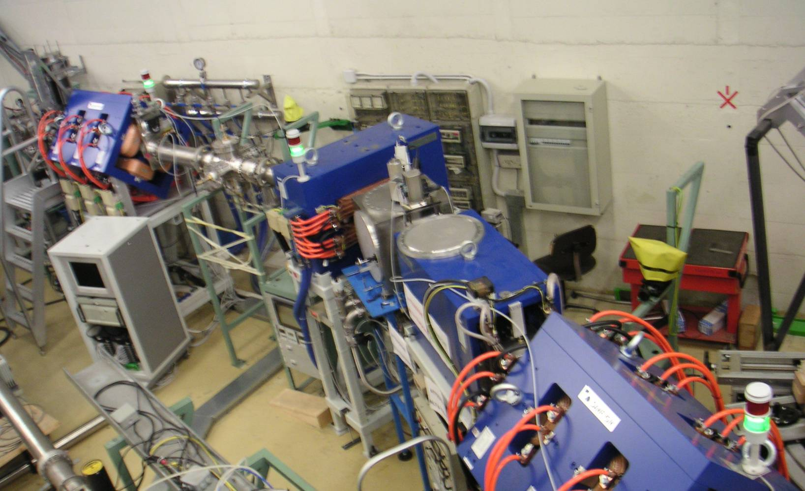
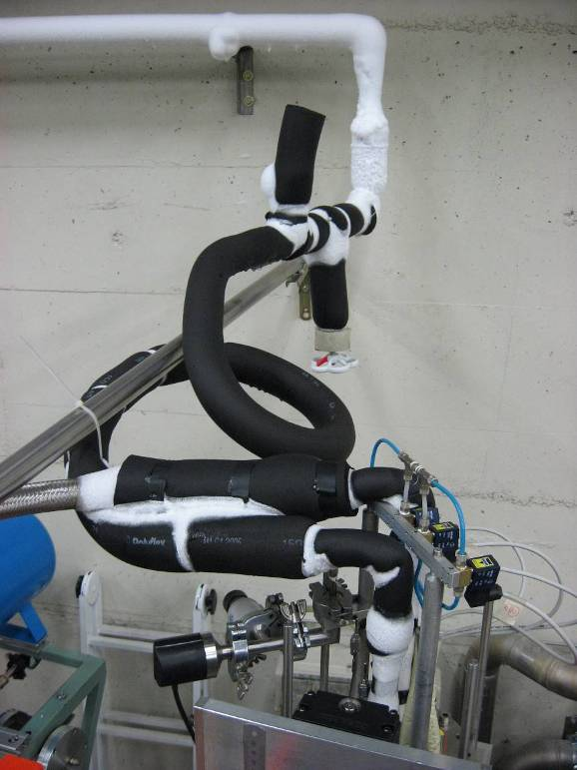
The Facility EXOTIC at LNL
Gas Target
1st Quadrupole Triplet
30°-Dipole Magnet
Wien Filter
2nd Quadrupole Triplet
4 Slit Systems
S3
Cryogenic Gas Target

