Slide 1

INPC2013 Florence June 2-7
Scattering of light halo nuclei on heavy target at energies around the Coulomb barrier
Olof TENGBLAD
Instituto de Estructura de la Materia, CSIC
On behalf of the E1104 & S1202 Collaborations: IEM-CSIC Madrid - U. Huelva- U. Sevilla
INFN-Catania - U. Aarhus - U. Chalmers – U. Lisboa – U. Saint Mary - U. York
TIGRESS @ TRIUMF

Slide 2
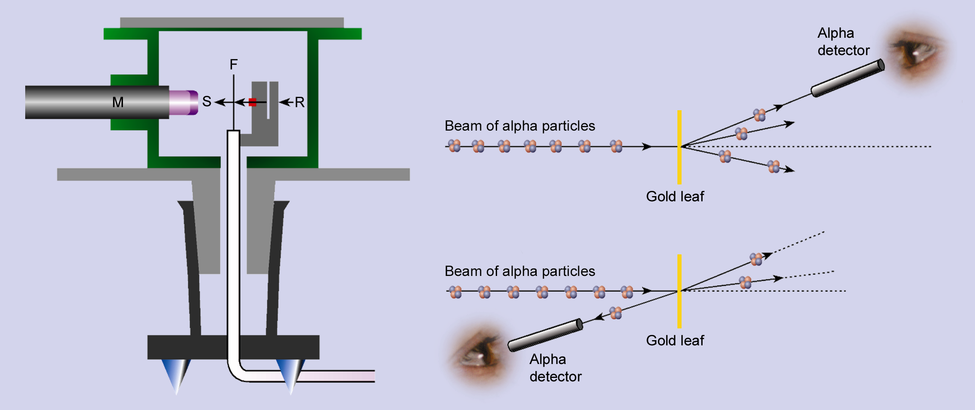

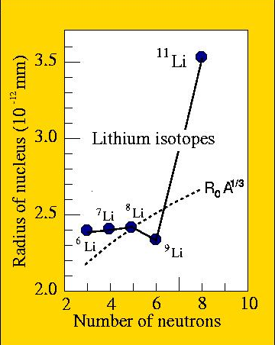
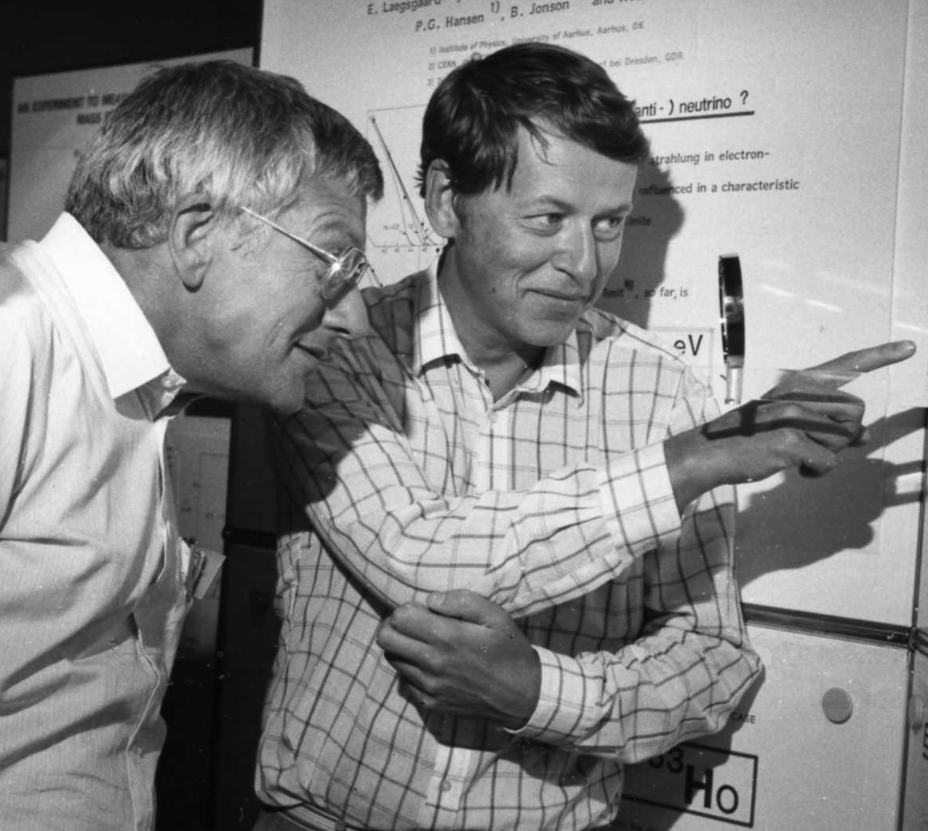
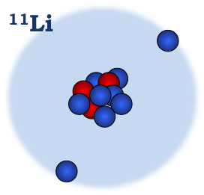
Reaction with stable and Radioactive beams
100 years
E. Rutherford
Geiger & Marsden
Tanihata, 1985
25 years
Halo Nuclei
Compact core
Extended n-distribution
Few or none excited states
P.G. Hansen & B. Jonson
Notes:
Nuclear structure has often been infered from nuclear reaction studies. The best example is certainly the structure of the atom infred by rutherford from the dtat of geiger and Marsden. And the halo structure infered by gregers hansen and Bjorn Jonson from the data of Tanihata

Slide 3
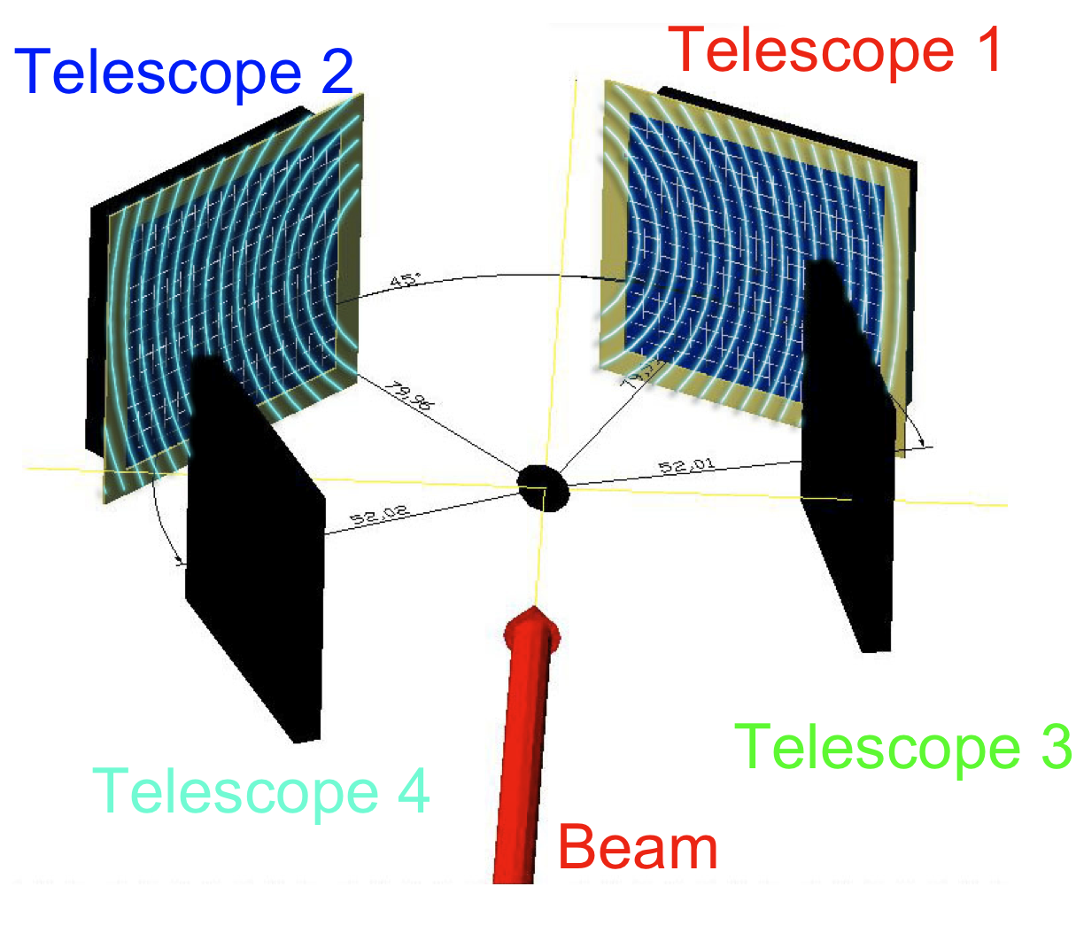
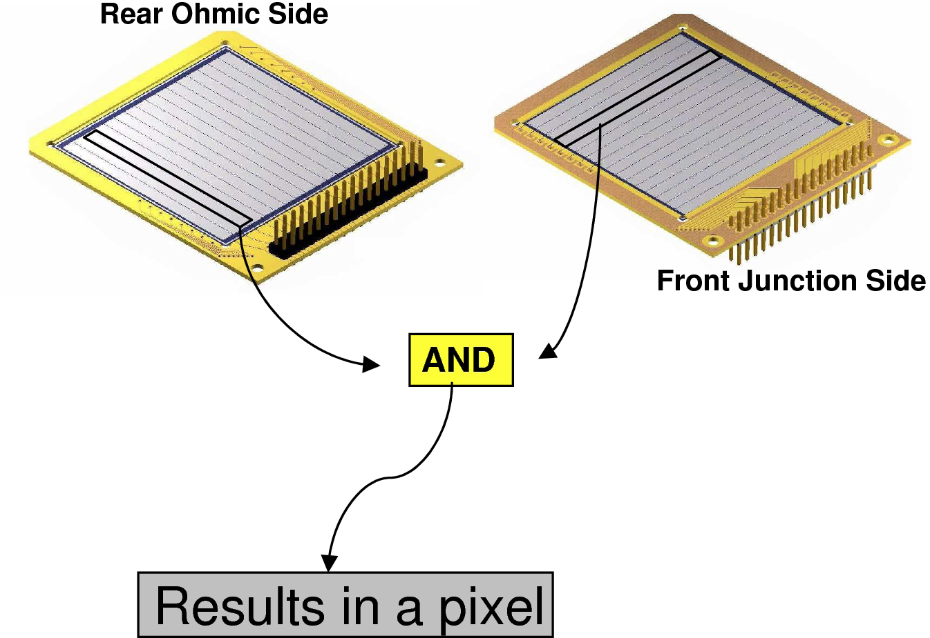
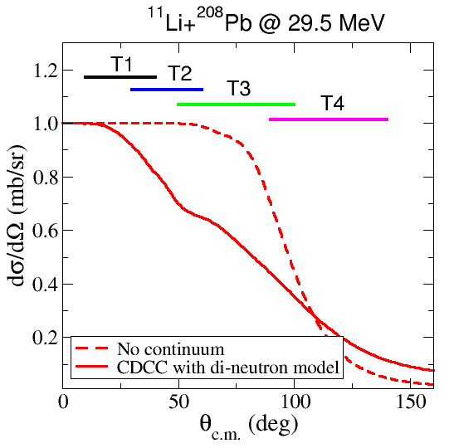
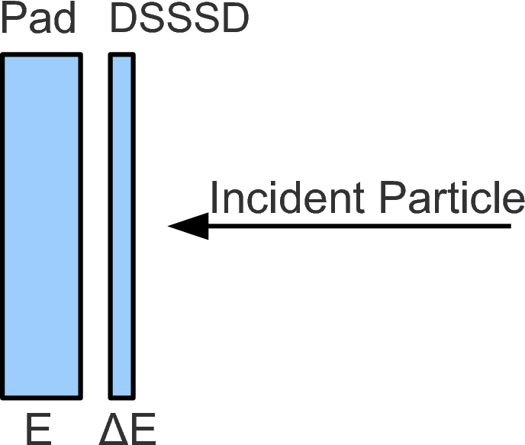
Experimental Set up @ ISAC-II TRIUM ⁹⁻¹¹Li on ²⁰⁸Pb
Scattering of halo nuclei on heavy target at Coulomb barrier energies
Telescope 1
80 mm
80 mm
52 mm
52 mm
1024 pixels !
Telescope 4
¹¹Li ions average 4300 pps on target
Beam | Energy (MeV/u) | Target Pb (mg/cm2) | Time (h)
⁹Li | 2.67 (24.0) | 1.45 | 11.75
 | 3.27 (29.4) | 1.45 | 7.63
 | 3.27 (29.4) | 1.9 | 9.95
 | 3.67 (33.0) | 1.9 | 31.05
¹¹Li | 2.2 (24.2) | 1.45 | 82.2
 | 2.7 (29.7) | 1.45 | 118.12
Detector | Thickness (μm) | Angular Range
T1: DSSSD+PAD | 45 + 500 | 10º - 40º
T2: DSSSD+PAD | 45 + 500 | 30º - 60º
T3: SSSD+DSSSD | 20 + 60 | 50º - 100º
T4: SSSD+DSSSD | 20 + 63 | 90º - 140º
Notes:
On the left the set up used is shpwn : The distance to the forward detectors was around 80 mm and 52 mm for the back detectors. The angular coverage was chosen as a compromise between having having reasonable statistics and
Covering the angles where a major variation of the potential with the different components is expected.

Slide 4
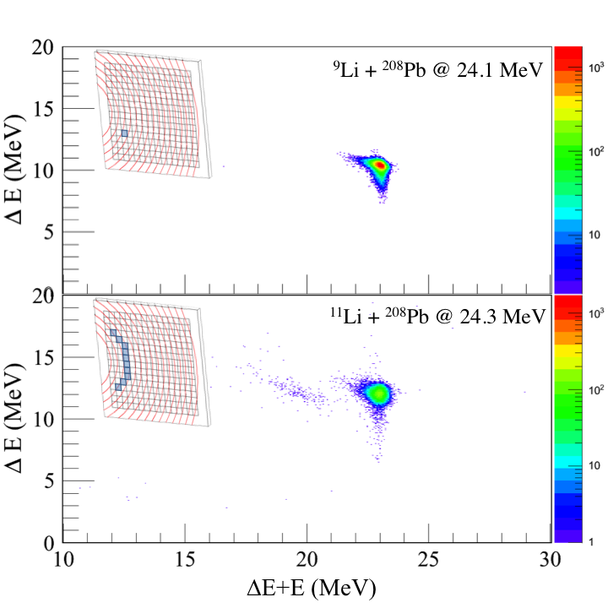
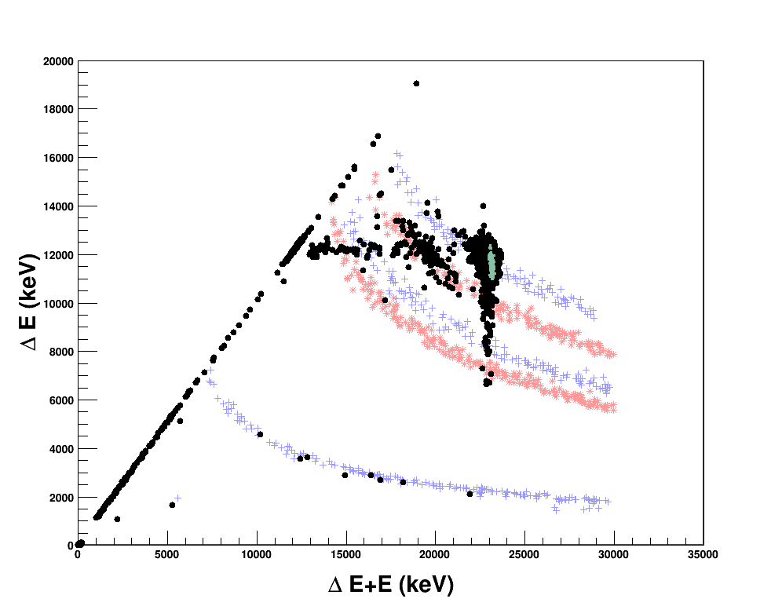
Elastic & Breakup / ¹¹Li & ⁹Li Data @ C.M. Energy
¹¹Li on ²⁰⁸Pb @ 24.2 MeV θ = 19.5(2)º
¹¹Li
⁹Li
13.9º
⁷Li
⁶Li
α
Large breakup contribution well below the Coulomb barrier (≈28 MeV)
MC Simulations of losses in the different sensitive and unsensitive materials.
14 (1)º
Notes:
On the left we show the scattering data for 9Li and 11Li at energies below the coulomb barrier. It is remarkable to see that
At energies well below the the Coulomb barrier we have a sizeble amount of breakup.
On the right MC simulations reproduce well the data and account for the sensitive and insensitive materials.

Slide 5
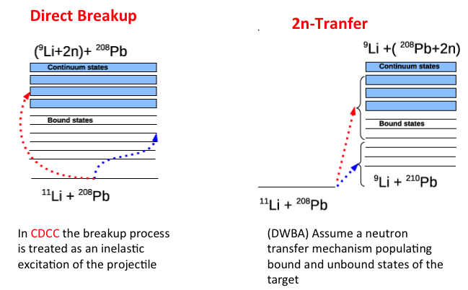
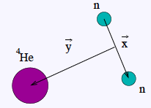
Theoretical
Interpretation
Which is the mechanism responsible of the ¹¹Li scattering?
What can we learn of the ¹¹Li structure?
Comparison of the experimental data with theoretical calculations.
⁹Li
Semicalssical Calculations for B(E1) and breakup data:
Include Coulomb coupling at first order
Continuum Discretised Coupled Channel (4b-CDCC):
V[n-n-⁹Li] + V[n-n-²⁰⁸Pb] + V[⁹Li + ²⁰⁸Pb]
Image the direct breakup of the projectile
Includes Coulomb and multipole nuclear couplings.
Continuum up to 5 MeV considering the binning procedure
(¹¹Li structure )
All J^{π} =1±, 2±, 3±
(from ⁹Li elastic scattering)
Based on M. Rodriguez-Carmona, PRC80 (2009) 051601R

Slide 6
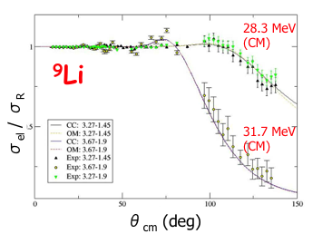
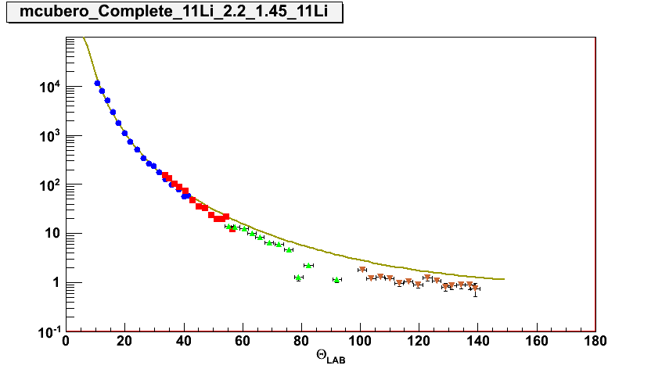
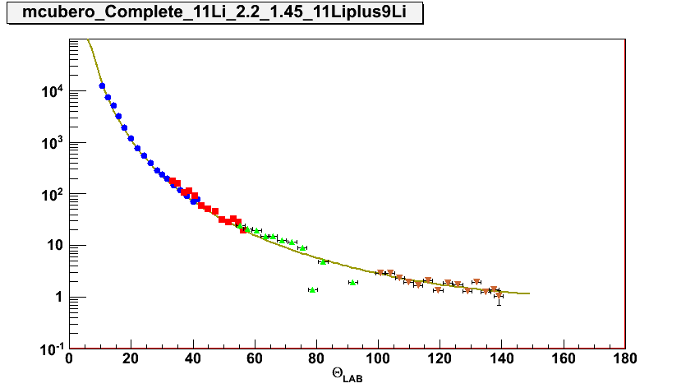
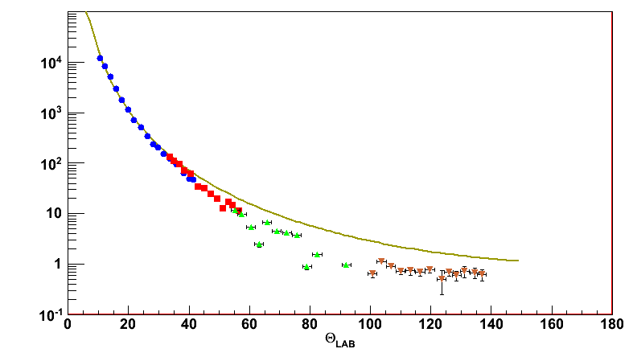
Elastic Scattering of ⁹Li used to tune the potential
Tune THEORY i.e. the potential
& the EXPERIMENT i.e. set-up
¹¹Li @ 23 MeV (CM)
Elastic Data
¹¹Li @ 23 MeV (CM)
¹¹Li + ⁹Li
dσ/dΩ
Elastic scattering of ⁹Li on ²⁰⁸Pb @ 2.67 MeV/u follows Rutherford.
The real part of the potential is from double folding Sao Paolo Potential (SPP) and the imaginary part from a Wood Saxon.: V_{SPP} + i.W_{WS}
It is possible to describe the data with fixed geometry, r_{i} = 1.35 fm , a_{i} = 0.51 fm
The contribution of 1st excited state in ⁹Li included in CC calculation
The OM and CC reproduce similarly well the data.
¹¹Li elastic scattering well below the barrier departs from Rutherford at 50º
¹¹Li @ 28.3 MeV (CM)
Elastic Data
dσ/dΩ
Notes:
In the following we show the elastic scatering of 9Li on lead for energies around the Coulomb barrier and well above. And for both types of targets.
Therefore the real part of the optical potential is describe using the double folding Sao Paolo Potential beased in the density distribution and a wood saxon for the imaginary part. The geometrical factor are kept constant and only the dept
Of the imaginary potential is change with energy. We see that we can describe the full set of data with the smae geometry parameters.

Slide 7
First determination of Elastic Scattering of ⁹Li & ¹¹Li around the Coulomb Barrier
E_{CM} = 23.1 MeV
The ⁹Li elastic scattering data follow the OM calculation as any other compact nuclei both below and around the Coulomb Barrier.
4body-CDCC calculation uses the OM potential deduced from the ⁹Li data for energies above the barrier.
If no continuum states are included 4body-CDCC is unable to describe the ¹¹Li data.
The 4b-CDCC calculations fit better the data if a low energy resonance around 0.3 MeV beyond threshold is included.
E_{CM} = 28.3 MeV
PRL 109,262701 (2012)
4b-CDCC calculations performed by Manoli Rodriguez-Gallardo

Slide 8
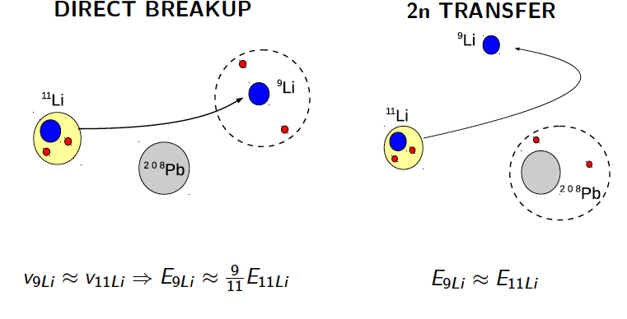
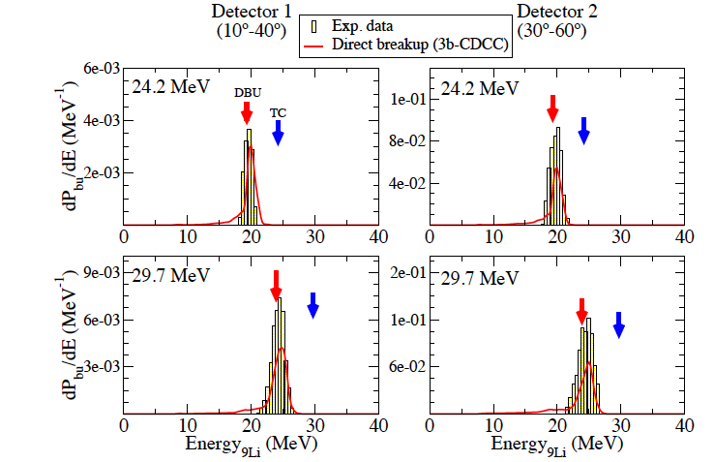
Which mechanism produces the breakup of the nucleus ?
Direct breakup mechanism dominates at small angles
Energy distribution of the ⁹Li fragments

Slide 9
Break-up probabilities
P_{bu} = N_{bu}/ (N_{bu} + N_{el})
Assuming
σ_{el} + σ_{bu} ≈ σ_{R}
Good agreement with 4b-CDCC, when a resonance 0.3 MeV above the threshold is considered
The dashed line is the Equivalent Phonon Method corresponding to B(E1) deduced from ¹¹Li 3-body CDCC
The point-dashed line is the Equivalent Phonon Method corresponding to the B(E1) measured by Nakamura et al. [PRL96 (2006) 252502]. This calculation follows the trend by underestimate the breakup probability at low angles.
PRL 110,142701 (2013)

Slide 10
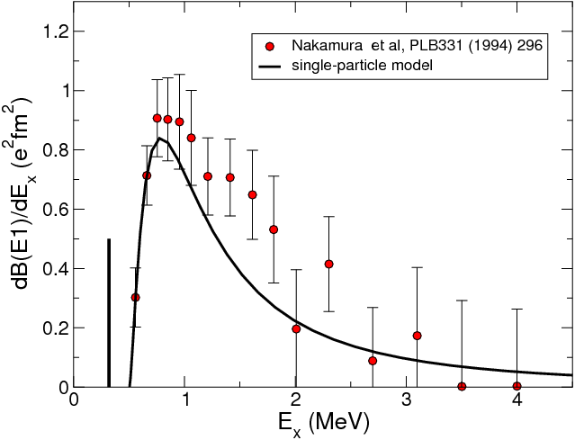
The 1n halo ¹¹Be
break up
in eleastic
elastic
503 keV
¹⁰Be+n
320 keV
½⁻
¹³C
13.8 s
½⁺
¹¹Be
¹²B
13.8 s
B(E1) = 0.116(12) e²fm²
¹¹Be
13.8 s
¹²Be
23.6 ms
¹³Be
806 ms
¹⁴Be
4.35 ms
Dipole polarizability
Bound dipole state
⁹Li
179 ms
¹⁰Li
806 ms
¹¹Li
8.5 ms
⁶He
806 ms
⁷He
806 ms
⁸He
119 ms
⁹He
806 ms
New Compilation for A = 11
Kelley et al., NPA880 (2012) 88-195
¹¹Be has a 2-body continuum: Simpler reaction mechanism.
But more complicated exp.
N=7

Slide 11
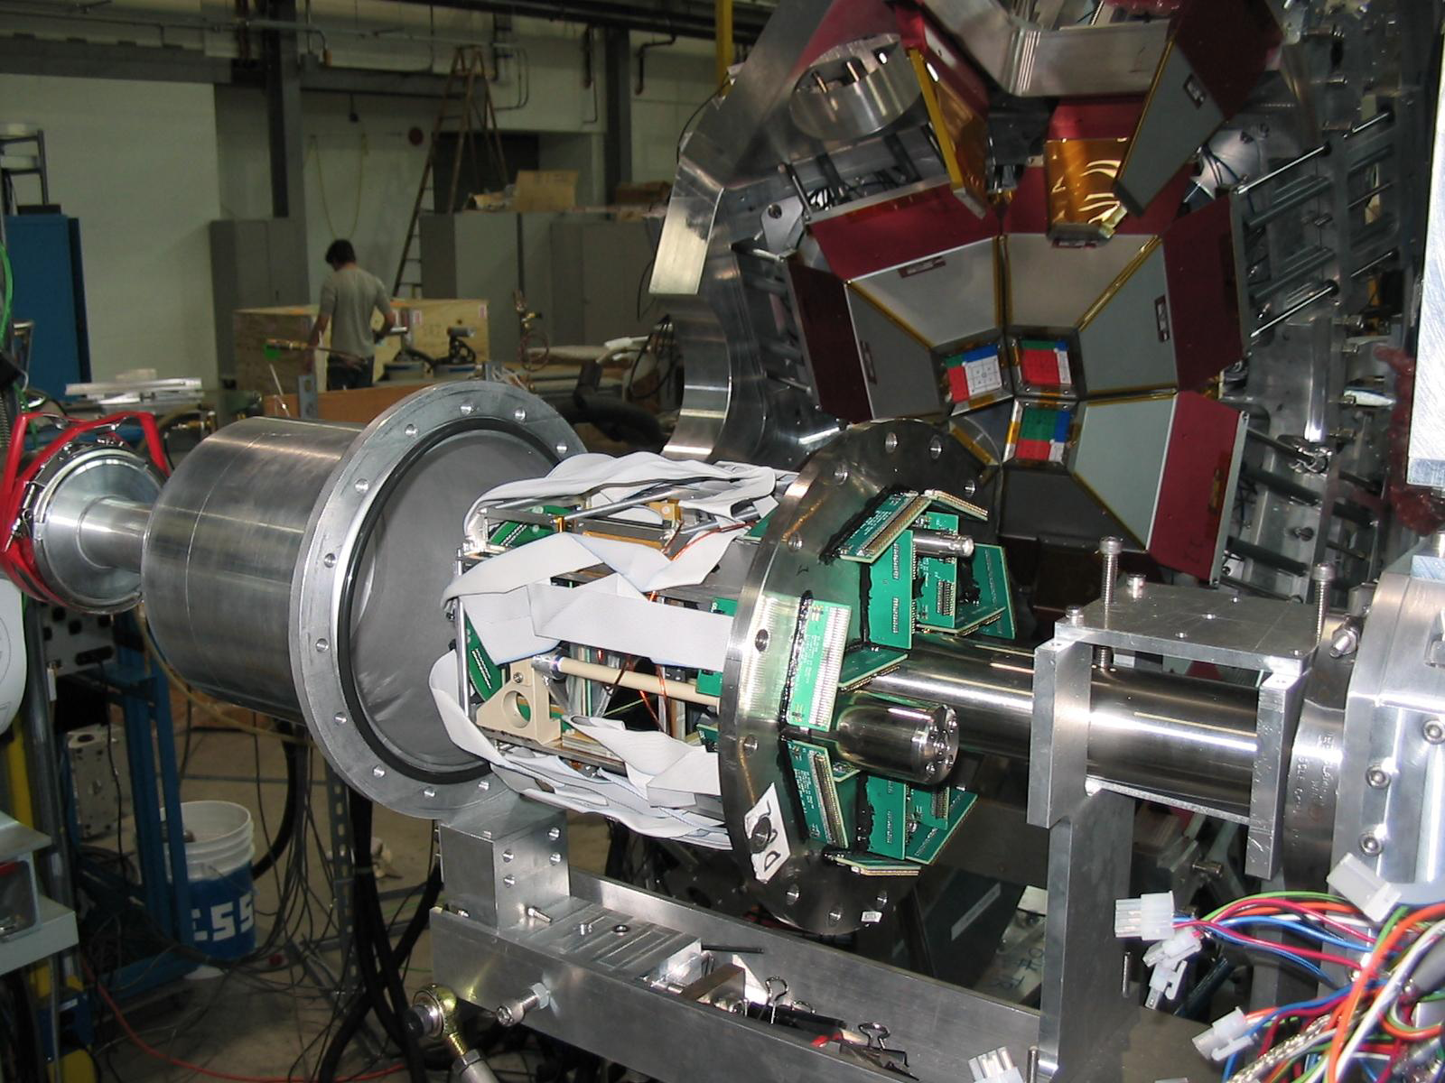
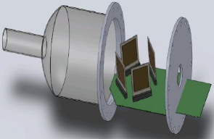
Experimental set-up to be used:
Reaction Chamber SHARC & TIGRESS
Energy resolution is an issue in this experiment
4x DSSSD 20-40 + 500 μm telescopes
Angular coverage 10 – 140 degrees on
New internal support for the detectors constructed in Madrid

Slide 12
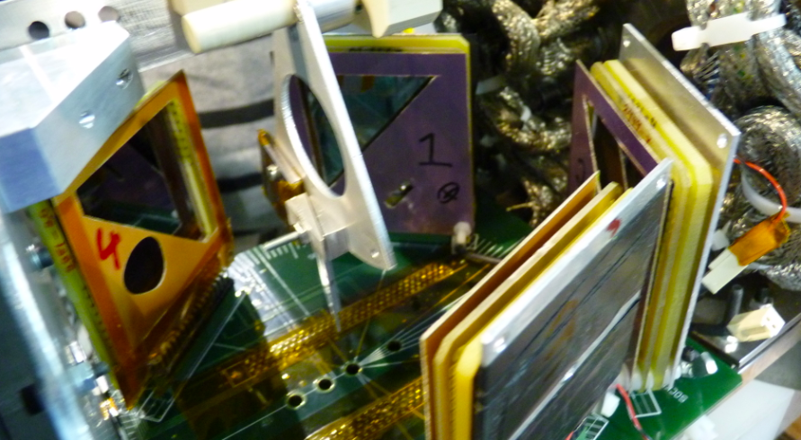
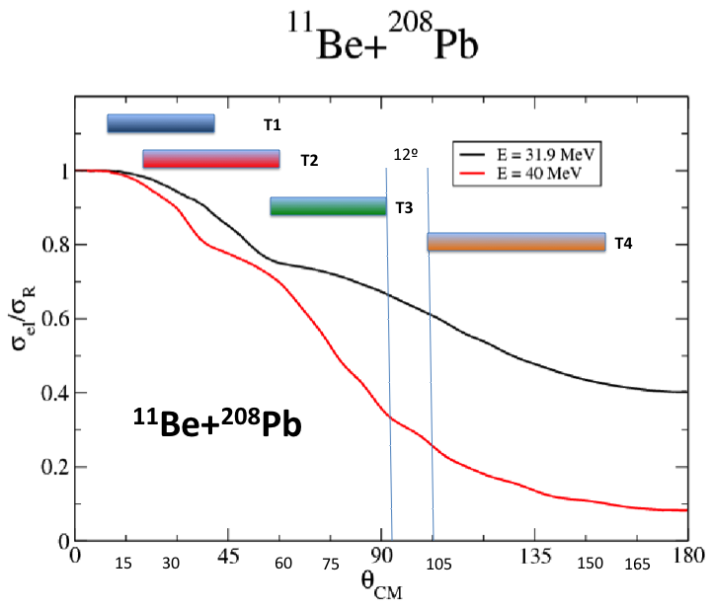
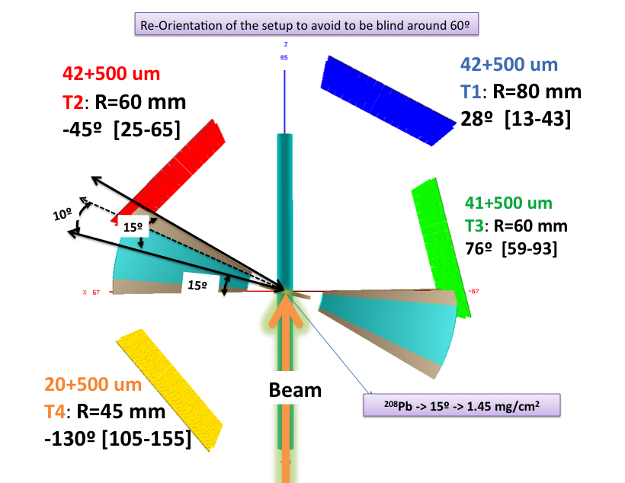
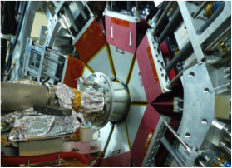
¹¹Be: ISAC II & TIGRESS @TRIUMF
July 2012 on ²⁰⁸Pb & June 2013 on ¹⁹⁷Au
T1
T2
T3
T4

Slide 13
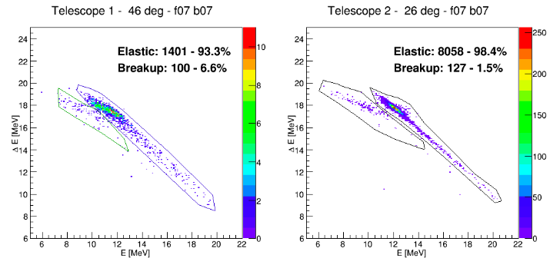
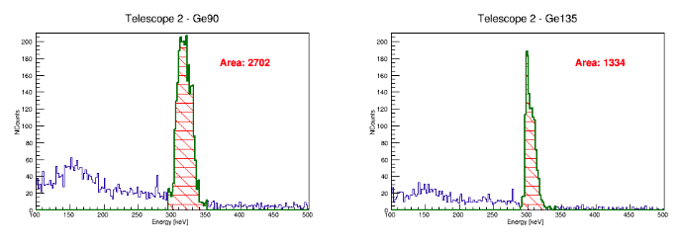
Online data: ¹¹Be on ¹⁹⁷Au @ 2.9 MeV/u 5 June 2013 TRIUMF
T1 @ 46º
T2 @ 26º
Elastic
&
Breakup
Ge@90º coincidence T2
Ge@135º coincidence T2
A= 2.700
A= 1.334
Inelastic
279 KeV
¹⁹⁷Au
279 KeV
¹⁹⁷Au

Slide 14
Summary & Outlook
Elastic and break-up cross section data for ⁹Li & ¹¹Li on ²⁰⁸Pb at energies near the Coulomb barrier were obtained for first time.
The designed experimental system is able to separate the elastic ejectiles and the fragments even at low energy and statistics.
The ¹¹Li elastic cross section depart strongly from Rutherford behaviour at energies well below the barrier. The behaviour is well described by 4b-CDCC when Coulomb and continuum couplings are taken into account.
Break-up cross sections are very large, even larger than predicted by CDCC calculations. Direct breakup dominates up to 50º.
For the breakup at forward angles, the semiclassic and 4b-CDCC calculations indicate that the dissociation of the projectile is mainly due to the dipolar Coulomb interaction.
The analysis of ¹¹Be on ¹⁹⁷Au and ²⁰⁸Pb @ TRIUMF is on progress

Slide 15
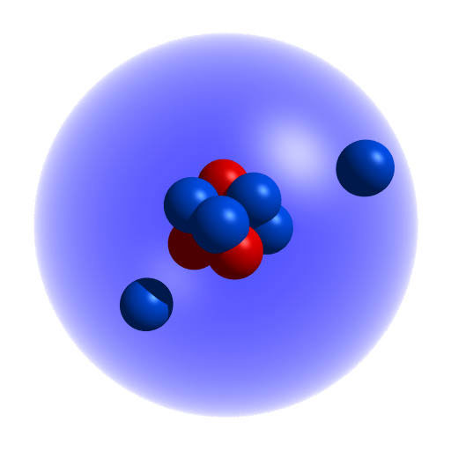
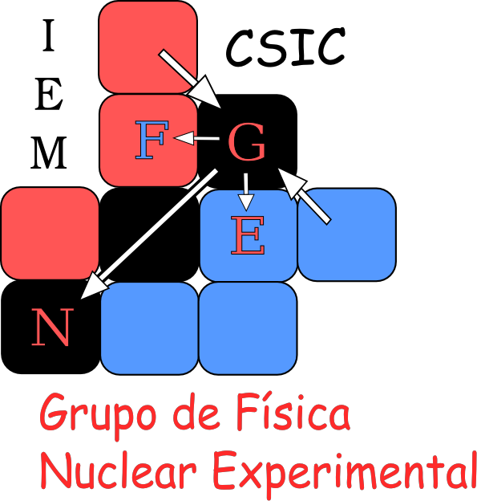
Thank you for your attention!
PhD work:
¹¹Li Break-up
Juan Pablo Fernandez-Garcia U. Sevilla
¹¹Li Elastic
Mario Cubero IEM-CSIC
¹¹Be
Vicente Pesudo IEM-CSIC

