Slide 1
Complete Set of Deuteron Analyzing Powers for dp Elastic Scattering at Intermediate Energies and Three Nucleon Force
Kimiko Sekiguchi
Department of Physics, Tohoku University

Slide 2
Nucleon-Deuteron Scattering
a good probe to study the dynamical aspects of 3NFs.
Momentum & Spin dependence
Iso-spin dependence : only T=1/2
Direct Comparison between Theory and Experiment
Theory : Faddeev Calculations
Rigorous Numerical Calculations of 3N System
Experiment : Precise Data
dσ/dΩ, Spin Observables (A_{ij}, K_{ij}, C_{ij})
2NF Input
CDBonn
Argonne V18 (AV18)
Nijmegen I, II, 93
3NF Input
Tucson-Melbourne
Urbana IX
etc..
2NF & 3NF Input
Chiral Effective Field Theory
Extract information of Three Nucleon Forces.

Slide 3
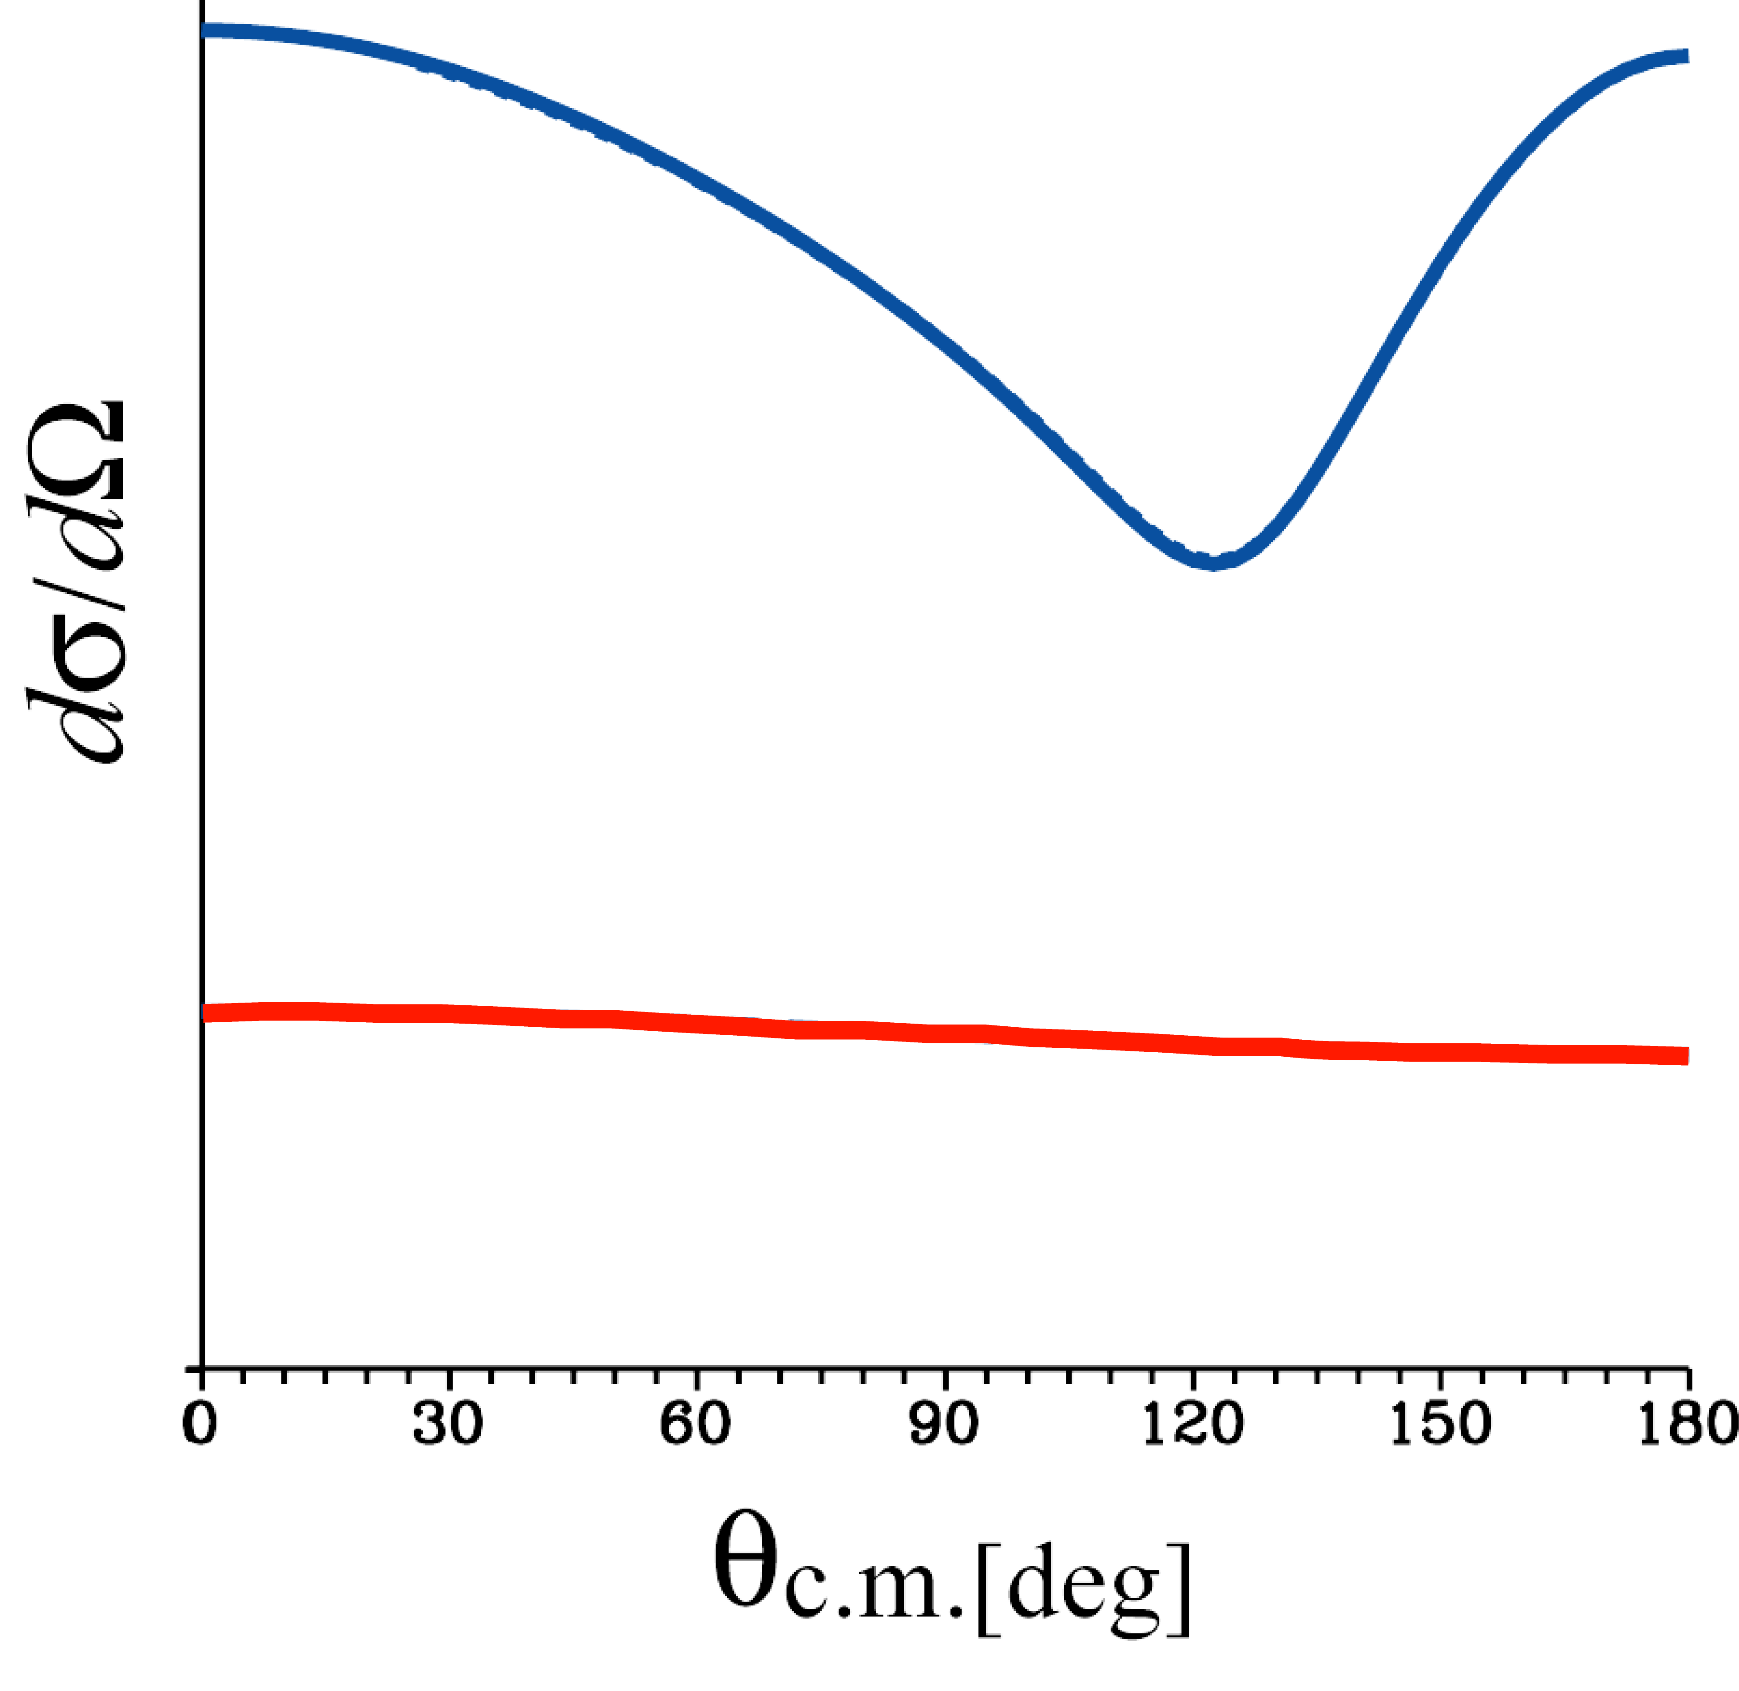
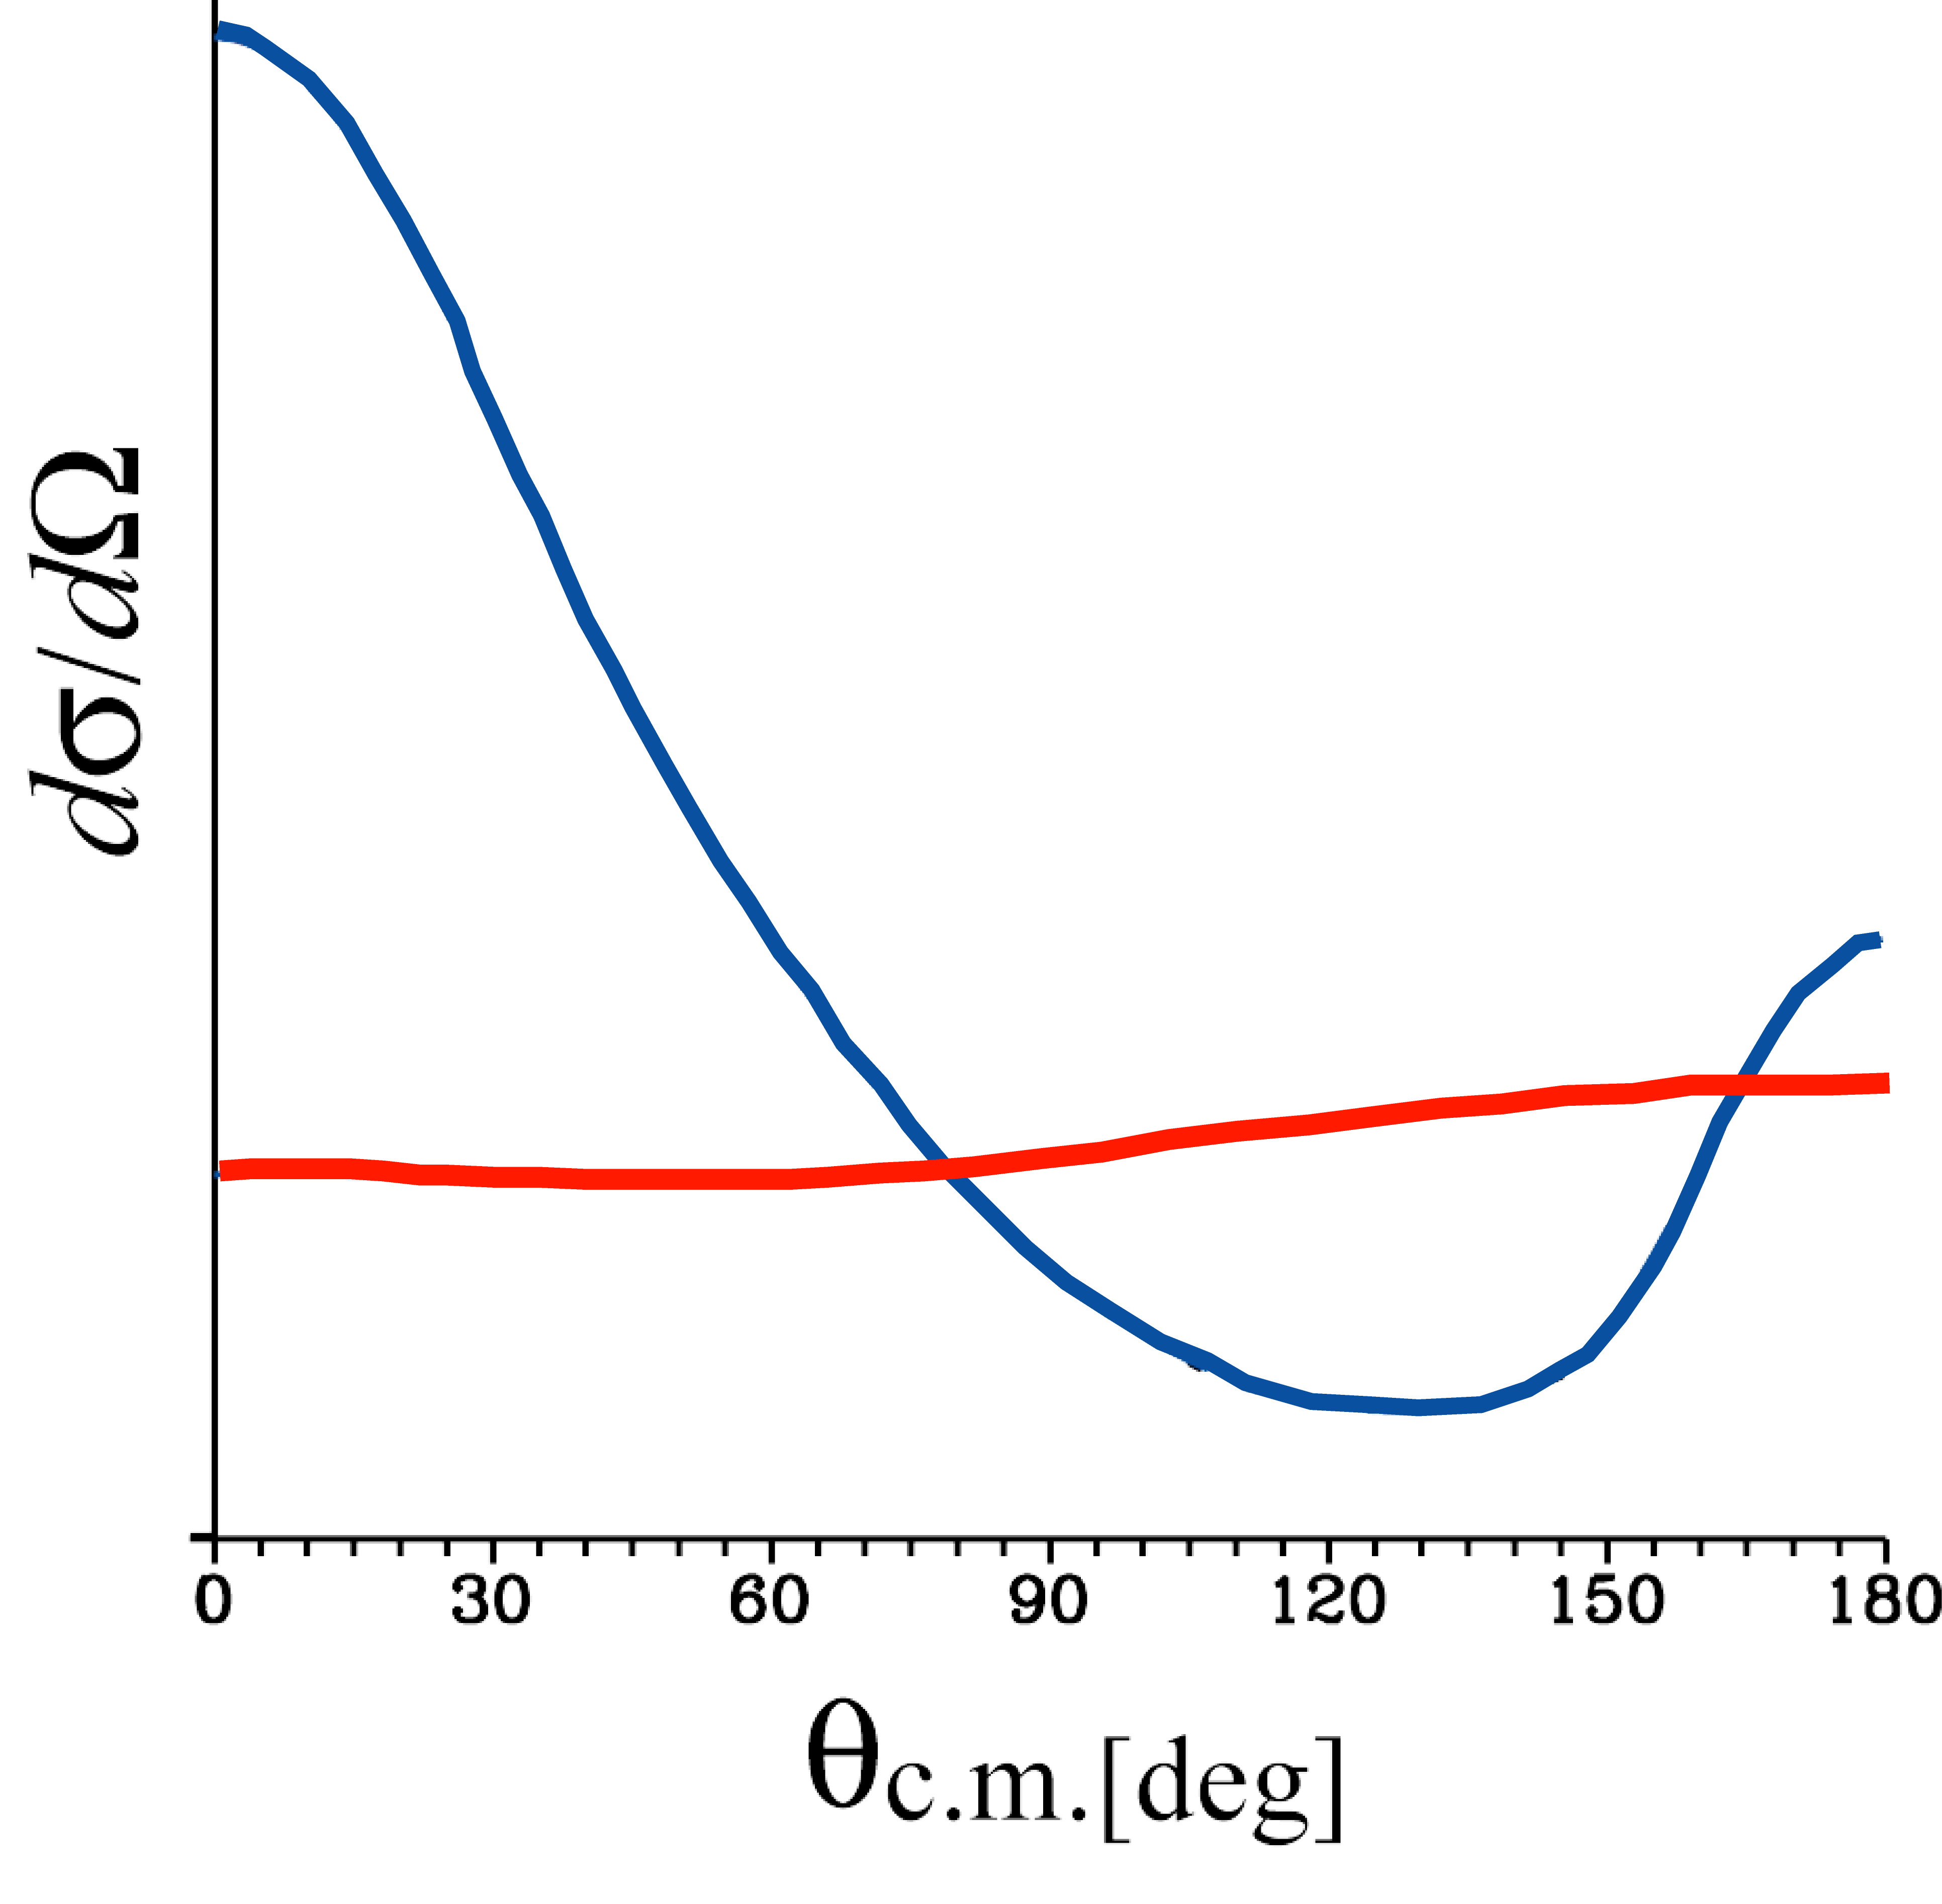
Where is the Hot Spot for 3NF Effects in Three Nucleon Scattering?
Predictions by H. Witala et al. (1998)
Cross Section minimum for Nd Scattering at 100-200 MeV/A
Low Energy
Nd scattering
Higher Energy
NN
direct term
3NF
NN
exchange term
Forward
Backward
3NF
3NF
q =0 ～ 4 fm⁻¹

Slide 4
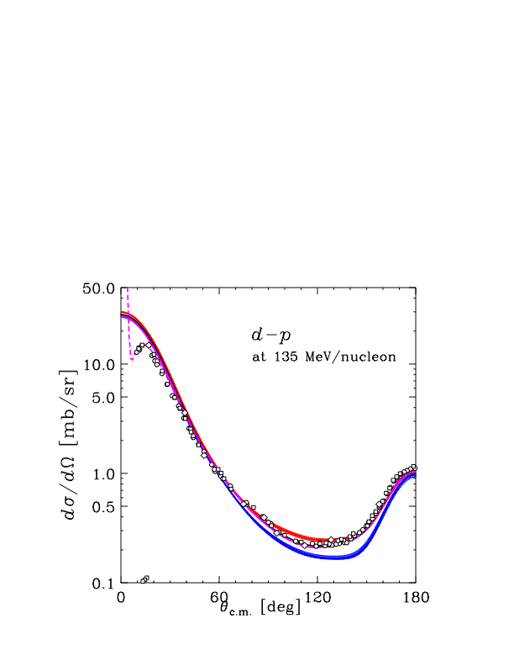
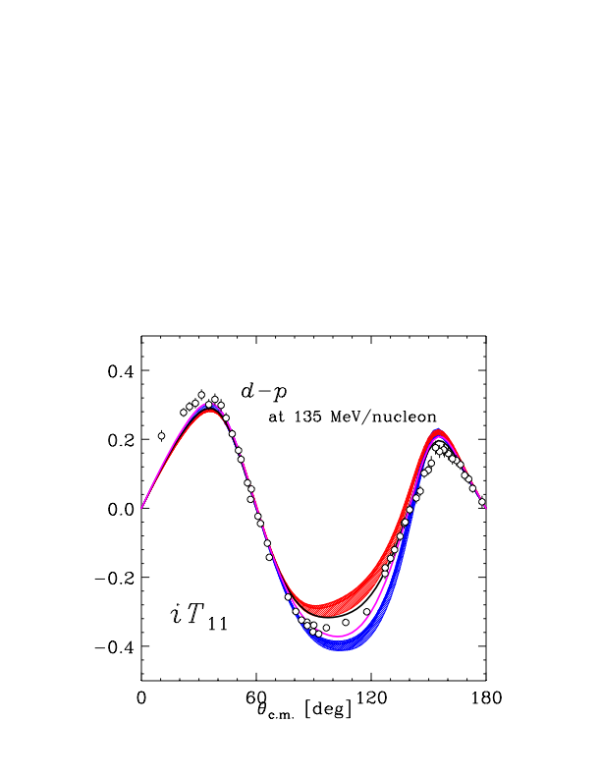
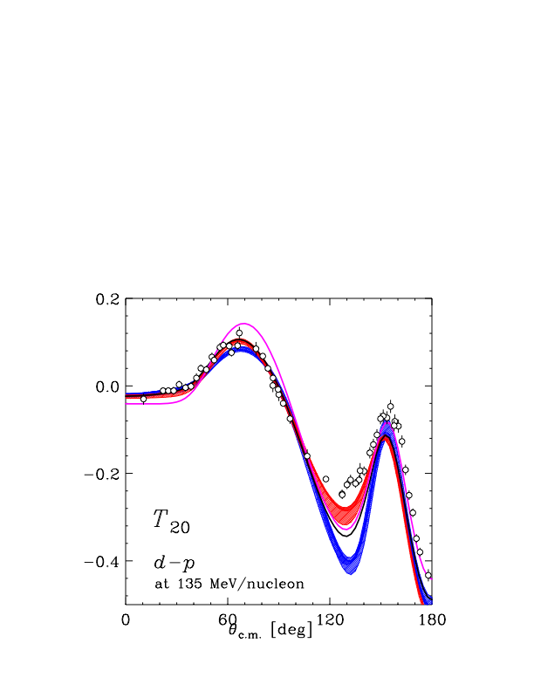
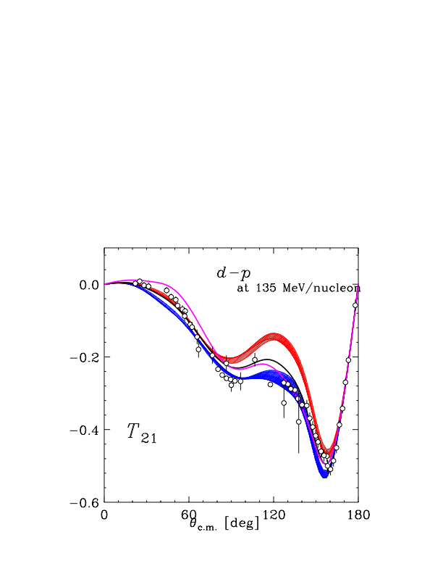
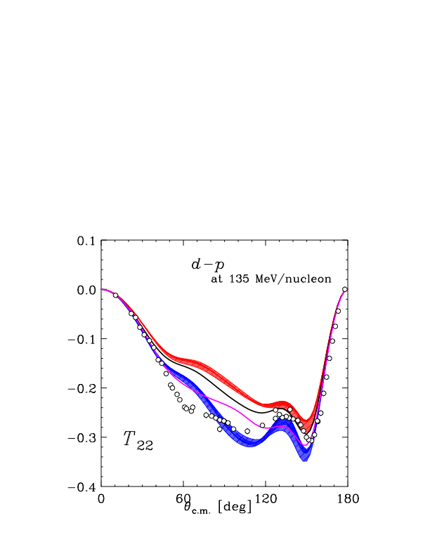
How to attack 3NF – 1st Step - d-p Elastic Scattering at 135 MeV/nucleon
@ RIKEN Accelerator Research Facility (RARF)
Cross Section : Good description by 2π-3NF
First Clear Signature of 3NFs in 3N scattering
Spin Observables : Insufficient descriptions by 2π-3NF
Defects of 3NF in Spin parts ??
K. S. et al., Phys. Rev. C 65, 034003 (2002).
K. S. et al., Phys. Rev. Lett. 95, 162301 (2005).
NN( CDBonn, AV18, Nijmegen I,II)
NN( CDBonn, AV18, Nijmegen I,II) + TM’99 3NF
NN( AV18 ) + Urbana IX 3NF
NN( CDBonn ) + Delta-isobar
NN( CDBonn ) + Delta-isobar + Coulomb

Slide 5
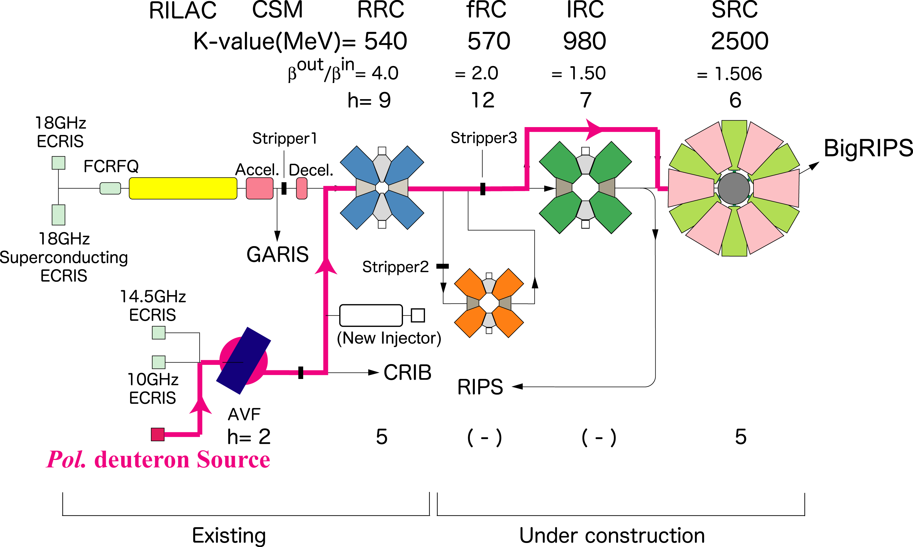
How to attack 3NF – Next Step - Few Nucleon Scattering with pol.d beams
@ RIKEN RI Beam Factory (RIBF)
RARF : AVF+RRC
Incident energy of deuteron :
65 – 135 MeV/nucleon
RIBF : AVF+RRC + SRC
Incident energy of deuteron :
170 - 400MeV/nucleon
First Experiment at RIBF
dp Elastic Scattering at 250 &300 MeV/nucleon
All deuteron analyzing powers
Wide Angular Range
High accuracy
Go to higher energies
- Effects of 3NFs are relatively enhanced.
- Theory : harder
Polarized Deuterons
- rich set of spin observables

Slide 6
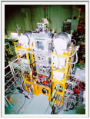
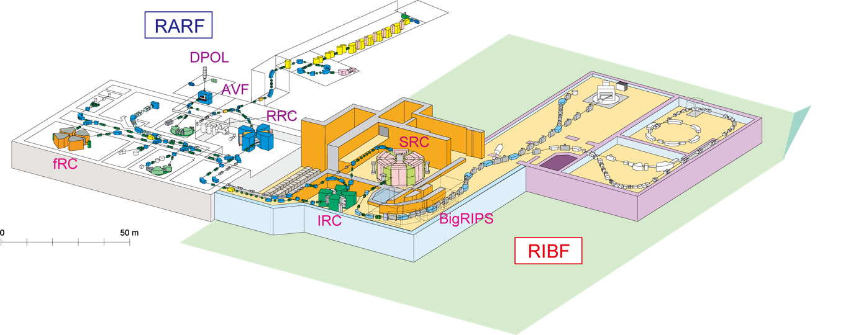
RIKEN RI Beam Factory (RIBF)
Polarized d beam was accelerated by the AVF+RRC+ the new cyclotron SRC up to 250 & 300 MeV/nucleon.
Spin axis of deuteron beam was rotated prior to acceleration.
Single turn extraction of beam was successfully obtained for all the cyclotrons.
Polarization amplitudes were maintained during acceleration.
Beam Polarization : 80% of theoretical maximum values
Spin axis of polarized d beams is freely controlled !
Polarized Ion Source
SRC
SMART
( - 2005)
Polarimeter
BigDpol

Slide 7
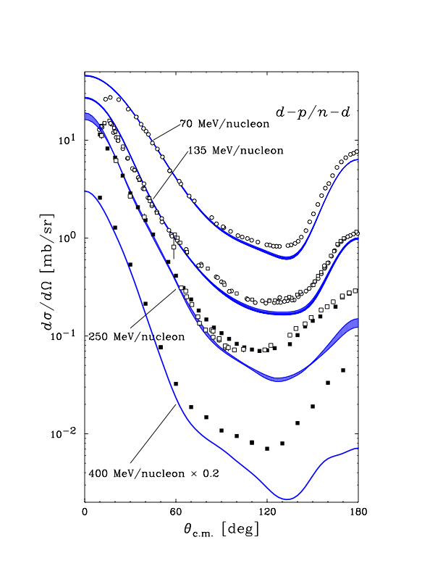
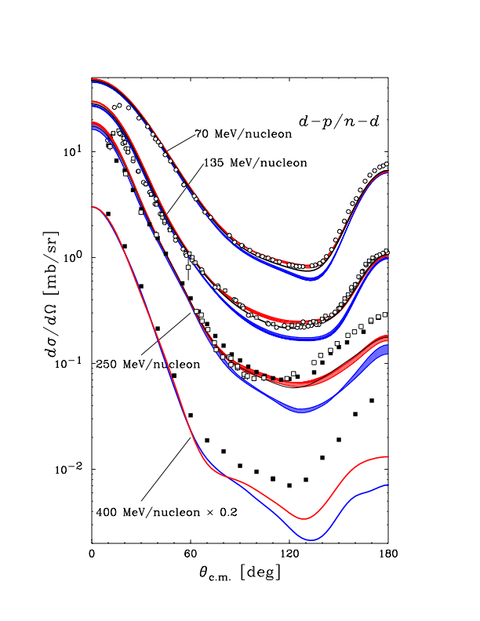
Differential Cross Section
at 70 - 400 MeV/nucleon
NN only
- Large discrepancy in the backward region
With 2π-3NF ?
- improve the agreement
- not enough at very backward
angles at higher energies

Slide 8
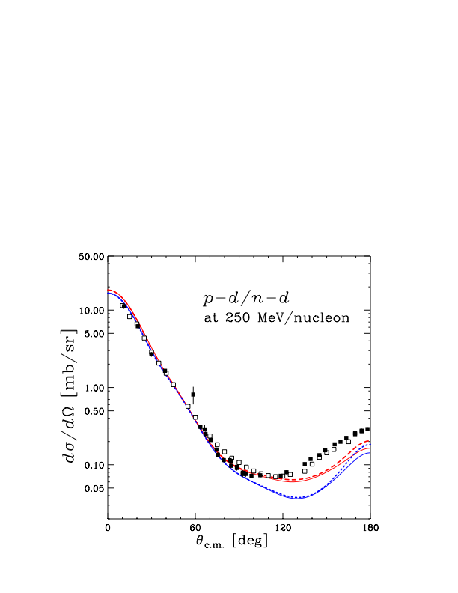
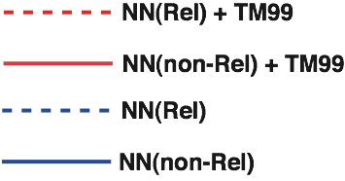
Differential Cross Section
at 70 - 400 MeV/nucleon
Relativistic Faddeev Calculations with TM’99 3NF
H. Witala et al, private communications
pd/nd @ 250 MeV
Relativistic effects are visible
at backward angles, but small.

Slide 9
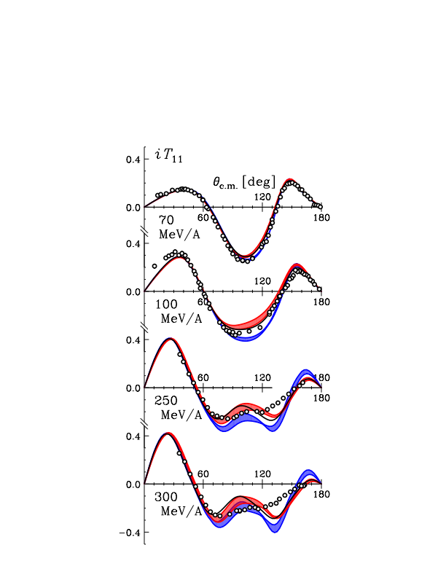
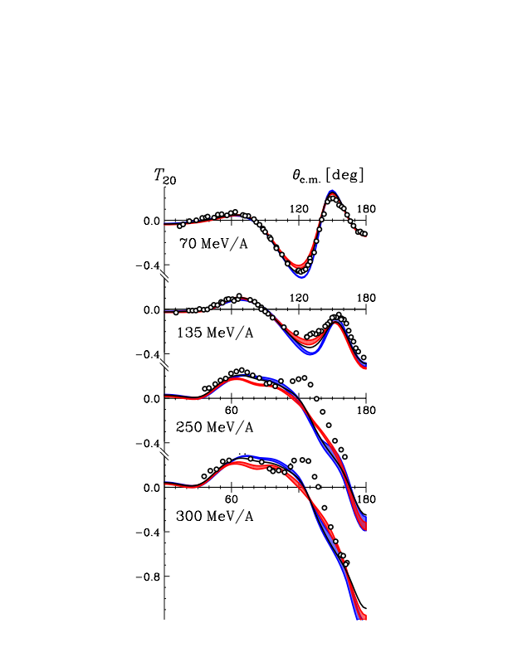
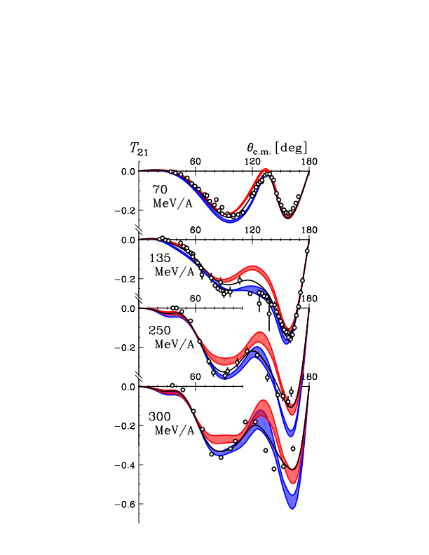
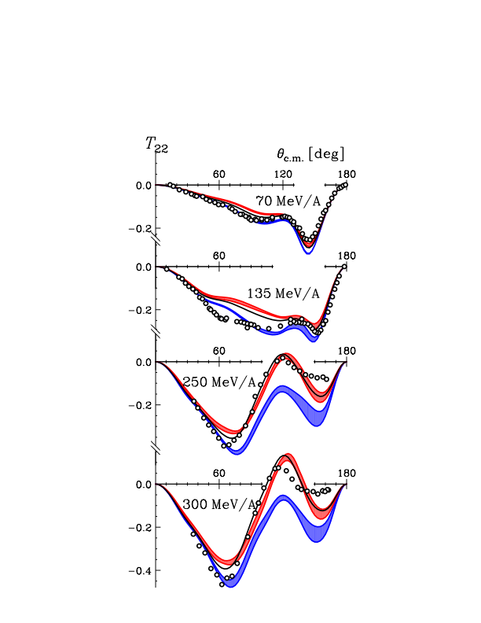
Deuteron Analyzing Powers at 70 - 300 MeV/nucleon
iT11
T20
T21
T22
135
MeV/A

Slide 10
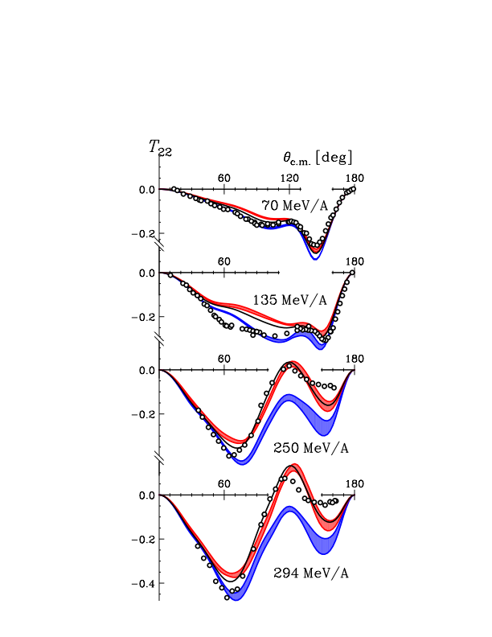
Deuteron Analyzing Powers at 70 - 300 MeV/nucleon
iT11
T22
NN only
- Large discrepancy in the backward region
+ 2π3NF at 〜 100 MeV/A
- results are NOT always
similar to the cross section.
+ 2π3NF at 〜 250 MeV/A
- improve the agreement
- not enough
at very backward angles
→similar to the cross section
K.S. et al., Phys. Rev. C 83,061001 (2011)

Slide 11
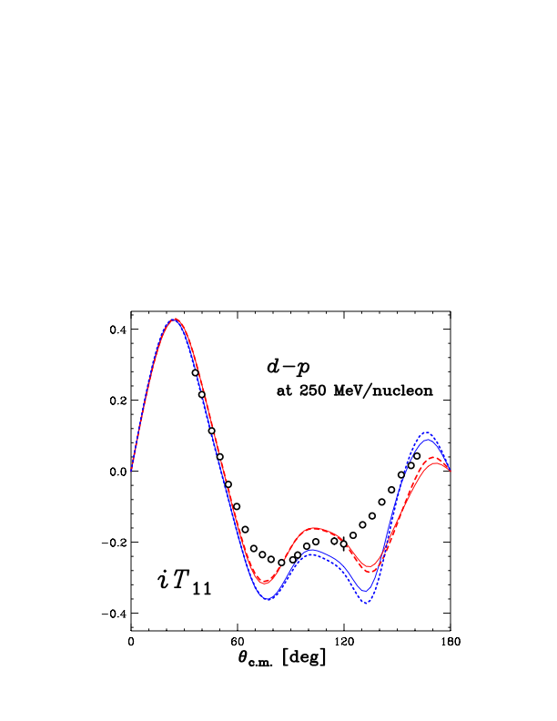
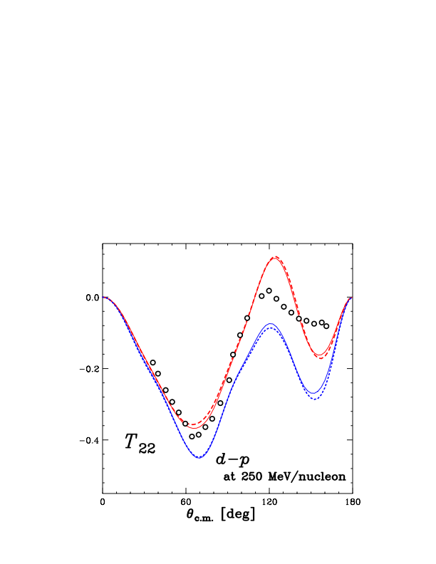
Deuteron Analyzing Powers
Relativistic Faddeev Calculations with TM’99 3NF
H. Witala et al, private communications
dp @ 250 MeV
iT11
T22
Small relativistic effects

Slide 12
Deuteron Analyzing Powers
Relativistic Faddeev Calculations with TM’99 3NF
H. Witala et al, private communications
dp @ 250 MeV
iT11
T22
Small relativistic effects

Slide 13
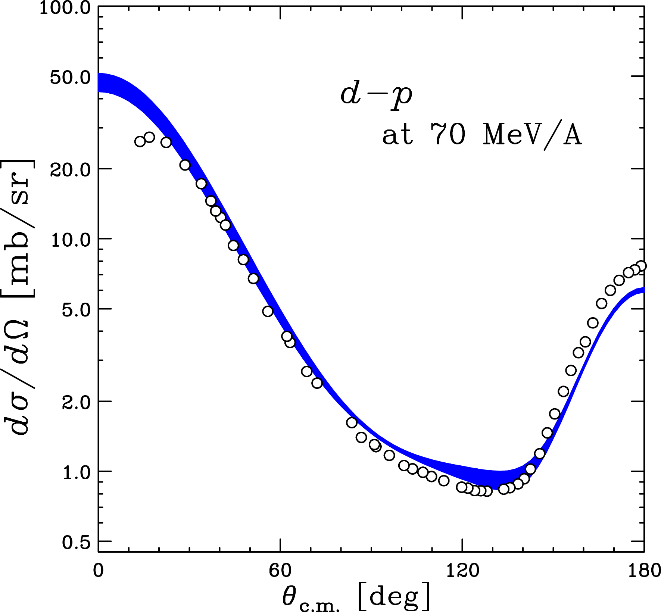
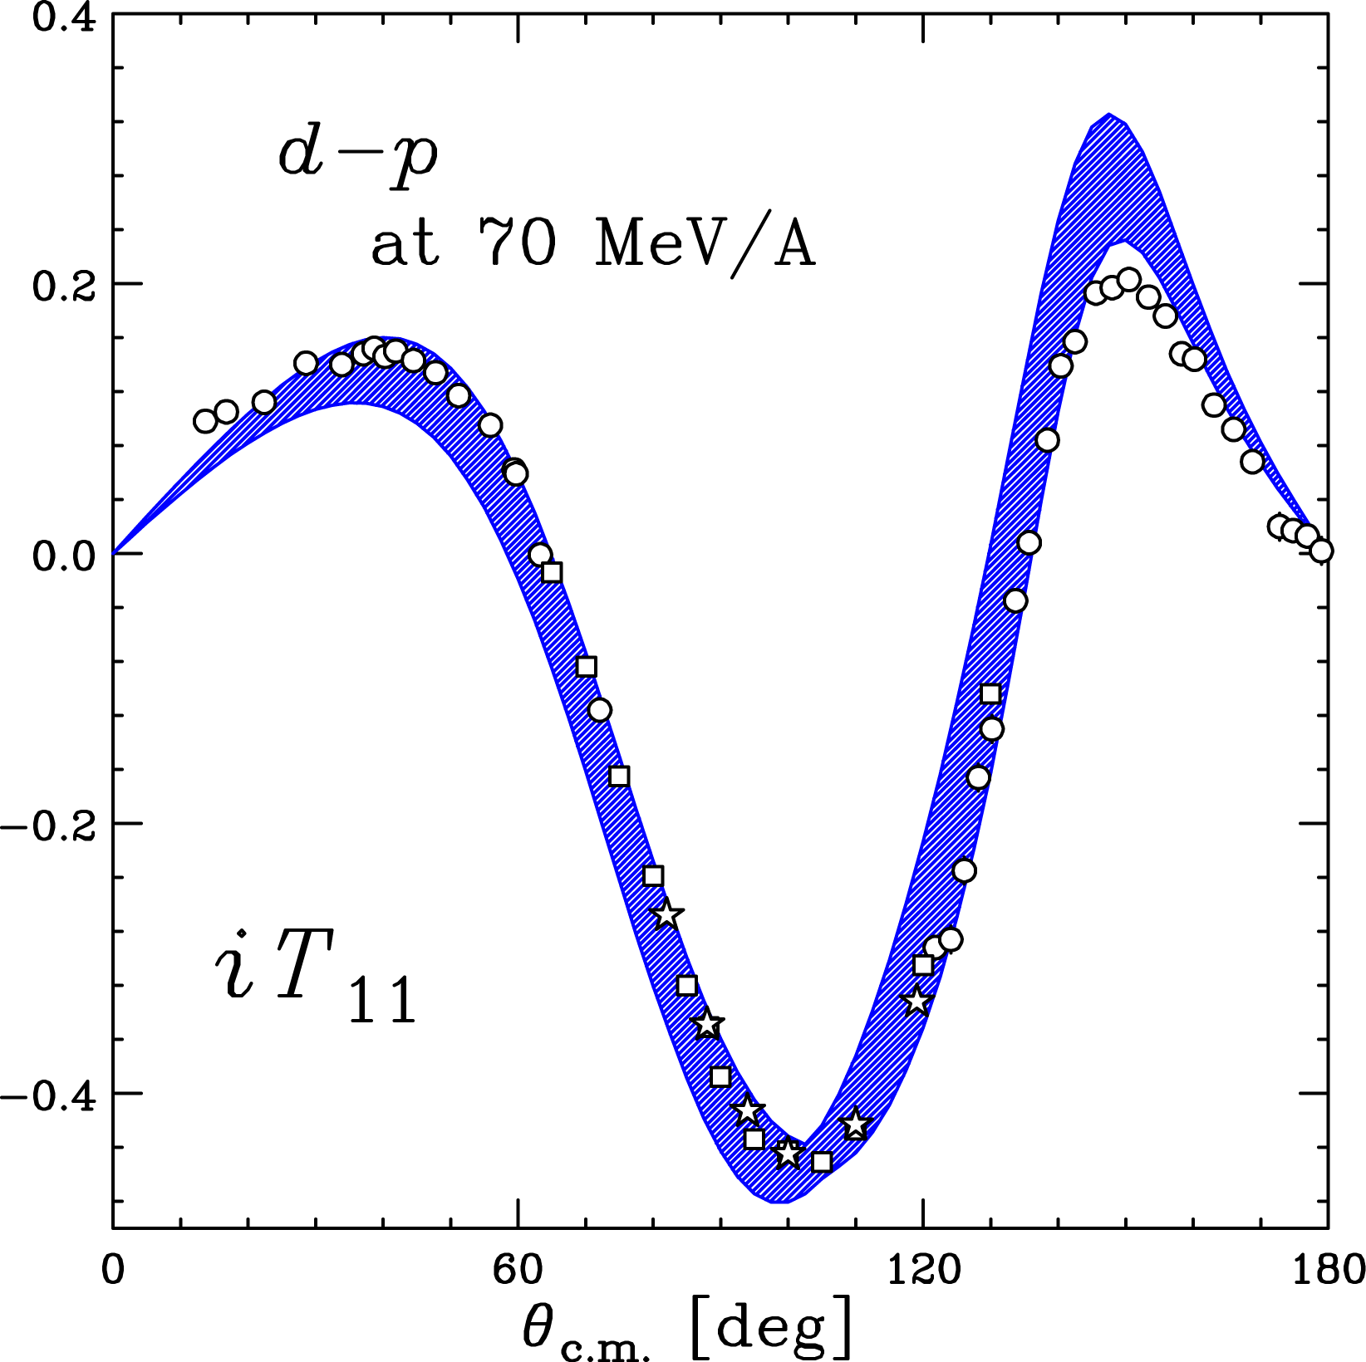
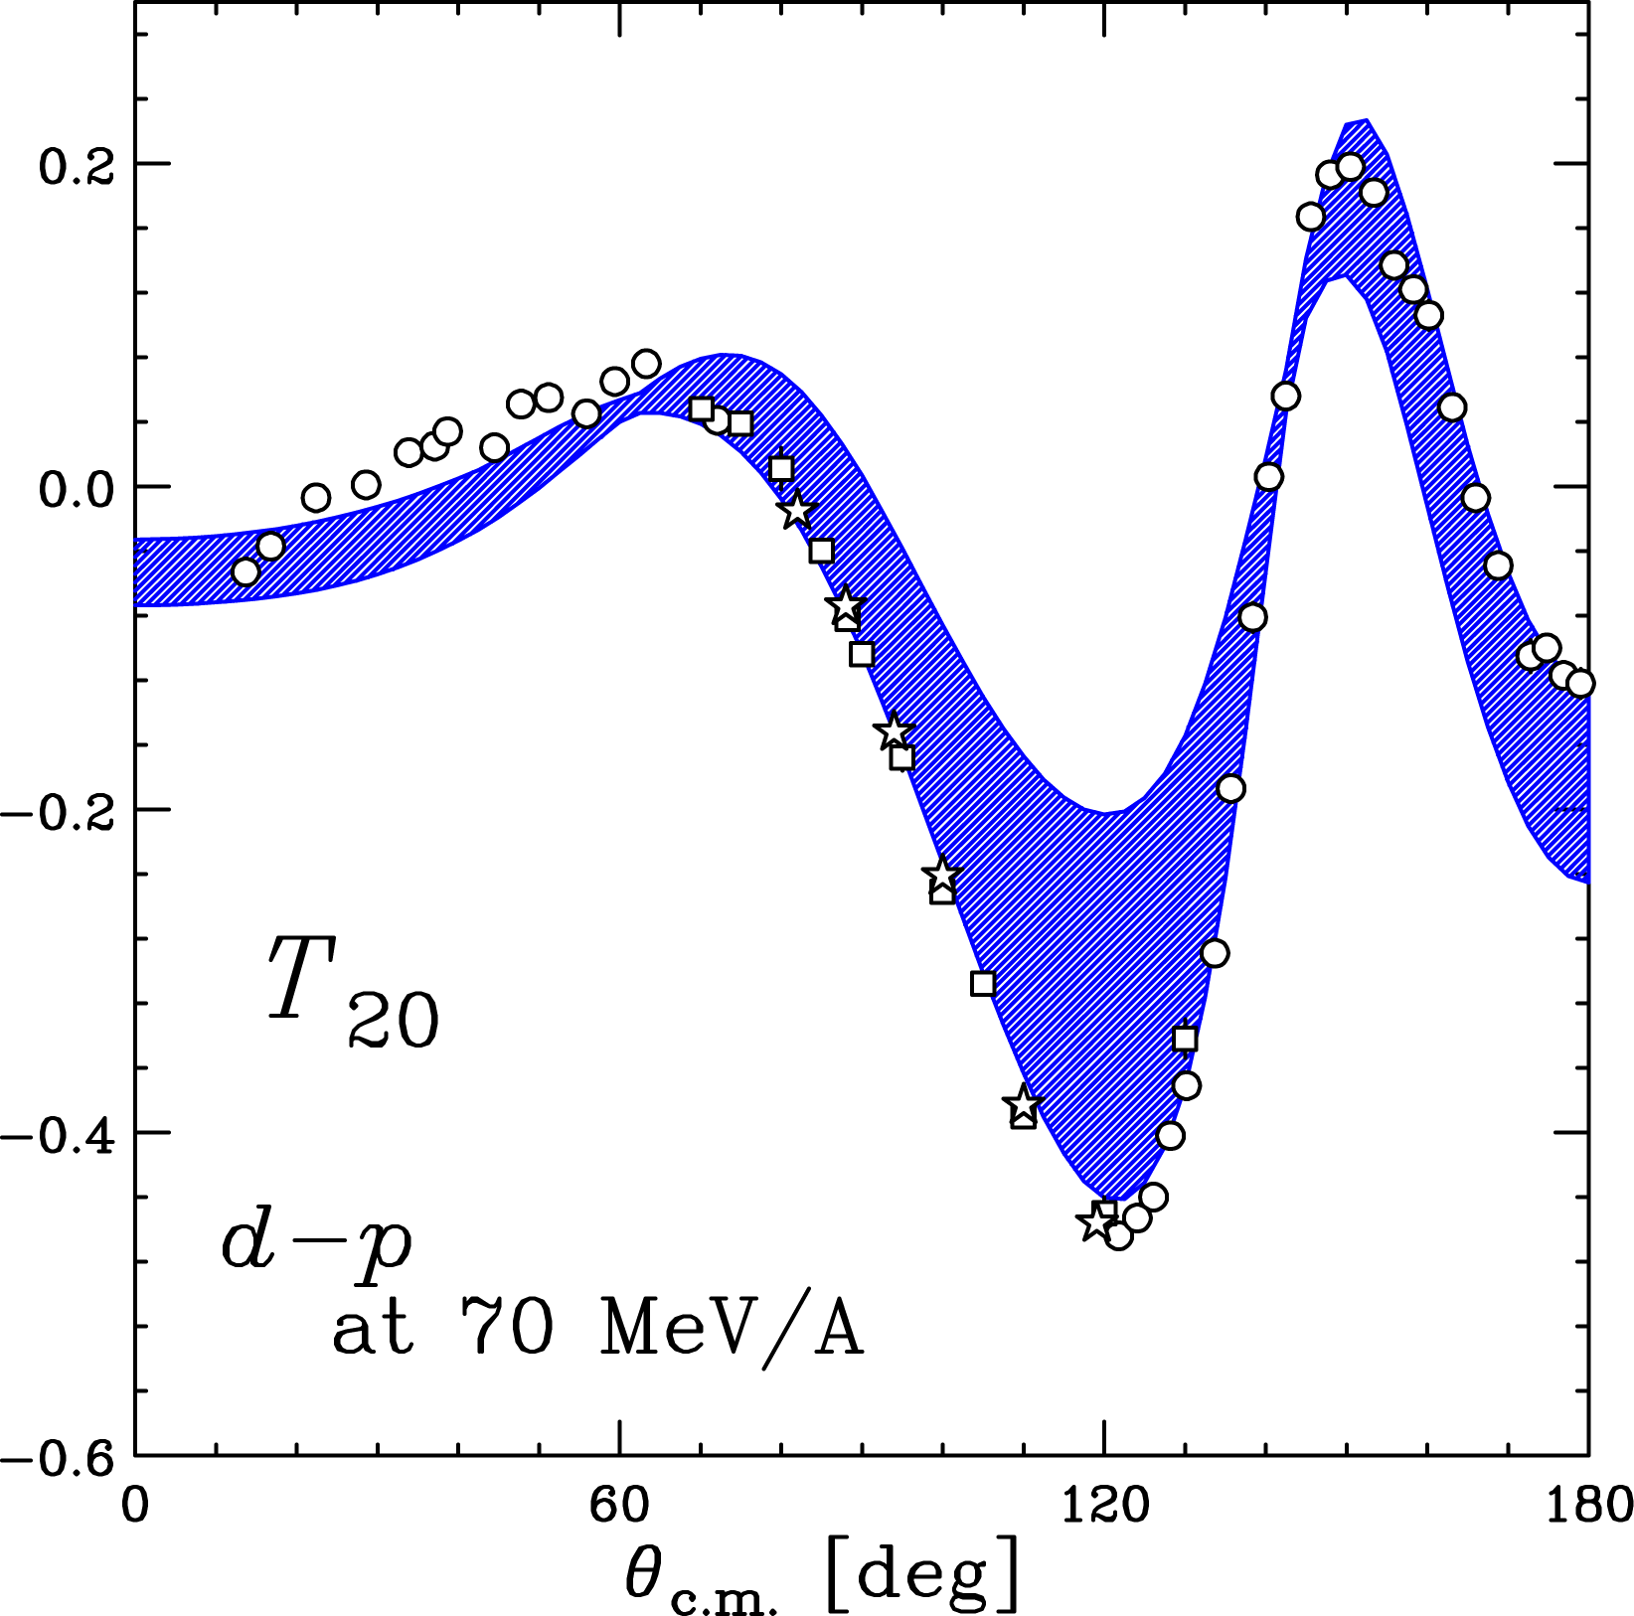
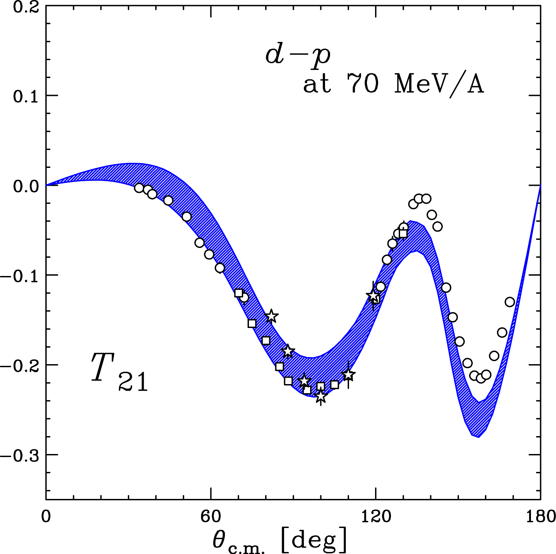
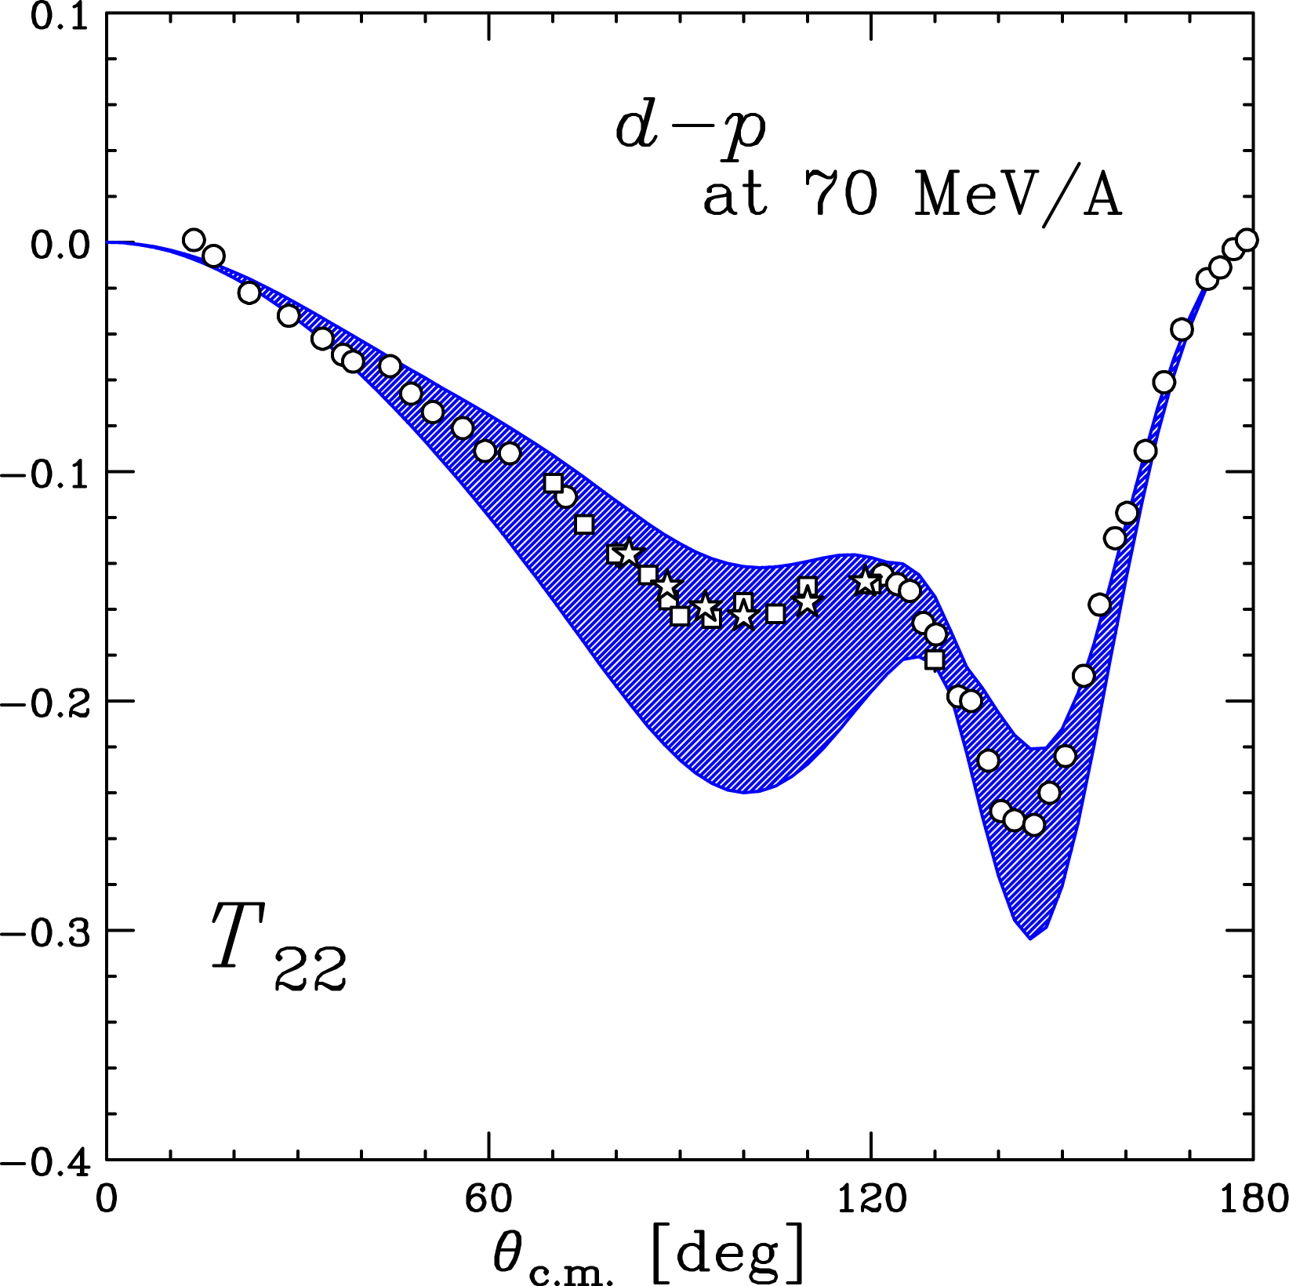
How does Chiral EFT pot. describe the Nd elastic scattering ?
Various types of 3NFs, including 2π3NF, appear in N²LO, N³LO.
Theory in Progress : up to N³LO (NN + NNN) for higher energies
So far calc. based on χEFT pot. is available below 100 MeV/nucleon.
3NFs in N²LO
d-p at 70 MeV/nucleon
Calc. with χEFT Pot. (N2LO)
by E. Epelbaum et al.
Notes:
In view of studying properties of 3NFs it is interesting to see how cEFT pot describe ...

Slide 14
Summary & Outlook
Nucleon-Deuteron Scattering
is a good probe to investigate the dynamics of 3NFs.
- Momentum & Spin dependence - . For iso-spin, T=1/2 only.
Precise data of dσ/dΩ and many spin observables at 65 - 300 MeV/nucleon
Cross Sections : 3NFs are clearly needed in Elastic Scattering.
Spin Observables : not always described by adding 2π-exchange 3NFs
New Data from RIBF at 250 & 300 MeV : serious discrepancy in backward angles
New Challenge to be solved
Next Step
Energy Dependence for Pol. Transfer and /or Spin Correlation Coefficients
for Elastic Nd Scattering : Natural extension of 3NF study in Elastic scatt.
Nd Breakup Experiments : Study of Relativistic Effects
Four Nucleon Scattering : from Few to Many & Iso-spin dependence

Slide 15
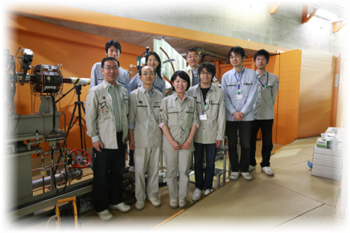
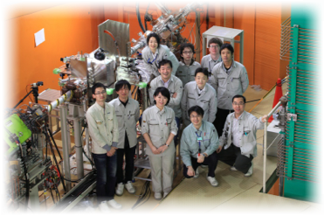
RIBF pol.d beam experiment Gr. (2009〜)
Collaboration
Tohoku University
K. Sekiguchi, J. Miyazaki, Y. Wada, T. Taguchi, U. Gebauer, K. Takahashi, T. Mashiko
RIKEN Nishina Center
N. Sakamoto, H. Sakai, T. Uesaka, M. Sasano, M. Dozono, Y. Shimizu
CNS, University of Tokyo
K. Yako, R. Tang, S. Kawase, Y. Kubota, C.S. Lee,
RCNP, Osaka University
H. Okamura, K. Miki
Kyushu University
T. Wakasa, S. Sakaguchi
Miyazaki University
Y. Maeda, T. Saito

