Slide 1
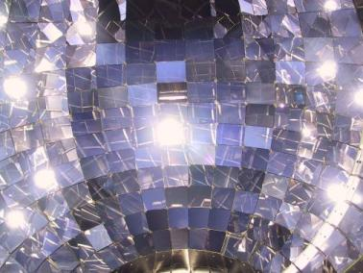
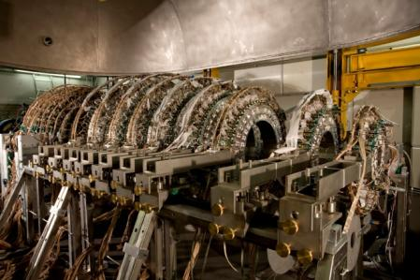


Transfer reactions on light exotic nuclei with CHIMERA detector at LNS
G.Cardella
for the
EXOCHIM collaboration

Slide 2
Outline
Short presentation of the CHIMERA detector and LNS fragmentation beams
Can one get precise angular distributions without extremely segmented detectors?
Test case ¹⁰Be+p→⁹Be+d
Extension of the method using coincidence γ-ray
Conclusions and perspectives
G.Cardella inpc2013

Slide 3
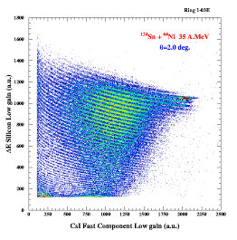
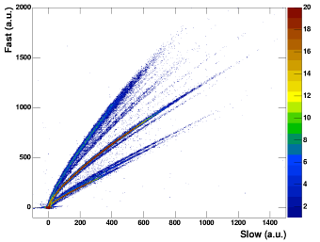

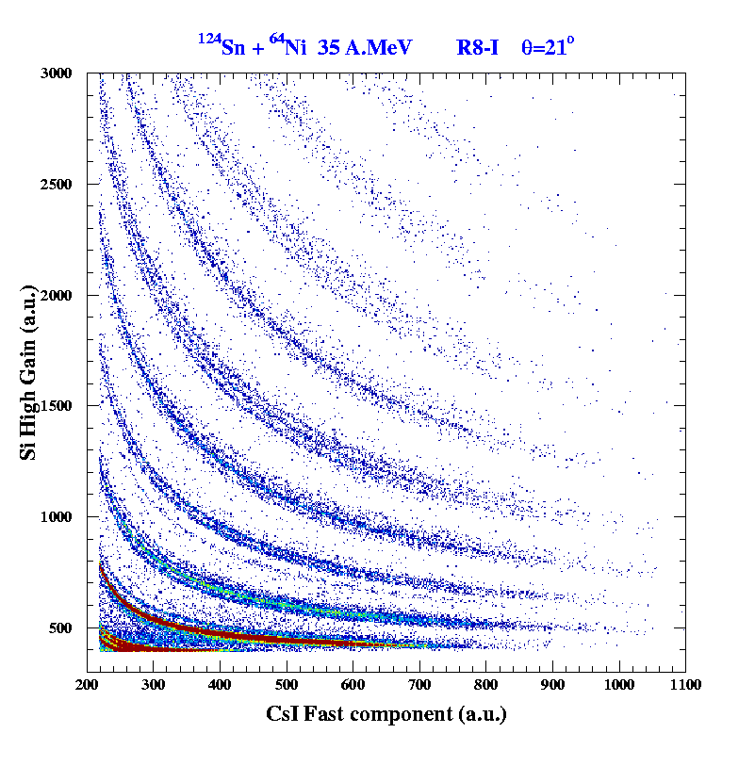
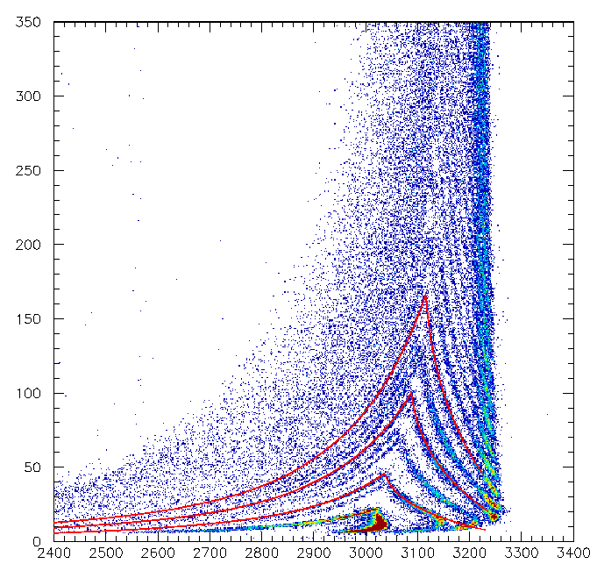
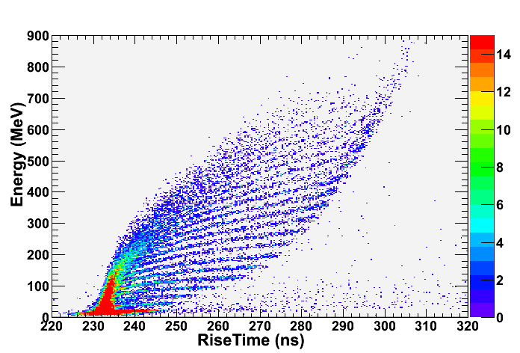
The CHIMERA detector : particle identification methods
CsI(Tl)
PSD – CsI
Isotopic identification up to Berillium
ΔE-E Si-Csi
Charge for particles punching trough silicon
1192
Be
Li
Si
a
Z=50
HI
³He
α
t
γ
d
p
Δθ=8°
ΔE-E
isotopic identification up to Z=12
Δθ<1°
ΔE-ToF
mass for particles stopped in silicon
Z=6
PSD – Si
charge for particles stopped in silicon
Z=16
Z=10
Z=6
G.Cardella inpc2013

Slide 4
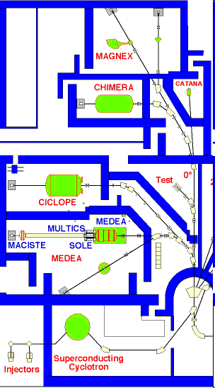

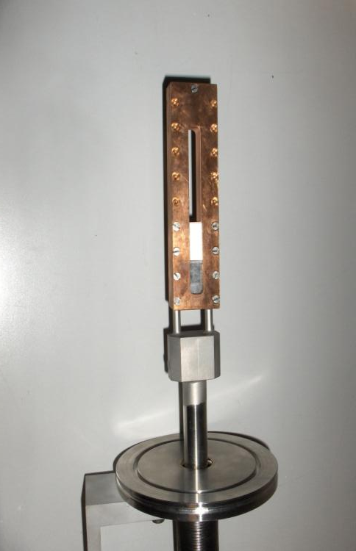
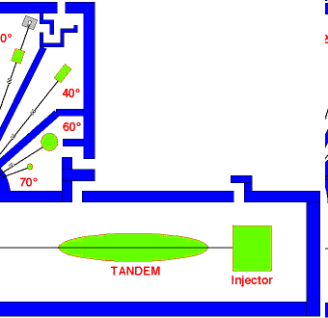
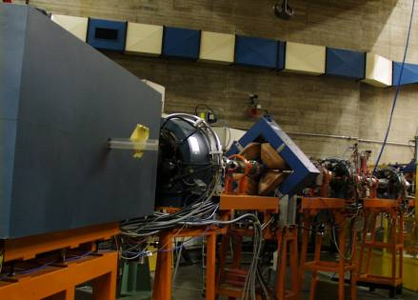
Fragmentation beams at INFN-LNS - Catania
Reaction target and fragment detection
Two 45° dipoles of the beam line do the fragment selection
Movable production Target water cooled
G.Cardella inpc2013

Slide 5
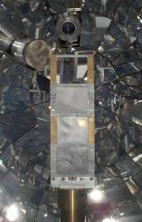

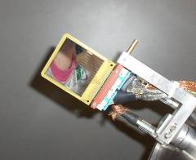
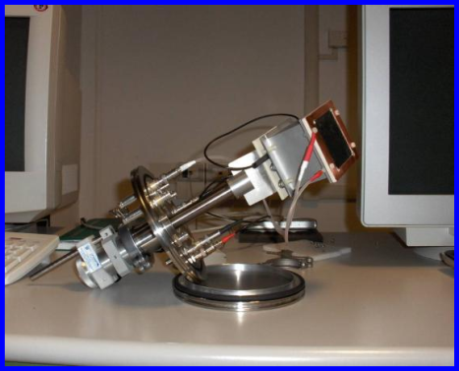
-Neutron transfer reactions near halo nuclei -
We study direct reactions using light exotic nuclei impinging on p, d targets useful to investigate on various structure effects ( see Alexandre Obertelli this morning )
EVENT SELECTION performed with kinematic coincidences – measuring in binary/ternary reactions all reaction partners we clean the events
Only charge identification in forward rings due to low gain preamplifiers
Tagged beam
¹¹Be
n
¹⁰Be
p
p
Target p/d
Tagging system
G.Cardella inpc2013
Notes:
5

Slide 6
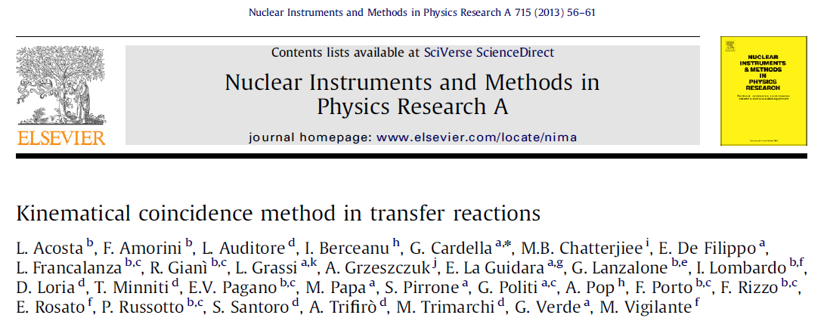
– Advantages of binary kinematics : the ¹⁰Be+p→⁹Be+d case -
The lab energy of the detected particle determines the CM emission angle
57 AMeV
Due to the relatively good energy resolution we can obtain an angular distribution with much better resolution than the one determined by the size of the detectors
G.Cardella inpc2013

Slide 7
– STEPS of the analysis ¹⁰Be+p→⁹Be+d
We select only complete events with two detected particles and with total detected charge Ztot=Zbeam+1
We can plot the Δφ angle between the two coincidence detectors – due to momentum conservation Δφ must be 180°
Δφ width due to the finite opening of the detectors
We also clean the events putting constraints on the total detected energy
must be equal to the beam energy 580 MeV + Q_{value} (-4.58 MeV)
Notwithstanding the scarce total energy resolution we see only GS events
⁹Be*→ n+α+α
S_{n}=1.66 MeV

Slide 8
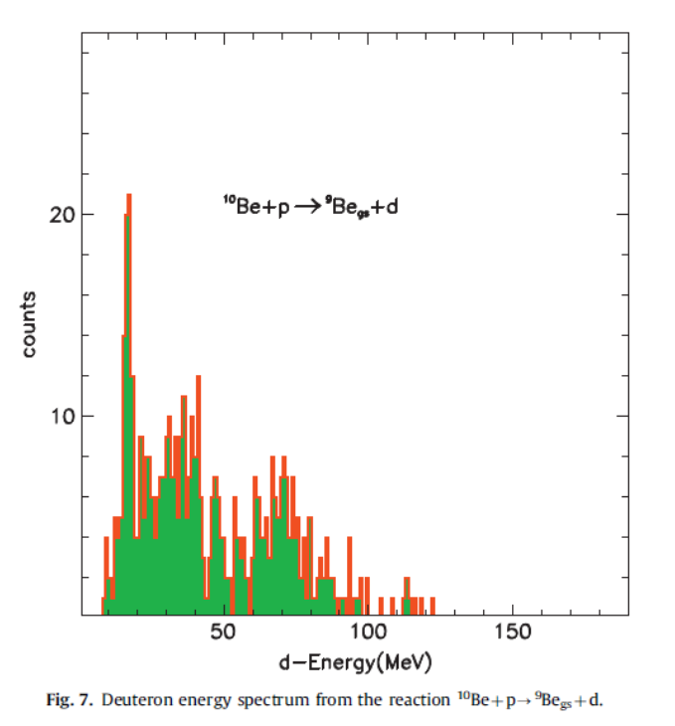
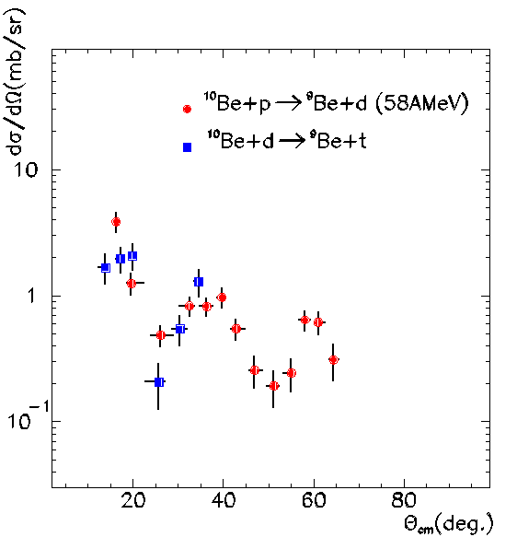
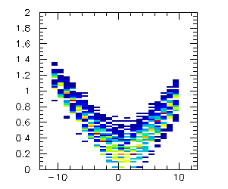
– The ¹⁰Be+p→⁹Be_{g.s.}+ d angular distribution -
From the analysis we get the deuteron energy spectrum
Using kinematics we can convert it from dN/dE → dN/dθ
θ(⁹Be)_{lab}
θ_{beam}
DSSSD-tag
DSSSD-traj
target
θ_{beam}
After efficiency correction taking into account few rings missing for a GSI experiment ( see P.Russotto C6 on Thursday) we get the angular distributions
strip
Note that angular distributions are automatically corrected for the fragmentation beam angular spread
G.Cardella inpc2013

Slide 9
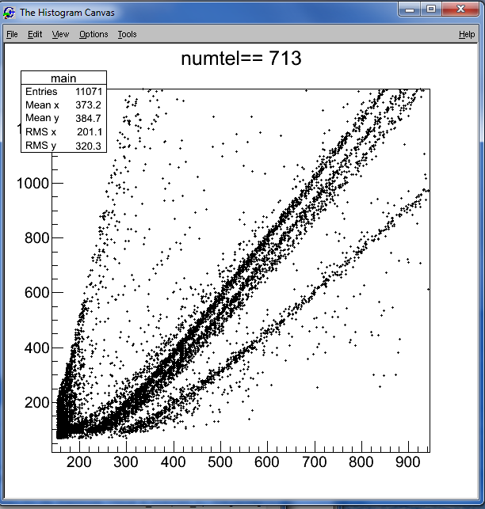
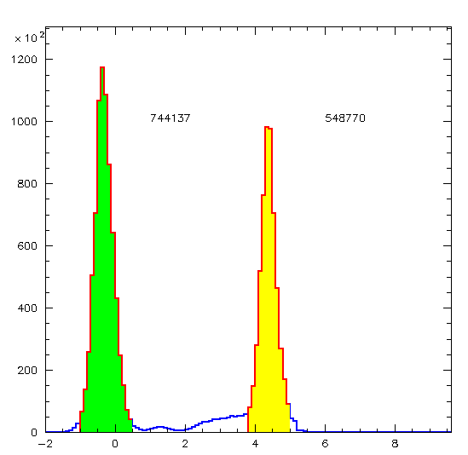
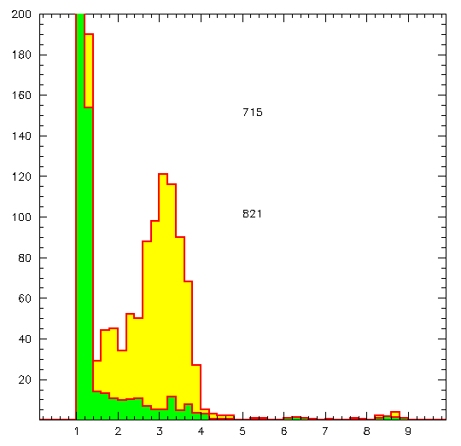
– Excited levels - γ-ray tagging? -
γ-ray tagging could be a solution to extend the method in case of excited levels -
How to combine efficient γ-ray detectors and CHIMERA?
d
t
p
CsI(Tl) have a large efficiency for gamma ray detection
α
γ
p + ¹²C → p + ¹²C (12 MeV)
The 4.44 MeV γ can be seen quite well in most detectors
We have measured the γ-ray signals from CsI(tl) using proton beam on carbon target and looking at excitation and decay of the 4.44 MeV ¹²C first excited state
E* (MeV)
E_{prot} (MeV)
G.Cardella inpc2013

Slide 10
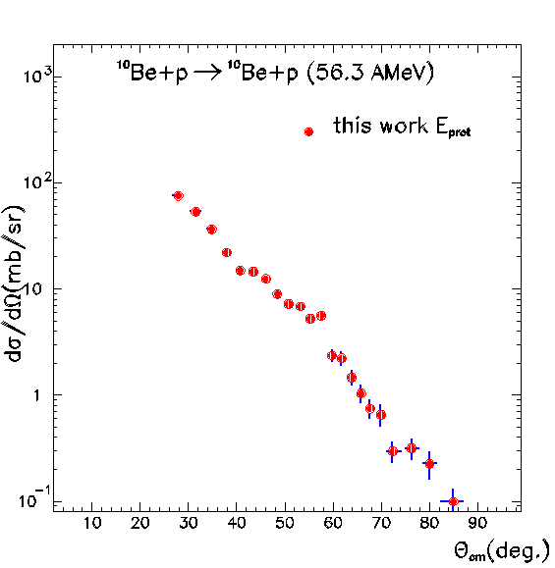
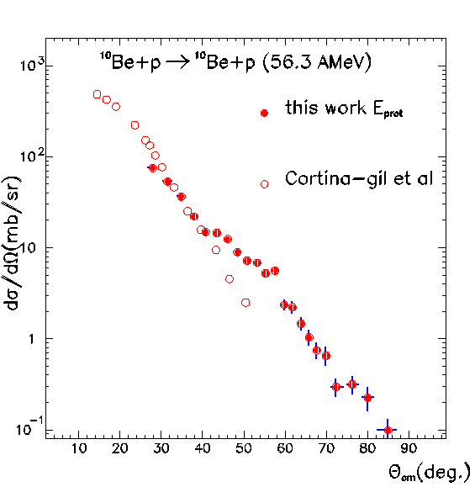
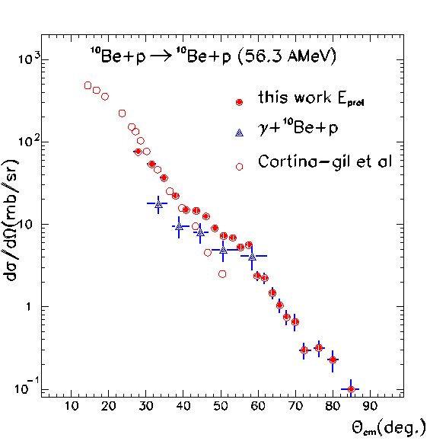
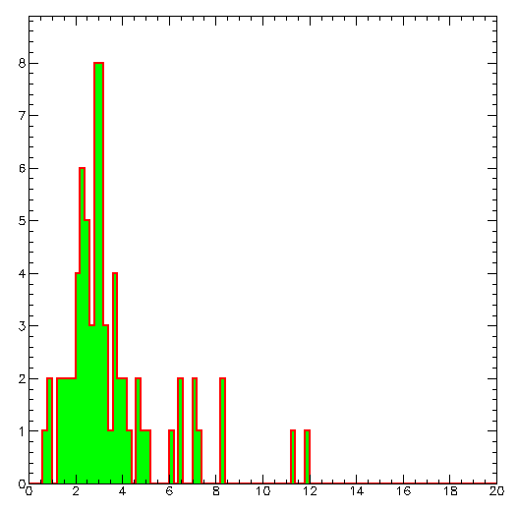
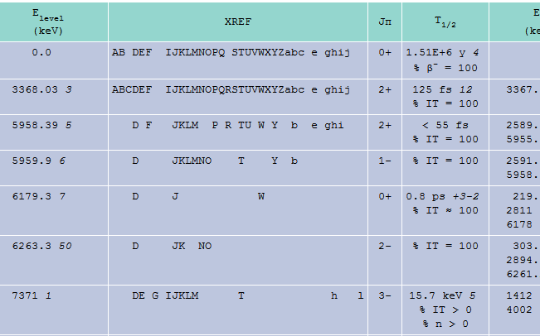
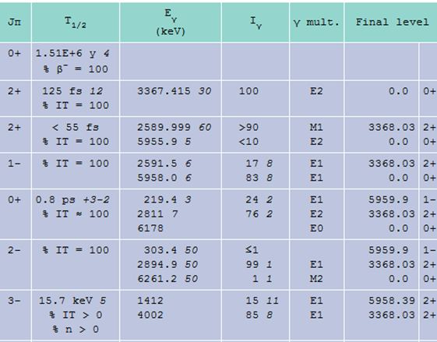
– Using the γ-ray tagging: the ¹⁰Be+p →¹⁰Be+p case -
The angular distribution we measure for this channel shows a slope change around 40°
This change of slope is not seen in previous data measured by Cortina-Gil et al Phys.Lett.b 401(1997)9
The proton angular distribution measured in coincidence with γ-rays explains the change of slope and the deviation from Cortina-Gil data
γ-ray from ¹⁰Be+p→¹⁰Be*+p
preliminary
The γ-ray spectrum measured is what we expect from ¹⁰Be* excited states decay
Eγ (MeV prot eq.)
G.Cardella inpc2013

Slide 11
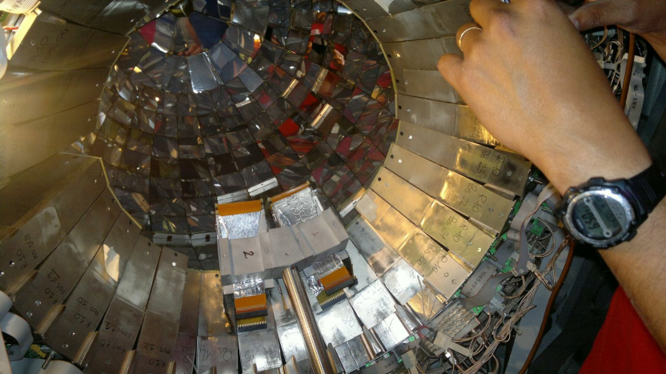
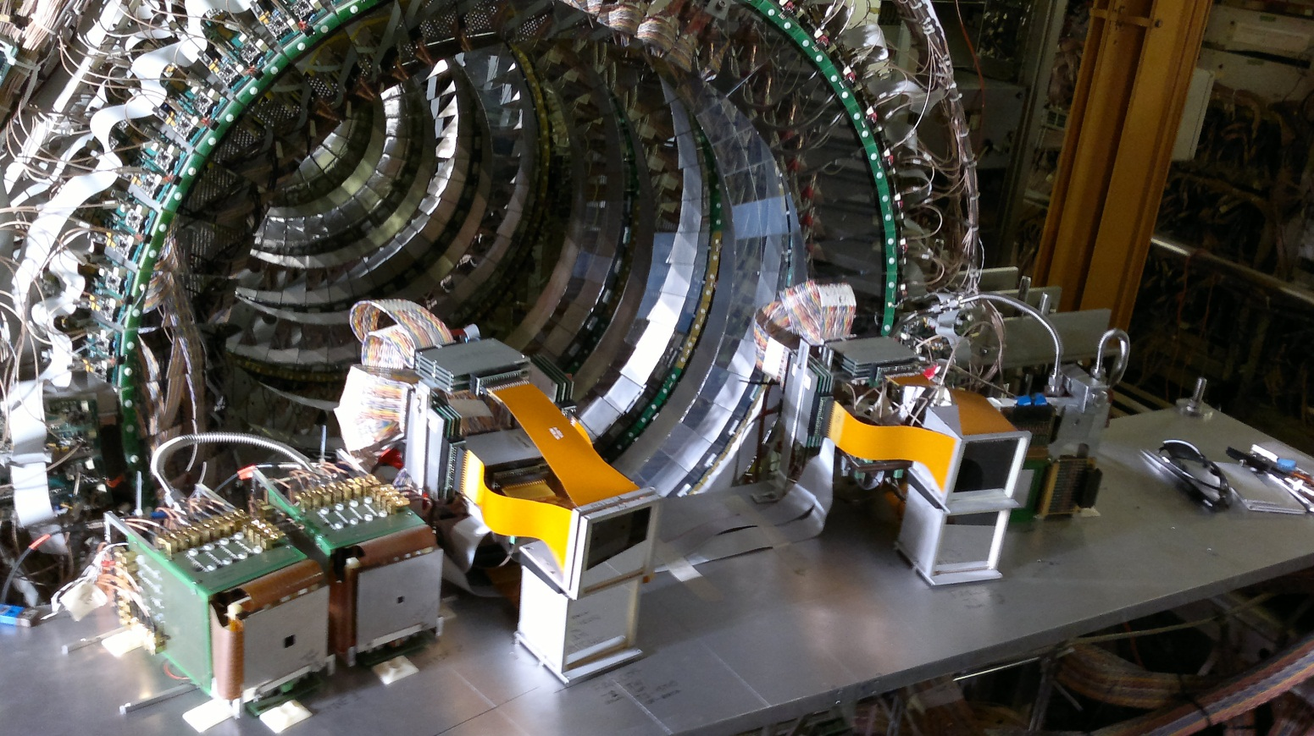
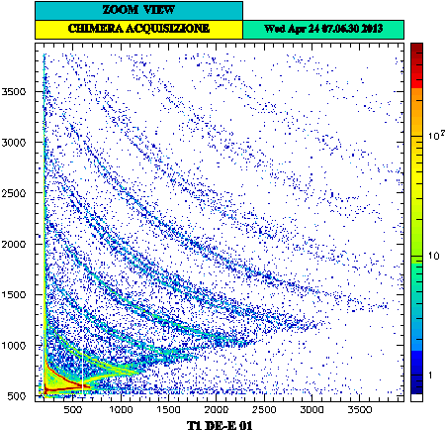
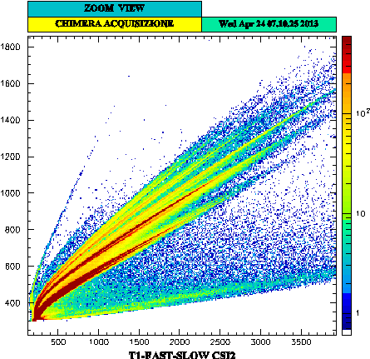
Future improvement : FARCOS as forward angle spectrometer
New triple telescopes Si-Si-CsI
First stage 32x32 strip 6.2x6.2cm² 300 μm DSSSD
Second stage 32x32 strip 1500 6.2x6.2cm² μm DSSSD
Third stage 4 CsI(tl) 3.1x3.1 cm² photodiode readout 6 cm thick
First test-experiment coupled with Chimera
April 2013 see E.De Flippo next Thursday C6 and Acosta poster Nf001
First test stand-alone
July - 2012
Improved CsI(Tl) energy resolution due to corrections for the particle detection position
Improved energy calibrations/resolution also due to the two stages of silicon detectors
Improved φ granularity and isotopic identification
G.Cardella inpc2013

Slide 12
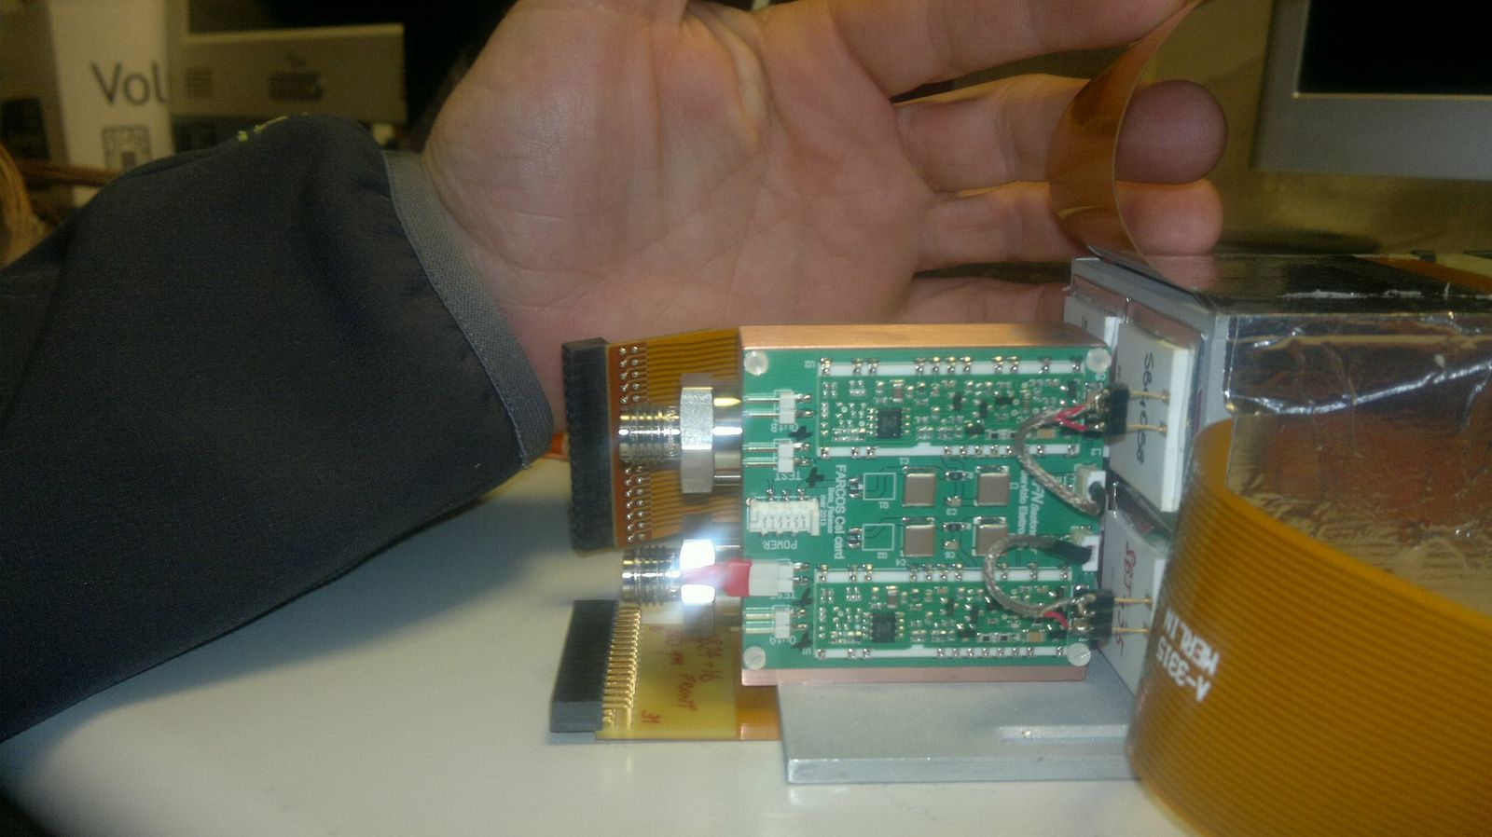
Conclusions and perspectives
Using cocktail of neutron rich beams with the CHIMERA detector we are able to extract angular distributions for many reaction channels searching for structure effects on cross sections
The 4π detection efficiency is very useful and allows extensive use of the kinematical coincidence technique
We can also detect γ-rays with our CsI(Tl) detectors in order to tag excited levels
For the future experiments we are working to improve our detection capabilities and resolutions also coupling CHIMERA to a new high resolution strip telescope array FARCOS and to neutron detectors
G.Cardella inpc2013

Slide 13
I wish to thank all my collaborators
L.Acosta¹, F.Amorini^{1,3}, A.Anzalone¹, L.Auditore⁴, I.Berceanu⁹, G.C.², M.B.Chatterjee¹⁰, E.De Filippo², L.Francalanza^{1,3}, S.Gianì^{1,3}, L.Grassi^{2,3}, E.La Guidara^{2,5}, G.Lanzalone^{1,6}, I.Lombardo⁸, D.Loria⁴, E.Morgana⁴, T.Minniti⁴, A.Pagano², E.V.Pagano^{1,3}, M.Papa², S.Pirrone², G.Politi^{2,3}, A.Pop⁹, F.Porto^{1,3}, F.Rizzo^{1,3}, E.Rosato⁸, P.Russotto^{2,3}, S.Santoro⁴, A.Trifirò⁴, M.Trimarchì⁴, G.Verde², M.Vigilante⁸
1) INFN Laboratori Nazionali del Sud, Catania, Italy
2) INFN, Sezione di Catania, Catania, Italy
3) Dipartimento di Fisica e Astronomia Università di Catania, Italy
4) INFN gruppo collegato di Messina & Dipartimento di Fisica e Astronomia Università di Messina, Italy
5) Centro Siciliano di Fisica Nucleare e Struttura della Materia, Italy
6) Università Kore di Enna, Enna, Italy
7) INFN Sezione di Milano & Dipartimento di Fisica e Astronomia Università di Milano, Italy
8) INFN Sezione di Napoli & Dipartimento di Fisica e Astronomia Università di Napoli, Italy
9) Institute for Physics and Nuclear Engineering, Bucharest, Romania
10) Saha Institute of Nuclear Physics, Kolkata, India
G.Cardella inpc2013

Slide 14
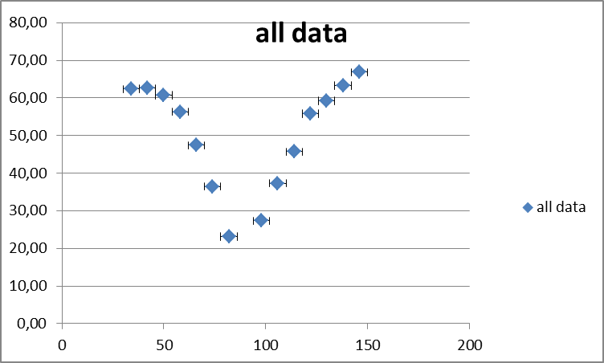
– Can I see excited channels using γ-ray tagging? -
Can we see γ-rays with the CHIMERA telescopes? – CsI(Tl) have a large efficiency for gamma ray detection
d
t
p
A simple check can be done using data on proton calibration beams taken with carbon targets looking to excitation and decay of the 4.44 MeV ¹²C level
α
γ
p + ¹²C → p + ¹²C (12 MeV)
The 4.44 MeV γ can be seen quite well in most detectors
We are also able to measure angular distributions of such γ-rays correcting efficiency of different rings with Geant
θ_{γ} (deg)
E* (MeV)
E_{prot} (MeV)
G.Cardella inpc2013

Slide 15
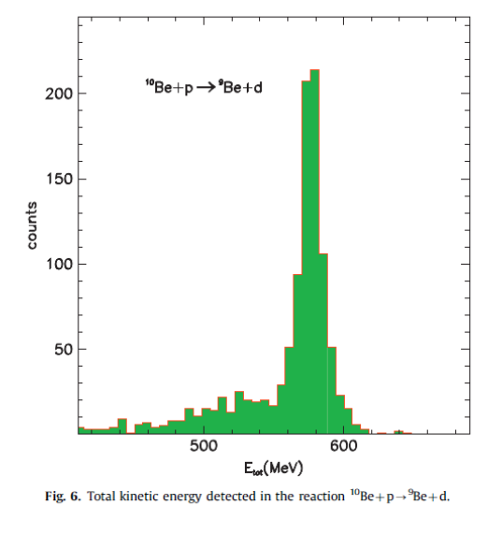
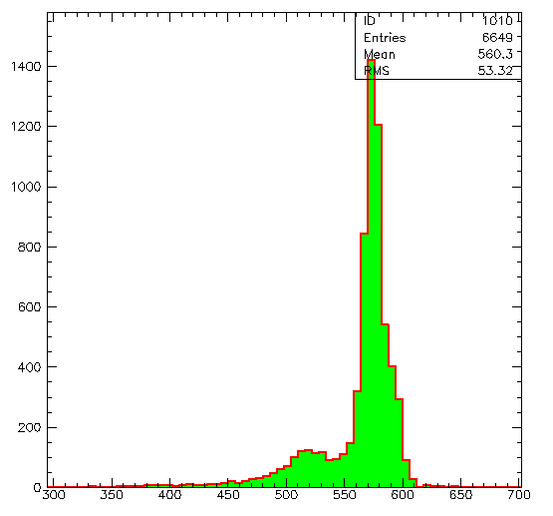
– Can I discriminate excited levels? -
¹⁰Be + p → ⁹Be + d
¹⁰Be + p → ¹⁰Be + p
look to the elastic channel were we have more statistics -
we can easily exclude from the analysis excited levels decaying by particle emission
Their contribution is in the structure at E_{tot} about 50 MeV smaller than the beam energy
~50 MeV are in fact subtracted on average by the emitted neutron
S_{n} ¹⁰Be=6.8 MeV
⁹Be
¹⁰Be*
n
If there are only few excited levels below the particle emission threshold it could be simple with γ-ray coincidences to disentangle excited levels from g.s.
G.Cardella inpc2013

Slide 16
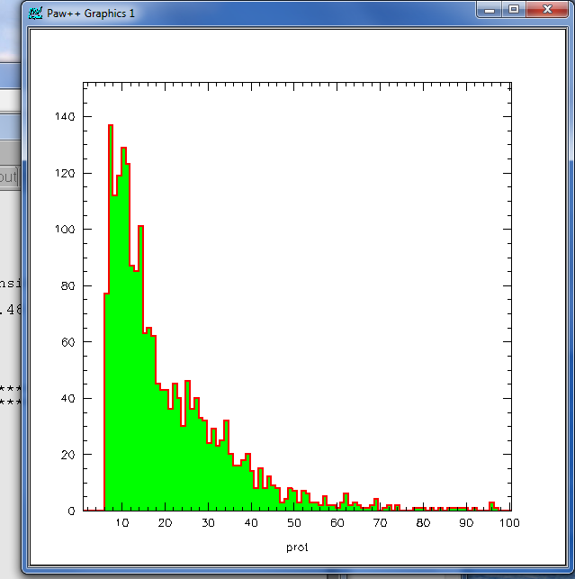
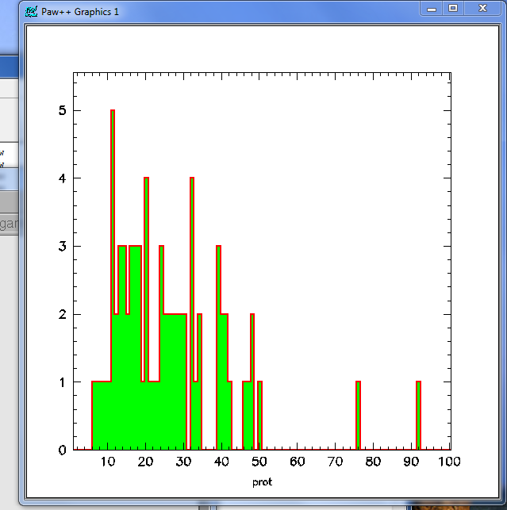
– comparison of proton spectra without and with γ-rays-
10Be+p→10Be+p
γ-rays

Slide 17
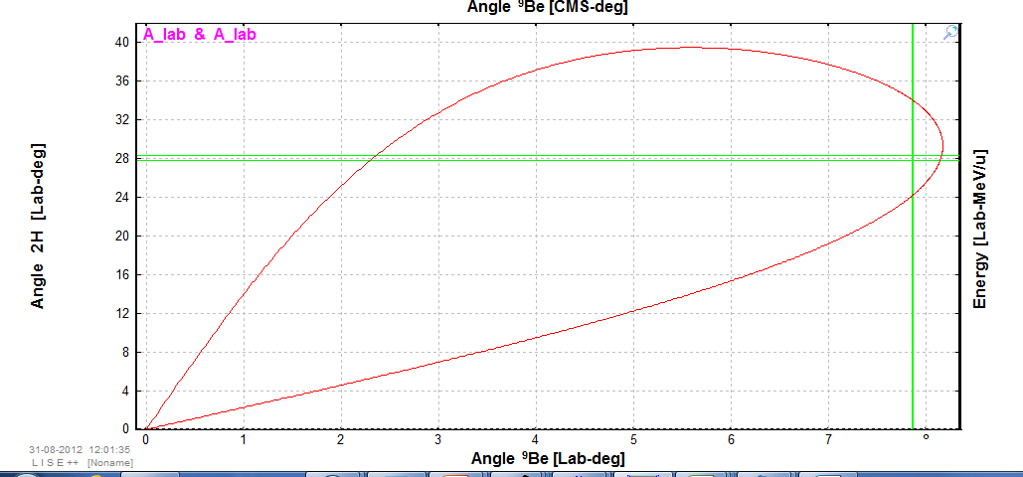
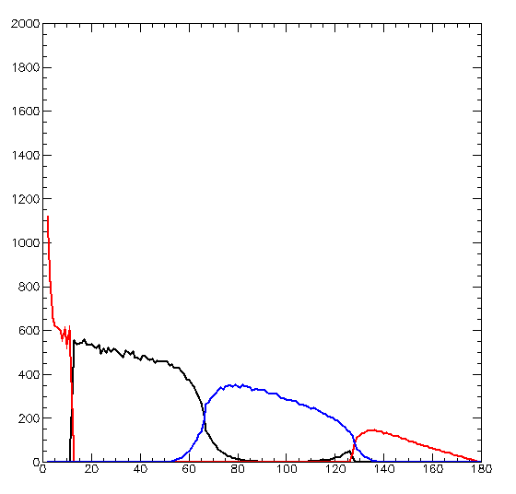
– ¹⁰Be+p→⁹Be_{g.s.}+d – efficiency effect of missing rings -
θ(d)_{lab}
CHIMERA ring 4-7 were used at GSI for another experiment so we have lost coincidences - we need efficiency correction
θ(⁹Be)_{lab}
θ_{beam}
θ(Be)_{lab}
dσ/dω (count/msr)
DSSSD-tag
DSSSD-traj
target
θ_{beam}
Simulations account also for the angular spread of the fragmentation beam
strip
θ_{C.M.}
G.Cardella Lisbona 2012

Slide 18
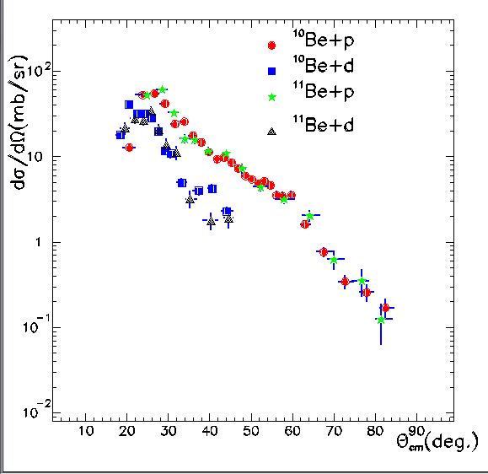
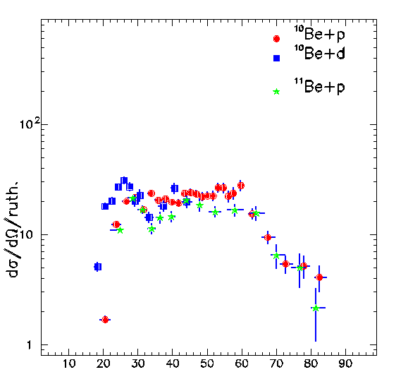
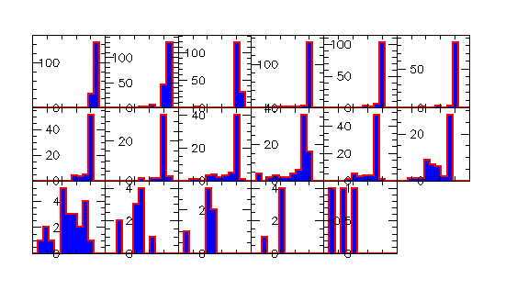

Slide 19
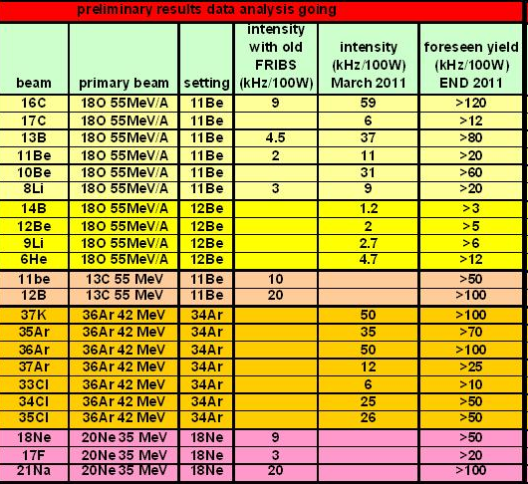
Foreseen yields

Slide 20
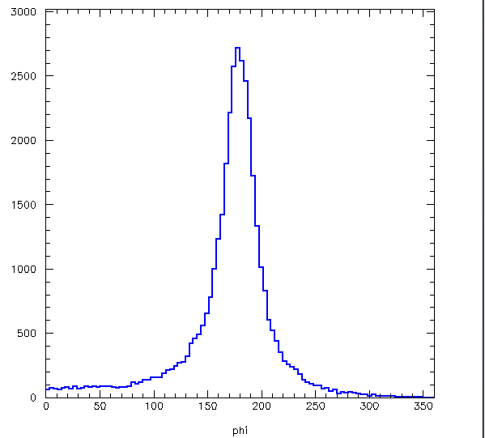
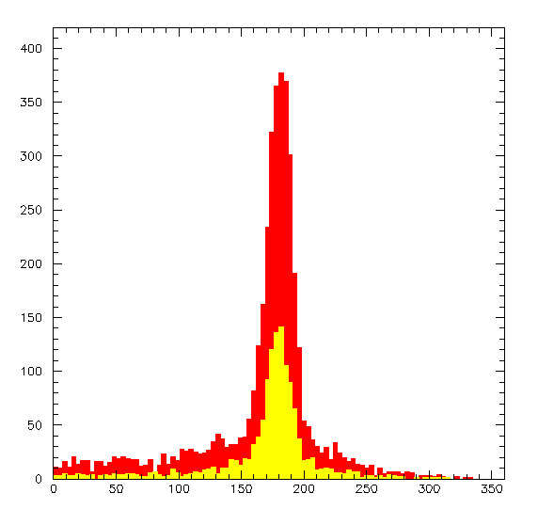
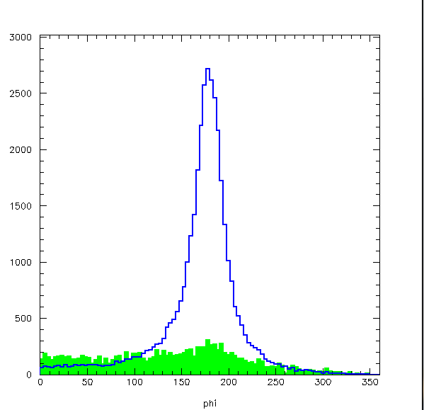
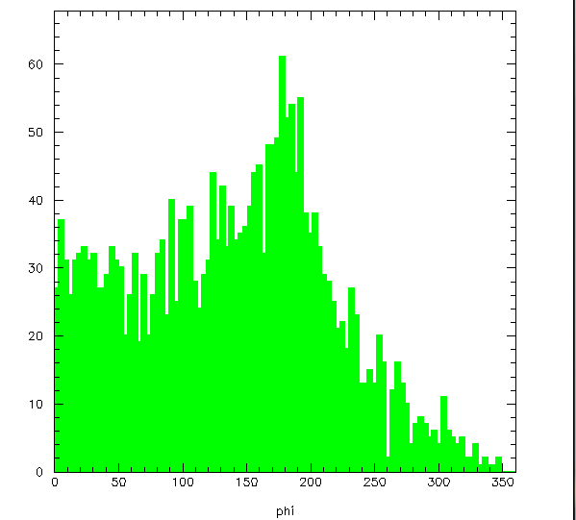
– Some preliminary results on “elastic-inelastic channel”
Count
Count
⁸Li
¹⁶C
⁹Li
Δφ
Count
Δφ
Carbon background beam ¹⁶C
Ztot>zbeam+1
We can plot the Δφ angle between the two coincidence detectors putting constraints on the complete event reconstruction
( Mult=2, ztot = zbeam+1)
Δφ width for elastic channels due to the finite opening of the detectors + effects of reactions + background
Δφ

Slide 21
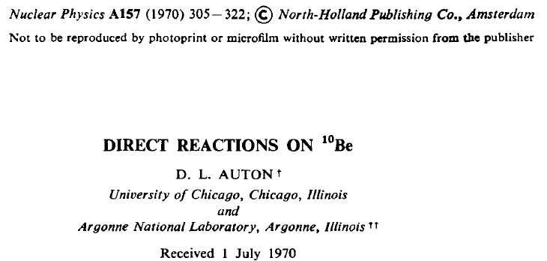
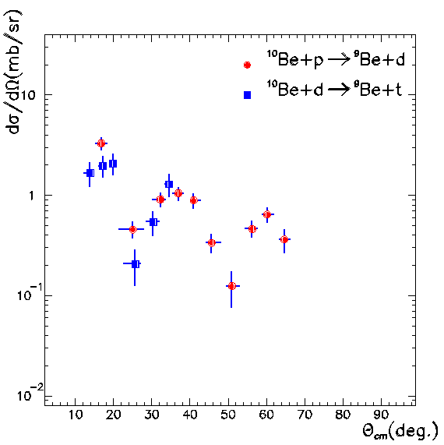
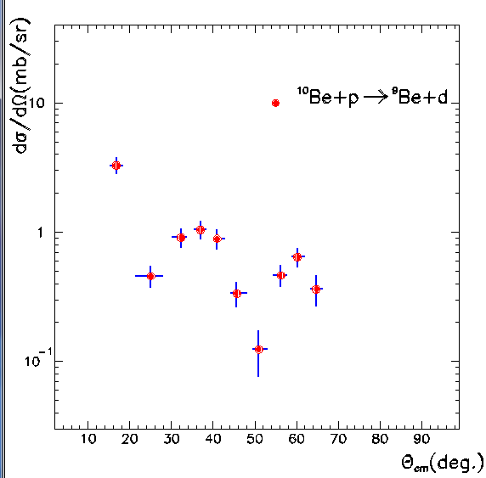

– ¹⁰Be+p→⁹Be_{g.s.}+d published data?
We used also a deuterium target but unfortunately in this case the missing rings give a smaller C.M. angular coverage and we see only one minimum around 25°
No previous data on p,d but similar minima observed in the d,t reaction -
G.Cardella inpc2013

