Slide 1
Recent shell-model results for exotic nuclei
Yutaka Utsuno
Advanced Science Research Center, Japan Atomic Energy Agency
Center for Nuclear Study, University of Tokyo
International Nuclear Physics Conference (INPC 2013), Florence, Italy, June 2-7, 2013

Slide 2
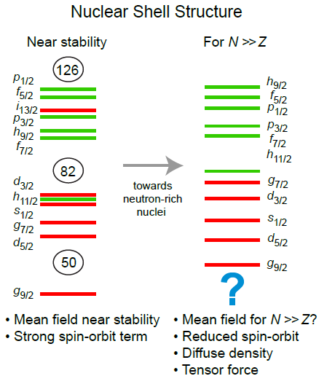
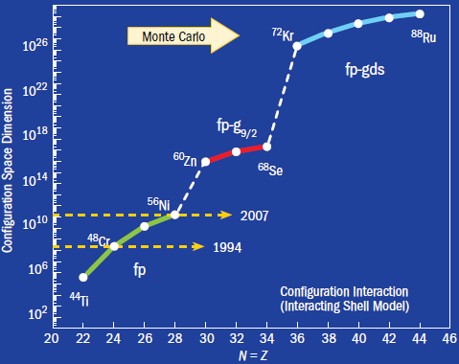
Outline
Two important issues in current nuclear-structure theory
  Understanding of the evolution of shell structure
    Towards universal description with V_{MU}
  Solving large-scale many-body problems
    Advancement of Monte Carlo shell model (MCSM)
NSCL Whitepaper, 2007.
SciDAC Review, Winter 2007.

Slide 3
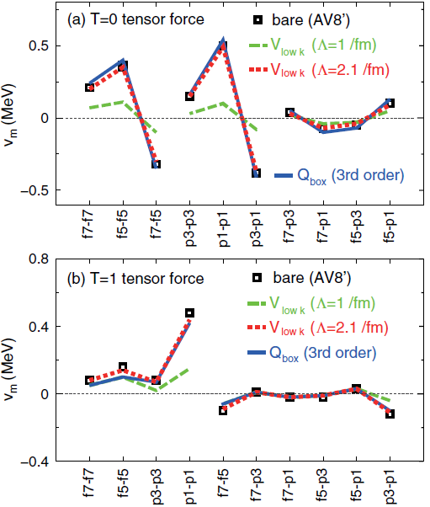
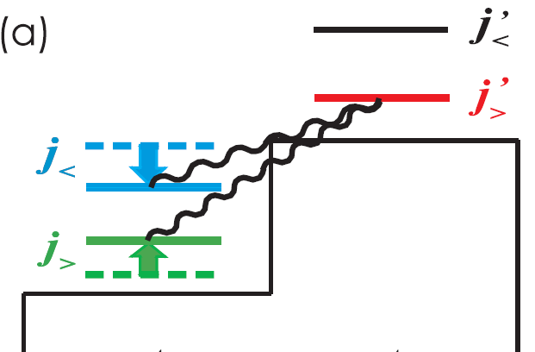
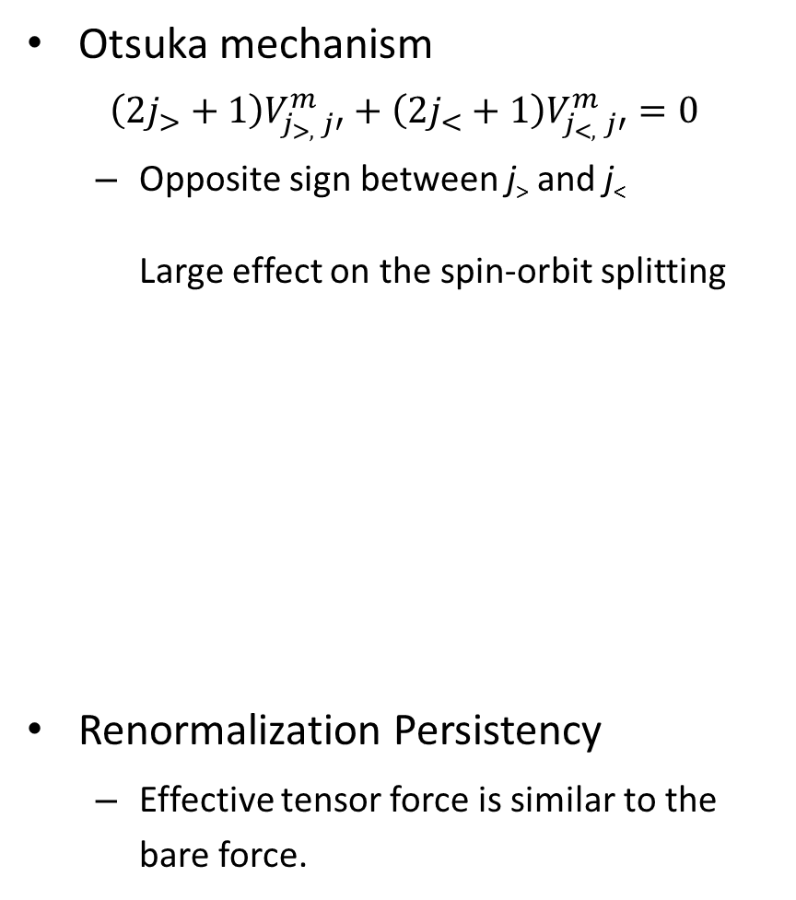
Shell evolution due to the tensor force
Otsuka mechanism
$\left(2j_{>}+1\right)V_{j_{>, }j′}^{m}+\left(2j_{<}+1\right)V_{j_{<,} j′}^{m}=0$
  Opposite sign between j> and j<
  Large effect on the spin-orbit splitting
Renormalization Persistency
  Effective tensor force is similar to the bare force.
T. Otsuka et al., Phys. Rev. Lett. 95, 232502 (2005).
T. Otsuka et al., Phys. Rev. Lett. 104, 012501 (2010);
N. Tsunoda et al., Phys. Rev. C 84, 044322 (2011).

Slide 4
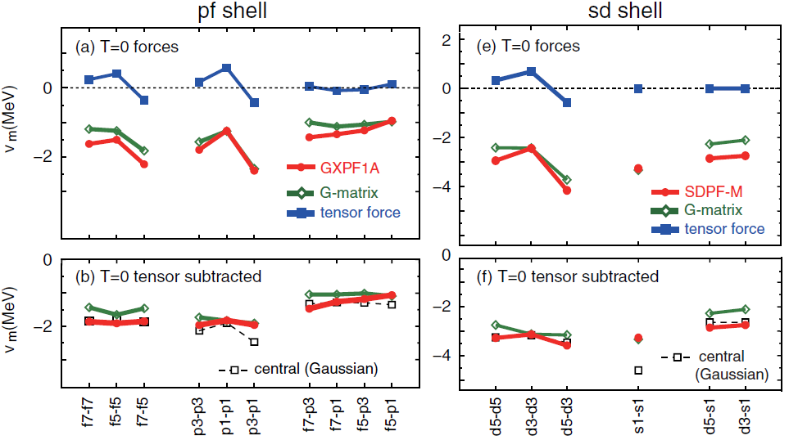
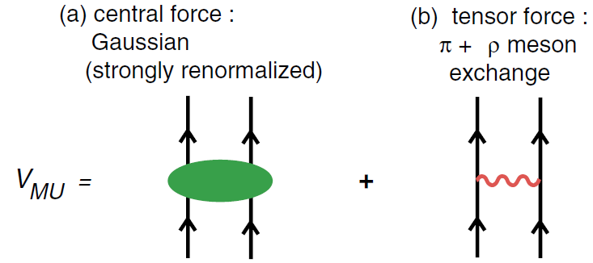
V_{MU}: towards universal shell evolution
Phenomenological simplicity for the central force
  Gaussian is a good choice.
proposed universal
effective force:
T. Otsuka et al., Phys. Rev. Lett. 104, 012501 (2010).

Slide 5
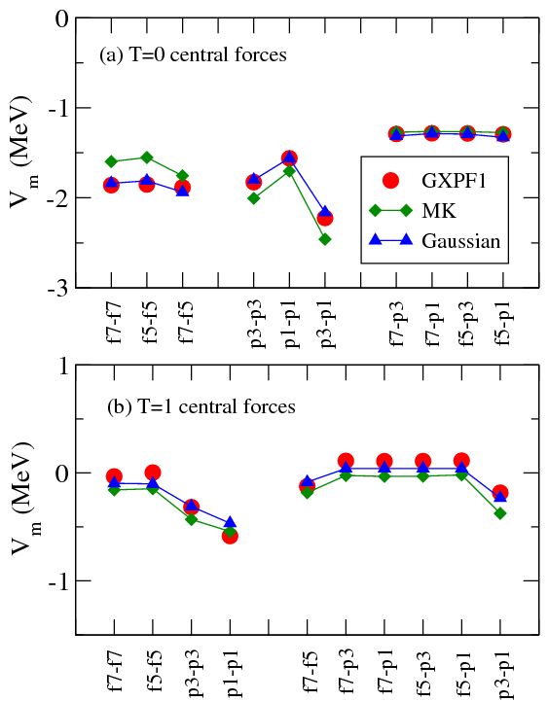
Refined V_{MU} for the shell-model
tensor: π+ρ
spin-orbit: M3Y
central: to be close to GXPF1
Central force fitted with six parameters
a promising way to construct a
shell-model interaction without
direct fitting to experiment
tested in some regions of interest

Slide 6
Example 1: sd-pf shell
V_{MU} is used for the cross-shell interaction.
sd- and pf-shell interactions are empirical one.
Evolution from N=20 to 28 is focused.
SDPF-MU int.
tensor force
central force
f_{7/2}
f_{7/2}
d_{3/2}
d_{3/2}
16
s_{1/2}
16
s_{1/2}
narrowing
14
nearly
constant
14
d_{5/2}
d_{5/2}

Slide 7
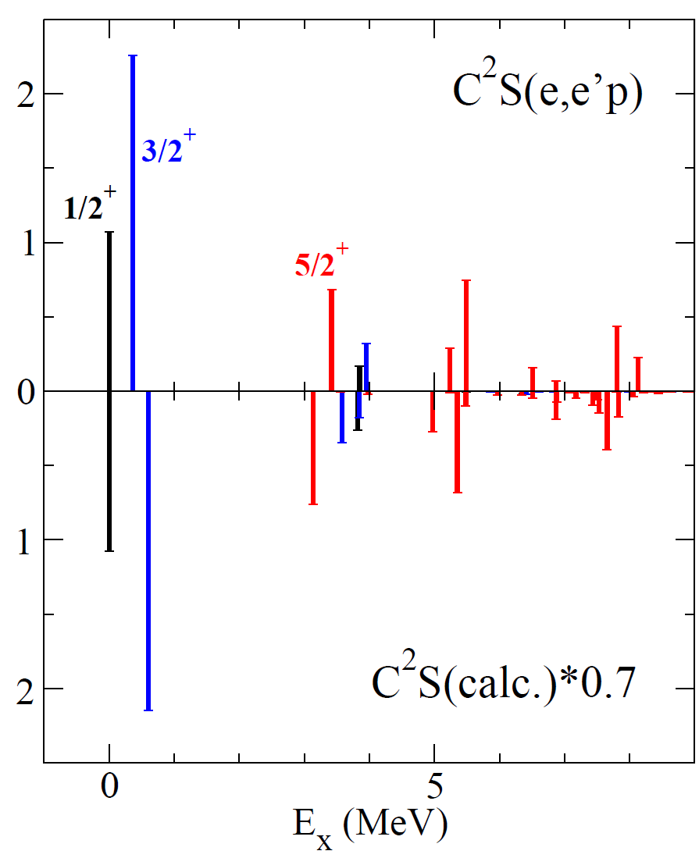
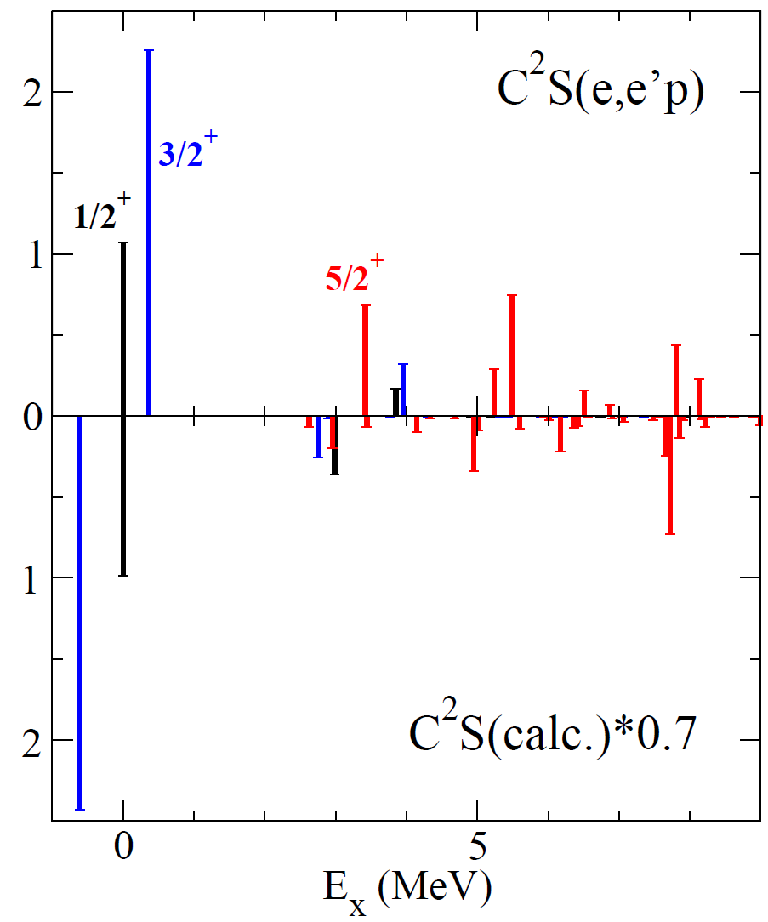
Example of success of V_{MU}: ls splitting of ⁴⁸Ca
full V_{MU} interaction (w/ tensor)
w/o tensor in the cross shell
Exp.
Cal.
d_{5/2}-s_{1/2} gap
d_{3/2}-s_{1/2} gap
Y. Utsuno et al., Phys. Rev. C 86, 051301(R) (2012).

Slide 8
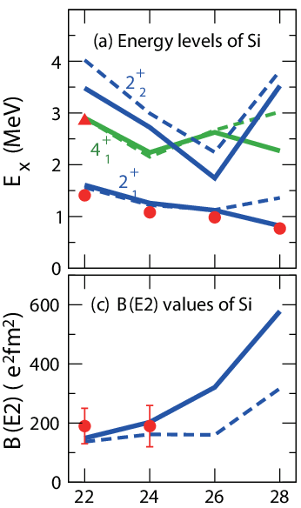
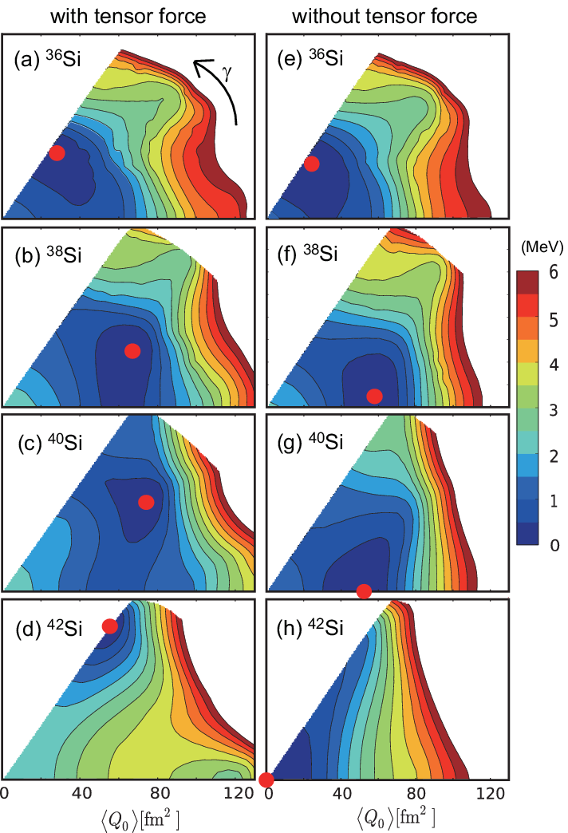
Tensor-force driven Jahn-Teller effect
Y. Utsuno et al., Phys. Rev. C 86, 051301(R) (2012).

Slide 9
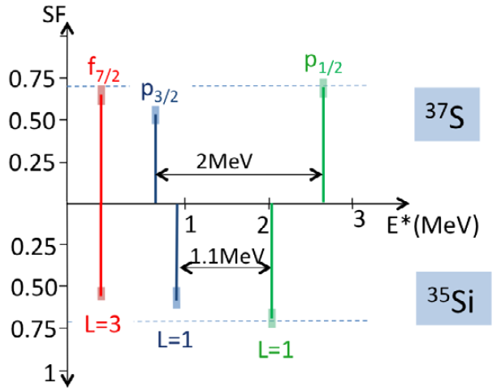
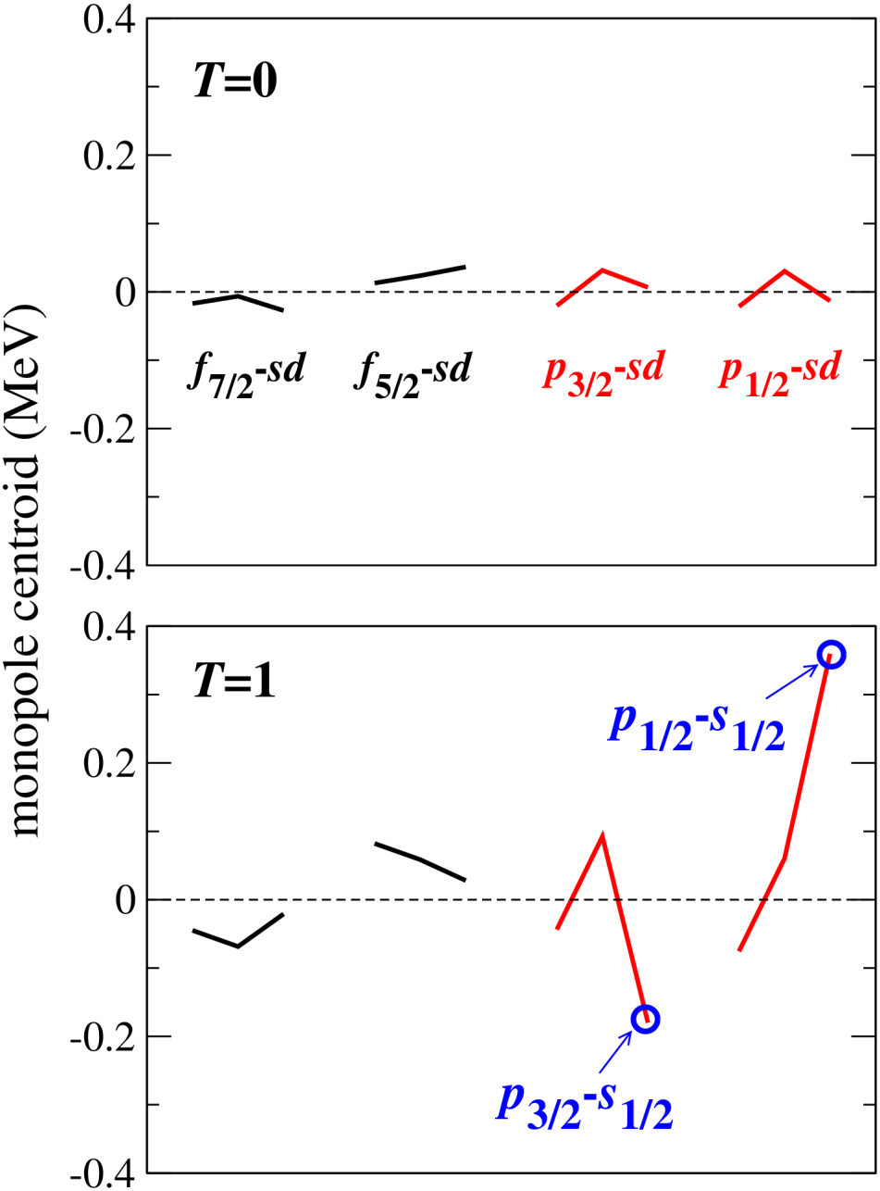
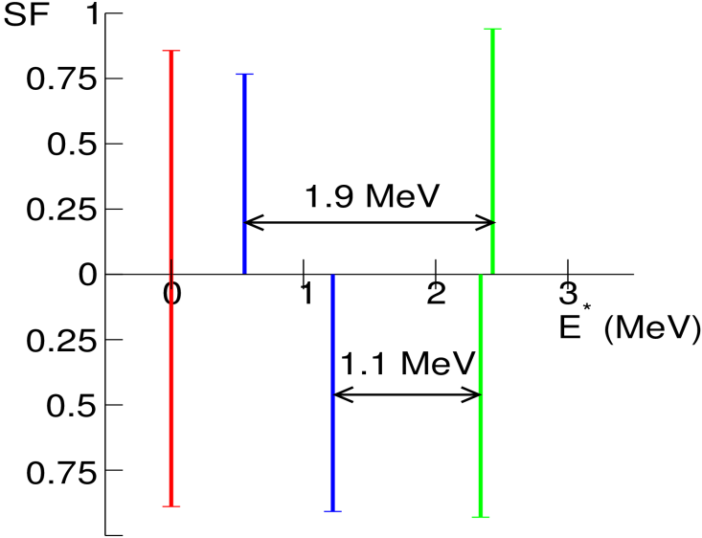
Probing the spin-orbit force: p_{3/2}-p_{1/2} splitting
Spin-orbit force of M3Y
Expt.
O. Sorlin and M.-G. Porquet, Phys. Scr. T152, 014003 (2013).
SDPF-MU

Slide 10
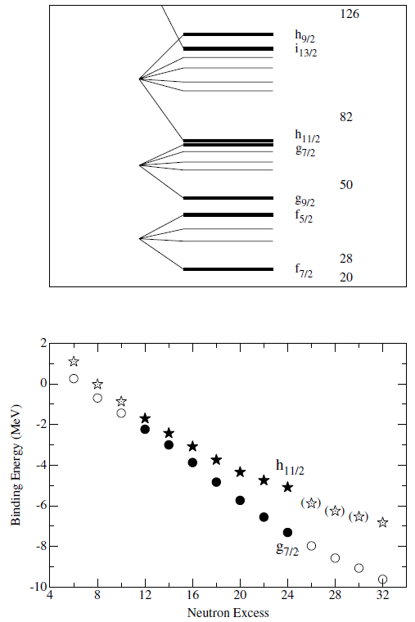
Example 2: Sb isotopes (Z=51)
V_{MU} is used for the proton-neutron interaction.
  Evolution of 7/2⁺ and 11/2⁻ levels
  “proton single-particle states” suggested by Schiffer et al. based on (α, t) reactions
    Tensor-force driven shell evolution
  considerable effect of correlation such as
  π(d_{5/2})*3⁻ suggested by Sorlin and Porquet
  based on (³He, d) reactions
Large-scale shell-model calculations in the full 50≤ N(Z) ≤82 shell
J. P. Schiffer et al., Phys. Rev. Lett. 92, 162501 (2004).

Slide 11
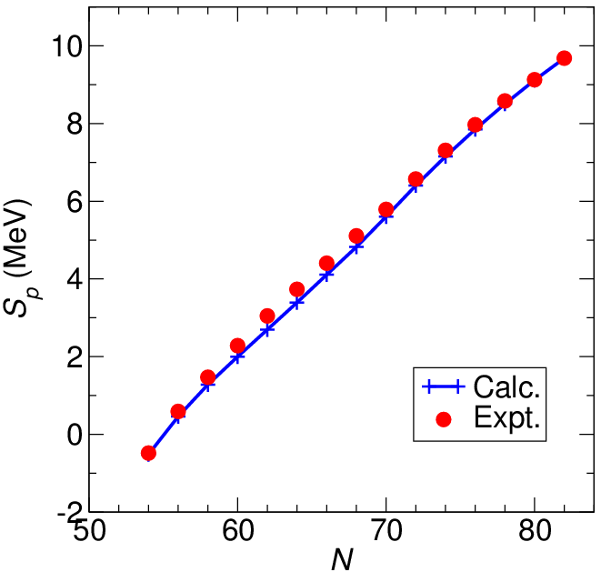
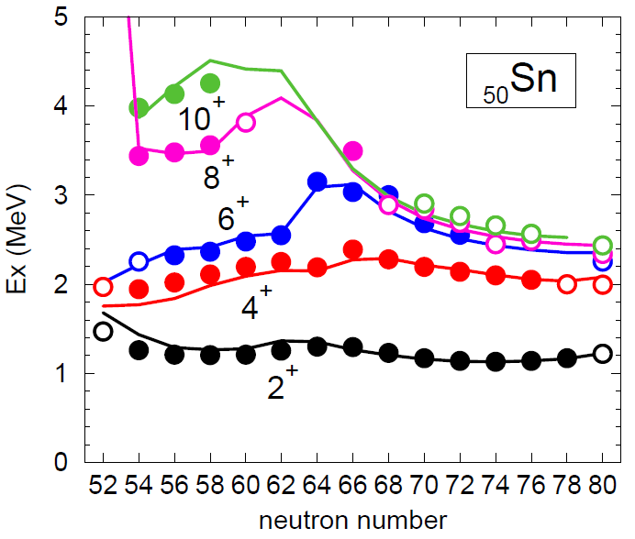
Some details about the Hamiltonian for Sb
Proton-neutron interaction
  strength of the central: adjusted by S_{p}
  → the only free parameter
Neutron-neutron interaction
  responsible for making “Sn core”
  a semi-empirical interaction by Honma et al. fitted to Sn isotopes including 3⁻
Proton single-particle energies
  fitted to experimental levels in ¹³³Sb
    The s.p. levels on top of the ¹⁰⁰Sn core is a prediction.
M. Honma et al., RIKEN Accel. Prog. Rep. (2012).

Slide 12
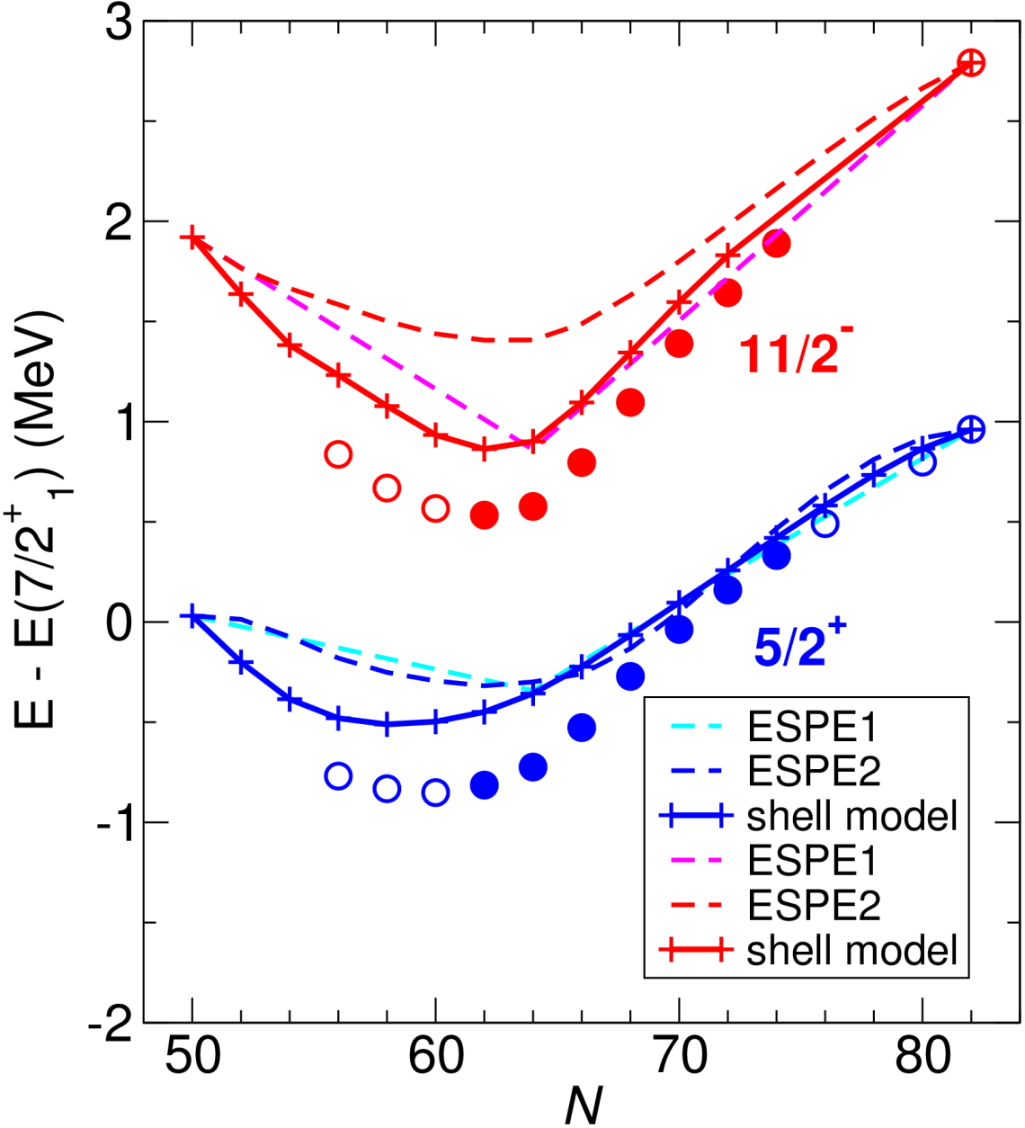
Evolution of the energy levels in Sb
11/2⁻₁ and 5/2⁺₁ levels measured from 7/2⁺₁
  Non-monotonic evolution is reproduced.
  full shell-model results vs. estimate from effective single-particle energies (ESPE) of two kinds
    ESPE1: filling configuration at N=64, i.e., no correlation included
    ESPE2: π(j)×Sn(0⁺₁), i.e., n-n correlation included
2.25 MeV

Slide 13
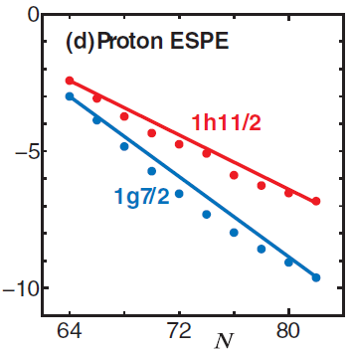
Evolution of the 11/2⁻–7/2⁺ spacing in Sb
Consider the change from N=64 (to 82): 2.215 MeV in expt.
  ESPE1: no correlation
    (6, 8, 0, 0, 0) for occupation
    in (d_{5/2}, g_{7/2}, h_{11/2}, s_{1/2}, d_{3/2})
    tensor only: 1.93 MeV
    central + ls + tensor: 1.93 MeV
  ESPE2: n-n correlation included
    (4.76, 5.91, 1.74, 0.69, 0.91)
    tensor only: 1.21 MeV
    central + ls + tensor: 1.38 MeV
  shell-model calculation: full correlation included
    central + ls + tensor: 1.89 MeV
Δn(h_{11/2})=12
occupation
from N=64 to 82
Δn(h_{11/2})=10.3
T. Otsuka et al., Phys. Rev. Lett. 95,
232502 (2005).
Canceling n-n and p-n correlation energies amounting to ~500 keV
The evolution of the level is still dominated by the tensor force.

Slide 14
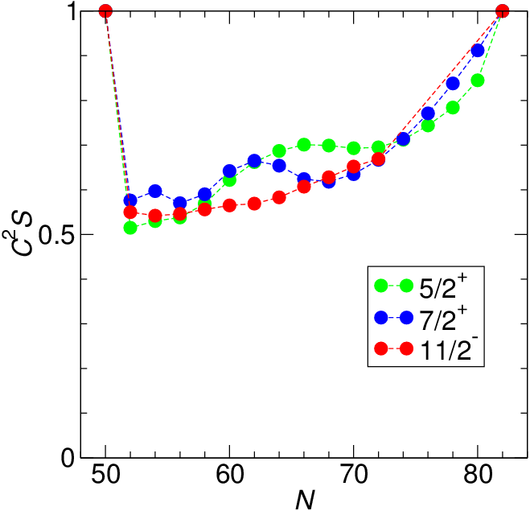
Single-particle strength for Sb
Shell model
N | 7/2⁺ |  | 11/2⁻
 | Conjeaud et al. | Schiffer et al. | Conjeaud et al. | Schiffer et al.
62 | 0.94 | 0.99 | 0.4 | 0.84
64 | 0.85 | 1.10 |  | 0.93
66 | 0.81 | 0.95 | 0.53 | 0.97
68 | 0.79 | 0.88 | 0.63 | 0.99
70 | 0.7 | 1.13 | 0.63 | 1.12
72 | 0.84 | 0.98 | 0.49 | 1.00
74 | 0.74 | 1.00 | 0.75 | 1.12
Experimental data exist.
(³He, d): M. Conjeaud et al., Nucl. Phys. A 117, 449 (1968).
(α, t): J. P. Schiffer et al., Phys. Rev. Lett. 92, 162501 (2004).
Absolute values are sensitive to the optical potential adopted.
Is there an alternative way to probe the single-particle strength?

Slide 15
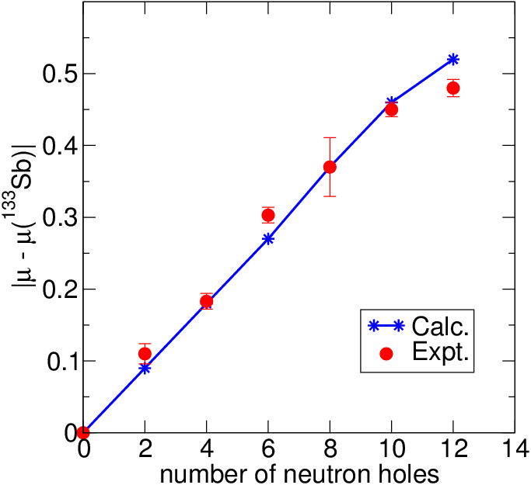
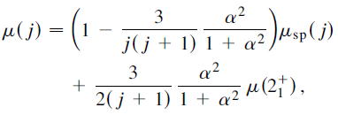
Evolution of μ in Sb from N=70 to 82
magnetic moment: sensitive to the degrees of mixing
  Particle-vibration coupling
increase of configuration mixing towards mid-shell
7/2⁺₁
N=70
11/2⁻₁ | Expt. | Calc.
¹¹⁵Sb | 5.53(8) | 5.53
¹¹⁷Sb | 5.35(9) | 5.63
N=82
effective nucleon g factor adopted:
isovector shift δg_{l}(IV)=0.1, spin quenching factor 0.6
c.f. 7.18 for the single-particle value
μ(¹³³Sb)=2.97 (calc.) vs. 3.00(1) (expt.)

Slide 16
Advanced Monte Carlo shell model (MCSM)
Basic idea of MCSM
  Good eigenstates are obtained with a small number of selected basis states.
(spherical-basis expression)
(deformed-basis expression)
T. Otsuka, M. Honma, T. Mizusaki, N. Shimizu, and Y. Utsuno, Prog. Part. Nucl. Phys. 47, 319 (2001).

Slide 17
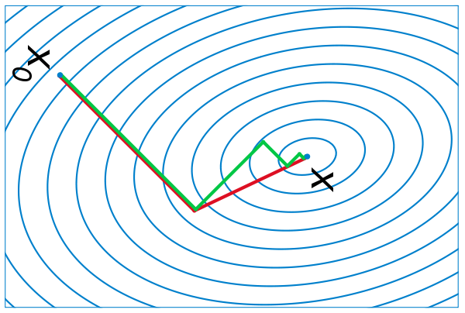
Wave function and its optimization
Superposition of deformed Slater determinants with projection
D^{(q)}’s are optimized stochastically (originally) or deterministically (recently) with the conjugate gradient (CG) method.
superposition
projection
deformed basis state
E
stochastic method
CG method
start
reject
|Φ>
accept

Slide 18
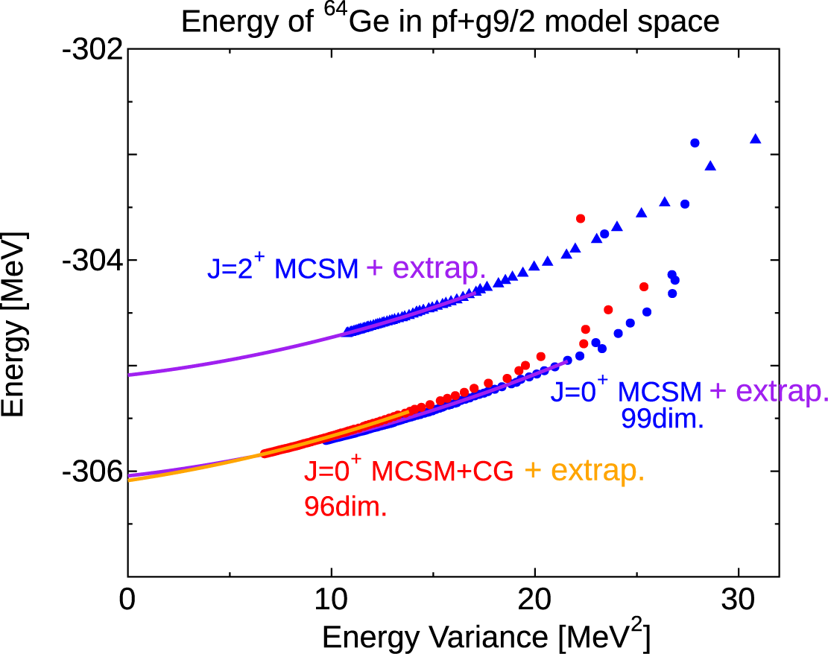
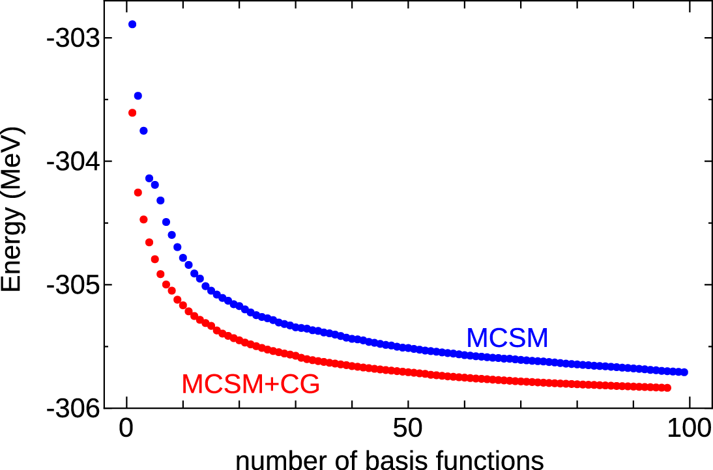
Novel extrapolation method
It is difficult to estimate the exact energy with the dimension plot.
The plot of the variance is more useful to estimate the energy.
  Energy variance defined as <H²>-<H>² vanishes for eigenstates.
  With a new formula to significantly reduce the computation of <H²>
with calc. of <H²>
Energy as a function of variance
Energy as a function of dimension
very far
N. Shimizu et al., Phys. Rev. C 82, 061305(R) (2010);
N. Shimizu et al., Phys. Rev. C 85, 054301 (2012).

Slide 19
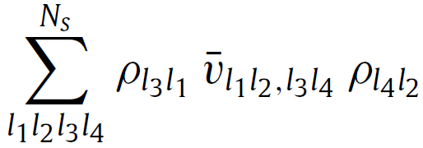
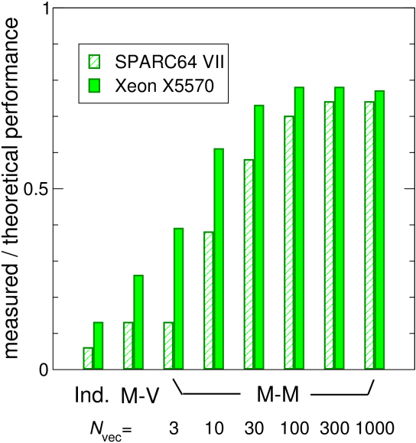
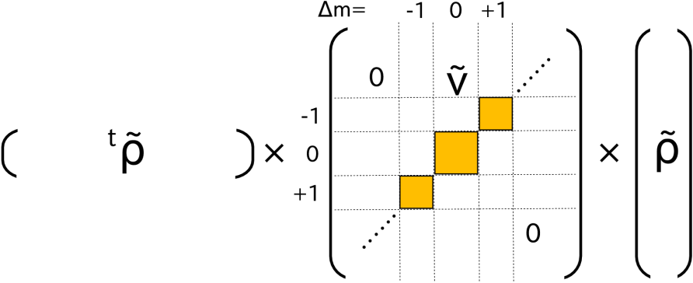
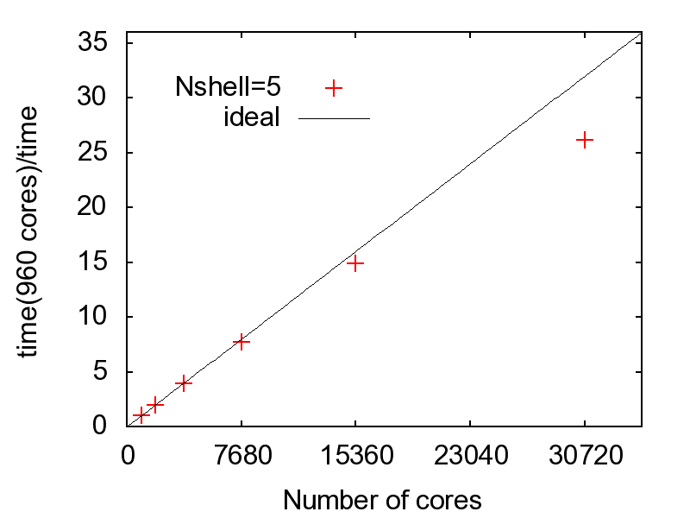
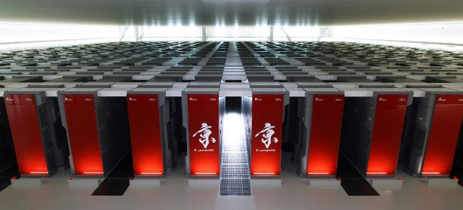
Computational aspects
~80% of theoretical
peak performance
Efficient computation of the Hamiltonian overlap
Use of the K computer in Kobe: 10 PFLOPS in total
  Good parallel efficiency demonstrated
Y. Utsuno et al., Comput. Phys. Commun. 184, 102 (2013).
Under HPCI Strategic Programs for Innovative Research (SPIRE)
Field 5 “The origin of matter and the universe”

Slide 20
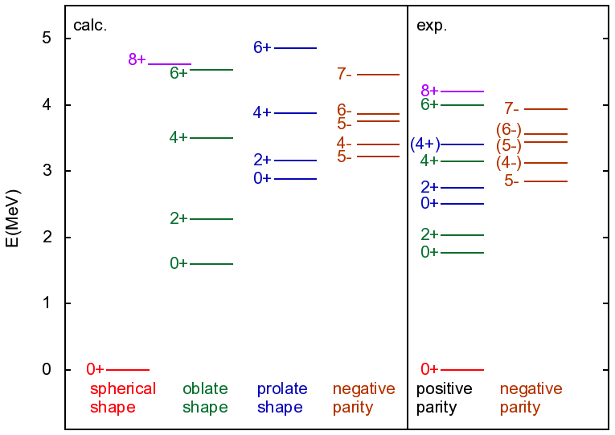
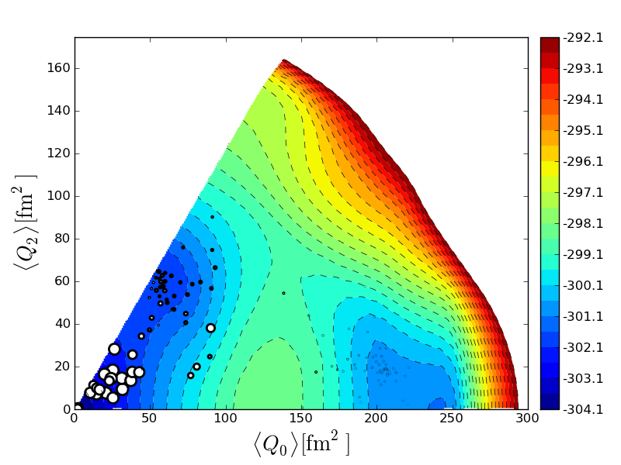
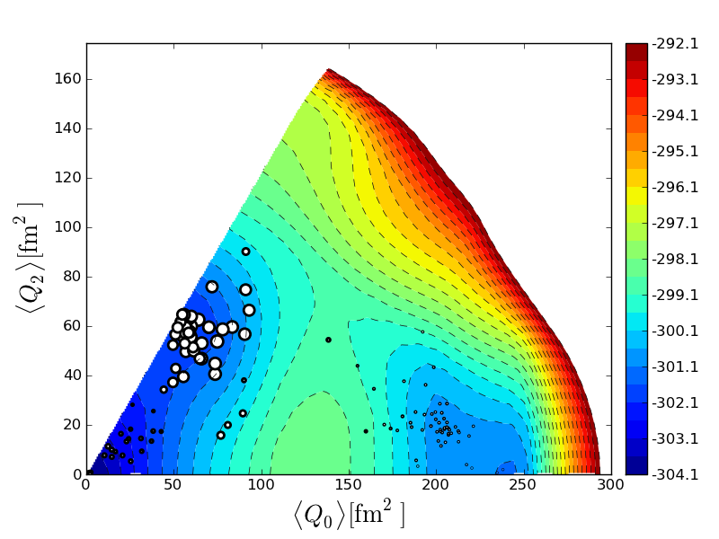
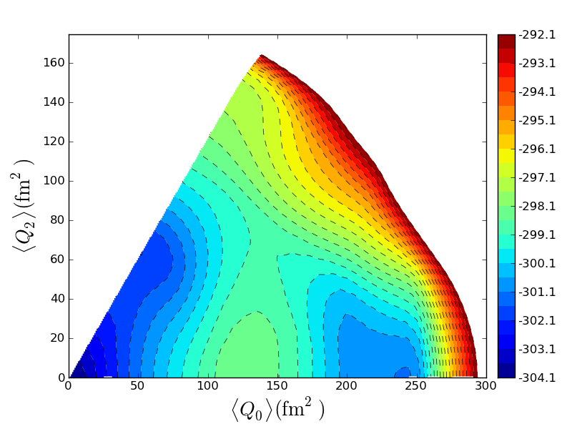
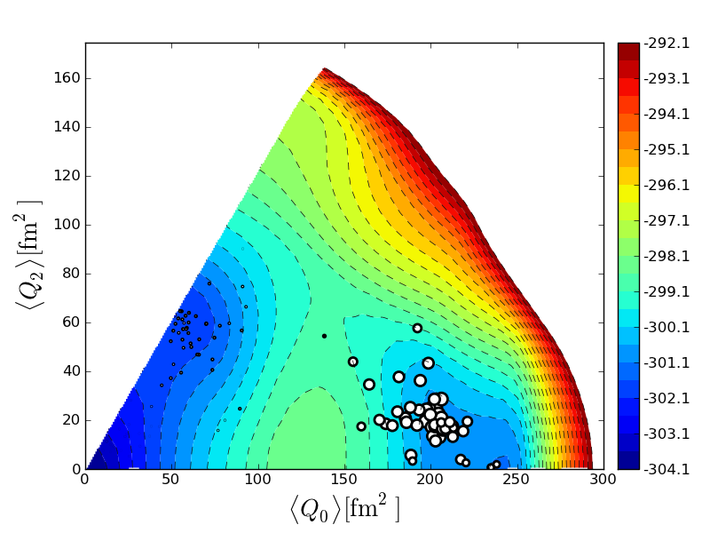
An application to exotic nuclei: ⁶⁸Ni
Two applications will be presented in the talks of T. Abe (no-core MCSM) and Y. Tsunoda (neutron-rich Ni region).
⁶⁸Ni: nature of low-lying 0⁺ states?
  MCSM wave function analyzed in terms of shape fluctuation
Deformation (position) and
overlap probability (size)
of each basis state for ⁶⁸Ni
Potential energy surface
of ⁶⁸Ni
0⁺₁
0⁺₃
0⁺₂
Y. Tsunoda et al., in preparation

Slide 21
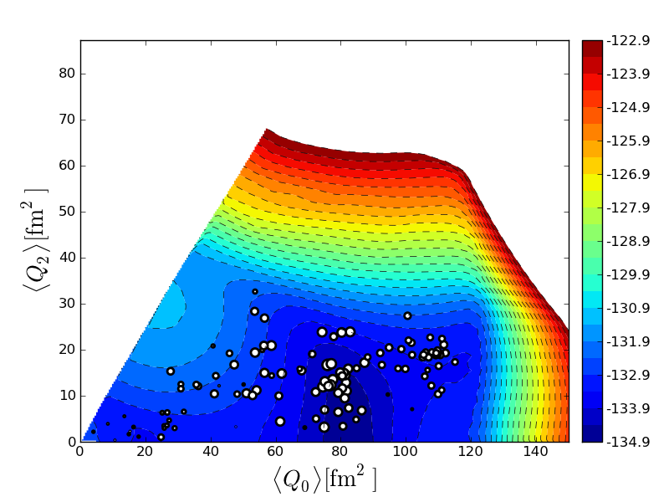
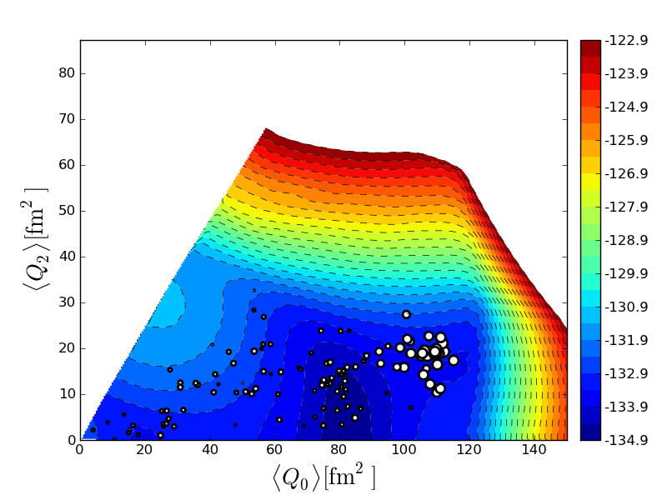

Case of ³²Mg
Very preliminary result
SDPF-MU + minimum modifications for the full configuration mixing
  N=20 shell gap
  scaling of the two-body interaction <sd sd|V|pf pf>
0⁺₁
0⁺₃
0⁺₂
Y. Tsunoda et al.

Slide 22
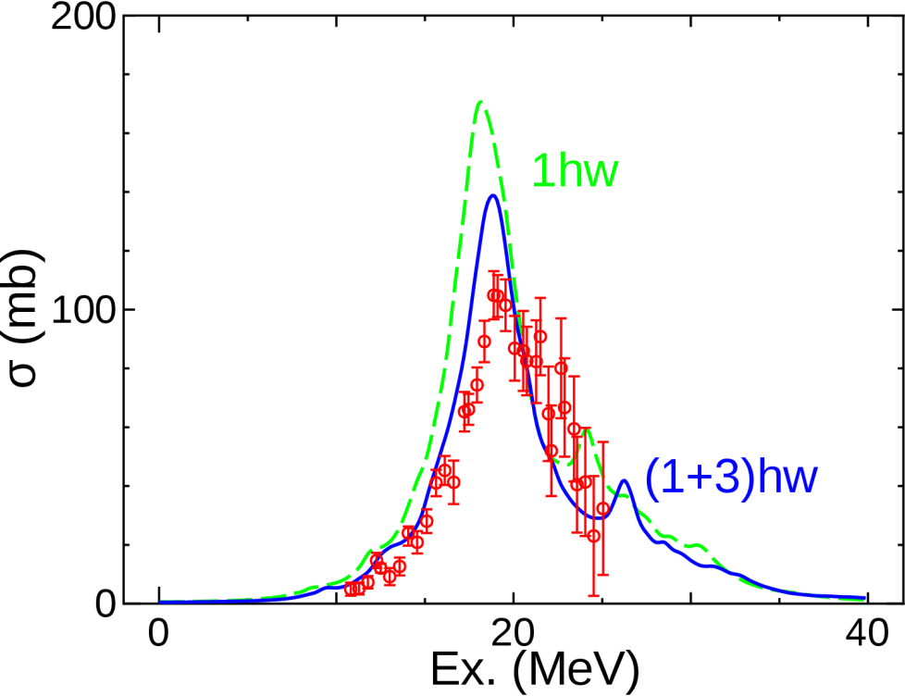
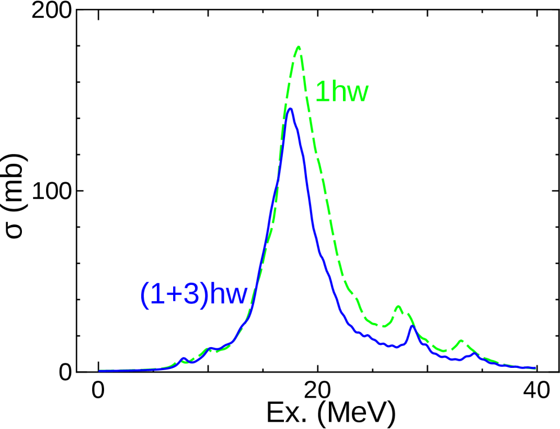
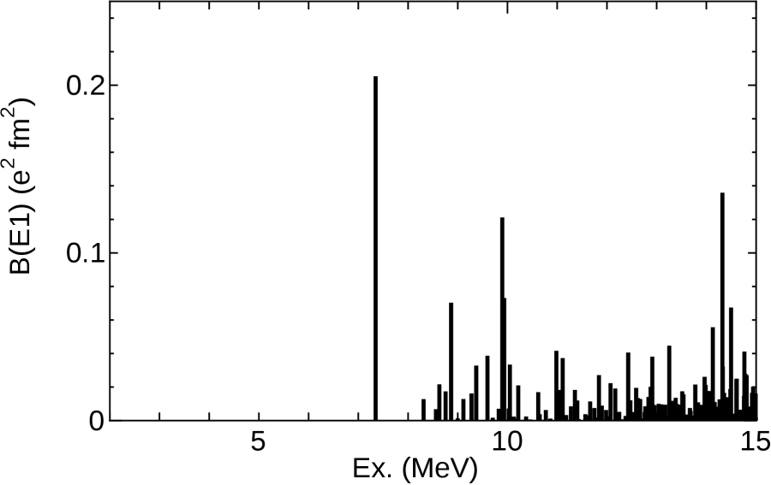
Pygmy and giant dipole resonance
Difficult with MCSM → Lanczos strength function method
E1 excitation in calcium isotopes in the sd-pf-sdg shell
dimension | 1ħω | (1+3)ħω
⁴⁸Ca | 2,859,294 | 7,973,474,255
⁵²Ca | 2,983,109 | 10,276,858,720
calculation performed
with a new parallel
shell-model code KSHELL
by N. Shimizu et al.
⁴⁸Ca
⁵²Ca
1ħω; exact diag.
N. Shimizu et al., in preparation.

Slide 23
Summary
Shell-model study of the shell evolution with V_{MU}:
microscopically established tensor + phenomenological central
  beyond single-particle states including correlation
  direct test of spin-orbit splitting in ⁴⁸Ca
  manifestation of tensor-force driven Jahn-Teller effect in ⁴²Si
  strongly correlated states in Sb isotopes; but still dominance of tensor
Advancement of the Monte Carlo shell model (MCSM):
a method to overcome the limit of exact diagonalization
  superposition of a small number of basis states with symmetry restoration
  exact solution precisely estimated using extrapolation of energy variance
  computational advancement and the K computer
  ⁶⁸Ni: shape coexistence and fluctuation analyzed with the MCSM bases
  Lanczos diagonalization: useful for the E1 strength function

Slide 24
Collaborators
T. Otsuka (Univ. Tokyo/CNS/MSU)
N. Shimizu (CNS, Univ. Tokyo): advanced MCSM
Y. Tsunoda (Univ. Tokyo): Ni isotopes
M. Honma (Univ. Aizu)
T. Mizusaki (Senshu Univ.)
B. A. Brown (MSU)
T. Abe (Univ. Tokyo)
T. Suzuki (Nihon Univ.)
M. Hjorth-Jensen (Univ. Oslo)
K. Tsukiyama (Univ. Tokyo)
N. Tsunoda (Univ. Tokyo)

Slide 25
backup

Slide 26
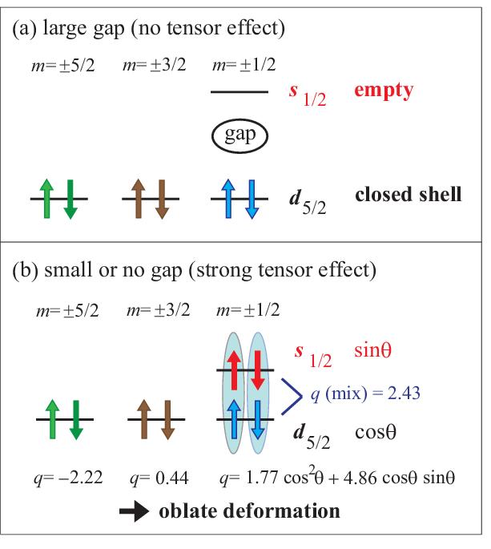
Tensor-force-driven Jahn-Teller effect

