Slide 1
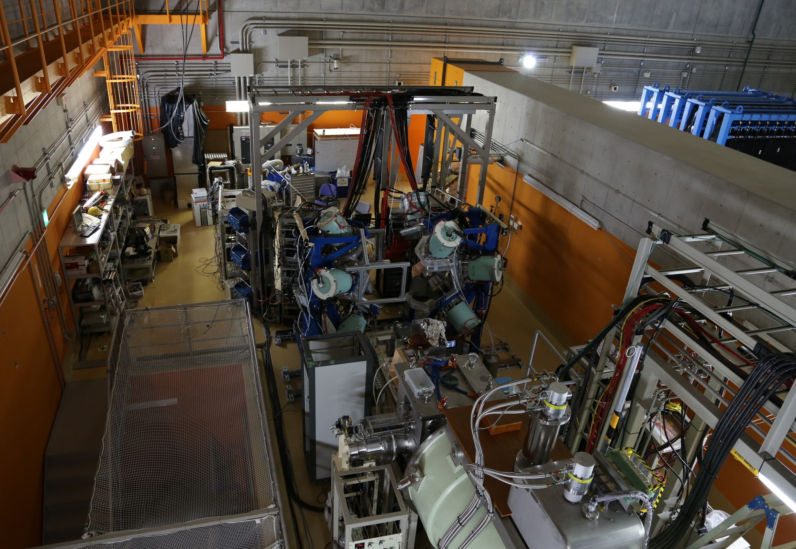



Decay spectroscopy of very neutron-rich nuclei at RIBF
INPC2013 June 03
Shunji NISHIMURA
( RIKEN Nishina Center )
for the EURICA* collaboration
(*) … EUROBALL RIKEN Cluster Array

Slide 2
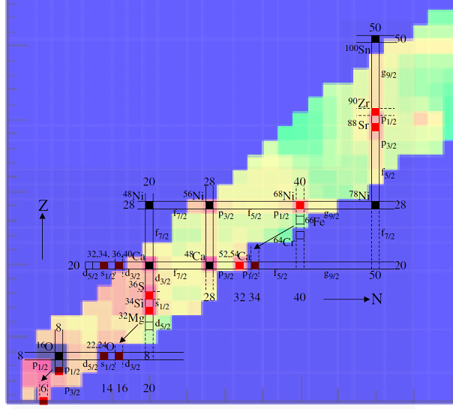
Motivation (Decay Spectroscopy)
Measurements by decay exp.
Standard shell nuclei
- Decay curve : T_{1/2}
- Excited states : E(2⁺), ..
- Isomeric states
- Q_{β}
- Neutron emission (P_{n})
New closed shell nuclei ?
Deformed shell quenched nuclei ?
Systematic
Study
Nuclear Structure
  New magic number ?
  Disappearance?
  Shell quenching?
  Deformation?
- Feedback to Nuclear Theory
- Study of Nuclear Astrophysics
Inputs

Slide 3
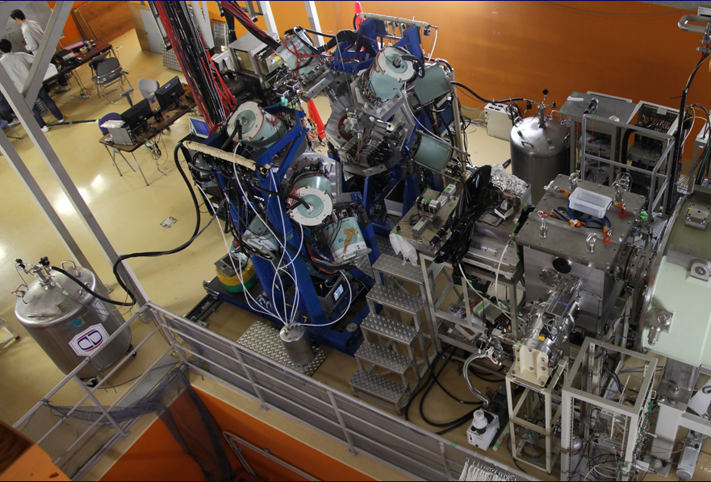
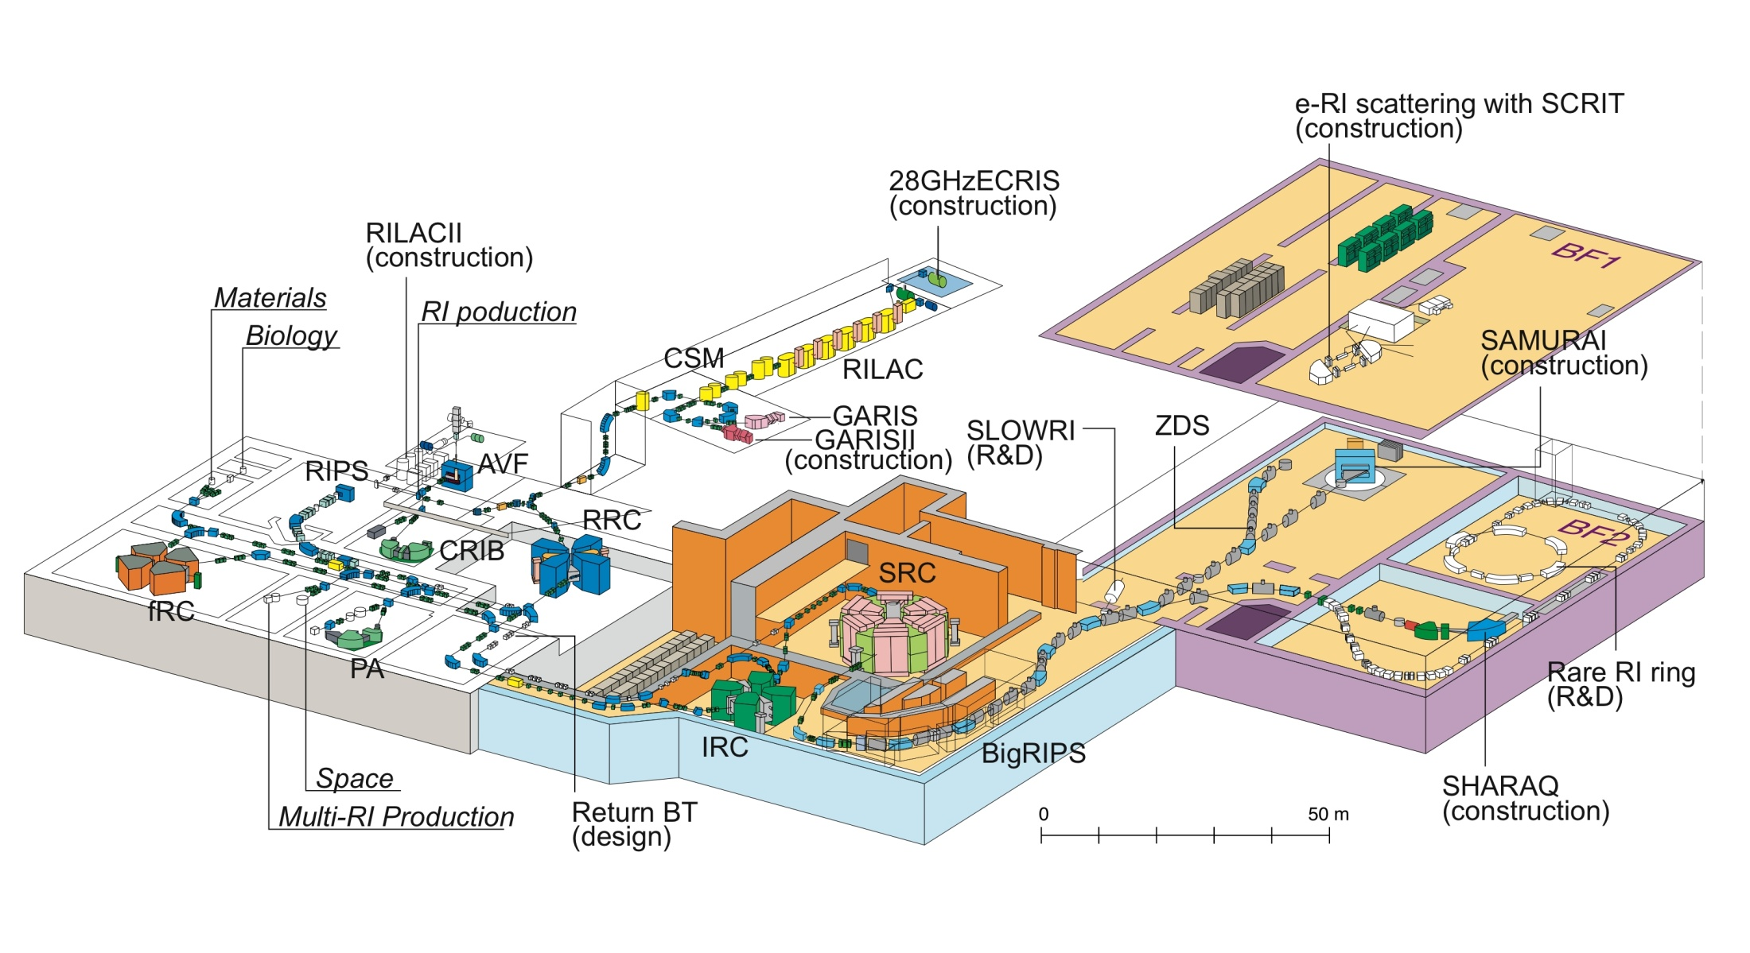
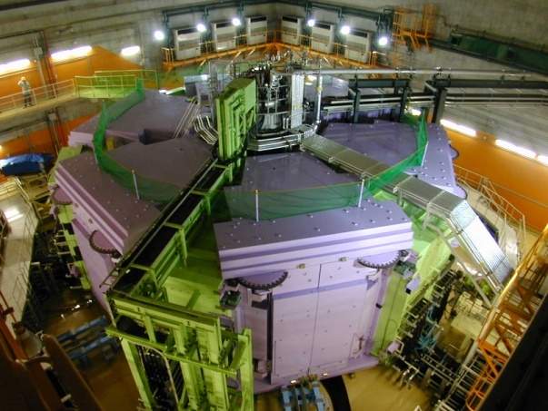
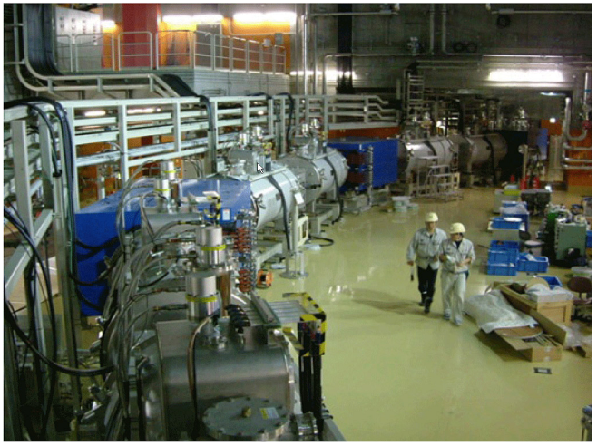
Location of Decay Station
Decay Exp.
²³⁸U … 345 MeV/u,
… Intensity = 5 – 12 pnA !

Slide 4
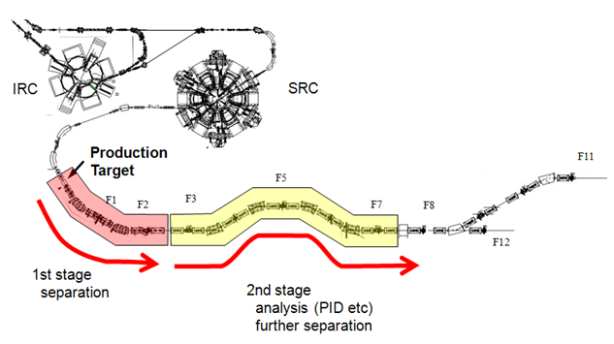
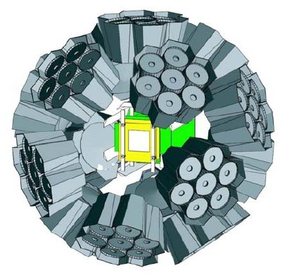

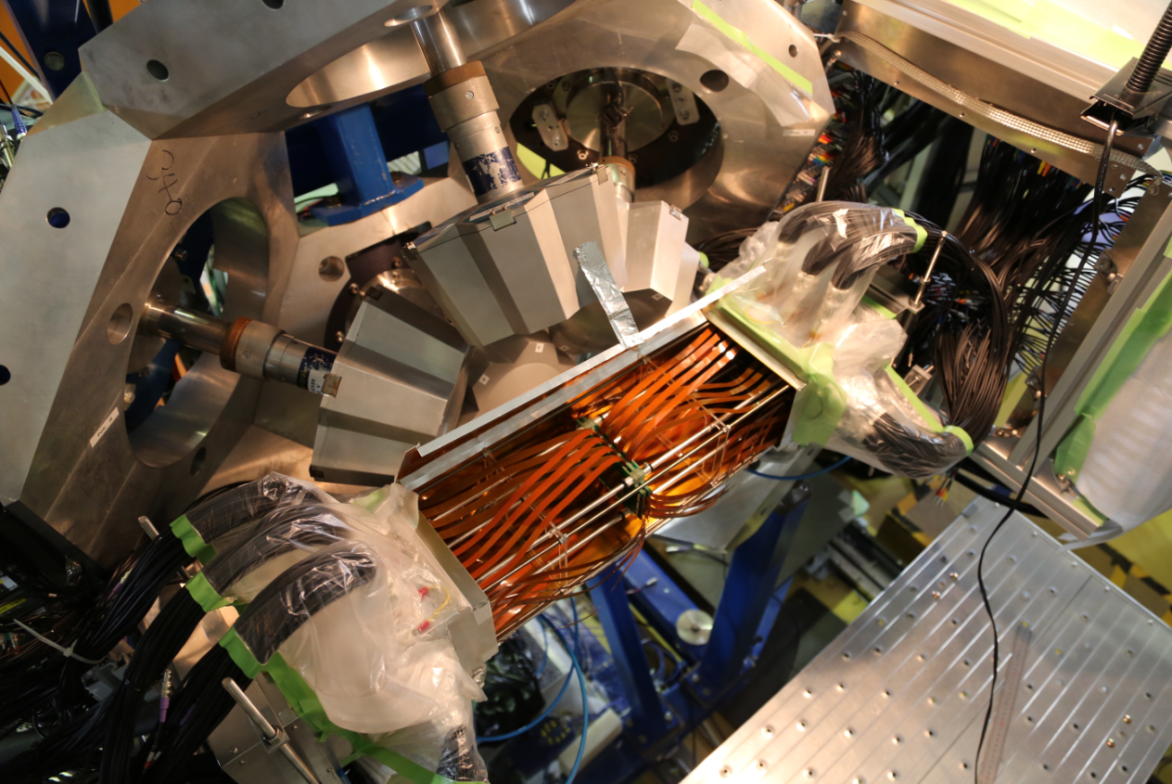
Beam Production at RIBF
²³⁸U
The implantation of an identified RI
is associated with the following
β-decay events that are detected
in the same silicon pixel (DSSSD).
⁹Be
ΔE-TOF-Bρ method using the
focal plane detectors.

Slide 5
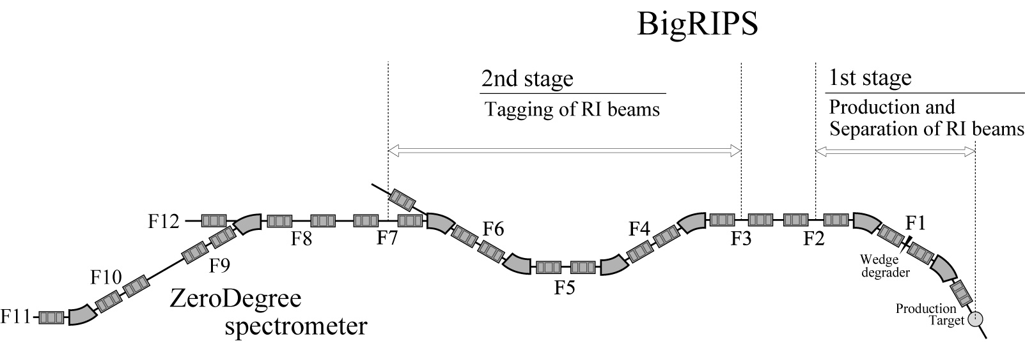
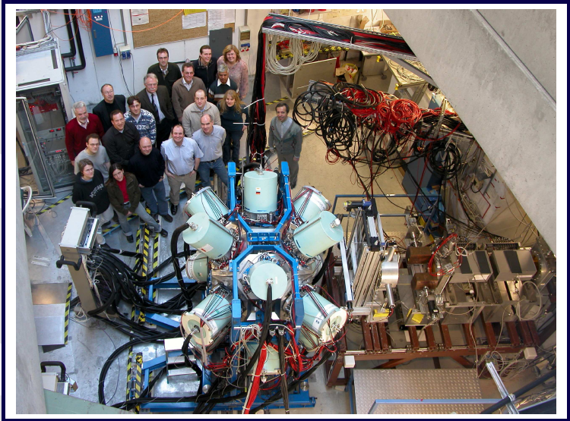
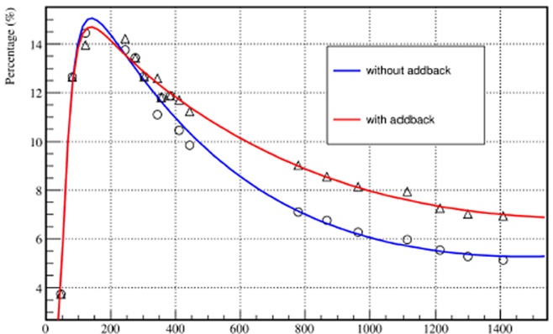



EURICA Project at RIBF
( EUROBALL
RIKEN
Cluster
Array)
RI beam
efficiency (%)
Effi. = 8% at 1MeV
Euroball Cluster detectors
Support structure
Readout electronics
used for GSI-RISING
E_{γ} (keV)
RIKEN RIBF
(Japan)
Installation completed in 2012 Feb.

Slide 6
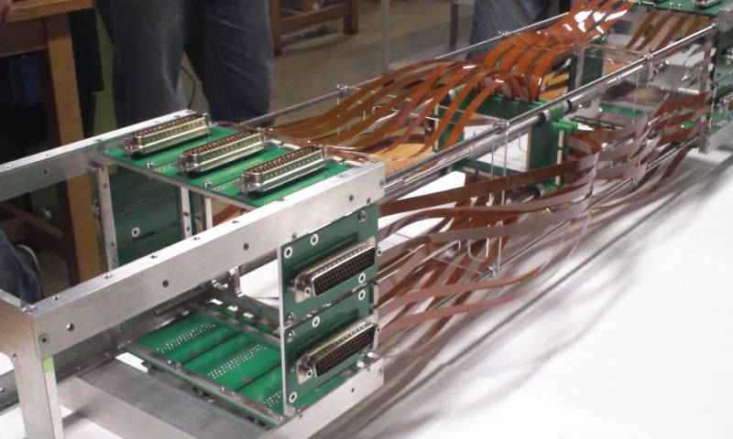
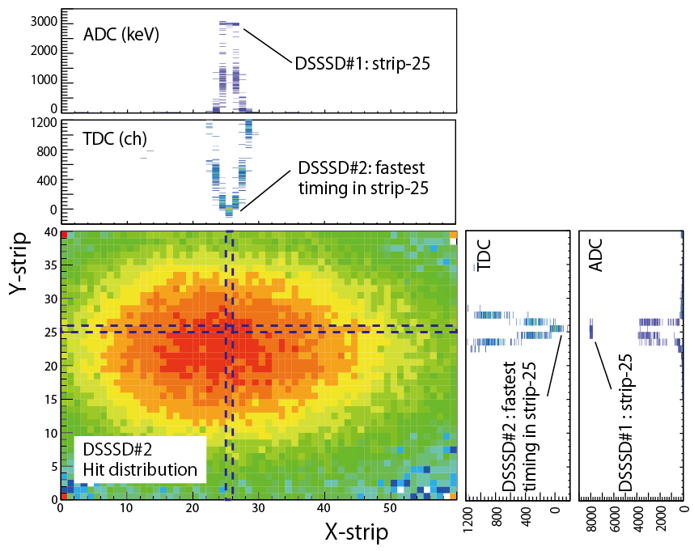
New Beta Counting System : WAS3ABi
(Wide-range Active Silicon-Strip Stopper Array for Beta and ion detection)
8 layers of DSSSDs
(40-strips x 60 strips)
RIKEN/IBS/TU München
In total, 14,400 pixels
(19,200 pixels)
Timing information is also used for
reconstruction of hit position.
Options:
- Qbeta calorimeter in 2012.
- Fast timing plastic scintillation detectors in 2013

Slide 7
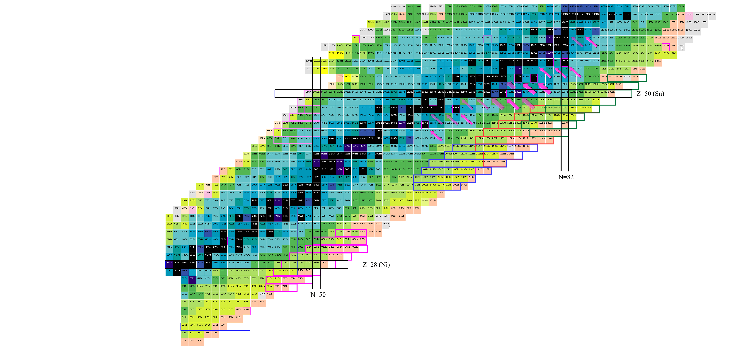
Survey of Decay Properties with EURICA
(Sn)
N=82
158Nd, 154Ce , 150Ba … 5 days
E.Ideguchi,G.Simpson
100Sn … 2013.06
(M.Lewitowicz/R.Gernhauser/SN)
140Te … 4.5 days
A.Odahara, Lozeva/Moon
98In,96Cd,94Ag … 6 days
P.Boutachkov
136Sn,138Sn,132Cd … 5 days
G.Simpson,A.Jungclaus)
→ Talk by A.Jungclaus
73Sr … 2013.06
GLorusso
115Nb ~ 128Pd … 10 days
H.Watanabe,G.Lorusso
110Zr … 10 days
(T.Sumikama)
○Beta-ray
Half-lives
Q_{β}
○Gamma-ray
E(2+), E(4+), ..
Isomeric states
○Neutron emission
○New isotopes
78Ni 7.5 days (SN) →Talk by Xu
81Cu 5.5 days (M.Niikura)
70Fe .. 5 days (G.Venzoni)

Slide 8
Decay Spectroscopy in the vicinity of double magic ⁷⁸Ni
(Z=28, N=50)

Slide 9
Beam production around ⁷⁸Ni region
Half-lives unknown
Spokesperson: S.Nishimura
⁸⁸Ge
Implantation rate
= 20 ~ 50 pps
Atomic number
⁸⁷Ga
⁸⁴Zn
New isotopes
(Candidates)
⁸³Cu
⁸⁰Ni
⁷⁸Ni
⁷⁷Co
⁷⁹Ni production is ..
⁷⁵Fe
⁷³Mn
A/Q
Additional ⁸¹Cu data (Niikura exp.)
→ ~ 10 k of ⁷⁸Ni produced in total.
Notes:
Competition of high transition energy FF beta-decays and low-energy GT decays at N>50
Stron np-interaction inducing a ground state J-pi inversion effects

Slide 10
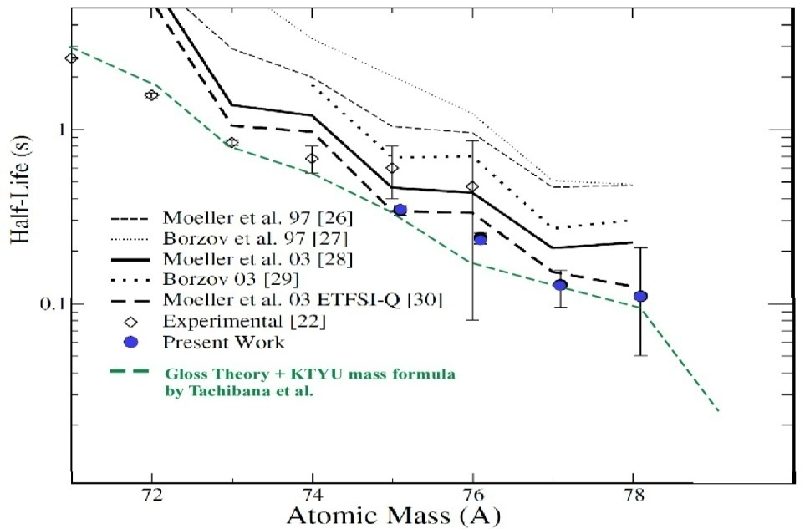
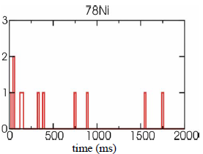
⁷⁸Ni beta-decay half-life
⁷⁸Ni
Hosmer (MSU)
PRL (2006)
⁷⁹Ni
?
Preliminary
Preliminary
Gated on β-delayed γ
Decay spectra obtained in WAS3ABi and with EURICA.
What about N=51 (⁷⁹Ni)? Z=27 (⁷⁷Co)?

Slide 11
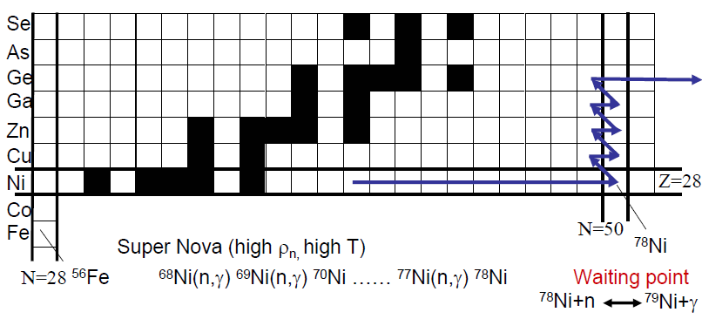
Beta-decay half-lives around ⁷⁸Ni
FRDM+QRPA
Z=28
N=50
FRDM+QRPA
RIBF
Preliminary
KTUY+GT2
⁷⁸Ni
⁷⁸Ni
KTUY+GT2
⁷⁹Ni
⁷⁷Co
Shorter half-lives beyond ⁷⁸Ni ( N=50 and Z=28)

Slide 12
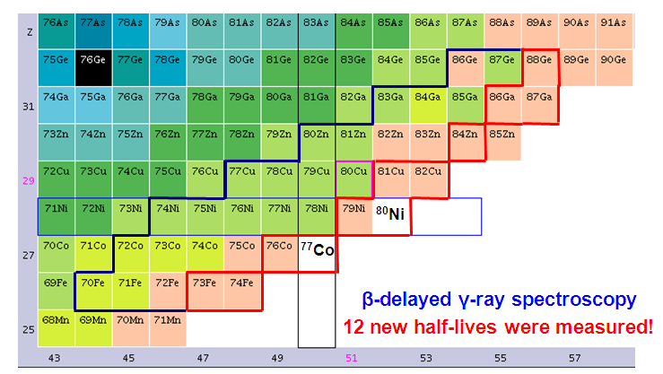
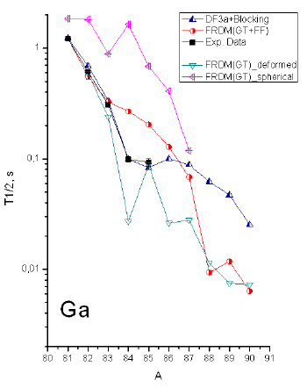
Systematic study of T_{1/2} around ⁷⁸Ni
To be reported by Z.Xu in this session !

Slide 13
Decay properties around double magic ¹³²Sn
( Z=50, N=82 )

Slide 14
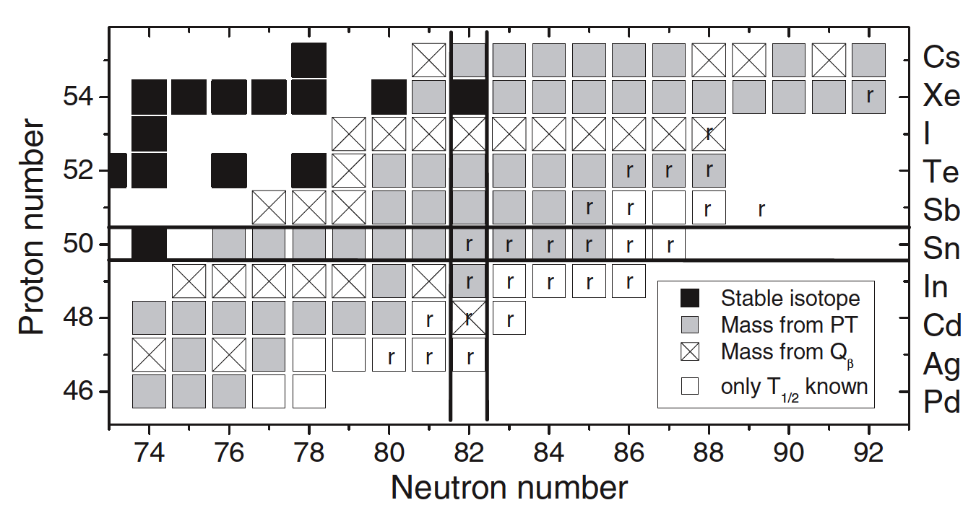
Decay properties around
¹³²Sn region
133Cd
masses
T_{1/2}
J. Hakala et al., Phys. Rev. Lett. 109 (2012) 032501

Slide 15
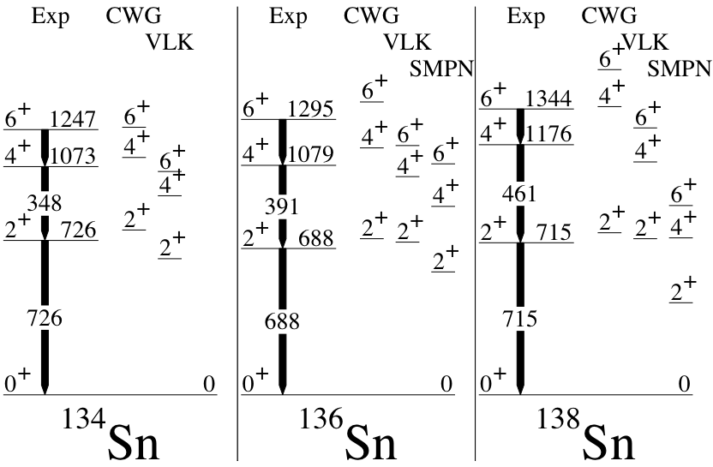
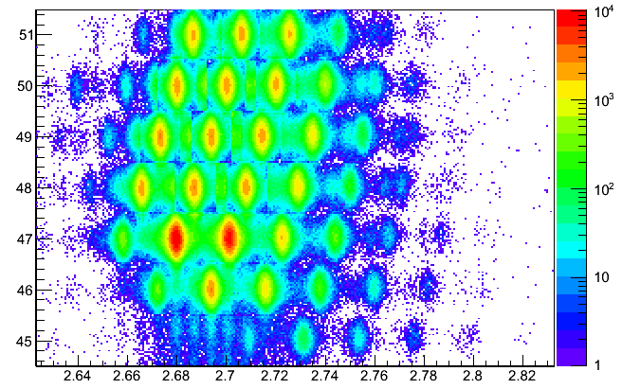
¹³⁶⁻¹³⁸Sn Region
Spokespersons:
G.Simpson /A.Jungclaus/Gadea
Unknown T_{1/2}
875.000 ions
¹³⁶Sn
Very short T_{1/2} !
¹³⁸Sn
5.000 ions
¹³⁶Sn
¹³⁸Sn
G. Simpson, G.Gey, A.J .,.
submitted to Phys. Rev. Lett.
- 136Sn, 138Sn isomers
- A milisecond γ-decaying high-spin trap in ¹²⁹Cd
→ Talk by A.Jungclaus tomorrow !
¹³⁶Sn
¹³⁸Sn
¹²⁹Cd
Analysis is in progress.
Notes:
The energies of these states are remarkably constant from 134Sn to 138S,
Implying that there are no obvious changes in the shell structure.

Slide 16
Decay Spectroscopy around ¹²⁸Pd and ¹¹⁵Nb
New Isotopes
Spokespersons: H.Watanabe/G.Lorusso
New isomers
in ¹²⁶Pd, ¹²⁸Pd!

Slide 17
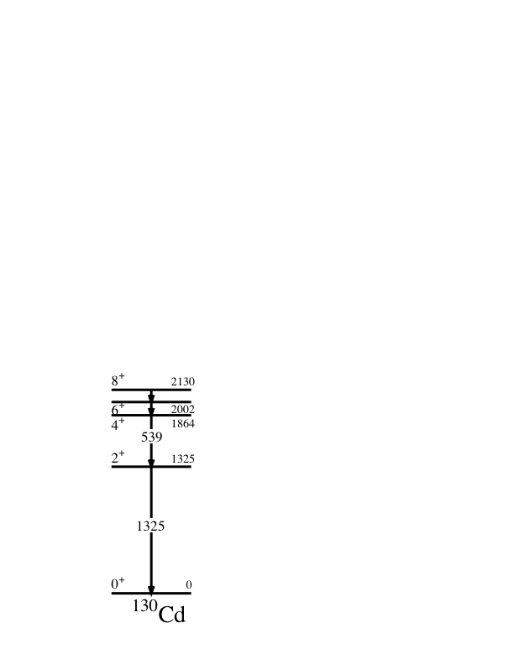
Most Neutron-Rich N=82 Isomer with EURICA
(r-Process waiting point)
A.Jungclaus,
PRL99, (2007)
No evidence
for shell quenching
T_{1/2} of Cd isotopes
delayed γ-ray spectrum
EURICA
Preliminary
H. Watanabe, G. Lorusso et al., to be published

Slide 18
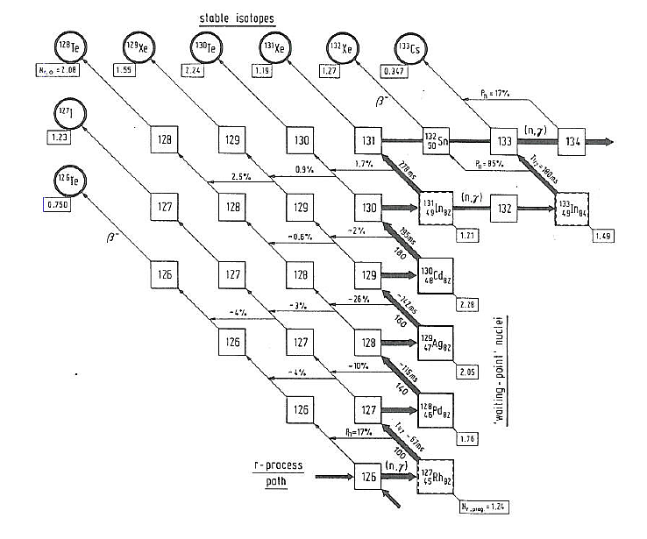
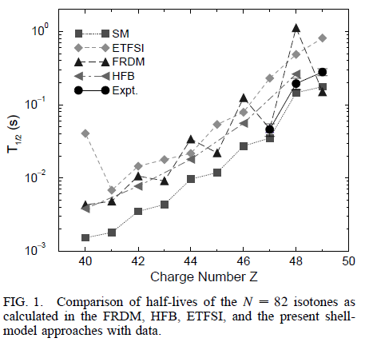
Systematic of beta-decay half-lives for Cd isotopes
G.Lorusso
Cd isotopes
RIBF
?
Reference
¹³⁰Cd
Pinedo & Langanke PRL 83 4502 (1999)
¹²⁹Ag
EURICA
Preliminary
¹²⁸Pd
¹²⁷Rh
- ¹²⁷⁻¹³⁰Cd has shorter T_{1/2}
- ¹³¹Cd has longer T_{1/2}
Significant impact to r-process calculation.
New data will give new feedback to SM calc.
Discrepancy !!
QuestionSM adjustment with previous T_{1/2}
… Z.Niu, et al. arXiv: 1210.0680

Slide 19
Mid-shell region
(2013 May)

Slide 20
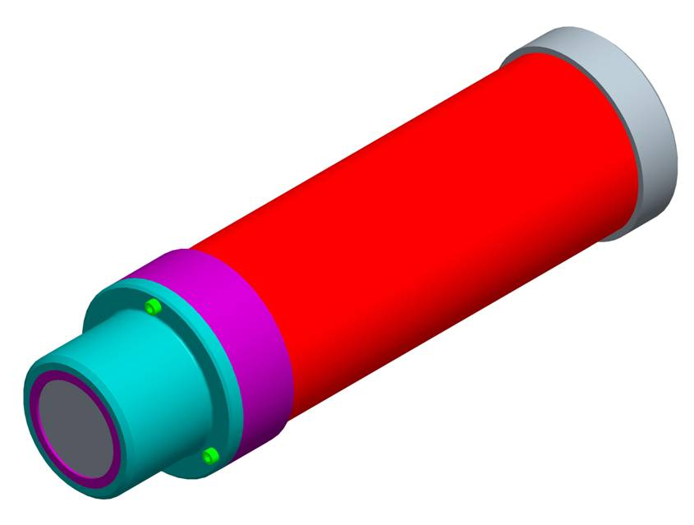
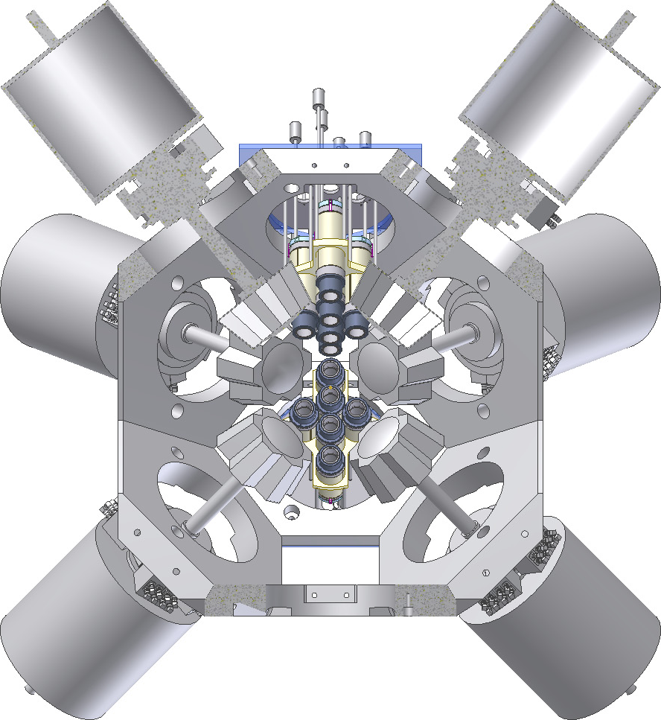
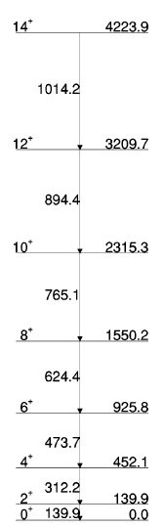
Complementary LaBr₃ array for fast timing with EURICA
18 detectors
φ1.5” x 2”
For short life-times a LaBr₃ array
for fast timing has been installed to
complement the HPGe detectors
The LaBr₃ detectors are a part of
the FATIMA project at FAIR
(Surrey and Brighton)
¹⁰⁴Y beta-decay is used as start.
Beta-decay of ¹⁰⁴Y → ¹⁰⁴Zr
Decay spectrum
of 140keV γ-ray
¹⁰⁴Zr
2⁺
Preliminary
^{106,108}Zr
→ T.Sumikama, F.Browne, A.Bruce

Slide 21
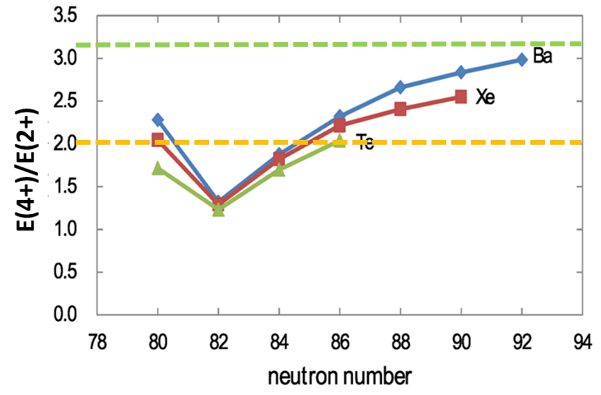
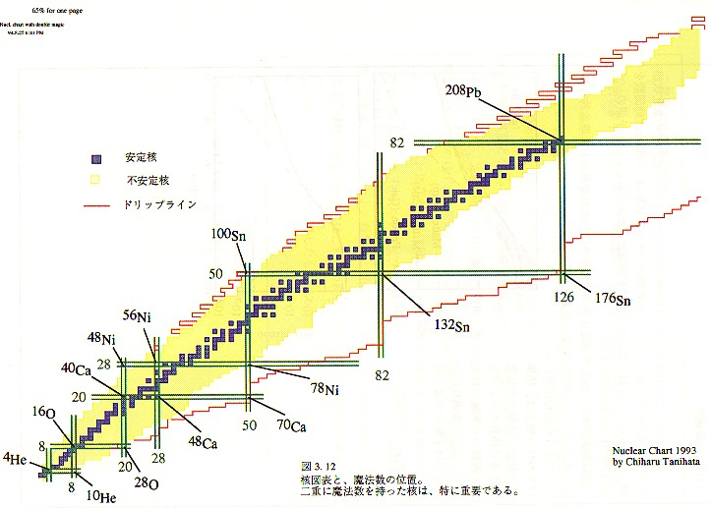
Shape evolution in neutron-rich A~140 nuclei beyond doubly-magic ¹³²Sn
A. Odahara (Osaka),
R. Lozeva (Strasbourg),
C.B. Moon (Hoseo)
₅₄Xe
Xe
Te
₅₂Te
proton number
doubly-magic nucleus
¹³²Sn (Z=50, N=82)
neutron number
A/Q
Notes:
1.2 to 3.0, nuclear structure changes from single-particle mode, vibrational mode (~2) to rotational motion with the prolate deformation (~3.3)

Slide 22
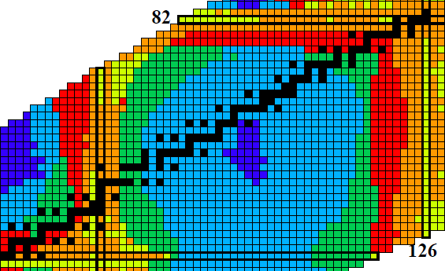
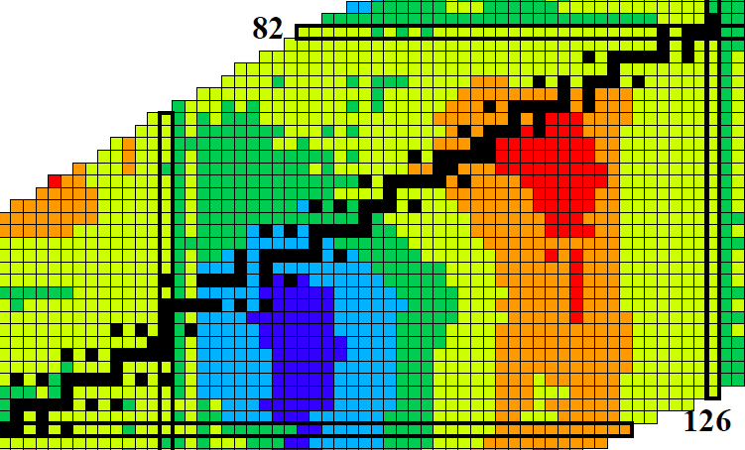
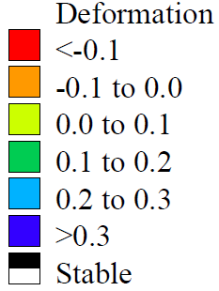
Search for K-isomers (Z ~ 60)
P. Möller et al., At. Data Nuc. Data Tab. 59, 185 (1995)
β₂
β₄
¹⁵⁶Nd

Slide 23
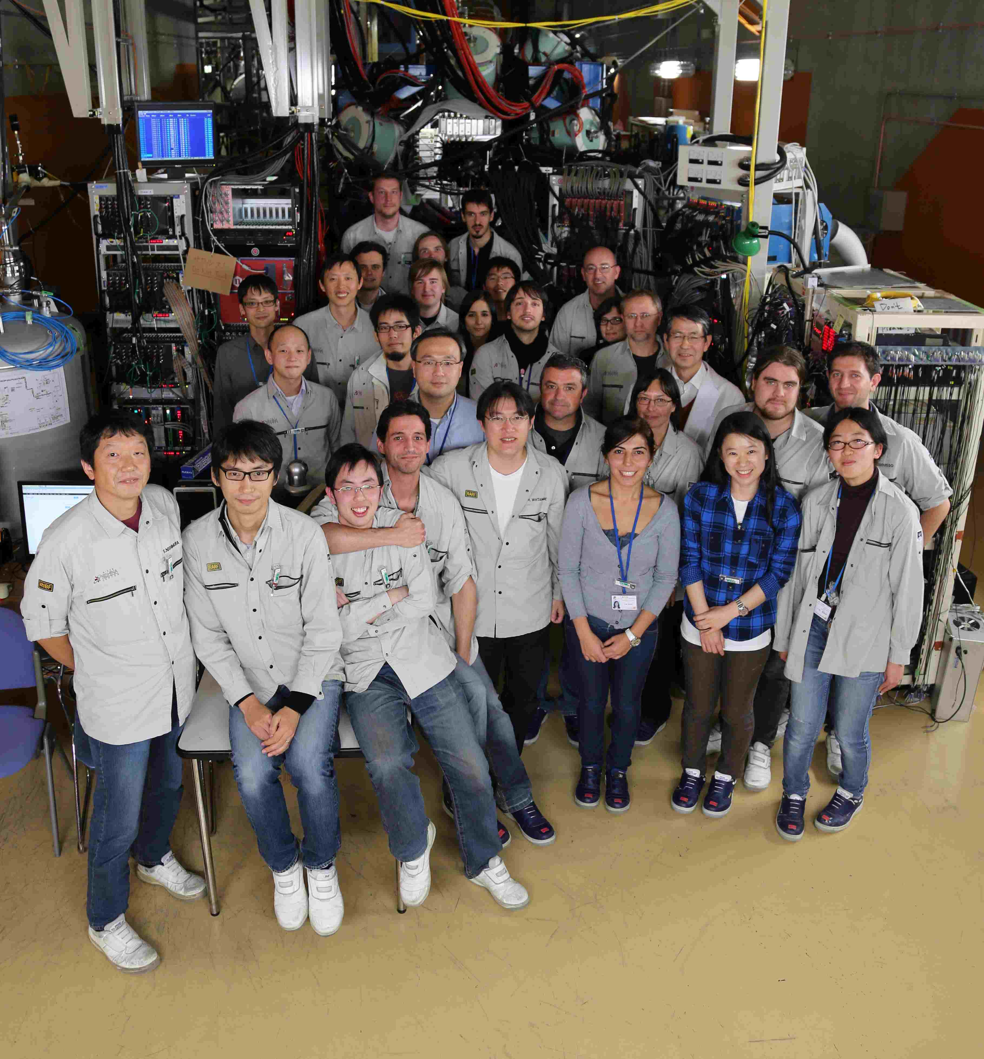
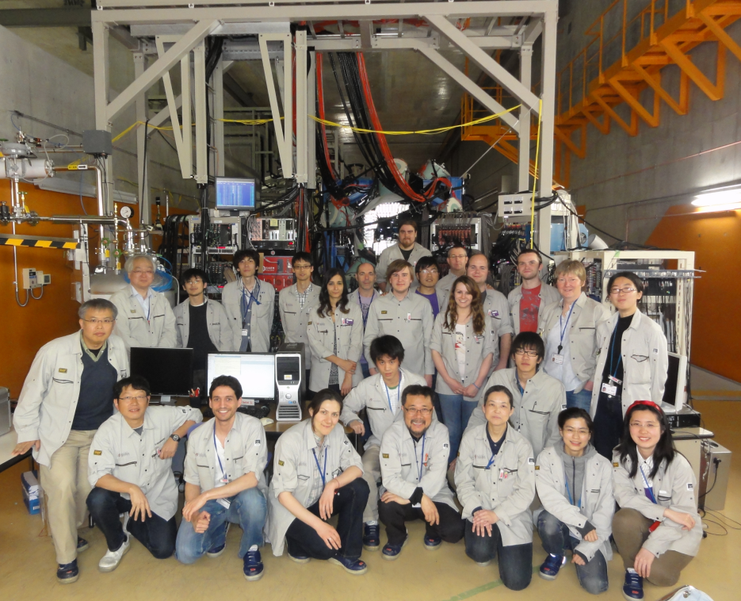
EURICA U-beam Campaigns
2012 Nov.-Dec.
2013 May
Collaboration:
Tohoku, Univ. Tokyo, Brighton Univ. Debrecen, Joseph Fourier, Osaka Univ. Peking, LPSC, IBS, Oslo,
Consejo Sup. De Inv. Cientificas, IPN Orsay, Padova, Leuven, SKKU, INFN, ANU, Koeln, TU Muenchen,
Fisica, Legnaro, ATOMKI, INFN-Milano, INFN-Firenze, INFN-LNL, Univ. di Padova, Surrey, GSI, ANL,
Yale, Milano, Univ. Madrid, Tech. Univ. Darmstadt, Univ. Istanbul, CNS, CEA, RCNP, Univ. Notre Dame, Inst. voor Kern-en Stralings Fysica, Hoseo Univ., Univ. Tsukuba, Inst. Plurid. Hubert Curien, and RIKEN

Slide 24
SUMMARY
158Nd, 154Ce , 150Ba … 5 days
E.Ideguchi,G.Simpson
100Sn … 2013.06
(M.Lewitowicz/R.Gernhaueser/SN)
140Te … 4.5 days
A.Odahara, Lozeva/Moon
98In,96Cd,94Ag … 6 days
P.Boutachkov
136Sn,138Sn,132Cd … 5 days
G.Simpson,A.Jungclaus)
→ Talk by A.Jungclaus
73Sr … 2013.06
GLorusso
115Nb ~ 128Pd … 10 days
H.Watanabe,G.Lorusso
110Zr … 10 days
(T.Sumikama)
○Beta-ray
Half-lives
Q_{β}
○Gamma-ray
E(2+), E(4+), ..
Isomeric states
○Neutron emission
○New isotopes
RIBF Accelerator
- High intensity radioactive beam
- U-beam … ~10 pnA, Xe-beam … > 20 pnA
BigRIPS/ZeroDegree Beam-line
- Large acceptance beam line
- Cocktail beam & Particle identification
Decay Station
- High efficiency gamma-ray detectors
(Euroball Ge detectors)
- High efficiency beta-ray detectors
(DSSSD: WAS3ABi)
Collaboration and Future
- Proposals, manpower, detectors
78Ni 7.5 days (SN) →Talk by Xu
81Cu 5.5 days (M.Niikura)
70Fe .. 5 days (G.Venzoni)
A lots of new results are coming from RIBF.
A lots of interesting results are coming from EUIRCA at RIBF!

Slide 25
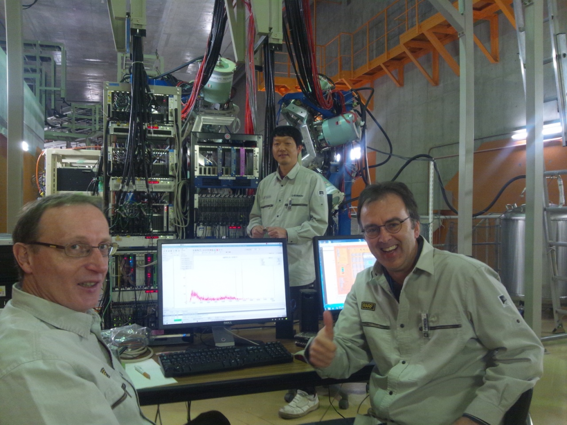
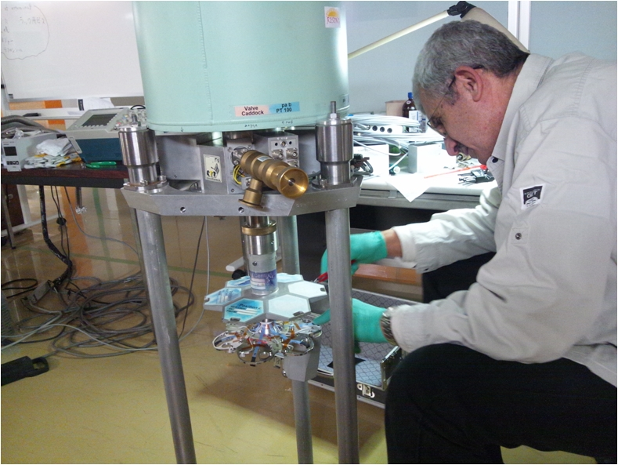
Thank you.
Acknowledgement
We acknowledge the EUROBALL Owners Committee for the
Loan of germanium detectors and the PreSpec Collaboration for
The readout electronics of the cluster detectors.
(*Equipments should be back to GSI by 2014 December. )
Part of the WAS3ABi was supported by the Rare Isotope Science
Project which is funded by the MEST and NRF of Korea.
GSI supports: I.Kojouharov, H.Schaffner, N.Kurz

