Slide 1




Beta-decay spectroscopy towards the r-process path
Giovanna Benzoni and A.I. Morales-Lopez (INFN - Milano)
Outline:
* Region “east” of ²⁰⁸Pb studied via fragmentation of ²³⁸U beam
* RISING array and exp. details
* β decay half-lives in ²¹⁹Bi ²¹¹⁻²¹²⁻²¹³Pb
* Alpha tagging method
* Conclusions
Notes:
15 minuti con domande….non ce la faro’ mai

Slide 2
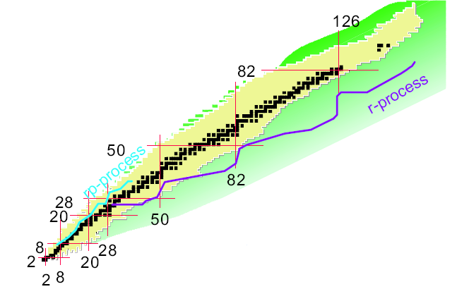


BETA-DECAY SPECTROSCOPIC STUDIES OF THE
N-RICH Tl, Pb and Bi ISOTOPES
The origin of heavy elements in the Universe is one of the foremost questions since nearly half of the heavy elements are produced in the r-­process
The decay of the neutron-rich Pb isotopes represents a key issue to investigate the matter flow through N=126 bottleneck and therefore have insight in the velocity of the synthesis of heavier r-process nuclei
Nuclei around the r-process waiting point A=195 are unexplored
Get useful shell model information to study evolution of Z=82 magic number at increasing N

Slide 3
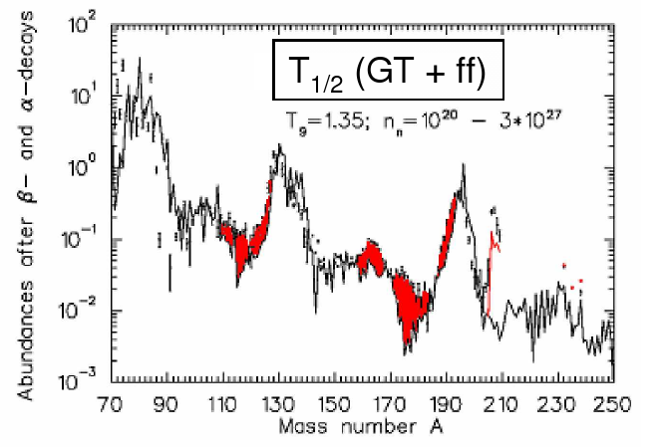
MOTIVATION
Half lives modify the abundance curve
Experimental lifetimes will constrain theoretical predictions around N~126
Bi
Our goals:
- Measure the structural properties of n-rich nuclei in the “east” side of ²⁰⁸Pb using:
• Isomeric spectroscopy
• β-delayed gamma ray spectroscopy
- Measure β-decay half-lives
[1] P. Möller et al., PRC (2003)
[2] I.N. Borzov and S. Goriely, PEPAN (2003)
2

Slide 4

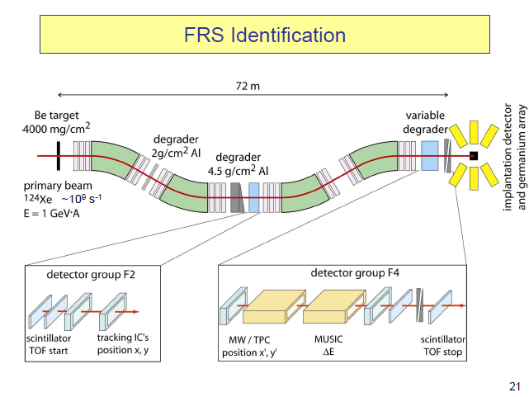
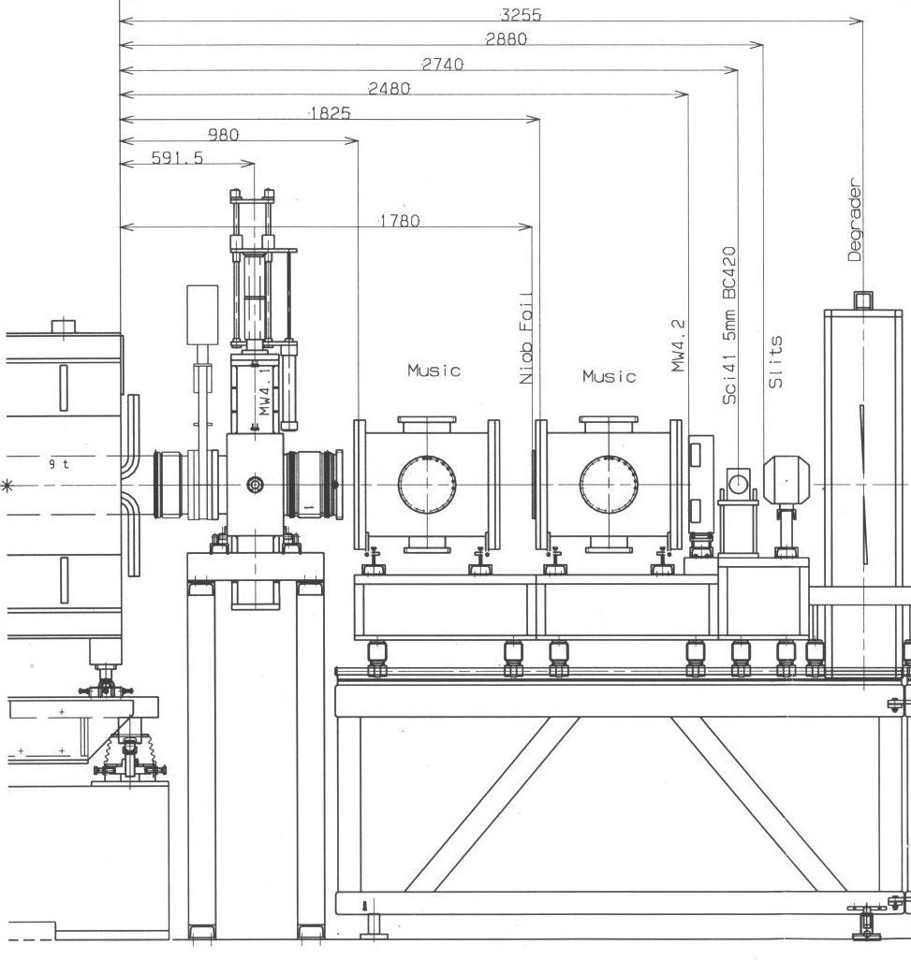
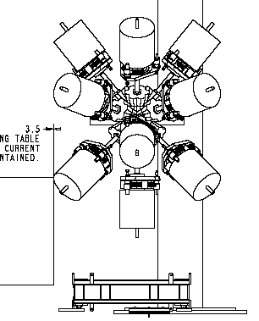
Experimental setup @ GSI: RISING
Fragmentation of ²³⁸U beam @ 1GeV/u
Ibeam ~ 3*10⁹ pps
Beam extraction 1s, beam cycle 3s
* 2 MUSIC for Z reconstruction
* 3 plastic scintillators as trigger and veto detectors
* 15 clusters with efficiency of 15% at 1.3 MeV
* 9 DSSSD (3 layers)
- surface 5x5 cm²
- thickness 1 mm
- 2 x 16 3.125 mm strips
RISING Ge
Cluster Array.
degrader
Optimization of implantation by using MONOENERGETIC beams
MW42
beam
MW41
MUSIC
MUSIC
Sci41

Slide 5
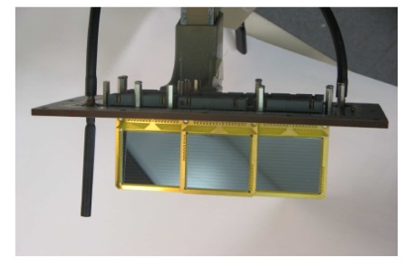
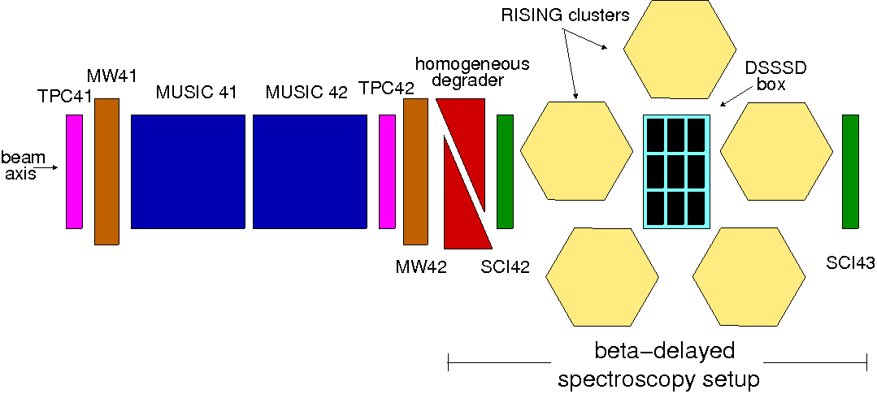
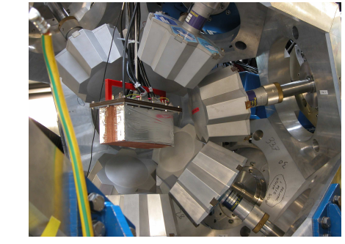
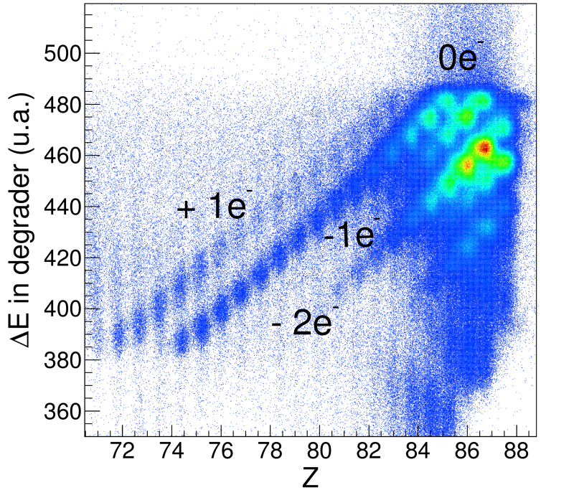
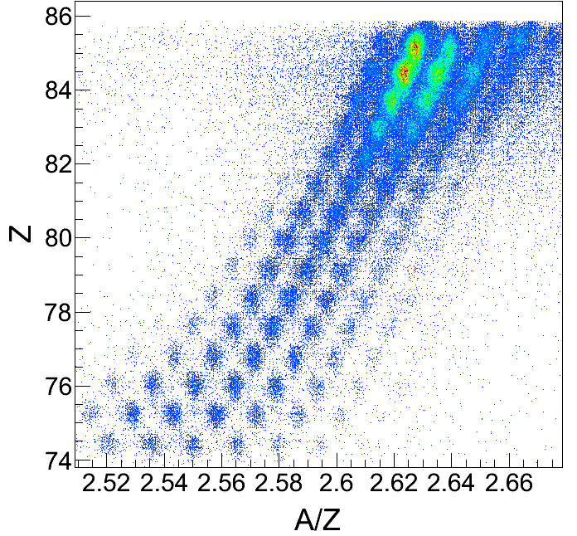
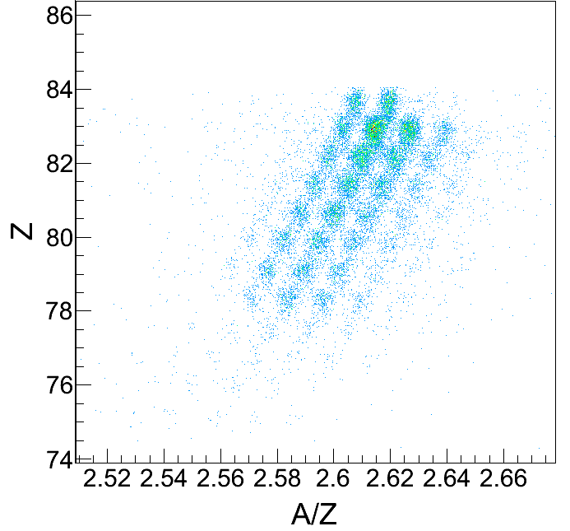
RISING EXPERIMENT: Particle IDentification
b–DELAYED SPECTROSCOPY SET UP
➢
Active Stopper:
Ion-β time-position
correlations
➢
RISING g-array:
β−γ prompt-time
correlations
Charge states selection
Ion production
Implanted ions (just 0e-0e)
4

Slide 6
β–DECAY DELAYED SPECTROSCOPY
WARNING: long lifetimes and high rates imply a careful study of bg contributions
➔ ion-β correlations : out of beam + ion-β position correlations + ion-β time correlations
➔ uncorrelated decays determined from backward-time ion-β correlations
²¹⁹Bi
²¹³Pb->²¹³Tl
forward
²¹¹Tl
backward
New spectroscopic information in ²¹⁹Po ²¹¹⁻²¹²⁻²¹³Pb
²¹²Tl

Slide 7
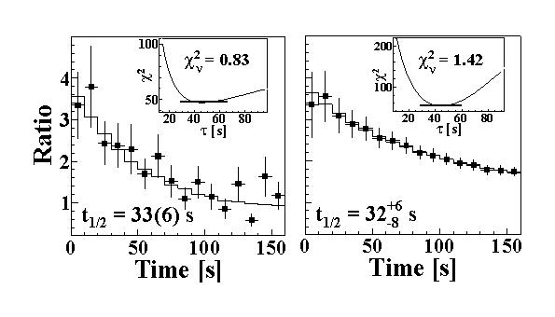
Half-lives measurement
Long half-lives ➔ cover many beam repetition cycles
High rate ➔ possible double implantations
Standard techniques are not available
➔ numerical fit based on Monte Carlo simulations of the implantation-decay process including experimental
implantation rates and having as free parameters the β decay half life and the β detection efficiency
χ² fits to two independent time correlations:
• Experimental ion-β time-correlated spectra
• Calculated time distribution obtained from Monte- Carlo simulations
Fitting function: ratio of forward/backward time-distribution functions
²¹⁸Bi:
Benchmark of Analysis
H. de Witte et al., PRC (2004)

Slide 8
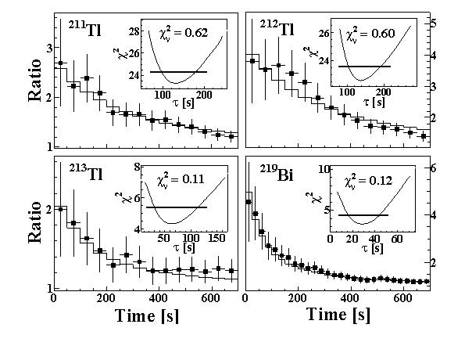
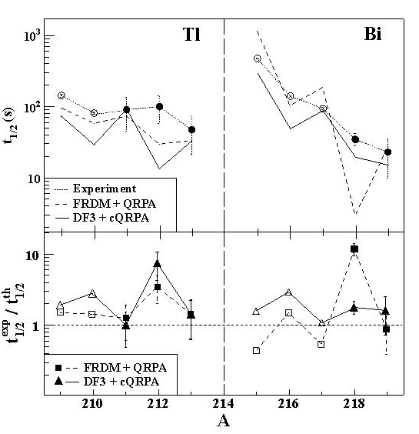
Half-lives measurement: new results
Improved measurement on ²¹²Tl
+484
t_{1/2} = 101 s
-46
L. Chen et al., PLB (2010)
The description of
first-forbidden (ff) transitions
using macroscopic statistical models
seems a good approach for these nuclei
at variance from N<126 nuclei
FRDM+QRPA and DF3 + QRPA models in agreement with our measurements

Slide 9
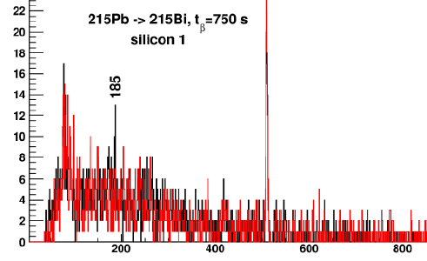
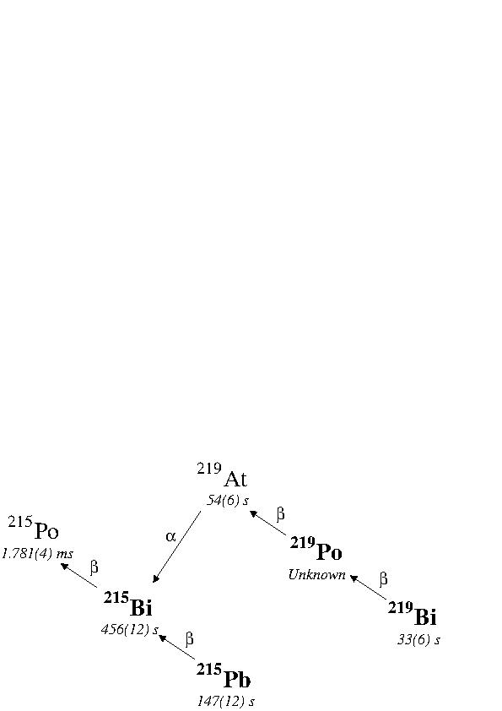
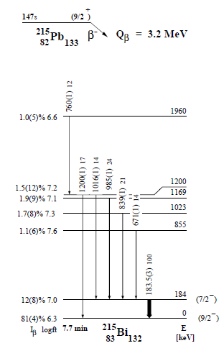
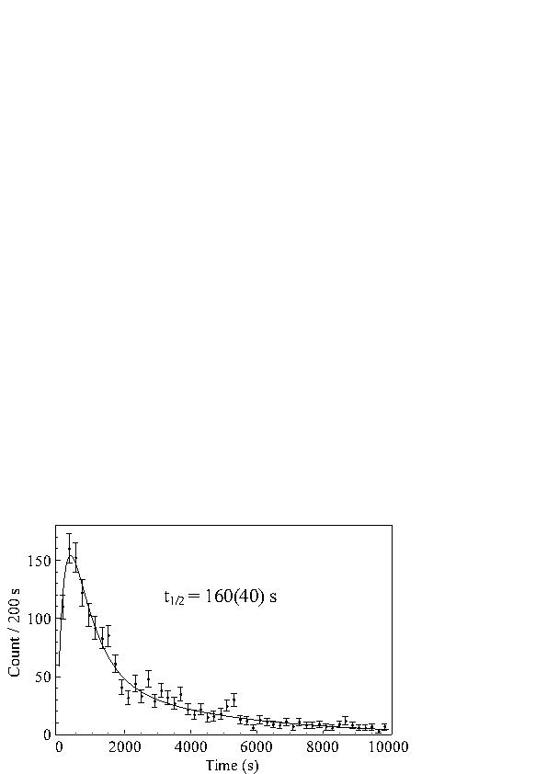
²¹⁵Pb decay via α tagging
²¹⁵Pb half-life could not be measured by γ tagging owing to strong bg. coming from nuclei implanted in same det.
Need to restrict conditions too much
²¹⁵Pb
α tagging allows to follow the decay chain up to grand-mother and extract correct half-life
H. De Witte et al., private communications

Slide 10
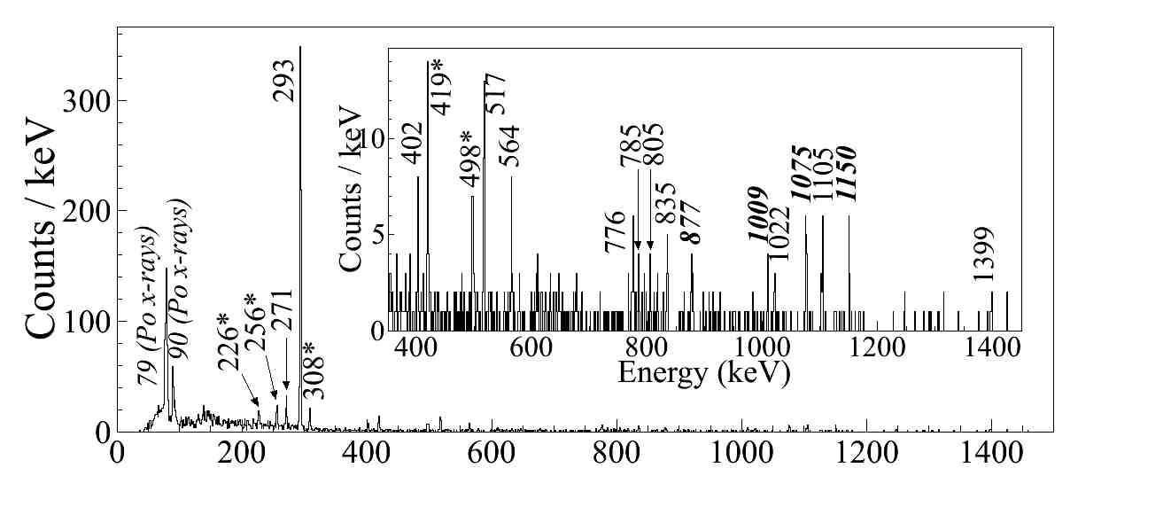
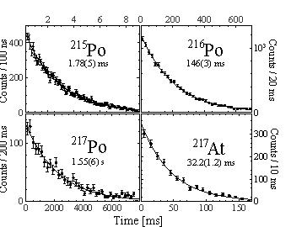
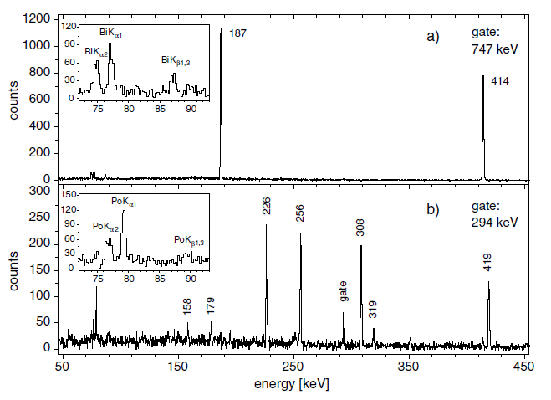
α tagging technique
Unique identification of α decay
Follow the decay chain back to grand-mother nucleus
α−β−β correlation in SAME pixel, backward in time
Transitions in ²¹⁵Po
Good reproduction of a decay half-lives warranties unique selection of decay
J.Kurpeta et al. EPJA 18 (2003)31-37

Slide 11
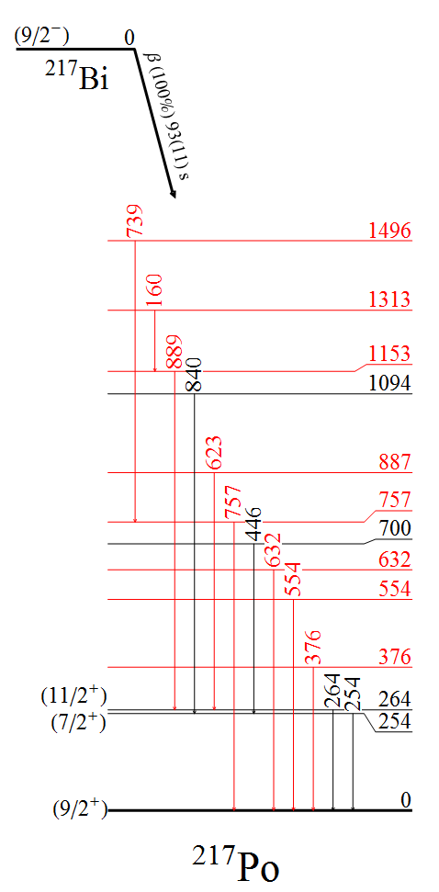
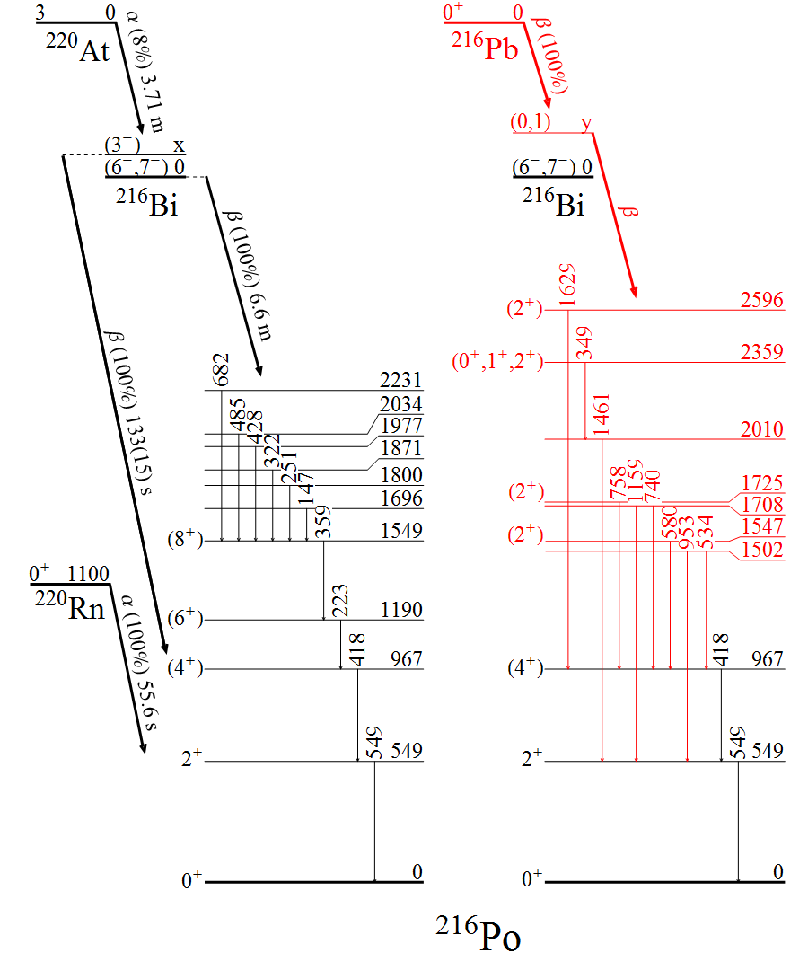
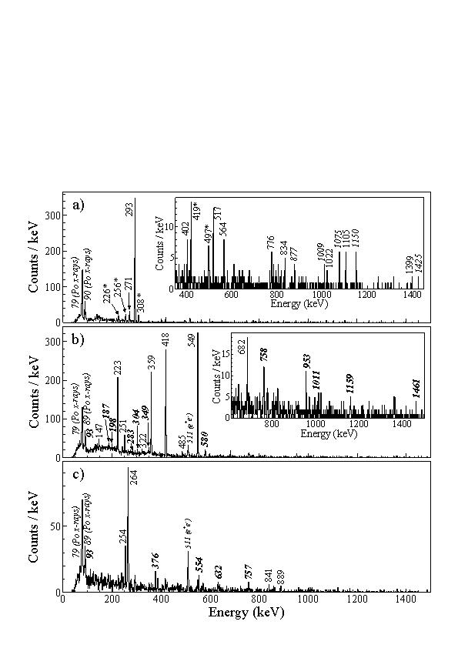
Same technique used to study decay scheme of ²¹⁶⁻²¹⁷Po
²¹⁵Po
²¹⁶Po
²¹⁷Po
Extension of level schemes
γ−γ coincidences help locate transitions
➔ Need for calculations to confirm level sequence

Slide 12
Conclusions:
Fragmentation facilities are ideal places to study decay spectroscopy in
  difficult-to-reach nuclei * very exotic * very heavy * very short-living
n-rich Pb experiment: heaviest region accessible
  * New lifetimes and isomeric decays measured
  * New spectroscopic information
  Analysis on going to exploit also α decay chains
References:
    G.Benzoni et al., Phys. Lett. B715, 293 (2012)
    A. Gottardo et al., Phys.Rev.Lett. 109, 162502 (2012)
Collaboration:
A.I.Morales, A. Gottardo, J.J. Valiente-Dobon,
A. Bracco, G. de Angelis, F.C.L. Crespi,F. Camera, A. Corsi, S. Leoni, B. Million, R. Nicolini ,O. Wieland, D.R. Napoli, E. Sahin, S.Lunardi,R. Menegazzo, D. Mengoni, F. Recchia, P. Boutachkov, L. Cortes, C. Domingo-Prado,F. Farinon, H. Geissel, J. Gerl, N. Goel, M. Gorska, J. Grebosz, E. Gregor, T.Haberman,I. Kojouharov, N. Kurz, C. Nociforo, S. Pietri, A. Prochazka, W.Prokopowicz, H. Schaffner,A. Sharma, H. Weick, H-J.Wollersheim, A.M. Bruce, A.M. Denis Bacelar, A. Algora,A. Gadea, M. Pf¨utzner, Zs. Podolyak, N. Al-Dahan, N. Alkhomashi, M. Bowry, M. Bunce,A. Deo, G.F. Farrelly, M.W. Reed, P.H. Regan, T.P.D. Swan, P.M. Walker, K. Eppinger,S. Klupp, K. Steger, J. Alcantara Nunez, Y. Ayyad, J. Benlliure, E. Casarejos,R. Janik,B. Sitar, P. Strmen, I. Szarka, M. Doncel, S.Mandal, D. Siwal, F. Naqvi,T. Pissulla,D. Rudolph,R. Hoischen,P.R.P. Allegro, R.V.Ribas,Zs. Dombradi
1 Universitàdi Padova e INFN sezione di Padova, Padova, I; 2 INFN-LNL, Legnaro (Pd), I;
3 Università degli Studi e INFN sezione di Milano, Milano, I; 4 University of the West of Scotland, Paisley, UK;
5 GSI, Darmstadt, D; 6 Univ. Of Brighton, Brighton, UK;
7 IFIC, Valencia, E; 8 University of Warsaw, Warsaw, Pl;
9 Universiy of Surrey, Guildford, UK; 10 TU Munich, Munich, D;
11University of Santiago de Compostela, Santiago de Compostela, E;
12 Univ. Of Salamanca, Salamanca, E; 13Univ. of Delhi, Delhi, IND;
14 IKP Koeln, Koeln, D; 15 Lund University, Lund, S;
16 Univ. Of Sao Paulo, Sao Paulo, Br; 17ATOMKI, Debrecen, H.

